Slide 1

What’s New in Windows 11
Phillip Schneider
Technology Librarian
Gail Borden Public Library

Slide 2
Agenda
Start Menu and Search
Right Clicking
Widget Bar
File Explorer
Windows Store
Settings

Slide 3
Start Menu and Search

Slide 4
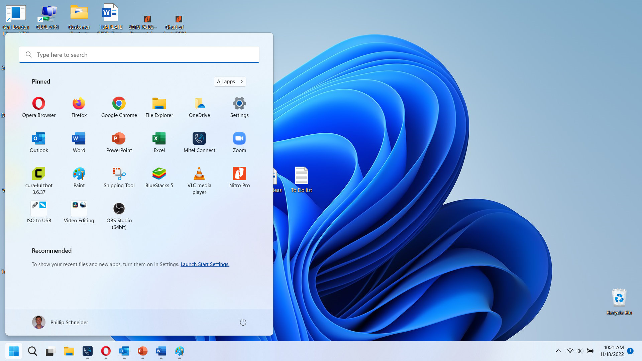
Start Menu

Slide 5
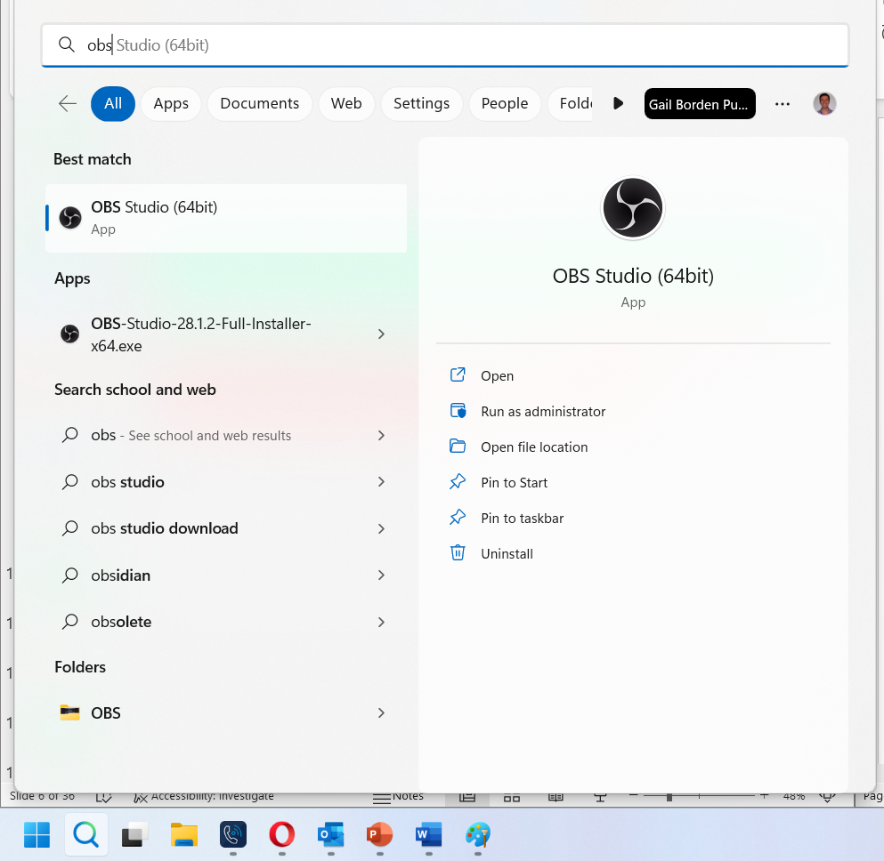
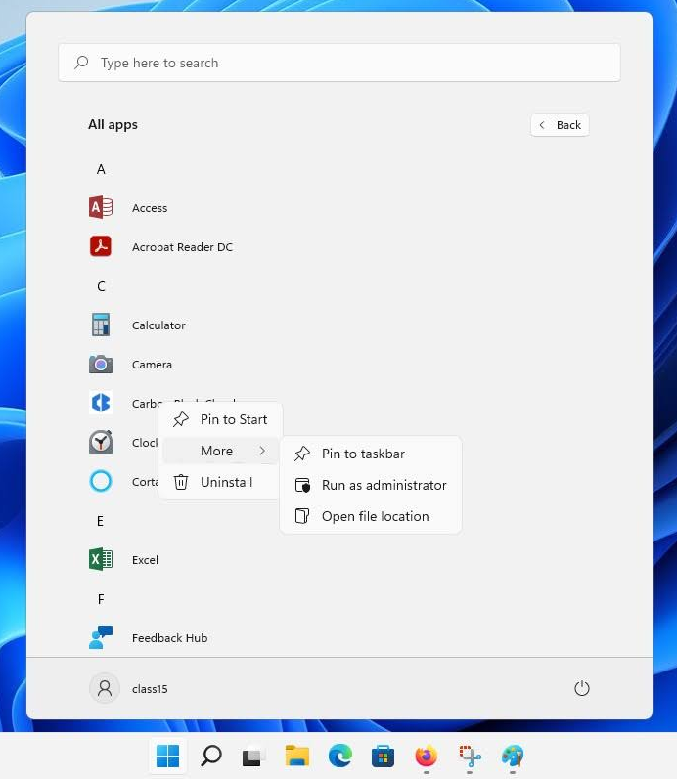
Tiles in the Start Menu or Taskbar

Slide 6
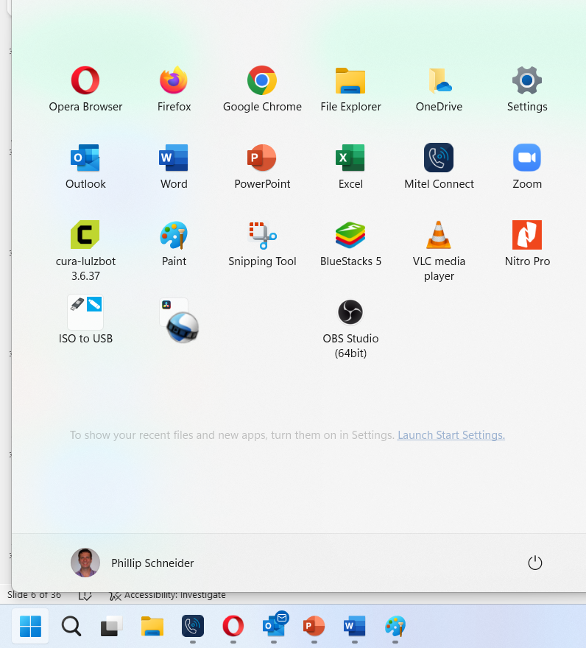
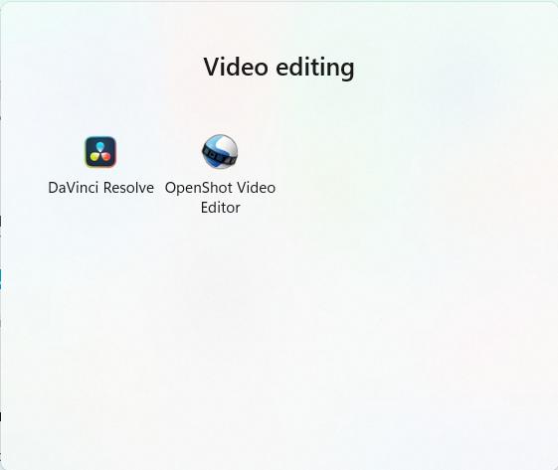
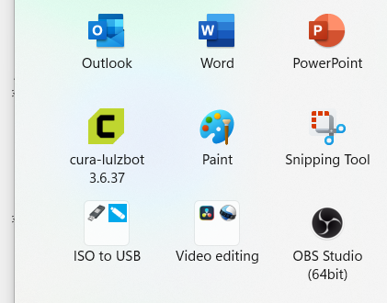
Windows Snapping
Hold left click on an item and drag it onto another to create a folder.

Slide 7
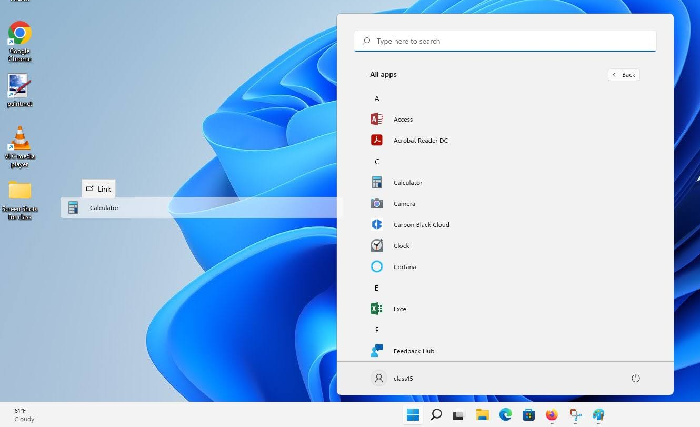
Creating a Desktop Icon

Slide 8
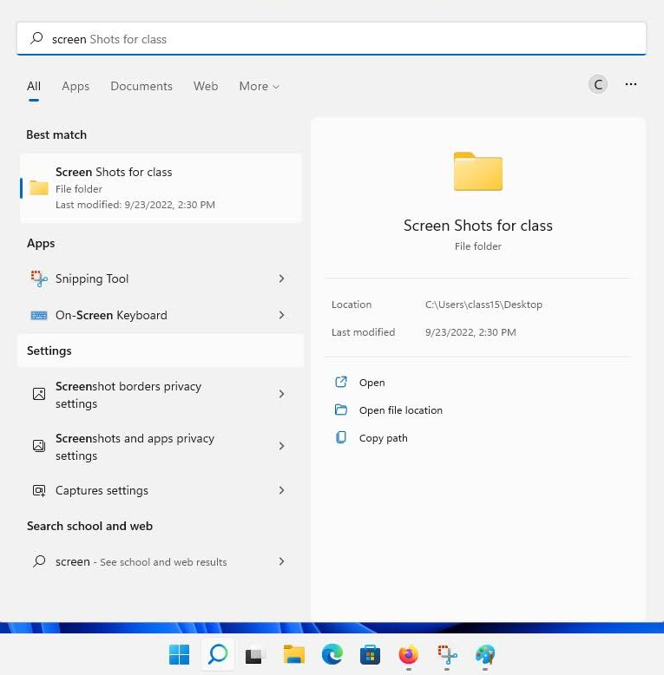
Search for Files or Apps

Slide 9
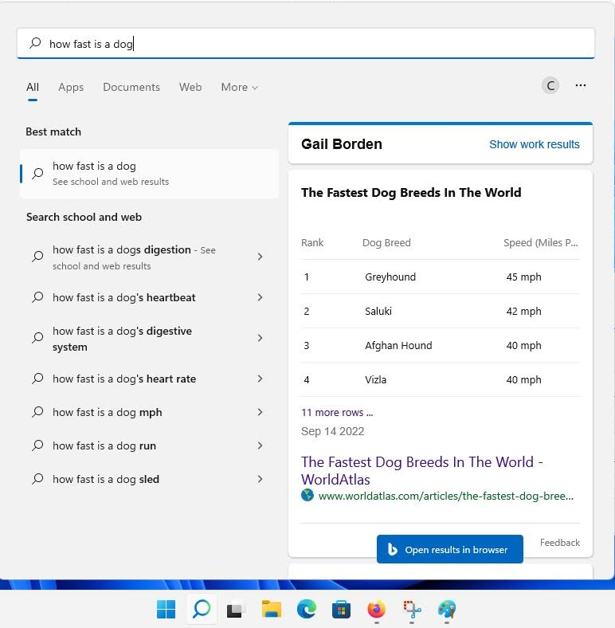
Search Web

Slide 10
Right Clicking And Windows Snapping

Slide 11
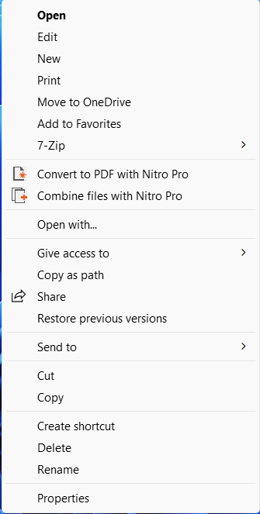
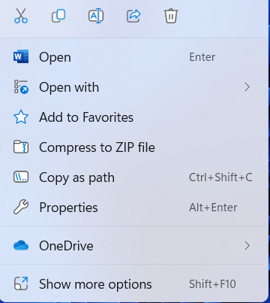
Rick Click Menu
Cut
Copy
Rename file
Share
Delete
1 2 3 4 5
Original Menu with full options

Slide 12
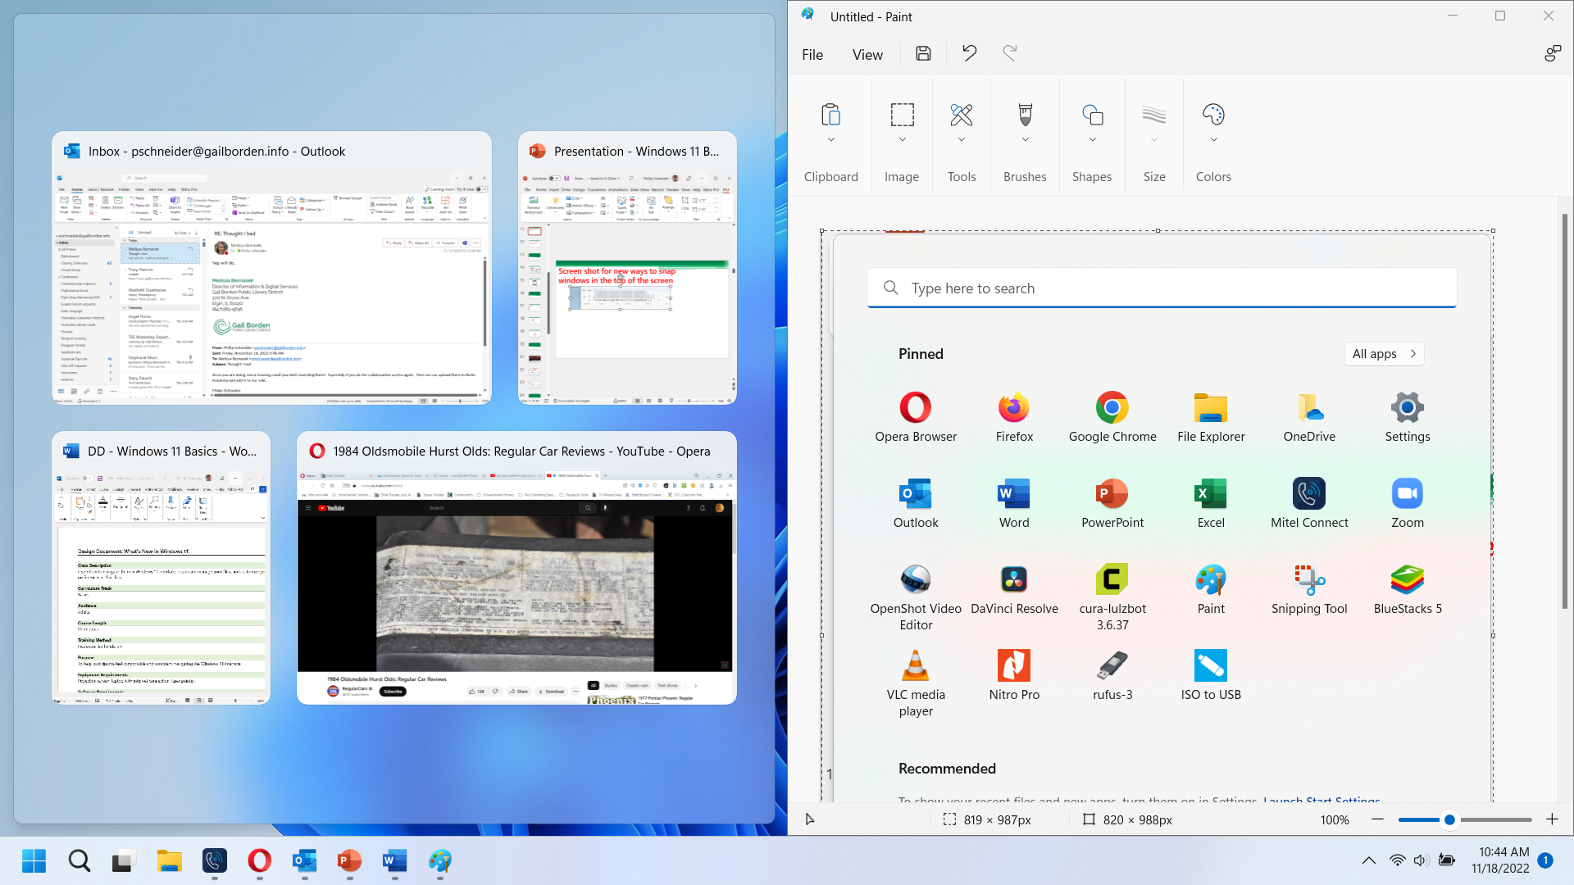
Windows Snapping
Hold left click on the top of a window and pull it to the right or left of the screen.
Once you let go pick the other window to pair with it

Slide 13
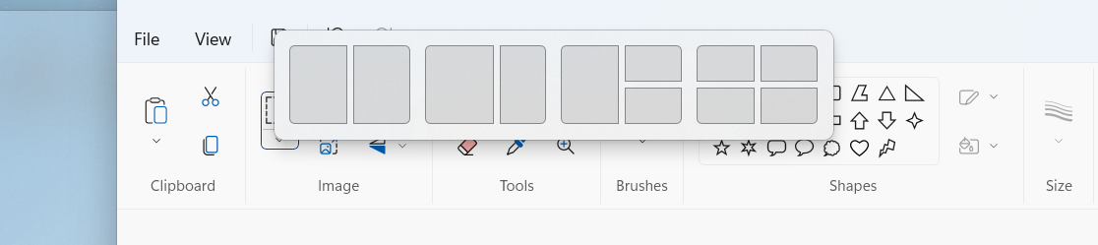
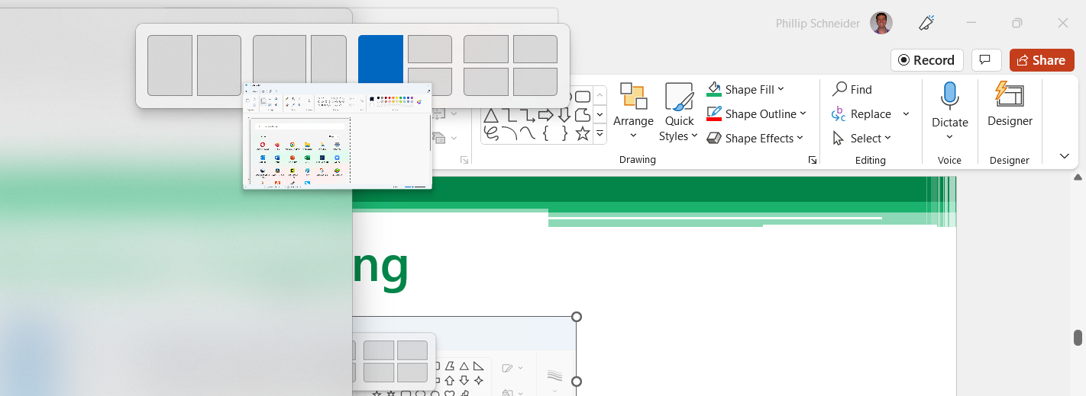
Windows Snapping
Hold left click on the top of a window and pull it to the top of the screen. Then move it into the square you want and let go.

Slide 14
Widget Bar

Slide 15
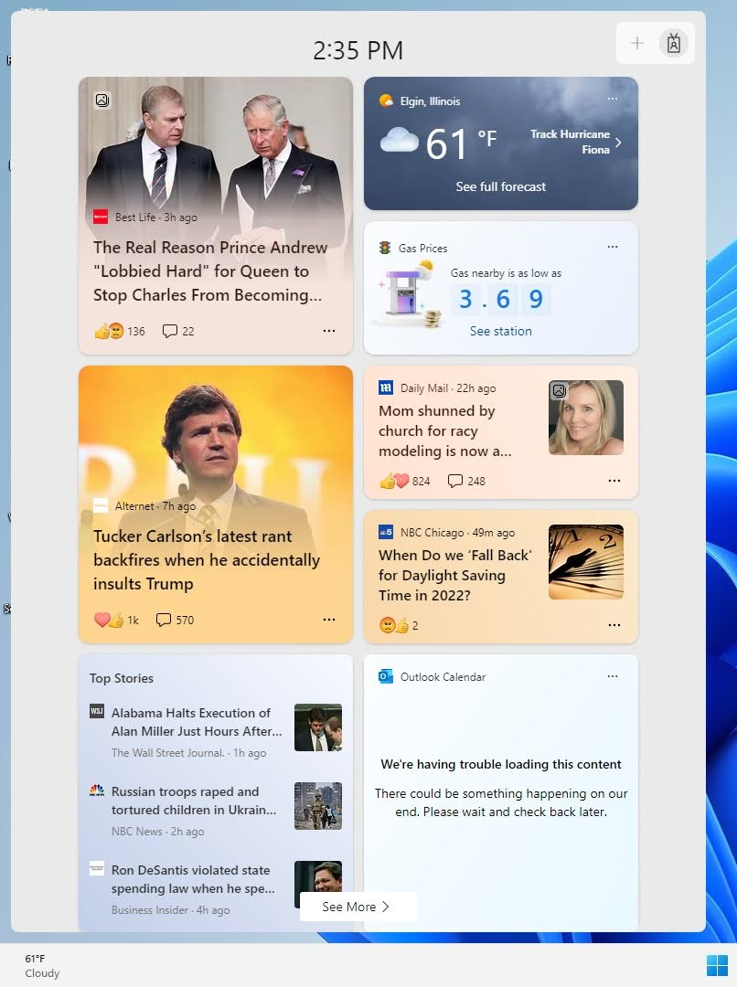
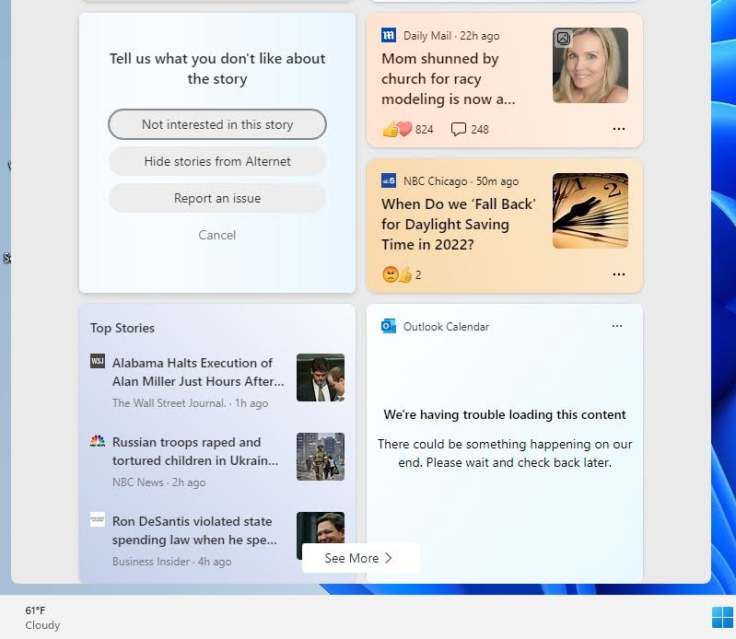

Widget Bar
Widget Icon

Slide 16
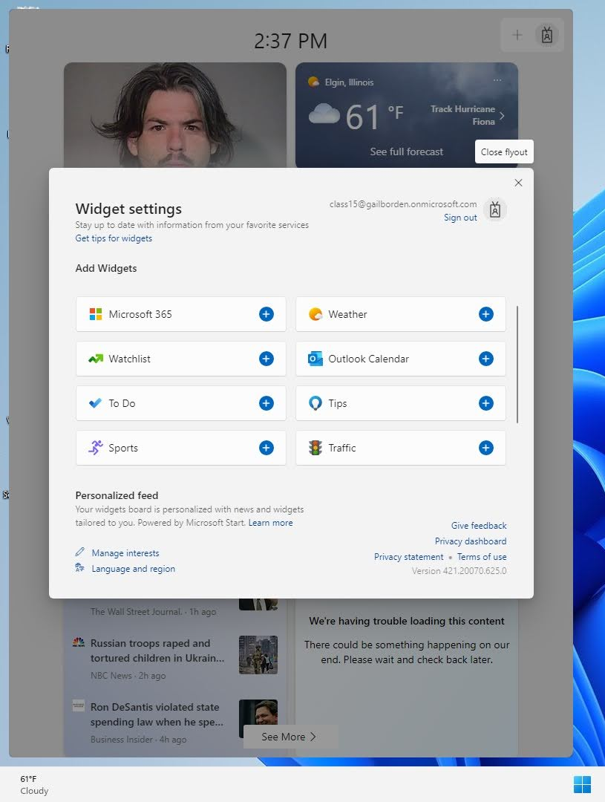
Widget Bar

Slide 17
File Explorer

Slide 18
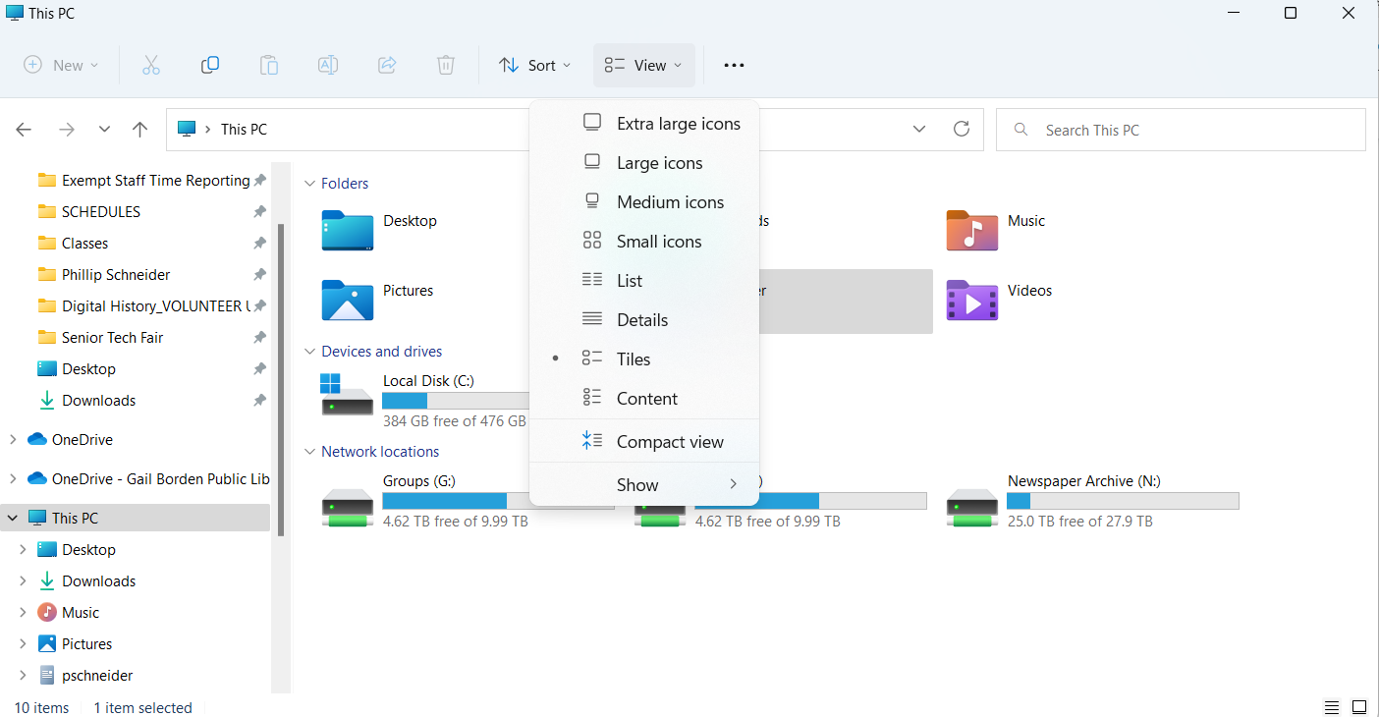
New File Explorer
1
6
2
5
3
Basic functions: cut, paste, rename, etc.
Navigation menu
Quick Access Items
All files
Change icon size with view
File search bar
4

Slide 19
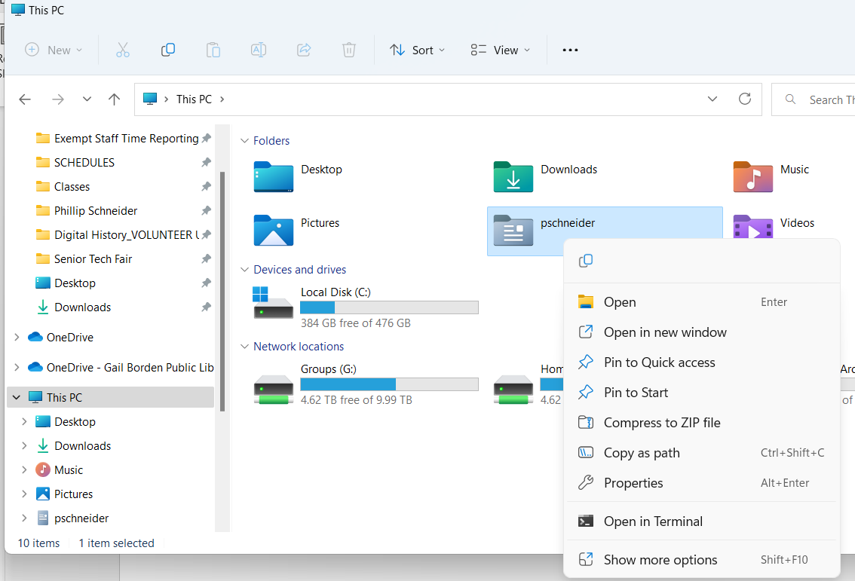
Pinning Apps

Slide 20
Windows Store

Slide 21
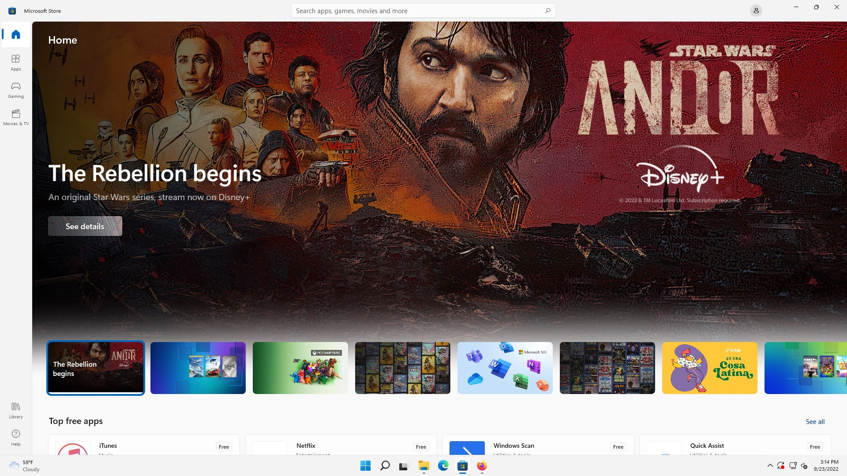
Tiles in the Start Menu

Slide 22
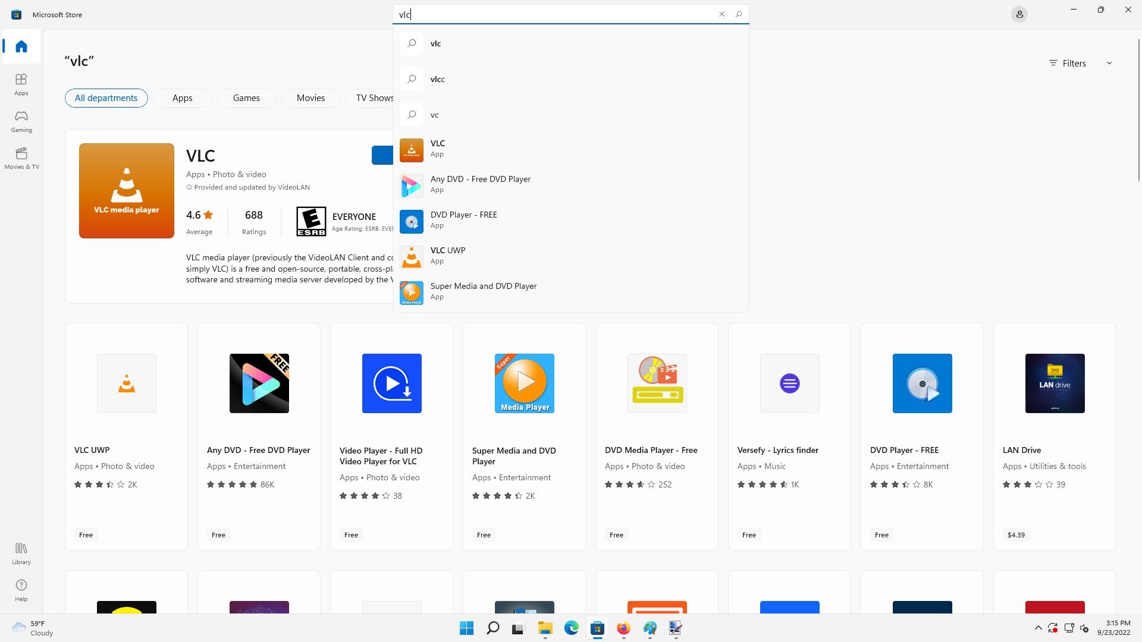
Tiles in the Start Menu

Slide 23
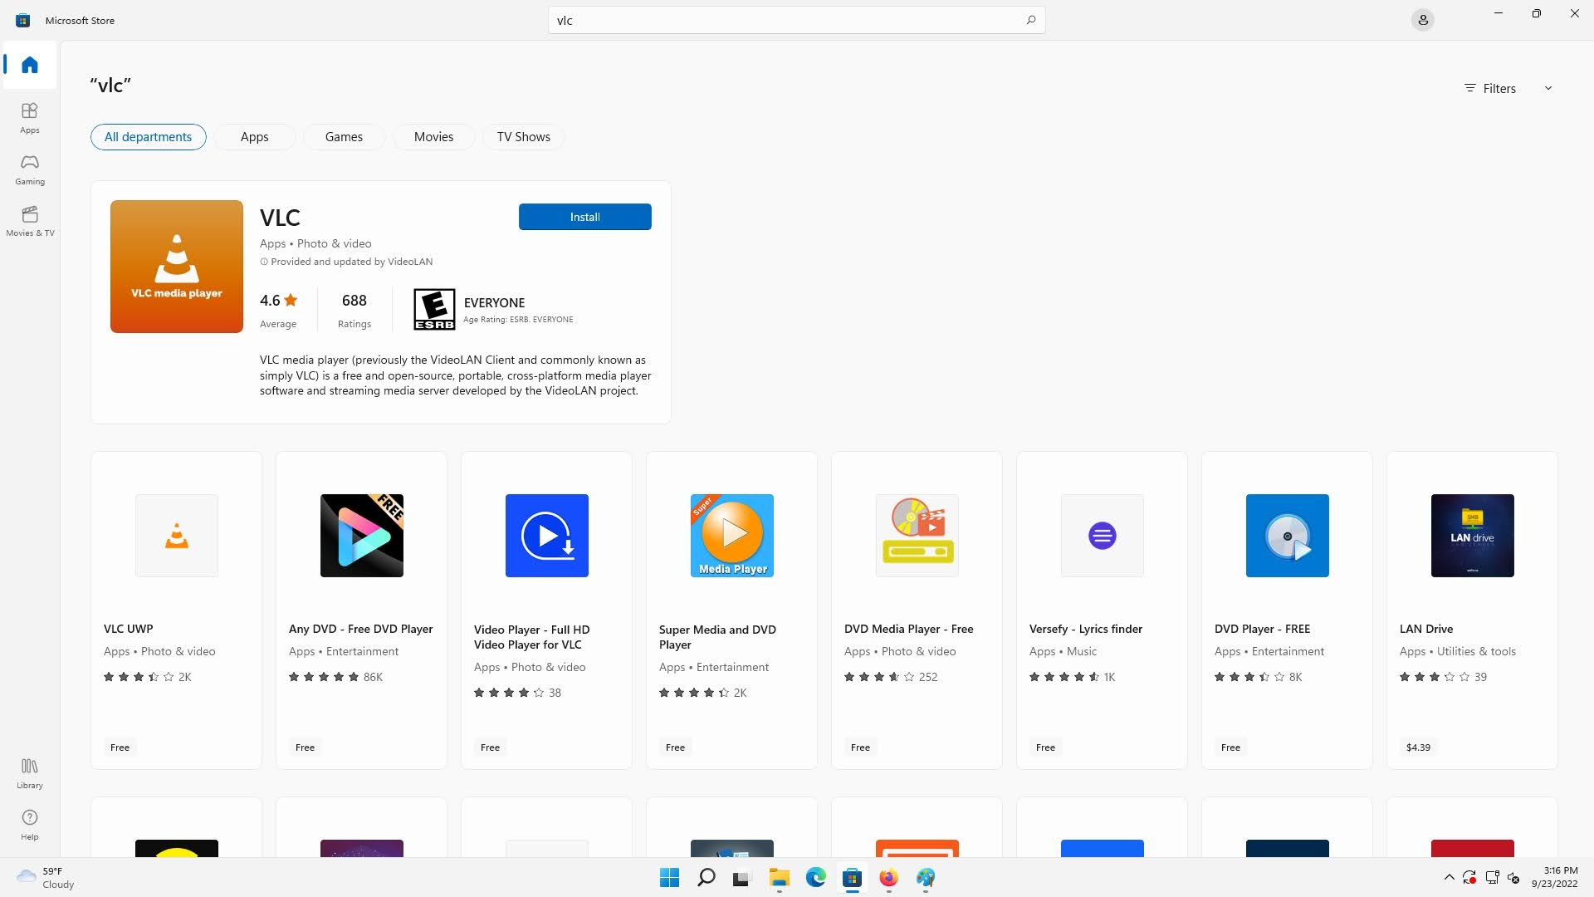
Tiles in the Start Menu

Slide 24
Settings

Slide 25
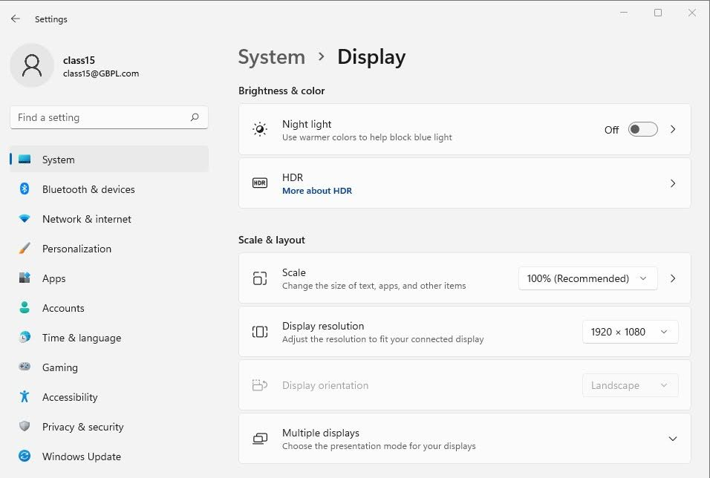
Display
Make screen nicer on your eyes at night
Turn HDR on or off (High Dynamic Range)
Changes the size of everything on your computer.
Multiple display settings

Slide 26
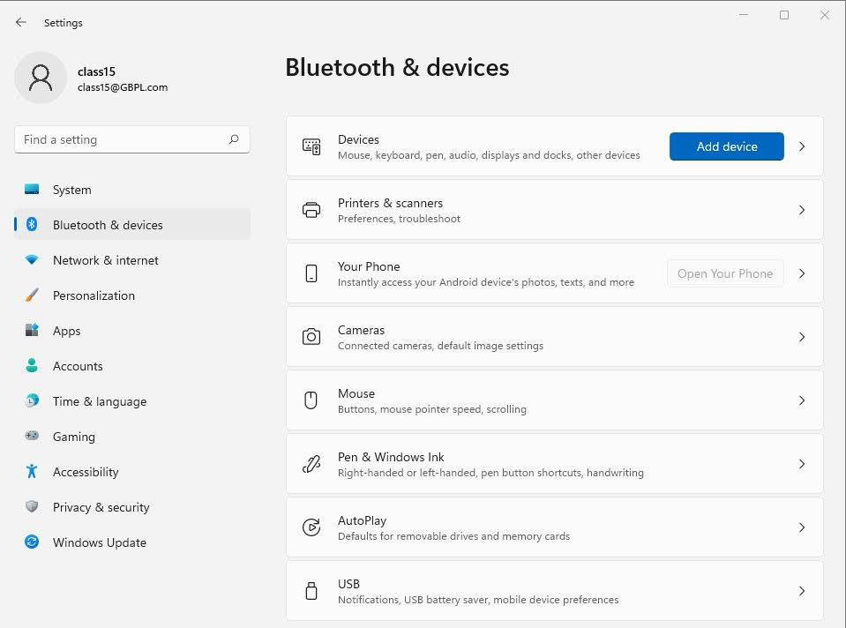
Bluetooth, printers and mice
Connected devices settings
Printer & Scanner settings
Change Mouse speed and pointer size

Slide 27
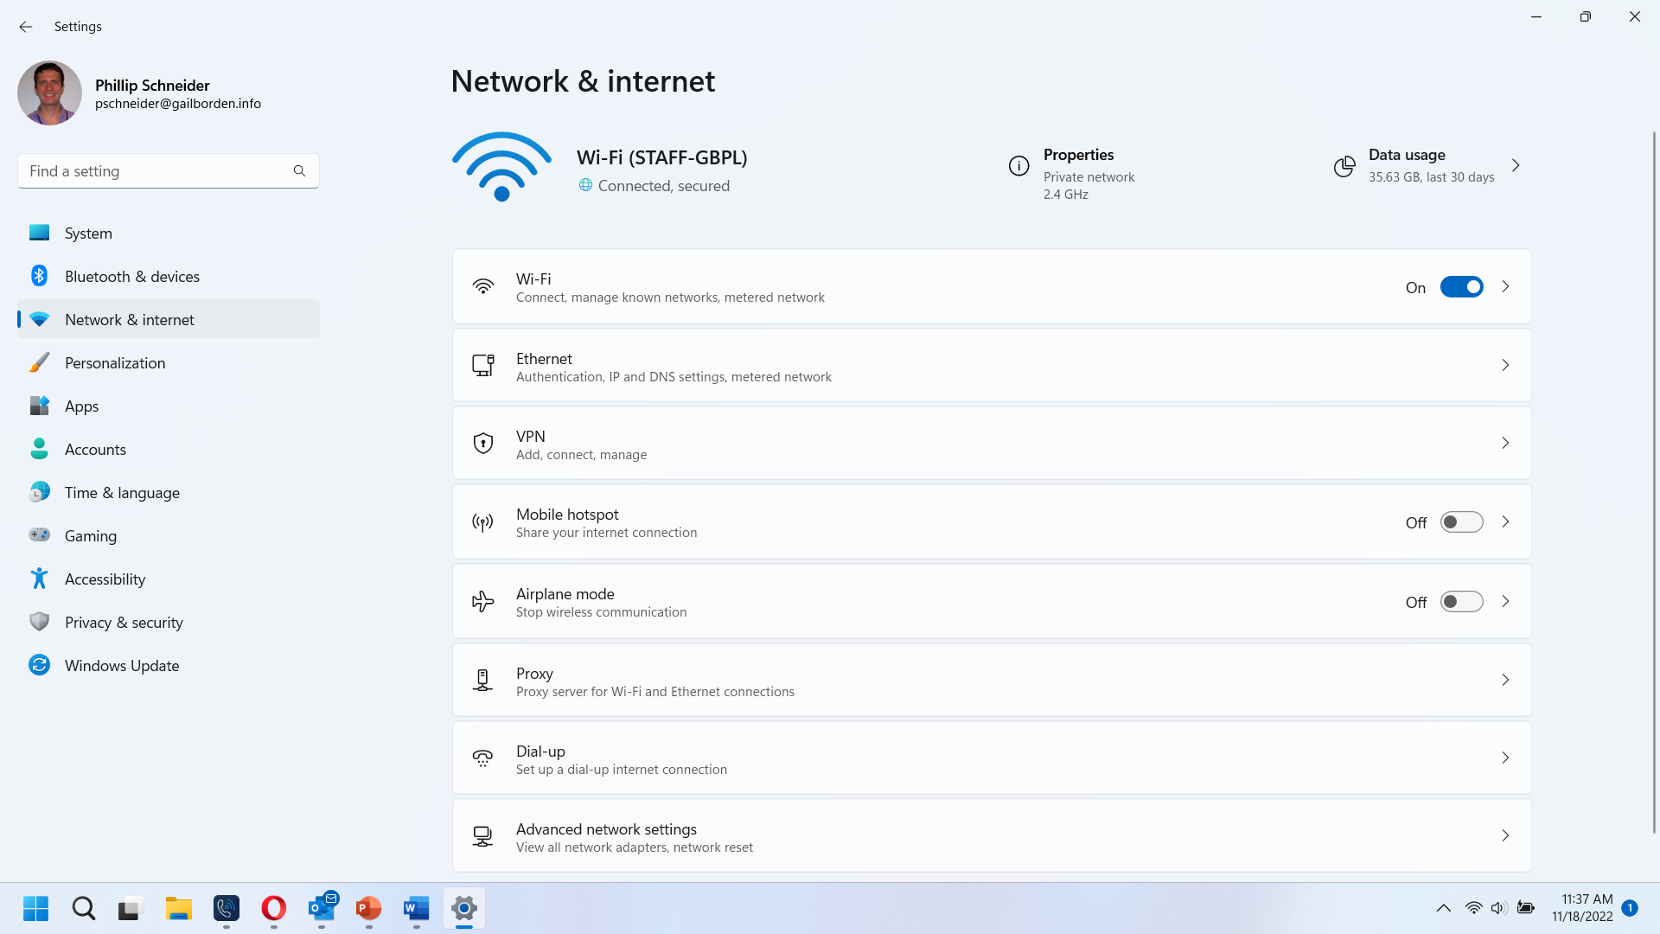
Network Settings

Slide 28
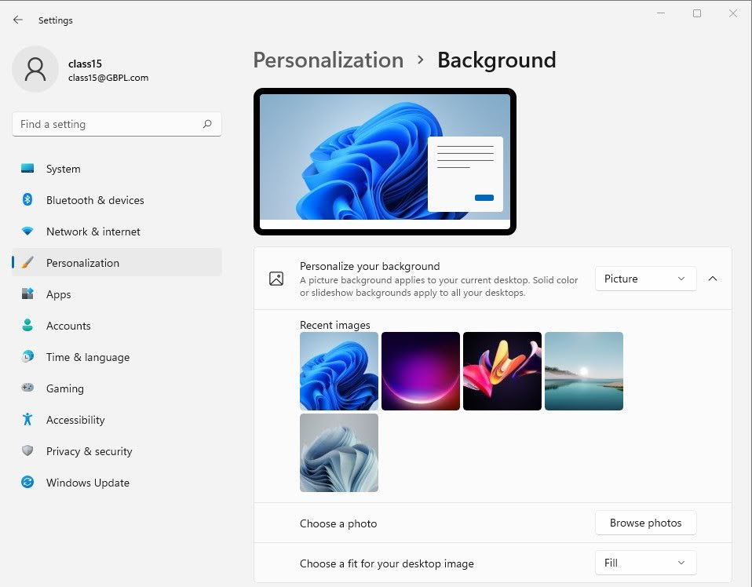
Changing background

Slide 29
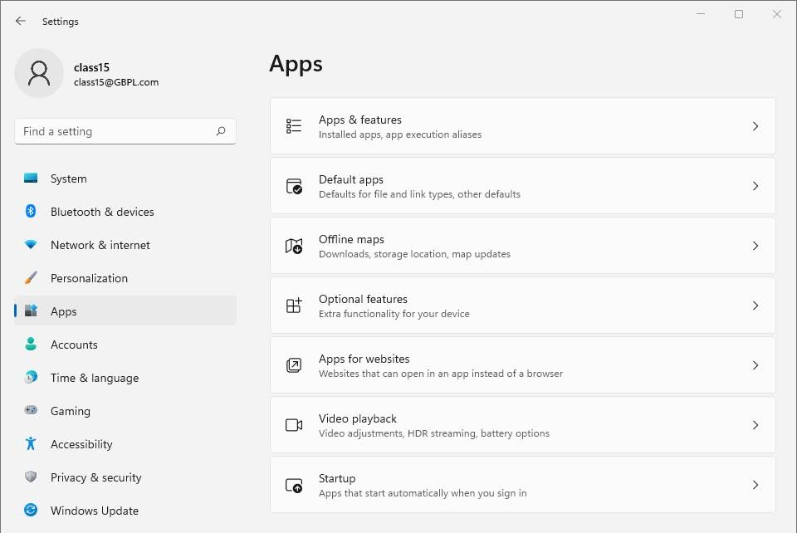
Apps
Uninstall apps
Change default apps

Slide 30
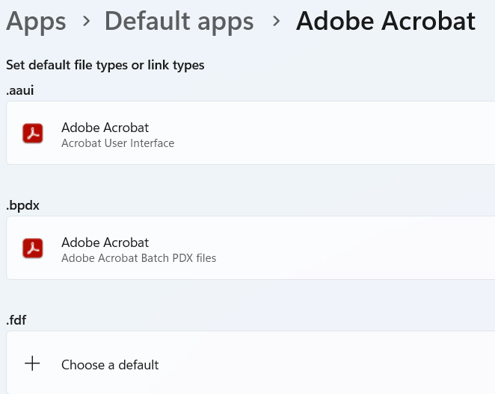
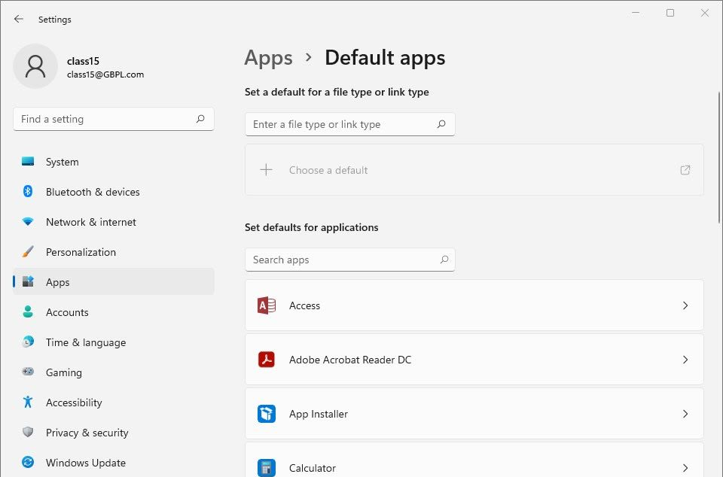
Deleting Apps
Choose the app and it will allow you to pick what files work with that program

Slide 31
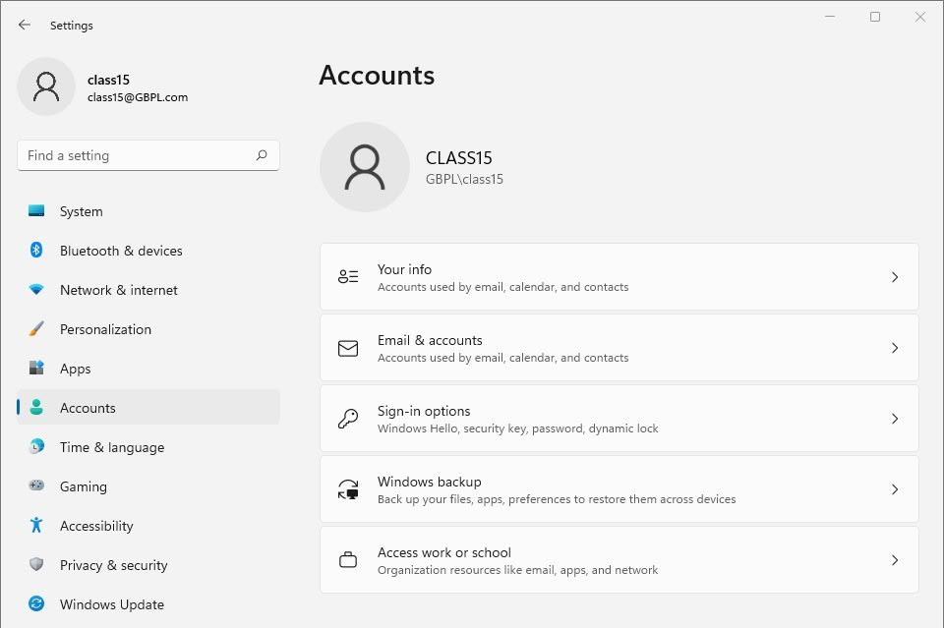
Accounts
Change password and/or login type
Manually back up your files and make Window restore points

Slide 32
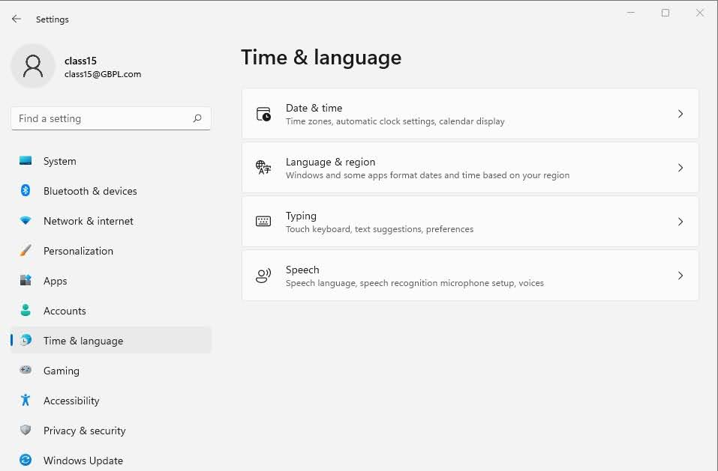
Time and Language
Change time, date and time zone

Slide 33
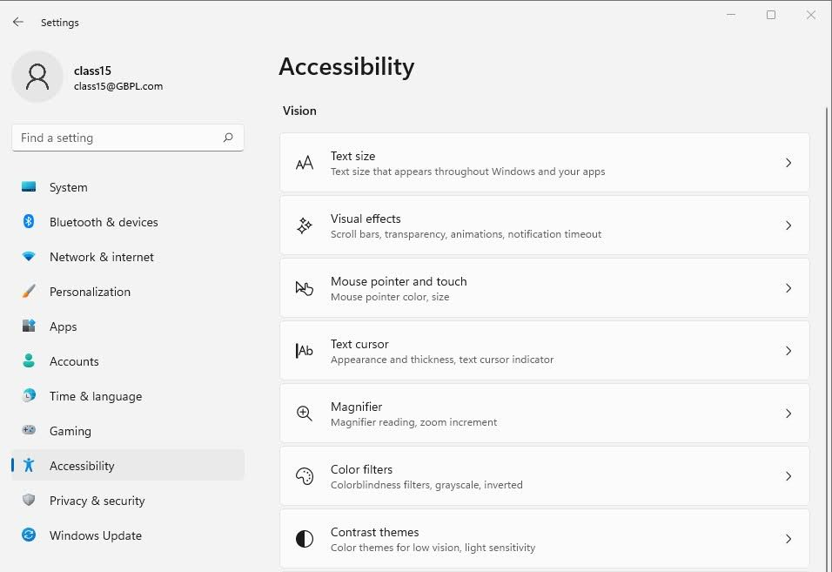
Text, mouse, and cursor size
Change Text size
Change Mouse speed
Increase text cursor size
Turn magnifier on and off and set magnification amount

Slide 34
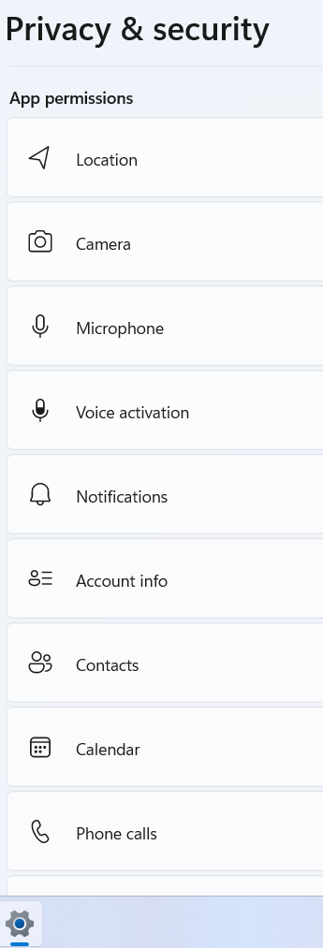
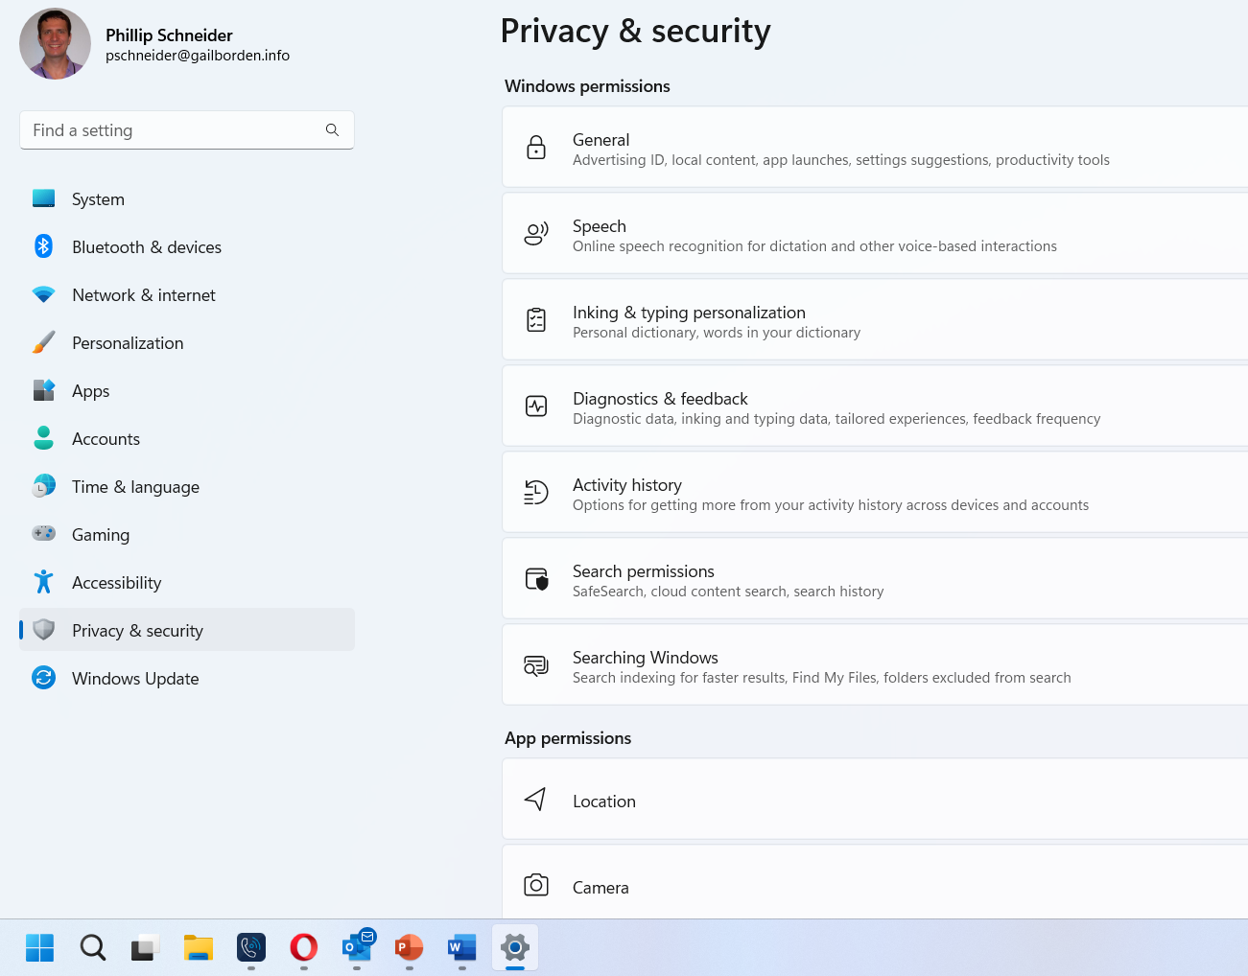
Privacy
Look through these settings and make sure you agree with their data collection and use.

Slide 35
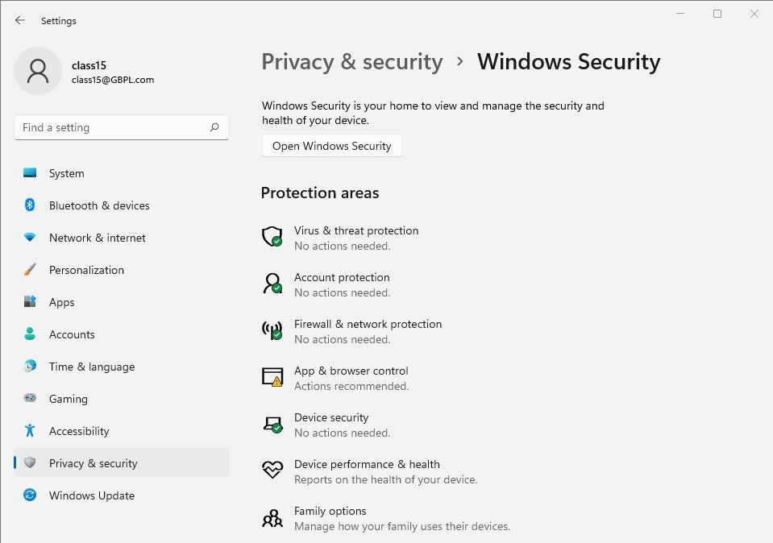
Windows Security

Slide 36
Questions?
THANKS FOR COMING!
Notes:
Thank participants for coming and ask if there are any outstanding questions.
Hand out the class surveys and encourage them to write in ideas for any additional classes.
When they submit their surveys, exchange them for handouts.
Encourage them to look for upcoming classes and register to attend

