Slide 1

Windows 10 Intermediate
Name
Title
Library Name
Courtesy of Gail Borden Public Library
and the Public Library Association

Slide 2
Agenda
Installing programs
Adding desktop shortcuts
Settings
Task Manager
Windows Defender
Uninstalling programs

Slide 3
Installing Programs

Slide 4
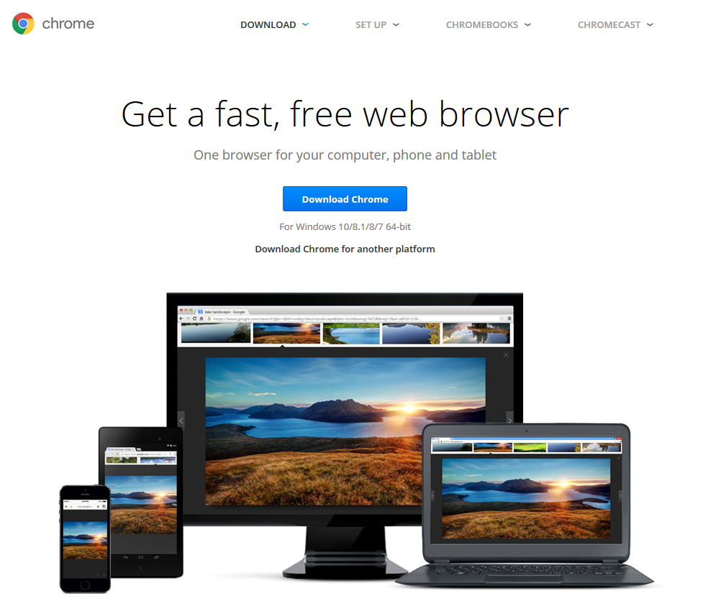
Installing Programs
Go to the company’s website for the program you wish to download (ex: www.opera.com)
Most programs installations are simple & follow the same basic steps
Download the program
Run
Follow the prompts in the installation window

Slide 5
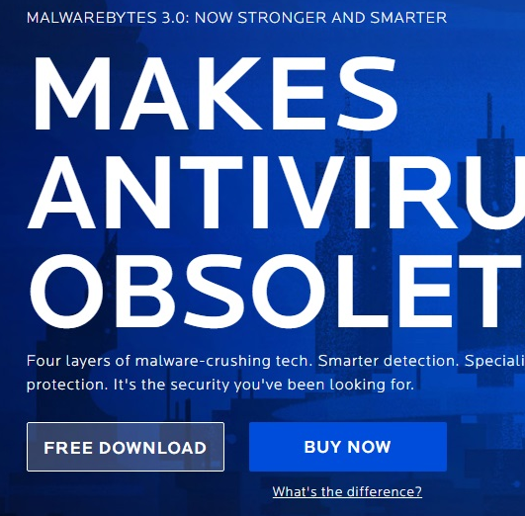

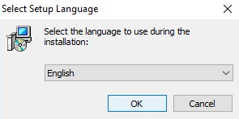
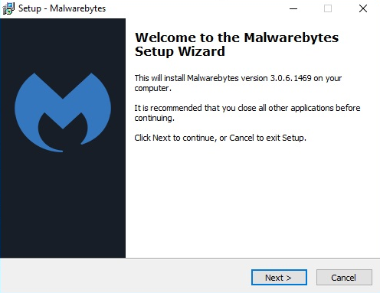
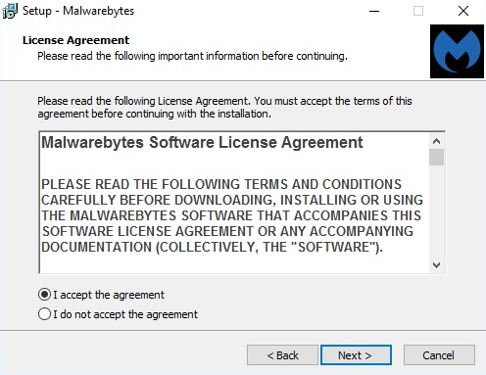
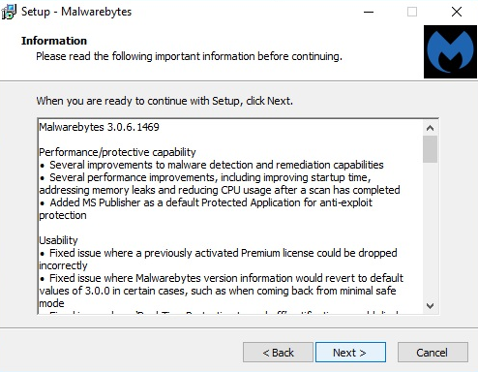
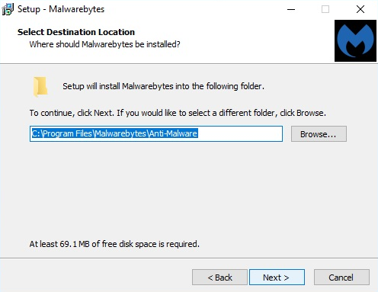
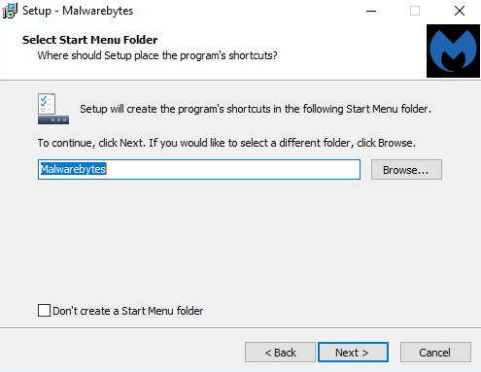
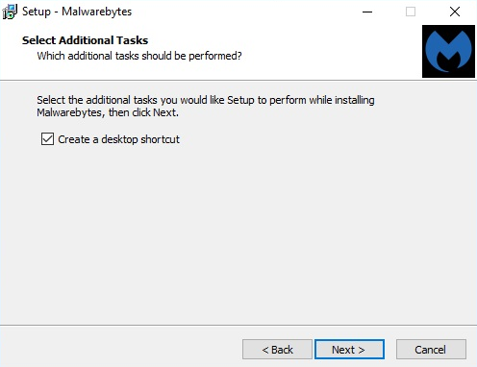
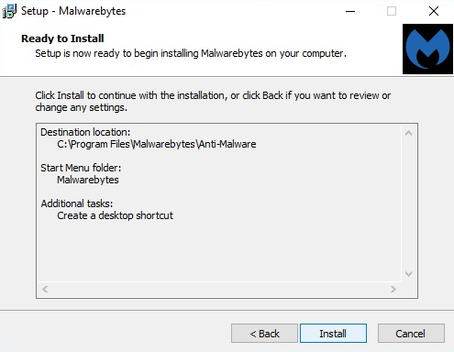
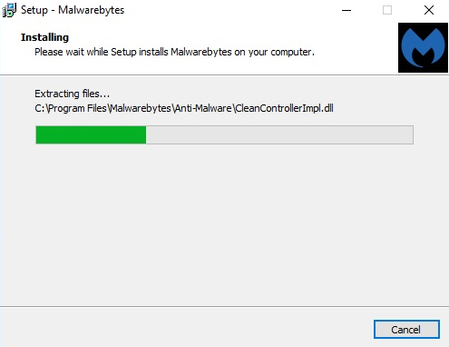
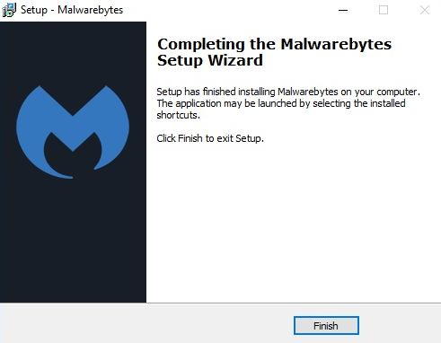
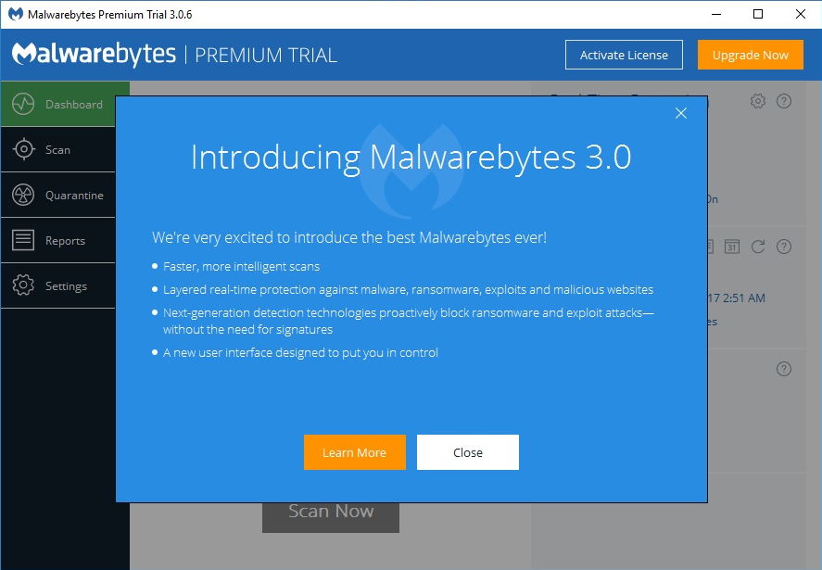
Installing Programs

Slide 6
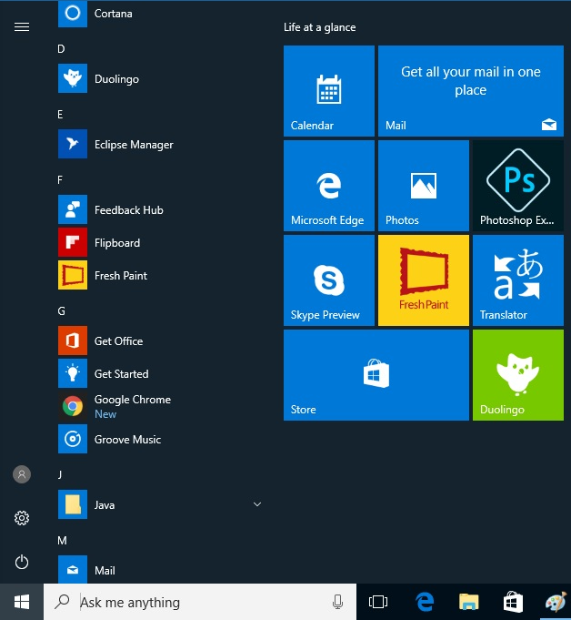

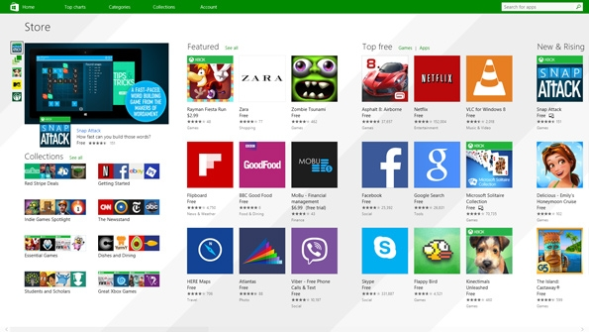
Installing Programs

Slide 7
Adding Desktop Icons

Slide 8
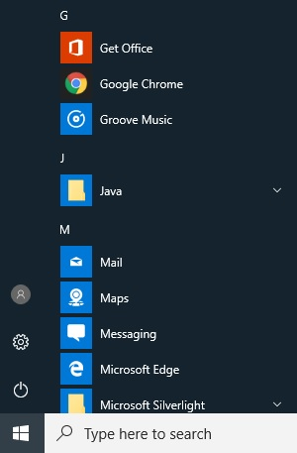
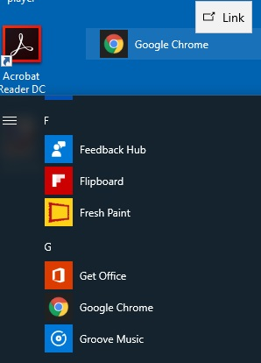

Adding Desktop Icons
Make sure all other windows are minimized or closed so you are looking at the desktop
Open the Start Menu
Find the app you want to create a shortcut for
Click and hold on the app name, then drag it out of the Start Menu and onto the Desktop

Slide 9
Settings

Slide 10
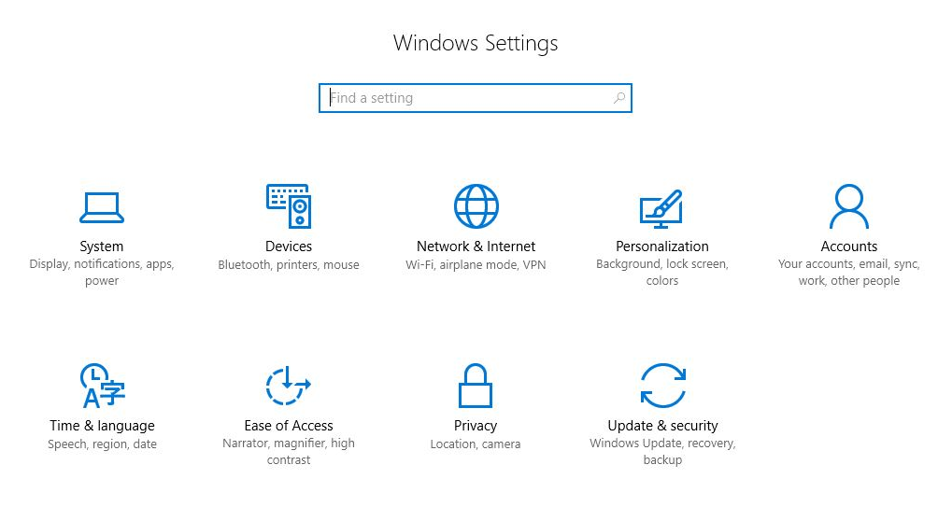
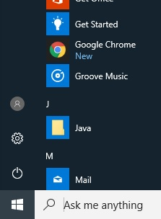
Settings

Slide 11
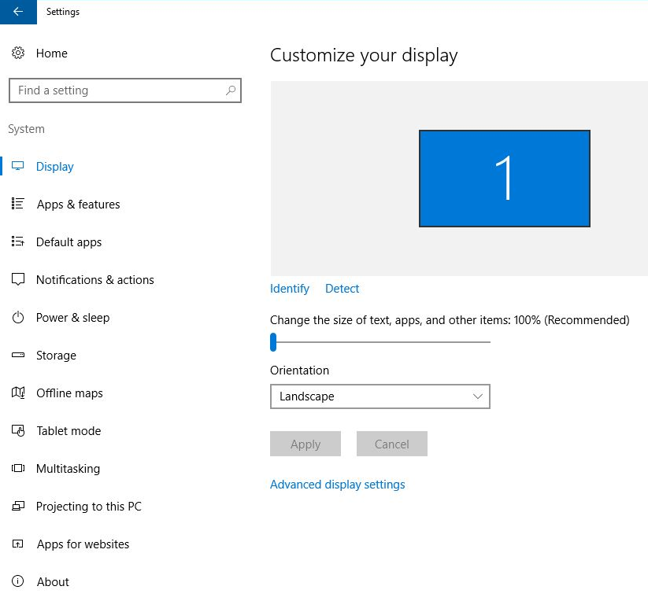
Settings

Slide 12
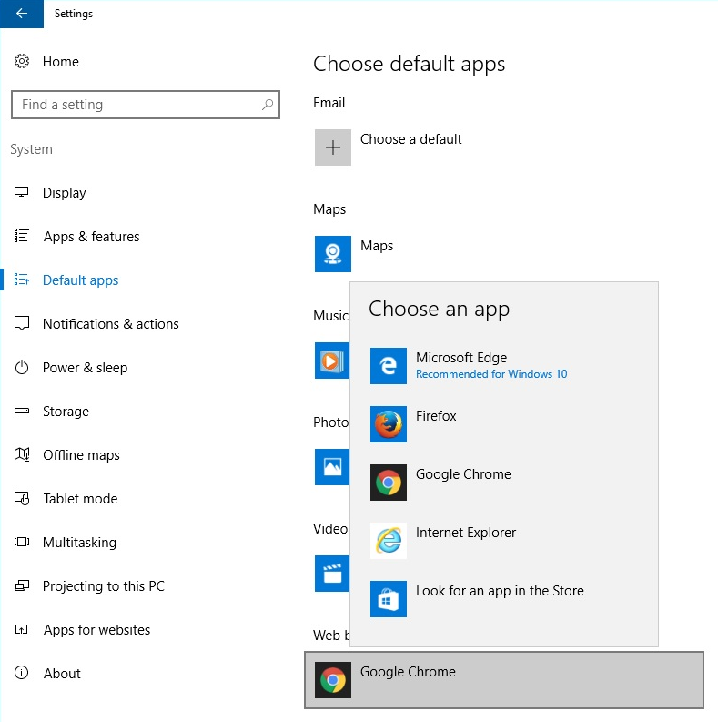
Settings

Slide 13
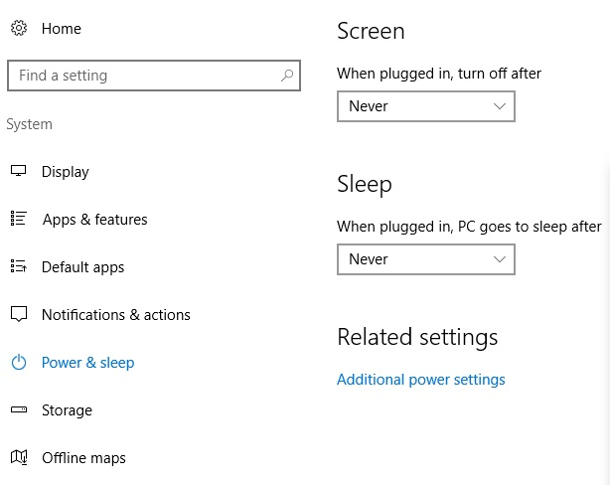
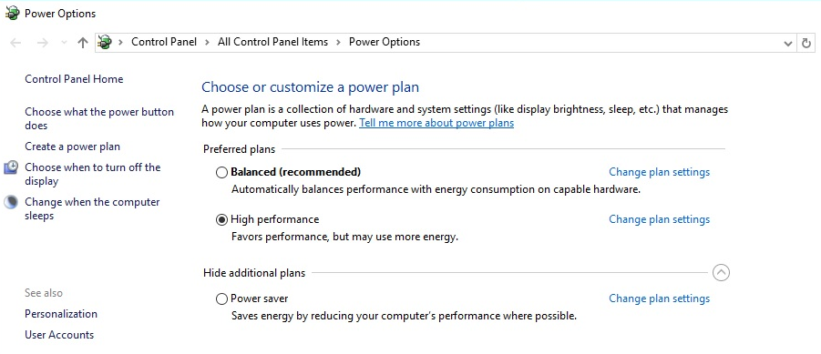
Settings

Slide 14
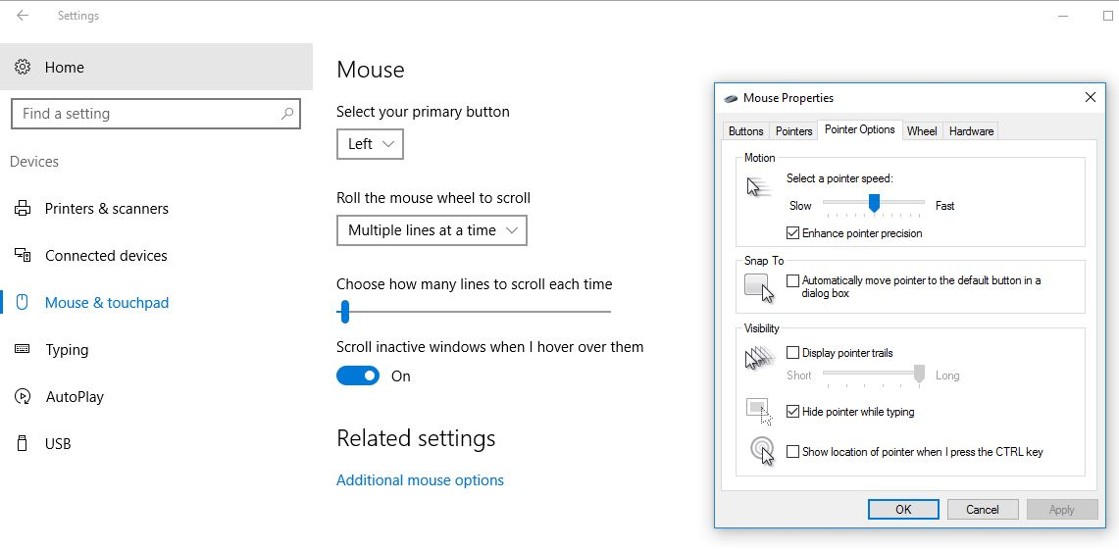
Settings

Slide 15
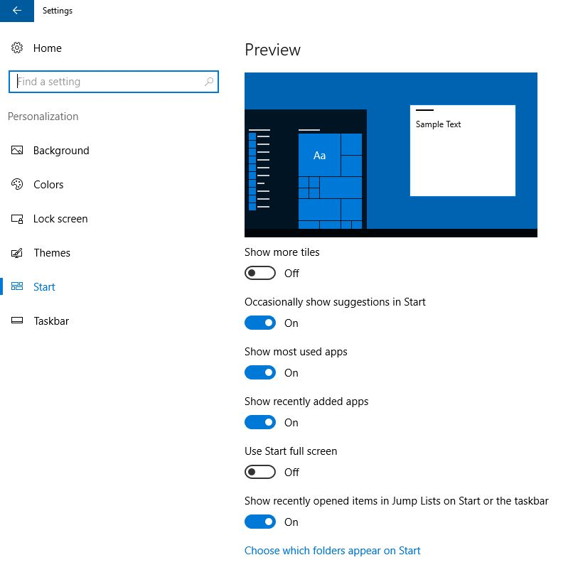
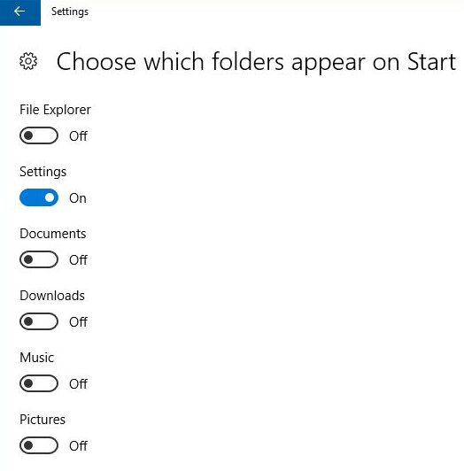
Settings

Slide 16
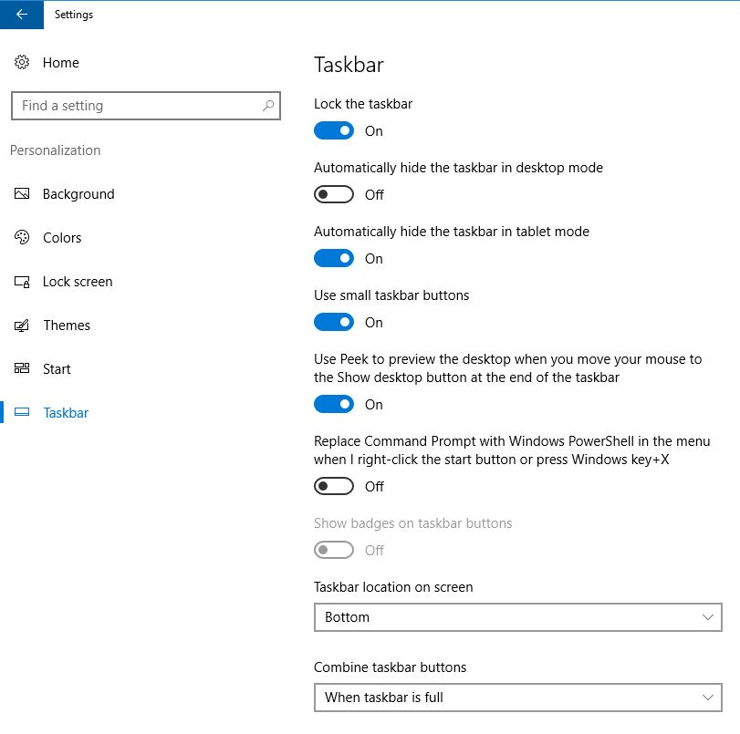
Settings

Slide 17
Task Manager

Slide 18
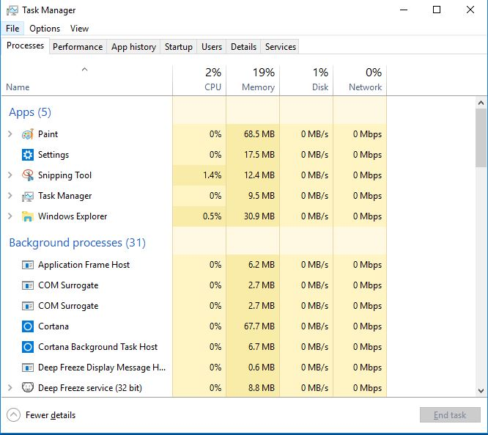
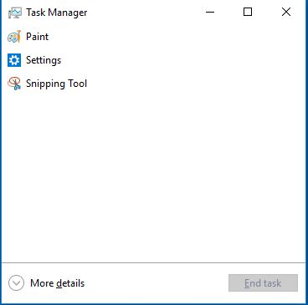
Task Manager

Slide 19
Task Manager
Select the app you wish to close by left clicking on it and then click on End Task

Slide 20
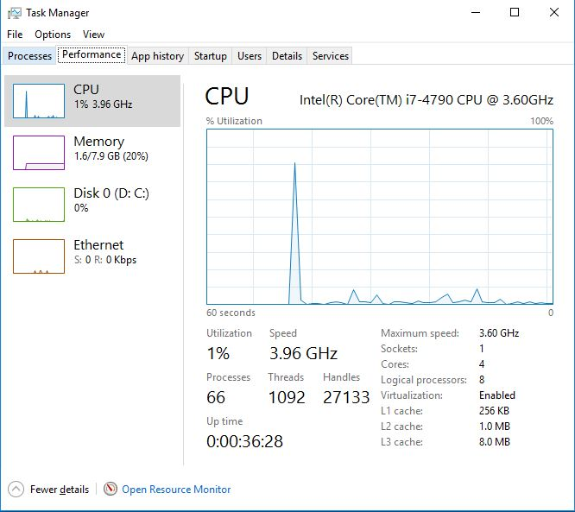
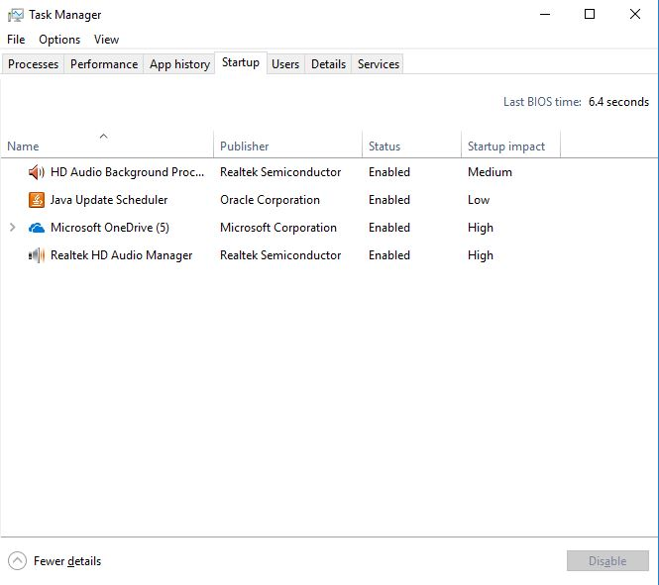
Task Manager

Slide 21
Windows Defender

Slide 22
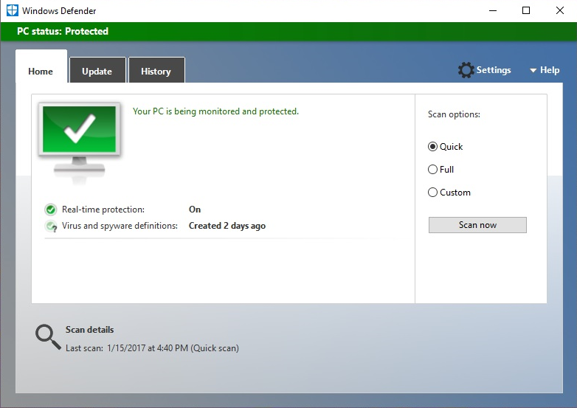
Windows Defender

Slide 23
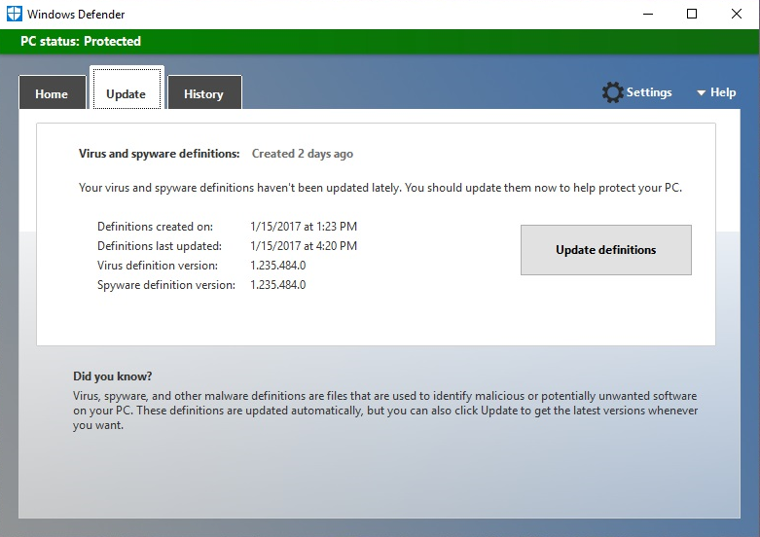
Windows Defender

Slide 24
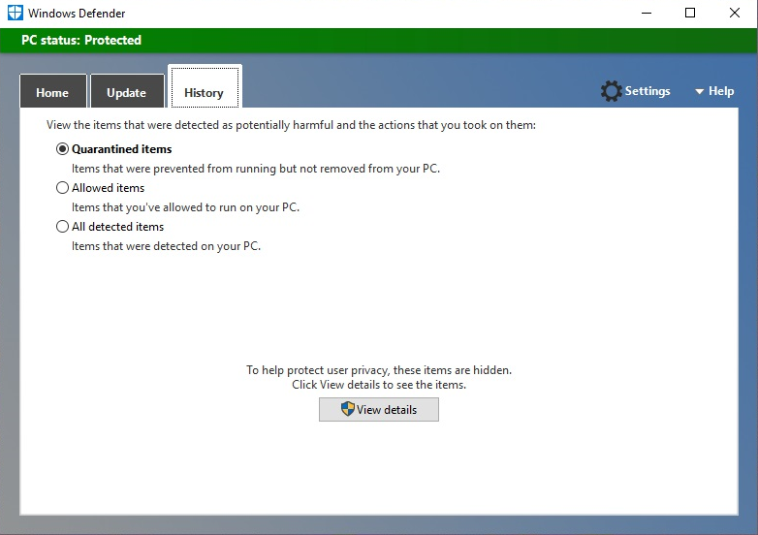
Windows Defender

Slide 25
Uninstalling Programs/Apps

Slide 26
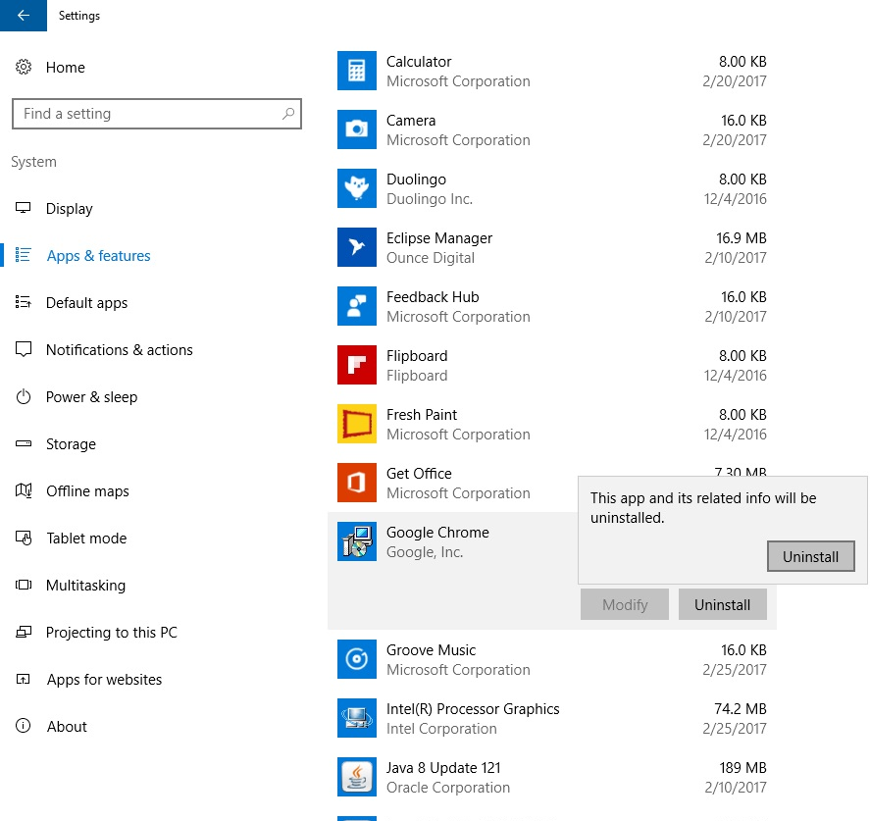
Uninstalling Programs/Apps

Slide 27
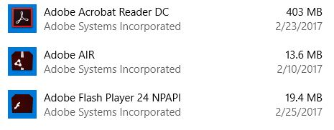
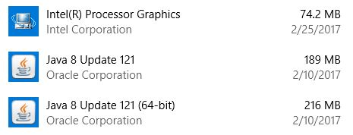

Uninstalling Programs/Apps
Avoid uninstalling drivers and necessary programs such as…

Slide 28
Questions?
THANK YOU FOR COMING!
Notes:
Thank participants for coming and ask if there are any outstanding questions.
Hand out the class surveys and encourage them to write in ideas for any additional classes.
When they submit their surveys, exchange them for handouts.
Encourage them to look for upcoming classes and register to attend

