Slide 1

Windows 10 Basics
Phillip Schneider
Information Services Librarian
Gail Borden Public Library
Courtesy of Gail Borden Public Library
and the Public Library Association

Slide 2
Agenda
Terminology and Descriptions
Accessing Apps
Customizing the Start Menu
System Settings
File Explorer
Microsoft Edge

Slide 3
Terminology and Descriptions

Slide 4

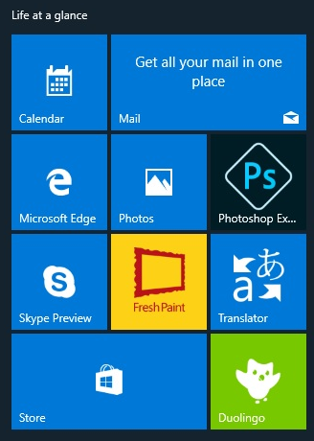
Terminology and Descriptions
Start Menu: The start menu can be found in the bottom left corner of your screen and contains access to apps/programs.
Tiles: Tiles are found in the start menu and are used to launch apps

Slide 5
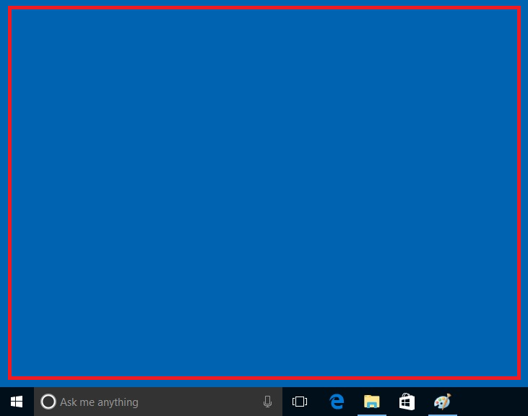
Terminology and Descriptions
  Apps/Programs: Apps and programs is the software on your computer such as Google Chrome, Microsoft Word, and iTunes.
  Desktop: The customizable, primary display are of your screen.

Slide 6
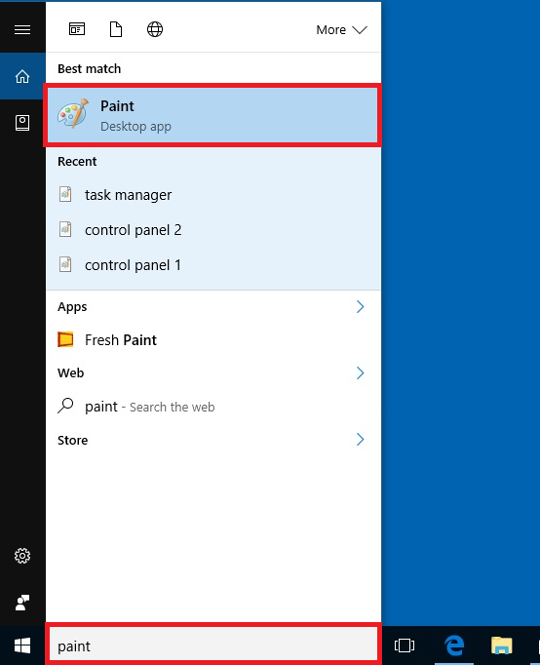
Terminology and Descriptions
  Cortana: A voice activated assistant used to perform tasks and discover information

Slide 7
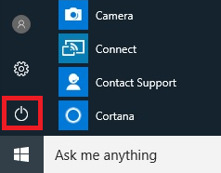
Terminology and Descriptions
  Taskbar: A stationary strip of open programs and frequently used programs
  Shut Down and Log off: You can find the power off button in the start menu

Slide 8
Accessing Apps

Slide 9
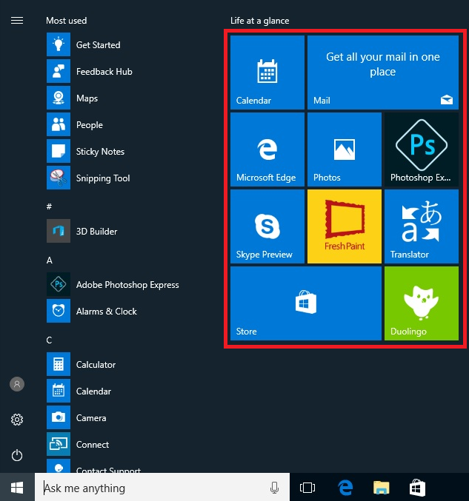
Accessing Apps
Start Menu Tiles

Slide 10
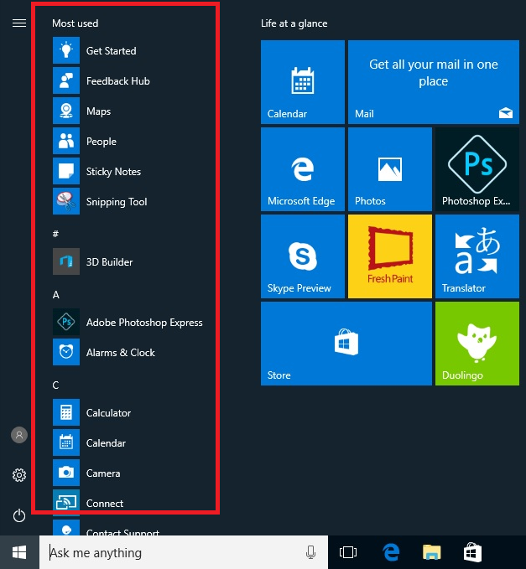
Accessing Apps
All Apps List

Slide 11
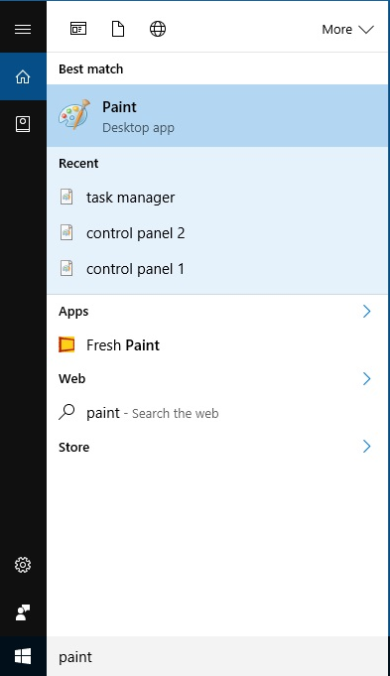

Accessing Apps
Search using Cortana
Enter the desired app you would like to open by typing/speaking it into Cortana.

Slide 12
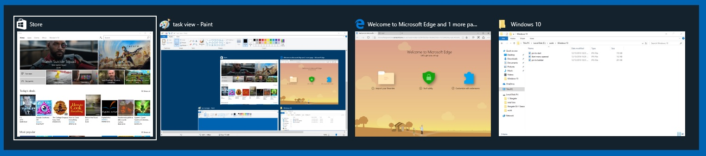
Accessing Apps
Switching Between Apps
You can switch between apps by using the task view which can be accessed by holding Alt and tapping Tab at the same time or by clicking on the Task View button.

Slide 13
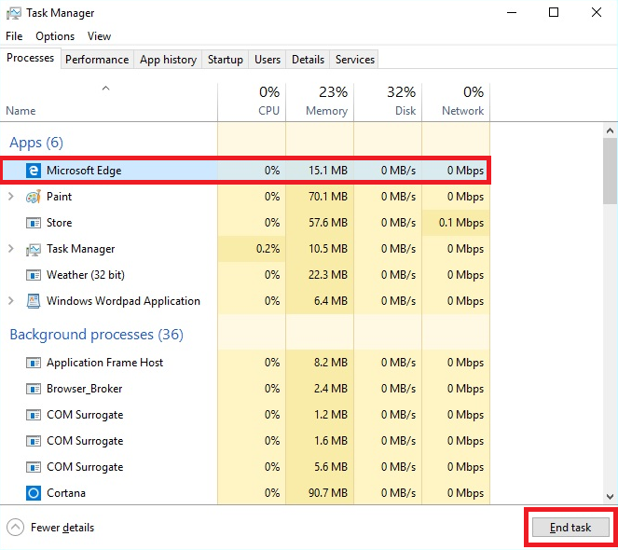
Accessing Apps
Closing “Hung-up” programs
Task Manager: The task manager allows you to close any program. To open it up hold down Ctrl+Shift+Esc all at the same time.

Slide 14
Activity 1

Slide 15
Customize the Start Menu

Slide 16
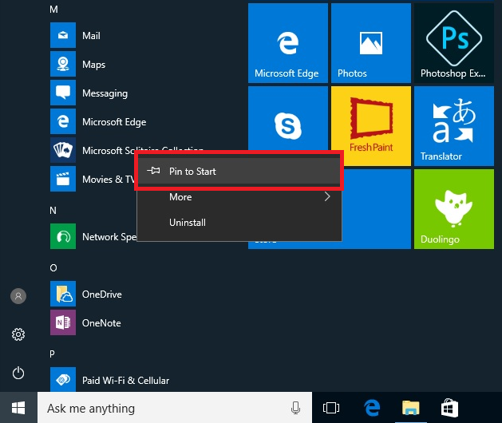

Customizing the Start Menu

Slide 17
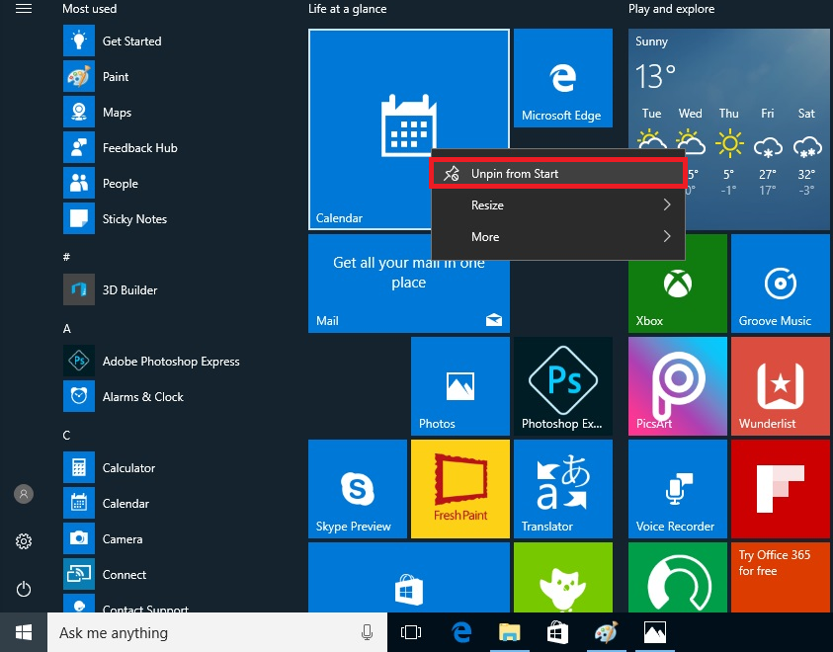
Customizing the Start Menu

Slide 18
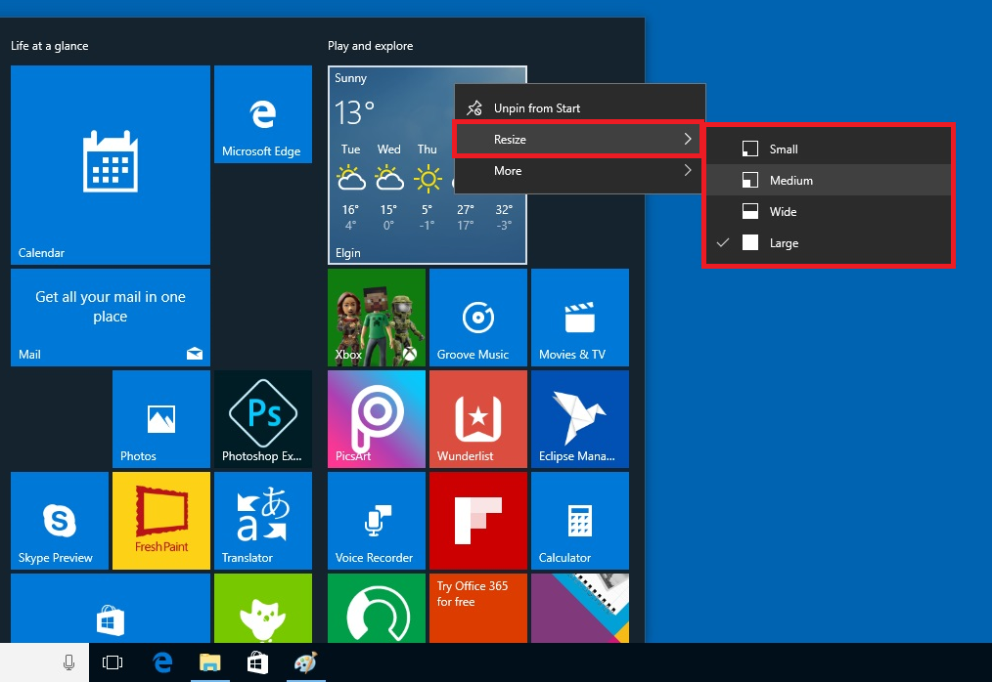
Customizing the Start Menu

Slide 19
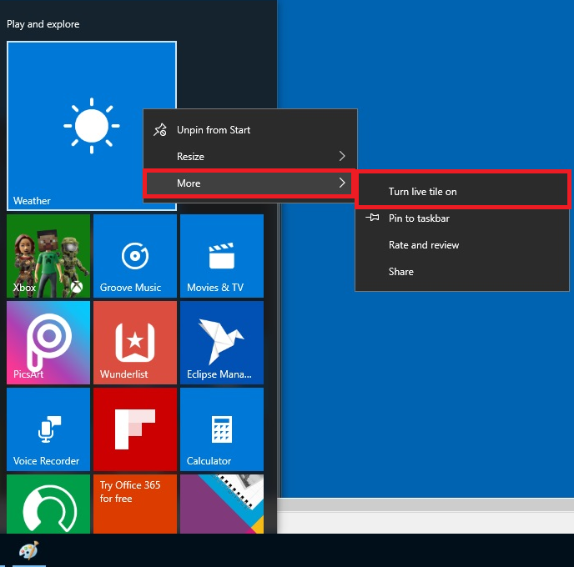

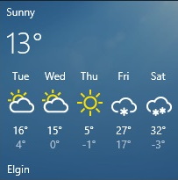
Customizing the Start Menu

Slide 20
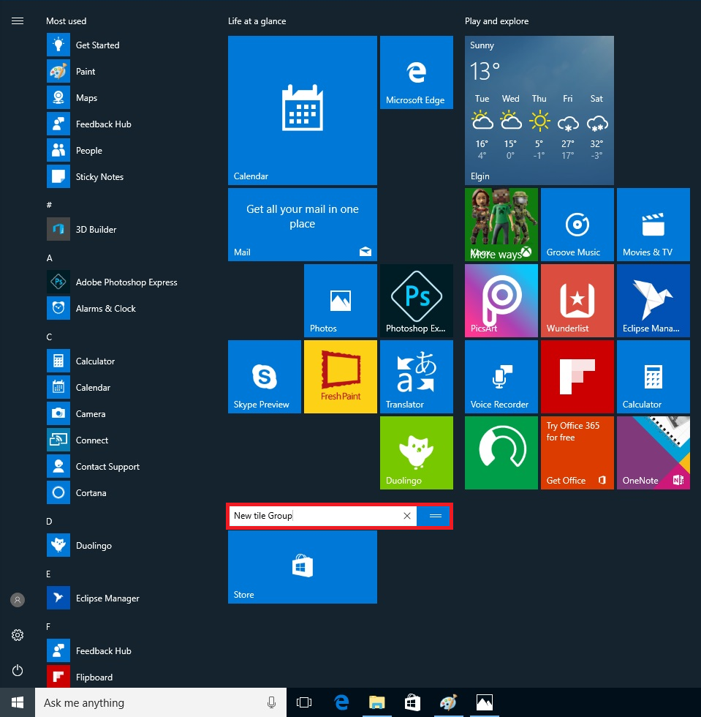
Customizing the Start Menu
Hold left click on tile and drag to desired area
Left click on group title to rename it.

Slide 21
Activity 2

Slide 22
System Settings

Slide 23
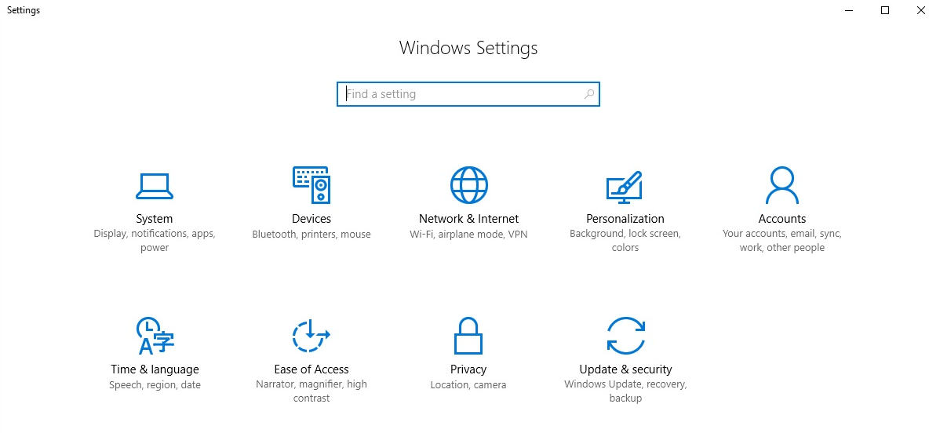
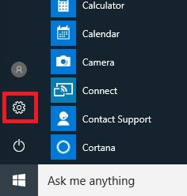
System Settings
Settings in Start Menu

Slide 24
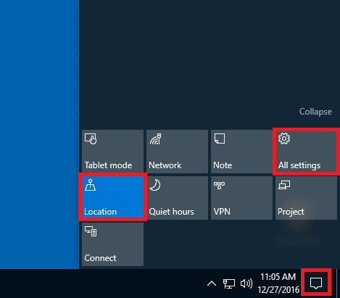
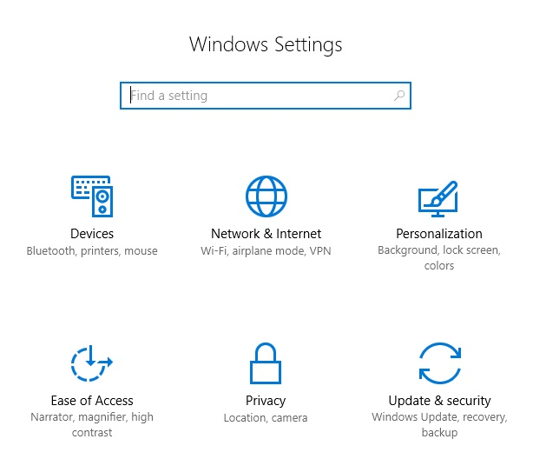
System Settings
Notification Button

Slide 25
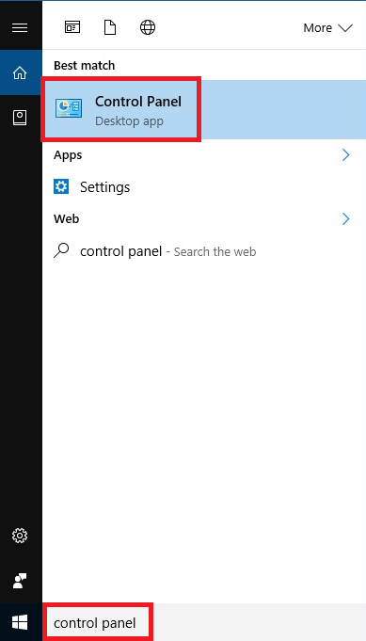
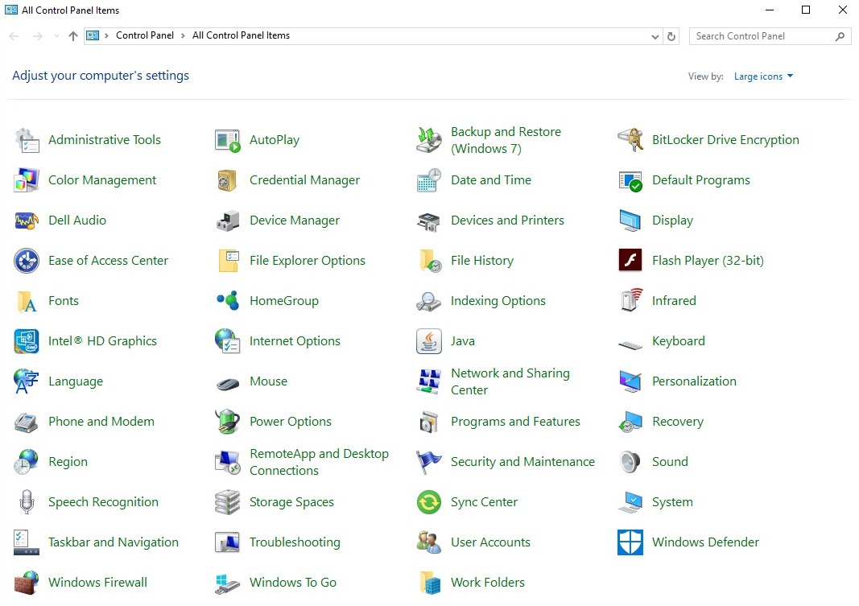
System Settings
Control Panel

Slide 26
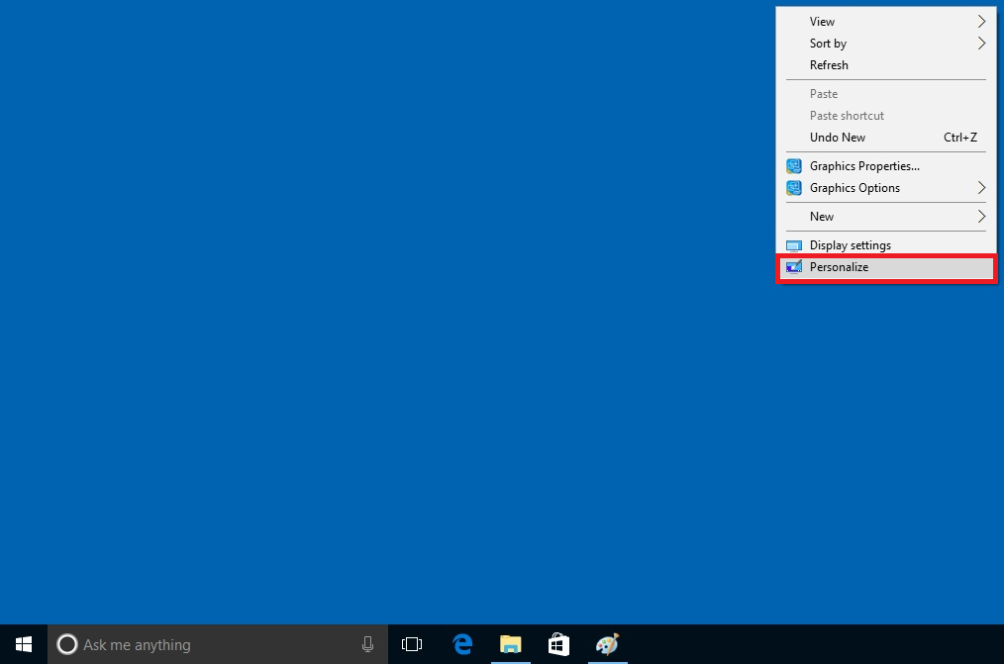

System Settings

Slide 27
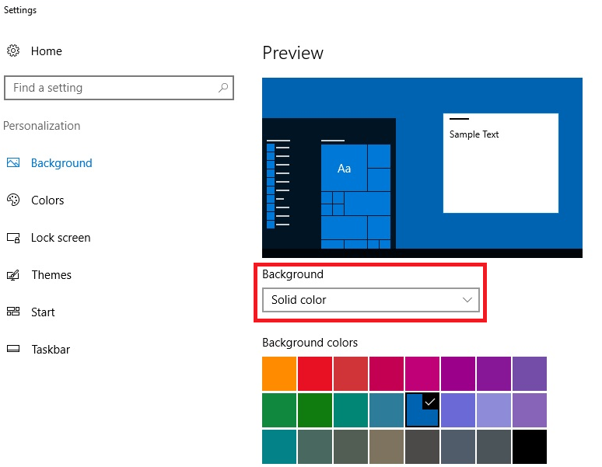
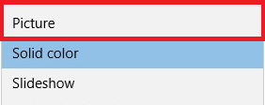
System Settings

Slide 28
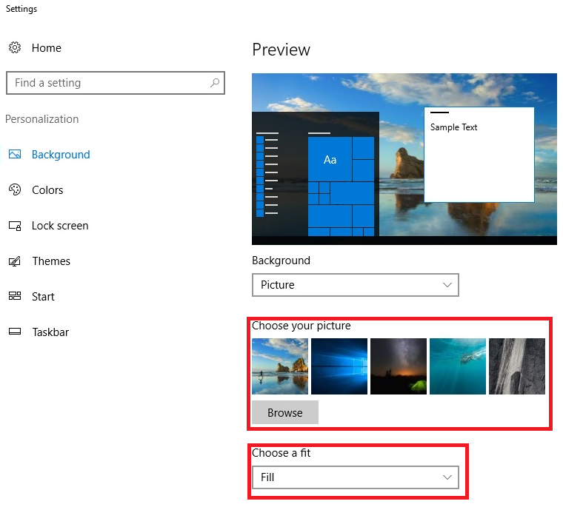
System Settings

Slide 29
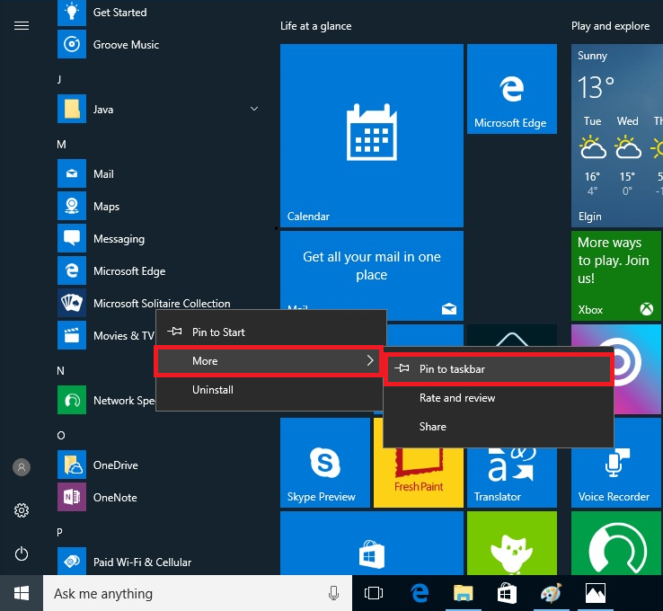
System Settings

Slide 30
Activity 3

Slide 31
File Explorer

Slide 32
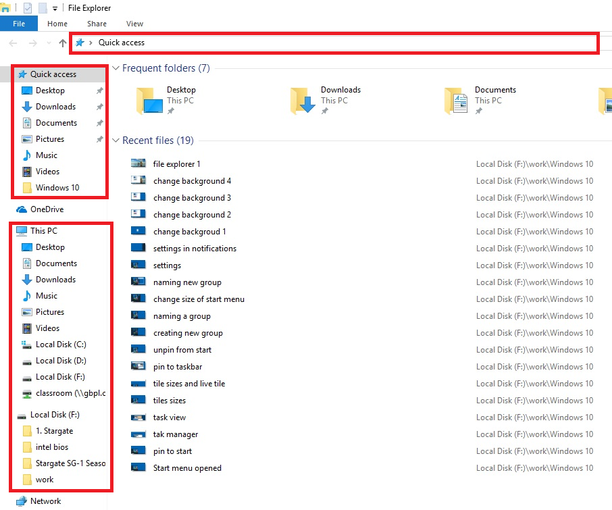
File Explorer
Navigation Pane
Quick Access
Common Folders

Slide 33
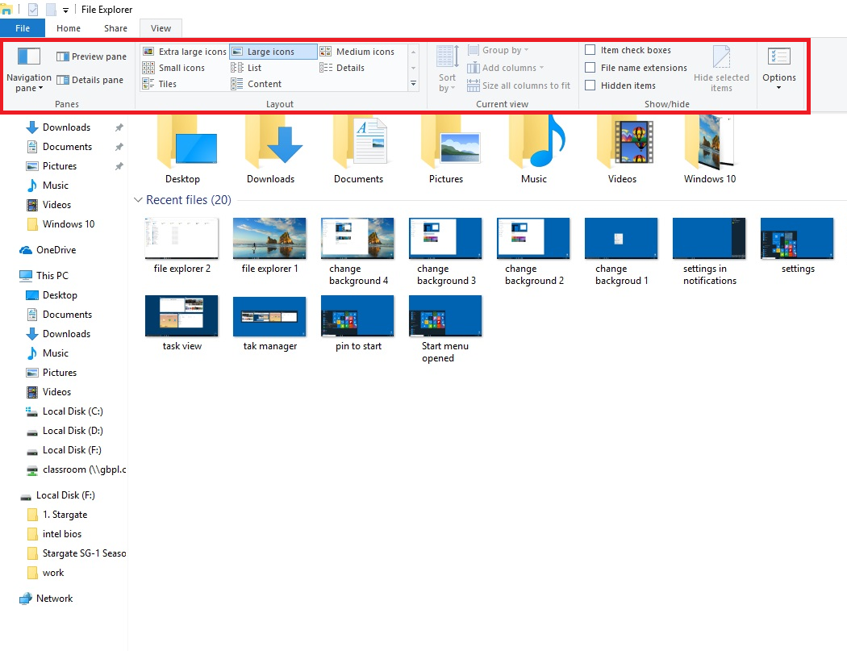
File Explorer
Icon Views and Layout

Slide 34
Activity 4

Slide 35
Microsoft Edge

Slide 36
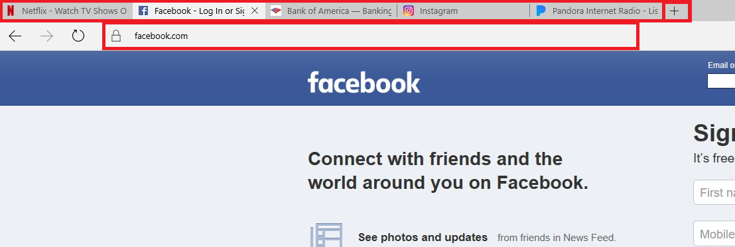
Microsoft Edge
Tabs
Address Bar
New Tab

Slide 37
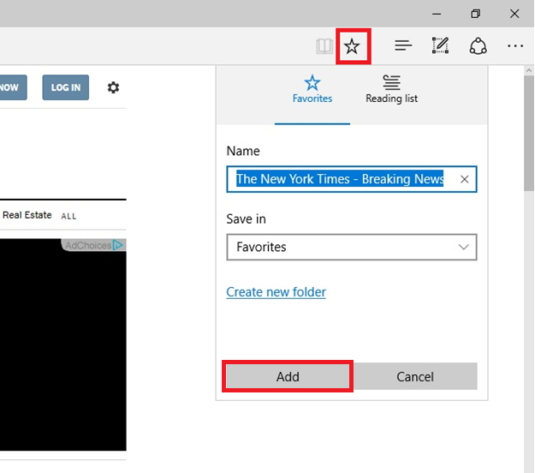
Microsoft Edge

Slide 38
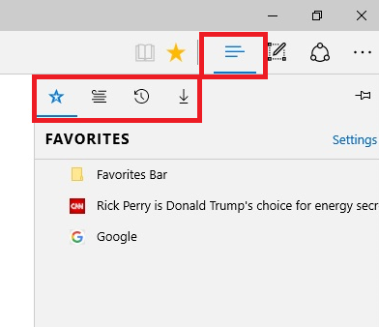
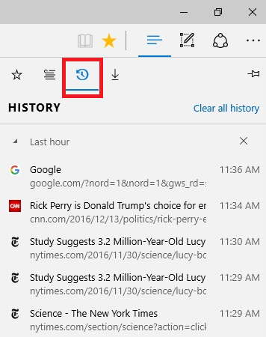
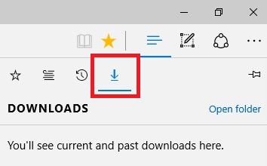
Microsoft Edge

Slide 39
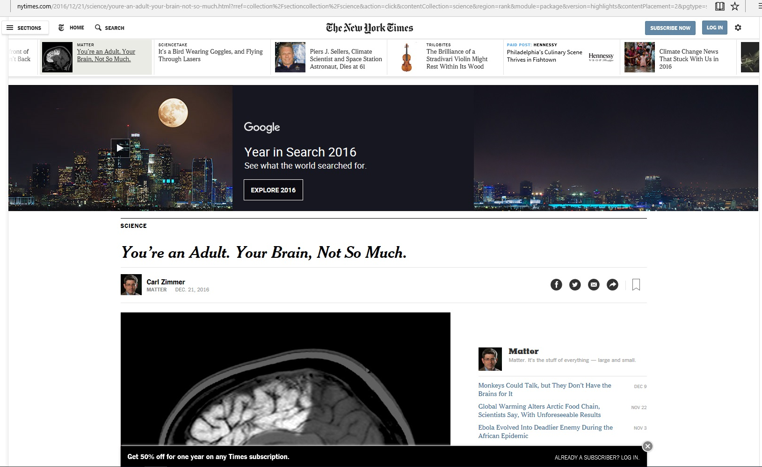

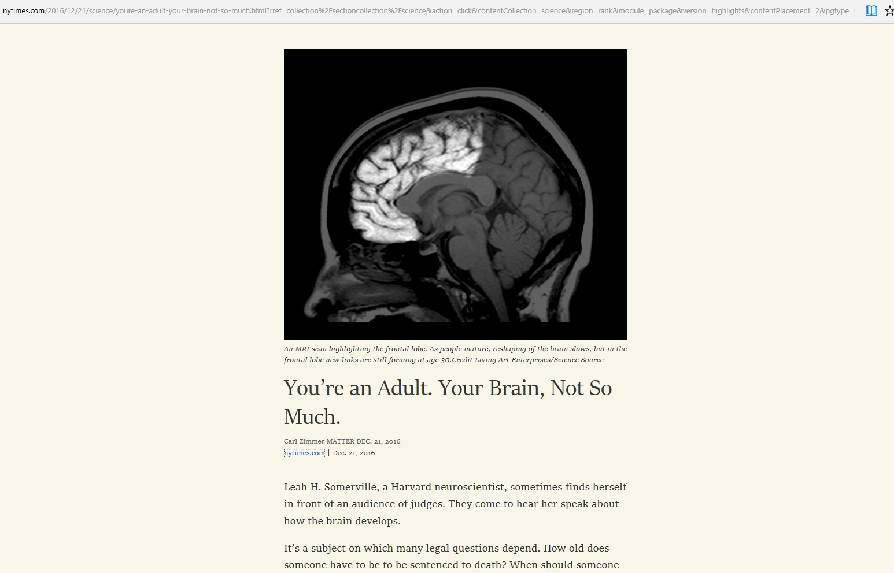
Microsoft Edge

Slide 40
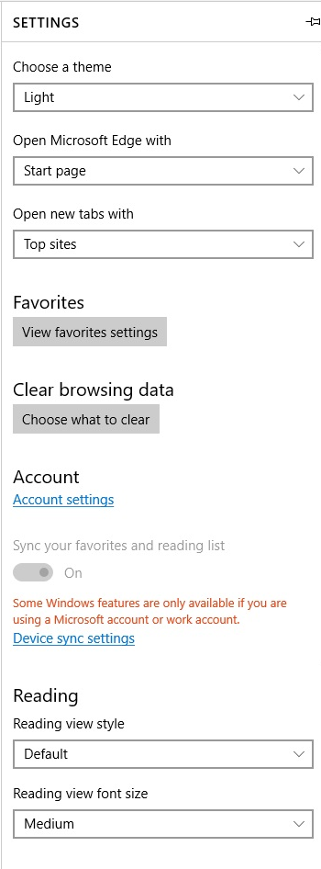
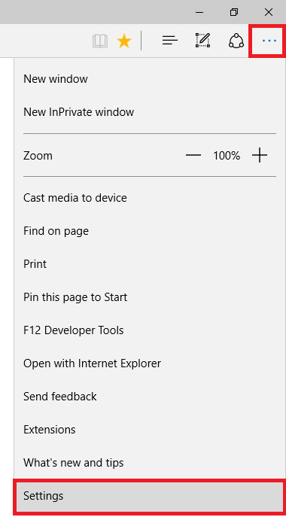
Microsoft Edge

Slide 41
Questions?
THANK YOU FOR COMING!
Notes:
Thank participants for coming and ask if there are any outstanding questions.
Hand out the class surveys and encourage them to write in ideas for any additional classes.
When they submit their surveys, exchange them for handouts.
Encourage them to look for upcoming classes and register to attend

