Slide 1


Video Conferencing Basics
Instructor Name:
Instructor Affiliation:
Location Name:
Insert Your Logo Here
Notes:
INSTRUCTOR NOTE: Please update this slide with the appropriate information:
Instructor Name
Instructor Affiliation (for example, library staff member, community volunteer, and so on)
Location Name
Your organization logo
INSTRUCTOR NOTE: Before the workshop, please review the Instructor Outline for guidance on what to do to prepare for the workshop. The outline includes notes on how to conduct the workshop, and it explains what you should do once the workshop ends.
Today’s workshop is provided with support from AT&T and the Public Library Association. [INSTRUCTOR NOTE: Include thank-you to community collaborator if applicable.]
My name is <your name here> and I am <brief description of yourself>. Before we get started here are a few housekeeping items [mention the items that are relevant to your workshop]:
Where are the restrooms?
Where are the emergency exits?
When/how to ask questions—Note where to locate the page number on each slide. Participants can note the page number if they have questions to ask later, so you can get back to the right spot easily.
If you have a cell phone with you, please make sure to either turn it off or set to silent.
Will there be a break?

Slide 2
Today’s Agenda
Introduction
  What is video conferencing?
Skill Building
  Joining meetings
  Creating a personal Zoom account
  Recognizing common features
  Scheduling an online meeting
Tips and Tricks for hosting
Practice
Notes:
In this workshop you will learn about video conferencing. We’ll work on building skills and confidence so you can engage in online meetings. This will include:
Joining meetings that others invite you to.
Creating your own personal Zoom account.
Recognizing common features you’ll use in an online meeting.
Scheduling an online meeting.
As we go, you’ll learn tips and tricks for hosting an online meeting. And you will have opportunities to practice what you’ve learned.
Let’s get started!

Slide 3

Introduction
Do you have any experiences to share about video conferencing?
Have you used these tools?
Notes:
INSTRUCTOR NOTE: Ask attendees the questions on the slide. Depending on what they share, you may want to ask follow-up questions, ask if others in the workshop have had similar or different experiences, or share your own experiences with video conferencing.

Slide 4
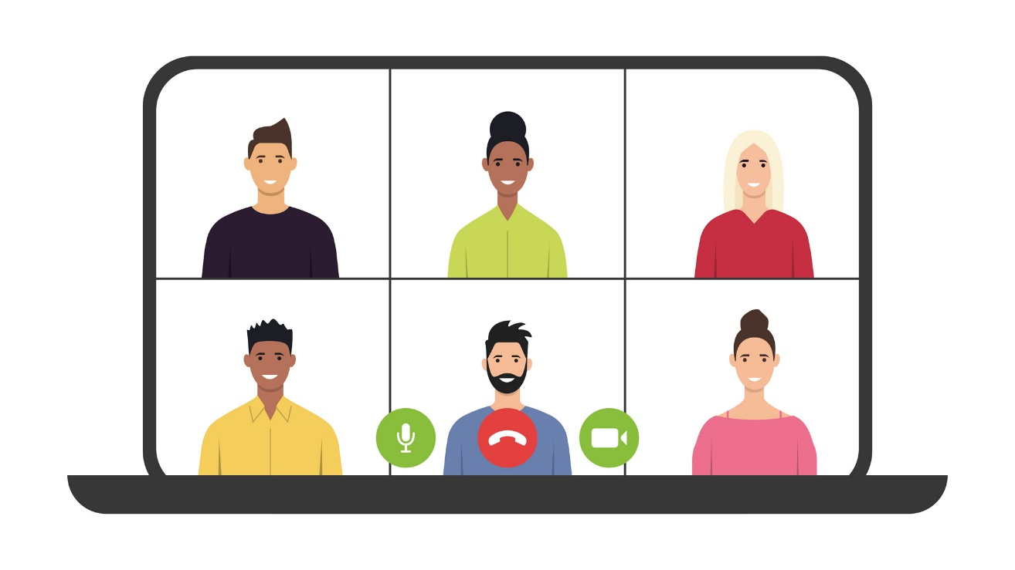



Introduction (continued)
Video conferencing:
A live meeting between two or more people online.
Common Tools
Notes:
Video conferencing, which is sometimes referred to as web conferencing, is a live meeting between two or more people online. You can use video conferencing tools to connect with family, friends, co-workers, your children’s teachers, and more. There are many tools you can use to meet with an individual or a group online. In this workshop, we’ll be using Zoom.

Slide 5
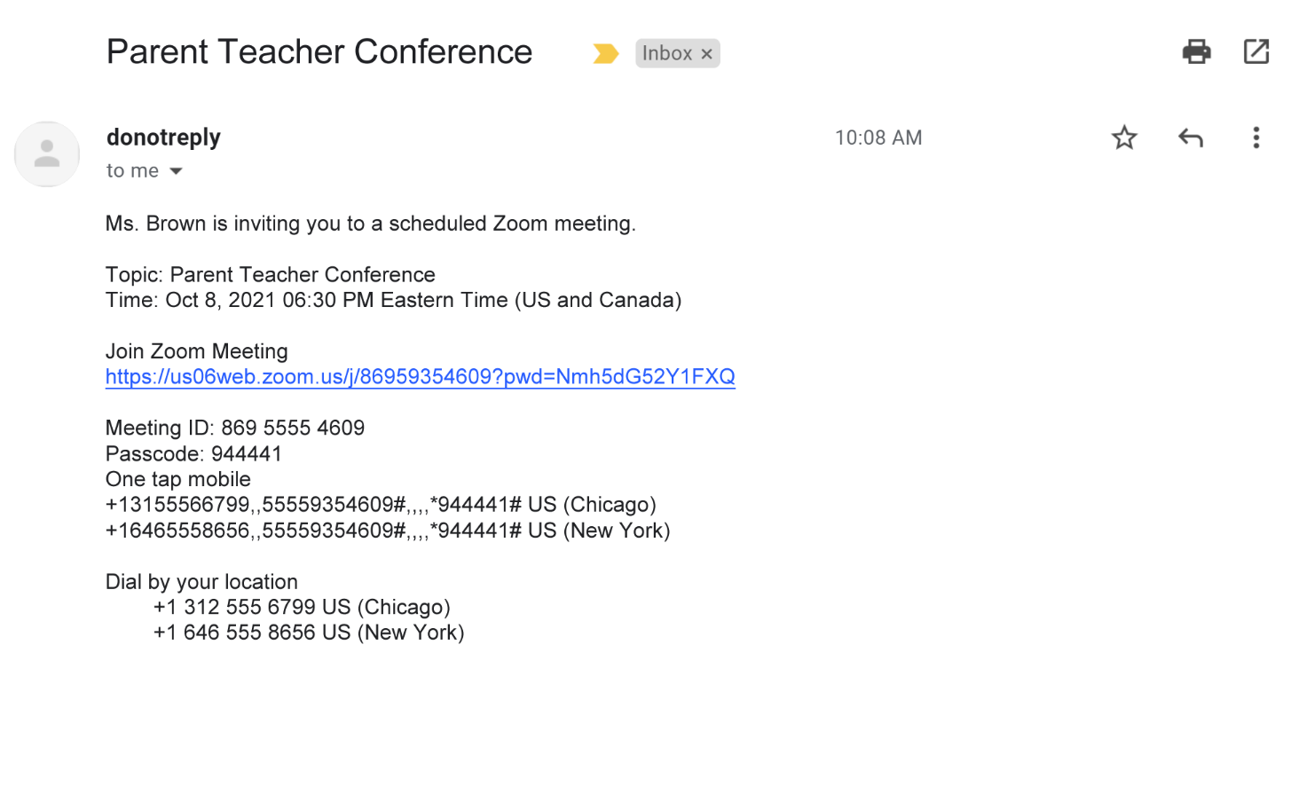
Joining a Meeting
Notes:
For many of us, the first time we use a video conferencing tool is when someone else invites us to a meeting. We typically receive an invitation through email. Let’s take a look at an example invitation.

Slide 6
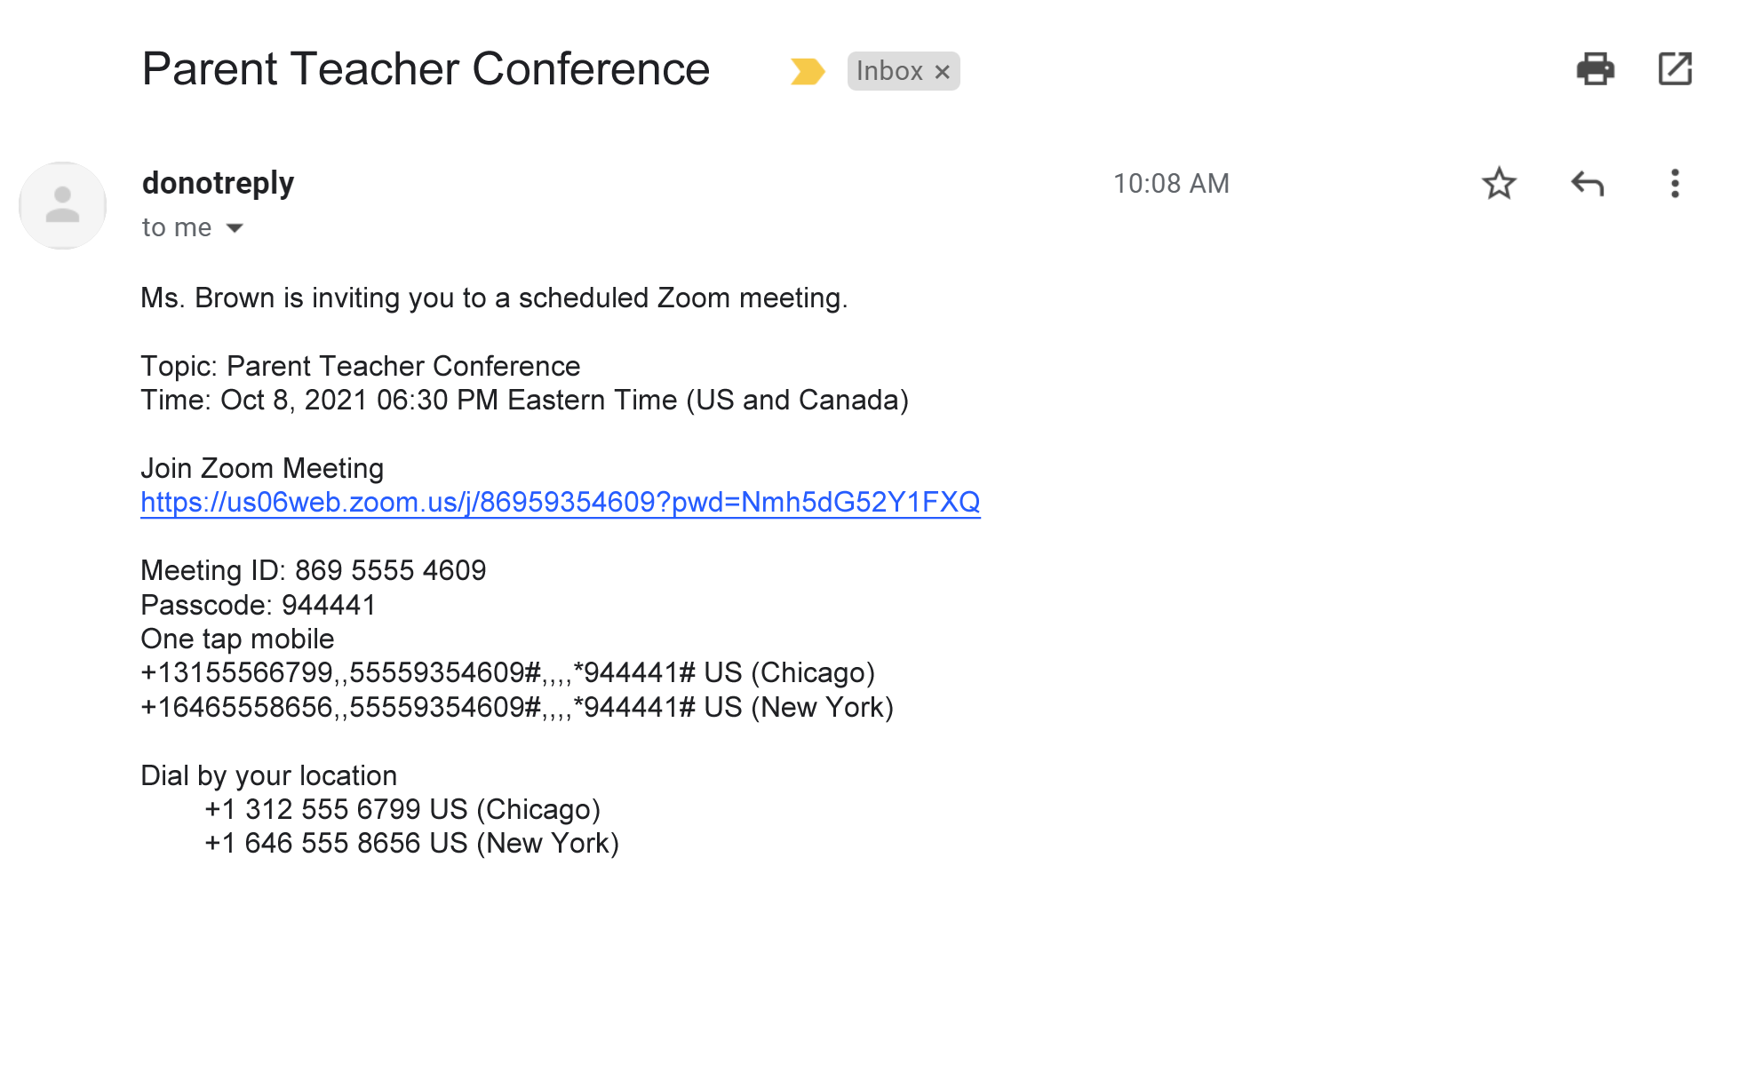
Notes:
INSTRUCTOR NOTE: Point out each element on the slide as you mention it.
The invitation includes:
Who is inviting you to the meeting
The purpose of the meeting (the topic)
The date and time
A link to join the meeting
Telephone numbers to use to call into the meeting (Phone numbers may or may not be part of the invite.)
You can still attend a meeting using your phone, even if you don't have access to a computer, the internet, or a mobile device that has a camera. When calling in from your phone, you may need to use your telephone keypad to enter the meeting ID and passcode.
On the day and time of the meeting, you would click on the Join Zoom Meeting link in the email you received. You can also access the meeting by pasting this link into an internet browser.

Slide 7
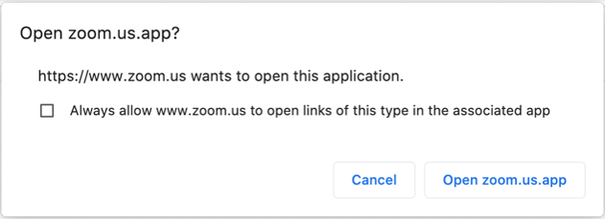
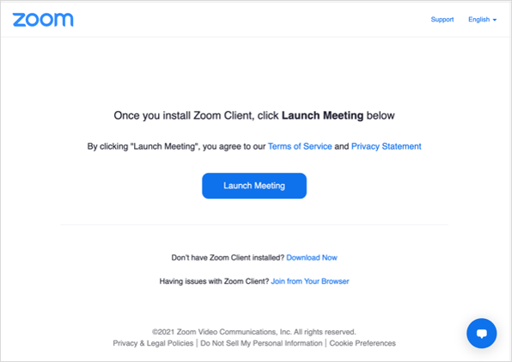
Joining a Meeting (continued)
Notes:
The first time you use Zoom, you’ll be asked to download and open a Zoom app. You can follow the prompts on screen to install the application.
[Click Enter to display pop-up] After it is installed, a pop-up window displays. Click the button that says Open Zoom.us.app.

Slide 8
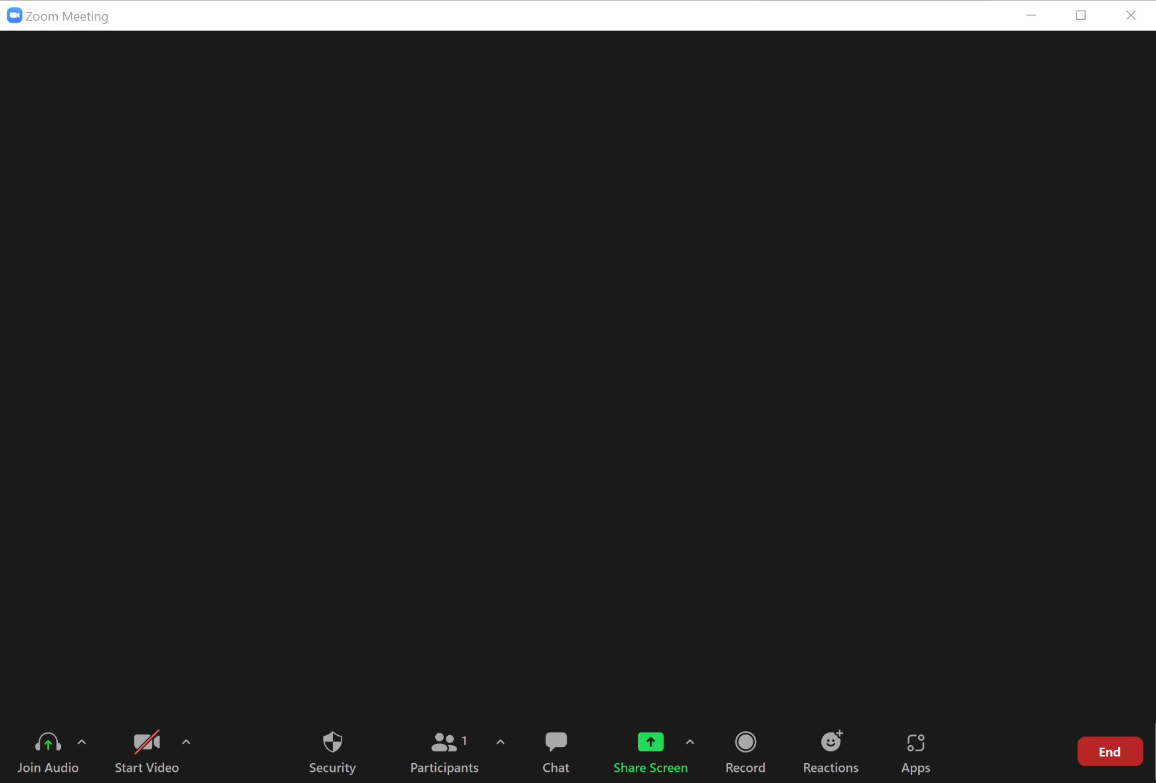
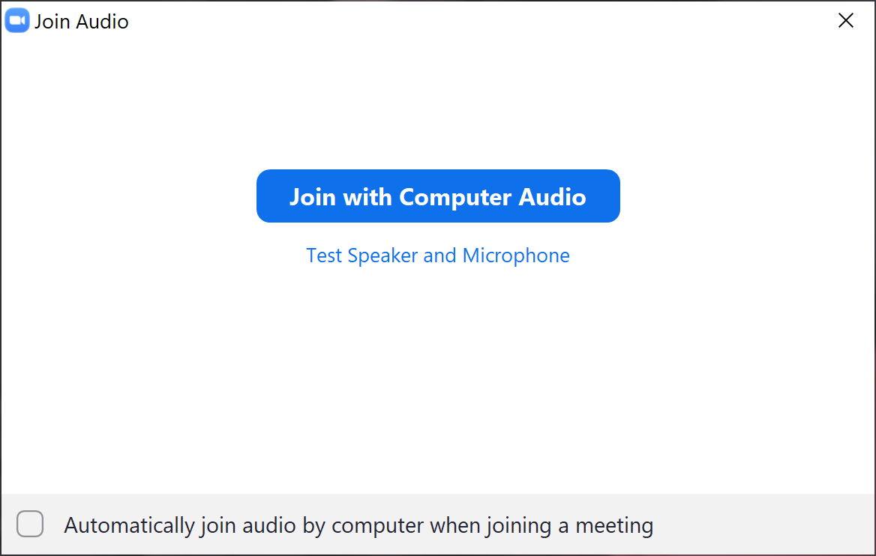
Notes:
Once you’re logged into the meeting, a box appears with a message asking if you would like to join with computer audio. When you click this link, you will enter the meeting.
During the meeting, Zoom will use your computer’s internal microphone and speakers or the headset you have connected to your computer. You need a microphone to make sure everyone in the meeting can hear you.

Slide 9
Notes:
What if you don’t have access to the internet, or you don’t want to use the microphone on your computer? In that case, you may be able to join the meeting by calling a telephone number in the meeting invitation. You will need to enter the meeting ID number and passcode before you can join the meeting.
INSTRUCTOR NOTE: Before moving to Activity 1, review “parking lot” questions. If there are no questions in the parking lot, ask the attendees if they have any questions before you move to Activity 1.

Slide 10
Activity #1
Notes:
INSTRUCTOR NOTE: Point attendees to Activity 1 on Activity Sheet page 1.

Slide 11
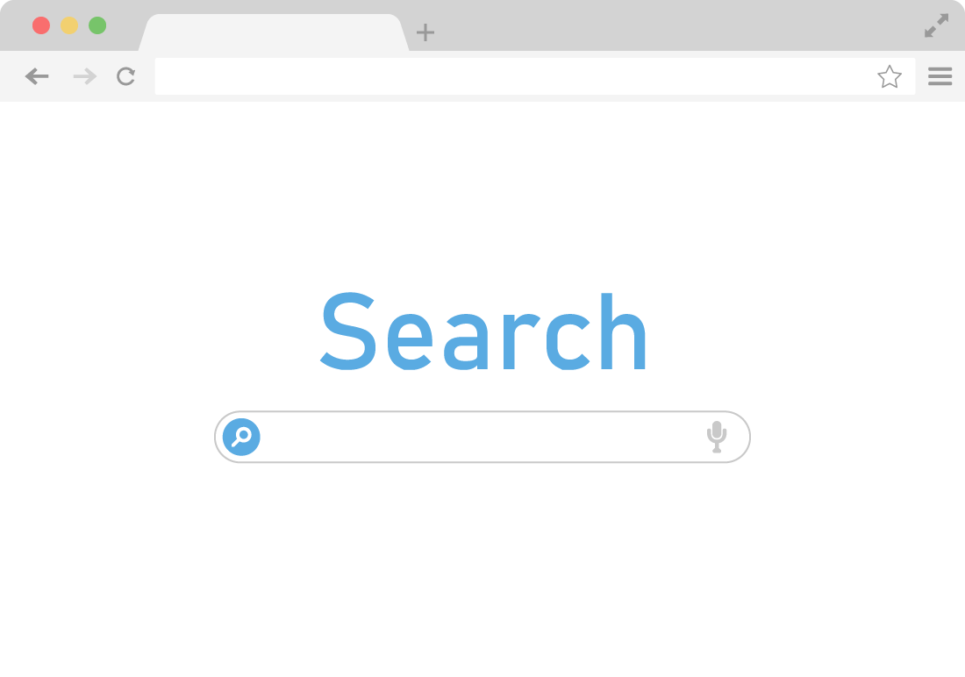
Creating a Zoom Account
https://zoom.us
Notes:
You can join Zoom meetings without an account of your own. But I want you to see the Zoom features for yourself. So, we’re going to create personal Zoom accounts as our first activity.
INSTRUCTOR NOTE: Lead participants through the first three steps in this activity. Invite participants to follow along in creating their own Zoom account. If this is an in-person presentation, walk around and support participants with the activity (in particular after step 3) as needed. After you’ve demonstrated the first three steps, go to the next slide.

Slide 12
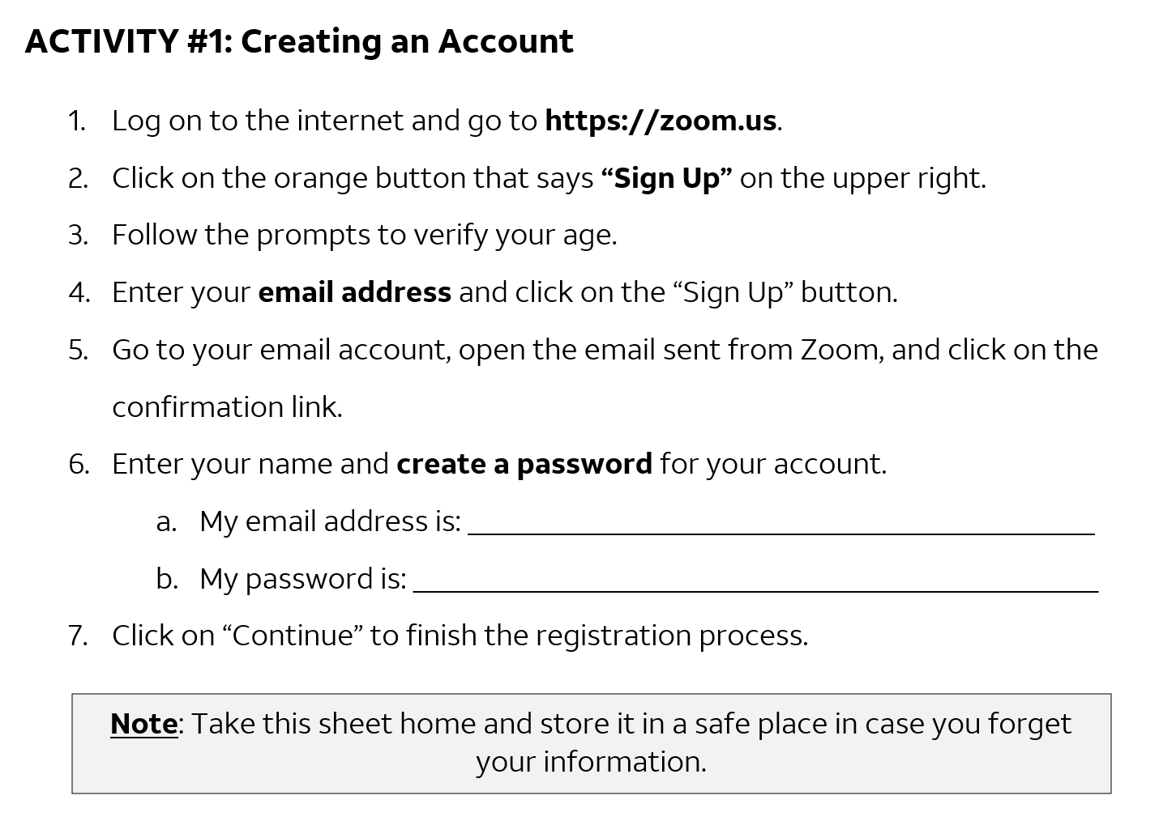
Notes:
INSTRUCTOR NOTE: Continue to walk around and support participants with this activity. Before moving on from this activity, please emphasize the importance of keeping passwords in a safe place.

Slide 13
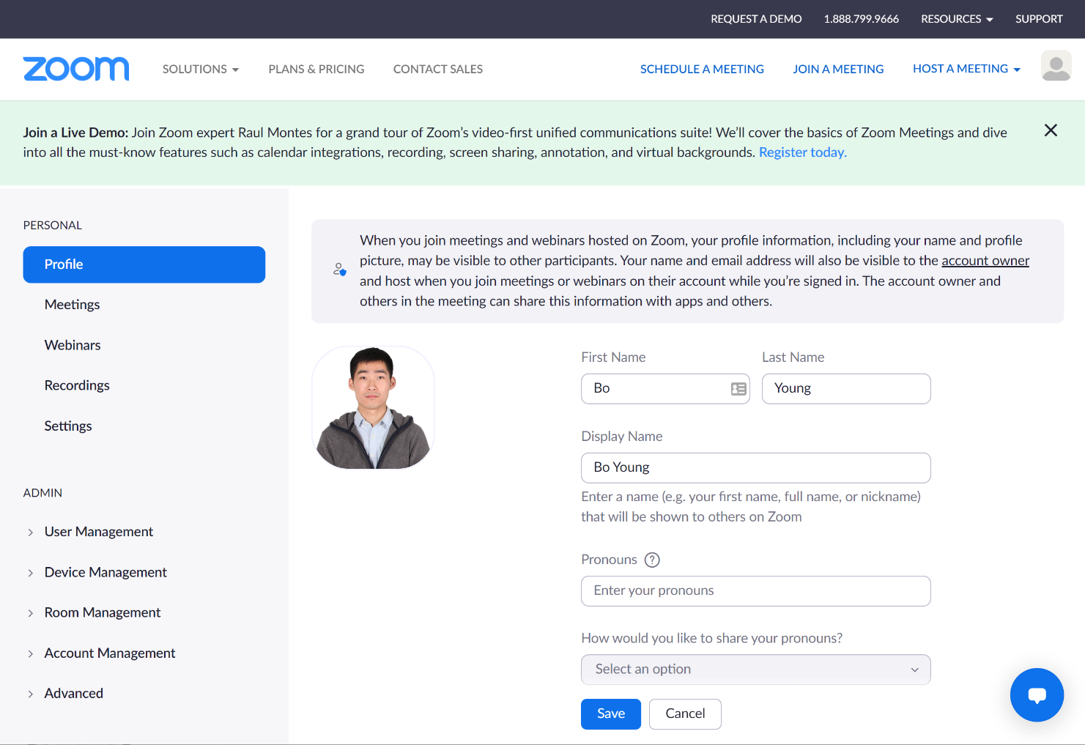
Demo: Common Participant Features
Notes:
Now that you’ve created an account, we’re going to look at some of the important features you’ll use as a meeting participant. From your new account, click on the link to host a meeting. Then choose With Video. This will start a meeting, and you’ll be able to see many of the features.

Slide 14
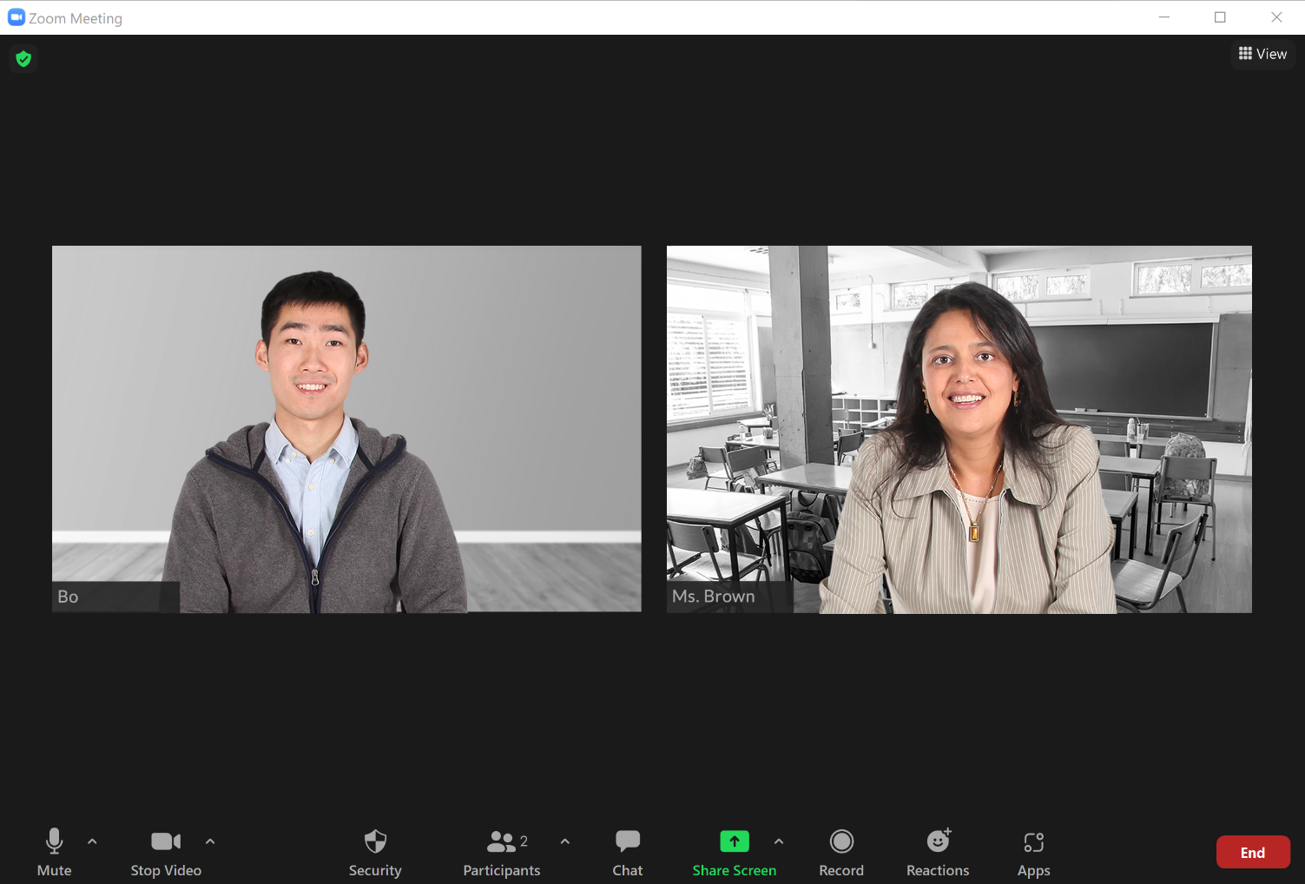
Demo: Common Participant Features
Notes:
INSTRUCTOR NOTE: Slide is to segue into the demo. Instructor will demo from here using AT&T Instructor Zoom Account . Volunteer will join at this point using the Volunteer Zoom Participant Guide.
INSTRUCTOR NOTE: See the Instructor Guide for script on how to demonstrate the Zoom features.

Slide 15
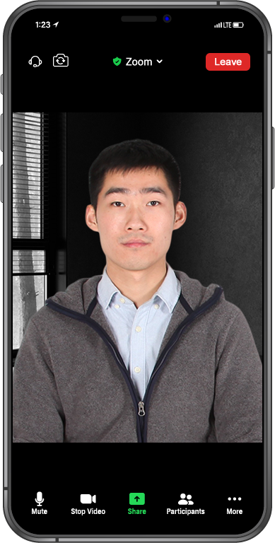

Features on a Mobile Device
You will need the Zoom app
Notes:
What if your computer does not have a camera? You can also connect with your mobile device, if it has a working camera. To do this, you will need to have the Zoom app installed on your phone.
Depending on which mobile device you use for video conferencing, some options may be in a different location on your screen. In this example, the Mute, Video, and Participants tabs are all at the bottom of the screen. You can click More to see other features, like Chat and Reactions.
INSTRUCTOR NOTE: Before moving to Activity 2, review “parking lot” questions. If there are no questions in the parking lot, ask the attendees if they have any questions before you move to Activity 2.

Slide 16
Activity #2
Notes:
INSTRUCTOR NOTE: Point attendees to Activity 2 on Activity Sheet page 2.

Slide 17
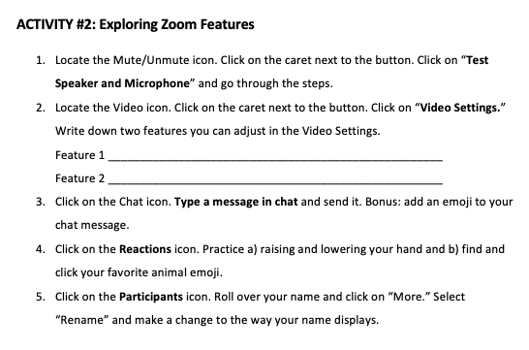
Notes:
INSTRUCTOR NOTE: If this is an in-person presentation, walk around and support participants with the activity as needed. Also, demonstrate features as needed. When participants have finished the activity, talk through each item and answer questions as needed.

Slide 18
Activity #3
Please use the activity sheet and follow along with the instructor.
Notes:
INSTRUCTOR NOTE: Point attendees to Activity 3 on Activity Sheet page 3.

Slide 19
Demo: Scheduling a Meeting
Notes:
One of the advantages of having your own Zoom account is that you can schedule and host an online meeting. To schedule a meeting, go to your account on the Zoom website. I’ll demonstrate the steps. Please follow along with me and take a look at the activity sheet.
INSTRUCTOR NOTE: Instructor will demo from here using the AT&T Instructor Zoom Account. Please encourage learners to follow along on their activity sheet as you demo. Support participants with the activity as needed. The script for the demonstration can be found in the Instructor Guide.

Slide 20
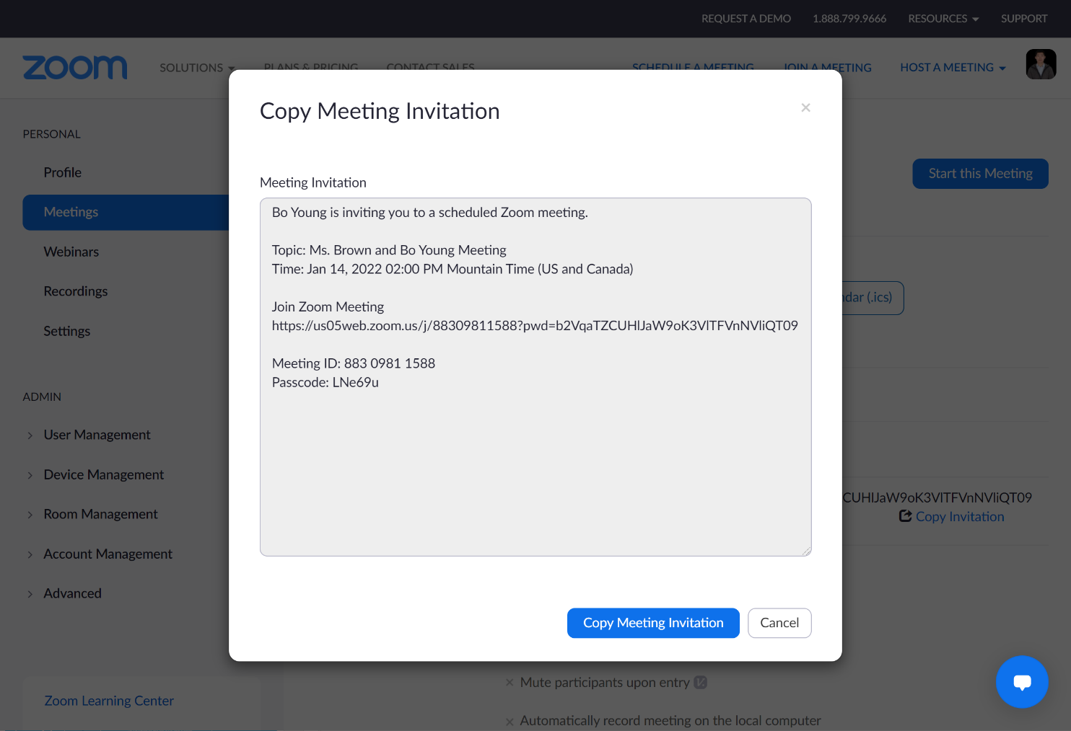
Demo: Scheduling a Meeting (continued)
Email address to send invitation: email@email.com
Notes:
INSTRUCTOR NOTE: See the Instructor Guide for more. At this point, you will have completed most of the demo. Return to this slide so learners are able to see the demo email account address.
Now that you have the meeting invitation pasted into an email, go ahead and send it to me. Here’s my email account. [Give out demo email account so learners can email you an invitation.]

Slide 21

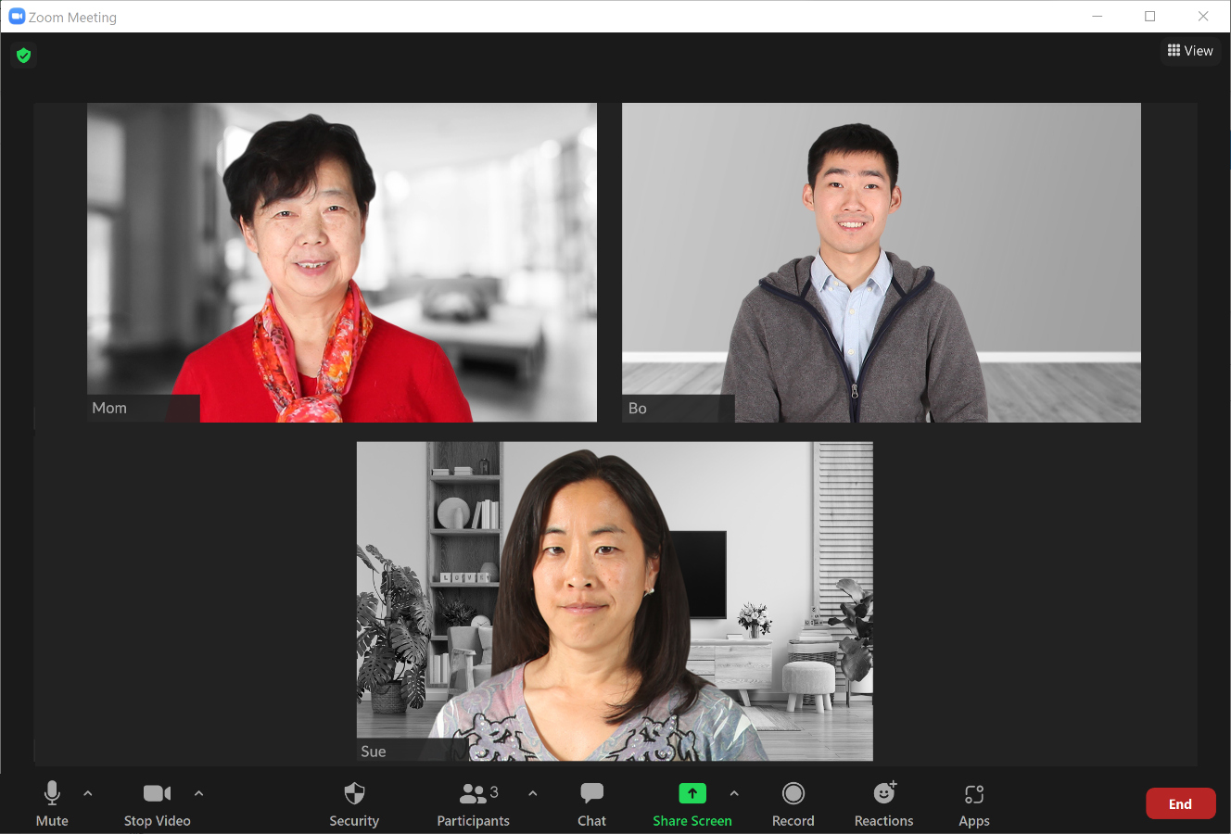
Hosting Tips
Notes:
When you’re the meeting host, you’re the one who is in control of the meeting. Here are some tips to make sure you have the best meeting possible.
The meeting host features are in the menu at the bottom of the screen. Since you’ve been in a meeting as a host, you’ve seen these features on the toolbar. But we haven’t discussed them before now. If you’re not a meeting host, you won’t see these features.

Slide 22

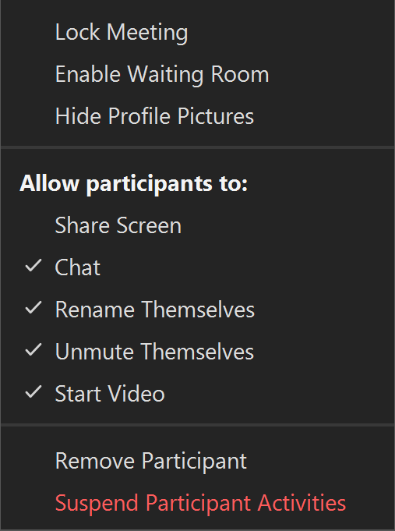
Lock a meeting after it starts
Notes:
Here are some tips related to using the security features.
Tip 1: You can lock a meeting after it starts. This keeps anyone unwanted from entering the meeting.

Slide 23
Enable the waiting room
Notes:
Tip 2: You can enable the waiting room so you only let people in that you want to attend the meeting.

Slide 24
Consider what you allow participants to do
Notes:
Tip 3: Consider what features you want participants to be able to do, such as unmute themselves, share their screen, or chat. You can adjust these features before the meeting begins, or you can take care of that during the meeting.

Slide 25
Use Remove Participant to remove someone
Notes:
Tip 4: If someone unwanted enters your meeting, you can use the Remove Participant feature to remove them. That person cannot rejoin the meeting until you allow it.

Slide 26
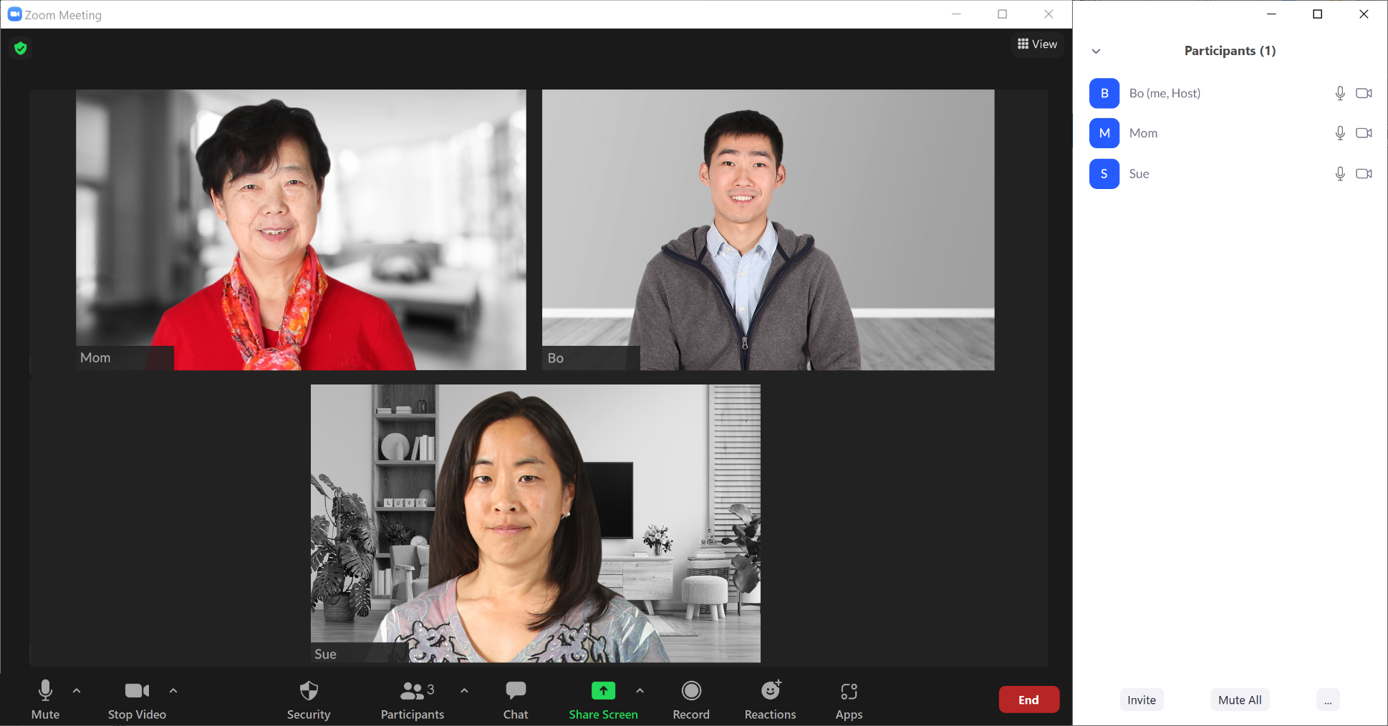
Mute everyone in a meeting using Mute All
Notes:
As the host, you also have more features available in the Participants panel. Here are a few more tips.
Tip 5: If someone will be making a presentation or speaking for a long time, you can mute everyone in a meeting using the Mute All button. This is helpful to keep background noise to a minimum.

Slide 27
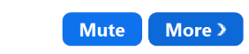
Mute a person
Notes:
Tip 6: If background sound is coming from a participant and they aren’t able to mute themselves, you can mute that person by clicking the Mute button next to their name.

Slide 28
If you’re recording the meeting, let attendees know
This will save a recording of the meeting to your computer or online Zoom account.
Notes:
If you want to keep a recording of the meeting, you can use the Record feature. This will save a recording of the meeting to your computer or online Zoom account.
Tip 7: Always let people know when you plan to record a meeting.

Slide 29
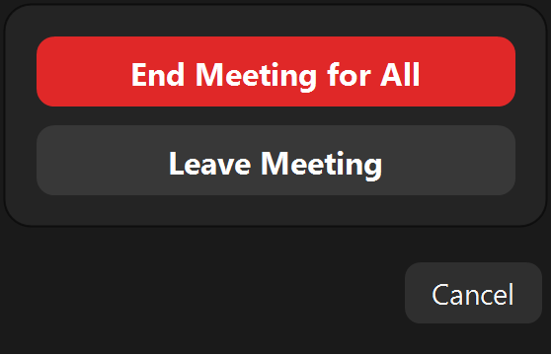
End the meeting
Notes:
Tip 8: As the host, it’s important for you to end the meeting when it’s over. To end the meeting, click on End. Then click End Meeting for All. As you might expect, this ends the meeting for all participants.
INSTRUCTOR NOTE: Before moving to Activity 4, review “parking lot” questions. If there are no questions in the parking lot, ask the attendees if they have any questions before you move to Activity 4.

Slide 30
Activity #4
In web browser address bar, type:
https://www.digitallearn.org
Notes:
In this activity, we will practice what we’ve covered and see what everyone has learned.
Open a web browser and type in https://www.digitallearn.org in the address bar. Click on Basics of Video Conferencing, and then click on Lesson 8—Practice.
INSTRUCTOR NOTE: Allow the learners several minutes to work on the practice lesson. Then go through the practice lesson as a demo and have learners answer the questions.

Slide 31
Questions
Anything you want to ask or clarify before we end?
Notes:
INSTRUCTOR NOTE: Ask if there are any other final questions. Answer any outstanding ones that may have been missed in the “parking lot” sections. (For more information about the parking lot, see the “Before Workshop Begins” section earlier in this document.)

Slide 32
Congratulations!
Today you . . .
  learned about video conferencing
  built skills to:
    join online meetings
    use common participant features
    schedule a meeting and invite others
  discovered useful tips to host an online meeting
Notes:
Congratulations! Today you . . .
learned about video conferencing
built skills to:
join online meetings
use common participant features
schedule a meeting and invite others
discovered useful tips to host an online meeting
INSTRUCTOR NOTE: Provide attendees with Certificate of Completion.

Slide 33
Today’s training is provided by AT&T and Public Library Association.
Visit <insert libraries URL here> and https://www.digitallearn.org for more courses and to build confidence using technology.
Notes:
INSTRUCTOR NOTE: Point the learners to additional courses available online at the website.

Slide 34
Thank you for coming!
THANK YOU FOR COMING!
Notes:
Thanks again to AT&T and PLA for this workshop. We appreciate all our participants for coming and we encourage you to keep learning!

