Slide 1

Build Your Own Desktop PC – Part 3
Name
Title
Library Name
Courtesy of Gail Borden Public Library
and the Public Library Association

Slide 2
Agenda
Terminology
Solving common problems
Should I upgrade?
How to purchase a new part
Installing the new part
Properly disposing old parts

Slide 3
Searching through ads
Terminology

Slide 4
Terminology Review
CPU: The main chip on your computer that runs programs and apps
GPU: The graphics card is what creates and allows images to be displayed on the screen
PSU: Powers all of your components
Motherboard: The mainboard that connects all your components
Hard drive: Saves your files, programs, and apps to the computer
RAM: The memory stick used to run all of your programs and apps

Slide 5
Terminology
Turns on: Fans and lights turn on, but may or may not have an image
POST: (Power On Self Test): Computer turns on and the motherboard starts up. You will see an image and text/logo.
Boot: Computer turns on and operating system starts
BIOS: (Basic input/output system): Small program that runs your motherboard and allows you to change its settings

Slide 6
Searching through ads
Solving Common Problems

Slide 7
Problem Solving 101
Always try the simplest solutions first
    Check cords, power strip, buttons, etc.
Replacing parts are expensive; do this as a last resort
If a replacement is needed, replace one part at a time

Slide 8
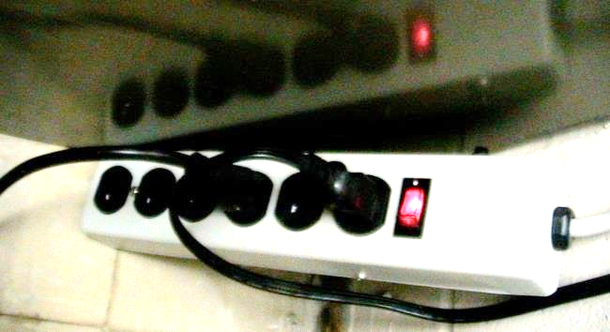
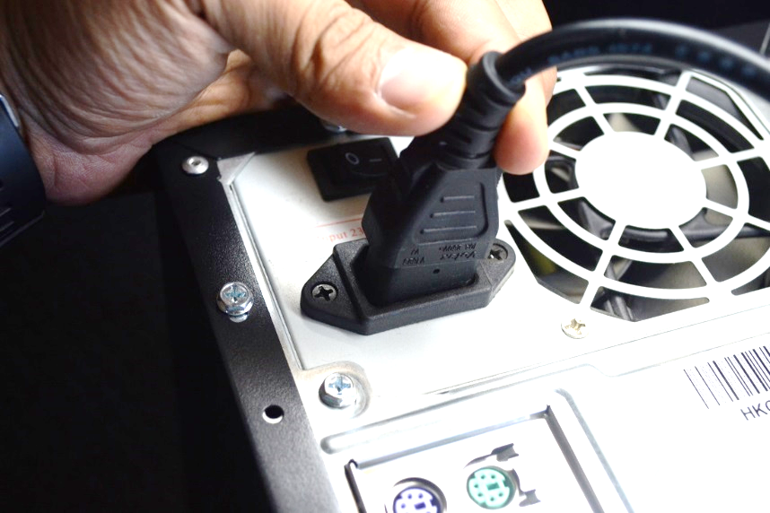
Solving Common Problems
My computer will not turn on!
Is the computer plugged into an outlet or surge protector?
  Is your surge protector on?
Make sure all connections are fine.
Did you press the Power Button?

Slide 9
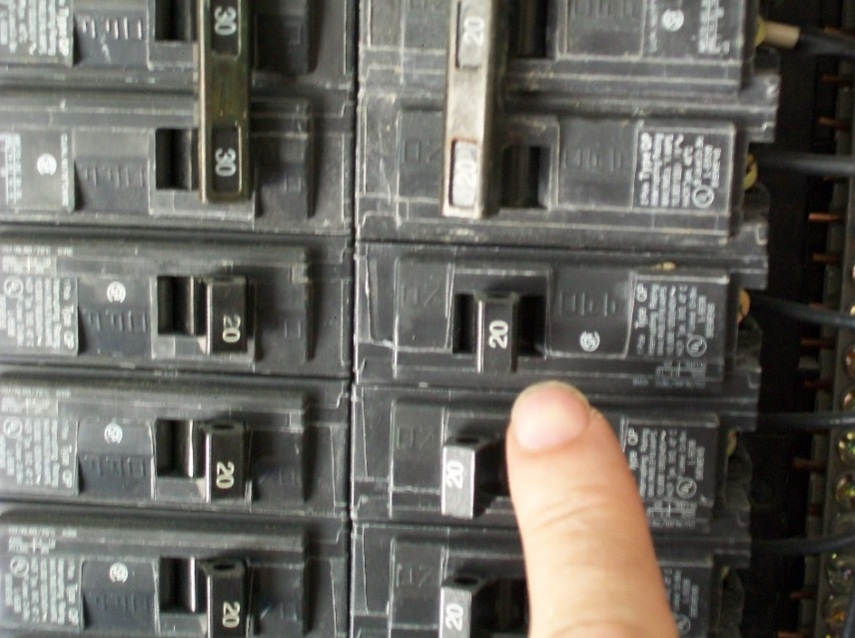
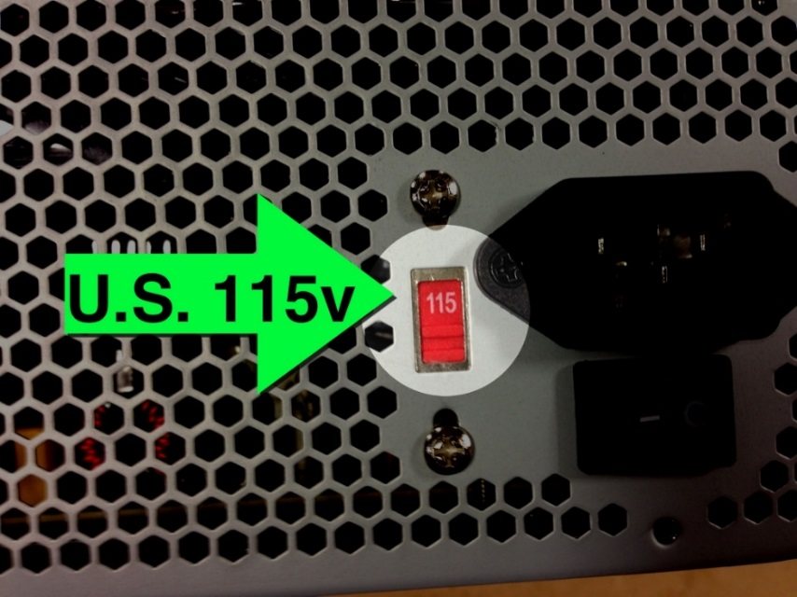
Solving Common Problems
My computer will not turn on!
Is your breaker tripped?
Is the power supply voltage switch on 115v?
If none of the above, the Motherboard or PSU is most likely damaged.

Slide 10
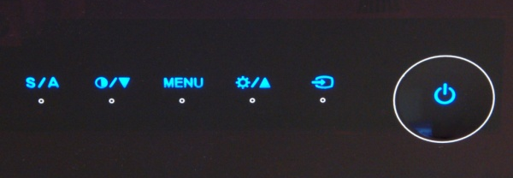
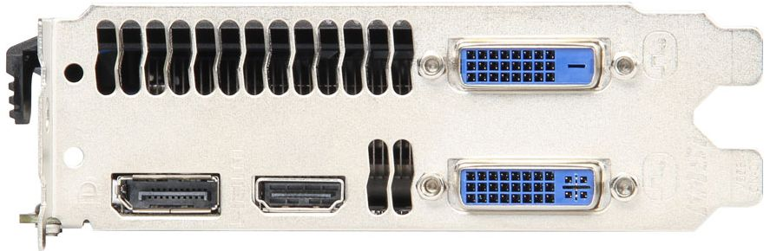
Solving Common Problems
My computer turns on but I get no image
Is your monitor/TV on?
  Is it on the correct source?
Did a video port or cord go bad? Try another one.

Slide 11
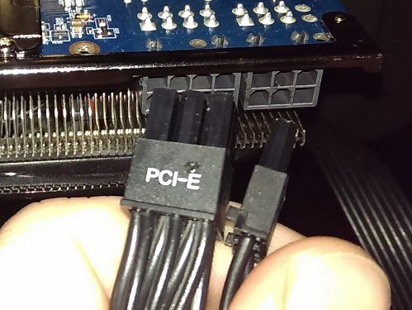
Solving Common Problems
My computer turns on but I get no image
Is your graphics card plugged in properly?
  If applicable: check if power cords are properly plugged into graphics card
  If applicable: try another PCS express port
If none of the above works, your Graphics card or APU are likely bad.

Slide 12
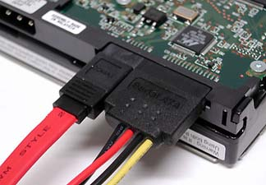

Solving Common Problems
My computer Turns on but Windows doesn’t boot!
Is your hard drive plugged in properly?
Your SATA cord or port may be bad. Motherboards have multiple ports, try another one.
Start up with a Windows disc inserted to attempt to a repair of the operating system

Slide 13
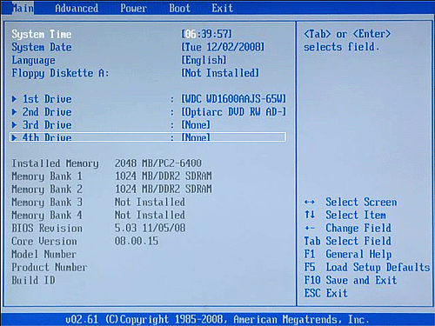
Solving Common Problems
My computer Turns on but Windows doesn’t boot!
Go into BIOS and make sure the hard drive is being recognized and set to boot first
If the hard drive is plugged in but not recognized, you likely need a new one.
Unfortunately, there is no recovery for SSD’s but data could be saved from a mechanical hard drive

Slide 14
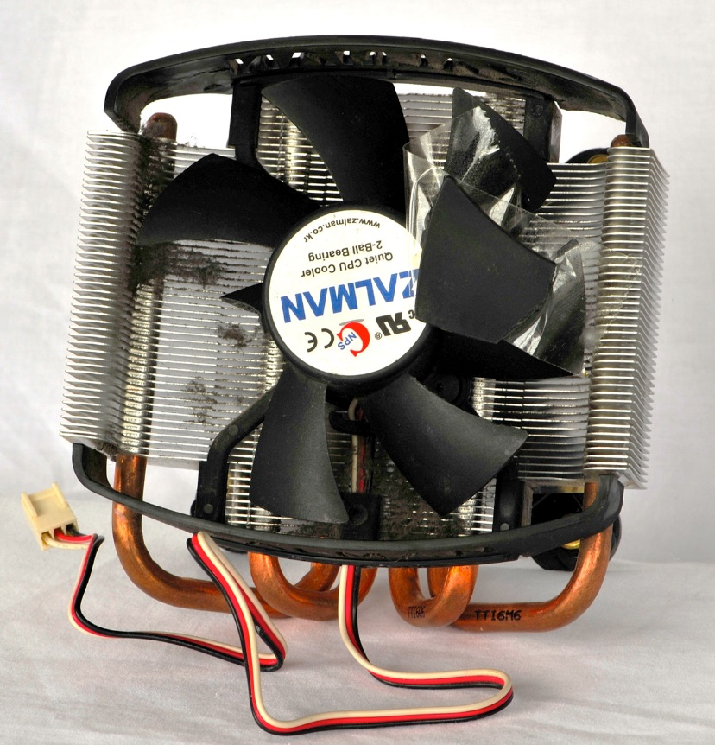
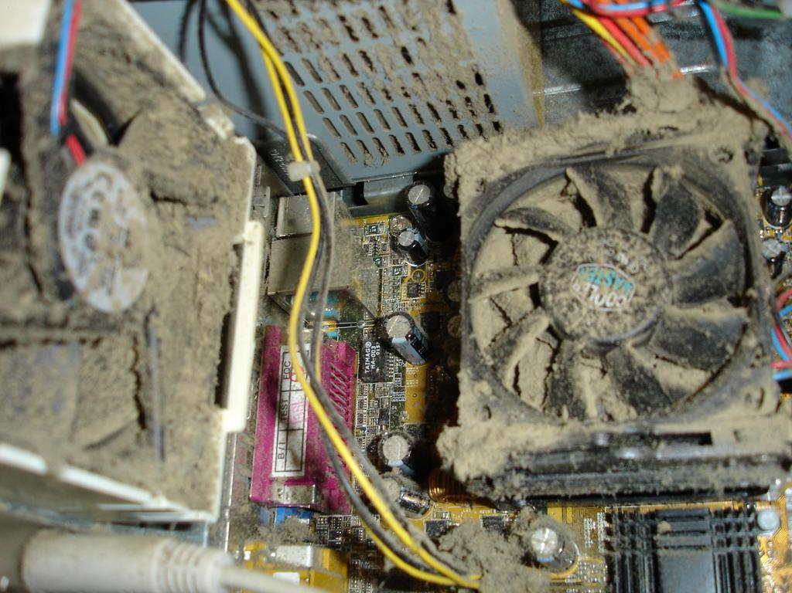
Solving Common Problems
My Computer Turns on but Crashes!
Room temperature is too high
    95 F or higher can often cause crashes
Fan(s) dirty and/or broken

Slide 15
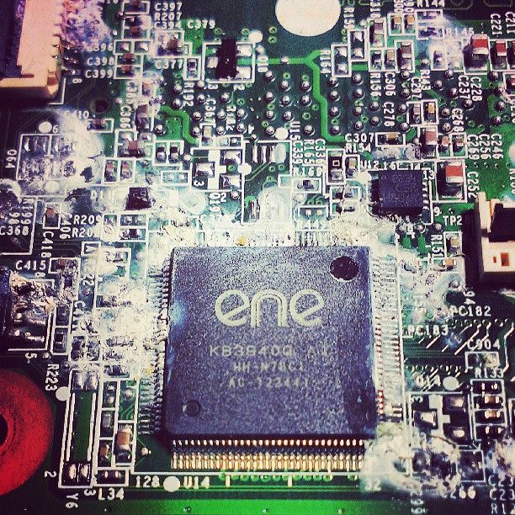
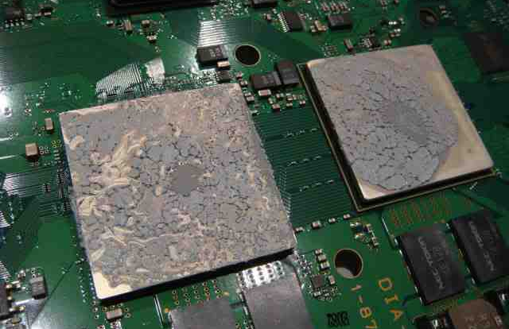
Solving Common Problems
My Computer Turns on but Crashes
Thermal Paste may need to be replaced on CPU/GPU. It’s good to replace every 4-5 years.
If heat is not the problem, then there might be a problem with RAM or PSU

Slide 16
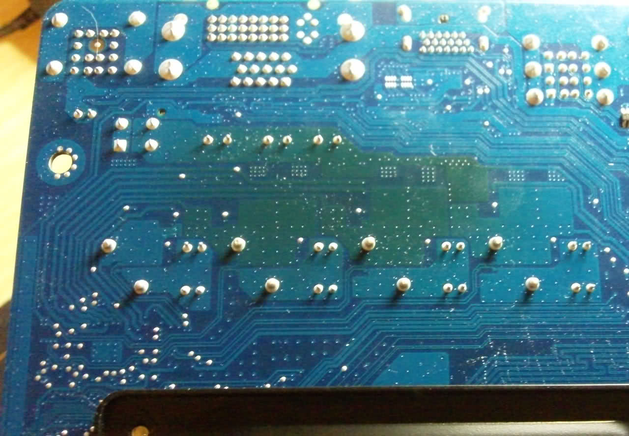
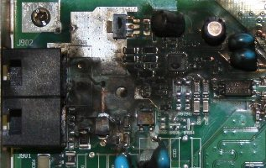
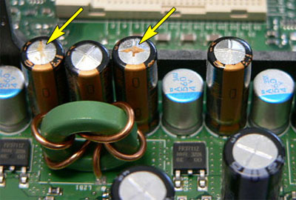
Solving Common Problems
Tips
For Motherboard issues, visually inspect for discoloration, burns or blown parts.

Slide 17
Solving Common Problems
Tips
Try the “bad” part in another computer
Try a good part in its place
Try the “bad” part in another PCI slot, RAM slot, etc.
For “bad” RAM remove one at a time to determine the bad stick
Fry’s Electronics allows you to return open box items for a full refund if there is no damage.

Slide 18
Searching through ads
Should I Upgrade?

Slide 19
Should I Upgrade?
Reasons to Upgrade
Computer running too slow
Increase lifespan of your computer
Cannot run a new program or game
Ran out of hard drive space
Fun/Bragging rights/You have too much money

Slide 20
Should I Upgrade?
Upgrade CPU
Can drastically increase speed of your computer, especially if you get one with more cores
  Check passmark.com to see if the upgrade will be significant
Allow you to run the newest programs
May increase multitasking speeds

Slide 21
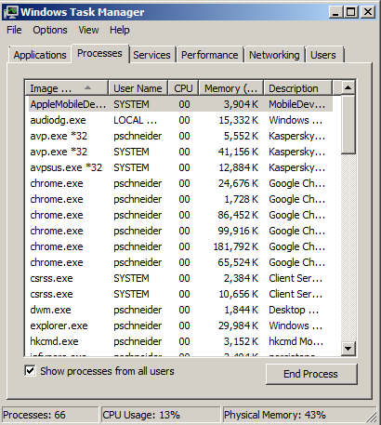
Should I Upgrade?
Upgrade RAM
Allows you to run more programs at once
Check Task Manager
  If Physical Memory is below 90%, you don’t need more RAM
  If CPU usage is near 100%, consider upgrading that instead

Slide 22
Should I Upgrade?
Upgrade Hard Drive
Upgrade to a SSD or Hybrid drive for faster Windows booting and program start up times by 2-3x.
  Hybrid drives decrease booting times by 30-50%
  Warning this will need a new Windows installation
Add an extra Hard drive or an external drive for more storage
You can always increase space with cloud storage to save money on hardware

Slide 23
Should I Upgrade?
Upgrade GPU
Only upgrade if you’re having issues with certain resolutions or frame rates. Make sure your GPU and monitor are compatible.
Allows you to play higher resolution videos such as 4K blu-rays or streaming
Increase the graphics and frame rate on video games and/or the ability to play the newest games

Slide 24
Searching through ads
How to Purchase a New Part

Slide 25
How to Purchase a New Part
Do your Homework First!
If not upgrading replace with the same part if possible
Make sure your motherboard is compatible
Make sure your PSU can handle the upgrade
Make sure the new part will fit in your case

Slide 26
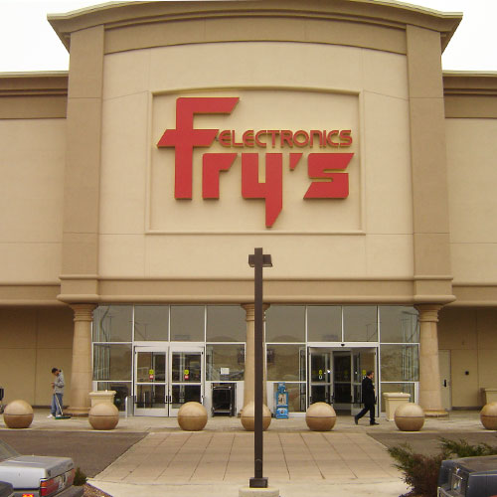
How to Purchase a New Part
Fry’s Electronics
Location: 3300 Finley Road
Downers Grove, IL
Price Match
Friendly knowledgeable
staff
Products out to test
Massive selection

Slide 27
How to Purchase a New Part
Newegg/Amazon
Great reviews for all items
Great customer service and return policies
Fast shipping
Lower or no taxes
Lower prices

Slide 28
Searching through ads
Installing a New Part

Slide 29
Installing a New Part
Tips
Remember to turn off and unplug your computer
    Warning! Do not touch components when computer is running! You could damage yourself or the computer
Remember to ground yourself on metal
Be careful and gentle
Test your computer before you close up the case

Slide 30
Searching through ads
Properly Disposing Old Parts

Slide 31
Properly Disposing Old Parts
Kane County Locations
St. Charles Public Works
West Dundee Public Works
MRK Group Event (Last Friday of every month)
Elgin Recycling
Kane County Recycling events
If still functioning you can sell parts on eBay/Craigslist or Donate to Goodwill/Salvation Army

Slide 32
Questions?
THANKS FOR ATTENDING!

