Slide 1

Selling on eBay
Phillip Schneider
Information Services Librarian
Gail Borden Public Library
Courtesy of Gail Borden Public Library
and the Public Library Association

Slide 2
Agenda
Things to know before you sell
Creating a listing
Maintaining your auctions
Receiving payment for your items
Shipping tips
Handling unhappy customers
eBay Help/Customer Support
Notes:
Check order of slides

Slide 3
Things to Know Before You Sell

Slide 4
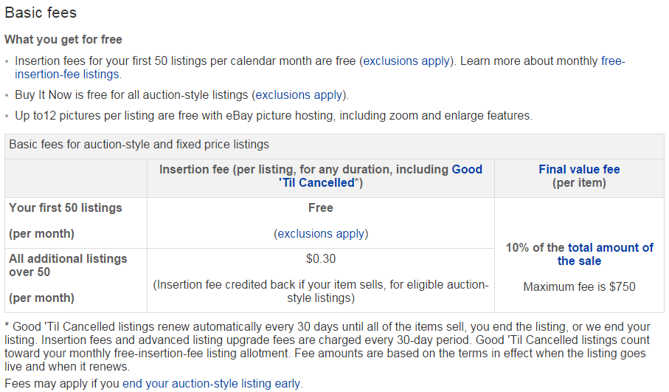
eBay Fees
Notes:
Additional info: It costs 30 cents more for auction style or a fixed price auction if you use up your 50 free auctions.

Slide 5
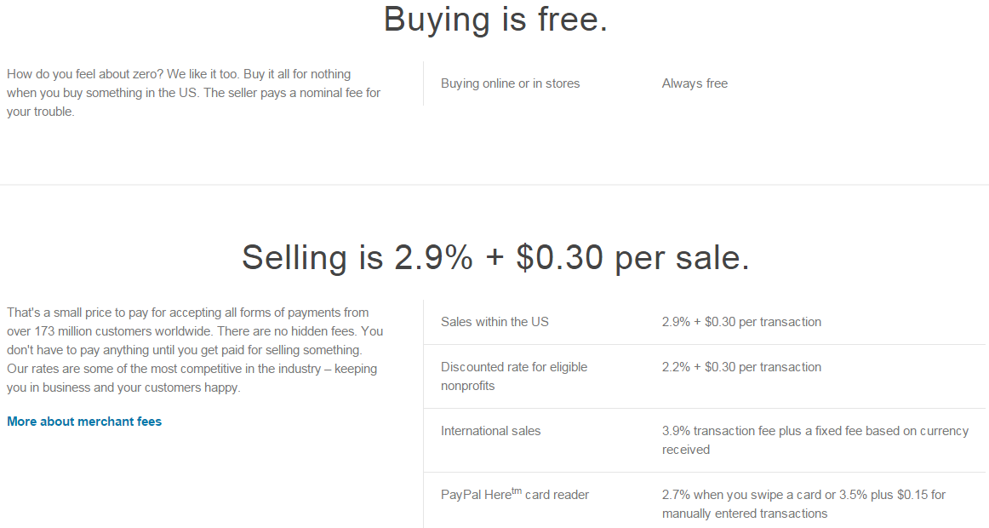
Paypal Fees

Slide 6
Prohibited Items
  Items that are illegal in the country or state you are selling to or from
  Alcohol
  Credit cards
  Used cosmetics
  Used under garments
  Lock picking devices
  Law Enforcement Items
  Firearms, most knives, swords, and other weaponry
  Prescription Drugs
  Tobacco
  Stocks and Security Interest
  Recalled Items
Notes:
Speaker note: This link covers the items that are unable to be listed on Ebay. As a rule of thumb, if you are unsure if your item will be allowed, make sure to review the official eBay website. http://pages.ebay.com/help/policies/items-ov.html

Slide 7
Restricted Items
  Coins
  Adult items
  Concert tickets
  Hazardous/restricted materials including pesticides
  Plants and seeds
  Travel packages
  Real Estate
  Political memorabilia
  Coupons
  Personal Information
  Human remains/body parts
  Native American artifacts
For a full list of prohibited and restricted items visit: http://pages.ebay.com/help/policies/items-ov.html
Notes:
Speaker note: This link covers the items that are unable to be listed on Ebay. As a rule of thumb, if you are unsure if your item will be allowed, make sure to review the official eBay website. http://pages.ebay.com/help/policies/items-ov.html

Slide 8
Creating a Listing

Slide 9
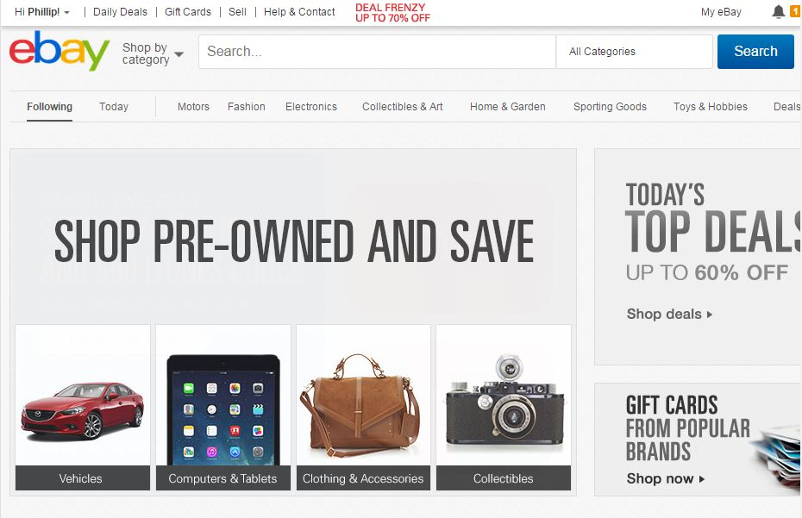
Creating a Listing

Slide 10
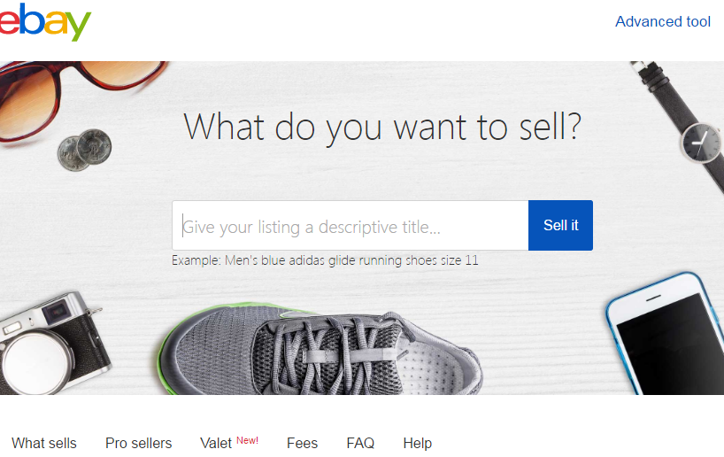
Creating a Listing

Slide 11
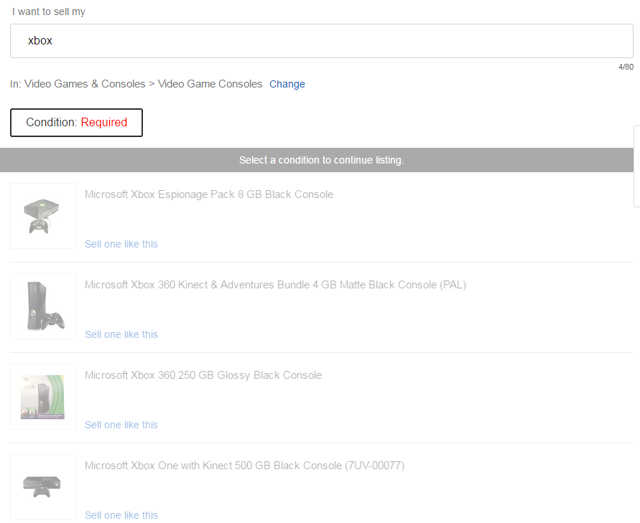
Creating a Listing

Slide 12
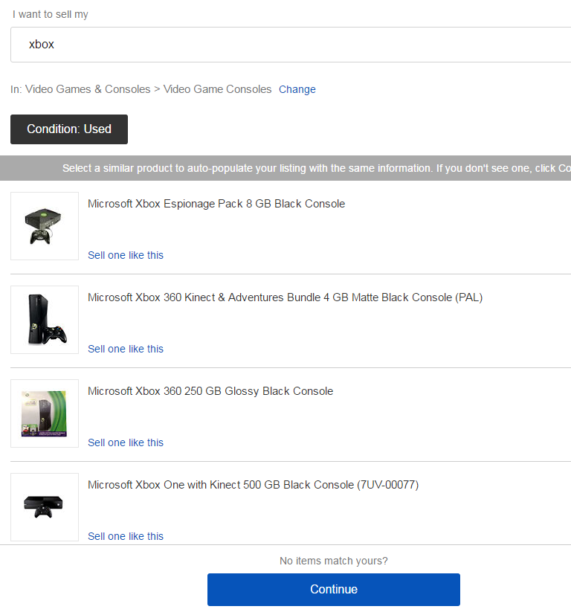
Creating a Listing

Slide 13
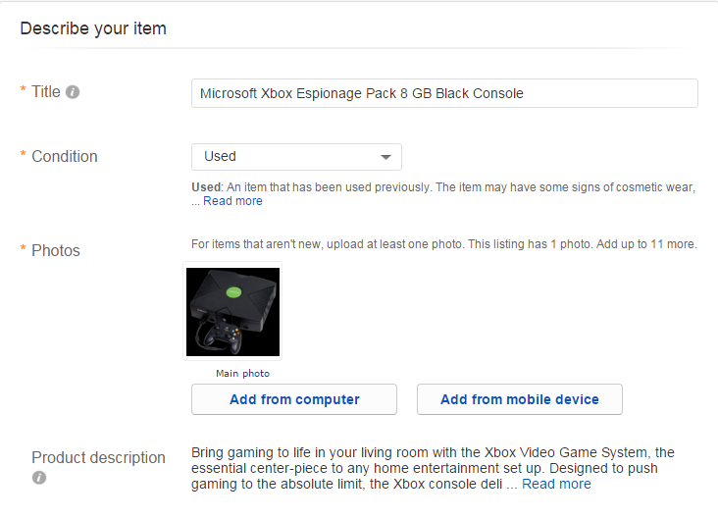
Creating a Listing
Notes:
Speaker Note: Make sure to accurately describe your item, and post quality pictures from multiple angles. The more a customer knows about the item, the more they will bid.

Slide 14
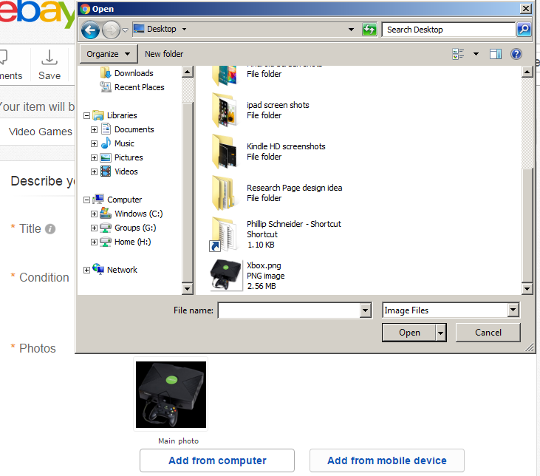
Creating a Listing
Notes:
Speaker Note: Make sure to accurately describe your item, and post quality pictures from multiple angles. The more a customer knows about the item, the more they will bid.

Slide 15
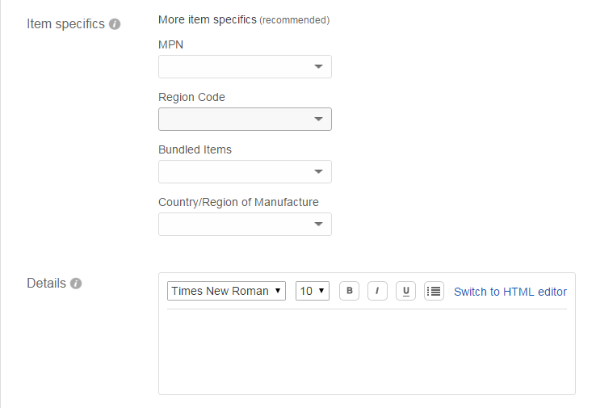
Creating a Listing
Notes:
Speaker Note: Make sure to accurately describe your item, and post quality pictures from multiple angles. The more a customer knows about the item, the more they will bid.

Slide 16
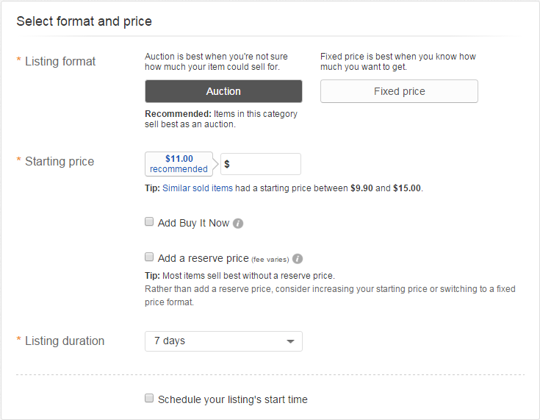
Creating a Listing
Notes:
Speaker Note: Determine if you will offer to ship internationally

Slide 17
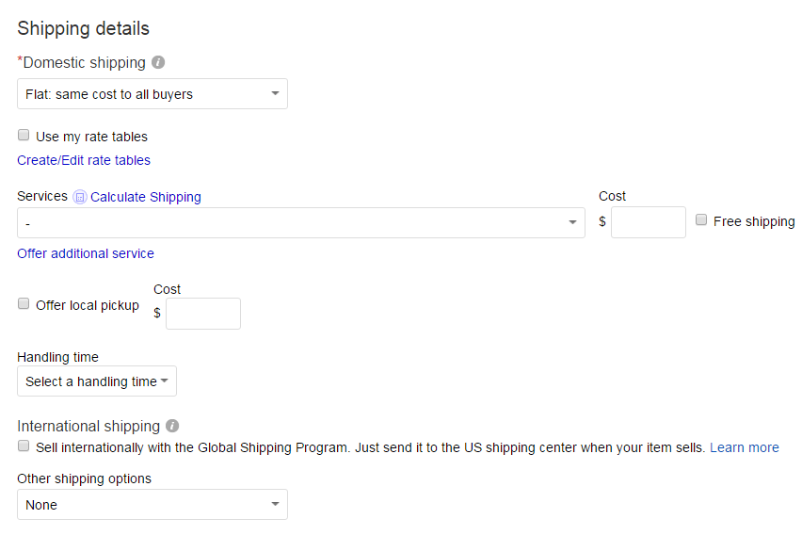
Creating a Listing(Shipping)

Slide 18
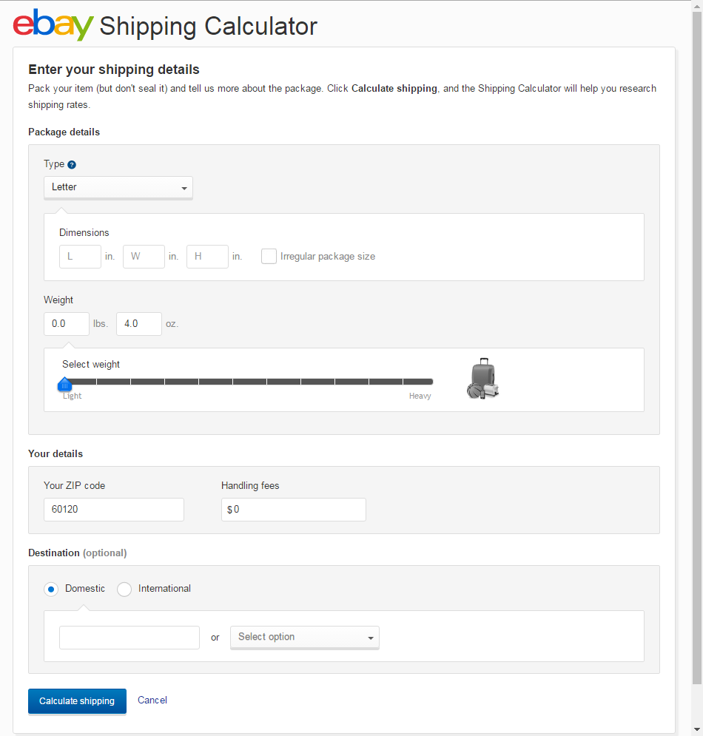
Creating a Listing(Shipping)

Slide 19
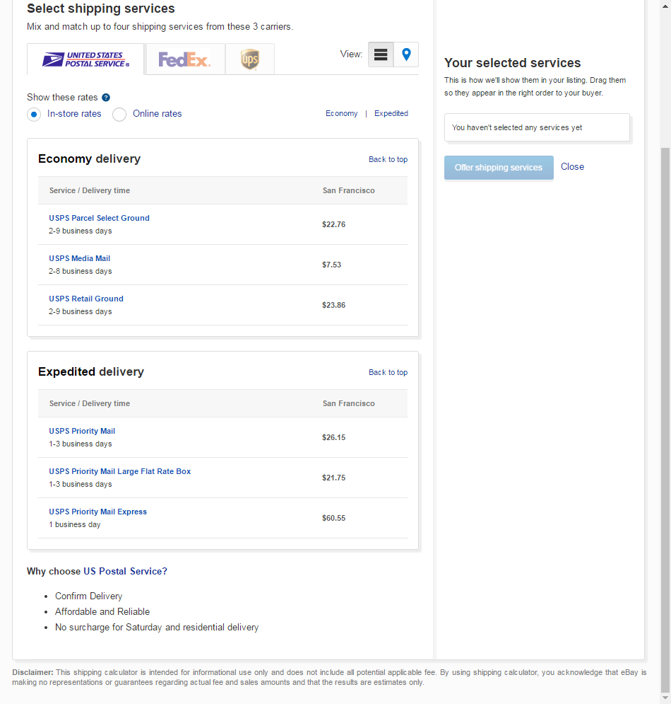
Creating a Listing(Shipping)

Slide 20
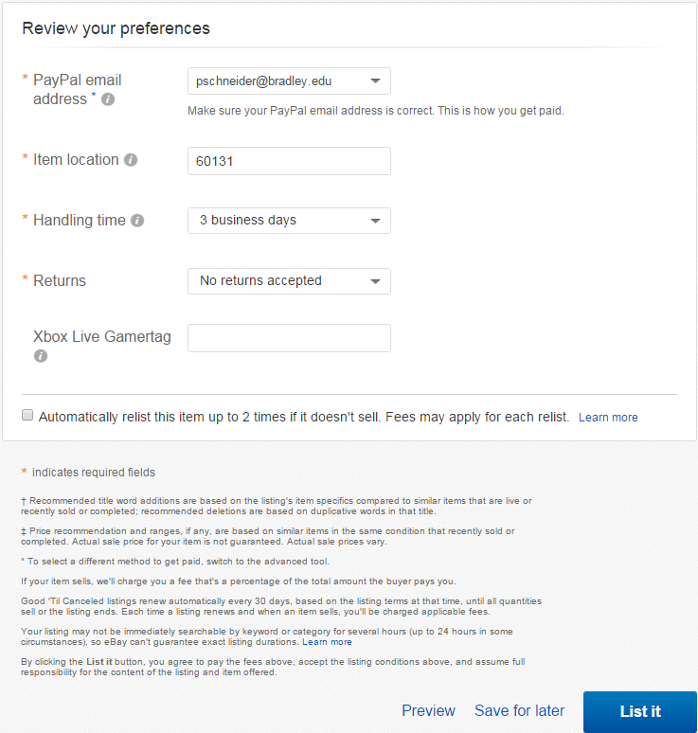
Creating a Listing

Slide 21
Maintaining Your Auctions

Slide 22
Maintaining Your Auctions
Maintain your auctions through My eBay under the Selling tab
Check your eBay Inbox twice a day to answer questions promptly
If anything changes regarding the auction or the item, revise the listing. If the changes are significant, consider removing the listing and reposting it.

Slide 23
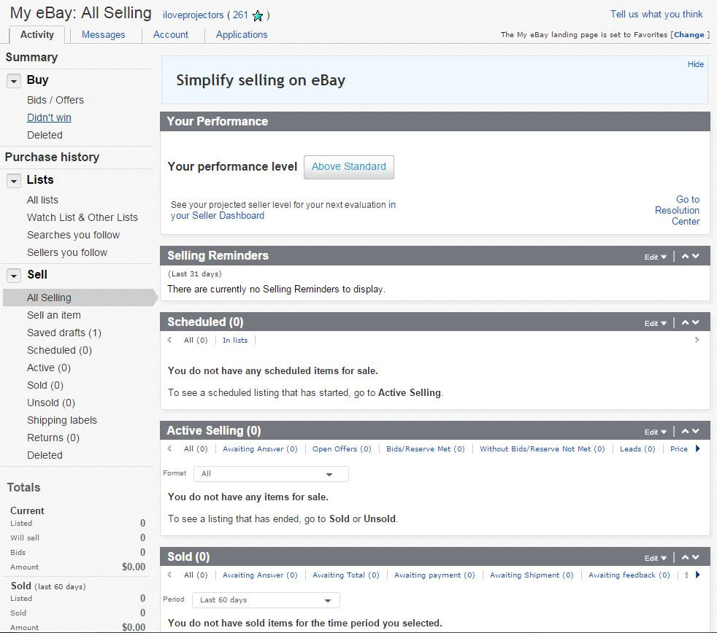
Maintaining Your Auctions

Slide 24
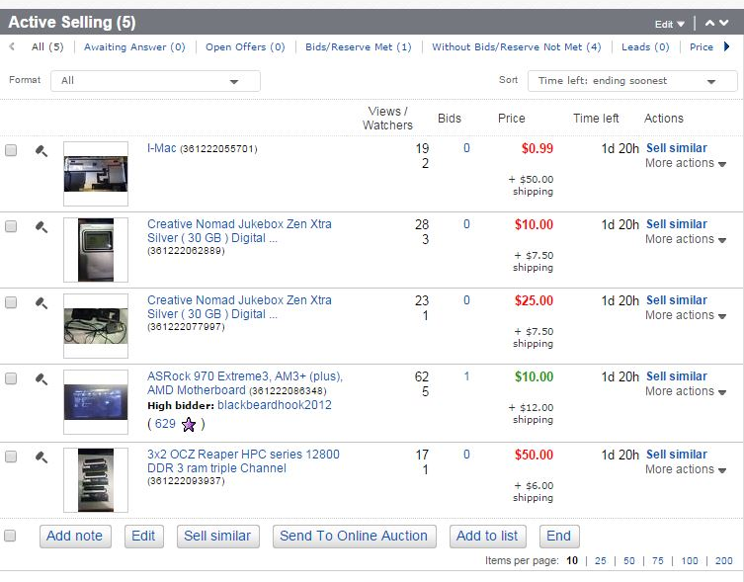
Maintaining Your Auctions

Slide 25
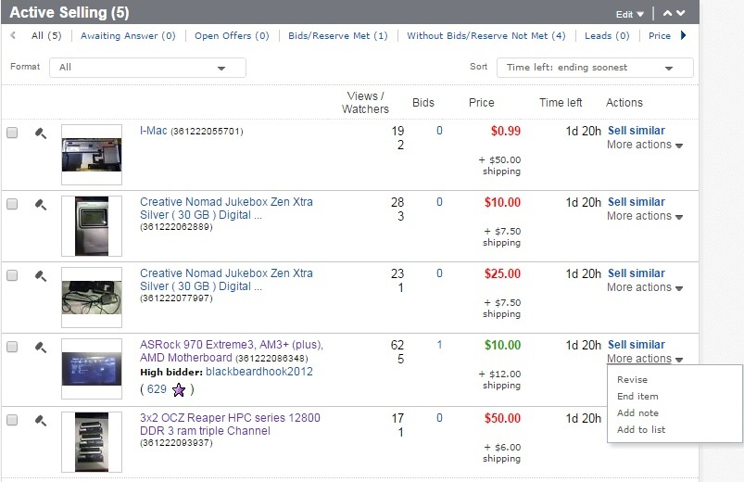
Maintaining Your Auctions

Slide 26
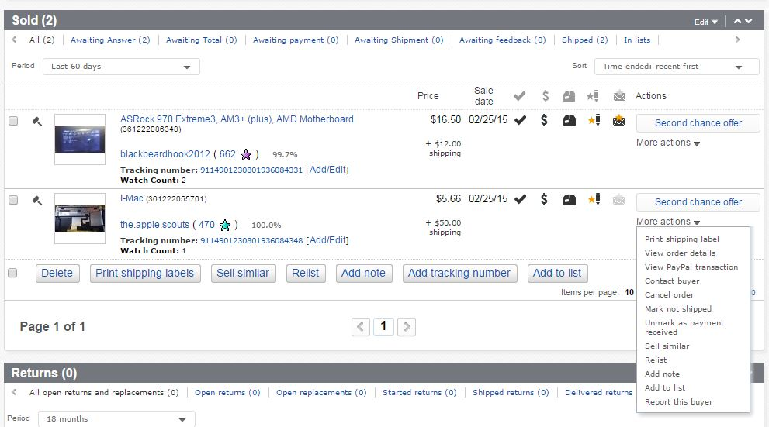
Maintaining Your Auctions

Slide 27
Maintaining Your Auctions
Notes:
Speaker Note: When you ship an item, it’s useful to purchase tracking. This proves you shipped the item. After the item is shipped share it with the customer by clicking on add tracking number and filling out the form.

Slide 28
Maintaining Your Auctions
Notes:
Speaker Note: If the buyer does not pay within the specified amount of days, use the report this buyer option to start an unpaid case with Ebay. Once a case is started with Ebay, they will attempt to get the buyer to pay. If the buyer does not pay in a certain period of time Ebay will refund you the ad cost and relist it.

Slide 29
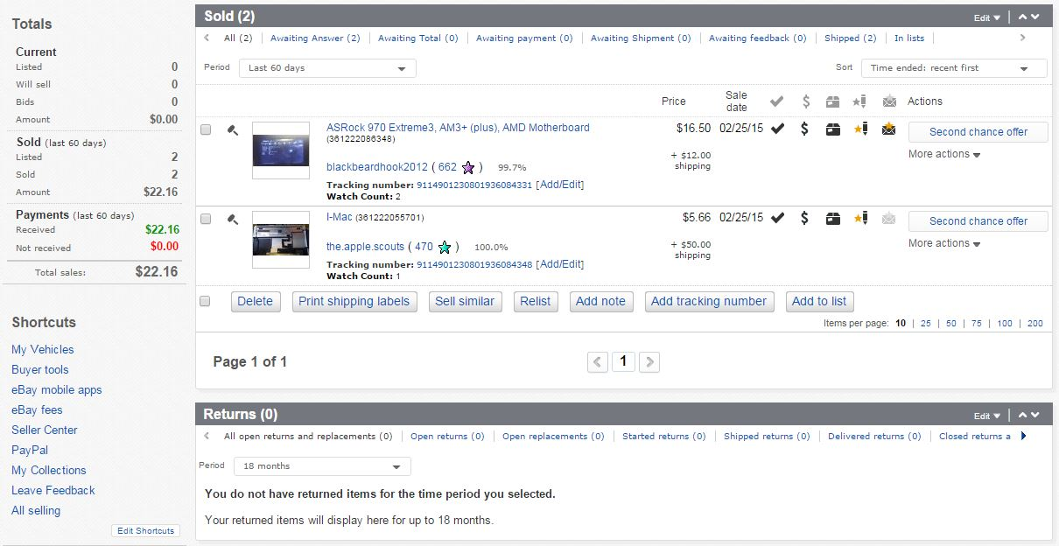
Maintaining Your Auctions

Slide 30
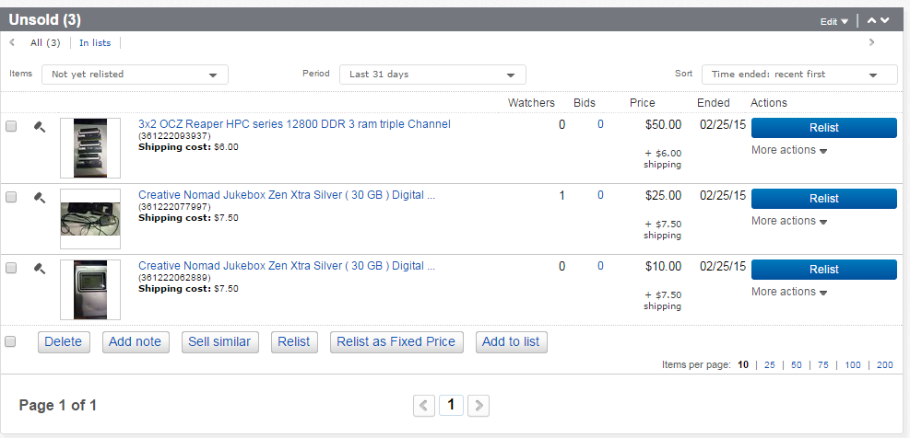
Maintaining Your Auctions

Slide 31
Shipping Tips

Slide 32
Shipping Tips
Leave 1” of padding between an item and its box.
    Newspaper, bubble wrap, etc. work well
To save money on materials, save packing materials and boxes from online purchases.
    Note: Make sure to remove old labels, stickers, and information.
Use exact size boxes when able for lowest price
Notes:
Personal Note: As a rule of thumb I put insurance on any item worth $100 or more, but the risk is up to you.

Slide 33
Handling Unhappy Customers
Notes:
Speaker Note: Make sure to mention that this is not the majority of customer interactions and to be honest about the item being listed (description, condition, price, etc.)

Slide 34
Tips
Answer and attend to all complaint in a timely manner
Give great customer service
    Apologize for problems and talk out a solution
    Keep the customer up to date with your actions on solving their problem
Offer a refund upon item being return if necessary
    Refund the buyer only after the item is returned

Slide 35
Tips
Avoid eBay being involved. This can lead to strikes on your account and negative feedback.
If eBay is involved follow their process and state your case for a quick resolution.
To avoid bad buyers block bad users and limit who can bid on your auctions.

Slide 36
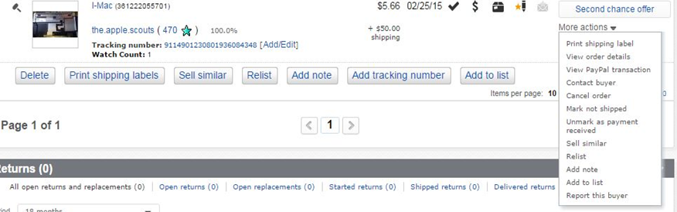
Refunds via eBay
You can give a full refund through eBay

Slide 37
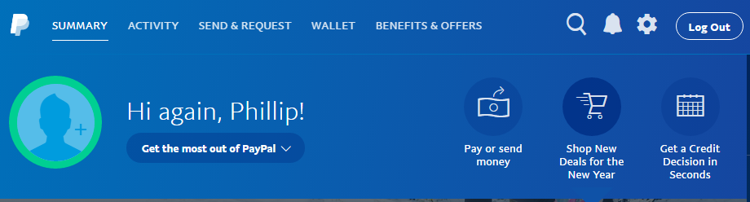
Refunds via PayPal
If you work out a deal you can give a partial refund to the customer through PayPal using their email address.

Slide 38
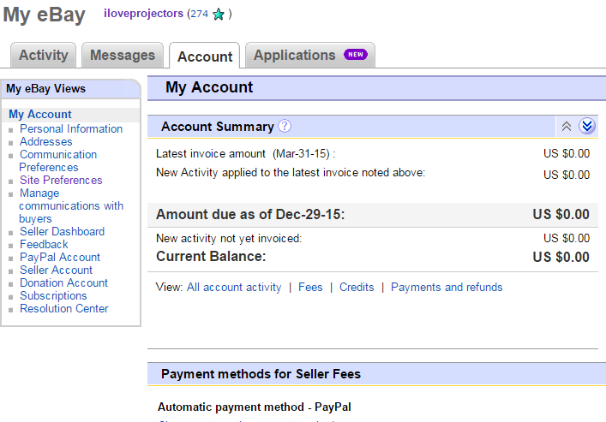
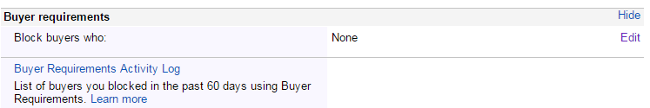
Handling Unhappy Customers

Slide 39
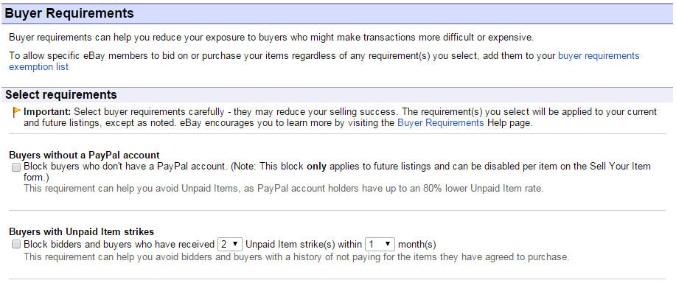
Handling Unhappy Customers

Slide 40
Handling Unhappy Customers

Slide 41
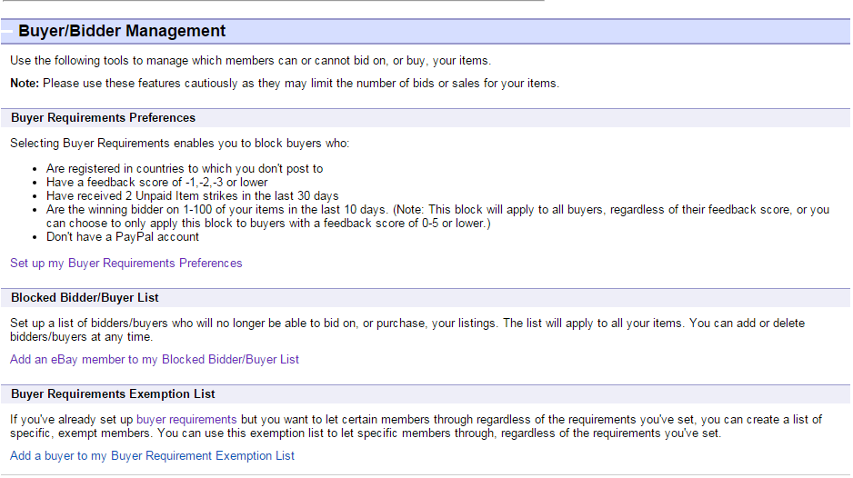
Handling Unhappy Customers

Slide 42
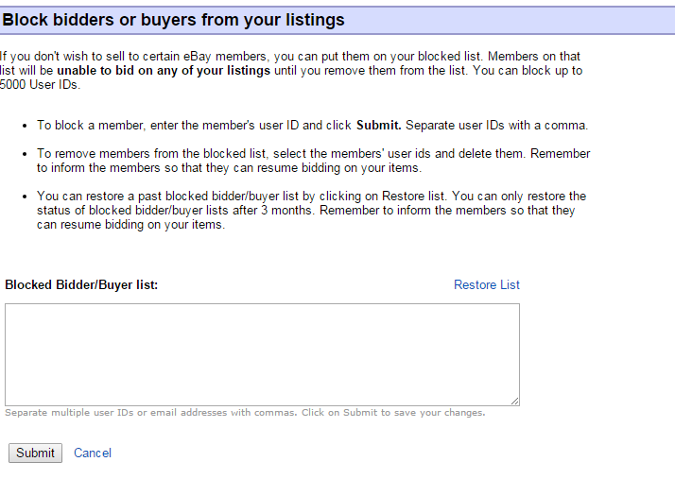
Handling Unhappy Customers

Slide 43
eBay Help/Customer Support
Notes:
Speaker Note: Make sure to mention that this is not the majority of customer interactions and to be honest about the item being listed (description, condition, price, etc.)

Slide 44
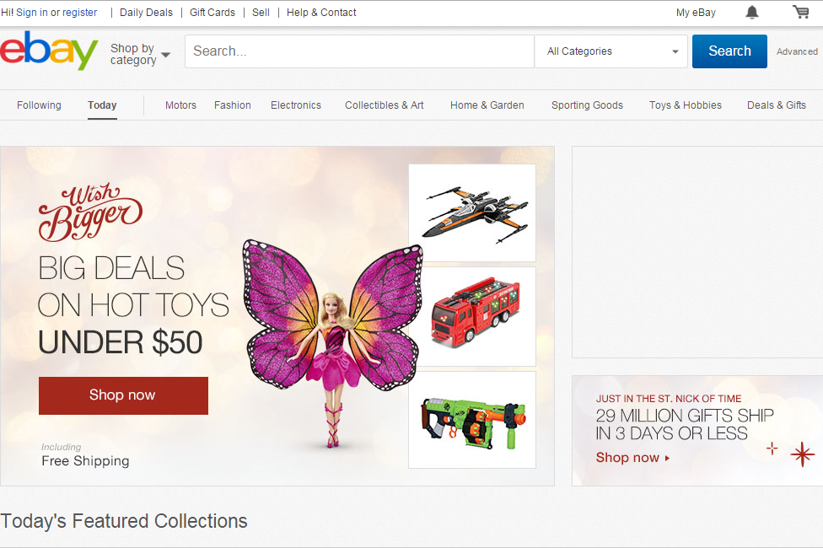
eBay Help/Customer Support

Slide 45
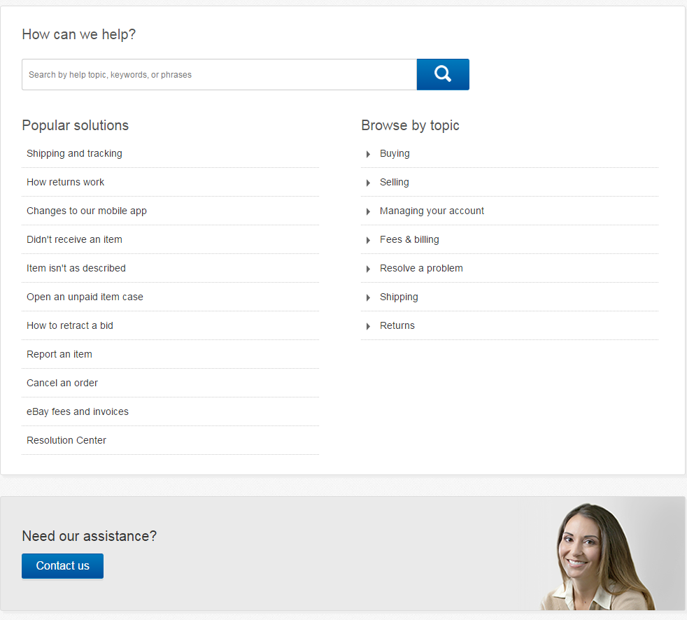
eBay Help/Customer Support

Slide 46
Thank you for attending
Questions?

