Slide 1

Resume Basics
Phil Schmitt
Technology Trainer
Gail Borden Public Library District
Courtesy of Gail Borden Public Library
and the Public Library Association

Slide 2
Agenda
Types of Resumes
Format & Language
Heading
Objective vs. Profile
Skills
Education
Work Experience
Additional Sections

Slide 3
Types of Resumes

Slide 4
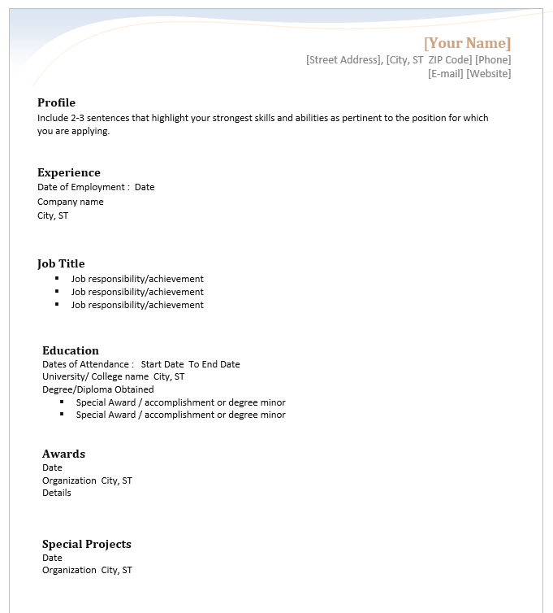
Chronological
Most traditional format
Stresses consistent employment within a specific field
Highlights promotions
1-2 pages in length
Recommended for:
  Those with solid work experience
  Those who wish to show progression over the course of a career

Slide 5
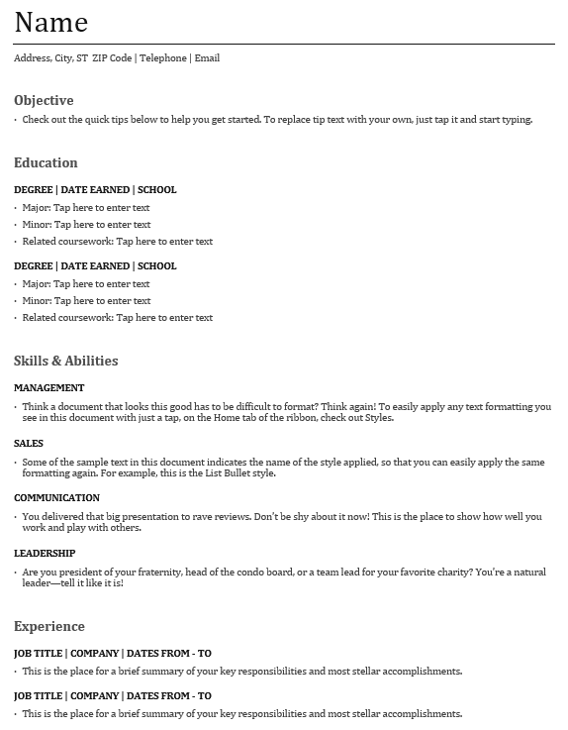
Functional
Stresses transferable skills and volunteer experience
Minimizes gaps in job history
1 page
Recommended for:
  Those with limited or no work experience
  Recent graduates
  Those with large gaps in employment history

Slide 6
Activity #1

Slide 7
Format & Language

Slide 8
QUESTION
How long do you think a person spends looking at a resume when he or she receives one?
5 to 10 seconds

Slide 9
Formatting Considerations
Overall readability
Fonts
Grammar & spelling
Length
Style
Margins & spacing
Paper/electronic format

Slide 10
Language
Use strong, brief descriptions that are action-focused
ex. Hired, trained, and managed production team
Use 3rd person objective voice
ex. Managed production team
Minimize abbreviations and jargon that need further explanation
ex. Member ISTE board

Slide 11
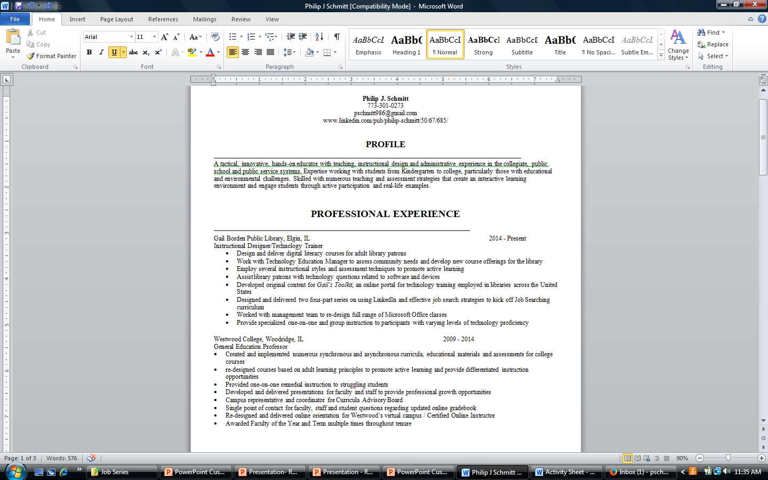
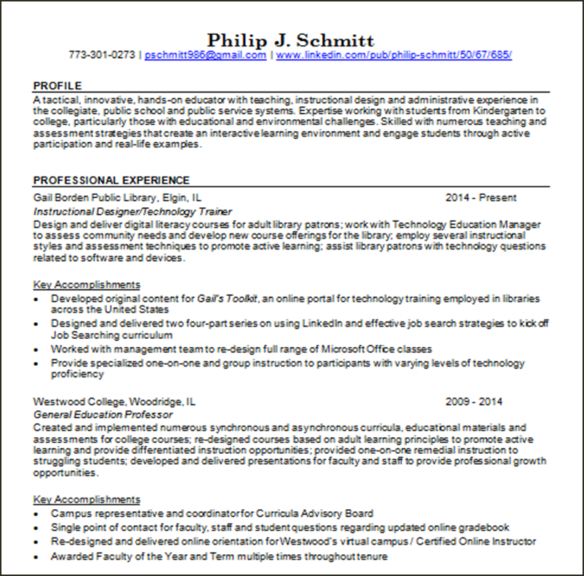
“Eye test”

Slide 12
Activity #2

Slide 13
Heading

Slide 14
Components
Headings include the following pieces of information:
  Name
  Phone Number
  Email address
They also may include the following:
  Address
  URL for LinkedIn profile, website, or portfolio

Slide 15
Examples
John R. Doe
555-555-5555 | jdoe@gmail.com | www.linkedin.com/in/johndoe
John R. Doe
1400 Spring St., Elgin, IL 60120
(847) 555-1000
johndoe@gmail.com

Slide 16
Activity #3

Slide 17
Objective vs. Profile

Slide 18
Objective
A brief statement that defines the type of employment you seek and/or your career goal(s)
An objective includes the following:
Position Title (mandatory)
Job or field (mandatory)
It also MAY include the following:
Position level
Name of the company to which you are applying

Slide 19
Examples
To acquire an entry-level position as a Medical
Assistant
To obtain a production manager position with
supervisory responsibilities at Aramark Industries
To secure a clerk position that allows long-term
advancement into a position of increased
responsibility

Slide 20
Profile
A brief statement that highlights the skills and abilities you have to offer potential employers
A profile statement is comprised of 2-3 sentences
that grab the reader’s attention and summarize the
following:
Most relevant experience
Transferrable skills
Best personal qualities

Slide 21
Example
A tactical, innovative, hands-on educator with on-ground and
online teaching experience in a collegiate, public, and non-
profit environment. Expertise working with students from
kindergarten to college, particularly those with educational and
environmental challenges. Skilled in numerous teaching and
assessment strategies that create an interactive learning
environment and engage students through active participation
and real-life examples.

Slide 22
What’s the difference?
FOCUS
Objective statements say…
“This is what I want”
Profile statements say…
“This is what I can offer you”

Slide 23
Activity #4

Slide 24
Skills

Slide 25
Components
Identify the skills listed in the job posting(s) and/or desired within the field and include the ones you have in your resume
Depending on your resume style, you can include them in one or more of the following sections:
  Skills (Functional)
  Profile (Chronological)
  Work Experience (Chronological & Functional)
Key skills to highlight include:
  Communication
  Teamwork
  Leadership
  Technical Proficiency

Slide 26

Example
Work Experience
Marketing Assistant, Nabisco Foods 1999-2013
Worked daily with Marketing Managers to analyze sales numbers, chart customer purchasing trends, and develop new product strategies to increase customer demand for new and existing products.

Slide 27
Activity #5

Slide 28
Education

Slide 29
Components
Include the following, as applicable:
  Higher education degrees:
    Associate / Bachelor / Master / PhD
    Can include honors, if desired (Magna / Summa / Cum Laude)
  High school
  Professional certifications, licenses, or training courses like:
    PE certification
    Six Sigma Green Belt Training
    ISO9001 Internal Auditor Training

Slide 30

Example

Slide 31
Activity #6

Slide 32
Work Experience

Slide 33
Components
Include the following:
  Company name and location (town and state)
  Job title
  Dates employed (years, at a minimum)
  Roles and responsibilities
    1-4 sentences or bullet points using action verbs that highlight transferrable skills and abilities
  Key accomplishments
    3-4 major projects, awards, promotions, or activities that show your potential

Slide 34
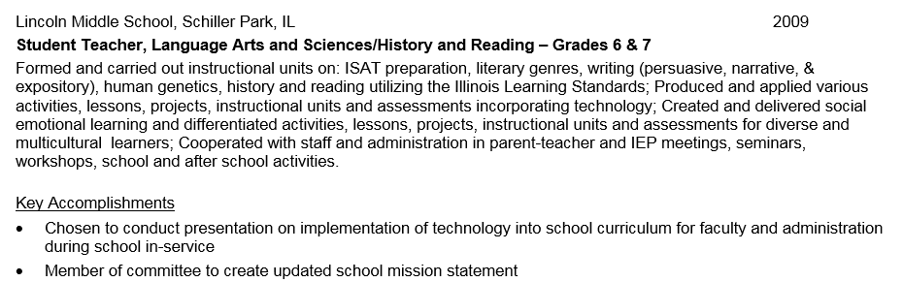
Example

Slide 35
Activity #7

Slide 36
Additional Sections

Slide 37
Examples
Volunteer Work
Military Experience
Software Applications
Groups & Organizations
Internships or Externships
Presentations, Publications, or Workshops

Slide 38
QUESTIONS?
THANK YOU FOR ATTENDING!
Next in the series:
Customizing Your Resume Part 1

