Slide 1

Pinterest: Getting Started
Instructor
Job Title
Library Name
Courtesy of Gail Borden Public Library
and the Public Library Association

Slide 2

Agenda
Navigating Pinterest
  The Homepage
  Your Profile Page
Using Pinterest
  Finding Pins
  Creating Boards
  Following
  Adding & Deleting Pins
Adjusting Settings

Slide 3
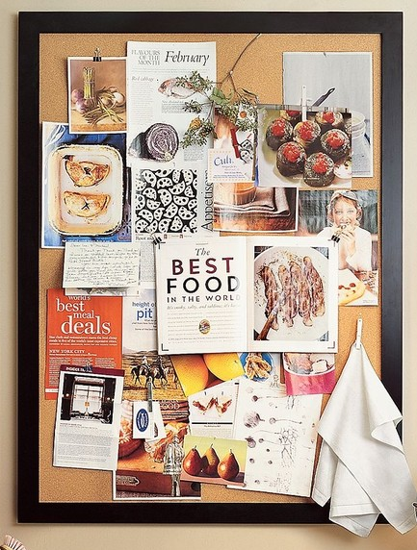
What is Pinterest?
Pin + Interesting = Pinterest!
A free, web-based virtual bulletin board
Pins are links to other websites highlighting articles, recipes, products, videos, etc.

Slide 4
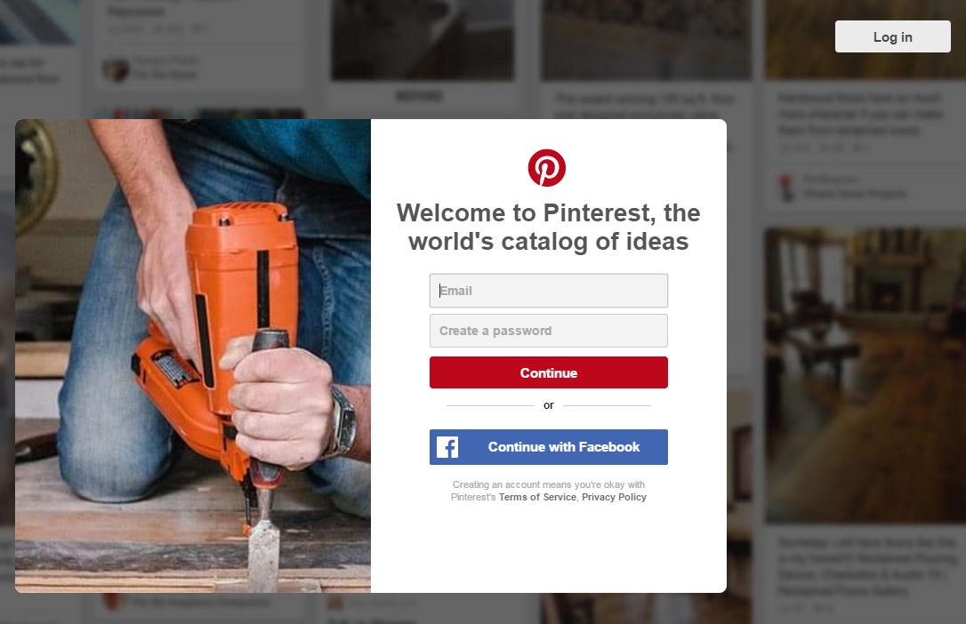
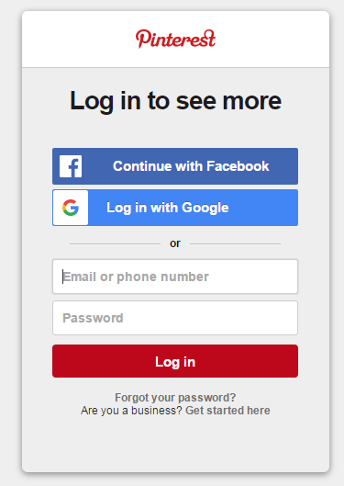
Logging In

Slide 5
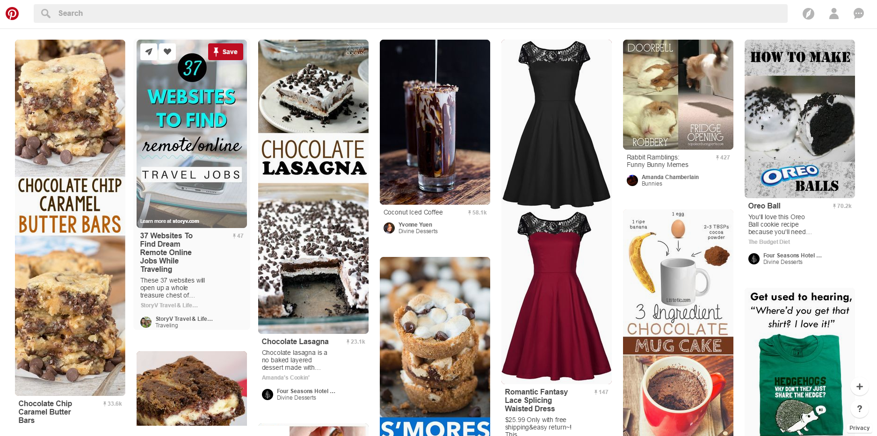
Your Homepage (Feed)
Search box
Home button
Categories, Profile, Notifications/Messages
Add a new pin & Help
On your homepage (“feed”), you’ll find pins related to…
Interests you follow
Pins from fellow pinners and boards you’ve followed
Suggested pins from advertised boards/pinners

Slide 6
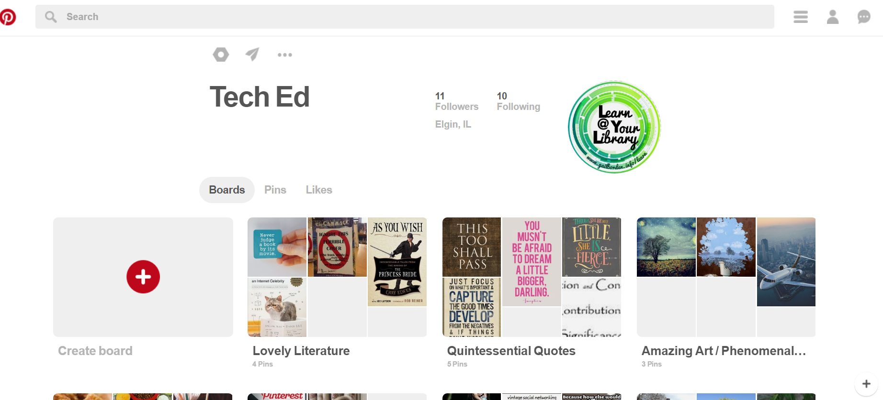
Your Profile Page
-Settings
-Messaging
-Log-out
Toggle between sections
Your Boards

Slide 7
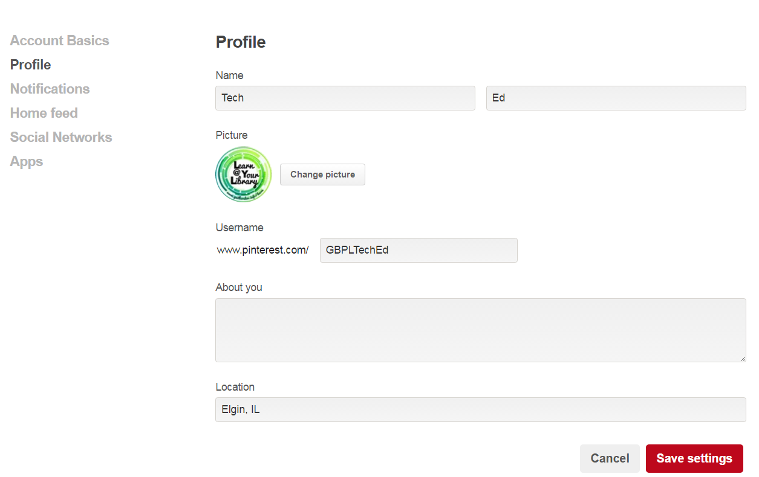
Editing Profile Information

Slide 8
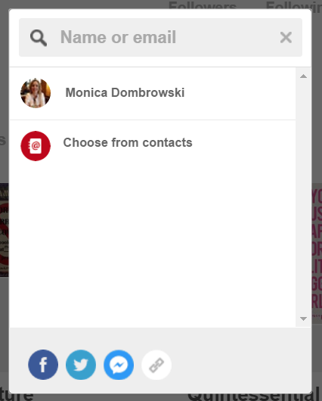
Sharing Your Page
Message a friend
Share your profile via social media

Slide 9
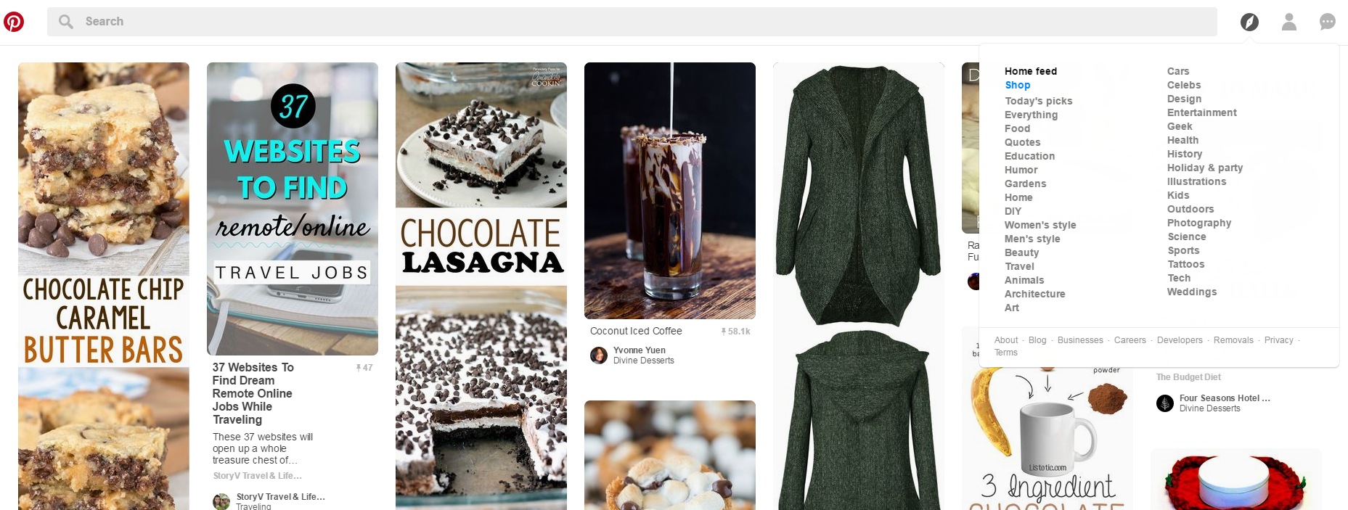
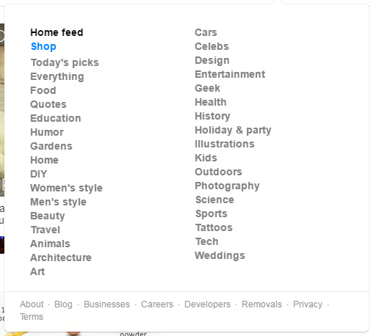
Finding Pins
Search by keyword or idea
Categories

Slide 10
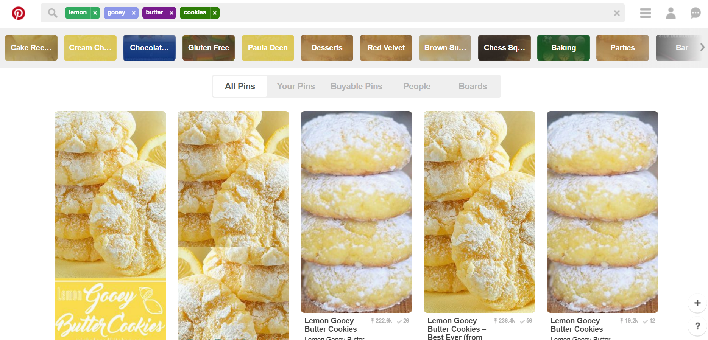
Search Results
Narrow down the topic by using the suggestions
Filter search results by clicking on
-Your Pins
-Buyable Pins
-People
-Boards

Slide 11
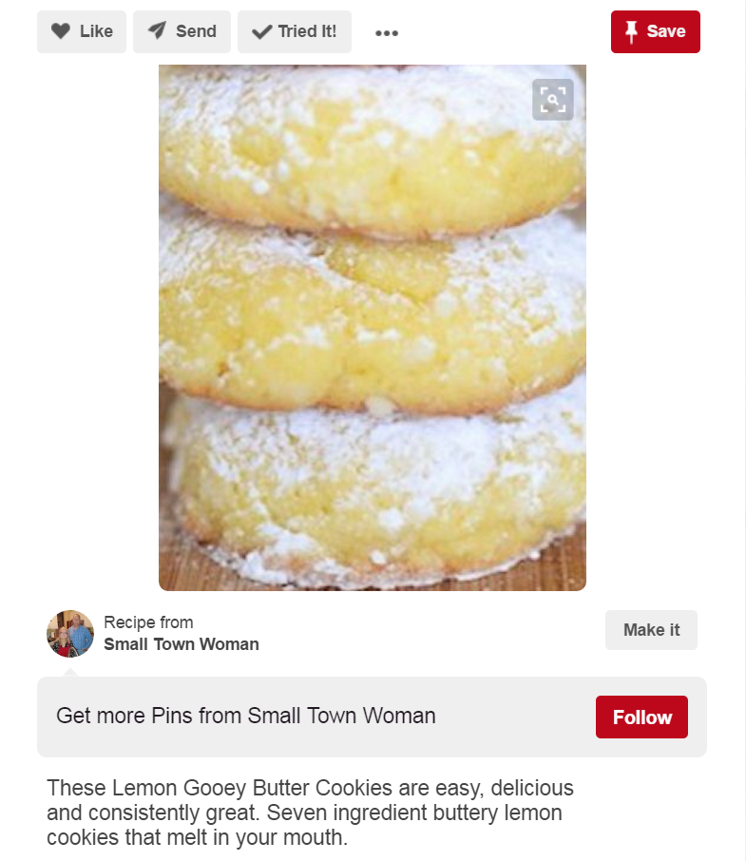
Pins
You can do one or more of the following…
-Like it
-Send it to a friend
-Mark that you’ve tried it
Save the Pin to one of your boards
Click on the image or the Make it button to access the link in a new tab

Slide 12
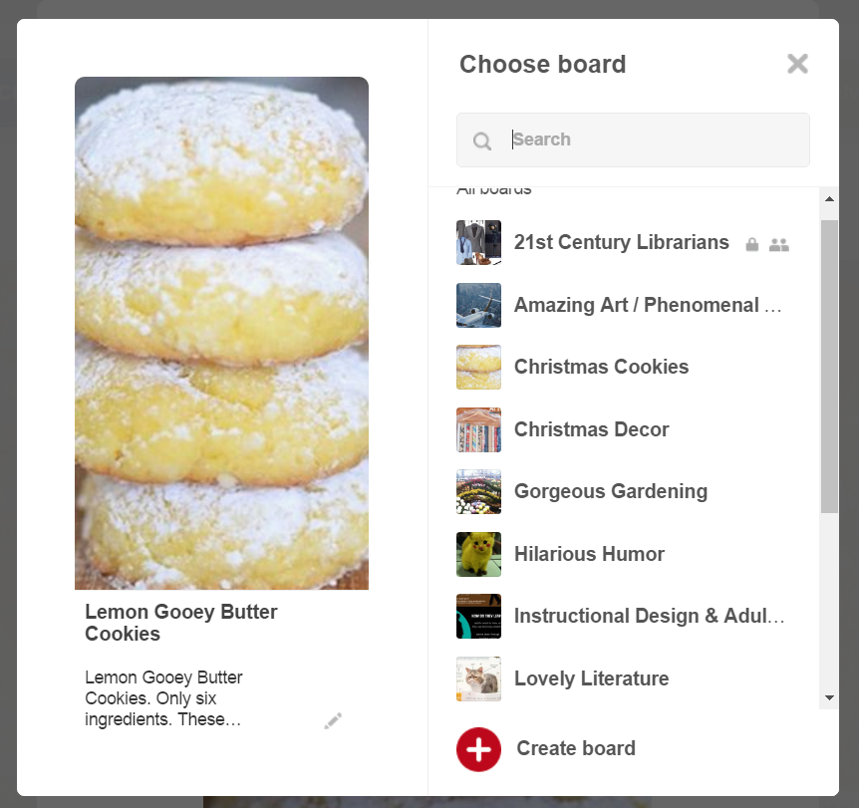
Saving Pins
Click Save, then select one of your boards, or create a new one

Slide 13
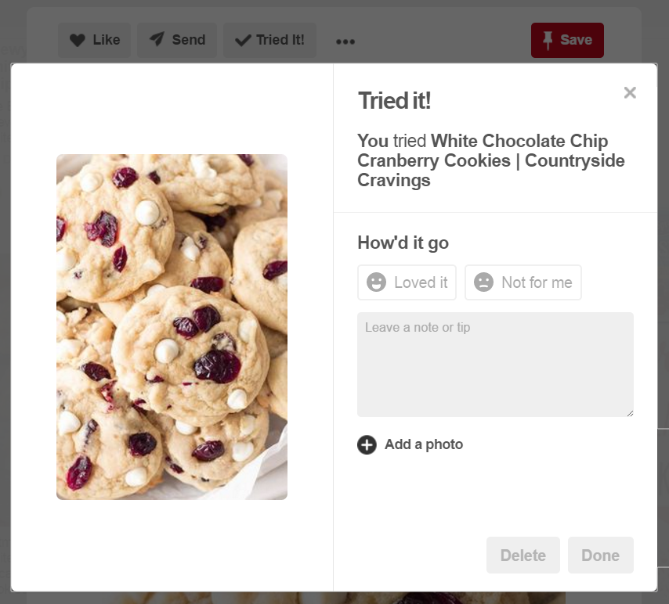
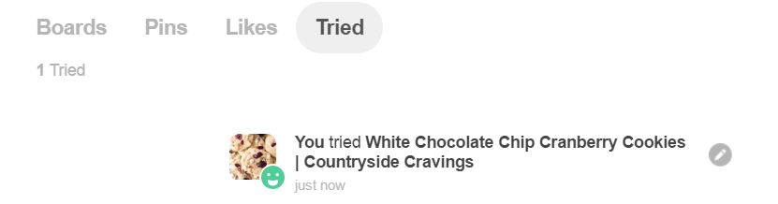
Tried It!
Mark that you’ve Tried It to keep track of those you’ve tested and to leave a review for others.
Once you’ve Tried a pin, a new tab will appear on your Profile

Slide 14
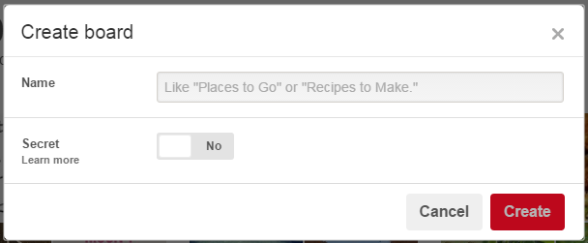
Creating Boards
Boards can be public (default) or Secret (only seen by you and those you invite)

Slide 15
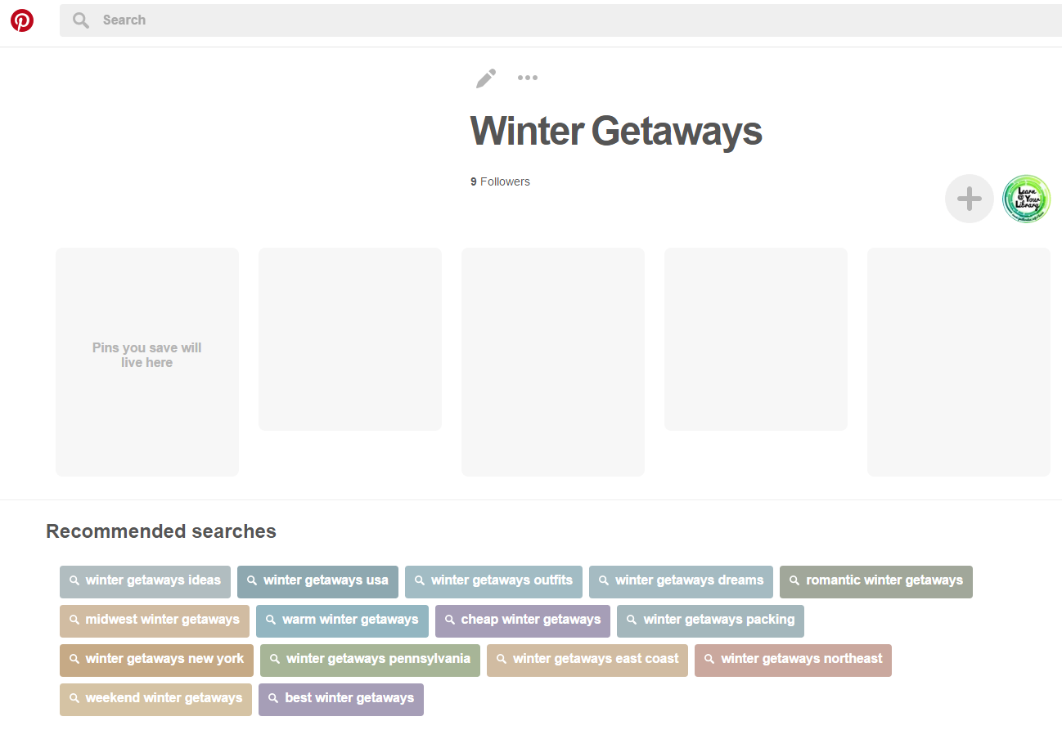
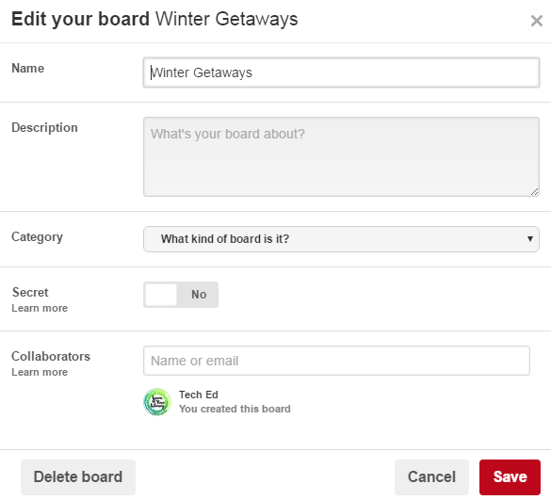
Editing Boards
Edit your Board
Add a Collaborator

Slide 16
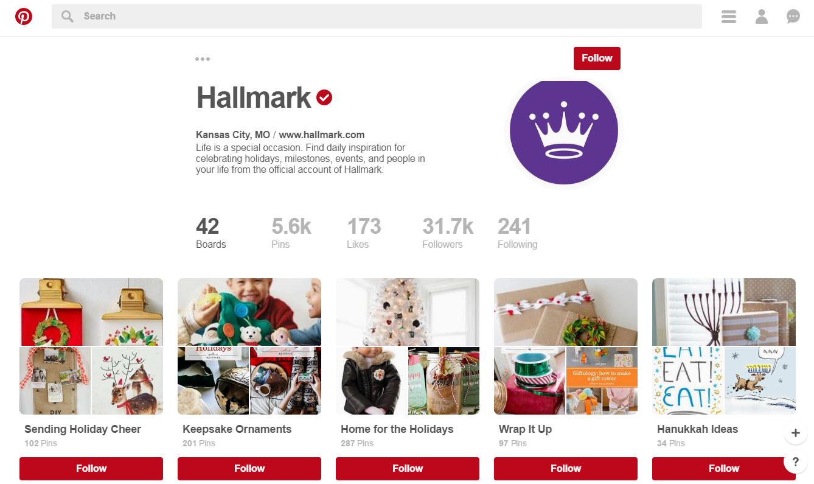
Following People
Following a person/company will subscribe to you all of their boards and the pins they post

Slide 17
Following Individual Boards
If you aren’t interested in every board or pin a person posts, follow individual ones

Slide 18
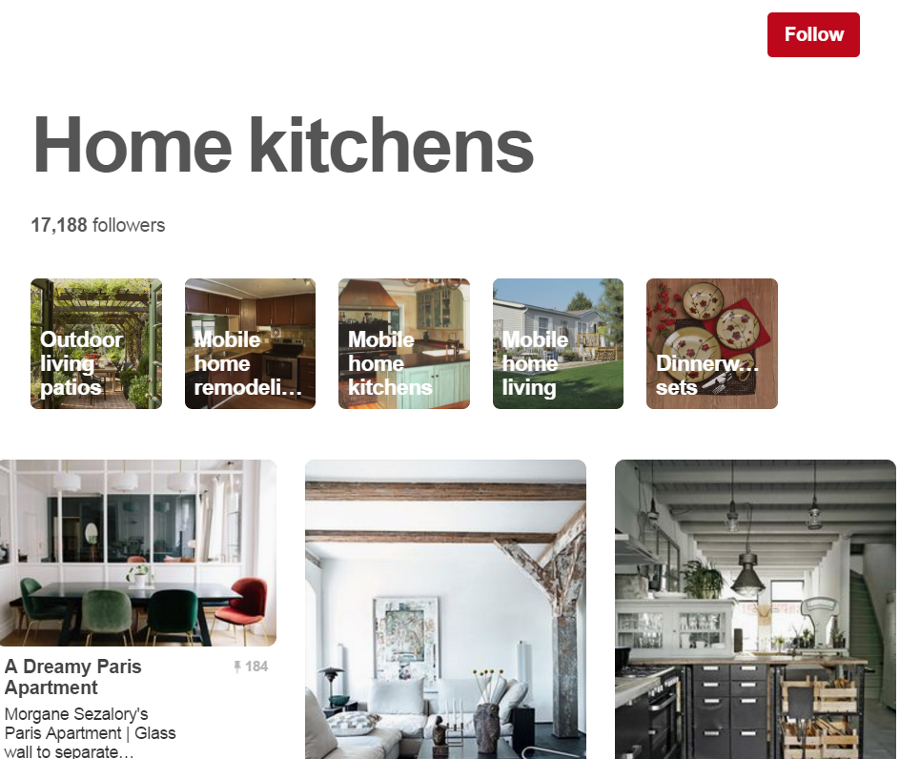
Following Topics/Interests
Use the Categories menu from the toolbar to find topics and interests to follow

Slide 19
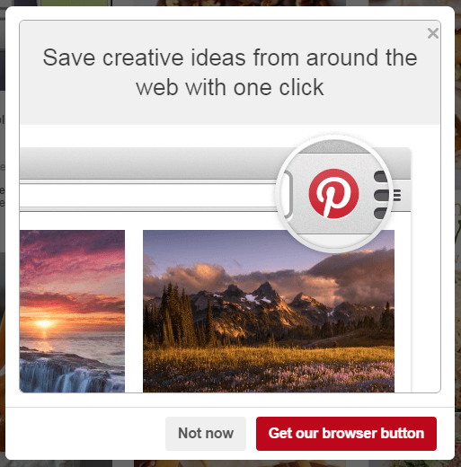
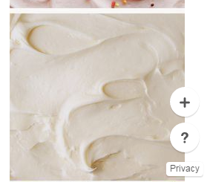
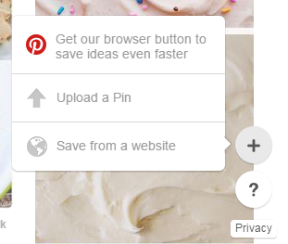
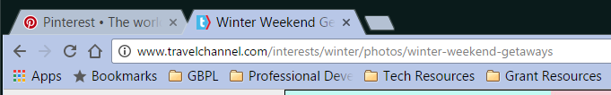
Adding New Pins
1. From the Home page, click the Add button
2. Pinterest may ask if you want to install the browser button for “quicker pinning” – this is optional
4. In a new tab, access the website you want to add the pin from
3. Click the add button again, then select one of the options

Slide 20
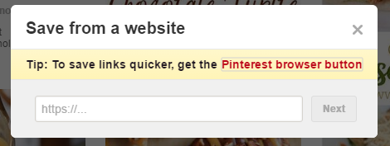
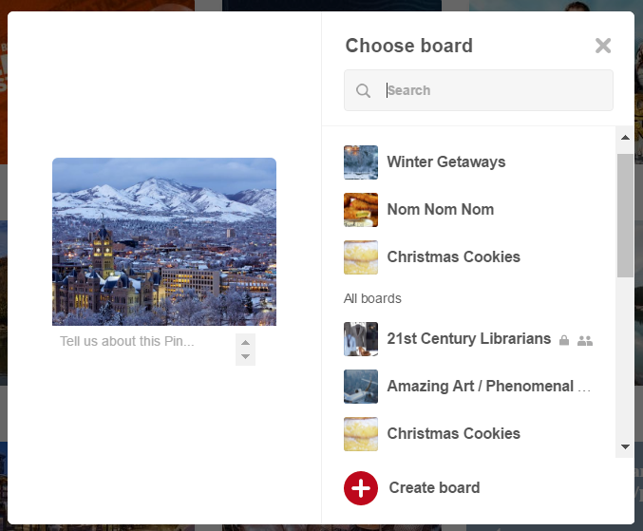
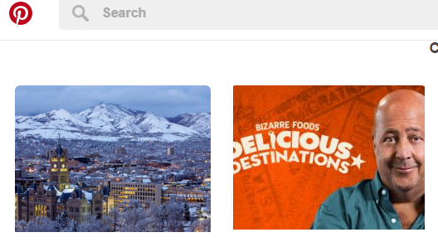

Adding New Pins
7. Add a description (optional), then select the board you want the pin to be posted on
5. Copy and paste the address into the box, then click Next
6. Select an image for the pin

Slide 21
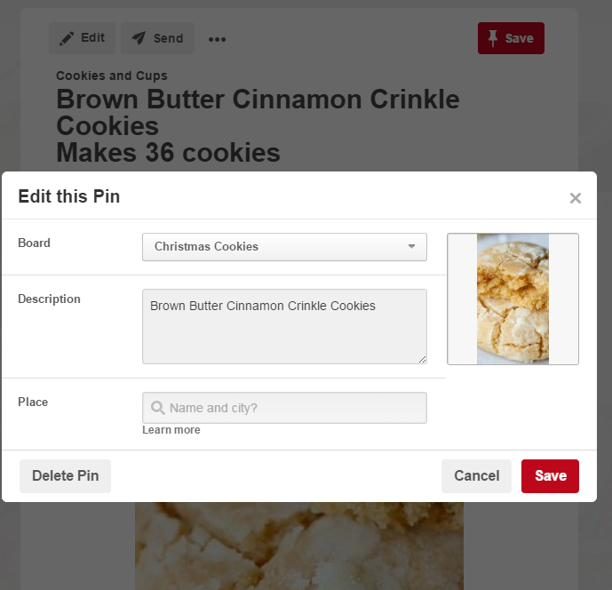
Deleting a Pin
2. Click Edit
1. Access the pin you wish to delete
3. Click on Delete Pin

Slide 22

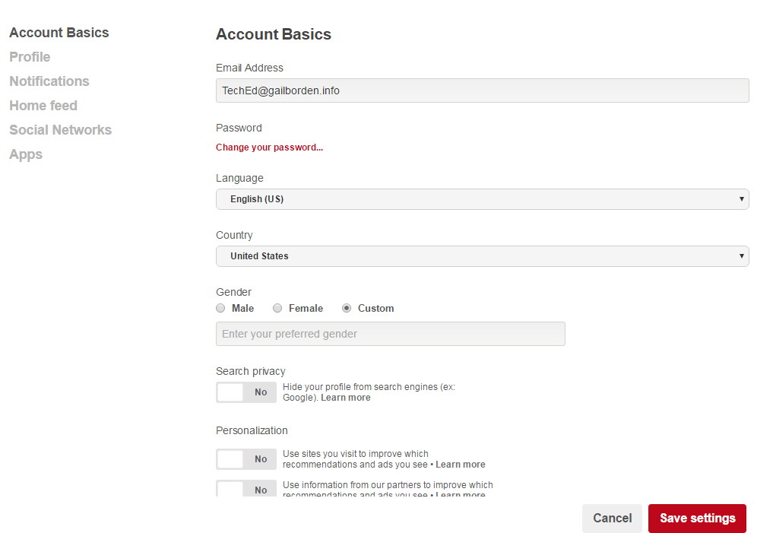
Settings
From your Profile page, click on the cog wheel to access settings
Settings are categorized
Scroll down to access more
Click Save Settings to save any changes

Slide 23
Questions?
THANK YOU FOR COMING!

