Slide 1

Pinterest Basics
Instructor Name
Job Title
Library Name
Courtesy of Gail Borden Public Library
and the Public Library Association

Slide 2

Agenda
What is Pinterest?
The Home Page (Feed)
The Profile Page
How it Works
Pinning Etiquette
Basic Settings
Creating an Account

Slide 3
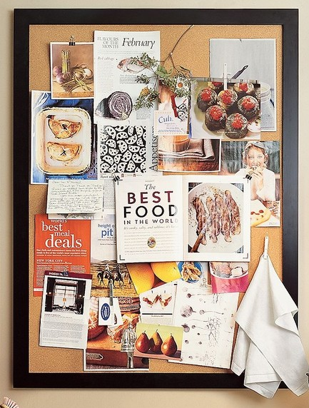
What is Pinterest?
Pin + Interesting = Pinterest!
A free, web-based virtual bulletin board
Pins are links to other websites highlighting articles, recipes, products, videos, etc.

Slide 4
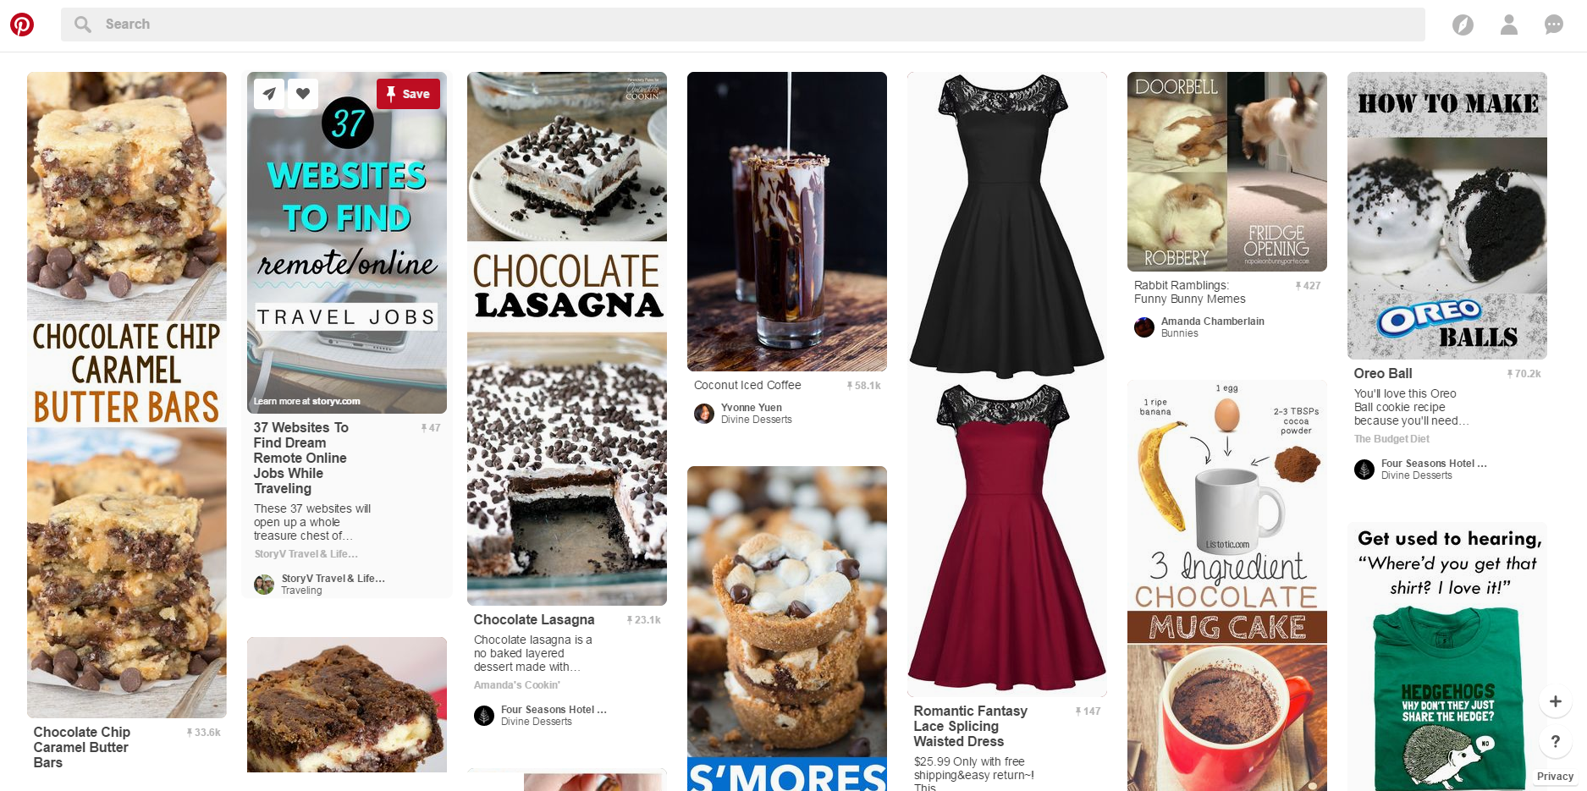
Your Homepage (Feed)
Search box
Home button
-Categories
-Profile,
-Notifications/Messages
Add a new pin & Help
The homepage is constantly updating with pins related to…
Pins from fellow pinners and boards you’ve followed
Interests you follow
Suggested pins from advertised boards/pinners

Slide 5
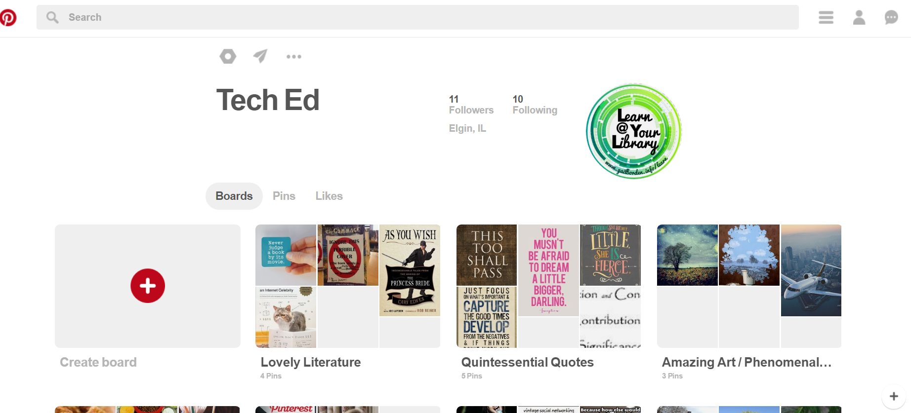
Your Profile Page
-Settings
-Messaging
-Log-out
Toggle between sections
Your Boards

Slide 6
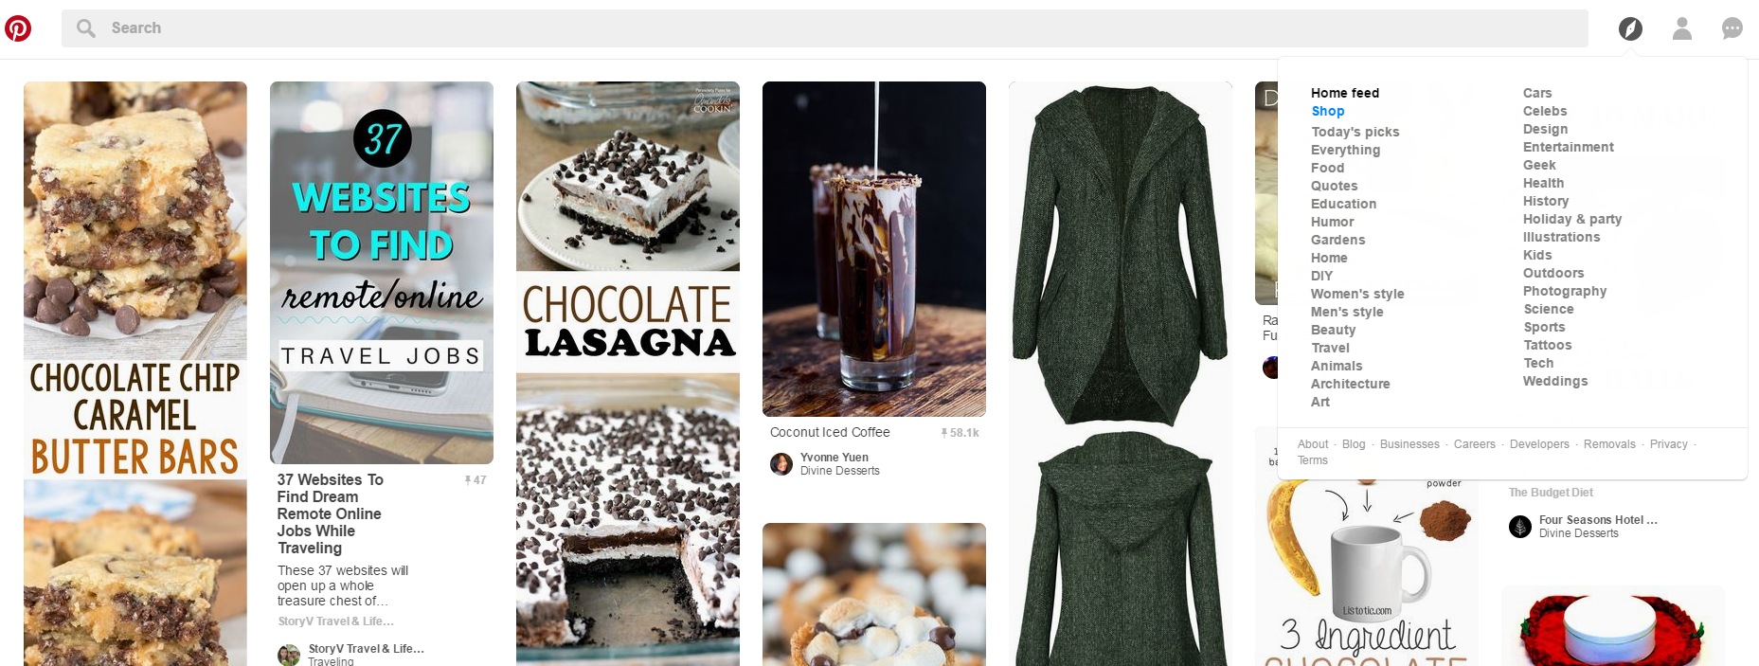
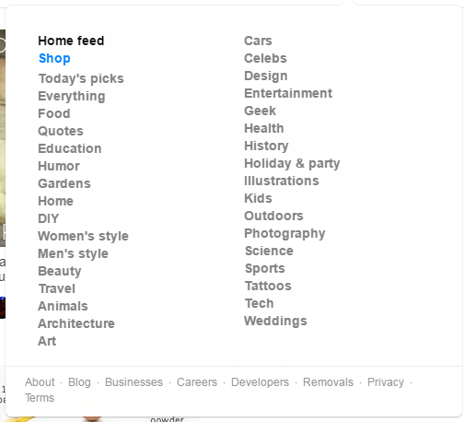
Searching for Pins
Search for pins by entering keywords into the Search box or browsing categories from he drop-down box

Slide 7
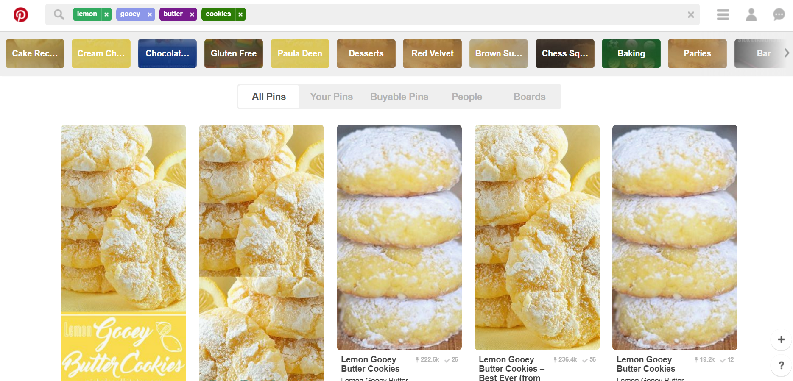
Search Results
Narrow down the topic by using the suggestions
Filter search results by clicking on
-Your Pins
-Buyable Pins
-People
-Boards

Slide 8
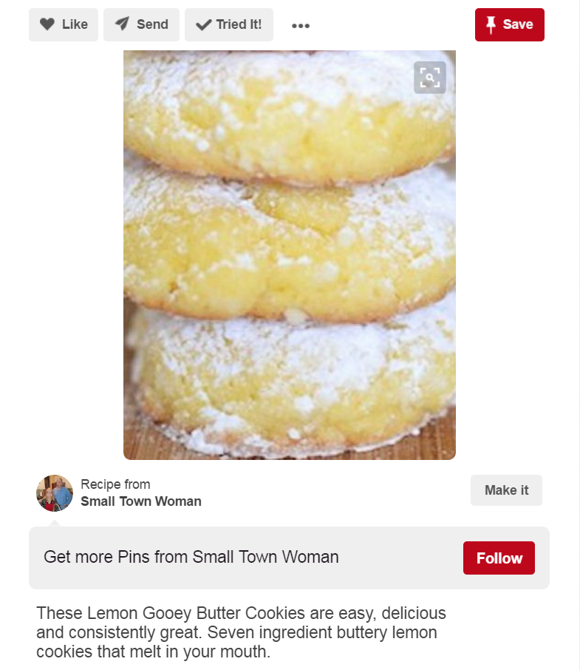
Pins
You can do one or more of the following…
-Like it
-Send it to a friend
-Mark that you’ve tried it
Save the Pin to one of your boards
Click on the image or the Make it button to access the link in a new tab

Slide 9
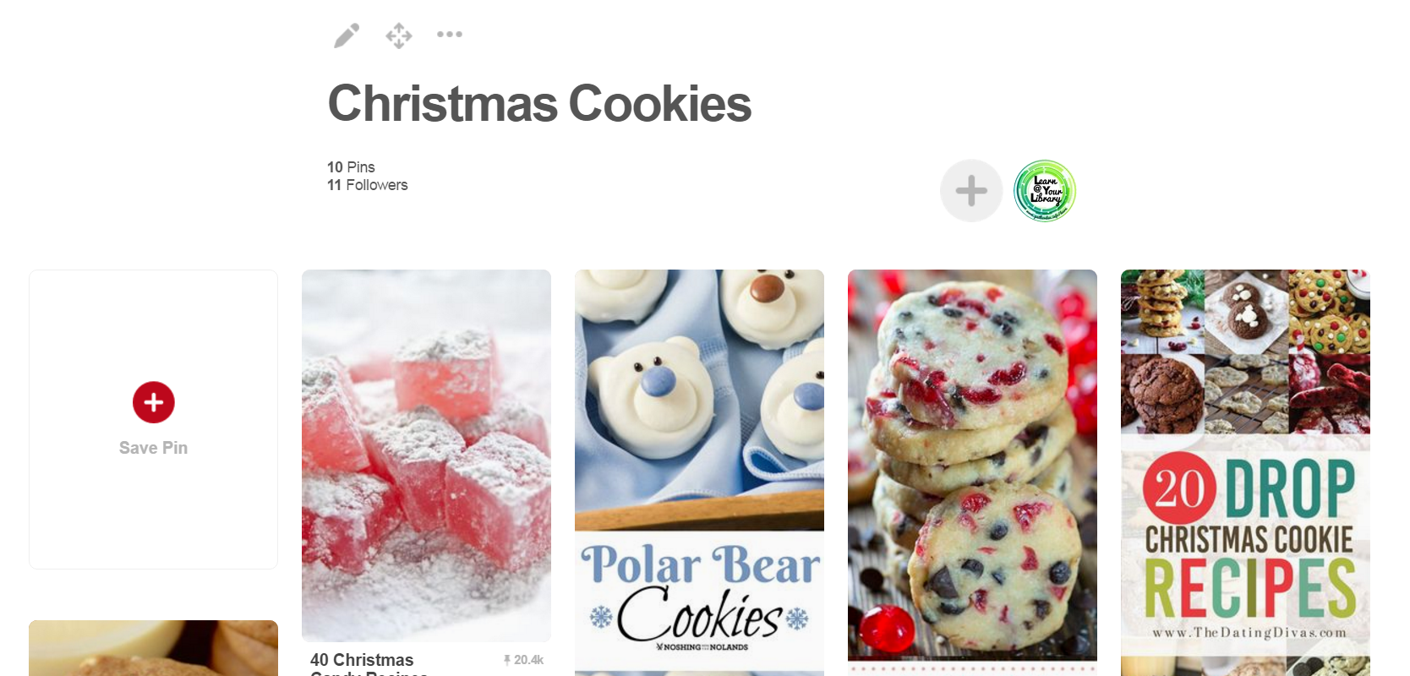
Boards
Boards allow you to grow an organized collection of pins

Slide 10
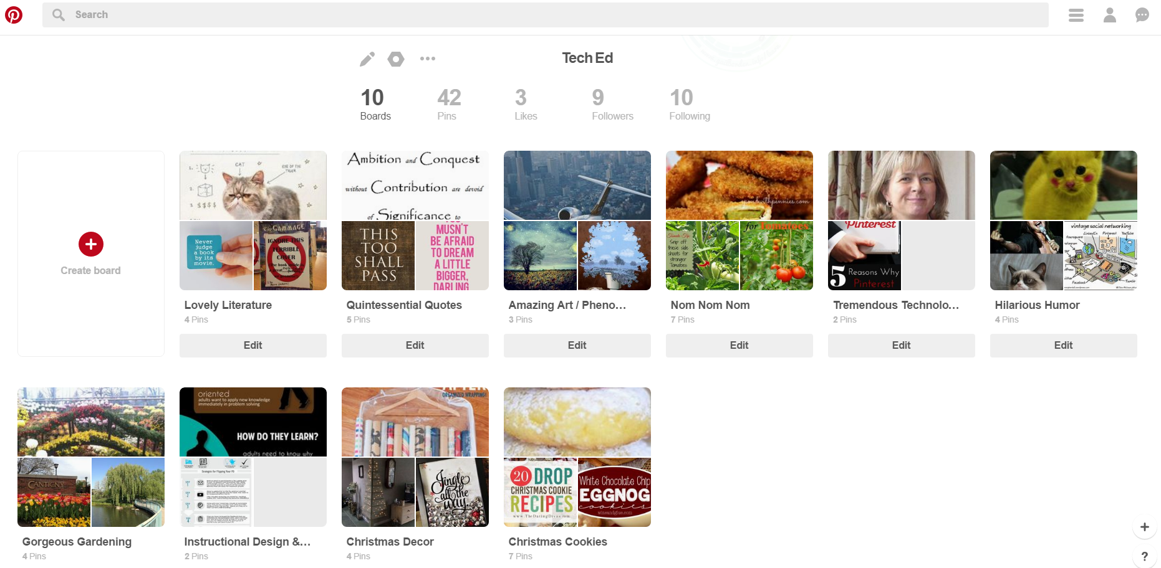
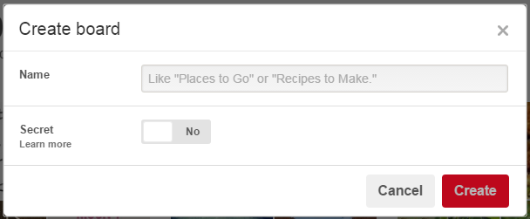
Creating Boards
Boards can be public (default) or Secret (only seen by you and those you invite)

Slide 11
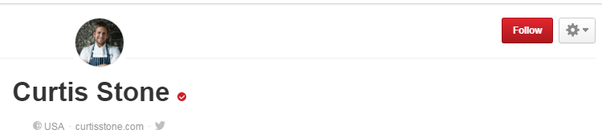
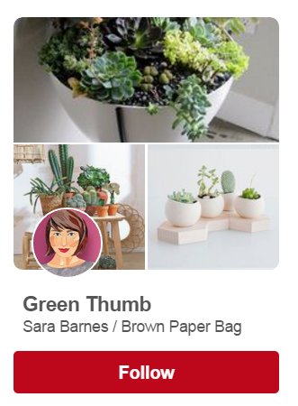
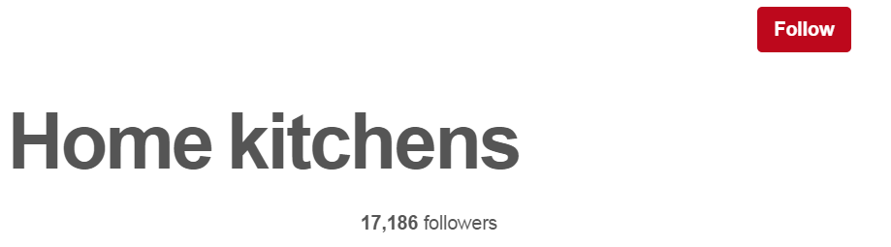
Following
The more you follow, the more pins you’ll see. Follow another user, individual boards, or interests

Slide 12

Pinning Etiquette
When adding a new pin, always pin from the original source
Check links prior to saving a pin, as some may be old or no longer available
Write a good description as text can link to searches
Personal pins can be risky – consider another site for personal photos
Don’t pin inappropriate or obscene images

Slide 13

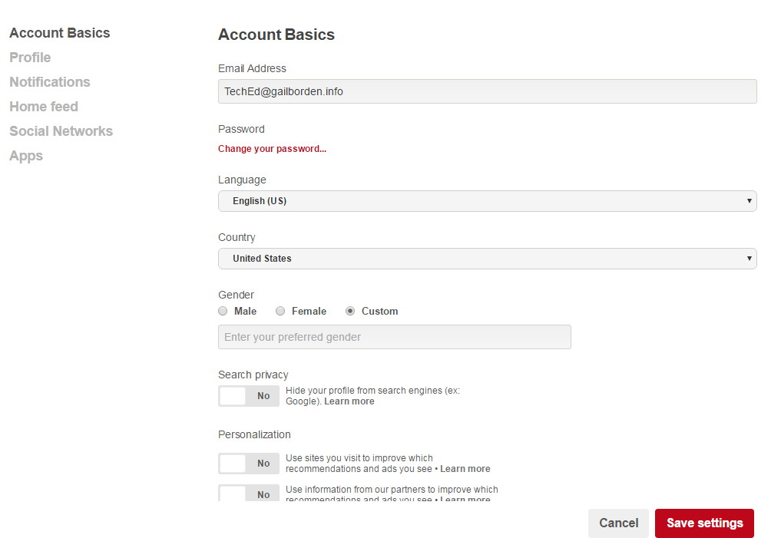
General Settings
From your Profile page, click on the cog wheel to access settings
Settings are categorized
Scroll down to access more
Click Save Settings to save any changes

Slide 14
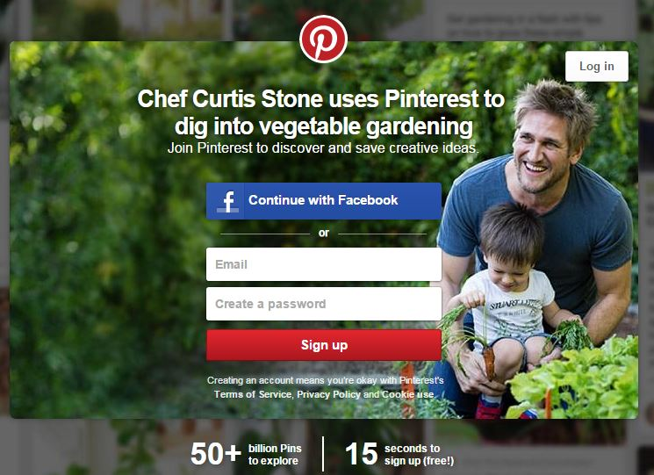
Creating an Account
Account set-up requirements
Name
Email Address
Password

Slide 15
Questions?
THANK YOU FOR COMING!

