Slide 1

Mouse & Keyboard Basics
Instructor Name
Instructor Title
Library Name
Courtesy of Gail Borden Public Library
and the Public Library Association

Slide 2
Agenda
The Mouse
The Keyboard
In-Class Practice
Questions

Slide 3

How to Hold the Mouse

Slide 4
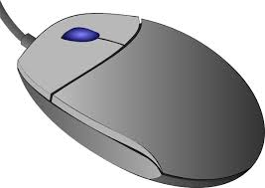
Parts of the Mouse
Scroll Wheel
Right button
Left button

Slide 5
Activity #1

Slide 6
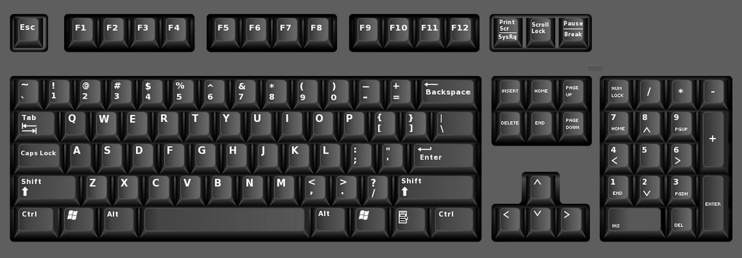
Parts of a Keyboard
Function keys
Navigation keys
Number keys
Numeric
keypad
Typing keys

Slide 7
Letter, Shift & Enter Keys
Enter
Shift
Letter keys

Slide 8
Activity #2

Slide 9
The Space Bar
Space Bar

Slide 10
Activity #3

Slide 11
Backspace, Delete & Arrow Keys
Backspace
Delete
Arrow Keys

Slide 12
Activity #4

Slide 13
Tab & Caps Lock
Tab
CapsLock

Slide 14
Activity #5

Slide 15

In-Class Practice

Slide 16
Questions?
THANK YOU FOR COMING!
Part Two Next Week
Computer Basics

