Slide 1

Mobile Device Basics—iOS
Instructor Name:
Instructor Title:
Library Name:
Insert your logo her
Provided by AT&T and the Public Library Association
Notes:
INSTRUCTOR NOTE: Please update this slide with the appropriate information:
Instructor name
Instructor affiliation (for instance, library staff member, community volunteer, etc.)
Location name
INSTRUCTOR NOTE: Before the workshop, please review the Instructor Outline for guidance on what to do to prepare for the workshop. You’ll find notes on how to conduct the workshop and details on what you should do once the workshop ends.
INSTRUCTOR NOTE: Please use the Volunteer Instructor Guide for talking points for the presentation. In that document, slide notations begin on page 6.
Today’s workshop is provided by AT&T and the Public Library Association.
INSTRUCTOR NOTE: Include thank-you to community collaborator if applicable.
My name is <your name here> and I am <brief description of yourself>. Before we get started here are a few housekeeping items: <mention the items that are relevant to your workshop>:
Where are the restrooms?
Where are the emergency exits?
When/how to ask questions—Note where to locate the page number on each slide for participants to include if they have questions to ask later.
If you have a cell phone with you, please make sure to either turn it off or set to silent.
Will there be a break?

Slide 2
Today’s Agenda
Introduction
Skill Building
  Navigating Your Device
  Getting Connected
  Common Apps
  Helpful Settings
Tips and Tricks
Practice
NOTE: This workshop is specific to Apple mobile devices and the iOS operating system. If you are interested in another operating system, please visit www.digitallearn.org or consider another workshop being offered.
Notes:
In this workshop, you’ll learn about mobile devices, and Apple devices in particular. We’ll work on building skills and confidence in using your iPhone or iPad. This will include:
An introduction to mobile devices
Skill building, including…
Navigating your mobile device
Getting connected to Wi-Fi on your device
Common apps on mobile devices
Helpful device settings for accessibility and privacy
You’ll also learn tips and tricks for safety and security with your device. And you’ll have opportunities to practice.
INSTRUCTOR NOTE: Please remind participants: This workshop is specific to Apple Mobile Devices and the iOS operating system. If you are interested in another operating system, please visit www.digitallearn.org or consider another workshop being offered.
Let’s get started!

Slide 3

Introduction
What brings you to this workshop?
Do you have a mobile device and you want to learn more?
Are you thinking about getting an iPhone or iPad?
Notes:
INSTRUCTOR NOTE: Ask learners the questions on the slide. Lead learners in a brief discussion on why they’re attending the workshop. Possibilities include that they have an Apple device and want to learn more, or that they’re in the process of deciding whether to buy an Apple device.

Slide 4

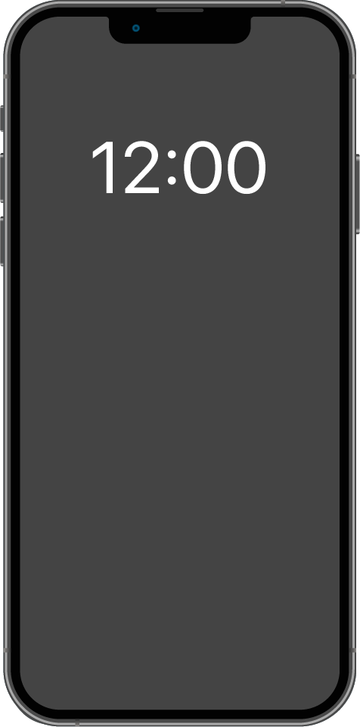
Introduction (continued)
Notes:
Today’s mobile devices can do many of the same things that a traditional computer can do. You can search the internet, access email messages, watch videos, play games, take pictures, listen to music, get directions, and connect with friends and family.

Slide 5

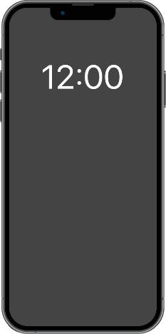
Introduction (continued)
Smartphone:
Mobile telephone with cellular and internet access
Tablet:
Portable computer that uses a touchscreen
Notes:
On the left, we see an iPhone, which is a kind of smartphone. A smartphone is a mobile telephone that has both cellular and internet access. Smartphones allow you to make and receive phone calls and text messages. Because they’re connected to the internet, they also have the capability to share photos, play videos or games, check and send email, and browse the web.
On the right, we see an iPad, which is a kind of tablet device. A tablet is a portable computer that uses a touchscreen. Most tablets are smaller and weigh less than a laptop computer but are usually bigger and weigh slightly more than a smartphone. Tablets connect to the internet through a Wi-Fi or cellular connection.

Slide 6
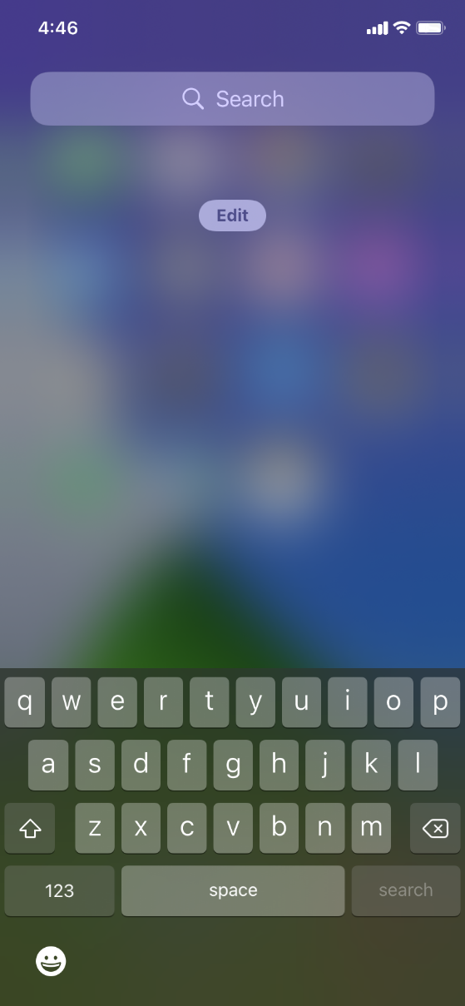


Touch Gestures
Notes:
A primary difference between a mobile device and a computer is the way you get around. Rather than using a mouse or keyboard, you use your fingers to tap, type, scroll, and more. You can also use your voice to help navigate your device.
INSTRUCTOR NOTE: If you have a mobile device, demonstrate these gestures on your phone.
Instead of clicking, you tap.
The keyboard is onscreen, and you type using that.
You scroll with your finger instead of using your mouse or pointer.

Slide 7
External Buttons
Ring/silent switch
Power button
Volume control
Notes:
INSTRUCTOR NOTE: If you have a mobile device, demonstrate these features on your phone, and encourage learners to find them on their own phones.
The ports and buttons on your smartphone or tablet will vary depending on the specific model you’re using. In general, phones and tablets have a power button and volume control. Smartphones typically have a ring/silent switch.

Slide 8
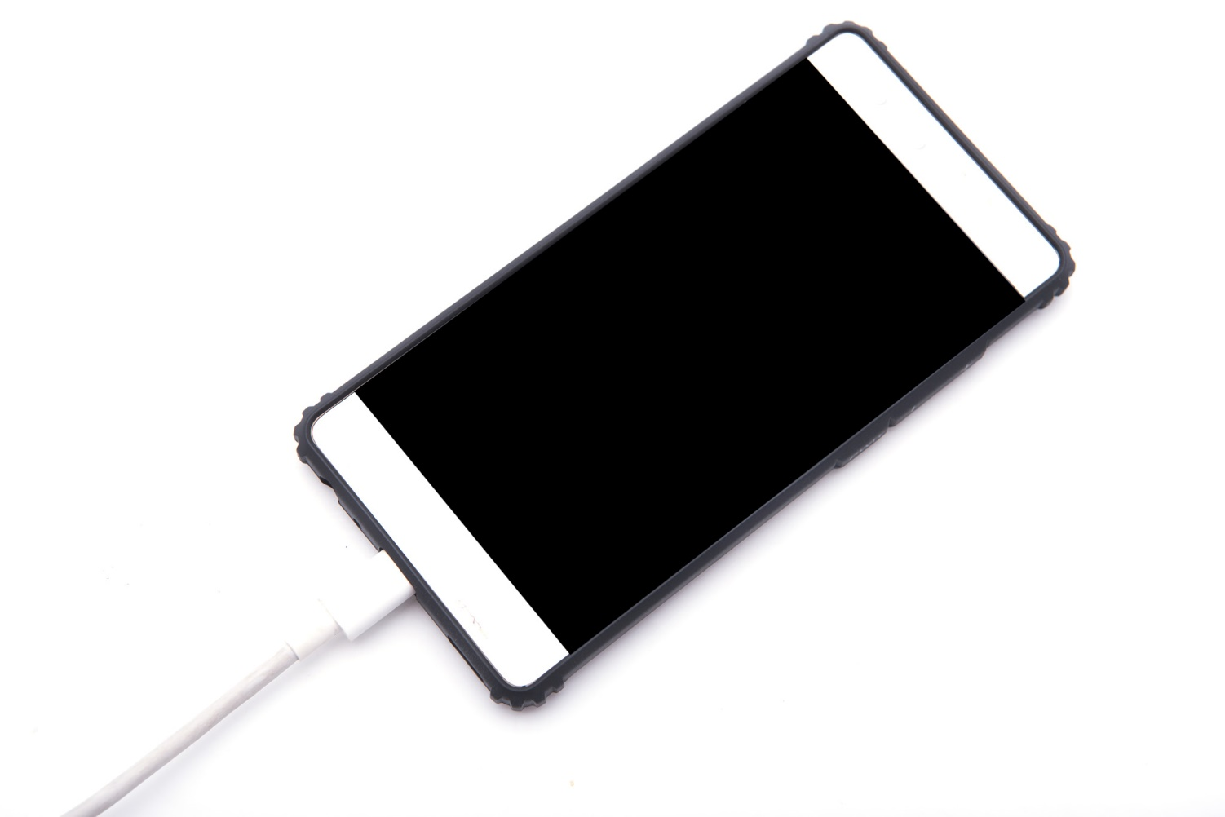
Charging Port
Notes:
INSTRUCTOR NOTE: If you have a mobile device, demonstrate the charging port on your phone, and encourage learners to find it on their own devices.
Both smartphones and tablets have a charging port.

Slide 9
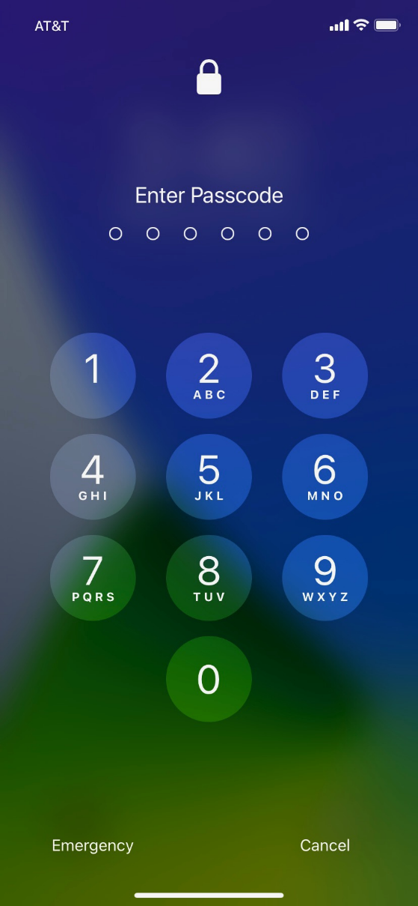
Unlocking Your Phone
Notes:
As we get started using the phone, the first thing we need to do is unlock the device. The way you do this depends on the choices you made when you set up your phone. You may have set up Face ID or a passcode. Depending on the iPhone you have, you may also have the option to use your fingerprint to unlock the phone.

Slide 10
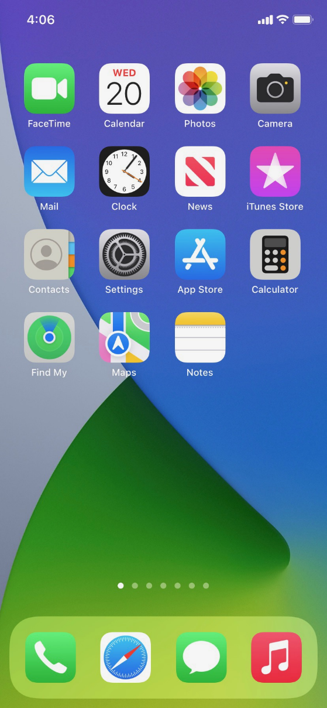
Home Screen
Notes:
INSTRUCTOR NOTE: Talking points for this slide include:
Home screen has built-in apps for your convenience.
Some apps are in the main part of the screen, and some are across the bottom of the screen.
Ask learners: What apps do you recognize? What apps have you used?
iPhones come with phone, messages, email, internet, camera, maps, clock, calendar, and more.
Top of screen includes status bar showing battery percentage, Wi-Fi, and cellular connection.

Slide 11
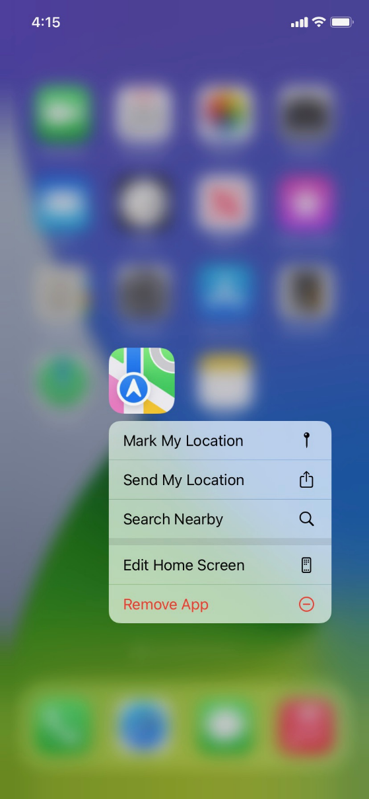

Tap | Tap and Hold
Notes:
INSTRUCTOR NOTE: If you have a mobile device, demonstrate the touch gestures of tapping and tapping and holding. This is just to show what a tap or tap and hold looks like with your finger, not to actually show your screen.
Tap your finger on the screen to activate a control, type on a keyboard, or select something on the screen. For example, you can tap on an app to open it. Give it a try. Go to the Maps app on your phone and open it. (To go back to the home screen, swipe up from the bottom of the screen. We’ll look at swiping again in a moment.)
Next, tap and hold with your finger to display a menu of options. In this example, if you tap and hold the Maps app icon, the menu opens. Give it a try. Go to any app on your phone, and then tap and hold. Do you see a menu appear?

Slide 12



Swipe Left/Right | Up/Down
Notes:
INSTRUCTOR NOTE: If you have a mobile device, demonstrate the swiping touch gestures. This is just to show what a swipe looks like with your finger, not to actually show your screen.
Swiping Left and Right: From the Apps view, you can swipe left to see more apps available on your phone. You can swipe left and right on many apps and websites to navigate around. From your Apps view, give this a try: swipe left across the screen to see the next page of apps.
Swiping Up and Down: Swiping up and down is what you do to scroll through apps and websites. You also use it to go back to the home screen from an open app.

Slide 13
Activity #1
Notes:
INSTRUCTOR NOTE: Point attendees to Activity 1 on Activity Sheet page 1.

Slide 14
ACTIVITY #1: External Buttons and Touch Gestures
Locate the button to turn on your phone. Turn your phone on.
Locate the buttons to turn your phone’s volume up and down. Turn the volume all the way down, then halfway up.
What do you do if you don’t want your phone to ring? Use the button to silence your phone.
How do you see all of your apps?
________________________________________
How do you scroll through a website?
________________________________________
Notes:
INSTRUCTOR NOTE: Walk around and support learners with the activity as needed. Demonstrate features on a device or use slide 13 as needed. When participants have finished the activity, talk through each item in the activity and answer questions as needed.
Answers to Questions 4 and 5: To see all of your apps, swipe left and right to page through all apps. To scroll through a website, you swipe up (to scroll down) and swipe down (to scroll up).

Slide 15
Common Apps
Notes:
INSTRUCTOR NOTE: In this section, you will introduce some of the most common apps on an iPhone. Encourage learners to use their own phones to follow along and explore the apps as you demonstrate them. Note that if learners are using tablets, they will be able to follow along with all apps except for the phone app.
Phones and tablets offer access to an almost unlimited number of apps. Apps are programs designed to help you accomplish different tasks.
When you turn on your phone and unlock it, you should see a screen that looks something like this one.
In this section of the workshop, I will introduce and talk about some of the most common apps on Apple devices shown here on the screen. Please follow along on your own device and briefly explore each of the apps.

Slide 16
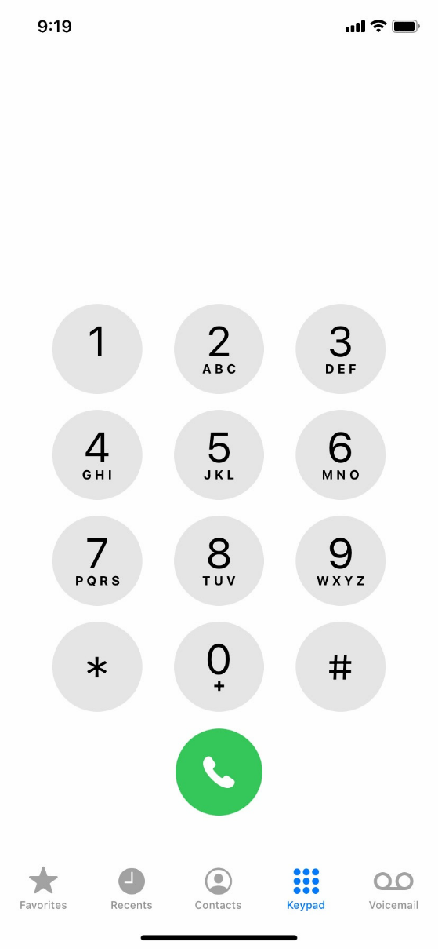
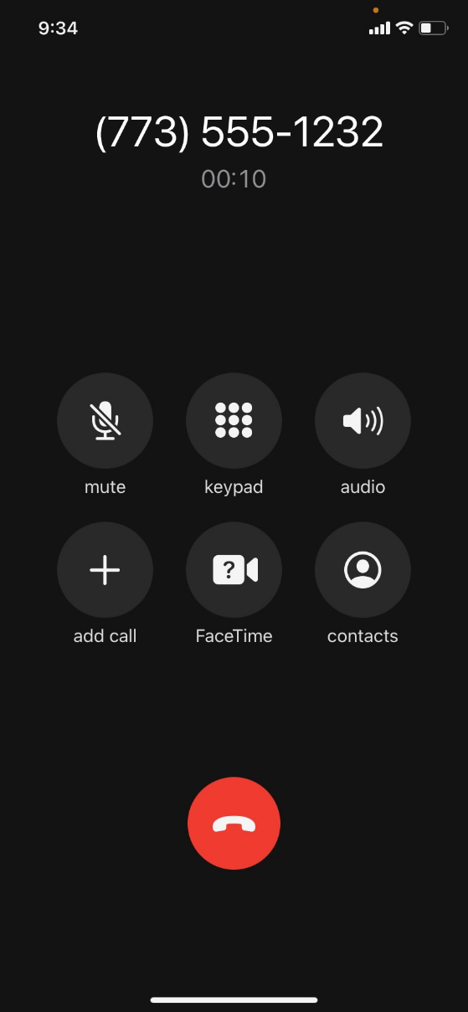
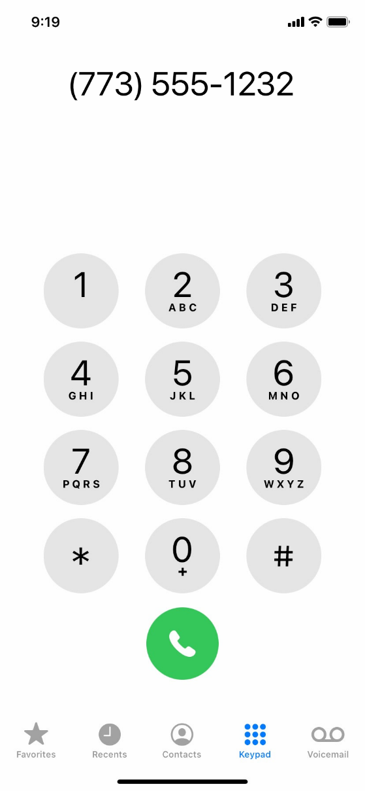
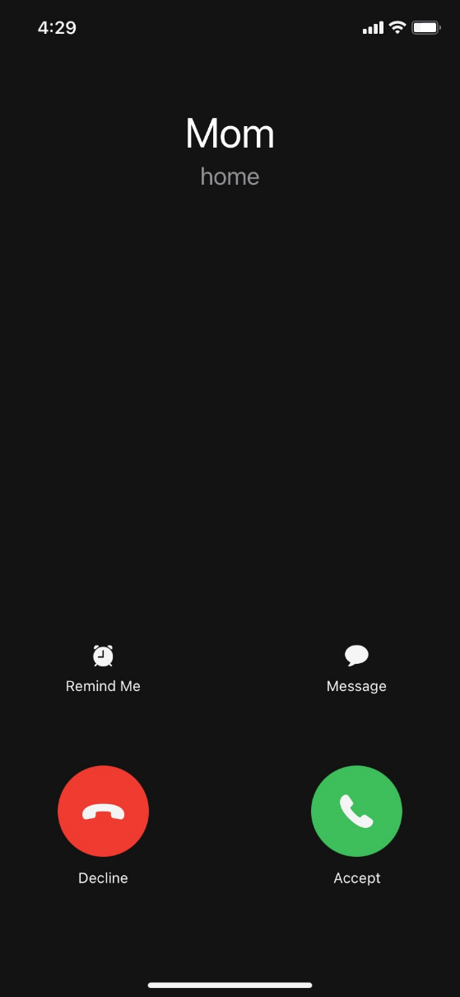
Phone
Notes:
The Phone app allows you to make and receive calls. To use it, tap on the app to open it.
INSTRUCTOR NOTE: Point out the Phone app, and then click ENTER to bring up the phone app image.
When the app opens, you’ll see the keypad. You’ll also see options to go to other screens for recent calls, your contacts, and more.
INSTRUCTOR NOTE: Point out these items in the bottom menu.
There are two main ways to make a call. You can tap the Contacts icon to select a name listed in your contacts app, or you can type a number on the keypad.
INSTRUCTOR NOTE: Press ENTER to advance to the next image.
After dialing a number, you’ll tap the green phone button to start the call.
INSTRUCTOR NOTE: Press ENTER to advance to the next image.
When you’re ready to hang up, tap the red phone button to end the call.
INSTRUCTOR NOTE: Press ENTER to bring up incoming call image.
To answer incoming calls, tap on Accept.

Slide 17
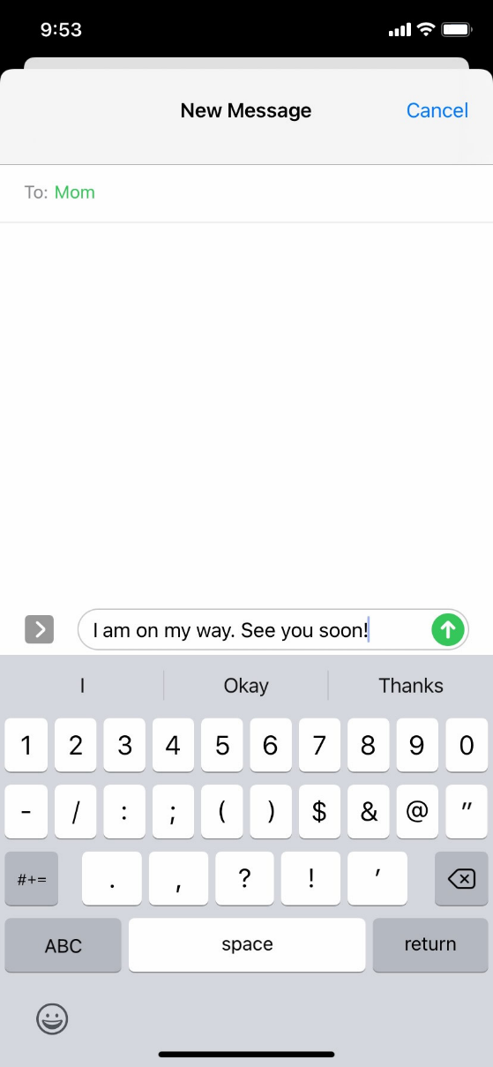
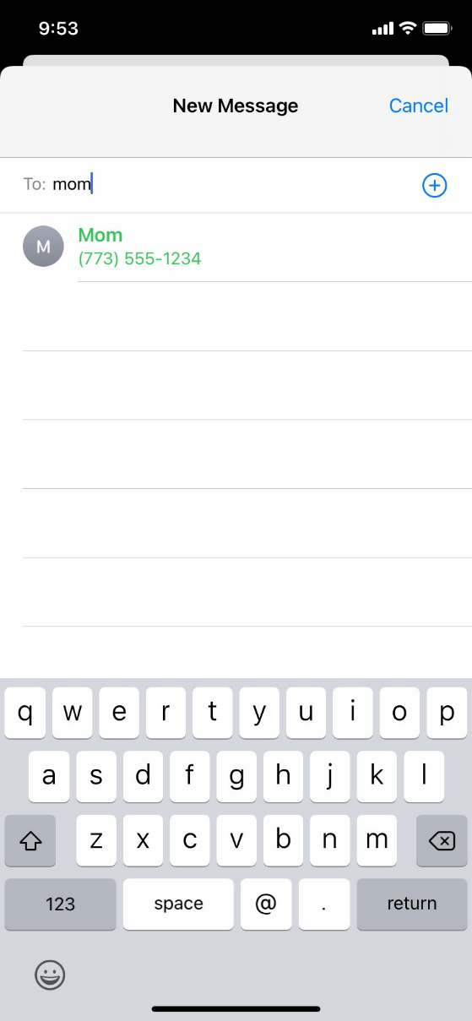
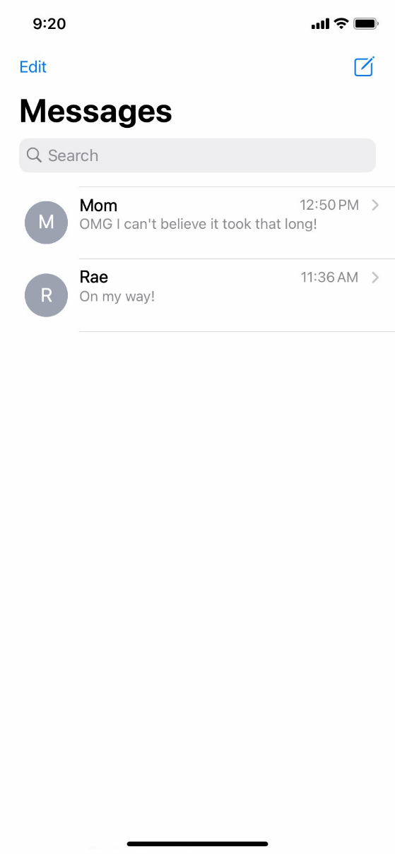
Messaging
Notes:
If you want to send a text message, you’ll use the Messages app. To open the app, tap on it on the home screen.
INSTRUCTOR NOTE: Point out the Messages app, and then click ENTER to bring up the Messages app image.
When you open the app, you’ll see your current conversations.
You can use the search box to search all your text messages. You can tap the Compose icon to start a new conversation, or you can tap a current conversation to send or read a new message and send a response.
INSTRUCTOR NOTE: Point out these items as you discuss them.
To create a new text message conversation, you’ll tap the Compose icon to start a conversation.
INSTRUCTOR NOTE: Press ENTER to bring up the next image.
You can send a text message to someone by typing their cell phone number in the To field. Or, if the person is in your contacts, you can begin to type their name. Once the name of the person displays, you’ll tap it to select it.
INSTRUCTOR NOTE: Press ENTER to bring up the next image.
Then you’ll type your message, and then tap the green arrow to send it.

Slide 18
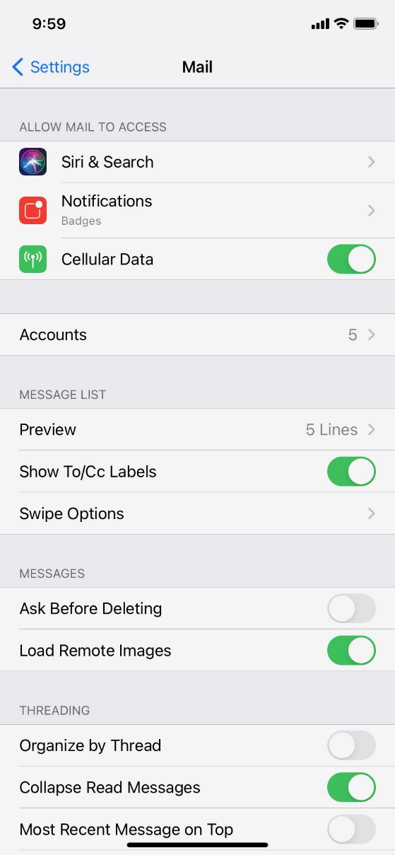
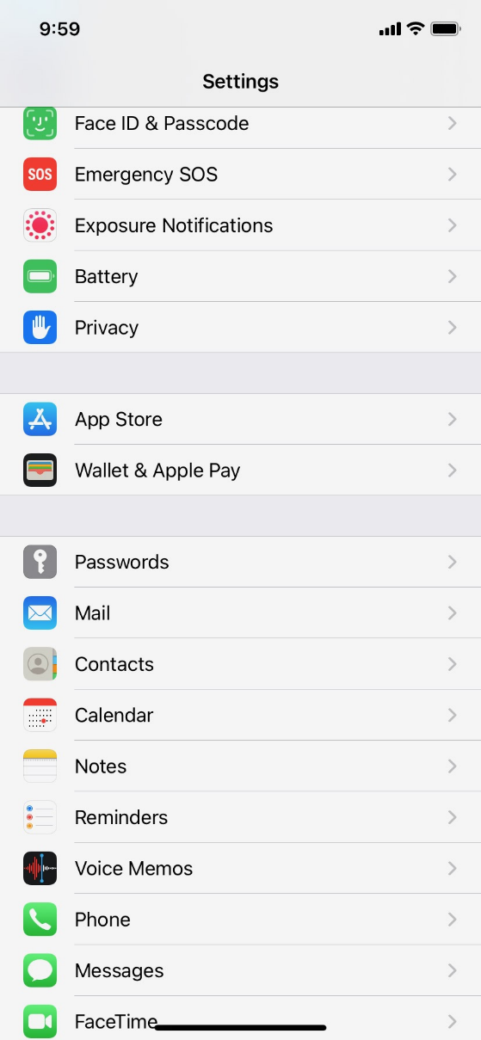
Email
Notes:
If you want to send or read an email, you’d use the Mail app.
INSTRUCTOR NOTE: Point out the Mail app.
But before you can receive or send an email, you must first set up your Mail app to connect to an email account. To set up an email account from the home screen, tap Settings.
INSTRUCTOR NOTE: Point out the Settings app, and then click ENTER to bring up the Settings app image.
Then you would scroll down and tap on Mail.
INSTRUCTOR NOTE: Press ENTER again to advance to the next image.
And then you’d click Accounts. We won’t go through these steps, but it’s helpful to know that you can add an email account from almost any email provider using the Settings app.

Slide 19
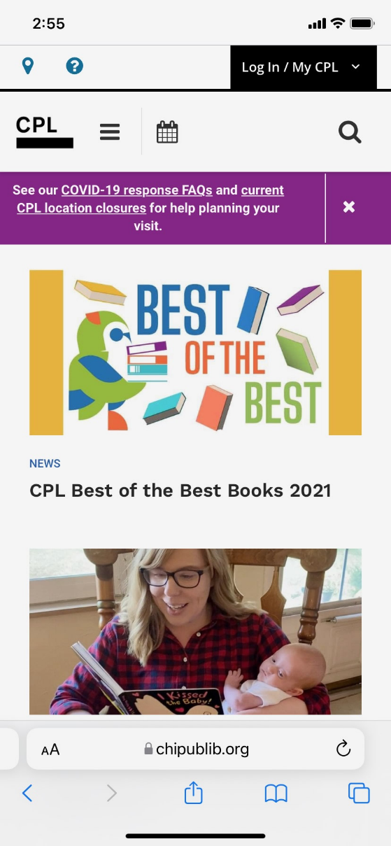
Browser
Notes:
When you want to search the web from your phone, tap the internet icon to launch a web browser. In this example, the web browser is Safari, which is included with the Apple device. This app works much like a web browser on a computer.
INSTRUCTOR NOTE: Point out the Safari app, and then press ENTER to bring up the browser image.
In this example, we can see the homepage of the library. You can search the web or visit a website using the address bar on the bottom.
INSTRUCTOR NOTE: Point out the address bar.
Once you have a webpage up in the browser, you can swipe up to scroll down the page.

Slide 20
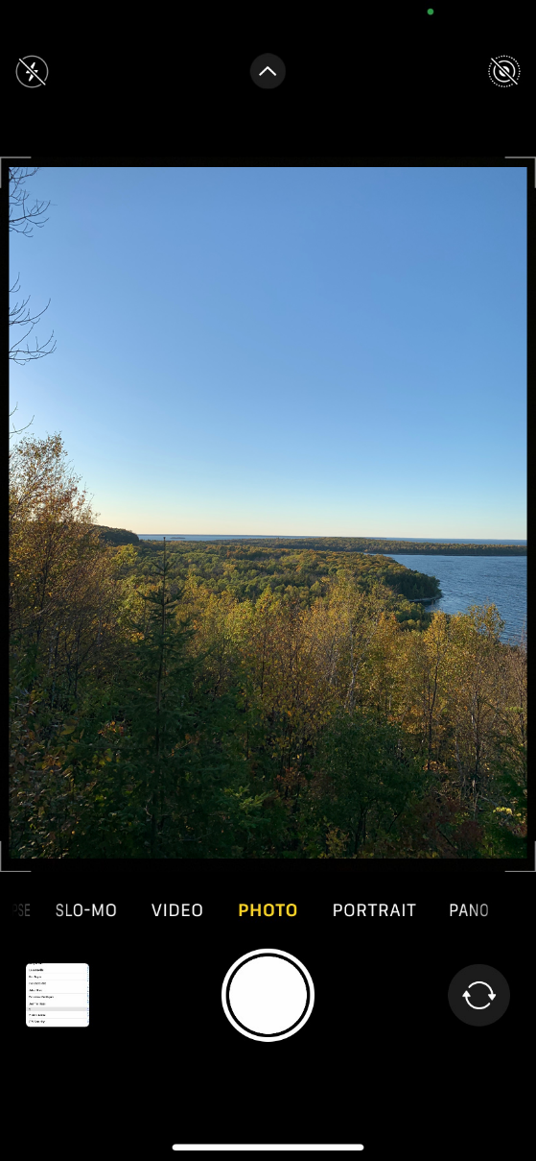
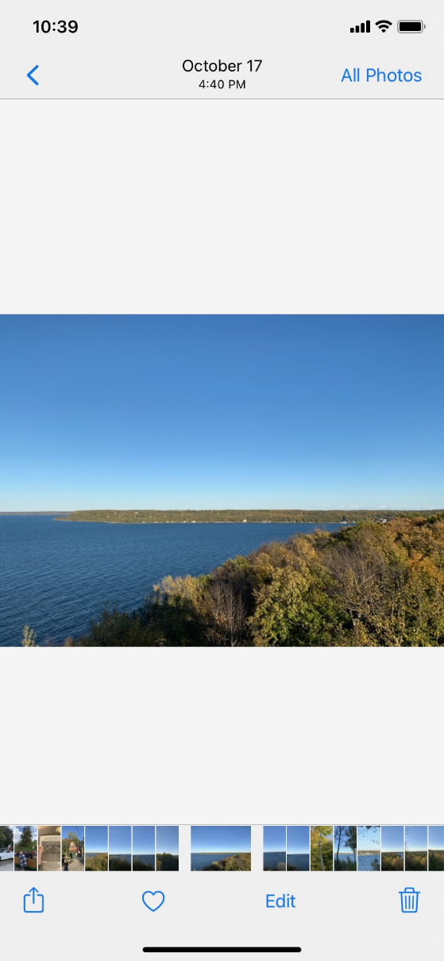
Camera
Notes:
When you want to take a picture or video, tap the Camera icon to launch the camera app.
INSTRUCTOR NOTE: Point out the Camera app, and then click ENTER to bring up the camera app image.
To take a picture or video, you would tap the button that’s shaped like a circle.
INSTRUCTOR NOTE: Point out the button.
You can scroll through this menu to switch between camera modes, including video, portrait, and panorama modes.
INSTRUCTOR NOTE: Point out these items as you discuss them. Then press ENTER again.
After you take a picture, you can click on the small image tile to view, edit, and share the image, or delete the photos and videos you’ve taken.
INSTRUCTOR NOTE: Point out these items as you discuss them.

Slide 21
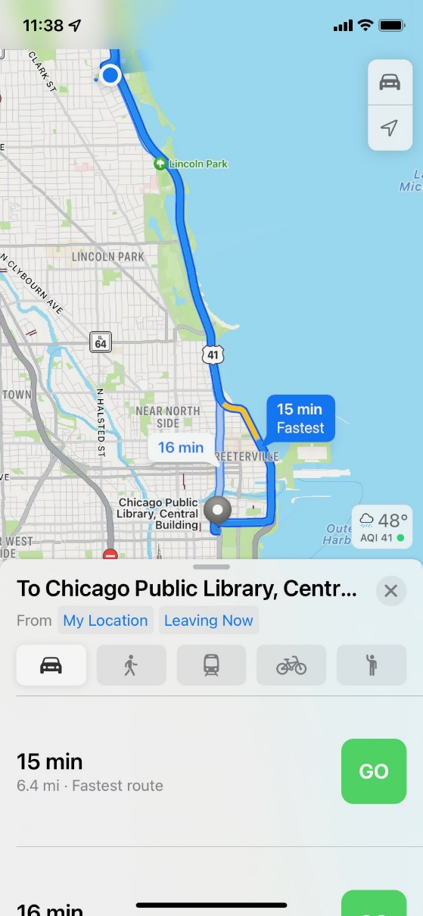
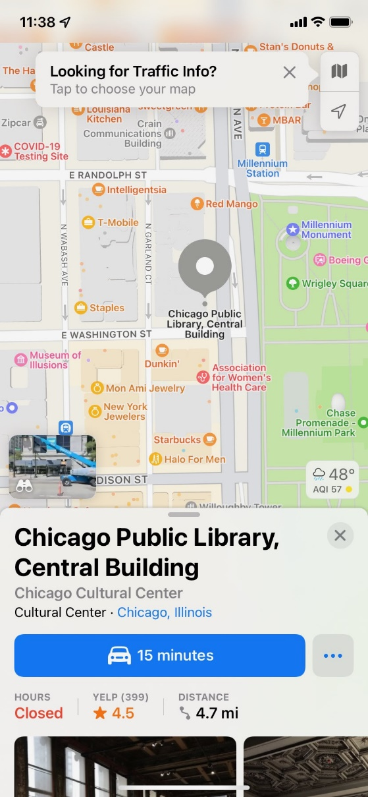
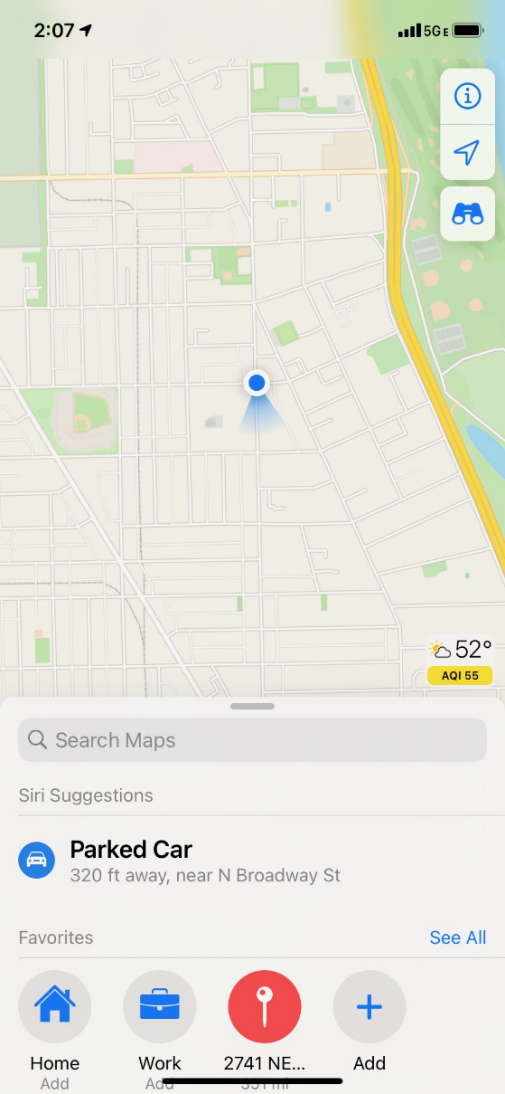
Maps
Notes:
When you want to find an address or get directions, you’ll tap the Maps icon to launch the Maps app.
INSTRUCTOR NOTE: Point out the Maps app, and then click ENTER to bring up the Maps app image.
To do a search, you would enter the location into the “Search Maps” box.
INSTRUCTOR NOTE: Press ENTER again to bring up the location.
Once you have the location on the screen, you would click the blue button to get directions to the location.
INSTRUCTOR NOTE: Press ENTER again to bring up directions.
From there, you can select directions for driving, walking, public transit, and more.
INSTRUCTOR NOTE: Point out these items as you discuss them.
To get live directions similar to a GPS, you must have a data plan and be connected to a cellular or Wi-Fi network. You may also need to give the app permission to view your location, or you can add your location manually.

Slide 22





Popular Categories of Apps
Games
Streaming Video
Streaming Music
Health and Fitness
Weather
Notes:
INSTRUCTOR NOTE: Ask participants: what other apps might you be interested in? Ask what apps they may know of in these popular categories, or others they come up with on their own (for example, Spotify or Pandora for music, Netflix or Hulu for streaming video, and so on.)

Slide 23
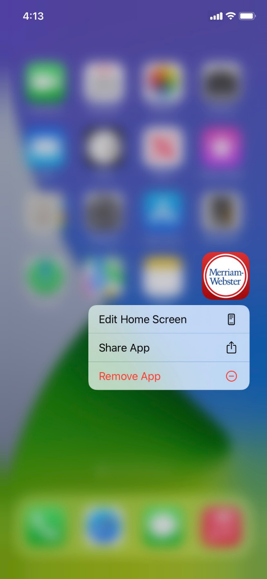
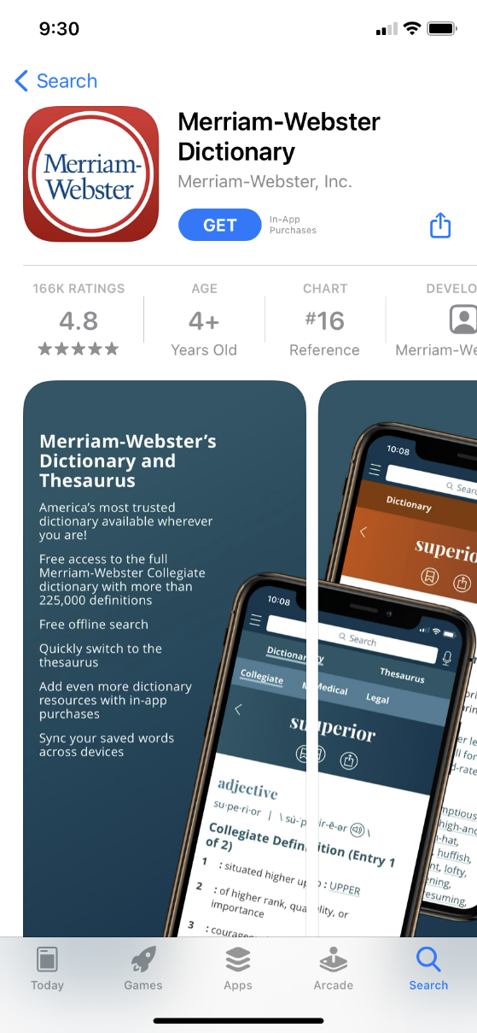
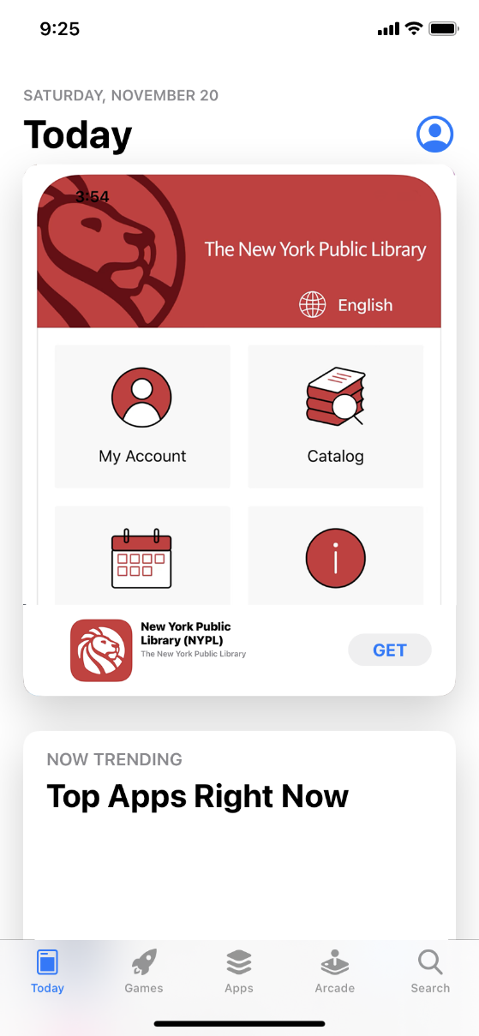
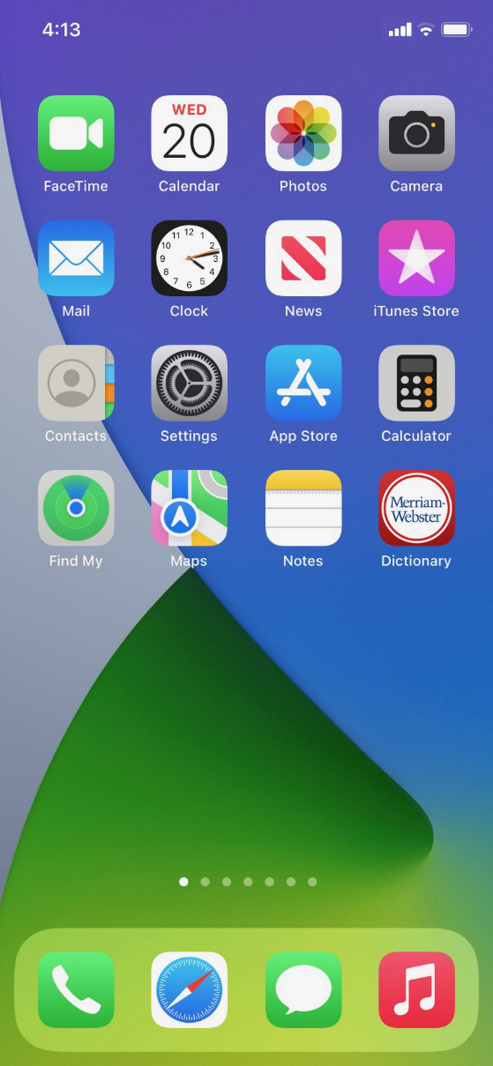
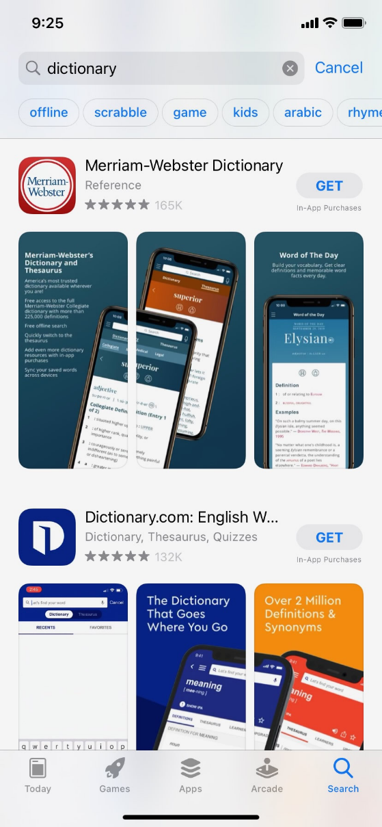
App Store
Notes:
To add new apps to an iPhone or iPad, tap the App Store icon located on the Home Screen.
INSTRUCTOR NOTE: Point out the App Store app, and then click ENTER to bring up the App Store image.
When the App Store is open, you can browse featured apps, look for games, or search for an app by name.
INSTRUCTOR NOTE: Point out these items as you discuss them. Then press ENTER again to bring up the results list.
Here we can see results from a search for a dictionary app. Let’s take a look at the first app in the list.
INSTRUCTOR NOTE: Press ENTER again to show the app screen.
If an app has a Get button instead of a price, like this example, the app is free. From this page you can learn more about the app, including preview pictures and customer reviews.
To install the app, you would click the Get button and follow the installation steps.
INSTRUCTOR NOTE: Press ENTER again.
Once the app downloads, it appears on the Home screen.
INSTRUCTOR NOTE: Press ENTER again to show the screen with the Remove App menu option.
To delete an app, tap and hold on the app. A menu will appear where you can remove the app.

Slide 24
Activity #2
Notes:
INSTRUCTOR NOTE: Point attendees to Activity 2 on Activity Sheet page 2.

Slide 25

ACTIVITY #2: Common Apps
What app do you use to:
Send an email? _______________________
Search the web? _____________________
Send a text? _________________________
Record a video? ______________________
Make a phone call? ____________________
How do you get back to the Home Screen when you have an app open?
Open the camera app and take a picture. Show the instructor the image you took.
Open the browser and search for the PLA Digital Learn website at https://www.digitallearn.org/. Scroll to the link Using a Mobile Device. Tap the link, and then show the instructor your screen.
Notes:
INSTRUCTOR NOTE: For the first six questions, ask learners the questions, and have them call out the answers. Encourage them to tap to open each of the apps. Consider asking one learner to show you their screen so you can check that learners are following along and are able to open the appropriate apps. Encourage learners without a device to answer using the Activity Sheet image.
What app do you use to:
Send an email? ________________________
Search the web? ______________________
Send a text? __________________________
Record a video? _______________________
Make a phone call? ____________________
How do you get back to the Home Screen when you have an app open? _________________________
Open the camera app and take a picture. Show the instructor the image you took.
Open the browser and search for the PLA Digital Learn website at https://www.digitallearn.org/. Scroll to the link Using a Mobile Device. Tap the link, and then show the instructor your screen.

Slide 26


Settings—Getting Connected
Cellular
Need a cellular service plan
Wi-Fi
All smartphones and tablets can connect to the Internet using Wi-Fi
Notes:
Mobile devices must be connected to a cellular or wireless network to access the internet and make calls. To connect your phone to a cellular network, you need to have a service plan with a cellular service provider. If you have a cellular plan, your phone will connect to the network automatically everywhere your cellular plan has coverage. You will know you are connected to the cellular network when you see the cell phone signal symbol to show the strength of the connection. The number of bars of the cellular connection lets you know how strong the signal is.
Another way you can connect your phone or tablet to the internet is by connecting to a Wi-Fi network. All smartphones and tablets can connect to the internet using Wi-Fi.
Many businesses, libraries, and other public places offer free Wi-Fi. You can use these public Wi-Fi networks while you visit these locations. Sometimes, you may need a password to access the network.
If you want to connect your iPhone or iPad to a Wi-Fi network in your home, you will need to sign up with an internet service provider (ISP).

Slide 27
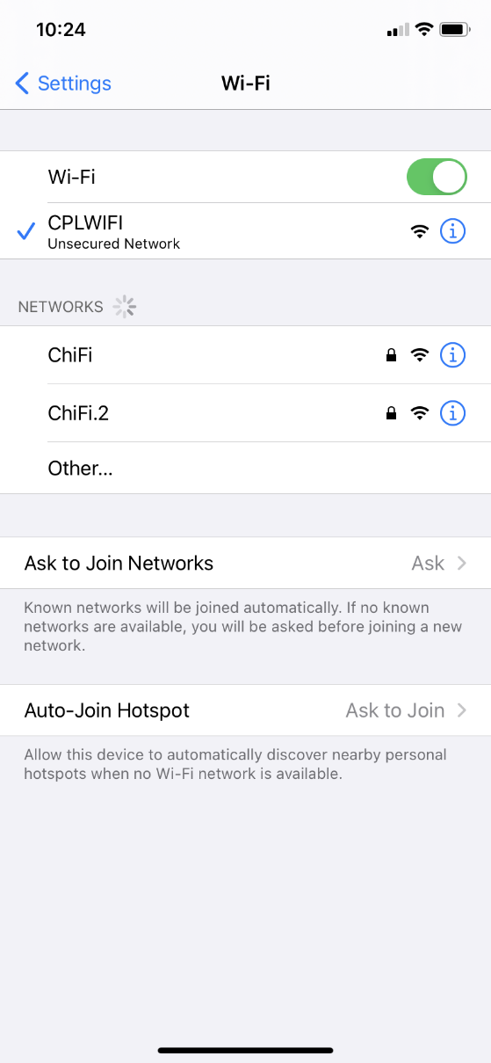
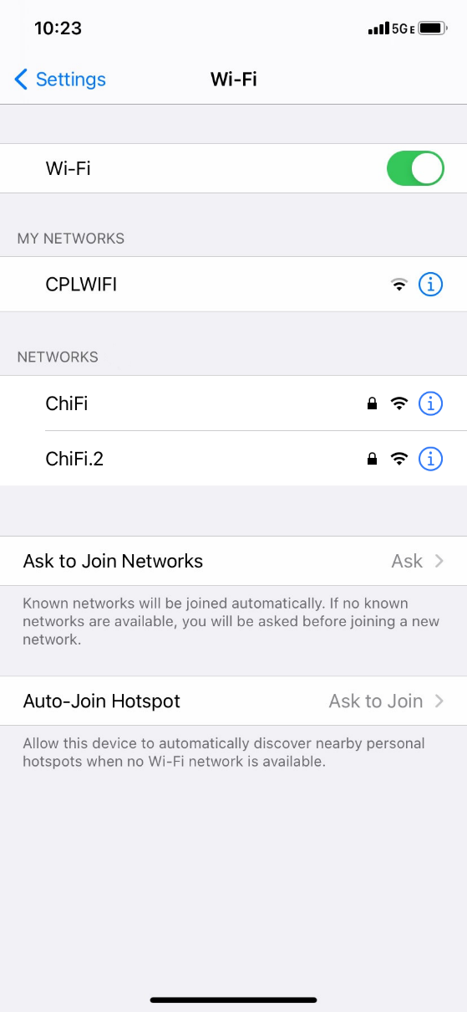
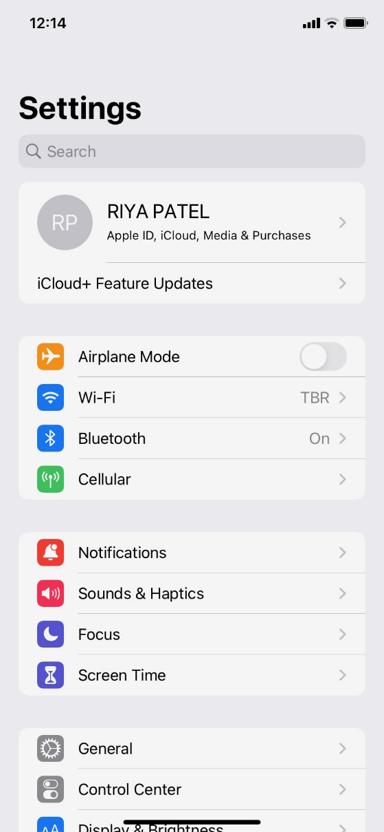
Getting Connected
Wi-Fi:
Notes:
INSTRUCTOR NOTE: Please edit this slide to add a text box with information on the Wi-Fi at your location, for learners to connect to.
If you want to connect to Wi-Fi, you’ll click on Settings on the Home Screen.
INSTRUCTOR NOTE: Point out the Settings app, and then click ENTER to bring up the Settings App image.
Then you’ll tap on Wi-Fi.
INSTRUCTOR NOTE: Point out Wi-Fi on the image. Then press ENTER again to bring up the next screen.
A list of Wi-Fi networks that are nearby display. Networks with a lock icon require a password. Networks without a lock are public and do not need a password. Some public networks may ask you to accept an agreement before they will allow you to connect your device.
Once you are connected to the Wi-Fi network, you will see the Wi-Fi icon in the status bar at the top of your device.
INSTRUCTOR NOTE: Point out the Wi-Fi icon on the status bar.

Slide 28


Wi-Fi Security Tips
Make sure you trust a network before connecting.
Try not to send private information over public Wi-Fi networks.
If you send personal information, make sure the website is secure
and begins with https.
Set up a password for your home network to block intruders
from accessing it.
Notes:
To keep your information safe when you connect to Wi-Fi, follow these Wi-Fi security tips.
INSTRUCTOR NOTE: Press ENTER to see bullet 1.
Make sure you trust a public network before connecting to it. Do you know who set up the network?
INSTRUCTOR NOTE: Press ENTER to see bullet 2.
Try not to send private information over public Wi-Fi networks.
INSTRUCTOR NOTE: Press ENTER to see bullet 3.
If you do send personal information, make sure the website is secure and begins with https.
INSTRUCTOR NOTE: Press ENTER to see bullet 4.
Set up a password for your home network to block intruders from accessing it.

Slide 29
Activity #3
Notes:
INSTRUCTOR NOTE: Point attendees to Activity 3 on Activity Sheet page 3.

Slide 30
ACTIVITY #3: Getting Connected
Navigate to the available Wi-Fi-Networks screen on your device. Write down what steps you took to get there.
__________________________________________________________
__________________________________________________________
Write down one of the networks that is secure (if applicable).
__________________________________________________________
Write down one that is public (if applicable).
__________________________________________________________
Notes:
INSTRUCTOR NOTE: Check the public and secured Wi-Fi options using your own device. Use this information to discuss learners’ answers about which networks are secure and which are public. Remember: Networks with a lock icon are secure and require a password. Networks without a lock icon are public and do not need a password.
If a learner doesn’t have their own device, they can use the image on the Activity Sheet to write down a secure network and a public network.

Slide 31
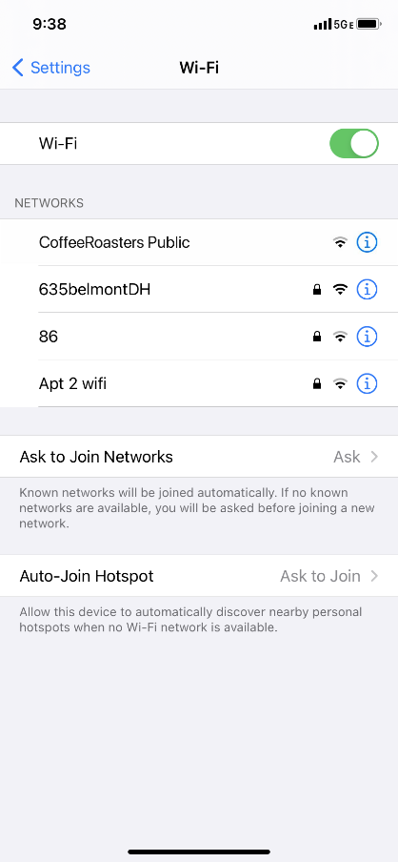
You’re relaxing in a coffee shop. You want to connect to Wi-Fi and do some personal tasks on your smartphone. On your phone, you see this list of Wi-Fi networks. Which would you connect to? Why or why not?
___________________________________________
___________________________________________
You want to do some online banking at the coffee shop. Is this a good idea on the Wi-Fi network you’re on? Why or why not?
________________________________________________
________________________________________________
Notes:
INSTRUCTOR NOTE: Talk through the questions on the scenario of using Wi-Fi in a coffee shop.
You’re relaxing in a coffee shop. You want to connect to Wi-Fi and do some personal tasks on your smartphone. On your phone, you see a list of Wi-Fi networks. Which would you connect to? Why or why not?
Answer: They would want to use the public Wi-Fi “CoffeeRoasters Public” because it’s free, but they would want to be careful about what personal tasks they are engaging in.
You want to do some online banking at the coffee shop. Is this a good idea on the Wi-Fi network you’re on? Why or why not?
Answer: It’s a bad idea to do banking on a public network. It’s best to wait to do banking on a private network where you know and trust the person who set up the network.

Slide 32
Settings—Security, Privacy, and Accessibility
Notes:
In the Settings app…
INSTRUCTOR NOTE: Press ENTER to bring up the next image
…you can view and change the settings on your mobile device, including accessibility features, biometrics and security preferences, software updates, and more.

Slide 33
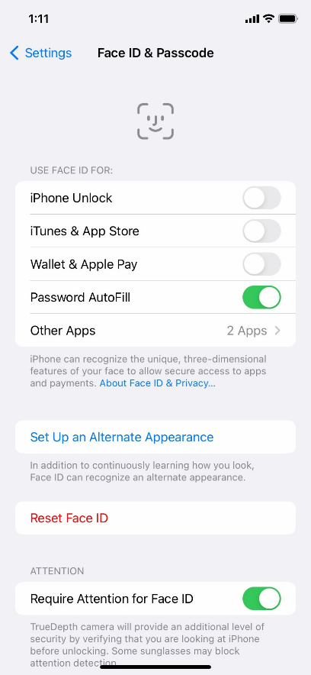
Unlocking Your Phone
What method are you using to lock and unlock your phone?
Notes:
INSTRUCTOR NOTE: Lead a brief discussion with learners: What method are you using to lock and unlock your phone?
Possible methods: PIN, passcode, Face ID, iris scan, or fingerprint
Mobile devices come with settings to help protect your device and your information. One of the most important things you can do is set a personal identification number (PIN) or passcode to access and use your mobile device. This will help protect the data that is stored on your device if the device is ever lost or stolen. Each time you turn on your device or wake up the screen, you will see a prompt to unlock it.

Slide 34
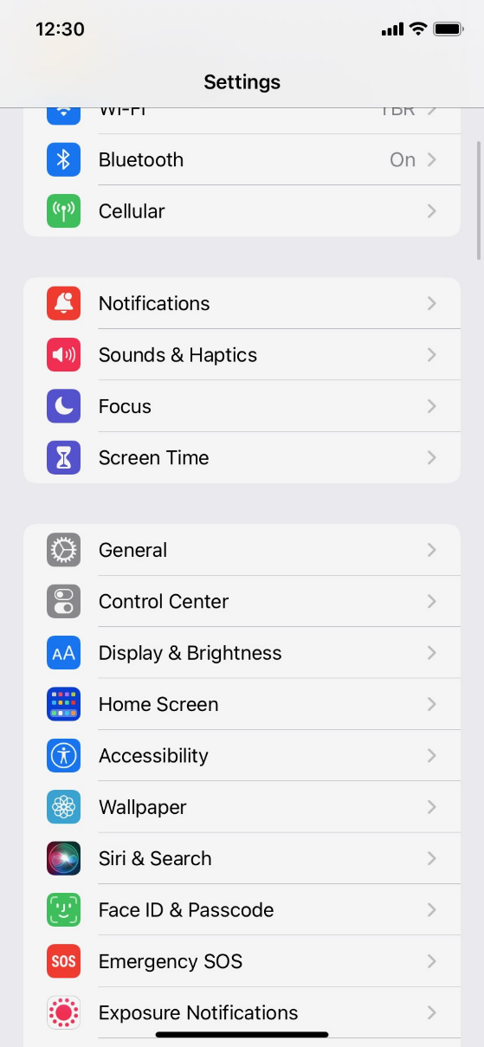

PIN or Passcode
Notes:
To set a pin or passcode, tap Settings.
INSTRUCTOR NOTE: Press ENTER to bring up the next screen.
Then look for the option for Face ID & Passcode.
INSTRUCTOR NOTE: Press ENTER again to bring up the next screen.
You’ll find the options there.
You can also unlock your phone using Face ID, iris scan, or on some models, a fingerprint. You would need to follow the prompts to store that information in your Settings before you can enable this feature.
INSTRUCTOR NOTE: Please recommend that learners explore these features on their own after the workshop. The Learner Handout includes this recommendation.

Slide 35
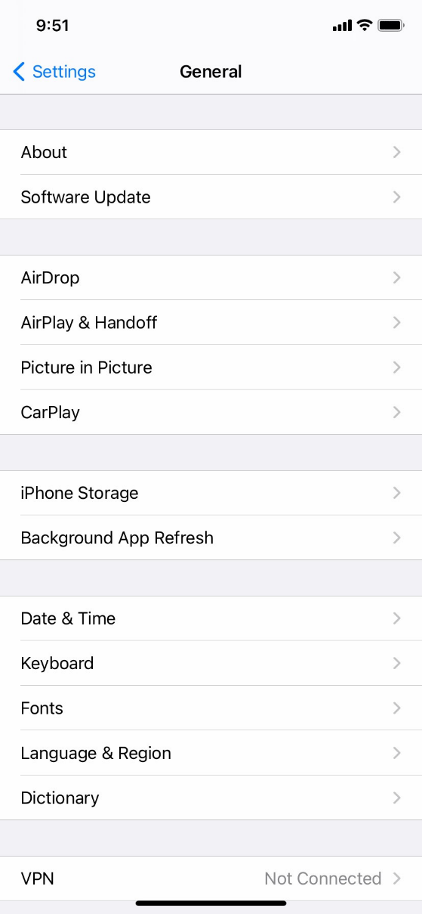
App Security
Notes:
Many apps on mobile devices have regular updates. Sometimes the updates have new features, but most importantly, updates fix bugs and problems and increase security.
You can see app and operating system update settings by going to Settings…
INSTRUCTOR NOTE: Press ENTER to bring up the next screen.
…then tapping General…
INSTRUCTOR NOTE: Press ENTER to bring up the next screen.
…then tapping Software Update. You’ll be able to see if there are any software updates to install. If there are, you can follow the prompts on the screen to install the updates.

Slide 36
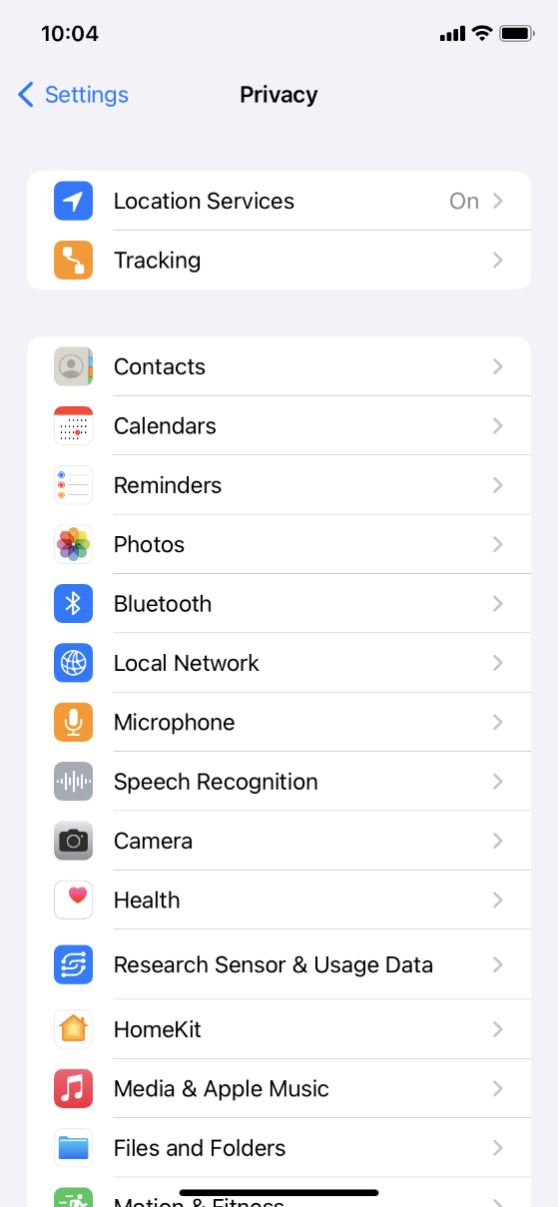
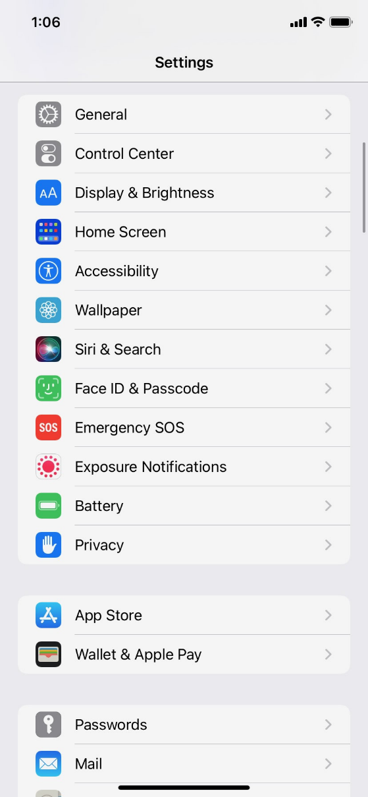
Privacy
Notes:
Privacy settings are also important for mobile devices. Using your phone’s privacy settings, you can decide which apps have access to information and data stored on your device, such as your location, photos, and microphone.
To access the privacy settings, tap the Settings icon.
INSTRUCTOR NOTE: Press ENTER to bring up the next screen.
Then scroll down and tap Privacy.
INSTRUCTOR NOTE: Press ENTER to bring up the next screen.
You can adjust settings for Location Services and Tracking. Also, you can change which apps can have access to specific features on your phone, such as contacts, photos, microphone, camera, and more.
INSTRUCTOR NOTE: Please recommend that learners explore these features on their own after the workshop. The Learner Handout includes this recommendation.

Slide 37
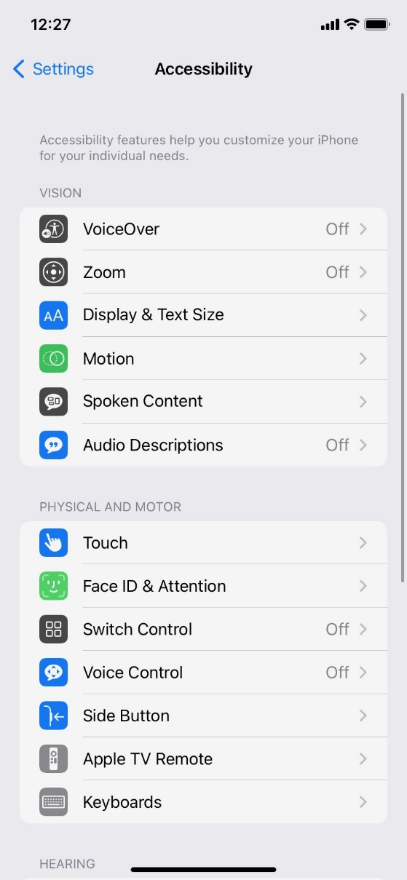
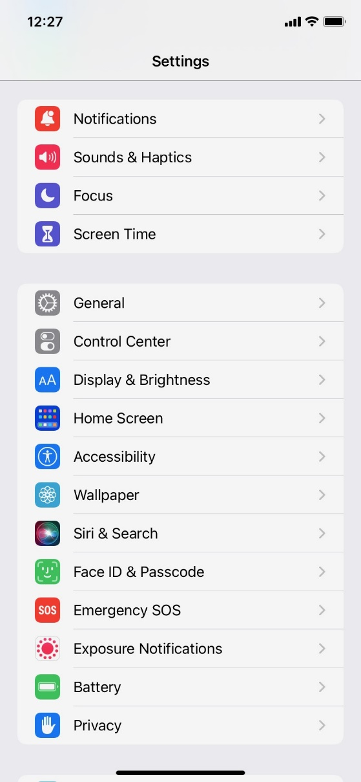





Accessibility
Notes:
Accessibility settings on your mobile device can help you customize your phone to meet your visual, physical, motion, or hearing needs. To find the Accessibility features, tap Settings.
INSTRUCTOR NOTE: Press ENTER to bring up the next screen.
Then scroll down the page and tap Accessibility.
INSTRUCTOR NOTE: Press ENTER to bring up the next screen.
INSTRUCTOR NOTE: Press ENTER to bring up examples.
Common features to explore include a voice assistant to get spoken guidance to navigate the device without needing to see the screen; changing text size, contrast, and display color of the screen; adjusting audio settings; and enhancing or changing the touch interactions.
INSTRUCTOR NOTE: Please recommend that learners explore these features on their own after the workshop. The Learner Handout includes this recommendation.

Slide 38
Activity #4
Notes:
INSTRUCTOR NOTE: Point attendees to Activity 4 on Activity Sheet page 4.

Slide 39
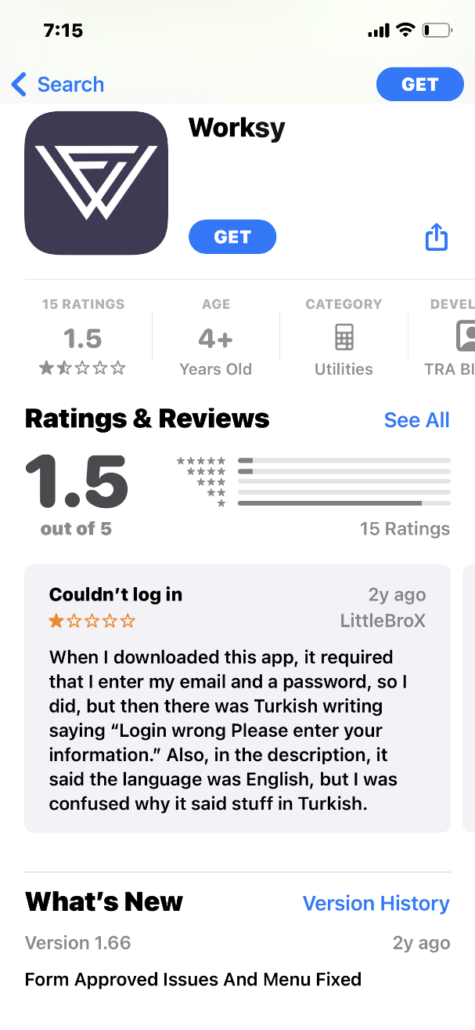
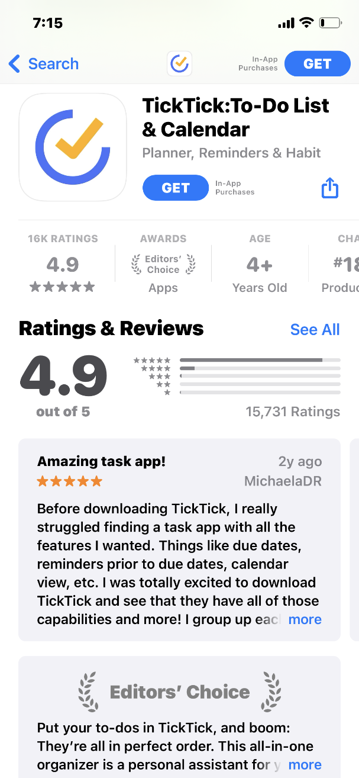
Which of these apps seems more trusted?
Notes:
INSTRUCTOR NOTE: When learners have completed the activity, lead a discussion on what people came up with.
Which of these apps seems more trusted? How do you know?
Answer: The second one (on the right) is the more trusted. In the first app, the reviews average 1.5. The reviews discuss issues with logging in. The second app has very good reviews and it has received an Editor’s Choice award. It also tells you that there are in-app purchases (this information increases trust).

Slide 40
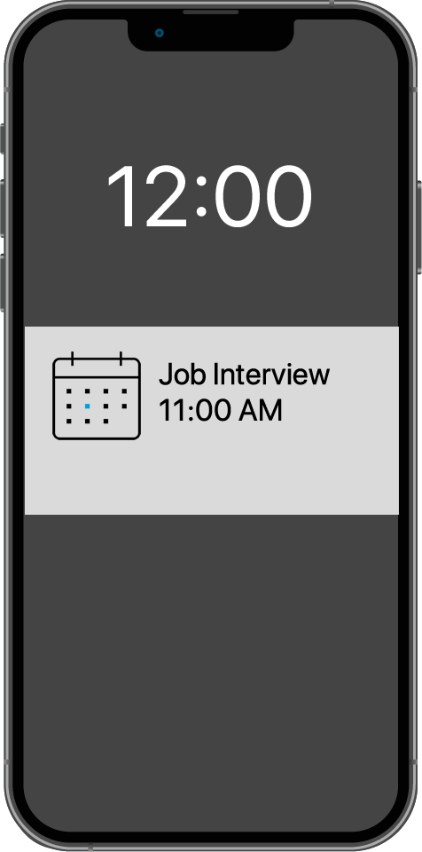
What might be a problem? How could you address it?
Notes:
Imagine you’re at work talking with some coworkers. Even though your phone is locked, you receive this notification. What might be a problem in this situation? How could you address this problem?
Answer: The problem is that you may want this information to be kept private, especially if coworkers could see it. Do you want your coworkers to know you have a job interview? To address this problem, you would go to Settings and then Privacy Settings. Then you would change your notification settings.
INSTRUCTOR NOTE: Allow learners a few minutes to find this setting on their phone and support them as needed.

Slide 41
Security Tips
Set a passcode on all of your devices.
Download trusted apps only.
Review your privacy settings and adjust them.
Adjust notifications to change what appears on the lock screen.
Check that apps and the operating system are up to date.
Notes:
Here are some security tips to keep you safe when using your mobile device.
INSTRUCTOR NOTE: Press ENTER to bring up bullet 1.
Set a passcode on all of your mobile devices to prevent someone from accessing the information stored on the device if it is lost or stolen.
INSTRUCTOR NOTE: Press ENTER to bring up bullet 2.
Download trusted apps only. You can determine this by reading reviews, ratings, and privacy statements.
INSTRUCTOR NOTE: Press ENTER to bring up bullet 3.
Review the privacy settings on your device. Adjust your settings to control which apps have permission to access your camera, location, microphone, and personal information.
INSTRUCTOR NOTE: Press ENTER to bring up bullet 4.
Adjust your notifications to change how much content will display on the lock screen when messages come in.
INSTRUCTOR NOTE: Press ENTER to bring up bullet 5.
Check that the apps and operating system are running the most up-to-date versions available, or set these to automatically update.

Slide 42
Activity #5
Notes:
In this activity, we’ll practice what we’ve covered and see what everyone has learned.
INSTRUCTOR NOTE: Lead the group in the following activity and have learners respond as a group.

Slide 43

If you want to open an app on your phone, what do you need to do?
Notes:
If you want to open an app on your phone, what do you need to do?
INSTRUCTOR NOTE: Press ENTER to bring up the next screen.
Answer: You would tap the app to open it.

Slide 44
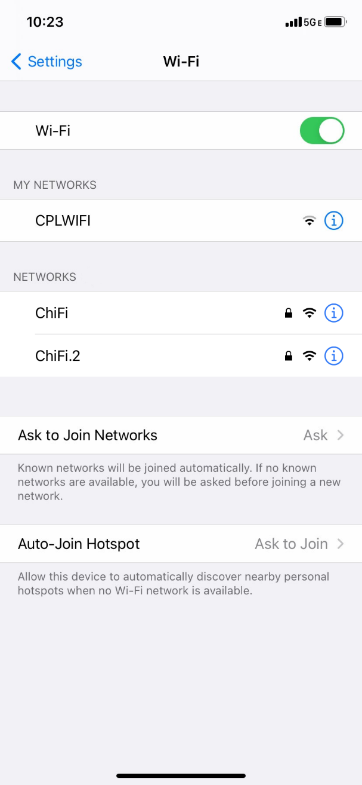

Which Wi-Fi network does not require a password?
Notes:
Which Wi-Fi network does not require a password?
INSTRUCTOR NOTE: Press ENTER to bring up the next screen.
Answer: The network that doesn’t have a lock icon doesn’t need a password.

Slide 45
To keep your information safe when connecting to a Wi-Fi network, what should you do?
Only connect to public Wi-Fi networks you trust.
Don’t send private information over public Wi-Fi networks.
Use secure websites that begin with https.
All of the above.
Notes:
To keep your information safe when connecting to a Wi-Fi network, what should you do?
Answer: All of the above

Slide 46
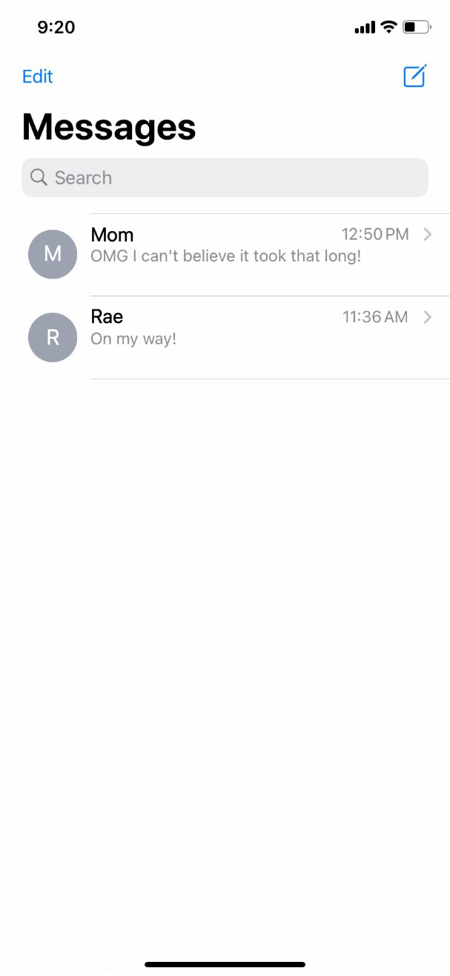

What icon would you click to start a new text message?
Notes:
What icon would you click to start a new text message?
INSTRUCTOR NOTE: Press ENTER to bring up the next screen.
Answer: You would tap the Compose icon.

Slide 47

If you want to search the web, what app would you use?
Notes:
If you want to search the web, what app would you use?
INSTRUCTOR NOTE: Press ENTER to bring up the next screen.
Answer: You would use the Safari icon, which is the web browser that comes with the iPhone and iPad.

Slide 48

If you want to download an app on your phone, what do you need to do?
Notes:
If you want to download an app on your phone, what do you need to do?
INSTRUCTOR NOTE: Press ENTER to bring up the next screen.
Answer: You would tap on the App Store icon to find the app and download it.

Slide 49
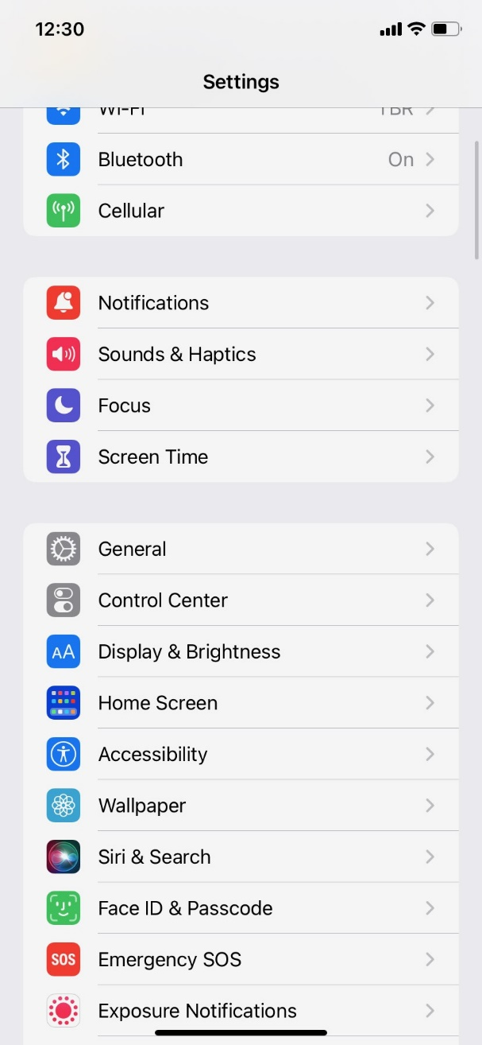

If you want to set a passcode to protect your device and information, what would you do?
Face ID & Passcode
Notes:
If you want to set a passcode to protect your device and information, what would you do?
INSTRUCTOR NOTE: Press ENTER to bring up the next screen.
Answer: You would go to Settings and click on Face ID and Passcode.

Slide 50
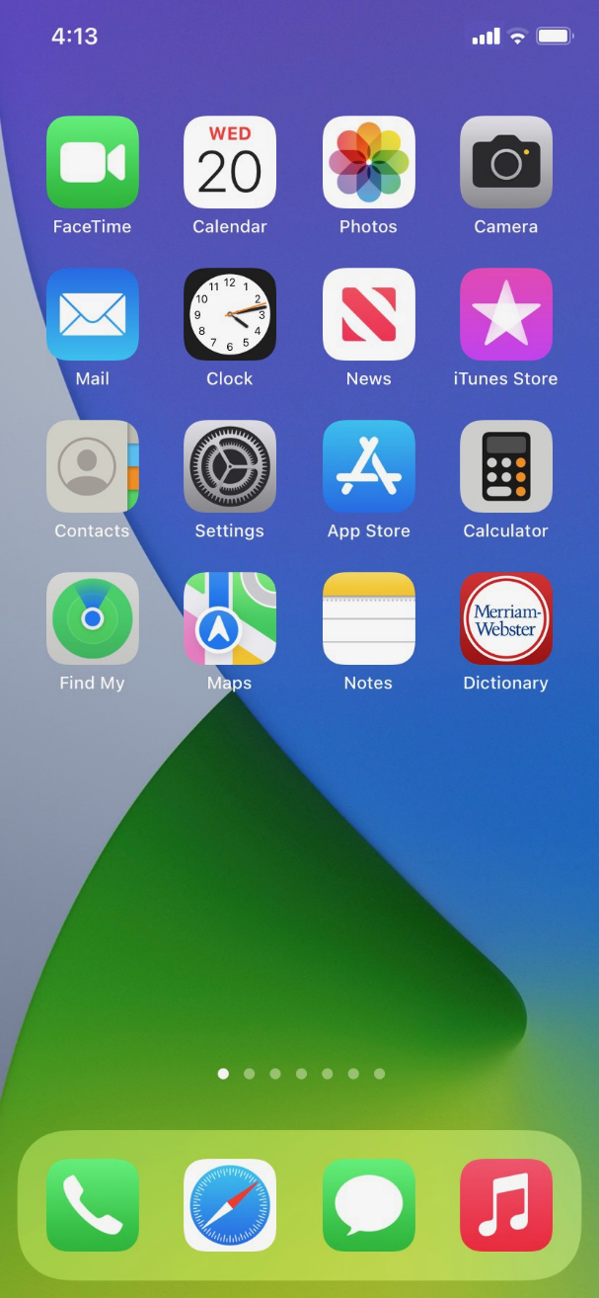

If you no longer want the dictionary app on your phone, what do you do?
Notes:
If you no longer want the dictionary app on your phone, what do you do?
INSTRUCTOR NOTE: Press ENTER to bring up the next screen.
Answer: You would tap and hold on the app to open the menu.

Slide 51
Questions
Anything you want to ask or clarify before we end?
Notes:
INSTRUCTOR NOTE: Ask if there are any other final questions and answer any outstanding ones that may have been missed in the parking lot sections.

Slide 52
Congratulations!
Today you
  Learned about iPhone and iPad mobile devices
  Built skills to:
    Navigate your device
    Get connected to Wi-Fi
    Identify common apps
    Identify helpful settings
  Learned useful tips to connect to Wi-Fi and use your device safely
Notes:
Congratulations! Today you have
Learned about iPhone and iPad mobile devices
Built skills to:
Navigate your device
Get connected to Wi-Fi
Identify common apps
Identify helpful settings
Learned useful tips to connect to Wi-Fi and use your device safely
INSTRUCTOR NOTE: Provide each learner with a Certificate of Completion.

Slide 53
Today’s training is provided by AT&T and the Public Library Association.
Visit <insert library’s URL here> and https://www.digitallearn.org for more courses and to build confidence using technology.
Notes:
INSTRUCTOR NOTE: Point the learners to additional courses that are available. Draw learners’ attention to the website address in the slide.

Slide 54
Thank you for coming!
THANK YOU FOR COMING!
Provided by AT&T and the Public Library Association.
Notes:
Thanks again to AT&T and PLA for this workshop. We appreciate all our participants for coming and we encourage you to keep learning!

