Slide 1

Mobile Device Basics—Android
Instructor Name
Instructor Title
Library Name
Insert Library Logo Here
Provided by AT&T and Public Library Association
Notes:
INSTRUCTOR NOTE: Please update this slide with the appropriate information:
Instructor name
Instructor affiliation (for instance, AT&T employee, library staff member, community volunteer, etc.)
Location name
INSTRUCTOR NOTE: Before the workshop, please review the Instructor Outline for guidance on what to do to prepare for the workshop. You’ll find notes on how to conduct the workshop and details on what you should do once the workshop ends.
INSTRUCTOR NOTE: Please use the Volunteer Instructor Guide for talking points for the presentation. In that document, slide notations begin on page 6.
Today’s workshop is provided by AT&T and the Public Library Association.
INSTRUCTOR NOTE: Include thank-you to community collaborator if applicable.
My name is <your name here> and I am <brief description of yourself>. Before we get started here are a few housekeeping items: <mention the items that are relevant to your workshop>:
Where are the restrooms?
Where are the emergency exits?
When/how to ask questions—Note where to locate the page number on each slide for participants to include when they have questions to ask later.
If you have a cell phone with you, please make sure to either turn it off or set to silent.
Will there be a break?

Slide 2
Today’s Agenda
Introduction
Skill Building
  Navigating Your Device
  Getting Connected
  Common Apps
  Helpful Settings
Tips and Tricks
Practice
NOTE: This workshop is specific to Android mobile devices and Android’s operating system. If you are interested in another operating system, please visit dititalliteracy.att.com or consider another workshop being offered.
Notes:
In this workshop you will learn about mobile devices in general and Android devices in particular. We’ll work on building skills and confidence in using your Android device. This will include:
An introduction to mobile devices
Skill building, including . . .
Navigating your mobile device
Common apps on mobile devices
Getting connected to Wi-Fi on your device
Helpful device settings for accessibility and privacy
You’ll also learn tips and tricks for safety and security with your device. And you will have opportunities to practice.
INSTRUCTOR NOTE: Please remind participants: This workshop is specific to Android mobile devices and Android’s operating system. If you are interested in another operating system, please visit dititalliteracy.att.com or consider another workshop being offered.
Let’s get started!

Slide 3

Introduction
What brings you to this workshop?
Do you have a mobile device and you want to learn more about it?
Are you thinking about getting an Android mobile device?
Notes:
INSTRUCTOR NOTE: Ask learners the question on the slide. Lead a brief discussion on why they’re attending the workshop. Possibilities include that they have an Android device and want to learn more, or that they’re in the process of deciding on whether to buy an Android device.

Slide 4
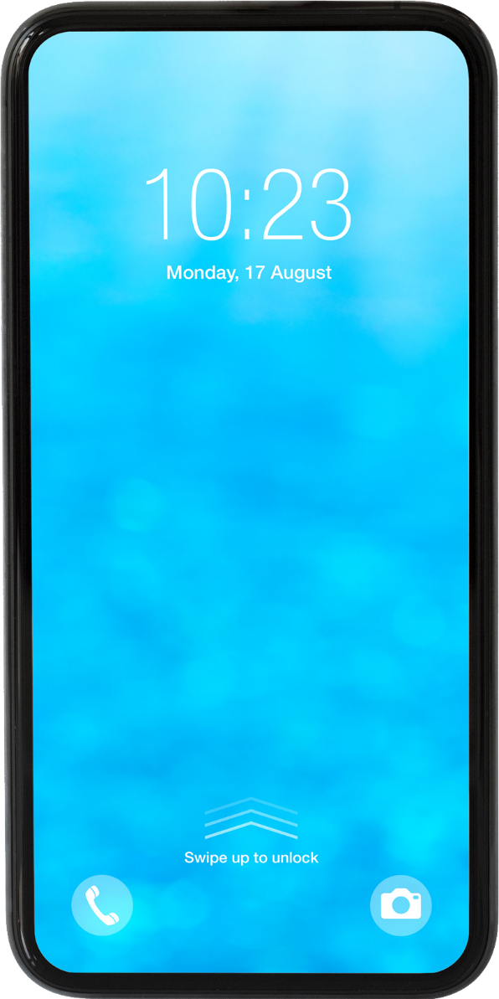
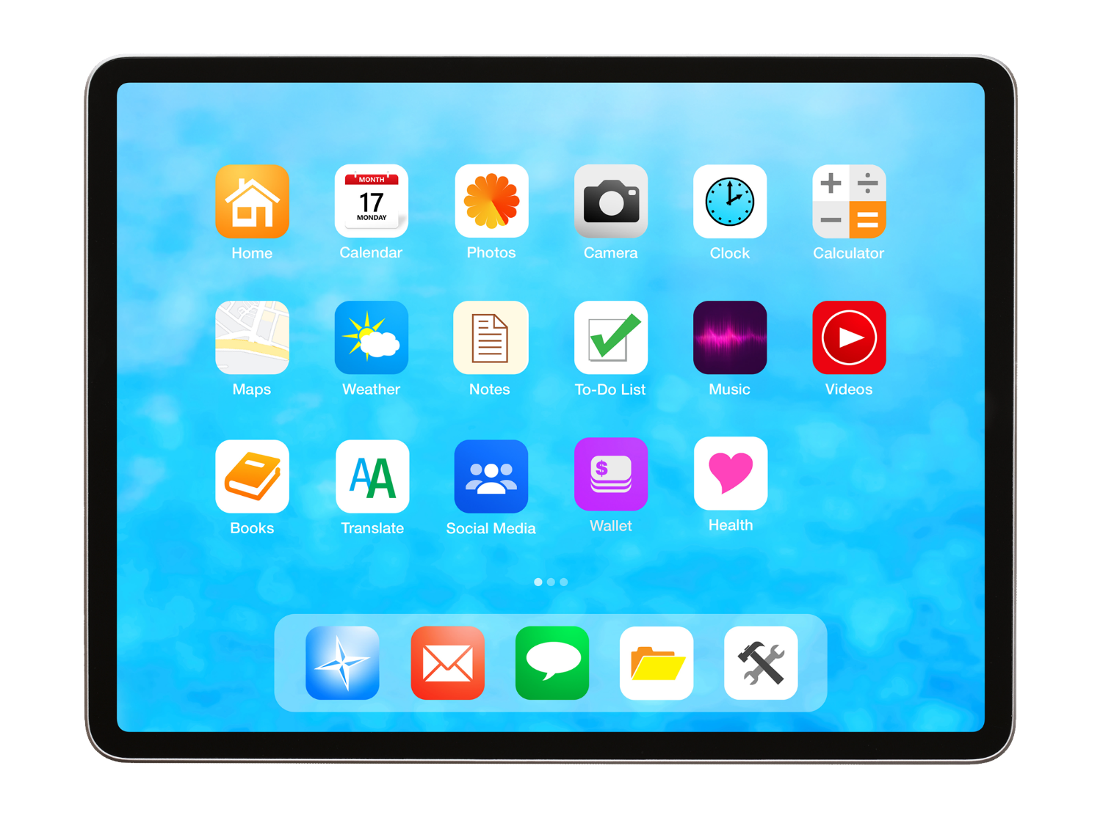
Introduction (continued)
Notes:
Today’s mobile devices can do many of the same things that a traditional computer can do. You can search the internet, access email messages, watch videos, play games, take pictures, listen to music, get directions, and connect with friends and family.

Slide 5
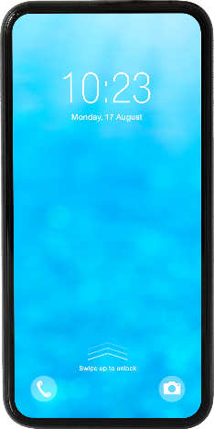

Introduction (continued)
Smartphone
Mobile telephone with cellular and internet access
Tablet
Portable computer that uses a touchscreen
Notes:
Here you can see an Android smartphone and an Android tablet.
A smartphone is a mobile telephone that has both cellular and internet access. Smartphones allow you to make and receive phone calls and text messages. Because they are connected to the internet, they also can help you share photos, play videos or games, check and send email, and browse the web.
A tablet is a portable computer that uses a touchscreen. Most tablets are smaller and weigh less than a computer laptop but are usually bigger and weigh slightly more than a smartphone. Tablets connect to the internet through a Wi-Fi or cellular connection.

Slide 6
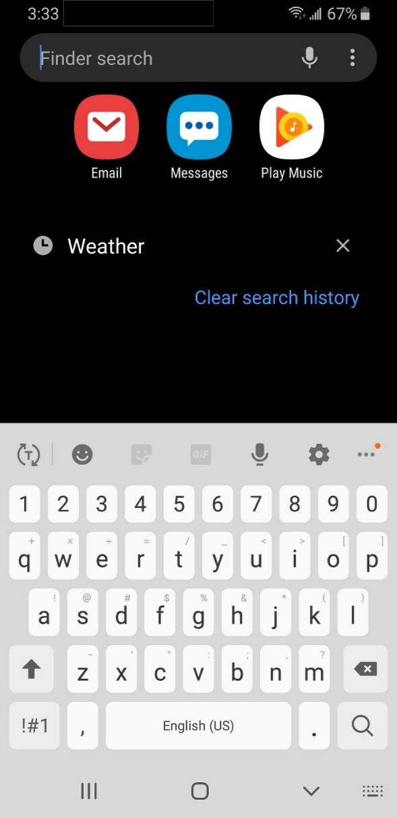


Touch Gestures
Notes:
A primary difference between a mobile device and a computer is the way you get around. Rather than using a mouse or keyboard, you use your fingers to tap, type, scroll, and more. You can also use your voice to help navigate your device.
INSTRUCTOR NOTE: If you have a mobile device, demonstrate these gestures on your phone:
Instead of clicking, you tap.
The keyboard is on your screen, and you type using that.
You scroll with your finger instead of using your mouse or pointer.

Slide 7
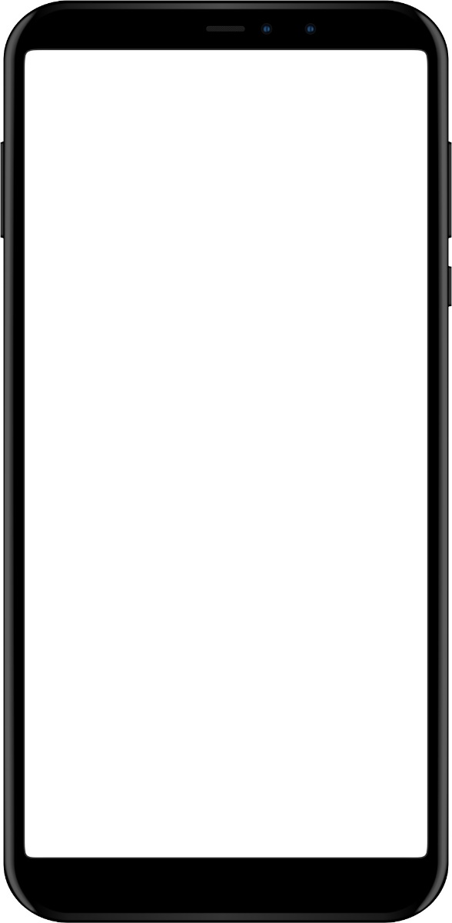
External Buttons
Volume control
Power button
Ring/silent switch
Notes:
INSTRUCTOR NOTE: If you have a mobile device, demonstrate these features on your phone, and encourage learners to find them on their own phones.
The ports and buttons on your smartphone or tablet will vary depending on the specific model you are using. In general, phones and tablets have a power button and volume control. Smartphones typically have a ring/silent switch.

Slide 8
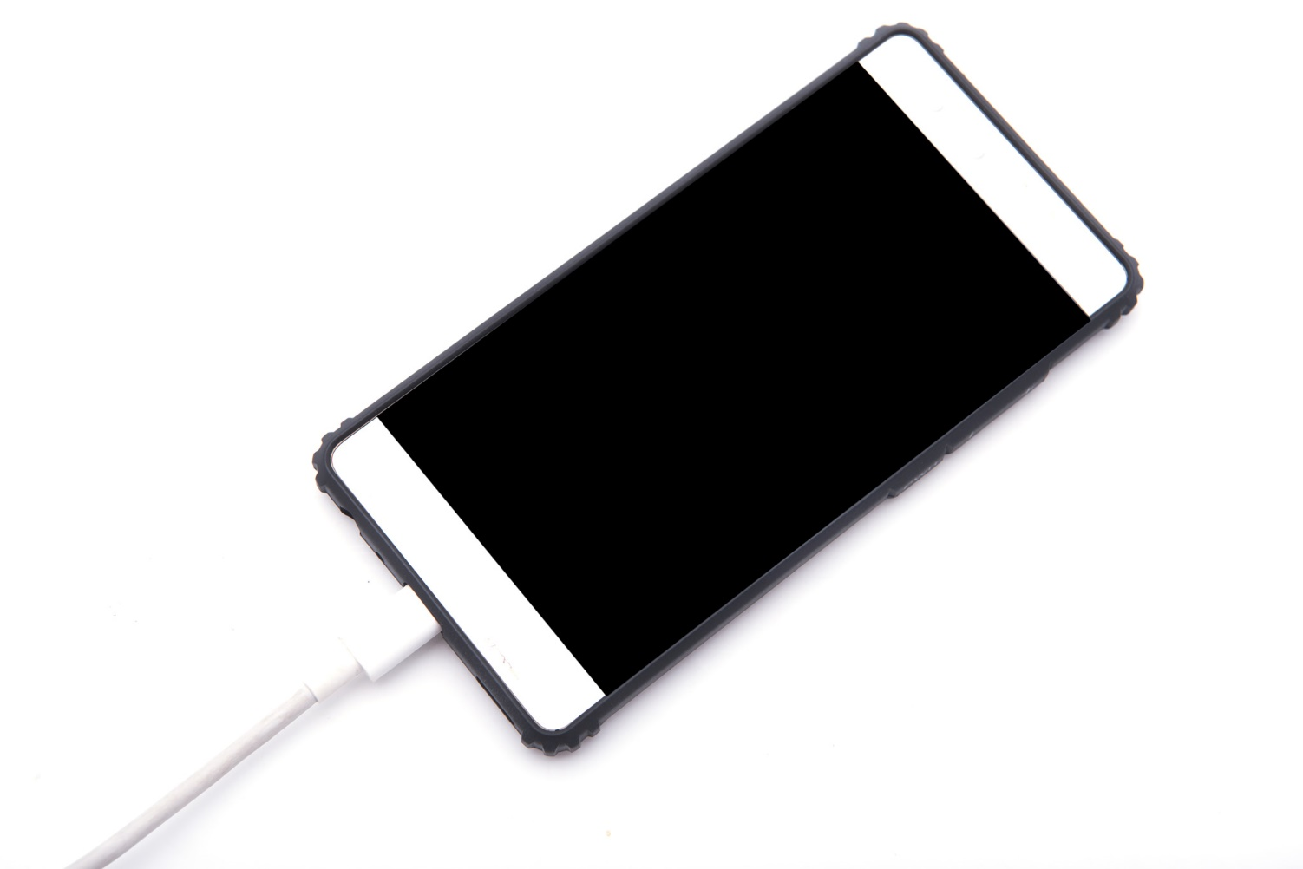
Charging Port
Notes:
INSTRUCTOR NOTE: If you have a mobile device, demonstrate the charging port on your phone, and encourage learners to find it on their own devices.
Both smartphones and tablets have a charging port.

Slide 9
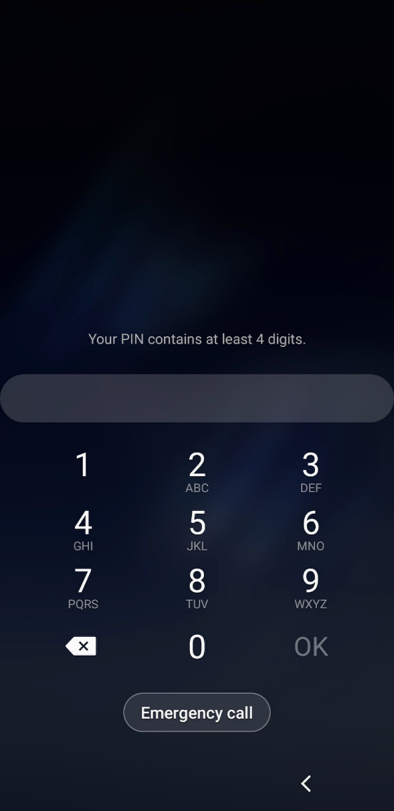
Unlocking Your Phone
Notes:
As we get started using the phone, the first thing we need to do is unlock the device. The way you do this depends on the Android device you have and the choices you made when you set up your phone.
Some phones allow you to unlock a phone with face recognition. Others unlock using your fingerprint, or you can enter a passcode or password.

Slide 10
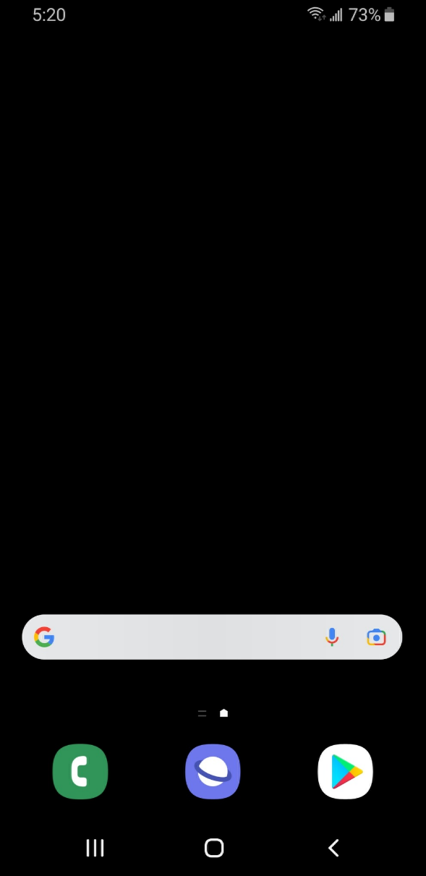
Home Screen
Notes:
INSTRUCTOR NOTE: Talking points for this slide include:
Home screen has some apps already, but you can add more that you like.
Top of screen includes a status bar that includes information about battery percentage, Wi-Fi, and cellular reception.
Navigation buttons are on the bottom.
Tap or swipe up (depending on your phone) to go to the Apps view.
Please point out to participants here and as needed throughout the workshop: The screens and the button locations in this presentation may look different from your own device, depending on the type of Android device and the carrier you use.

Slide 11
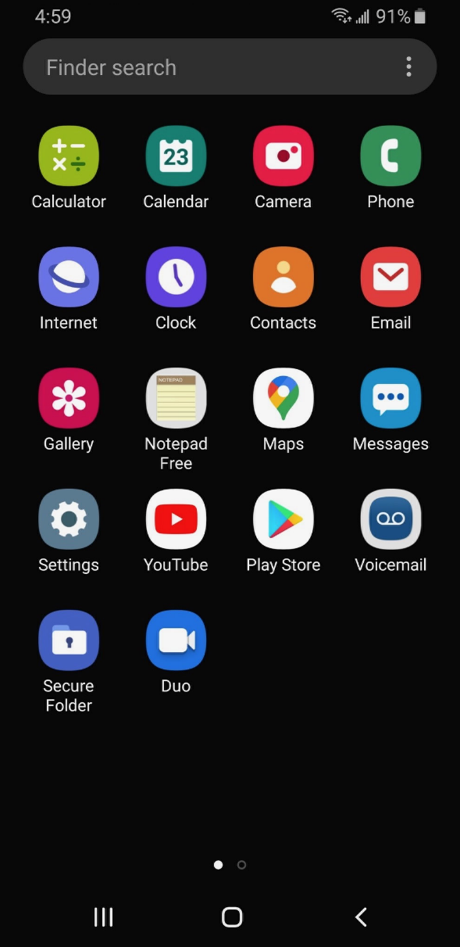
Apps View
Notes:
Apps are on the Apps view screen. All Android mobile devices have built-in apps for your convenience.
INSTRUCTOR NOTE: Ask learners: What apps do you recognize? What apps have you used?
Android phones come with these basics: phone, messages, email, internet, camera, maps, clock, calendar and more.

Slide 12
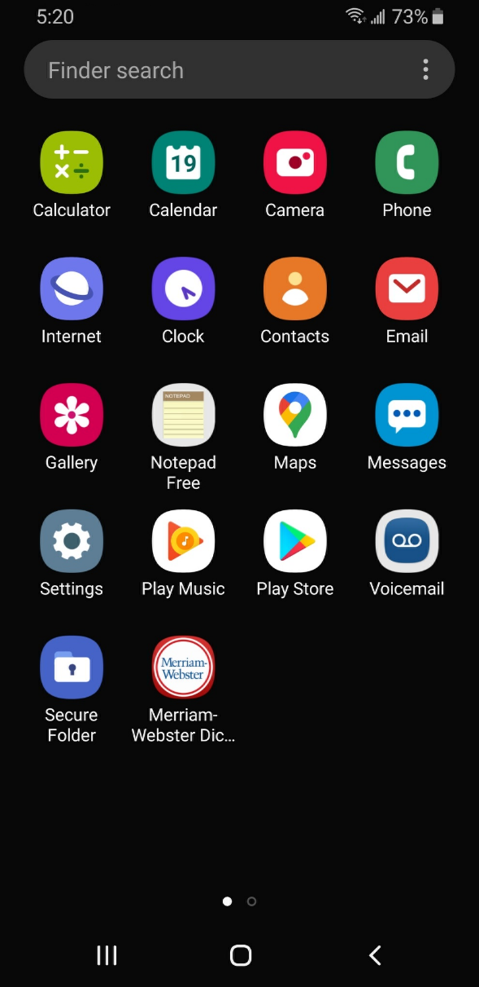
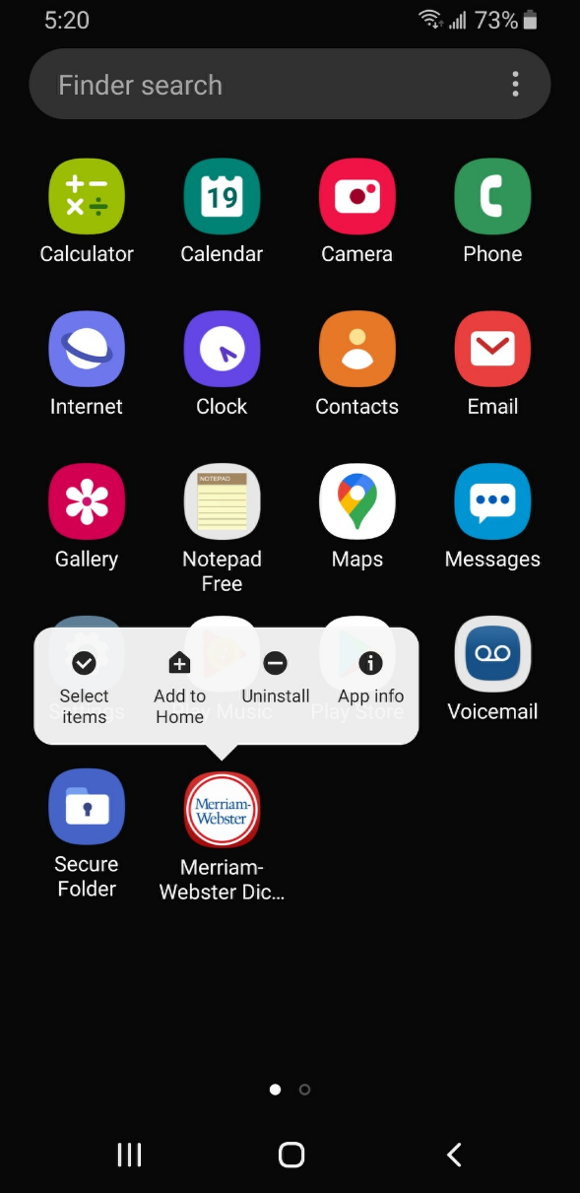

Tap | Tap and Hold
Notes:
INSTRUCTOR NOTE: If you have a mobile device, demonstrate the touch gesture of tapping and then the gesture of tapping and holding. This is just to show what a tap or tap-and-hold looks like, not to actually show your screen.
Tap your finger on the screen to activate a control, type on a keyboard, or select something onscreen. For example, you can tap on an app to open it. Give it a try. Go to the Maps app on your phone, and open it. (To close the app, swipe up from the bottom of the screen. We’ll look at swiping again in a moment.)
Tap-and-hold with your finger to display a menu of options. In this example, if you tap and hold the Meriam-Webster app icon, the menu opens. Give it a try. Go to an app on your phone, and then tap and hold. Do you see a menu appear?

Slide 13


Swipe Up/Down | Left/Right
Notes:
INSTRUCTOR NOTE: If you have a mobile device, demonstrate the swiping touch gestures. This is just to show what a swipe looks like with your finger, not to actually show your screen.
Swiping Up or Down: From the home page, you can swipe up from the bottom of the screen. This will bring you to the Apps view on your phone. Swiping up and down is what you do to scroll through apps and websites. If you’re on your home screen, give this a try: swipe up from the bottom of the screen to see your Apps view.
Swiping Left or Right: From the Apps view, you can swipe left to see more apps available on your phone. You can swipe left and right on many apps and websites to navigate around. From your Apps view, give this a try: swipe left across the screen to see the next page of apps.

Slide 14
Activity #1
Notes:
INSTRUCTOR NOTE: Point attendees to Activity 1 on Activity Sheet page 1.

Slide 15
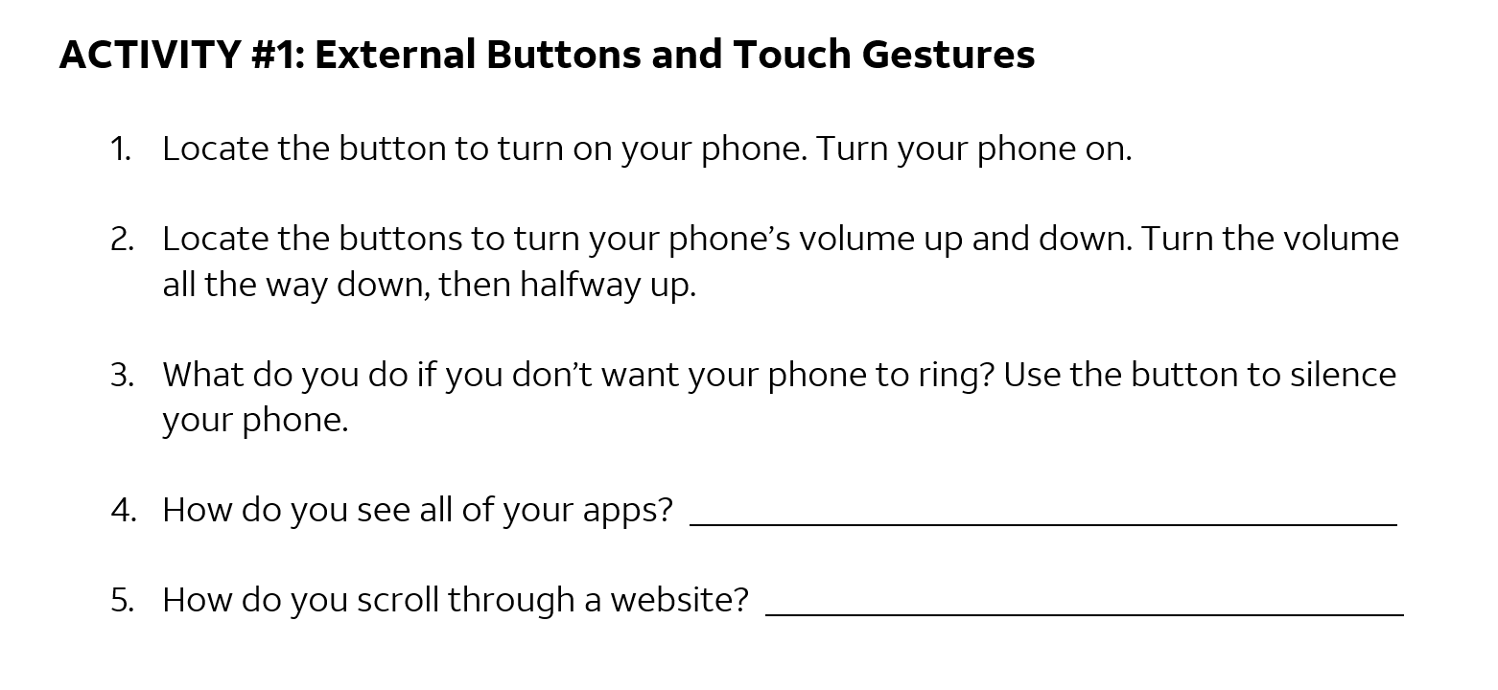
Notes:
INSTRUCTOR NOTE: Walk around and help learners with activity as needed. Demonstrate features on a device, or use slides 12 and 13 as needed. When participants have finished the activity, talk through each item in the activity and answer questions as needed.
Answers to questions 4 and 5: To see all your apps, swipe up from the bottom of the screen. To scroll through a website, swipe up (to scroll down) and swipe down (to scroll up).

Slide 16
Common Apps
Notes:
INSTRUCTOR NOTE: In this section, you will introduce seven of the most common apps on an Android smartphone. Encourage participants to use their own phones to follow along and explore the apps as you demo them. Note that if attendees are on a tablet, they will be able to follow along with all apps except for the phone app.
Please point out to participants: Your screen and the button locations may look different than the device shown on the slides, depending on the type of Android device and the carrier you use.
Phones and tablets offer access to an almost unlimited number of apps. Apps are programs designed to help you accomplish different tasks.
When you turn on your phone and want to get to the Apps view screen, swipe up from the bottom of the Home screen. You should then see a screen that looks something like this one.
In this section of the workshop, I will introduce and talk about some of the most common apps on Android devices, shown here on the screen. Please follow along on your own device and briefly explore each of the apps.

Slide 17
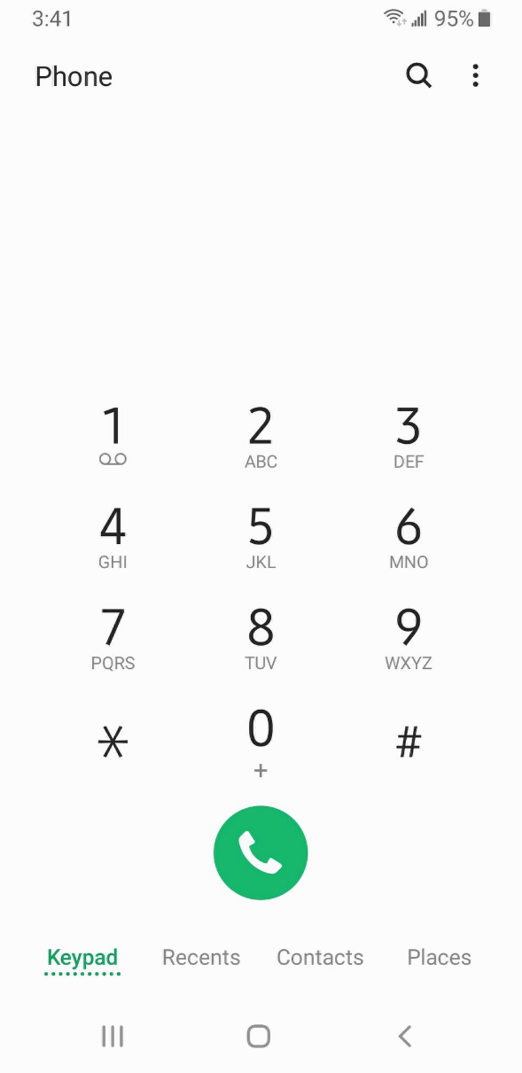
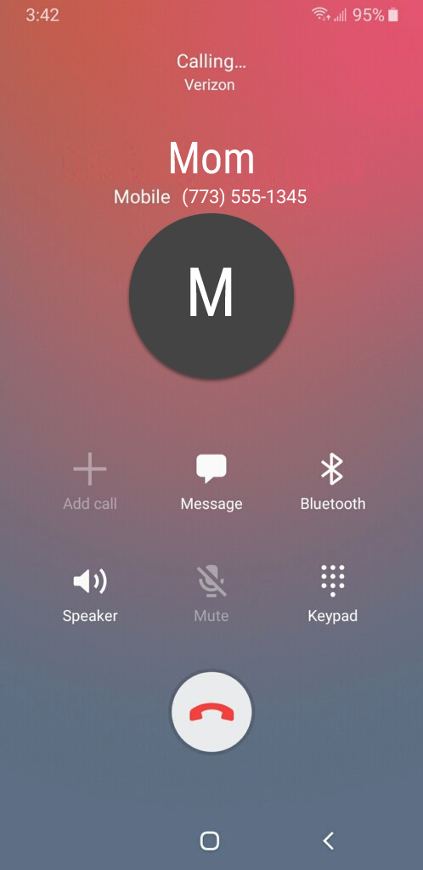
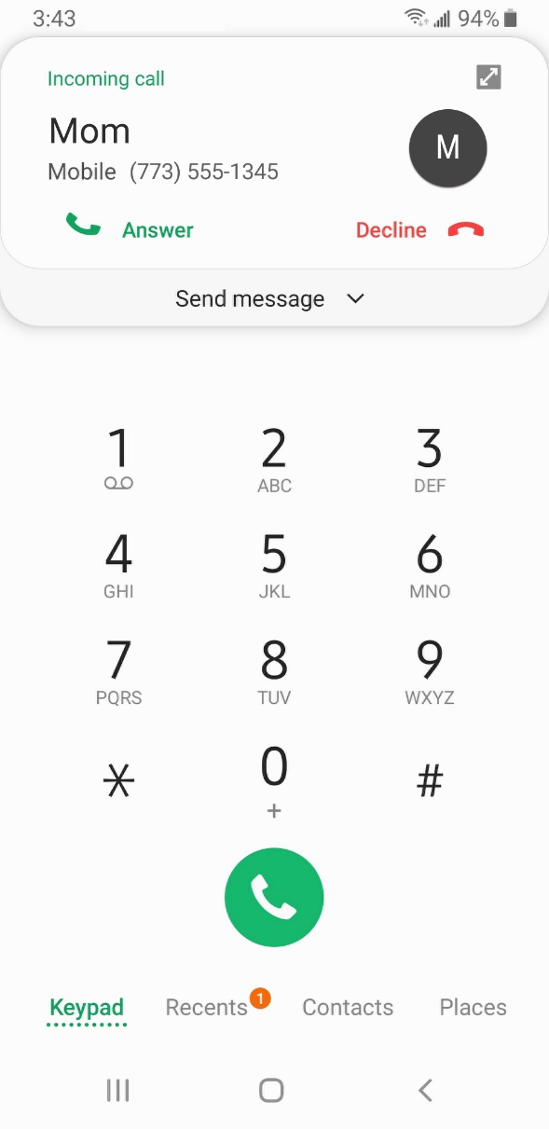
Phone
Notes:
The Phone app allows you to make and receive calls. To use it, tap on the app to open it. [INSTRUCTOR NOTE: Point out the Phone app, and then click ENTER to bring up the phone app image.]
When the app opens, you will see the keypad. You will also see options to go to other screens for recent calls, your contacts, and places. [INSTRUCTOR NOTE: Point out these items in the bottom menu.]
There are two main ways to make a call. You can tap the Contacts icon to select a name listed in your Contacts app. Or you can type a number on the keypad. After dialing a number, you’ll tap the green phone button to start the call.
When you’re ready to hang up, tap the red phone button to end the call.
To answer incoming calls, tap on Answer.

Slide 18
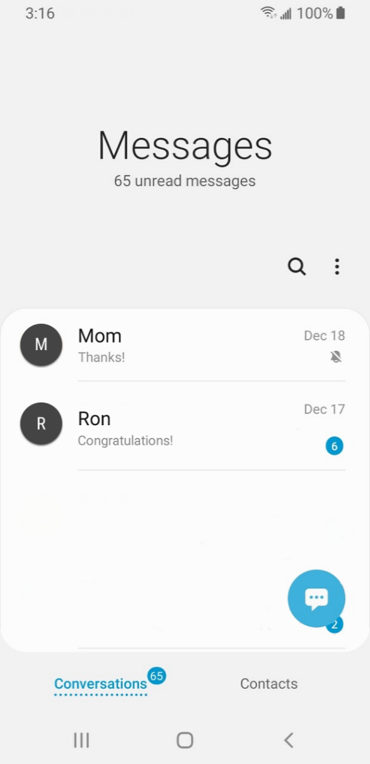
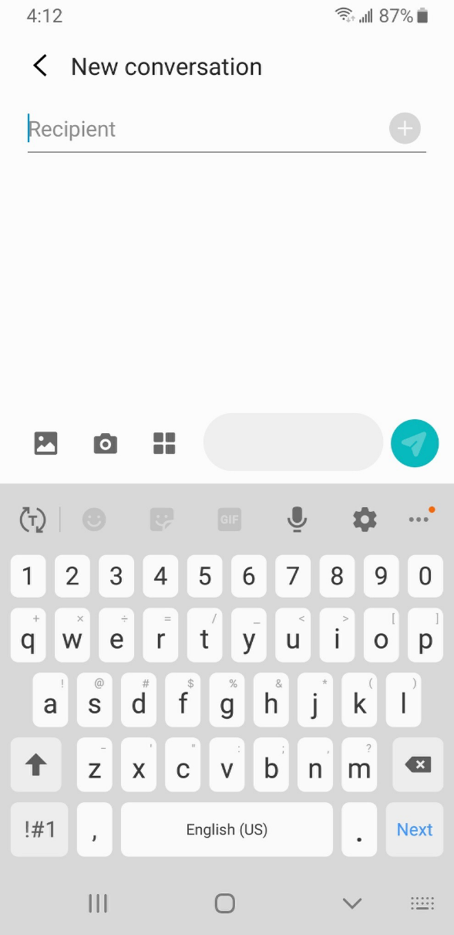
Messaging
Notes:
If you want to send a text message, you’ll use the Messages app. To open the app, tap on it on the Apps view screen. [INSTRUCTOR NOTE: Point out the Messages app, and then click ENTER to bring up the Messages app image.]
When you open the app, you’ll see your current conversations.
You can use the Search box to search all of your text messages. You can tap the blue button to start a new conversation, or you can tap a current conversation to send or read a new messages and send a response. [INSTRUCTOR NOTE: Point out these items as you discuss them.]
To create a new text message conversation, you’ll tap on the blue button to start a conversation.
You can send a text message to a someone by typing their cell phone number in the To field, or, if the person is in your contacts, you can begin to type their name. Once the name of the person displays, you’ll tap it to select it. Then you’ll type your message and then tap on the blue arrow to send it.

Slide 19
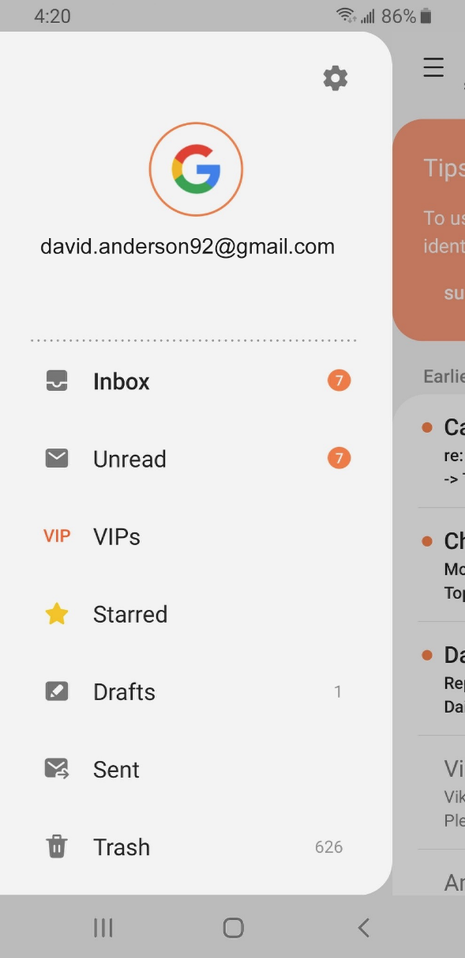
Email
Notes:
If you want to read or send email, you would tap on the Email app from the Apps view. [INSTRUCTOR NOTE: Point out the Email app, and then click ENTER to bring up the email app image.]
In the example on the screen, this individual (David) used his Google account to set up his email on his mobile device. When you open the email app on your phone, you’ll see the Gmail account you used to set up your phone.
You can add more apps to your phone in the Settings app. We won’t go through these steps, but it’s helpful to know that you can add an email account from almost any email provider using the Settings app.

Slide 20
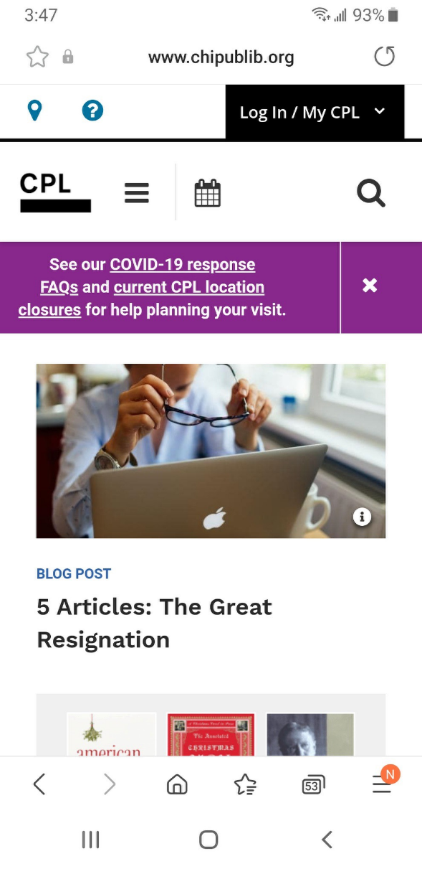
Browser
Notes:
When you want to search the web from your phone, tap on the Internet icon to launch a web browser. This app works much like a web browser on a computer. [INSTRUCTOR NOTE: Point out the Internet app, and then click ENTER to bring up the internet app image.]
In this example, we can see the homepage of the Chicago Public Library. You can search the web or visit a website using the address bar on the top. [INSTRUCTOR NOTE: Point out the address bar.]
Once you have a webpage up in the browser, you can swipe up to scroll down the page.

Slide 21
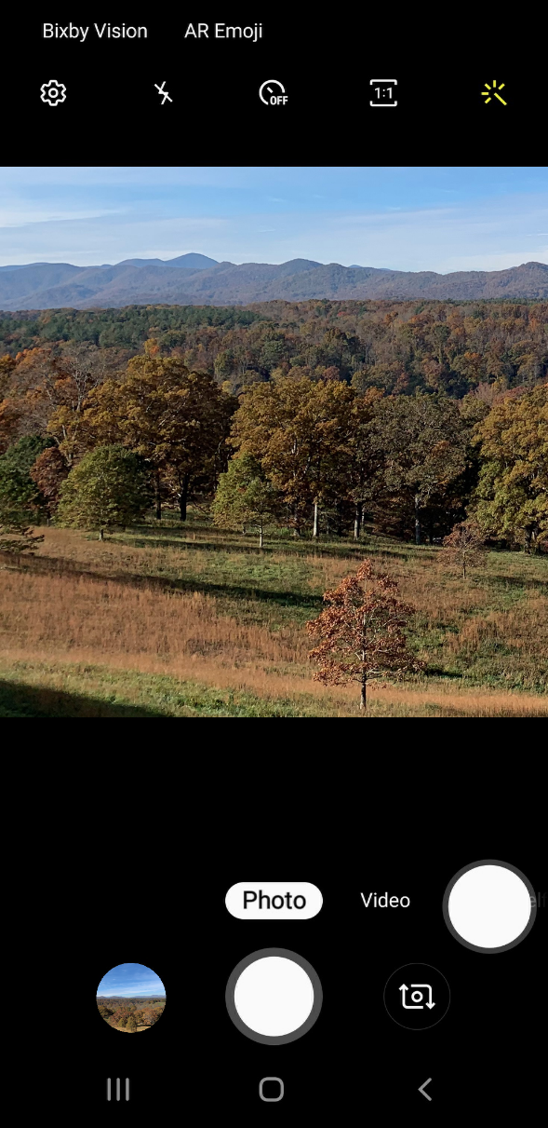

Camera
Notes:
When you want to take a picture or video, tap on the Camera icon to launch the camera app. [INSTRUCTOR NOTE: Point out the Camera app, and then click Enter to bring up the camera app image.]
You can use these buttons to switch between camera modes—photo and video. [INSTRUCTOR NOTE: Point out these items as you discuss them.]
This menu across the top allows you to change the camera settings, turn the flash on or off, set a time, change the aspect ratio, or add a filter. [INSTRUCTOR NOTE: Point out these items as you discuss them.]
Tap this button to take a picture or record a video. [INSTRUCTOR NOTE: Point out the button.]
After you take a picture, you have the option to like the image, edit the image, share the image, or delete the image. [INSTRUCTOR NOTE: Point out these items as you discuss them.]
[INSTRUCTOR NOTE: Press ENTER again.]
If you want to share your photo or video by email, text message, or other sharing platform (such as social media), tap the Share icon.

Slide 22
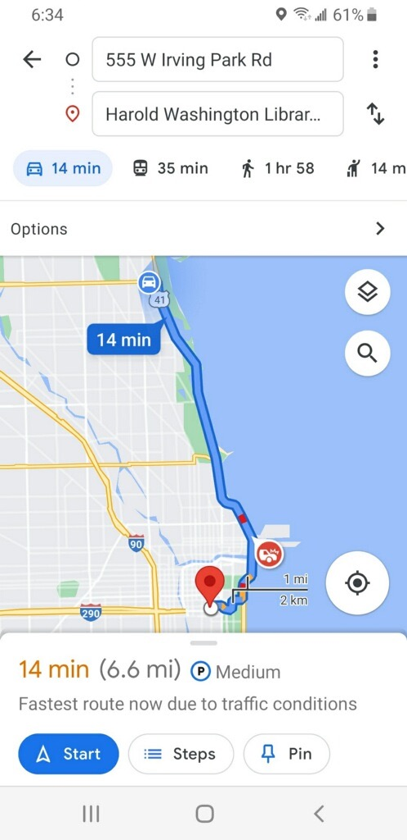
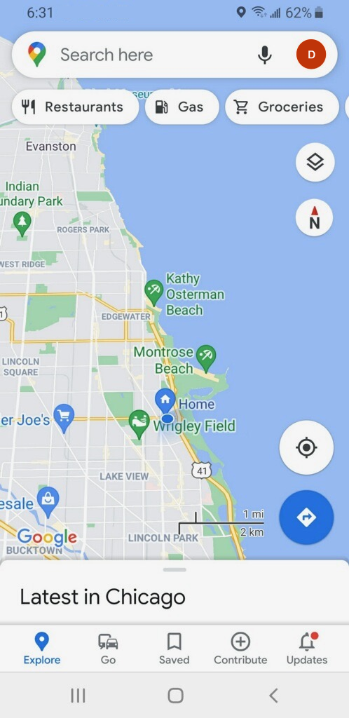
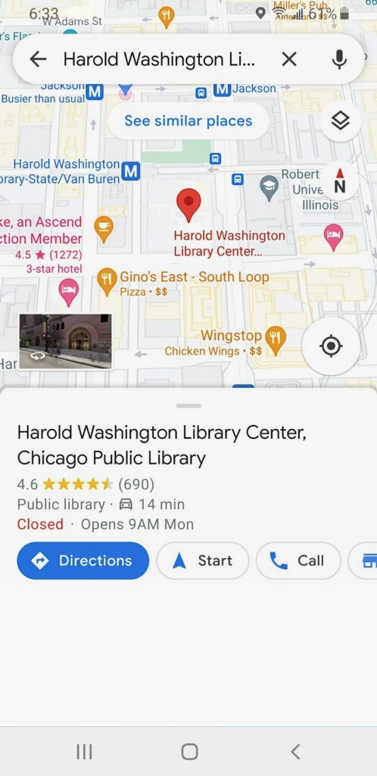
Maps
Notes:
When you want to find an address or get directions, you’ll tap on the Maps icon to launch the maps app. As you can see in this example, Android devices come preinstalled with Google Maps. [INSTRUCTOR NOTE: Point out the Maps app, and then click Enter to bring up the maps app image.]
To do a search, enter the location into the “Search here” box.
Once you have the location on the screen, click on Directions to get directions to the location.
From there, you can select directions for driving, public transit, walking, and more. [INSTRUCTOR NOTE: Point out these items as you discuss them.]
To get live directions similar to a GPS, you must have a data plan and be connected to a cellular or Wi-Fi network. You may also need to give the app permission to view your location, or you can add your location manually.

Slide 23





Popular Categories of Apps
Games
Streaming Video
Streaming Music
Health and Fitness
Weather
Notes:
INSTRUCTOR NOTE: Ask learners: what other apps might you be interested in? Ask what popular apps they may know of in these popular categories, or others they come up with on their own (for example, Spotify or Pandora for music, Netflix or Hulu for streaming video, and so on).

Slide 24
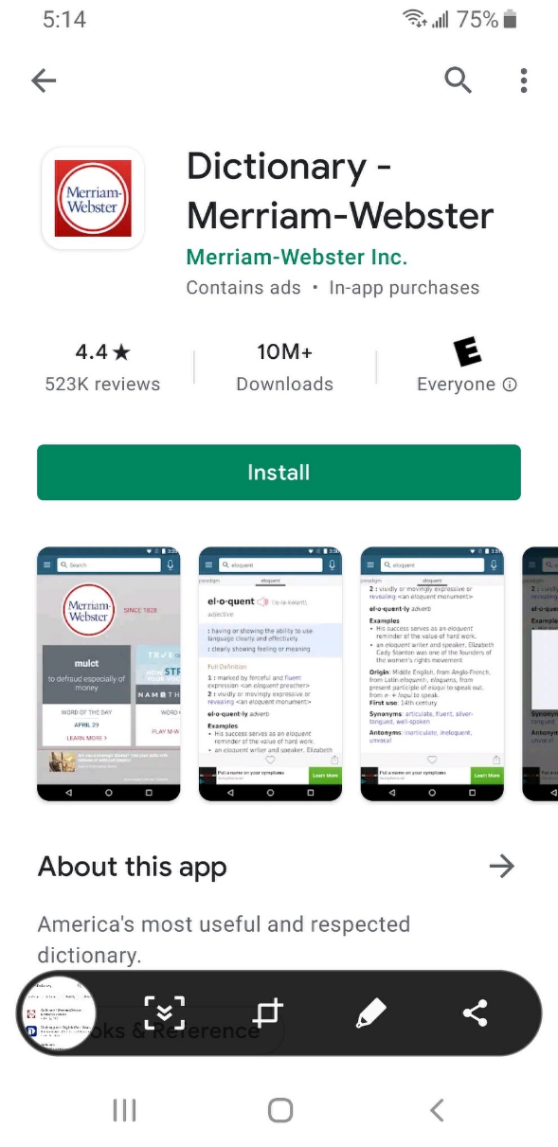
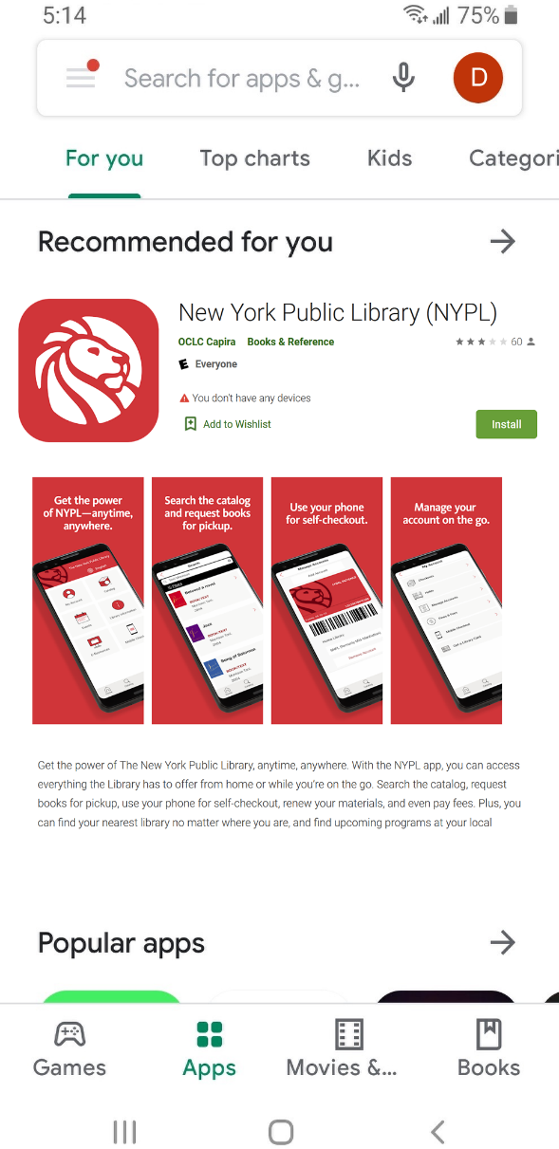
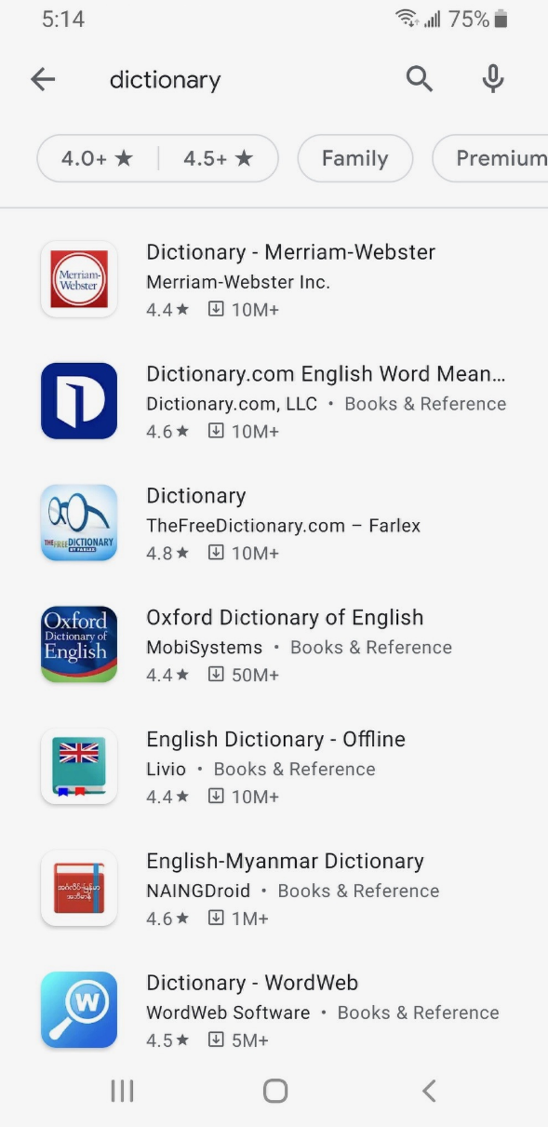
Play Store
Notes:
To add apps on any Android-supported device, you would tap on the Play Store icon, located on the Apps view screen. [INSTRUCTOR NOTE: Point out the Play Store app, and then click Enter to bring up the Play Store image.]
From the Play Store, you can browse Featured Apps, look through categories, or search for an app by name. [INSTRUCTOR NOTE: Point out these items as you discuss them.]
Here we can see results from a search for a dictionary app. Let’s take a look at the first app in the list.
If an app has an Install button instead of a price, like this example, the app is free. If you instead see an Open button, the app is already installed on your device. From this page you can learn more about the app, including preview pictures and customer reviews.
To install the app, you would click on the Install button. Once the app downloads, it appears on your Apps view screen. If the app is not free, you may be required to authorize the purchase by typing in your email account password or by verifying with your facial recognition or fingerprint.
To delete an app, tap and hold on the app. A menu will appear where you can uninstall the app.

Slide 25
Activity #2
Notes:
INSTRUCTOR NOTE: Point attendees to Activity 2 on Activity Sheet page 2.

Slide 26
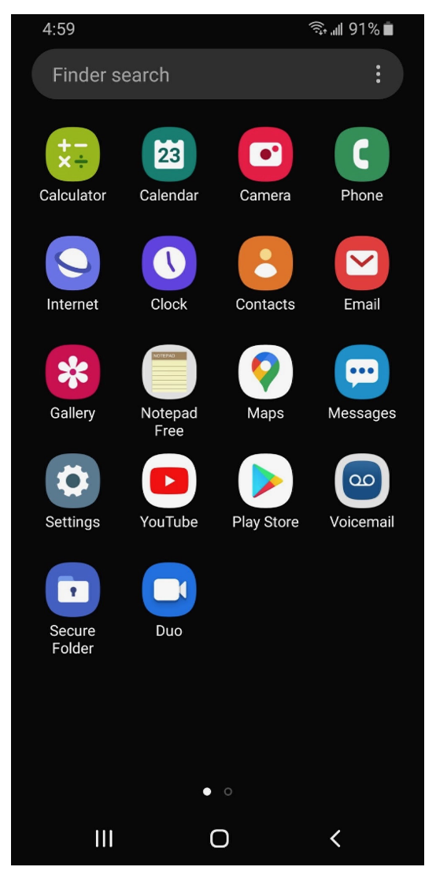
ACTIVITY #2: Common Apps
What app do you use to:
Send an email? _______________________
Search the web? ______________________
Send a text? __________________________
Record a video? _______________________
Make a phone call? ____________________
How do you get back to the Apps view when you have an app open?
Open the camera app and take a picture. Show the instructor the image you took.
Open the browser and search for the PLA Digital Learn website: https://www.digitallearn.org/ Scroll to the link about Accounts and Passwords. Tap the link and show the instructor your screen.
Notes:
INSTRUCTOR NOTE: For the first six questions, ask learners the questions, and have them call out the answers. Encourage them to tap to open each of the apps. Consider asking one learner to show you their screen so you can check that learners are following along and are able to open the appropriate apps. Encourage learners without a device to answer using the Activity Sheet image.
What app do you use to:
Send an email? ________________________
Search the web? ______________________
Send a text? __________________________
Record a video? _______________________
Make a phone call? ____________________
How do you get back to the Apps view when you have an app open? _________________________
Open the camera app and take a picture. Show the instructor the image you took.
Open the browser and search for the PLA Digital Learn website: https://www.digitallearn.org/ Scroll to the link about Accounts and Passwords. Tap the link and show the instructor your screen.

Slide 27


Settings—Getting Connected
Cellular
Need a cellular service plan
Wi-Fi
All smartphones and tablets can connect to the Internet using Wi-Fi
Notes:
Mobile devices must be connected to a cellular or wireless network to access the internet and make calls. To connect your phone to a cellular network, you need to have a service plan with a cellular service provider. If you have a cellular plan, your phone will connect to the network automatically everywhere that your cellular plan has coverage. You will know you are connected to the cellular network when you see the cell phone signal symbol to show the strength of the connection. The number of bars of the cellular connection lets you know how strong the signal is.
Another way you can connect your phone or tablet to the internet is connecting to a Wi-Fi network. All smartphones and tablets can connect to the internet using Wi-Fi.
Many businesses, libraries, and other public places offer free Wi-Fi. You can use these public Wi-Fi networks while you visit these locations. Sometimes, you may need a password to access the network.
If you want to connect your Android phone to a Wi-Fi network in your home, you will need to sign up with an internet service provider (ISP).

Slide 28
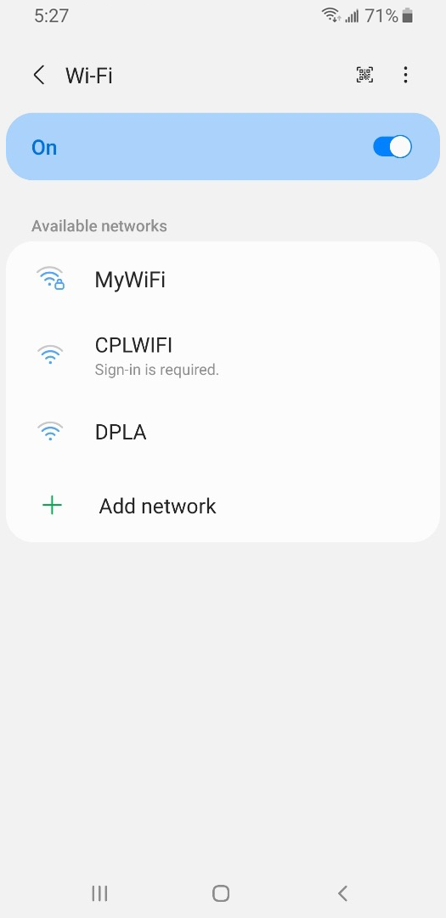
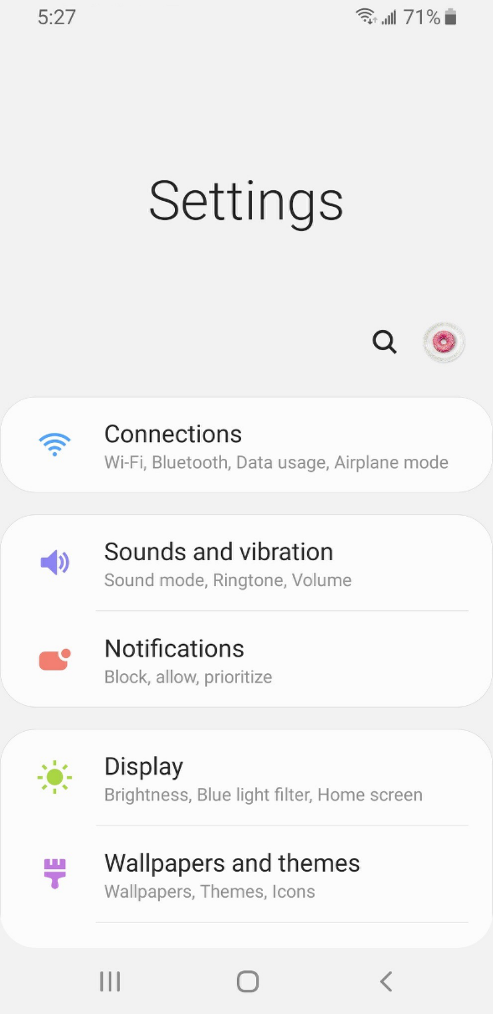
Getting Connected
Notes:
INSTRUCTOR NOTE: Please edit this slide to add a text box with information on the Wi-Fi at your location, for learners to connect to.
If you want to connect to Wi-Fi, you’ll click on Settings on the Apps view screen. [INSTRUCTOR NOTE: Point out the Settings app, and then click Enter to bring up the settings app image.]
Then you’ll tap on Connections. [INSTRUCTOR NOTE: Point out Connections on the image.]
You’ll see a list of Wi-Fi networks that are nearby. Networks with a lock icon require a password. Networks without a lock are public and do not need a password. Some public networks may ask you to accept an agreement before they will allow you to connect your device.
Once you are connected to the Wi-Fi network, you will see the Wi-Fi icon in the status bar at the top of your device. [INSTRUCTOR NOTE: Point out the Wi-Fi icon on the status bar.]

Slide 29


Wi-Fi Security Tips
Make sure you trust a network before connecting.
Try not to send private information over public Wi-Fi networks.
If you send personal information, make sure the website is secure
and begins with https.
Set up a password for your home network to block intruders
from accessing it.
Notes:
To keep your information safe when you connect to Wi-Fi, follow these Wi-Fi security tips.
Make sure you trust a public network before connecting to it. Do you know who set up the network?
Try not to send private information over public Wi-Fi networks.
If you do send personal information, make sure the website is secure and begins with https.
Set up a password for your home network to block intruders from accessing it.

Slide 30
Activity #3
Notes:
INSTRUCTOR NOTE: Point attendees to Activity 3 on Activity Sheet page 3 and 4.

Slide 31
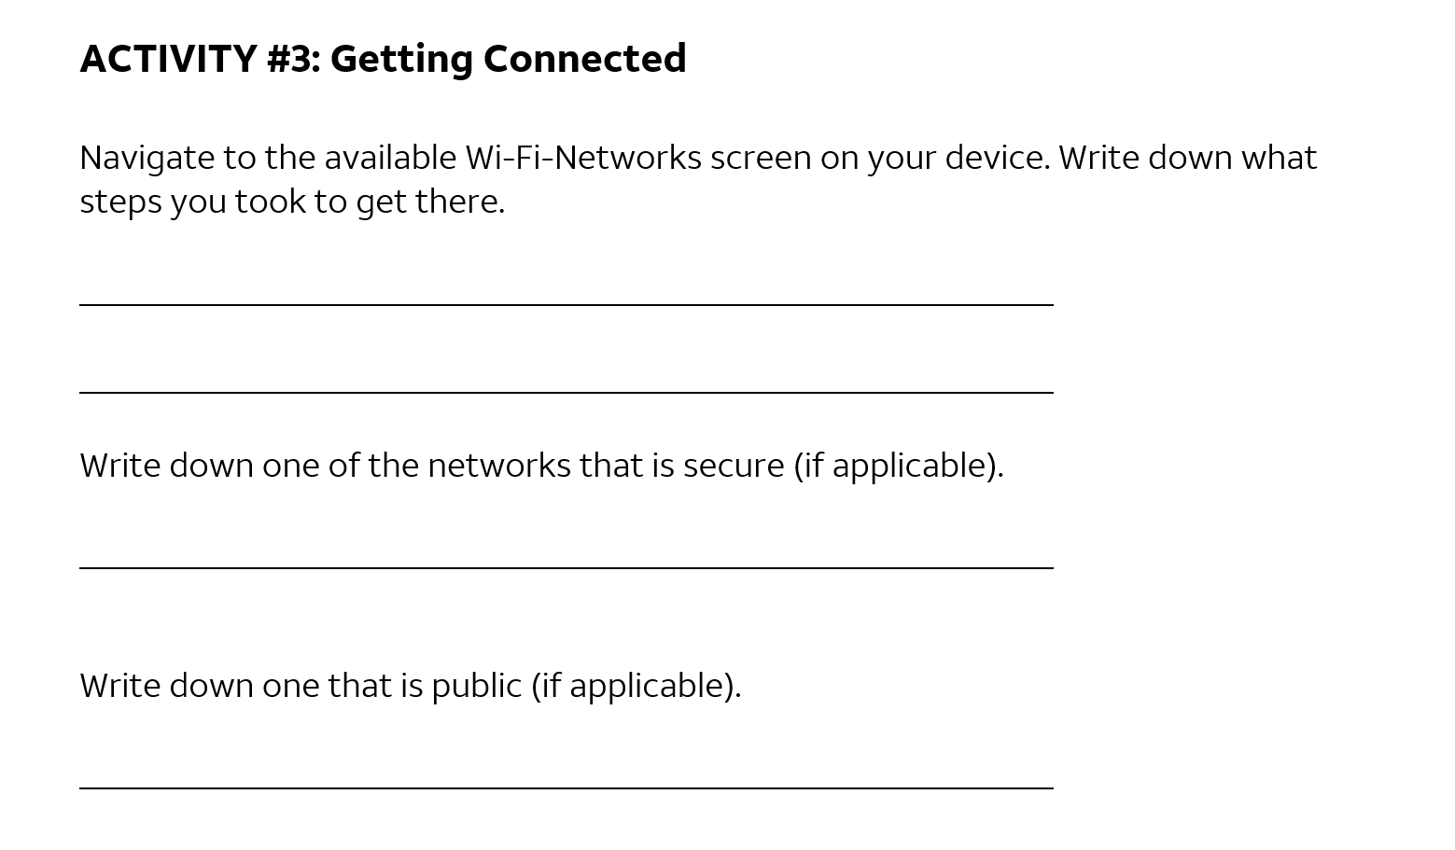
Notes:
INSTRUCTOR NOTE: Check the public and secured Wi-Fi options using your own device. Use this information to discuss learners’ answers about which are secure and which are public.
If a participant doesn’t have their own device, they can use the image on the Activity Sheet to write down a secure and a public network.

Slide 32
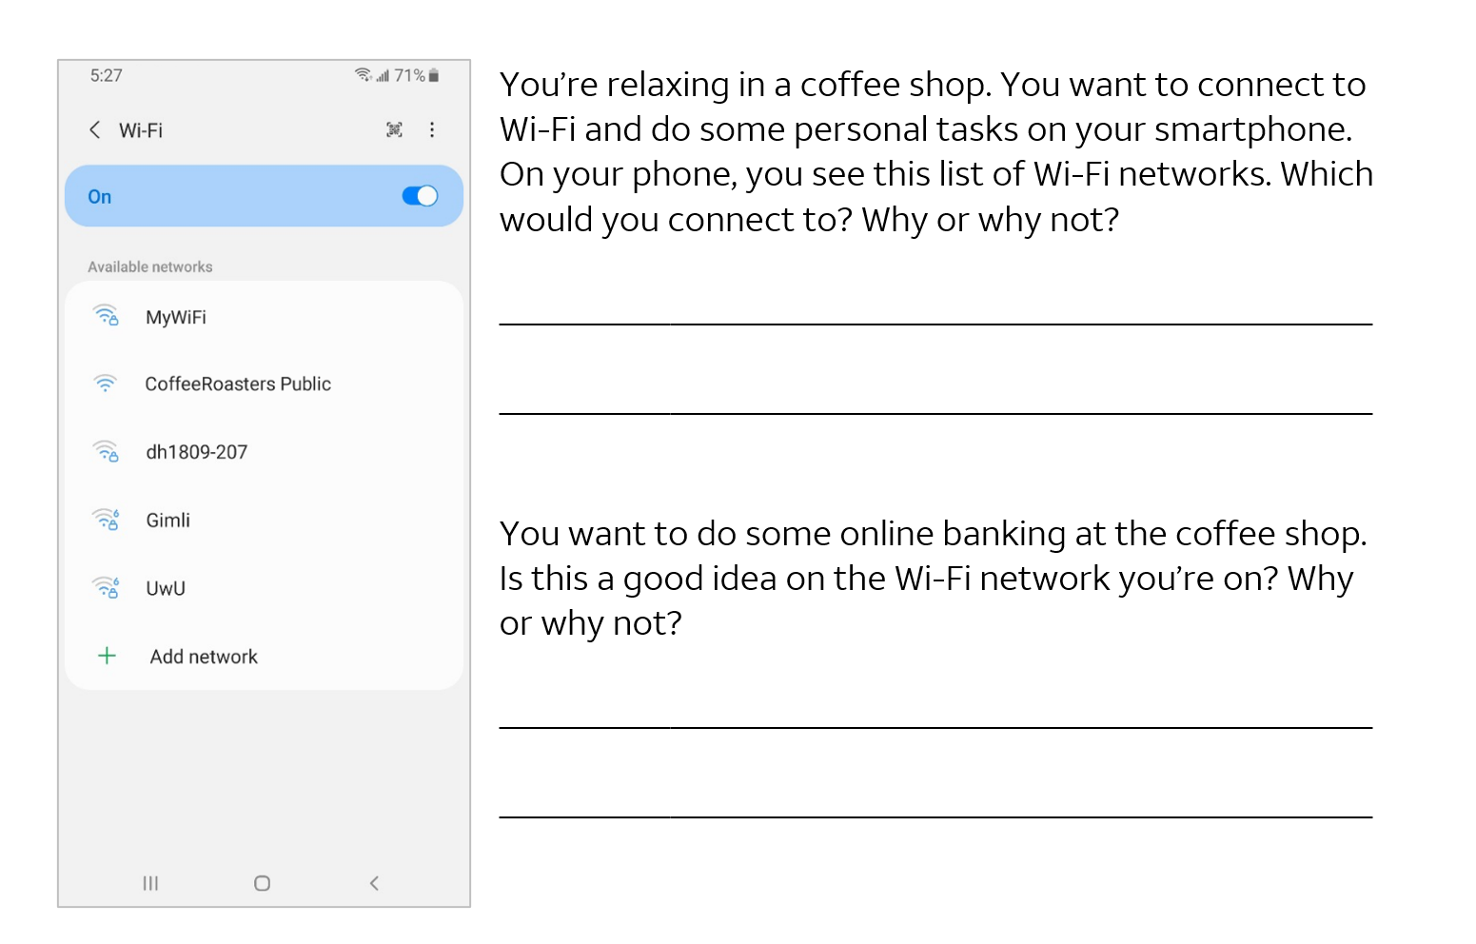
Notes:
INSTRUCTOR NOTE: Talk through the questions on the scenario of using Wi-Fi in a coffee shop.
You’re relaxing in a coffee shop. You want to connect to Wi-Fi and do some personal tasks on your smartphone. On your phone, you see a list of Wi-Fi networks. Which would you connect to? Why or why not?
Answer: They would want to use the public Wi-Fi because it’s free, but they would want to be careful about which personal tasks they are engaging in.
You want to do some online banking at the coffee shop. Is this a good idea on the Wi-Fi network you’re on? Why or why not?
Answer: It’s a bad idea to do banking on a public network. It’s best to wait to do banking on a private network where you know and trust the person who set up the network.

Slide 33
Settings—Security, Privacy, and Accessibility
Notes:
INSTRUCTOR NOTE: Please point out to participants: This screen and the button locations may look different from your own device, depending on the type of Android device you have and the carrier you use.
In the Settings app, you can view and change the settings on your mobile device, including accessibility features, biometrics and security preferences, software updates, and more.

Slide 34
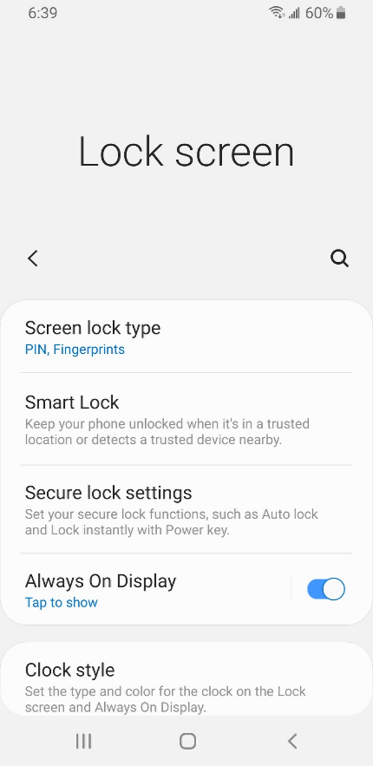
Unlocking Your Phone
What method are using to lock and unlock your phone?
Notes:
INSTRUCTOR NOTE: Lead a brief discussion with learners: What method are using to lock and unlock your phone?
Possible methods: PIN, passcode, Face ID, iris scan, or fingerprint
Mobile devices come with settings to help protect your device and your information. One of the most important things you can do is set a personal identification number (PIN) or passcode to access and use your mobile device. This will help protect the data that is stored on your device if the device is ever lost or stolen. Each time you turn on your device or wake up the screen, you will see a prompt to unlock it.

Slide 35

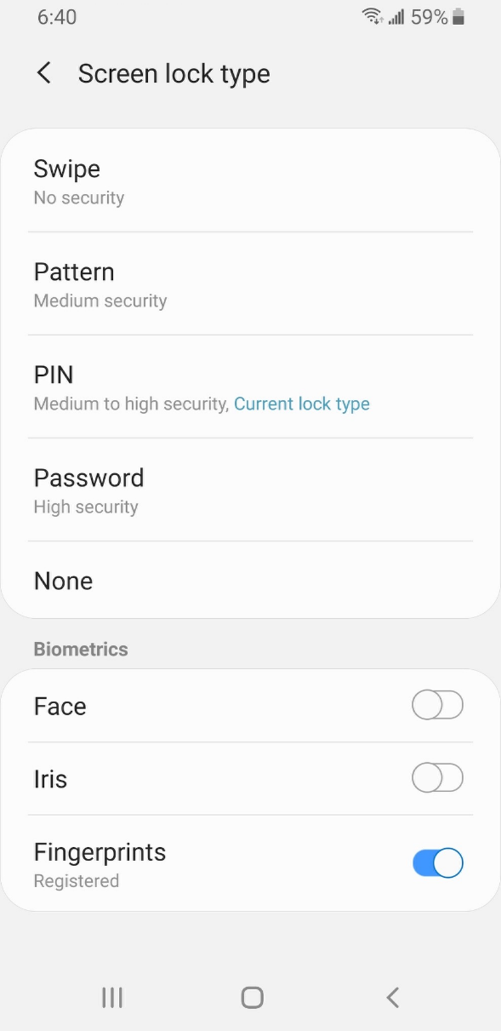
PIN or Passcode
Notes:
To set a pin or passcode, tap Settings.
Then look for the option to lock the screen.
You’ll find the options there.
You can also use unlock your phone using Face ID, iris scan, or fingerprint. You would need to follow the prompts to store that information in your Settings before you can enable this feature.
INSTRUCTOR NOTE: Please recommend that learners explore these features on their own after the workshop. The Learner Handout includes this recommendation.

Slide 36
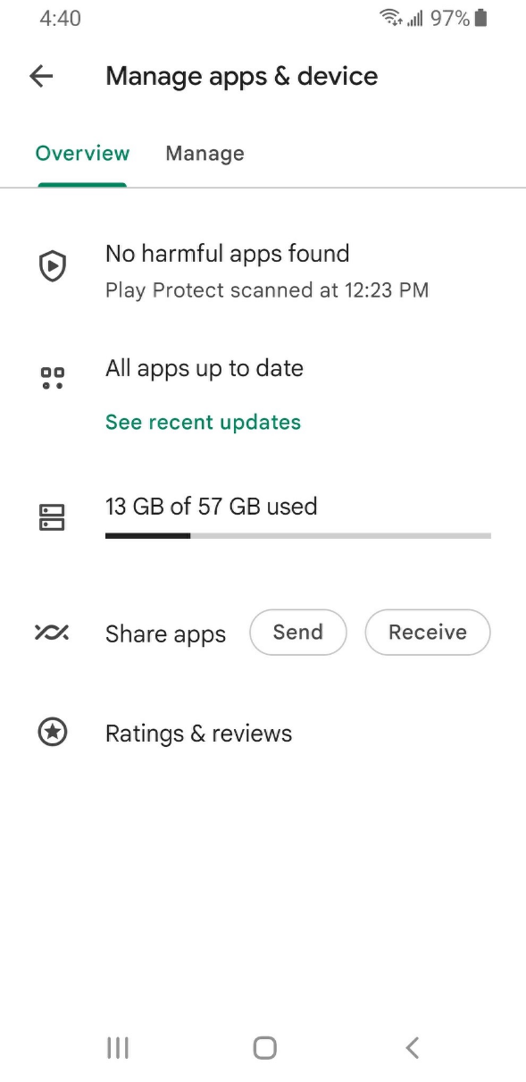
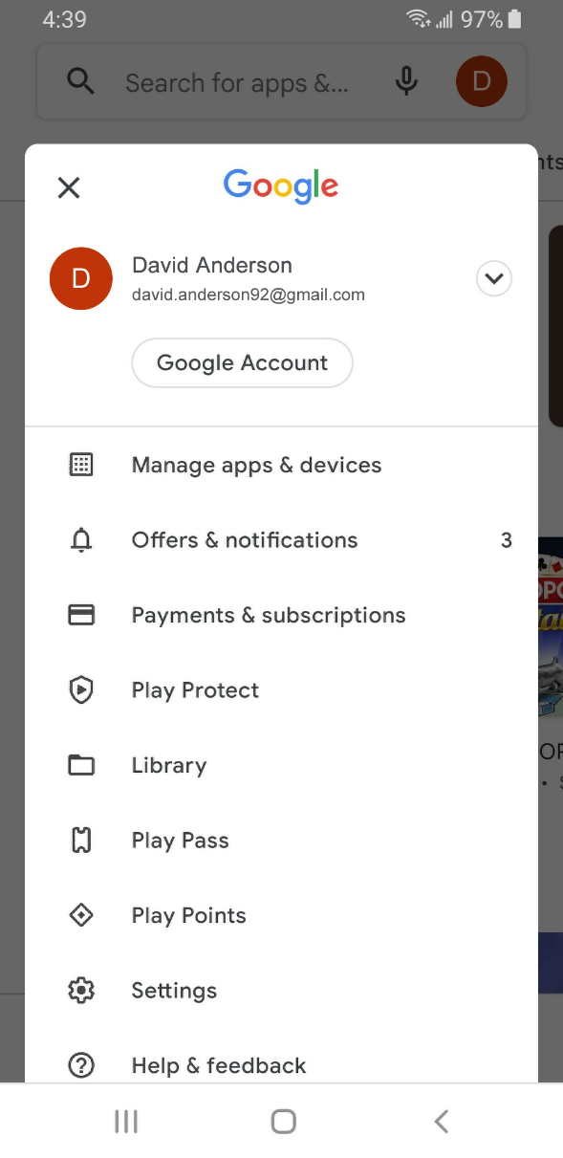
App Security
Notes:
Many apps on mobile devices have regular updates. Sometimes the updates have new features, but most importantly, updates fix bugs and problems and increase security. Android will automatically update the apps when the phone is connected to a Wi-Fi network.
You can see these settings by going to the Play Store.
Then go into your account and tap “Manage Apps & Devices.”
A list of how many updates are available displays. In this example all of the apps are up to date.

Slide 37
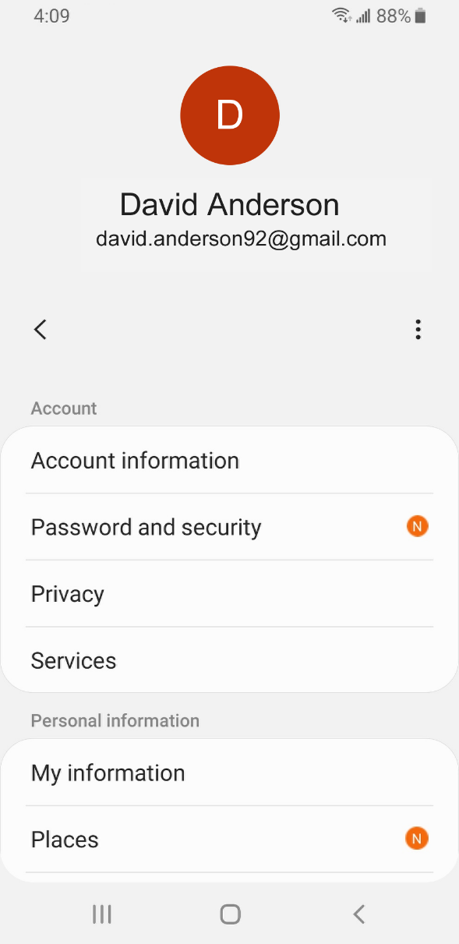
Privacy
Notes:
Privacy settings are also important for mobile devices. Using your phone’s privacy settings, you can decide which apps have access to information and data stored on your device, such as your location, photos, and microphone.
To access the privacy settings, tap on the Settings icon.
Then tap the donut icon.
Then tap Privacy and follow the prompts. The way you set your privacy settings may differ depending on the device manufacturer. Because there’s a variety of Android mobile devices, you may notice slight differences between your device and this example.
INSTRUCTOR NOTE: Please recommend that learners explore these features on their own after the workshop. The Learner Handout includes this recommendation.

Slide 38
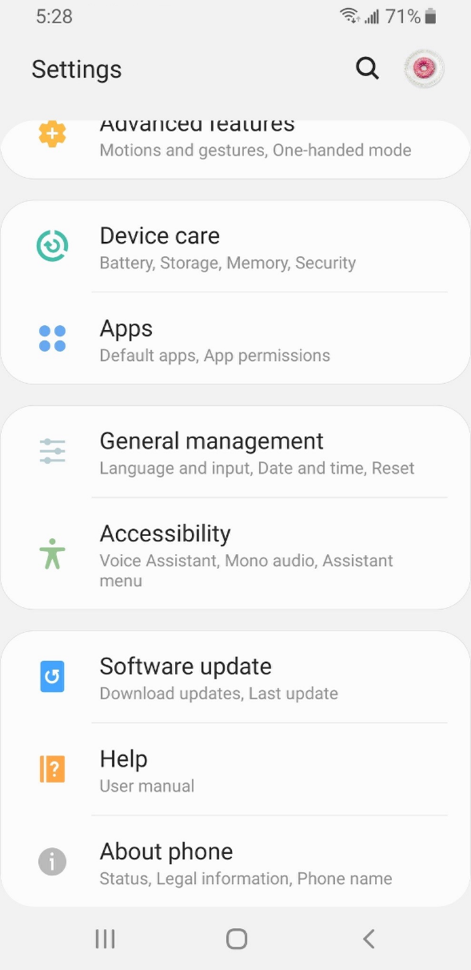





Accessibility
Notes:
Accessibility settings on your mobile device can help you customize your phone to meet your visual, physical, motion, or hearing needs. To find the accessibility features, tap on Settings. Then scroll down the page and tap Accessibility.
Common features to explore include a voice assistant to get spoken guidance to navigate the device without needing to see the screen; changing text size, contrast, and display color of the screen; adjusting audio settings; and enhancing or changing the touch interactions.
INSTRUCTOR NOTE: Please recommend that learners explore these features on their own after the workshop. The Learner Handout includes this recommendation.

Slide 39
Activity #4
Notes:
INSTRUCTOR NOTE: Point attendees to Activity 4 on Activity Sheet pages 4 and 5.

Slide 40
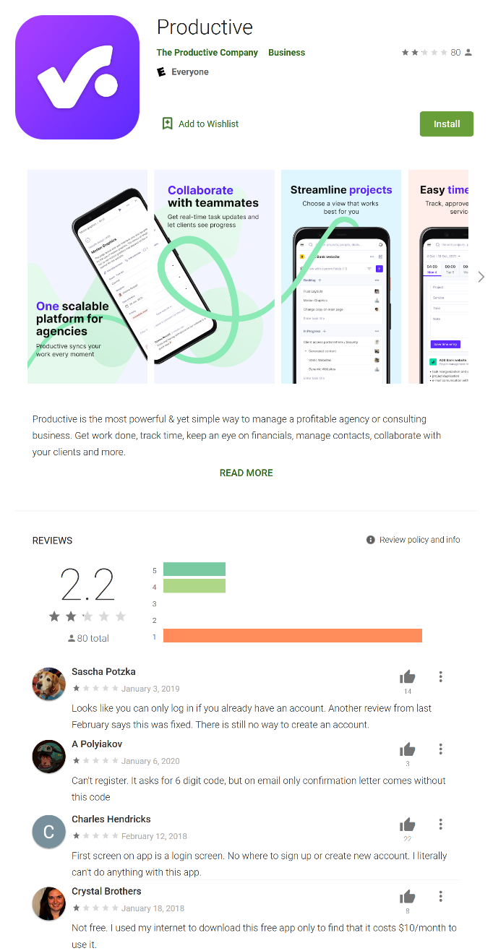
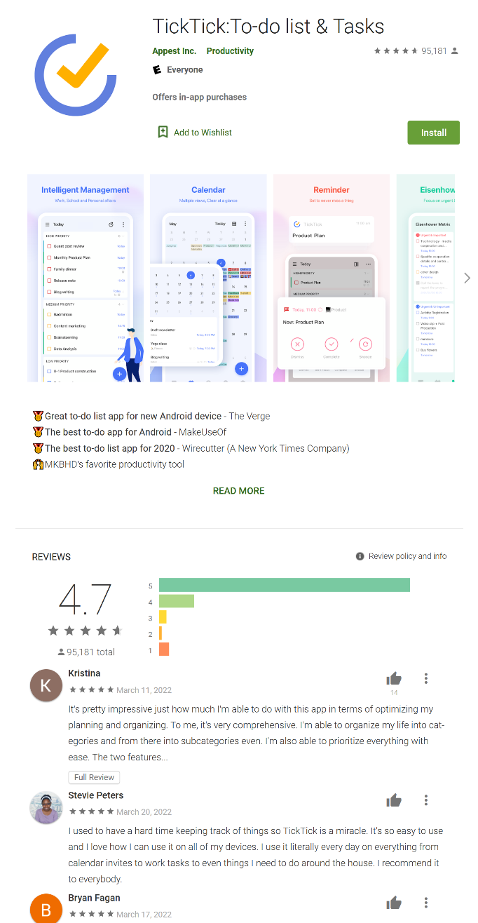
Which of these apps seems more trusted?
Notes:
INSTRUCTOR NOTE: When learners have completed the activity, lead a discussion on what people came up with.
Which of these apps seems more trusted? How do you know?
Answer: The second one is the more trusted. In the first app, the reviews average 2.2. The reviews discuss that the app isn’t free, and that they can’t figure out how to log in. The second app has very good reviews. It also tells you that there are in-app purchases (this information increases trust).

Slide 41
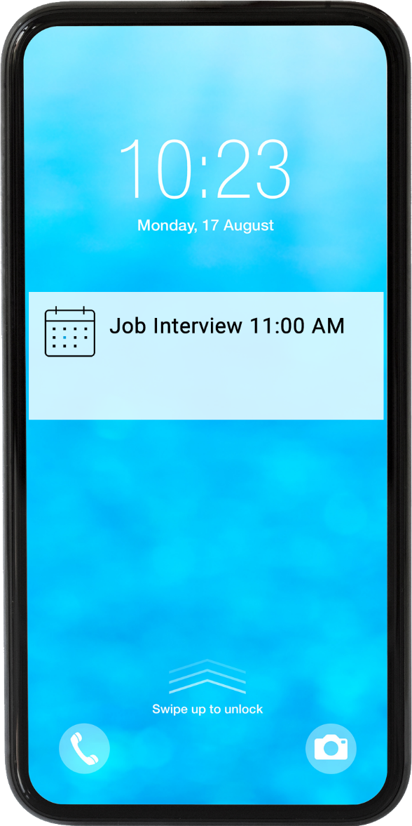
What might be a problem? How could you address it?
Notes:
Imagine you’re at work talking with some co-workers. Even though your phone is locked, you receive this notification. What might be a problem in this situation? How could you address this problem?
Answer: The problem is that you may want this information to be kept private, especially if co-workers could see it. Do you want your co-workers to know you have a job interview? To address this problem, you would go to Settings and then Privacy Settings. Then you would change your notification settings.
INSTRUCTOR NOTE: Allow learners a few minutes to find this setting on their phones and support them as needed.

Slide 42
Security Tips
Set a passcode on each of your devices.
Download trusted apps only.
Review your privacy settings and adjust them as needed.
Adjust notifications to change what appears on the lock screen.
Check that apps and the operating system are up to date.
Notes:
Here are some security tips to keep you and your mobile device safe.
Set a passcode on each of your mobile devices to prevent someone from accessing the information stored on a device if it is lost or stolen.
Download trusted apps only. You can determine this by reading reviews, ratings, and privacy statements.
Review the privacy settings on your device. Adjust your settings to control which apps have permission to access your camera, location, microphone, and personal information.
Adjust your notifications to change how much content will display on the lock screen when messages come in.
Check that the apps and operating system are running the most up-to-date versions available, or set these to automatically update.

Slide 43
Activity #5
In web browser address bar, type:
https://www.digitallearn.org
Notes:
In this activity, we will practice what we’ve covered and see what everyone has learned.
Open a web browser and type www.digitallearn.org in the address bar. Click on “Using a Mobile Device (Android).” Then click on “Lesson 7: Practice.”
INSTRUCTOR NOTE: Allow learners several minutes to work on the Practice lesson. Then go through the Practice lesson as a demo and have learners answer the questions. Learners can also complete this activity on their mobile device by going to the web address above.

Slide 44
Questions
Anything you want to ask or clarify before we end?
Notes:
INSTRUCTOR NOTE: Ask if there are any other final questions and answer any outstanding ones that may have been missed in the “parking lot” sections. For information about what the parking lot is, see the “Before the Workshop Begins” section of the Instructor Guide.

Slide 45
Congratulations!
Today you have:
  Learned about Android mobile devices
  Built skills to:
    Navigate your device
    Get connected to Wi-Fi
    Identify common apps
    Identify helpful settings
  Learned useful tips to connect to Wi-Fi and use your device safely
Notes:
Congratulations! Today you have:
Learned about Android mobile devices
Built skills to:
Navigate your device
Get connected to Wi-Fi
Identify common apps
Identify helpful settings
Learned useful tips to connect to Wi-Fi and use your device safely
INSTRUCTOR NOTE: Provide each learner with a Certificate of Completion.

Slide 46
Today’s training is provided by AT&T and the Public Library Association.
Visit <insert libraries URL here> and https://www.digitallearn.org for more courses and to build confidence using technology.
Provided by AT&T and Public Library Association.
Notes:
INSTRUCTOR NOTE: Point the learners to additional courses that are available. Draw learners’ attention to the website address in the slide.

Slide 47
Thank you for coming!
THANK YOU FOR COMING!
Provided by AT&T and Public Library Association.
Notes:
Thanks again to AT&T and PLA for this workshop. We appreciate all our participants for coming and we encourage you to keep learning!

