Slide 1

LinkedIn: Tips & Tricks
Monica Dombrowski
Technology Education Manager
Gail Borden Public Library
Courtesy of Gail Borden Public Library
and the Public Library Association

Slide 2
Agenda
Endorsements
Recommendations
Groups
Companies
Jobs
Privacy Settings
Notes:
How presentation will benefit audience: Adult learners are more interested in a subject if they know how or why it is important to them.
Presenter’s level of expertise in the subject: Briefly state your credentials in this area, or explain why participants should listen to you.

Slide 3
Endorsements
Notes:
How presentation will benefit audience: Adult learners are more interested in a subject if they know how or why it is important to them.
Presenter’s level of expertise in the subject: Briefly state your credentials in this area, or explain why participants should listen to you.

Slide 4
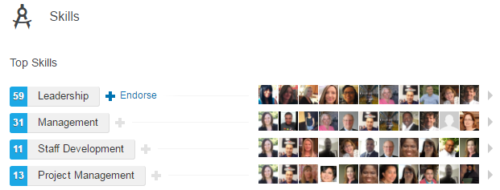
About Endorsements
Confirmation from Connections that you have a skill
Lend credibility to a Profile
Help users call attention to specific areas of expertise
Can be given and received
Appear in the Skills section of the Profile
Notes:
How presentation will benefit audience: Adult learners are more interested in a subject if they know how or why it is important to them.
Presenter’s level of expertise in the subject: Briefly state your credentials in this area, or explain why participants should listen to you.

Slide 5
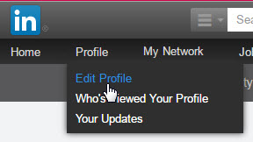
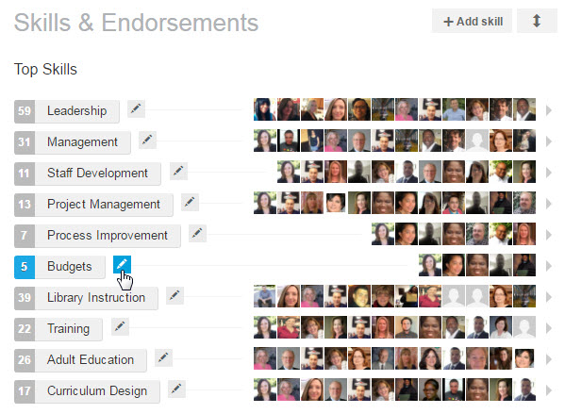
Getting Endorsements
In the top toolbar, click on the Profile hyperlink and select the Edit Profile option from the drop-down list
Scroll to the Skills & Endorsements section and click on the icon next to any of the skills listed
Notes:
How presentation will benefit audience: Adult learners are more interested in a subject if they know how or why it is important to them.
Presenter’s level of expertise in the subject: Briefly state your credentials in this area, or explain why participants should listen to you.

Slide 6
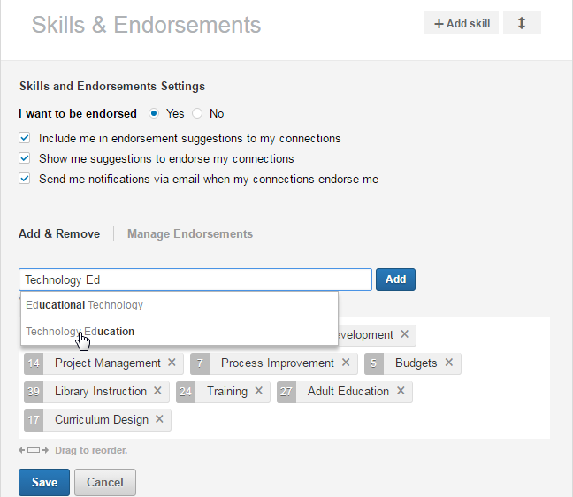
Getting Endorsements
Click on Yes next to the I want to be endorsed option
Check the box next to the Include me in endorsement suggestions to my connections option
Check or uncheck the box next to the Send me notifications via email when my connections endorse me option
Click the Save button at the bottom of the section
Notes:
How presentation will benefit audience: Adult learners are more interested in a subject if they know how or why it is important to them.
Presenter’s level of expertise in the subject: Briefly state your credentials in this area, or explain why participants should listen to you.

Slide 7
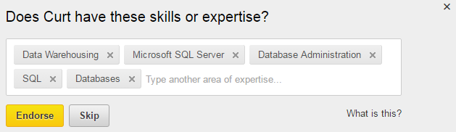
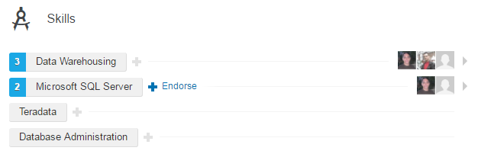
Endorsing Connections
Two methods for endorsing Connections:
Using the wizard on their Profile page
In the Skills section on their Profile page
Notes:
How presentation will benefit audience: Adult learners are more interested in a subject if they know how or why it is important to them.
Presenter’s level of expertise in the subject: Briefly state your credentials in this area, or explain why participants should listen to you.

Slide 8
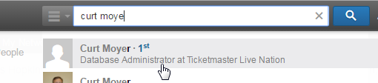
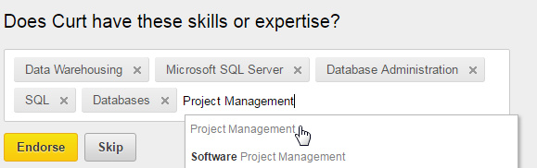
Using the Wizard
Follow these steps to use the wizard:
Type a Connection’s name in the search box at the top of the page
Click on the Connection’s name when it appears
Click on the Endorse button to endorse the skills listed
OR
Click the Type another area of expertise field to enter a new skill
Click on the Endorse button
Notes:
How presentation will benefit audience: Adult learners are more interested in a subject if they know how or why it is important to them.
Presenter’s level of expertise in the subject: Briefly state your credentials in this area, or explain why participants should listen to you.

Slide 9
In The Skills Section
Follow these steps to endorse a Connection in the Skills section:
Type a Connection’s name in the search box at the top of the page
Click on the Connection’s name when it appears
Scroll to the Skills section
Click on the Endorse button next to any skill
Notes:
How presentation will benefit audience: Adult learners are more interested in a subject if they know how or why it is important to them.
Presenter’s level of expertise in the subject: Briefly state your credentials in this area, or explain why participants should listen to you.

Slide 10
Activity #1
Notes:
How presentation will benefit audience: Adult learners are more interested in a subject if they know how or why it is important to them.
Presenter’s level of expertise in the subject: Briefly state your credentials in this area, or explain why participants should listen to you.

Slide 11
Recommendations
Notes:
How presentation will benefit audience: Adult learners are more interested in a subject if they know how or why it is important to them.
Presenter’s level of expertise in the subject: Briefly state your credentials in this area, or explain why participants should listen to you.

Slide 12
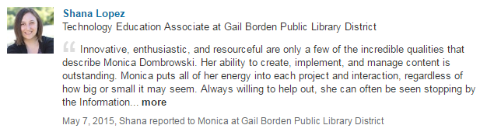
About Recommendations
Like reference letters written by and for Connections
Provide testimonials about past performance from those who can provide insight (former bosses, employees, etc.)
Appear in two places:
  The Recommendations section of the Profile page
  Under the position for which they were written
Notes:
How presentation will benefit audience: Adult learners are more interested in a subject if they know how or why it is important to them.
Presenter’s level of expertise in the subject: Briefly state your credentials in this area, or explain why participants should listen to you.

Slide 13
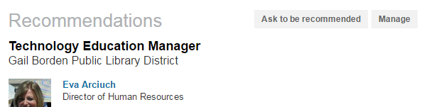
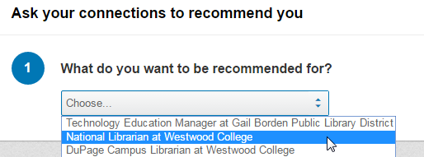
Requesting Recommendations
Follow these steps to use the wizard:
Scroll to the Recommendations section of the Profile and click on the Ask to be recommended button that appears
On the Recommendations page, select a position from the drop-down list in the What you’d like to be recommended for box
Notes:
How presentation will benefit audience: Adult learners are more interested in a subject if they know how or why it is important to them.
Presenter’s level of expertise in the subject: Briefly state your credentials in this area, or explain why participants should listen to you.

Slide 14
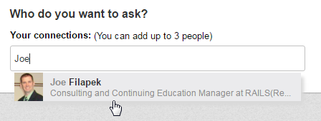
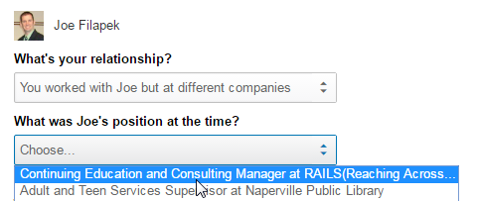
Requesting Recommendations
Type a Connection name (you can enter up to 3) in the Who do you want to ask box and select the appropriate Connection from the drop-down list
Choose a relationship and position from the drop-down lists in the What’s your relationship? and What was (Connection’s name) position at the time? boxes
Notes:
How presentation will benefit audience: Adult learners are more interested in a subject if they know how or why it is important to them.
Presenter’s level of expertise in the subject: Briefly state your credentials in this area, or explain why participants should listen to you.

Slide 15
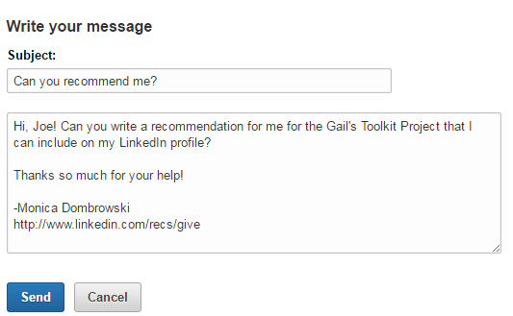
Requesting Recommendations
Type a personalized message into the Write your message box, or use the one that auto-fills, as desired
Click on the Send button
Notes:
How presentation will benefit audience: Adult learners are more interested in a subject if they know how or why it is important to them.
Presenter’s level of expertise in the subject: Briefly state your credentials in this area, or explain why participants should listen to you.

Slide 16
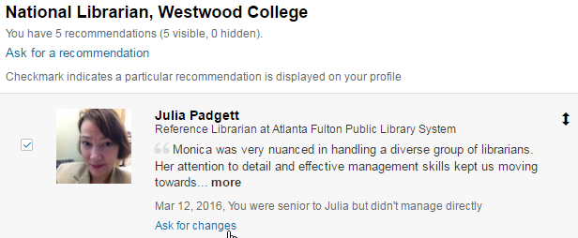
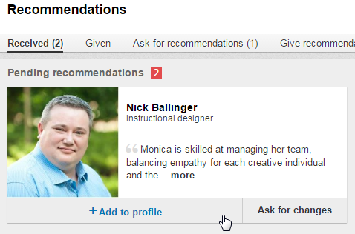
Recommendation Actions
Recommendations received from Connections are visible in the Received section of the Recommendations page
Users can take the following actions regarding Recommendations they’ve received:
Add them to their profiles
Ask for modifications to Recommendations
Hide or change the display order on their Profile pages
Notes:
How presentation will benefit audience: Adult learners are more interested in a subject if they know how or why it is important to them.
Presenter’s level of expertise in the subject: Briefly state your credentials in this area, or explain why participants should listen to you.

Slide 17

Writing Recommendations
Follow these steps to use the wizard:
Scroll to the Recommendations section of the Profile and click on the Manage button that appears (if already on the Recommendations page, skip this step)
Click on the Give recommendations link at the top of the page
Notes:
How presentation will benefit audience: Adult learners are more interested in a subject if they know how or why it is important to them.
Presenter’s level of expertise in the subject: Briefly state your credentials in this area, or explain why participants should listen to you.

Slide 18
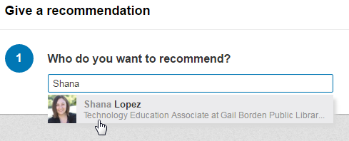
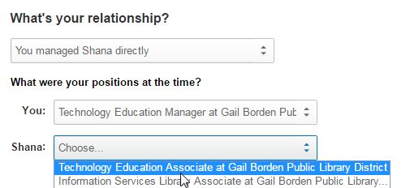
Writing Recommendations
Type a Connection name into the Who do you want to recommend? box and select the appropriate Connection name
Choose a relationship and your respective positions from the drop-down list in the What’s your relationship? and What were your positions at the time? boxes
Notes:
How presentation will benefit audience: Adult learners are more interested in a subject if they know how or why it is important to them.
Presenter’s level of expertise in the subject: Briefly state your credentials in this area, or explain why participants should listen to you.

Slide 19
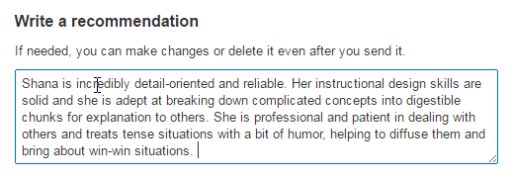
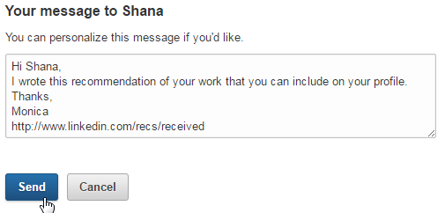
Writing Recommendations
Type your recommendation into the Write a recommendation box
Type a personalized message, if desired, into the Your Message to box
Click on the Send button
Notes:
How presentation will benefit audience: Adult learners are more interested in a subject if they know how or why it is important to them.
Presenter’s level of expertise in the subject: Briefly state your credentials in this area, or explain why participants should listen to you.

Slide 20
Activity #2
Notes:
How presentation will benefit audience: Adult learners are more interested in a subject if they know how or why it is important to them.
Presenter’s level of expertise in the subject: Briefly state your credentials in this area, or explain why participants should listen to you.

Slide 21
Groups
Notes:
How presentation will benefit audience: Adult learners are more interested in a subject if they know how or why it is important to them.
Presenter’s level of expertise in the subject: Briefly state your credentials in this area, or explain why participants should listen to you.

Slide 22
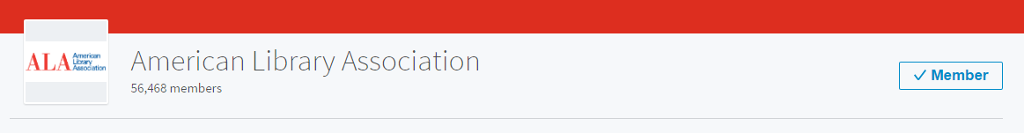
About Groups
Groups are how users engage with others who have similar interests
Groups provides a portal for networking, participating in conversations, sharing information and articles, and even finding job leads
Users must join Groups
Users control settings that determine how much information they see
Notes:
How presentation will benefit audience: Adult learners are more interested in a subject if they know how or why it is important to them.
Presenter’s level of expertise in the subject: Briefly state your credentials in this area, or explain why participants should listen to you.

Slide 23
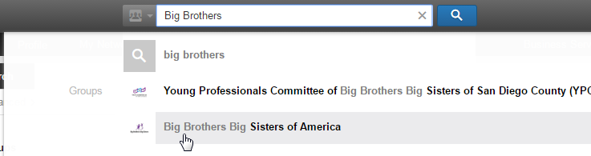
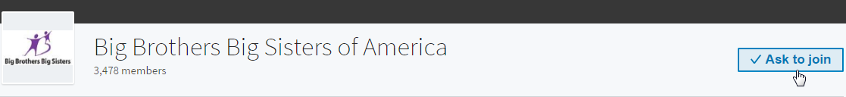
Finding a Group
If you know the name of a group you want to join, follow these steps:
Type the name of the group into the search box at the top of the page and click on the group name when it appears
Click on the Ask to join button next to the Group name
Notes:
How presentation will benefit audience: Adult learners are more interested in a subject if they know how or why it is important to them.
Presenter’s level of expertise in the subject: Briefly state your credentials in this area, or explain why participants should listen to you.

Slide 24
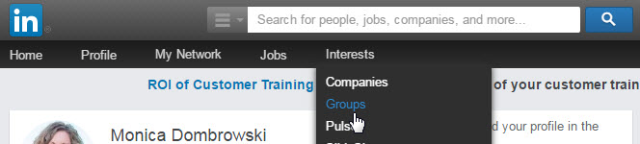
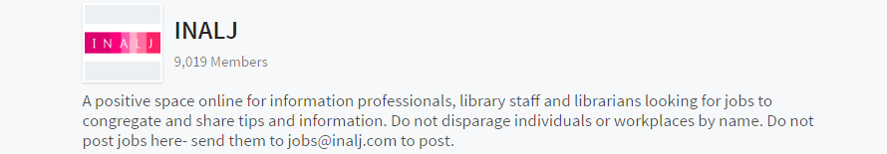
Browsing Groups
To browse LinkedIn Groups, follow these steps:
Click on the Interests hyperlink in the top toolbar and select Groups from the drop-down list
Click on the Discover link on the Groups home page
Notes:
How presentation will benefit audience: Adult learners are more interested in a subject if they know how or why it is important to them.
Presenter’s level of expertise in the subject: Briefly state your credentials in this area, or explain why participants should listen to you.

Slide 25
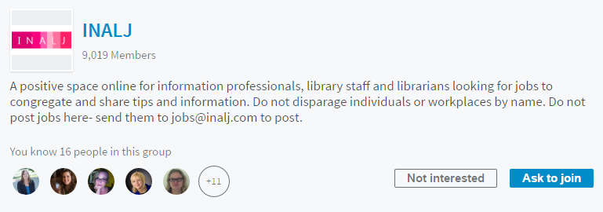
Browsing Groups
Review Connections who already belong to the Group and click on the Ask to join button if you wish to become a member
Notes:
How presentation will benefit audience: Adult learners are more interested in a subject if they know how or why it is important to them.
Presenter’s level of expertise in the subject: Briefly state your credentials in this area, or explain why participants should listen to you.

Slide 26

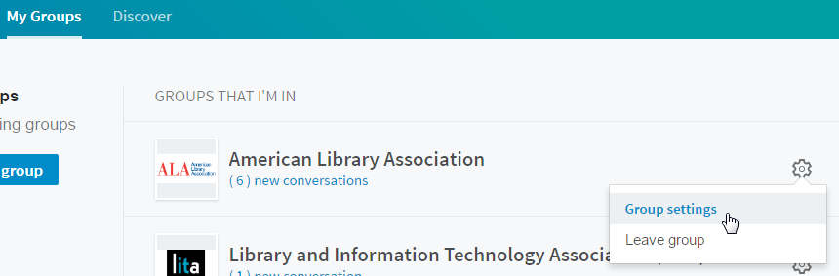
Adjusting Group Settings
To adjust Group settings, follow these steps:
Click on the My Groups hyperlink in the toolbar
Scroll to the desired group and click on the icon
Click on the Group settings hyperlink
1
2
3
Notes:
How presentation will benefit audience: Adult learners are more interested in a subject if they know how or why it is important to them.
Presenter’s level of expertise in the subject: Briefly state your credentials in this area, or explain why participants should listen to you.

Slide 27
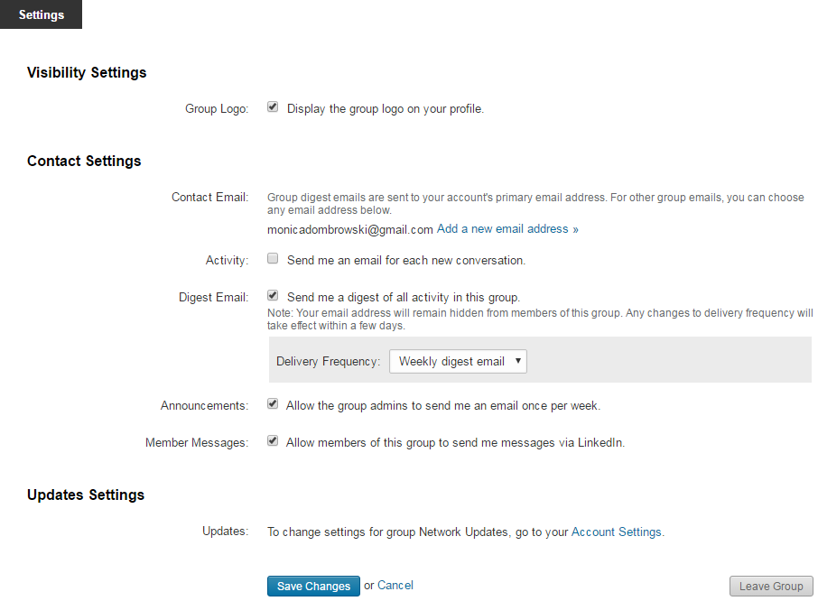
Adjusting Group Settings
Adjust the various settings, as desired, and click on the Save Changes button
Notes:
How presentation will benefit audience: Adult learners are more interested in a subject if they know how or why it is important to them.
Presenter’s level of expertise in the subject: Briefly state your credentials in this area, or explain why participants should listen to you.

Slide 28
Activity #3
Notes:
How presentation will benefit audience: Adult learners are more interested in a subject if they know how or why it is important to them.
Presenter’s level of expertise in the subject: Briefly state your credentials in this area, or explain why participants should listen to you.

Slide 29
Companies
Notes:
How presentation will benefit audience: Adult learners are more interested in a subject if they know how or why it is important to them.
Presenter’s level of expertise in the subject: Briefly state your credentials in this area, or explain why participants should listen to you.

Slide 30
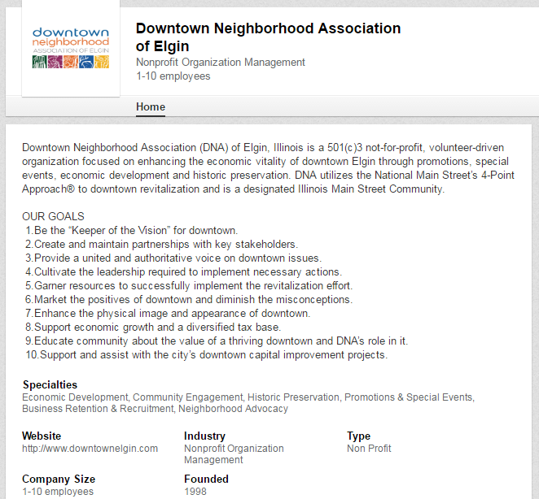
About Companies
Users “follow” companies to see news, events, and updates
More one-way communication with chances to comment or “like”
No setting adjustments
Great for finding out about a company’s culture, leaders, and job openings!
Notes:
How presentation will benefit audience: Adult learners are more interested in a subject if they know how or why it is important to them.
Presenter’s level of expertise in the subject: Briefly state your credentials in this area, or explain why participants should listen to you.

Slide 31
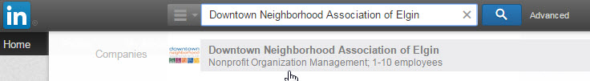
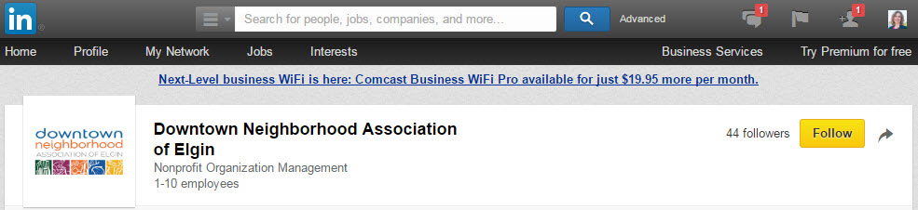
Following Companies
To follow a company, complete these steps:
Type the name of the company into the search box at the top of the page and click on the company name when it appears
Click on the Follow button next to the company name
Notes:
How presentation will benefit audience: Adult learners are more interested in a subject if they know how or why it is important to them.
Presenter’s level of expertise in the subject: Briefly state your credentials in this area, or explain why participants should listen to you.

Slide 32
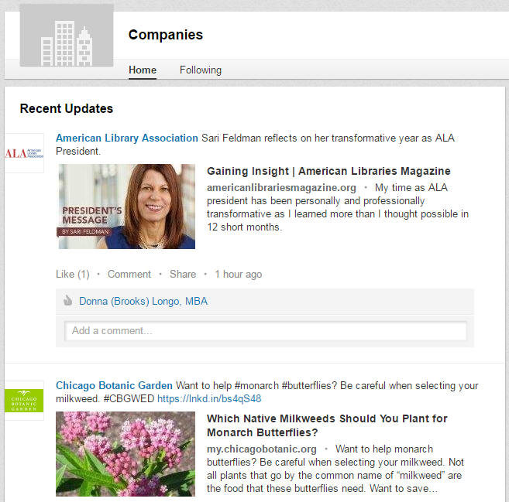
Company News Feed
Company News Feed
Notes:
How presentation will benefit audience: Adult learners are more interested in a subject if they know how or why it is important to them.
Presenter’s level of expertise in the subject: Briefly state your credentials in this area, or explain why participants should listen to you.

Slide 33
Activity #4
Notes:
How presentation will benefit audience: Adult learners are more interested in a subject if they know how or why it is important to them.
Presenter’s level of expertise in the subject: Briefly state your credentials in this area, or explain why participants should listen to you.

Slide 34
Jobs
Notes:
How presentation will benefit audience: Adult learners are more interested in a subject if they know how or why it is important to them.
Presenter’s level of expertise in the subject: Briefly state your credentials in this area, or explain why participants should listen to you.

Slide 35
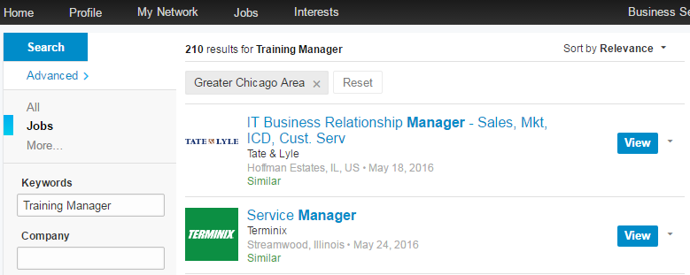
About Jobs
As of June 2016, over 6.8 million jobs posted on LinkedIn
94% of recruiters using LinkedIn to research candidates
Contains features that allow users to:
  Save jobs/job searches and receive email notifications
  Limit search results by geographical area
  Apply for jobs or link to employer websites
Notes:
How presentation will benefit audience: Adult learners are more interested in a subject if they know how or why it is important to them.
Presenter’s level of expertise in the subject: Briefly state your credentials in this area, or explain why participants should listen to you.

Slide 36

Searching for Jobs
To search for jobs, follow these steps:
Click on the Jobs hyperlink in the toolbar
Type the desired keywords into the Job title, keywords, or company name box and enter the city or area into the Location box
Click on the Search button
To view a job, click on the View button
Notes:
How presentation will benefit audience: Adult learners are more interested in a subject if they know how or why it is important to them.
Presenter’s level of expertise in the subject: Briefly state your credentials in this area, or explain why participants should listen to you.

Slide 37
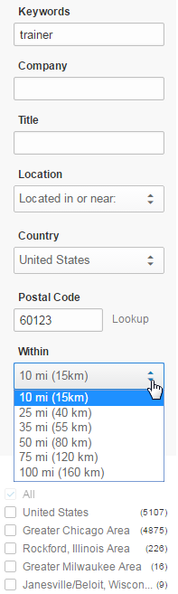
Applying Location Filters
Click on the drop-down list and select the desired proximity
Check the appropriate box(es) from the list of options
Notes:
How presentation will benefit audience: Adult learners are more interested in a subject if they know how or why it is important to them.
Presenter’s level of expertise in the subject: Briefly state your credentials in this area, or explain why participants should listen to you.

Slide 38
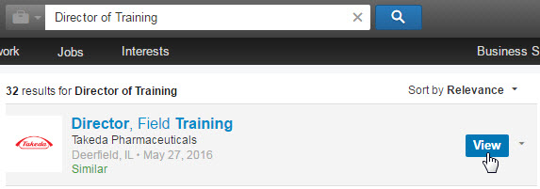
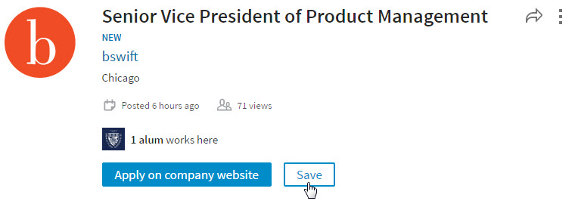
Saving a Job
To save a job, follow these steps:
Click on the View button
Click on the Save button
Notes:
How presentation will benefit audience: Adult learners are more interested in a subject if they know how or why it is important to them.
Presenter’s level of expertise in the subject: Briefly state your credentials in this area, or explain why participants should listen to you.

Slide 39
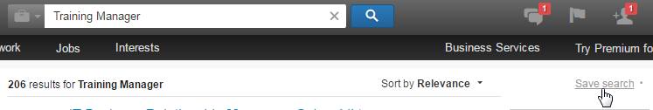
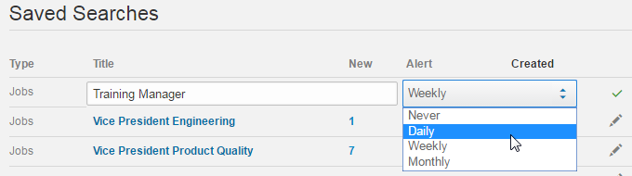
Saving a Job Search
To save a job search, follow these steps:
Click on the Save search hyperlink on the Jobs Search Results page
Select the appropriate option from the Alert drop-down list
Click on the button to save the search
Notes:
How presentation will benefit audience: Adult learners are more interested in a subject if they know how or why it is important to them.
Presenter’s level of expertise in the subject: Briefly state your credentials in this area, or explain why participants should listen to you.

Slide 40
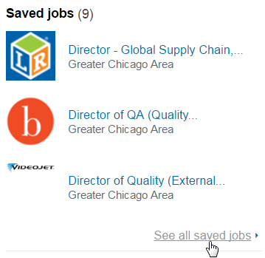

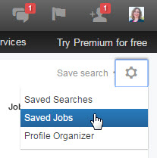
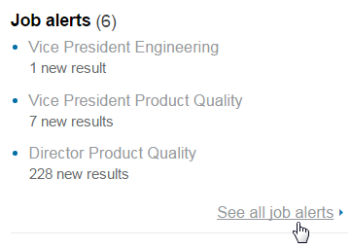
Accessing Saved Jobs/Searches
Access saved job searches and jobs using one of these methods:
From the Jobs Search Results page, click on the icon and select Saved Searches or Saved Jobs
From the Jobs homepage, click on the See all saved jobs hyperlink or See all job alerts hyperlink
Notes:
How presentation will benefit audience: Adult learners are more interested in a subject if they know how or why it is important to them.
Presenter’s level of expertise in the subject: Briefly state your credentials in this area, or explain why participants should listen to you.

Slide 41
Activity #5
Notes:
How presentation will benefit audience: Adult learners are more interested in a subject if they know how or why it is important to them.
Presenter’s level of expertise in the subject: Briefly state your credentials in this area, or explain why participants should listen to you.

Slide 42
Privacy Settings
Notes:
How presentation will benefit audience: Adult learners are more interested in a subject if they know how or why it is important to them.
Presenter’s level of expertise in the subject: Briefly state your credentials in this area, or explain why participants should listen to you.

Slide 43
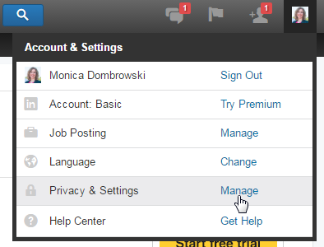
Accessing Privacy Settings
To access Account Settings, follow these steps:
Click on your profile picture in the upper toolbar
Scroll to the Privacy & Settings option in the drop-down list and click on the Manage hyperlink
Notes:
How presentation will benefit audience: Adult learners are more interested in a subject if they know how or why it is important to them.
Presenter’s level of expertise in the subject: Briefly state your credentials in this area, or explain why participants should listen to you.

Slide 44
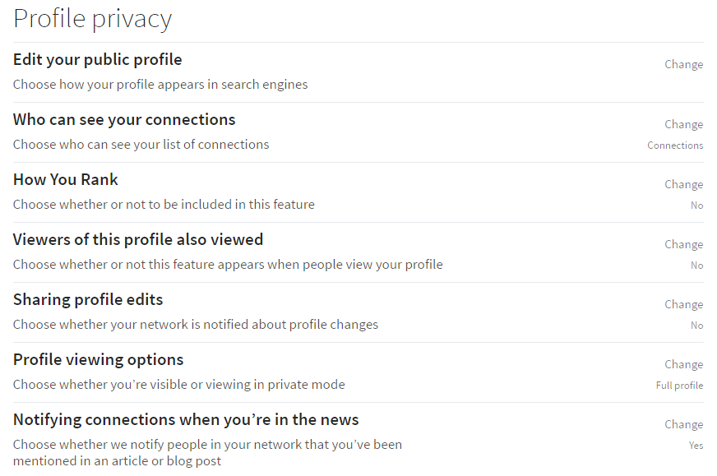
Profile Privacy
Notes:
How presentation will benefit audience: Adult learners are more interested in a subject if they know how or why it is important to them.
Presenter’s level of expertise in the subject: Briefly state your credentials in this area, or explain why participants should listen to you.

Slide 45
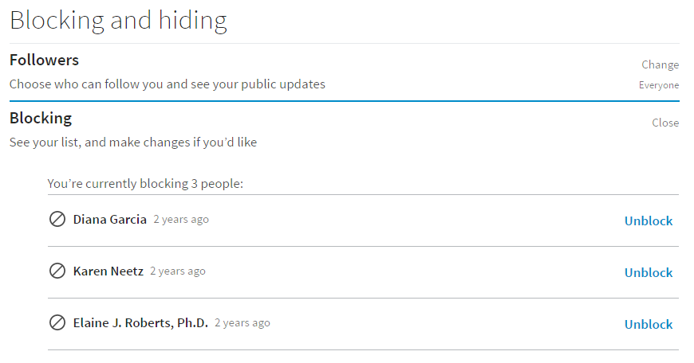
Blocking & Hiding
Notes:
How presentation will benefit audience: Adult learners are more interested in a subject if they know how or why it is important to them.
Presenter’s level of expertise in the subject: Briefly state your credentials in this area, or explain why participants should listen to you.

Slide 46
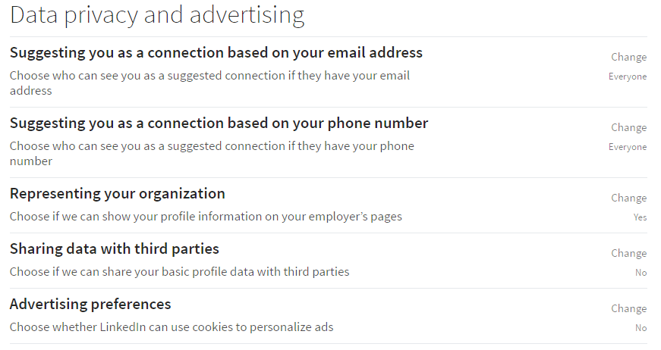
Data Privacy & Advertising
Notes:
How presentation will benefit audience: Adult learners are more interested in a subject if they know how or why it is important to them.
Presenter’s level of expertise in the subject: Briefly state your credentials in this area, or explain why participants should listen to you.

Slide 47
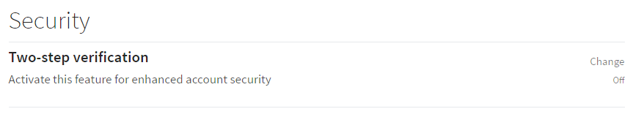
Security
Notes:
How presentation will benefit audience: Adult learners are more interested in a subject if they know how or why it is important to them.
Presenter’s level of expertise in the subject: Briefly state your credentials in this area, or explain why participants should listen to you.

Slide 48
Activity #6
Notes:
How presentation will benefit audience: Adult learners are more interested in a subject if they know how or why it is important to them.
Presenter’s level of expertise in the subject: Briefly state your credentials in this area, or explain why participants should listen to you.

Slide 49
Questions?
Thank You!!!
mdombrowski@gailborden.info
slopez@gailborden.info
Notes:
Thank participants for coming and remind them of the URL.
Provide each with a handout and class survey.
Encourage them to sign up for class two in the series.

