Slide 1

LinkedIn: Getting Started
Monica Dombrowski
Technology Education Manager
Gail Borden Public Library
Courtesy of Gail Borden Public Library
and the Public Library Association

Slide 2
Agenda
Creating a Profile
Making Connections
Notes:
How presentation will benefit audience: Adult learners are more interested in a subject if they know how or why it is important to them.
Presenter’s level of expertise in the subject: Briefly state your credentials in this area, or explain why participants should listen to you.

Slide 3
Creating a Profile
Notes:
How presentation will benefit audience: Adult learners are more interested in a subject if they know how or why it is important to them.
Presenter’s level of expertise in the subject: Briefly state your credentials in this area, or explain why participants should listen to you.

Slide 4
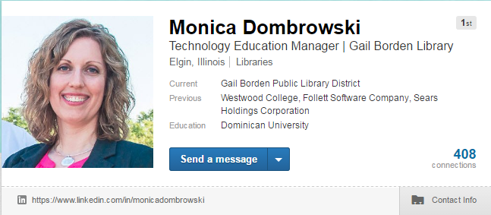
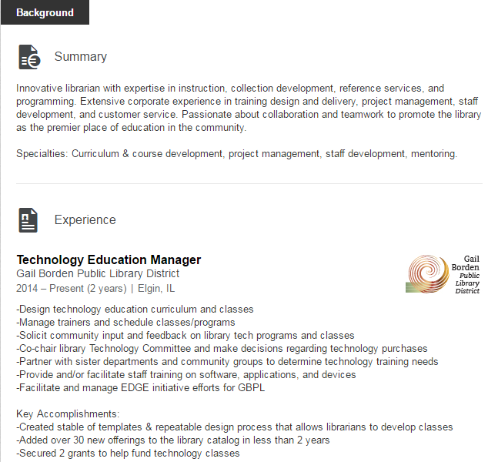
Profile
Meat and potatoes
Online portfolio
Strengthens your brand

Slide 5
Profile Sections
Headline
Language
Volunteering
Test Scores
Patents
Causes You Care About
Supported Organizations
Publications
Certifications
Interests
Personal Details
Posts
Summary
Experience
Projects
Organizations
Education
Skills & Endorsements
Recommendations
Groups
Following
Notes:
How presentation will benefit audience: Adult learners are more interested in a subject if they know how or why it is important to them.
Presenter’s level of expertise in the subject: Briefly state your credentials in this area, or explain why participants should listen to you.

Slide 6
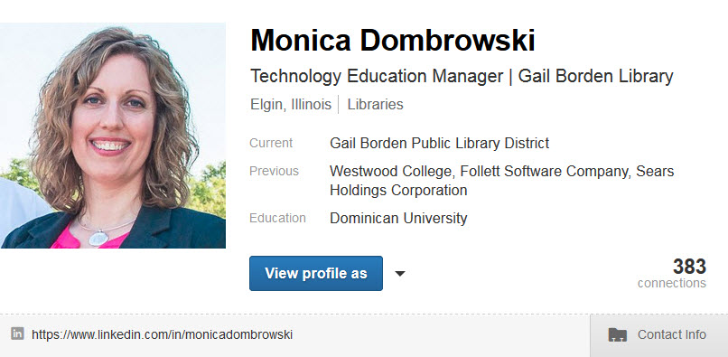
Headline
Similar to a virtual business card
Elements:
        Photo
        Name
        Title
        Company
        Location
        Industry
        Current Employer
        Previous Employer
        Education
        LinkedIn URL
        Contact Information
Notes:
How presentation will benefit audience: Adult learners are more interested in a subject if they know how or why it is important to them.
Presenter’s level of expertise in the subject: Briefly state your credentials in this area, or explain why participants should listen to you.

Slide 7
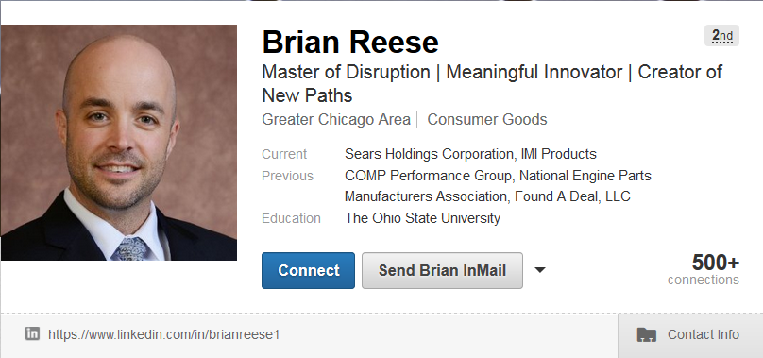
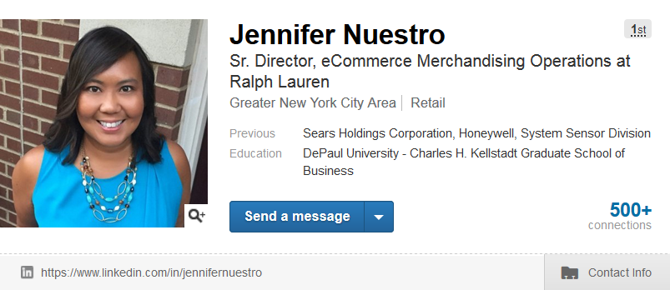
Examples
Can you tell what these two people do based on their headlines?
Notes:
How presentation will benefit audience: Adult learners are more interested in a subject if they know how or why it is important to them.
Presenter’s level of expertise in the subject: Briefly state your credentials in this area, or explain why participants should listen to you.

Slide 8
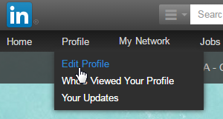
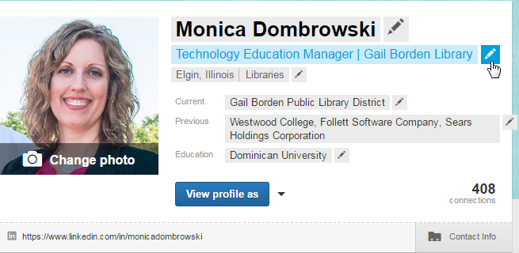
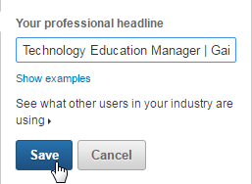
To Edit Fields in LinkedIn:
Click on Profile > Edit Profile
Hover over the field you want to edit
When the pencil icon appears, click on it
Make your changes, then click on the Save button
Notes:
How presentation will benefit audience: Adult learners are more interested in a subject if they know how or why it is important to them.
Presenter’s level of expertise in the subject: Briefly state your credentials in this area, or explain why participants should listen to you.

Slide 9
Activity #1
Notes:
How presentation will benefit audience: Adult learners are more interested in a subject if they know how or why it is important to them.
Presenter’s level of expertise in the subject: Briefly state your credentials in this area, or explain why participants should listen to you.

Slide 10
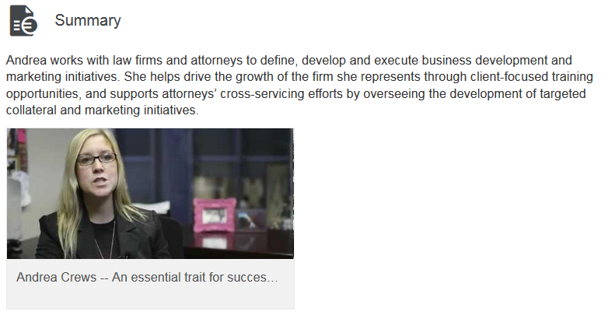
Summary
2-3 sentence summary of skills, talent, and experience
Provides a 30,000 ft view and hooks readers
Uses strong, relevant key words
Mix of business and interpersonal skills
May add specialties and media files, if desired
Notes:
How presentation will benefit audience: Adult learners are more interested in a subject if they know how or why it is important to them.
Presenter’s level of expertise in the subject: Briefly state your credentials in this area, or explain why participants should listen to you.

Slide 11
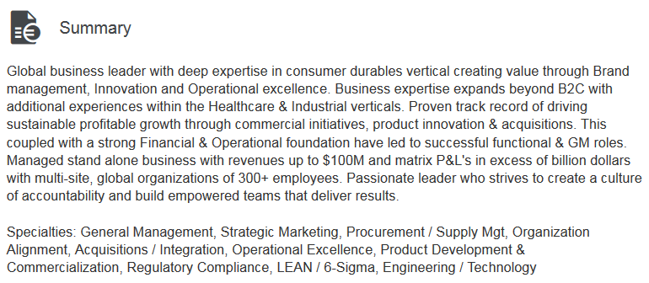
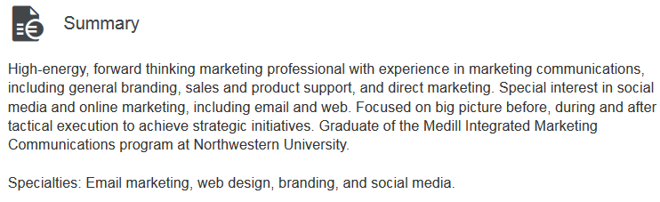
Examples
Notes:
How presentation will benefit audience: Adult learners are more interested in a subject if they know how or why it is important to them.
Presenter’s level of expertise in the subject: Briefly state your credentials in this area, or explain why participants should listen to you.

Slide 12
Activity #2
Notes:
How presentation will benefit audience: Adult learners are more interested in a subject if they know how or why it is important to them.
Presenter’s level of expertise in the subject: Briefly state your credentials in this area, or explain why participants should listen to you.

Slide 13
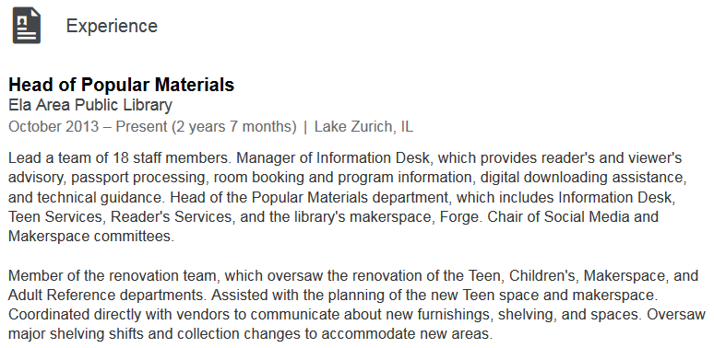
Experience
Similar to the same section on a resume
Forms: narrative (paragraph), bulleted list, or combination
Use strong, action-oriented words and descriptions
Highlight key accomplishments that involve making
money, saving money, saving time, or doing more with less
Notes:
How presentation will benefit audience: Adult learners are more interested in a subject if they know how or why it is important to them.
Presenter’s level of expertise in the subject: Briefly state your credentials in this area, or explain why participants should listen to you.

Slide 14
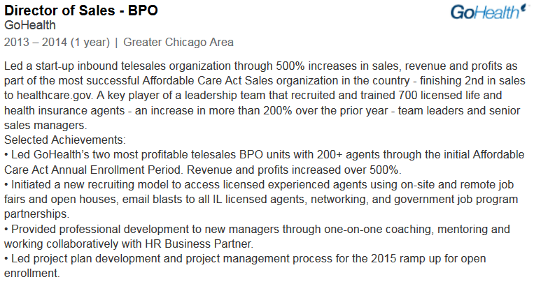
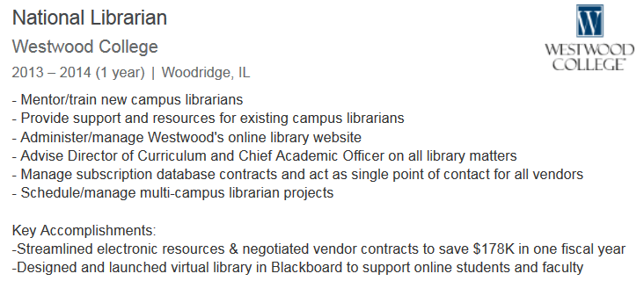
Examples
Notes:
How presentation will benefit audience: Adult learners are more interested in a subject if they know how or why it is important to them.
Presenter’s level of expertise in the subject: Briefly state your credentials in this area, or explain why participants should listen to you.

Slide 15
Activity #3
Notes:
How presentation will benefit audience: Adult learners are more interested in a subject if they know how or why it is important to them.
Presenter’s level of expertise in the subject: Briefly state your credentials in this area, or explain why participants should listen to you.

Slide 16
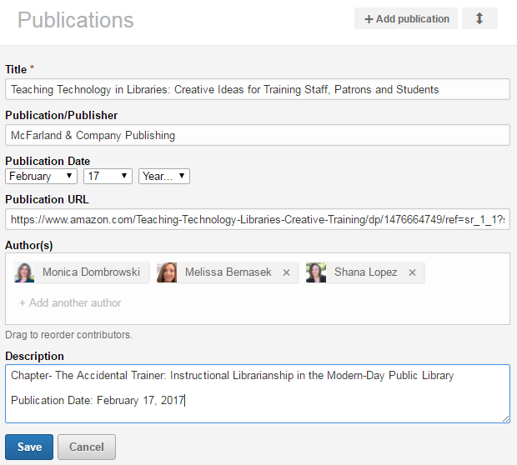
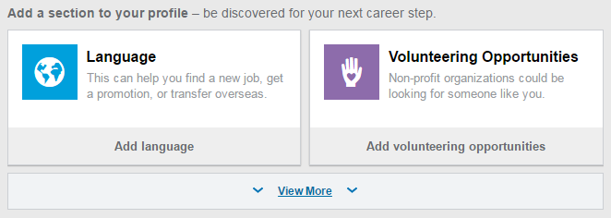
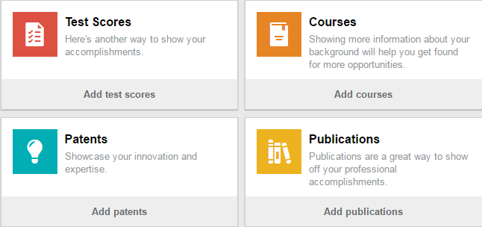
How to Add Sections
3
1
2
Notes:
How presentation will benefit audience: Adult learners are more interested in a subject if they know how or why it is important to them.
Presenter’s level of expertise in the subject: Briefly state your credentials in this area, or explain why participants should listen to you.

Slide 17
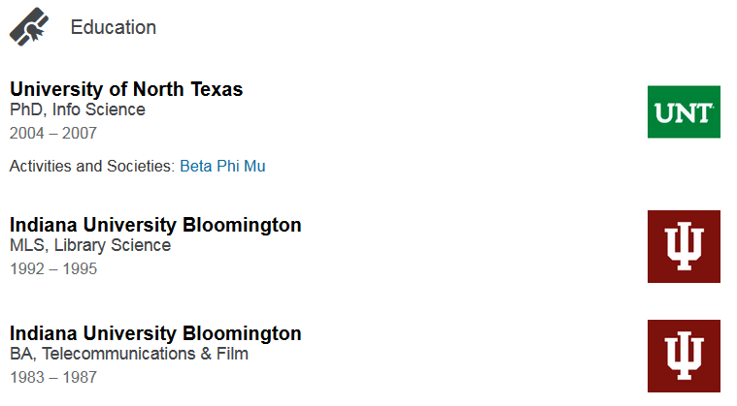
Education
Associate, Bachelor, Master, or Doctorate & degree
If no college, high school
Graduation year and honors are optional
Level of detail is based on personal preference
Notes:
How presentation will benefit audience: Adult learners are more interested in a subject if they know how or why it is important to them.
Presenter’s level of expertise in the subject: Briefly state your credentials in this area, or explain why participants should listen to you.

Slide 18
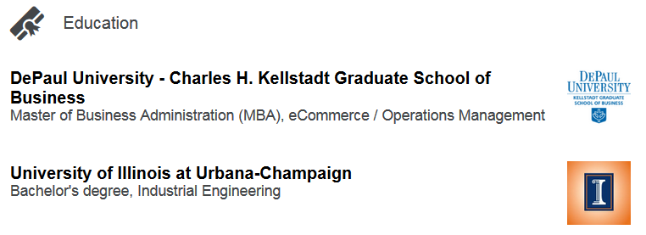
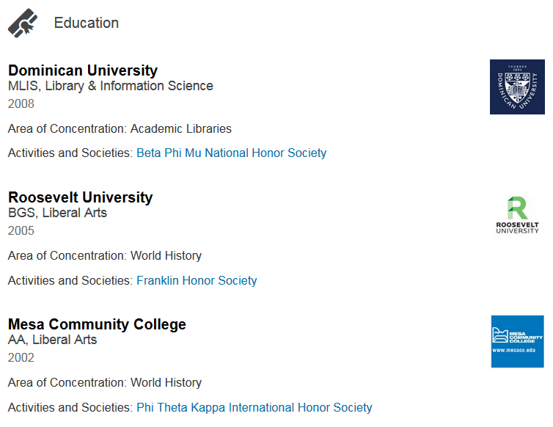
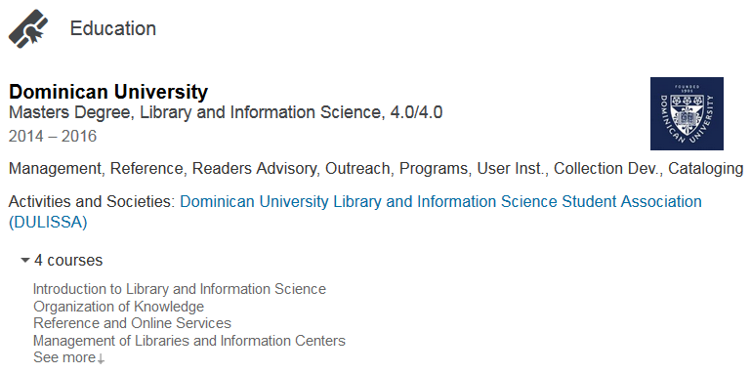
Examples
Notes:
How presentation will benefit audience: Adult learners are more interested in a subject if they know how or why it is important to them.
Presenter’s level of expertise in the subject: Briefly state your credentials in this area, or explain why participants should listen to you.

Slide 19
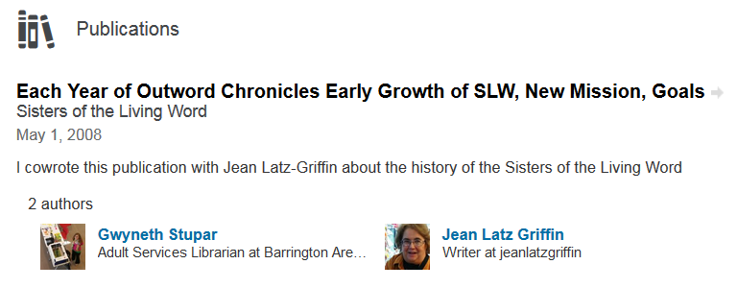
Projects & Publications
Areas to put large projects and articles/papers/books
Appear in their own sections & below related positions
Can include a URL to link directly to website or media
Can include additional project members or collaborators
Notes:
How presentation will benefit audience: Adult learners are more interested in a subject if they know how or why it is important to them.
Presenter’s level of expertise in the subject: Briefly state your credentials in this area, or explain why participants should listen to you.

Slide 20
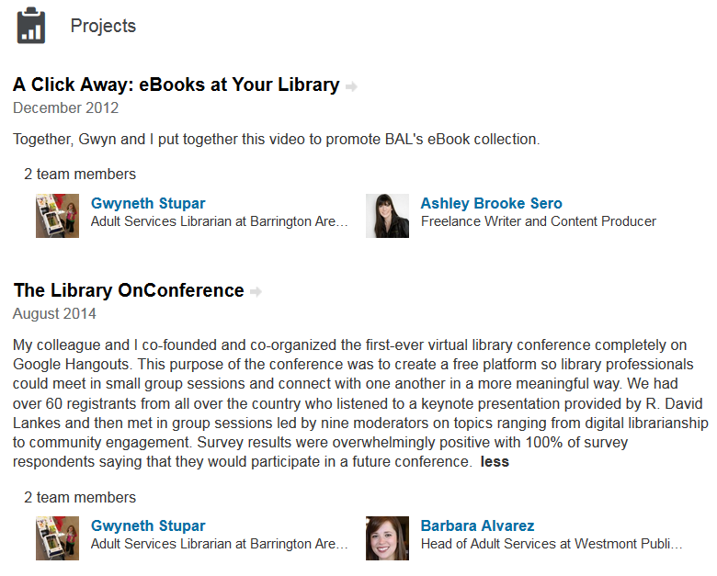
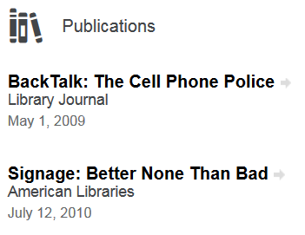
Examples
Projects
Publications
Notes:
How presentation will benefit audience: Adult learners are more interested in a subject if they know how or why it is important to them.
Presenter’s level of expertise in the subject: Briefly state your credentials in this area, or explain why participants should listen to you.

Slide 21
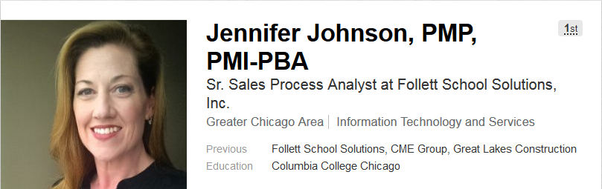
Certifications
Add any required for your profession
Add any that lend credibility to your experience
Optional to list after your name in Headline
Notes:
How presentation will benefit audience: Adult learners are more interested in a subject if they know how or why it is important to them.
Presenter’s level of expertise in the subject: Briefly state your credentials in this area, or explain why participants should listen to you.

Slide 22
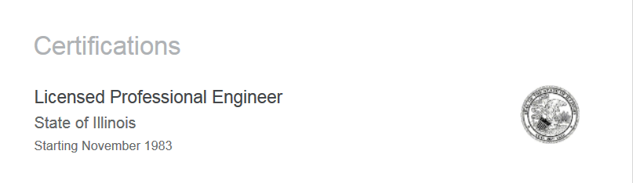
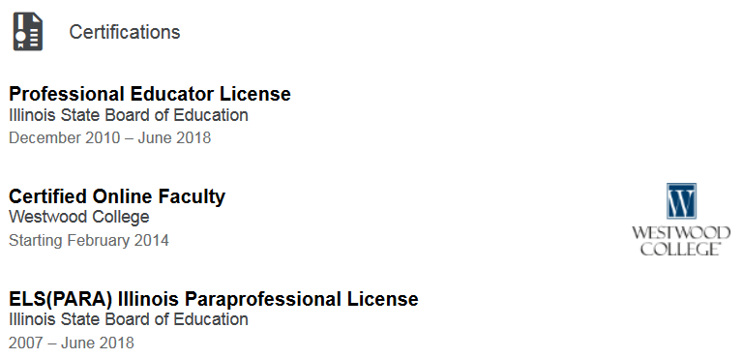
Examples
Notes:
How presentation will benefit audience: Adult learners are more interested in a subject if they know how or why it is important to them.
Presenter’s level of expertise in the subject: Briefly state your credentials in this area, or explain why participants should listen to you.

Slide 23
Activity #4
Notes:
How presentation will benefit audience: Adult learners are more interested in a subject if they know how or why it is important to them.
Presenter’s level of expertise in the subject: Briefly state your credentials in this area, or explain why participants should listen to you.

Slide 24
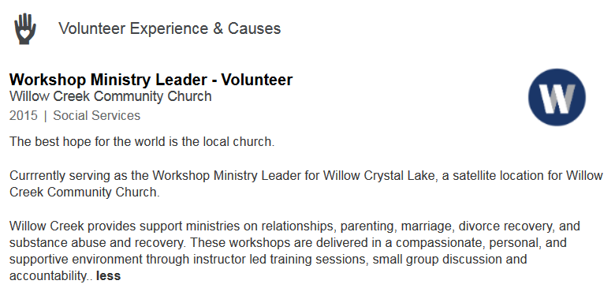
Volunteering
Organizations like candidates who give back
Shows a dedication to developing skill-sets
Helps non-profits strengthen their brands
Including social impact in professional identity is becoming
the norm
Notes:
How presentation will benefit audience: Adult learners are more interested in a subject if they know how or why it is important to them.
Presenter’s level of expertise in the subject: Briefly state your credentials in this area, or explain why participants should listen to you.

Slide 25
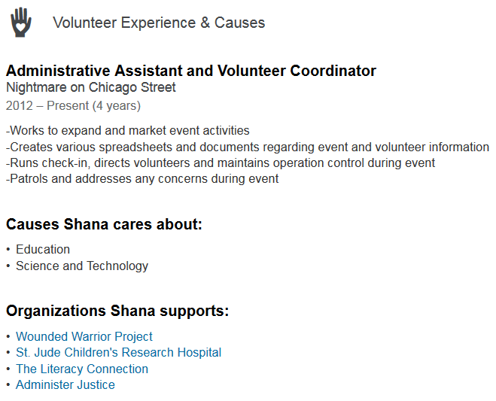
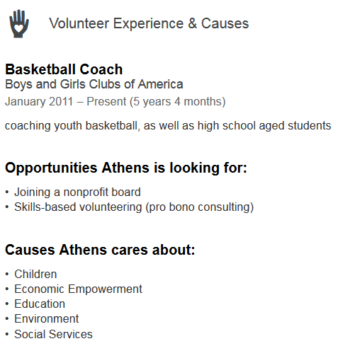
Examples
Notes:
How presentation will benefit audience: Adult learners are more interested in a subject if they know how or why it is important to them.
Presenter’s level of expertise in the subject: Briefly state your credentials in this area, or explain why participants should listen to you.

Slide 26
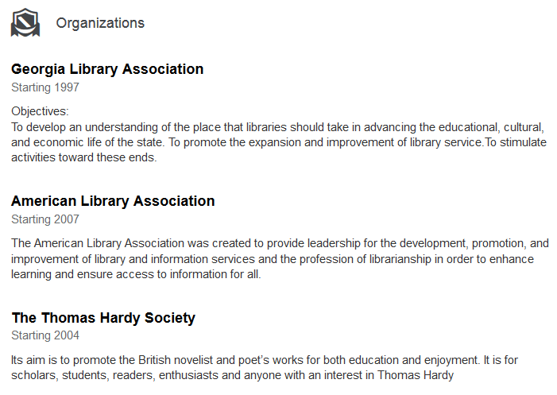
Organizations
Professional associations
Show dedication to field of professional practice
Notes:
How presentation will benefit audience: Adult learners are more interested in a subject if they know how or why it is important to them.
Presenter’s level of expertise in the subject: Briefly state your credentials in this area, or explain why participants should listen to you.

Slide 27
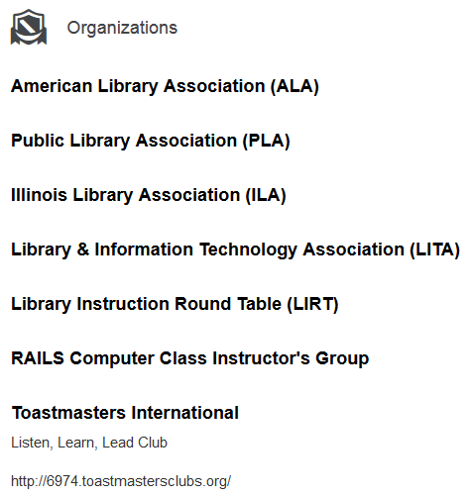
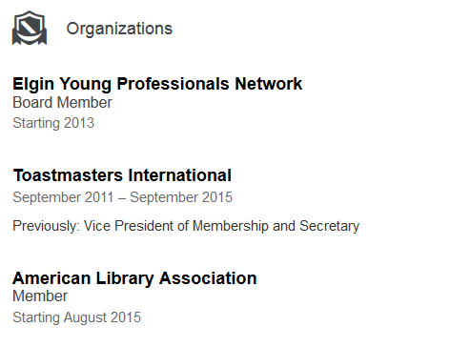
Examples
Notes:
How presentation will benefit audience: Adult learners are more interested in a subject if they know how or why it is important to them.
Presenter’s level of expertise in the subject: Briefly state your credentials in this area, or explain why participants should listen to you.

Slide 28
Activity #5
Notes:
How presentation will benefit audience: Adult learners are more interested in a subject if they know how or why it is important to them.
Presenter’s level of expertise in the subject: Briefly state your credentials in this area, or explain why participants should listen to you.

Slide 29
Making Connections
Notes:
How presentation will benefit audience: Adult learners are more interested in a subject if they know how or why it is important to them.
Presenter’s level of expertise in the subject: Briefly state your credentials in this area, or explain why participants should listen to you.

Slide 30
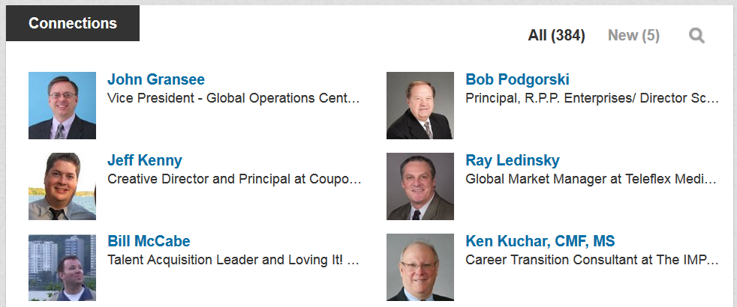
Why Connect?
At some point, most of us will be looking for a new job
94% of recruiters mine social media for info on candidates*
Employers who used social media to recruit reported a 49%
increase in satisfaction rate with candidates*
Build your network now, before you need it!
*Source: http://blog.capterra.com/top-15-recruiting-statistics-2014/
Notes:
How presentation will benefit audience: Adult learners are more interested in a subject if they know how or why it is important to them.
Presenter’s level of expertise in the subject: Briefly state your credentials in this area, or explain why participants should listen to you.

Slide 31
Connect with…
Bosses
Employees
Coworkers
Professors/Teachers
Colleagues
Organizations
Companies
Anyone familiar with your work… past or present!
Notes:
How presentation will benefit audience: Adult learners are more interested in a subject if they know how or why it is important to them.
Presenter’s level of expertise in the subject: Briefly state your credentials in this area, or explain why participants should listen to you.

Slide 32
Benefits of Connecting
Build a professional network
Give and receive job leads
Collaborate on projects
Give and receive Recommendations & Skill Endorsements
Ask for professional advice
Share and solicit professional development resources
Get feedback on Profile
Notes:
How presentation will benefit audience: Adult learners are more interested in a subject if they know how or why it is important to them.
Presenter’s level of expertise in the subject: Briefly state your credentials in this area, or explain why participants should listen to you.

Slide 33
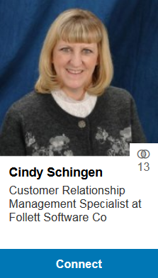
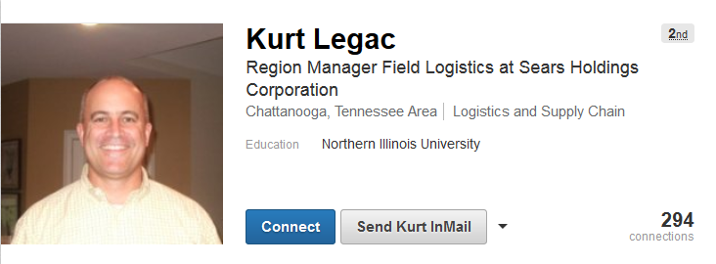

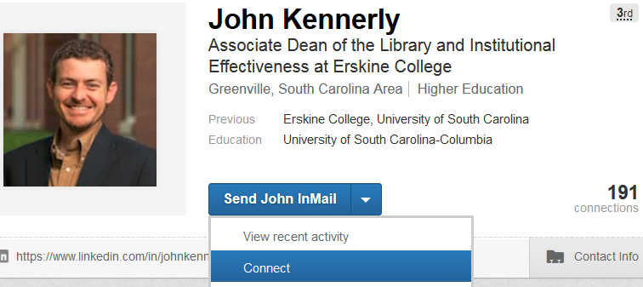
Connecting is Easy!
Notes:
How presentation will benefit audience: Adult learners are more interested in a subject if they know how or why it is important to them.
Presenter’s level of expertise in the subject: Briefly state your credentials in this area, or explain why participants should listen to you.

Slide 34
Activity #6
Notes:
How presentation will benefit audience: Adult learners are more interested in a subject if they know how or why it is important to them.
Presenter’s level of expertise in the subject: Briefly state your credentials in this area, or explain why participants should listen to you.

Slide 35
Questions?
Thank You!!!
Part Three Next Week
LinkedIn: Tips & Tricks
Notes:
Thank participants for coming and remind them of the URL.
Provide each with a handout and class survey.
Encourage them to sign up for class two in the series.

