Slide 1

LinkedIn Basics
Monica Dombrowski
Technology Education Manager
Gail Borden Public Library
Courtesy of Gail Borden Public Library
and the Public Library Association

Slide 2
Agenda
General Info
Navigation
The Home Page
The Profile Page
My Network
Jobs
Interests
Notes:
Review agenda with participants so they know what to expect. Ask them to hold their questions until you review all the features, in case it’s part of the agenda.

Slide 3
General Info
Notes:
How presentation will benefit audience: Adult learners are more interested in a subject if they know how or why it is important to them.
Presenter’s level of expertise in the subject: Briefly state your credentials in this area, or explain why participants should listen to you.

Slide 4
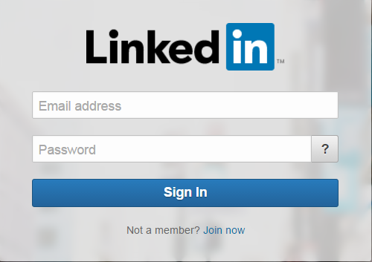
About LinkedIn
      www.linkedin.com
Launched in 2003
Over 300 million users in 200 countries
Social networking site designed to help
professionals connect
Notes:
Timeframe: 5 minutes
Explain that LinkedIn is a global network of business professionals with over 300 million users in over 200 countries.
Share that the purpose of LinkedIn is to allow people in like industries and companies to connect, share information and recruit talent for jobs and projects.
Discuss that Home page is the place where users are notified of what’s going on in their circles (like articles, notifications, suggested jobs, groups, and connections).
Share that Profile page is the area where folks build their online “resume,” and that it includes many category options, depending on how detailed folks want to be.
Explain that a Connection is someone to whom the user has linked his or herself and that as a result, they are able to see each other’s information, write recommendations, endorse each other and other activities (like a “Friend” on Facebook). Explain that there are 3 levels of connection- 1st (1:1 connection), 2nd (connection of a connection), and 3rd (connection of a connection of a connection). Share that this can be useful in building a professional network.
Highlight that an Introduction is a tool for getting connected with a 2nd or 3rd level connection.
Discuss that one of the most powerful tools in LinkedIn is the Recommendation feature, which allows users to write online recommendations for one another that are visible on their profiles. Share that recruiters use this ALL THE TIME as a way to screen job candidates.
Explain that the Jobs section allows users to search for open positions in their industries and in many cases, apply directly from LinkedIn.
Share that the Interests section allows users to get information on companies and organizations, follow them, and join groups.

Slide 5
Terms
The Toolbar: The stationary bar used to navigate between different areas of LinkedIn.
Notes:
Timeframe: 5 minutes
Explain that LinkedIn is a global network of business professionals with over 300 million users in over 200 countries.
Share that the purpose of LinkedIn is to allow people in like industries and companies to connect, share information and recruit talent for jobs and projects.
Discuss that Home page is the place where users are notified of what’s going on in their circles (like articles, notifications, suggested jobs, groups, and connections).
Share that Profile page is the area where folks build their online “resume,” and that it includes many category options, depending on how detailed folks want to be.
Explain that a Connection is someone to whom the user has linked his or herself and that as a result, they are able to see each other’s information, write recommendations, endorse each other and other activities (like a “Friend” on Facebook). Explain that there are 3 levels of connection- 1st (1:1 connection), 2nd (connection of a connection), and 3rd (connection of a connection of a connection). Share that this can be useful in building a professional network.
Highlight that an Introduction is a tool for getting connected with a 2nd or 3rd level connection.
Discuss that one of the most powerful tools in LinkedIn is the Recommendation feature, which allows users to write online recommendations for one another that are visible on their profiles. Share that recruiters use this ALL THE TIME as a way to screen job candidates.
Explain that the Jobs section allows users to search for open positions in their industries and in many cases, apply directly from LinkedIn.
Share that the Interests section allows users to get information on companies and organizations, follow them, and join groups.

Slide 6

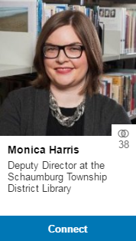
Terms
Connections: Professional contacts to whom you’re directly connected
Potential Connections:
Connections of Connections
Notes:
Timeframe: 5 minutes
Explain that LinkedIn is a global network of business professionals with over 300 million users in over 200 countries.
Share that the purpose of LinkedIn is to allow people in like industries and companies to connect, share information and recruit talent for jobs and projects.
Discuss that Home page is the place where users are notified of what’s going on in their circles (like articles, notifications, suggested jobs, groups, and connections).
Share that Profile page is the area where folks build their online “resume,” and that it includes many category options, depending on how detailed folks want to be.
Explain that a Connection is someone to whom the user has linked his or herself and that as a result, they are able to see each other’s information, write recommendations, endorse each other and other activities (like a “Friend” on Facebook). Explain that there are 3 levels of connection- 1st (1:1 connection), 2nd (connection of a connection), and 3rd (connection of a connection of a connection). Share that this can be useful in building a professional network.
Highlight that an Introduction is a tool for getting connected with a 2nd or 3rd level connection.
Discuss that one of the most powerful tools in LinkedIn is the Recommendation feature, which allows users to write online recommendations for one another that are visible on their profiles. Share that recruiters use this ALL THE TIME as a way to screen job candidates.
Explain that the Jobs section allows users to search for open positions in their industries and in many cases, apply directly from LinkedIn.
Share that the Interests section allows users to get information on companies and organizations, follow them, and join groups.

Slide 7
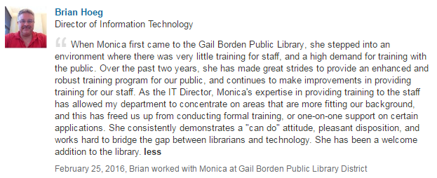
Terms
Recommendations: Comments written by other LinkedIn members to recognize or commend you for your work
Notes:
Timeframe: 5 minutes
Explain that LinkedIn is a global network of business professionals with over 300 million users in over 200 countries.
Share that the purpose of LinkedIn is to allow people in like industries and companies to connect, share information and recruit talent for jobs and projects.
Discuss that Home page is the place where users are notified of what’s going on in their circles (like articles, notifications, suggested jobs, groups, and connections).
Share that Profile page is the area where folks build their online “resume,” and that it includes many category options, depending on how detailed folks want to be.
Explain that a Connection is someone to whom the user has linked his or herself and that as a result, they are able to see each other’s information, write recommendations, endorse each other and other activities (like a “Friend” on Facebook). Explain that there are 3 levels of connection- 1st (1:1 connection), 2nd (connection of a connection), and 3rd (connection of a connection of a connection). Share that this can be useful in building a professional network.
Highlight that an Introduction is a tool for getting connected with a 2nd or 3rd level connection.
Discuss that one of the most powerful tools in LinkedIn is the Recommendation feature, which allows users to write online recommendations for one another that are visible on their profiles. Share that recruiters use this ALL THE TIME as a way to screen job candidates.
Explain that the Jobs section allows users to search for open positions in their industries and in many cases, apply directly from LinkedIn.
Share that the Interests section allows users to get information on companies and organizations, follow them, and join groups.

Slide 8
Navigation
Notes:
How presentation will benefit audience: Adult learners are more interested in a subject if they know how or why it is important to them.
Presenter’s level of expertise in the subject: Briefly state your credentials in this area, or explain why participants should listen to you.

Slide 9
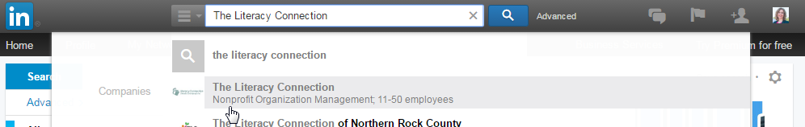
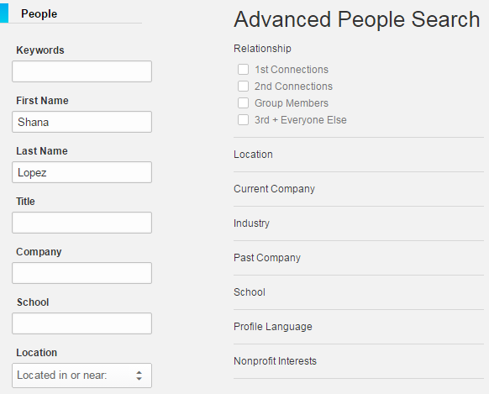
Search Box
Search for:
People
Jobs
Companies
Organizations
Universities
Use limiters to narrow your search
Notes:
Timeframe: 5 minutes
Explain that LinkedIn is a global network of business professionals with over 300 million users in over 200 countries.
Share that the purpose of LinkedIn is to allow people in like industries and companies to connect, share information and recruit talent for jobs and projects.
Discuss that Home page is the place where users are notified of what’s going on in their circles (like articles, notifications, suggested jobs, groups, and connections).
Share that Profile page is the area where folks build their online “resume,” and that it includes many category options, depending on how detailed folks want to be.
Explain that a Connection is someone to whom the user has linked his or herself and that as a result, they are able to see each other’s information, write recommendations, endorse each other and other activities (like a “Friend” on Facebook). Explain that there are 3 levels of connection- 1st (1:1 connection), 2nd (connection of a connection), and 3rd (connection of a connection of a connection). Share that this can be useful in building a professional network.
Highlight that an Introduction is a tool for getting connected with a 2nd or 3rd level connection.
Discuss that one of the most powerful tools in LinkedIn is the Recommendation feature, which allows users to write online recommendations for one another that are visible on their profiles. Share that recruiters use this ALL THE TIME as a way to screen job candidates.
Explain that the Jobs section allows users to search for open positions in their industries and in many cases, apply directly from LinkedIn.
Share that the Interests section allows users to get information on companies and organizations, follow them, and join groups.

Slide 10
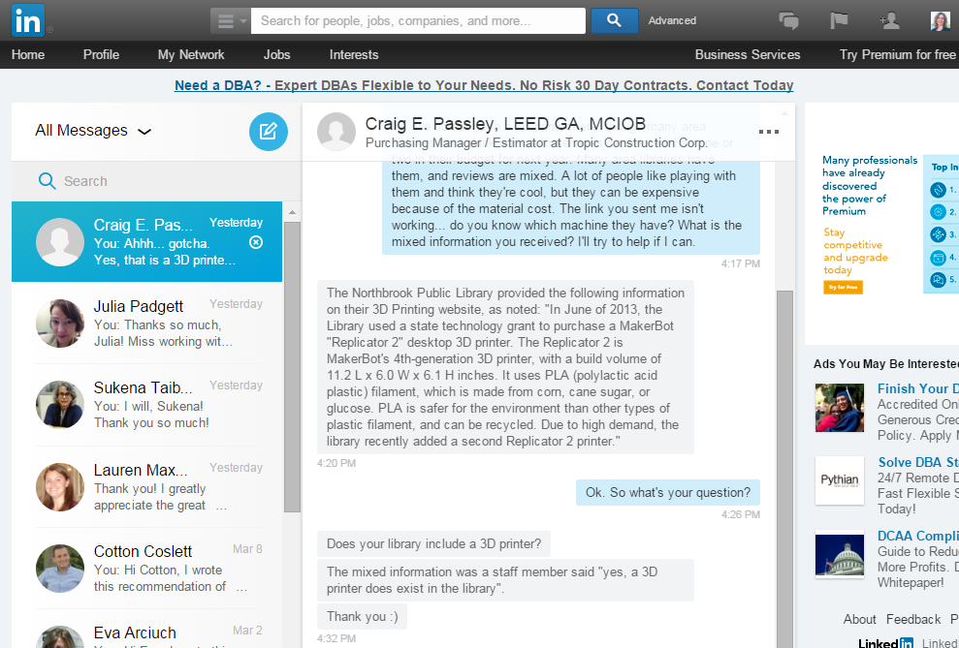
Messages
Notes:
Timeframe: 5 minutes
Explain that LinkedIn is a global network of business professionals with over 300 million users in over 200 countries.
Share that the purpose of LinkedIn is to allow people in like industries and companies to connect, share information and recruit talent for jobs and projects.
Discuss that Home page is the place where users are notified of what’s going on in their circles (like articles, notifications, suggested jobs, groups, and connections).
Share that Profile page is the area where folks build their online “resume,” and that it includes many category options, depending on how detailed folks want to be.
Explain that a Connection is someone to whom the user has linked his or herself and that as a result, they are able to see each other’s information, write recommendations, endorse each other and other activities (like a “Friend” on Facebook). Explain that there are 3 levels of connection- 1st (1:1 connection), 2nd (connection of a connection), and 3rd (connection of a connection of a connection). Share that this can be useful in building a professional network.
Highlight that an Introduction is a tool for getting connected with a 2nd or 3rd level connection.
Discuss that one of the most powerful tools in LinkedIn is the Recommendation feature, which allows users to write online recommendations for one another that are visible on their profiles. Share that recruiters use this ALL THE TIME as a way to screen job candidates.
Explain that the Jobs section allows users to search for open positions in their industries and in many cases, apply directly from LinkedIn.
Share that the Interests section allows users to get information on companies and organizations, follow them, and join groups.

Slide 11
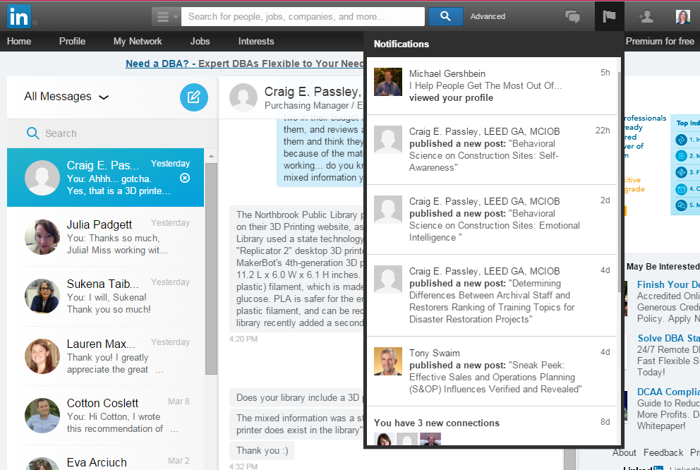
Notifications
Notes:
Timeframe: 5 minutes
Explain that LinkedIn is a global network of business professionals with over 300 million users in over 200 countries.
Share that the purpose of LinkedIn is to allow people in like industries and companies to connect, share information and recruit talent for jobs and projects.
Discuss that Home page is the place where users are notified of what’s going on in their circles (like articles, notifications, suggested jobs, groups, and connections).
Share that Profile page is the area where folks build their online “resume,” and that it includes many category options, depending on how detailed folks want to be.
Explain that a Connection is someone to whom the user has linked his or herself and that as a result, they are able to see each other’s information, write recommendations, endorse each other and other activities (like a “Friend” on Facebook). Explain that there are 3 levels of connection- 1st (1:1 connection), 2nd (connection of a connection), and 3rd (connection of a connection of a connection). Share that this can be useful in building a professional network.
Highlight that an Introduction is a tool for getting connected with a 2nd or 3rd level connection.
Discuss that one of the most powerful tools in LinkedIn is the Recommendation feature, which allows users to write online recommendations for one another that are visible on their profiles. Share that recruiters use this ALL THE TIME as a way to screen job candidates.
Explain that the Jobs section allows users to search for open positions in their industries and in many cases, apply directly from LinkedIn.
Share that the Interests section allows users to get information on companies and organizations, follow them, and join groups.

Slide 12
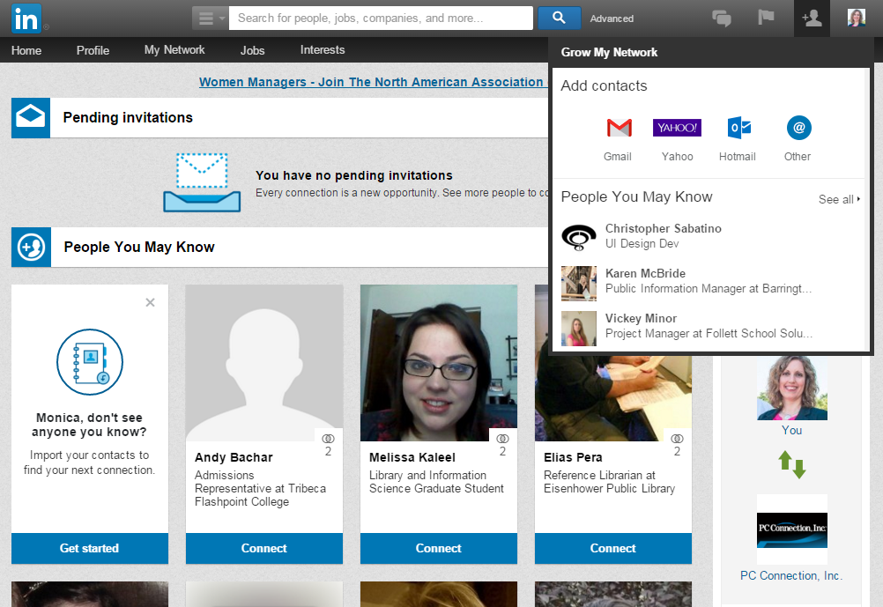
Grow My Network
Notes:
Timeframe: 5 minutes
Explain that LinkedIn is a global network of business professionals with over 300 million users in over 200 countries.
Share that the purpose of LinkedIn is to allow people in like industries and companies to connect, share information and recruit talent for jobs and projects.
Discuss that Home page is the place where users are notified of what’s going on in their circles (like articles, notifications, suggested jobs, groups, and connections).
Share that Profile page is the area where folks build their online “resume,” and that it includes many category options, depending on how detailed folks want to be.
Explain that a Connection is someone to whom the user has linked his or herself and that as a result, they are able to see each other’s information, write recommendations, endorse each other and other activities (like a “Friend” on Facebook). Explain that there are 3 levels of connection- 1st (1:1 connection), 2nd (connection of a connection), and 3rd (connection of a connection of a connection). Share that this can be useful in building a professional network.
Highlight that an Introduction is a tool for getting connected with a 2nd or 3rd level connection.
Discuss that one of the most powerful tools in LinkedIn is the Recommendation feature, which allows users to write online recommendations for one another that are visible on their profiles. Share that recruiters use this ALL THE TIME as a way to screen job candidates.
Explain that the Jobs section allows users to search for open positions in their industries and in many cases, apply directly from LinkedIn.
Share that the Interests section allows users to get information on companies and organizations, follow them, and join groups.

Slide 13
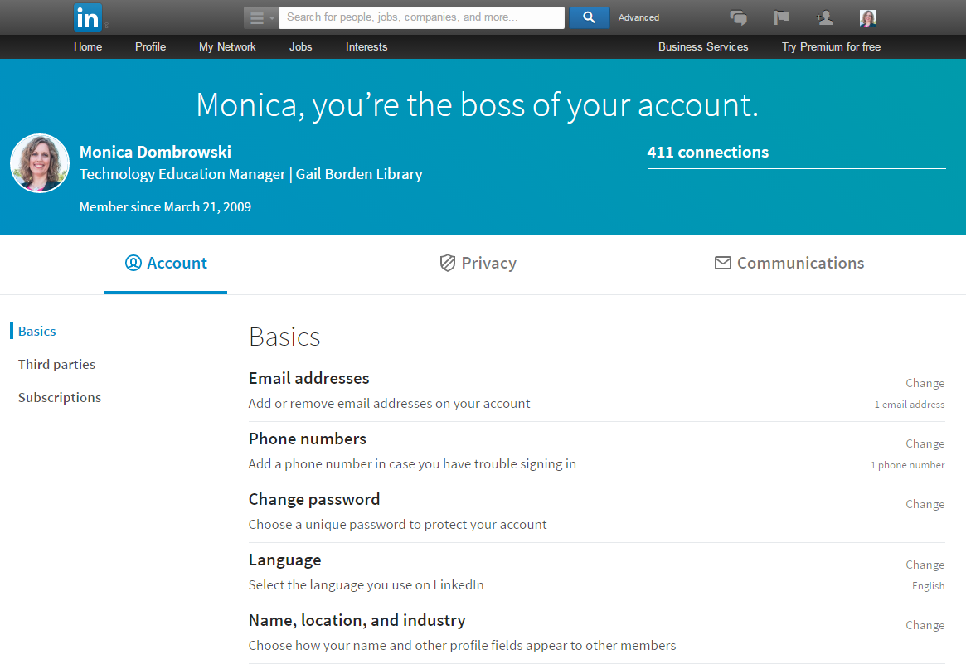
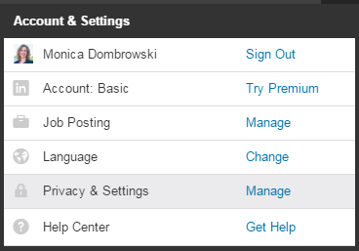
Account & Settings
Notes:
Timeframe: 5 minutes
Explain that LinkedIn is a global network of business professionals with over 300 million users in over 200 countries.
Share that the purpose of LinkedIn is to allow people in like industries and companies to connect, share information and recruit talent for jobs and projects.
Discuss that Home page is the place where users are notified of what’s going on in their circles (like articles, notifications, suggested jobs, groups, and connections).
Share that Profile page is the area where folks build their online “resume,” and that it includes many category options, depending on how detailed folks want to be.
Explain that a Connection is someone to whom the user has linked his or herself and that as a result, they are able to see each other’s information, write recommendations, endorse each other and other activities (like a “Friend” on Facebook). Explain that there are 3 levels of connection- 1st (1:1 connection), 2nd (connection of a connection), and 3rd (connection of a connection of a connection). Share that this can be useful in building a professional network.
Highlight that an Introduction is a tool for getting connected with a 2nd or 3rd level connection.
Discuss that one of the most powerful tools in LinkedIn is the Recommendation feature, which allows users to write online recommendations for one another that are visible on their profiles. Share that recruiters use this ALL THE TIME as a way to screen job candidates.
Explain that the Jobs section allows users to search for open positions in their industries and in many cases, apply directly from LinkedIn.
Share that the Interests section allows users to get information on companies and organizations, follow them, and join groups.

Slide 14
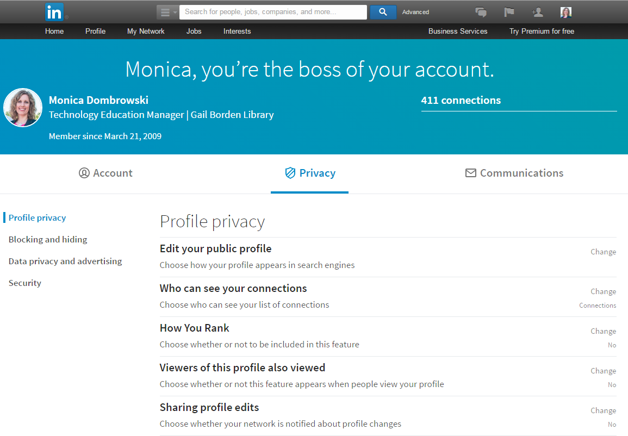
Account & Settings
Notes:
Timeframe: 5 minutes
Explain that LinkedIn is a global network of business professionals with over 300 million users in over 200 countries.
Share that the purpose of LinkedIn is to allow people in like industries and companies to connect, share information and recruit talent for jobs and projects.
Discuss that Home page is the place where users are notified of what’s going on in their circles (like articles, notifications, suggested jobs, groups, and connections).
Share that Profile page is the area where folks build their online “resume,” and that it includes many category options, depending on how detailed folks want to be.
Explain that a Connection is someone to whom the user has linked his or herself and that as a result, they are able to see each other’s information, write recommendations, endorse each other and other activities (like a “Friend” on Facebook). Explain that there are 3 levels of connection- 1st (1:1 connection), 2nd (connection of a connection), and 3rd (connection of a connection of a connection). Share that this can be useful in building a professional network.
Highlight that an Introduction is a tool for getting connected with a 2nd or 3rd level connection.
Discuss that one of the most powerful tools in LinkedIn is the Recommendation feature, which allows users to write online recommendations for one another that are visible on their profiles. Share that recruiters use this ALL THE TIME as a way to screen job candidates.
Explain that the Jobs section allows users to search for open positions in their industries and in many cases, apply directly from LinkedIn.
Share that the Interests section allows users to get information on companies and organizations, follow them, and join groups.

Slide 15
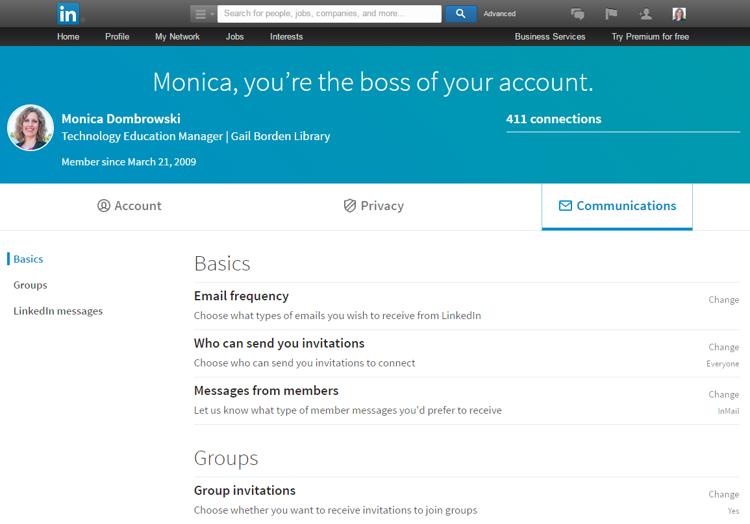
Account & Settings
Notes:
Timeframe: 5 minutes
Explain that LinkedIn is a global network of business professionals with over 300 million users in over 200 countries.
Share that the purpose of LinkedIn is to allow people in like industries and companies to connect, share information and recruit talent for jobs and projects.
Discuss that Home page is the place where users are notified of what’s going on in their circles (like articles, notifications, suggested jobs, groups, and connections).
Share that Profile page is the area where folks build their online “resume,” and that it includes many category options, depending on how detailed folks want to be.
Explain that a Connection is someone to whom the user has linked his or herself and that as a result, they are able to see each other’s information, write recommendations, endorse each other and other activities (like a “Friend” on Facebook). Explain that there are 3 levels of connection- 1st (1:1 connection), 2nd (connection of a connection), and 3rd (connection of a connection of a connection). Share that this can be useful in building a professional network.
Highlight that an Introduction is a tool for getting connected with a 2nd or 3rd level connection.
Discuss that one of the most powerful tools in LinkedIn is the Recommendation feature, which allows users to write online recommendations for one another that are visible on their profiles. Share that recruiters use this ALL THE TIME as a way to screen job candidates.
Explain that the Jobs section allows users to search for open positions in their industries and in many cases, apply directly from LinkedIn.
Share that the Interests section allows users to get information on companies and organizations, follow them, and join groups.

Slide 16
The Home Page
Notes:
How presentation will benefit audience: Adult learners are more interested in a subject if they know how or why it is important to them.
Presenter’s level of expertise in the subject: Briefly state your credentials in this area, or explain why participants should listen to you.

Slide 17
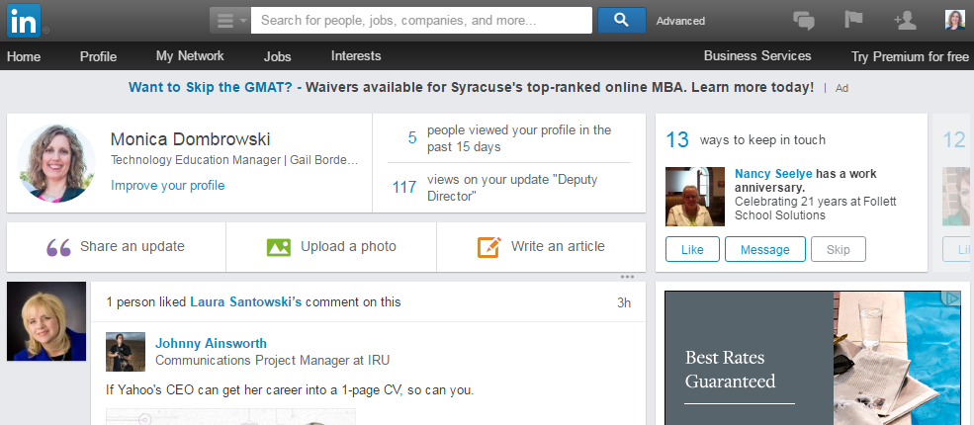
The Home Page
Notes:
Do a live demo of the Home page. Highlight and discuss the areas of the page listed above.

Slide 18
The Profile Page
Notes:
How presentation will benefit audience: Adult learners are more interested in a subject if they know how or why it is important to them.
Presenter’s level of expertise in the subject: Briefly state your credentials in this area, or explain why participants should listen to you.

Slide 19
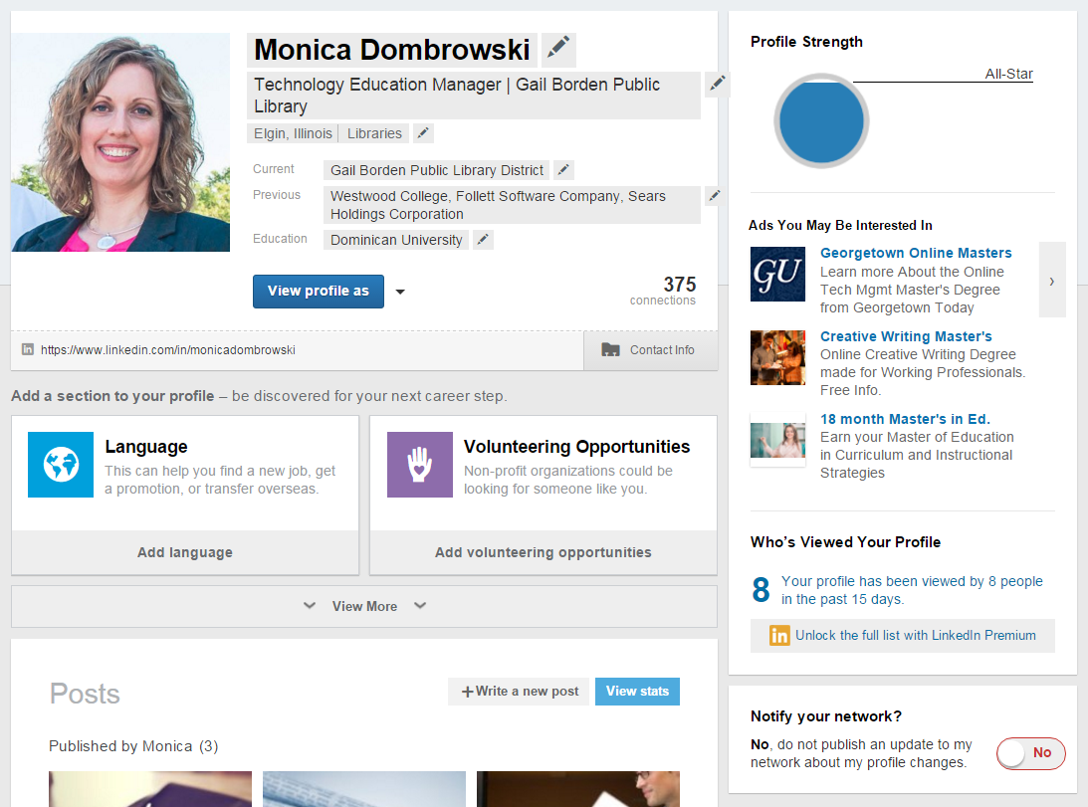
The Profile Page
Notes:
Do a live demo of the Profile page. Highlight and discuss the areas of the page listed above.

Slide 20
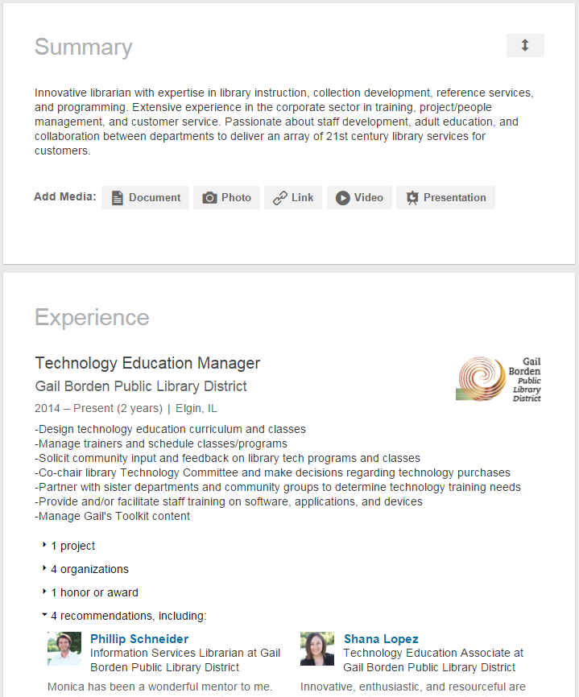
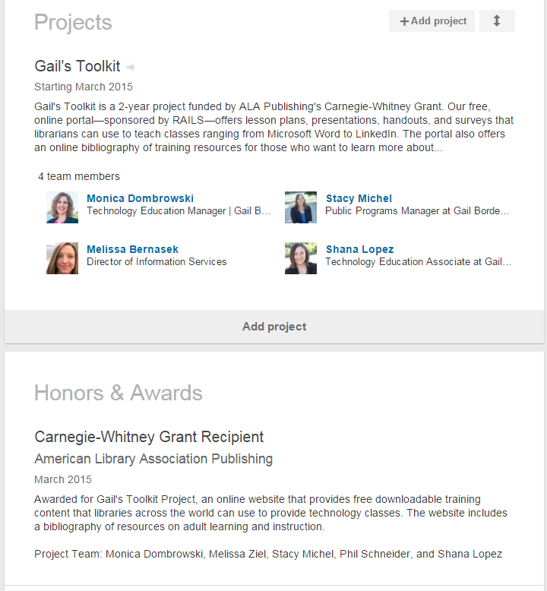
The Profile Page
= Required for all Profiles
Notes:
Do a live demo of the Profile page. Highlight and discuss the areas of the page listed above.

Slide 21
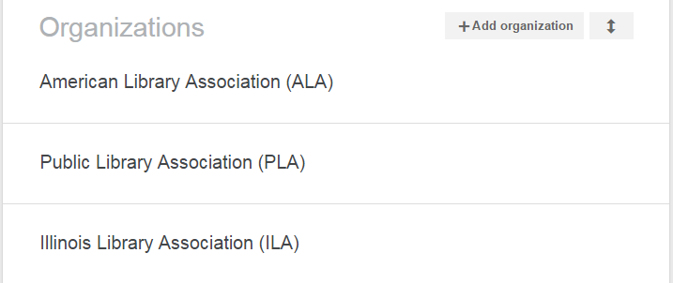
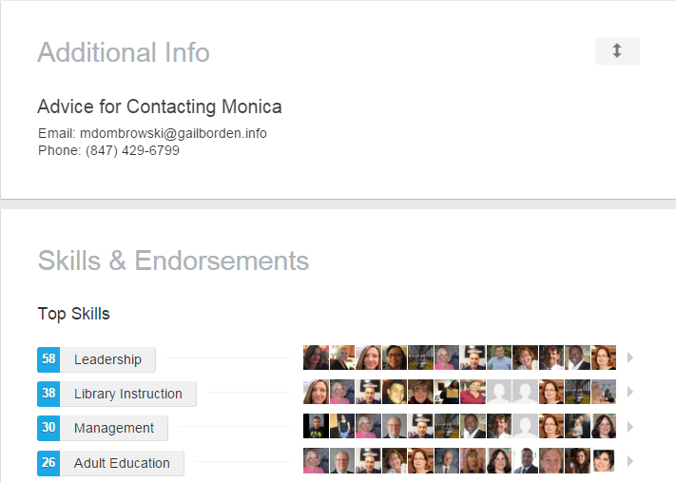
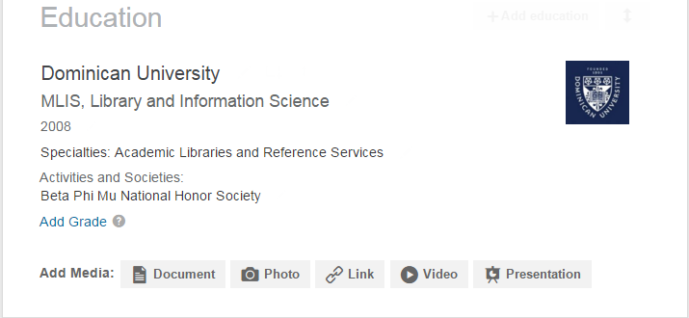
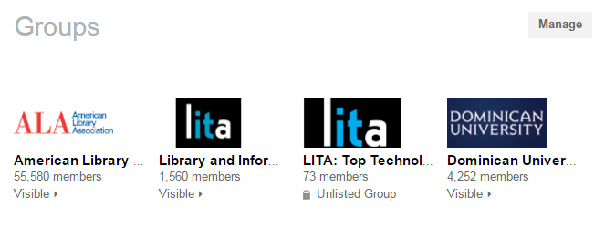
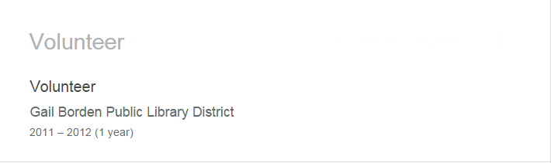
The Profile Page
Notes:
Do a live demo of the Profile page. Highlight and discuss the areas of the page listed above.

Slide 22
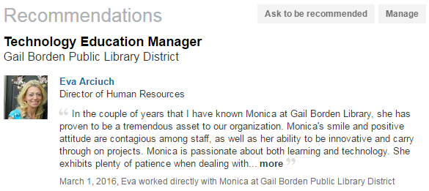
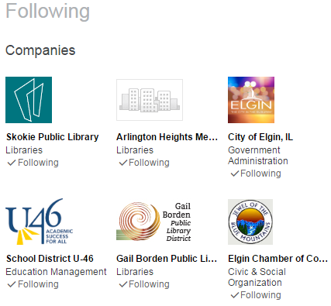
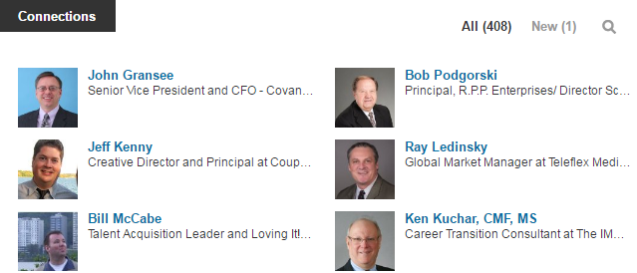
The Profile Page
Notes:
Do a live demo of the Profile page. Highlight and discuss the areas of the page listed above.

Slide 23
My Network
Notes:
How presentation will benefit audience: Adult learners are more interested in a subject if they know how or why it is important to them.
Presenter’s level of expertise in the subject: Briefly state your credentials in this area, or explain why participants should listen to you.

Slide 24
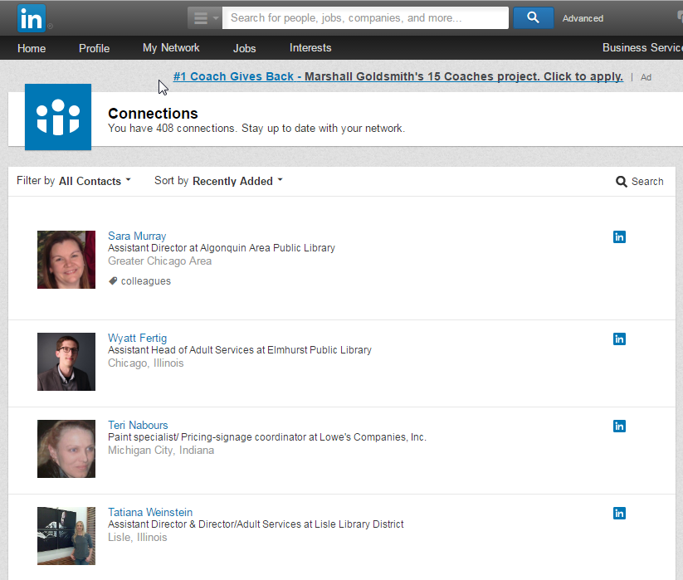
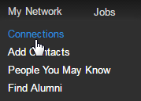
Connections
Notes:
Do a live demo of the Interests: Companies page. Highlight and discuss the areas of the page listed above.

Slide 25
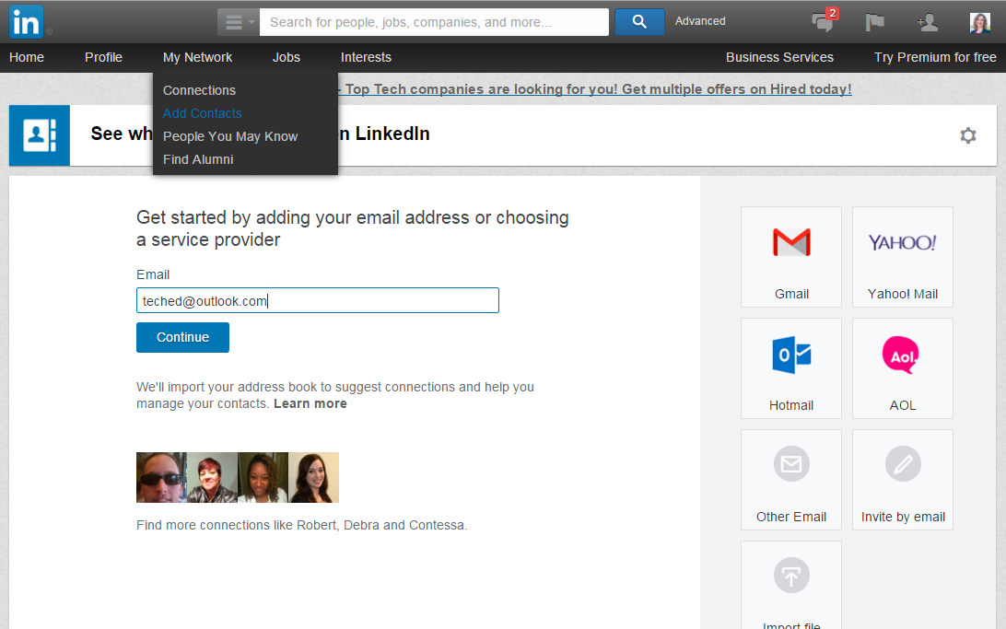
Add Contacts
Notes:
Do a live demo of the Interests: Companies page. Highlight and discuss the areas of the page listed above.

Slide 26
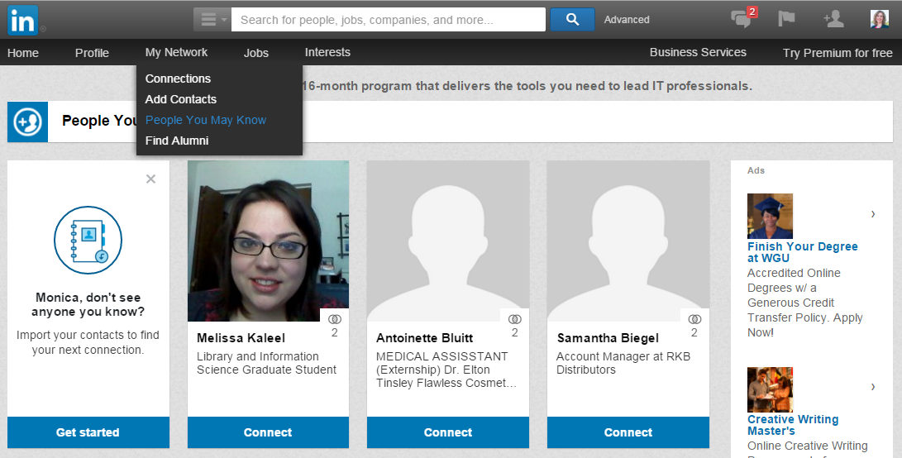
People You May Know
Notes:
Do a live demo of the Interests: Companies page. Highlight and discuss the areas of the page listed above.

Slide 27
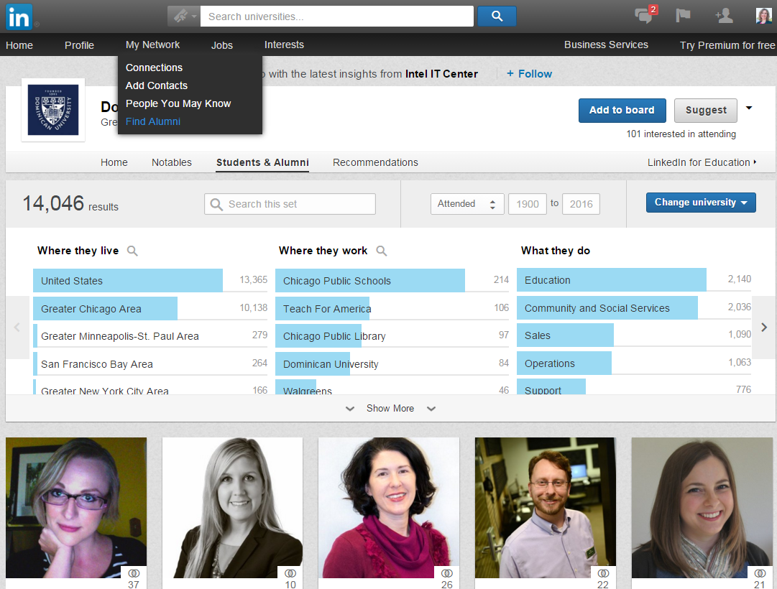
Find Alumni
Notes:
Do a live demo of the Interests: Companies page. Highlight and discuss the areas of the page listed above.

Slide 28
Jobs
Notes:
How presentation will benefit audience: Adult learners are more interested in a subject if they know how or why it is important to them.
Presenter’s level of expertise in the subject: Briefly state your credentials in this area, or explain why participants should listen to you.

Slide 29
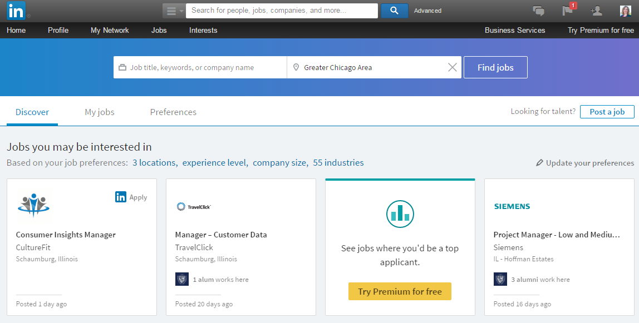
Jobs
Notes:
Do a live demo of the Jobs page. Highlight and discuss the areas of the page listed above.

Slide 30
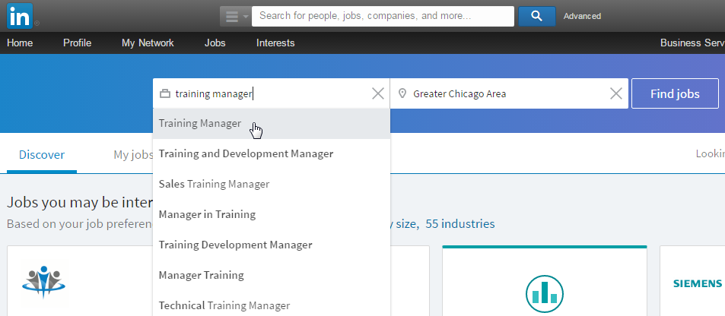
Search box

Slide 31
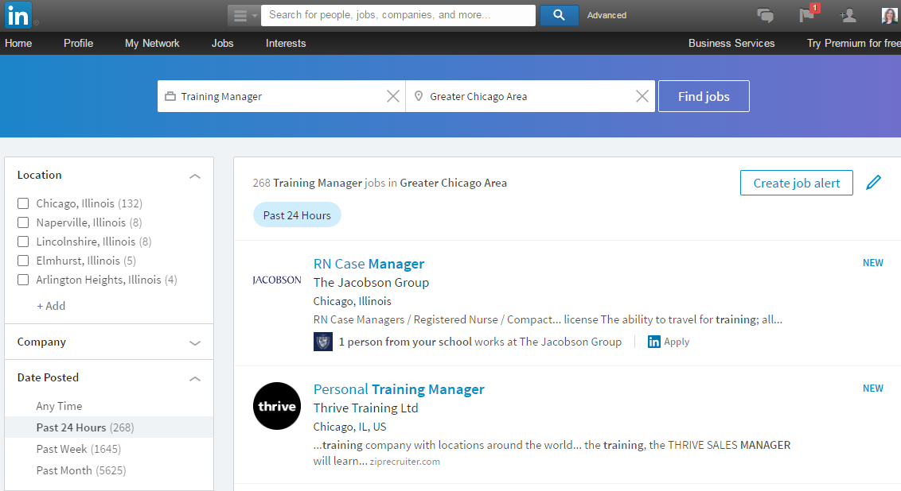
Results & Limiters

Slide 32
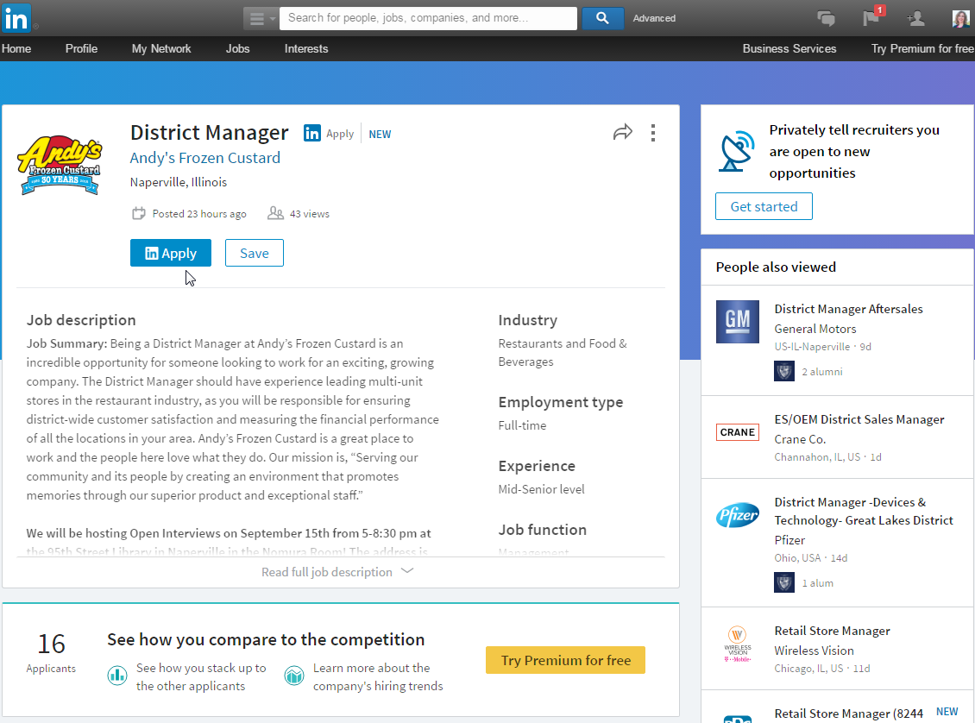
Viewing Jobs

Slide 33
Interests
Notes:
How presentation will benefit audience: Adult learners are more interested in a subject if they know how or why it is important to them.
Presenter’s level of expertise in the subject: Briefly state your credentials in this area, or explain why participants should listen to you.

Slide 34
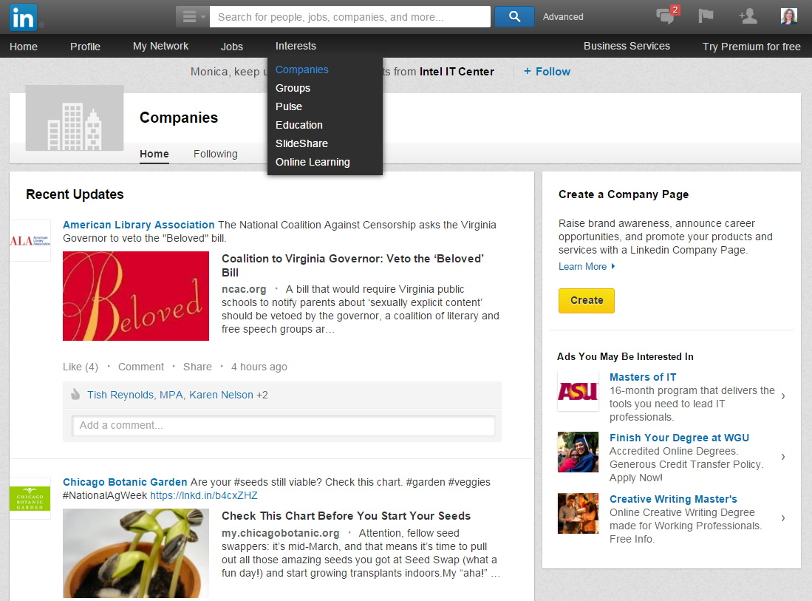
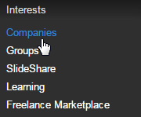
Companies
Notes:
Do a live demo of the Interests: Groups page. Highlight and discuss the areas of the page listed above.

Slide 35
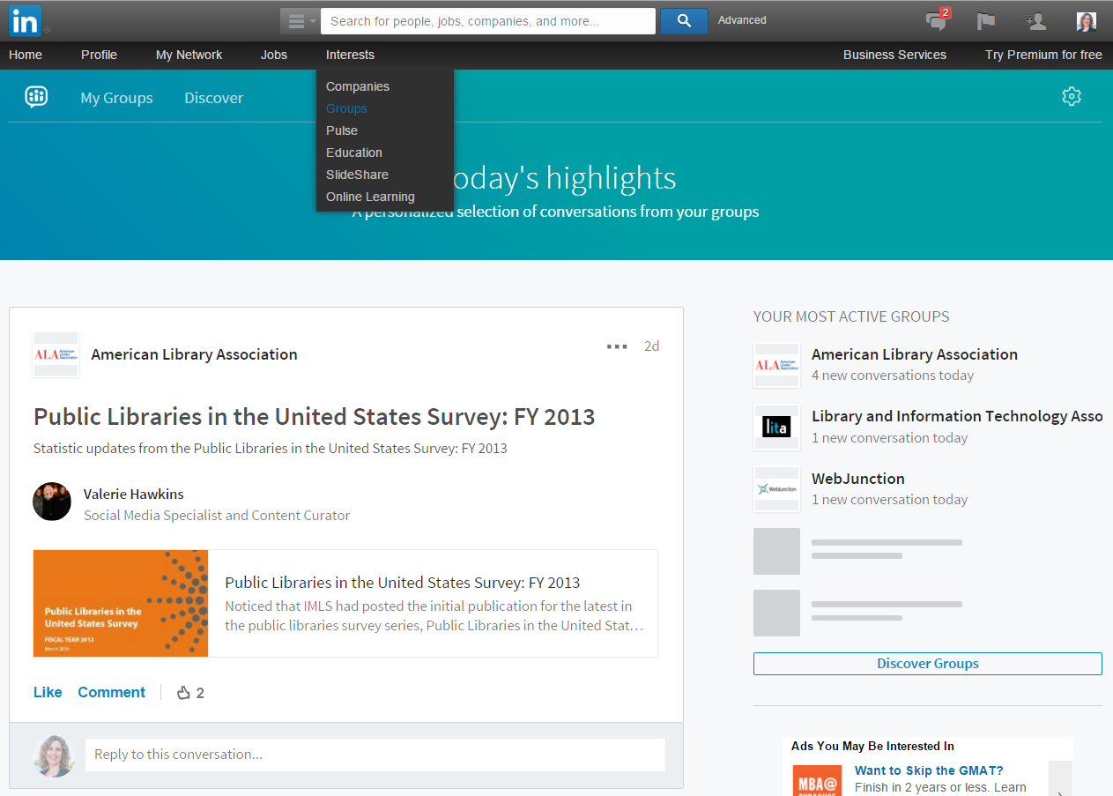
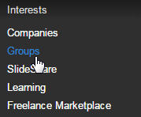
Groups
Notes:
Do a live demo of the Interests: Groups page. Highlight and discuss the areas of the page listed above.

Slide 36
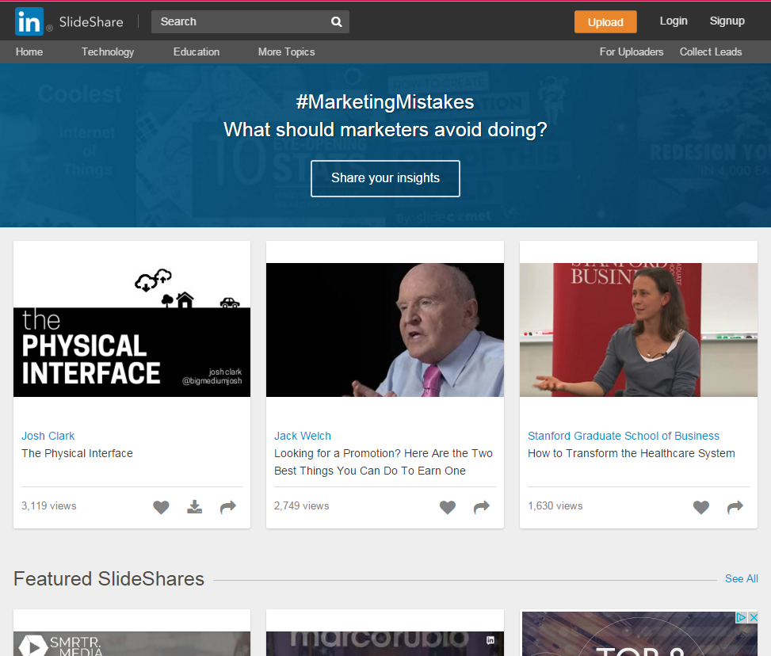
SlideShare
Notes:
Do a live demo of the Interests: Groups page. Highlight and discuss the areas of the page listed above.

Slide 37
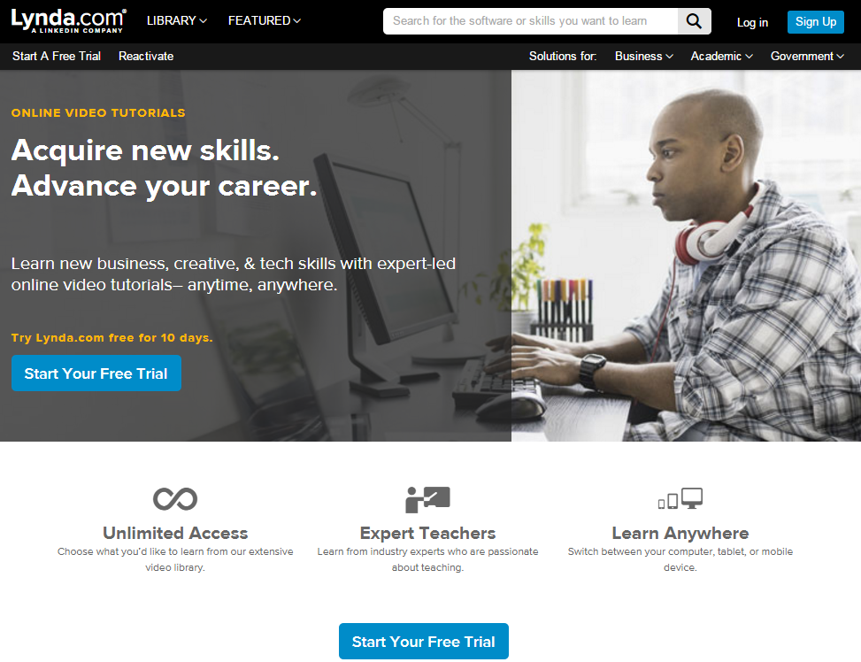
Learning
Notes:
Do a live demo of the Interests: Groups page. Highlight and discuss the areas of the page listed above.

Slide 38
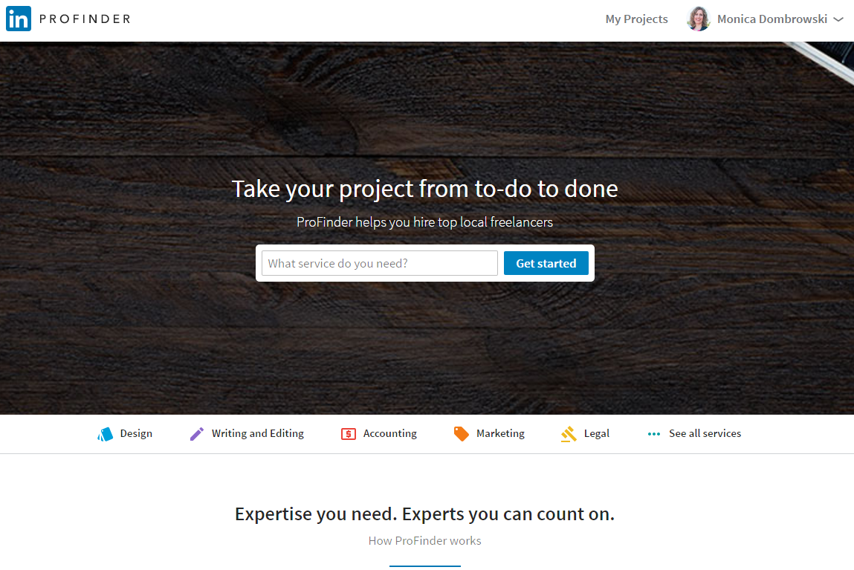
Freelance Marketplace
Notes:
Do a live demo of the Interests: Groups page. Highlight and discuss the areas of the page listed above.

Slide 39
Creating an Account
Notes:
How presentation will benefit audience: Adult learners are more interested in a subject if they know how or why it is important to them.
Presenter’s level of expertise in the subject: Briefly state your credentials in this area, or explain why participants should listen to you.

Slide 40
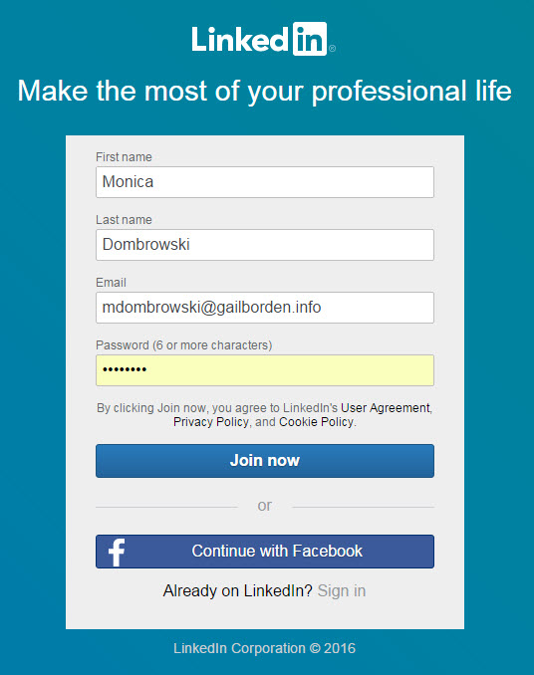
Creating an Account
Notes:
How presentation will benefit audience: Adult learners are more interested in a subject if they know how or why it is important to them.
Presenter’s level of expertise in the subject: Briefly state your credentials in this area, or explain why participants should listen to you.

Slide 41
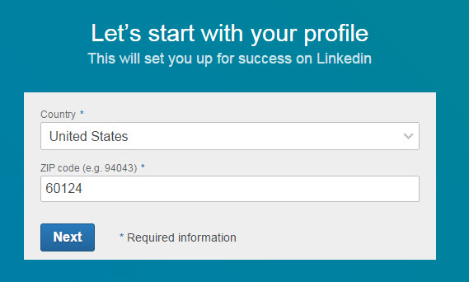
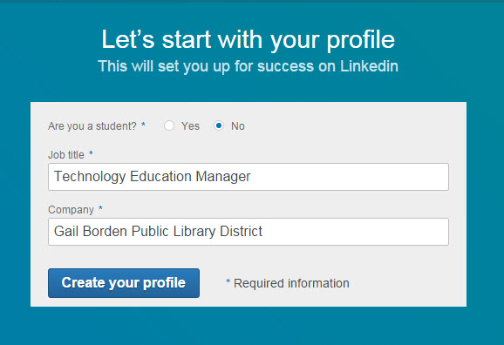
Creating an Account
Notes:
How presentation will benefit audience: Adult learners are more interested in a subject if they know how or why it is important to them.
Presenter’s level of expertise in the subject: Briefly state your credentials in this area, or explain why participants should listen to you.

Slide 42
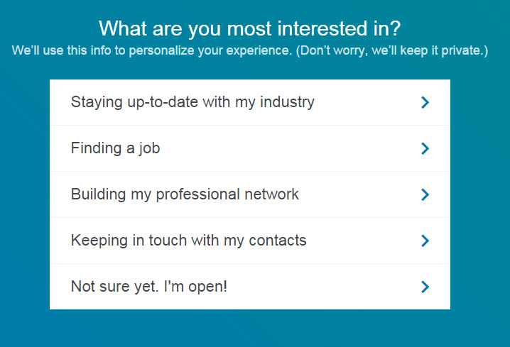
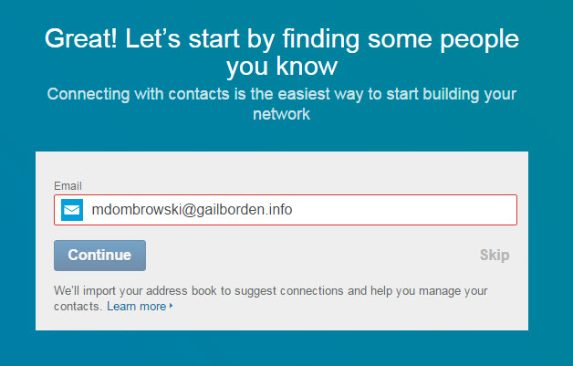
Creating an Account
Notes:
How presentation will benefit audience: Adult learners are more interested in a subject if they know how or why it is important to them.
Presenter’s level of expertise in the subject: Briefly state your credentials in this area, or explain why participants should listen to you.

Slide 43
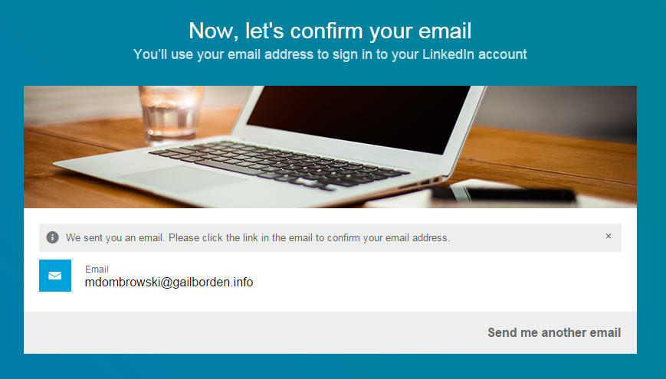
Creating an Account
Notes:
How presentation will benefit audience: Adult learners are more interested in a subject if they know how or why it is important to them.
Presenter’s level of expertise in the subject: Briefly state your credentials in this area, or explain why participants should listen to you.

Slide 44
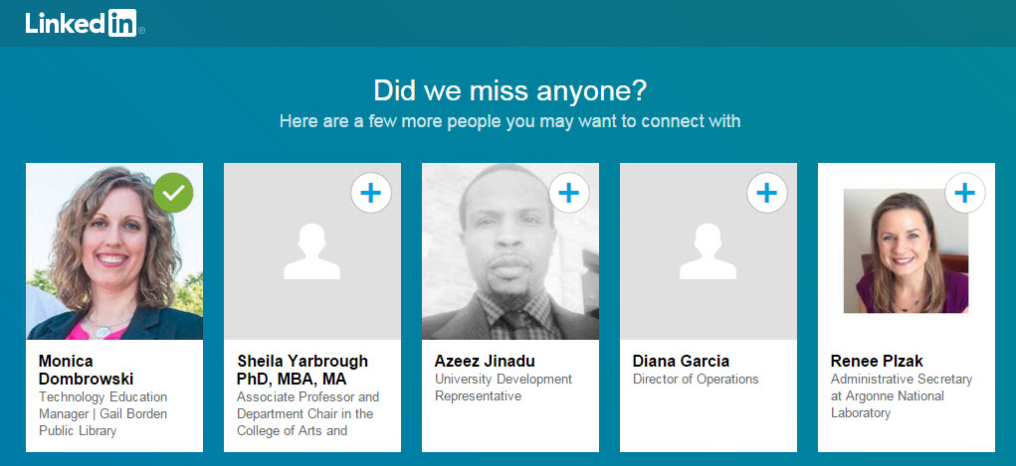
Creating an Account
Notes:
How presentation will benefit audience: Adult learners are more interested in a subject if they know how or why it is important to them.
Presenter’s level of expertise in the subject: Briefly state your credentials in this area, or explain why participants should listen to you.

Slide 45
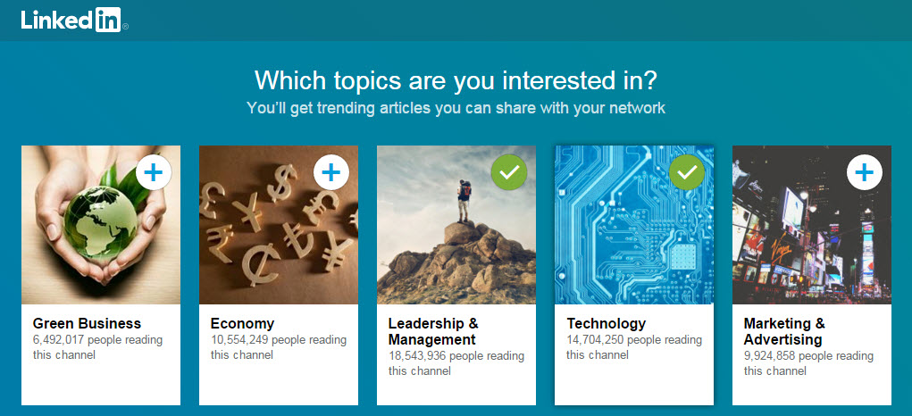
Creating an Account
Notes:
How presentation will benefit audience: Adult learners are more interested in a subject if they know how or why it is important to them.
Presenter’s level of expertise in the subject: Briefly state your credentials in this area, or explain why participants should listen to you.

Slide 46
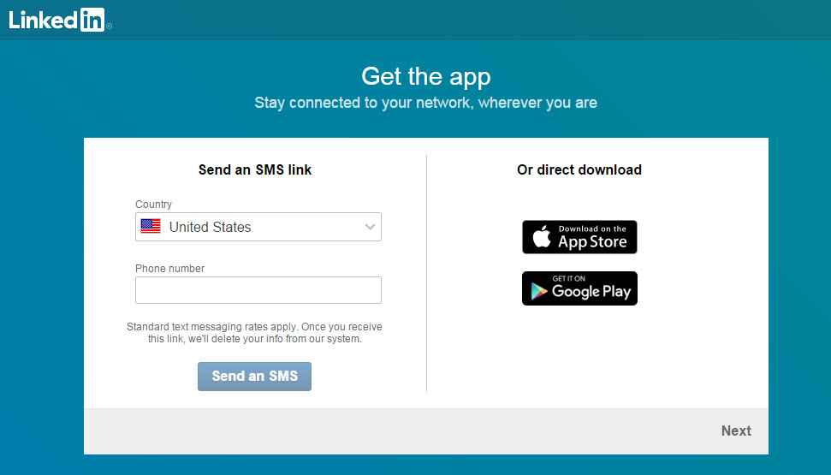
Creating an Account
Notes:
How presentation will benefit audience: Adult learners are more interested in a subject if they know how or why it is important to them.
Presenter’s level of expertise in the subject: Briefly state your credentials in this area, or explain why participants should listen to you.

Slide 47
Questions?
Thank You!!!
Part Two Next Week
LinkedIn: Getting Started
Notes:
Thank participants for coming and remind them of the URL.
Provide each with a handout and class survey.
Encourage them to sign up for class two in the series.

