Slide 1

Intro to Google Tools
John Bordsen
Technology Trainer
Gail Borden Public Library District
Courtesy of Gail Borden Public Library
and the Public Library Association
Notes:
Ask audience: What comes to mind when you think of Google?

Slide 2
Agenda
Google Overview
Desktop Applications
Getting Started

Slide 3
Google Overview

Slide 4
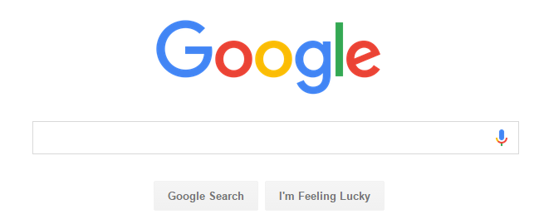
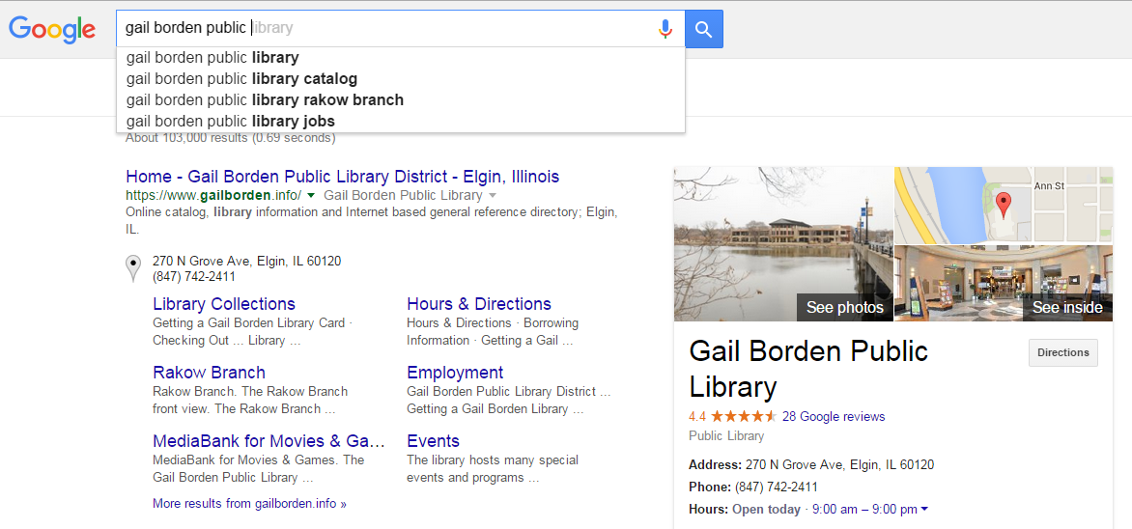
Just Google It

Slide 5
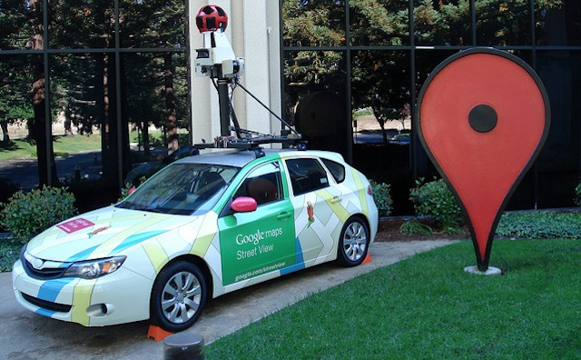
World of Google
More than a search engine
Advertising services
Android OS
Maps
YouTube
Desktop Applications

Slide 6
Desktop Applications

Slide 7

Desktop Apps
Used for…
Communication
Collaboration
Productivity
Sharing
Creativity

Slide 8

Desktop Apps
Used by…
Consumers
Businesses
Schools
Non-profits
Government Agencies

Slide 9

Why Google?
Free
Requires only one account and no installation
Apps integrate seamlessly with each other
15GB of free storage in the Cloud
Secure (auto-updates for bugs)

Slide 10
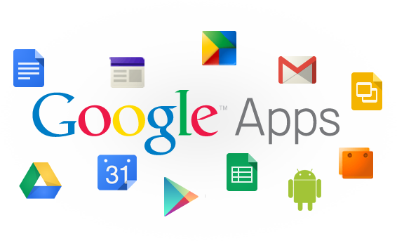
Google Tools
Gmail
Contacts
Calendar
Hangouts
Google+
Apps for work (Docs/Sheets/Forms/Slides/Sites)
Drive
Chrome

Slide 11

Gmail
Google Mail
Fast, searchable email with less spam
Allows importing from other webmail providers
Access to Contacts & Tasks
Single sign-on for all Google tools

Slide 12
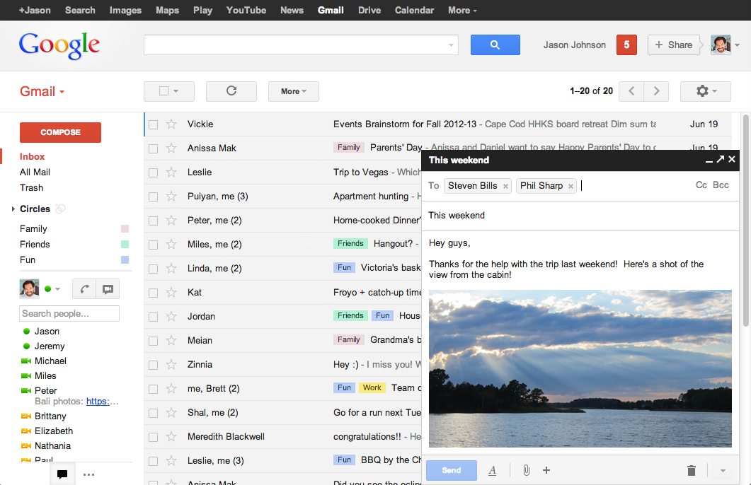
Gmail
Inbox
Settings
Search
Labels
New
Message
Chat

Slide 13

Contacts
Contact Manager
Online address book
Integrates with Gmail, Calendar, and other Google products
Can organize by groups or “circles”
Syncs contacts across multiple devices
Allows importing from other webmail providers

Slide 14
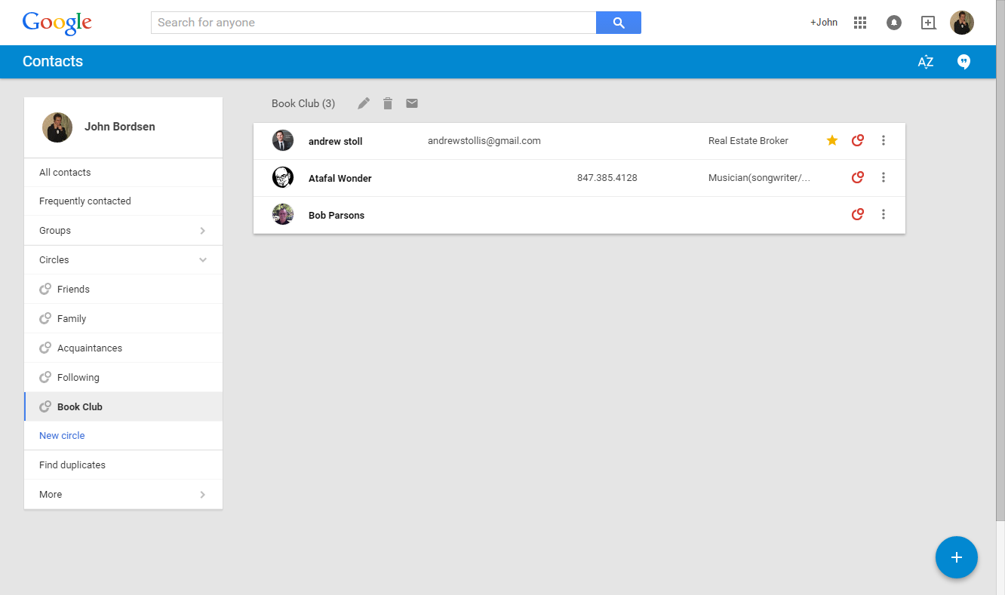
Google Contacts
Search
Contacts
Groups

Slide 15

Calendar
Schedule Manager
Organize your schedule
Share events
Display availability or busy time
Sync appointments and reminders across multiple devices

Slide 16
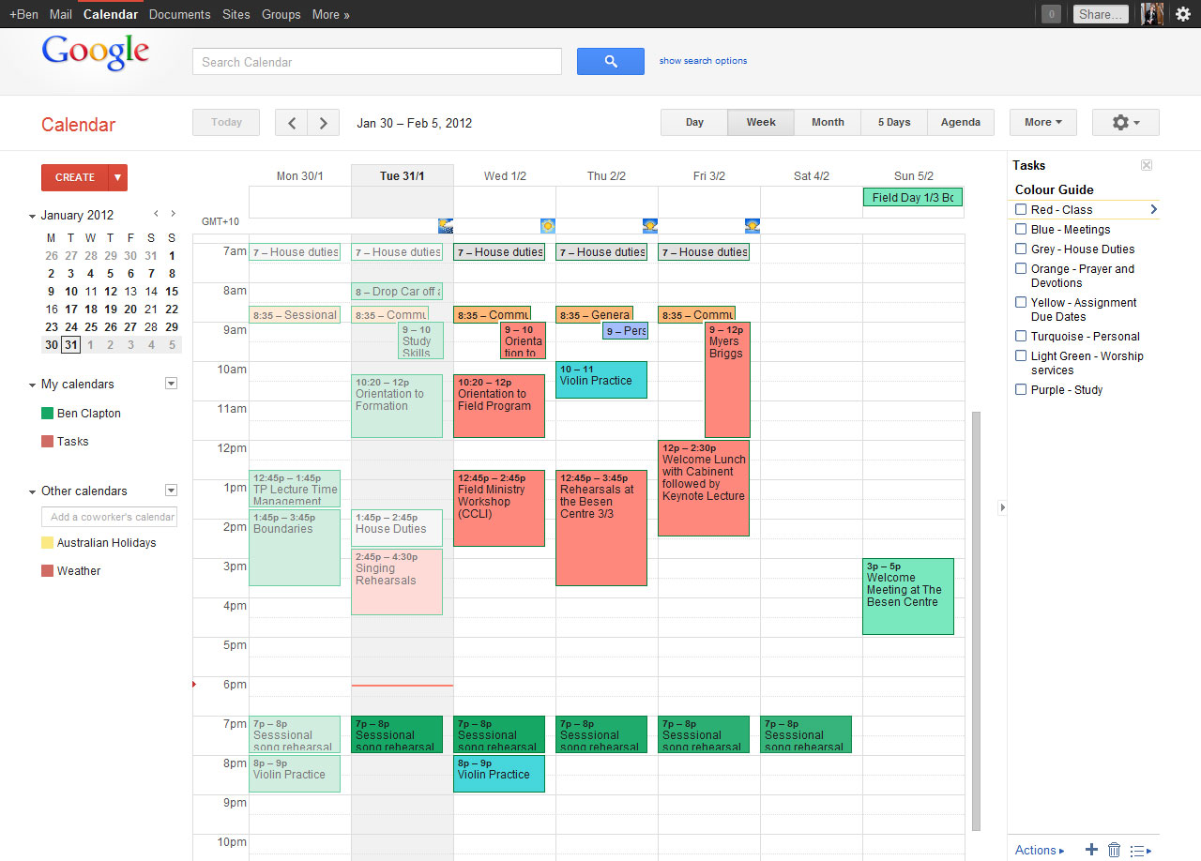
Google Calendar
Search
Display Options
Personal
Tasks
Current Time
Shared

Slide 17

Hangouts
Communication & Collaboration
Chat / instant messaging
Make video or phone calls
Screen sharing
Conversations carried across multiple devices

Slide 18
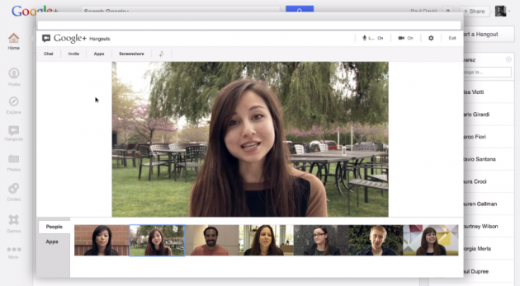
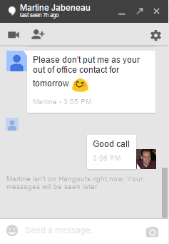
Hangouts
Chat & Video
Accessible via:
Gmail
Chrome Browser
Google+
Desktop App
Mobile Device

Slide 19

Google+
Social Networking
Find people you know
Share a post, video, photo, or event
View, organize, and add photos
Filter by contact groups (Circles)

Slide 20
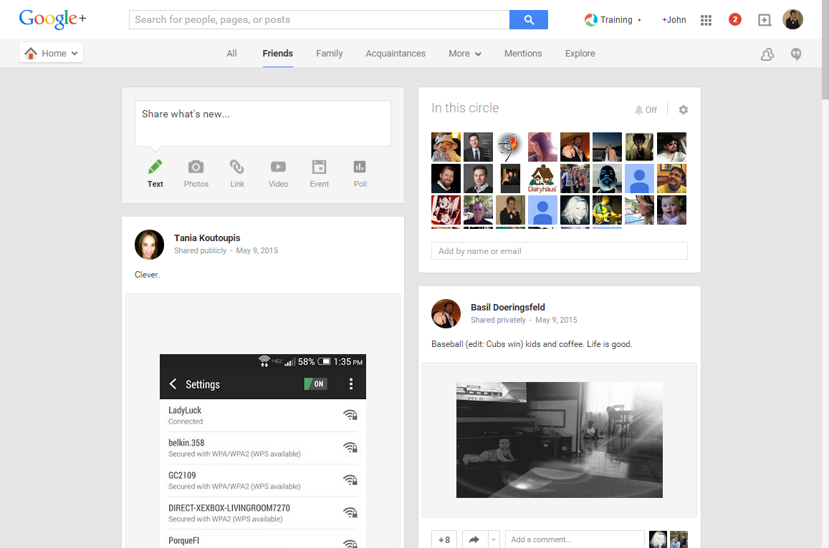
Google+
Select Circle
Post an Update
Members of Circle
Friend’s Updates

Slide 21
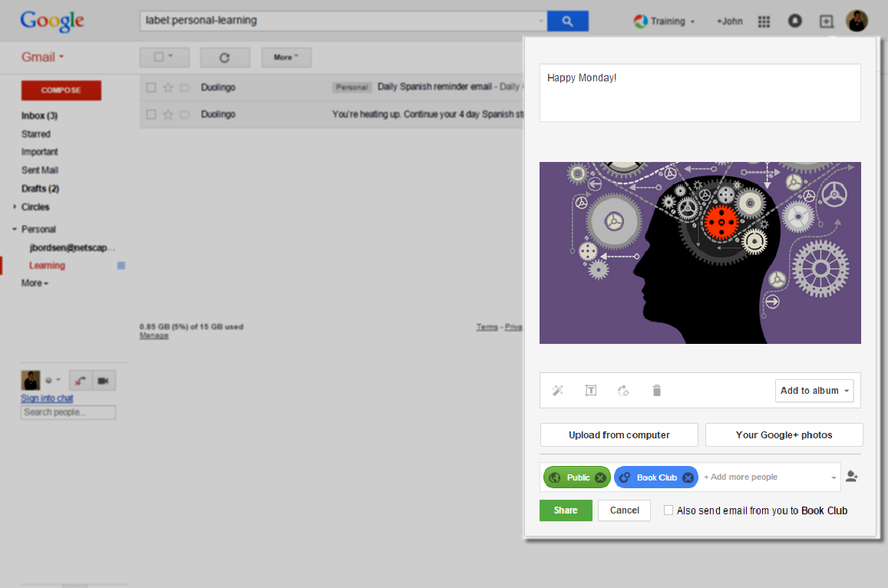
Google+
Share (+)
Share from Gmail
Message
Insert Media
Audience

Slide 22

Drive
Store and access files anywhere
Share w/ others and choose their level of access - view, comment, or edit
15GB of free storage

Slide 23
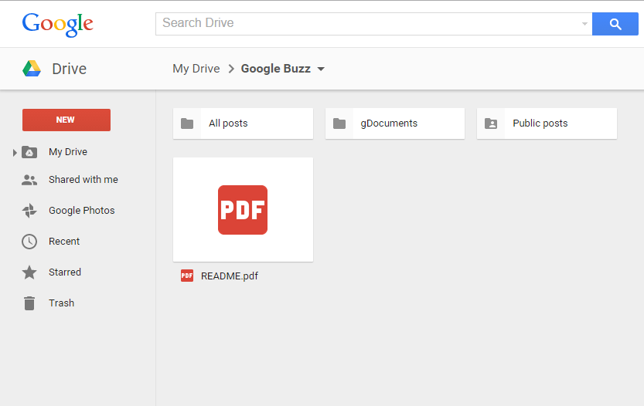
Drive
Store and share files

Slide 24
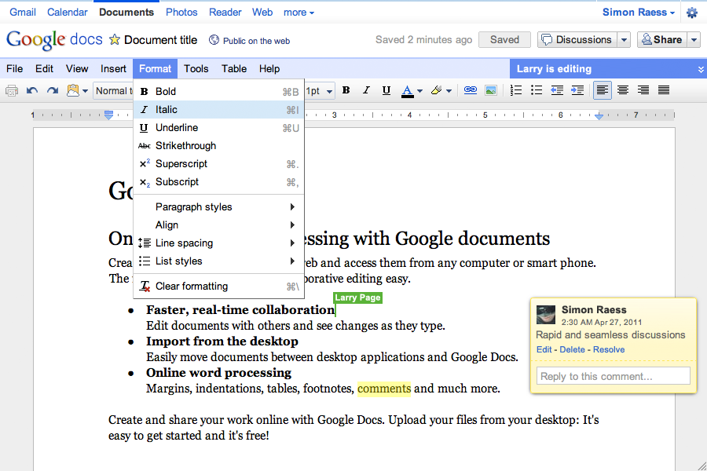
Docs
Create documents
Share
Edit
Real-time Collaboration
Comment

Slide 25
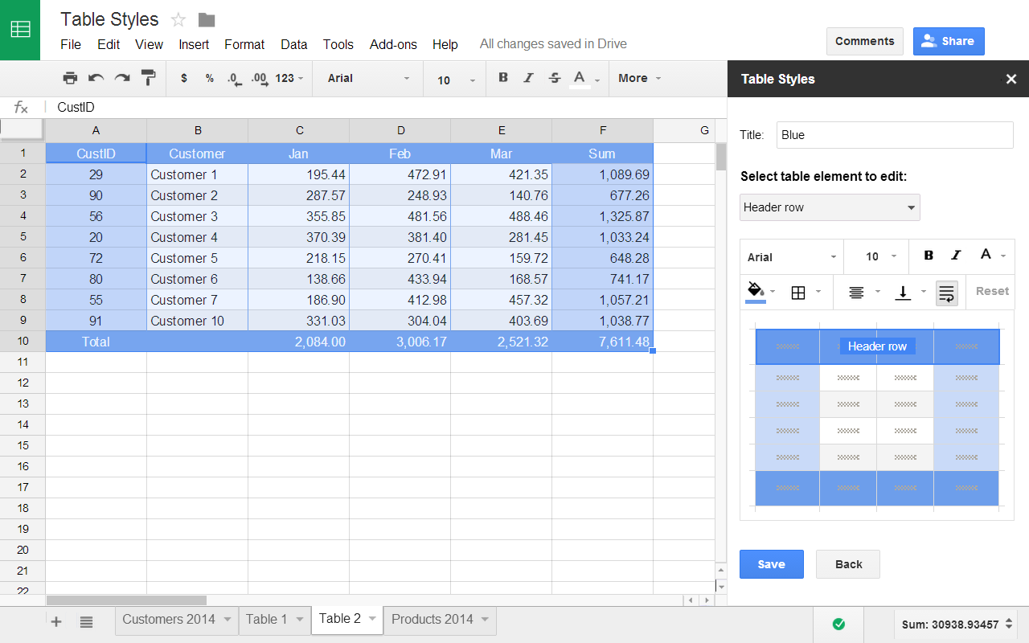
Sheets
Create spreadsheets

Slide 26
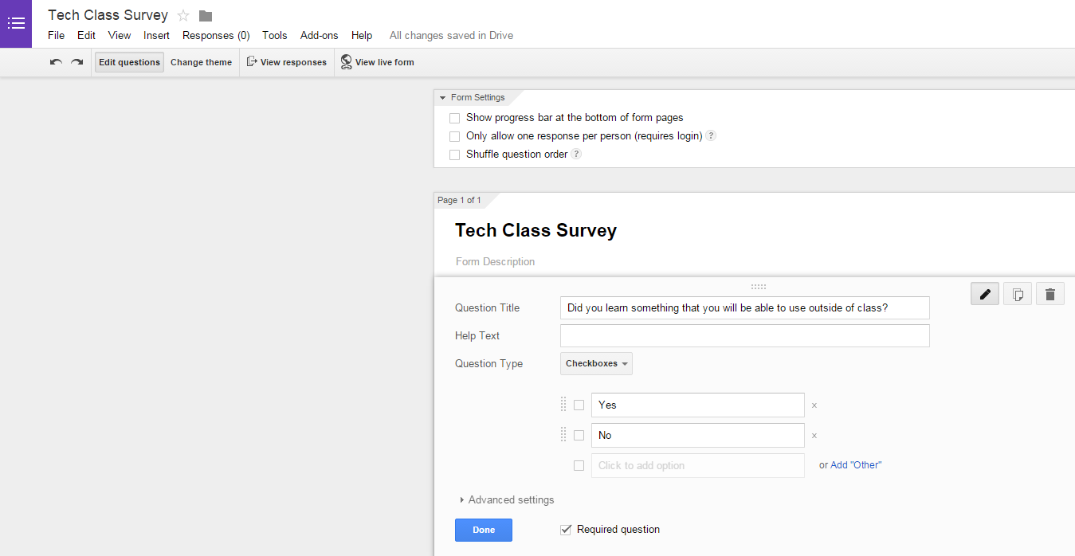
Forms
Create surveys

Slide 27
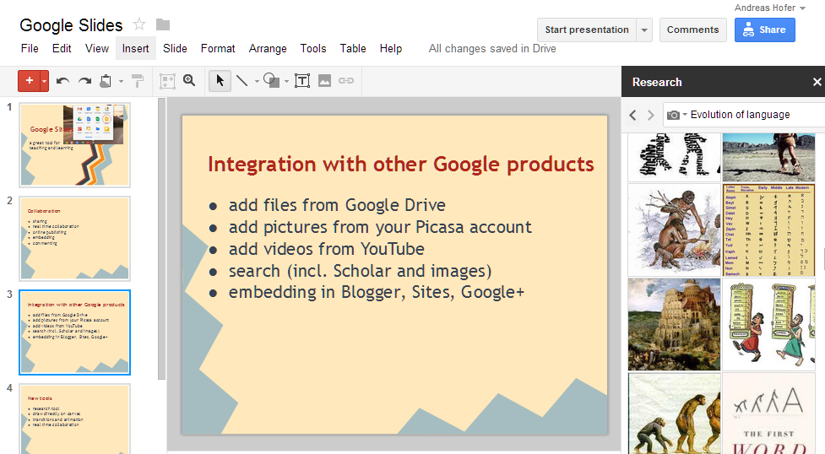
Slides
Create presentations

Slide 28
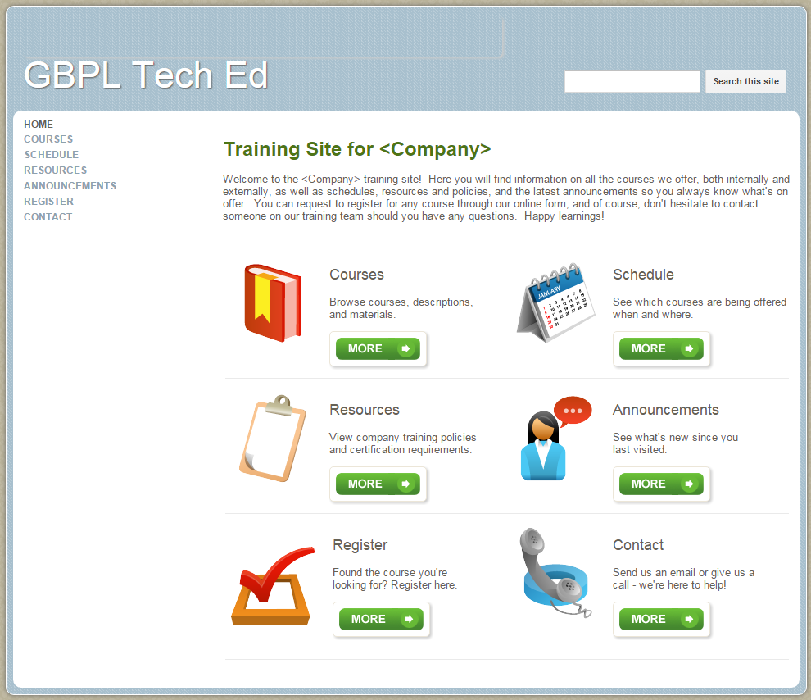
Sites
Create websites

Slide 29

Chrome
Search the Web
Fast, simple, and secure
Imports bookmarks, settings, & history
Highly customizable
Launch pad to other Google apps

Slide 30
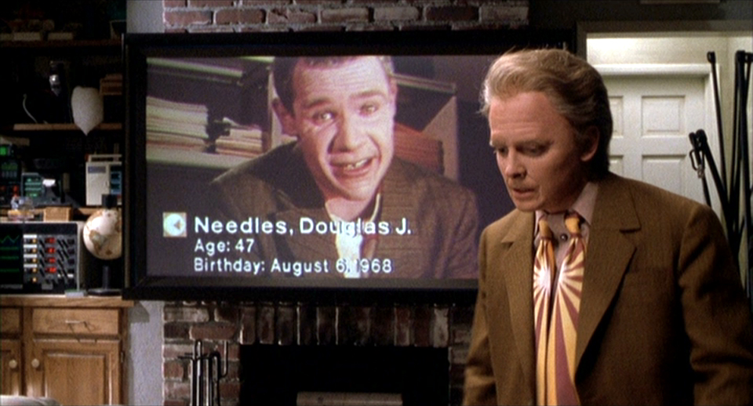




Pop quiz!
Marty McFly can utilize which Google tool to conduct a video chat with Douglas J. Needles?
Google+
Drive
Hangouts
Apps

Slide 31
Getting Started

Slide 32

Next Steps
Before Class Two:
Explore Google Chrome
Create a Gmail account
Explore Google’s apps
Visit the Google Help Center
    https://support.google.com/

Slide 33
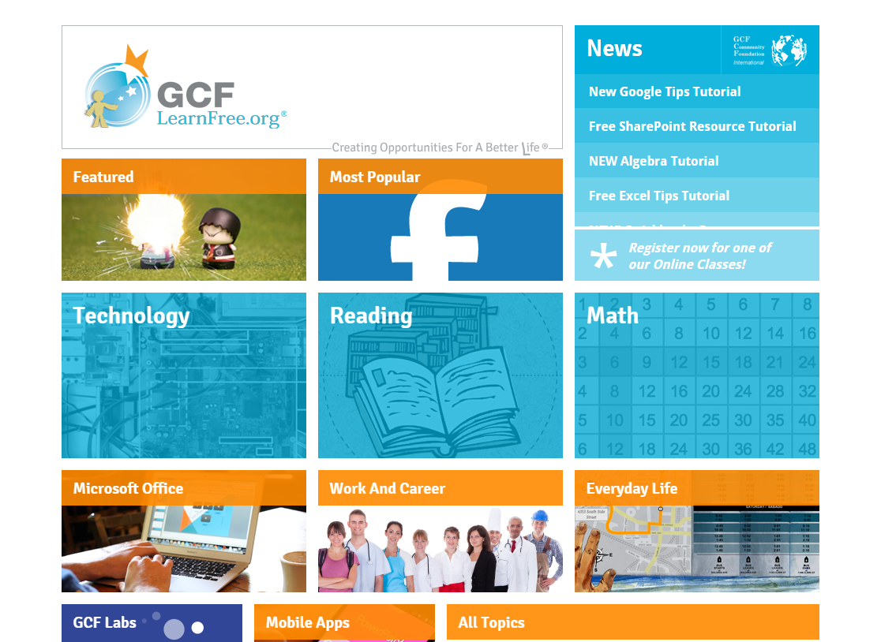
Learn More
GCF Learn Free
www.gcflearnfree.org/usingthecloud

Slide 34
Questions?
THANK YOU FOR COMING!
Part Two Next Week
Google Tools for Communication

