Slide 1

Internet Basics
Instructor Name:
Instructor Title:
Library Name:
Insert your logo her
Provided by AT&T and the Public Library Association

Slide 2
Today’s Agenda
Introduction
  Web browsers
  Search engine
Skill Building
  Using a web browser
  Using a search engine
  Navigating a website
  Search engine tips & tricks
Practice
Notes:
In this workshop you will:
• Learn about web browsers and search engines.
• Build skills to navigate the internet, including:
- Using a web browser
Using a search engine
Navigating a website
- Learning tips and tricks for basic and advanced searches
• Practice your new skills.
Let’s get started!

Slide 3
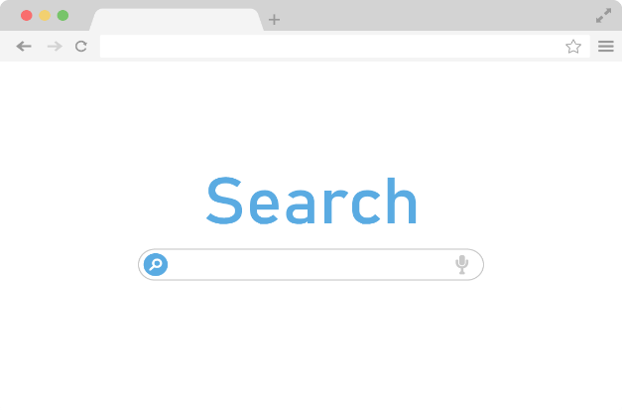









Introduction
Web Browser: A program that allows you to view websites and navigate between them using hyperlinks
Search Engine: A website that allows you to look up information and view content on the internet
Common Browsers
Common Search Engines
Notes:
There is a lot of information on the internet. And today we are going learn internet basics, so that you can search and find information and resources.
What kind of information do you want to find on the internet? (Directions, maps, news, etc.)
The internet is a global network that allows people to share digital information with one another. There are two main tools you will need to navigate the internet so you can find the information you’re looking for.
First, you’ll need a web browser.
A web browser is a program that allows you to view websites and navigate between them using hyperlinks. People use it to access web-based applications (including email) and to store and access documents (such as photos, forms, and music).
Some commonly used web browsers are:
Microsoft Edge
Mozilla Firefox
Google Chrome
Apple Safari
Second, you’ll need a search engine.
A search engine is a website that allows you to look up information and view content on the internet.
In today’s workshop we are going to use the Google search engine. Some examples of other commonly used search engines are
Bing
Duck Duck Go
Yahoo!
Let’s talk about how to use a search engine to find information on the internet.

Slide 4

Using a Web Browser
Opening a Web Browser:
  Desktop Shortcut
  Menu Bar
Edge
Mozilla Firefox
Google Chrome
Safari
Notes:
INSTRUCTOR NOTE: USE POWERPOINT OR LIVE DEMONSTRATION:
Demonstrate steps to open a web browser. If possible, use the icon on the desktop menu. Point out that the icon may be in a different location on another computer, but it’s still possible to access a browser from somewhere on the desktop.
Today we are going to use <insert web browser name here>. You can access this through your menu bar or desktop. Let me demonstrate.

Slide 5
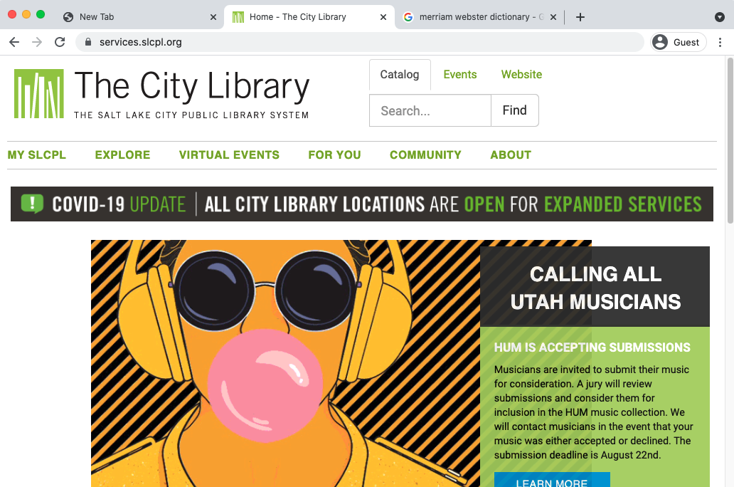
Using a Web Browser
Address Bar: Use this to type in the address of a website or web page.
Notes:
INSTRUCTOR NOTE: USE POWERPOINT OR LIVE DEMONSTRATION:
Demonstrate the main features of a web browser.
The Address Bar: Use this to type in the address of a website or web page.

Slide 6
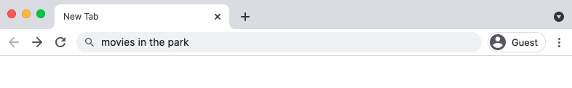
Using a Web Browser
Search Box: Use this to enter keywords when the exact address is unknown.
Note: Some browsers only have a single “omnibox” that is used to enter both web addresses and keywords (like Google).
Notes:
INSTRUCTOR NOTE: USE POWERPOINT OR LIVE DEMONSTRATION:
Demonstrate the main features of a web browser.
The Search Box: Use this to enter keywords when the exact address is unknown.
Note: Some browsers only have a single “omnibox” that is used to enter both web addresses and keywords (like Google).

Slide 7
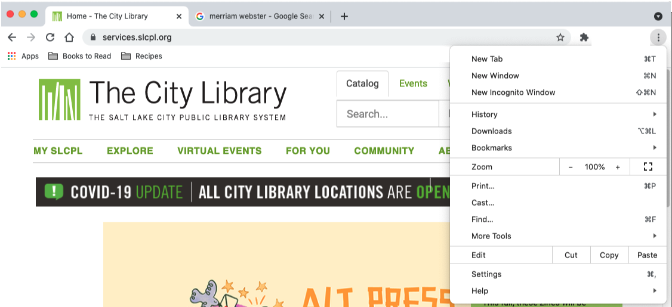
Using a Web Browser
Browser Window: This is how you view and navigate web pages. Within a browser window, you can have multiple tabs. You can also have multiple browser windows open at the same time.
Notes:
INSTRUCTOR NOTE: USE POWERPOINT OR LIVE DEMONSTRATION:
Demonstrate the main features of a web browser.
The Browser Window: This is how you view and navigate web pages. Within a browser window, you can have multiple tabs. You can also have multiple browser windows open at the same time.

Slide 8
Using a Web Browser
Tabs: Use these to open a web page without closing the current one so you can navigate back and forth between them. To open a new tab, click the + sign.
Notes:
INSTRUCTOR NOTE: USE POWERPOINT OR LIVE DEMONSTRATION:
Demonstrate the main features of a web browser.
The Tabs: Use these to open a web page without closing the current one so you can navigate back and forth between them. To open a new tab, click the plus sign.

Slide 9
Using a Web Browser
Back: Use this to return to the previous screen in the web browser.
Forward: Use this to return to the screen that appeared before you hit the back button in the web browser.
Notes:
INSTRUCTOR NOTE: USE POWERPOINT OR LIVE DEMONSTRATION:
Demonstrate the main features of a web browser.
The Back and Forward commands:
Back: Use this to return to the previous screen in the web browser.
Forward: Use this to return to the screen that appeared before you hit the back button in the web browser.

Slide 10
Using a Web Browser
Stop: Use this to stop a web page from loading when it’s taking too long or you realize you selected the wrong web page.
Notes:
INSTRUCTOR NOTE: USE POWERPOINT OR LIVE DEMONSTRATION:
Demonstrate the main features of a web browser.
The Stop command:
Use this to stop a web page from loading when it’s taking too long or you realize you selected the wrong web page.

Slide 11
Using a Web Browser
Reload or Refresh: Use this to reload the web page to ensure the page content is up to date.
Notes:
INSTRUCTOR NOTE: USE POWERPOINT OR LIVE DEMONSTRATION:
Demonstrate the main features of a web browser.
The Reload or Refresh command:
Use this to reload the web page to ensure the page content is up to date.

Slide 12
Using a Web Browser
Home: Use this to return to the homepage of the web browser. You can select which web page you want to set as your homepage in the web browser’s settings.
Notes:
INSTRUCTOR NOTE: USE POWERPOINT OR LIVE DEMONSTRATION:
Demonstrate the main features of a web browser.
The Home command:
Use this to return to the homepage of the web browser. You can select which web page you want to set as your homepage in the web browser’s settings.

Slide 13
Using a Web Browser
Bookmarks or Favorites: Use this to save favorite or frequently visited web pages so they are easier to find later.
Notes:
INSTRUCTOR NOTE: USE POWERPOINT OR LIVE DEMONSTRATION:
Demonstrate the main features of a web browser.
The Bookmarks or Favorites command:
Use this to save favorite or frequently visited web pages so they are easier to find later.
INSTRUCTOR NOTE: Before moving to Activity 1, review “parking lot” questions on the Using a Web Browser section. If there are no questions in the parking lot, ask the attendees if they have any questions before you move to Activity 1.

Slide 14
Activity #1
Notes:
INSTRUCTOR NOTE: Have participants complete Activity #1 on the Activity Sheet.
“Let’s practice what you’ve learned.”
If learner has access to a workshop computer: “Please complete Activity 1 on the Activity Sheet. Please let me know if you have any questions.“
INSTRUCTOR NOTE: Once attendees are done, review the exercise and answers. To review the exercise, complete the activity in a web browser. Ask attendees to guide you through the process.
If learner does not have access to a workshop computer: “Let’s complete Activity 1 together. Feel free to write the answers on the Activity Guide as we complete the tasks together.”
INSTRUCTOR NOTE (if there are no participant computers): Participants can follow along as you go through each question. Encourage them to call out answers, and then confirm the correct answer to have them update their Activity Sheet.
After learners complete Activity 1: “Great job, everyone! In the next section you’ll learn how to use a search engine.”

Slide 15
ACTIVITY #1: Using a Web Browser
Use a web browser or follow along with the instructor to complete the following tasks.
1. Use the address bar to go to www.google.com and search for puppies.
2. Click the back button. What web page displays?
3. Click the forward button. What web page displays?
4. Click on the homepage. What web page displays?
5. What icon on the browser would you click to bookmark this page?
Notes:
INSTRUCTOR NOTE: For Activity 1, use PowerPoint or a live demonstration.
“Let’s practice what you’ve learned. Feel free to write the answers on the Activity Guide as we complete the tasks together.”
1. Use the address bar to go to www.google.com and search for puppies.
2. Click the back button. What web page displays?
3. Click the forward button. What web page displays?
4. Click on the homepage. What web page displays?
5. What icon on the browser would you click to bookmark this page?
After learners complete Activity #1: “Great job, everyone! In the next section you’ll learn how to use a search engine.”

Slide 16
Using a Search Engine
Opening a Search Engine
  Open a web browser
    Desktop shortcut
    Menu bar
Edge
Mozilla Firefox
Google Chrome
Safari
Notes:
INSTRUCTOR NOTE: USE POWERPOINT OR LIVE DEMONSTRATION:
Demonstrate steps to launch a search engine (for example, use your web browser to type in an address or URL).
“Today we are going to use Google.”
REMINDER: A search engine is a website that allows you to look up information and view content on the internet.
To find information on the internet, you use a search engine. Let’s explore how you can use one.

Slide 17
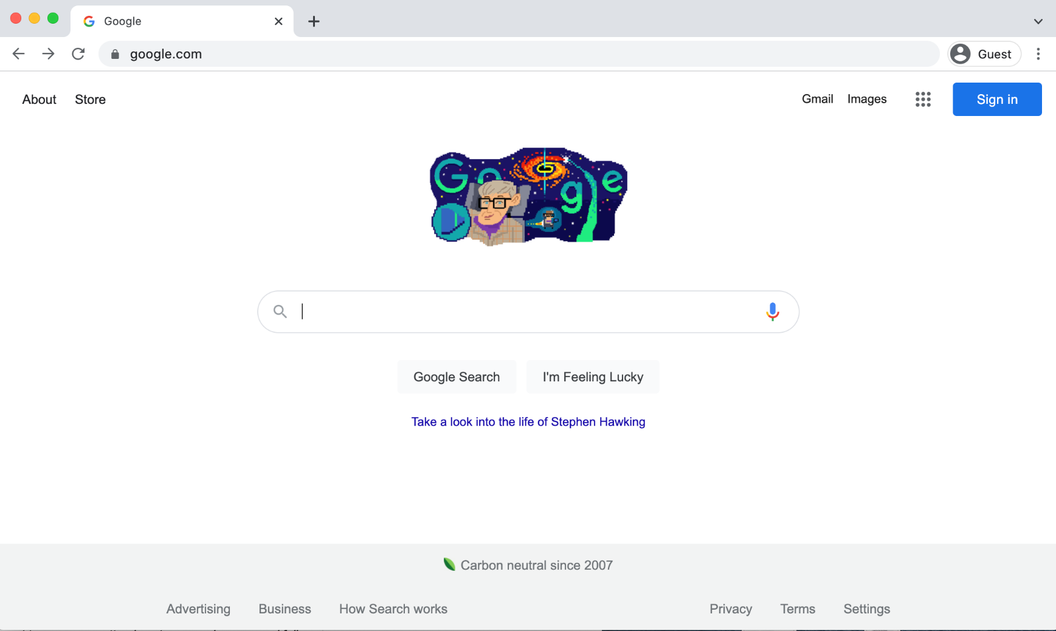
Using a Search Engine
Searching the web: Use this search box to type your search terms.
Notes:
INSTRUCTOR NOTE: USE POWERPOINT OR LIVE DEMONSTRATION:
Demonstrate the main features of a search engine.
Searching the web: You can use a search engine to find information like a recipe or the address and menu of a restaurant. You can use the internet to plan a trip or learn something new. Let’s try a search.
INSTRUCTOR NOTE: If you feel comfortable and devices are available, ask attendees for topics they would like to search on the web. Or you can use the example in this presentation, which is planning a trip to Chicago. Based on the size of the workshop, you may want to encourage attendees to open a browser and follow along.

Slide 18
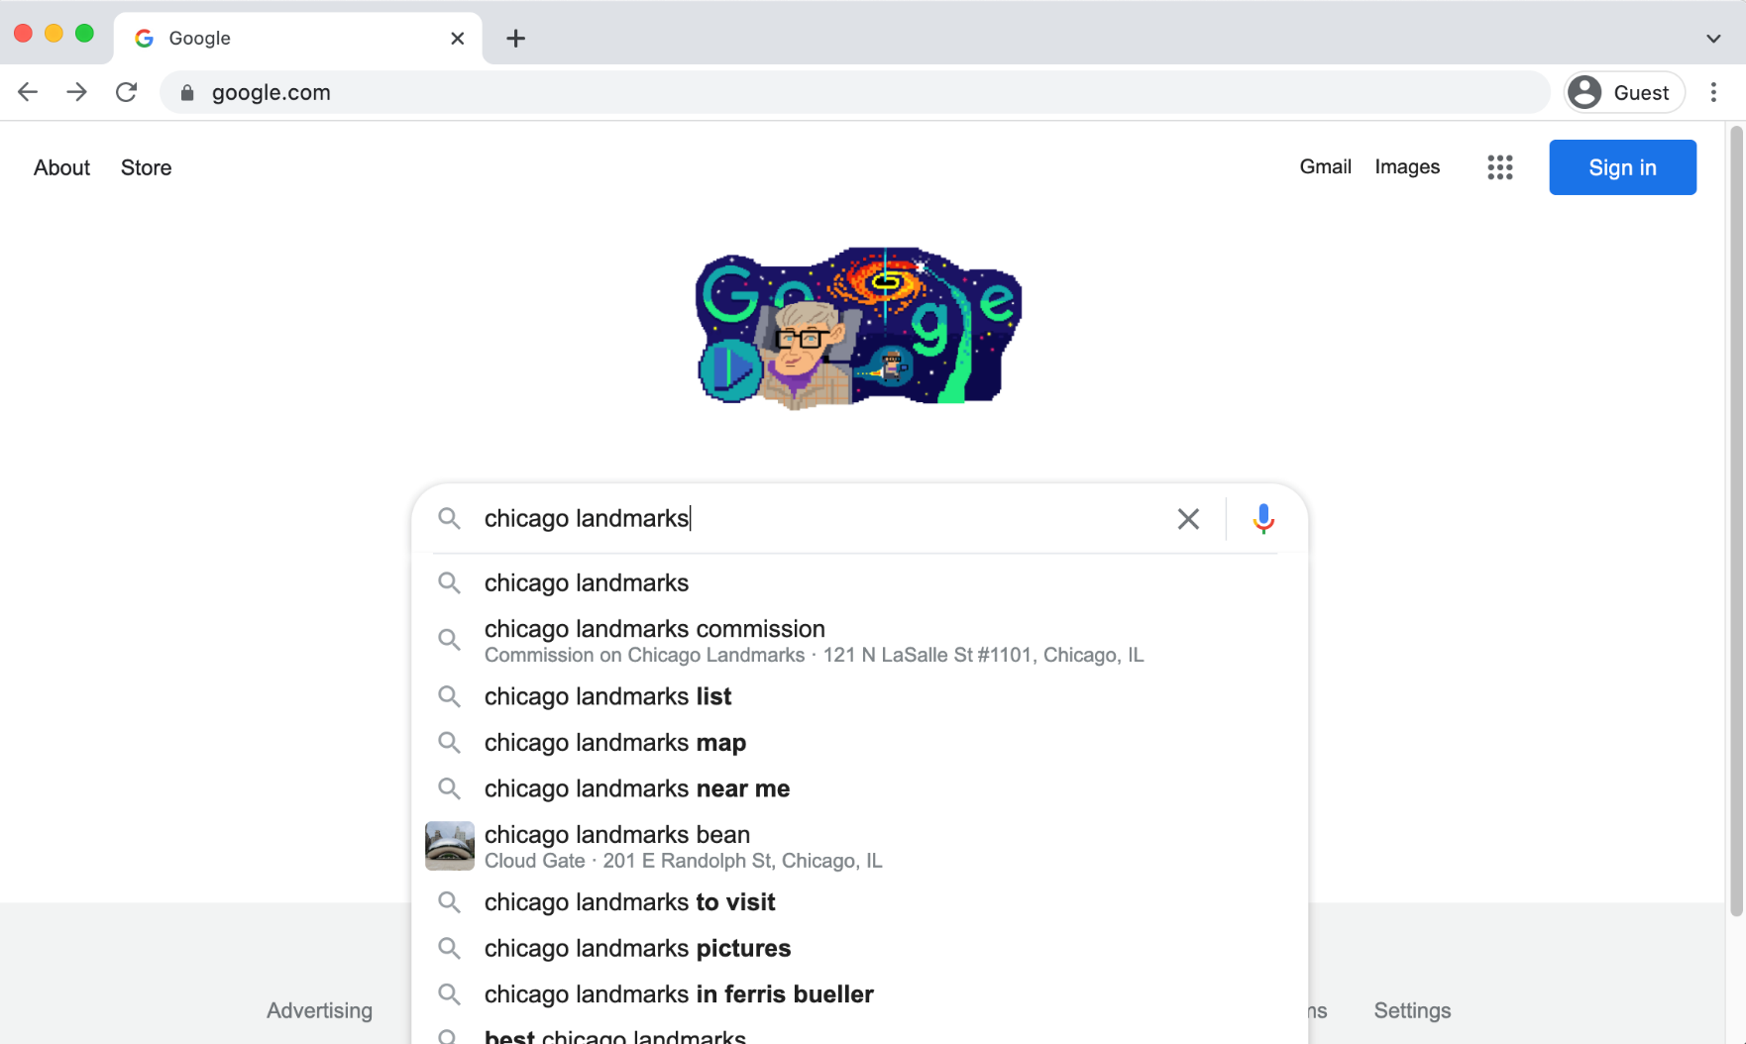
Using a Search Engine
Search Recommendations: When you begin to type in your search, the search engine will recommend relevant search terms.
Notes:
INSTRUCTOR NOTE: USE POWERPOINT OR LIVE DEMONSTRATION:
Demonstrate the main features of a search engine.
Search Recommendations: In today’s example let’s plan a trip to visit Chicago. Type your search “Chicago landmarks” into the search box. By default, Google will search for things that include both of those words. Let’s look for landmarks you might want to see when you visit Chicago.
When you begin to type your search, the search engine will display some suggestions of keywords or phrases that are related to your search. You can select one of the recommended searches by clicking on it, or you can complete your own search by typing your term and clicking the Enter or Return key on your computer.

Slide 19
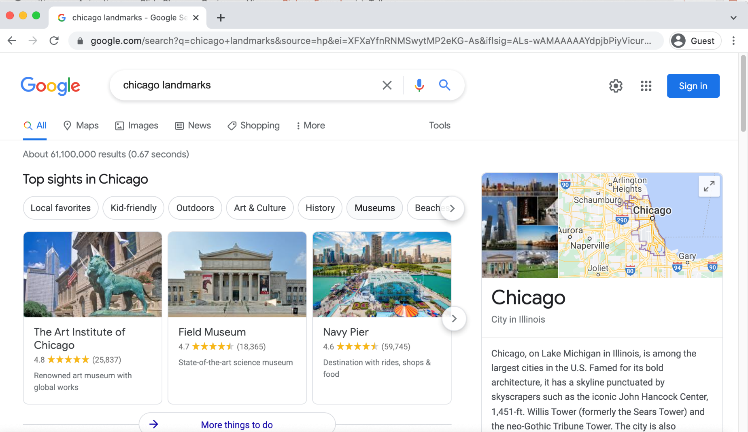
Using a Search Engine
Search Term
Notes:
INSTRUCTOR NOTE: USE POWERPOINT OR LIVE DEMONSTRATION:
Demonstrate the main features of a search engine.
Search Term: The search term you entered will display at the top of the page. You can enter new search terms in this search box if you want to revise your search or search for something else.

Slide 20
Using a Search Engine
Search Results: A list of items that match the search terms.
Notes:
INSTRUCTOR NOTE: USE POWERPOINT OR LIVE DEMONSTRATION:
Demonstrate the main features of a search engine.
Search Results: The search results page will include a list of web pages that are relevant to your search. As you see, there are links to famous landmarks in Chicago, including the Art Institute of Chicago, the Field Museum, and Navy Pier.
INSTRUCTOR NOTE: Please point out the locations on the screen as you mention them. If learners are following along on their devices, ask if their search displayed different locations.

Slide 21
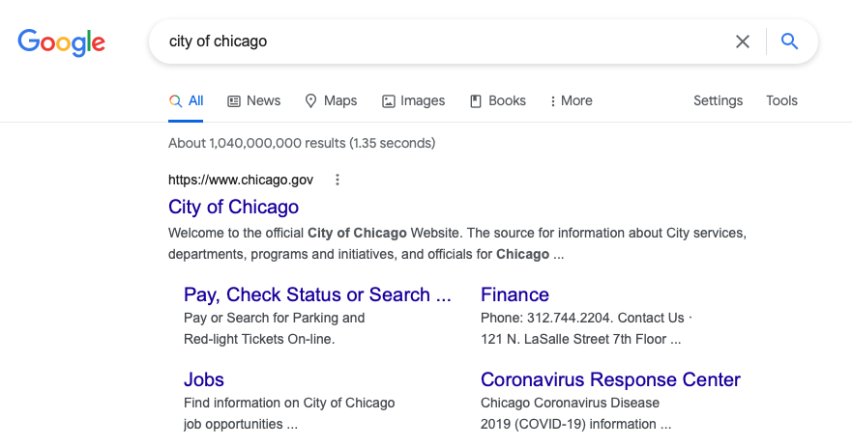
Using a Search Engine
Hyperlink (also known as a link): It is an element on the web page that when clicked takes you to another document on the internet.
Notes:
INSTRUCTOR NOTE: USE POWERPOINT OR LIVE DEMONSTRATION:
Demonstrate the areas where hyperlinks are featured on a search result page.
Hyperlinks: The search results page includes a list of hyperlinks. A hyperlink (also known as a link) is an element on the web page that when clicked takes you to another document on the internet. In the example you see here, the items in orange boxes are examples of hyperlinks. When you click each link, it will bring you to a different page.

Slide 22
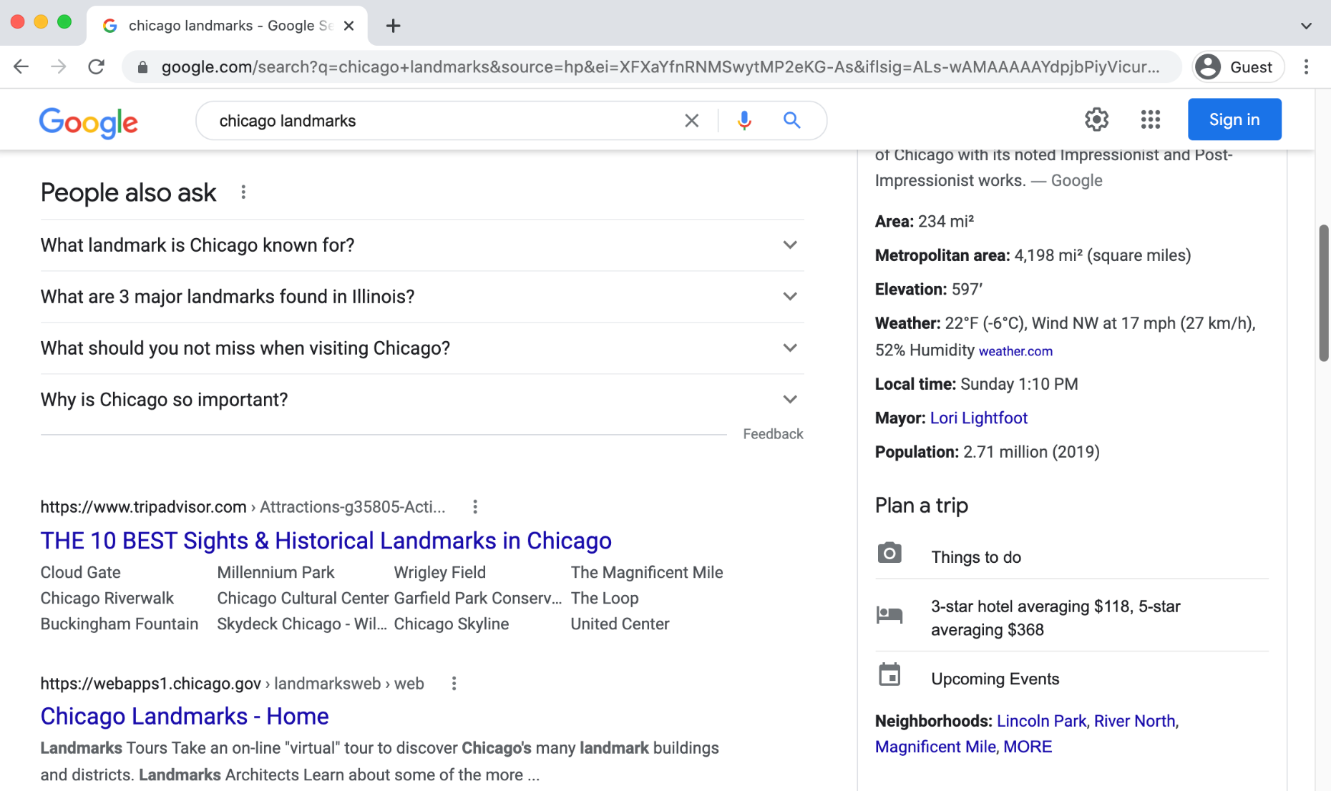
Using a Search Engine
Search Results Continued . . .
Notes:
INSTRUCTOR NOTE: USE POWERPOINT OR LIVE DEMONSTRATION:
Demonstrate the the other areas where hyperlinks appear.
As you scroll down the page, you will see more links.
INSTRUCTOR NOTE: Ask the learners to point out a few hyperlinks before you move on.

Slide 23
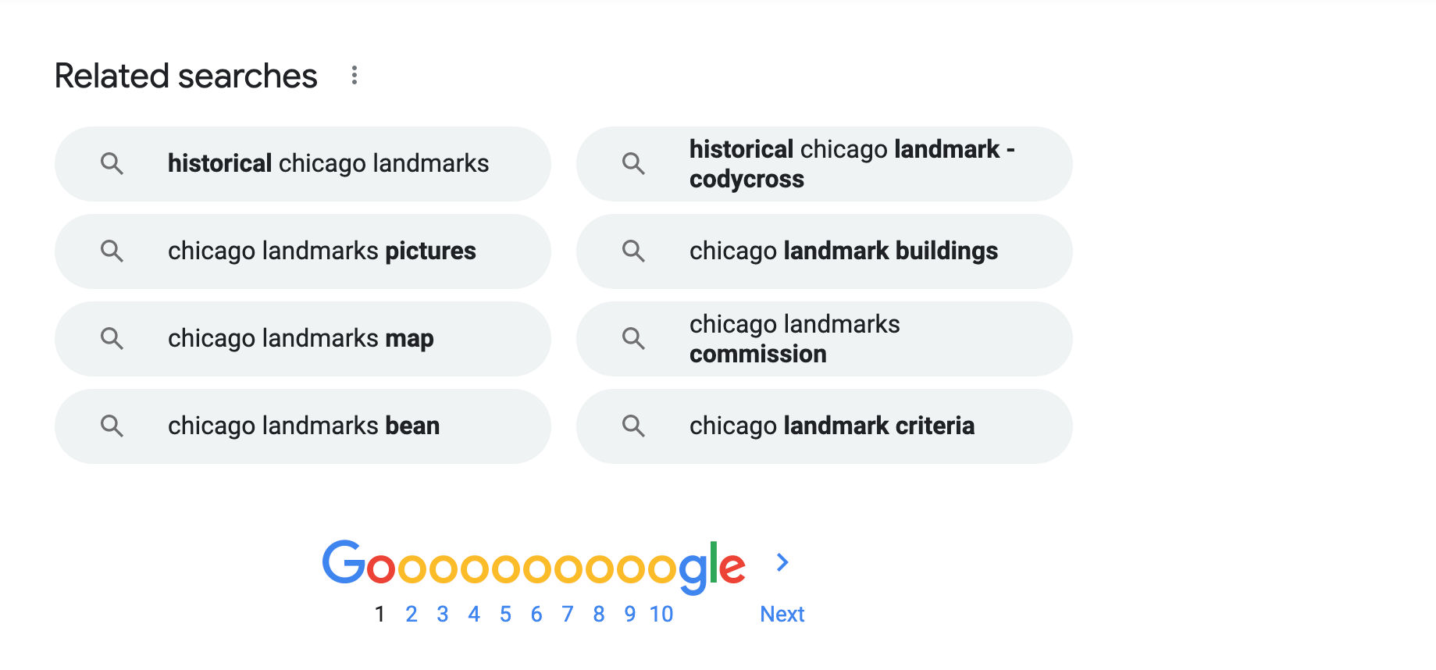
Search Engine
Related Searches or Also Try: The search engine recommends similar searches you may want to try. To execute the search, click the search term.
Notes:
INSTRUCTOR NOTE: USE POWERPOINT OR LIVE DEMONSTRATION:
Demonstrate where the search term is located on a search web page.
Related Searches or Also Try: Near the bottom of the search results page, you will see Related Searches or Also Try. The search engine recommends similar searches you may want to try. To execute the search, just click on the search term.

Slide 24
Using a Search Engine
Additional Results: These links show other web pages that relate to your search. Clicking Next or the right arrow takes you to the next page. You can go to a specific page of results by clicking the page number.
Notes:
INSTRUCTOR NOTE: USE POWERPOINT OR LIVE DEMONSTRATION:
Demonstrate where the additional results are located on a search web page.
Additional Results: To see Additional Results, use these links to see other web pages that are relevant to your search. Clicking Next or the right arrow takes you to the next page. You can also go to a specific page of results by clicking on the page number.

Slide 25
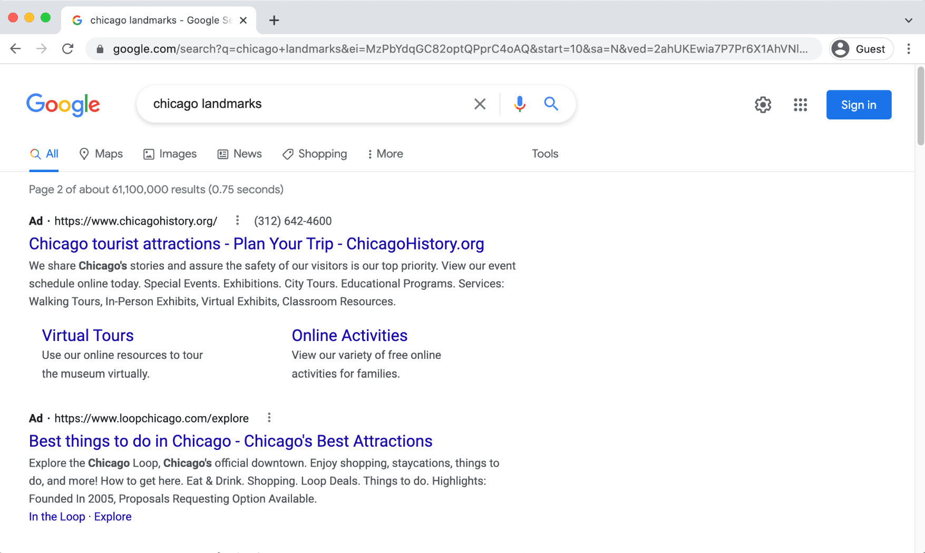
Search Engine
Ads in Search Results: Search engines sometimes display advertisements related to the search result.
Notes:
INSTRUCTOR NOTE: USE POWERPOINT OR LIVE DEMONSTRATION:
Demonstrate where to identify advertising links on search web page.
Ads in Search: We are using Google as a search engine to show how ads display in search results. They often appear at the top of the search results.
There is nothing wrong with using the links from the ads, but it is good to be aware of the difference between the links on the page that are part of your search results and those that pay to be on the page.

Slide 26
Using a Search Engine
Search by Format Type
Notes:
INSTRUCTOR NOTE: USE POWERPOINT OR LIVE DEMONSTRATION:
Demonstrate search by format type. You can click on a few each to show how the search results change based on format. Or follow along to the next slides for examples.
Search by Format Type: Many search engines allow you to search by format. Examples include images, videos, shopping opportunities, and news articles.
This is how you limit your search results to specific formats using the Google search engine.

Slide 27
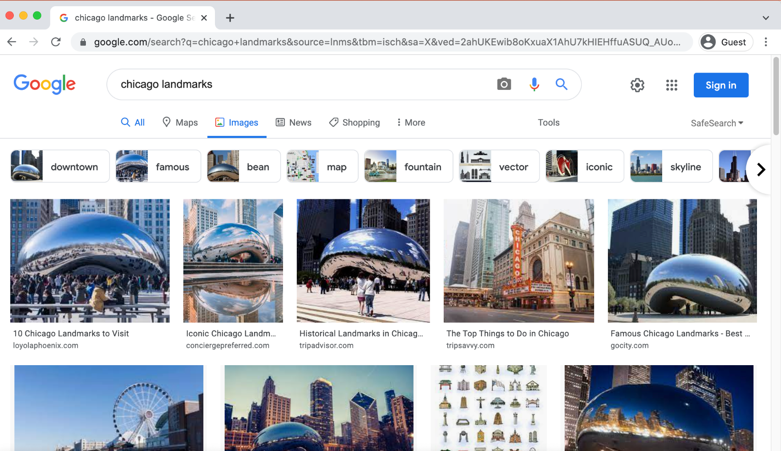
Using a Search Engine
Search by Format Type Example
Notes:
INSTRUCTOR NOTE: USE POWERPOINT OR LIVE DEMONSTRATION:
Demonstrate the main features of a search engine.
Search by Format Type Example: When you click on one of the format types, it will display items related to your search. In this example when you click on the word Images, images of Chicago landmarks display.

Slide 28
Using a Search Engine
Search by Format Type Example (continued)
Notes:
INSTRUCTOR NOTE: USE POWERPOINT OR LIVE DEMONSTRATION:
Demonstrate the main features of a search engine.
Search by Format Type, continued: To get back to the full list of search results, click on All.
INSTRUCTOR NOTE: Before moving to Activity 2, review “parking lot” questions on the Using a Search Engine section. If there are no questions in the parking lot, ask the attendees if they have any questions before you move to Activity 2.

Slide 29
Activity #2
Open Internet Basics: Basic Search Practice Module
Notes:
Let’s practice what you’ve learned.
INSTRUCTOR NOTE: You can either:
Launch the Practice section online by clicking on the link “Open Internet Basics: Basic Search Practice Module” on the slide
OR Ask learners if they would prefer a demo to walk through these instructions, which are also listed on the Learner Activity Sheet
In the address bar of the web browser, enter https://www.digitallearn.org/ > Click on “Basic Search” > Click on “Practice Lesson”
OR Use the next four slides to review what students have learned in the Using a Search Engine section.
Participants should follow along as you go through each question. Engage them by asking them to call out answers. Then confirm the correct answer.

Slide 30
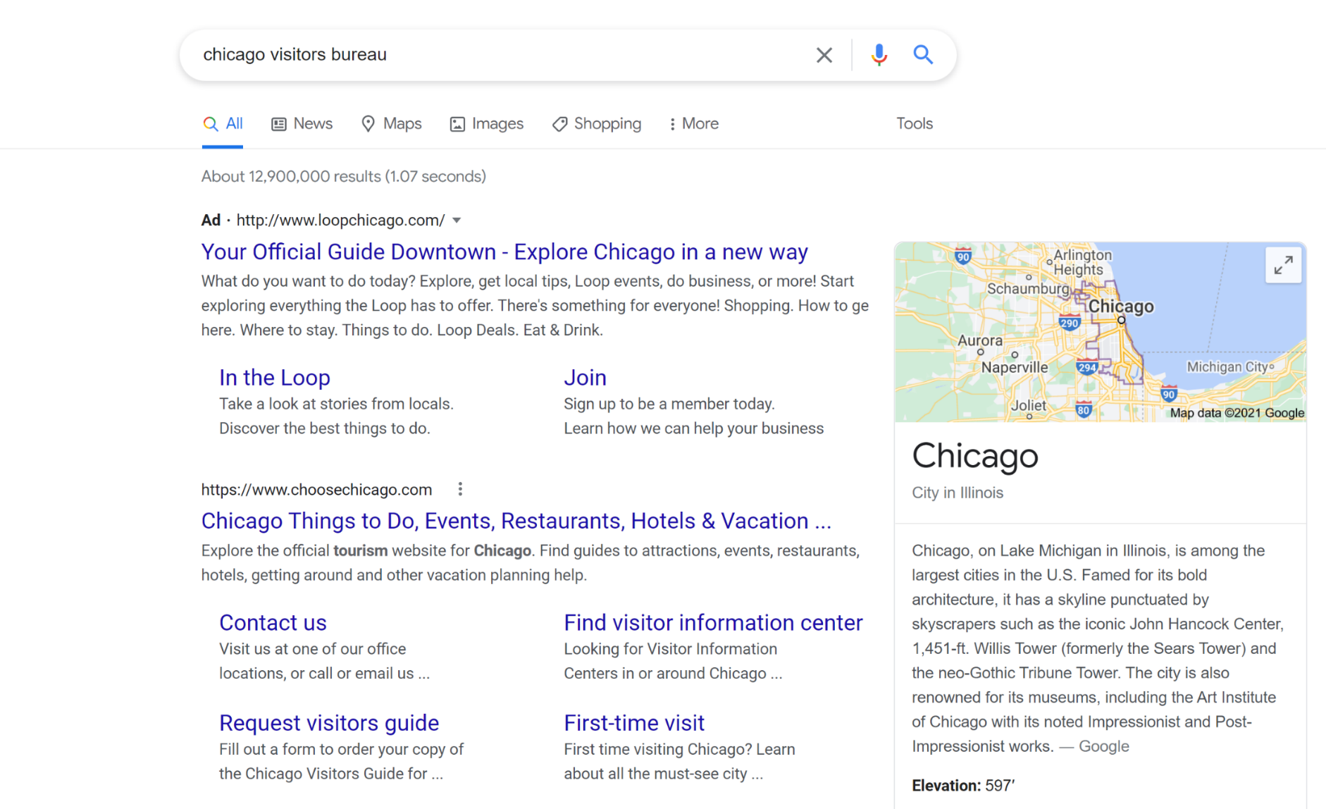
Can you identify where you enter your search terms when searching Google?
Notes:
INSTRUCTOR NOTE: USE POWERPOINT OR LIVE DEMONSTRATION: Practice questions are online at Internet Basics: Basic Search Practice Module: https://www.digitallearn.org/courses/basic-search-new/lessons/practice-www
Review concepts from the Using a Search Engine section.
Can you identify where you enter your search terms when searching Google?
INSTRUCTOR NOTE: Solicit answers from the learners.
Answer: It is the search box.
INSTRUCTOR NOTE: Point out the search box.

Slide 31
Can you identify where the ad appears?
Notes:
INSTRUCTOR NOTE: USE POWERPOINT OR LIVE DEMONSTRATION: Practice questions are online at Internet Basics: Basic Search Practice Module https://www.digitallearn.org/courses/basic-search-new/lessons/practice-www
Review concepts from the Using a Search Engine section.
Can you identify where the ad appears?
INSTRUCTOR NOTE: Solicit answers from the learners.
Answer: It is the first link in the search results. It has the word “Ad” in boldface type at the beginning.
INSTRUCTOR NOTE: Point out the link with the Ad marker next to it.

Slide 32
There are two ways to get to a map. What are they?
Notes:
INSTRUCTOR NOTE: USE POWERPOINT OR LIVE DEMONSTRATION: Practice questions are online at Internet Basics: Basic Search Practice Module: https://www.digitallearn.org/courses/basic-search-new/lessons/practice-www
Review concepts from the Using a Search Engine section.
In this example, there are two ways to get to a map. What are they?
INSTRUCTOR NOTE: Solicit answers from the learners.
Answer: The first is the Maps link under the search box. The second location is the map on the right-hand side of the screen.
INSTRUCTOR NOTE: Point out the two areas.

Slide 33
Which link will take you to the image results?
Notes:
INSTRUCTOR NOTE: USE POWERPOINT OR LIVE DEMONSTRATION: Practice questions are online at Internet Basics: Basic Search Practice Module: https://www.digitallearn.org/courses/basic-search-new/lessons/practice-www
Review concepts from the Using a Search Engine section.
Which link will take you to the image results?
INSTRUCTOR NOTE: Solicit answers from the learners.
Answer: The Images link is right below the search box.
INSTRUCTOR NOTE: Point out the Images link.
After Activity 2 is completed: Great job everyone! In the next section, you’ll learn some search tips and tricks.

Slide 34

Search Tips & Tricks
  Use quotation marks to search for an exact phrase.
  Example: “Illinois State Fair”
  AND narrows your search results. It finds web pages that contain all the search terms.
  Example: Chicago AND events
  OR expands your search. It finds web pages that contain either word.
  Example: college OR university
  You can exclude terms from the search results by using the (-) minus symbol.
  Example: cardinal -baseball
Notes:
Demonstrate Search Tips & Tricks.
Search tips: Use these tricks to search like a pro.
Use quotation marks to search for an exact phrase. Example: “Illinois State Fair”
AND narrows your search results. It finds web pages that contain all the search terms.
Example: Chicago AND events
OR expands your search. It finds web pages that contain either word.
Example: college OR university
Exclude terms from the search results by using the (-) minus symbol. Example: cardinal –baseball (Otherwise, results will include sports teams with that name instead of birds.)
INSTRUCTOR NOTE: If time permits open a browser window and conduct a search in a search engine using the same two search terms. Use the different search types (quotation marks, the word OR, the word AND, and the minus symbol). Highlight how the search result number changes based on the search conducted.

Slide 35
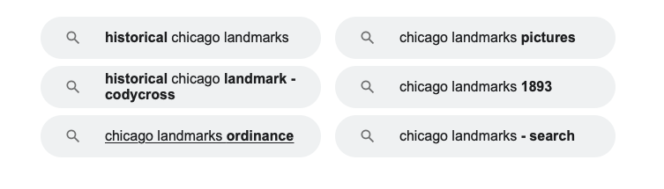
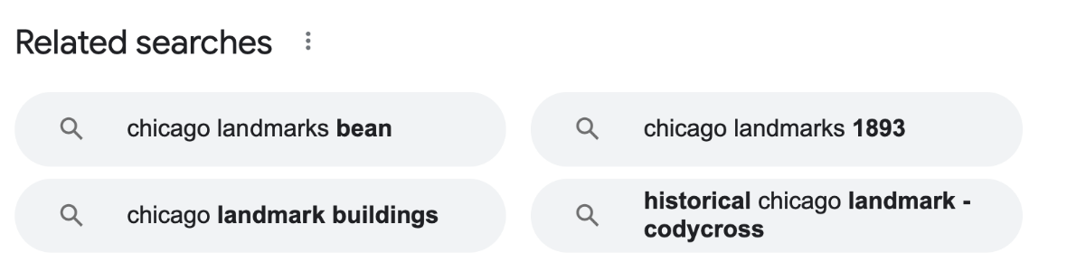
Search Tips & Tricks
Review the search results list before clicking a link.
Check multiple pages before using a new keyword search.
Use “Also try” or “Searches related to.”
If you can’t find a web page, try using the recommended searches feature available on most search result pages.
Notes:
INSTRUCTOR NOTE: USE POWERPOINT OR LIVE DEMONSTRATION:
Demonstrate Search Tips & Tricks.
INSTRUCTOR NOTE for live demo: It may be useful to use the two Search Tips & Tricks slides with this information first or print a Learner Handout to help learners follow along. Then follow up with a quick live demo by asking for search suggestions and demonstrating a few of these tips.
When reviewing your search results:
Review the search results list before clicking a link.
Check multiple pages before using a new keyword search.
Use “Also try” or “Searches related to.” If you can’t find a web page, try using the recommended searches feature, which is available on most search result pages.
INSTRUCTOR NOTE: Before moving to Activity 3, review “parking lot” questions on the Search Tips & Tricks section. If there are no questions in the parking lot, ask the attendees if they have any questions before you move to Activity 3.

Slide 36
Activity #3
Notes:
Let’s practice what you’ve learned.
If you want to search for “brave new world” as a phrase, what should you do?
INSTRUCTOR NOTE: Enter “brave new world” in quotation marks into the search box.
Let’s say you want to search for “brave new world” and you do not want the book to show up in the search results. What should you enter in the search box?
INSTRUCTOR NOTE: Enter “brave new world” –book into the search box.
If you want to search for a recipe that includes chicken, what should you enter in the search box?
INSTRUCTOR NOTE: Enter chicken AND recipe into the search box.
If you want to search for a recipe that includes chicken or fish, what should you enter in the search box?
INSTRUCTOR NOTE: Enter chicken OR fish AND recipe into the search box.
If you want recommendations on other searches you could try, what should you click?
INSTRUCTOR NOTE: Scroll to the bottom of the results page and click Related Searches.
INSTRUCTOR NOTE: Participants can follow along as you go through each question. Encourage them to call out answers, and then confirm the correct answer before moving to the next question.

Slide 37
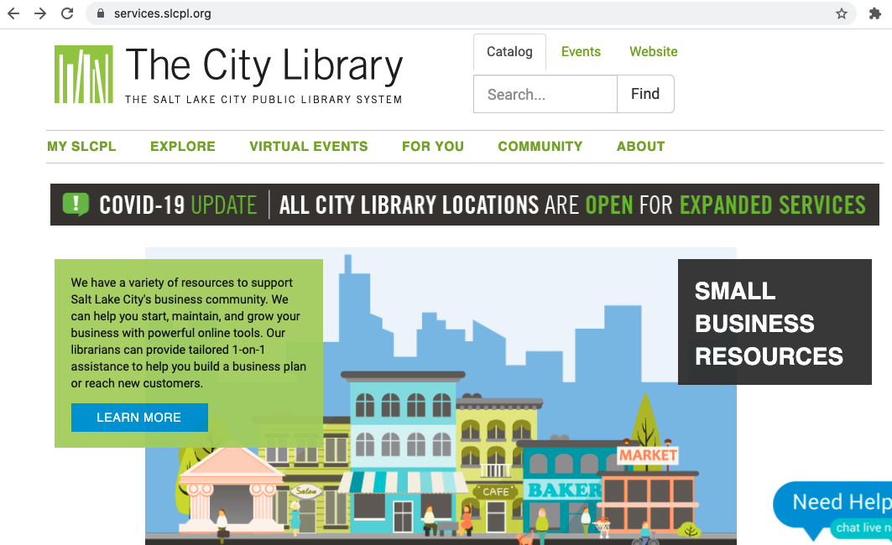
Navigating a Website
Website: A collection of web pages that provide information about a particular business, group, organization, or person (such as the Salt Lake City Public Library).
Notes:
INSTRUCTOR NOTE: USE POWERPOINT OR LIVE DEMONSTRATION:
Demonstrate the main features of a website, following the Instructor Guide for definition of terms.
INSTRUCTOR NOTE (Live Demo): Feel free to use this suggested site or a different one, like your library website. Make sure to verify before the class begins that the website you select includes each of the features highlighted in this section. Areas to highlight:
Navigation menu
Footer
Search box
Main content
Side navigation—you will most likely need to click a content link to see this menu
If you do click a link, demonstrate how to get back to the previous page.
When you search for information using a search engine, the search results will return web pages that match your search. Let’s learn how to navigate different parts of a website to find the information you are looking for.
Reminder: A website is a collection of web pages that provide information about a particular business, group, organization, or person (such as the Salt Lake City Public Library). Let’s look at the most common sections of a website.
Most websites have a menu of navigation choices at the top of the page. Many menu choices outline the main sections of the website. You can click on these sections to browse around the site. You can often find your way around on a website using the navigation menu, since the sections serve as directions to where you’re going.

Slide 38
Navigating a Website
Navigation Menu: A collection of links to the main sections of the website. Navigation menus usually appear near the top of the page. Click these links to browse other sections of the website.
Notes:
INSTRUCTOR NOTE: USE POWERPOINT OR LIVE DEMONSTRATION:
Demonstrate the main features of a website.
Navigation Menu: Most websites include a navigation menu. This menu is a collection of links to the main sections of the website. Navigation menus usually appear near the top of the page.
INSTRUCTOR NOTE: Click these links to demonstrate other sections of the website, or refer to the previous slide as an example. If devices are available, have learners take a moment to explore.

Slide 39

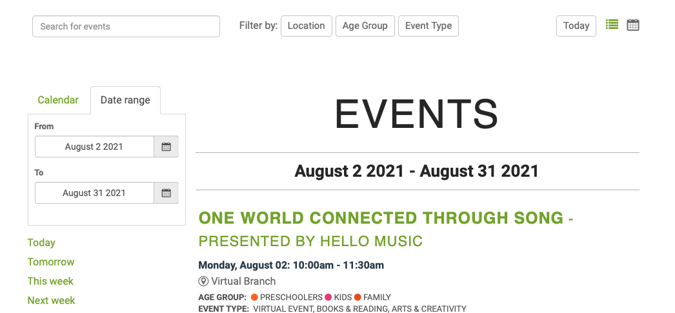
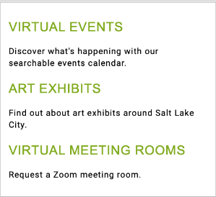
Navigating a Website
Navigation Menu: Main section hyperlink
Notes:
INSTRUCTOR NOTE: USE POWERPOINT OR LIVE DEMONSTRATION:
Demonstrate the main features of a website.
Main section hyperlink: This will send you to a new page of the website. The link will either take you directly to the page or produce a drop-down menu so you can choose a section.
INSTRUCTOR NOTE: The slide example is the Explore section of the website. Choosing Virtual Events results in this new page of the website.

Slide 40
Navigating a Website
Search Box: Just like a search engine searches the internet, the search box on a website allows visitors to search for specific information on the site they are visiting.
Notes:
INSTRUCTOR NOTE: USE POWERPOINT OR LIVE DEMONSTRATION:
Demonstrate the main features of a website.
Search Box: Just like you can use a search engine to search the internet, most websites include a search box that allows you to search for specific information on the site you are visiting.
INSTRUCTOR NOTE: Ask learners for something to search and demonstrate. If devices are available, ask learners to search to follow along.

Slide 41
Navigating a Website
Main Content: This is the big area in the middle of the web page that contains most of the information. Examples: a story you want to read, a video you want to watch, a recipe you want to bake, etc.
Notes:
INSTRUCTOR NOTE: USE POWERPOINT OR LIVE DEMONSTRATION:
Demonstrate the main features of a website.
Main Content: This is the big area in the middle of the web page that contains most of the information. Examples: a story you want to read, a video you want to watch, a recipe you want to bake, etc.

Slide 42

Navigating a Website
Footer: A collection of links that appears on the bottom of each page. The footer often includes basic information about the website or company, including contact information, terms of use, social media links, and more.
Notes:
INSTRUCTOR NOTE: USE POWERPOINT OR LIVE DEMONSTRATION:
Demonstrate the main features of a website.
Footer: If you scroll all the way to the bottom of the page, you will see the footer. This is a collection of links that appears on the bottom of each page. It often includes basic information about the website or the company or other organization that produced it. This can include contact information, terms of use, social media links, and more. In today’s example, we are showing links to the site’s FAQ (frequently asked questions section) as well as icons that link to the social websites Facebook, Twitter, and YouTube. There is also a link to contact information for the site.
INSTRUCTORS NOTE: Please point to the links on the slide or in the live demo: In today’s example, we are showing links to FAQ (Frequently Answered Questions), quick links to social websites as illustrated for Facebook, Twitter, YouTube, etc. and Contact information for the site.

Slide 43
Navigating a Website
Sidebar Navigation: This is collection of links that allows the user to navigate to information in a particular section of the website.
Notes:
INSTRUCTOR NOTE: USE POWERPOINT OR LIVE DEMONSTRATION:
Demonstrate the main features of a website.
Sidebar Navigation: In addition to the main navigation, some sites also include sidebar navigation. The sidebar navigation is a collection of links that allows you to navigate to information in a particular section of the website. The sidebar is a little bit like the table of contents in a book.

Slide 44
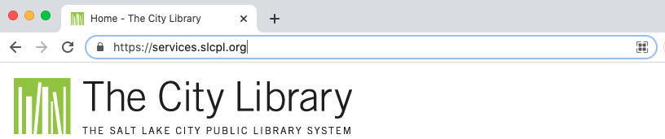
Tips & Tricks
Safety Tips: Here are some tips to ensure that you use the internet safely.
  Secure websites: These usually begin with https:// or show a lock icon
  or message to alert users that the website owner employs their own security team to ensure encryption of the user’s information.
  Fake URLs: Sometimes fraudsters create a fake URL as part of an online scam. Check the website address or URL to make sure you are on the website you intended to visit. A missing letter, a typo, or grammatical errors can be a sign that the website may be part of a scam.
  Security settings: Check the security settings in your web browser to view and set your security preferences.
Notes:
INSTRUCTOR NOTE: USE POWERPOINT OR LIVE DEMONSTRATION:
Safety Tips: Here are some tips to ensure that you use the internet safely.
Secure websites: These usually begin with https:// or show a lock icon or message to alert you that the website owner employs their own security team to ensure encryption of your information.
INSTRUCTOR NOTE: Point out the lock icon in the graphic on the slide.
Fake URLs: Sometimes fraudsters create a fake URL as part of an online scam. Check the website address or URL to make sure you are on the website you intended to visit. A missing letter, a typo, or grammatical errors can be signs that the website may be part of a scam.
Security settings: Check the security settings in your web browser to view and set your security preferences.
INSTRUCTOR NOTE: Before moving to Activity 4, review “parking lot” questions on the Navigating a Website section. If there are no questions in the parking lot, ask the attendees if they have any questions before you move to Activity 4.

Slide 45
Activity #4
Notes:
INSTRUCTOR NOTE: Have participants complete Activity #4 on the Activity Sheet. You may need to help the attendees find and open a web browser, which is needed to answer the questions.
INSTRUCTOR NOTE if there are no participant computers: Participants can follow along as you go through each question. Encourage them to call out answers. Then confirm the correct answer and have them update their Activity Sheet.

Slide 46
ACTIVITY #4: Practice
Practice what you’ve learned. Use a web browser to visit https://www.digitallearn.org and answer the following questions or follow along with the instructor to complete the following tasks.
1. How many courses are available?
2. How many activities are in the Navigating a Website course?
3. What information is available in the footer?
4. What links are in the navigation menu?
5. List one resource that is hyperlinked on the web page
6. Are there ads on the website? If yes, how many?
7. Does the website have a search function?
Notes:
INSTRUCTOR NOTE: For Activity 4, use PowerPoint or a live demonstration.
Practice what you’ve learned. Use a web browser to visit https://www.digitallearn.org
and answer the following questions or follow along with the instructor to complete the following tasks.
1. How many courses are available?
2. How many activities are in the Navigating a Website course?
3. What information is available in the footer?
4. What links are in the navigation menu?
5. List one resource that is hyperlinked on the web page
6. Are there ads on the website? If yes, how many?
7. Does the website have a search function?
After learners complete Activity #4: “Great job, everyone!

Slide 47
Congratulations, Learners!
Today you have learned:
  What web browsers and search engines do
  Which skills you need to navigate the internet, including:
    Using a web browser
    Using a search engine
    Navigating a website
  Tips & tricks for basic and advanced searches
Notes:
Congratulations, learners! Today you have learned:
What web browsers and search engines do
Which skills you need to navigate the internet, including:
Using a web browser
Using a search engine
Navigating a website
Tips & Tricks for basic and advanced searches
INSTRUCTOR NOTE: Provide each learner with a Certificate of Completion.

Slide 48
Today’s training is provided by AT&T and the Public Library Association.
Visit <insert library’s URL here> and https://www.digitallearn.org for more courses and to build confidence using technology.
Notes:
INSTRUCTOR NOTE: Point the learners to additional courses that are available. Draw learners’ attention to the website address in the slide.

Slide 49
Thank you for coming!
THANK YOU FOR COMING!
Provided by AT&T and the Public Library Association.
Notes:
Thanks again to AT&T and PLA for this workshop. We appreciate all our participants for coming and we encourage you to keep learning!

