Slide 1

Google Tools: Slides
John Bordsen
Technology Trainer
Gail Borden Public Library
Courtesy of Gail Borden Public Library
and the Public Library Association

Slide 2
Agenda
Getting Started with Google Slides
Creating and Working with Presentations
Editing and Formatting Presentations
Working with Slides
Inserting Objects
Presenting
Sharing and Collaborating

Slide 3

Getting Started with Slides
Google Slides is a web-based presentation application
that enables you to create and collaborate on slide
presentations with people in real-time.
Use the familiar interface to navigate easily
Save and access files via the cloud (Drive)
Convert Microsoft PowerPoint presentations
to Google Slides and vice versa
Revert to any prior versions of your
presentation

Slide 4

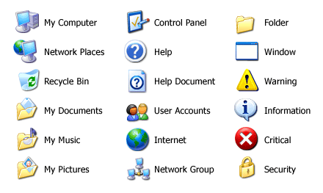

Accessing Google Slides
    slides.google.com
    Tip! Google Slides is designed
    for optimal performance
    using Google Chrome.

Slide 5
ACTIVITY #1

Slide 6
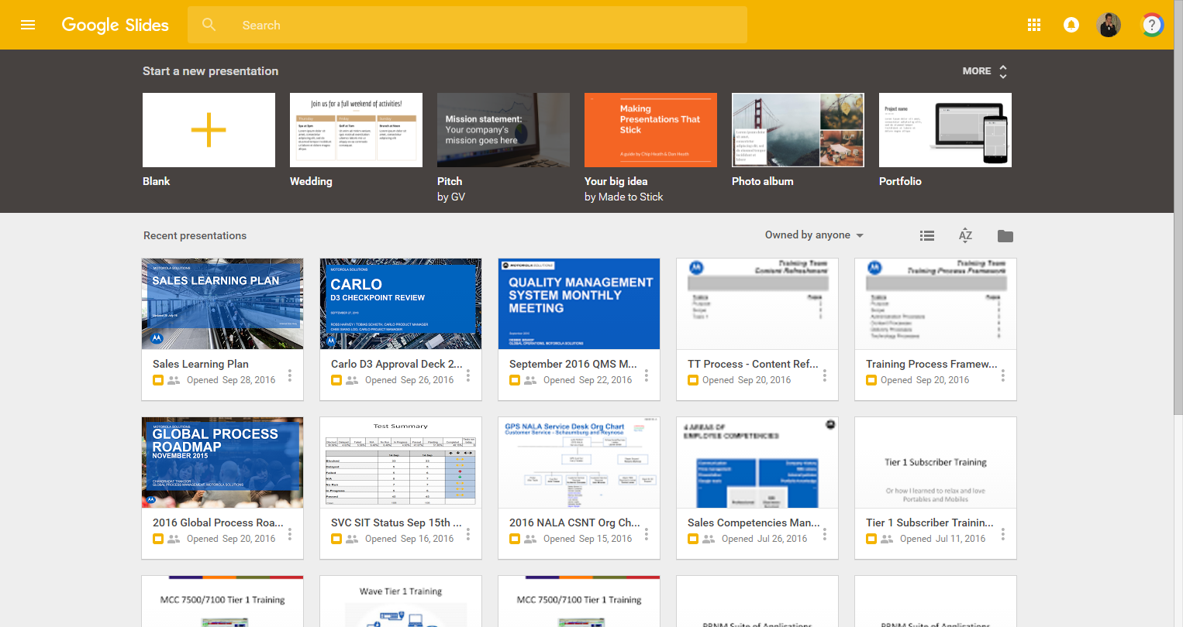
Navigating Google Slides
Search for Files
Templates/New Doc
Display options
File picker
Your files

Slide 7

Creating & Working w/ Slides
Use Google Slides to create new presentations and make
quick, easy changes.
Create a new presentation or use premade
templates
Rename a document
Copy/duplicate a document
Delete presentations

Slide 8
Using Premade Templates
Create a new presentation from a template on the
Google Slides home screen.
Select from a template or view more options

Slide 9
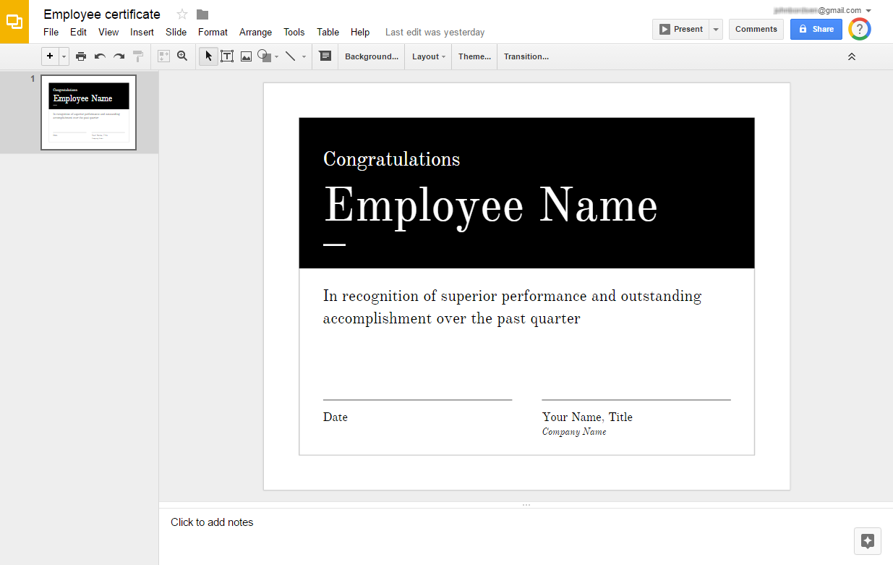
Navigating a Presentation
File Name
Menu bar
Tool bar
Present
Share
Slides
home
Slide(s)
Workspace

Slide 10
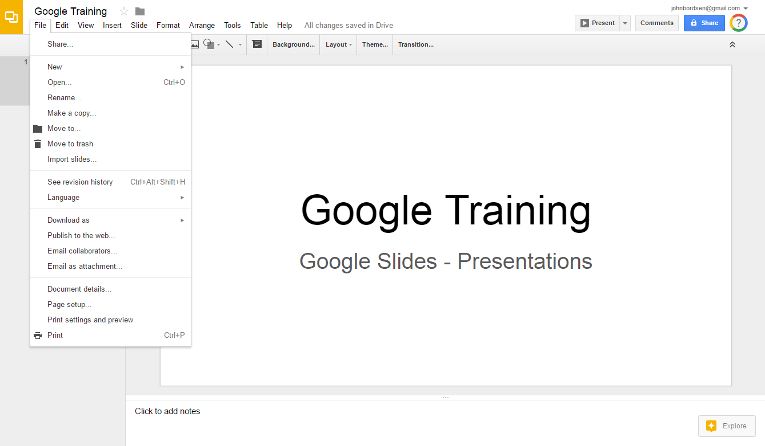
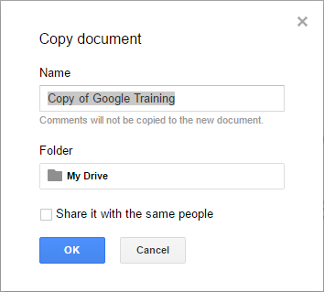
Create a Copy of a Document
Duplicate your presentation quickly and easily.
1. Select “File”
2. Make a copy
3. Click OK

Slide 11
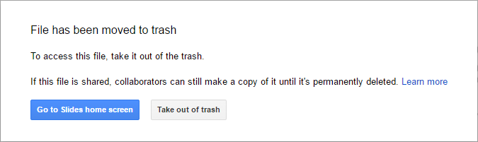
Delete a Presentation
Delete a presentation if it’s no longer needed.
1. Select “File”
2. Move to trash
3. Go to Slides home screen

Slide 12
ACTIVITY #2

Slide 13
Creating a New Presentation
Newly created documents are automatically saved
to your Google Drive account.
Create a new presentation

Slide 14
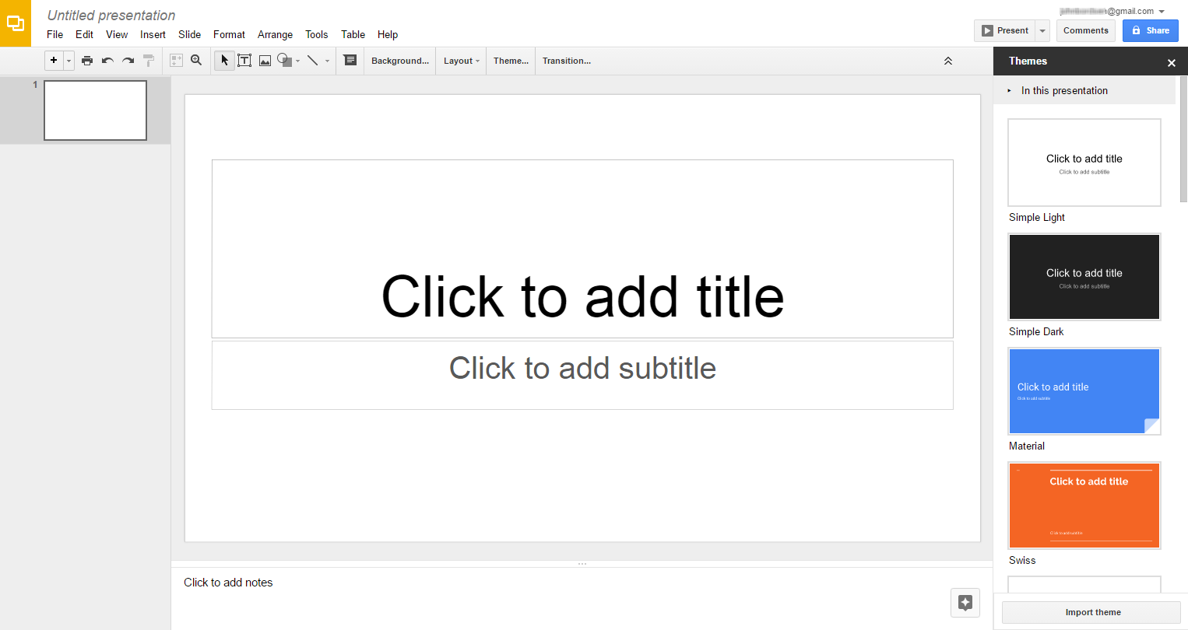
Renaming a Document
Edit the name of your file at anytime by clicking and
typing in the “Document Name” field.
Document Name
    Tip! The default name of
    any new Google file
    is Untitled document.

Slide 15

Editing & Formatting
Modify and enhance your slide presentation with a
customized look and feel.
Select a presentation theme
Undo and redo a change
Adjust background color or add a background
image
Change slide layout to match your content

Slide 16






Presentation Themes
Themes provide slide presentations with a new background
color, text style, and unique layout.

Slide 17
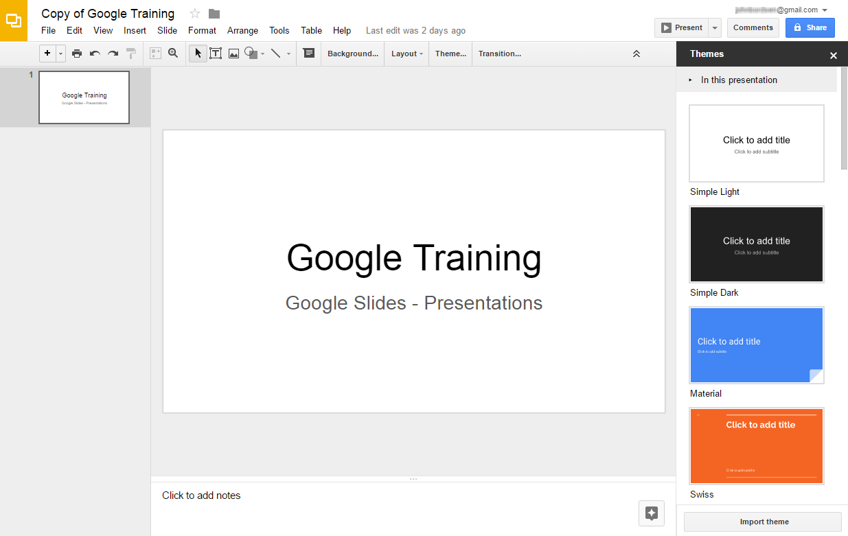
Selecting a Theme
Choose a new theme at anytime, even after you’ve begun
adding content.
1. Click “Theme…”
2. Select a theme
    Tip! Existing content in your
    slides is not deleted, but
    will be formatted differently.

Slide 18
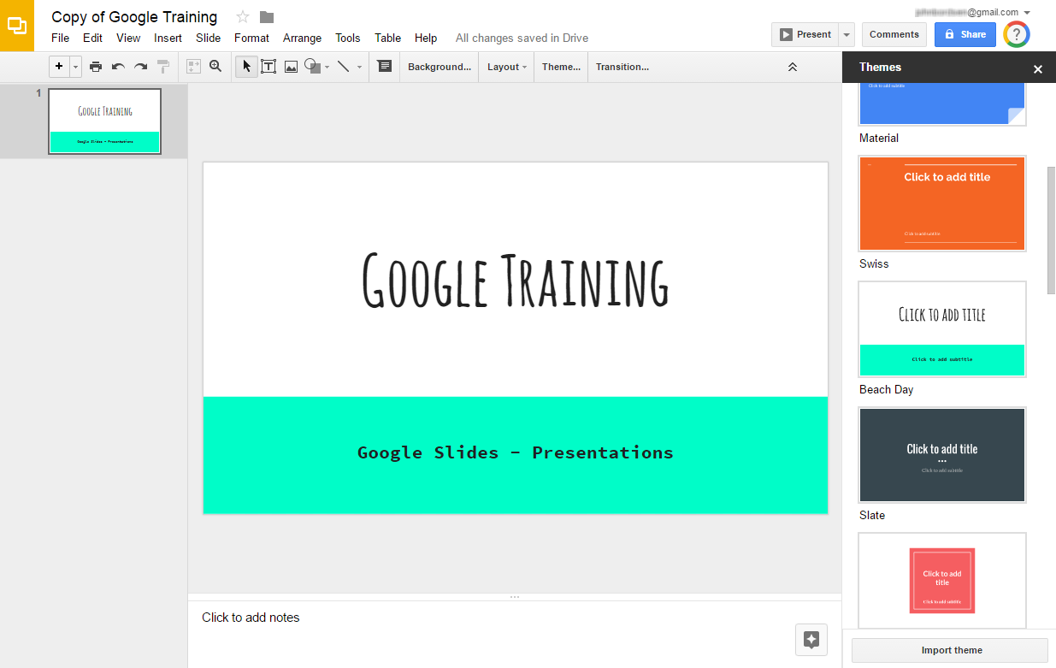
Selecting a Theme (cont)
Upon selecting a new theme, the slides are automatically
updated.
3. Click “X” to close the
“Themes” window

Slide 19
ACTIVITY #3

Slide 20
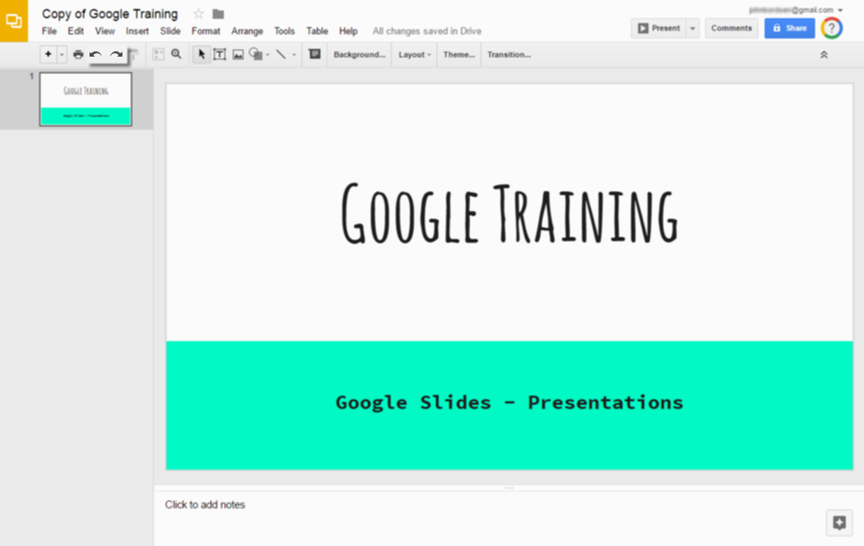
Using Undo and Redo
Undo or redo the last change you’ve made.
Undo (Ctrl+Z)
Redo (Ctrl+Y)

Slide 21
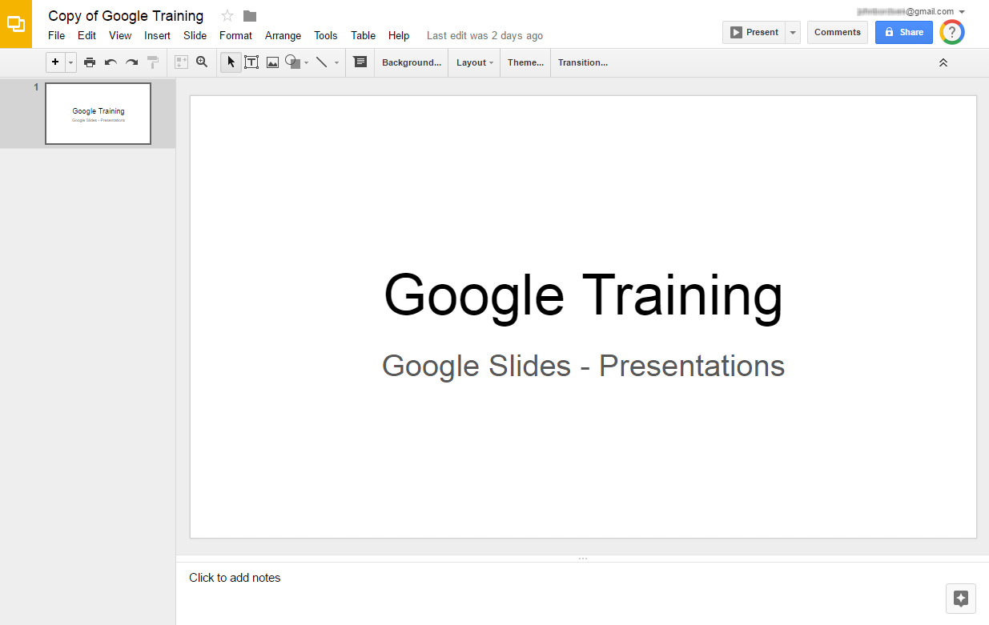
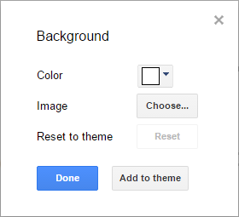
Adjusting Background
Select a color or image for the slide background.
1. Click “Background…”
2. Select a color or image
3. Click the “Done” button

Slide 22
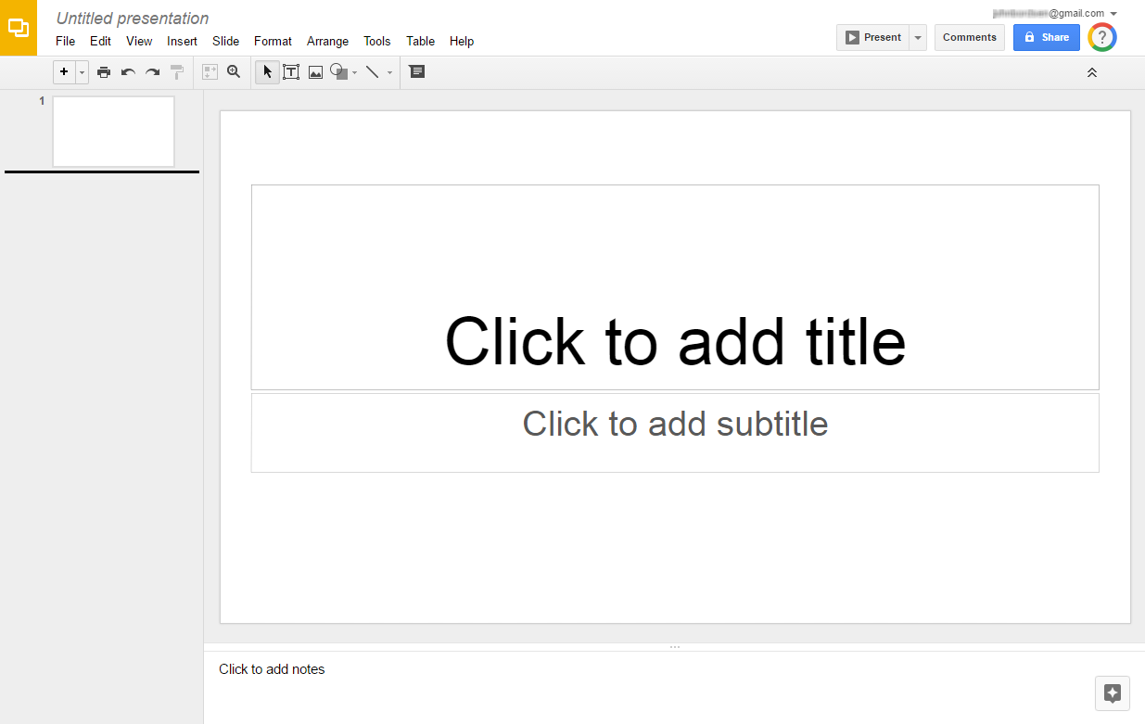
Slide Layouts
Each new slide has a basic layout which includes text box
placeholders in specific locations.
Basic layout with two text boxes
(title and subtitle)

Slide 23








Adjusting Slide Layouts
Select from preset layouts which best fit the type of
content you wish to display.

Slide 24
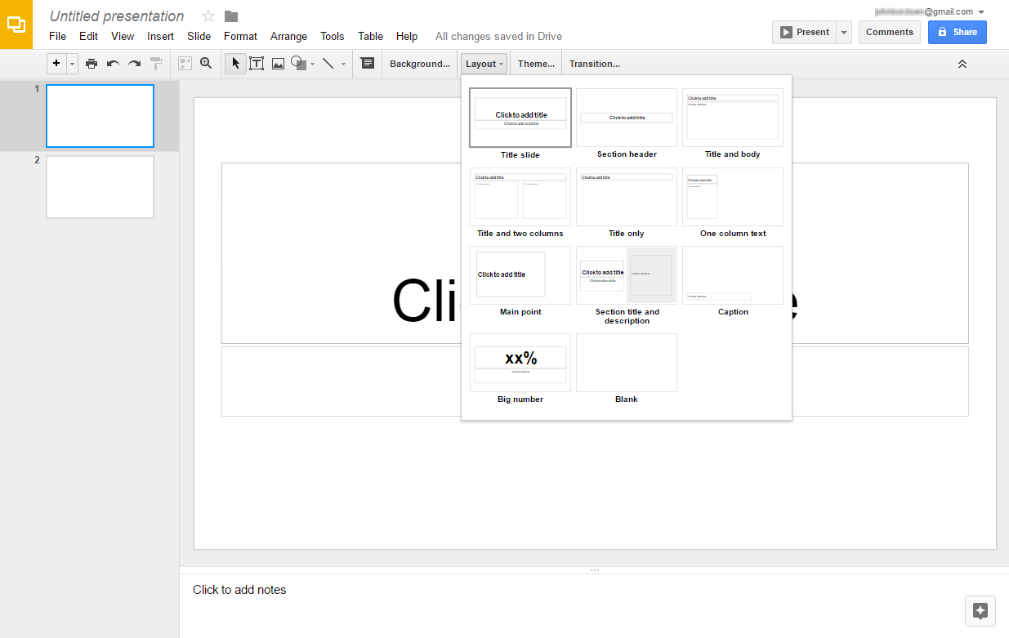
Adjusting Slide Layouts (cont)
Select any presentation slide to modify its layout.
1. Click “Layout”
2. Select a desired layout

Slide 25
ACTIVITY #4

Slide 26
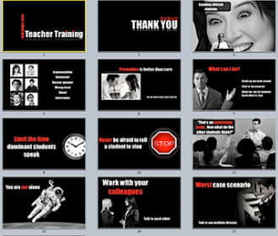
Working with Slides
Adding and modifying slides allows for a more robust
presentation with maximum impact.
Insert additional slides to your presentation
Duplicate an existing slide
Delete slides which are no longer needed
Modify the order of slides
View revision history and revert to prior
versions

Slide 27
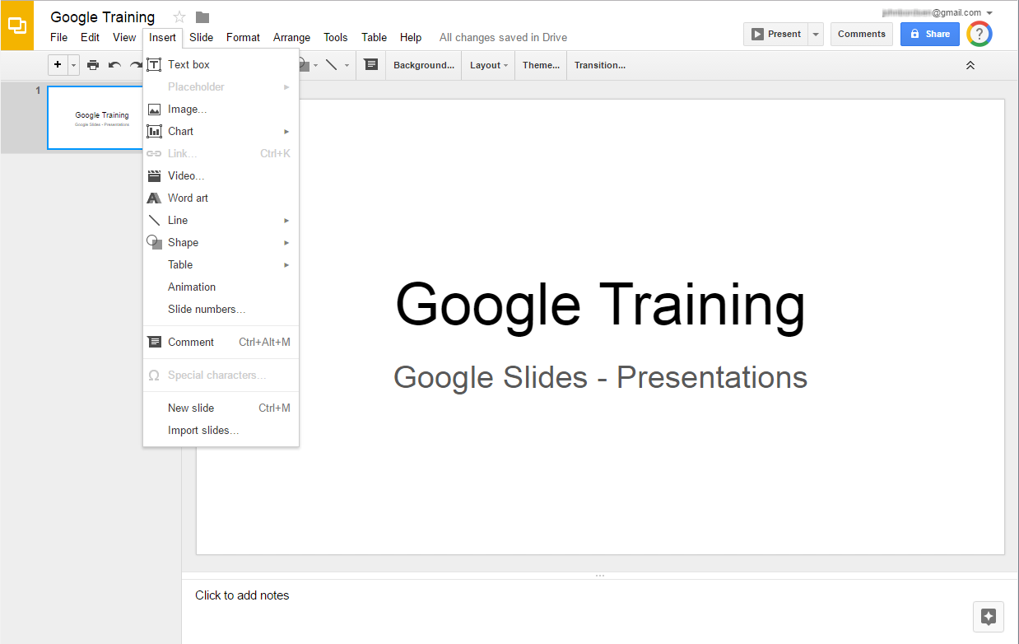
Inserting a New Slide
1. Click Insert
2. New slide

Slide 28
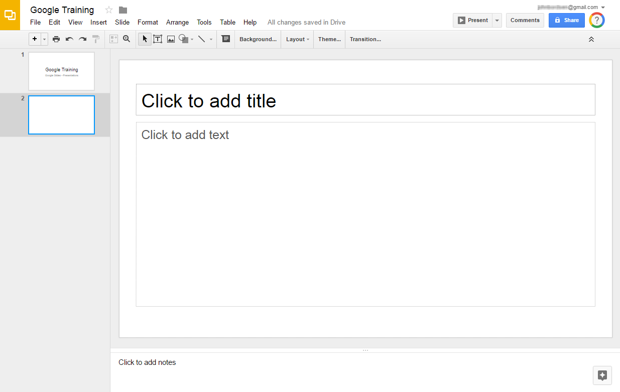
Inserting a New Slide (cont)
New slide is inserted

Slide 29
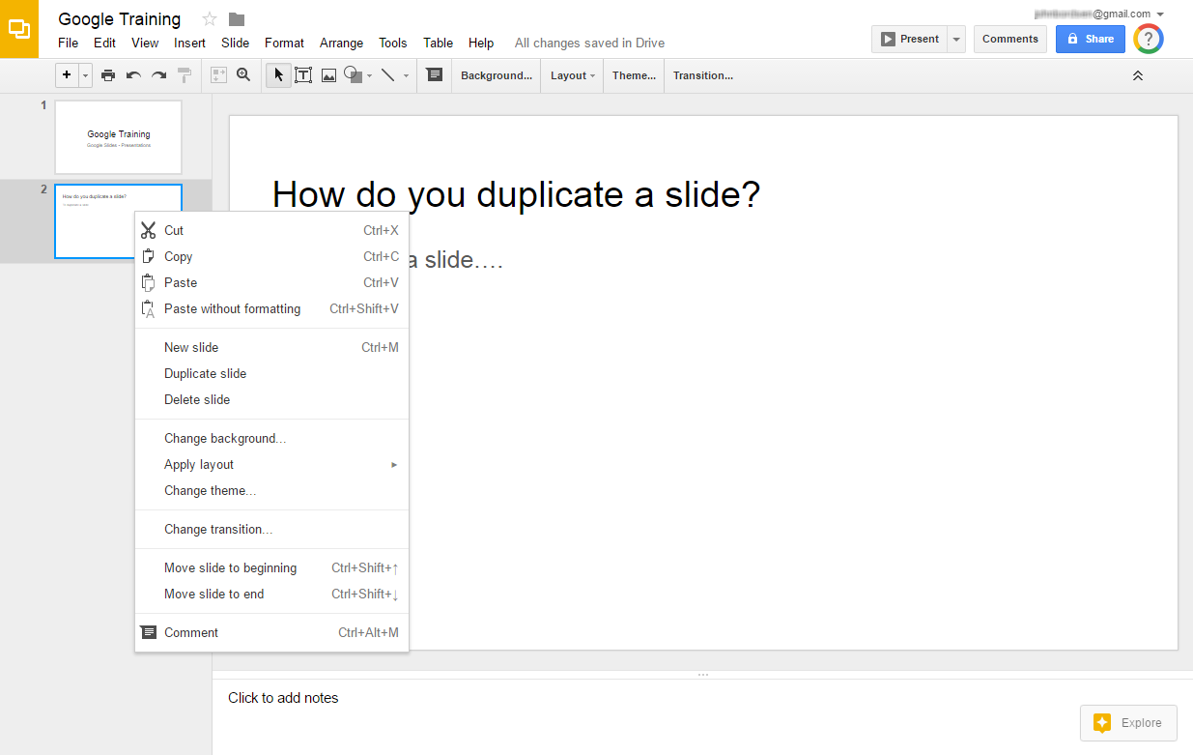
Duplicating a Slide
Create a new slide with the same content and formatting
of an existing slide.
1. Right-click
the slide
2. Duplicate slide

Slide 30
Deleting a Slide
Remove slides which are no longer needed.
1. Right-click
the slide
2. Delete slide

Slide 31
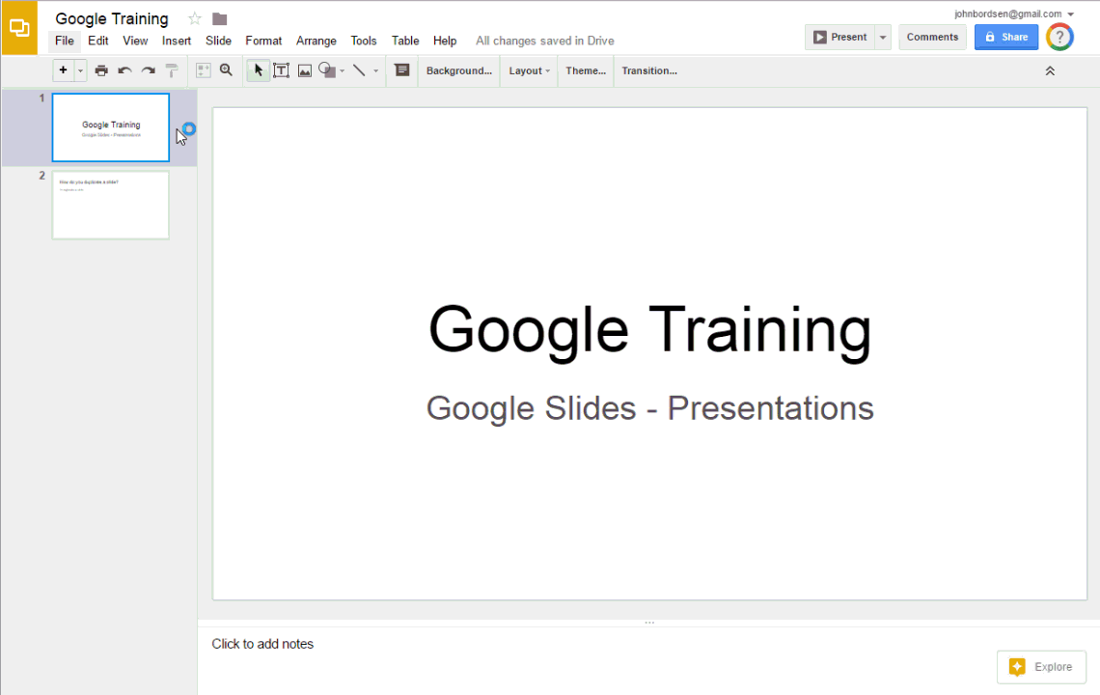
Modifying the Order of Slides
Click and drag a slide to move it into a new location.
Click, drag, and release

Slide 32
Viewing Revision History
View or revert to any prior version of the document
via “Revision History.”
1. Select “File”
2. See revision
history

Slide 33
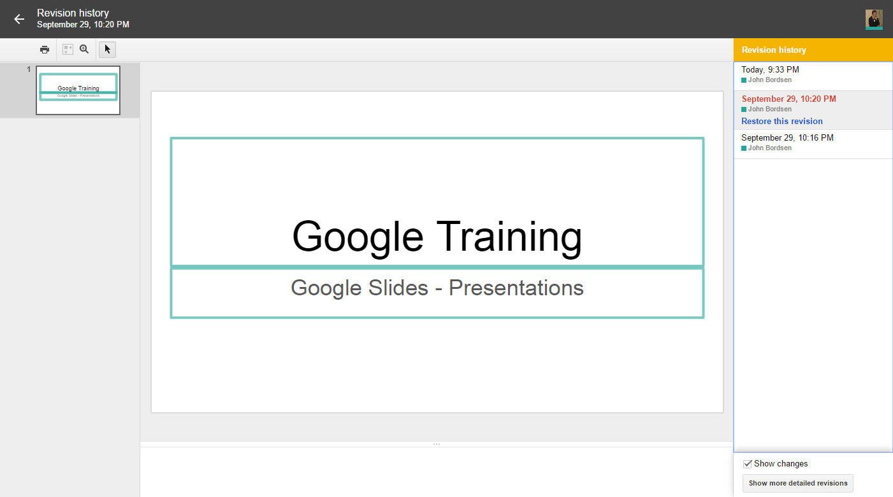
Reverting to Prior Versions
Select a prior revision to preview it.
Click “Restore this version” to revert to it.
Exit
Prior revisions
Revert to selected revision
Preview window
    Tip! Revision History keep track
    of every single change you
    and your collaborators make
    to a document.

Slide 34
ACTIVITY #5

Slide 35

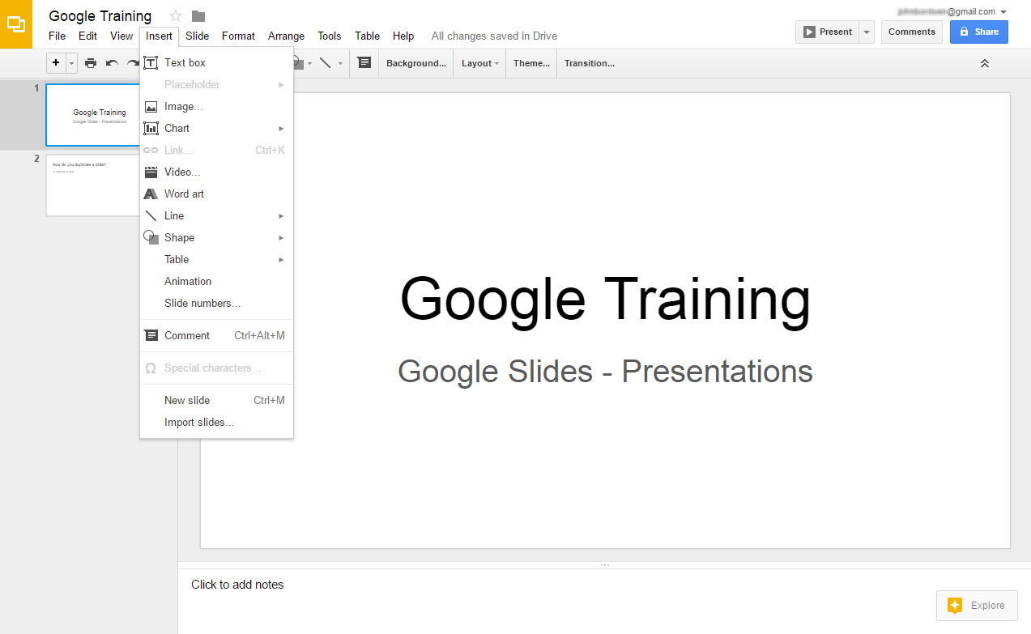
Inserting Objects
Enhance your presentation slides with shapes, text boxes,
images, and more.
1. Select “Insert”
2. Click an object to insert it

Slide 36

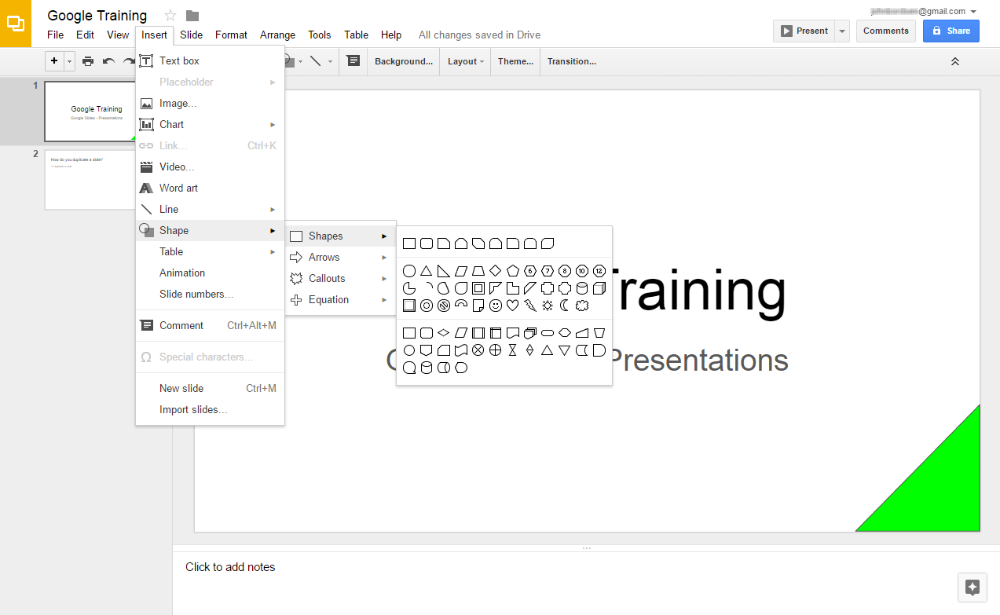
Inserting Objects: Shapes
Insert > Shape
Categories
Shapes
Format, recolor, & move shapes

Slide 37
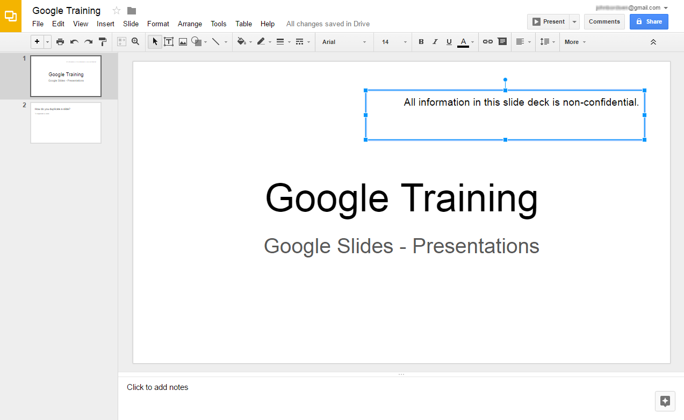
Inserting Objects: Text Box
Insert > Text Box
Place additional text boxes anywhere on a slide

Slide 38
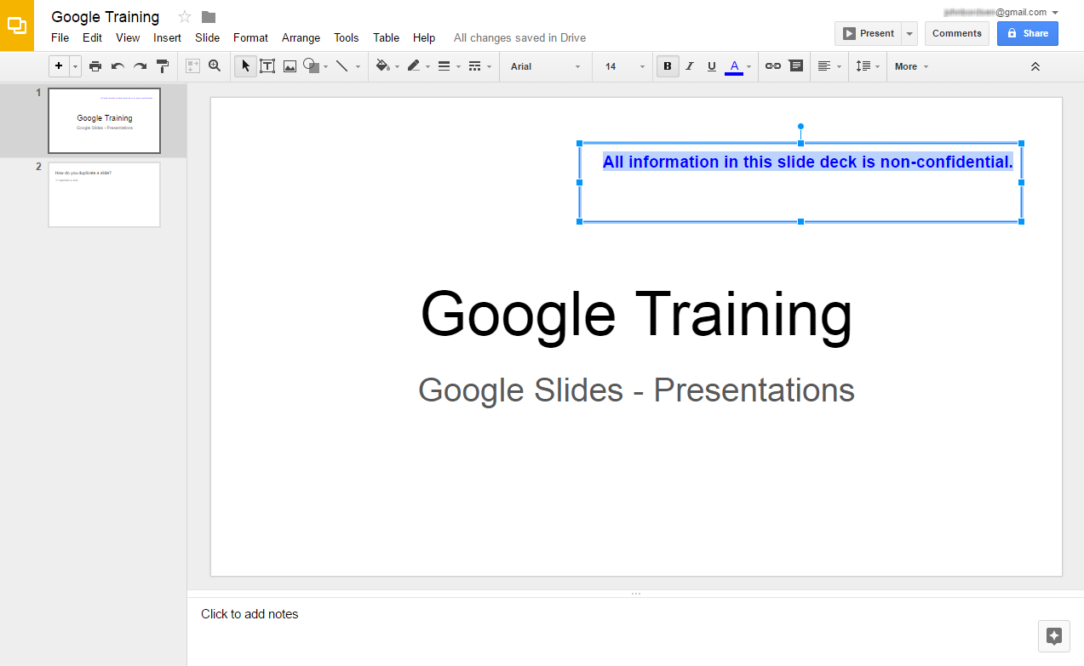
Changing Text Formatting
Use Bold, italics, underline, colors, and more!
2. Select desired
formatting options
1. Highlight text

Slide 39
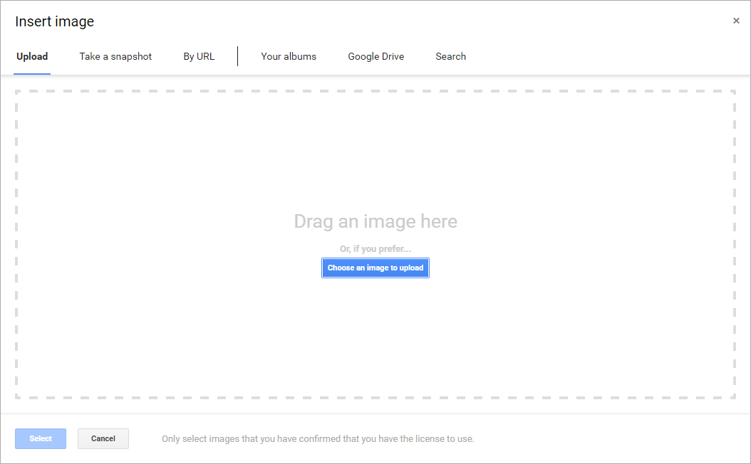

Inserting Objects: Image
Insert > Image
Insert pictures and images from a variety of sources:
Upload from PC
Webcam
URL
Google Drive
Web Search
Image sources

Slide 40
ACTIVITY #6

Slide 41

Presenting Your Slides
Display your slides in presentation mode when speaking
with an audience.
Present in “Presentation” Mode
Move between slides or exit full screen mode
with the navigation tool box

Slide 42
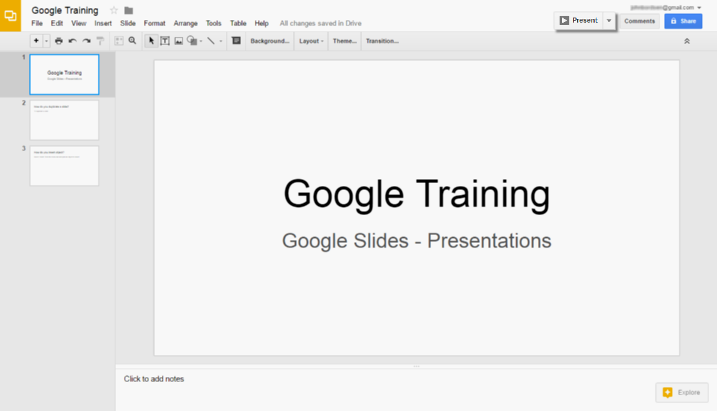
Launch Presentation Mode
Launch full screen mode to present your slides.
Click on “Present”

Slide 43
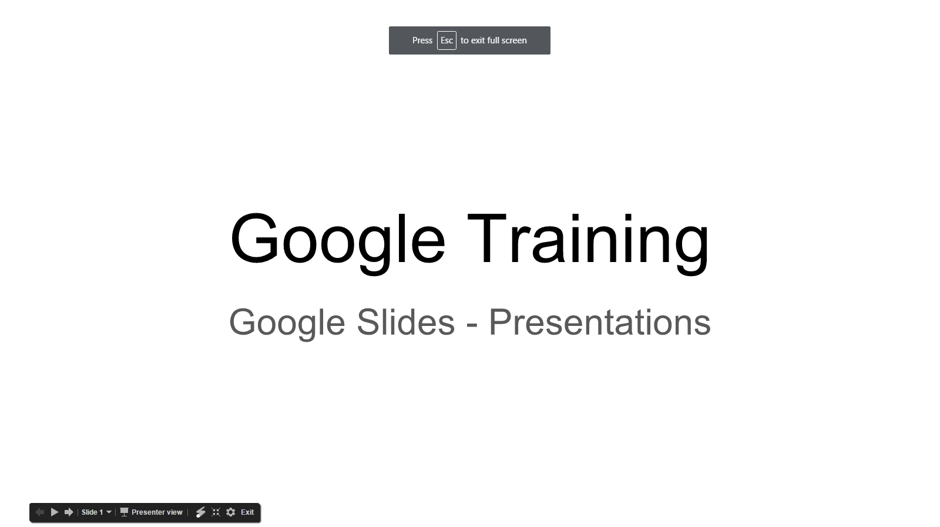


Using Presentation Mode
Press the “Esc” (escape) key to exit
Navigation tool box
    Tip! Use keyboard arrows to
    navigate between slides.

Slide 44

Sharing a Presentation
Provide others with access to your slide presentation(s).
Allow others to view, download, or edit files
Collaborate with colleagues on a presentation
Send slides to a friend or client
Share with both Google and non-Google users

Slide 45
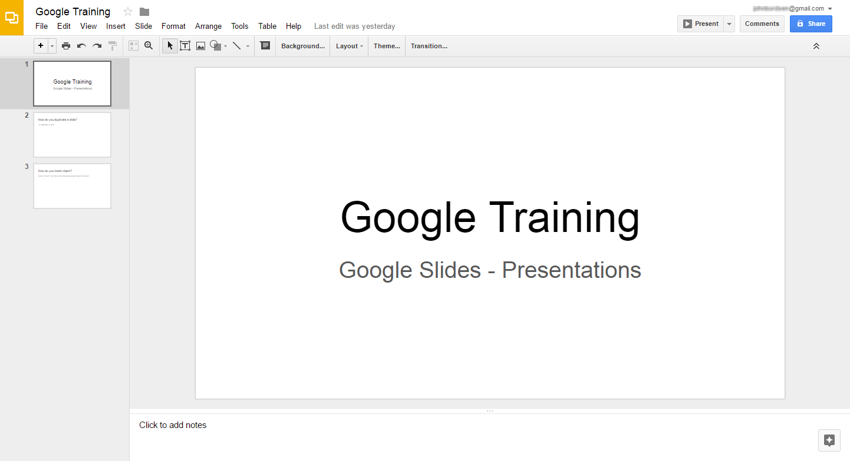
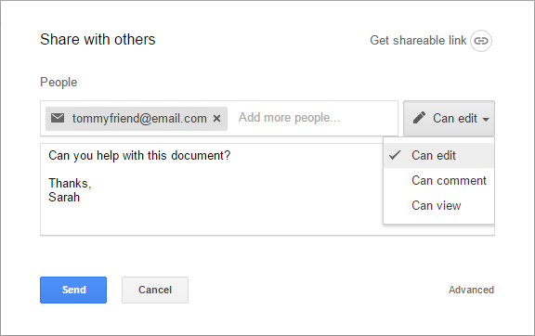
Sharing a Presentation
Share a presentation and choose the collaborator’s level of
access/permissions (Edit, Comment, or View).
1. Click “Share”
2. Select sharing options
Recipient(s)
Permissions
Optional message
3. Click “Send”

Slide 46
ACTIVITY #7

Slide 47
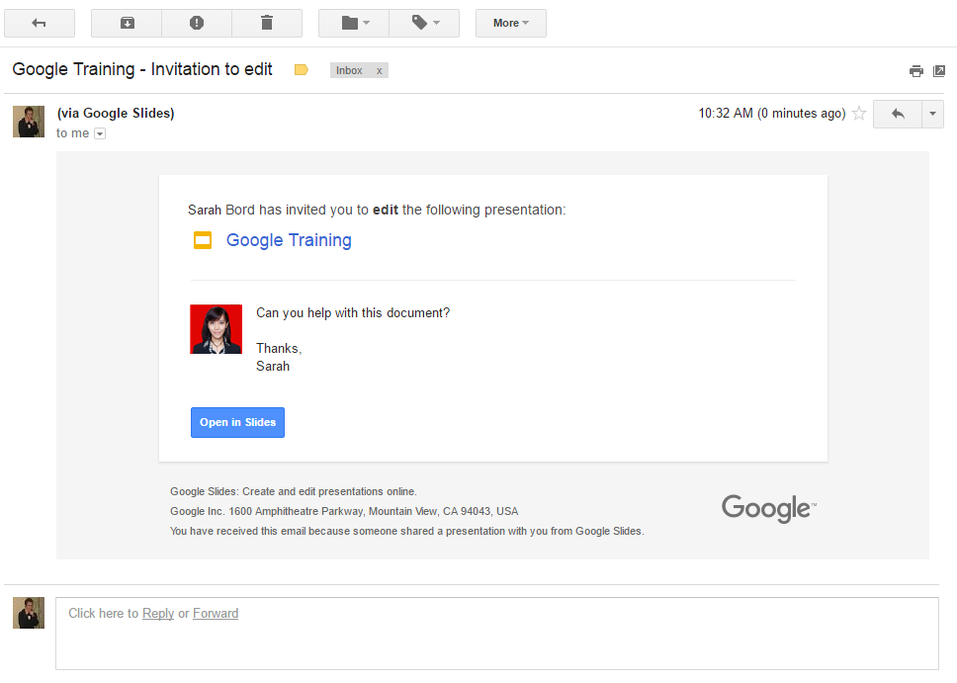
Viewing Email Notifications
Recipients of a shared file receive an email notification.
Shared files can be accessed via email using the “Open” button
    Tip! Non-Google users will only have “View”
    access; they cannot edit Google Slides.

Slide 48
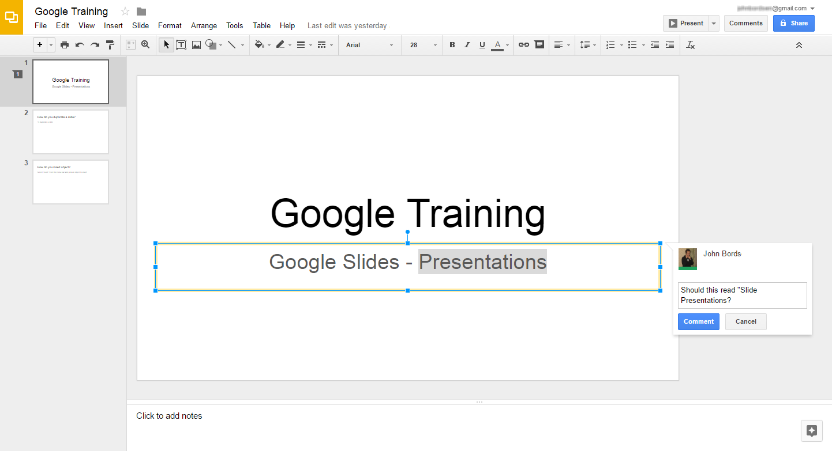
Adding Comments
Use comments as a way to add notes or ask a question to
either yourself or other collaborators.
1. Select an object
(Ex: text box)
2. Click the “Add a
comment” button
3. Add your comment

Slide 49
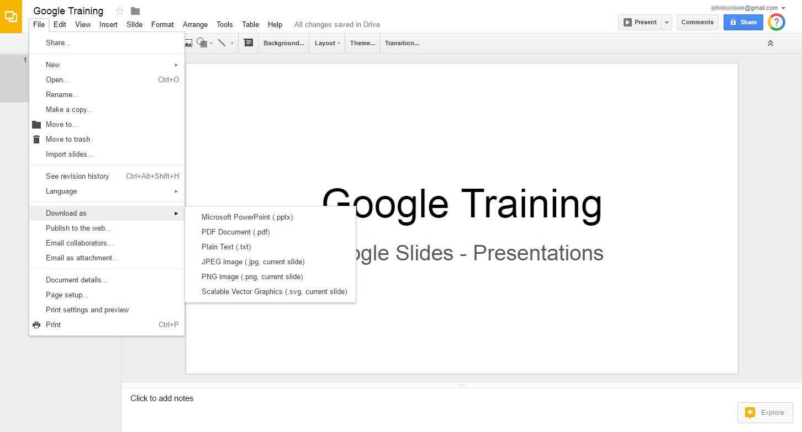
Downloading a Document
Save a slide presentation to your computer.
1. Select “File”
2. Download as
3. Select file type
    Tip! Popular file types include
    Microsoft PowerPoint (.pptx)
    and PDF.

Slide 50
Questions?
THANK YOU FOR COMING!
Part Seven Next Week
Google Tools: Calendar
Notes:
Thank participants for coming and ask if there are any outstanding questions.
Hand out the class surveys and encourage them to write in ideas for any additional classes.
When they submit their surveys, exchange them for handouts.
Encourage them to look for upcoming classes and register to attend

