Slide 1

Google Tools: Sheets
John Bordsen
Technology Trainer
Gail Borden Public Library District
Courtesy of Gail Borden Public Library
and the Public Library Association

Slide 2
Agenda
Getting Started with Google Sheets
Creating and Working with Sheets
Working with Cells and Tabs
Working with Formulas and Functions
Sharing and Collaborating

Slide 3

Getting Started with Sheets
Google Sheets is a free, web-based spreadsheet
application.
Create and collaborate on documents with
people in real time
Save and access files in the cloud (Drive)
Convert Microsoft Excel documents (.xls)
to Google Docs and vice versa
Revert to any prior versions of a spreadsheet

Slide 4

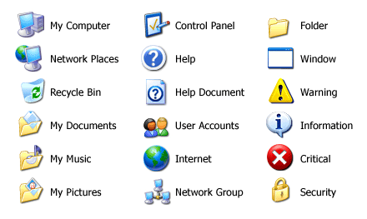

Accessing Google Sheets
    sheets.google.com
    Tip! Sheets is designed for
    optimal performance
    using Google Chrome.

Slide 5
ACTIVITY #1

Slide 6
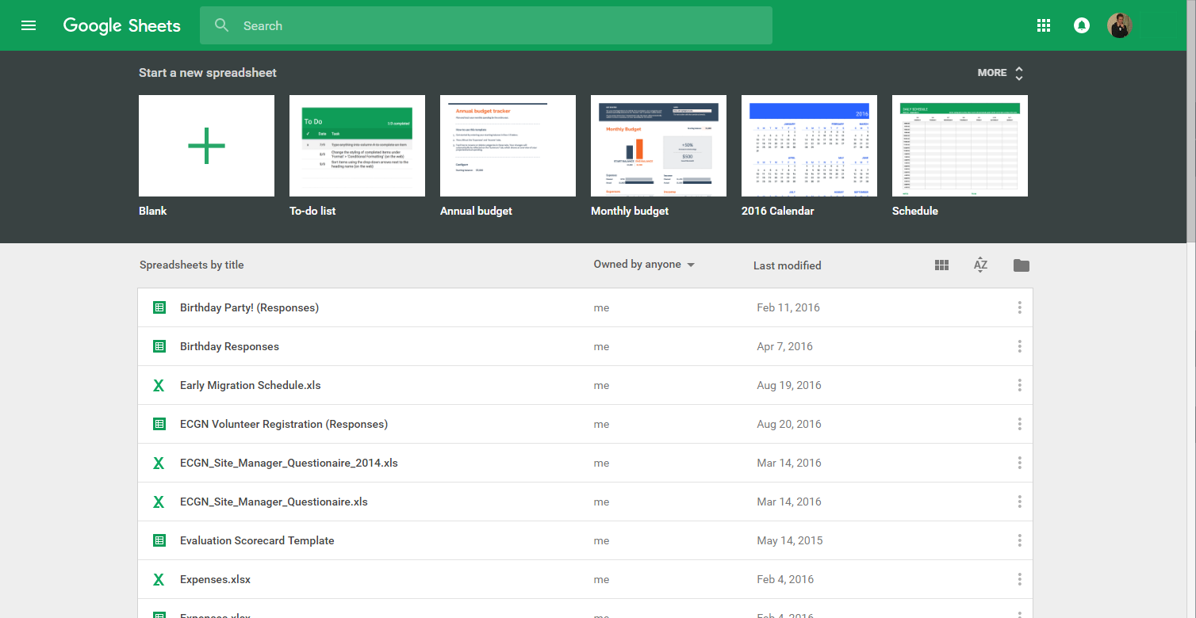
Navigating Google Sheets
Templates/New Doc
Search Bar
Display options
File picker
Your Sheets

Slide 7

Creating & Working w/ Sheets
Use Google Sheets to create new spreadsheets and make
quick, easy changes.
Rename a spreadsheet
Add data
Copy / duplicate a Sheet
Download from the cloud
Use templates for various spreadsheet types

Slide 8
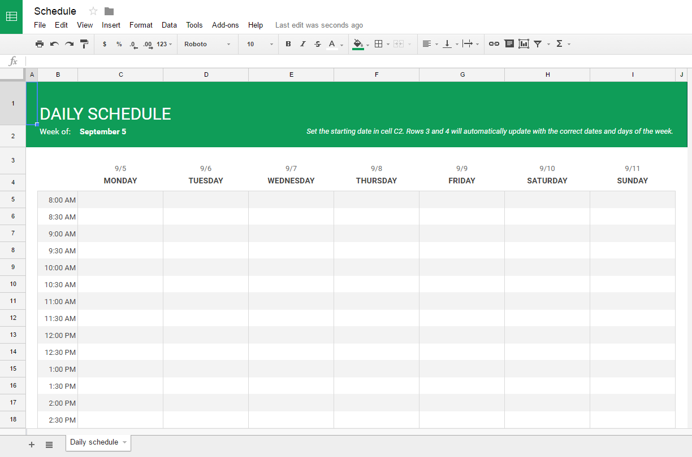
Google Docs Templates
Create new spreadsheets using various templates:
Monthly Budget
Annual Budget
Calendar
To-do List
Invoice
And more…

Slide 9
Using Premade Templates
Create a new document from a template on the
Google Sheet’s home screen.
Create a new Sheet or view more templates

Slide 10
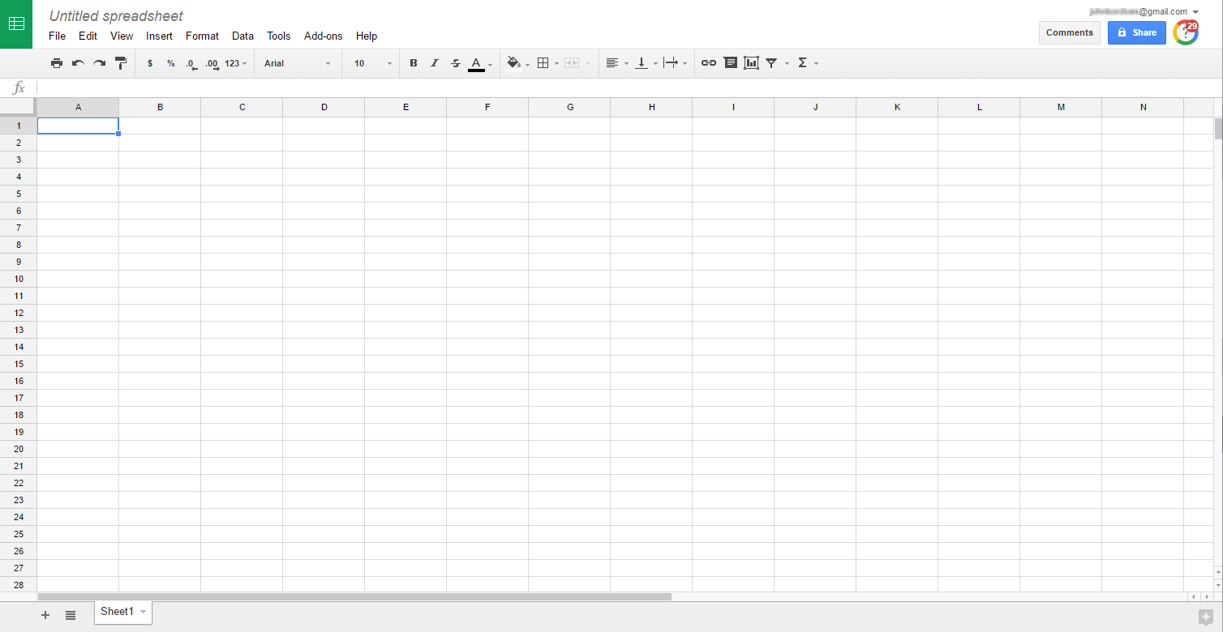
Renaming a Sheet
Edit the name of your file at anytime by clicking and
typing in the “Document Name” field.
Document Name
    Tip! The default name of
    any new Google Sheet
    is Untitled document.

Slide 11
ACTIVITY #2

Slide 12
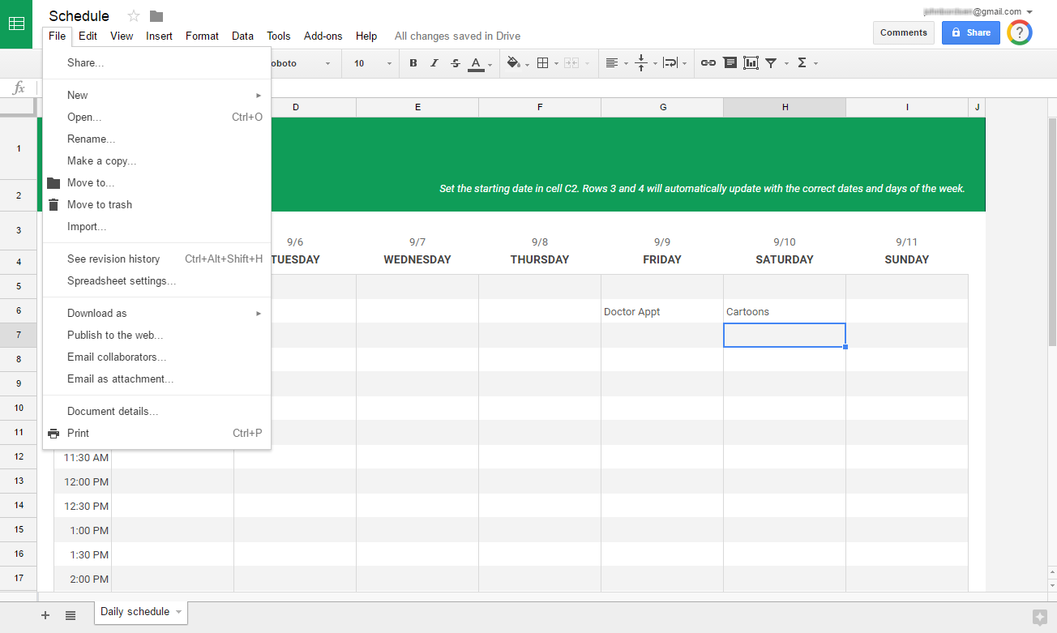
Viewing Revision History
View or revert to any prior version of the
spreadsheet via Revision History.
1. Select “File”
2. See revision
history

Slide 13
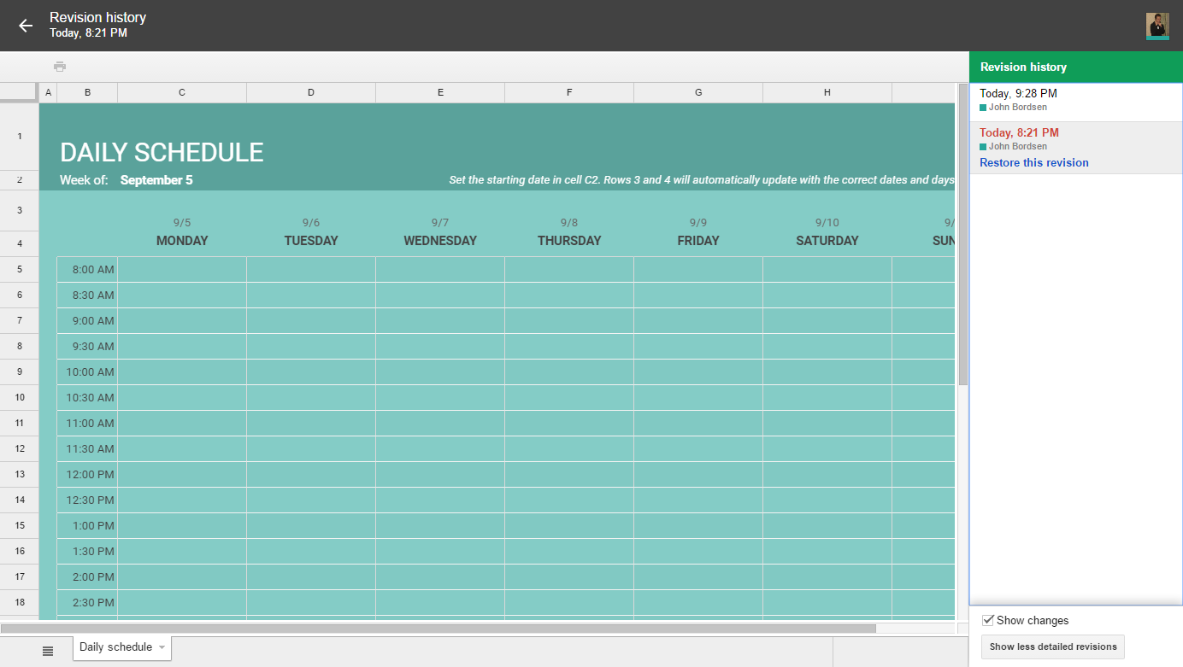
Reverting to Prior Versions
Select a prior revision to preview it.
Click “Restore this version” to revert to it.
Select from any prior revision
Preview window
Revert to selected revision
    Tip! Revision History keep track
    of every single change you
    and your collaborators make
    to a document.

Slide 14
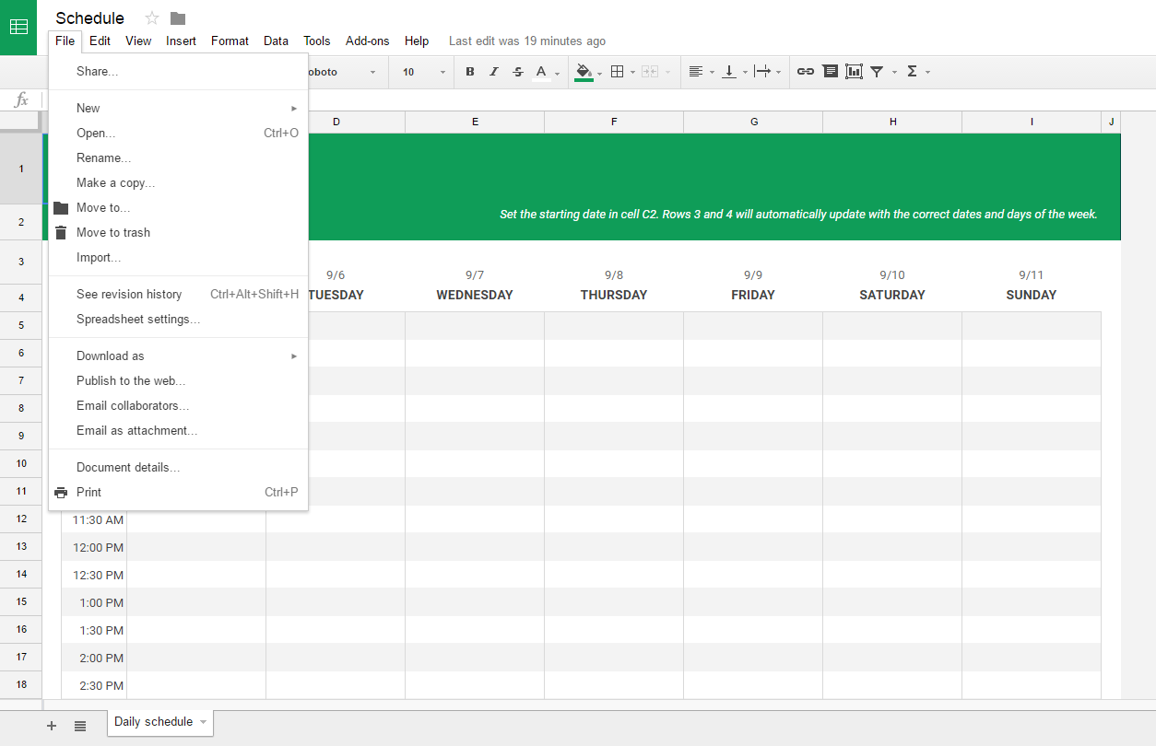
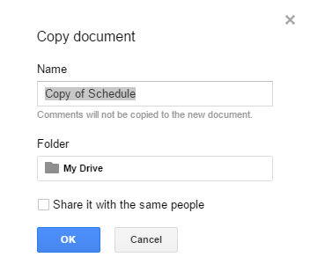
Create a Copy of a Sheet
Duplicate a spreadsheet with ease.
1. Select “File”
2. Make a copy
3. Click OK

Slide 15
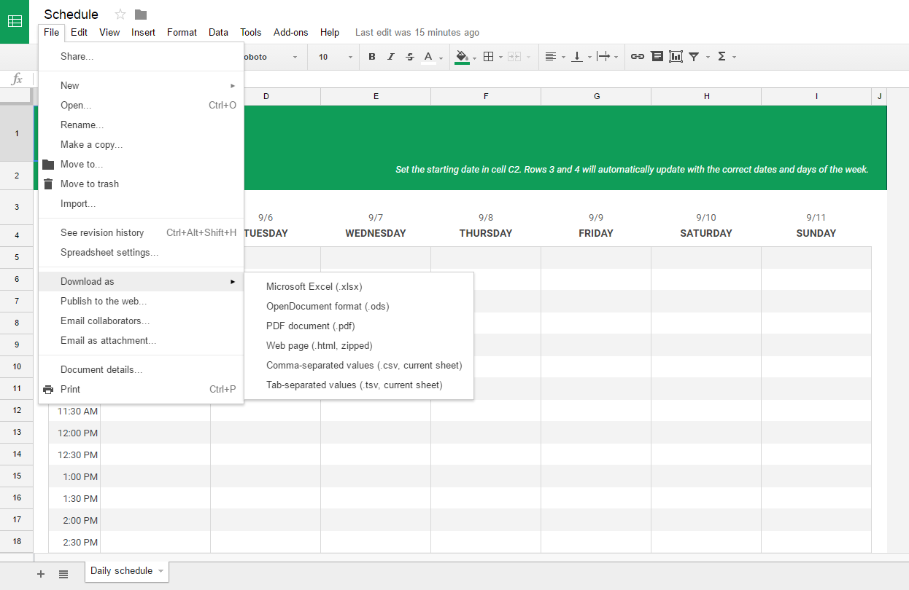
Downloading a Sheet
Save a Google spreadsheet to your computer.
1. Select “File”
2. Download as
3. Select file type
    Tip! Popular file types include
    Microsoft Excel and PDF.

Slide 16
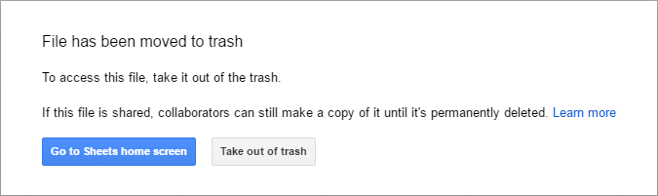
Deleting a Sheet
Send a spreadsheet to the trash.
1. Select “File”
2. Move to trash
3. Confirm

Slide 17
Creating a New Sheet
Newly created Sheets are automatically saved to
your Google Drive account.
Create a new Sheet

Slide 18
ACTIVITY #3

Slide 19

Working w/ Cells and Sheets
Modify your spreadsheet with data, various formatting
options, and more.
Enter text or data into cells
Modify formatting of numbers, text, and cells
Add, modify, or delete tabs (sheets)

Slide 20
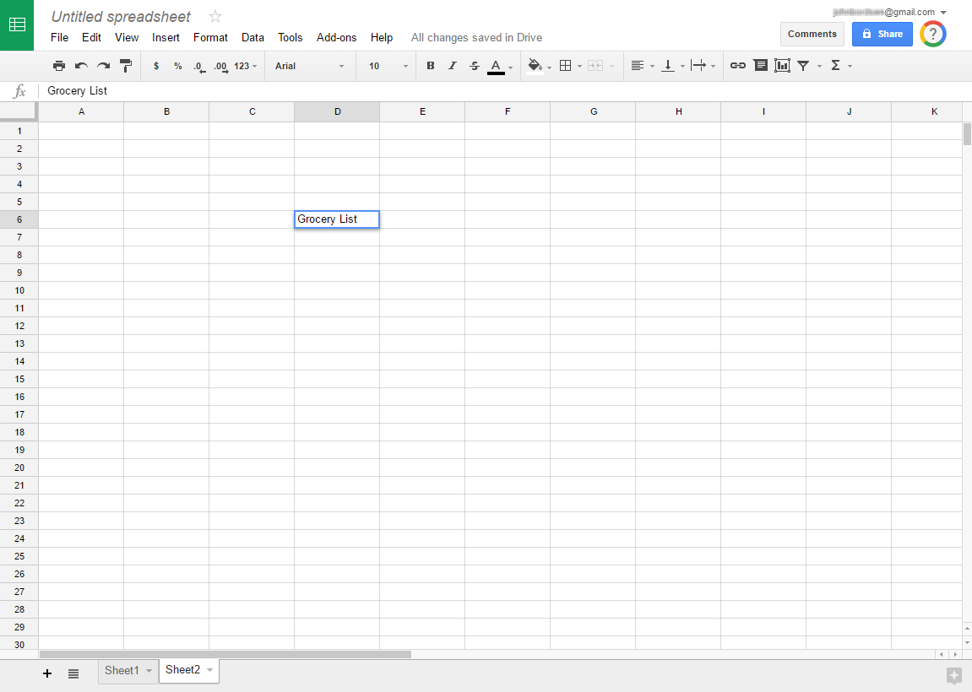
Entering Data to a Cell
Simply click in a cell to begin writing data.
1. Click a cell
    Overwriting Text in a Cell
    Click once on the cell
    Type desired text and press Enter
    Modifying Text in a Cell
    Double-click on the cell
    Modify text as desired and press Enter
2. Beginning typing and
then press Enter

Slide 21
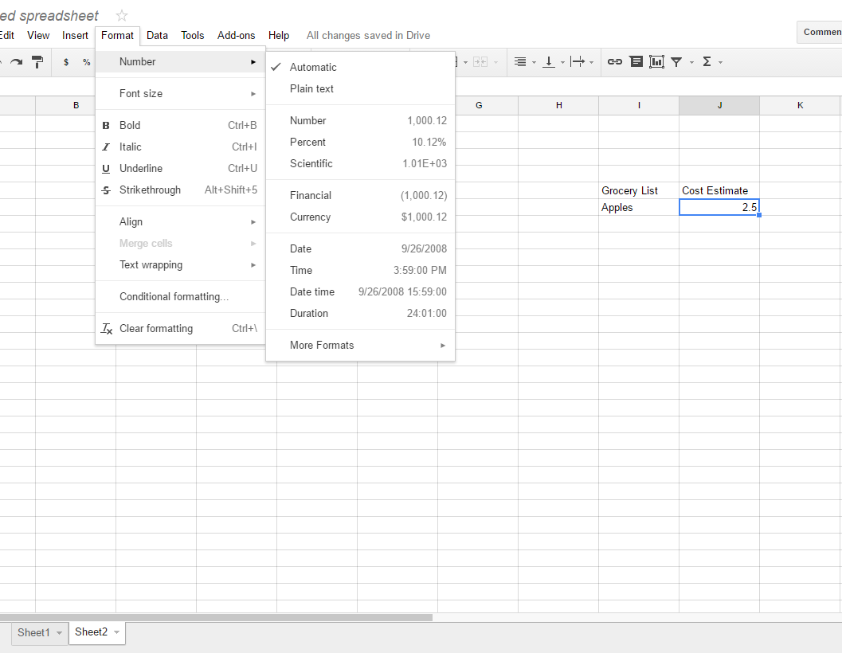
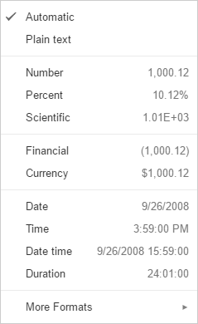
Modifying Number Formatting
Select the type of numerical data entered.
Number (10.12)
Percent (10.12%)
Currency ($10.12)
Date (10/12/2016)
Time (10:12:00 PM)
And more…
    Modifying Number Formatting
    Click once on the cell(s)
    Select Format > Number
    Click the desired numerical format

Slide 22
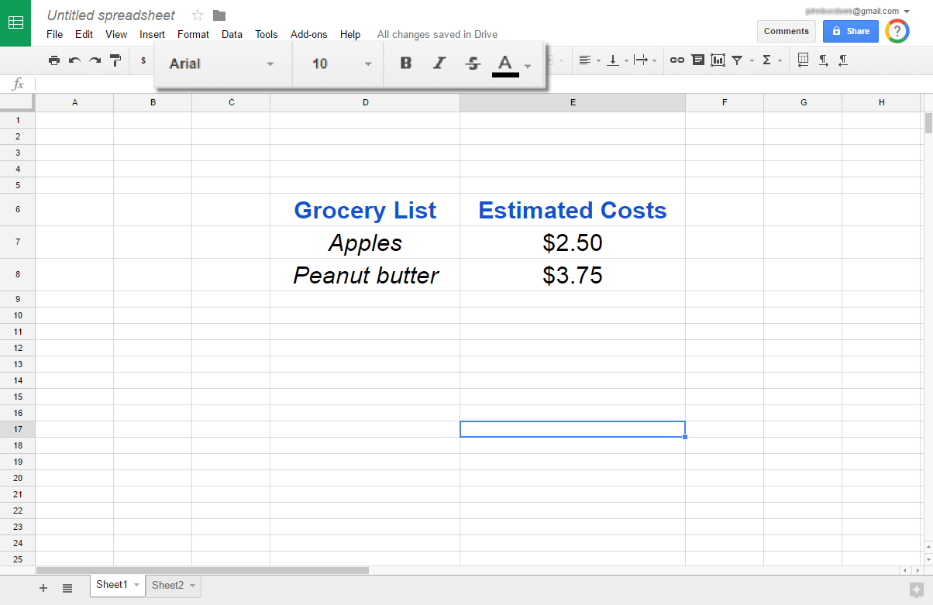
Modifying Text Formatting
Select a format for text within a cell.
Bold
Italics
Underline
Colors
And more…
    Modifying Text Formatting
    Click once on the cell(s)
    Select text formatting option(s) from tool bar

Slide 23
ACTIVITY #4

Slide 24


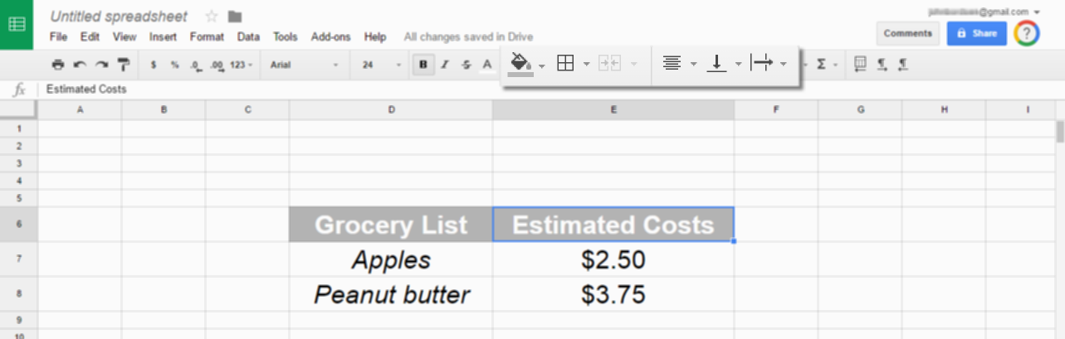
Modifying Cell Formatting
Use cell formatting to select:
Horizontal alignment (left, right, center)
Vertical Alignment (top, middle, bottom)
Fill color
Borders
Text wrapping (overflow, wrap, clip)
Cell Formatting

Slide 25
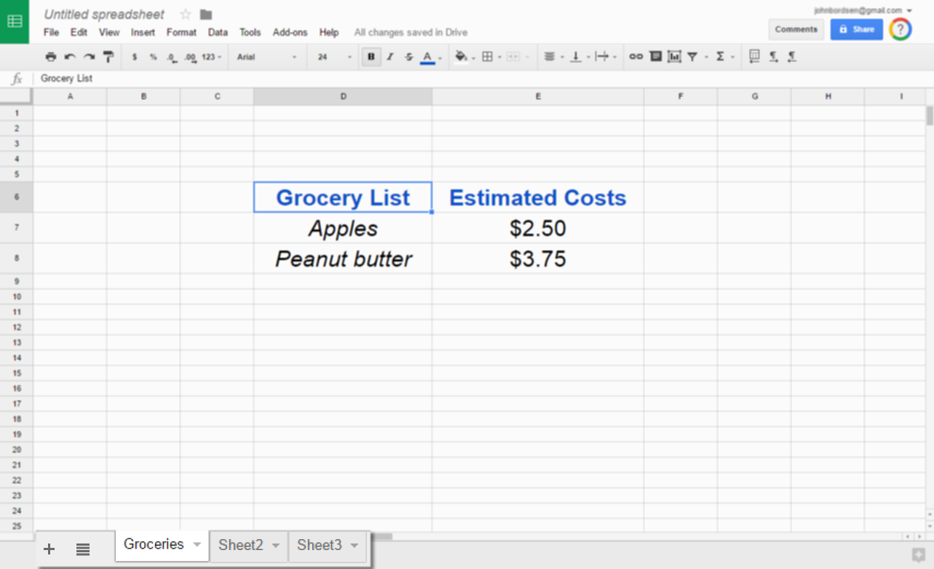
Adding a Sheet (tab)
Click the plus sign + in the lower left corner to add a new
sheet (tab) into your spreadsheet.

Slide 26
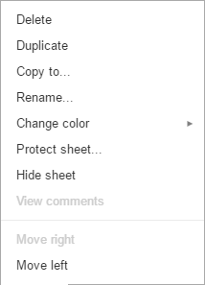
Modifying a Sheet (tab)
Rename a sheet, delete it, apply a color, and more.
Right-click a tab to see menu options

Slide 27

Working w/ Formulas and Functions
Perform different types of calculations by using functions
to create formulas in Google Sheets.
Add all values from a row or column with the
SUM function
Utilize nearly functions found in Excel and
other spreadsheet applications
Access a list of functions online

Slide 28
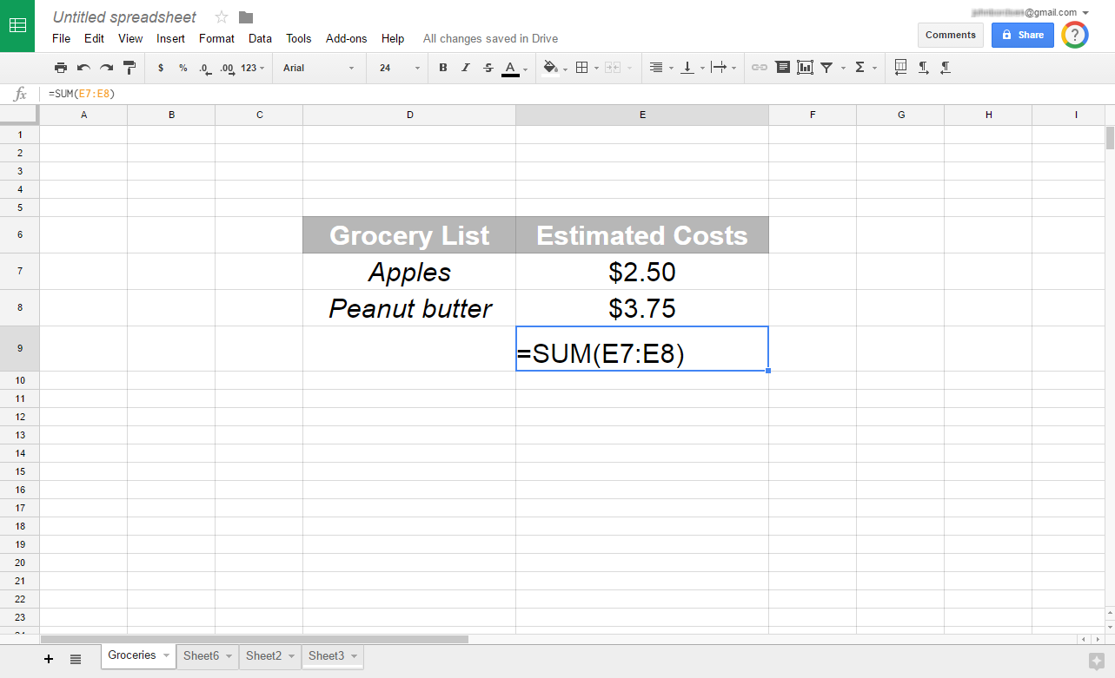
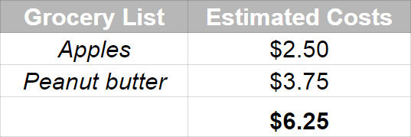
Using the SUM Function
Calculate the total sum of a range of cells.
Cell Range (Ex: E7:E8)
SUM Function

Slide 29
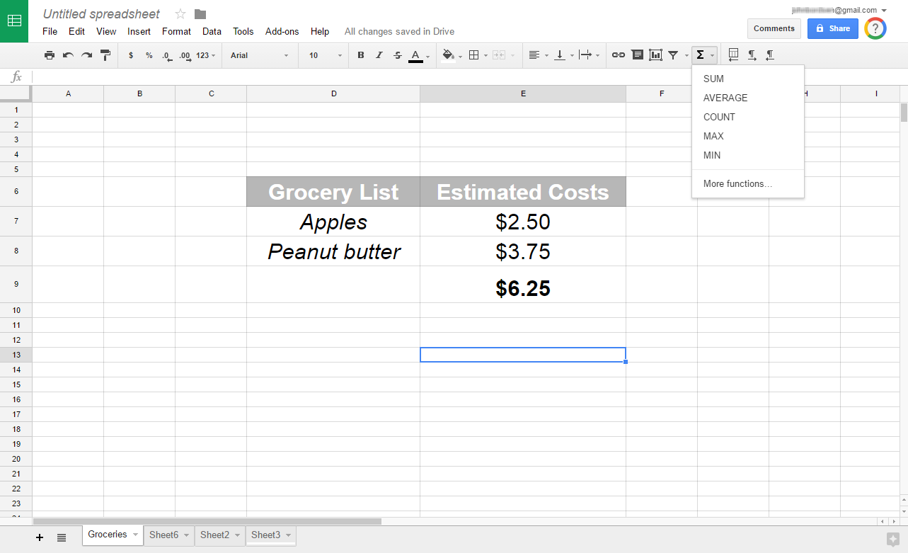
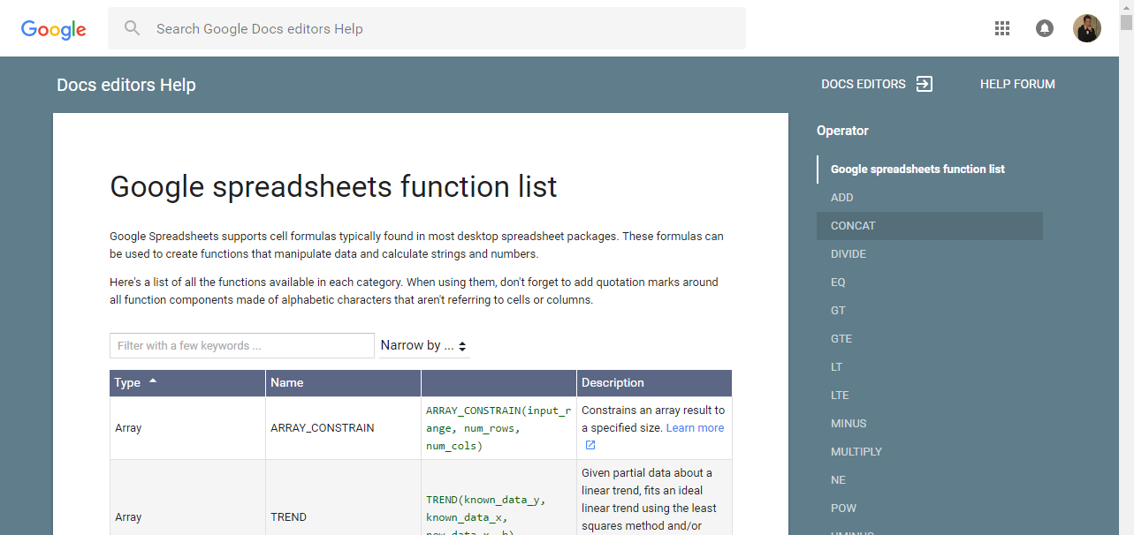
Accessing Other Functions
1. Click
2. Click More functions…
3. View functions
list on the web

Slide 30
ACTIVITY #5

Slide 31

Sharing a Sheet
Provide others with access to spreadsheets of your
choosing.
Allow others to view, download, or edit
Collaborate with colleagues on a project
Send a file to a friend or client
Share with both Google and non-Google users

Slide 32
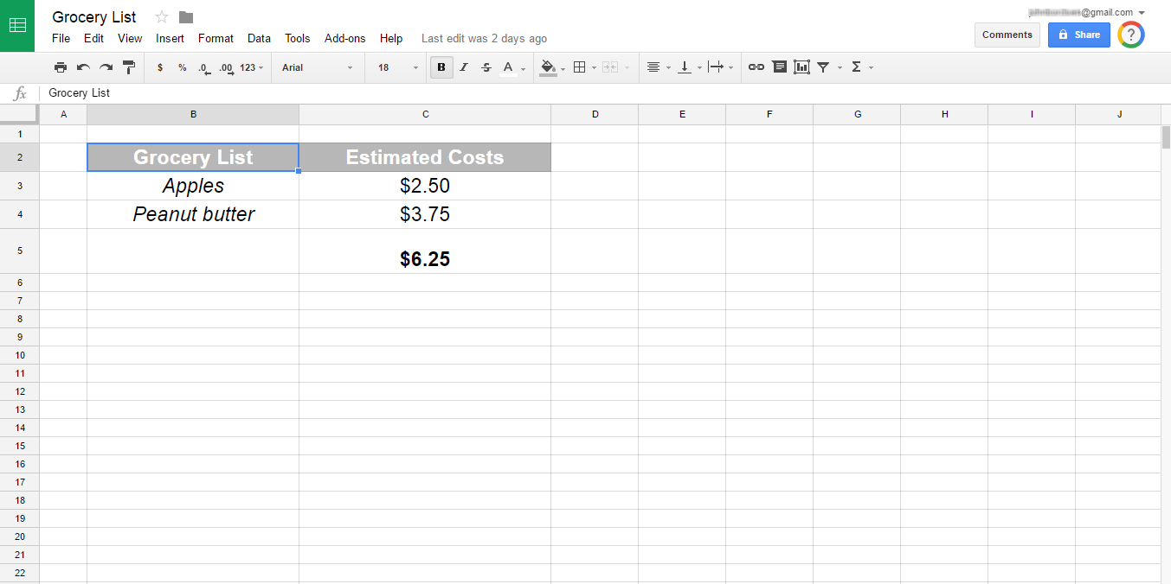
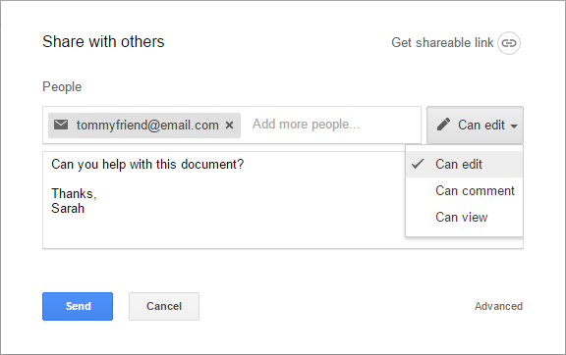
Sharing a Document
Share a spreadsheet and choose the collaborator’s level of
access/permissions (Edit, Comment, or View).
1. Click “Share”
2. Select sharing options
Recipient(s)
Permissions
Optional message
3. Click “Send”

Slide 33
ACTIVITY #6

Slide 34
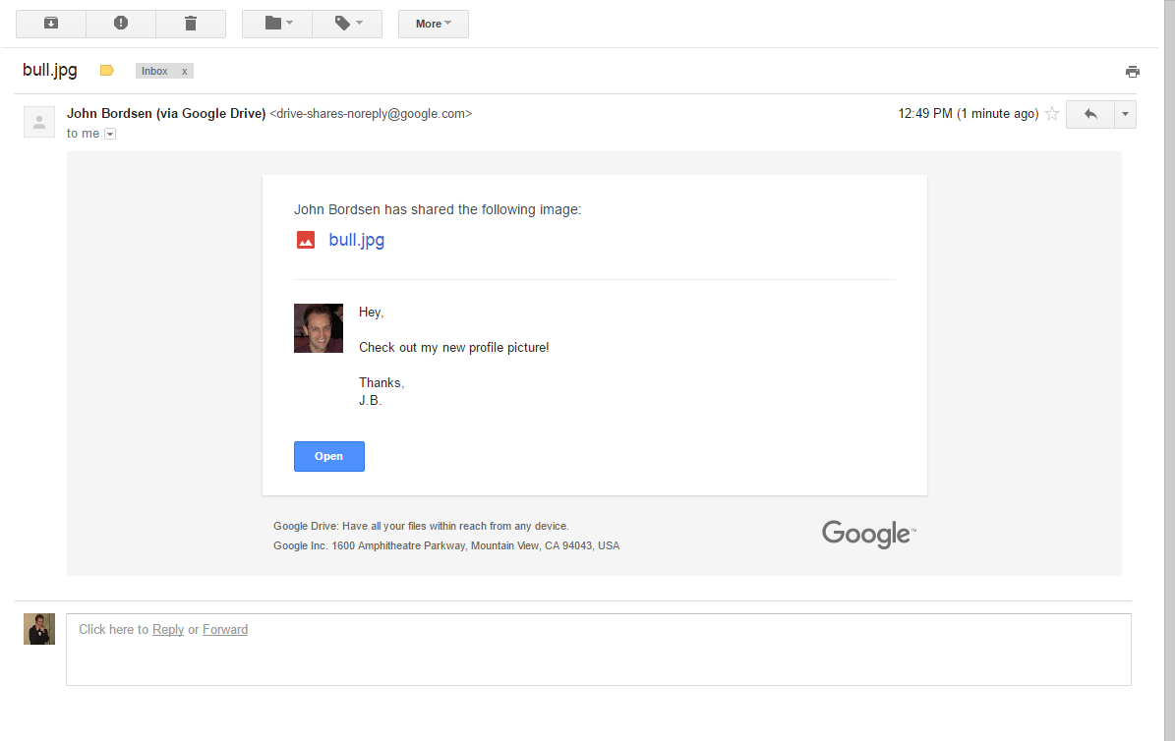
Viewing Email Notifications
Recipients of a shared file receive an email notification.
Shared files can be accessed via email using the “Open” button
    Tip! Non-Google users will only have “View”
    access; they cannot edit Google Sheets.

Slide 35
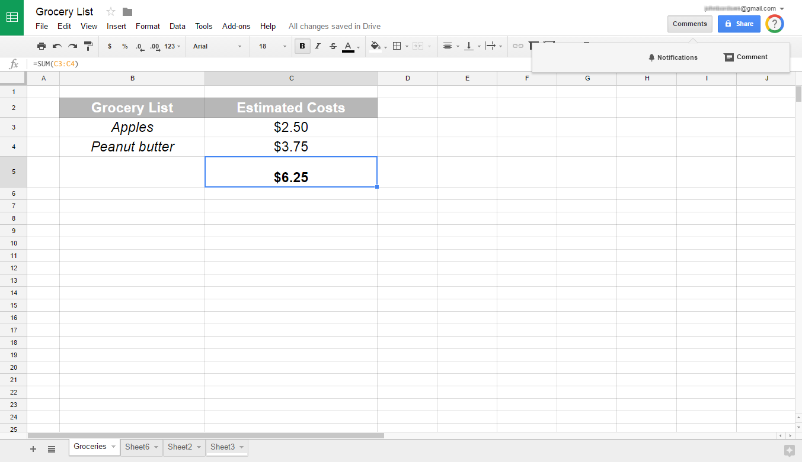
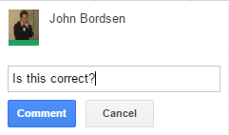
Adding Comments
Use comments to add notes or ask a question to either
yourself or other collaborators.
1. Select a cell
2. Click Comments
3. Click Comment
4. Add your comment

Slide 36
Questions?
THANK YOU FOR COMING!
Part Six Next Week
Google Tools: Slides
Notes:
Thank participants for coming and ask if there are any outstanding questions.
Hand out the class surveys and encourage them to write in ideas for any additional classes.
When they submit their surveys, exchange them for handouts.
Encourage them to look for upcoming classes and register to attend

