Slide 1

Google Tools: Forms
Instructor Name
Instructor Title
Library Name
Courtesy of Gail Borden Public Library
and the Public Library Association

Slide 2
Agenda
Getting Started with Google Forms
Creating and Working with Forms
Adding Questions and Other Items
Publishing Your Form
Managing Response Data

Slide 3

Getting Started with Forms
Google Forms is a web-based application that allows
users to create and share online, interactive questionnaires.
Gather information from a group
Distribute via email, social networks, or
publish to the web
Collect survey or quiz responses, contact
info, event registrations, employee or
customer feedback, and more

Slide 4
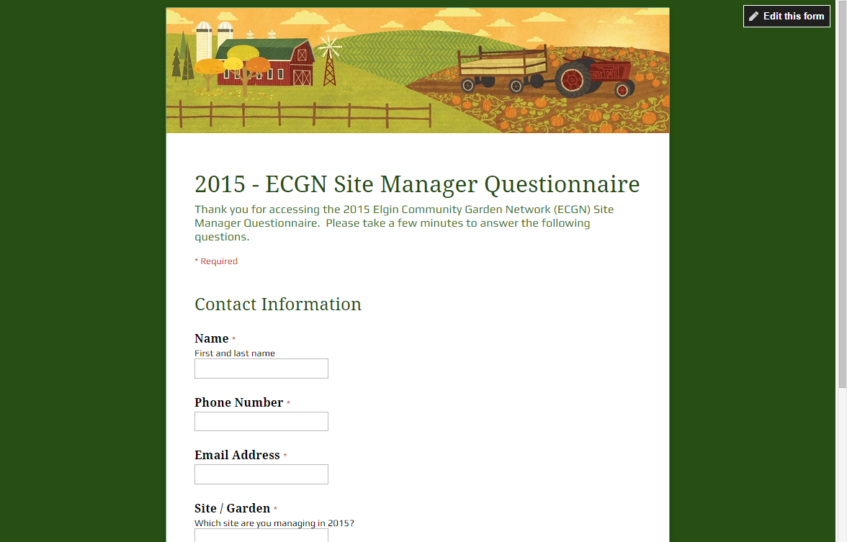

Viewing a Published Form
Published forms can have a variety of looks and
be used for numerous purposes.
Theme
Title & Intro
Survey Questions

Slide 5
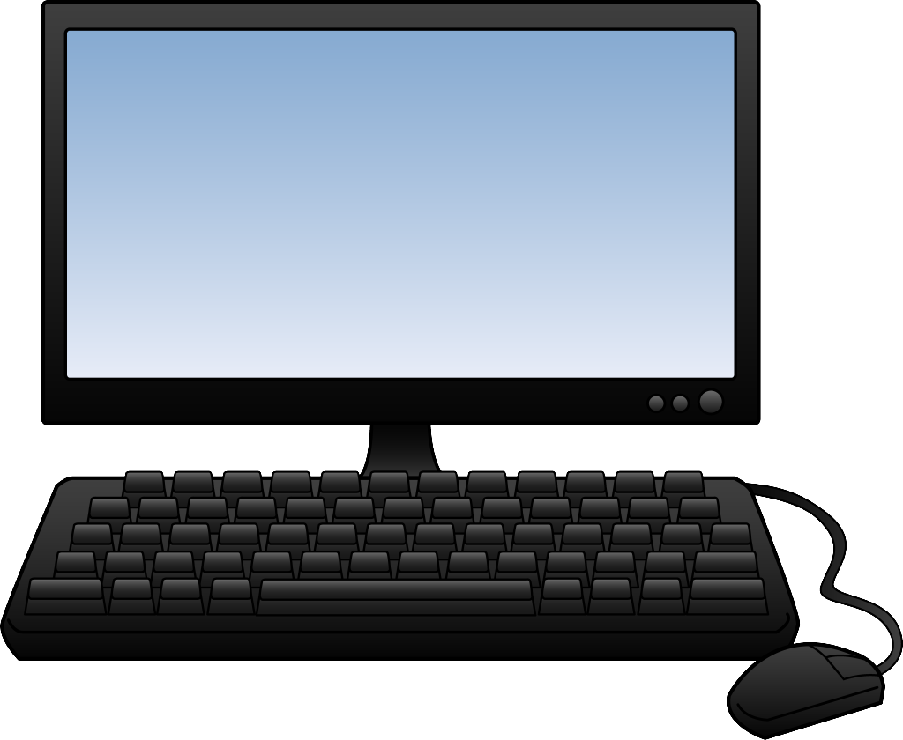
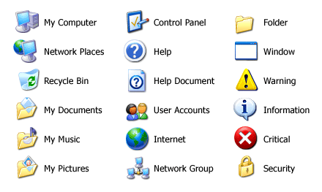

Accessing Google Forms
    forms.google.com
    Tip! Google Forms is designed
    for optimal performance
    using Google Chrome.

Slide 6
ACTIVITY #1

Slide 7
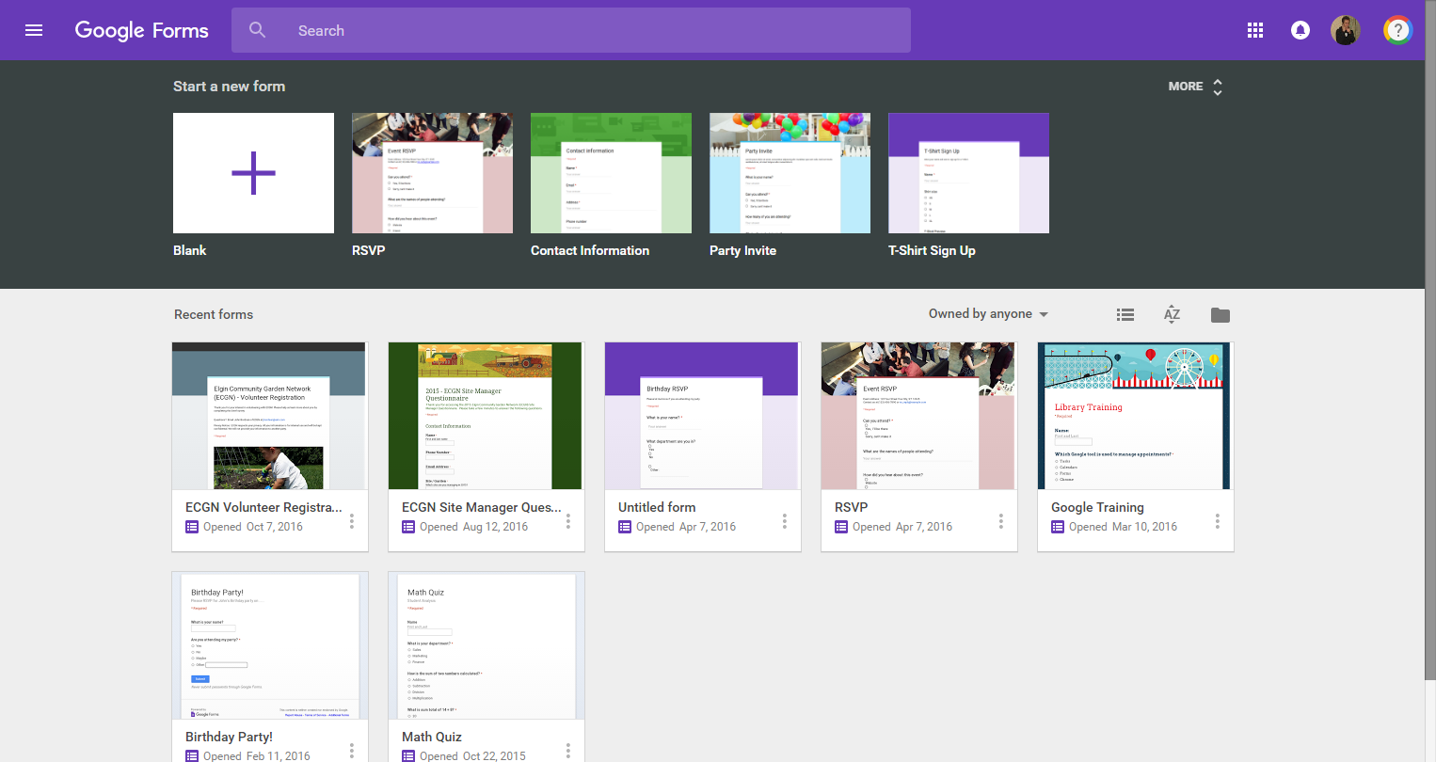
Navigating Google Forms
Search for Docs
Create a new Form
Display options
File Picker
Your Forms

Slide 8

Creating & Working w/ Forms
Use Google Forms to create and customize online
questionnaires.
Use a template or start from scratch
Provide your form with a new title
Change the overall look (theme) of the form
Preview your form before publishing
Delete forms that are no longer needed

Slide 9
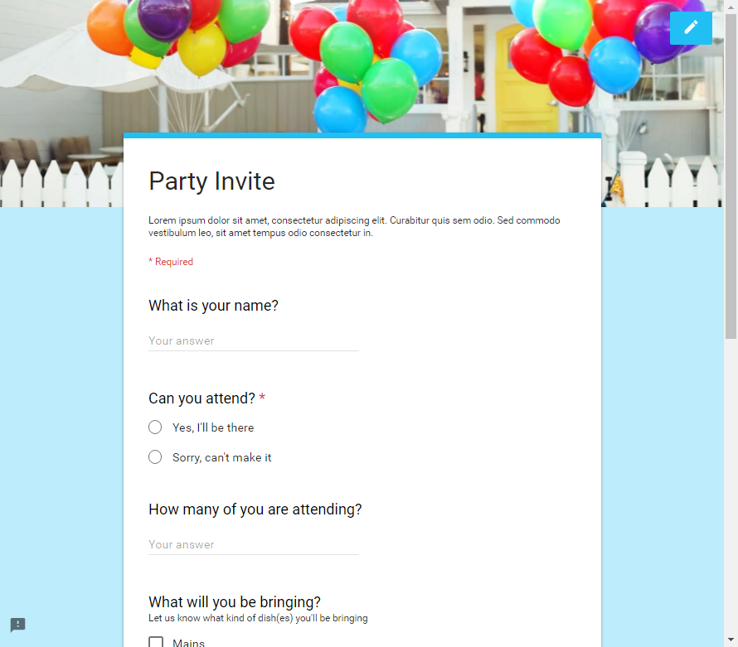
Google Forms Templates
Create a new form using a template with preset questions
and formatting. Templates include:
Event RSVP
Event Feedback
Party Invite
Order Form
Course Evaluation
And more…

Slide 10
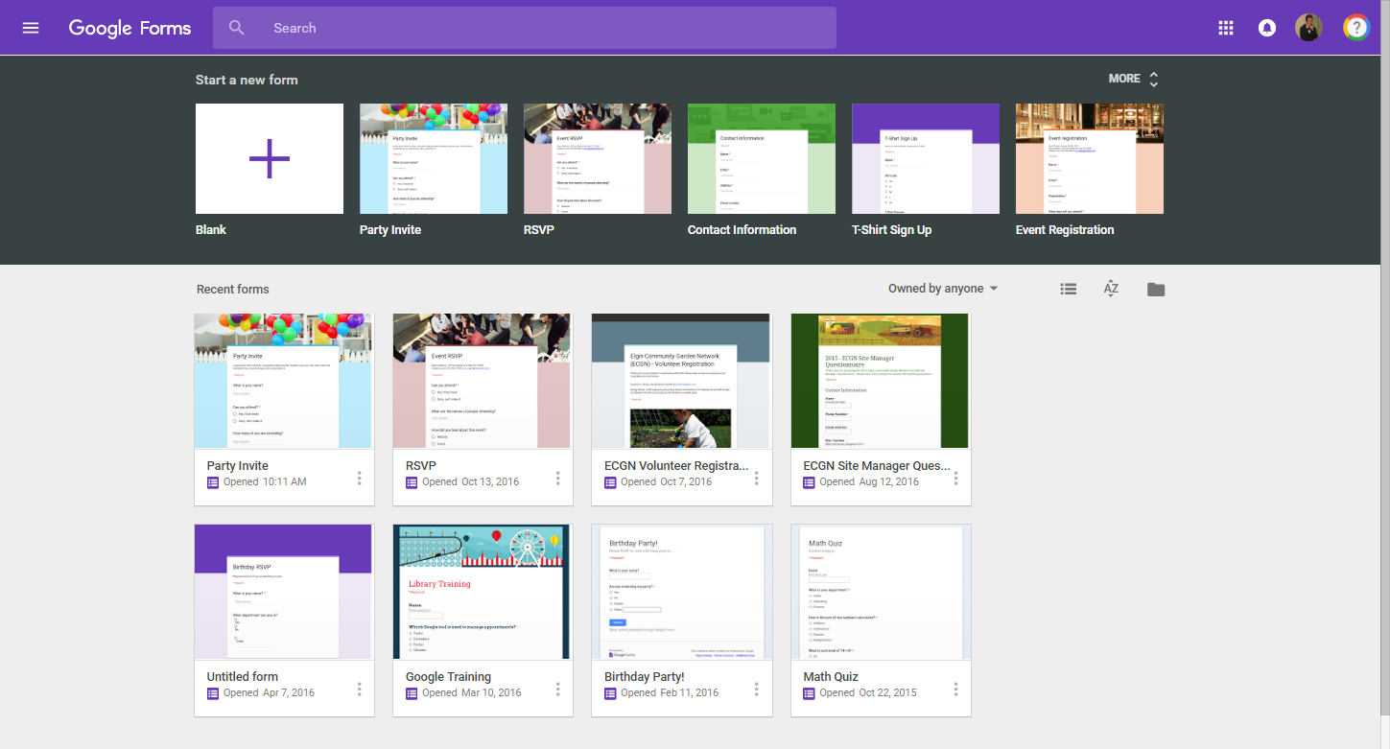

Using Premade Templates
Create a new form using a template on the Google Forms
home screen.
Create a new Form or view more templates

Slide 11
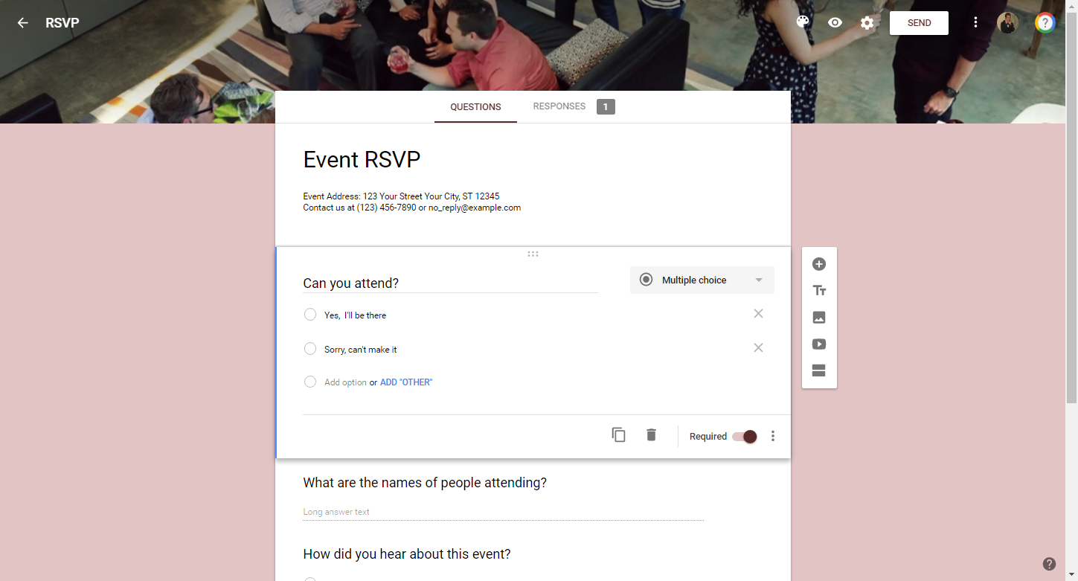
Navigating Forms Interface
Form Name
Preview
Select Theme
Settings
Publish / Share
Menu
Forms home
Edit questions or view response data
Form title & description
Question(s)
Insert Items
(Ex: Add questions)

Slide 12
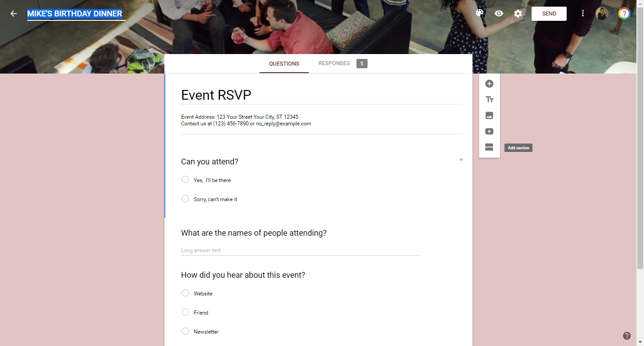
Renaming a Form
Edit the name of your Form at anytime by clicking and
typing in the “Form Name” field.
Form Name
    Tip! All changes to the form
    are saved in real-time.

Slide 13
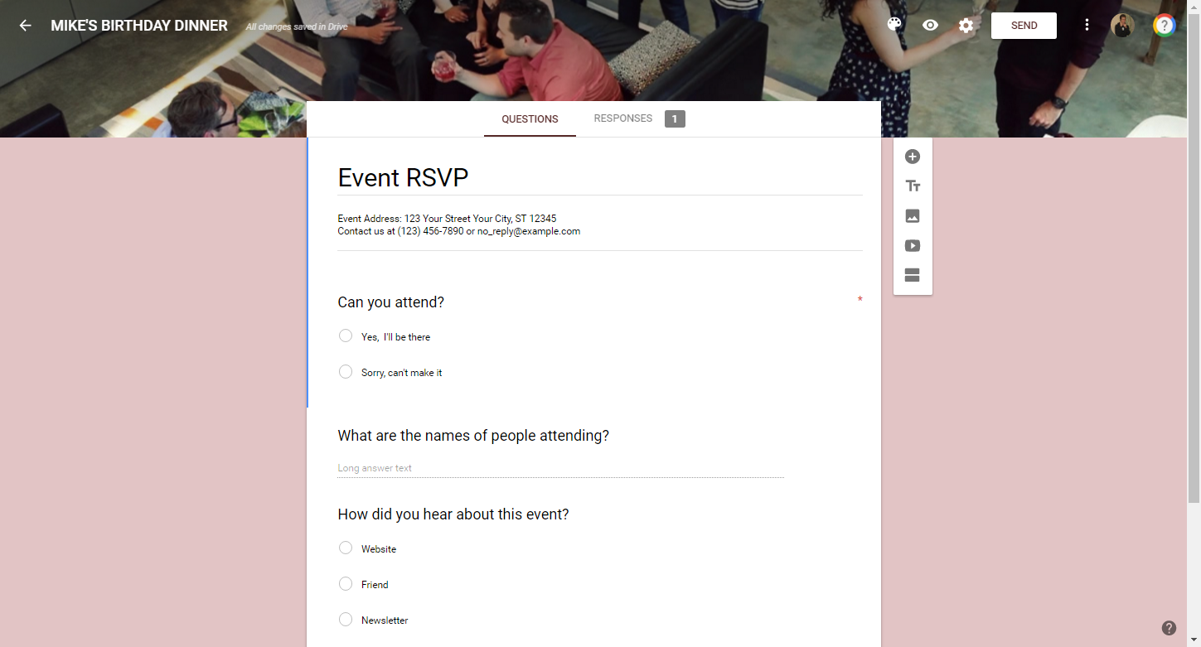
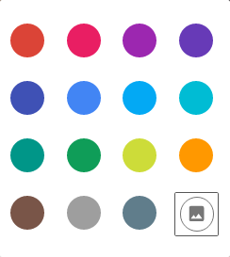

Changing the Theme
Themes provide published forms with a unique background
color and/or header-level image.
1. Click
Header-level image
2. Select color palette or
choose a theme via
Background color

Slide 14
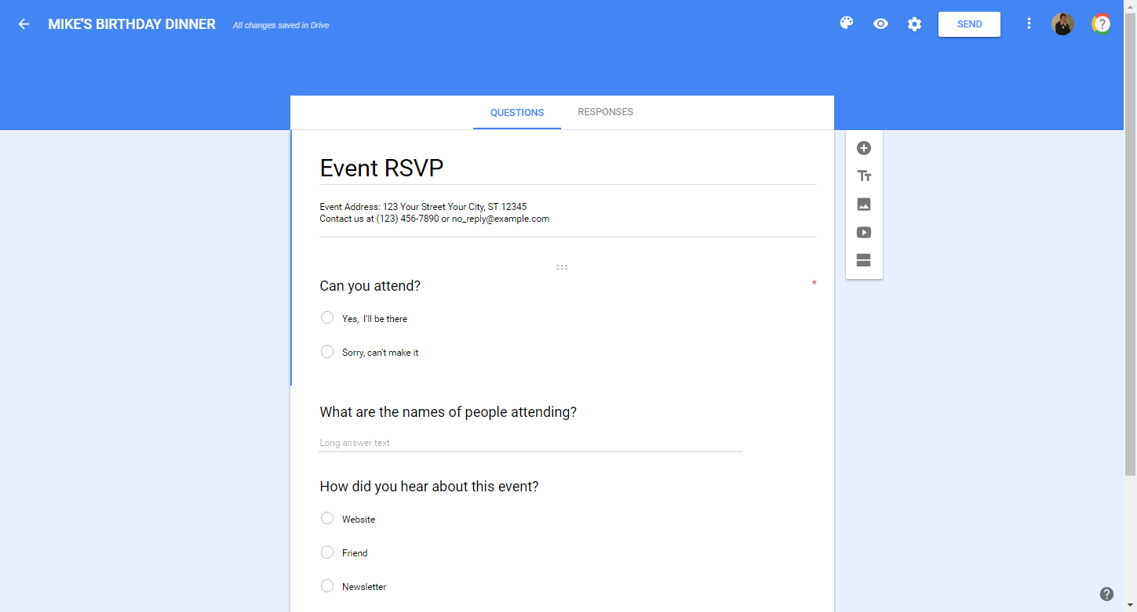
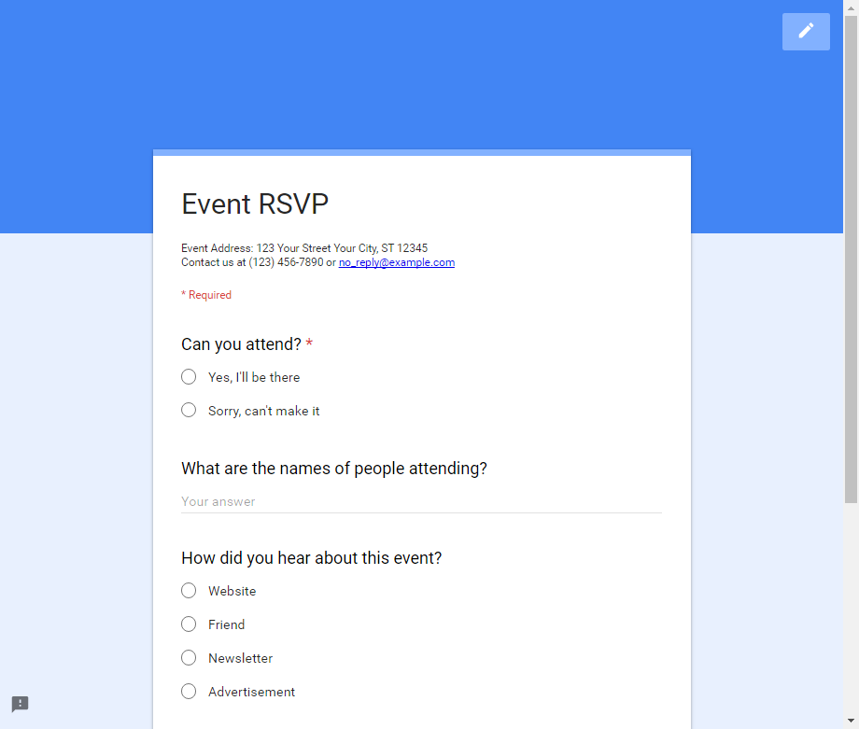
Previewing Your Form
Before sharing a Form, view what the published version
will look like to respondents.
1. Click
2. View your form
3. Return to “edit” view by closing
the browser tab or click on

Slide 15
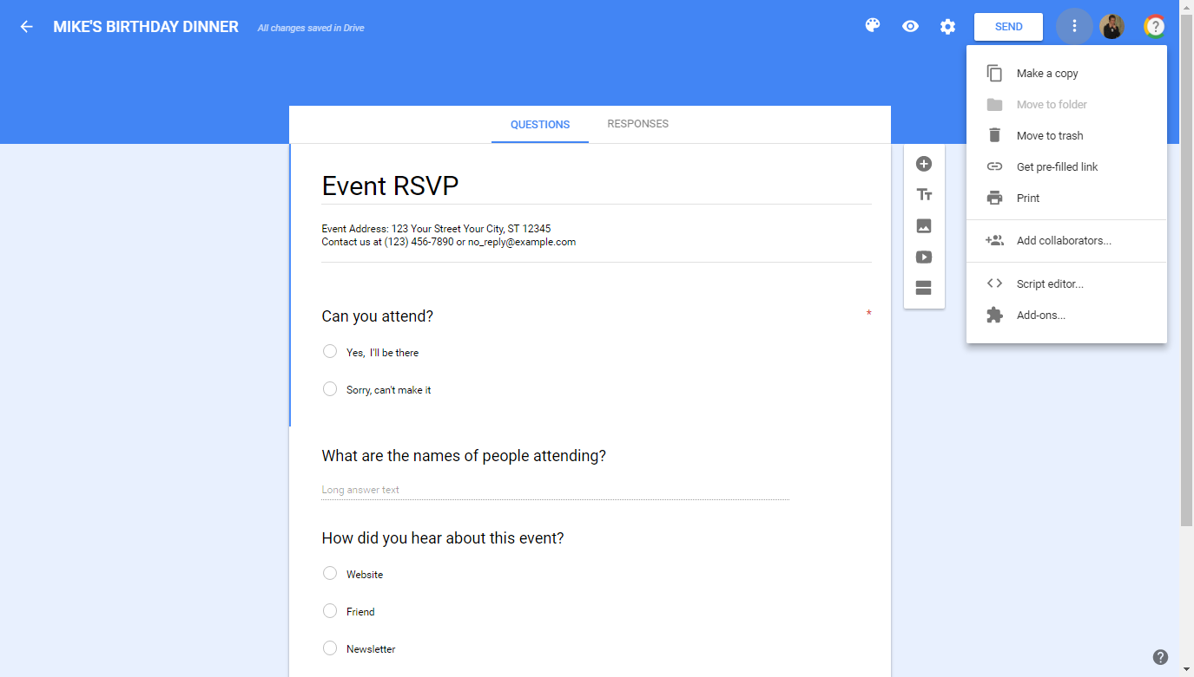
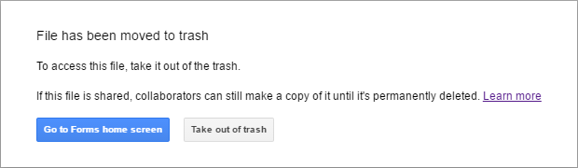
Deleting a Form
Move your Form to the “Trash” if you no longer wish to
use or keep it; it can then be retrieved for 30 days.
1. Click
2. Click “Move to trash”
3. Click “Go to Forms home screen”
    Tip! To remove a Form from the
    trash, access Google Drive.

Slide 16
ACTIVITY #2

Slide 17
Creating a New Form
Create a new “blank” Form to start from scratch.
Create a new form

Slide 18

Adding Questions & Items
Build your new Form by adding questions, section titles,
pictures and more.
Select from a variety of question types
Insert an image or video
Add section headers and page breaks

Slide 19
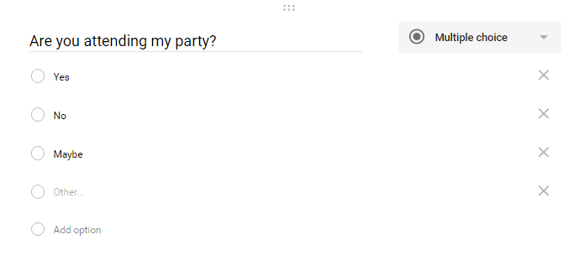
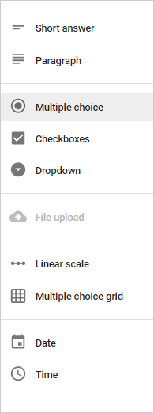
Available Question Types
Select from a variety of question types to insert in a form:
Freeform Text
Multiple Choice
Checkboxes
Dropdown list
Rating/Linear Scale
Multiple Choice Grid
Date and Time

Slide 20
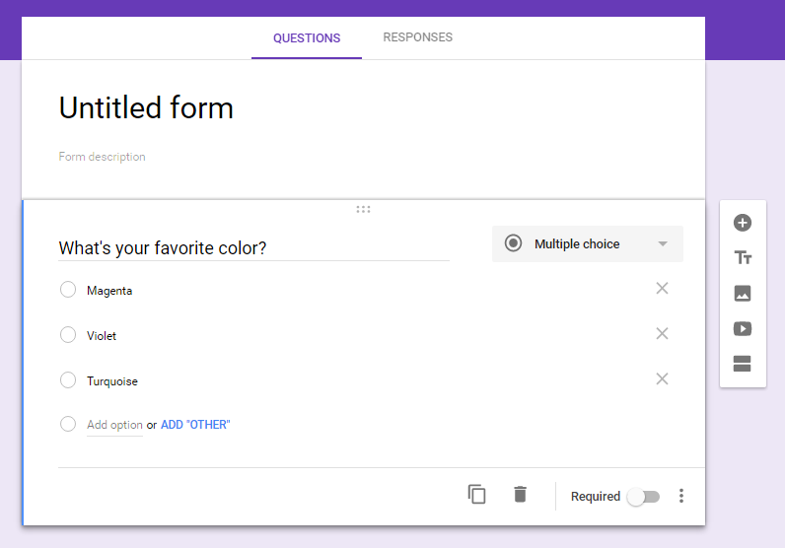
Inserting Questions
Select from a variety of options when adding a question.
Select a question type
Add a new question
Enter a question
Responses
Add a new response
Miscellaneous options

Slide 21
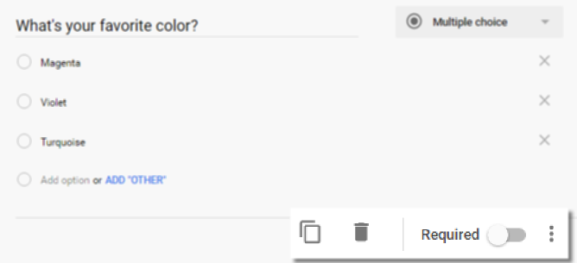
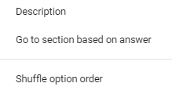
Misc. Question Options
Required response
Duplicate
Delete
Add’l options

Slide 22
ACTIVITY #3
Notes:
Adding questions to the Form

Slide 23

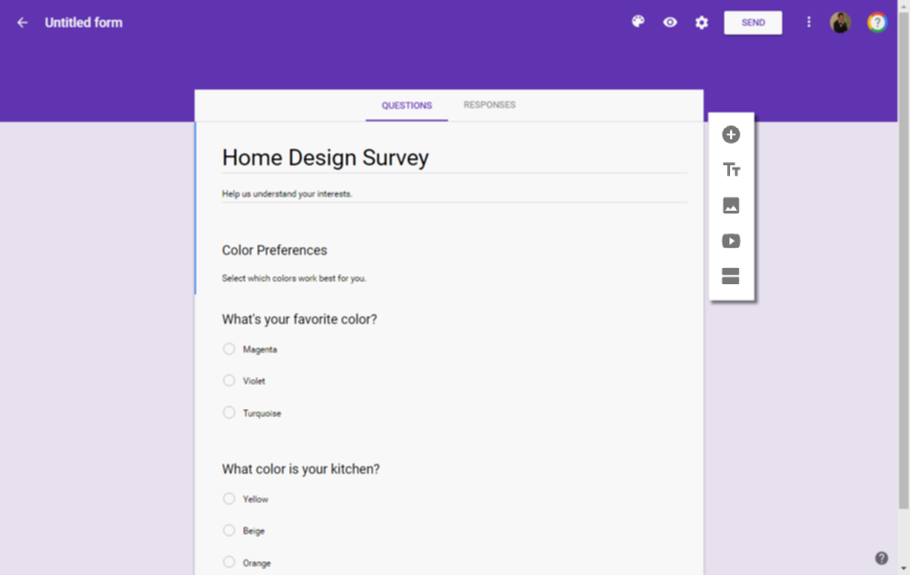
Using Other Form Items
Select from a variety of other items to insert in a form.
Section Header
Image
Video (YouTube)
Page Break
1. Click desired item
2. Follow the prompts
(if applicable)

Slide 24
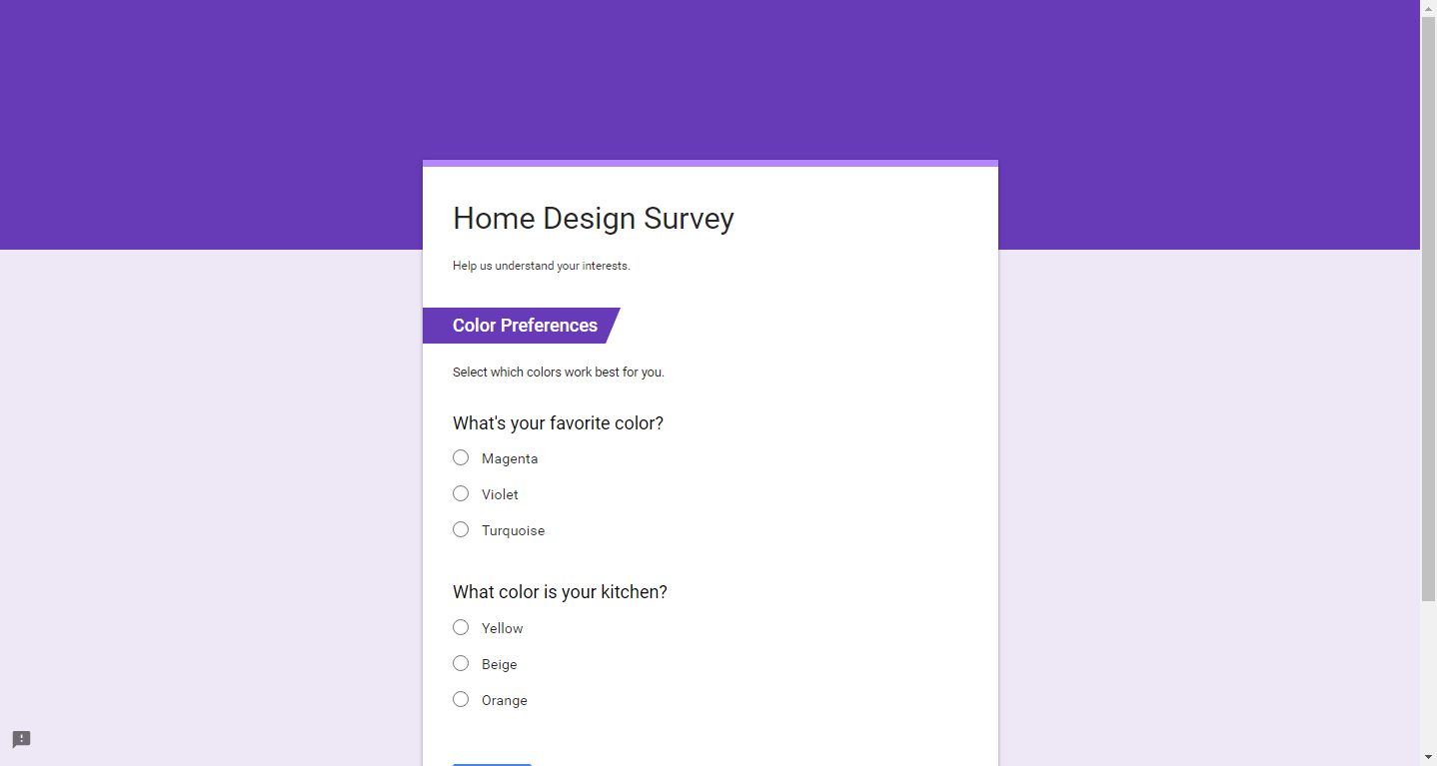
Using Other Form Items
- Section Headers
Provide your Form with a visual cue which highlights a
particular category or section of questions.

Slide 25
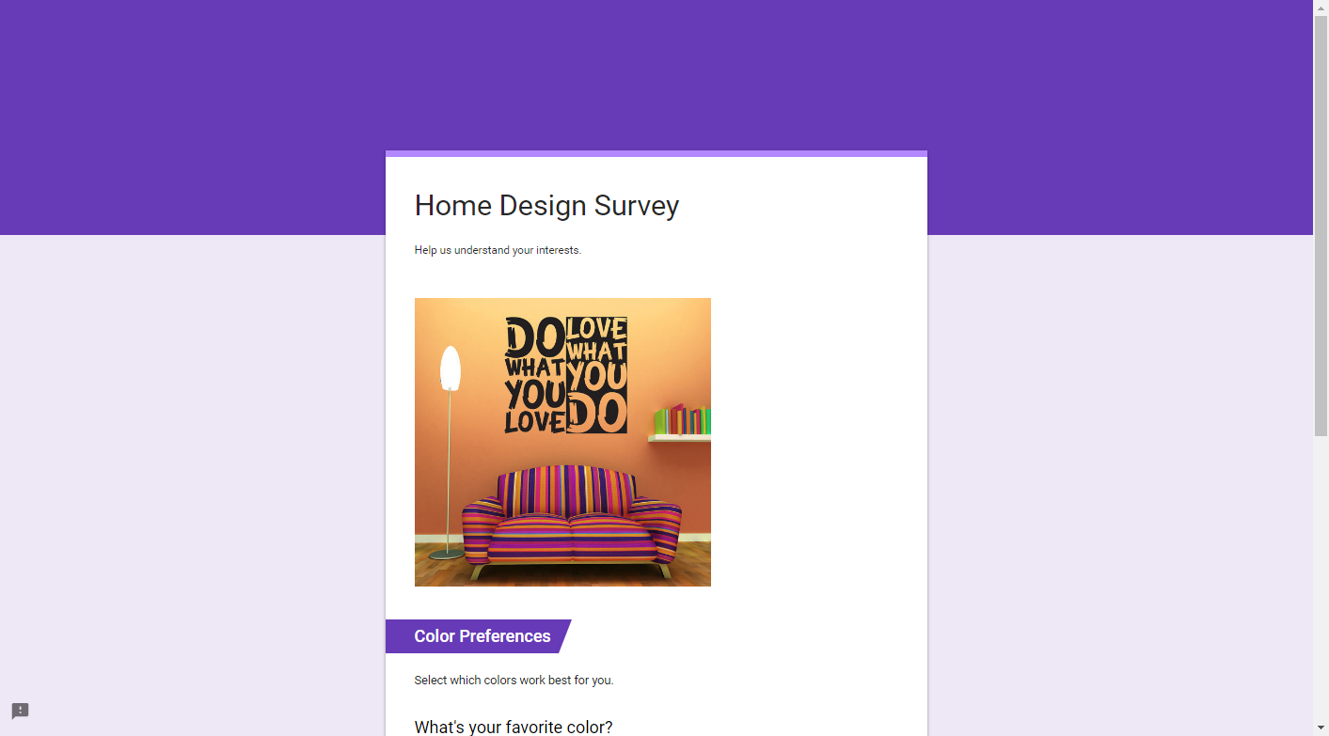
Using Other Form Items
- Images
Add pictures from your PC, Drive account, or the web.

Slide 26
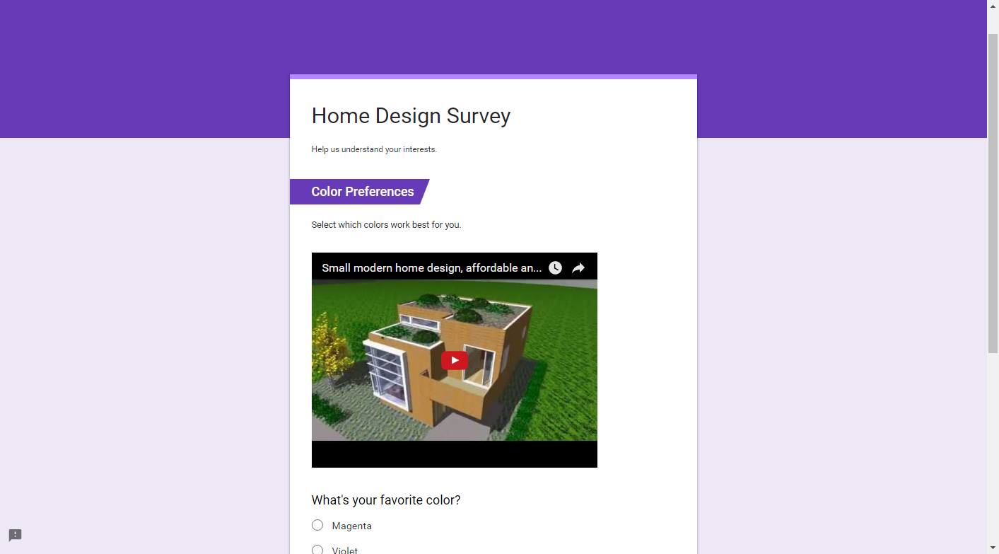
Using Other Form Items
- Video
Insert a video from YouTube.

Slide 27
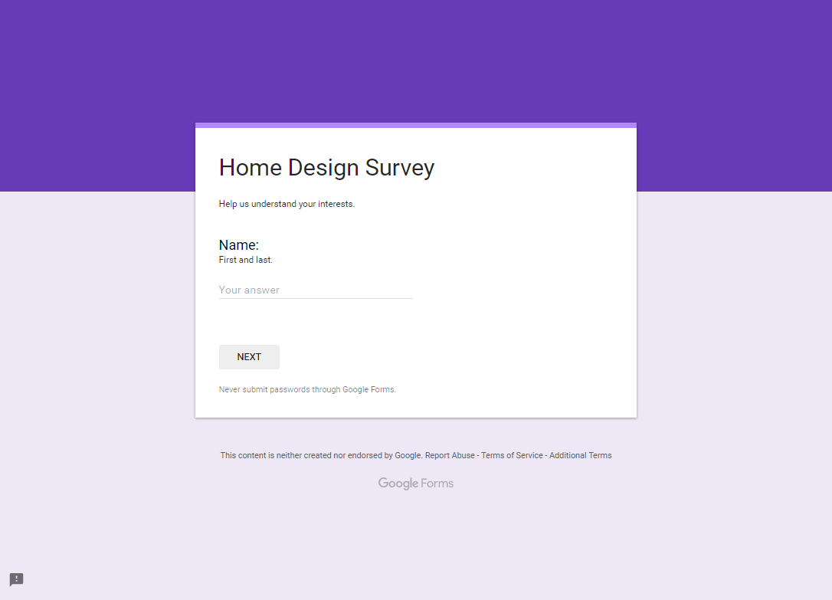
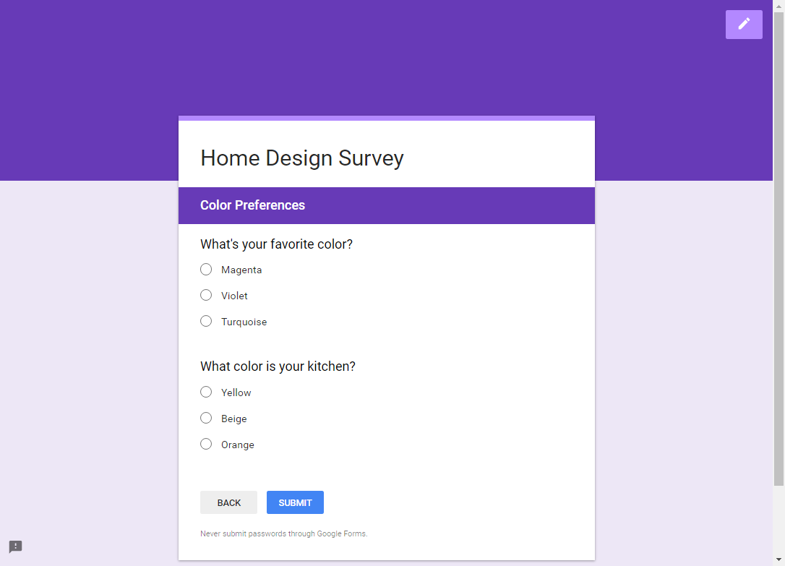
Using Other Form Items
- Page Break
Divide your Form into multiple pages (“sections”).
Page 1
Page 2

Slide 28
ACTIVITY #4
Notes:
Adding other items to the Form

Slide 29
Publishing Your Form
Publishing a Form allows others to access your online
questionnaire and submit their responses.
Send to others via email
Share via social networks
Obtain a web link to share outside of Forms
Embed your form on a website

Slide 30
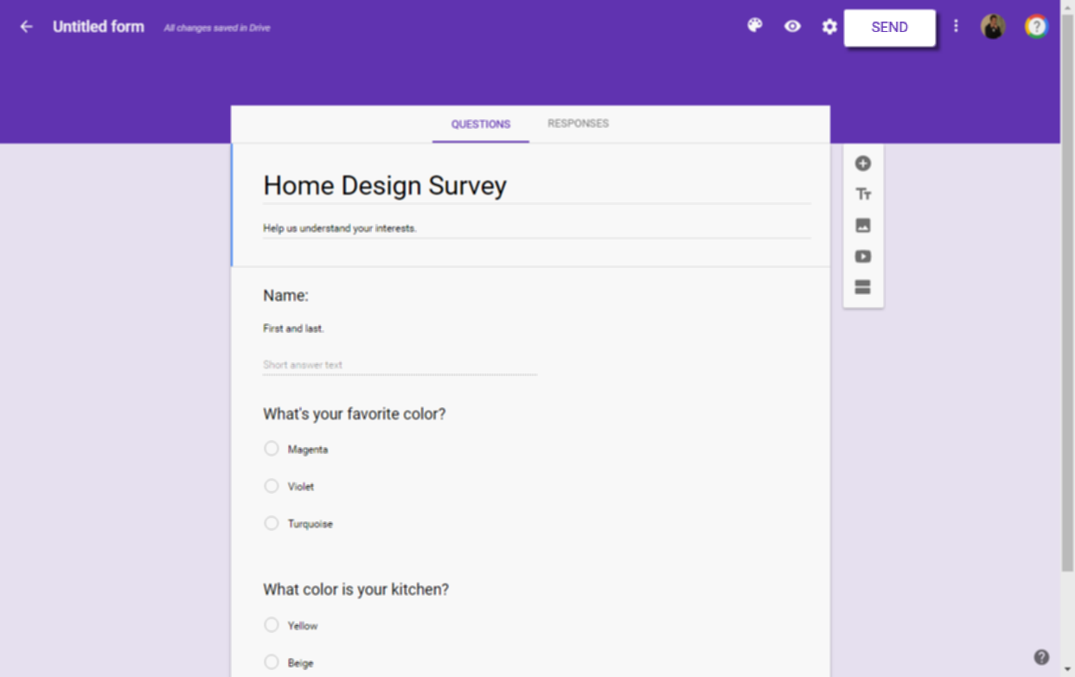
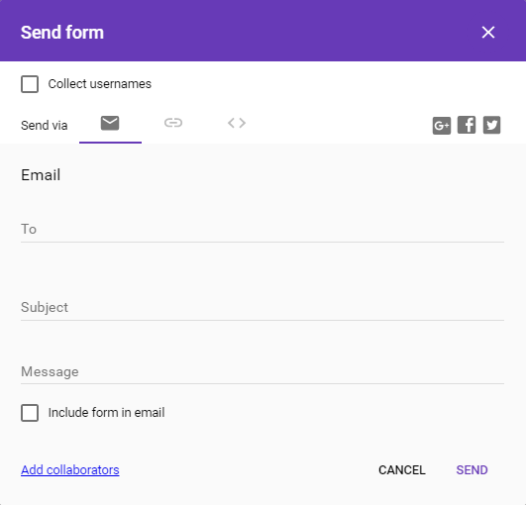
Publish/Share Your Form
1. Click “Send”
2. Select publication method
    Publication Methods
    Email
    Web Link
    Embed on website
    Google+
    Facebook
    Twitter
3. Complete add’l prompts

Slide 31
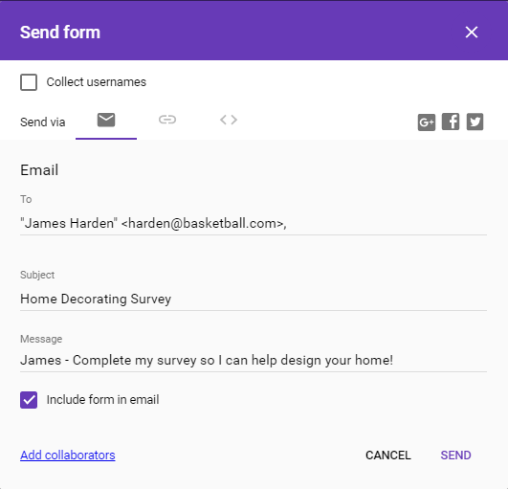
“Send Form” Options
Remove anonymity
Sharing options
Req’d fields for sharing via email
Allow collaborators to co-manage and edit the Form
Send / Cancel

Slide 32
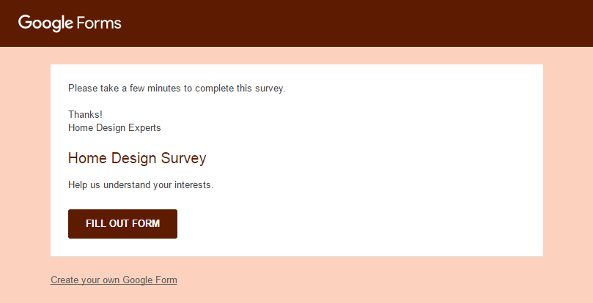
Viewing Email Notifications
Recipients of a published Form receive an email notification.

Slide 33
ACTIVITY #5
Notes:
Publishing a Form

Slide 34

Managing Response Data
After publishing your Form and collecting responses, it is
time to view and analyze the data.
View response data within Google Forms
Link data to a spreadsheet to view and sort
Receive email notifications for new responses
Prevent add’l user responses by disabling a
form

Slide 35
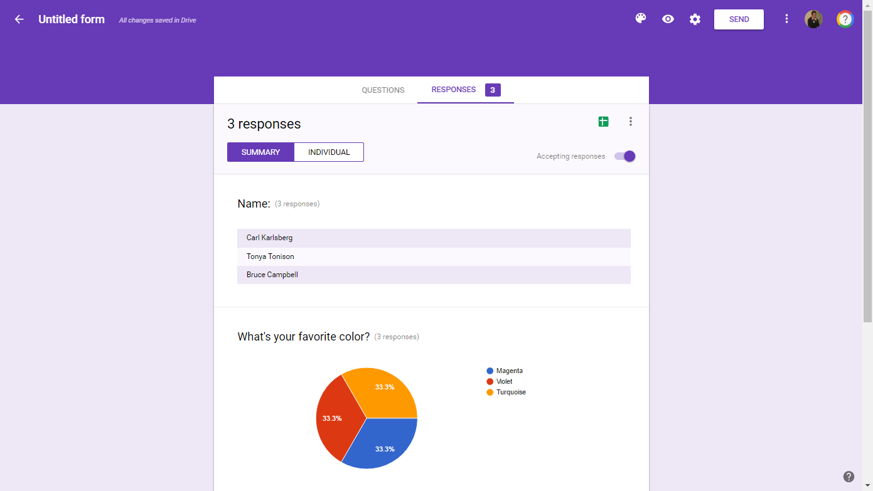
Viewing Responses in Forms
View a summary of responses to your form.
1. Access the “Responses” tab
2. Select desired view
3. View responses

Slide 36
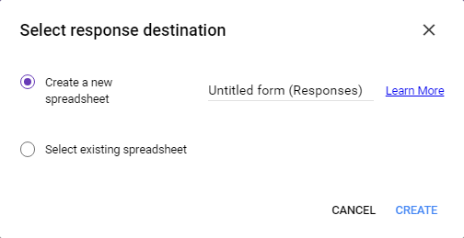
Linking Data to a Spreadsheet
Send response data directly to a Google Sheet; existing
and future responses are sent there automatically.
1. Click
2. Select “Create a
new spreadsheet”
3. Click “Create”

Slide 37
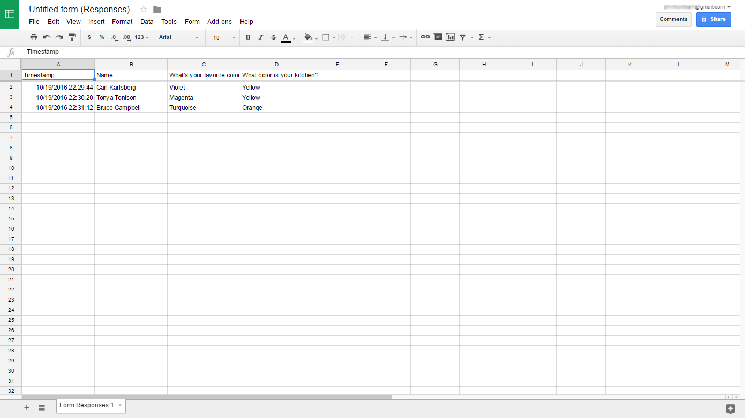
Viewing Spreadsheet Data
All responses are saved within the Google Sheet
(accessible via Drive, Sheets, or your Google Form).

Slide 38
ACTIVITY #6
Notes:
Viewing response data

Slide 39
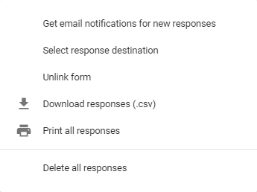
Enabling Response Notices
Receive an email notification each time a respondent
completes your form.
1. Access the “Responses” tab
2. Click
3. Click “Get email
notifications for
new responses”

Slide 40
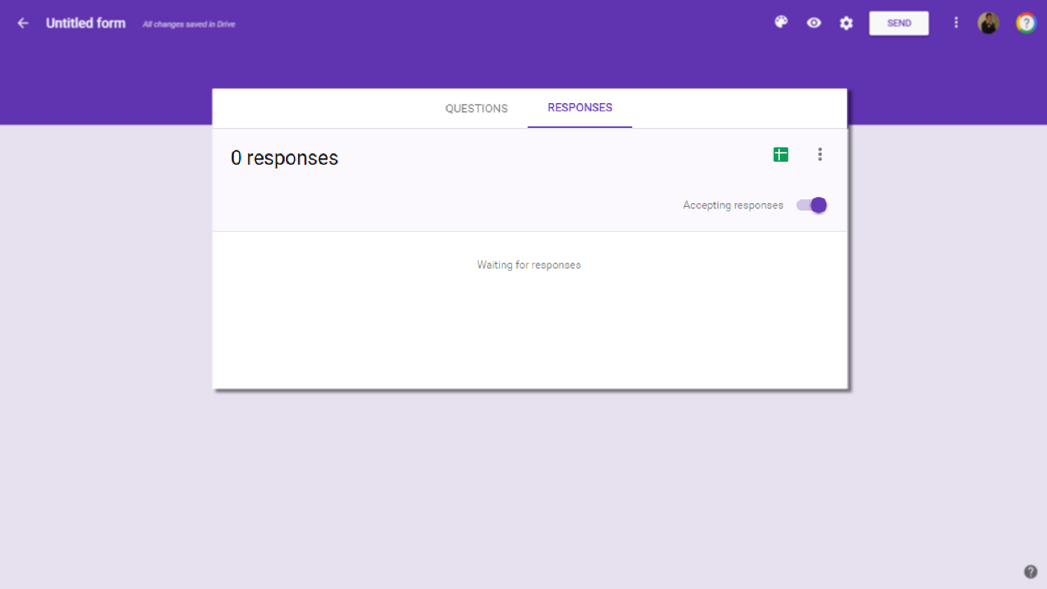
Disabling User Responses
At any time, turn off the availability of your Form to
respondents (Ex: registration deadline has passed).
1. Access the “Responses” tab
2. Toggle “Accepting responses” switch
    Tip! By default, all Forms are ready to accept
    responses as soon as they are created.

Slide 41
Questions?
THANK YOU FOR COMING!
Notes:
Thank participants for coming and ask if there are any outstanding questions.
Hand out the class surveys and encourage them to write in ideas for any additional classes.
When they submit their surveys, exchange them for handouts.
Encourage them to look for upcoming classes and register to attend

