Slide 1

Google Drive
Instructor Name
Instructor Title
Library Name
Courtesy of Gail Borden Public Library
and the Public Library Association

Slide 2
Agenda
Introduction to Google Drive
Working with Files and Folders
Sharing Files and Folders
Searching for Files and Folders
Moving Beyond the Basics

Slide 3
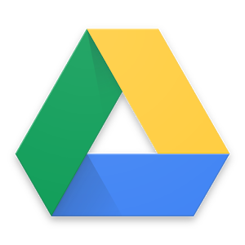
Introduction to Drive
Cloud Storage and Sharing
Drive is a cloud storage solution that allows you to keep all
files in one place and access them from any device.
Store files safely and securely in the cloud
Access your files from a PC, tablet, or mobile
device
Share files w/ others and access files shared
with you
Upload up to 15GB for free
Notes:
Drive is a Cloud storage solution that allows you to keep all files in one place and access them from any device. Similar to Dropbox or other online cloud storage service

Slide 4
File Storage Considerations
Consider this…
Drive storage capacity (15GB)
  Emails and attachments in Gmail count towards limit
  Files created in Google docs, like Slides or Sheets, don’t count towards storage limit
  Increased storage available for nominal monthly fee
File Compatibility
  Nearly all file types and sizes can be uploaded (Ex: PDF’s, MP3’s, GIF’s, ZIP’s, etc.)
  Microsoft Office files can be converted to Google docs (and vice versa)

Slide 5
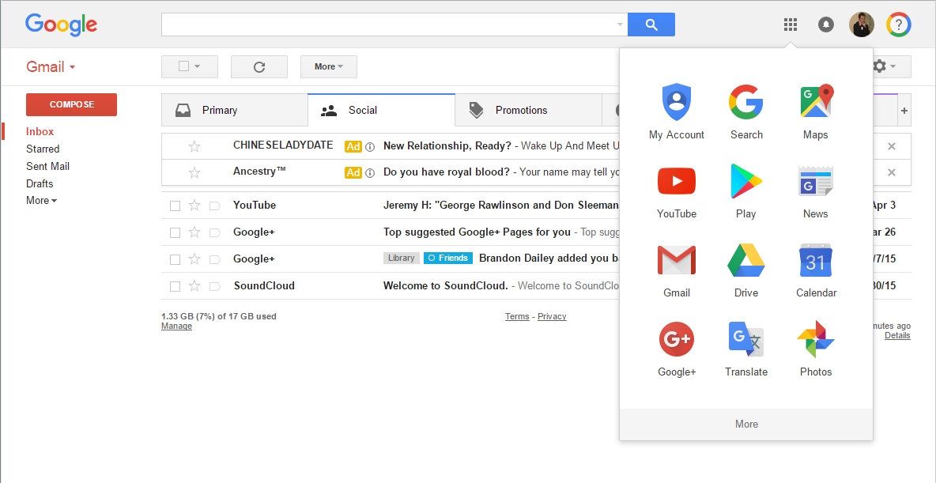
Accessing Drive
    www.gmail.com
1. Click Apps icon
2. Click on “Drive”
    Tip! Drive is designed for optimal
    performance using Google Chrome.

Slide 6
ACTIVITY #1

Slide 7
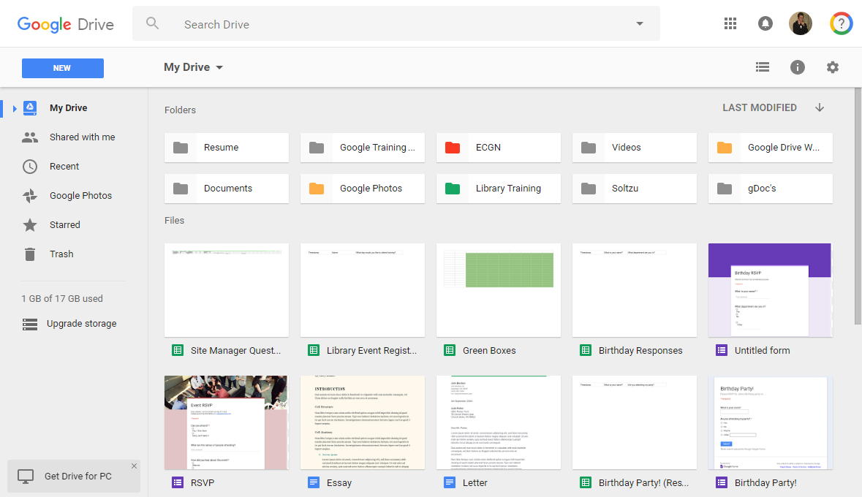
Navigating Drive
Create or Upload
Search Bar
Settings and Display Options
Navigation Pane
Sorting
Folders
Remaining Storage
Files
Notes:
The Drive interface provides you with tools to help manage files and who has access to them.
New: Create new folders, Google Docs, and other App files within Drive; or upload folders and files from your computer
Navigation Links: Covered in more detail later on
Search Drive: Locate files w/in Drive; search for text within documents for very accurate results
Settings and Sorting: Show thumbnails or a list; display in alphabetical order; modify settings
Files and Folders: Displays documents and subfolders within the selected folder

Slide 8

Working w/ Files & Folders
Manage existing files and folders from your computer or
other device by uploading to Drive.
Upload a single file or entire folder from your
computer
Organize files on Drive with folders and
subfolders
Mark individual files or folders as favorites for
quick and easy access
Delete or download files from Drive as needed

Slide 9
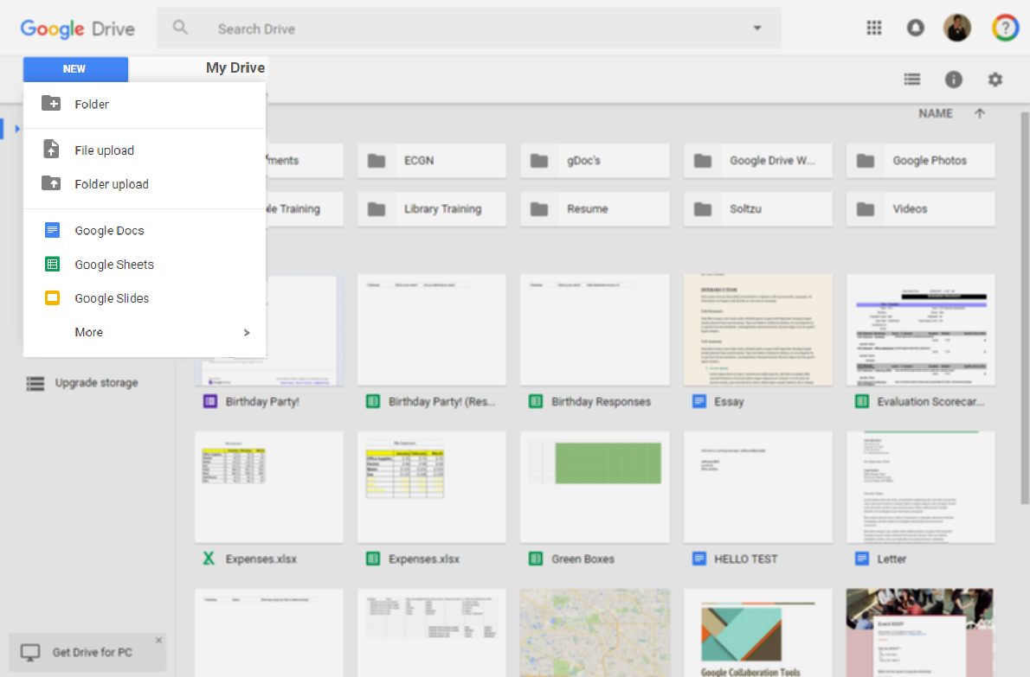
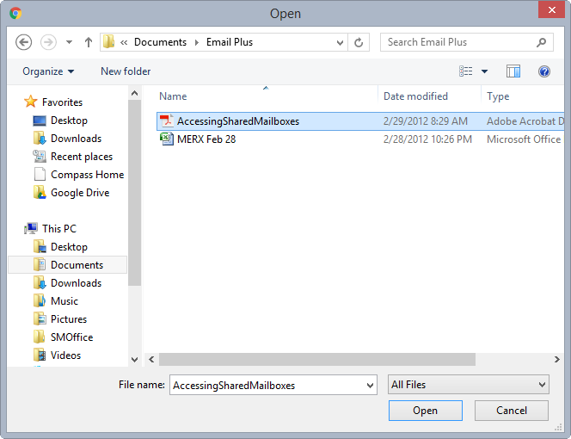
Uploading Files to Drive
1. Click NEW
2. Click File upload
or Folder upload
3. Locate and select the file
or folder from your PC
    Tip! Another method to upload is by
    dragging files from your PC to Drive.
4. Click Open

Slide 10
ACTIVITY #2

Slide 11
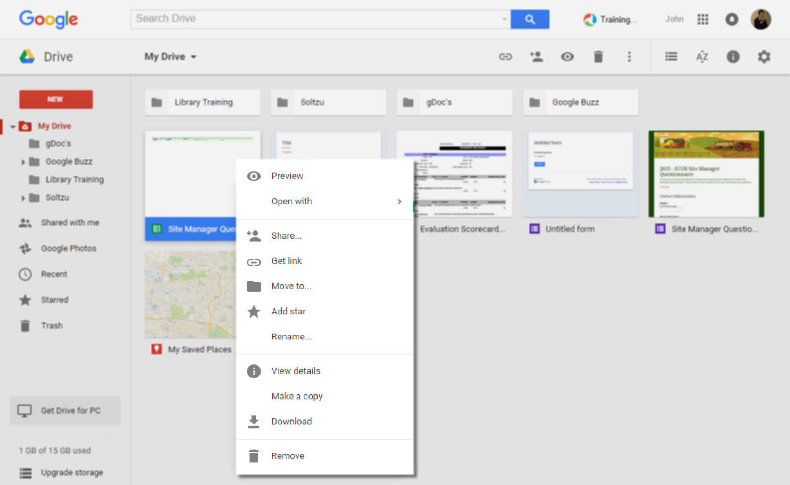
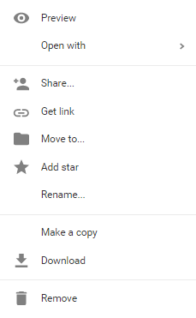
Managing Files in Drive
Manage your Files in Drive
Right-clicking on a file provides numerous options:
Preview
Open
Share
Move between folders
Add star (Mark as a favorite)
Rename
View Details
Download (Save to desktop)
Remove (Delete)

Slide 12
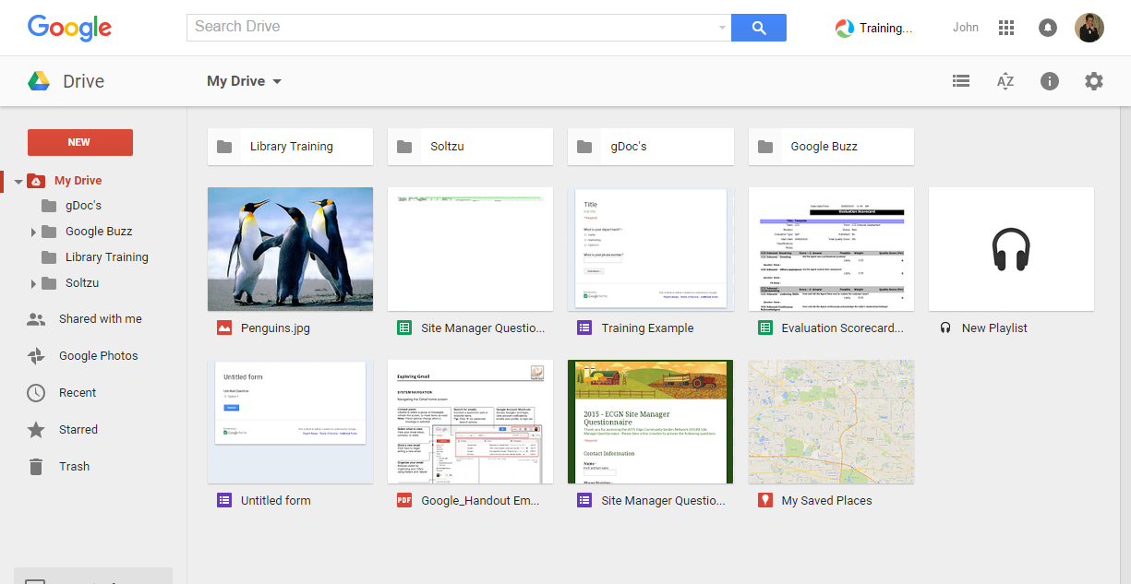
Using Drive Folders
Staying Organized
Group together files related to same project or topic
Create and use sub-folders for more in-depth organization
Your Folders
Currently Selected Folder

Slide 13
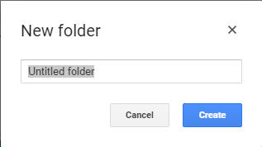
Using Drive Folders (cont)
Creating a New Folder or Sub-Folder
1. Click “New” >
“Folder”
2. Name the folder
3. Click “Create”

Slide 14
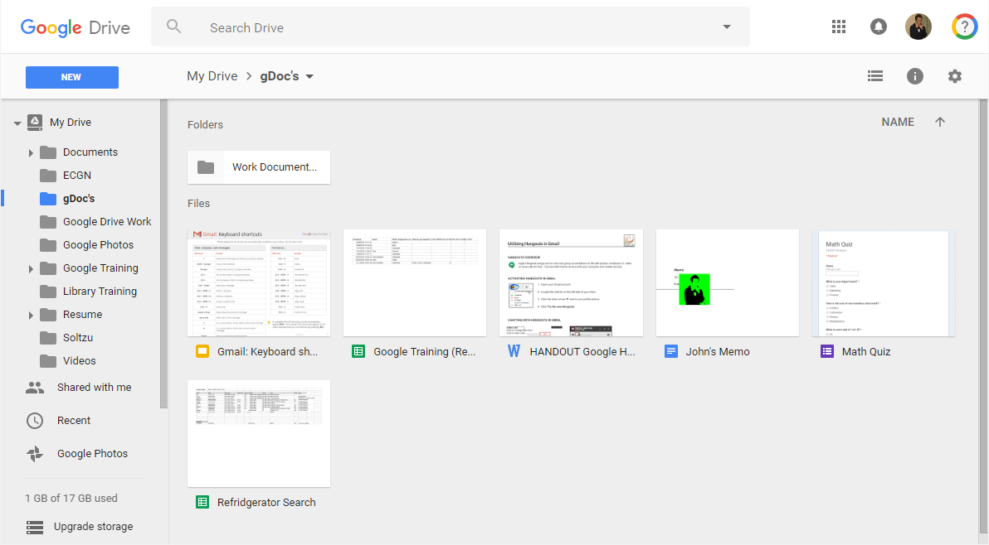
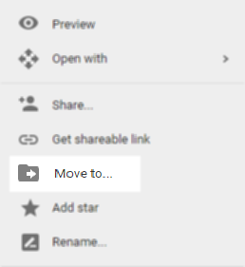
Using Drive Folders (cont)
Moving Files Between Folders
Two options are available for moving files to a folder.
    Option 2 – Right Click
    Right click on a file and select the “Move to….” option to choose a destination folder
Option 1
Option 2
    Option 1 - Drag & Drop
    Drag and drop a file to the destination folder

Slide 15
ACTIVITY #3

Slide 16
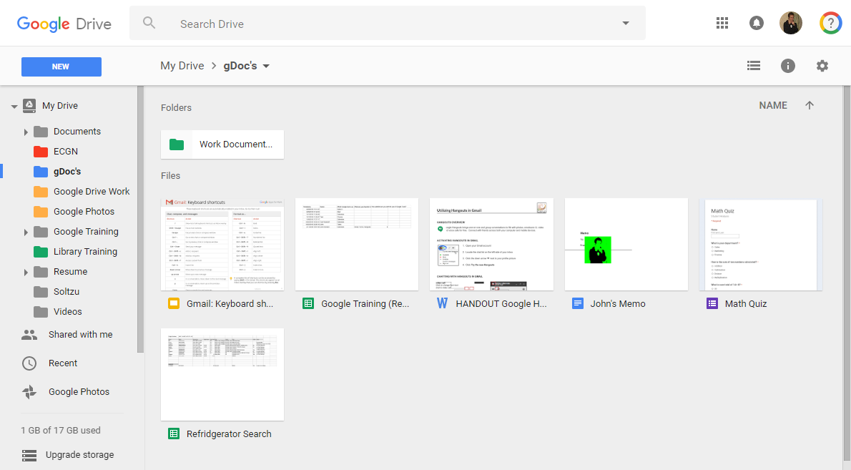
Using Drive Folders (cont)
Use colors to code your folders
    Tip! Apply colors to your folders to provide
    a visual distinction between them.

Slide 17
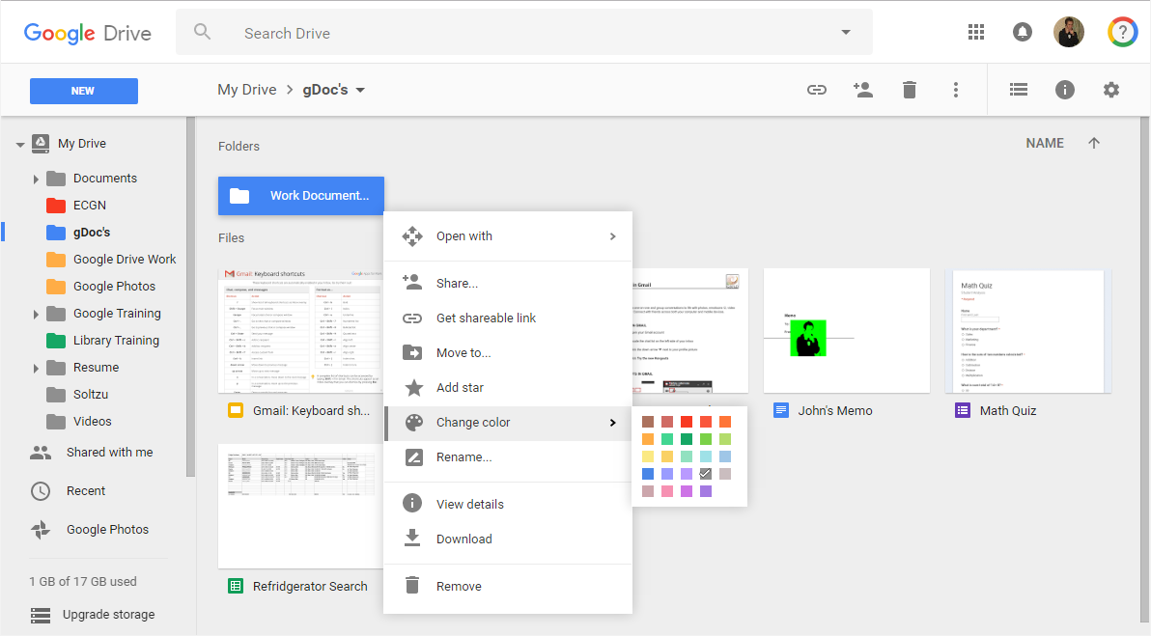
Using Drive Folders (cont)
Applying a color to a folder
1. Right click the folder
2. Select “Change Color”
3. Pick a color

Slide 18
Downloading Files
Download a file from Drive when you need to:
Save to your local hard-drive
Open with an application on your PC
Share with non-Google users
1. Right-click the file
2. Click “Download” and
follow the prompts

Slide 19
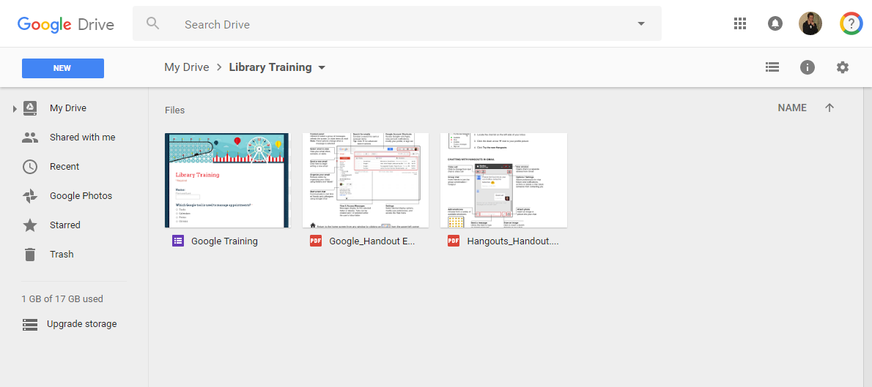

Viewing Files in Drive
Double-click a file to view it:
Google docs open in the applicable Google App
Videos, PDFs, Microsoft files, audio files, and photos
open in the Drive “Preview” window
Double-click a file to view it

Slide 20
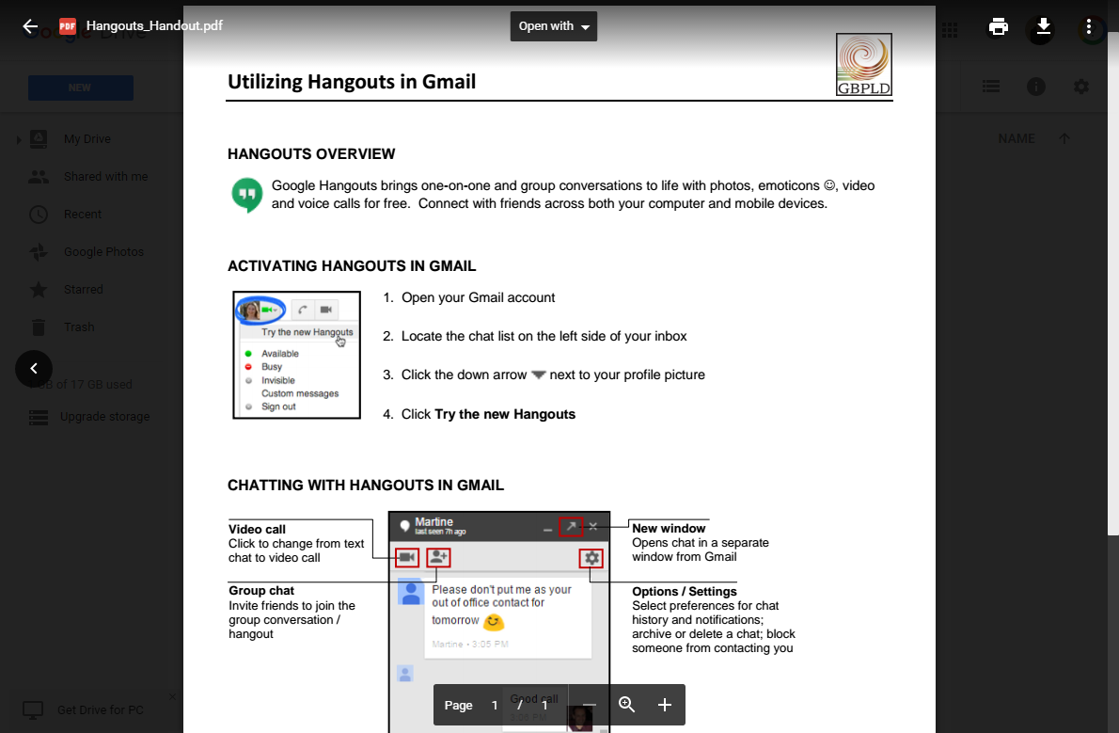
Using the Preview Window
Access the “Preview” window by double-clicking a file.
Open File
Print
Download
Return to Drive
More Actions

Slide 21
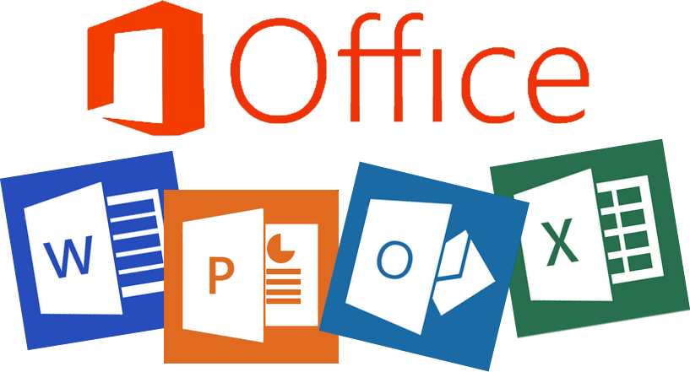
Working w/ Microsoft Files
Microsoft Office files do not open directly from Drive.
Double-click Office files to “preview” them in Drive
Download Office files from Drive to open and edit them
from your PC, then re-upload to Drive

Slide 22
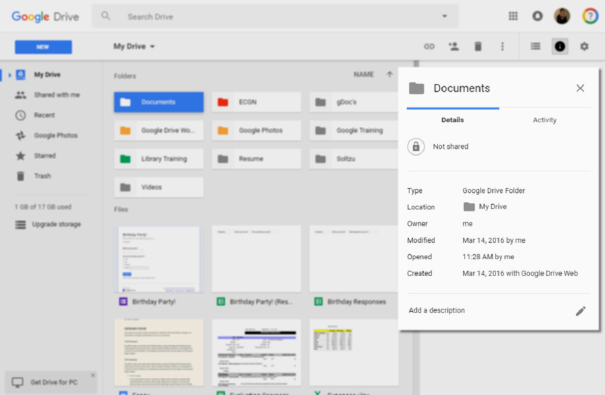
Viewing File Details & Activity
See various details and history of a file or folder, including:
File type
File size
Location
Owner
Activity dates
Create date

Slide 23
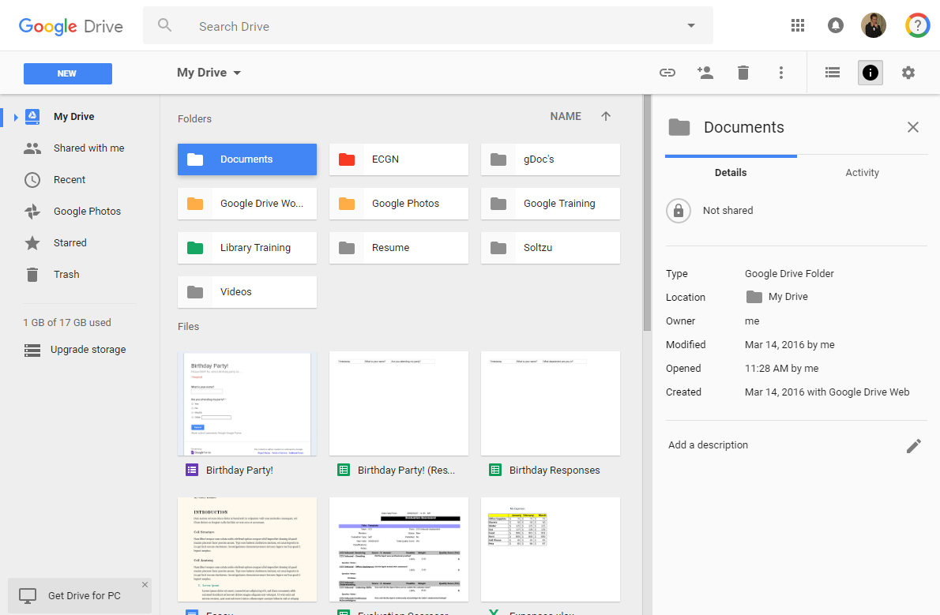
Viewing File Details & Activity
Toggling on file details or activity
1. Select a file or folder
2. Click “View details”
3. Select “Details”
or “Activity”

Slide 24
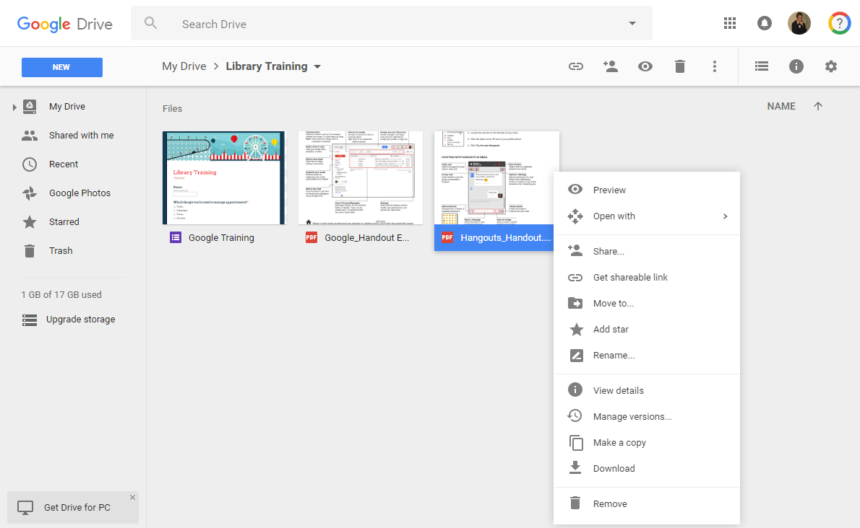
Starring a File or Folder
Add a star to files or folders that you wish to access
quickly and easily.
1. Right-click the file
2. Click “Add star”

Slide 25
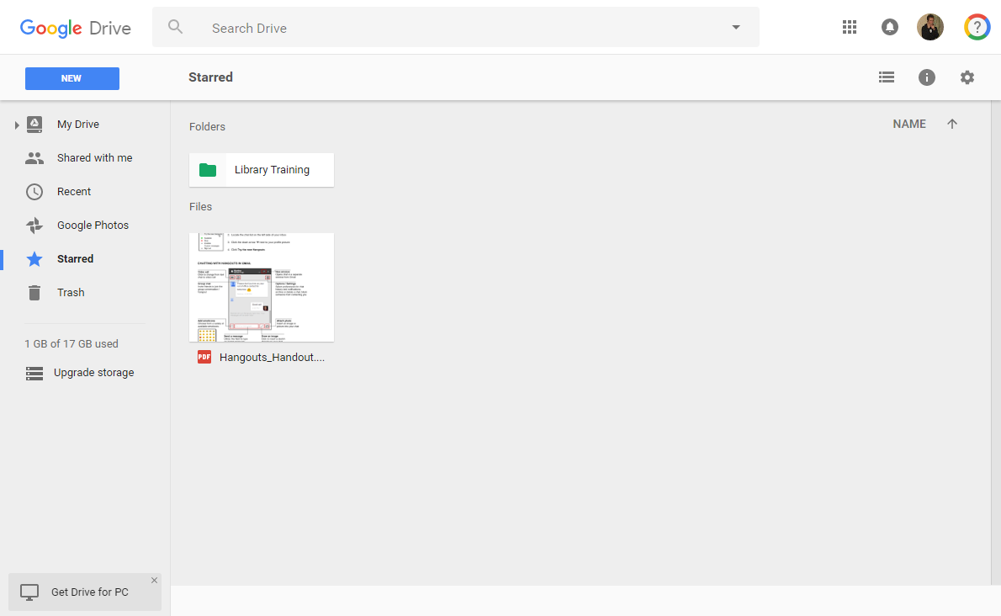
Viewing Starred Items
View all starred items via the “Starred” folder in the
navigation pane.
“Starred” Folder

Slide 26
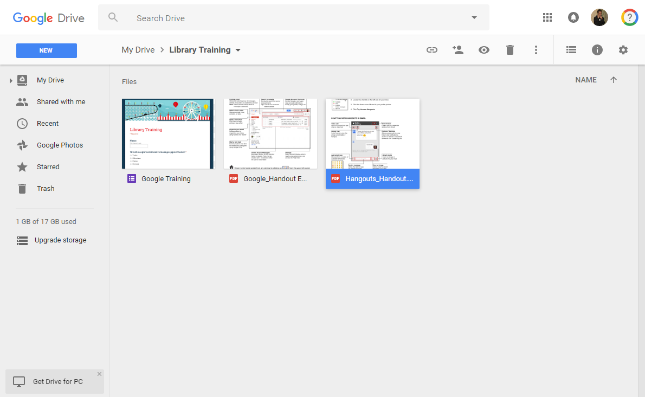
Deleting Files from Drive
2. Click trash icon
1. Click once on the file
    Tip! Deleted files remain available
    for 30 days in the “Trash” .

Slide 27
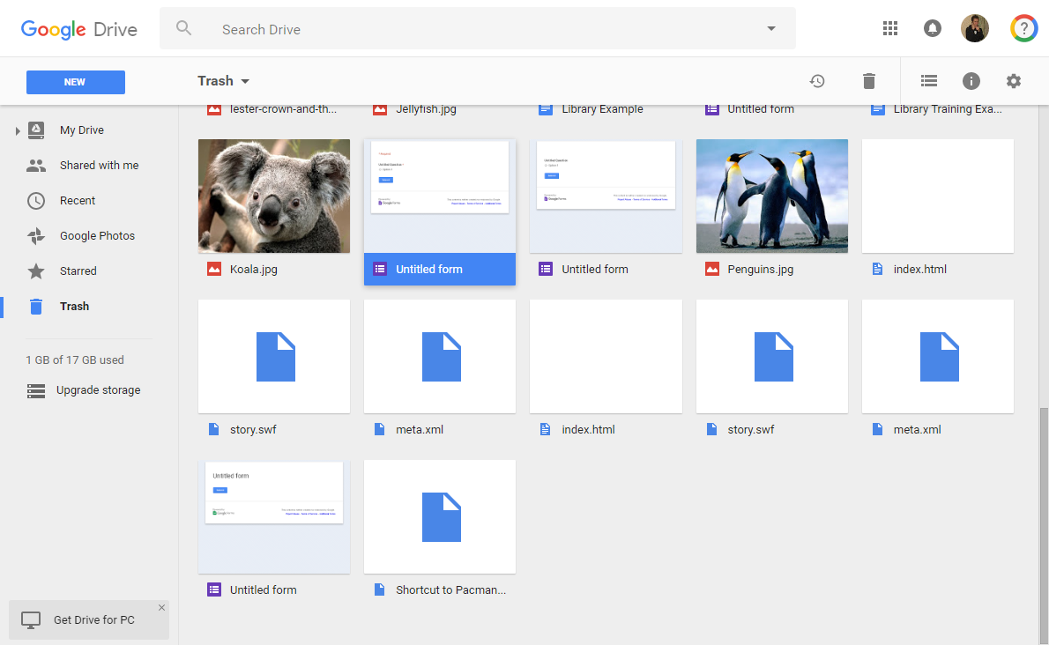
Restoring Files from Trash
Files remain in the “Trash” for 30 days only.
3. Click on Restore
2. Click once on the file
1. Access Trash
    Tip! Restored files are moved back
    to their prior location/folder.

Slide 28
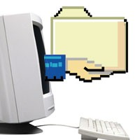
Sharing Files & Folders
Provide others with access to files and folders of your
choosing.
Allow others to view, download, or edit files
Collaborate with colleagues on a project
Send a file to a friend or client
Share with both Google and non-Google users

Slide 29
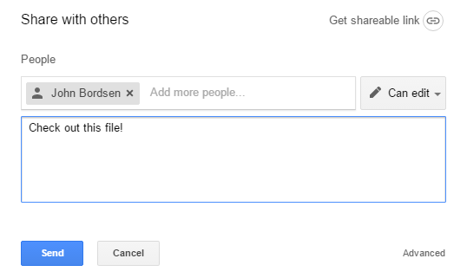
Sharing on Drive
Share a File or Folder
1. Click once on the file
2. Click the share icon
3. Enter recipient(s)
4. Type a message
5. Click on “Send”
Notes:
Creates a document in a new window
Click on New
Select desired file type (For this example, we’re using Docs)
In other classes, we cover how to create Sheets and Slides

Slide 30
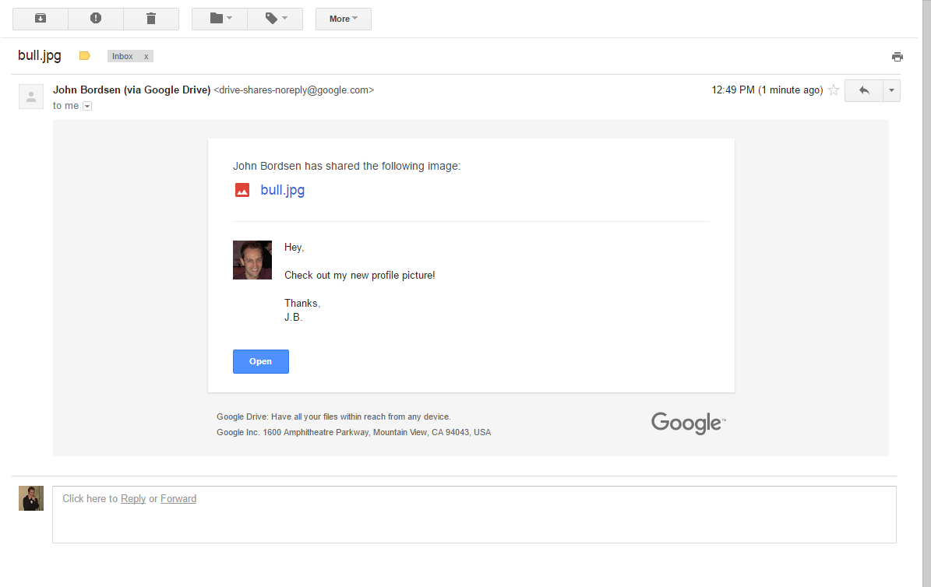
Viewing Email Notifications
Recipients of a shared file receive an email notification
Shared files can be accessed via email using the “Open” button

Slide 31
ACTIVITY #4

Slide 32
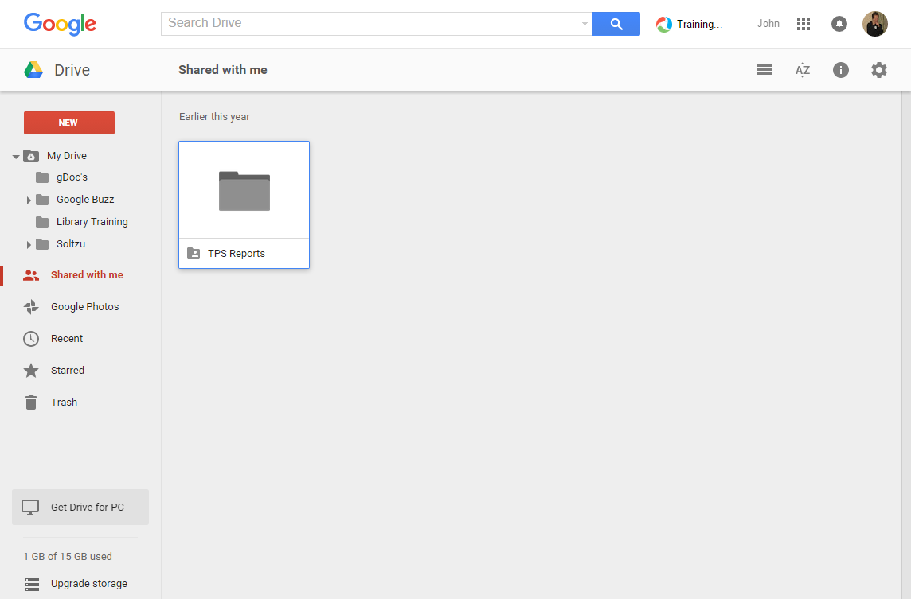
Files Shared w/ You
Understanding how Drive accounts for shared files
Files shared with you display in the “Shared with me” folder; sub-folders are not allowable here
File size does not count towards your storage
Deleting shared files removes it only from your Drive (unless you are the file owner)
“Shared with me” folder

Slide 33
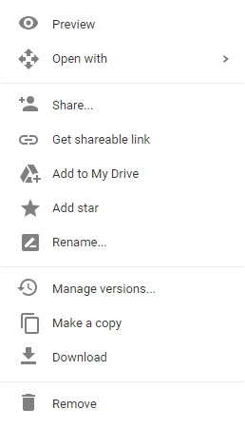
Files Shared w/ You (cont)
Managing Files Shared with You in Drive
Right-clicking a document provides options to move,
download, delete, share, and more.
“Shared with me” folder
Right-click menu options
    Tip! Select “Add to My Drive”
    to store the file in a folder
    of your choosing.

Slide 34
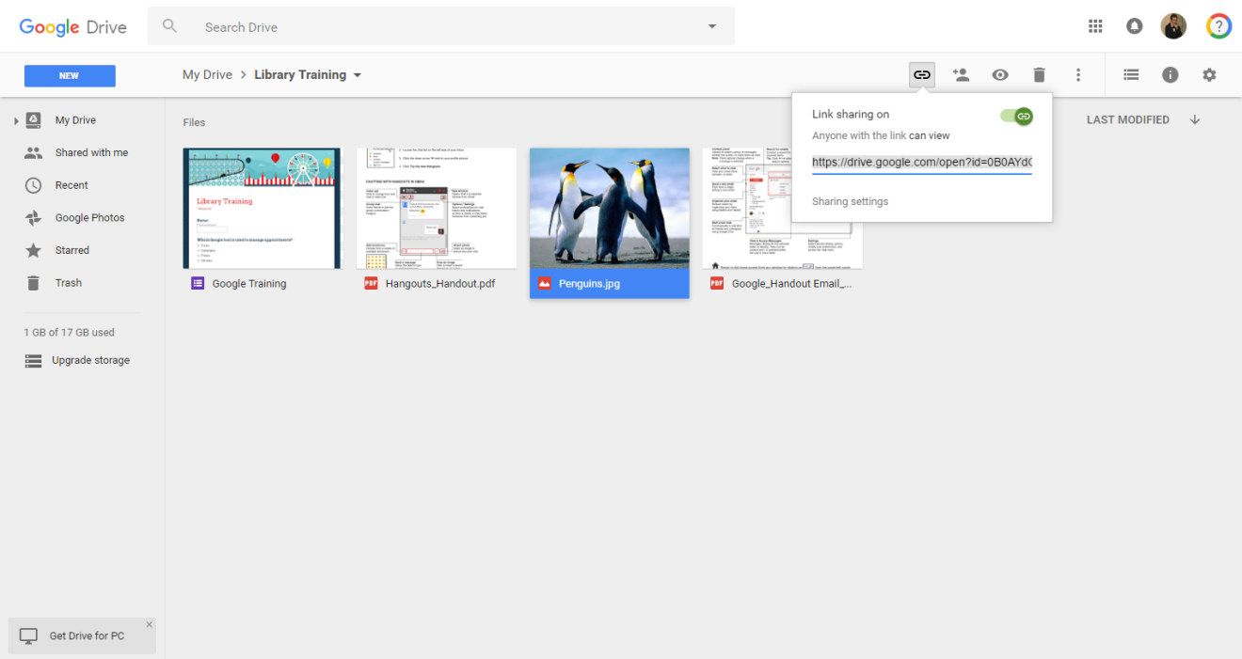
Obtaining a Shareable Link
Rather than share files with direct recipients, Drive can provide a
hyperlink to share with anyone or anywhere.
1. Select the file
2. Click the “shareable link” icon
3. Copy hyperlink
    CAUTION! Obtaining a shareable link makes the file available to any Internet user who has the hyperlink.

Slide 35

Searching for Files & Folders
Locate files or folders in Drive using various search methods
and criteria.
Search by keywords found in the name of a file
or from within its contents
Use advanced search options to locate a file
based on a variety of properties

Slide 36
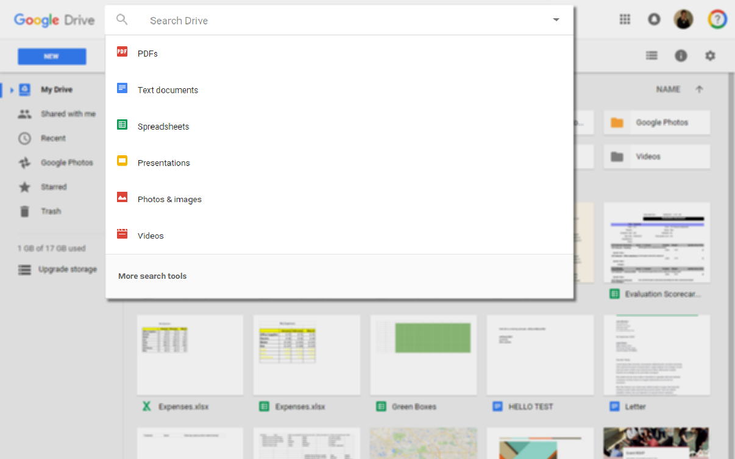
Searching for Files and Folders
All searches begin in the “Search” bar
Search by keyword
Search by file type
Use advanced search options
Notes:
Creates a document in a new window
Click on New
Select desired file type (For this example, we’re using Docs)
In other classes, we cover how to create Sheets and Slides

Slide 37
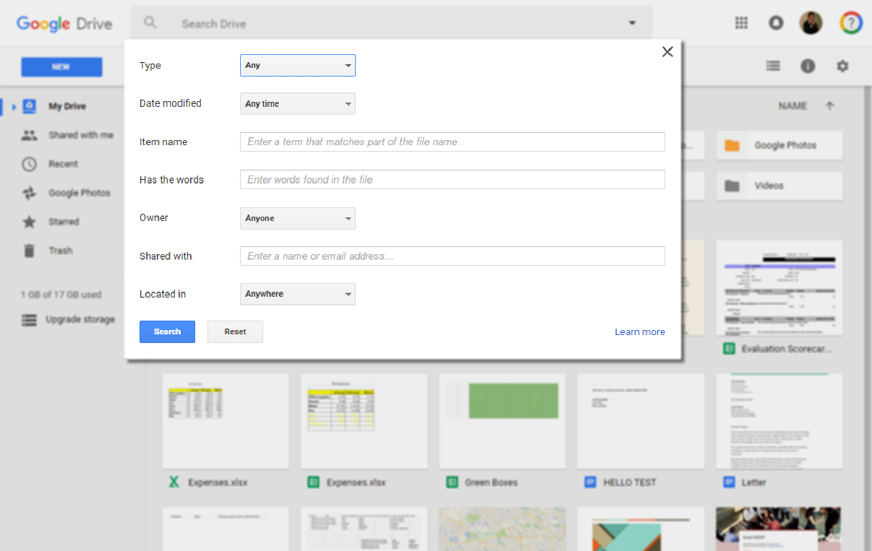
Using the Advanced Search
Select from multiple file properties to conduct a search
Notes:
Creates a document in a new window
Click on New
Select desired file type (For this example, we’re using Docs)
In other classes, we cover how to create Sheets and Slides

Slide 38

Next Steps
Move beyond the basics of Google Drive.
Review your Drive settings
Explore additional learning resources
Complete the class survey
Attend upcoming classes on Google Docs

Slide 39
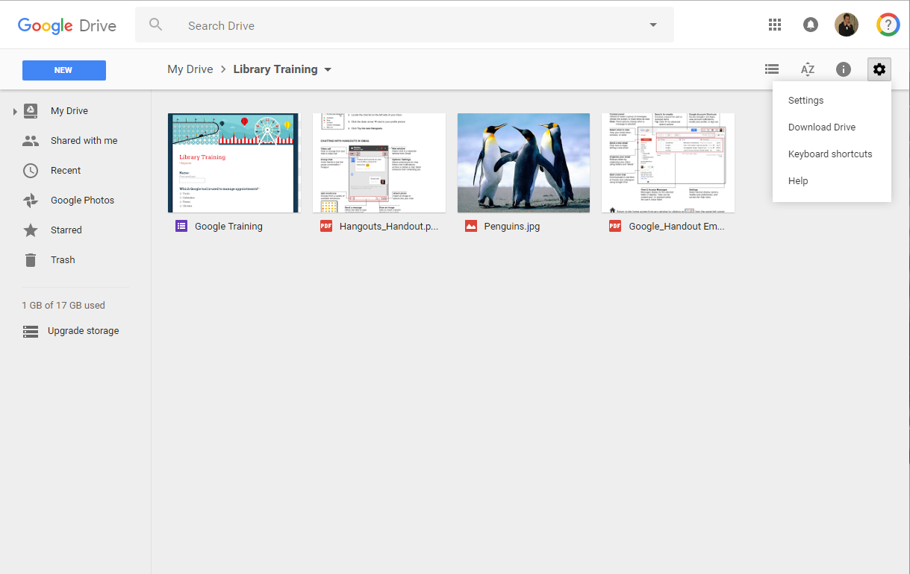
Accessing Drive Settings
Access Settings to modify display density, notification
preferences, and more.
1. Gear icon
2. Settings
Notes:
Creates a document in a new window
Click on New
Select desired file type (For this example, we’re using Docs)
In other classes, we cover how to create Sheets and Slides

Slide 40
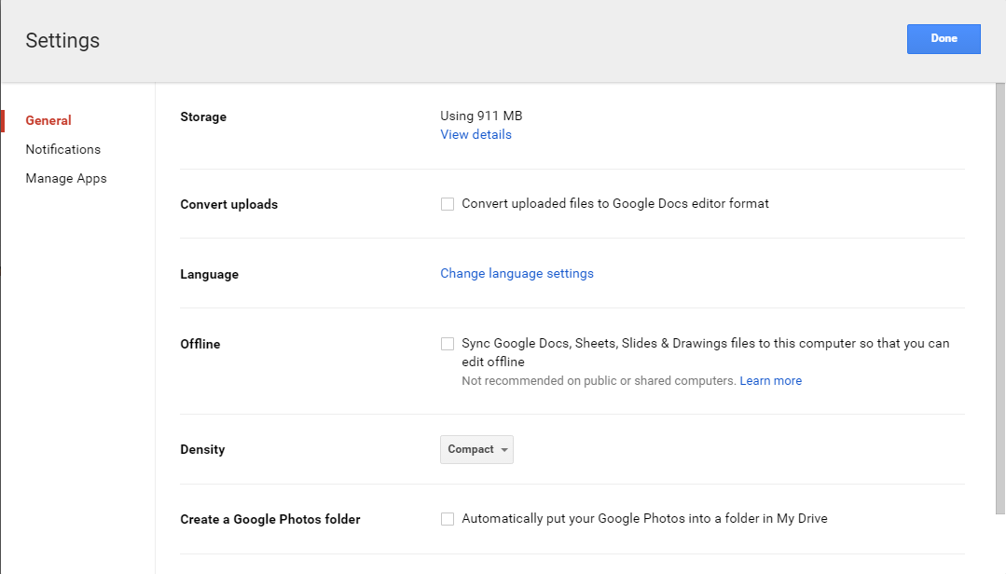
Navigating Drive Settings
Save / Exit
Navigate between categories
Select desired settings
Notes:
Creates a document in a new window
Click on New
Select desired file type (For this example, we’re using Docs)
In other classes, we cover how to create Sheets and Slides

Slide 41
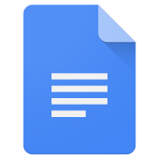
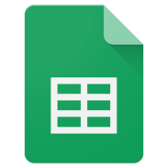

Creating Google Docs
Google docs are similar to Microsoft Office documents,
but created with Google apps.
Docs - Word processer application that enables you to create and collaborate on documents similar to Microsoft Word
Sheets - Spreadsheet application that enables you to create and collaborate on spreadsheets with people in real time; similar to Excel
Slides - Web-based presentation application that enables you to create and collaborate on presentations; similar to PowerPoint
Notes:
Creates a document in a new window
Click on New
Select desired file type (For this example, we’re using Docs)
In other classes, we cover how to create Sheets and Slides

Slide 42
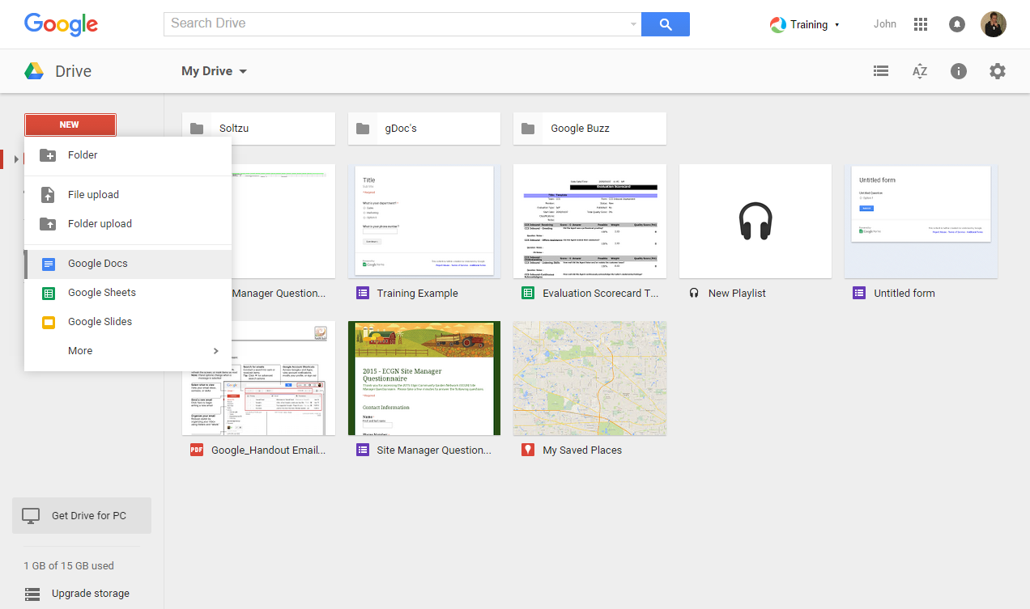
Creating Google Docs
Google docs are similar to Microsoft Office documents,
but created with Google apps.
1. New
2. Google Docs
Notes:
Creates a document in a new window
Click on New
Select desired file type (For this example, we’re using Docs)
In other classes, we cover how to create Sheets and Slides

Slide 43
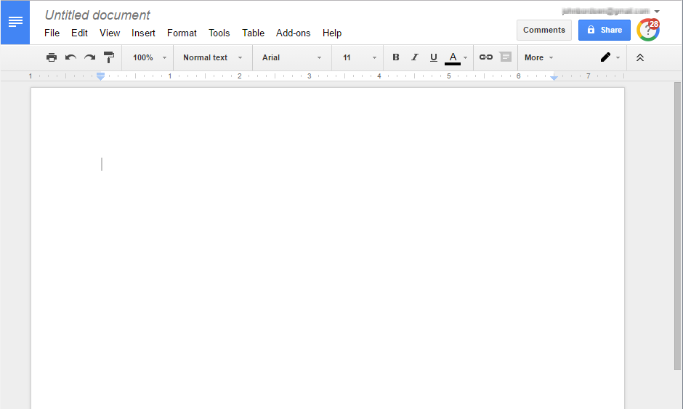
Modifying Google Docs
All changes to Google Docs are automatically
saved to Drive.
Notes:
Creates a document in a new window
Click on New
Select desired file type (For this example, we’re using Docs)
In other classes, we cover how to create Sheets and Slides

Slide 44
ACTIVITY #5

Slide 45
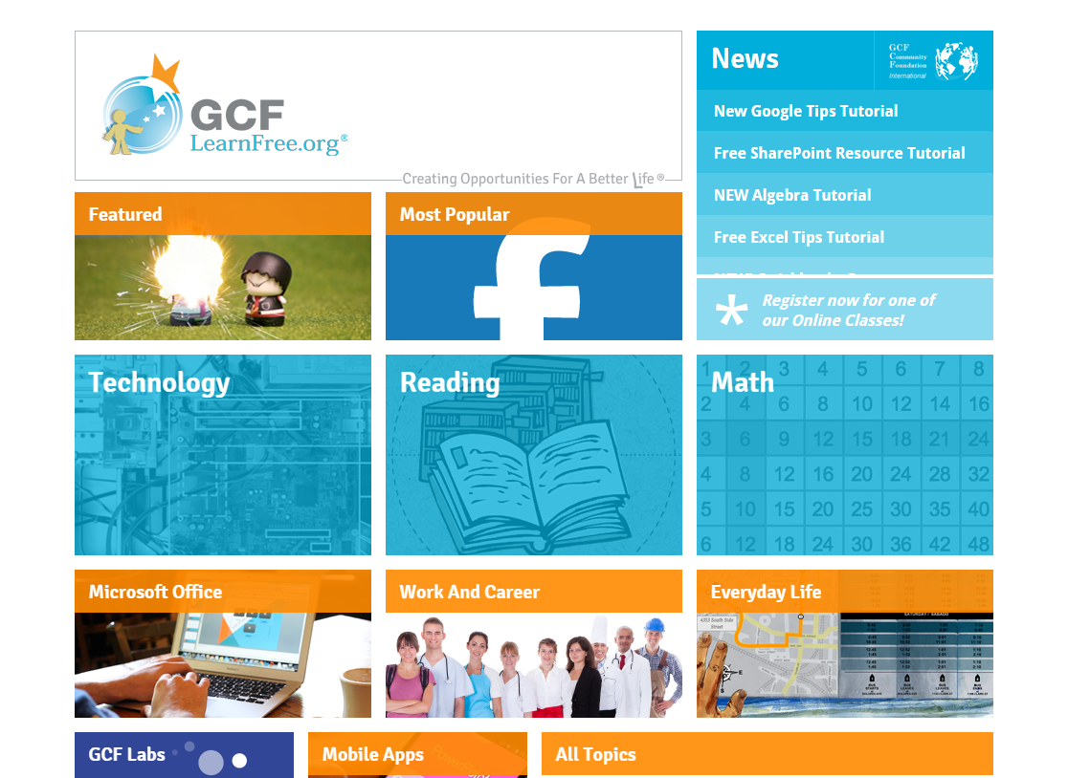
Learning Resources
GCF Learn Free
www.GCFLearnFree.org/GoogleDriveAndDocs
Notes:
Accessible via Library website

Slide 46
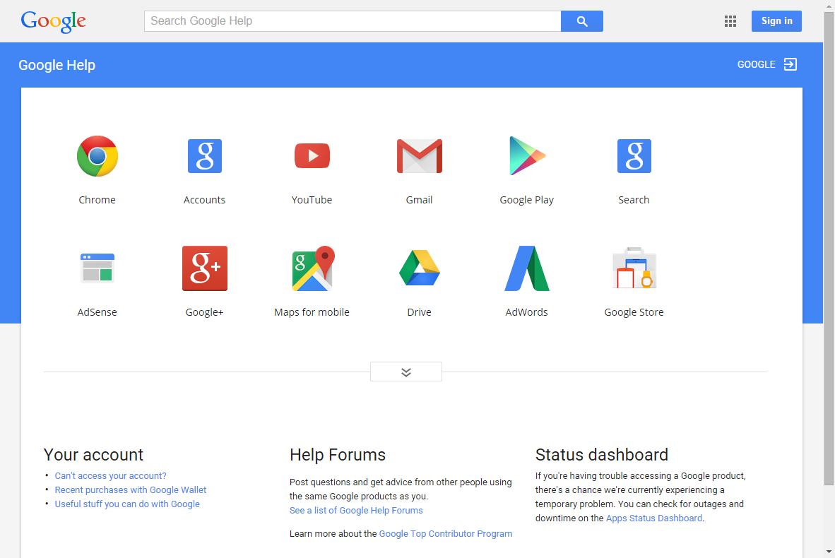
Learning Resources
Google Help
https://support.google.com/
Drive
Notes:
Learn about basic functionality and advanced features
View FAQs

Slide 47
Questions?
THANK YOU FOR COMING!
Part Four Next Week
Google Docs
Notes:
Thank participants for coming and ask if there are any outstanding questions.
Hand out the class surveys and encourage them to write in ideas for any additional classes.
When they submit their surveys, exchange them for handouts.
Encourage them to look for upcoming classes and register to attend

