Slide 1

Google Tools: Docs
Instructor Name
Instructor Title
Library Name
Courtesy of Gail Borden Public Library
and the Public Library Association

Slide 2
Agenda
Getting Started with Google Docs
Creating and Working with Docs
Editing and Formatting a Doc
Inserting Objects
Sharing and Collaborating

Slide 3

Getting Started with Docs
Google Docs is a free, web-based word processer.
Create and collaborate on documents with
people in real time
Save and access files in the cloud (Drive)
Convert Microsoft Word documents (.docx)
to Google Docs and vice versa
Revert to any prior versions of a Doc

Slide 4

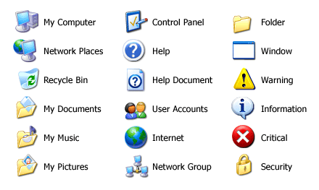

Accessing Google Docs
    docs.google.com
    Tip! Google Docs is designed
    for optimal performance
    using Google Chrome.

Slide 5
ACTIVITY #1

Slide 6
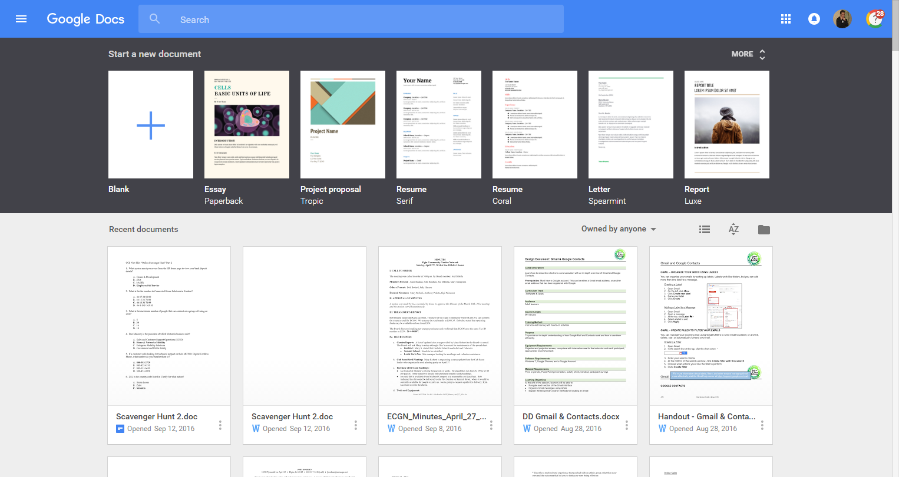
Navigating Google Docs
Search for Docs
Templates/New Doc
Display options
File picker
Your Docs

Slide 7

Creating & Working w/ Docs
Use Google Docs to create new documents and make
quick, easy changes.
Rename a document
Add text
Copy / duplicate a document
Download from the cloud
Use templates for various document types

Slide 8
Creating a New Document
Newly created documents are automatically saved
to your Google Drive account.
Create a new doc

Slide 9
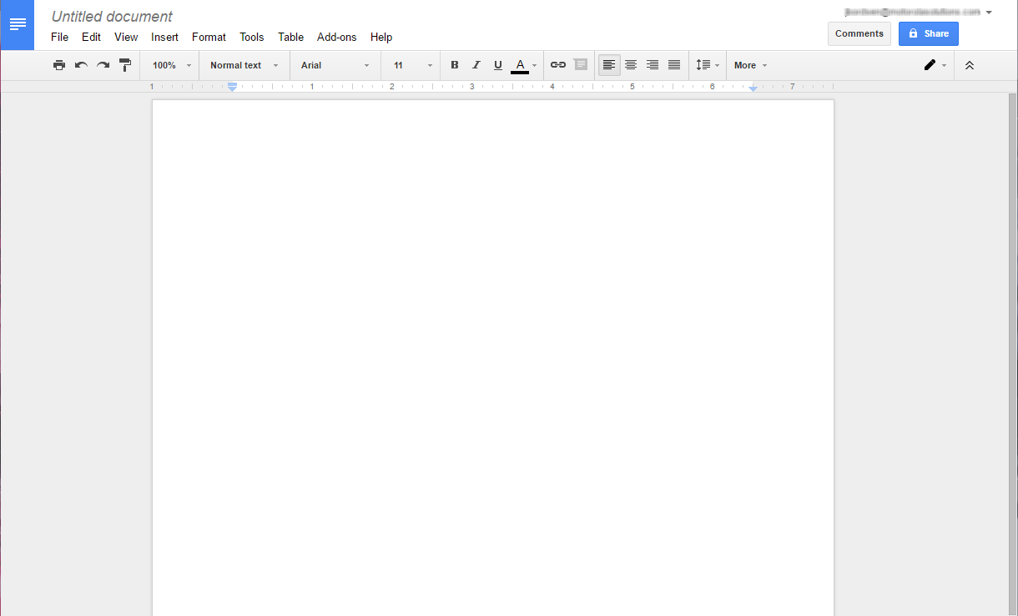
Rename
Menu bar
Share
Docs home screen
Text formatting
Paragraph formatting

Slide 10
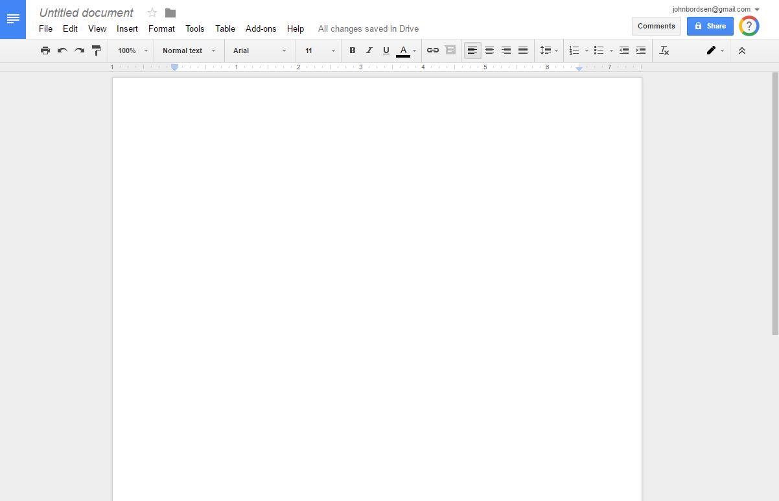
Renaming a Document
Edit the name of your file at anytime by clicking and
typing in the “Document Name” field.
Document Name
    Tip! The default name of
    any new Google Doc
    is Untitled document.

Slide 11
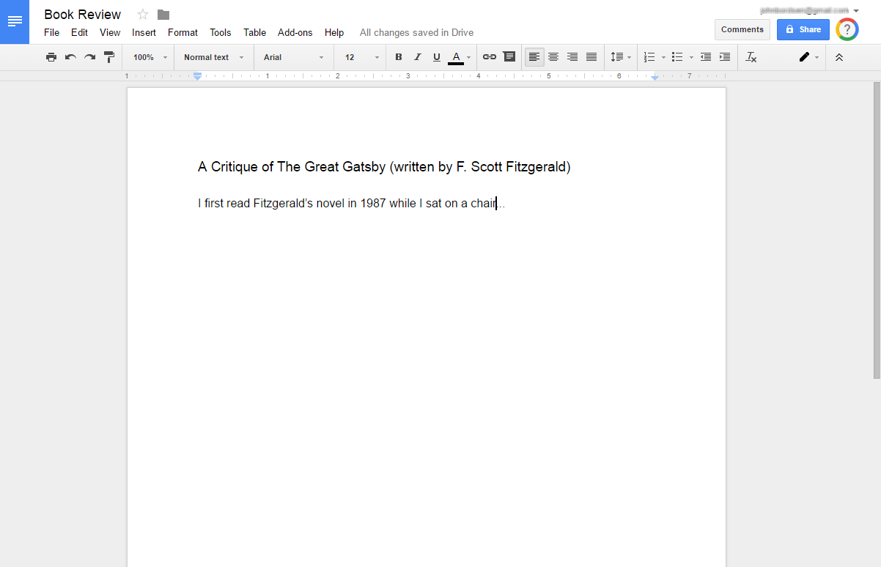
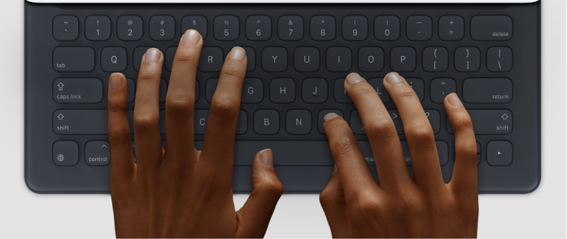
Adding Text to a Document
Click anywhere in your document to begin typing.

Slide 12
ACTIVITY #2

Slide 13
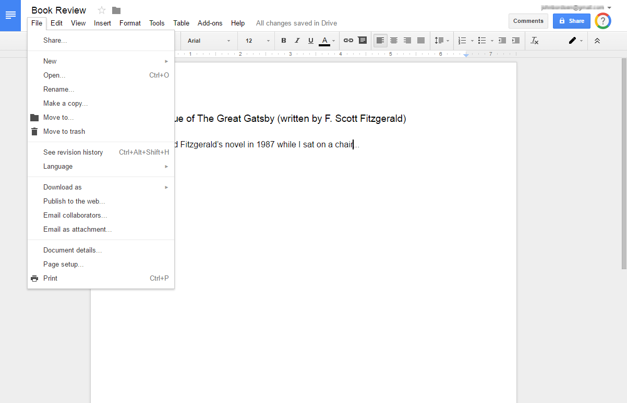
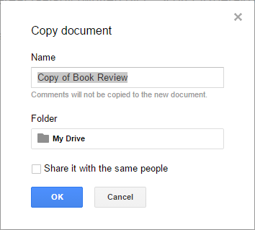
Create a Copy of a Document
Because two documents are better than one.
1. Select “File”
2. Make a copy
3. Click OK

Slide 14
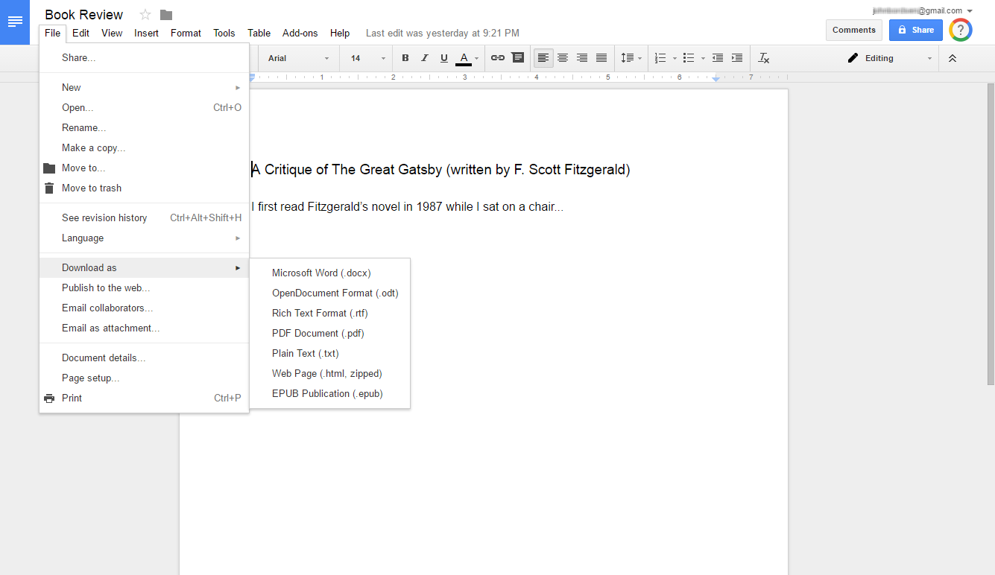
Downloading a Document
Save a Google document to your computer.
1. Select “File”
2. Download as
3. Select file type
    Tip! Popular file types include
    Microsoft Word and PDF.

Slide 15

Deleting a Document
Removing a Doc.
1. Select “File”
2. Move to Trash
    Tip! This can also be done from the Doc homepage by clicking the three vertical dots next to the title

Slide 16
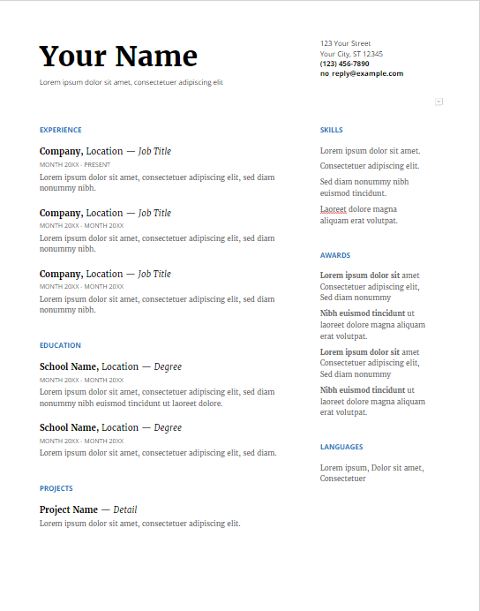
Google Docs Templates
Create new documents using various templates:
Resumes
Letters
Project Proposals
Essays
Newsletters
Brochures
Meeting Notes

Slide 17
Using Premade Templates
Create a new document from a template on the
Google Doc’s home screen.
Create a new doc or view more templates

Slide 18

Editing & Formatting a Doc
Modify your document with various formatting options,
page settings, and more.
Change font type and styles
Undo and redo a change
View revision history and revert to prior
versions
Update paragraph formatting and page
settings

Slide 19
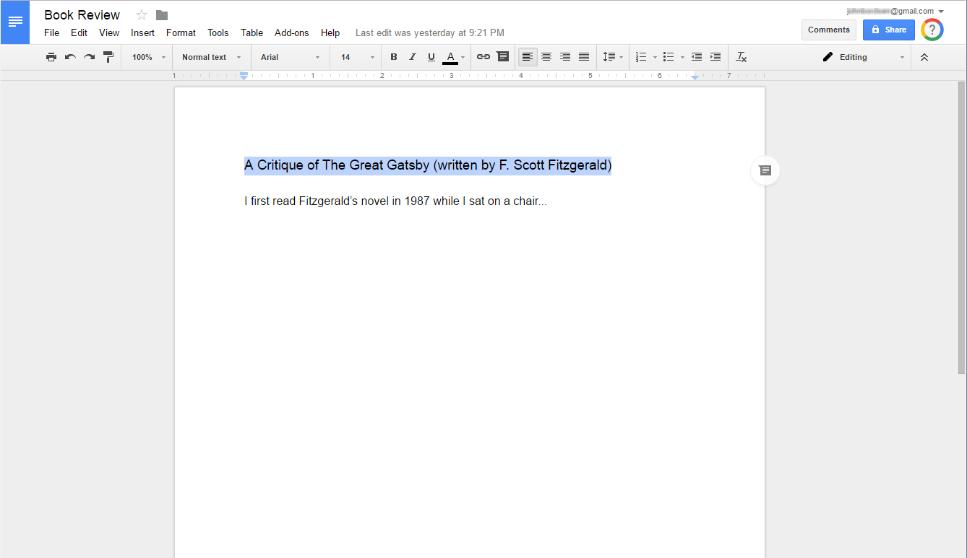
Changing Text Formatting
Use Bold, italics, underline, colors, and more!
2. Select desired formatting options
1. Highlight text

Slide 20
ACTIVITY #3

Slide 21
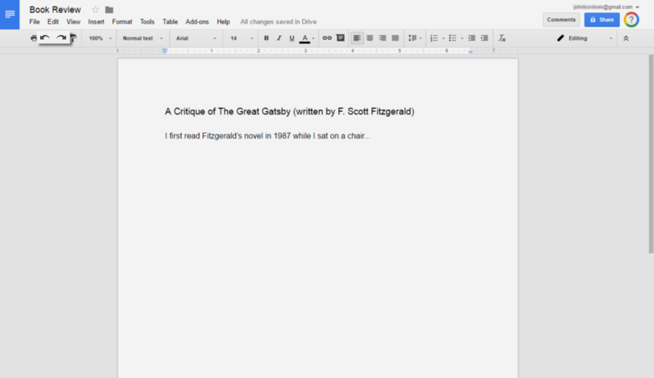
Using Undo and Redo
Undo or redo the last change you’ve made.
Undo (Ctrl+Z)
Redo (Ctrl+Y)

Slide 22
Viewing Revision History
View or revert to any prior version of the document
via Revision History.
1. Select “File”
2. See revision
history

Slide 23
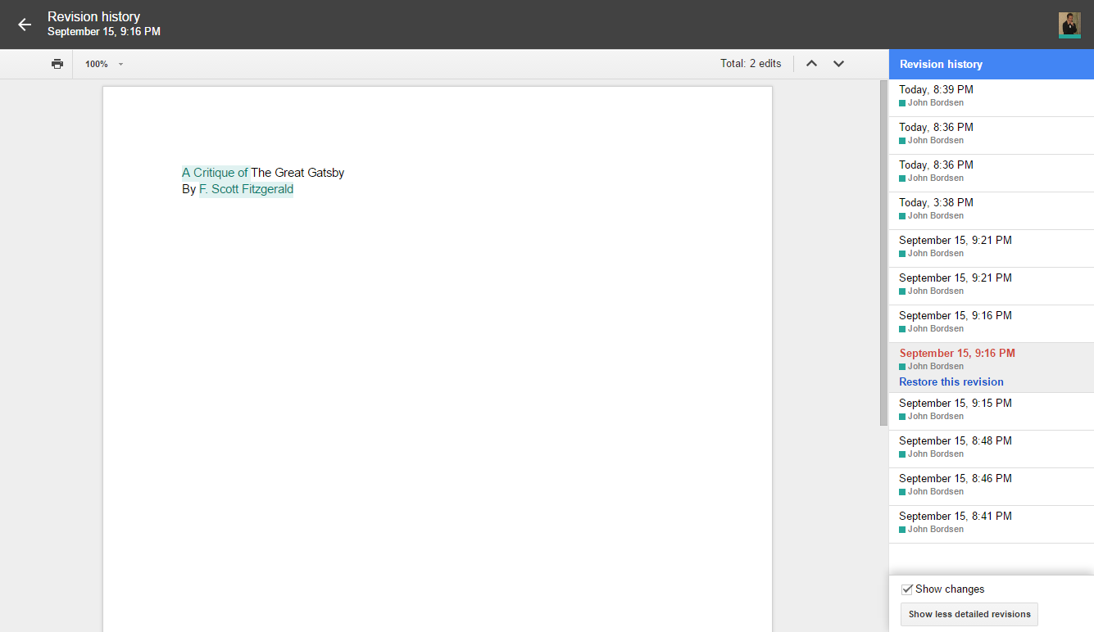
Reverting to Prior Versions
Select a prior revision to preview it.
Click “Restore this version” to revert to it.
Preview window
Select from any prior revision
    Tip! Revision History keep track
    of every single change you
    and your collaborators make
    to a document.
Revert to selected revision

Slide 24
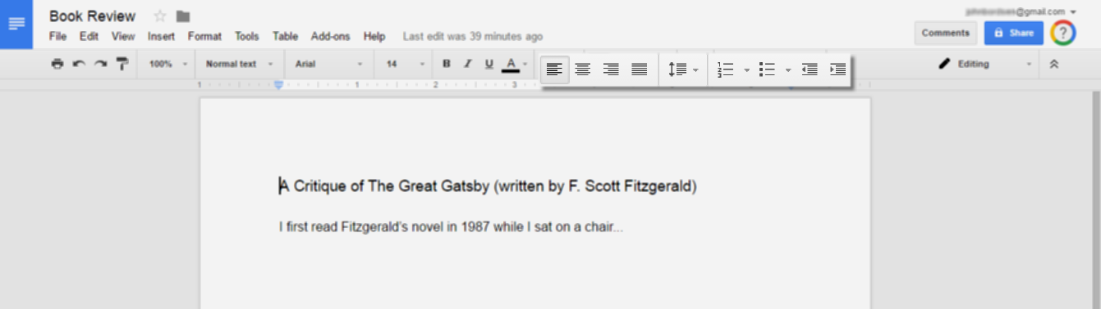
Paragraph Formatting
Use paragraph formatting to select:
Text alignment (left, centered, or right)
Spacing between lines of text
Bulleted or numbered list
Indentation of text
Paragraph Formatting

Slide 25
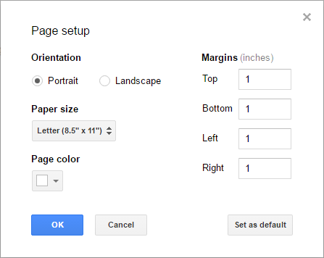
Adjusting Page Settings
Modify page orientation, margin sizes, background
color, or paper size.
1. Select “File”
3. Select options
2. Page setup...

Slide 26

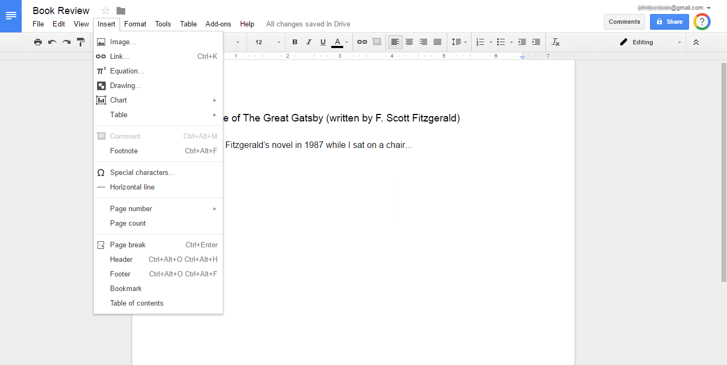
Inserting Objects
Enhance your document with images, links, tables,
drawings, and more.
1. Select “Insert”
2. Click an object to insert it

Slide 27
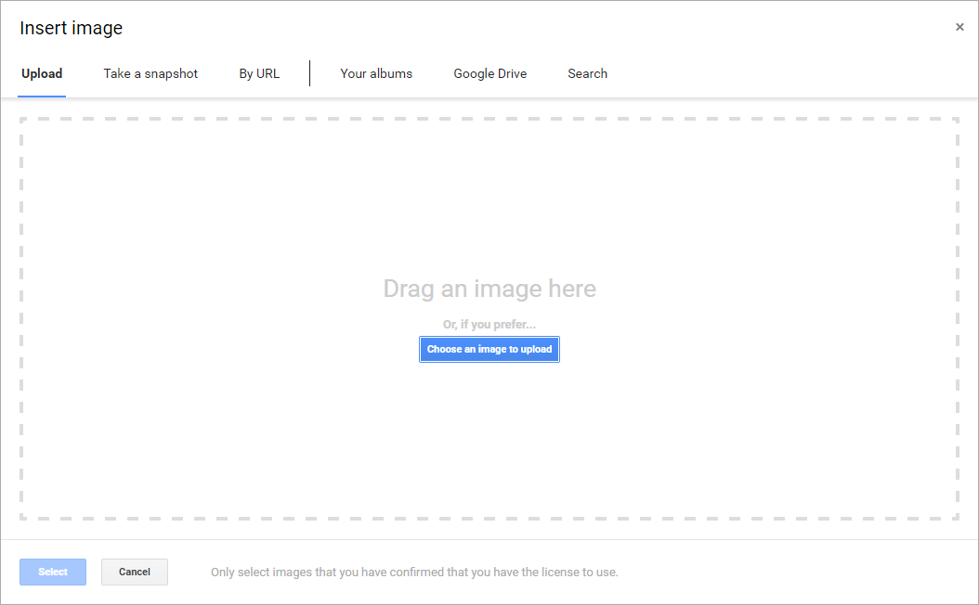

Inserting Objects: Image
Insert > Image
Insert pictures and images from various sources:
Upload from PC
Webcam
URL
Google Drive
Web Search
Image sources

Slide 28
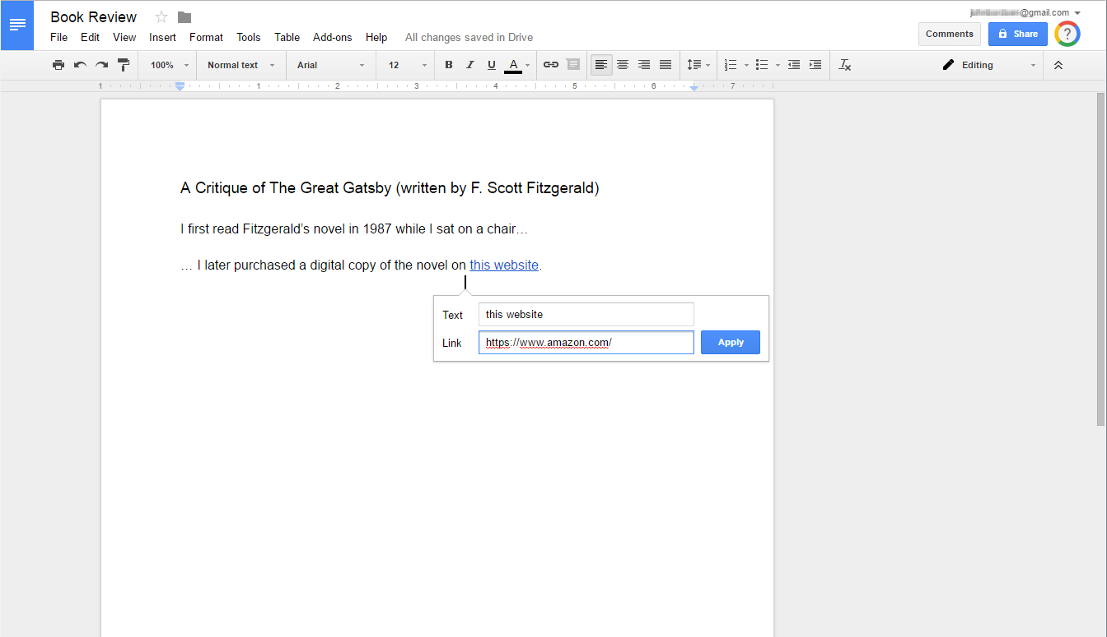

Inserting Objects: Link
Insert > Link
Add text which links to a website or email address.
Text which will display in the document
Web or email address

Slide 29
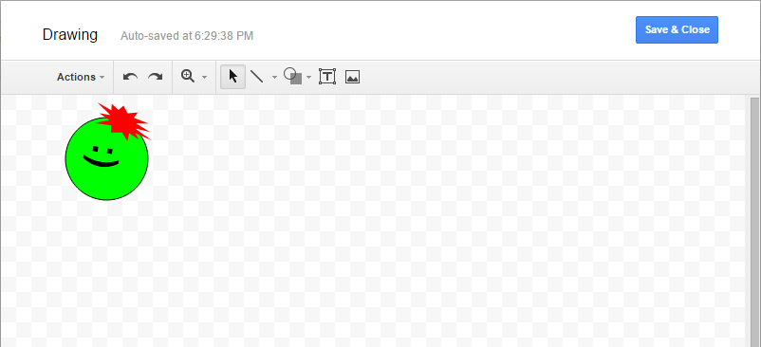

Inserting Objects: Drawing
Insert > Drawing
Use drawings to insert shapes, lines, text boxes,
arrows, and more.

Slide 30
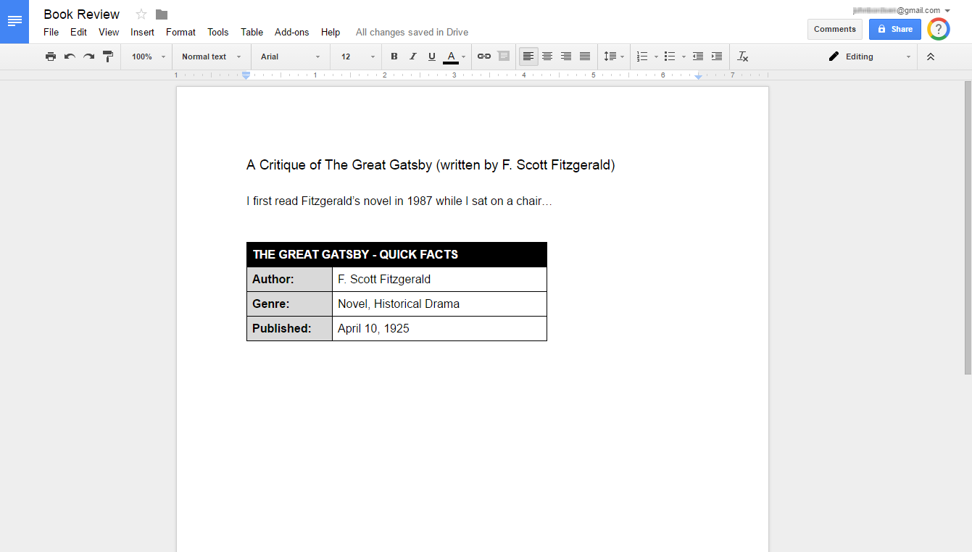
Inserting Objects: Table
Use tables to organize and display related pieces
of information.

Slide 31
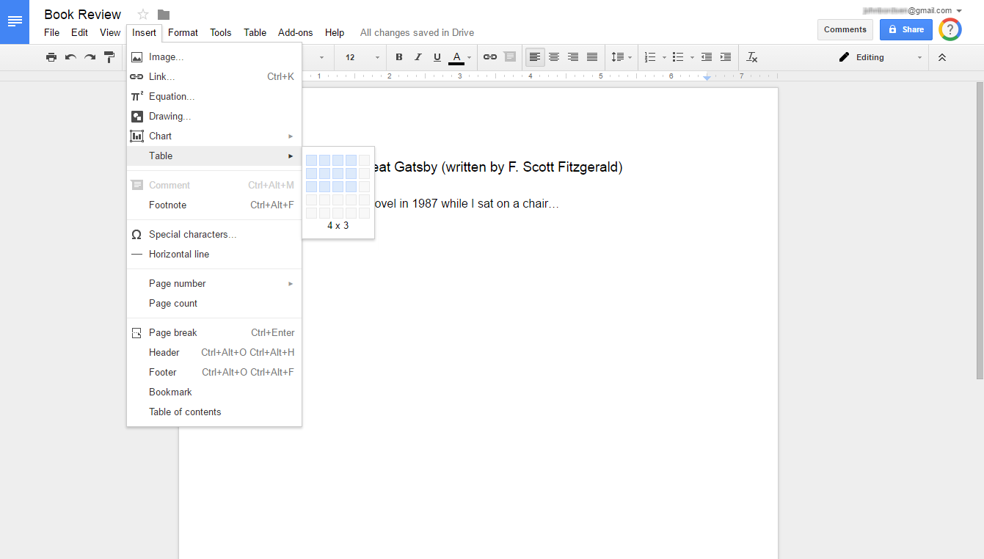

Inserting Objects: Table (cont)
Insert > Table
Select the number of cells to display both
horizontally and vertically (Ex: 4x3)
    Tip! Tables which are already added to a doc
    can be modified with additional rows,
    columns, and other formatting options.

Slide 32
ACTIVITY #4

Slide 33

Sharing a Document
Provide others with access to documents of your
choosing.
Allow others to view, download, or edit files
Collaborate with colleagues on a project
Send a file to a friend or client
Share with both Google and non-Google users

Slide 34
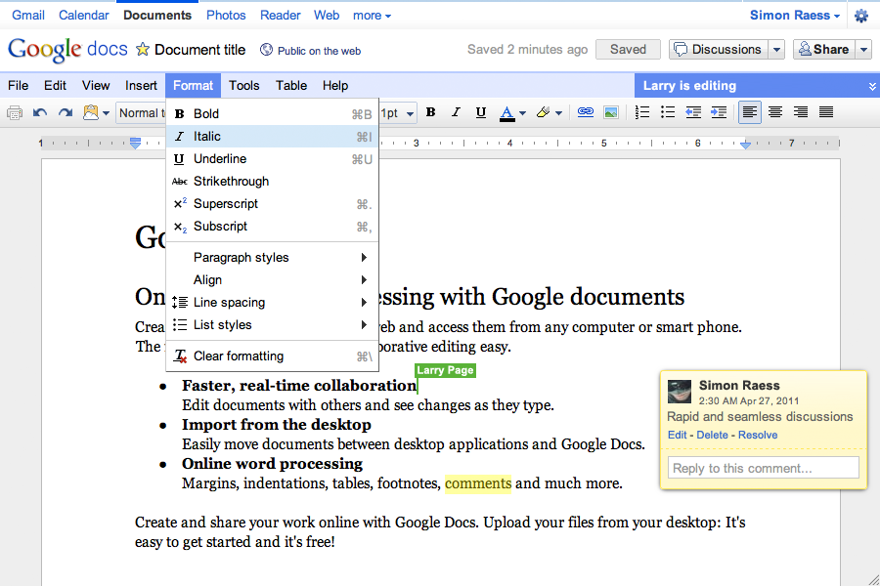
Collaborating w/ Others
Understanding Collaboration Features
Real-time Collaboration
Others with “Edit” permissions can make any changes
Comments

Slide 35
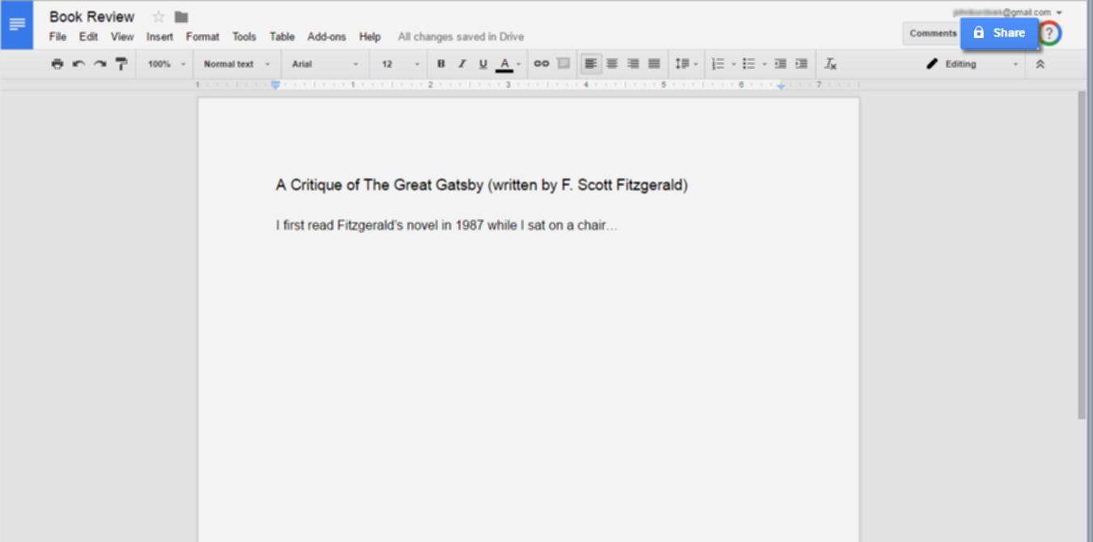
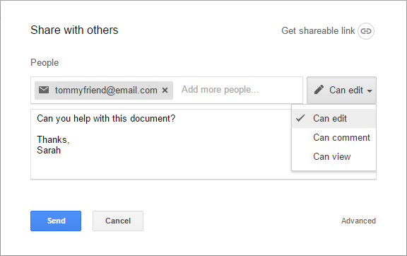
Sharing a Document
Collaborating with Others on a Doc
Share a document and choose the collaborator’s level of
access/permissions (Edit, Comment, or View).
1. Click “Share”
2. Select sharing options
Recipient(s)
Permissions
Optional message
3. Click “Send”

Slide 36
ACTIVITY #5

Slide 37
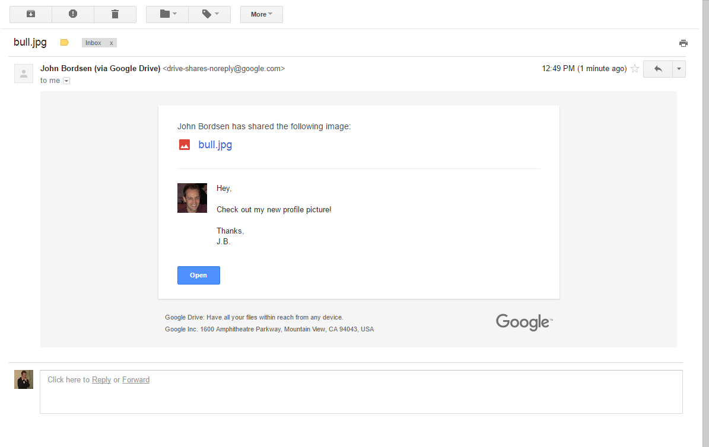
Viewing Email Notifications
Recipients of a shared file receive an email notification.
Shared files can be accessed via email using the “Open” button
    Tip! Non-Google users will only have “View”
    access; they cannot edit Google Docs.

Slide 38
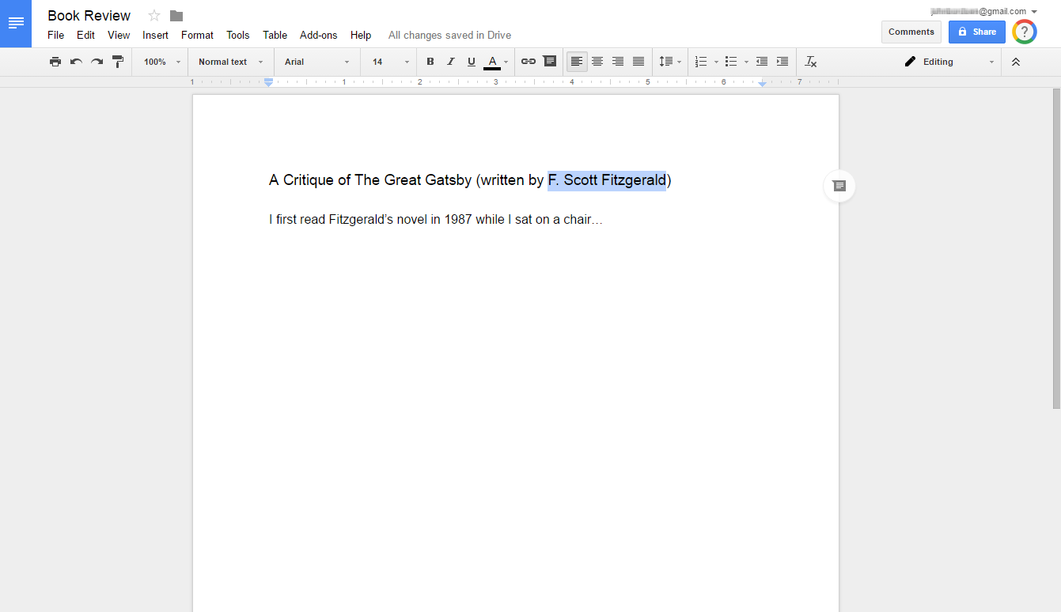
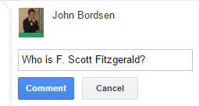
Adding Comments to a Doc
Use comments to add notes or ask a question to
either yourself or other collaborators.
2. Click “Add a comment” button
1. Highlight a section of text
3. Add your comment

Slide 39
Questions?
THANK YOU FOR COMING!
Part Five Next Week
Google Tools: Sheets
Notes:
Thank participants for coming and ask if there are any outstanding questions.
Hand out the class surveys and encourage them to write in ideas for any additional classes.
When they submit their surveys, exchange them for handouts.
Encourage them to look for upcoming classes and register to attend

