Slide 1

Google Chrome
John Bordsen
Technology Trainer
Gail Borden Public Library District
Courtesy of Gail Borden Public Library
and the Public Library Association

Slide 2
Agenda
Google Chrome
Chrome User Profiles
Chrome Web Store
Locating & Using Apps
Installing Chrome Extensions
Notes:
How presentation will benefit audience: Adult learners are more interested in a subject if they know how or why it is important to them.
Presenter’s level of expertise in the subject: Briefly state your credentials in this area, or explain why participants should listen to you.

Slide 3

Introduction
    Google Chrome A web browser available for your laptop, phone, and tablet
Chrome Web Store An online market place offering apps, extensions, and themes for Google Chrome
Apps Programs designed to be used within Google Chrome
Extensions Browser add-ons designed to add new functionality

Slide 4
Google Chrome
    A free web browser offering unique
    features and customizable functionality
    Save bookmarks and set a homepage
    Customize your experience with a User Profile
    Do more with Apps and Extensions

Slide 5

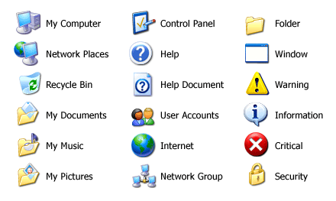
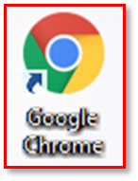
Accessing Chrome
    Tip: Chrome can be installed for free via the Web if it’s not pre-loaded on your PC

Slide 6
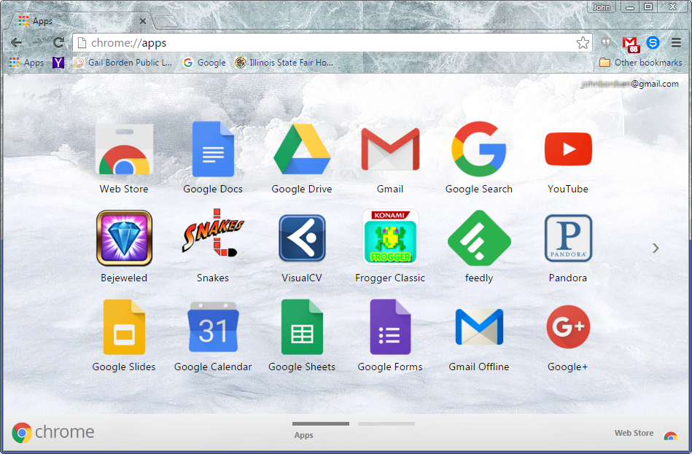
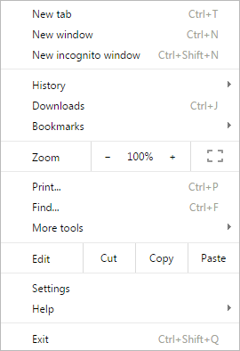
Chrome User Interface (UI)
Address Bar
Extensions
Tab(s)
Bookmark Bar
User / Sign-in
Menu
Apps

Slide 7


Chrome User Profiles
    A login account which saves your personal browser
    settings and data
    Access your bookmarks, homepage, auto-fill data, and passwords from any device
    Access other Google services, like Gmail or YouTube, with no additional sign-in
    Use different profiles to separate work and personal settings (or for multiple users at home)
    When using a public computer, always sign out or
    remove your user profile from Chrome at the end of
    the browsing session

Slide 8
Chrome User Profiles (cont)
    Bookmarks Shortcuts to specific websites or apps; typically ones visited frequently
Autofill Data Passwords and personal data which Chrome can use to automatically fill out web forms
Startup Page(s) A specific page or set of pages which open upon launching Chrome
Apps/Extensions Web-based programs and browser add-ons accessed via the Chrome Web Store

Slide 9

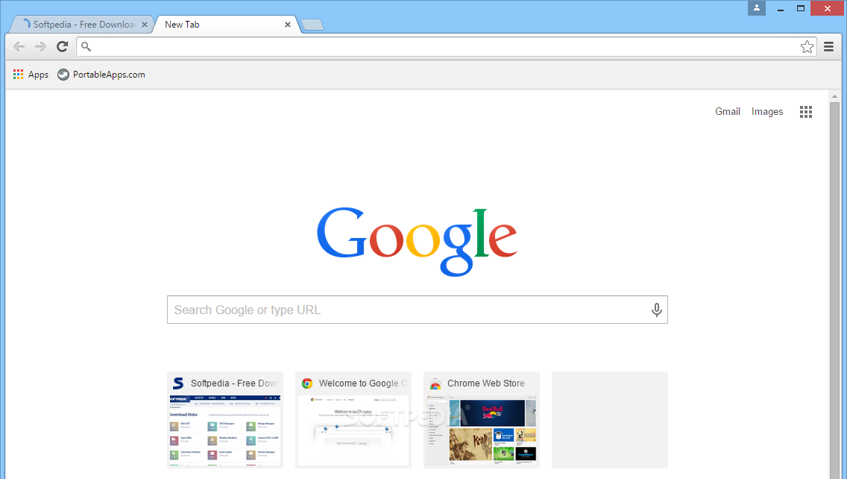
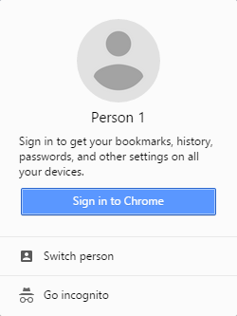
Logging in to Chrome
1. Click
    xxxxx
2. Sign in

Slide 10
Activity #1

Slide 11

Personalizing Chrome
    Personal settings and preferences in
    Chrome allow for a more streamlined
    and unique browsing experience.
    Optimize bookmark usage
    Select startup page(s)
    Manage passwords

Slide 12
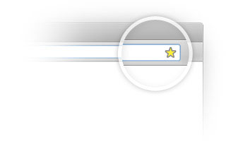
Using Bookmarks
    A bookmark is a shortcut to a specific webpage or place
    within Chrome.
    Bookmark usage in Chrome includes:
    Setting bookmarks
    Accessing saved bookmarks
    Managing bookmarks
    Enabling the “bookmarks bar”

Slide 13
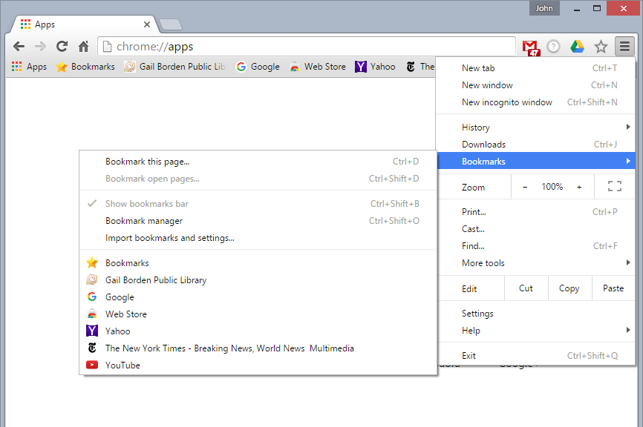
Accessing & Managing Bookmarks
1. Click
2. Bookmarks
3. Click link to
visit page
    Tip: Right-clicking on a bookmark allows you to change its name, remove it from the list, or create a new folder to store it in

Slide 14
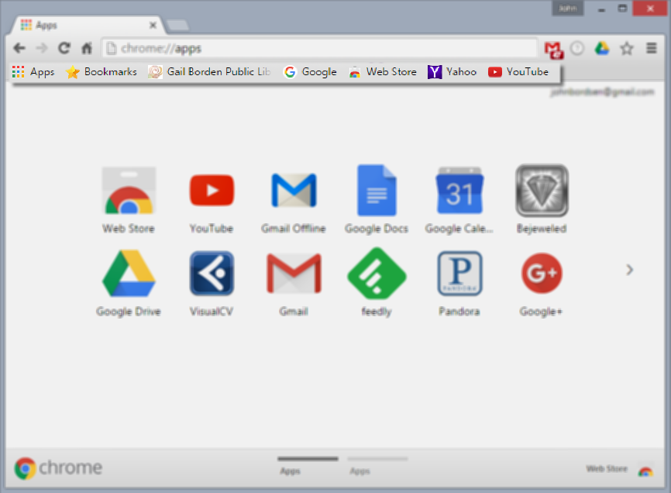
Enabling the “Bookmarks Bar”
    Enabling Bookmarks Bar
    Access Settings > Appearance
    Select the Always show the bookmarks bar checkbox
    Adding Favorites to the Bar
    Visit desired webpage
    Drag URL from address bar to the bookmarks bar

Slide 15
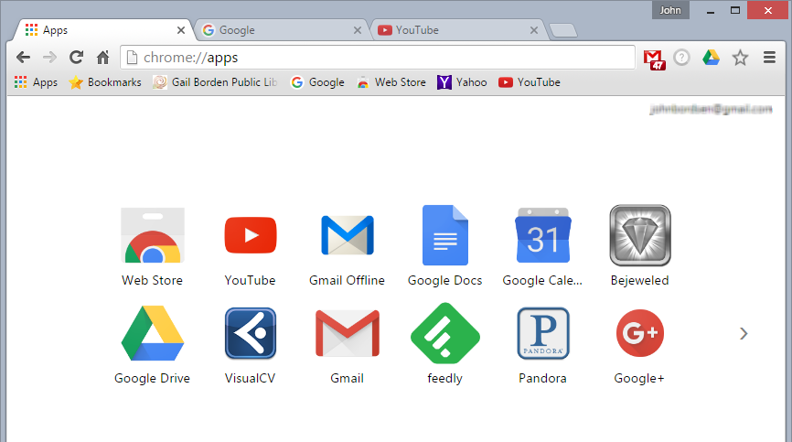
Selecting Startup Pages
    Startup pages are those that open automatically upon
    launching the Chrome application.
Startup Page(s)
    Setting Startup Pages
    Access Settings > On startup
    Select the checkbox for Open a specific page or set of pages
    Click Set pages
    Enter URL(s) for desired page(s)
    Click OK

Slide 16
Activity #2

Slide 17

Managing Passwords
    Chrome can remember your passwords for different sites.
    Enabling this feature allows you to:
    Auto-populate your login credentials into “sign-in” forms
    View your username/password combination for any site
    Opt out for designated sites, if desired

Slide 18
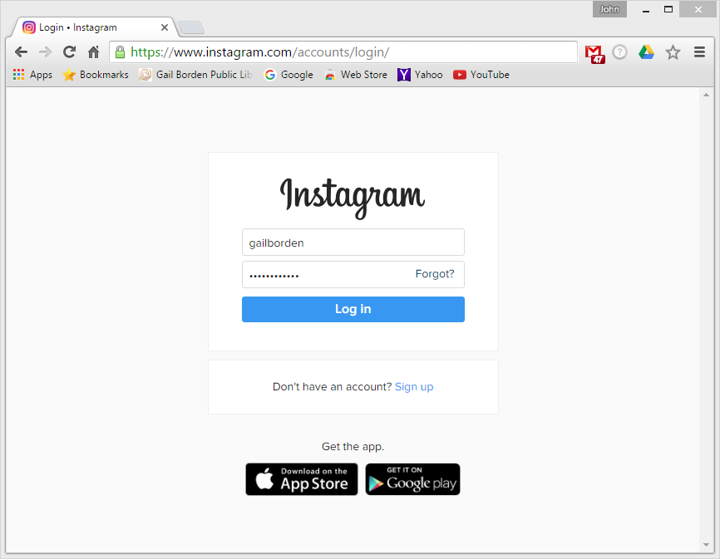
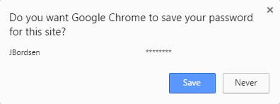
Saving & Updating Passwords
1. Access desired site
3. Click Save
2. Login
    Upon next site visit, your login
    credentials automatically populate

Slide 19
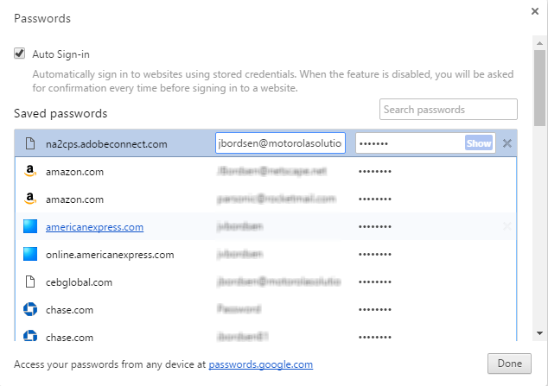
Viewing & Deleting Passwords
    Access Chrome password manager via:
    Settings > Passwords and forms > Manage passwords
View Password
Site Name
User Name
Delete Password

Slide 20
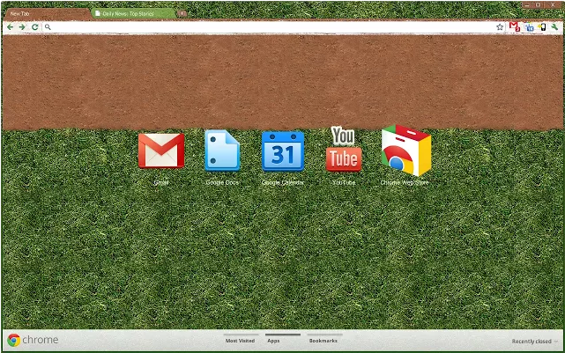
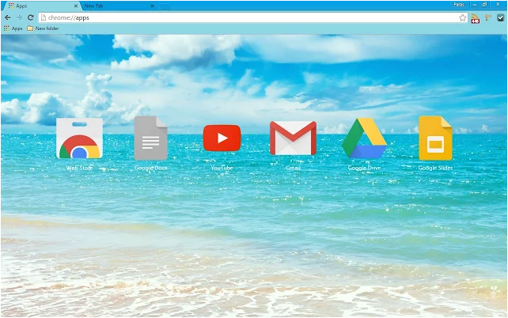
Setting a Theme
    Themes are custom browser skins that let you personalize
    Google Chrome; installed via the Chrome Web Store

Slide 21

Google Chrome Web Store
    An online marketplace for downloading
    apps, games, extensions, and themes
    designed to work with Google Chrome

Slide 22
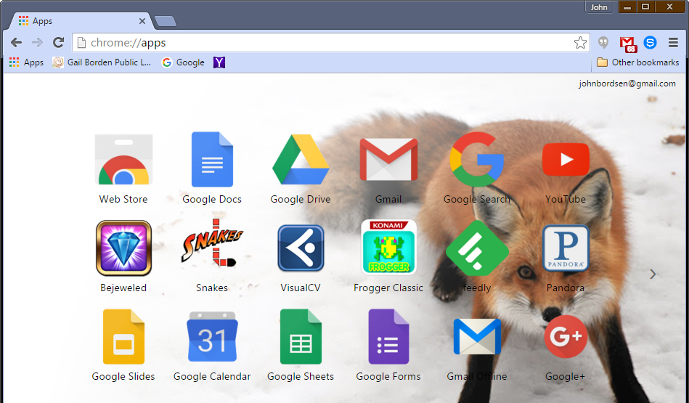
Accessing the Web Store
    Select > Web Store:
1. Apps
2. Web Store

Slide 23
Activity #3

Slide 24
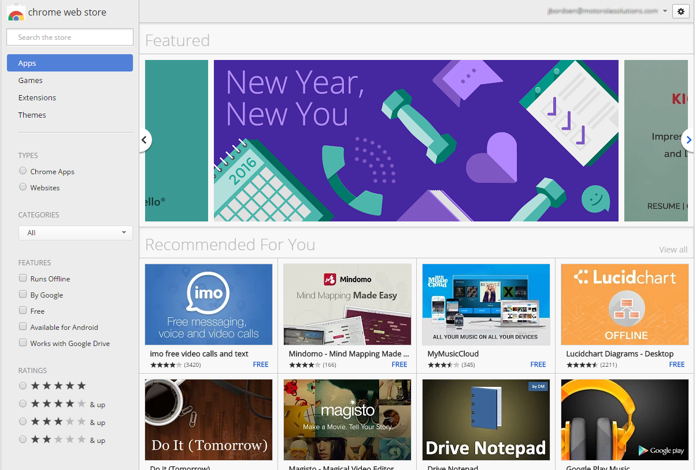
Web Store Interface
Featured Content
Settings
Search Box
Search Filters
Apps

Slide 25

Downloading & Using Apps
    Web apps from the Chrome store offer
    functionality similar to traditional desktop
    applications
    Thousands available for download
    Many are free; some require payment
    Created and published by various developers
    Sync data with your mobile device or tablet

Slide 26
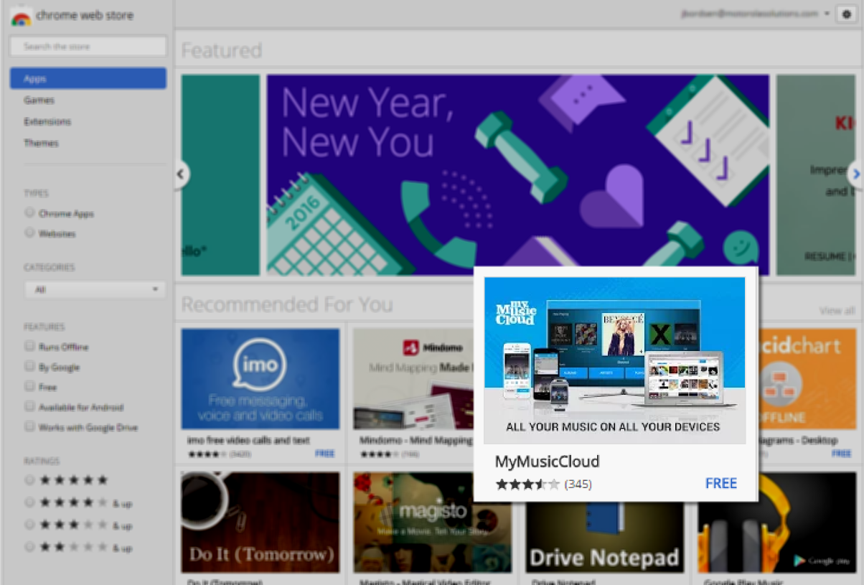
Web Store - App Details
    Tip: Click on any App to view more detailed information
Description
Cost
Ratings

Slide 27
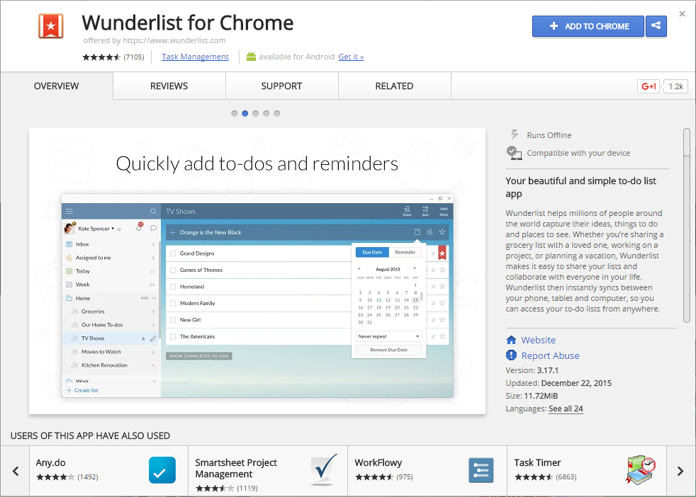
Web Store - App Details
App Name
Install Button
Tabs
Overview
Reviews
Support
Related
Summary of App
Screen Shot(s)
Similar Apps

Slide 28
Activity #4

Slide 29
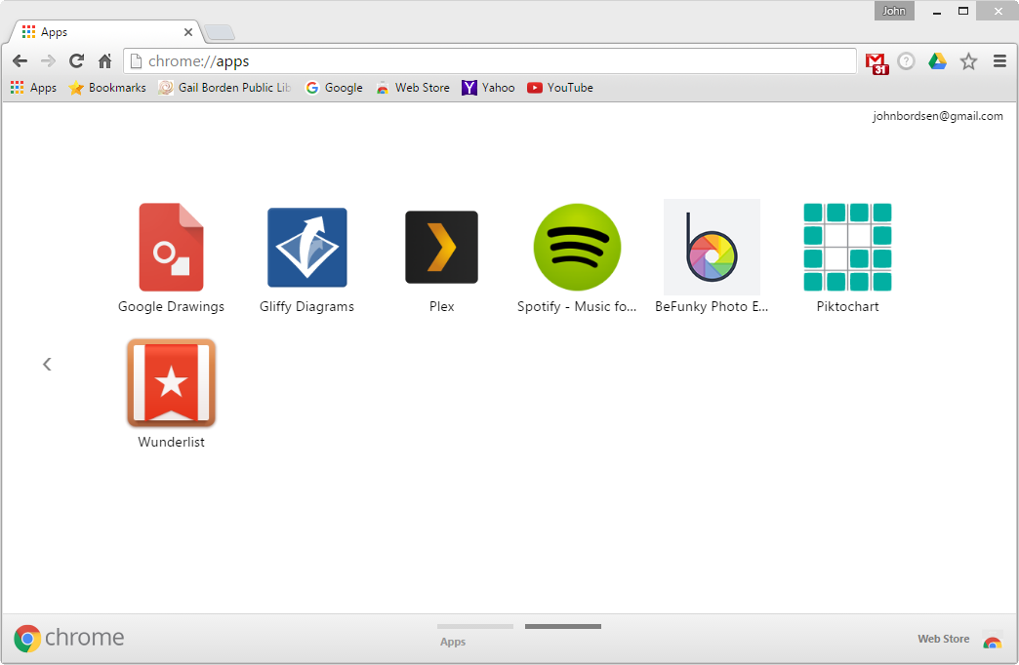
Accessing Your Apps
    Simply click the Apps icon to view your Apps.
1. Apps
2. Click desired App to open
Toggle pages

Slide 30
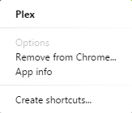
Managing Your Apps
    Apps can be deleted, arranged in a new order, or added as
    a shortcut to your desktop and taskbar.
1. Right click on app
2. Select desired option

Slide 31

Chrome Extensions
    Extensions are browser add-ons which
    enable new features and functionality in
    Chrome.
    Available via the Web Store
    Installed the same way as Apps

Slide 32
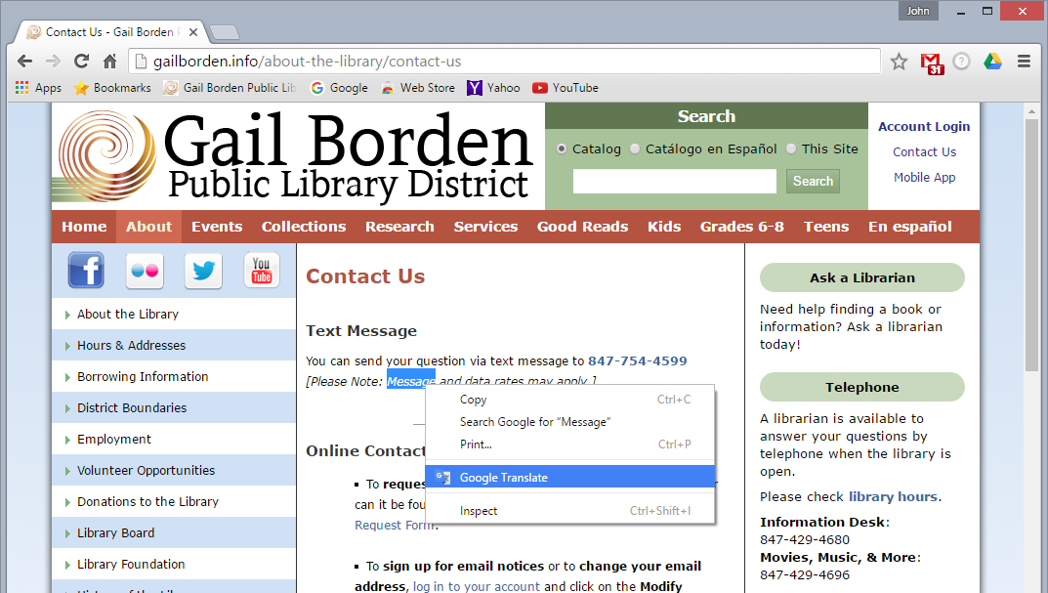
Using Extensions
    Every extension is unique. Once installed, many can be used:
    Within the Chrome toolbar –OR–
    When visiting Webpages
Example 1 (Toolbar) - Google Mail Checker
Displays the number of unread messages from your inbox
Example 2 (Webpage) -
Google Translate
Highlight text on a webpage to view a translation of the word(s)

Slide 33
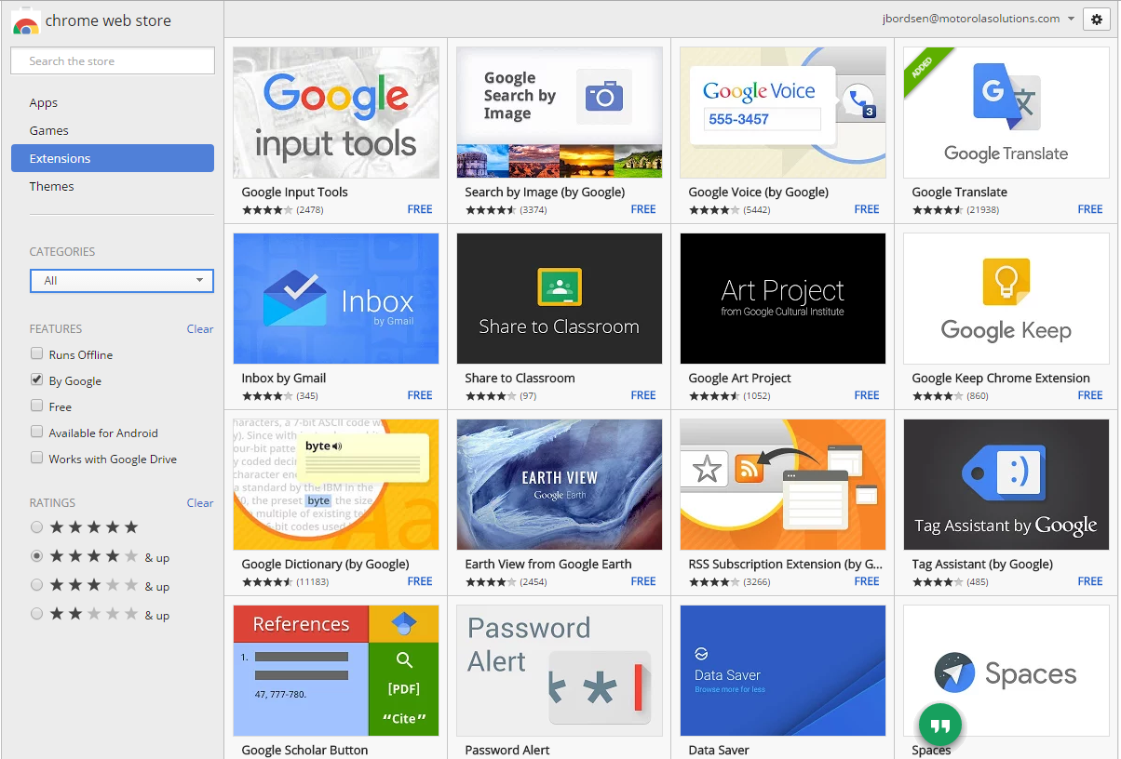
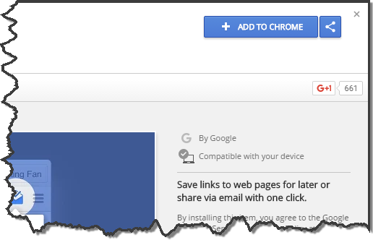
Adding Chrome Extensions
1. Select search criteria
2. Click on search result
3. Click install button

Slide 34
Activity #5

Slide 35
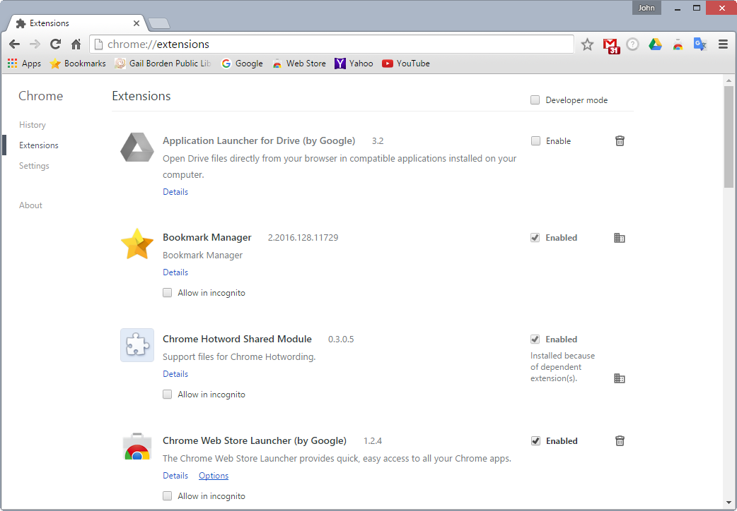
Removing Extensions
    Delete or disable extensions via chrome://extensions
1. Access chrome://extensions
TIP: The extensions page is also accessible
via the Chrome menu icon > More
tools > Extensions
2. Locate the desired extension
3. Click trash icon

Slide 36
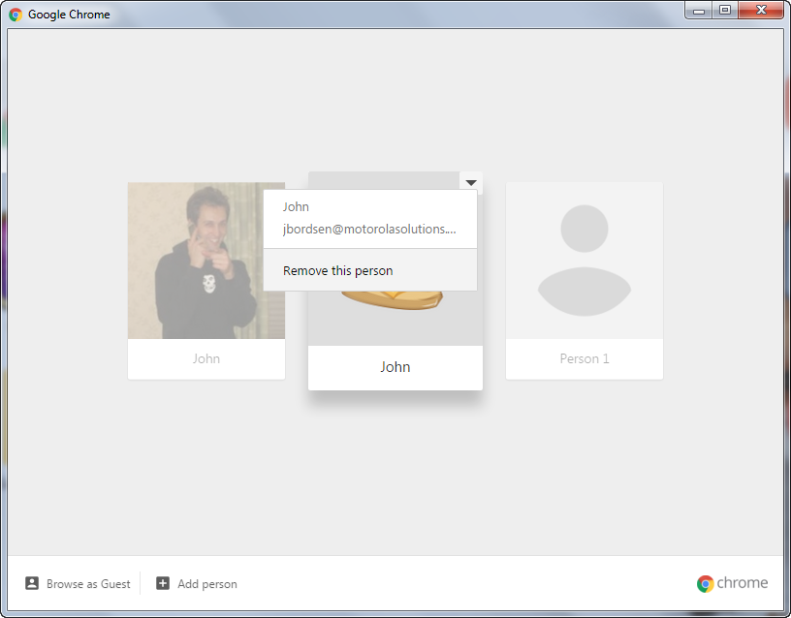
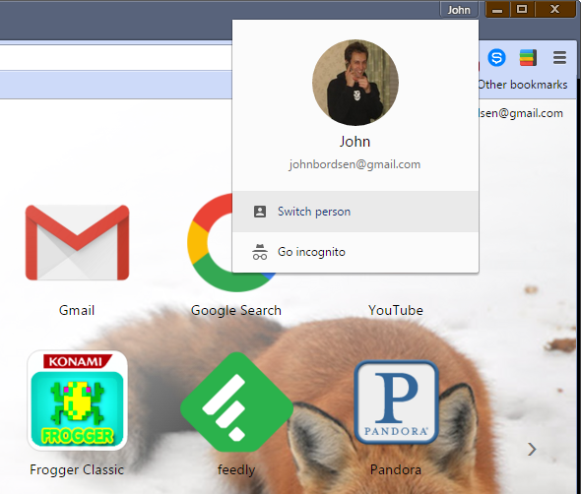
Logging Out of Chrome
Remove your user profile from Chrome
STEP 1
STEP 3
STEP 4
STEP 2
Notes:
Accessible via Library website

Slide 37
Activity #6

Slide 38
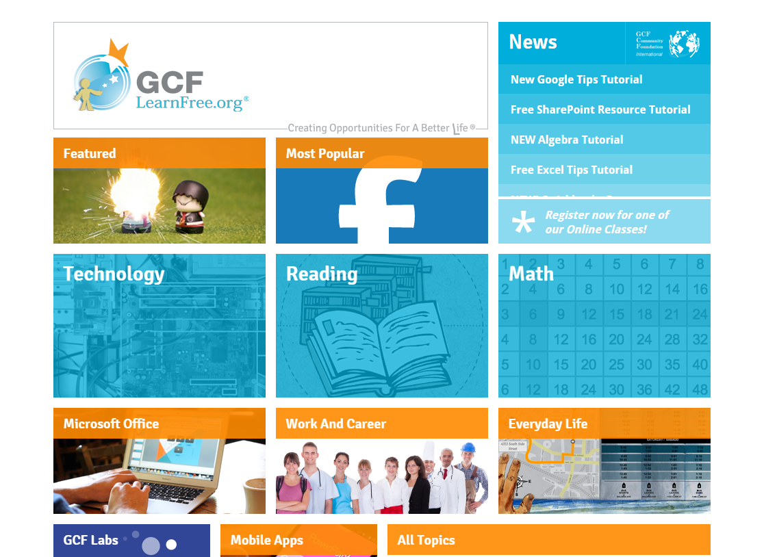
Learning Resources
GCF Learn Free
www.GCFLearnFree.org
Notes:
Accessible via Library website

Slide 39
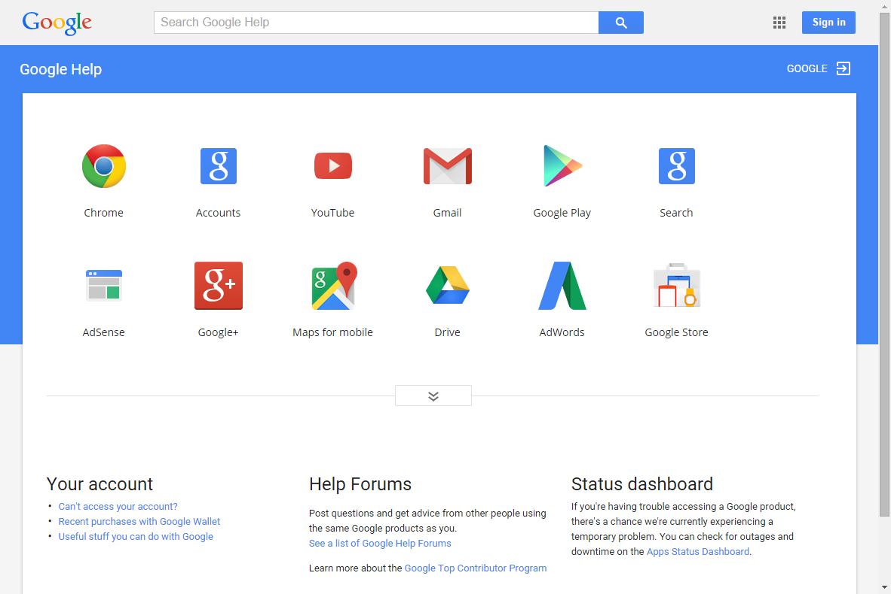
Learning Resources
Google Help
https://support.google.com/
Notes:
Learn about basic functionality and advanced features
View FAQs

Slide 40
Questions?
THANK YOU FOR COMING!
Notes:
Thank participants for coming and ask if there are any outstanding questions.
Hand out the class surveys and encourage them to write in ideas for any additional classes.
When they submit their surveys, exchange them for handouts.
Encourage them to look for upcoming classes and register to attend

