Slide 1

Google Tools: Calendar
Instructor Name
Instructor Title
Library Name
Courtesy of Gail Borden Public Library
and the Public Library Association

Slide 2
Agenda
Introduction to Google Calendar
Creating and Managing Calendar Events
Working with Multiple Calendars
Managing To-Do’s with Google Tasks
Modifying Calendar Settings

Slide 3
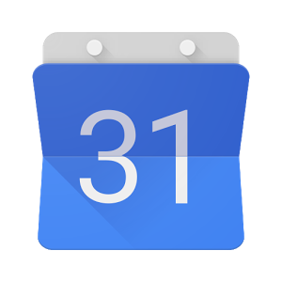
Intro to Google Calendar
Google Calendar is an online, time-management
tool used to manage your schedule.
Stay organized with calendar events
Share events with others and show your
availability / busy time
Sync appointments and reminders across
multiple devices

Slide 4
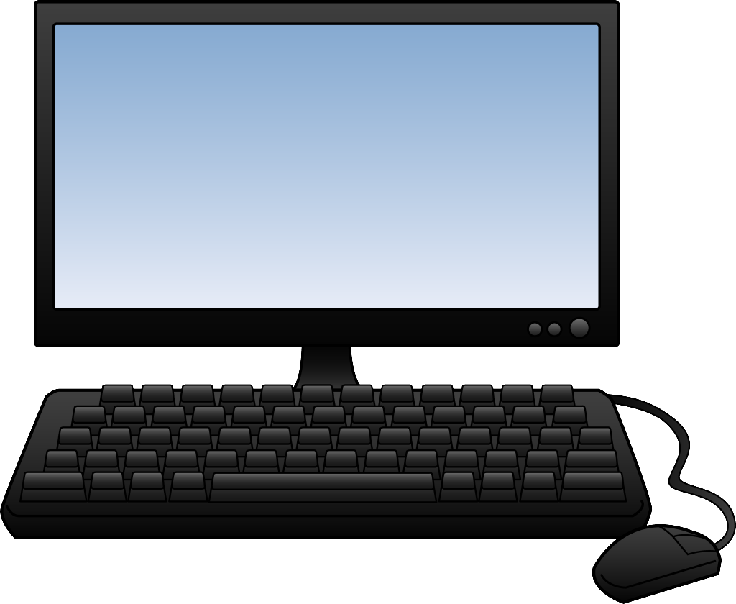
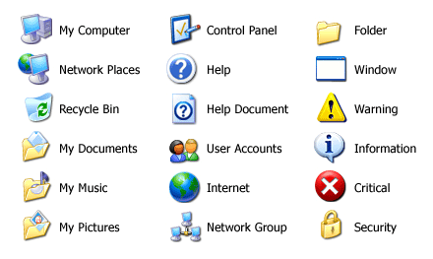

Accessing Google Calendar
    calendar.google.com
    Tip! Calendar is designed for
    optimal performance
    using Google Chrome.

Slide 5
ACTIVITY #1

Slide 6
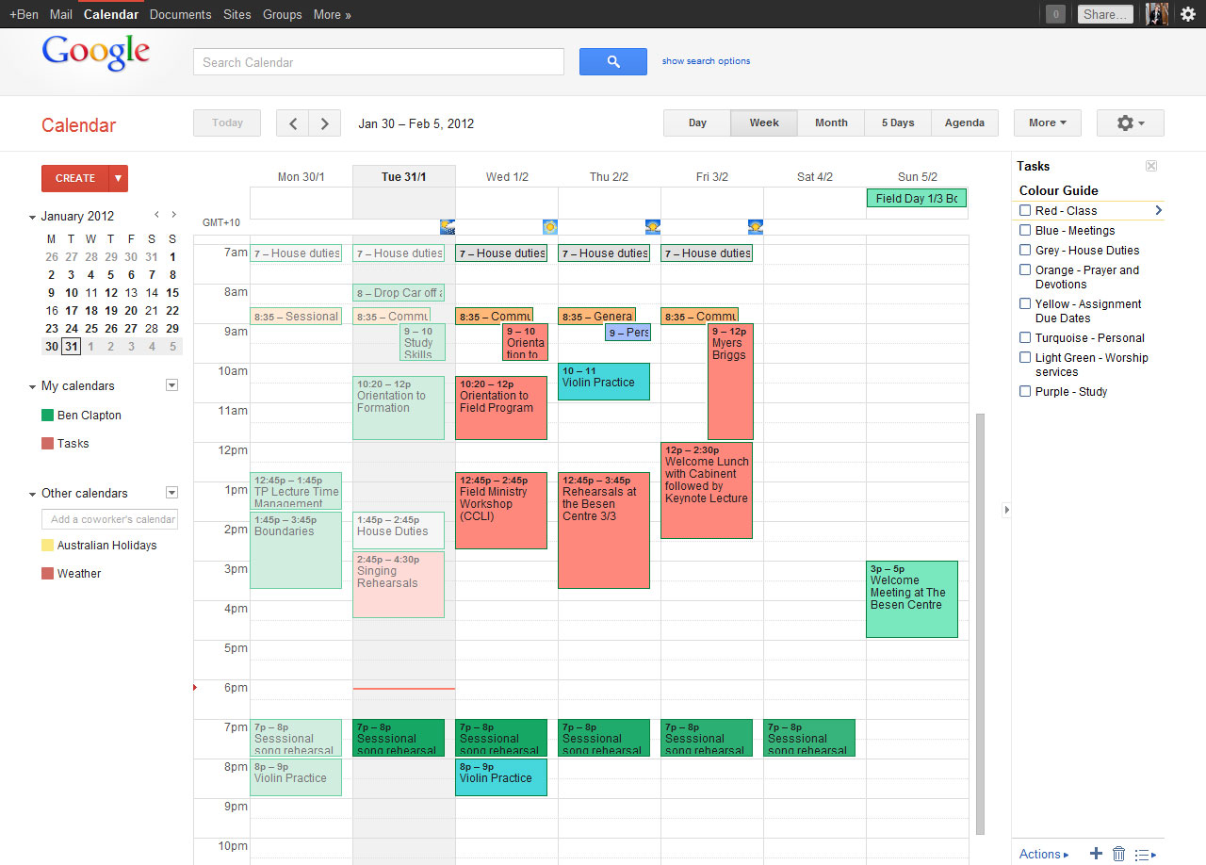
Navigating Google Calendar
Display Options
Search bar
Print and Refresh page
Create events
Settings
Tasks
Personal calendars
Shared calendars
Events
Notes:
The calendar interface is designed to give you numerous ways to view and manage your schedule.
Create button – Add new calendar events
My Calendars and Others Calendars –
Your calendars and ones shared by others.
Select which to view by clicking on them.
Colors are coordinated
Sizes of calendar events visually represent their length
Current date and time displays as a red line
Navigation
Display at top
Can change your view
Search options available

Slide 7

Creating & Managing Calendar Events
Events are used for managing your time by tracking
upcoming commitments or coordinating schedules
with others.
Create events to track meetings,
appointments, or other planned activities
Schedule time with others

Slide 8

Creating a New Event
Three methods are available to create new calendar events:
Use “Quick Add”
Select an empty time slot
in your calendar
Click the “Create” button

Slide 9
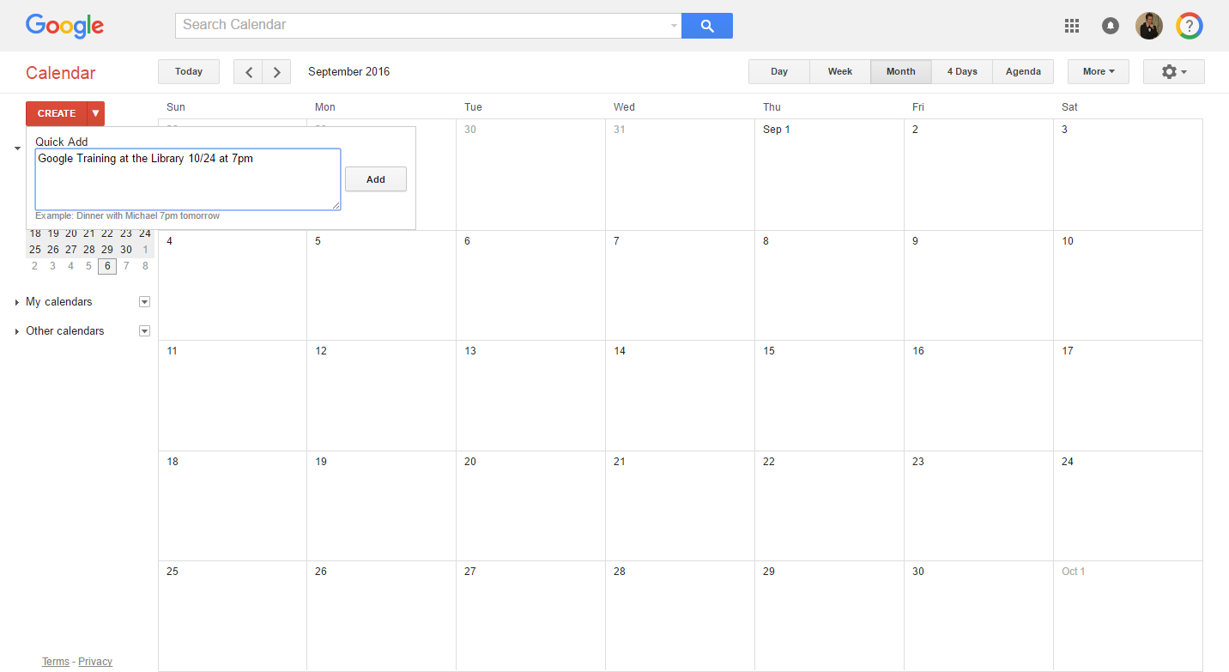
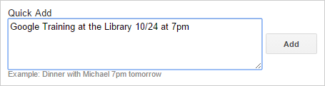
Creating a New Event –
Quick Add
“Quick Add” events include a description, date, and time.
1. Click down arrow
2. Type event details
and click “Add”
    Event details can include:
    Description (Ex: Family Dinner)
    Date (Ex: 11/24 or Nov 24)
    Time (Ex: 6pm or 6:00pm)

Slide 10
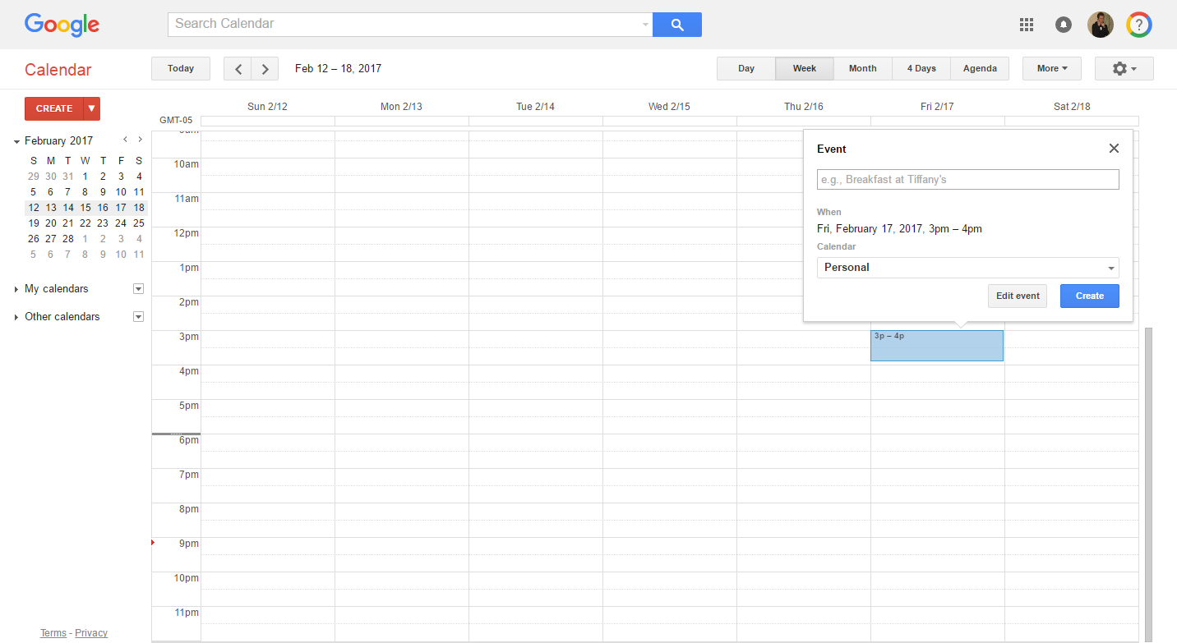
Creating a New Event –
Select a Time Slot
Click on an empty time slot within your calendar to
quickly add an event.
1. Click an empty slot
2. Add an event description
and click “Create”
    The length of the event is based on the “default duration” selection under settings (Ex: 60 minutes)

Slide 11
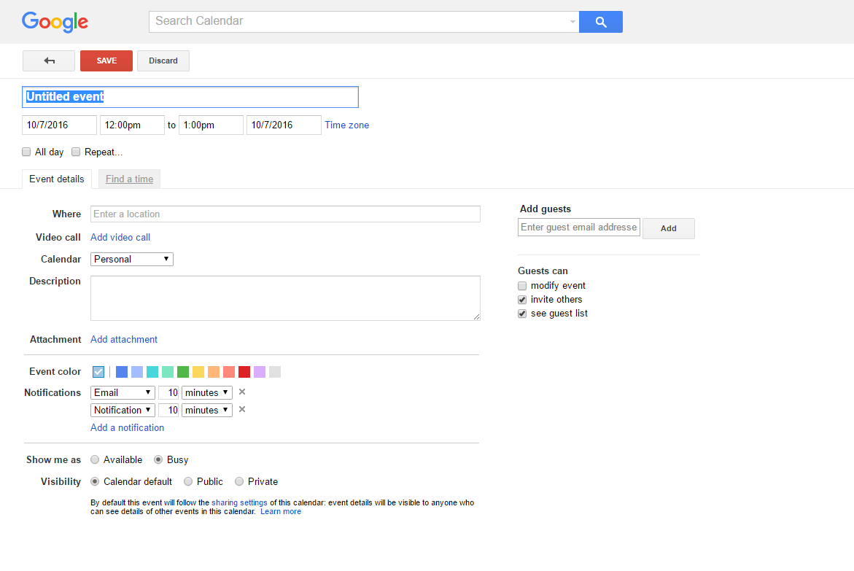
Creating a New Event –
Click the “Create” button
Add a detailed calendar event using the “Create” button.
1. Click “Create”
2. Edit event details
and click “Save”

Slide 12
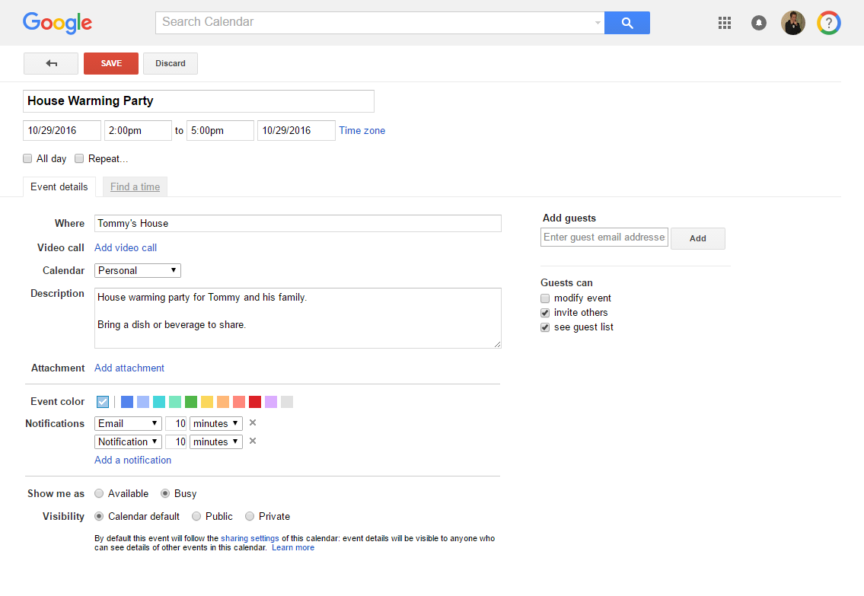
Detailed Calendar Events
Adding basic event details.
Save or discard
Event name
Date & time
Location
Detailed description
Notification reminders
Notes:
Google Calendar

Slide 13
Detailed Calendar Events (cont)
Adding additional event details.
Recurrence
Video call
Select Calendar
Invite guests
Add attachment
Event color
Show availability
Visibility
Notes:
Google Calendar

Slide 14
ACTIVITY #2

Slide 15
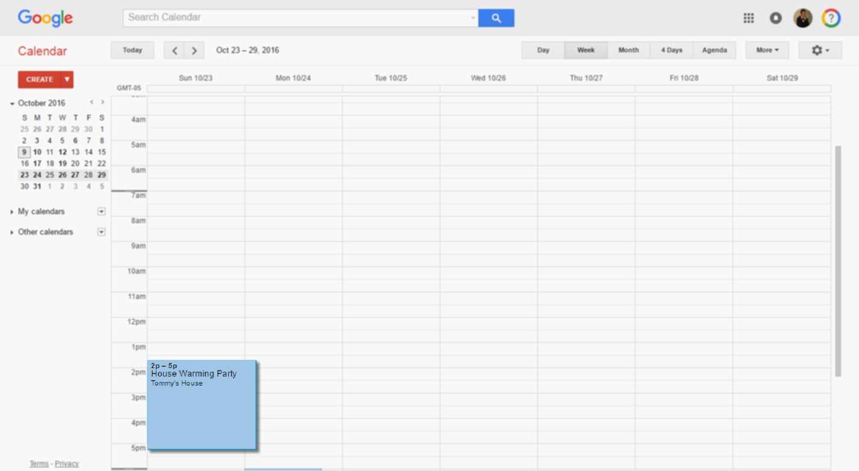
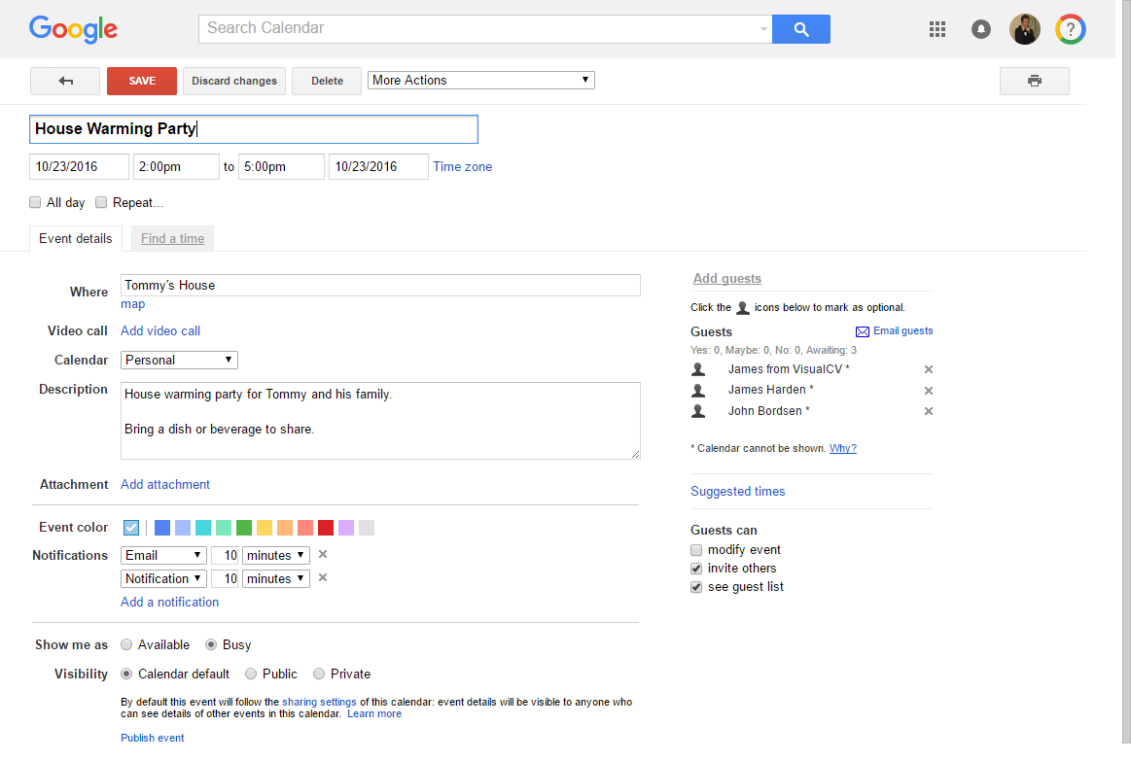
Modifying an Event
Change event details at any time.
1. Click the event title
2. Edit details and click “Save”

Slide 16
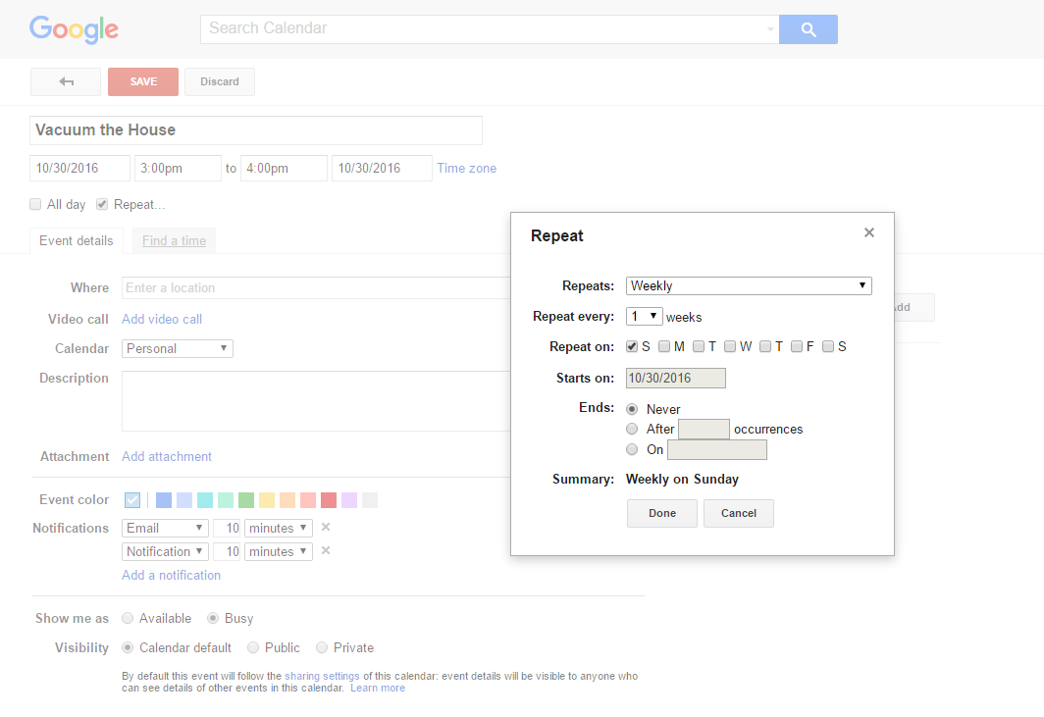
Set a Recurring Event
Create an event which repeats at a regular interval.
1. Click “Repeat”
2. Select recurrence
details and click
“Done”

Slide 17
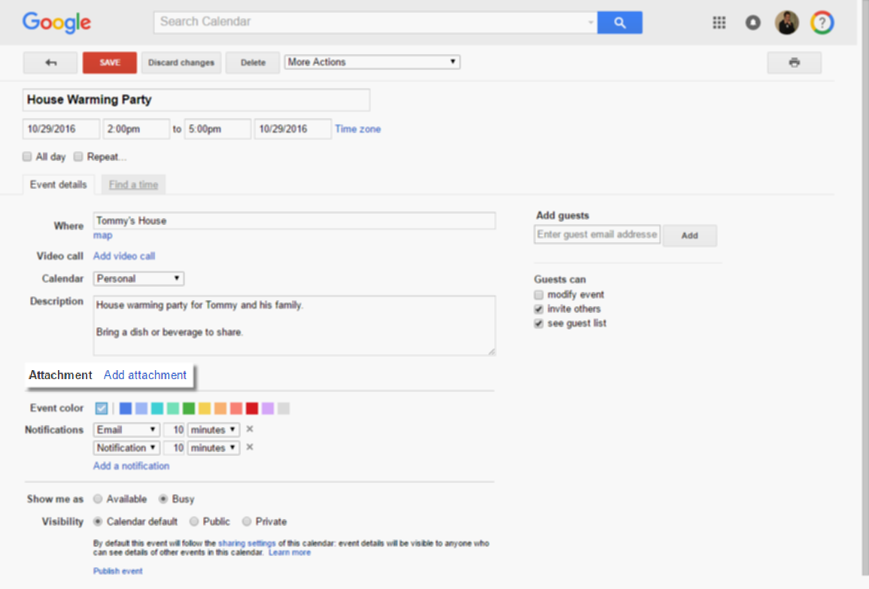
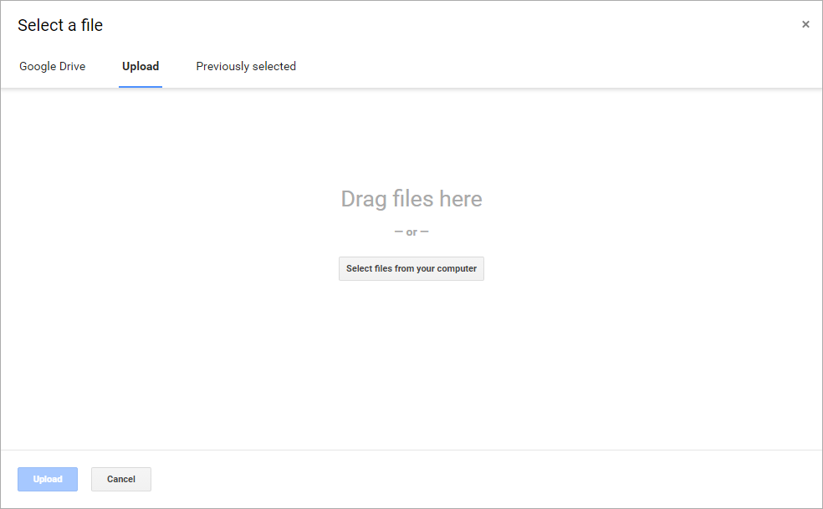
Adding an Attachment
Add documents, spreadsheets, or other files directly to an
event so your guests have all the information they need.
2. Select file location
and click through
the prompts
1. Click “Add
Attachment”

Slide 18
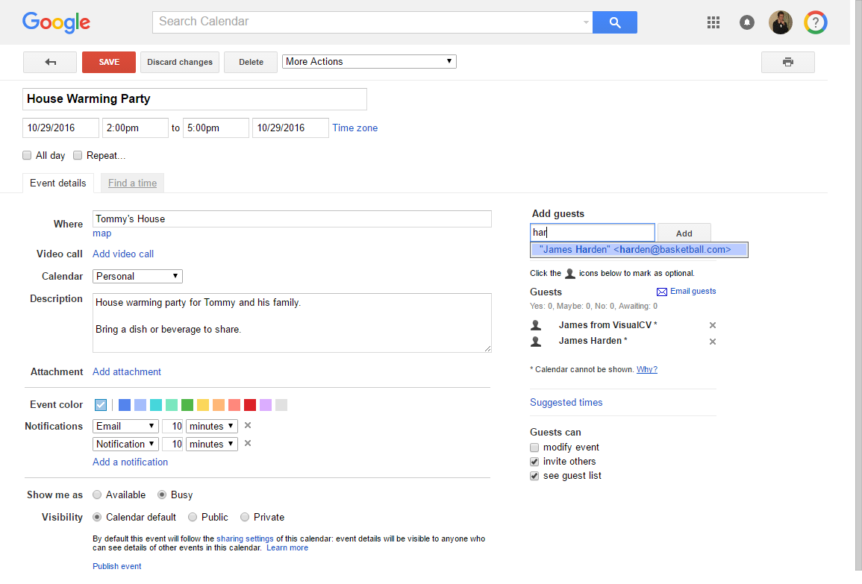
Invite Guests to an Event
Add anyone to an event using their email address, even if
they don’t have Google Calendar.
2. Click “Add”
1. Add guest’s name
or email address
    Once guests are added, click “Save” to send them an email invitation.

Slide 19
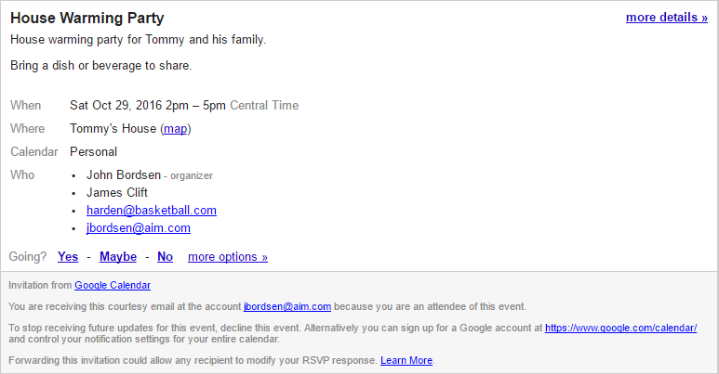
Viewing an Event Invite
Respond to event invitations from Google Calendar when
you are invited as a guest.
Going?
(Yes, No, Maybe)
    By accepting an invite, the event is automatically added to your calendar.

Slide 20
ACTIVITY #3

Slide 21
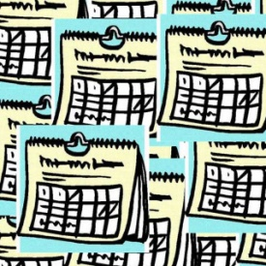
Working with Calendars
Multiple options are available for creating, working
with, viewing, and modifying calendars.
Share calendar details with a friend or
colleague
Create a personal or shared calendar
Subscribe to “interesting” calendars
(Ex: holidays, sporting events, and more)

Slide 22



Sharing Your Calendar
Share your calendar with friends, family, or coworkers and
select what they can see or whether they can make changes.
Sharing Options (Permission Settings)
Make changes and manage sharing
Make changes to events
See all event details
See only free/busy (hide details)
See all event details
See only free/busy

Slide 23
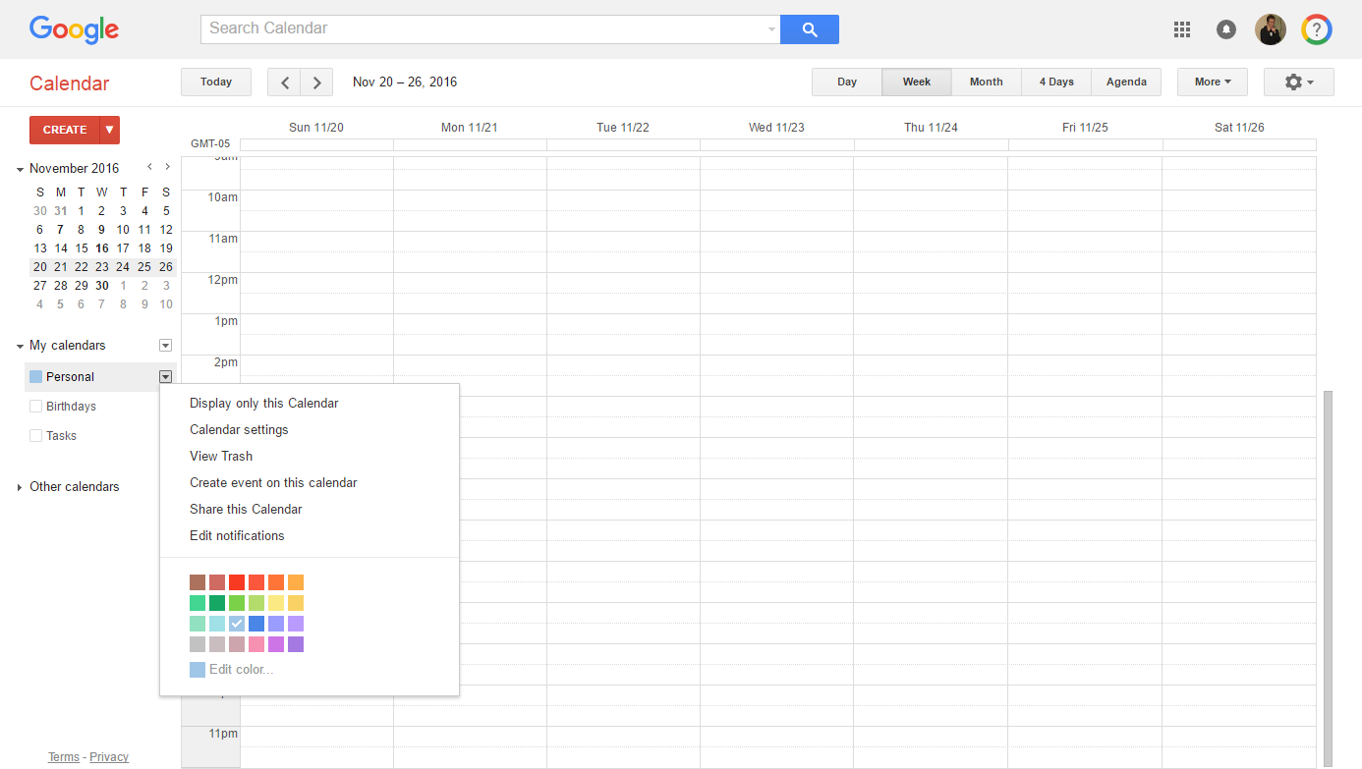
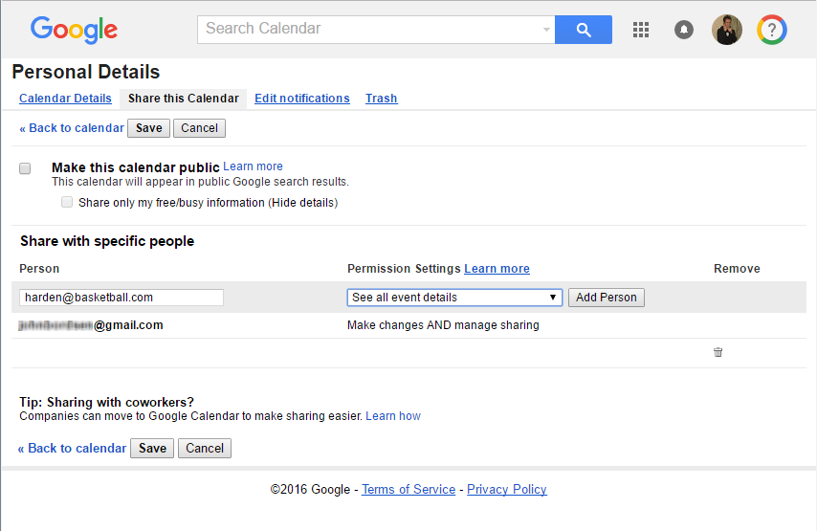
Sharing Your Calendar
1. Click the down arrow
next to the calendar name
3. Add the person’s email &
select their permissions
2. Click “Share
this Calendar”
4. Click “Save”

Slide 24
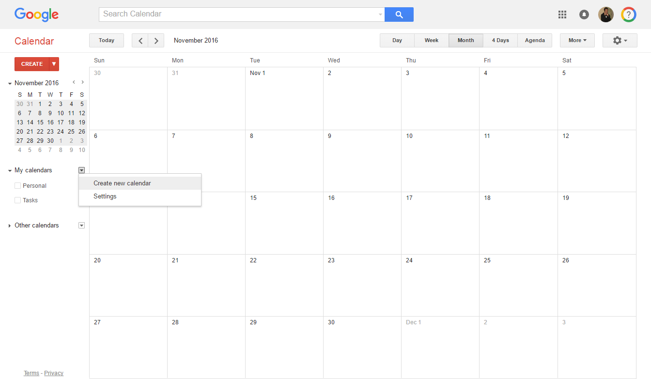
Creating a New Calendar
Create a new calendar to better organize your
events or use as a shared schedule manager.
1. Next to “My calendars,” click
the down arrow icon
2. Click “Create new calendar”
Notes:
Calendar View: Day, Week, Month, 4 Days, Agenda (good for printing)
Sharing: Public vs limited to specific people; permission
View other’s calendars: Beneficial for coordinating events with family or co-workers
Create add’l Calendars: Helps organize different parts of your life) i.e. Create one for your family and one for a team

Slide 25
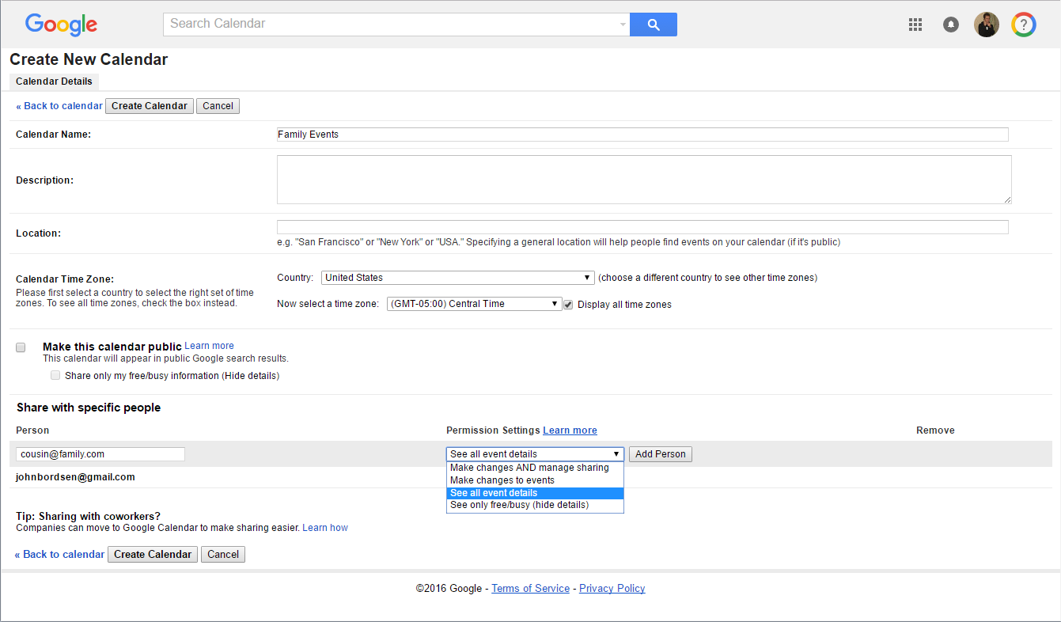
Creating a New Calendar (cont)
Select calendar details.
3. Enter a calendar name
4. If sharing, select people
and permission settings
5. Click “Create Calendar”

Slide 26
ACTIVITY #4

Slide 27
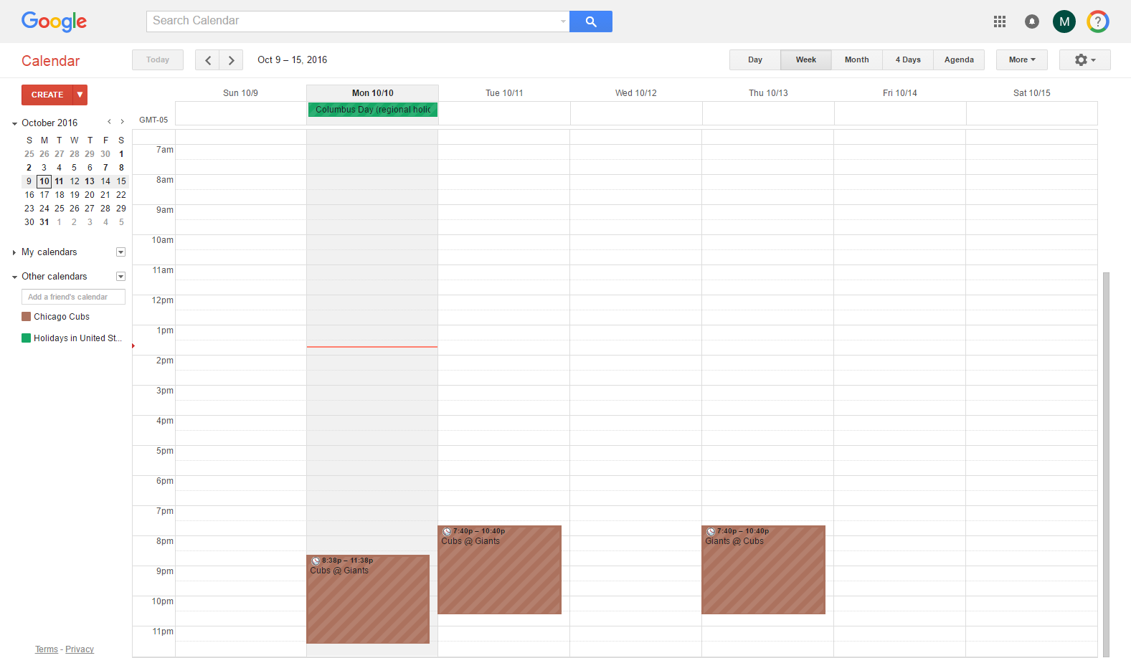
Interesting Calendars
“Interesting” calendars let you add holidays,
sporting events, and other dates of significance to
your calendar.
Holidays
(all day event)
Sporting events
Interesting Calendars

Slide 28
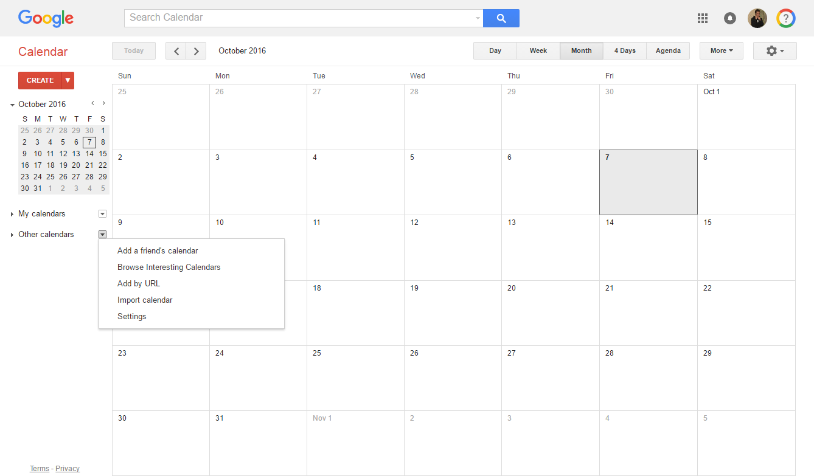
View Interesting Calendars
Subscribe to interesting calendars to see the
events in your calendar.
1. Next to “Other calendars,” click
the down arrow icon
2. Click “Browse Interesting Calendars”

Slide 29
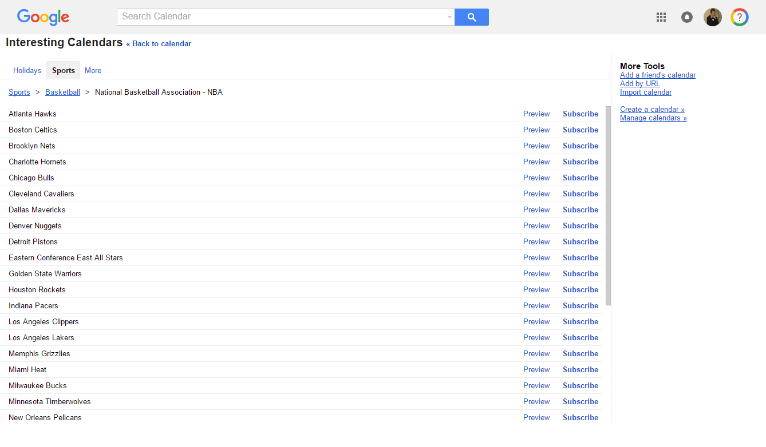
View Interesting Calendars (cont)
3. Navigate between tabs/categories (Ex: Holidays, Sports, and More)
4. Locate an interesting calendar
5. Click “Subscribe”

Slide 30
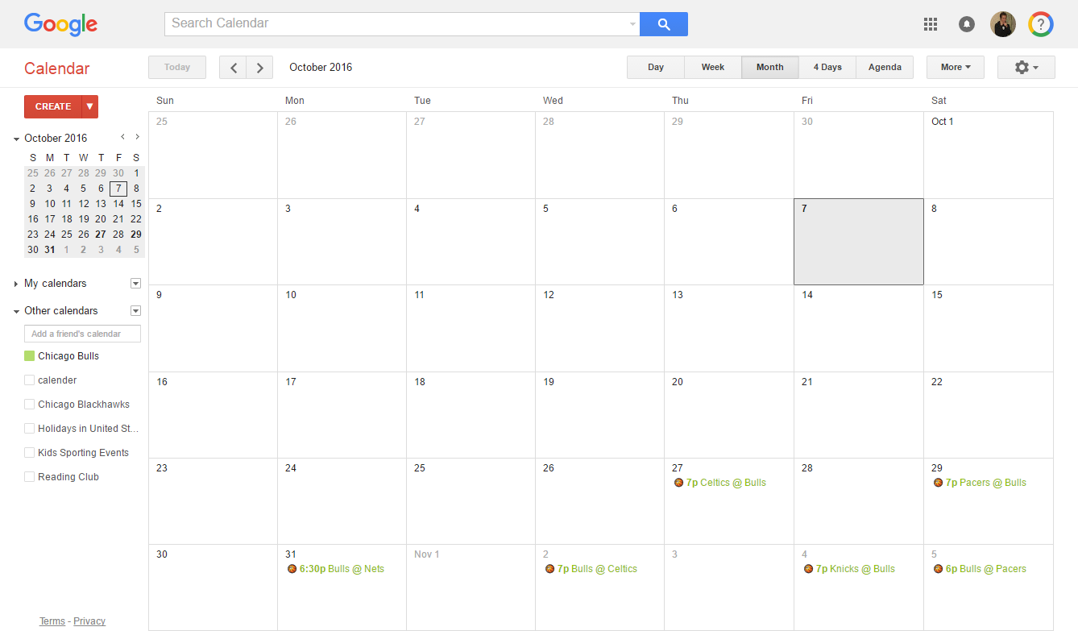
Hiding Calendar Events
Toggle on or off events from a personal or shared
calendar.
Calendar events
Toggle calendar events on or off

Slide 31
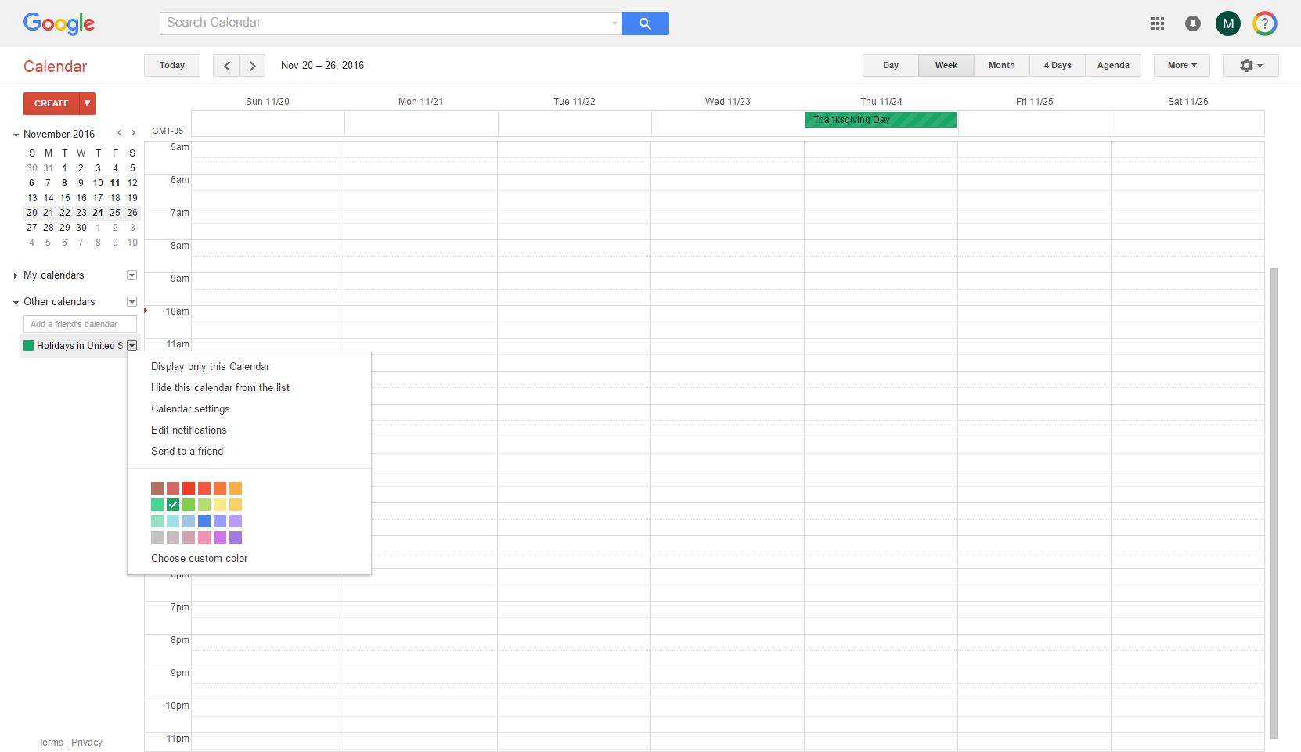
Removing a Calendar
If a calendar is no longer needed, remove it from
your list of personal or shared calendars.
1. Click the down arrow
next to the calendar name
2. Click “Hide this calendar from the list”

Slide 32
ACTIVITY #5

Slide 33

Google Tasks
A task management system which helps you keep track
of to-do’s.
Access Tasks directly from Calendar (or Gmail)
Create tasks and assign a due date
Organize and modify your tasks
Review past completed tasks
Notes:
Google Calendar

Slide 34
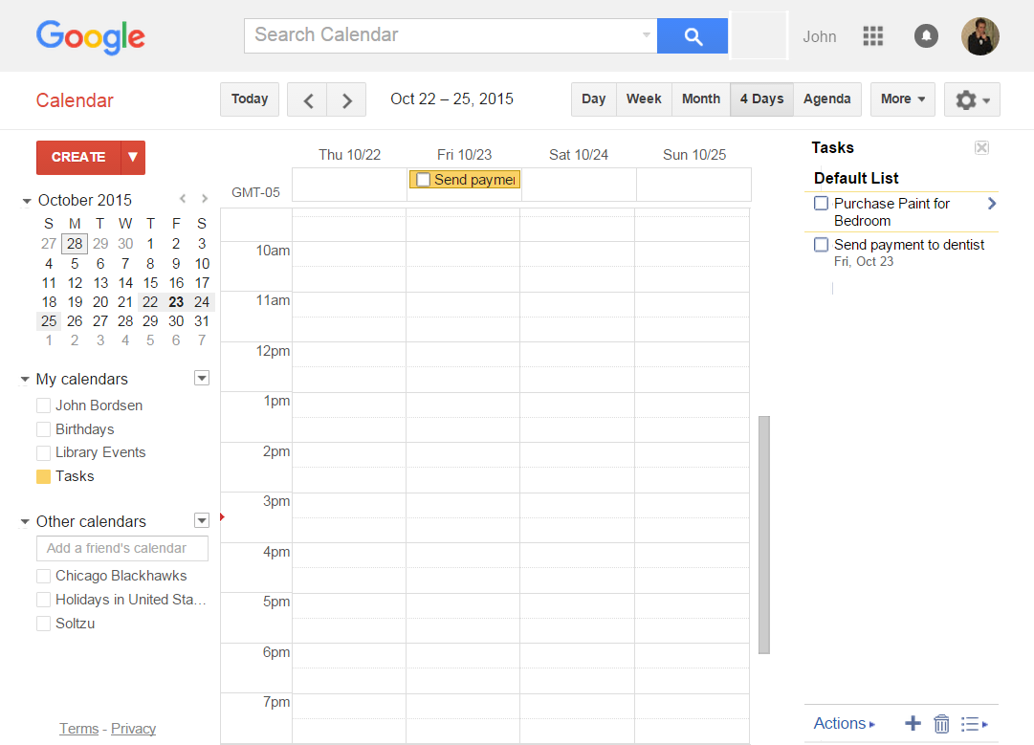

Navigating Google Tasks
Tasks are enabled under the “My Calendar”
heading in the left sidebar.
Due task
Task List
Tasks
Actions
Notes:
Tasks can be managed via calendar (or Gmail)
Tasks display within the Calendar and can be assigned a due date (cannot specify an exact time; only the day).
Turn on/off task view under “My calendars”

Slide 35
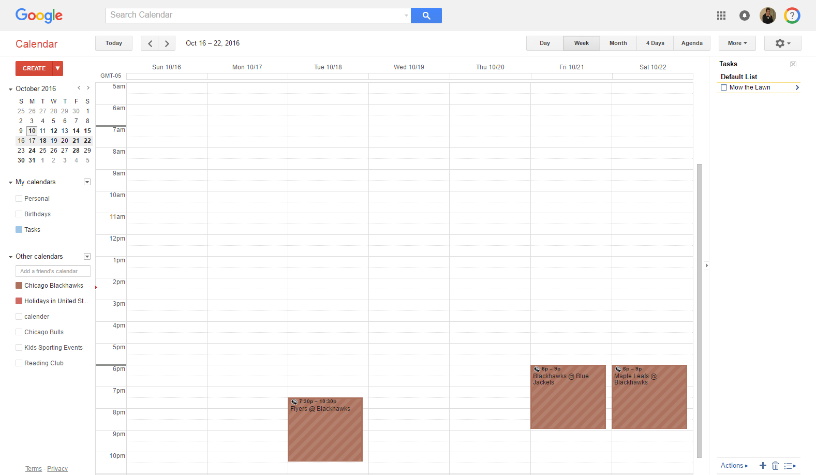

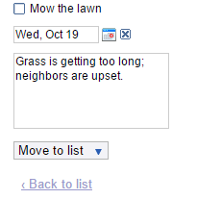
Creating a Task
2. Type in the task
and press Enter
1. Enable Tasks
3. Click to add
a due date
and/or notes:
Notes:
Tasks can be managed via calendar (or Gmail)
Tasks display within the Calendar and can be assigned a due date (cannot specify an exact time; only the day).
Turn on/off task view under “My calendars”

Slide 36
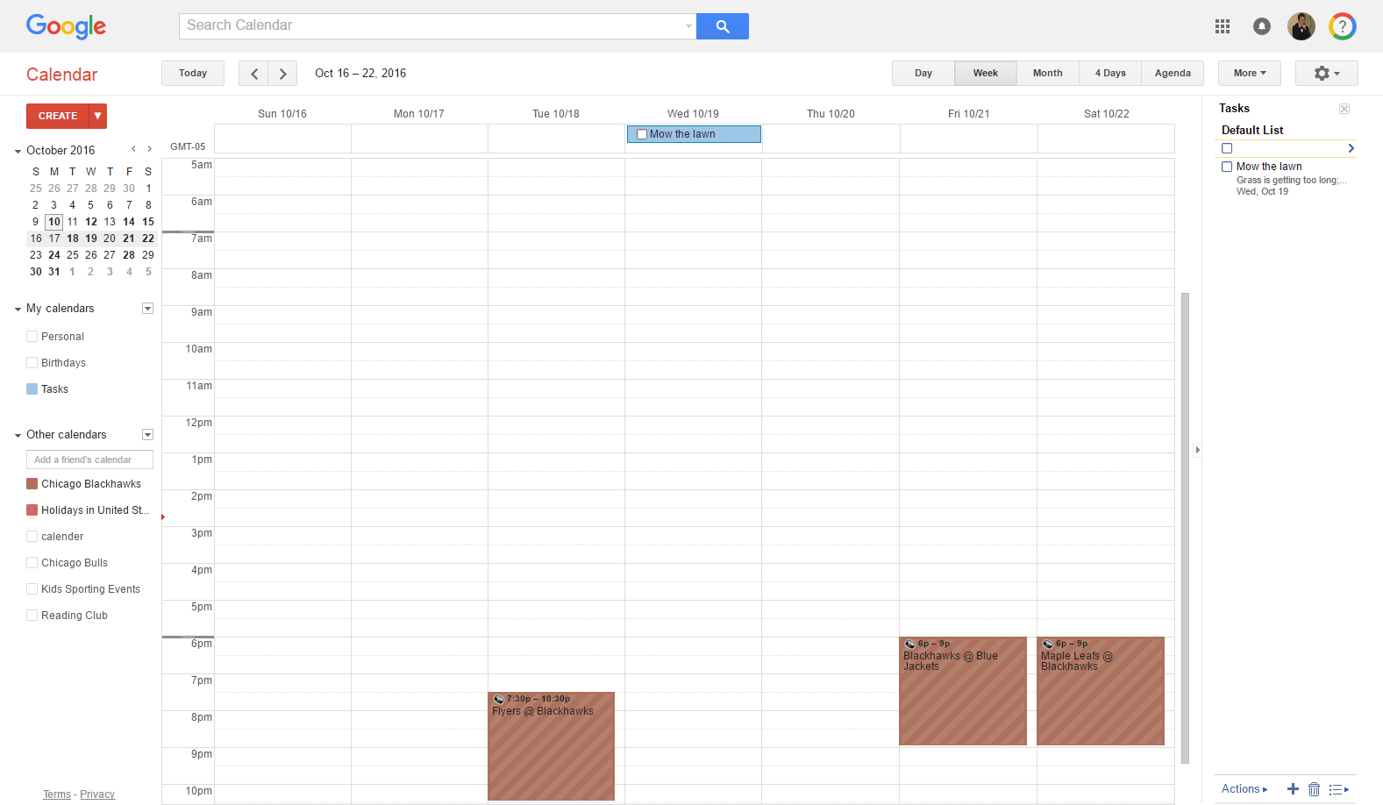
Marking Tasks Complete
1. Enable Tasks
2. Select checkbox next
to task (in either the
calendar or task list)
Notes:
Tasks can be managed via calendar (or Gmail)
Tasks display within the Calendar and can be assigned a due date (cannot specify an exact time; only the day).
Turn on/off task view under “My calendars”

Slide 37
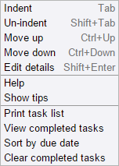
Using the Task Action Bar
Available actions include:
Access the Actions menu
Create Task
Delete Task
Create/modify lists
Task Action Bar

Slide 38
ACTIVITY #6

Slide 39

Working with Settings
Enhance your Calendar experience by selecting
settings which best suit your preferences.
Modify your calendar display settings
Select a default event duration
View and enable “Labs”

Slide 40
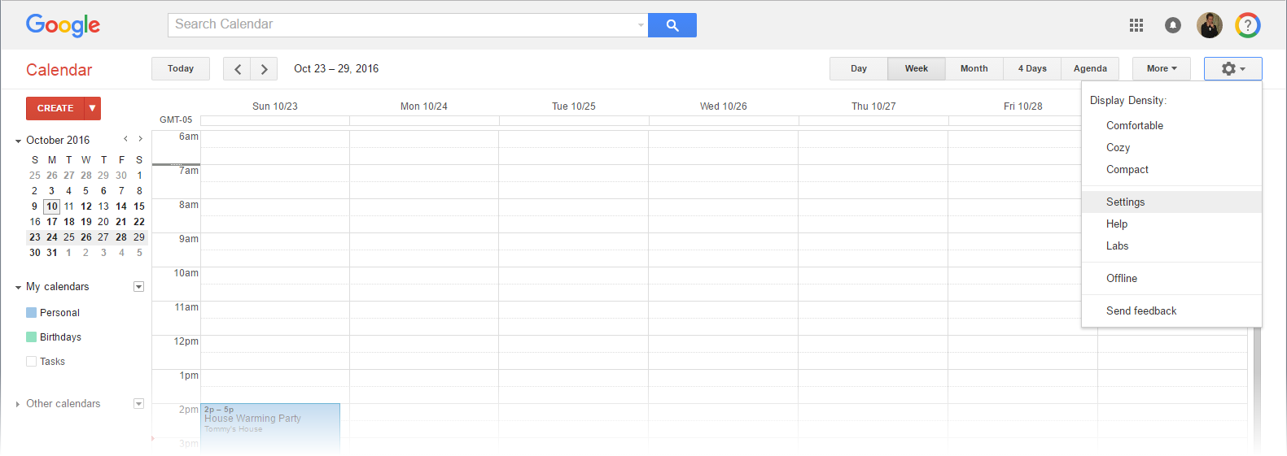

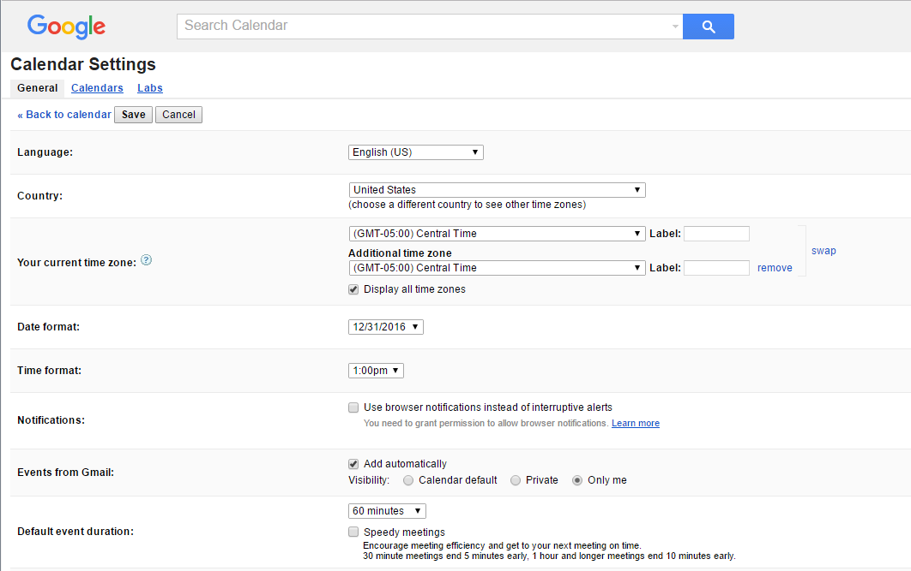

Changing Calendar Settings
1. Click Gear icon
2. Click “Settings”
3. Select a tab:
General
Calendars
Labs
4. Make changes
and click “Save”

Slide 41
General Settings
Options within the “General” tab include:
Language (changes system labels)
Default event duration
Display options
  Event dimming (for past events)
  Toggle on/off weekends in “week” and ”month” views
  Show weather in calendar
And more…

Slide 42
Calendar Settings
Options within the “Calendars” tab include:
Hide calendars from list in sidebar
Edit notifications for specific calendars
Unsubscribe from shared or interesting calendars
Import and export calendars

Slide 43

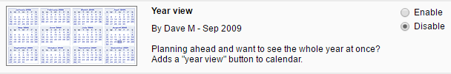
Labs Settings
The “Labs” tab provides options for enabling and
disabling new calendar features.
Labs are experimental features
Labs can change, break, or disappear at any time
Labs Example:

Slide 44
QUESTIONS?
THANKS FOR COMING!
Need more help?
Schedule a 1:1 appointment with a librarian!

