Slide 1

Email Basics (Gmail)
Mary Stoner
Library Director
Anne West Lindsey District Library
Courtesy of Gail Borden Public Library
and the Public Library Association

Slide 2
Agenda
Terminology & Descriptions
Creating a Gmail Account
Managing & Customizing the Inbox
Viewing & Composing an Email
Attaching a File to an Email

Slide 3

Terminology & Descriptions
Email
A system for sending messages from one user to another via a computer with an internet connection

Slide 4
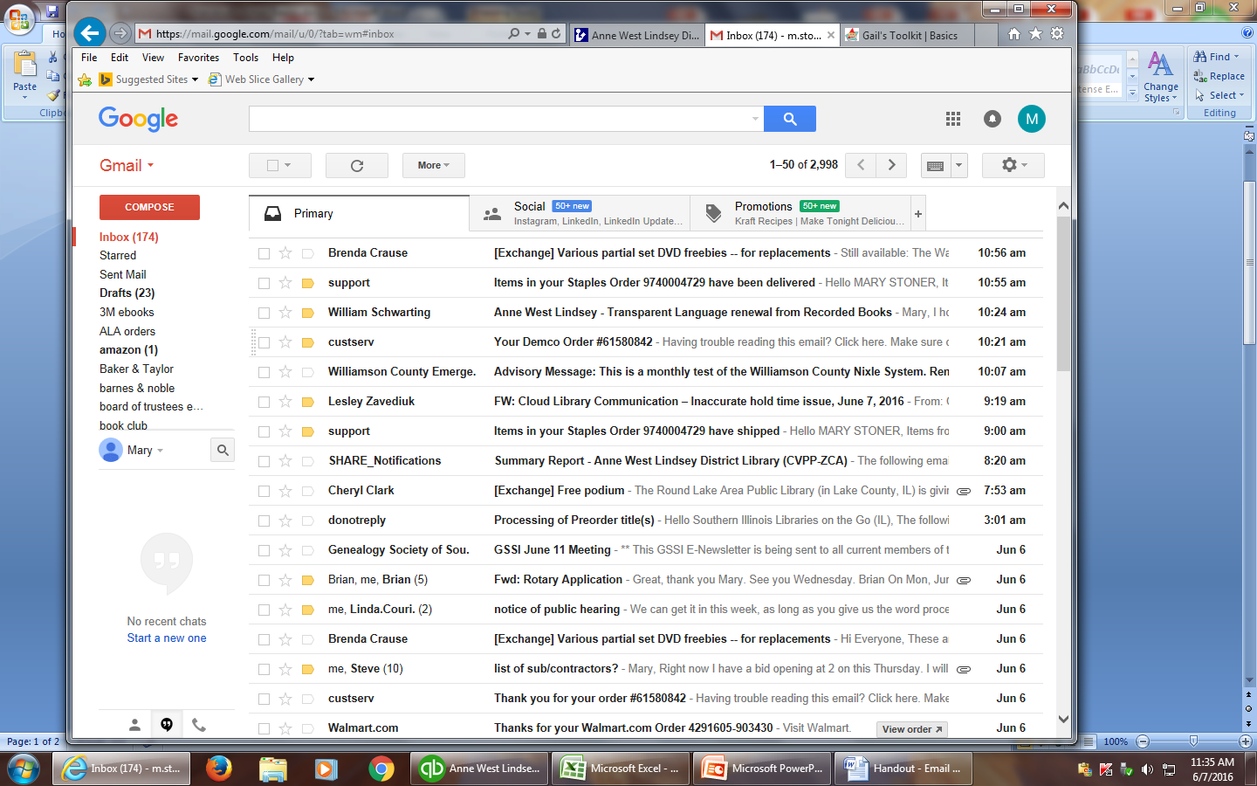
Terminology & Descriptions
Inbox
The area of your email program where new messages arrive

Slide 5
Terminology & Descriptions
Folder
A tool for storing and organizing messages inside your email program

Slide 6
Terminology & Descriptions
Sent mail
The folder where messages you send to others are stored

Slide 7
Terminology & Descriptions
Attachment
An electronic stand-alone document or file that is delivered through an email message

Slide 8
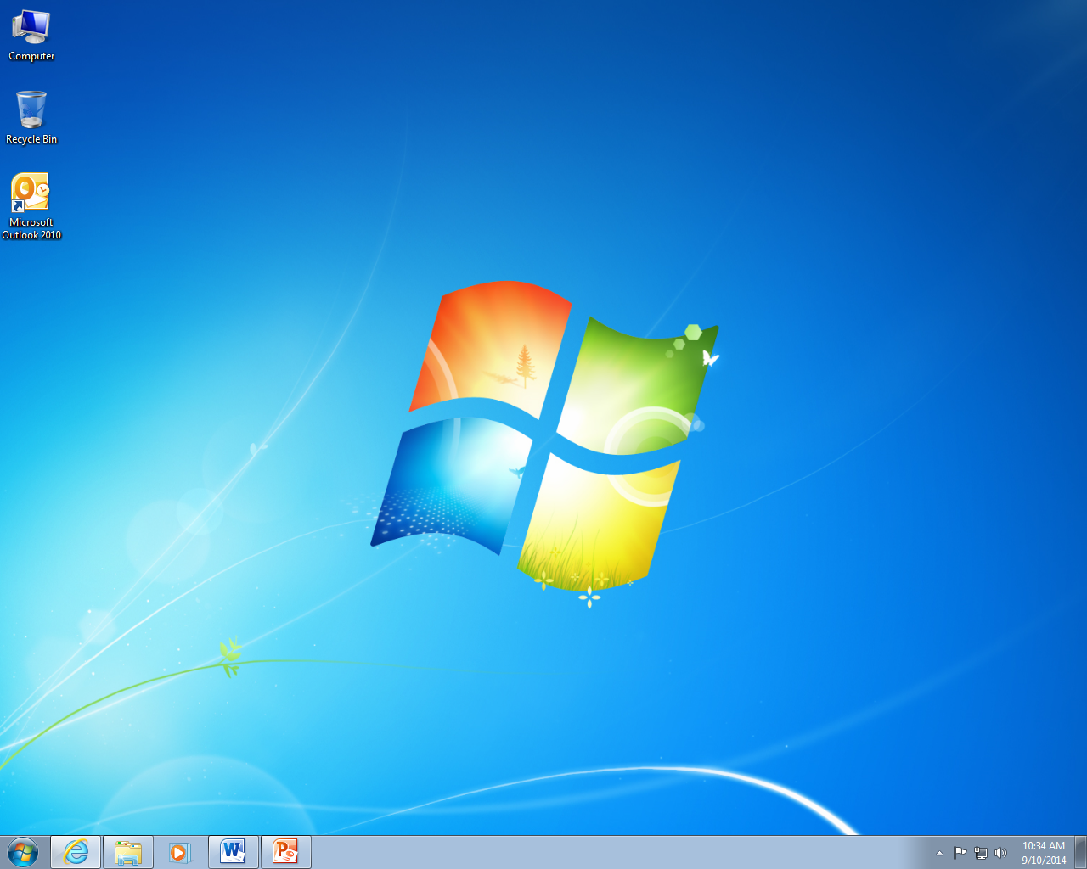
Creating a Gmail Account
Click on the Internet Explorer, Chrome, or Firefox icon to open a browser.

Slide 9
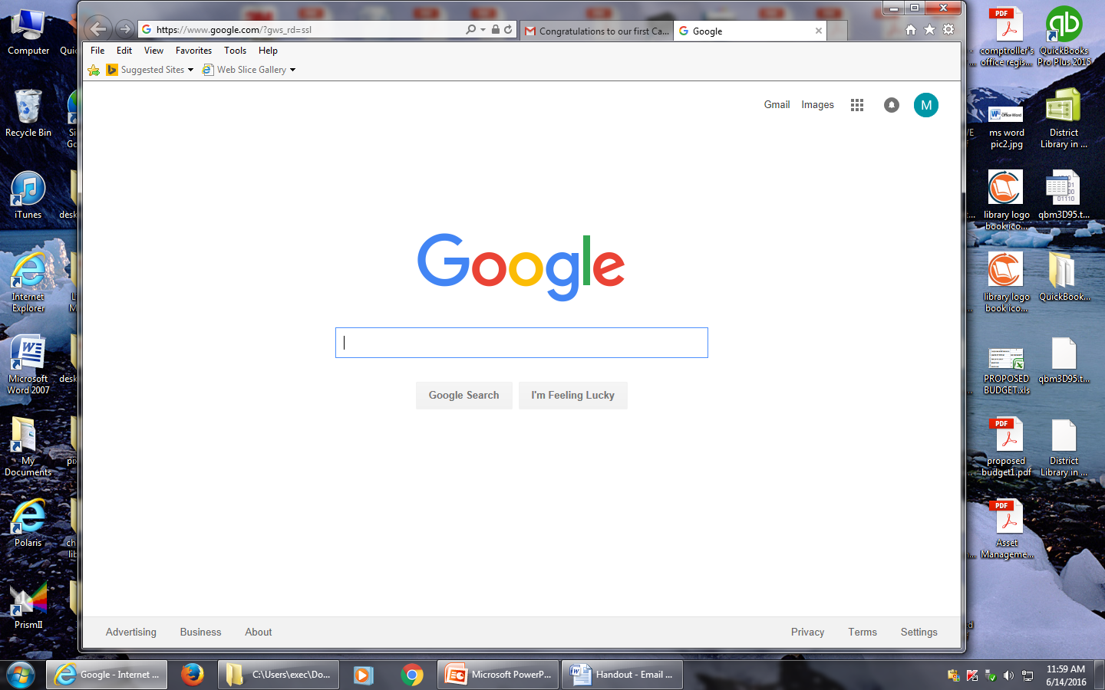
Creating a Gmail Account
Type google.com in the Address bar

Slide 10
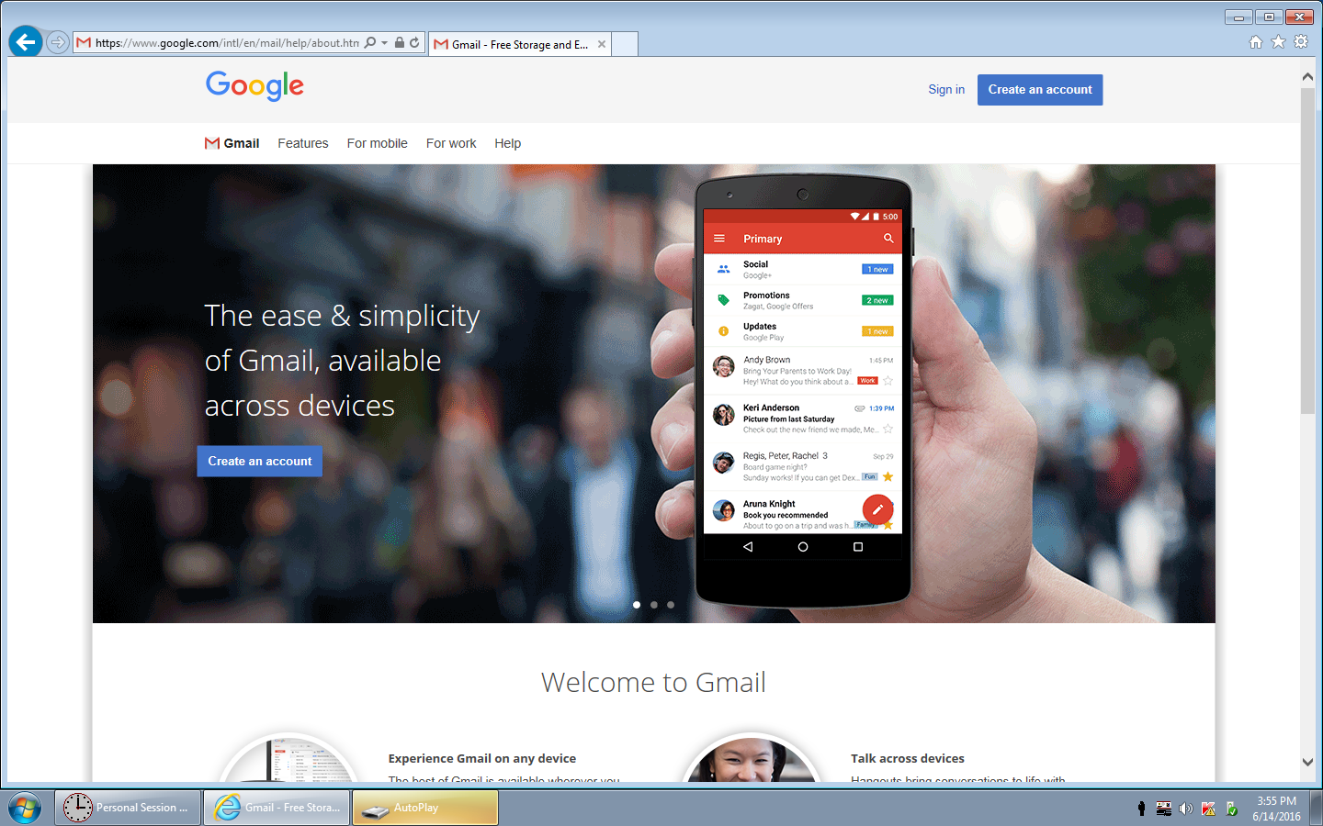
Creating a Gmail Account
Click on Create an account

Slide 11
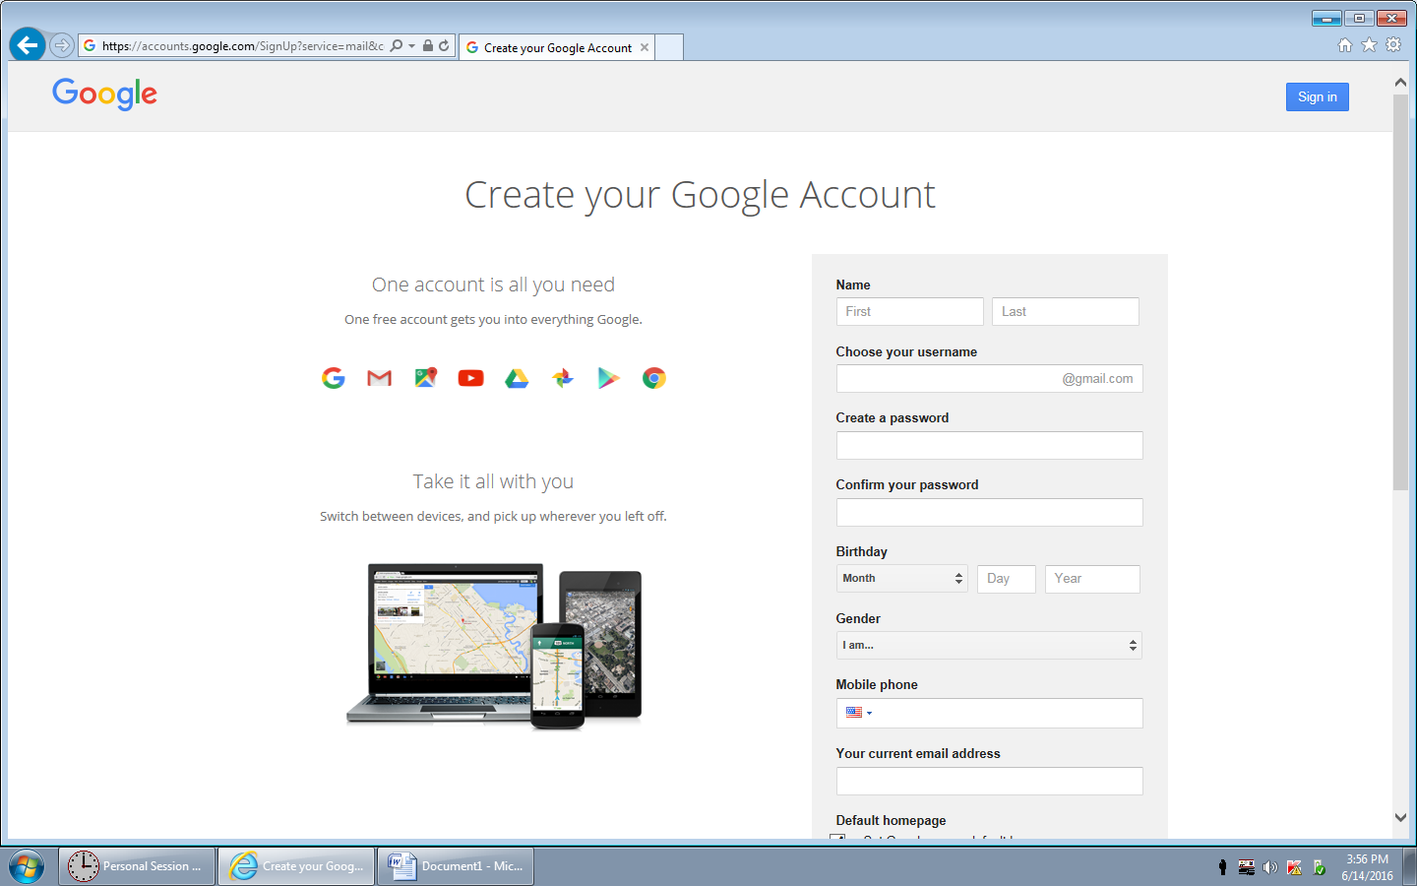
Creating a Gmail Account

Slide 12
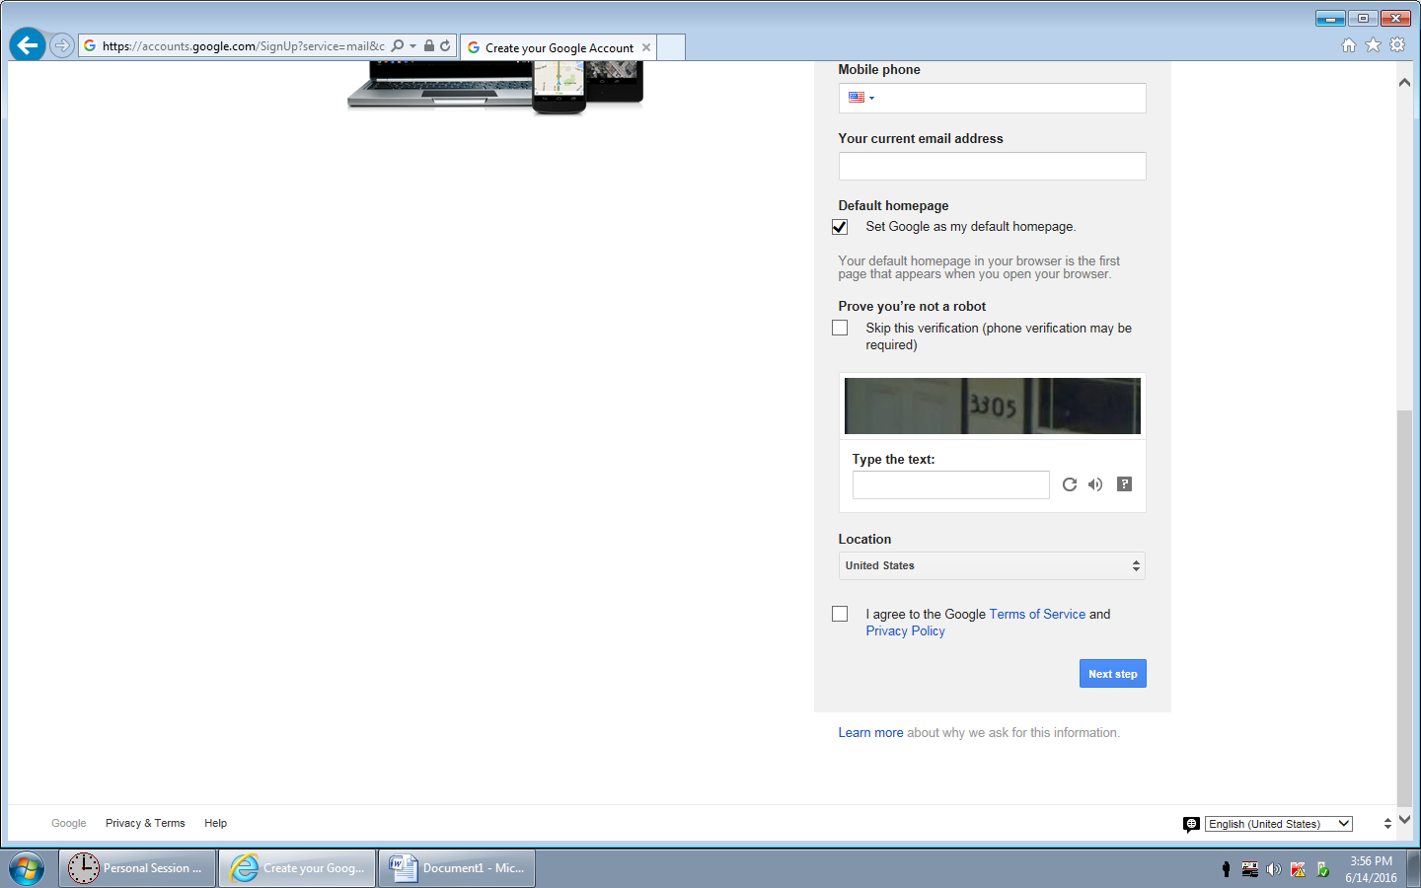
Creating a Gmail Account
After you finish entering your information, click the Next Step button

Slide 13
Activity #1

Slide 14
Managing & Customizing the Inbox
Navigation bar

Slide 15
Managing & Customizing the Inbox
Search box

Slide 16
Managing & Customizing the Inbox
Compose a new email

Slide 17
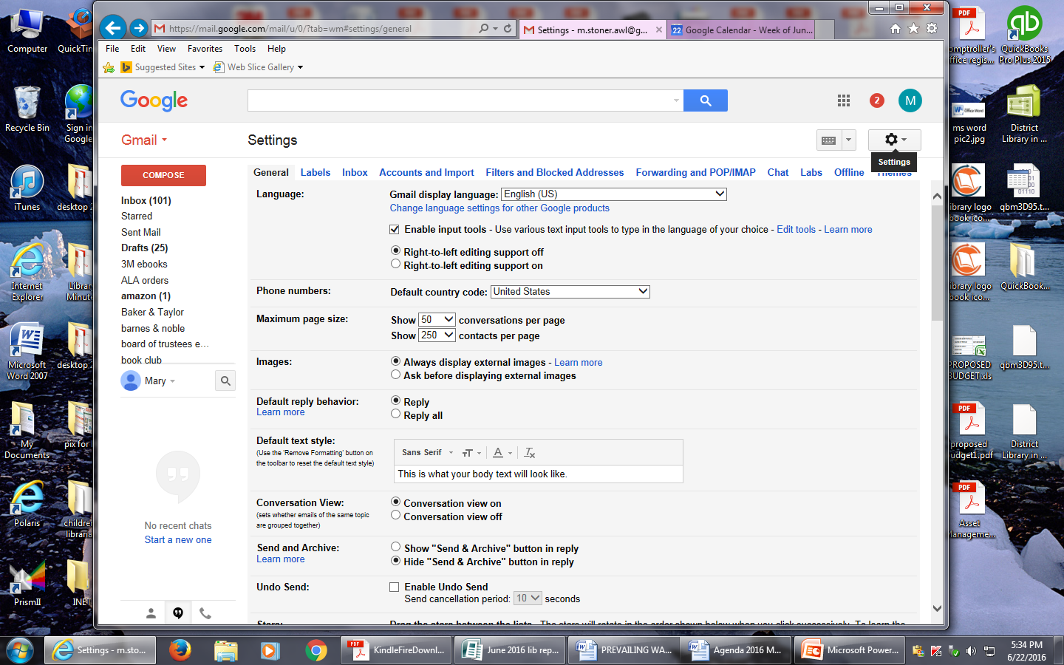
Managing & Customizing the Inbox

Slide 18
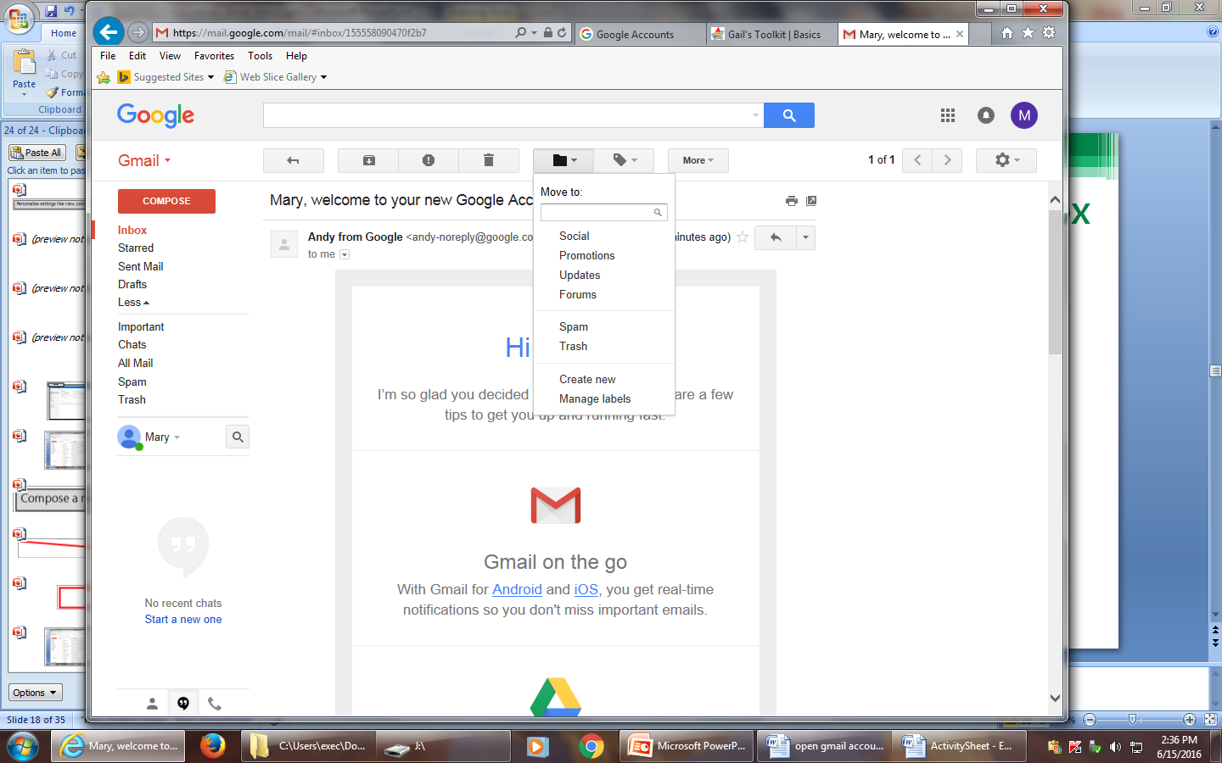
Managing & Customizing the Inbox
Click on any email
Click on the “Move to” folder icon at the top
Click on “Create new” to add categories

Slide 19
Managing & Customizing the Inbox
Folders

Slide 20
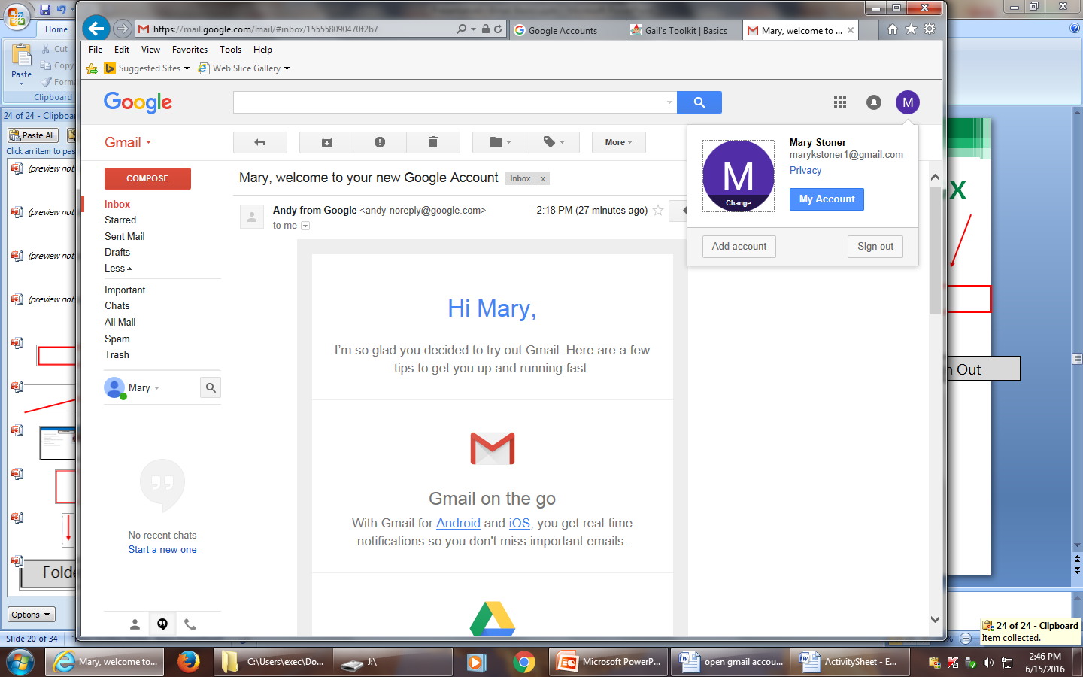
Managing & Customizing the Inbox
To sign out, click on icon (circle on far right with letter inside) next to google notifications icon (bell inside a circle). It will drop down a menu. Click on sign out.
Sign Out

Slide 21
Managing & Customizing the Inbox
Click on an email
Click on the “Move to” folder icon at the top
Click on category to place that specific email in that category
Move an email to a folder

Slide 22
Activity #2

Slide 23
Viewing & Composing an Email
Sender
Attachment
Subject

Slide 24
Viewing & Composing an Email
Click on an email to open it

Slide 25
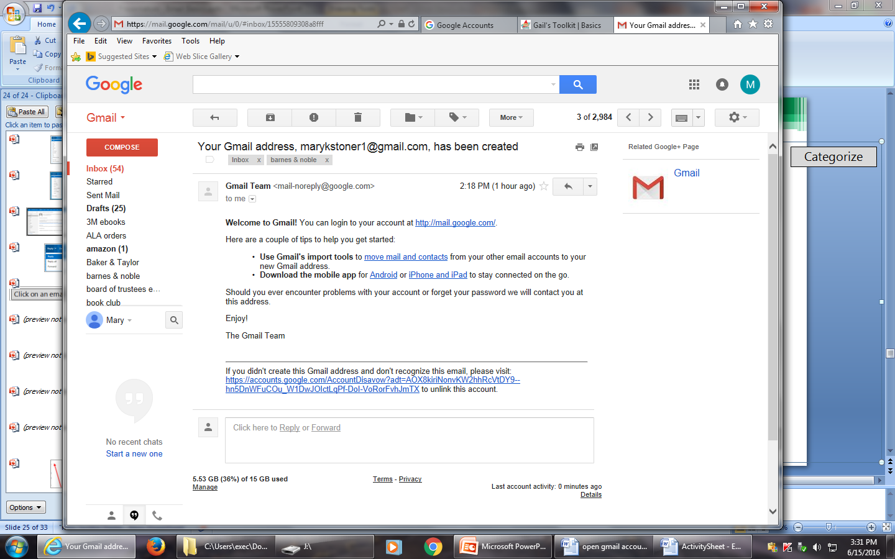
Viewing & Composing an Email
Reply, Forward or Print

Slide 26
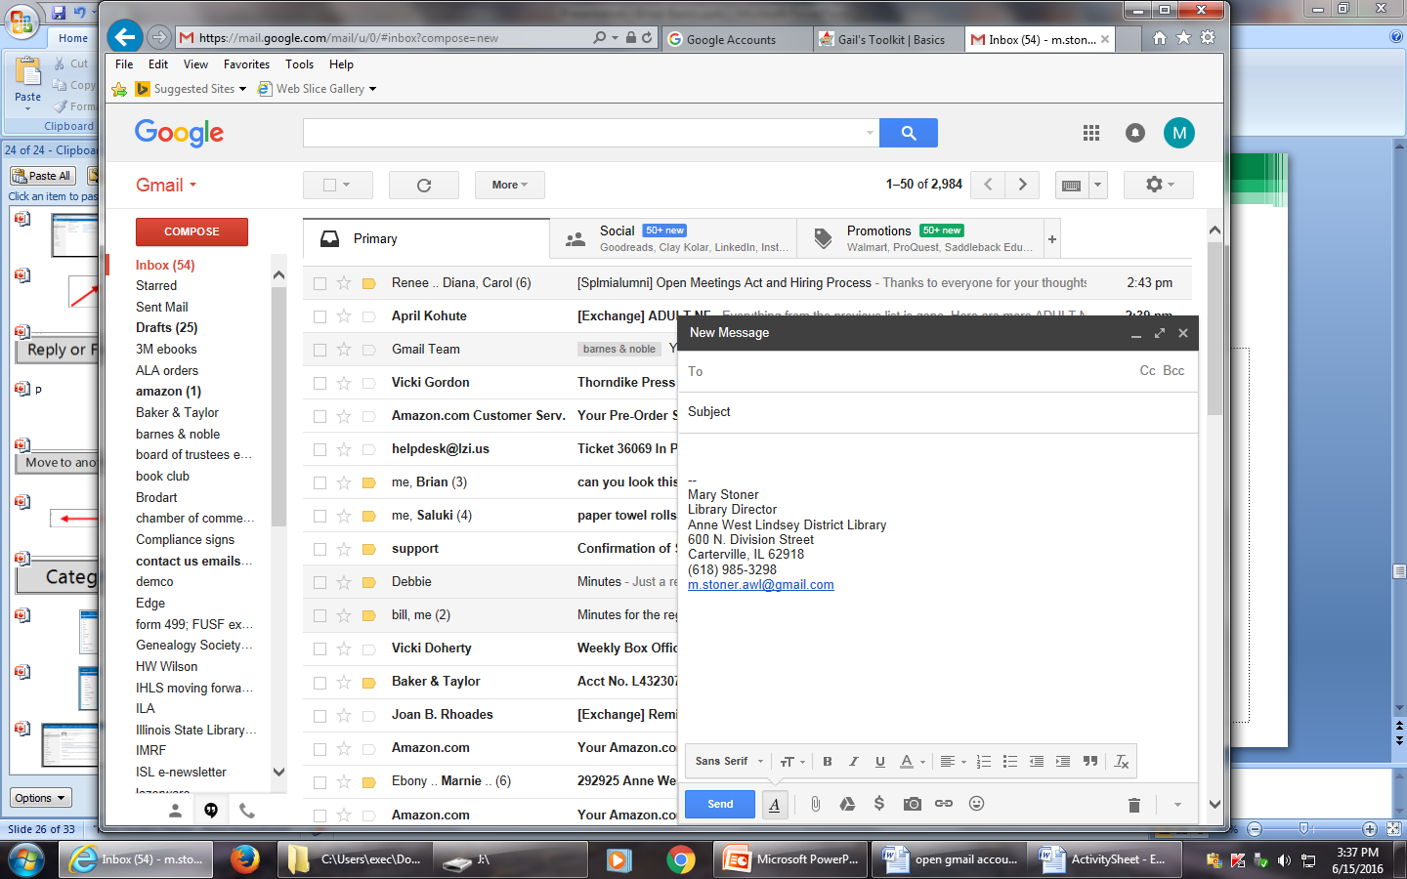
Viewing & Composing an Email
Compose a new email

Slide 27
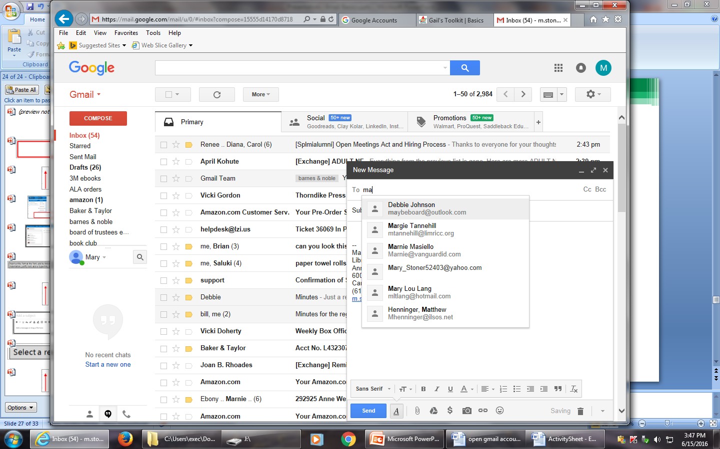
Viewing & Composing an Email
Select a recipient
Format the font, add bullets or numbers, increase or decrease indentation
Send the message
Attach a file

Slide 28
Activity #3

Slide 29
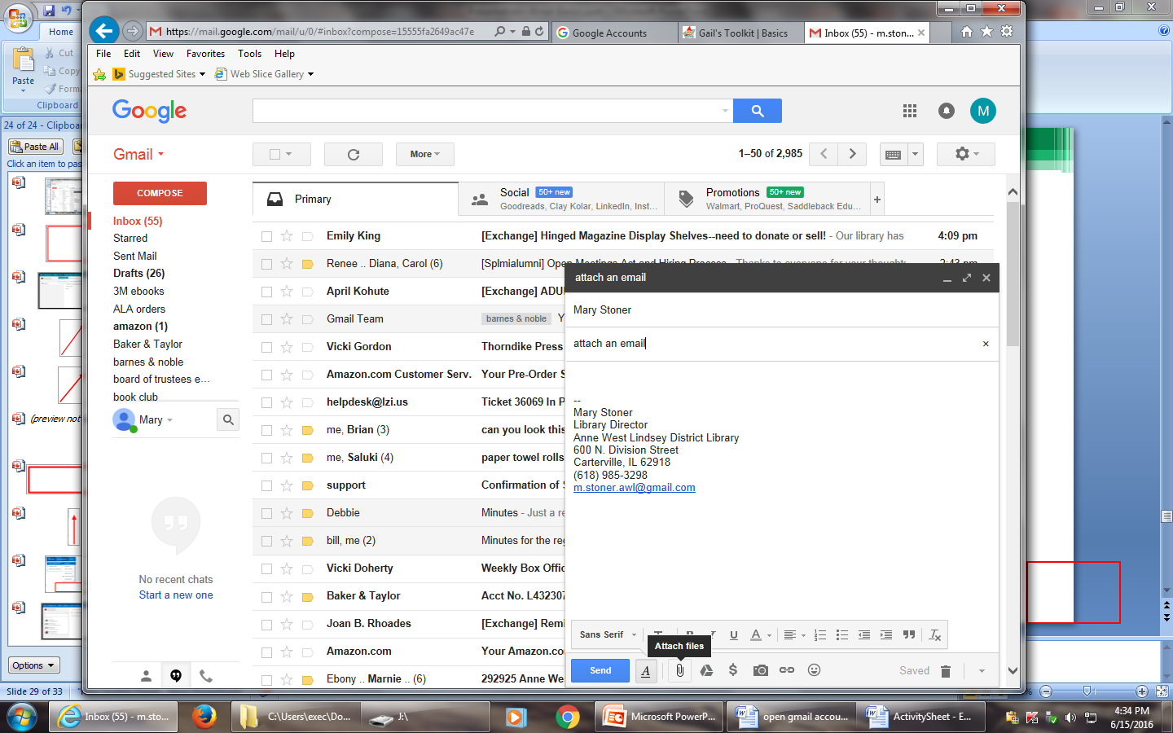
Attaching a File to an Email
Insert > Files as attachments

Slide 30
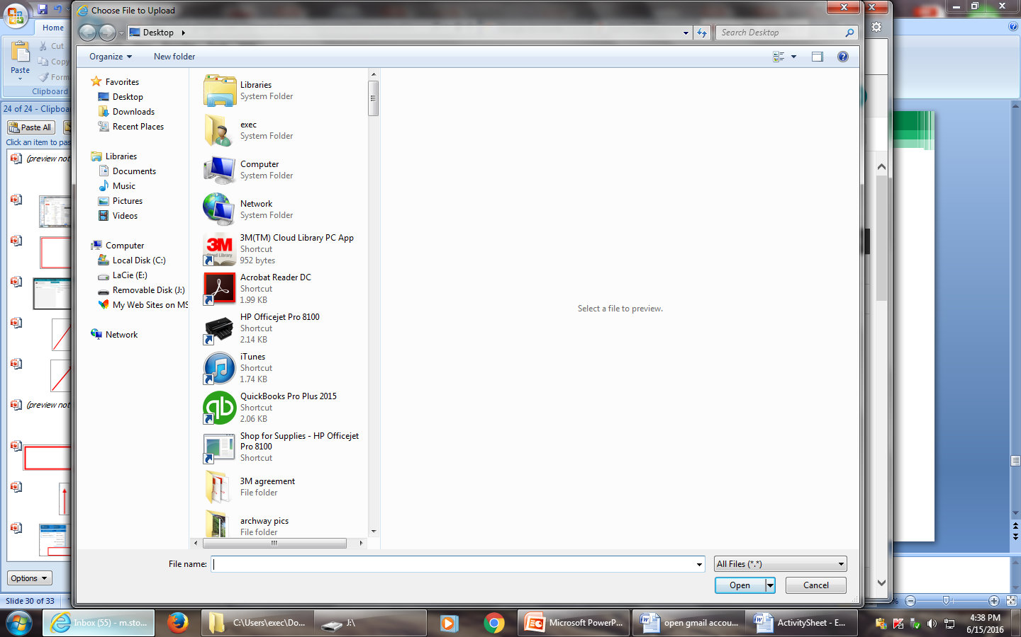
Attaching a File to an Email
Browse to the file’s location, click on the file, and click the Open button

Slide 31
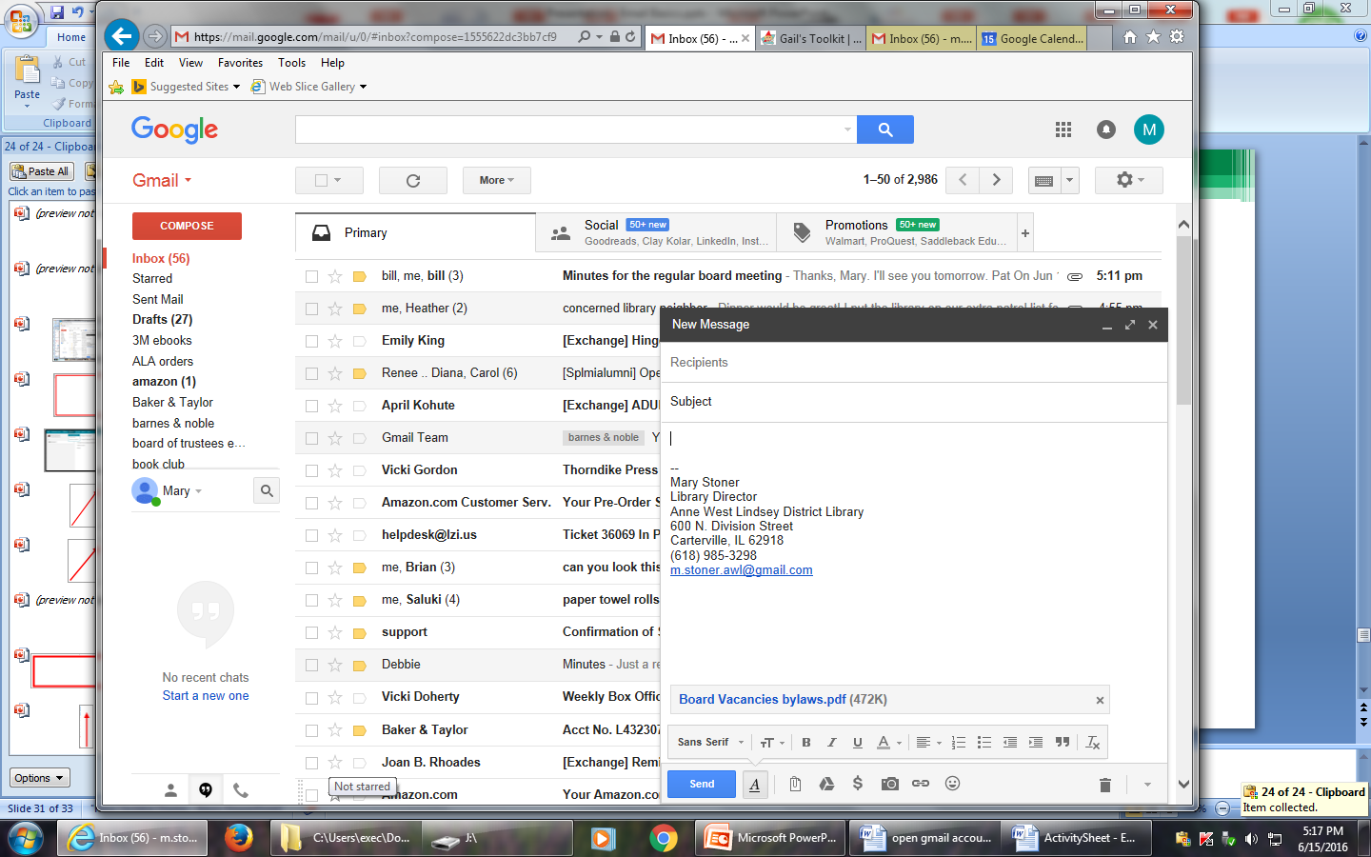
Attaching a File to an Email
Click the Send button

Slide 32
Activity #4

Slide 33
QUESTIONS?
THANKS FOR COMING!

