Slide 1

Getting Started with Telehealth
Instructor Name
Instructor Title
Library Name
Insert Library Logo Here
Provided by Public Library Association with support from Heartland Forward
Notes:
USE POWERPOINT
Workshop Introduction
ADDITIONAL DETAILS: Please update this slide with the appropriate information:
Instructor name
Instructor affiliation (for instance, library staff member, community volunteer, etc.)
Location name
Library’s logo
ADDITIONAL DETAILS: Before the workshop, please review the Instructor Outline for guidance on what to do to prepare for the workshop. You’ll find notes on how to conduct the workshop and details on what you should do once the workshop ends.
INSTRUCTOR NOTE: Please use the Volunteer Instructor Guide for talking points for the presentation. In that document, slide notations begin on page 5.
Example Script to begin the workshop: My name is <your name here> and I am <brief description of yourself>.” Today’s workshop is provided by the Public Library Association with support from Heartland Forward.”
Before we get started, here are a few housekeeping items: [Mention the items that are relevant to your workshop.]
Also, include a thank-you to community collaborator if applicable.
INSTRUCTOR NOTE: Include thank-you to community collaborator if applicable.
Example Script to begin the workshop: My name is <your name here> and I am <brief description of yourself>.” Before we get started, here are a few housekeeping items: [Mention the items that are relevant to your workshop.]
Where are the restrooms?
Where are the emergency exits?
When/how to ask questions. Point to the page number located on each slide for participants to write down along with their question.
If you have a cell phone with you, please make sure to either turn it off or set it to silent.
Will there be a break?

Slide 2
Today’s Agenda
What is Telehealth
Using the Patient Portal
  What you can do
  Creating your account
  Using the Messaging feature
  Helpful Settings
Technical Requirements
  Which device is best for you
  Tips for troubleshooting common technical problems
Attending the Appointment
  What to prepare
  What to expect the day of the appointment
  After the appointment
Notes:
USE POWERPOINT
Workshop Introduction
In this workshop, you will learn about telehealth. We’ll work on answering your telehealth questions and building skills so you feel more confident about receiving health care using telehealth. This will include:
What is Telehealth
Using the Patient Portal
What you can do
Creating your account
Using the Messaging feature
Helpful Settings
Technical Requirements
Which device is best for you
Tips for troubleshooting common technical problems
Attending the Appointment
What to prepare
What to expect the day of the appointment
After the appointment
Let’s get started!

Slide 3

What is Telehealth?
It is a way to see your health care provider using a computer, tablet, or phone, without visiting their office.
Notes:
USE POWERPOINT
What is telehealth?
What is telehealth? Telehealth is a way to see your health care provider using a computer, tablet, or phone, without visiting their office. Think of it like a phone call or a video call with your doctor. Telehealth services may also include managing different aspects of your health care online.
A health care provider is the person or organization that provides medical care or treatment.

Slide 4

Introduction
How many of you attended a telehealth appointment?
What are you hoping to learn in today’s session?
Notes:
USE POWERPOINT
Question: What is telehealth?
Ask the learners to raise their hands if they have attended a telehealth appointment.
INSTRUCTOR NOTE: Ask learners the questions on the slide and help facilitate a conversation to engage learners with the questions.
Lead a brief discussion on why they’re attending the workshop. Possibilities include they want to learn
what type of care they can receive via telehealth.
what to expect during a telehealth visit.
how to use the technology needed to attend a telehealth visit.

Slide 5
Types of Health Care Providers
Doctors
Nurses
Pharmacists
Mental health care professionals
Physical and occupational therapists
Medical offices
Clinics
Hospitals
Home health agencies
Notes:
USE POWERPOINT
What is telehealth?
Some examples of people who provide telehealth services include doctors, nurses, pharmacists, mental health care professionals, and physical and occupational therapists.
Organizations also support telehealth. Examples include medical offices, clinics, hospitals, and home health agencies.
In this course, we will use the word provider when talking about health care providers.

Slide 6
Types of Telehealth Care
Schedule appointments.
Check-in on medical issues.
Discuss lab tests or X-ray results.
Follow up on prescription medications.
Receive post-surgical follow-up.
Receive preventive care like nutrition counseling.
Receive referrals to specialists.
Mental health treatment.
Notes:
USE POWERPOINT
What is telehealth?
You can get many types of care through telehealth. You can schedule appointments, check in on medical issues, discuss lab tests or x-ray results, follow up on prescription medications, receive post-surgical follow-up, or preventive care like nutrition counseling, referrals to specialists, and mental health treatment, including therapy and counseling.

Slide 7

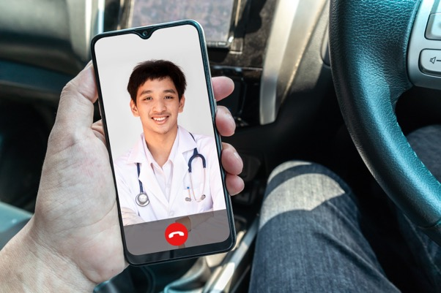
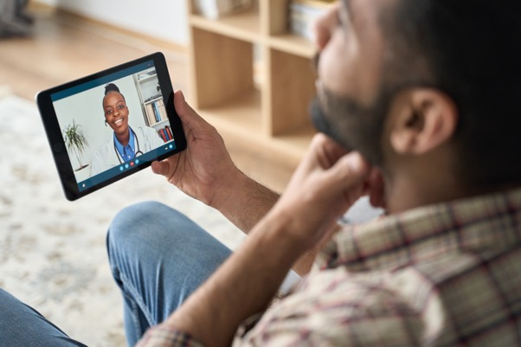

Telehealth is Convenient
Notes:
USE POWERPOINT
What is telehealth?
There are a lot of reasons why you might decide to get your health care through telehealth.
It’s convenient. Telehealth allows you to receive care where you are, like work, home, or your car; you do not need to travel to and from your appointment, and it’s easier to see providers who may be far away.

Slide 8
When to Meet in Person
Provider may want a face-to-face visit.
Provider may need to conduct a physical examination.
Provider may need to use specialty equipment.
Insurance may not cover your telehealth appointment but may cover an in-person visit.
Notes:
USE POWERPOINT
What is telehealth?
While there are benefits to telehealth, here are some reasons why you may need to meet with your provider in person.
1. If this is your first visit or you just started seeing a new doctor, they may want a face-to-face visit so you can get to know each other better.
2. Your provider may need to conduct a physical examination.
3. Your provider may need to use specialty equipment that is available at a health care facility during the appointment, like an X-ray machine, ultrasound, or ECG machine.
4. Insurance may not cover your telehealth appointment but may cover an in-person visit. Insurance coverage for telehealth visits varies based on the type of health insurance you have and where you live. Contact your insurance company or your doctor's office before your telehealth visit to find out if the care you need is covered and how much you'll have to pay out of pocket.

Slide 9
Types of Telehealth Care
Video visits
Audio-only visits
Secure messaging
Remote monitoring
Notes:
USE POWERPOINT
What is telehealth?
There are different types of telehealth care, including video visits, audio-only visits, secure messaging, and remote monitoring.
Let’s learn more about each option.

Slide 10
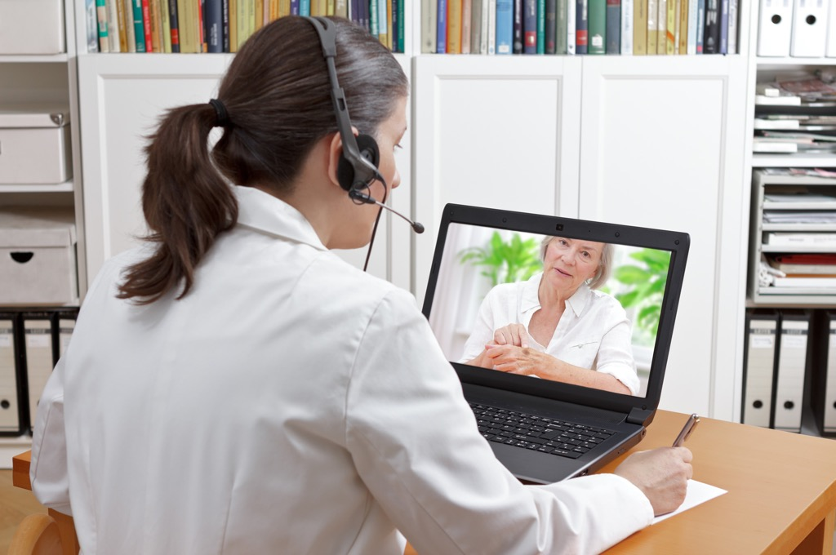
Live Video Visits
Notes:
USE POWERPOINT
What is telehealth?
INSTRUCTOR NOTE: Before providing the definition, ask the learners if any of them have ever used video a conferencing tool to communicate with their friends, families, for work, school, church, etc. If they don’t know, ask if they have used tools like FaceTime, Google Meet, Zoom, Teams, etc. If you ask this question, add this transition: Live video visits are a lot like the video calls you have had with friends, family, or co-workers. Include additional examples mentioned by the learners. .
Live video visits. This is a live video conferencing appointment between you and a provider like your doctor or nurse practitioner.

Slide 11
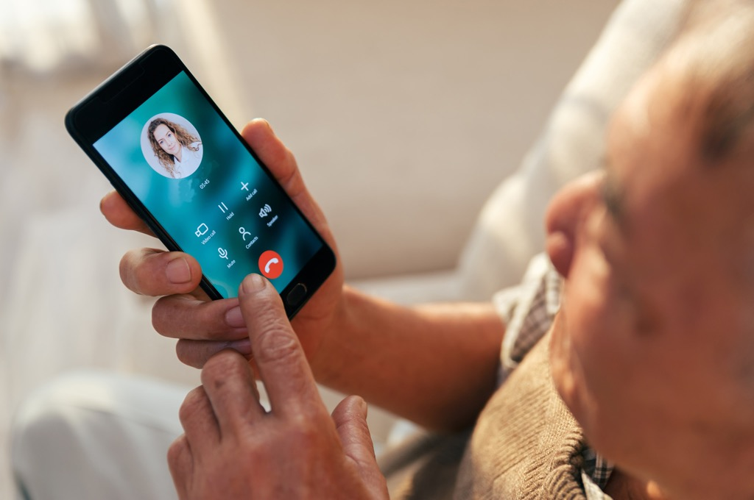
Audio Only Visits
Notes:
USE POWERPOINT
What is telehealth?
Audio Visits. The appointment with your health care provider is a phone call.

Slide 12


Secure Messaging
Notes:
USE POWERPOINT
What is telehealth?
Secure messaging. It’s a way for a patient and provider to send messages back and forth online, privately and securely, about the patient’s medical care. It’s like sending an email, but using the portal makes sure that only you and your health care providers have access to this communication. For instance, a provider may want to share the results of a medical test like an X-ray, and they can do this by sending a message. Or they may ask you a question. Other times, you may have a question you want to ask your provider. For example, you have a new prescription, and you don’t understand the instructions on the label.

Slide 13
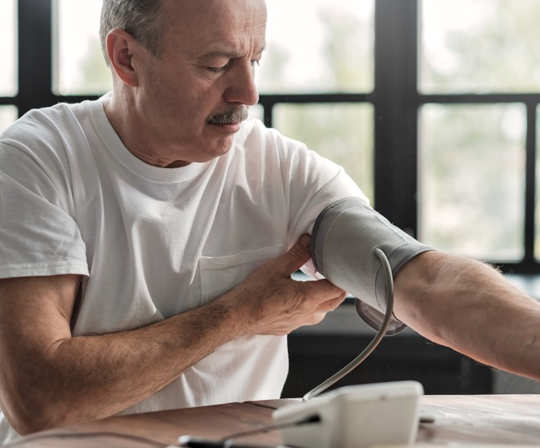
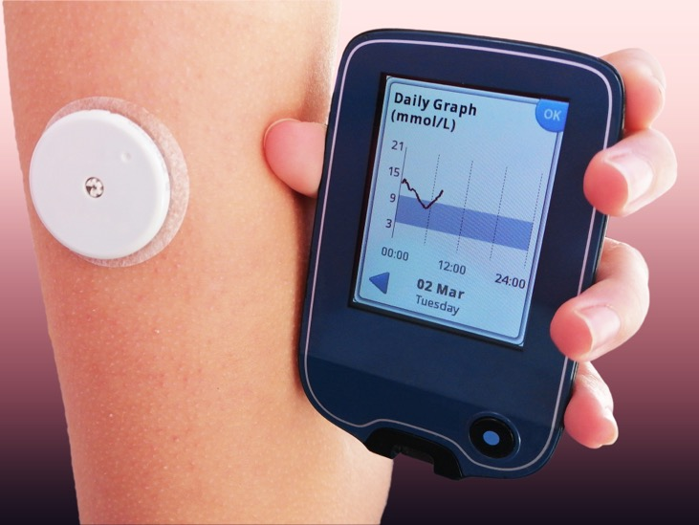
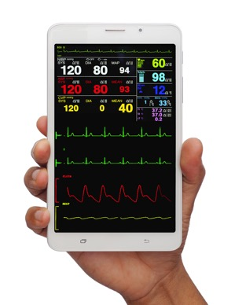
Remote Monitoring
Notes:
USE POWERPOINT
What is telehealth?
Remote monitoring. A provider may want to monitor certain health conditions over time. In these cases, you might use a medical device with an internet connection to share information with your doctor, like your blood pressure, glucose levels, and more.

Slide 14

Finding Telehealth Options
Ask your current provider what telehealth options they offer.
Contact your health insurance company, Medicare or Medicaid, to see if they have a list of providers who offer telehealth services.
Notes:
USE POWERPOINT
What is telehealth?
How can you find a health care provider who supports telehealth?
[INSTRUCTOR NOTE: Click ENTER to display the first bullet point.]
Ask your current provider what telehealth options they offer.
[INSTRUCTOR NOTE: Click ENTER to display the second bullet point.]
Contact your health insurance company, Medicare or Medicaid, to see if they have a list of providers who offer telehealth services.
ADDITIONAL DETAILS: If there are local options for receiving telehealth care regardless of a patient's ability to pay, you should list the resources here or slide 15. Also, add the resources to the Learner Handout and inform the learners that the resources are listed on the handout for later reference.

Slide 15
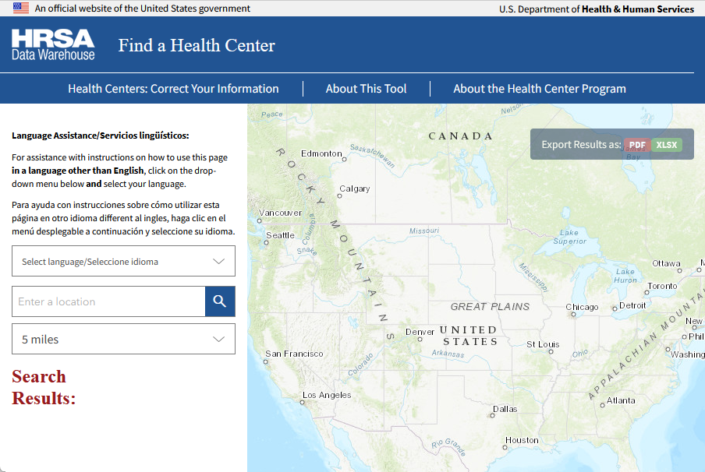
Finding Telehealth Options
If you don’t have health insurance, see if a health care center in your area provides telehealth services.
https://findahealthcenter.hrsa.gov
Notes:
USE POWERPOINT
What is telehealth?
If you don’t have health insurance, health care centers in your area may provide telehealth services regardless of a patient's ability to pay. The Health Resources & Services Administration has locations across the US that provide free or low-cost health care. They have a tool to find health centers in your area. The link is available in the Learner Handout we provided to you earlier.
INSTRUCTOR NOTE: The link to the HRSA tool is clickable if you would like to do a live demonstration.

Slide 16
Questions
Do you have any questions before we move to the next section?
Notes:
USE POWERPOINT
Review: what is telehealth?
Do you have any questions before we move to the next section?
INSTRUCTOR NOTE: Review and address items in the “parking lot”.
ADDITIONAL DETAILS: For information about what the parking lot is, see the “Before the Workshop Begins” section of the Instructor Guide.

Slide 17
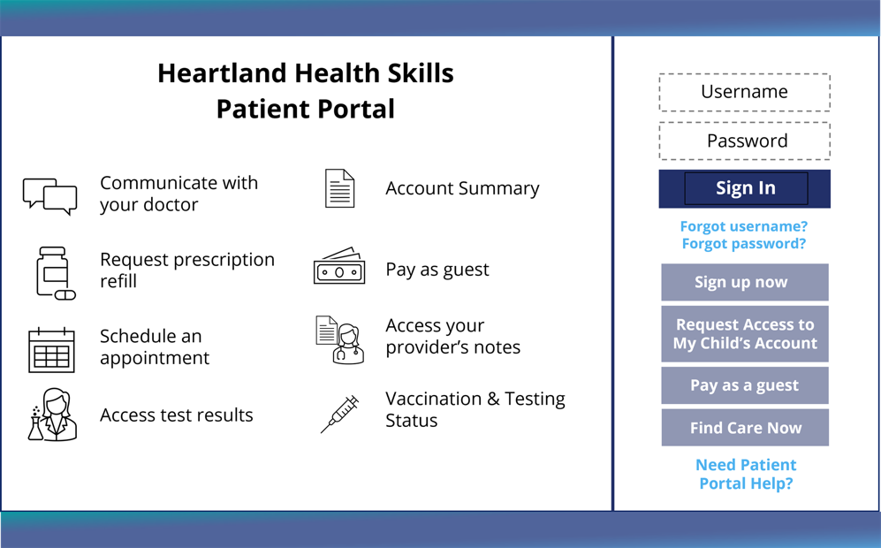
What is a Patient Portal?
It is a secure website provided by a health care provider, a hospital, or clinic, to manage your medical care.
Notes:
USE POWERPOINT
Using a Patient Portal
A patient portal is a secure website provided by a health care provider, a hospital, or clinic, to manage your medical care. You can access your patient portal using an internet browser or app on your smartphone or tablet.
Even if your health care provider has a patient portal, you can still call you provider on the phone just like you do now.
Please note, if you receive medical care from different health care systems, you may need to create an account for each portal.

Slide 18
Introduction
Does your health care provider have a portal?
How many of you have used your provider's patient portal?
What can you do on the health care provider’s portal?
Notes:
USE POWERPOINT
Introduction to Using a Patient Portal
Does your health care provider have a portal? Raise your hands if you know if your health care provider has a portal.
[INSTRUCTOR NOTE: Click ENTER to display the second question.]
How many of you have used your provider's patient portal? Raise your hands if you have used your health care provider’s portal.
[INSTRUCTOR NOTE: Click ENTER to display the third question.]
What can you do on the health care provider’s portal?
INSTRUCTOR NOTE: Lead a brief discussion about what they can do on the health care provider’s portal? Actions that were already covered include:
Contact their health care provider to ask questions about a problem or to renew a prescription.
Schedule appointments.
See a list of upcoming and past appointments.
Access lab results.
See your health care provider’s notes from a past appointment.

Slide 19
Things You Can Do with a Patient Portal
Read your provider's notes about your medical visits.
View a list of your medications and request refills.
See a history of your medical care.
Track which appointments you need to schedule and which ones you have already scheduled.
Schedule your appointments.
Pay and view your bills.
And access lab and imaging results.
Notes:
USE POWERPOINT
Using a Patient Portal
The patient portal allows you to:
[INSTRUCTOR NOTE: Click ENTER to display Bullet 1.]
Read your provider's notes about your medical visits.
[INSTRUCTOR NOTE: Click ENTER to display Bullet 2.]
View a list of your medications and request refills.
[INSTRUCTOR NOTE: Click ENTER to display Bullet 3.]
See a history of your medical care.
[INSTRUCTOR NOTE: Click ENTER to display Bullet 4.]
Track which appointments you need to schedule and which ones you have already scheduled.
[INSTRUCTOR NOTE: Click ENTER to display Bullet 5.]
Sometimes, you will be able to schedule your appointments, but sometimes, you will still need to call your provider on the phone.
[INSTRUCTOR NOTE: Click ENTER to display Bullet 6.]
Pay and view your bills.
[INSTRUCTOR NOTE: Click ENTER to display Bullet 7.]
And access lab and imaging results.
Before you can use all of these features you will need to create an account to use the patient portal.

Slide 20


Before You Begin
Notes:
USE POWERPOINT
Using a Patient Portal
To create a patient portal account, you will need a computer, laptop, tablet, or smartphone, internet access and a web browser.
INSTRUCTOR NOTE: To engage the learners, ask the participants which device or devices they will use to access the patient portal?

Slide 21
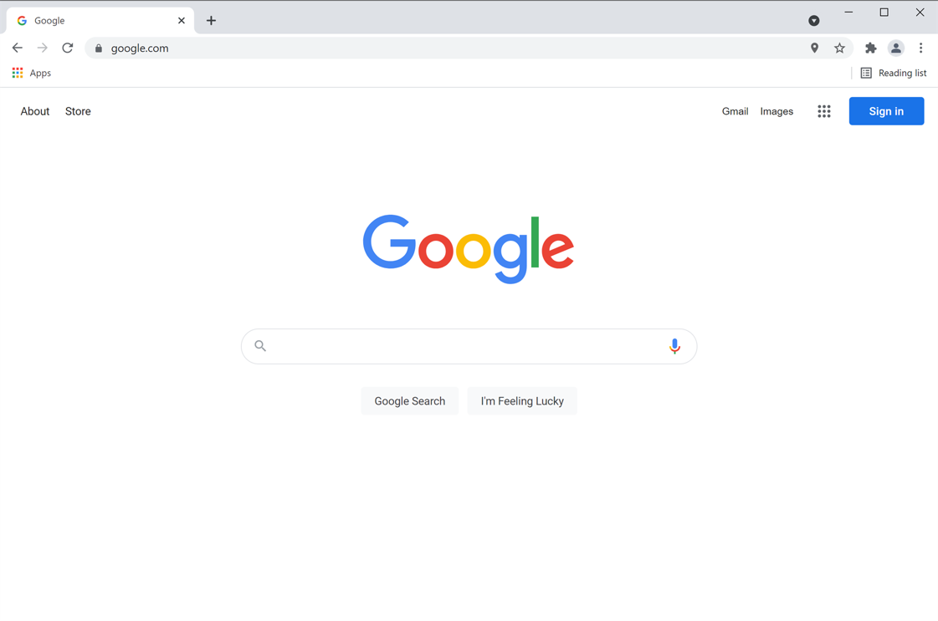
Find Your Provider’s Portal Online
Notes:
USE POWERPOINT OR LIVE DEMONSTRATION
Using a Patient Portal
To create an account, you must first go to your health care provider’s patient portal. To do this, open your web browser.
If you have the URL of the portal, you can enter it into your web browser. If you don’t, you can search for it online. To search, type in the name of the health care system and the words patient portal into the search box and click enter on the keyboard or tap Go on your smartphone or tablet.
INSTRUCTOR NOTE: You could do a live demonstration and search for one of health care systems in your community.

Slide 22




Find Your Provider’s Portal Online
Google
Chrome
Microsoft
Edge
Apple
Safari
Mozilla
Firefox
Notes:
USE POWERPOINT OR LIVE DEMONSTRATION
Using a Patient Portal
Here are a few web browsers you can use.
Google Chrome
Microsoft Edge
Apple Safari
Mozilla Firefox
INSTRUCTOR NOTE: To engage the learners, you may want to ask the participants what web browser they use. You may also want to inform them which browser you have on the library’s public computers.

Slide 23
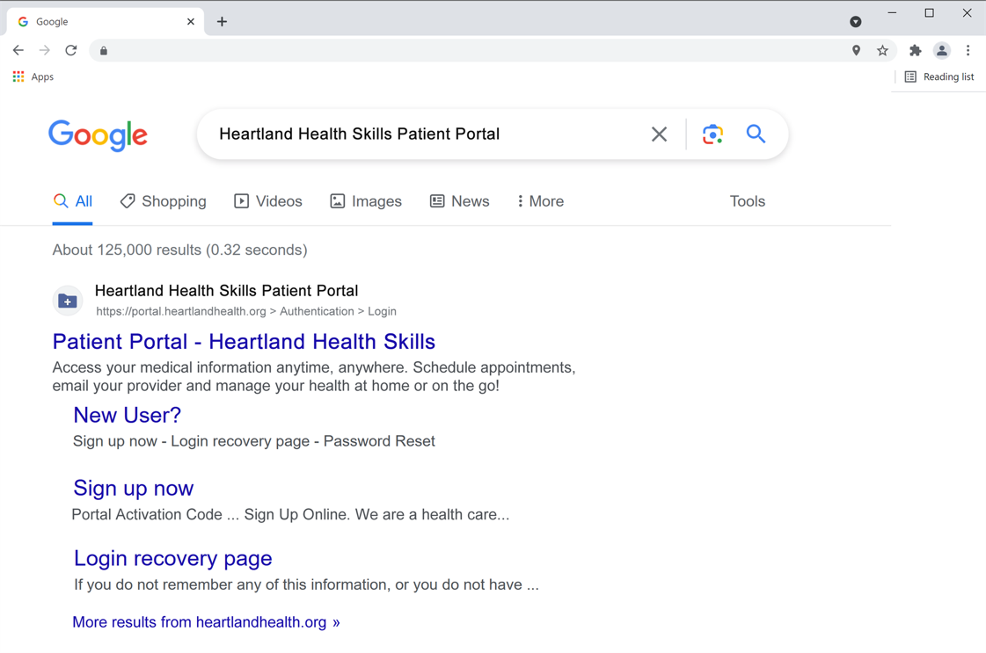
Search Results
Notes:
USE POWERPOINT OR LIVE DEMONSTRATION
Using a Patient Portal
The search results appear. Since we are searching for “Heartland Health Skills Patient Portal”
[INSTRUCTOR NOTE: Click ENTER to highlight the patient portal link for Heartland Health Skills.]
you would click on that link to go to that portal’s web page.
INSTRUCTOR NOTE: Heartland Heath Skills Patient Portal is only an example and does not have a website. If doing a live demonstration, click on the link for the local health care systems you searched.

Slide 24

Getting Started with the Patient Portal
Notes:
USE POWERPOINT
Using a Patient Portal
The Heartland Health Skills patient portal web page displays. Your patient portal may look different, but you should be able to apply what you learned today when you use your health care provider’s patient portal.
[INSTRUCTOR NOTE: Click ENTER to highlight the Sign up now button.]
To create your account, you will click on the button that says Sign up now or Create account.
If you receive medical care from different health care systems, you may need to create an account for each portal.

Slide 25
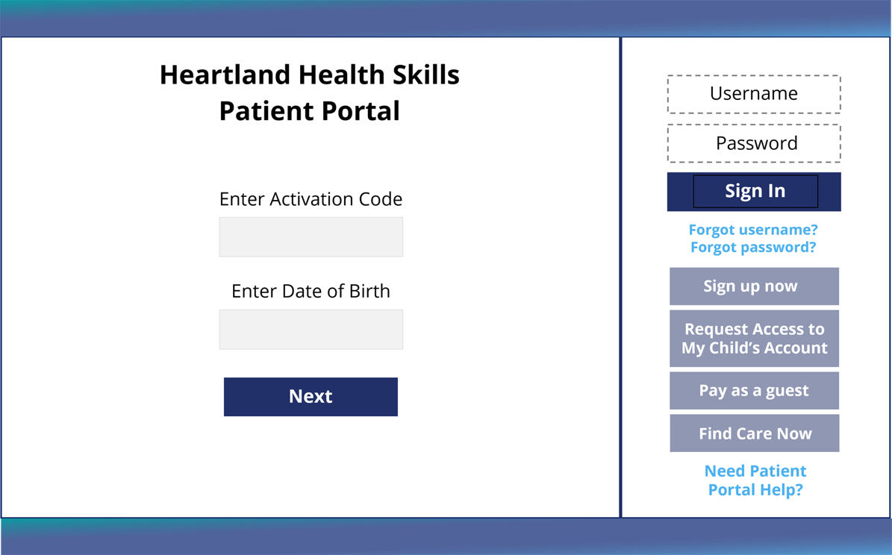
Getting Started with the Patient Portal
Notes:
USE POWERPOINT
Using a Patient Portal
You may need to enter an activation code and your date of birth to create your portal account. If you are required to enter an activation code your provider should send you the code in advance, either by email or in the mail. Each portal is different so follow the instructions that display on the web page.
[INSTRUCTOR NOTE: Click ENTER to highlight the Enter Activation Code box.]
This system requires an activation code so you would enter that code into the text box,
[INSTRUCTOR NOTE: Click ENTER to highlight the Date of Birth box.]
and then enter your birthday.
[INSTRUCTOR NOTE: Click ENTER to highlight the Next button.]
Then click the Next button.
Contact your provider if you need them to resend the code or if you need help.
You will only need the activation code to set up your account.

Slide 26
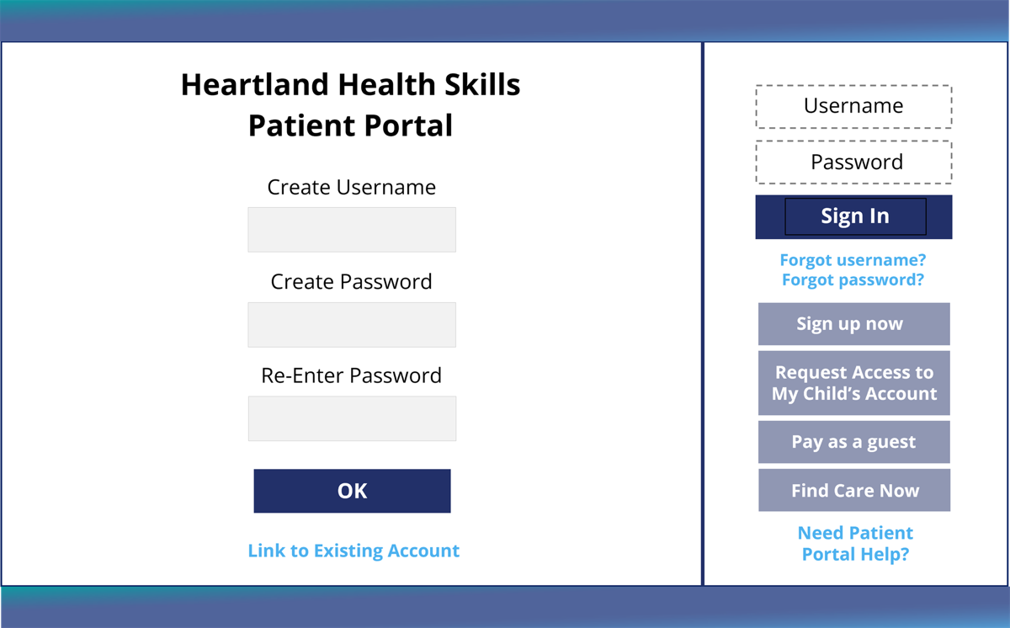
Getting Started with the Patient Portal
Notes:
USE POWERPOINT
Using a Patient Portal
You will then be asked to create a username and password. You will use it each time you log into the portal website so it is important to pick a username and password that you will remember.
[INSTRUCTOR NOTE: Click ENTER to highlight the Create Username box.]
Enter the username you selected in the Create Username text box.
[INSTRUCTOR NOTE: Click ENTER to highlight the Create Password box.]
Then enter your password.
[INSTRUCTOR NOTE: Click ENTER to highlight the Re-enter Password box.]
Re-enter your password. It must match the password you entered above.
[INSTRUCTOR NOTE: Click ENTER to highlight the Okay box.]
To create the account, click OK.
[INSTRUCTOR NOTE: Click ENTER to highlight the Link to Existing Account link.]
If you are a parent of a minor child or the authorized caregiver of an adult, for instance, your parent, you can link their account with your account so that you only need to use one username and password to access both accounts. Contact your provider if you need help.

Slide 27
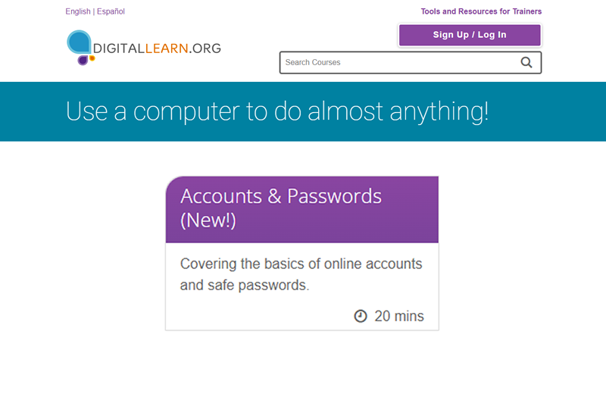
PLA DigitalLearn: Accounts & Passwords
https://www.digitallearn.org/
Notes:
USE POWERPOINT
Using a Patient Portal
To learn how to create online accounts that are safe and secure, watch the PLA DigitalLearn course Accounts and Passwords. See the Learner Handout that you received during the workshop for a link to PLA DigitalLearn.
INSTRUCTOR NOTE: The link to the PLA DigitalLearn tool is clickable if you would like to do a live demonstration and show the learner how to access this course from the PLA DigitalLearn site.

Slide 28
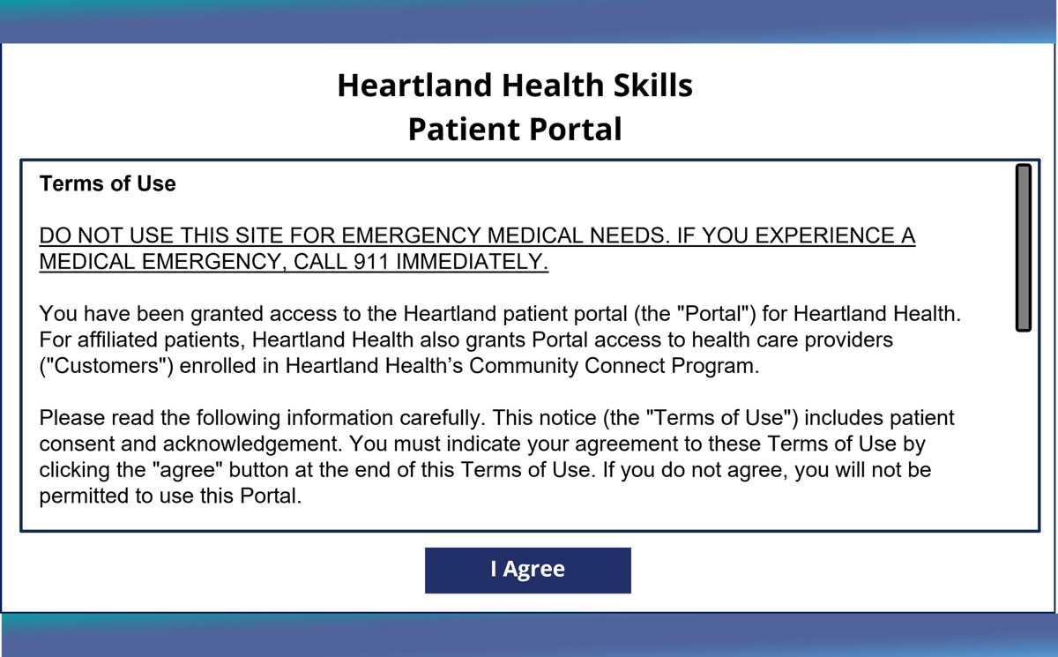
Getting Started with the Patient Portal
Notes:
USE POWERPOINT
Using a Patient Portal
A web page with the Terms of Use displays. It explains how the health care system can use your information in the portal. You need to agree to the Terms to use the portal.
[INSTRUCTOR NOTE: Click ENTER to highlight the I agree box.]
After reading it, click I Agree.

Slide 29
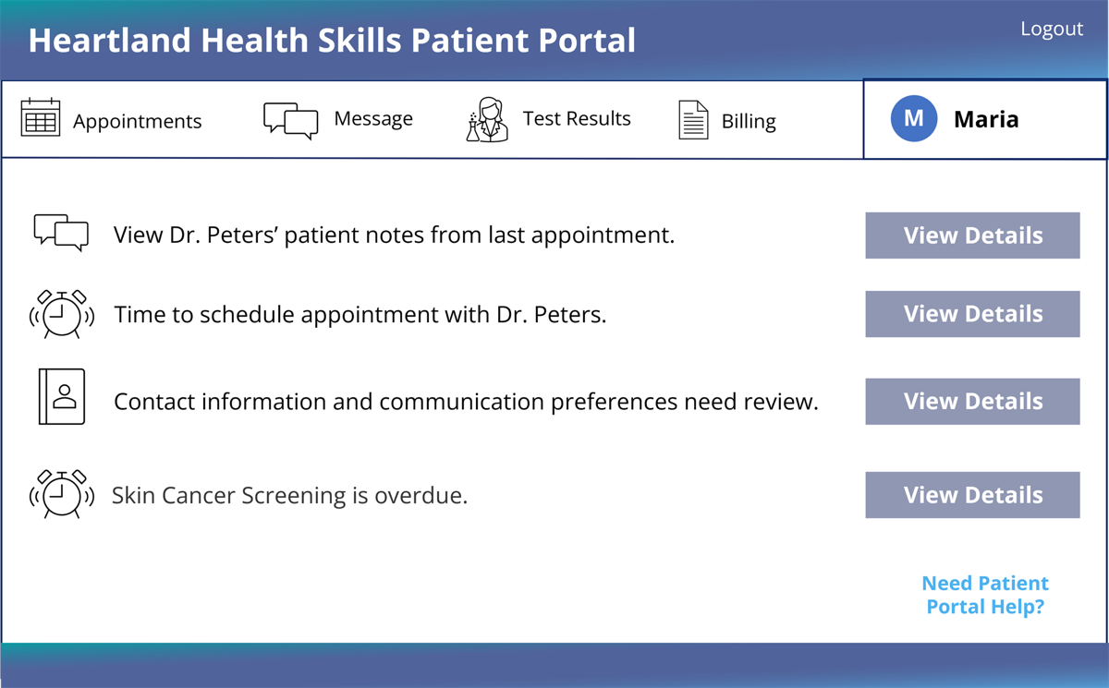
Getting Started with the Patient Portal
Notes:
USE POWERPOINT
Using a Patient Portal
Congratulations! Your account is created and information about you will appear on the screen.
Remember that each patient portal is slightly different so follow the instructions that display on the screen as you create your account on your provider’s patient portal. If you have questions or experience problems, check your health care provider's website for instructions or you can give them a call to ask for additional assistance.

Slide 30
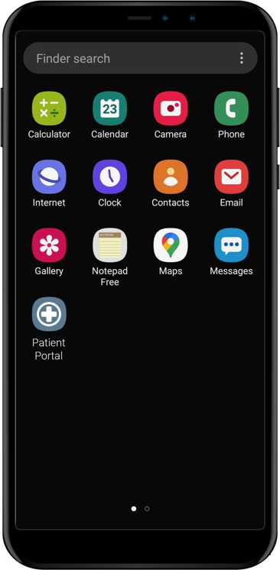
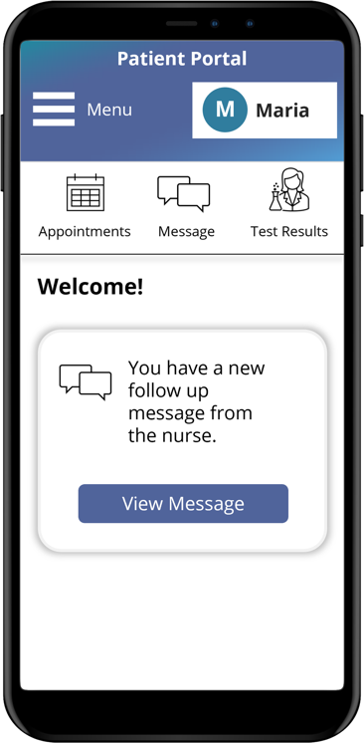
Getting Started with the Patient Portal
Notes:
USE POWERPOINT
Using a Patient Portal
If you choose to use your tablet or smartphone to create an account or log into the patient portal, you can use that device’s web browser. Some health care systems may also have an app. You will need to download and install the app on your phone or tablet. Ask your provider how to find their app.
[INSTRUCTOR NOTE: Click ENTER to highlight the Patient Portal app.]
To open the app, tap the portal icon, then the portal app will open.

Slide 31
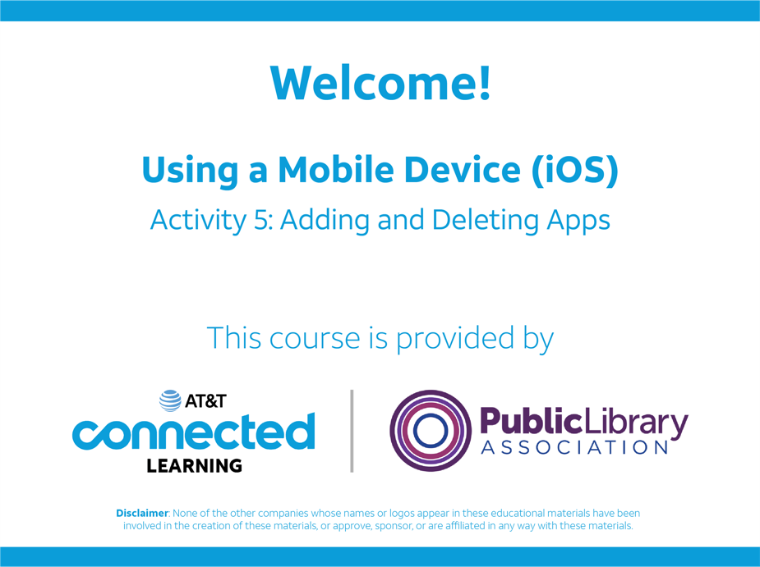
PLA DigitalLearn: Using a Mobile Device (iOS and Android)
https://www.digitallearn.org/
Notes:
USE POWERPOINT
Using a Patient Portal
To learn more about how to find, download and install an app on your smartphone, watch PLA DigitalLearn’s course Using a Mobile Device Lesson 5 for help. See the Learner Handout that you received during the workshop for a link to PLA DigitalLearn.
INSTRUCTOR NOTE: The link to the PLA DigitalLearn tool is clickable if you would like to do a live demonstration and show the learner how to access this course from the PLA DigitalLearn site.

Slide 32
Communicating with Your Provider Using the Patient Portal
Notes:
USE POWERPOINT
Using a Patient Portal
While you can still call your health care provider on the phone, you can also send messages using the patient portal. When you send information to your provider, it is recommended that you use your patient portal instead of using your personal email or sending a text message.
When you send a message to your medical team using the patient portal only you and your medical team can see information in your medical record.
Messages sent outside of the portal may not protect your information because the communication is not secure.
[INSTRUCTOR NOTE: Click ENTER to highlight the Message icon.]
To send a message to your provider, click on the Message icon in the portal. Remember, you must be logged into the patient portal to message your provider!

Slide 33
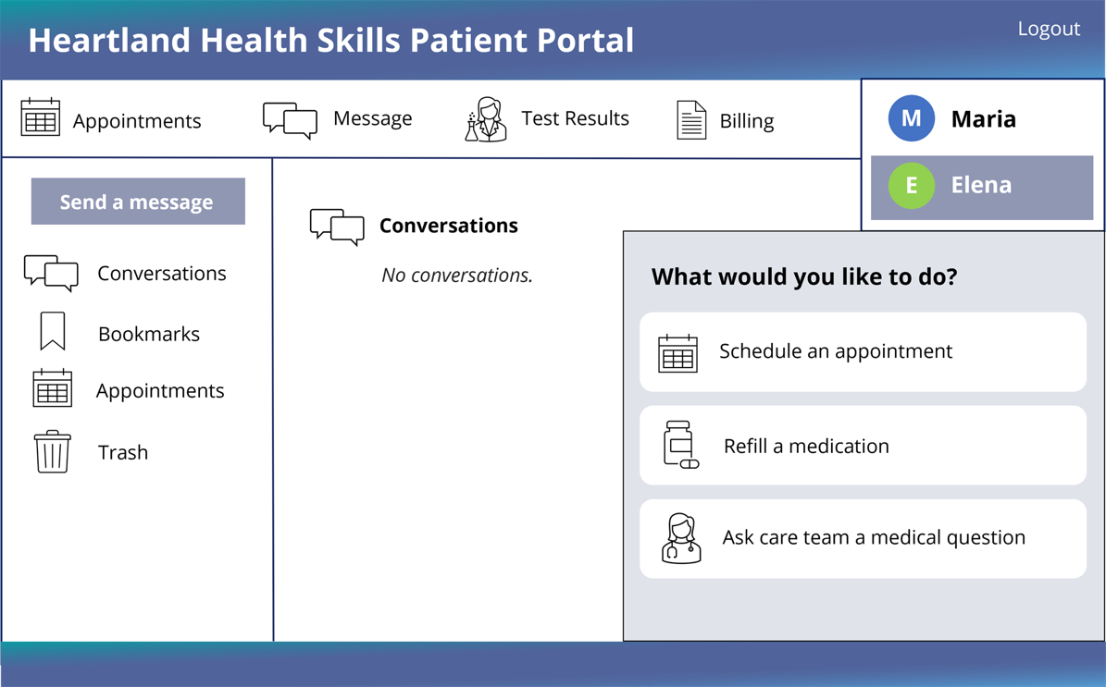
Communicating with Your Provider Using the Patient Portal
Notes:
USE POWERPOINT
Using a Patient Portal
A menu will usually appear asking, ”What would you like to do?” Remember, each patient portal may have slightly different menu choices. This portal has three choices:
Schedule an appointment.
Refill a medication.
Ask a care team a medical question.
You will select the choice that matches your request.

Slide 34
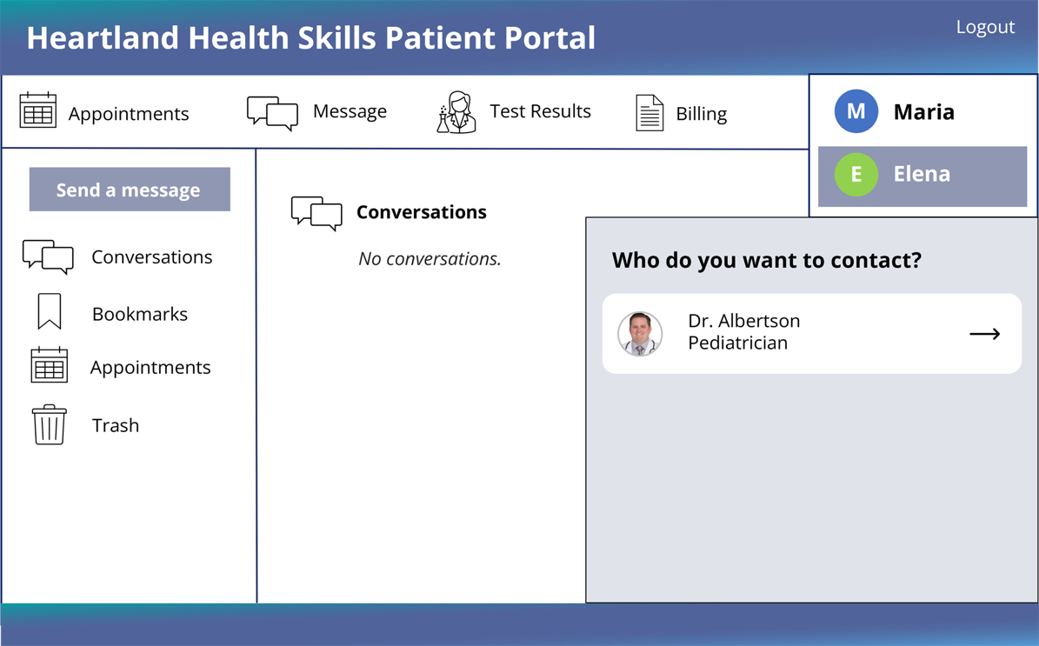
Communicating with Your Provider Using the Patient Portal
Notes:
USE POWERPOINT
Using a Patient Portal
If you have more than one provider, you will need to select which health care provider you would like to send the message to.

Slide 35
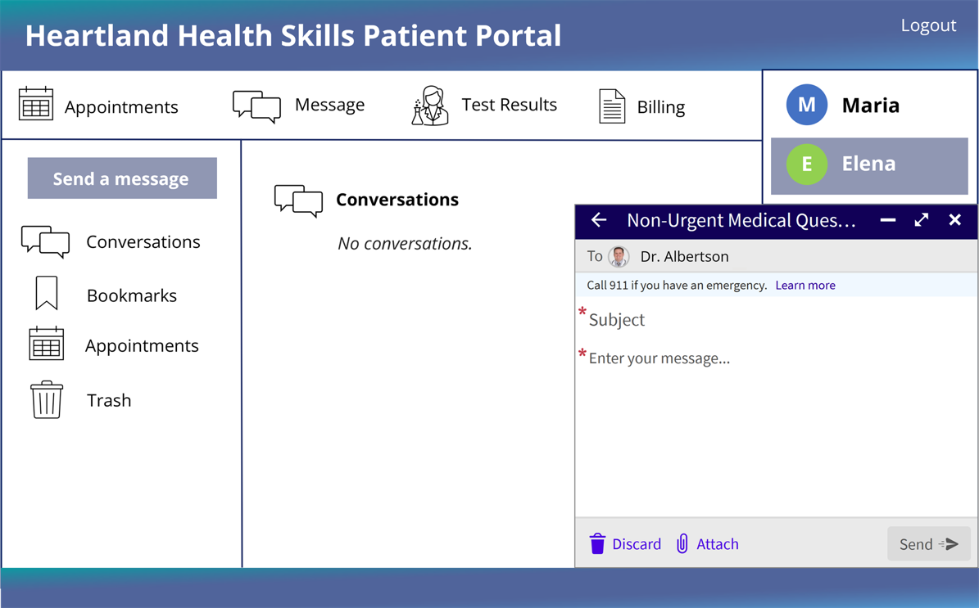
Communicating with Your Provider Using the Patient Portal
Notes:
USE POWERPOINT
Using a Patient Portal
You will then enter a Subject and Message into the message box.

Slide 36
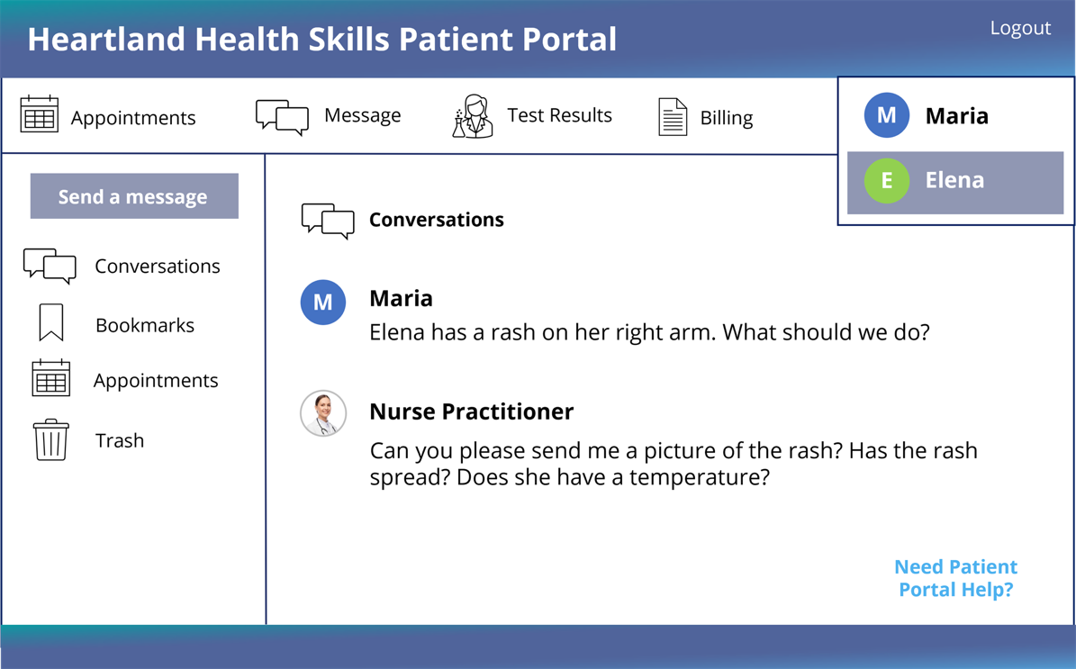
Communicating with Your Provider Using the Patient Portal
Notes:
USE POWERPOINT
Using a Patient Portal
A health care provider will respond. Sometimes, they will send you a message using the portal, or they might give you a phone call. In this example, a nurse responds using the portal’s messaging system and asks for additional information. You can use the portal to respond to the questions.

Slide 37
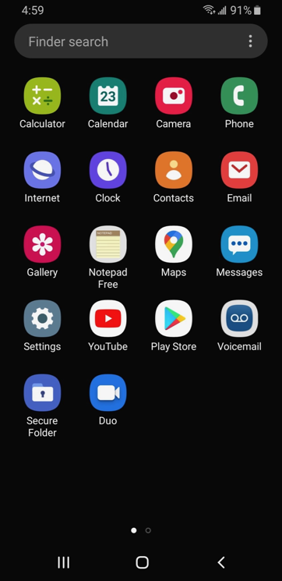
Communicating with Your Provider Using the Patient Portal
Notes:
USE POWERPOINT
Using a Patient Portal
Don’t forget that the patient portal can be accessed using any computing device that has a web browser and internet access. You can send a message using your computer or laptop, but you can respond to a message using your tablet or phone or vice versa.
When using a tablet or smartphone, you can either connect with the patient portal using
[INSTRUCTOR NOTE: Click ENTER to highlight the Web Browser app.]
the web browser or
[INSTRUCTOR NOTE: Click ENTER to highlight the Patient Portal app.]
the app once you have downloaded and installed it on your device.

Slide 38
Question
What questions might you ask your health care provider using the patient portal messaging feature?
Notes:
USE POWERPOINT
Review: Using a Patient Portal
What questions might you ask your health care provider using the patient portal messaging feature?
INSTRUCTOR NOTE: Lead a brief discussion about how they can use the Message feature of the patient portal. Possibilities include
To ask a question about a current prescription
Request a referral to see a specialist
Ask if you need to schedule an appointment for an issue. For instance, you have a rash, and it is not going away. Should you go to urgent care, schedule an appointment to see the doctor, or see if a telehealth visit may work to diagnose the problem?
INSTRUCTOR NOTE: Consider an example (either your own, a story from a friend, or a scenario you could expect to happen) that illustrates a way the learners can use telehealth in case no one volunteers.
INSTRUCTOR NOTE: Before moving to the next slide, remind the learners that, Communicating through the portal is not for emergency situations. Dial 911 if you need immediate care.

Slide 39
Let’s Review
What is a patient portal?
What are some of the things you can do with a patient portal?
Notes:
USE POWERPOINT
Review: Using a Patient Portal
Before we move to the next section let’s review. What is a patient portal?
INSTRUCTOR NOTE: Lead a brief discussion about what is a patient portal.
It is a secure website that allows you to access your medical information and communicate with your health care providers online using an internet browser or app on a computer, laptop, tablet, or smartphone.
INSTRUCTOR NOTE: Lead a brief discussion about how they can use the patient portal? Possibilities include
schedule appointments
check-in on medical issues
discuss lab tests or X-ray results
follow up on prescription medications
receive post-surgical follow-up
receive preventive care like nutrition counseling
receive referrals to specialists,
receive mental health treatment, including therapy and counseling
Before we move to the next section do you have any questions?
INSTRUCTOR NOTE: Review and address items in the “parking lot”.
ADDITIONAL DETAILS: For information about what the parking lot is, see the “Before the Workshop Begins” section of the Instructor Guide.

Slide 40

Technical Requirements of a Video
Telehealth Visit
Notes:
USE POWERPOINT
Technical Requirements
Let’s explore what technology you need to participate in a video telehealth visit.

Slide 41

Technical Requirements: What You Need
A computing device with a:
  Camera
  Microphone
  Speaker
Notes:
USE POWERPOINT
Technical Requirements
To connect to a video telehealth visit, you need to pick a device with a camera, microphone, and speaker.
Let’s explore what device you should pick by learning about the pros and cons of using a smartphone, tablet, computer, and laptop for a telehealth visit.

Slide 42

Smartphone or Tablet
Advantages
Built-in microphone, speaker and camera
Easy to maneuver
It’s portable
Disadvantages
May need to download an app
Smartphone screens are small
Place the device on a stand
Notes:
USE POWERPOINT
Technical Requirements
Some of the benefits of using a smartphone or tablet include it has a built-in microphone, speaker, and camera.
They are easy to move so that you can easily show the provider something like a rash on your arm.
And it’s portable, so you can easily move the device to the place you want to have the meeting.
[INSTRUCTOR NOTE: Click ENTER to display the Disadvantages.]
While there are many benefits to using a smartphone or tablet, there are some disadvantages as well. For instance, you may need to download an app to connect to the appointment.
Also, smartphone screens are small, so it may be hard to see the person on the screen or any documents shared with you.
You may also want to place your device on a stand, so you don’t have to hold it during the appointment. This will allow you to take notes and make sure your image on the screen does not move.

Slide 43
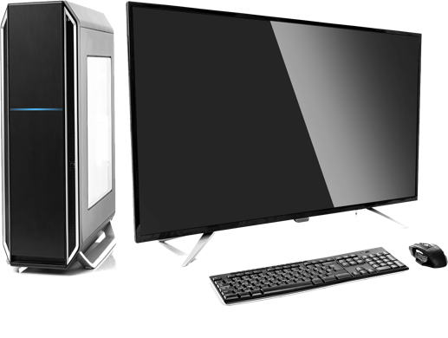

Computer or Laptop
Advantages
Screen is large making it easy to see the provider and anything they share
Most devices include built-in microphone, speaker, and camera
Laptops are portable
Notes:
USE POWERPOINT
Technical Requirements
Some of the reasons you might choose to use a desktop or laptop computer include they have a large screen, so it is easy to see the health care provider and any documents they share.
Most laptops and desktop computers include a built-in microphone, speaker, and camera. If you use a laptop, it is portable, so you can meet where it’s convenient for you.

Slide 44
Computer or Laptop
Disadvantages
Desktop computers are not portable.
Some devices may not include built-in microphone, speaker and camera.
Notes:
USE POWERPOINT
Technical Requirements
There are some disadvantages to think about as well. For instance, desktop computers are not portable.
If the computer is in a shared area, you may not have the privacy you need.
Older desktop and laptop computers may not have a built-in camera, microphone, or speakers. However, you can attach an external camera and headphones with a built-in microphone to your device.

Slide 45

Question
Which device or devices will you use to participate in your video conferencing telehealth appointment? Why?
Notes:
USE POWERPOINT
Review: Technical Requirements
INSTRUCTOR NOTE: Lead a brief discussion about which device or devices the learners will use to participate in their video conferencing telehealth appointment. Ask them why they selected the device.
Before we move to the next section, do you have any questions?
INSTRUCTOR NOTE: Review and address items in the “parking lot”.
ADDITIONAL DETAILS: For information about what the parking lot is, see the “Before the Workshop Begins” section of the Instructor Guide

Slide 46
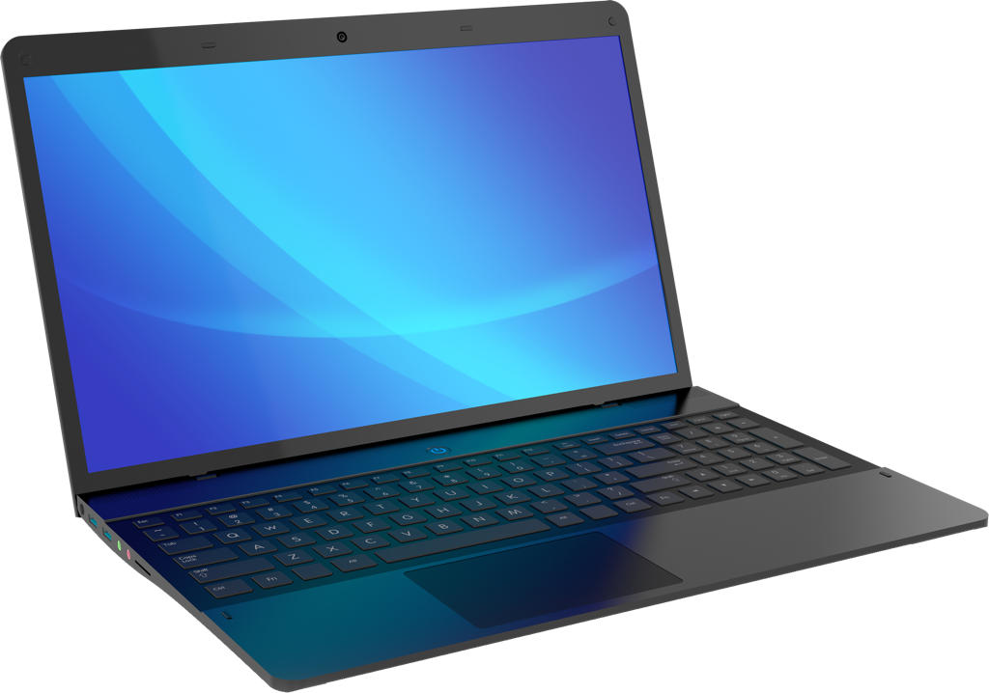

Check Your Internet Connection
Notes:
USE POWERPOINT
Technical Requirements
Now that you have selected which device you will use for your video telehealth appointment, you will need to check your internet connection to make sure it is strong enough for your appointment. It is best to check your device well before your visit so you can troubleshoot any issues. Test your computer where you will attend the telehealth visit so that you are sure the connection in that location can support your video appointment. So, if you are going to use your computing device at your kitchen table, check the internet speed from that location. You should also choose a location that is quiet and private.

Slide 47
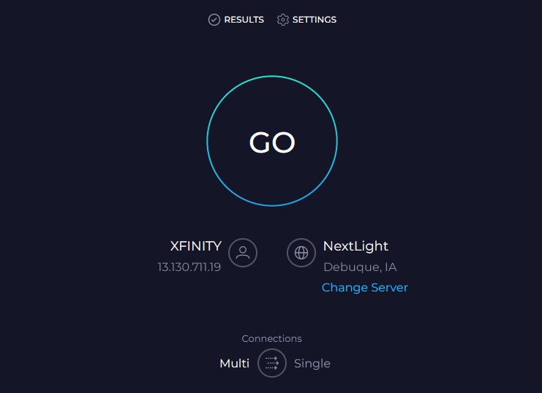
Check Your Internet Connection
https://www.speedtest.net/
Notes:
USE POWERPOINT OR LIVE DEMONTRATION
Technical Requirements
To test your internet connection use a website like Speedtest. This website works on computers, laptops, tablets and smartphones.
INSTRUCTOR NOTE: The link to the Speedtest tool is clickable if you would like to do a live demonstration and show the learner how to run the test on the website. You can demonstrate this on your computer and/or have learners try this search on their smartphone (if they have one).

Slide 48
Check Your Internet Connection
Google
Chrome
Microsoft
Edge
Apple
Safari
Mozilla
Firefox
Notes:
USE POWERPOINT OR LIVE DEMONSTRATION
Technical Requirements
To run the test, open a web browser from the device you are going to use. Here are a few web browsers:
Google Chrome
Microsoft Edge
Apple Safari
Mozilla Firefox

Slide 49
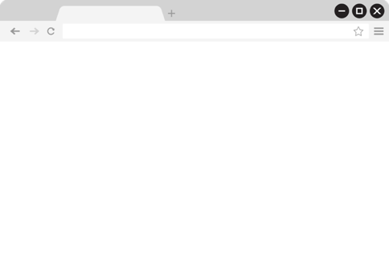
Check Your Internet Connection
speedtest.net
Notes:
USE POWERPOINT OR LIVE DEMONSTRATION
Technical Requirements
Open the web browser
[INSTRUCTOR NOTE: Click ENTER to display the URL.]
and type speedtest.net in the search bar. Once you type the URL, click enter on the keyboard or tap Go on your smartphone or tablet.

Slide 50
Check Your Internet Connection
Notes:
USE POWERPOINT OR LIVE DEMONSTRATION
Technical Requirements
The test will appear. Click the Go button to run the test.

Slide 51
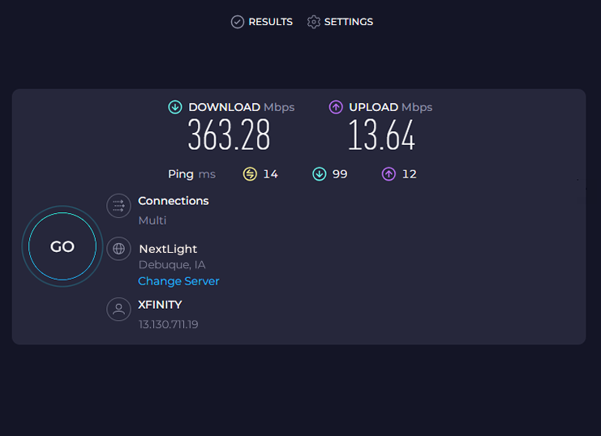
Check Your Internet Connection
Minimum download
speed 1.5 Mbps
Minimum upload
speed 12 Mbps
Notes:
USE POWERPOINT OR LIVE DEMONSTRATION
Technical Requirements
To attend a video telehealth appointment, you should have a minimum download speed of 1.5 Mbps and a minimum upload speed of 12 Mbps.
If there is more than one device in your location using the internet service at the same time as your appointment, you may need a higher upload and download speed to ensure that all the devices connecting to the internet during your appointment have adequate internet access.
When you run this test on a smartphone, only the download speed will display.

Slide 52
Do You Have the Required Software?
Google
Chrome
Microsoft
Edge
Apple
Safari
Mozilla
Firefox
Notes:
USE POWERPOINT
Technical Requirements
Sometimes all you will need to connect to your appointment is a web browser. Make sure you have the recommended browser installed on your computer and that it is up to date. Sometimes you will need to download and install an application on your device. Your provider should send you instructions. Install and test the software before your appointment so you have time to fix problems before your appointment begins.

Slide 53
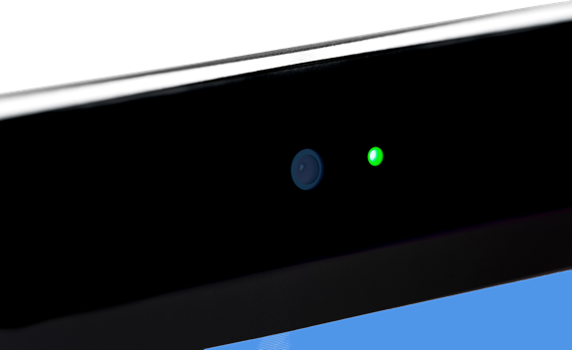

Do You Have a Camera?
Notes:
USE POWERPOINT
Technical Requirements
For a video appointment, you will need to use a device that has a camera. While most devices include a built-in camera, some do not. One way to check if your device has a camera is to look for a small camera lens. On computers and laptops, the camera is usually located at the top edge of the monitor, in the center.

Slide 54
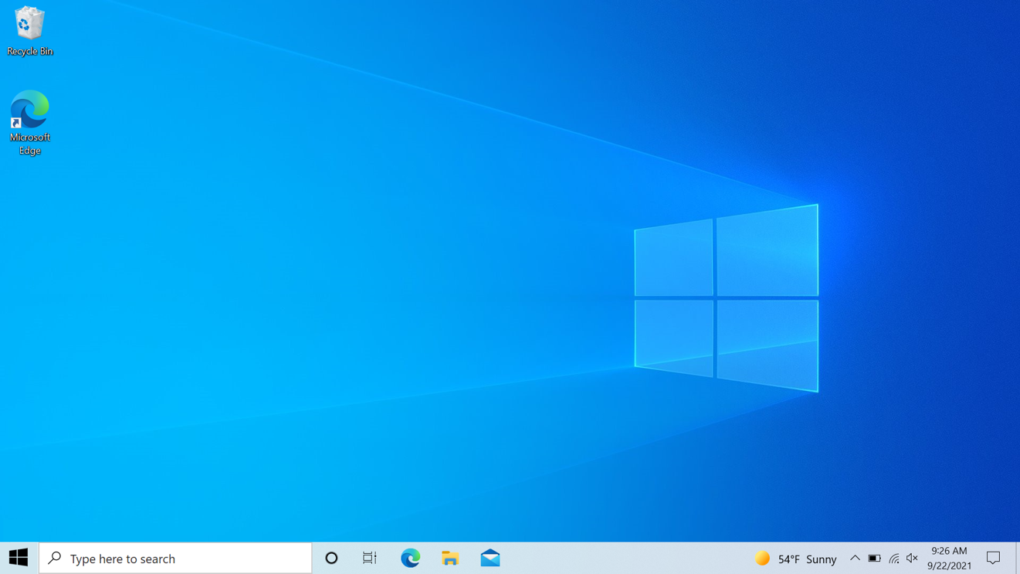
Do You Have a Camera?
camera
Notes:
USE POWERPOINT
Technical Requirements
If you can’t find the camera lens, check to see if your computer or laptop includes software to run a camera.
If you are using a Windows operating system, try searching for the software on your computer.
[INSTRUCTOR NOTE: Click ENTER to highlight the Search box.]
Some Windows computers include a search box in the taskbar,
[INSTRUCTOR NOTE: Click ENTER to highlight the Start Menu.]
or you may need to click on the Start Menu to find the search box.
[INSTRUCTOR NOTE: Click ENTER to highlight the word Camera in the Search in the Start Menu.]
Type camera in the search box and click enter on the keyboard.

Slide 55
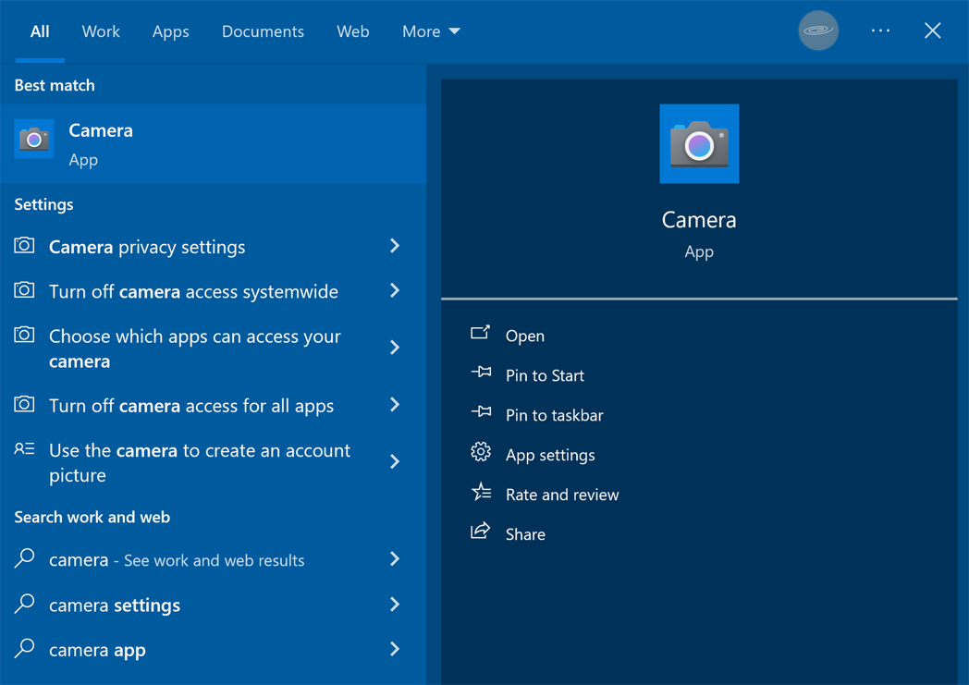
Do You Have a Camera?
Notes:
USE POWERPOINT
Technical Requirements
If the Windows Camera icon appears in the search result, click Open.

Slide 56

Do You Have a Camera?
Notes:
USE POWERPOINT
Technical Requirements
If you have a camera installed on your device, it should turn on when you click the link.

Slide 57



Do You Have a Camera?
Notes:
USE POWERPOINT
Technical Requirements
If you are using a smartphone or tablet check for a small camera lens which is usually located at the top edge of the screen or the back side of the device. In this example there are two cameras.
If you can’t find the camera lens, check to see if your smartphone or tablet includes software to use a camera.
[INSTRUCTOR NOTE: Click ENTER TWICE to remove the highlight from the camera and to highlight the camera app.]
If you are using a device running the Android operating system, look for an icon of a camera or a menu with the heading titled photo. Tap the camera icon or menu item.

Slide 58
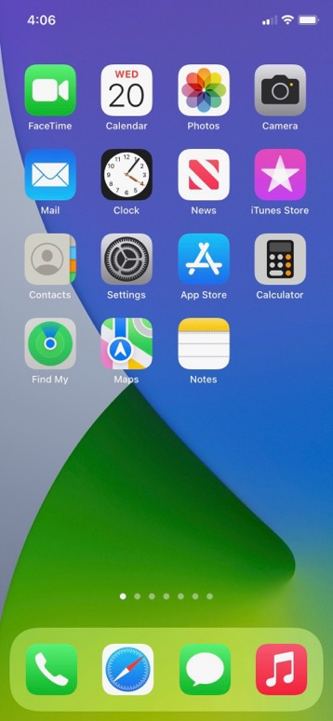
Do You Have A Camera?
Notes:
USE POWERPOINT
Technical Requirements
Apple smartphones and tablets include a camera. Most Mac computers also include a camera. A simple way to check to see if your device's camera works is to tap on the FaceTime or Camera icon.

Slide 59

Do You Have A Camera?
Notes:
USE POWERPOINT
Technical Requirements
The camera should automatically turn on when these applications open.

Slide 60

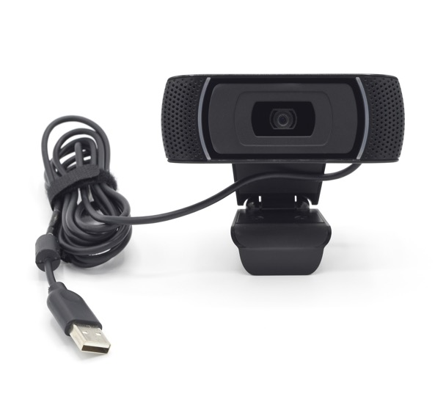

Do You Have A Camera?
Attach an external camera
Check to see if an audio-only
appointment is possible.
Notes:
USE POWERPOINT
Technical Requirements
If your computer or laptop does not have a camera, you can attach an external camera or ask your health care provider if an audio-only appointment is possible.
If these steps do not work, you should check the manufacturer's website for more information on how to troubleshoot your device's issues.

Slide 61
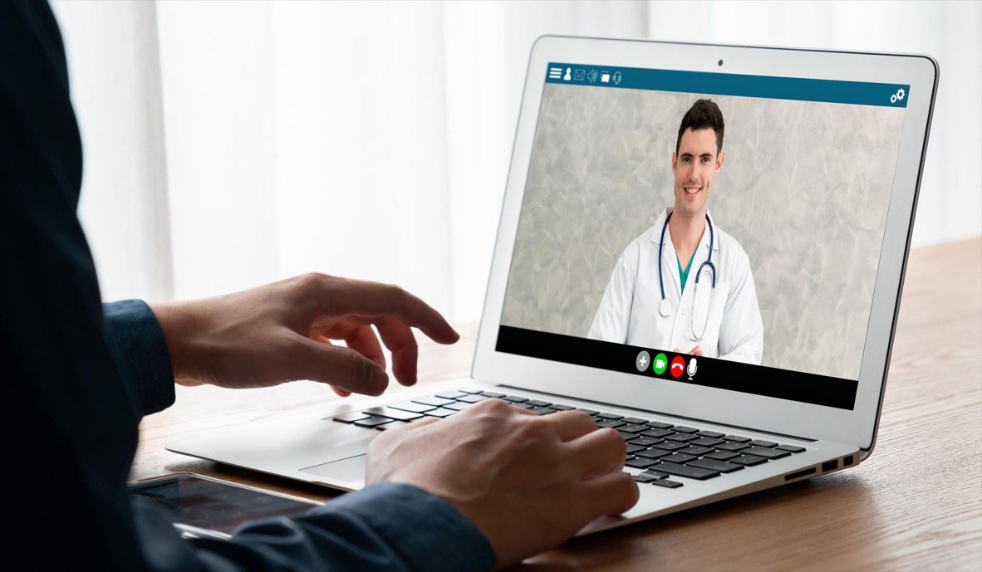
Do You Have A Camera?
Notes:
USE POWERPOINT
Technical Requirements
When possible, make sure your device is on a stable surface so your camera remains in the same position during your appointment.

Slide 62


Do You Have a Microphone and Speakers?
Notes:
USE POWERPOINT
Technical Requirements
You will also need a microphone and speaker to talk to your provider and hear their response. Many devices have a built-in microphone and speaker.

Slide 63
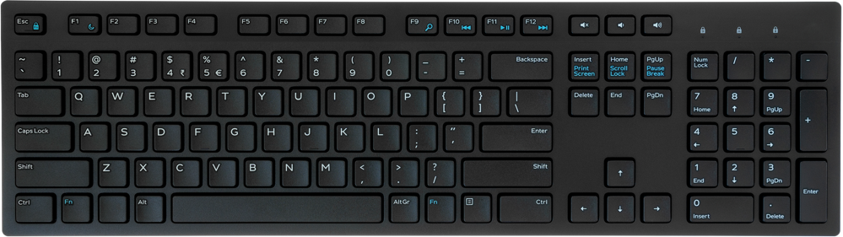

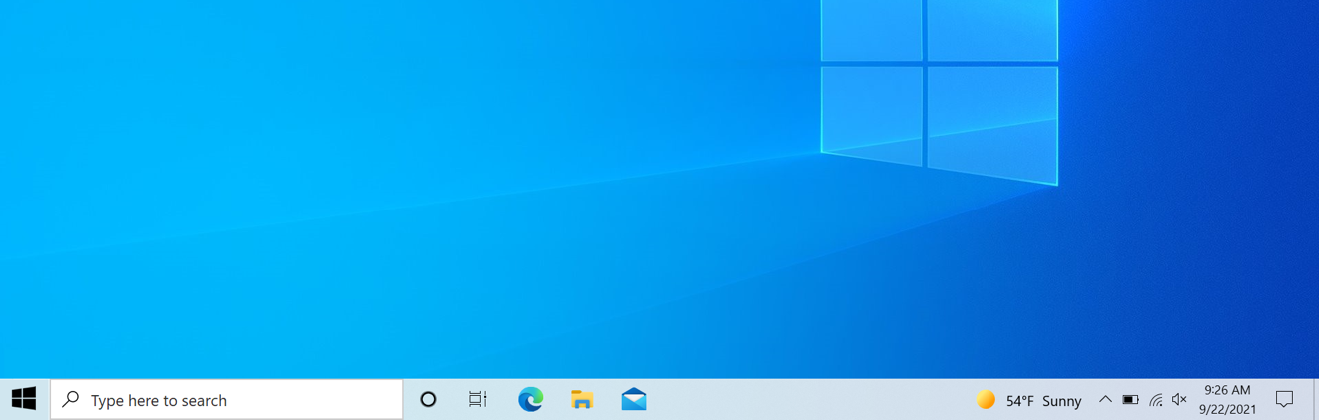

Do You Have a Microphone and Speakers?
Notes:
USE POWERPOINT OR LIVE DEMONSTRATION
Technical Requirements
INSTRUCTOR NOTE: If you are using a Windows computer for the training you may want to do a live demonstration of this section.
If you are using a computer or laptop running the Windows operating system and you can’t hear any sound, click on the volume button to increase the sound. The button may be on your keyboard or on your screen.

Slide 64
Do You Have a Microphone and Speakers?
Notes:
USE POWERPOINT OR LIVE DEMONSTRATION
Technical Requirements
If that does not fix the problem, right-click the speaker icon on the taskbar. The icon is on the lower right-hand side of the screen.

Slide 65
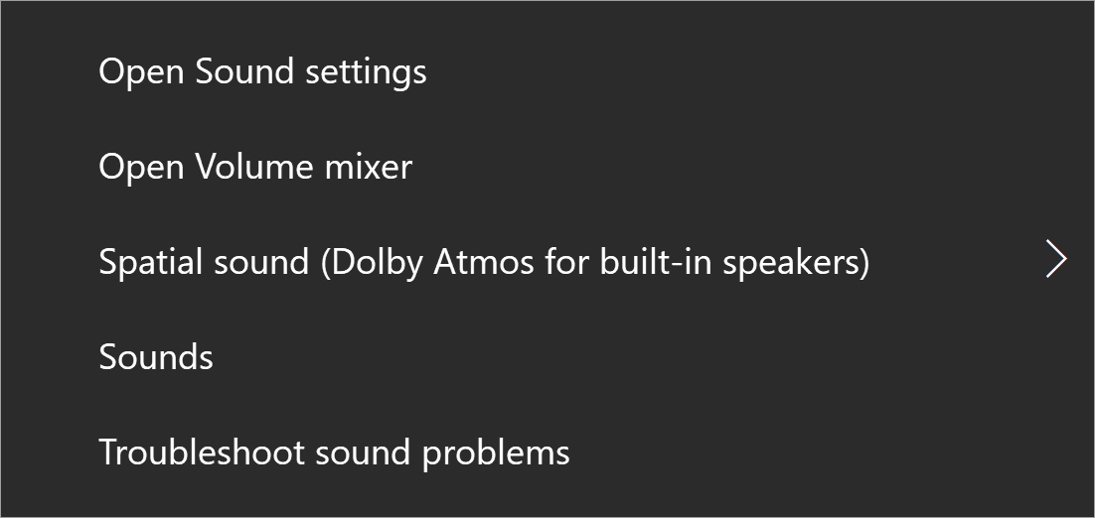
Do You Have a Microphone and Speakers?
Notes:
USE POWERPOINT OR LIVE DEMONSTRATION
Technical Requirements
The Sound menu appears. Click on Open Sound settings.

Slide 66
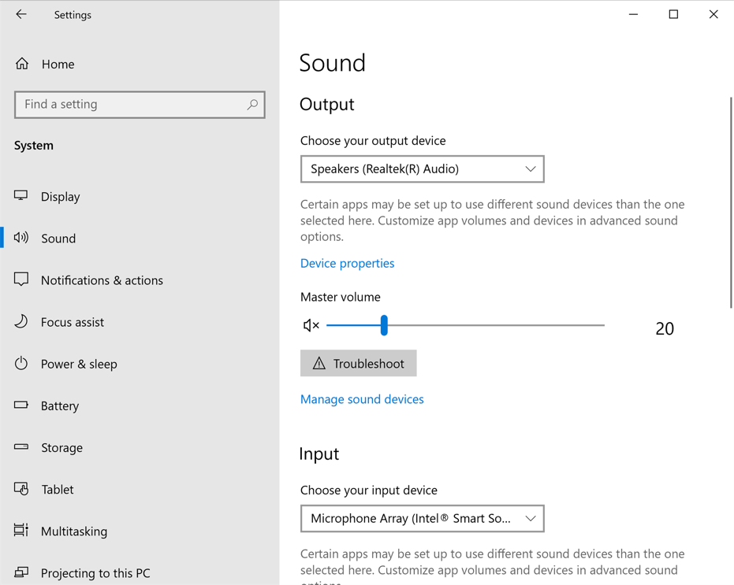
Do You Have a Microphone and Speakers?
Notes:
USE POWERPOINT OR LIVE DEMONSTRATION
Technical Requirements
If your Windows desktop or laptop has a speaker and microphone, it will show up on this screen.

Slide 67
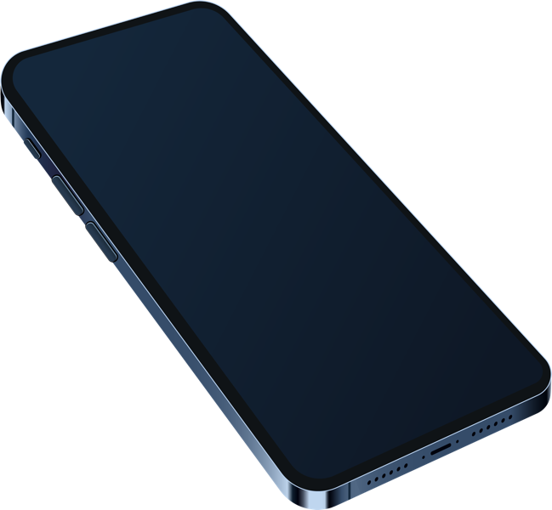

Do You Have a Microphone and Speakers?
Volume Control
Speaker/Microphone
Notes:
USE POWERPOINT
Technical Requirements
While each smartphone and tablet is different, the microphone and speaker are usually located at the bottom of your device near where you plug in the device to recharge. The microphone and speaker may be a series of little holes or may look like a vent. Make sure you do not cover the speaker and microphone when using your device.
If you can’t hear sound through the speakers, make sure the volume is turned up. There are usually one or two buttons on the side of the device that is used to control the volume.

Slide 68
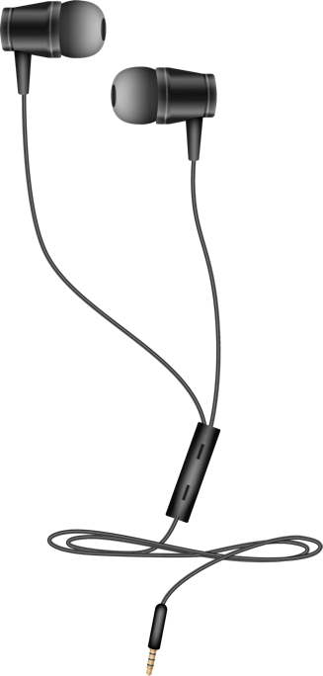

Do You Have a Microphone and Speakers?
Notes:
USE POWERPOINT
Technical Requirements
You can attach external headphones with a built-in microphone to your device if it does not include a microphone or speaker. You may want to use external headphones so that others around you cannot hear what the provider is saying. Headphones may also provide a clearer audio connection.
If these steps do not work, check the device manufacturer's website for more information.

Slide 69
Technical Requirements
A computing device with a:
  Camera
  Microphone
  Speaker
Notes:
USE POWERPOINT
Technical Requirements
If you have a computing device with a camera, microphone and speaker along with strong internet access you will be able to attend a video telehealth appointment.

Slide 70

Tips for Troubleshooting Technical Problems
Notes:
USE POWERPOINT
Tips for Troubleshooting Technical Problems
Now, let’s explore how to fix some of the most common technical problems you may have with your device when you try to connect to your telehealth appointment.

Slide 71

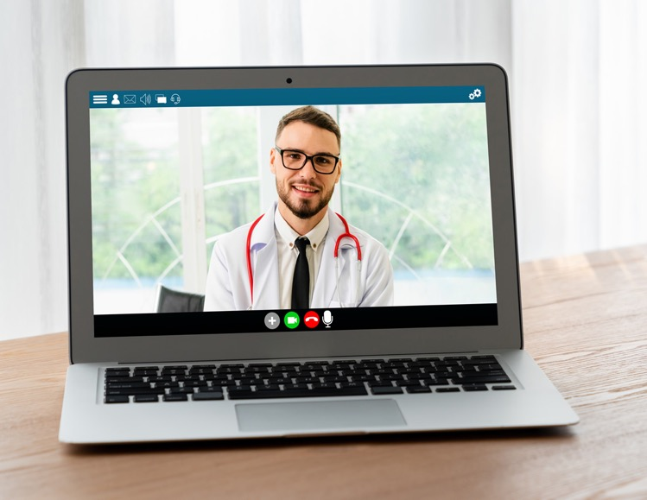





Tips for Troubleshooting Technical Problems
Make sure your camera and microphone are turned on!
OFF
ON
Notes:
USE POWERPOINT
Tips for Troubleshooting Technical Problems
Make sure your camera and microphone are turned on! If icons of a camera and microphone have a slash through them, it means they are turned off, and your provider can’t hear or see you.
[INSTRUCTOR NOTE: Click ENTER to display the Video and Microphone ON icons and image on-screen displays.]
To turn them on, click on the icon. The slash across the camera or microphone will disappear.

Slide 72
Tips for Troubleshooting Technical Problems
Restart your device.
Notes:
USE POWERPOINT OR LIVE DEMONSTRATION
Tips for Troubleshooting Technical Problems
If you experience problems, try restarting your computer or laptop. If you are using a computer running the Windows operating system, click on the Start menu on the lower left-hand side of the screen

Slide 73
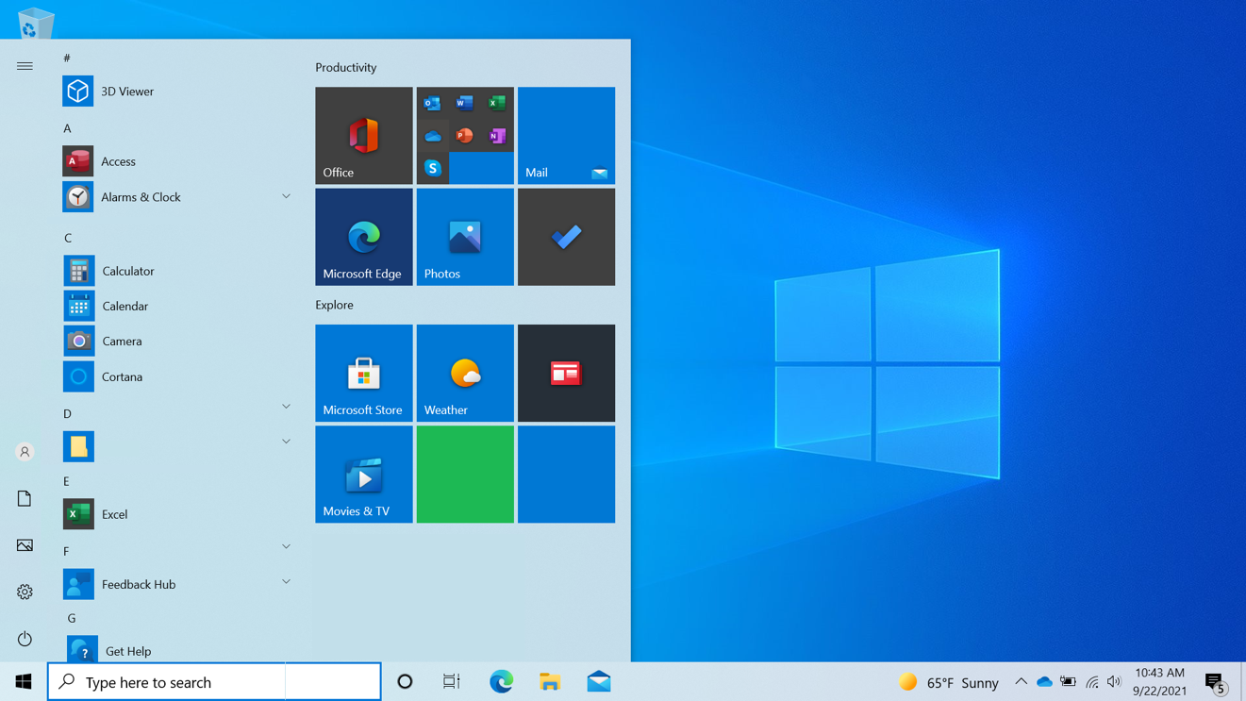
Tips for Troubleshooting Technical Problems
Restart your device.
Notes:
USE POWERPOINT OR LIVE DEMONSTRATION
Tips for Troubleshooting Technical Problems
then Power,

Slide 74
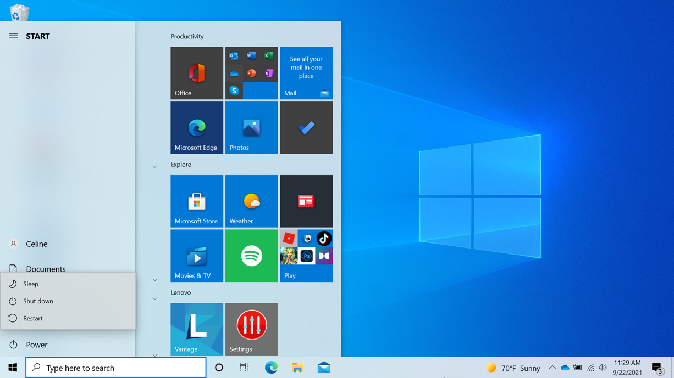
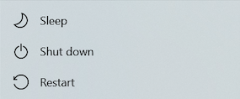
Tips for Troubleshooting Technical Problems
Restart your device.
Notes:
USE POWERPOINT OR LIVE DEMONSTRATION
Tips for Troubleshooting Technical Problems
A menu displays. Click Restart to restart your computer.

Slide 75
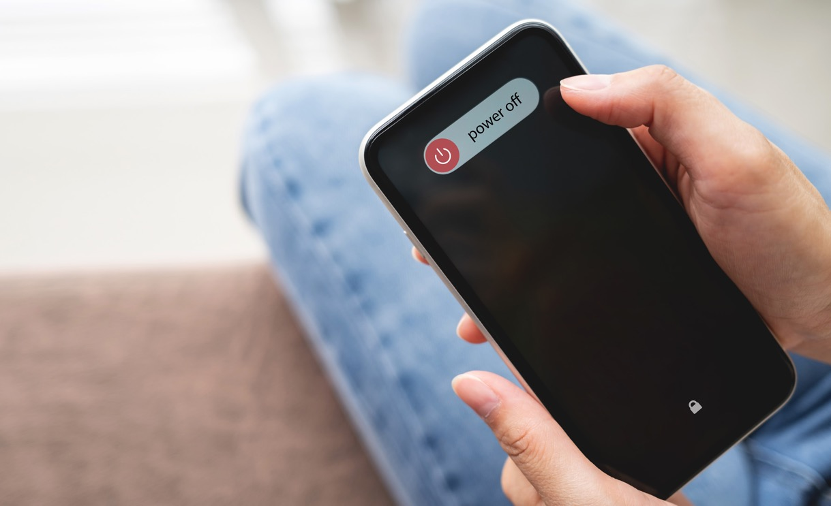
Tips for Troubleshooting Technical Problems
Restart your device.
Notes:
USE POWERPOINT OR LIVE DEMONSTRATION
Tips for Troubleshooting Technical Problems
If you are using a smartphone or tablet, the steps vary depending on the manufacturer and model of your device. If needed, check the manufacturer's website for information on how to restart your particular device.

Slide 76

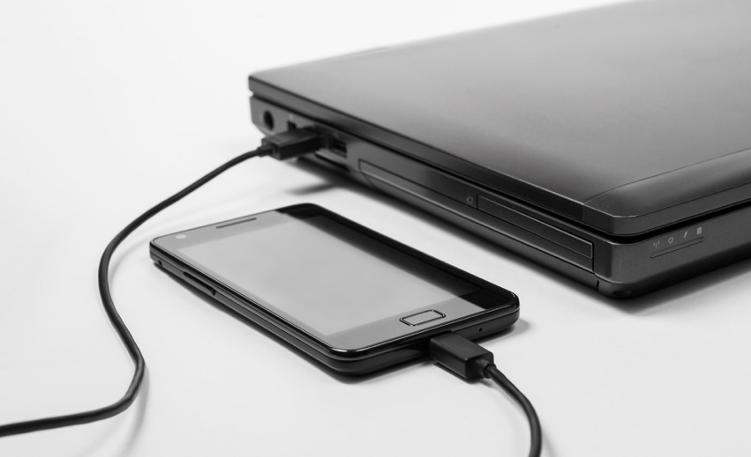
Tips for Troubleshooting Technical Problems
Make sure your device is fully charged or plugged in.
Notes:
USE POWERPOINT
Tips for Troubleshooting Technical Problems
Make sure your device is fully charged or plugged in.

Slide 77

Tips for Troubleshooting Technical Problems
Close other applications.
Notes:
USE POWERPOINT OR LIVE DEMONSTRATION
Tips for Troubleshooting Technical Problems
INSTRUCTOR NOTE: You may want to do a live demonstration using the instructor's computer. Make sure to have a Window open that you can easily close.
If you are having problems with your internet connection, try closing applications you are not using. Closing applications can increase the amount of internet available to run the portal.
[INSTRUCTOR NOTE: Click ENTER to highlight the X on the top right side of the browser window.]
If you are using a laptop or computer running a Windows operating system, click on the X at the top right side of the window to close it.

Slide 78
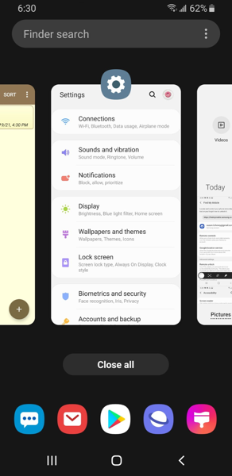

Tips for Troubleshooting Technical Problems
Close other applications.
Step 1
Step 2
Notes:
USE POWERPOINT OR LIVE DEMONSTRATION
Tips for Troubleshooting Technical Problems
To close an app on an Android device, tap the Overview button, which is usually located at the lower middle of the screen.
[INSTRUCTOR NOTE: Click ENTER to display STEP 2.]
When you tap on this icon, it will display all the apps that are currently open. To close an app, tap the app and swipe up. You may notice differences between your device and what is shown. If that is the case, check with your device’s manufacturer's website for more information.

Slide 79
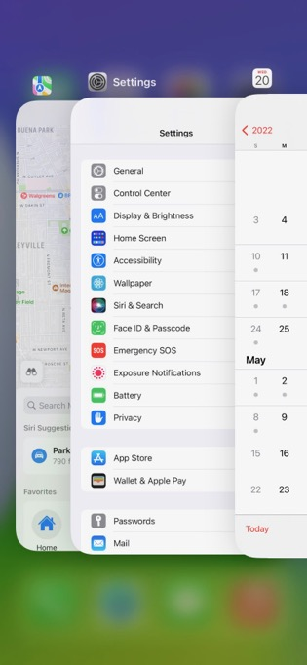

Tips for Troubleshooting Technical Problems
Close other applications.
Notes:
USE POWERPOINT OR LIVE DEMONSTRATION
Tips for Troubleshooting Technical Problems
If you are using an Apple tablet or smartphone, swipe up from the bottom of the screen to see all of the apps that are open. To close an app, tap the app and swipe up.

Slide 80
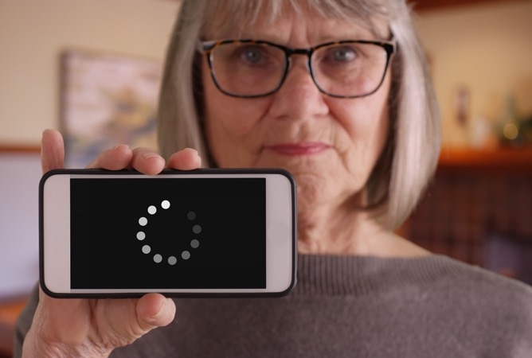

Tips for Troubleshooting Technical Problems
Try turning off your camera.
Notes:
USE POWERPOINT
Tips for Troubleshooting Technical Problems
Keep in mind that when the camera is on, it uses more bandwidth, so if the connection starts to break up, you may need to turn off the camera when it is not needed.

Slide 81

Tips for Troubleshooting Technical Problems
Make sure the application is up to date.
Notes:
USE POWERPOINT
Tips for Troubleshooting Technical Problems
Make sure the software you need for the appointment is up to date. Some telehealth appointments only need a web browser. Others may need additional software to connect to the appointment. Check with your provider to make sure you have the software you will need to attend the appointment.

Slide 82
Tips for Troubleshooting Technical Problems
Try using another device.
Notes:
USE POWERPOINT
Tips for Troubleshooting Technical Problems
If you can't connect to your visit on your device, try using another device if you have one.

Slide 83

Tips for Troubleshooting Technical Problems
Contact your provider for help.
Notes:
USE POWERPOINT
Tips for Troubleshooting Technical Problems
If none of the previous tips work for you, contact your health care provider for help. The number to call for assistance may be found in your confirmation email or on the health care provider's website.

Slide 84
Tips for Troubleshooting Technical Problems:
Questions
Are there tips you would like to share?
Is there a problem you have encountered that we did not cover?
Notes:
USE POWERPOINT
Review: Tips for Troubleshooting Technical Problems
Are there any tips you have used to troubleshoot technical problems that you would like to share?
Is there a problem you have encountered that we did not cover?
INSTRUCTOR NOTE: Lead a brief discussion. Ask the participants if they have any tips they would like to share or if there are any problems they have encountered that were not covered.
Before we move to the next section, do you have any questions?
INSTRUCTOR NOTE: Review and address items in the “parking lot”.
ADDITIONAL DETAILS: For information about what the parking lot is, see the “Before the Workshop Begins” section of the Instructor Guide.

Slide 85

Attending the Telehealth Appointment
Notes:
USE POWERPOINT
Attending the Telehealth Appointment
Now that we know we have the technology we need for a telehealth appointment, let’s explore what you need to do to schedule and attend a telehealth appointment.

Slide 86
Scheduling the Appointment
Ask the scheduler if the appointment can be a telehealth visit.
Verify that your insurance will cover the telehealth appointment.
Let them know if you need accommodations.
Notes:
USE POWERPOINT
Attending the Telehealth Appointment
[INSTRUCTOR NOTE: Click ENTER to display BULLET 1.]
If you would like to see if your next appointment can be a telehealth appointment, just ask!
[INSTRUCTOR NOTE: Click ENTER to display BULLET 2.]
Verify that your insurance will cover the telehealth appointment. Whether you have Medicare, Medicaid, private insurance, or a marketplace insurance plan, it's important to check if telehealth appointments are covered.
[INSTRUCTOR NOTE: Click ENTER to display BULLET 3.]
Let them know if you need accommodations. Accommodations include needing an interpreter, real-time captioning, telecommunications relay service, video relay service, or remote interpreting.

Slide 87
Information to Prepare Before the Appointment
Your allergies
Your current prescriptions
Medical devices you use
Your preexisting conditions
Your doctors and recent medical appointments or hospitalizations
Address of you’re your preferred pharmacy
Make a list of questions
Notes:
USE POWERPOINT
Attending the Telehealth Appointment
A couple of days before the appointment, you will want to gather the information you may need for your appointment. That includes a list of your allergies, an up-to-date list of your prescriptions, a list of the medical devices you use, a list of preexisting conditions, a list of your doctors and information about recent medical appointments or hospitalizations, and the phone number and address of your preferred pharmacy.
You may also want to make a list of your health concerns and questions you want to discuss with your doctor during the appointment.
A medical professional may contact you shortly before the appointment to gather and ask you for information like your vitals, a summary of why you scheduled an appointment, and more.

Slide 88

Log Into The Patient Portal
Make sure you remember your username and password.
Check that your information is up to date.
Check if health care provider has requested any information for the appointment.
Notes:
USE POWERPOINT
Attending the Telehealth Appointment
Before the appointment, log into the patient portal to make sure you remember your username and password. Once you log in, check that your information is up to date, and to see if the provider has asked you to provide any information before the appointment.

Slide 89
The Day of the Appointment
Verify you received a link to attend the telehealth visit.
Review the instructions about how to access the telehealth appointment.
Wear clothing that easily shows areas of your body your provider may need to see.
Make sure you have your provider's telephone number in case you experience problems connecting to the appointment.
Fill out any paperwork that is required as part of the check-in process.
Log in 15 minutes early to resolve technical issues.
Be patient. You may be put in a virtual waiting room until the provider is ready to see you.
A pop-up message may appear asking for access to your microphone and camera. Click “Yes” or “Allow”.
If you bring another person to your appointment, you may need to fill out a consent form.
Notes:
USE POWERPOINT
Attending the Telehealth Appointment
On the day of the appointment, there are several things to do to prepare. Don’t worry you do not need to write this down. All of this information can be found in the Learner’s Handout.
[INSTRUCTOR NOTE: Click ENTER to display BULLET 1.]
First, verify that you have received a link to attend the telehealth visit. It may be sent via text message, email, or in the patient portal.
[INSTRUCTOR NOTE: Click ENTER to display BULLET 2.]
Review the instructions about how to access the telehealth appointment.
[INSTRUCTOR NOTE: Click ENTER to display BULLET 3.]
Wear clothing that makes it easy to show areas of your body your provider may need to see.
[INSTRUCTOR NOTE: Click ENTER to display BULLET 4.]
Make sure you have your provider's telephone number in case you experience problems connecting to the appointment.
[INSTRUCTOR NOTE: Click ENTER to display BULLET 5.]
Fill out any paperwork that is required as part of the check-in process. Your provider will send you instructions on how to complete the paperwork before your appointment.
[INSTRUCTOR NOTE: Click ENTER to display BULLET 6.]
Approach your telehealth appointment the way you approach your in-person appointments. You should log in 15 minutes early to resolve technical issues.
[INSTRUCTOR NOTE: Click ENTER to display BULLET 7.]
Be patient. You may be put in a virtual waiting room until the provider is ready to see you.
[INSTRUCTOR NOTE: Click ENTER to display BULLET 8.]
A pop-up message may appear asking for access to your microphone and camera. Click yes or allow.
[INSTRUCTOR NOTE: Click ENTER to display BULLET 9.]
If you bring another person to your appointment, you may need to fill out a consent form.

Slide 90
During the Appointment
Make sure your health care provider can see and hear you.
Let your health care provider know if you have problems seeing or hearing them.
Review your list of questions. Ask questions if you need help understanding something.
Take notes.
Notes:
USE POWERPOINT
Attending the Telehealth Appointment
During the appointment,
[INSTRUCTOR NOTE: Click ENTER to display BULLET 1.]
Make sure your health care provider can see and hear you.
[INSTRUCTOR NOTE: Click ENTER to display BULLET 2.]
Let your health care provider know if you have problems seeing or hearing them.
[INSTRUCTOR NOTE: Click ENTER to display BULLET 3.]
Review your list of questions. Ask questions if you need help understanding something.
[INSTRUCTOR NOTE: Click ENTER to display BULLET 4.]
Take notes that you can review after the appointment is over.

Slide 91

Summary of Your Telehealth Appointment
Notes:
USE POWERPOINT
Attending the Telehealth Appointment
At the end of the appointment, the health care provider should outline the next steps and add a summary of your appointment to your medical record. You should be able to access this summary in your patient portal.
If you have questions after the appointment, you can call your provider or submit a question using the patient portal. Depending on the question, the provider may answer the question in the portal or give you a call. This care is usually considered part of your telehealth appointment. More difficult questions, questions not related to your appointment, or questions you have months after the appointment may require payment.

Slide 92
Congratulations!
Today you have:
  Learned about the benefits of telehealth.
  Built skills to:
    Create an account with the patient portal and log in.
    Message your provider using the portal.
    Identify a device to use to connect to a telehealth appointment.
    Identify how to fix common technical issues.
    Prepare for and attend your telehealth appointment.
Notes:
USE POWERPOINT
Conclusion
Congratulations! Today you have:
Learned about the benefits of telehealth
Built skills to:
Create an account with the patient portal and log in
Message your provider using the portal
Identify a device to use to connect to a telehealth appointment
Identify how to fix common technical issues
Prepare and attend your telehealth appointment
Are there any other questions before today’s workshop ends?
INSTRUCTOR NOTE: Review and address items in the “parking lot”.
ADDITIONAL DETAILS: For information about what the parking lot is, see the “Before the Workshop Begins” section of the Instructor Guide.
INSTRUCTOR NOTE: Provide each learner with a Certificate of Completion.

Slide 93
Today’s training is provided the Public Library Association with support from Heartland Forward.
Visit <insert libraries URL here> and https://www.digitallearn.org for more courses and to build confidence using technology.
Provided by Public Library Association with support from Heartland Forward
Notes:
USE POWERPOINT
Conclusion
INSTRUCTOR NOTE: Close out the session by following these steps:
(If applicable): Mention future PLA digital learning workshops planned for the location and/or community.
Ask if there are any other final questions and answer any outstanding ones that may have been missed in the parking lot sections.
End by reading the course acknowledgment: “This course was made possible by the Public Library Association with support from Heartland Forward. We appreciate all our participants for coming and we encourage you to keep learning!”
ADDITIONAL DETAILS: Before the workshop begins, insert your library’s URL on the PowerPoint slide. Identify future workshops learners may want to attend and mention those classes as you wrap up the workshop.

Slide 94
Thank you for coming!
THANK YOU FOR COMING!
Provided by Public Library Association with support from Heartland Forward
Notes:
USE POWERPOINT
Conclusion
We appreciate all our participants for coming and we encourage you to keep learning!
(If applicable): Please fill out the survey before you leave today.

