Slide 1

Facebook: Getting Started
Instructor Name
Job Title
Library Name
Courtesy of Gail Borden Public Library
and the Public Library Association

Slide 2
Agenda
Navigating & Searching
Sending & Accepting Friend Requests
Setting Your Cover Photo & Profile Picture
Filling Out Your Profile
Posting a Status Update or Photo
Commenting, Liking, & Replying
Sending & Responding to Messages
Viewing Notifications
Adjusting Privacy Settings

Slide 3
Navigating & Searching

Slide 4






Navigation Elements
Search box
Profile Page
Home Page
Friend Requests
Messages
Notifications
Privacy Shortcuts

Slide 5
Activity #1

Slide 6
Sending & Accepting Friend Requests

Slide 7
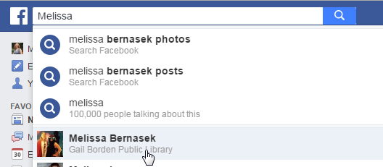
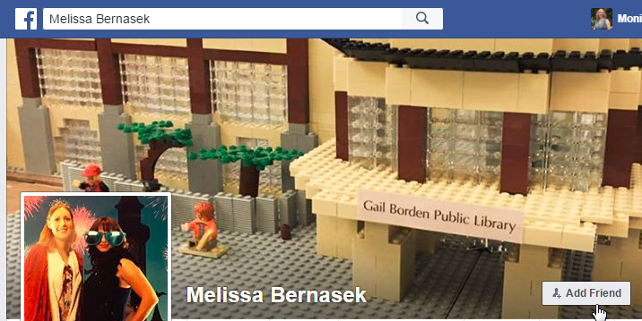
Sending a Friend Request
Type someone’s name into the Search box and click on the icon.
Click on the Add Friend button.

Slide 8
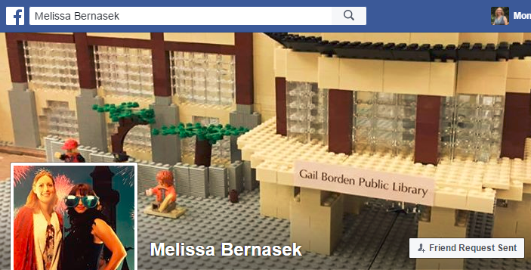
Sending a Friend Request
The Friend Request Sent button appears and remains until the person either accepts your friend request or deletes it.

Slide 9

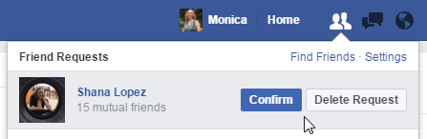
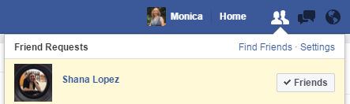
Accepting a Friend Request
Click on the Friend Requests icon when it contains a red box.
Click on the Confirm button to accept the request or the Delete Request button to ignore it.
If you accept the request, the button changes to ✓ Friends.

Slide 10
Activity #2

Slide 11
Setting Your Cover Photo & Profile Picture

Slide 12
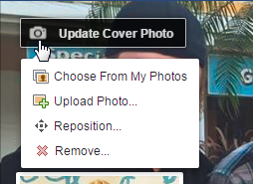

Setting the Cover Photo
Hover over the camera icon until the Update Cover Photo option appears; when it does, click on it.
Click on the Upload Photo option.

Slide 13
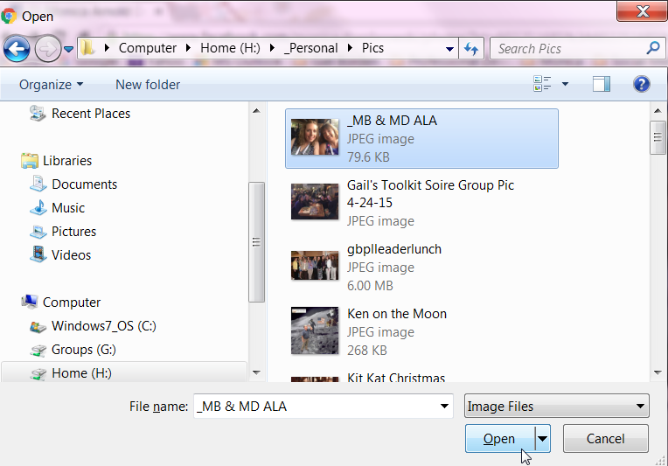
Setting Your Cover Photo
Click to the location where the desired photo is stored.
Double-click on the photo to select it, then click on the Open button to add it to Facebook.

Slide 14
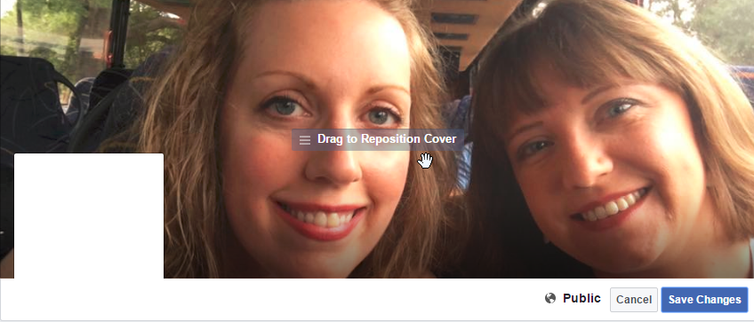
Setting Your Cover Photo
When your picture appears in the frame, click and hold the mouse button to reposition the picture.
Click on the Save Changes button to add the picture to Facebook.

Slide 15
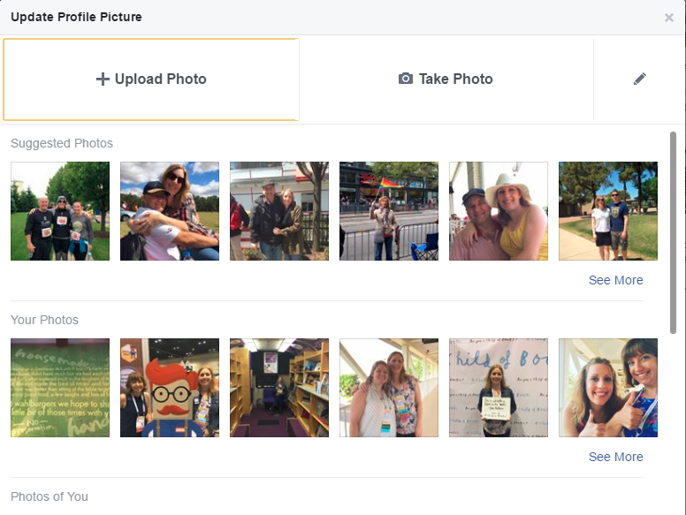
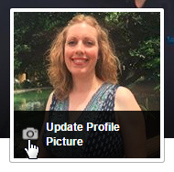
Setting Your Profile Picture
Hover over the camera icon until the Update Profile Picture option appears; when it does, click on it.
When the Update Profile Picture window appears, click on a picture, or click on the Upload Photo button.

Slide 16
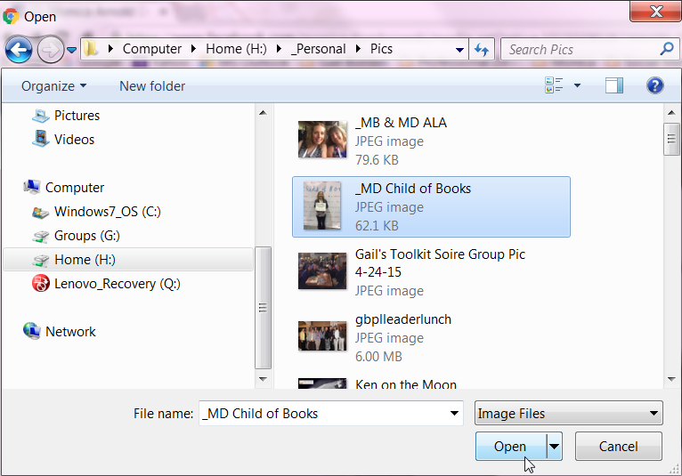
Setting Your Profile Picture
Click to the location where the desired photo is stored.
Double-click on the picture to select it, then click on the Open button to add it to Facebook.

Slide 17
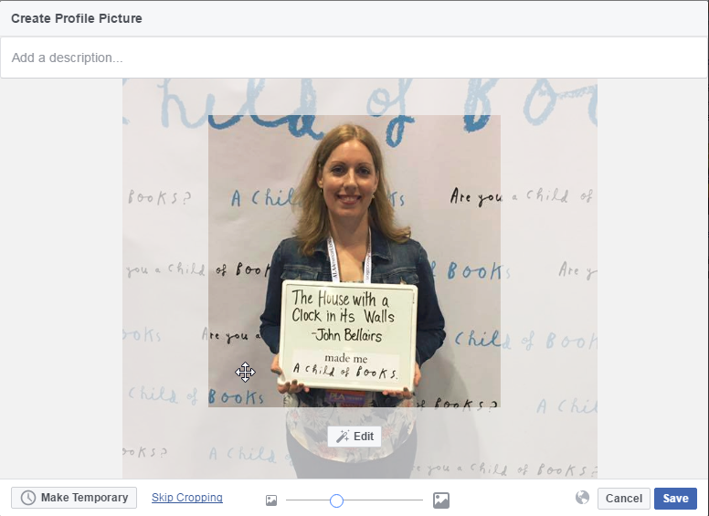
Setting Your Profile Picture
Click and hold the mouse button on the picture to reposition it, then click the Edit button to enhance your picture.

Slide 18
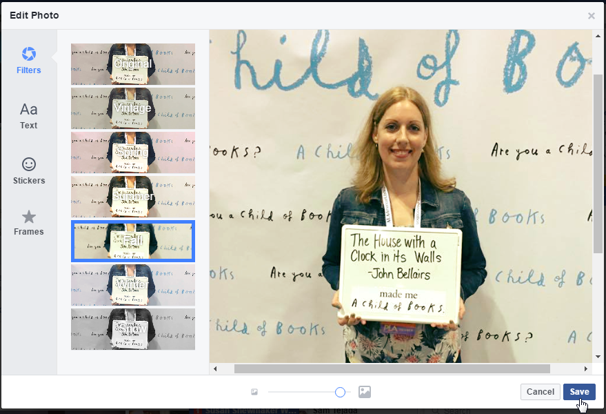
Setting Your Profile Picture
Apply a filter, add text, add stickers, and/or add a frame
Click the Save button to apply your changes and set your picture.

Slide 19
Activity #3

Slide 20
Filling Out Your Profile

Slide 21
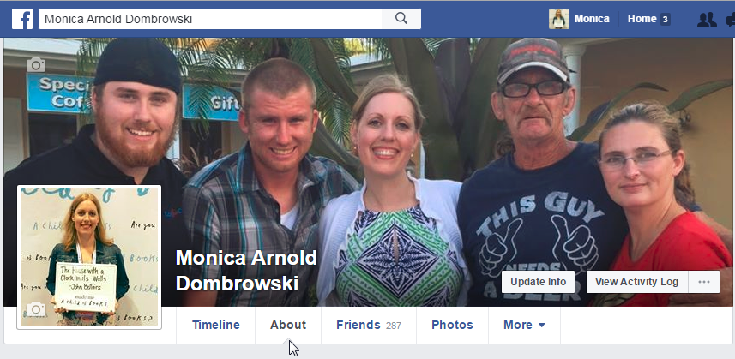
Filling Out Your Profile
Click on the About hyperlink on the Profile Page.

Slide 22
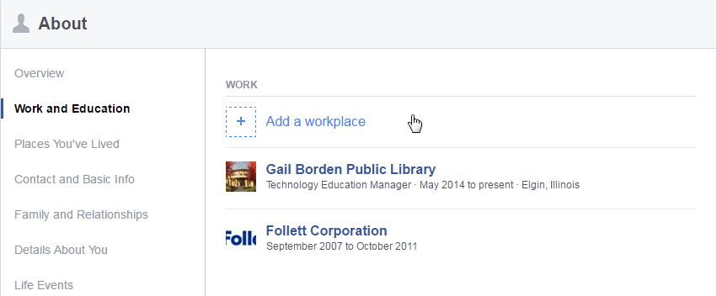
Filling Out Your Profile
Click on the category you wish to add content to on the left side of the screen.

Slide 23
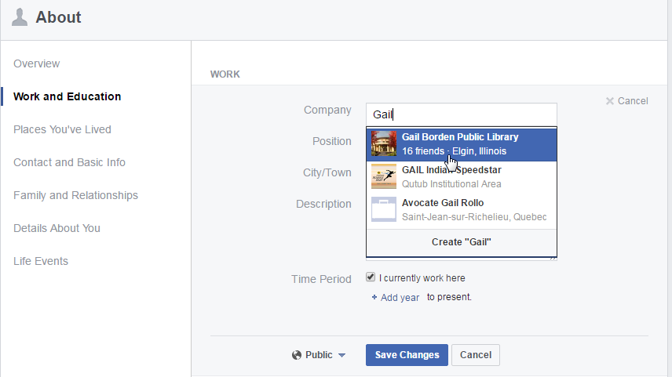
Filling Out Your Profile
Follow the wizard to add your information, then click on the Save Changes button to add it to your profile.

Slide 24
Activity #4

Slide 25
Posting a Status Update or Photo

Slide 26

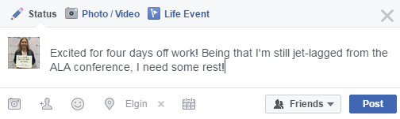
Posting a Status Update
Click on the Profile icon in the toolbar to access your Profile Page.
Click inside the Status box on your Profile Page and type in your update.
Click on the Post button to save your changes.

Slide 27
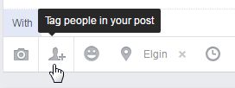

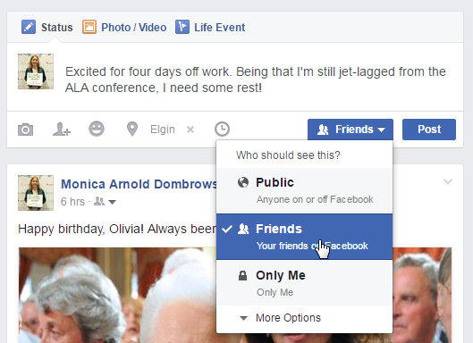


Posting a Status Update
Tag friends, add a location, adjust viewing permissions, add an activity or feeling, or add a photo or video to your update.
Click on the Post button to save your changes.

Slide 28
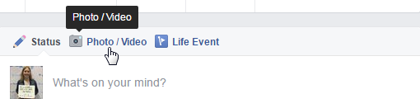
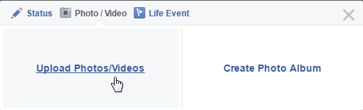
Posting a Photo
Click on the icon in the toolbar to access your Profile Page.
Click on the Photo/Video icon in the Status box.
Click on the Upload Photos/Videos hyperlink.

Slide 29
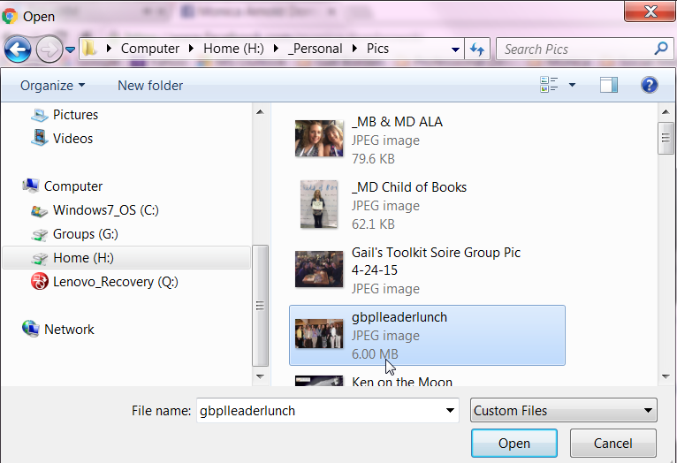
Posting a Photo
Browse to the location of the desired picture.
Click on the picture, then on the Open button.

Slide 30
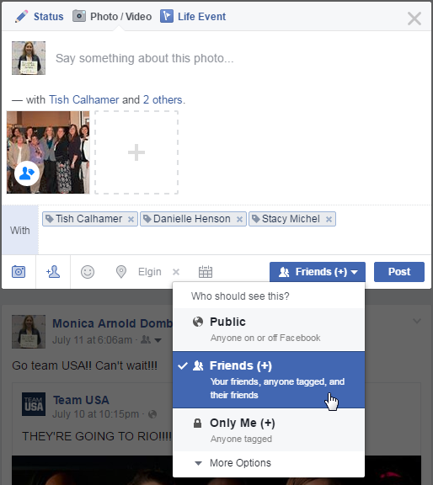
Posting a Photo
Add a comment, adjust viewing permissions, add a location, add an activity or feeling, and tag friends.
Click on the Post button to save your changes.

Slide 31
Activity #5

Slide 32
Commenting, Liking, & Replying

Slide 33
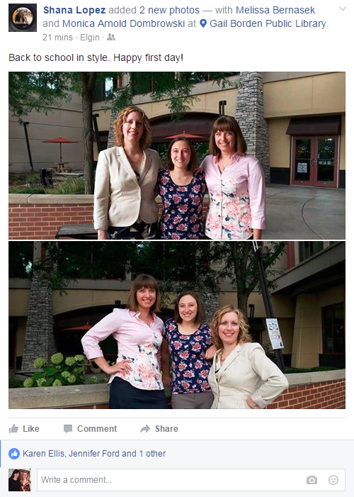
Commenting & Liking
Click on the Like icon to show you “Like” a post, photo, or video.
Click inside the Write a Comment box to add a comment to a post, photo, or video.

Slide 34
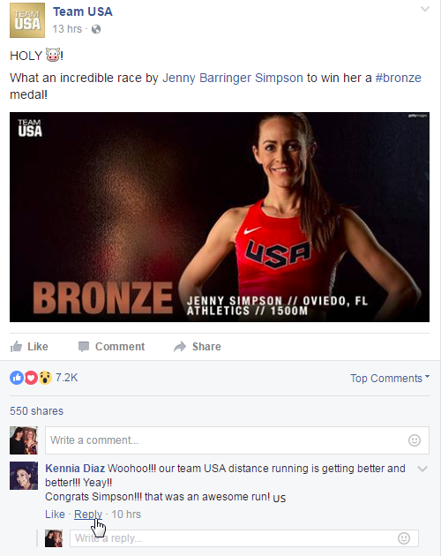
Replying
Click inside the Write a Reply box to add a reply to someone’s comment on a post, photo, or video.
Click on the Reply link.

Slide 35
Activity #6

Slide 36
Sending & Responding to Messages

Slide 37

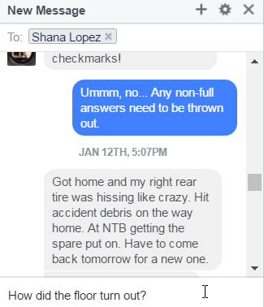
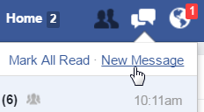
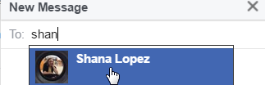
Sending a Message
Click on the Messages icon in the toolbar.
Click on the New Message hyperlink inside the Messages window.
Begin typing a name; when the desired names appears, click on it.
Click inside the Type a Message box and type your message.
Press the Enter button on the keyboard to send the message.

Slide 38

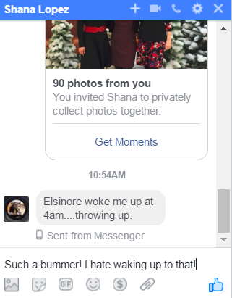
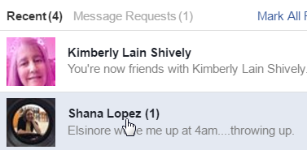
Responding to a Message
Click on the Message icon in the toolbar.
Click on the New Message hyperlink inside the Messages window.
Click inside the Type a Message box and type your reply.
Press the Enter button on the keyboard to send the message.

Slide 39
Activity #7

Slide 40
Viewing Notifications

Slide 41
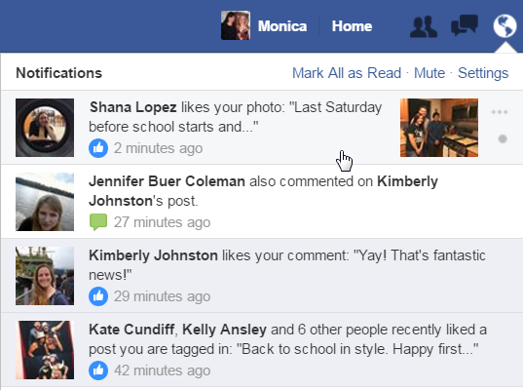

Viewing Notifications
Click on the Notifications icon in the toolbar.
Scroll to the desired notification, then click on it.

Slide 42
Adjusting Privacy Settings

Slide 43
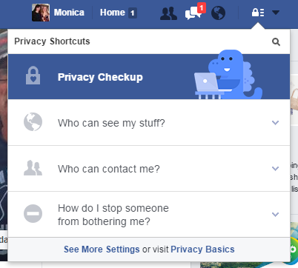
Adjusting Privacy Settings
Click on the Privacy Shortcuts icon, then on the See More Settings hyperlink.

Slide 44
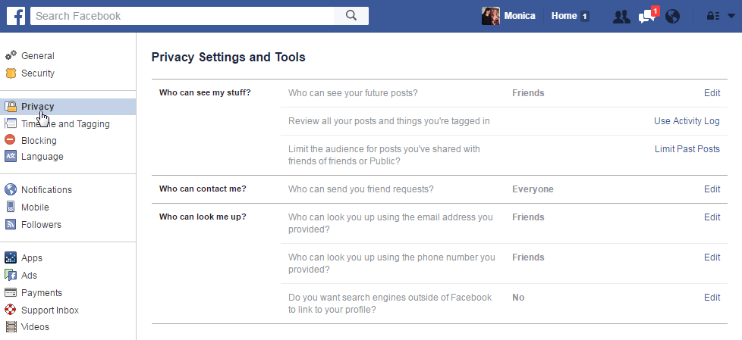
Adjusting Privacy Settings
Click on the Privacy hyperlink in the left menu. To edit any settings, click on the Edit hyperlink next to a section.

Slide 45
Activity #8

Slide 46
QUESTIONS?
THANKS FOR COMING!

