Slide 1

Facebook Basics
Instructor Name
Instructor Title
Gail Borden Public Library District
Courtesy of Gail Borden Public Library
and the Public Library Association

Slide 2
Agenda
How it Works
The Toolbar
The Home Page
The Timeline
Etiquette
Settings
Creating an Account

Slide 3
How It Works

Slide 4
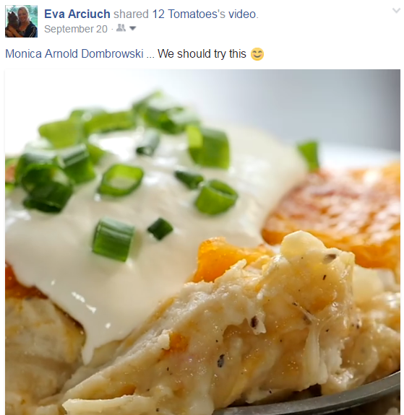
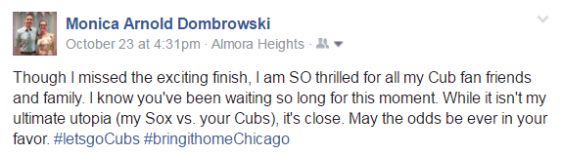
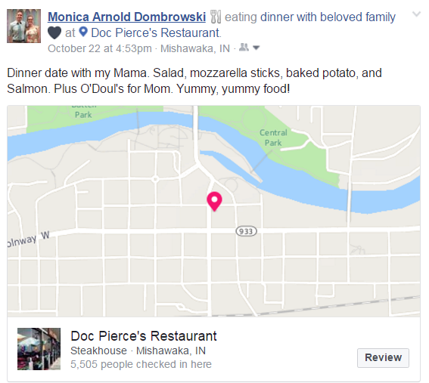
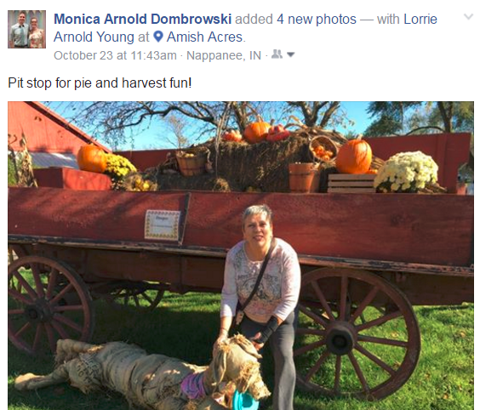
Share Content

Slide 5
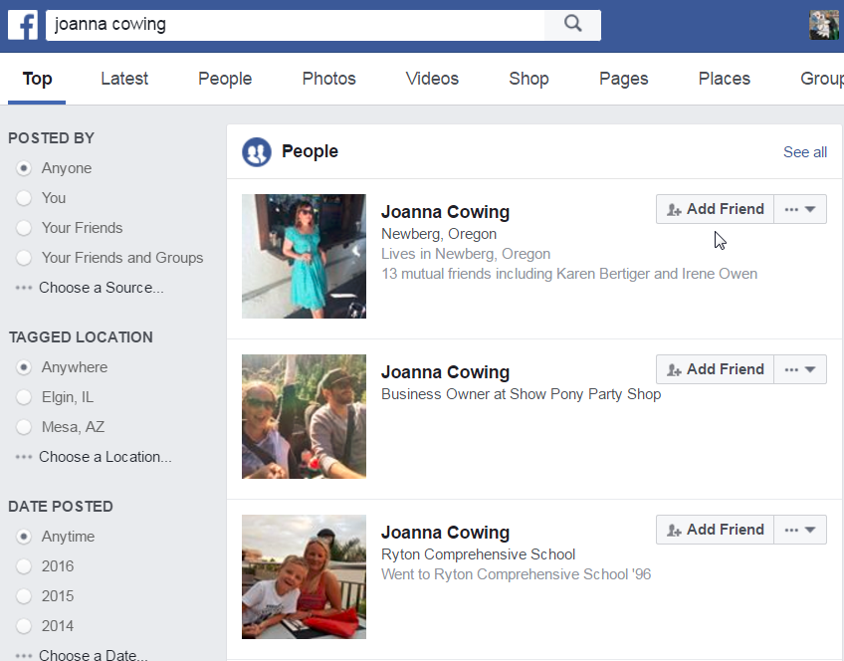
Make Friends

Slide 6
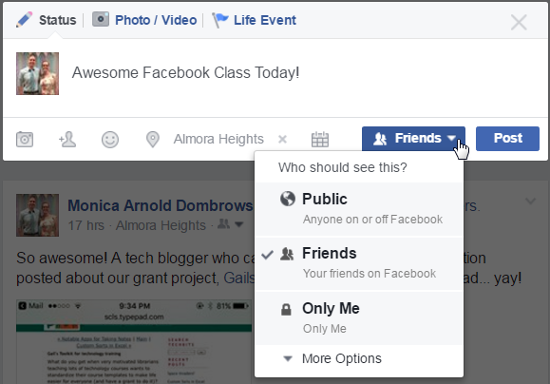
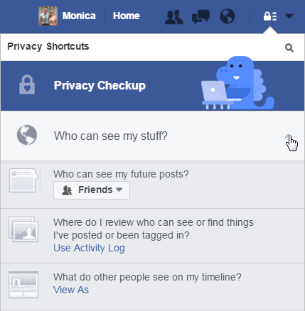
Determine Who Sees What

Slide 7
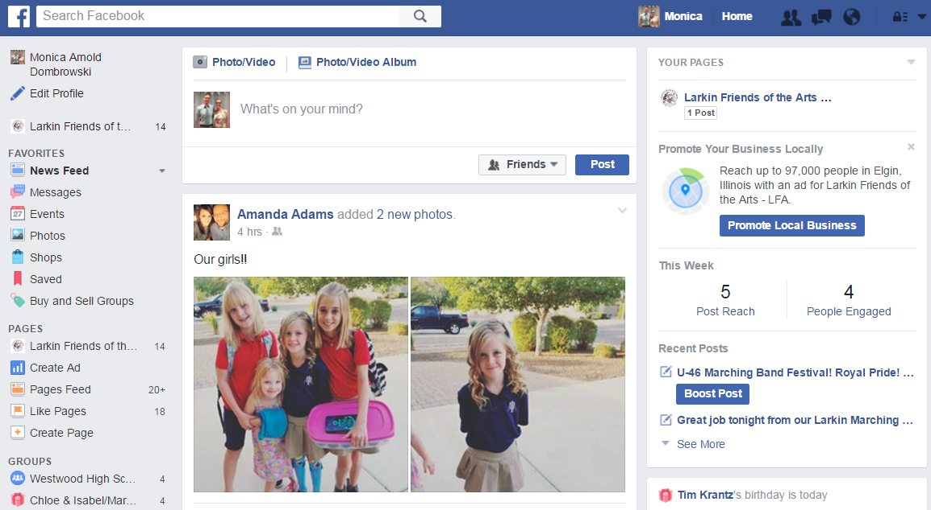
Interact on the Home Page

Slide 8
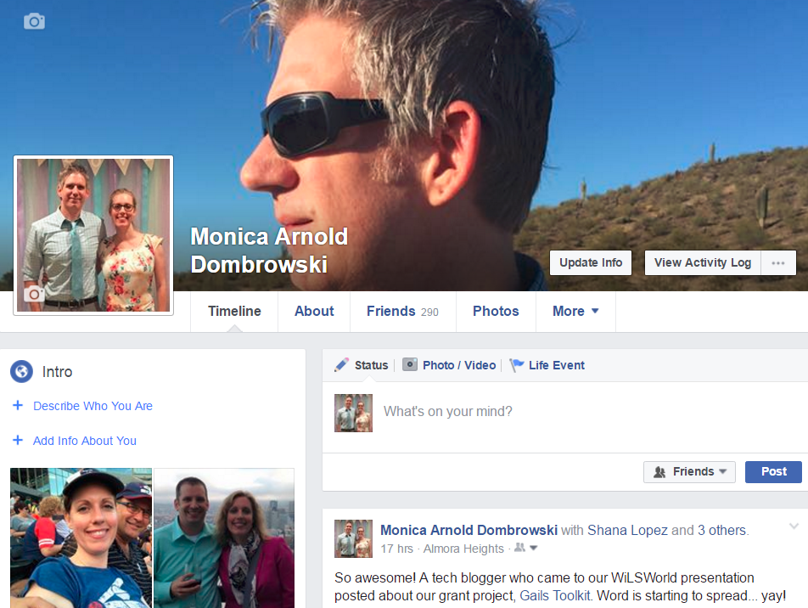
Share Info on the Timeline

Slide 9
The Toolbar

Slide 10
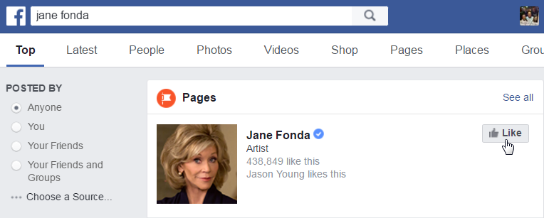

Search Box
1. Search for a person or organization name
2. Click on the Add Friend button (Friend) or Like button (Follow)

Slide 11
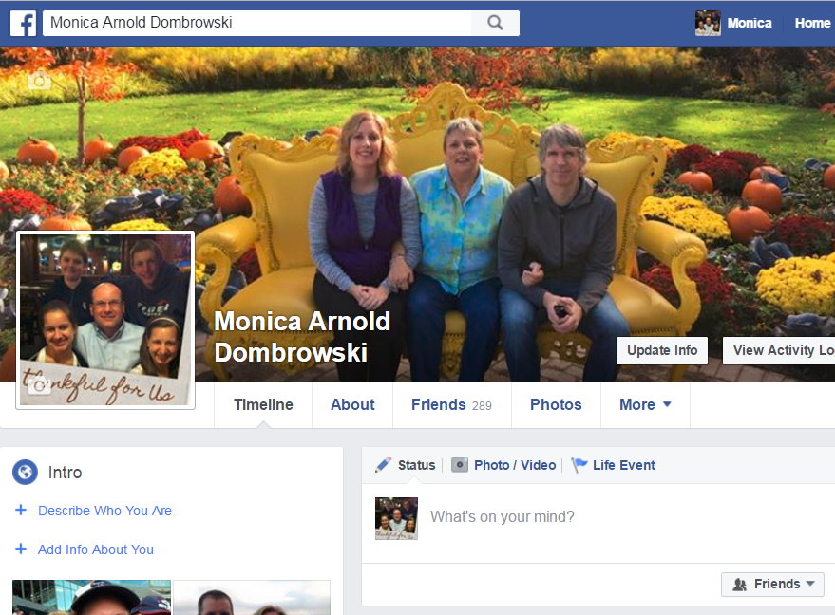
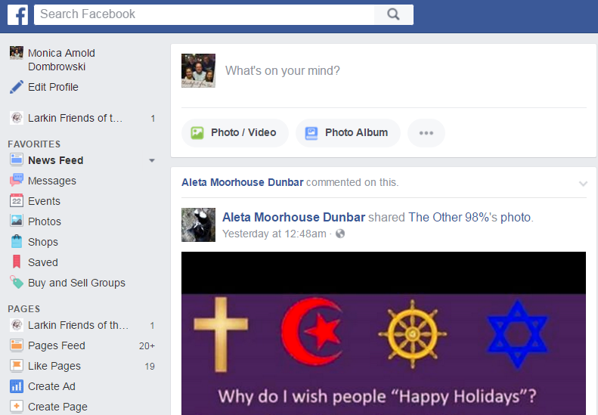
Navigation buttons
Takes users to the Timeline
Takes users to the Home page

Slide 12

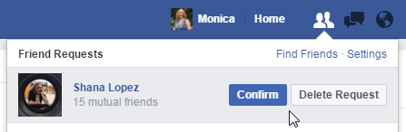
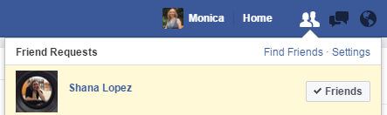
Friend Requests
1. Click on the Friend Requests button
2. Click on the Confirm button
or Delete Request button

Slide 13
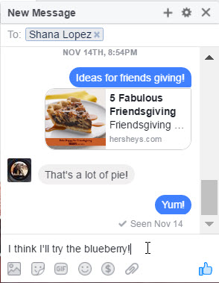
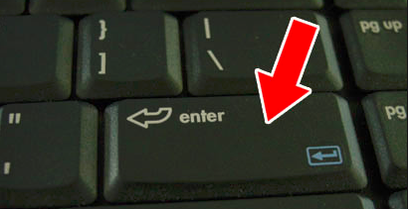
Messages
1. Click on the Messages icon
2. Click on the New Messages link
3. Type Friend name in the To box
3. Type message in box
4. Press the Enter key to send your message

Slide 14
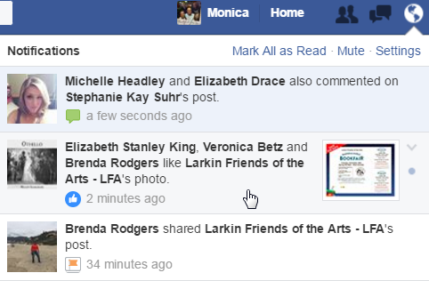

Notifications
1. Click on the Notifications icon
2. Click on a notification

Slide 15
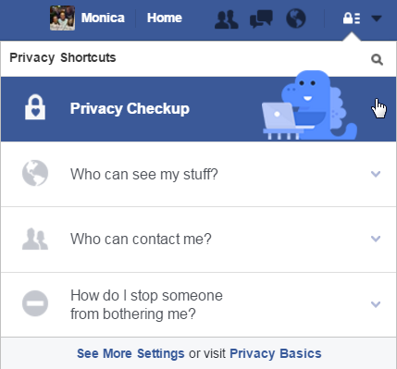
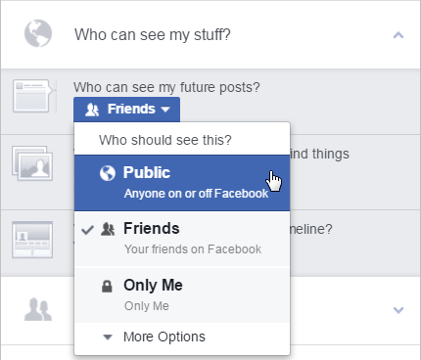
Privacy Shortcuts
1. Click on the Privacy Shortcuts icon
2. Click on the desired setting
3. Click on the desired option

Slide 16
The Home Page

Slide 17
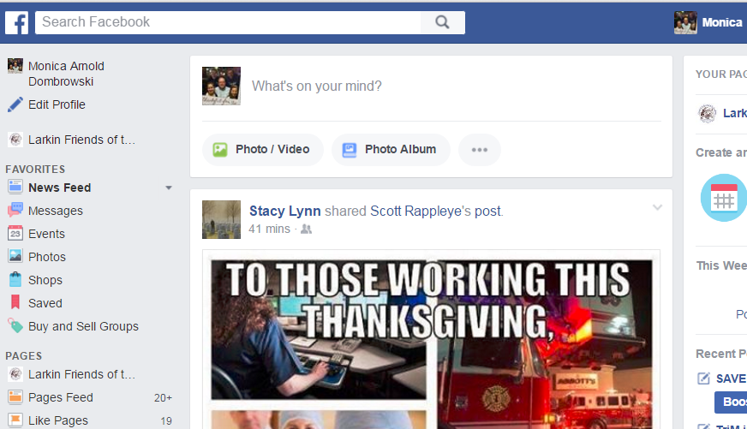
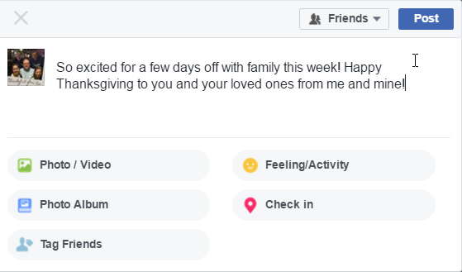
Update Status
Who can see your update?
What do you want to share?
Add your update
Add a Photo/Video
How are you feeling or what are you doing?
Create an Album
Tag Friends
Where are you?

Slide 18
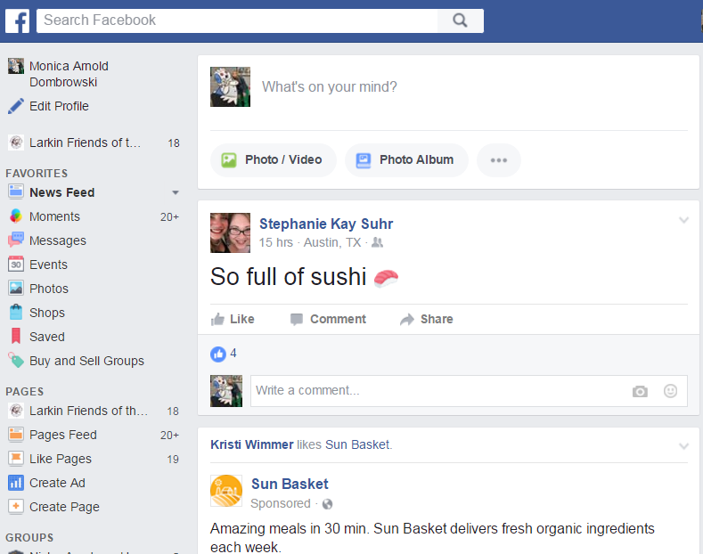
News Feed

Slide 19
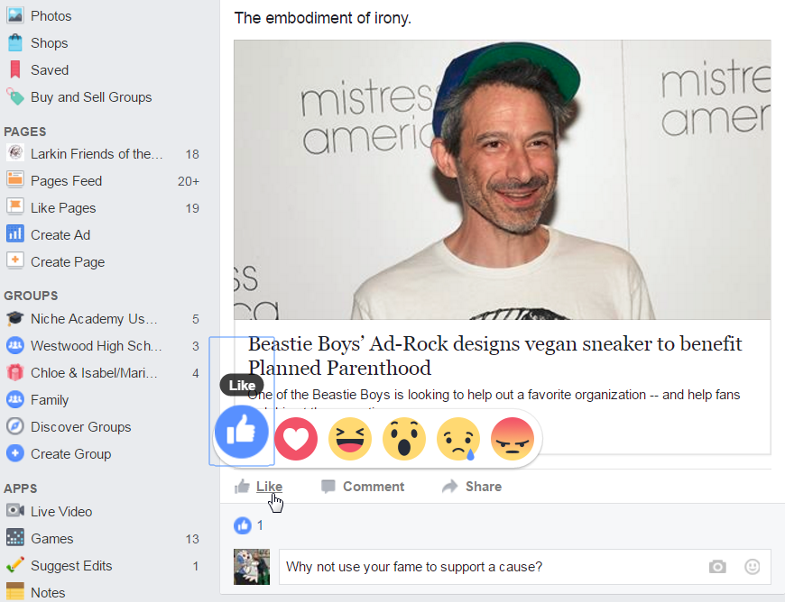
Like/React/Comment

Slide 20
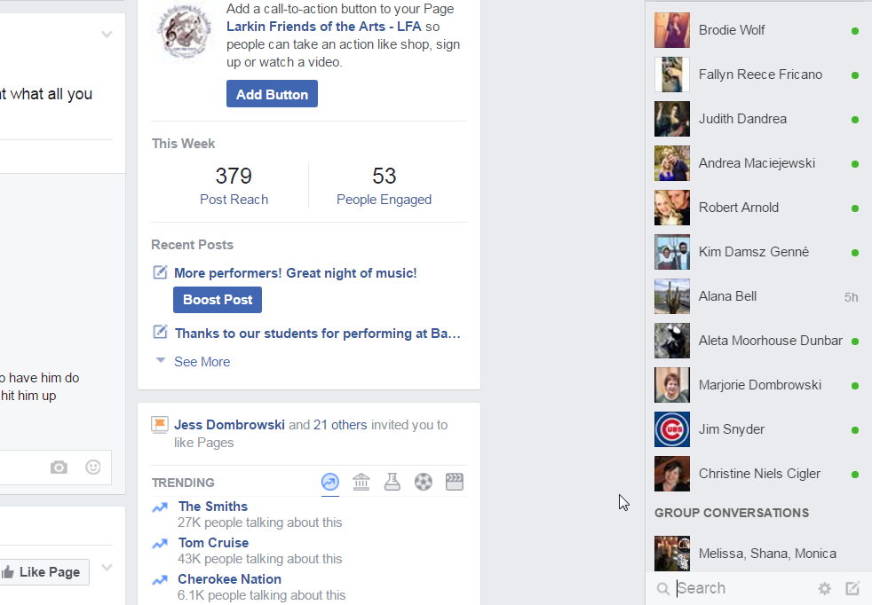
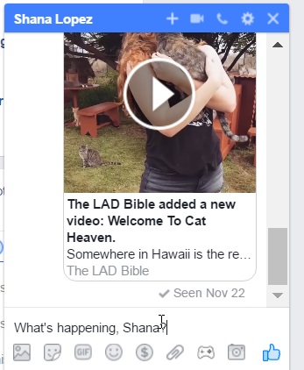
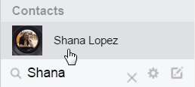
See Who’s Active & Chat

Slide 21
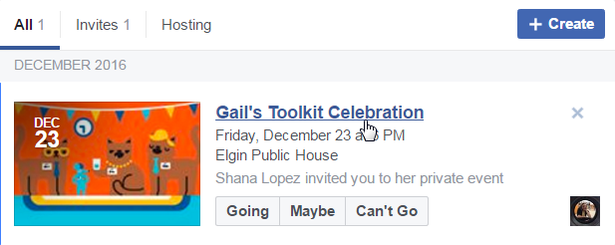
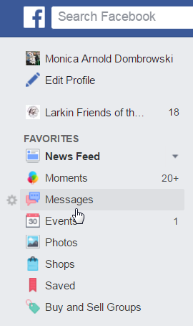
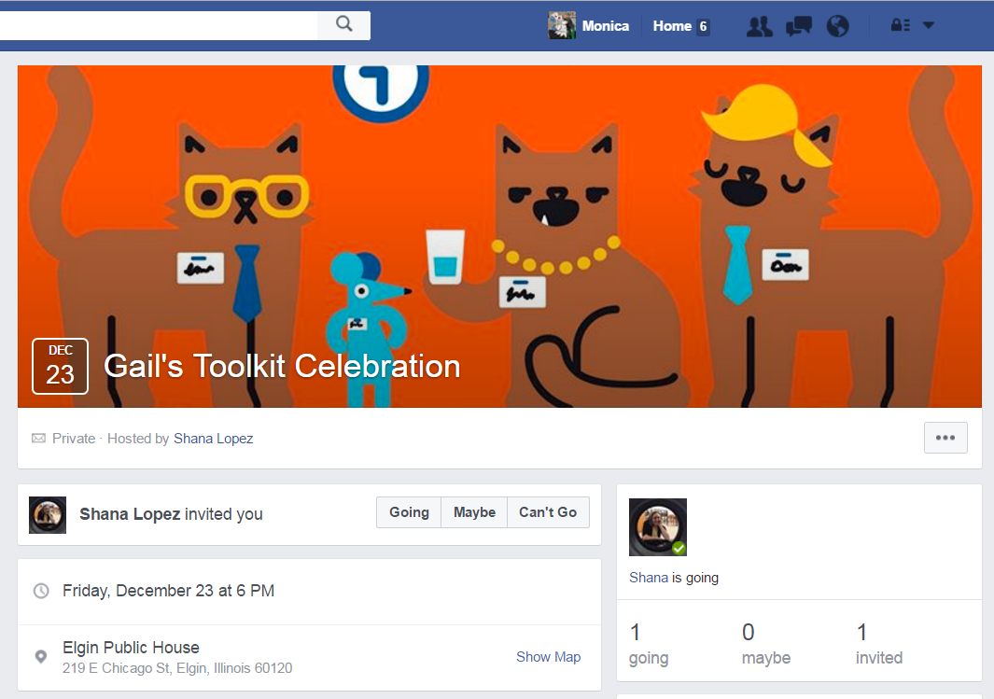
Events

Slide 22
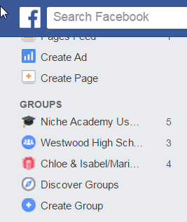
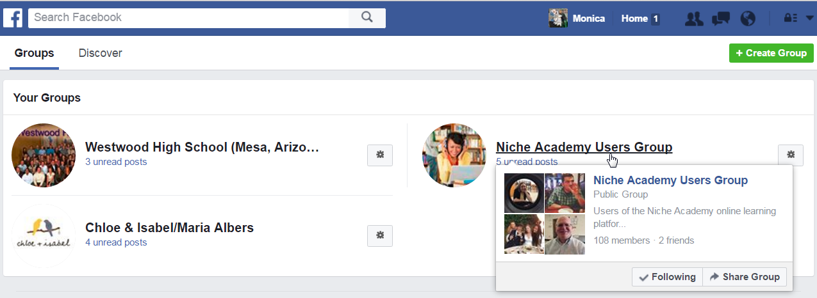
Groups

Slide 23
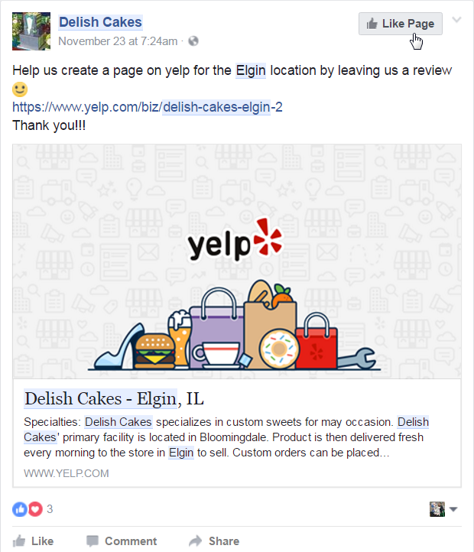
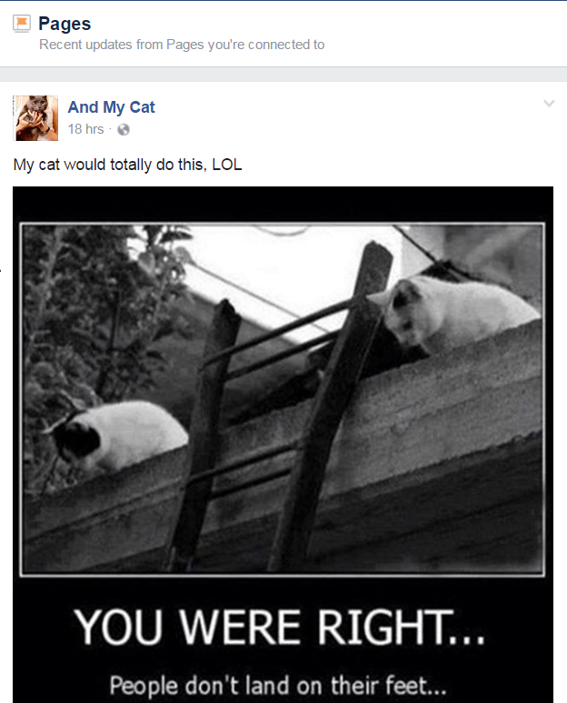
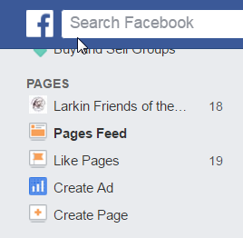
Pages

Slide 24
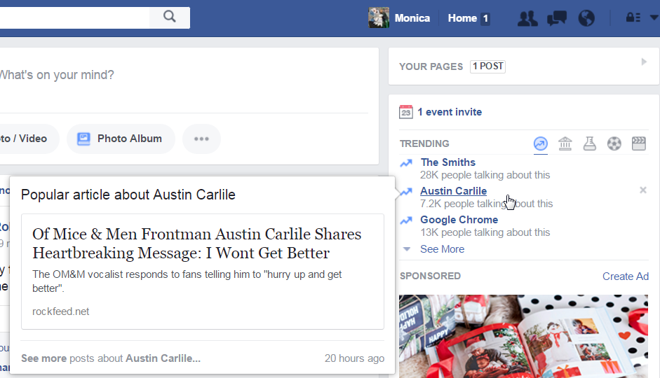
Trending

Slide 25
The Timeline

Slide 26
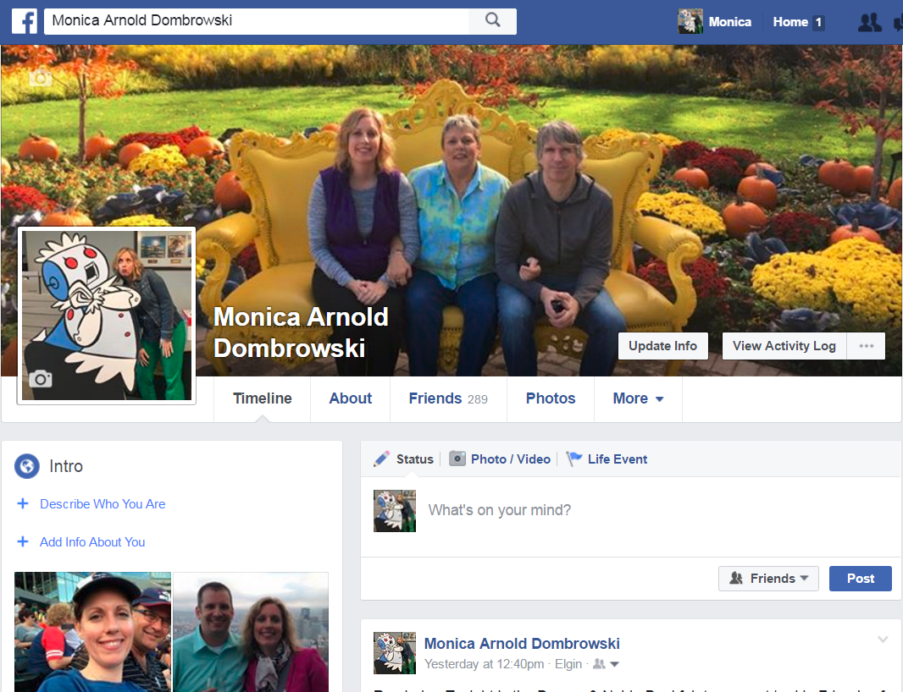
Timeline Home

Slide 27
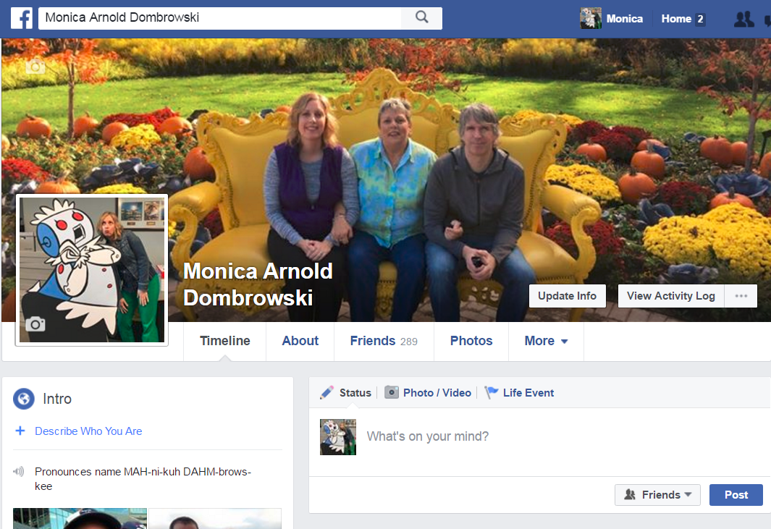
Status
Who can see your update?
What do you want to share?
Add your update
Add a Photo/Video
How are you feeling or what are you doing?
Create an Album
Tag Friends
Where are you?

Slide 28
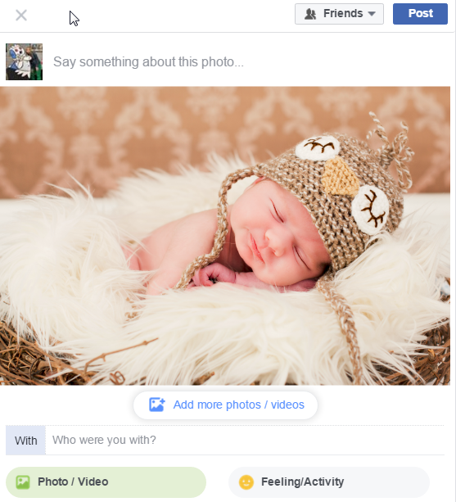
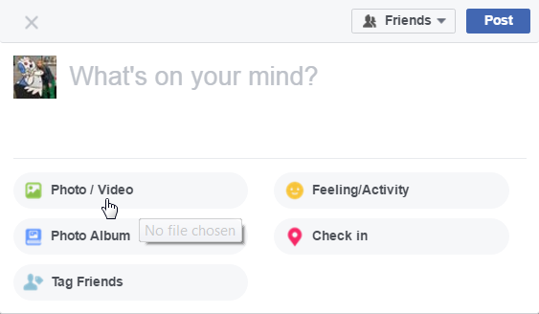
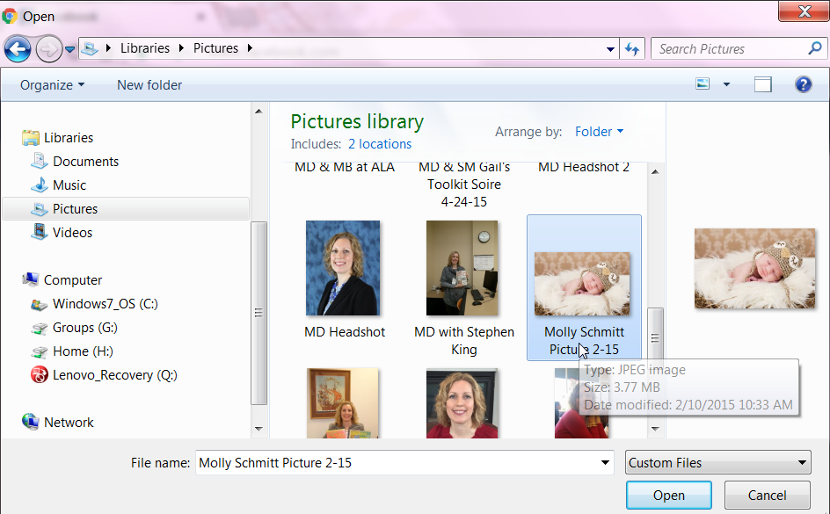
Add Photos/Video

Slide 29
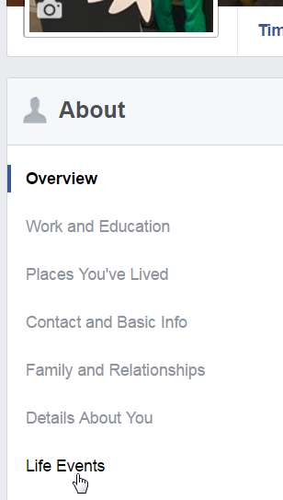
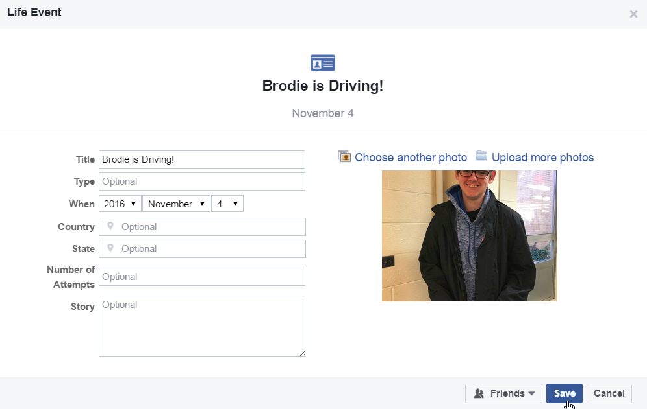
Life Event

Slide 30
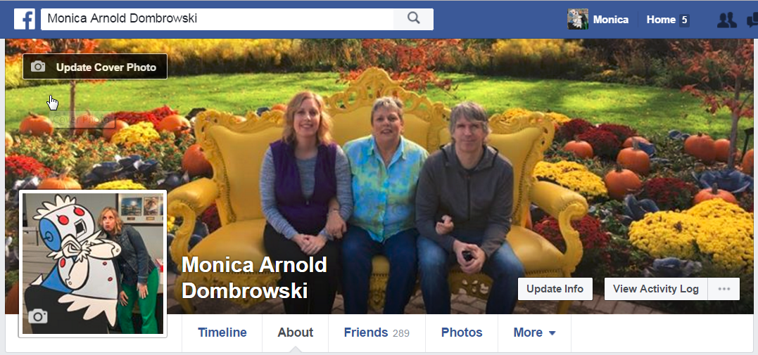
Cover Photo

Slide 31
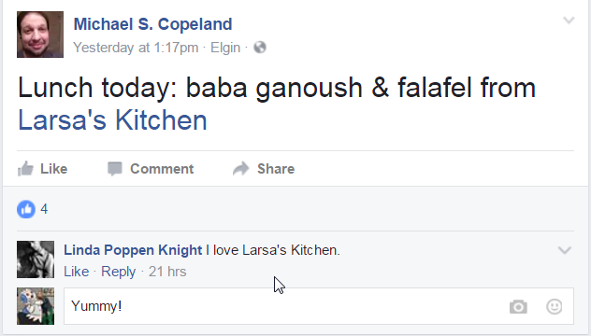
Profile Photo

Slide 32
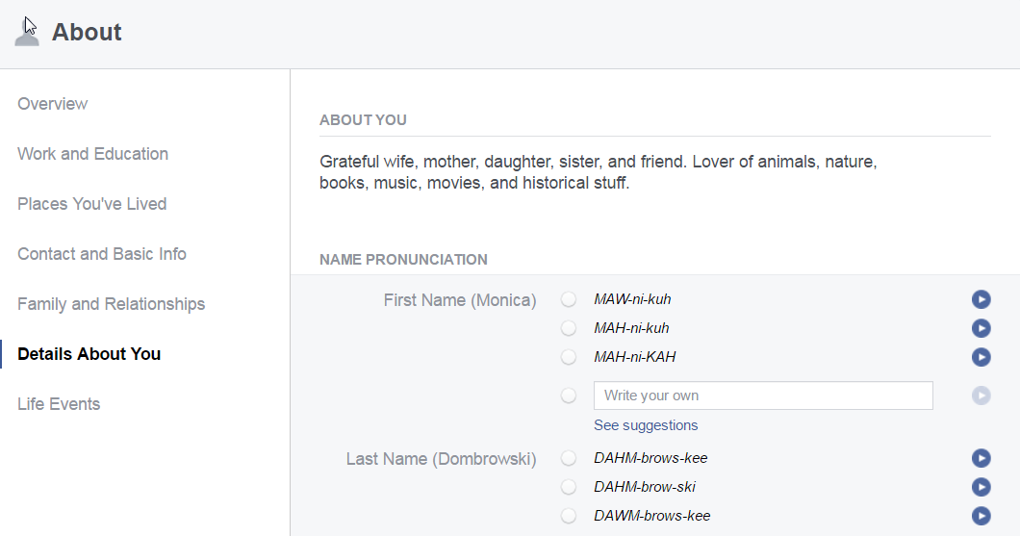
About

Slide 33
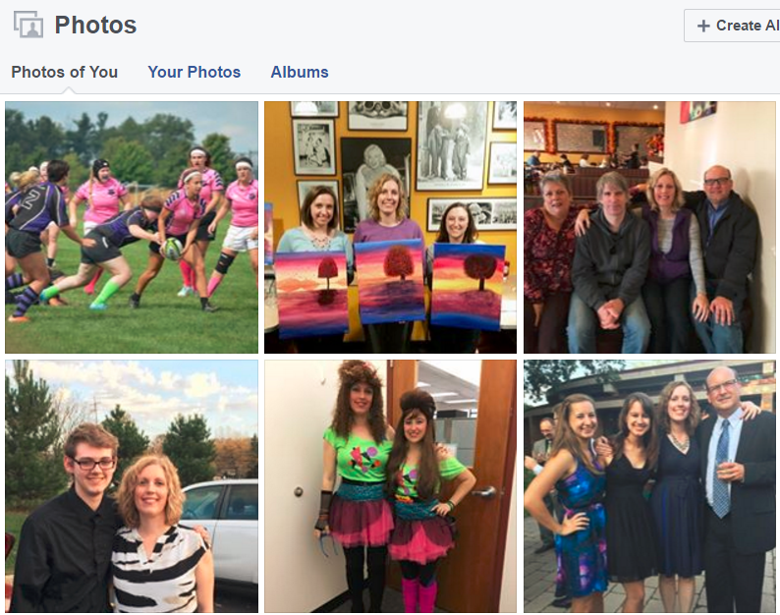
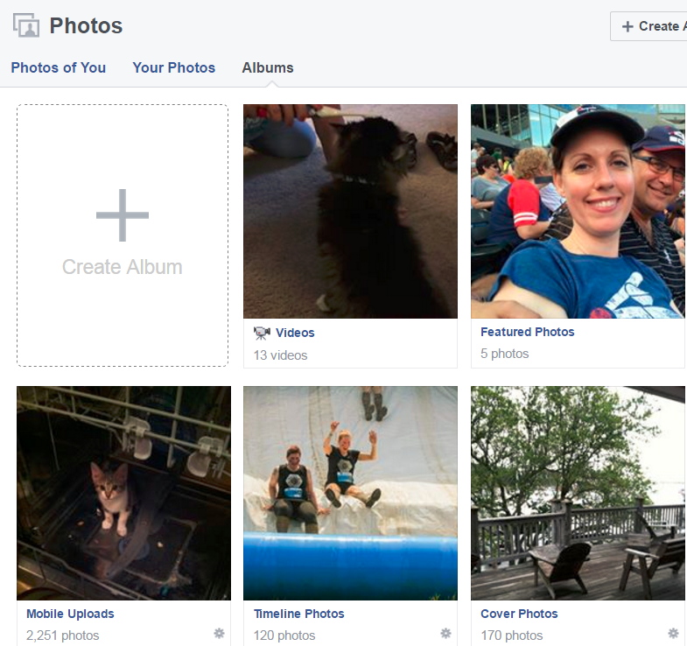
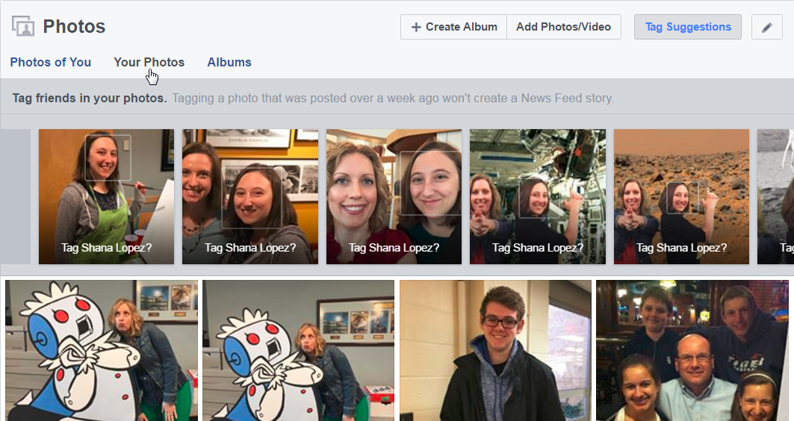
Photos

Slide 34
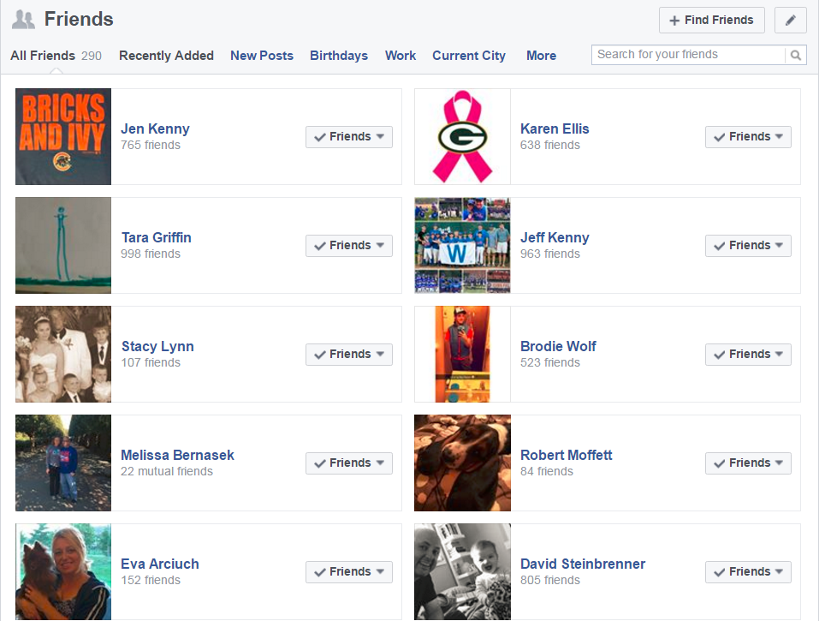
Friends

Slide 35
Facebook Etiquette

Slide 36
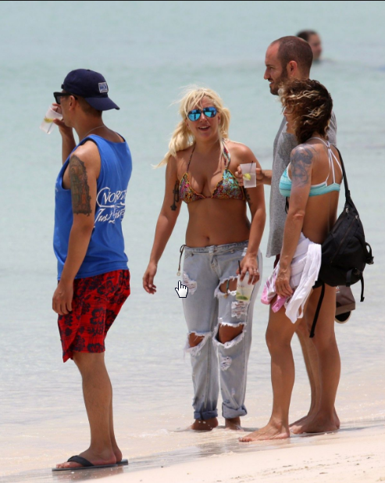
Things to Know
What you post on someone’s timeline is visible to all their friends as are all comments you make on a post.
Almost everyone is on Facebook including your boss, significant other, relatives, employees, coworkers, and community members.
  Don’t post this if you called out sick today!
Facebook leaves on online footprint; once something is posted, it will always be out there!

Slide 37

Not Sure? Send a Message
They’re private.
You can include multiple people.

Slide 38
Settings

Slide 39

Who Can See My Stuff?

Slide 40


Who Can Contact Me?

Slide 41


Other Privacy Settings

Slide 42
QUESTIONS?
THANKS FOR COMING!
Notes:
Timeframe: 5 minutes
Distribute handouts and class surveys.
Thank participants for coming.

