Slide 1


Email Basics
Instructor Name
Instructor Title
Library Name
Insert your logo her
Notes:
INSTRUCTOR NOTE: Please update this slide with the appropriate information:
Instructor name
Instructor affiliation (for instance, library staff member, community volunteer, etc.)
Location name
INSTRUCTOR NOTE: Before the workshop, please review the Instructor Outline for guidance on what to do to prepare for the workshop. You’ll find notes on how to conduct the workshop and details on what you should do once the workshop ends.
INSTRUCTOR NOTE: Please use the Instructor Outline for talking points for the presentation. Slide notations begin on page 5 of Instructor Outline.
Today’s workshop is provided with support from AT&T and the Public Library Association.
INSTRUCTOR NOTE: Include thank-you to community collaborator if applicable.
My name is <your name here> and I am <brief description of yourself>. Before we get started here are a few housekeeping items: <mention the items that are relevant to your workshop>:
Where are the restrooms?
Where are the emergency exits?
When/how to ask questions—Note where to locate the page number on each slide for participants to include when they have questions to ask later.
If you have a cell phone with you, please make sure to either turn it off or set to silent.
Will there be a break?

Slide 2
Today’s Agenda
Introduction
  Name the tools and apps needed to use email
Skill Building
  Perform basic email functions including:
    Log into and out of an email account
    Send, receive, and reply to an email
    Recognize and deal with spam
    Organize, search, and delete email
  Tips and Tricks
    How to keep your account safe
    How to use other email functions, such as CC, BCC, and attachments
Practice
Notes:
Here’s what we’ll cover in today’s workshop.
Introduction
Name the tools and apps needed to use email
Skill Building
Perform basic email functions, including:
Log into and out of an email account
Send, receive, and reply to an email
Recognize and deal with spam
Organize, search, and delete email
Tips and Tricks
Get started with Gmail
Create a username and strong password
How to use the Draft email feature
How to include attachments
When to use Reply, Reply All, and Forward
How to use CC and BCC
• And you will have opportunities to practice.
Let’s get started!

Slide 3

Introduction
There are many things you can do with an email account. What do you want to do with your email account?
Notes:
INSTRUCTOR NOTE: Ask learners the question on the slide and lead a brief discussion about what people can do with computers. Allow a moment for the learners to think about it, and then proceed with the conversation. Examples include: create online accounts, email family and friends, shop online, apply for jobs, communicate with children’s teachers, and so on.

Slide 4
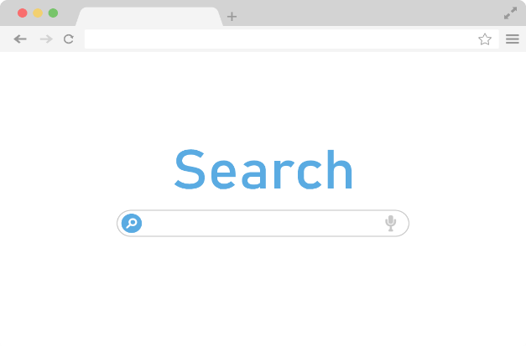




Introduction (continued)
Web browser: a program that allows you to view websites and navigate between them using hyperlinks
Common Browsers
Notes:
INSTRUCTOR NOTE: USE POWERPOINT
In today’s workshop we’re going to introduce you to the basics of using email.
A web browser is a program that allows you to view websites and navigate between them using hyperlinks.
People use browsers to access web-based applications (such as email) and to store and access documents (such as photos, forms, and music).
Some commonly used web browsers are:
Microsoft Edge
Mozilla Firefox
Google Chrome
Apple Safari
In today’s workshop we will be using <insert browser name here>.

Slide 5




Introduction (continued)
Email: a way to send mail digitally through the internet
Notes:
INSTRUCTOR NOTE: USE POWERPOINT
Introduction to Email
Email is a way to send mail digitally through the internet.
In order to access your email, you will need to set up an account with an email service provider.
In today’s workshop, we are going to use Google Gmail. Some examples of other commonly used email programs are Apple’s Mail, Microsoft Outlook, and Yahoo!. Let’s learn more about email.

Slide 6


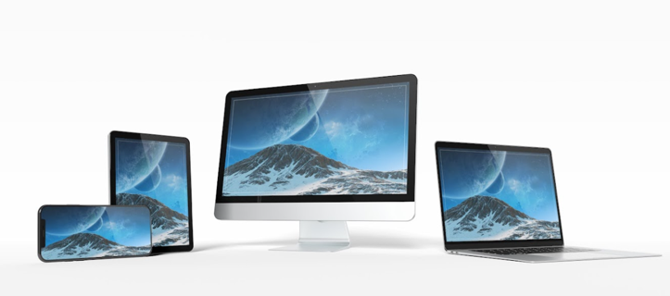
Introduction (continued)
Benefits of Using Email
You can send an email message to one
person or multiple people at the same time.
  In most cases, the person or people will receive the
  email almost immediately after you send it.
  People can access email accounts on any device with internet access, including a computer, smartphone, or tablet.
  Messages can include text, pictures, documents, videos, and other computer files.
Notes:
Benefits of using email:
You can send an email message to one person or multiple people at the same time.
In most cases, the person or people will receive the email almost immediately after you send it.
People can access email accounts on any device with internet access, including a computer, smartphone, or tablet.
Messages can include text, pictures, documents, videos, and other computer files.

Slide 7
Introduction (continued)
Anatomy of an Email Address
AmyLeighSmith82@gmail.com
Amy Leigh Smith
82 Evergreen Terrace
Springfield, OR 97477
Person’s Name
Address
Notes:
INSTRUCTOR NOTE: Point out the parts of an email on the screen.
Like a street address on an envelope, an email address has to be typed correctly or the other person will not receive their mail. An email address will always have two main parts, which are connected by the “at” symbol.
The second part of the email address is the location. It could be the name of an email provider, the organization the person works for, or a website that the person is associated with.

Slide 8
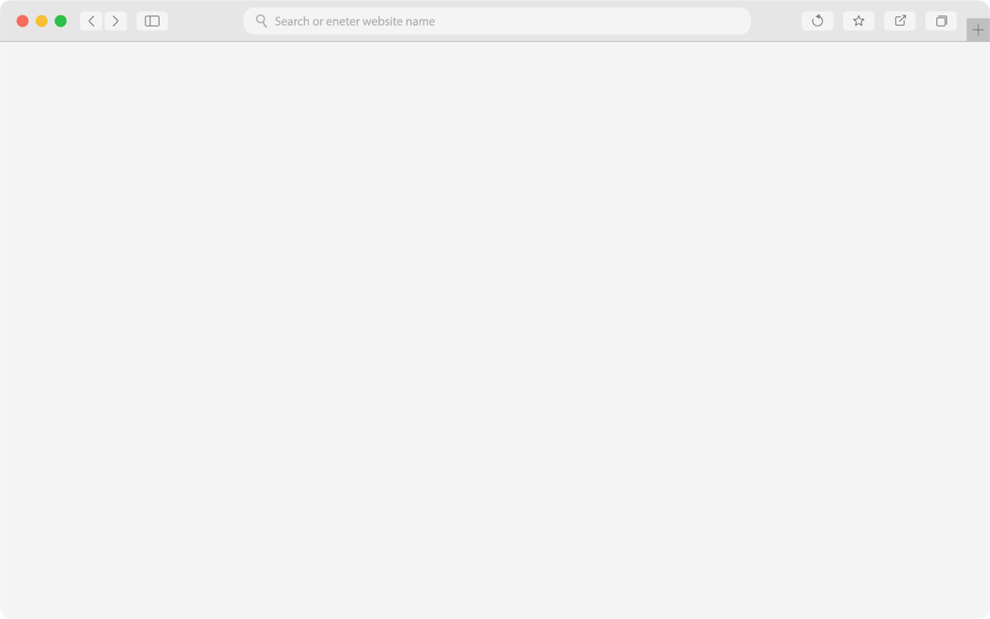
Signing Up for an Email Account
Open a web browser.
Go to gmail.com in the address bar.
Press Enter to go to the Gmail website.
Click “Create an account.”
Notes:
INSTRUCTOR NOTE: For the first part of the “Signing Up for an Email Account” section (slides 9 and 10), use PowerPoint or a live demonstration.
To send and receive email, you will need an email account. In today’s workshop we are going to sign up for a Gmail email account.
To create an email account:
Open a web browser. Today we will use <insert browser name here>.
Go to gmail.com in the address bar.
Press Enter to go to the Gmail website.
Click “Create an account.”

Slide 9
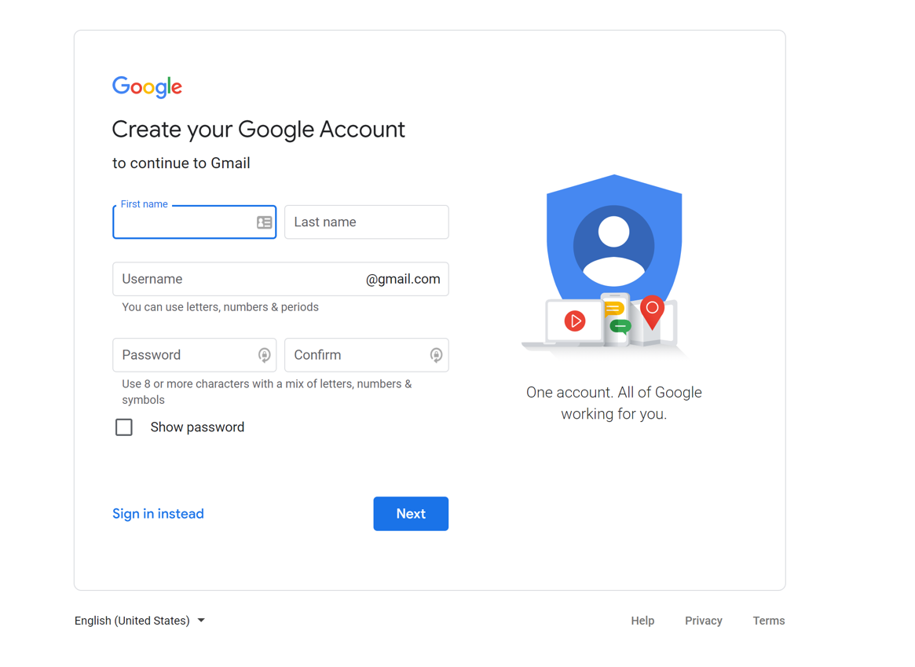
Signing Up for an Email Account (continued)
Notes:
When you click on the “Create an account” link, a form appears. If you’d like the website to display in a language other than English, you can change the language using the drop-down menu at the bottom. To complete this form, you will need to enter your first and last name. You will then need to choose a username and password.
If you are going to create your email account today, you will need access to a cell phone to complete registration.
INSTRUCTOR NOTE: Point out the language drop-down menu.

Slide 10
Signing Up for an Email Account (continued)
Selecting a Username
Username must be unique
  May need to add numbers or other
  identifying factors to it
  Select a username that is appropriate to share
Notes:
INSTRUCTOR NOTE: Use PowerPoint to walk through the signup process (slides 10 to 117).
You will also need to create a username. The username will become part of your email address. Keep in mind that usernames are unique to each account, so it may be hard to find something that is not already taken. You may have to be creative with your username and add numbers or other identifying factors to it. Since usernames become a part of your email address, you will want to use something that is appropriate to share with anyone you may give your email to, such as your child’s teacher or an employer.

Slide 11
Signing Up for an Email Account (continued)
Creating a Password
Don’t share your password with others. Passwords should be kept private.
Minimum of eight characters.
  Should not be a word that is easy to guess.
Add capital letters, numbers, and symbols to make your password more secure.
Longer is stronger.
Notes:
Passwords are secret because they are like the lock to your mailbox. To keep your password secret, it will be masked with symbols as you type it so that others watching can’t see the characters.
A password on Gmail must be at least eight characters long. It should not be a word that is too easy to guess, like “password” or “12345678.” You can add capital letters, numbers, and symbols to make your password more secure. You should not use your name or other common words that people could easily guess.
Passwords don’t need to be complex and hard to remember. You can make your passwords longer and stronger by using a phrase—for example, “Cows help make cheese.”
Don’t share your password with others. Passwords should be kept private.

Slide 12
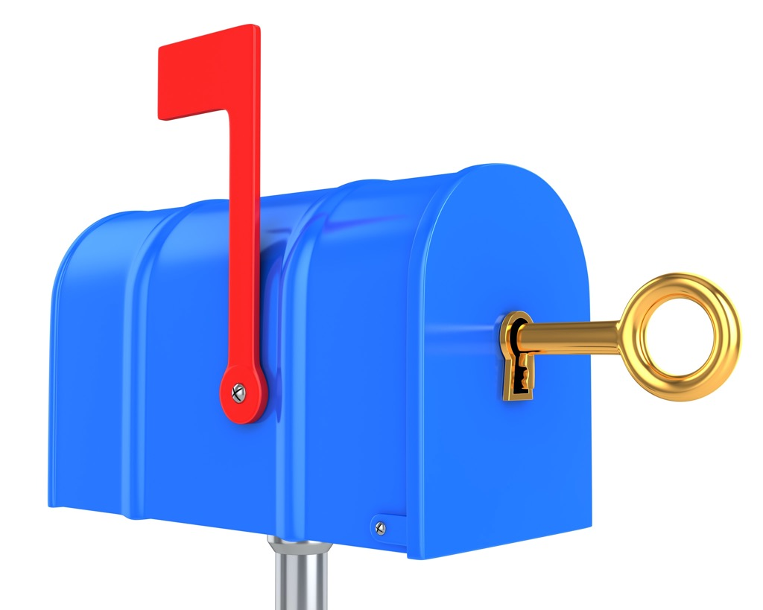
Signing Up for an Email Account (continued)
Notes:
Your email account is protected by a password of your choice, so that the only person who has access to your email is you. Think about your password as the key to your mailbox. This provides you with protection and privacy. Make sure to keep your password safe.

Slide 13
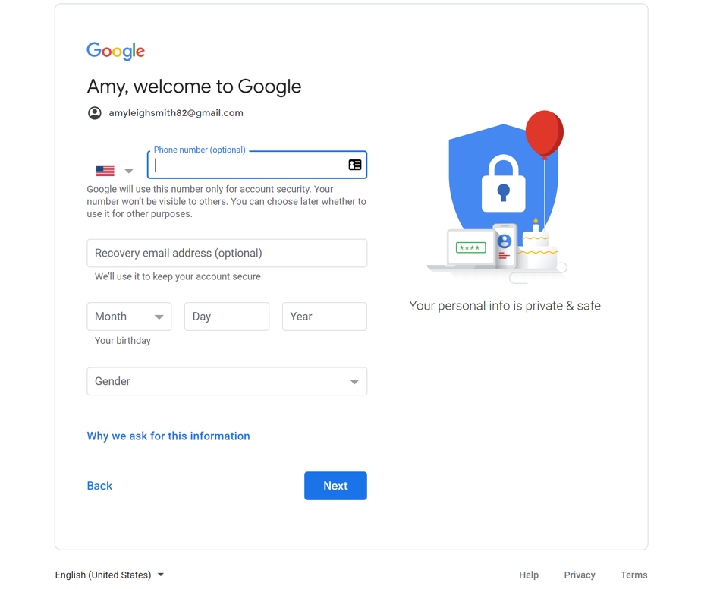
Signing Up for an Email Account (continued)
Notes:
After you create your username and password, you will need to enter your phone number.
There’s also an option to enter an alternate email address. The phone number and recovery email address will be used if you lose your password and need help accessing your account.
You will then need to enter your date of birth, typing all four digits of the year.
Then select your gender from the drop-down box.
Then click Next.

Slide 14
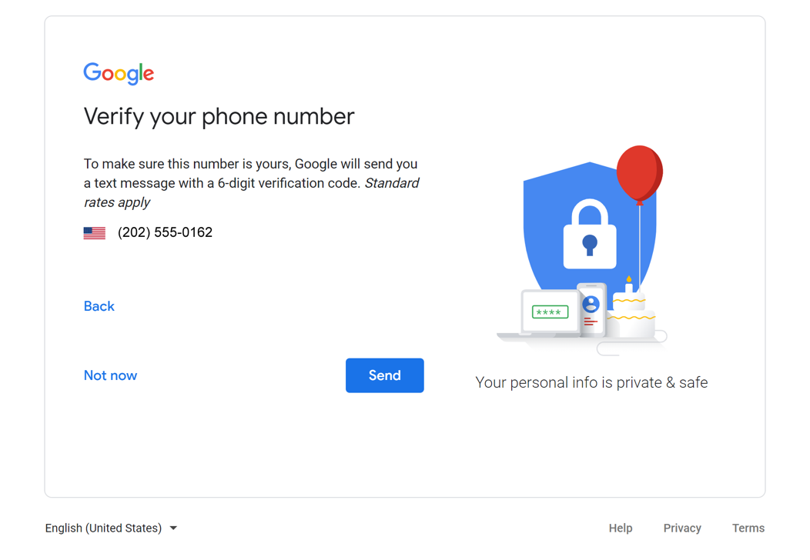
Signing Up for an Email Account (continued)
Notes:
Now you will need to verify your phone number. This shows you’re a real person and not a robot automatically creating accounts.

Slide 15
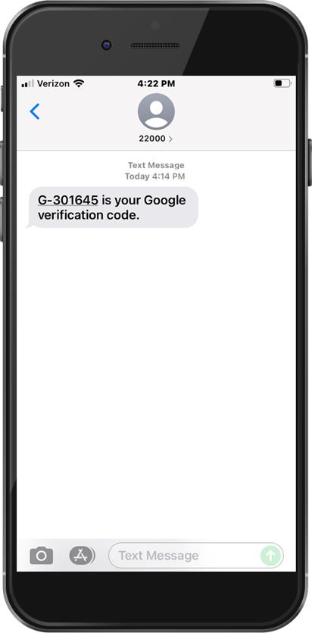
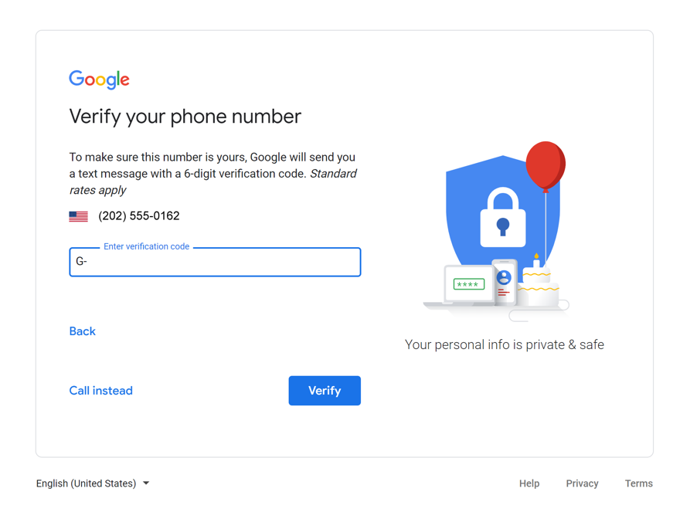
Signing Up for an Email Account (continued)
Notes:
In most cases you will need to have your phone with you when you complete the step. When you click on the Verify button, it will send a verification code to your phone. Your cell phone will receive a text message from Google with a code. You will then type the code in this box.
INSTRUCTOR NOTE: The learner will need access to a cell phone to complete registration.

Slide 16

Signing Up for an Email Account (continued)
Notes:
To receive a phone call instead of a text, click the link to call instead. When you answer the phone, you will hear an automated message reading the verification code. If you don’t have a cell phone, you can try at a later time using a home phone and selecting the “Call Instead” option.
After entering your code, click Verify.

Slide 17
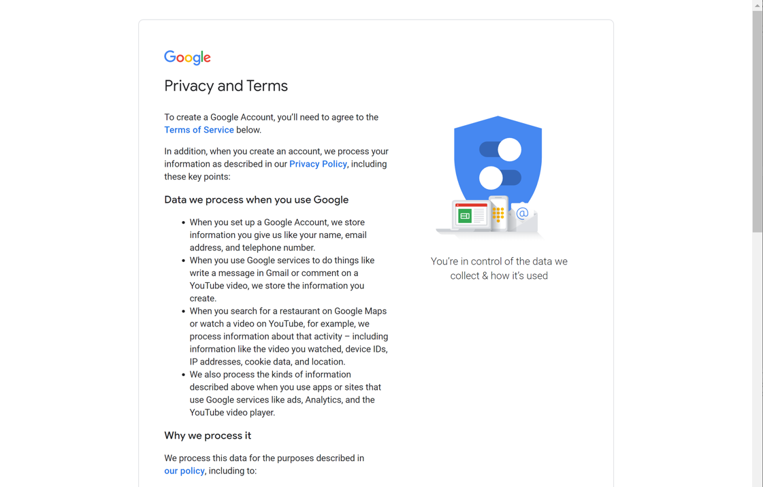
Signing Up for an Email Account (continued)
Notes:
Read Google’s Terms of Service and Privacy Policy. This explains how Google can use your information while you use Google services. After you read it, if you still want to sign up, click the button labeled “I Agree” to create the account.

Slide 18
Logging Into Your Email Account
To check your email,
you can type gmail.com in the address bar, or you can visit Google.com and click on the link that says Gmail.
Notes:
INSTRUCTOR NOTE: For the “Logging Into Your Email Account” section (slides 18 through 24), use PowerPoint or a live demonstration.
To check your email, you can type gmail.com in the address bar, or, you can visit Google.com and click on the link that says Gmail.

Slide 19
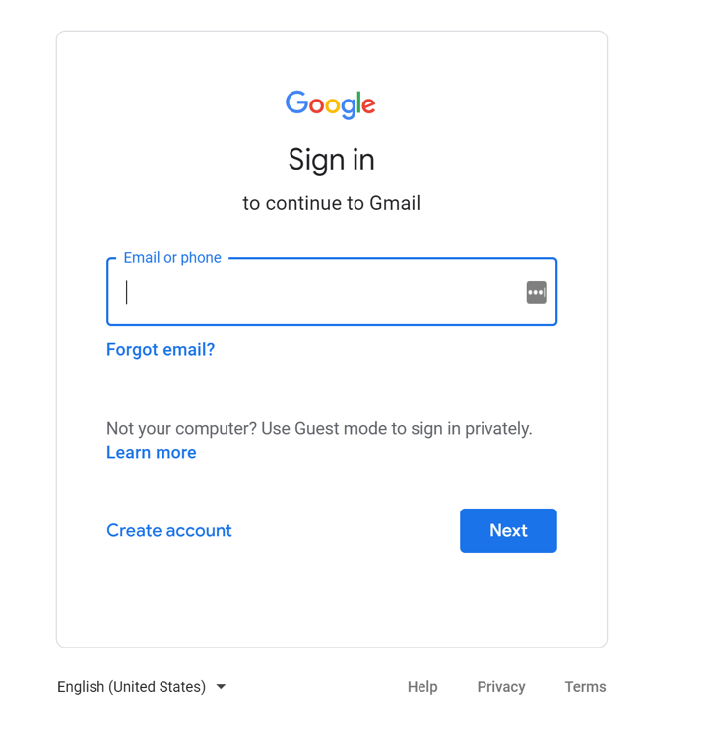
Logging Into Your Email Account (continued)
Notes:
At the Gmail login page, type your email address into the box. Then click Next.

Slide 20
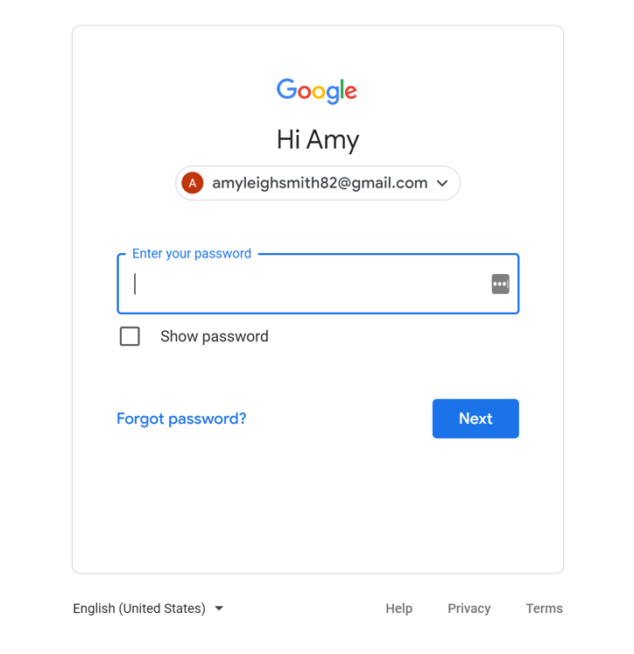
Logging Into Your Email Account (continued)
Notes:
After you enter your username, type in your password. Then click Next.

Slide 21
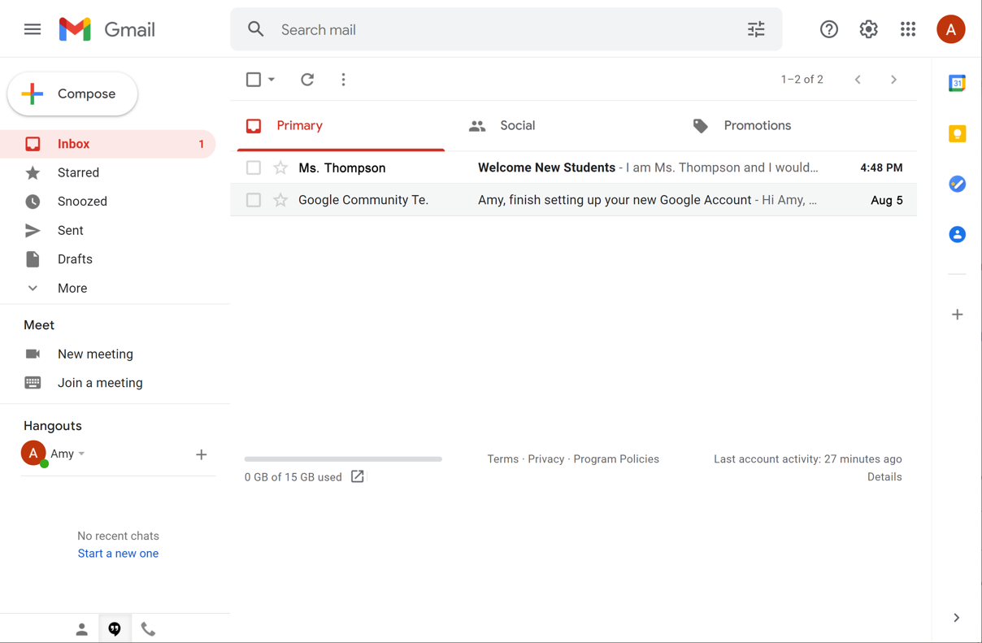
Logging Into Your Email Account (continued)
Notes:
You are now logged in to your email account!

Slide 22
Logging Into Your Email Account (continued)
When your email first opens, you will see the Inbox.
There’s a list of email messages in the middle of the screen.
  The menu on the left side allows you to switch between folders that organize your email messages, such as the Inbox, Sent Mail, Drafts, and Deleted Messages.
You can look for specific messages using the search box at the top.
You can access your account settings on the top right.
Notes:
When your email first opens, you will see the Inbox.
There’s a list of email messages in the middle of the screen.
The menu on the left side allows you to switch between folders that organize your email messages, such as the Inbox, Sent Mail, Drafts, and Deleted Messages.
You can look for specific messages using the search box at the top.
And you can access your account settings on the top right.

Slide 23

Logging Out of Your Email
Notes:
INSTRUCTOR NOTE: For the “Logging Out of Your Email Account” section (slides 23 and 24), use PowerPoint or a live demonstration.
When you are finished using your email, sign out by clicking on your account button at the top-right corner.

Slide 24
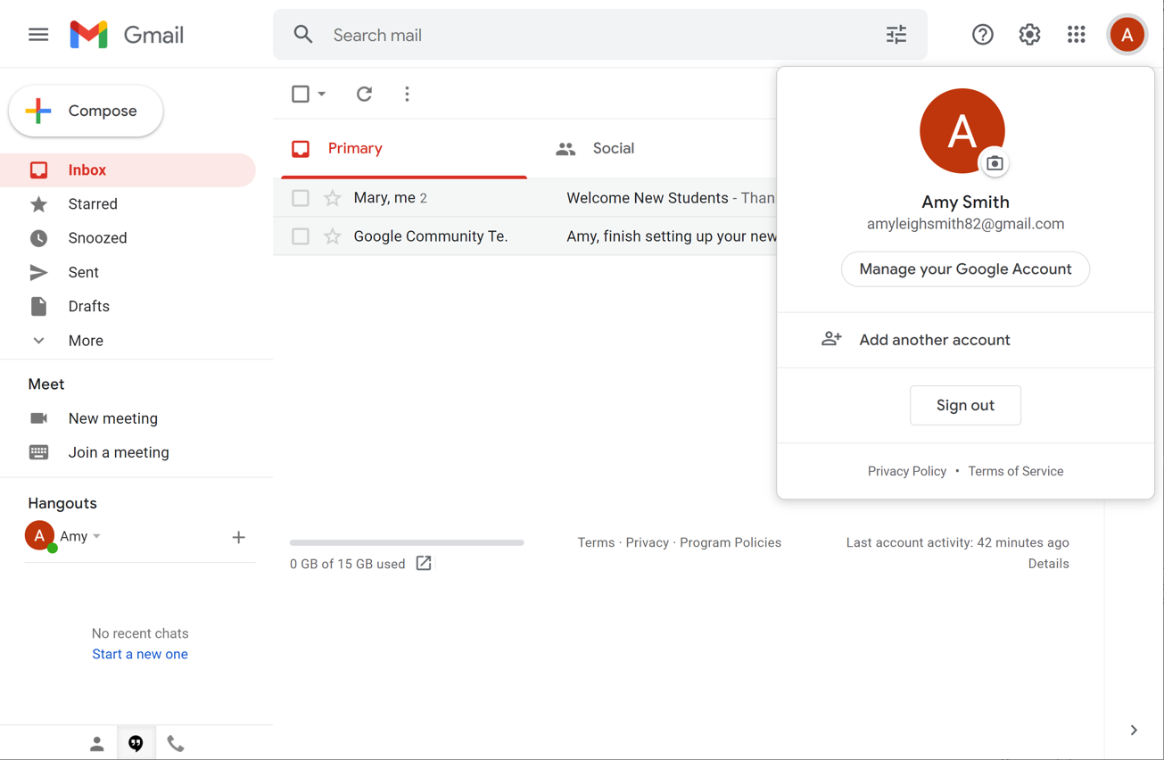
Logging Out of Your Email (continued)
Notes:
Then click Sign Out.
INSTRUCTOR NOTE: Before moving to the activity, review any “parking lot” questions. For information about what the parking lot is, see the “Before the Workshop Begins” section of the Instructor Guide. If there are no questions in the parking lot, ask learners if they have any questions before you move to the activity.

Slide 25
Activity #1
Notes:
INSTRUCTOR NOTE: Point attendees to Activity 1 on Activity Sheet page 1. Review the topics in this section. Go to the Desktop. Ask the learners to call out the answers to the questions on the next slide. If the learners have computers, encourage them to follow along on their computers. Encourage them to call out answers, and then confirm the correct answer to have them update their Activity Sheet.

Slide 26
ACTIVITY #1: Your Email Account
Use the computer desktop to answer the following questions.
If you don’t have your own computer, follow along with the instructor.
Open a web browser and keep it open.
In the address bar type www.gmail.com.
Log into your Gmail account.
Notes:
INSTRUCTOR NOTE: For Activity 1, use PowerPoint or a live demonstration.
“Let’s practice what you’ve learned. Feel free to write the answers on the Activity Guide as we complete the tasks together.”
1. Open a web browser and keep it open.
2. In the address bar, type www.gmail.com.
3. Log into your Gmail account.
After learners complete Activity #1: “Great job, everyone! In the next section you’ll learn how to open emails and reply to them.”

Slide 27

Opening and Replying
Inbox: Where your email is received
Notes:
INSTRUCTOR NOTE: For the “Opening and Replying” section (slides 27 through 32), use PowerPoint or a live demonstration.
Please use the file called “Student Email” and follow the instructions to create an email. Save it in your demo account Inbox, and use it for this section or (if needed) for other general email examples. DO NOT DELETE IT FROM THE INBOX.
The first thing you see when you open your account is the Inbox. The Inbox is where all of your messages are received, and where you will be able to manage all your messages.

Slide 28
Opening and Replying (continued)
Notes:
INSTRUCTOR NOTE: Point out each section on the screen as you describe it.
Each email includes the name of the sender.
INSTRUCTOR NOTE: Click the right arrow for the sender to highlight it with an orange box. Then click the right arrow again to remove the highlight from the sender.
Each email also includes the subject of the message.
INSTRUCTOR NOTE: Click the right arrow for the subject to highlight it with an orange box. Then click the right arrow again to remove the highlight from the subject.
And each email includes a preview of the message.
INSTRUCTOR NOTE: Click the right arrow for the preview to highlight it with an orange box. Then click the right arrow again to remove the highlight from the preview.
Finally, each email includes the date the message was sent.
INSTRUCTOR NOTE: Click the right arrow for the date to highlight it with an orange box. Then click the right arrow again to remove the highlight from the date.
The newest emails are always at the top of the Inbox.
Unread emails are in boldface type.
To open an email, click on the message you would like to read.

Slide 29
Opening and Replying (continued)
Notes:
INSTRUCTOR NOTE: Point out each section on the screen as you describe it.
You will notice some things about the inbox. A menu on the left side allows you to switch between folders that organize your email messages, such as the Inbox, Sent Mail, Drafts, and Deleted Messages.
INSTRUCTOR NOTE: Click the right arrow for the menu to highlight it with an orange box. Then click the right arrow again to remove the highlight from the menu.
You can look for specific messages using the search box at the top.
INSTRUCTOR NOTE: Click the right arrow for the search box to highlight it with an orange box. Then click the right arrow to remove the highlight from the search box.
And you can access your account settings on the top right.
INSTRUCTOR NOTE: Click the right arrow for the account settings to highlight them with an orange box. Then click the right arrow to remove the highlight from the account settings.
The message is in the middle of the screen.
INSTRUCTOR NOTE: Click the right arrow for the messages to highlight them with an orange box. Then click the right arrow to remove the highlight from the middle of the screen.
To open the first message, click on it.

Slide 30
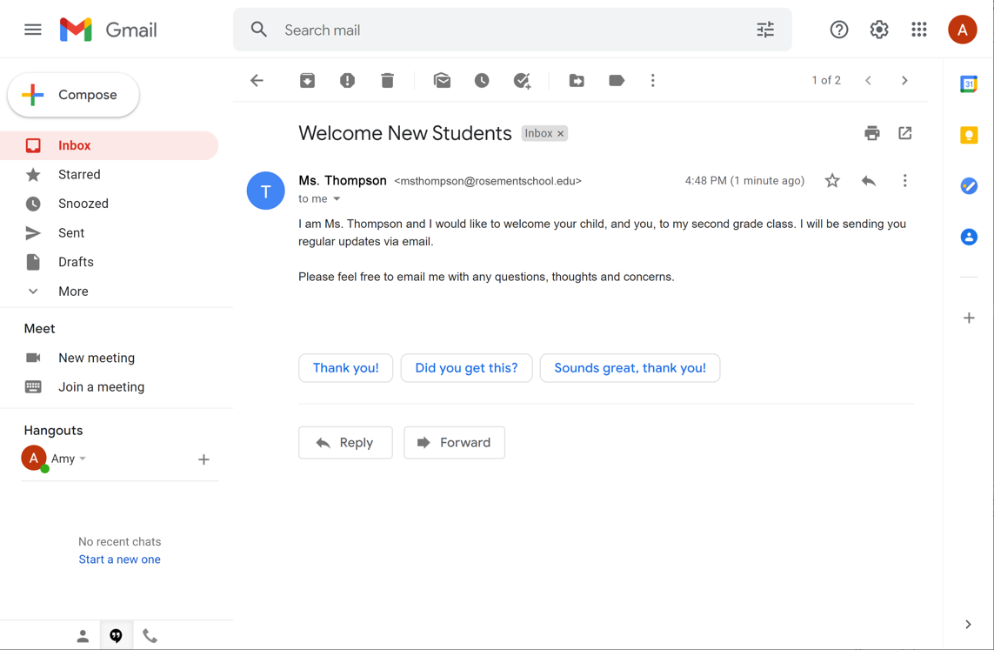
Opening and Replying (continued)
Reply: to send a message to the person who sent the email
Notes:
The message opens. There are two ways you can reply to a message.
You can click on the reply link in the box right below the message.
INSTRUCTOR NOTE: Click the right arrow to highlight the Reply button. Then click the right arrow again to remove the highlight around the Reply button.
Or you can click the arrow on the right-hand side of the message.
INSTRUCTOR NOTE: Click the right arrow to highlight the Reply arrow onscreen. Then click the right arrow again to remove the highlight around the Reply arrow.

Slide 31
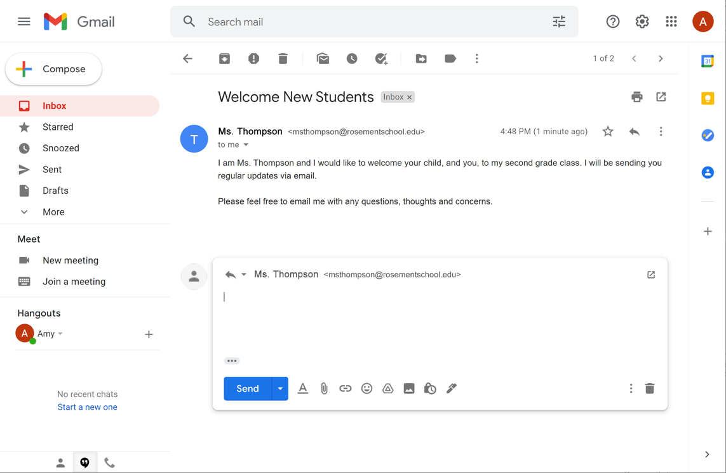
Opening and Replying (continued)
Reply
Notes:
When you click Reply, a text box appears in the large box under the recipient’s name. Type your response in the box and then click Send.

Slide 32
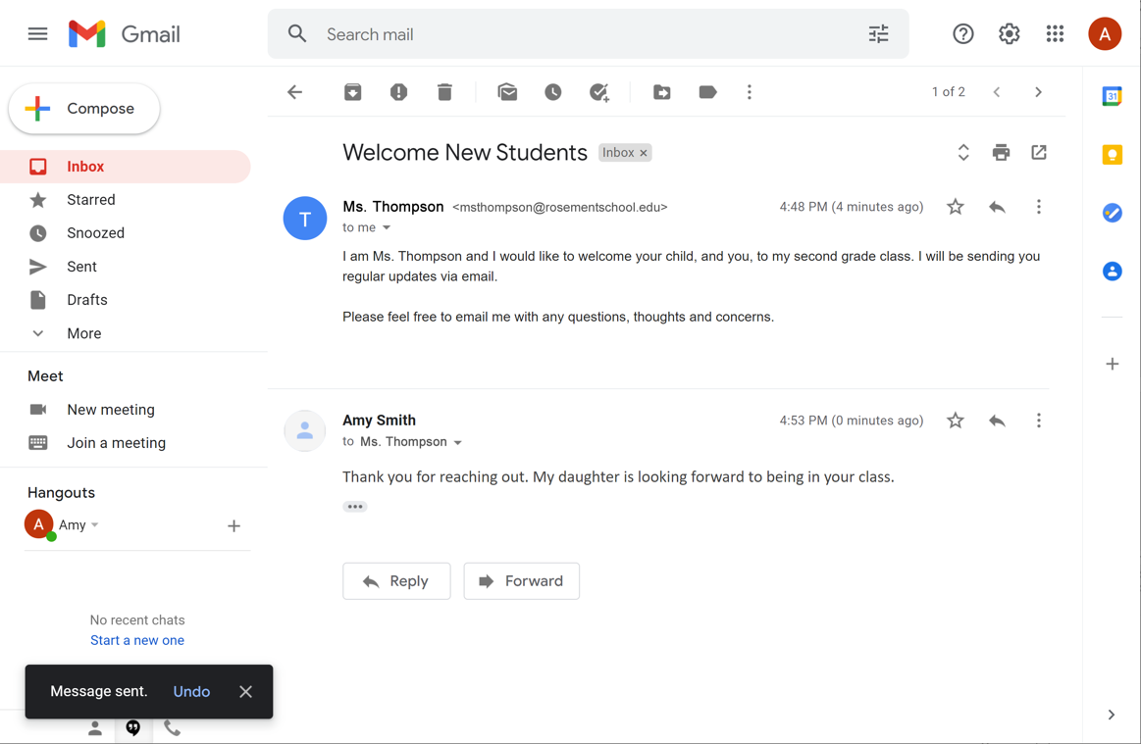
Opening and Replying (continued)
Reply
Notes:
Once the reply is sent, a notification appears at the bottom of the screen, and the reply email appears below the first message.

Slide 33
Sending New Messages
Notes:
INSTRUCTOR NOTE: For the “Sending New Messages” section (slides 34 through 39), use PowerPoint or a live demonstration.
To send a new message, click the Compose button on the top left.

Slide 34
Sending New Messages (continued)
Notes:
A message box appears. From here you will fill in who the message is to, the subject of the message, and the message itself.

Slide 35
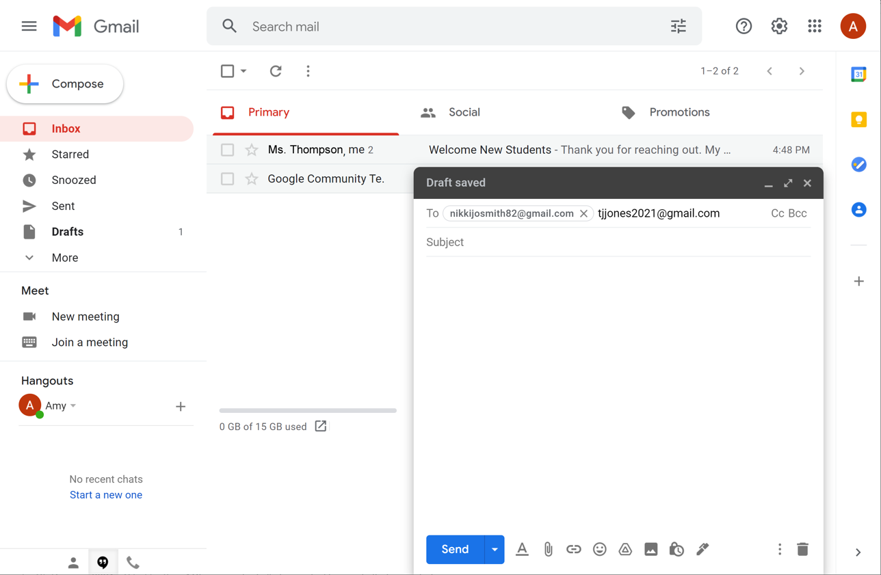
Sending New Messages (continued)
Notes:
If you want to send this message to more than one person, you can type several email addresses, separated by commas.

Slide 36
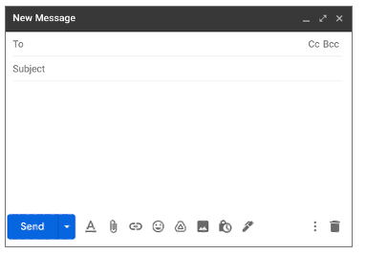
Sending New Messages (continued)
Include the email address or addresses of the person or people you are sending the message to.
Provide a subject, which lets the person know what the message is about.
Type a message in the body of the email.
Notes:
When sending a message, be sure to include:
The email address or addresses of the person or people you are sending the message to.
A subject, which lets the person know what the message is about; and
A message in the body of the email.
Once you’re done, click Send.

Slide 37
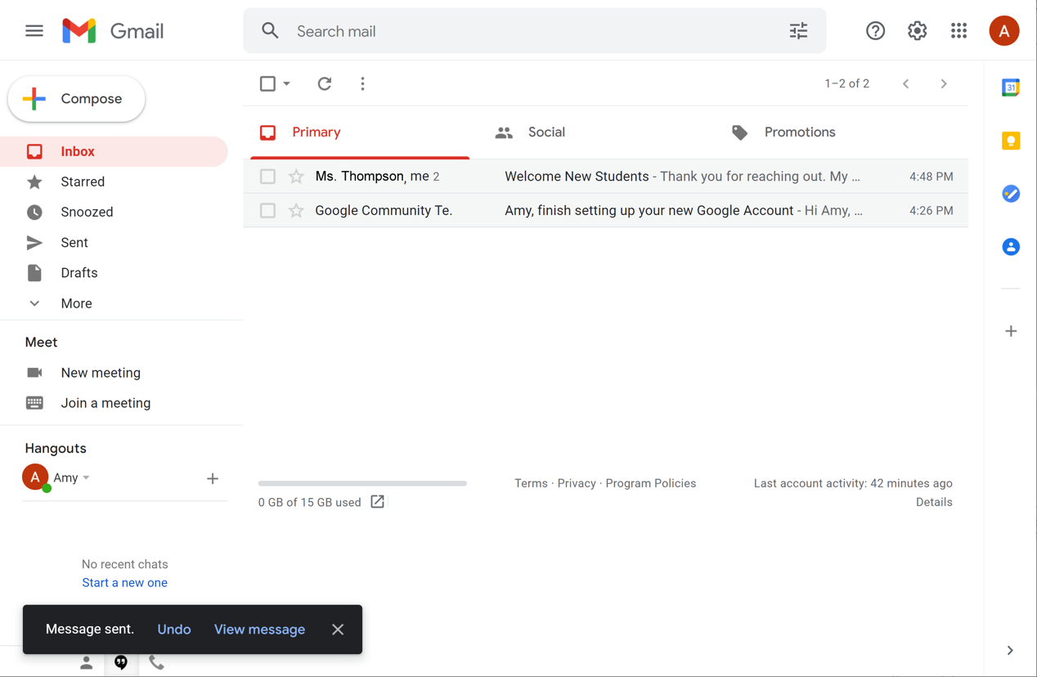
Sending New Messages (continued)
Notes:
Once the message is sent, a notification appears at the bottom of the screen confirming the email has been sent.

Slide 38
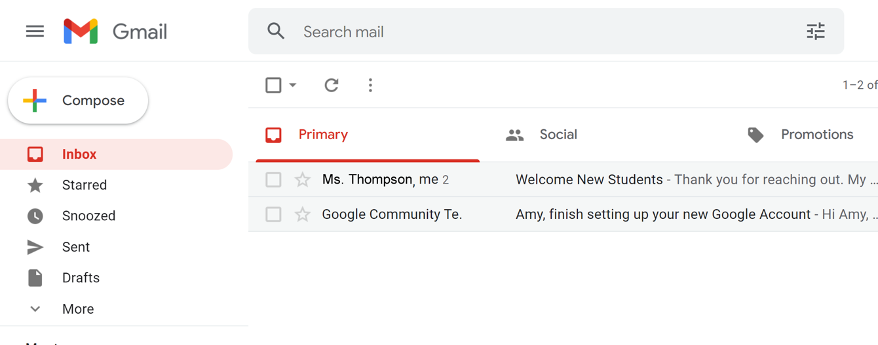
Sending New Messages (continued)
Notes:
You can find the message in the Sent folder along with other emails you have sent.
INSTRUCTOR NOTE: Before moving to the activity, review any “parking lot” questions. If there are no questions in the parking lot, ask learners if they have any questions before you move to the activity.

Slide 39
Activity #2
Notes:
INSTRUCTOR NOTE: Point attendees to Activity 2 on Activity Sheet pages 1 and 2. Review the topics in this section. Go to the Desktop. Ask the learners to call out the answers to the questions on the next slide. If the learners have computers, encourage them to follow along on their computers. Encourage them to call out answers, and then confirm the correct answer to have them update their Activity Sheet.

Slide 40
ACTIVITY #2: Sending New Messages
Open a web browser and go to www.gmail.com
Log into your Gmail account if you are not already logged in.
Compose a new message. Include the following information in the new message:
  In the To field enter <insert Instructor Demonstration Account email address here>
  The Subject: Email Basics
  In the Body: This is a new message.
  Click Send.
Where can you find the message you just sent?
Compose a new message. Include the following information in the new message:
  Your email address
  The Subject: Email Basics: What I Learned
  In the Body: Write one new thing you learned about using email in today’s workshop.
  Click Send.
Notes:
INSTRUCTOR NOTE: For Activity 1, use PowerPoint or a live demonstration.
“Let’s practice what you’ve learned. Feel free to write the answers on the Activity Guide as we complete the tasks together.”
1. Open a web browser and go to www.gmail.com
2. Log into your Gmail account if you are not already logged in.
3. Compose a new message. Include the following information in the new message:
In the To field enter <insert your demonstration account email here>
The Subject: Email Basics
In the Body: This is a new message.
Click Send.
4. Where can you find the message you just sent? Answer: In the Sent folder
5. Compose a new message. Include the following information in the new message:
Your email address
The Subject: Email Basics: What I Learned
In the Body: Write one new thing you learned about using email in today’s workshop.
Click Send.
After learners complete Activity 2: “Great job, everyone! In the next section you’ll learn what to do about spam and junk mail.”

Slide 41
Unwanted Online Communication
What are some examples of junk mail
that you receive at home?
Notes:
INSTRUCTOR NOTE: Ask learners the question on the slide. Examples might include: advertisements, sale notifications, and invitations to sign up or apply for new services, and coupons. Explain that electronic junk mail is similar to paper junk mail.

Slide 42
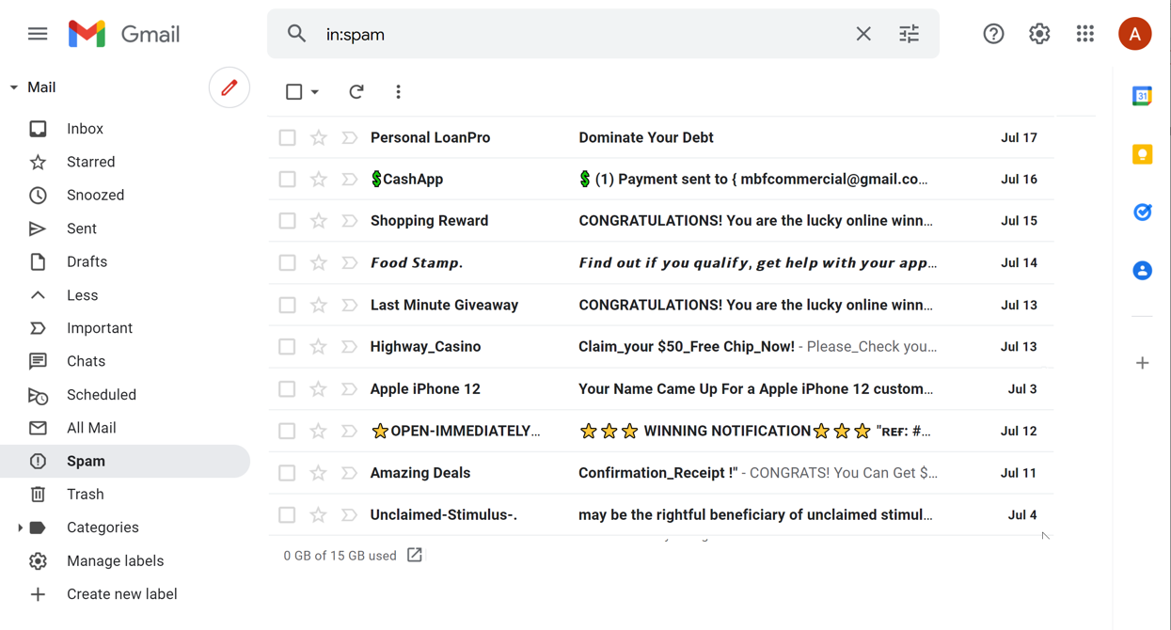
Spam and Junk Email
Spam: unwanted online communication
Notes:
INSTRUCTOR NOTE: For the “Spam and Junk Email” section (slides 42 through 46), use PowerPoint or a live demonstration.
Just like with regular mail, you can get junk sent to your email. That kind of junk email is called spam.
Spam emails often contain links to websites, pictures, and other things that you don’t need. Some spam is annoying but harmless. But other spam can cause a virus or serious problems on your computer or lead you to a fraudulent website.

Slide 43
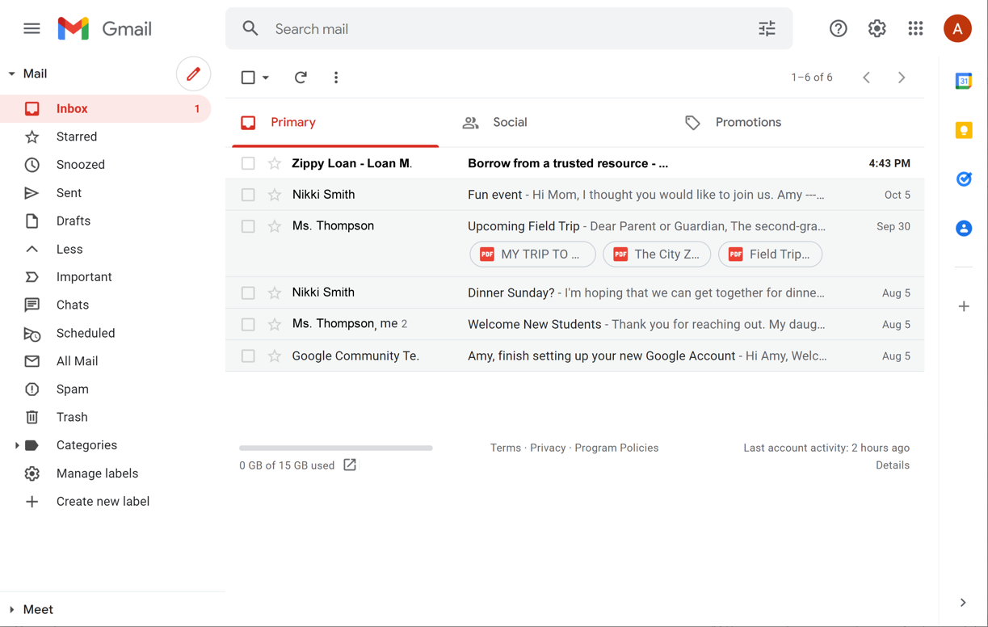
Spam and Junk Email (continued)
Notes:
There’s a Spam folder in Gmail. Most email flagged as Spam automatically goes here, so you don’t see it in the Inbox.

Slide 44
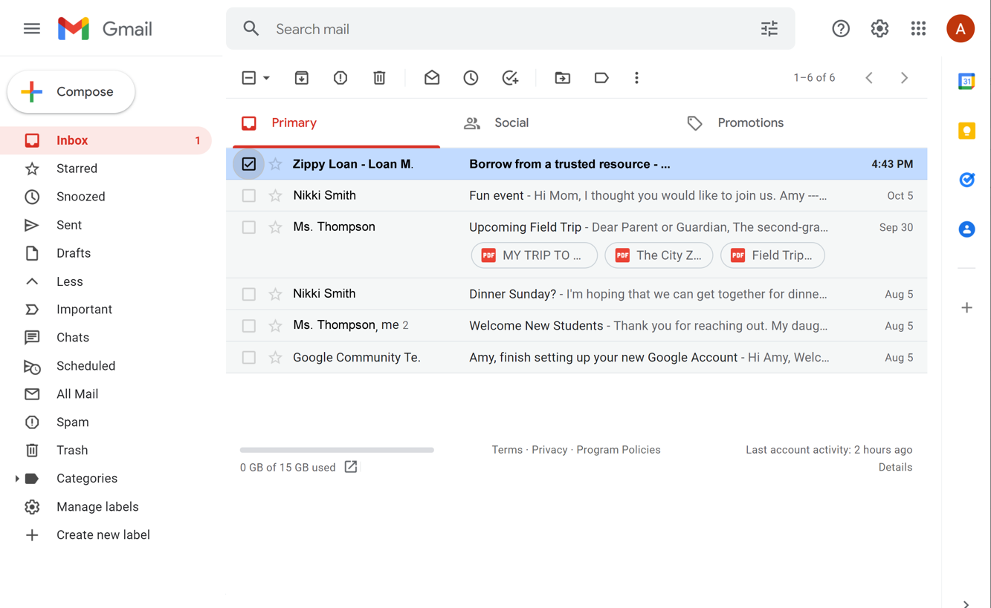

Spam and Junk Email (continued)
Notes:
Occasionally, you might see a spam email in your Inbox. If this happens, click the box next to the email that looks like spam. Then click the button to mark it as spam.
INSTRUCTOR NOTE: Point out spam icon on the screen. Avoid opening the message, clicking on any links, or viewing any pictures in the message.

Slide 45
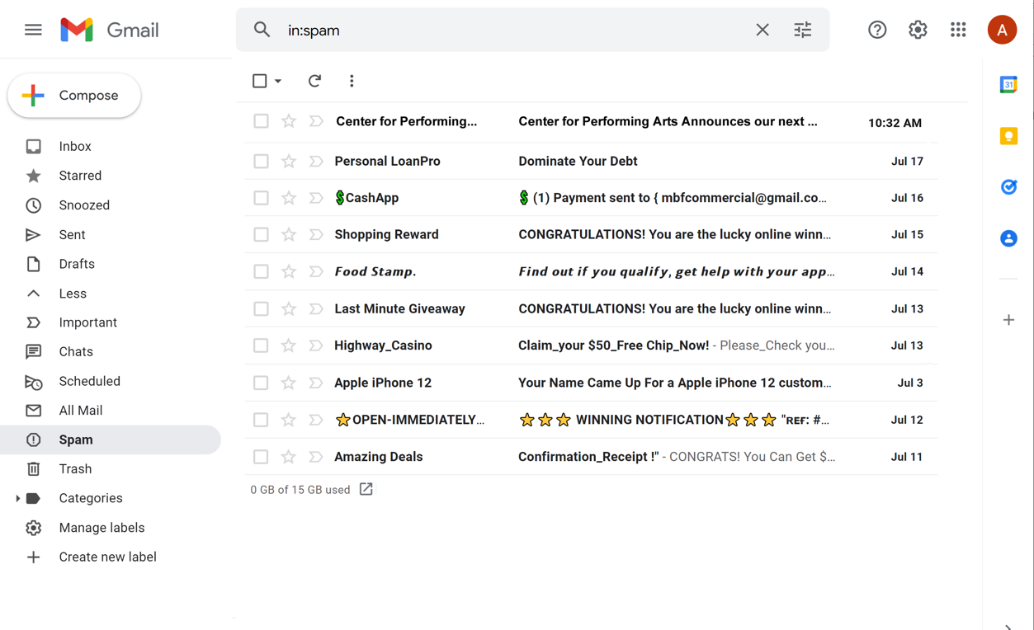
Spam and Junk Email (continued)
Notes:
INSTRUCTOR NOTE: To provide a demo of this function, use the example provided in the materials.
If you find an email in your spam folder that you want to keep, you can alert Gmail that the message isn’t spam. For today’s purposes we will use the same spam example to demonstrate.

Slide 46
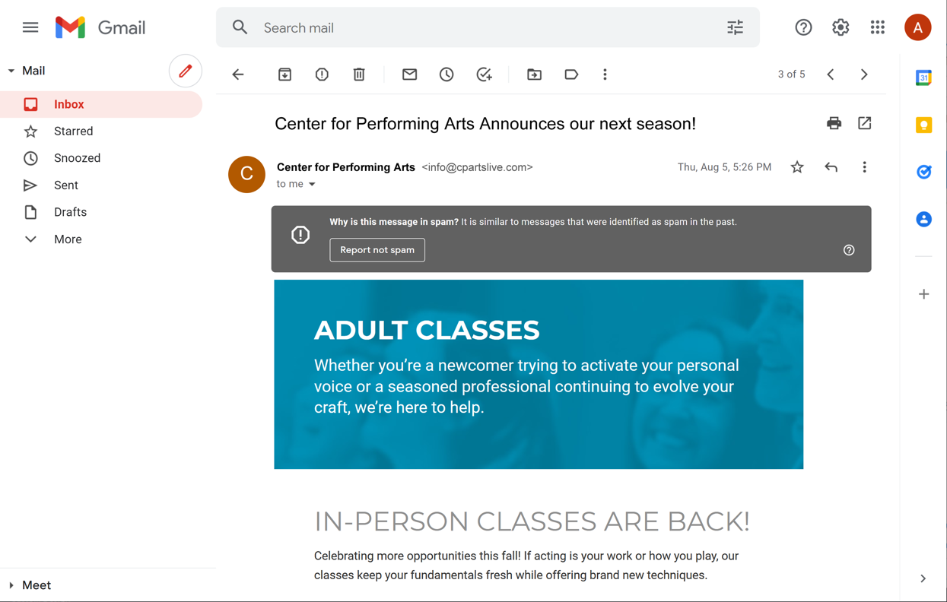
Spam and Junk Email (continued)
Notes:
After you open the message, click on the Not Spam button.
INSTRUCTOR NOTE: Use the same spam example to move this back to the inbox for the next volunteer.
From then on, if you get an email from the same email address, it will arrive in your Inbox instead of being marked as spam.
Occasionally Gmail puts safe emails in the Spam folder by mistake. If you’re missing an email from someone, be sure to check the Spam folder to see if it’s there!

Slide 47
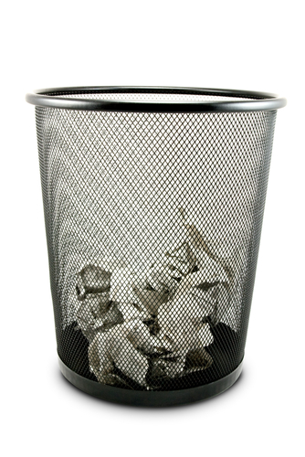
Organizing and Deleting Email
Notes:
INSTRUCTOR NOTE: For the “Organizing and Deleting Email” section (slides 47 through 55), use PowerPoint or a live demonstration.
When we receive mail through the postal service at home, we keep some things and recycle or throw away others. It’s the same way with email.

Slide 48
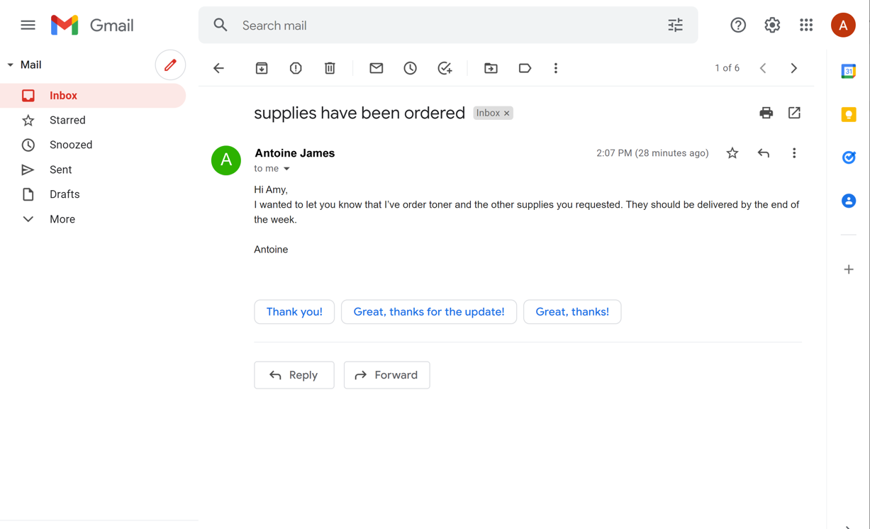
Organizing and Deleting Email (continued)
Notes:
Removing old emails can clean out your inbox and make your important emails easier to find.

Slide 49
Organizing and Deleting Email (continued)
Archive: Saves the message inside the All Mail folder. You can still find it later, but it won’t show up in your Inbox.
Notes:
The Archive button will save the message inside the All Mail folder. You can still find it later, but it won’t show up in your Inbox.

Slide 50
Organizing and Deleting Email (continued)
Delete: Moves the email to the Trash folder temporarily—usually for 30 days—and then deletes it permanently
Notes:
The Delete button will delete the message. It will stay inside the Trash folder temporarily—usually for 30 days—and then Gmail will delete it permanently.

Slide 51
Organizing and Deleting Email (continued)
Labels: Used to organize and find emails about a similar topic. You can apply more than one label to an email.
Notes:
You can give an email one or more labels that will help you stay organized find emails about a particular topic later.

Slide 52
Organizing and Deleting Email (continued)
Move To: Puts the email in another folder that you created
Notes:
Or you can move an email to another folder that you create. To retrieve the message later, you would click on the folder name on the right-hand side of the screen.

Slide 53
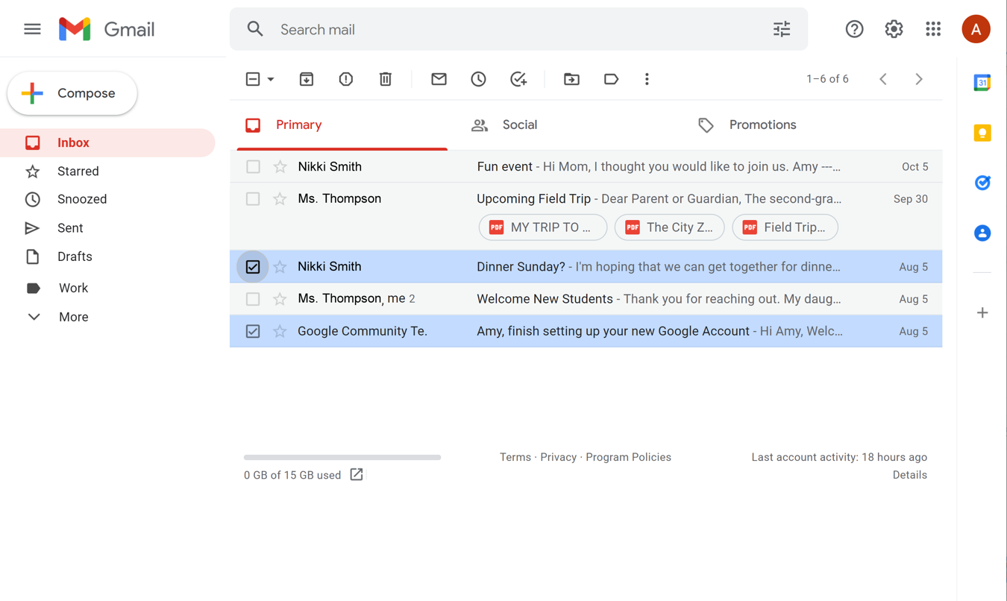
Organizing and Deleting Email (continued)
Notes:
You can also delete or organize messages directly from the Inbox. To do this click the box next to the message you want to delete, move, label, or archive.
INSTRUCTOR NOTE: Point out the icons on the screen as you say their names.
You can select several messages at the same time and then delete or move them all at once.

Slide 54
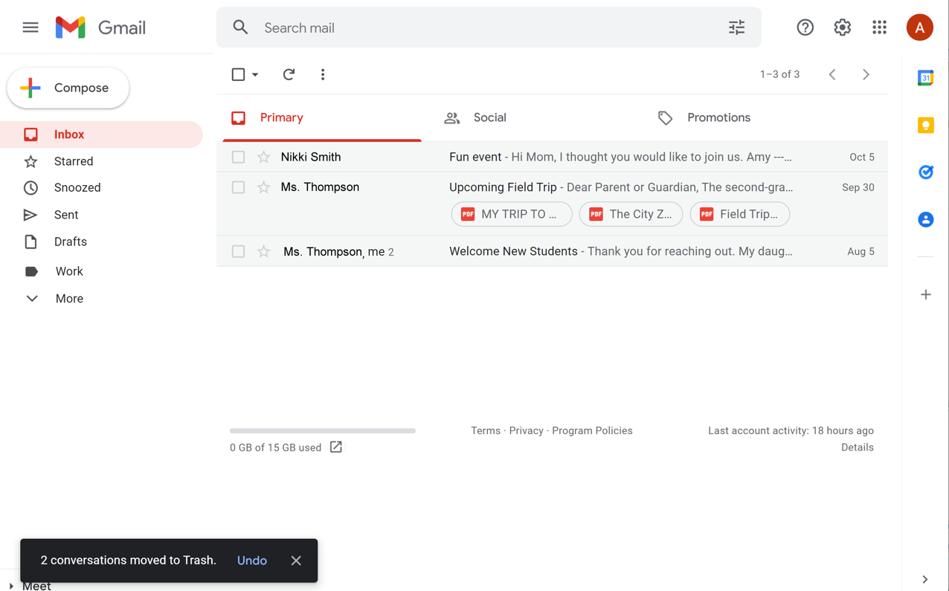
Organizing and Deleting Email (continued)
Notes:
INSTRUCTOR NOTE: Point out confirmation message.
When you click the Trash icon, a message will appear confirming the messages were moved to the Trash.
You can access the messages in the Trash by clicking on More in the right-hand menu.

Slide 55
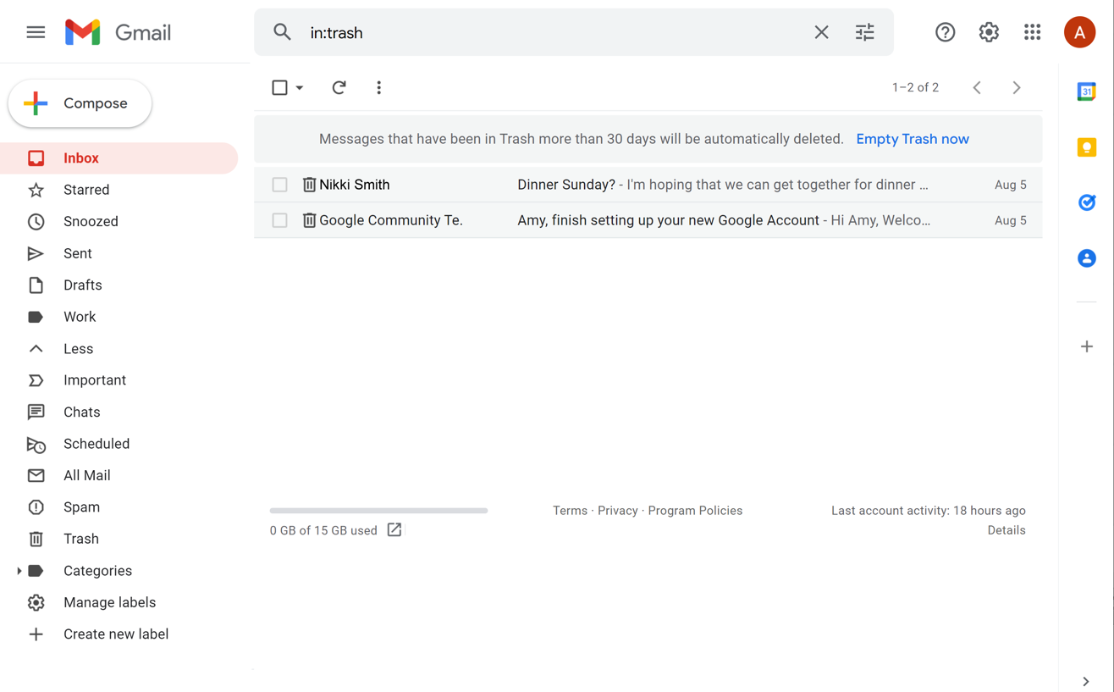
Organizing and Deleting Email (continued)
Notes:
Once you click More you will see a list of all of the folders, including Trash.
All the messages in the Trash folder can be opened, replied to, or forwarded, just like messages in the Inbox.
Remember that messages do not stay in the Trash folder forever. Many email programs, including Gmail, will permanently remove a message from the Trash after 30 days.
INSTRUCTOR NOTE: Point out the warning message.
If you want, you can click on Empty Trash Now to permanently delete everything in the Trash folder. Be careful with this, because you won’t be able to retrieve those messages once they’re gone!

Slide 56
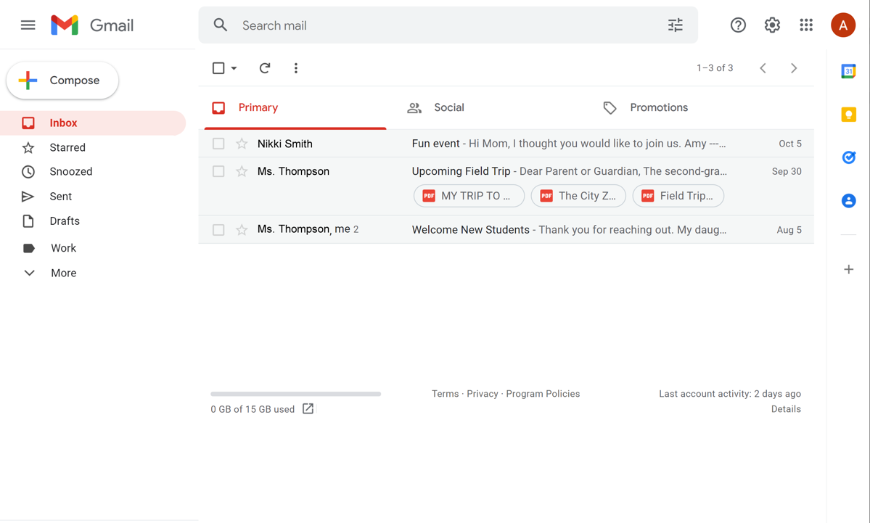
Searching for Messages
Notes:
INSTRUCTOR NOTE: For the “Searching for Messages” section (slides 56 through 61), use PowerPoint or a live demonstration. Before the class, please use the file “Search Email” and follow instructions to create an email, save it as a draft, and then search for it.
You just learned how to organize your email. Now let’s explore how you can use the Search box to find email.
If you need to find a specific email, you don’t have to look through the Inbox or other folders. Instead, you can use the Search field at the top. This will search through all of your email, no matter where it is or how old it is.

Slide 57
Searching for Messages (continued)
You can search for a
Person’s name
  Word in the Subject line
Word in the message
Notes:
You can find messages even if you don’t know who sent it or when. Just like searching for a website, you can type any word or phrase to find what you’re looking for. This could be a person’s name, a word in the subject, or a word in the message.

Slide 58
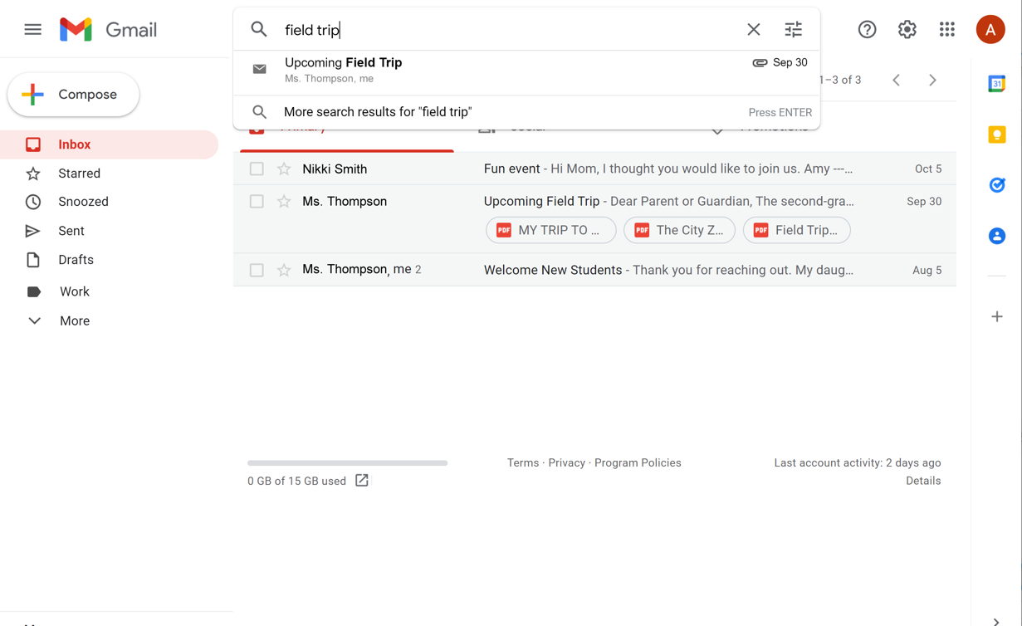
Searching for Messages (continued)
Notes:
When you are looking for a particular email, you can type a word or words into the search box that you know are in the email and then click the Enter key on your keyboard. Emails that match your search term will display. This example shows a search for “field trip.”

Slide 59
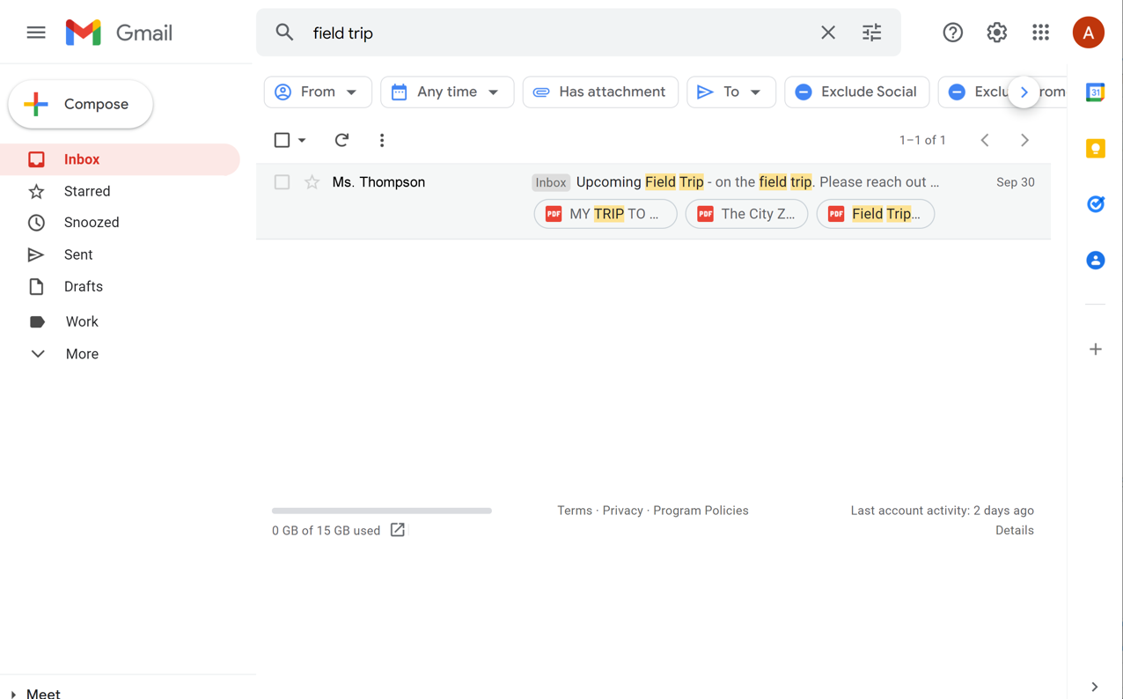
Searching for Messages (continued)
Notes:
In this email account, when the phrase “field trip” is entered these are the emails that Gmail retrieved. You can open any email in the search results list by clicking on it. Most email providers will highlight the term that you searched. This is helpful when you’re looking for an item in your search results.

Slide 60
Searching for Messages (continued)
Notes:
If you can’t find what you are looking for, or you want to narrow down the search, you can click the Search Options icon at the end of the search box.

Slide 61
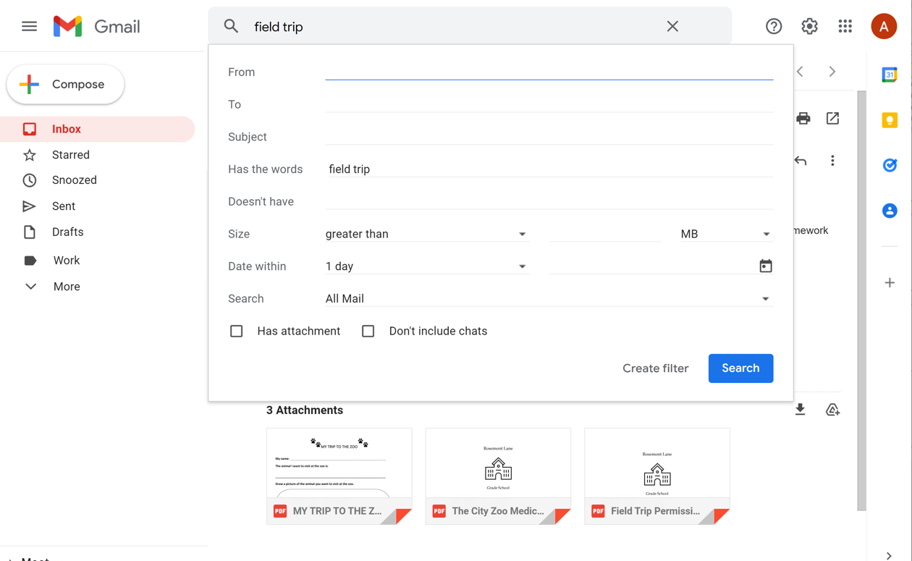
Searching for Messages (continued)
Notes:
With these options, you can find messages sent to or from certain people, with a specific subject, from a certain date range, or with an attachment. You can also use the drop-down menu to search within a specific folder.
INSTRUCTOR NOTE: Highlight each section as they go through each field.
INSTRUCTOR NOTE: Before moving to the activity, review any “parking lot” questions. For information about what the parking lot is, see the “Before the Workshop Begins” section of the Instructor Guide. If there are no questions in the parking lot, ask learners if they have any questions before you move to the activity.

Slide 62
Activity #3
Notes:
INSTRUCTOR NOTE: Point attendees to Activity 3 on Activity Sheet page 2. Review the topics in this section. Go to the Desktop. Ask the learners to call out the answers to the questions on the next slide. If the learners have computers, encourage them to follow along on their computers. Encourage them to call out answers, and then confirm the correct answer to have them update their Activity Sheet.

Slide 63
ACTIVITY #3: Searching and Deleting Email
Open the web browser.
Log into your email account.
Open the email with the subject “Email Basics: What I Learned.”
Add a label to the email called Email Basics.
Create a folder called Workshops.
Move the “Email Basics: What I Learned” email to the Workshops folder.
Open the Sent folder.
Delete the email with the subject “Email Basics: What I Learned.”
Log out of your account.
Notes:
For Activity #3, use PowerPoint or a live demonstration.
“Let’s practice what you’ve learned. Feel free to write the answers on the Activity Guide as we complete the tasks together. Use the computer desktop to answer the following questions. If you don’t have your own computer, follow along with me.”
1. Open the web browser.
2. Log into your email account.
3. Open the email with the subject “Email Basics: What I Learned.”
4. Add a label to the email called Email Basics.
5. Create a folder called Workshops.
6. Move the “Email Basics: What I Learned” email to the Workshops folder.
7. Open the Sent folder.
8. Delete the email with the subject “Email Basics: What I Learned.”
9. Log out of your account.
After learners complete Activity 3: “Great job, everyone! In the next section you’ll learn about drafts and attachments.”

Slide 64
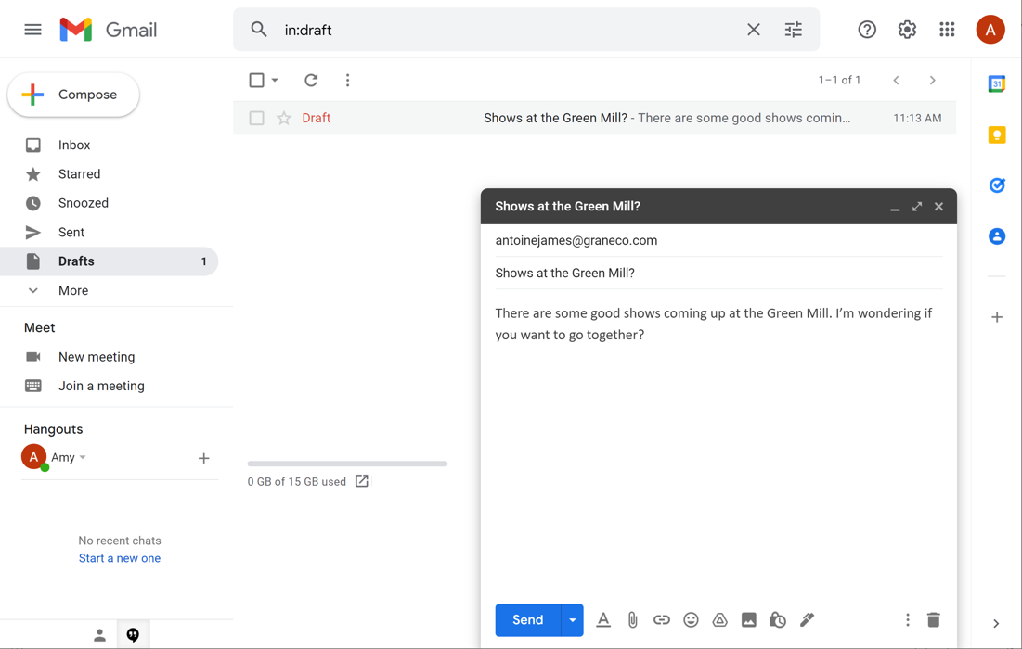
Tips and Tricks
Draft: A saved copy of an email that you have not completed. It can be edited later and sent.
Notes:
INSTRUCTOR NOTE: For the “Tips and Tricks” section (slides 64 through 71), use PowerPoint or a live demonstration. If performing a live demonstration, compose a new email and use it to demonstrate the tips and tricks.
Tips and tricks: We will go through these quickly. Please refer to your Learner Handout to review at any time.
Did you know you don’t have to finish an entire email in one sitting before you send it? A draft is a saved copy of an email that you haven’t completed. You can edit it and send it later.
To do this, you start a new message. As you type, Gmail automatically begins to save a draft. The Draft folder on the right-hand side will show you how many messages are in the Drafts folder.
When you need to stop, you don’t have to do anything except close the message. You can even log out of Gmail and leave your computer. The draft will still be waiting for you the next time you log in.
When you’re ready to finish the message, click on Drafts. The draft email includes the word “Draft” on the left side, so it’s clear the email hasn’t been sent yet. Just click on the email and begin typing.

Slide 65
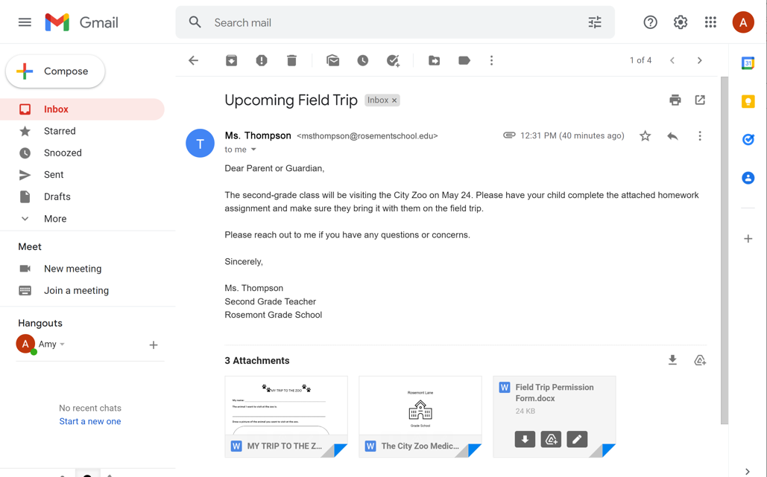
Tips and Tricks (continued)
Attachments: Files included as part of the email
Notes:
Attachments are files included as part of the email.
If you want to send a file like a picture, video, or document to someone, you can do it using email. You can attach many files to a single message, but sometimes there’s a limit on the size of files that you can send.
To send an attachment, click on the paper clip icon to attach the file or files to your email. Once the files are attached, you can send the email.
People can also send you files. Only open attachments from people you trust. As we discussed earlier, sometimes you will receive malicious spam emails that include a link or attachment with them. If the sender is not someone you know and trust, or if something looks suspicious about the message, it’s best to just delete the email and don’t open the link or the attachment. Opening malicious links and downloading attachments can spread a virus to your computer.
INSTRUCTOR NOTE: If you are performing a live demonstration of adding an attachment to an email, make sure you have a file to attach. There is a file called “School Party” included as part of the instructor materials that you can use for this purpose. Make sure to download the file to your computer before the workshop.

Slide 66
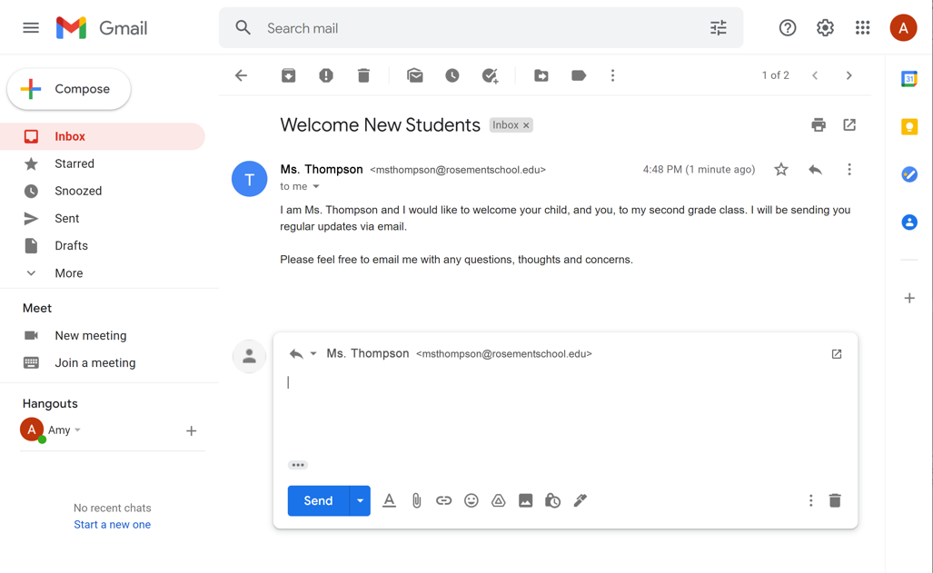
Tips and Tricks (continued)
Reply: The email goes only to the person who sent the message
Notes:
When you reply to a message, only the person who emailed you will receive a reply.

Slide 67
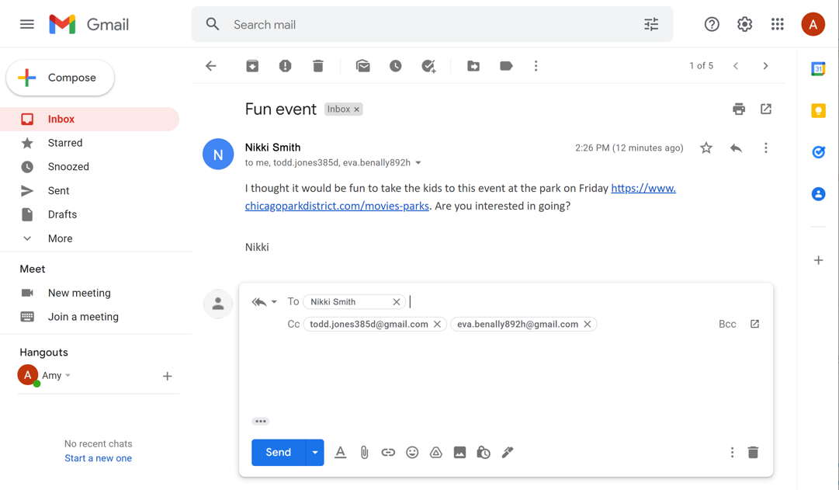
Tips and Tricks (continued)
Reply All: Sends the email to everyone who received the message
Notes:
If you want to respond to an email that includes multiple recipients, you can either Reply or Reply All. Reply sends the email only to the person who sent the message. If you click Reply All, the message will go to all emails in the To, CC, and BCC fields.

Slide 68
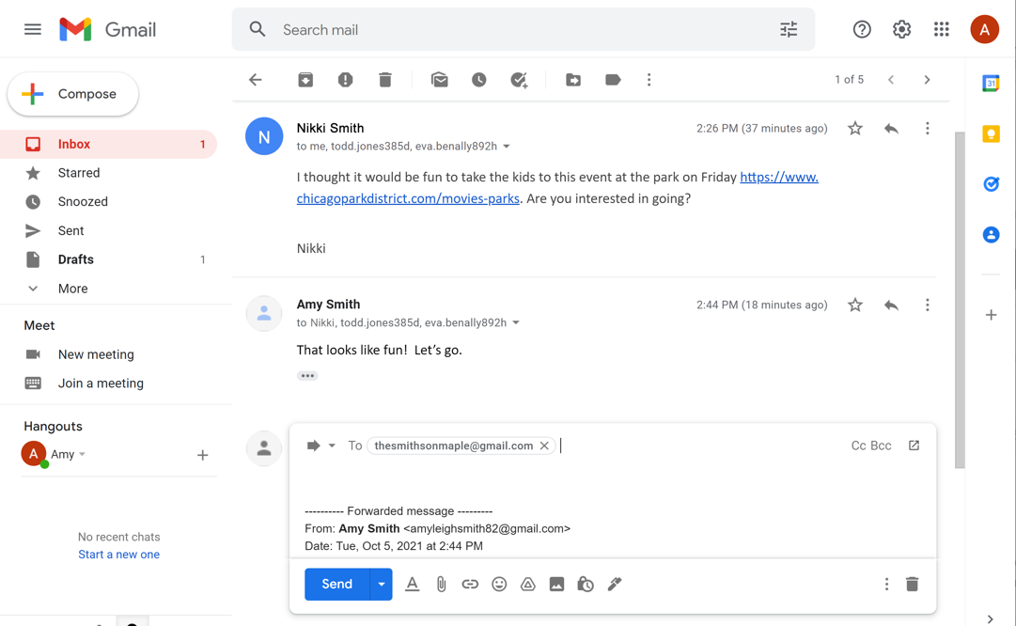
Tips and Tricks (continued)
Forward: Send an existing email to another person
Notes:
There are times when you receive an email, and you want to pass it along to other people. This is called forwarding.
To do this, click on the Forward button. Enter the email address of the person or people you want to send it to. You can also enter a message if you wish. Then click Send. The original message along with your note, if you added one, will go to the person in the “To” field.

Slide 69
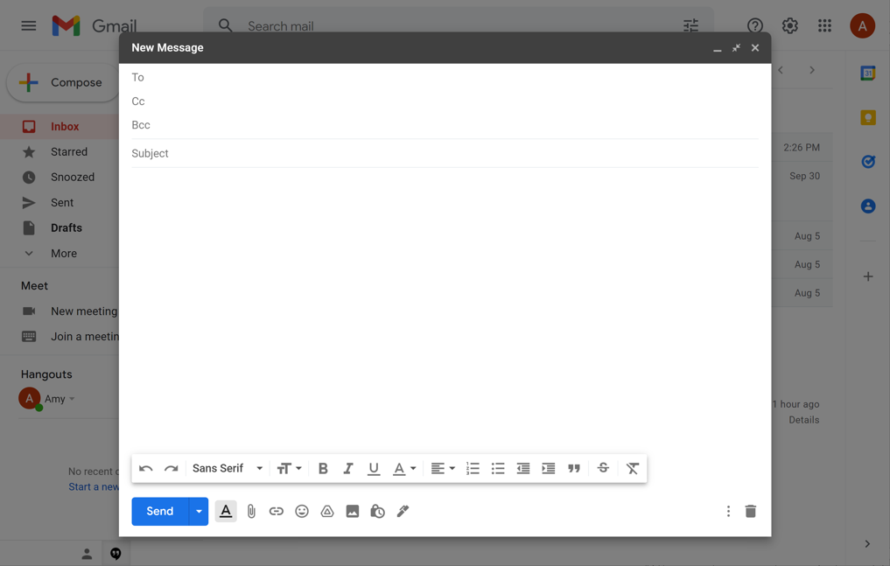
Tips and Tricks (continued)
CC: Carbon Copy
Notes:
Let’s look at the CC field, which stands for “Carbon Copy.” You can also think of it as a “Courtesy Copy.”
You can type email addresses in the CC field just like you do in the “To” field, but they are used for different reasons.
The “To” field should be used for the primary audience for a message. The CC field is used for other people that you may want to notify that the message was sent. For example, at work you might CC your supervisor to let them know that a conversation is taking place.
INSTRUCTOR NOTE: If you are doing a live demonstration, add the address of your email demo account to the “To” and “CC” fields. Do not send the message. Instead, move to next slide.

Slide 70
Tips and Tricks (continued)
BCC: Blind Carbon Copy
Notes:
The BCC field is also known as Blind Carbon Copy. It’s very similar to the CC field. The difference with BCC is that people receiving the email can’t see who is inside the BCC field. Once the email is sent, only the sender can view all recipients, including the BCC recipients, in the Sent folder.
INSTRUCTOR NOTE: If you are doing a live demonstration, add on a BCC using your demo account address. Then send the email and show the example in the inbox to show that the CC is visible and BCC is not visible to other recipients. After that, check the Sent folder and show how only the sender can see all of the recipients.

Slide 71
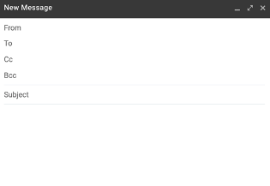
Tips and Tricks (continued)
The CC field lets the recipient know that it is a courtesy copy for their records, and they often don’t need to reply or take any action.
The BCC field keeps the email address private.
You can use multiple email addresses in all three fields—To, CC, and BCC—anytime you send a message.
Notes:
To recap:
Putting an email in the CC field lets the recipient know that it is a courtesy copy for their records, and they often don’t need to reply or take any action.
Using the BCC field keeps the email address private.
You can use multiple email addresses in all three fields—To, CC, and BCC—anytime you send a message.
Can you think of a time when these tips and tricks would be useful for you?
INSTRUCTOR NOTE: Before moving to the activity, review any “parking lot” questions. For information about what the parking lot is, see the “Before the Workshop Begins” section of the Instructor Guide. If there are no questions in the parking lot, ask learners if they have any questions before you move to the activity.

Slide 72
Activity #4
Open Intro to Email 2: Beyond the Basics Practice
Notes:
“Let’s practice what you’ve learned.”
INSTRUCTOR NOTE: You can either:
Launch the Practice section online by clicking on the link “Intro to Email 2: Beyond the Basics Practice” on the slide
OR Ask learners if they would prefer a demo to walk through these instructions, which are also listed on the Learner Activity Sheet.
In the address bar of the web browser, enter https://www.digitallearn.org > Click on “Intro to Email 2: Beyond the Basics” > Click on “Practice”
OR Use the next four slides to review what students have learned in the Email Basics section.
Learners should follow along as you go through each question. Engage them by asking them to call out answers. Then confirm the correct answers.

Slide 73
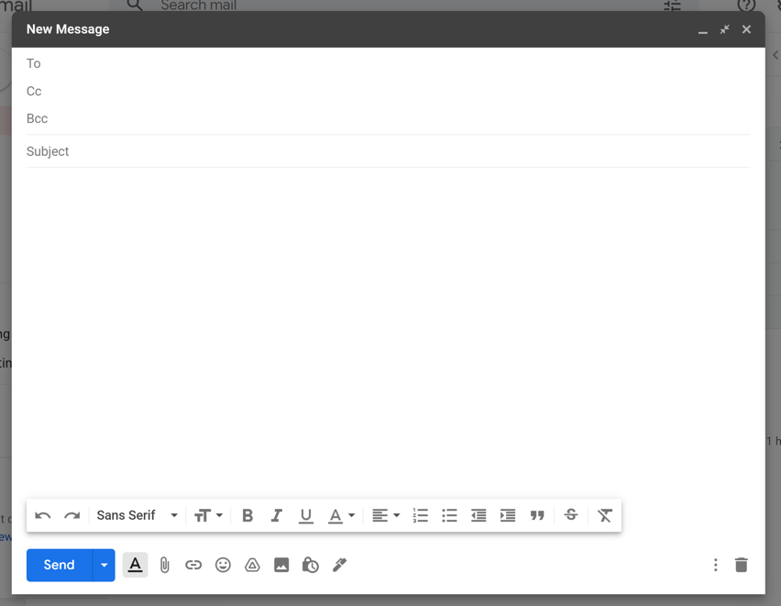
What do you click on to add an attachment?
Notes:
INSTRUCTOR NOTE: For the rest of the “Tips and Tricks” section (slides 73 through 78), use PowerPoint or a live demonstration.
What do you click on to add an attachment?
Answer: Paper clip icon
INSTRUCTOR NOTE: Point out the paper clip icon.

Slide 74
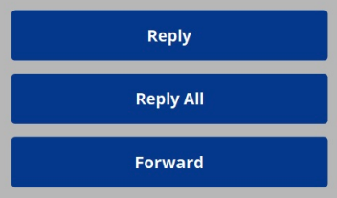
If you want to reply to everyone who received the message, which option do you choose?
Notes:
If you want to reply to everyone who received the message, which option do you choose?
Answer: Reply All
If you want to reply to everyone who received a message, you need to click “Reply All.” If you select “Reply,” the message will go only to the person who sent the message. If you select “Forward,” you can send the message to other people.

Slide 75
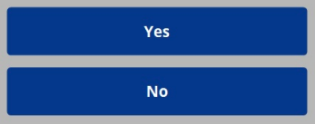
If you BCC your mother in an email, will your friends see your mother’s email address when they receive the email?
Notes:
If you BCC your mother in an email, will your friends see your mother’s email address when they receive the email?
Answer: No. BCC means Blind Carbon Copy. The people receiving the email can’t see the names or email addresses inside the BCC field.

Slide 76
If you want to finish an email that you started yesterday but did not send, where would you find it?
Notes:
If you want to finish an email that you started yesterday but did not send, where would you find it?
Answer: Drafts folder
INSTRUCTOR NOTE: Point out the Drafts link on the screen.

Slide 77
After reading this email, you decide you want to delete it. Which icon should you click to delete the message?
Notes:
After reading this email, you decide you want to delete it. Which icon should you click to delete the message?
Answer: Trash icon
INSTRUCTOR NOTE: Point out the Trash icon.

Slide 78
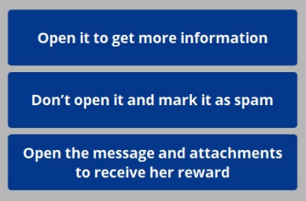
You see an email from a sender you don’t recognize. It seems too good to be true! What should you do with the message?
Notes:
You see an email from a sender you don’t recognize. It seems too good to be true! What should you do with the message?
Answer: Don’t open it and mark it as spam.
A message from someone you don’t recognize may be spam. It’s safest to not open the message and mark it as spam.

Slide 79
Congratulations!
Today you have learned:
The tools and apps needed to use email
The skills to perform basic email functions, including:
  Logging into and out of an email account
  Communicating through email
  Recognizing and managing spam
  Organizing and deleting email
  Searching for messages
Email tips and tricks, including:
  Getting started with Gmail
  Keeping your email account safe
  Draft, Attachments, Reply All, Forward, CC, and BCC
Notes:
Congratulations, learners! Today you have learned:
The tools and apps needed to use email
The skills to perform basic email functions, including:
Logging into and out of an email account
Communicating through email
Recognizing and dealing with spam
Organizing and deleting email
Searching for messages
Email tips and tricks, including:
Getting started with Gmail
Using the Draft email feature
Including attachments
When to use Reply, Reply All, and Forward
How to use CC and BCC
INSTRUCTOR NOTE: Provide each learner with a Certificate of Completion.

Slide 80
Today’s training is provided by AT&T and the Public Library Association.
Visit <insert library’s URL here> and https://www.digitallearn.org for more courses and to build confidence using technology.
Notes:
INSTRUCTOR NOTE: Point the learners to additional courses that are available. Draw learners’ attention to the website address in the slide.

Slide 81
Thank you for coming!
THANK YOU FOR COMING!
Notes:
Thanks again to AT&T and PLA for this workshop. We appreciate all our participants for coming and we encourage you to keep learning!

