Slide 1

eBay Basics
Phillip Schneider
Information Services Librarian
Gail Borden Public Library District
Courtesy of Gail Borden Public Library
and the Public Library Association

Slide 2
Agenda
What is eBay?
Creating an eBay account
Creating a PayPal account
Searching, viewing & bidding
Exploring and My eBay
Making a purchase
Paying with PayPal
After you pay
Strategies for winning
Questions?

Slide 3
What is eBay?

Slide 4
What is eBay?
eBay = an auction website
  Similar to live, in person auctions
No fees for buyers
Sellers pay minimal auction fees
Buyer guarantee
Must have a PayPal account
Craigslist vs eBay
Notes:
www.ebay.com – Click Sign In

Slide 5
Creating an eBay Account

Slide 6
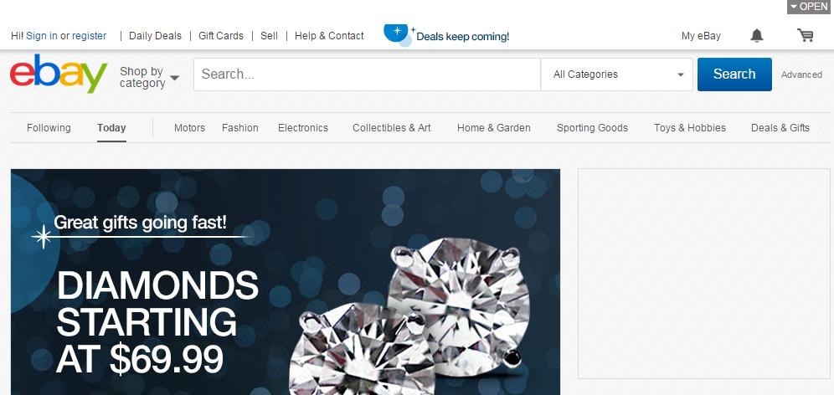
Creating an eBay Account
Notes:
www.ebay.com – Click Sign In

Slide 7
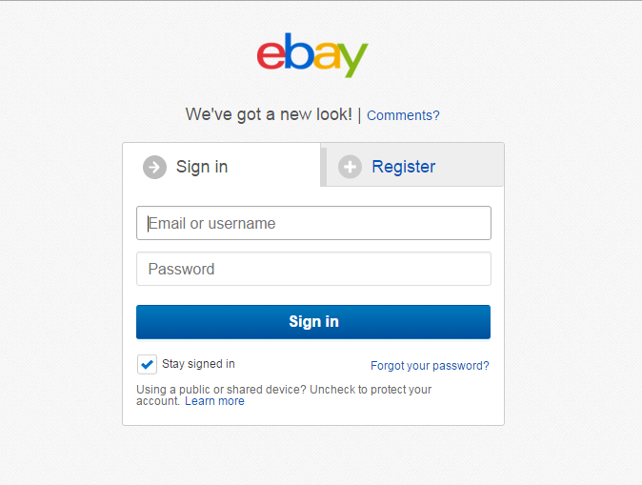
Creating an eBay Account
Notes:
Click Register

Slide 8
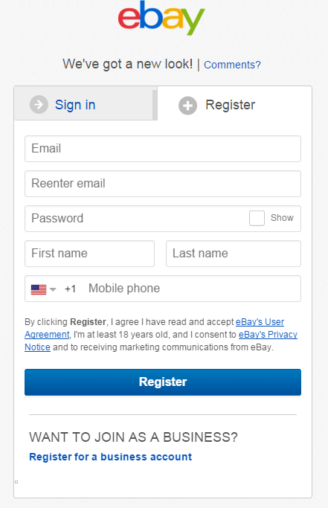
Creating an eBay Account
Fill in the required info
Read the User Agreement / Privacy Policy
Click Register

Slide 9
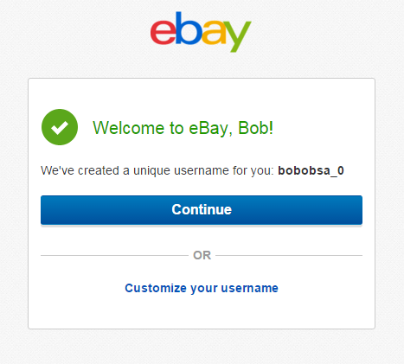
Creating an eBay Account
Notes:
Congrats, your eBay account is now active! You can keep the username given to you or customize it. Click Continue to begin!

Slide 10
Creating a PayPal Account

Slide 11

Creating a PayPal Account
Notes:
Explain why they must go to PayPal to sign up for an account and how it interacts with eBay. Mention safety and security of info. Explain that it’s easier to sest this all up before hand rather than after you have found an item you want. www.paypal.com Click Sign Up.

Slide 12
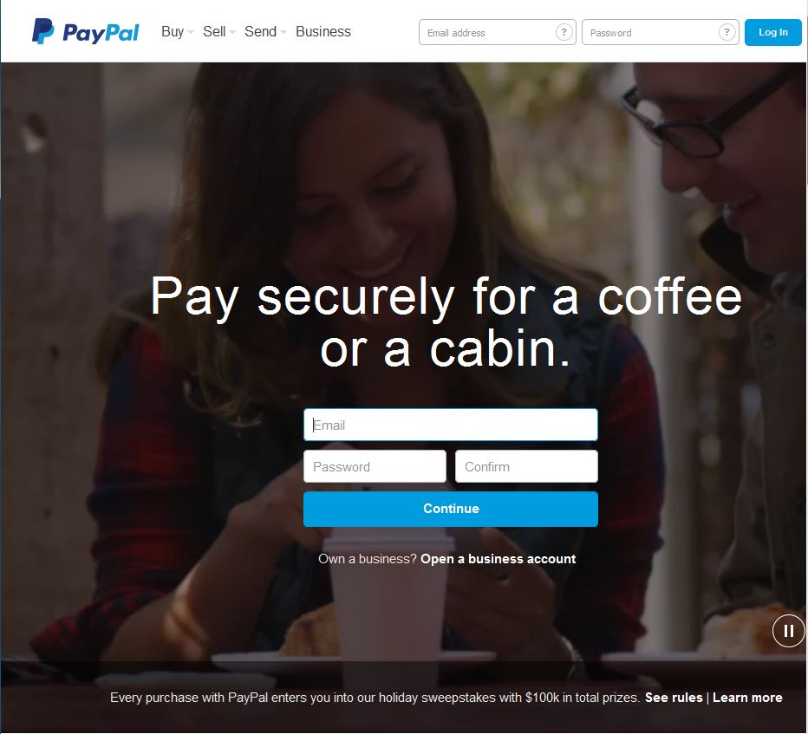
Creating a PayPal Account
Notes:
Fill out the required info (email & password) and click Continue

Slide 13
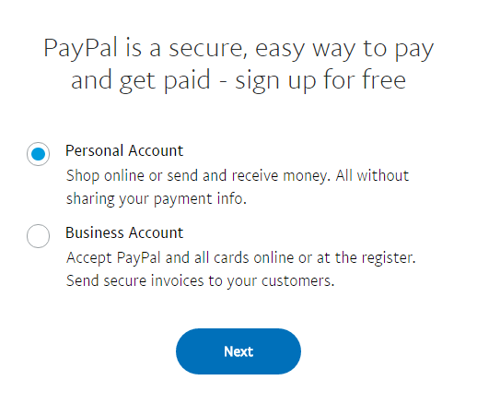
Creating a PayPal Account
Choose Personal Account
Notes:
PayPal requires personal information.

Slide 14
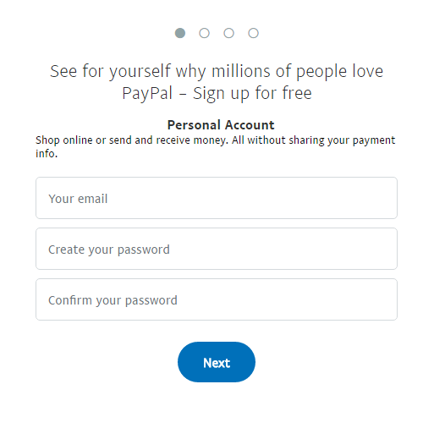
Creating a PayPal Account
Fill in your personal information
Click Next
Notes:
PayPal requires personal information.

Slide 15
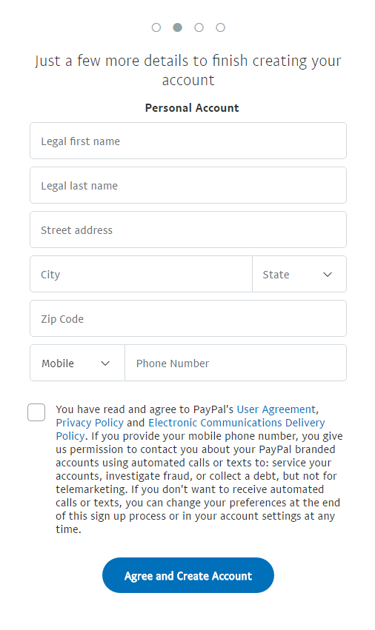
Creating a PayPal Account
Fill in your personal information
Read the PayPal's policies and terms
Check that you agree to them
Click Agree and Create Account
Notes:
PayPal requires Debit Card, Credit Card and/or Bank Account information. Select the option you’d like to fill out first and enter the required information.

Slide 16
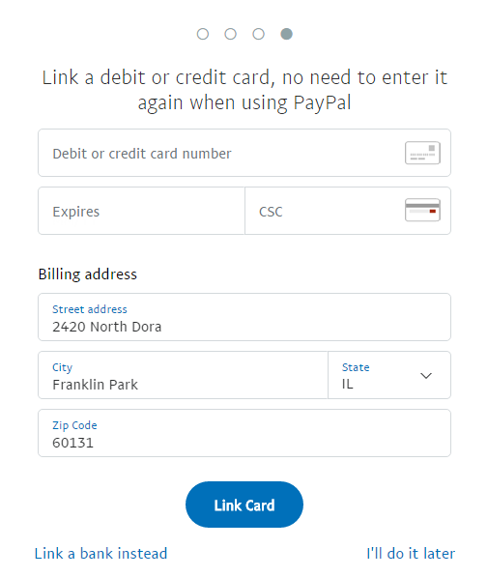
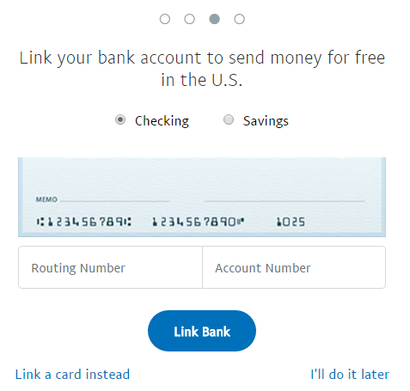
Creating a PayPal Account
Notes:
The Bank account screen will look similar to this. Fill in the required info and hit continue.

Slide 17
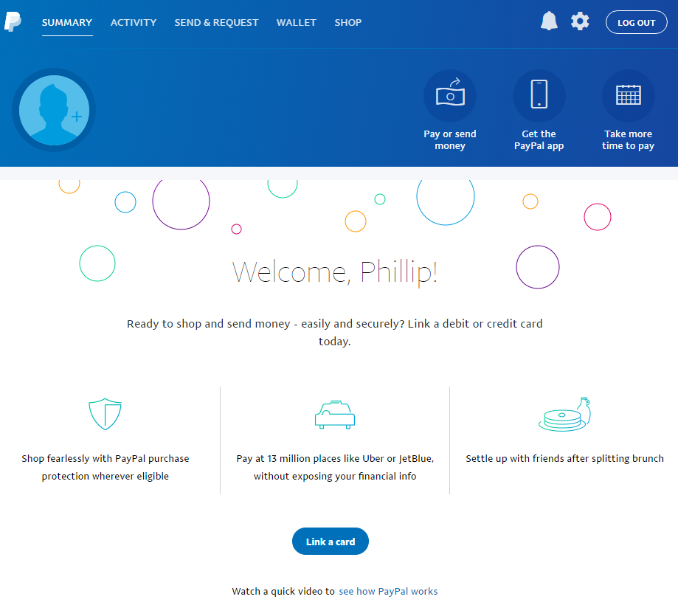
Creating a PayPal Account
Notes:
When finished, you have the option to explore your account and see what all PayPal can do for you

Slide 18
Searching, Viewing & Bidding

Slide 19
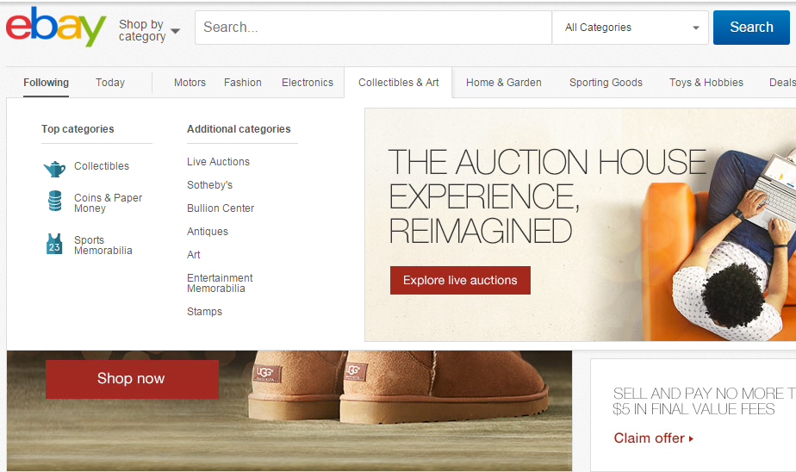
Searching, Viewing & Biding
Notes:
To begin searching, type keywords into the search bar at the top. Search in specific categories or in general.

Slide 20
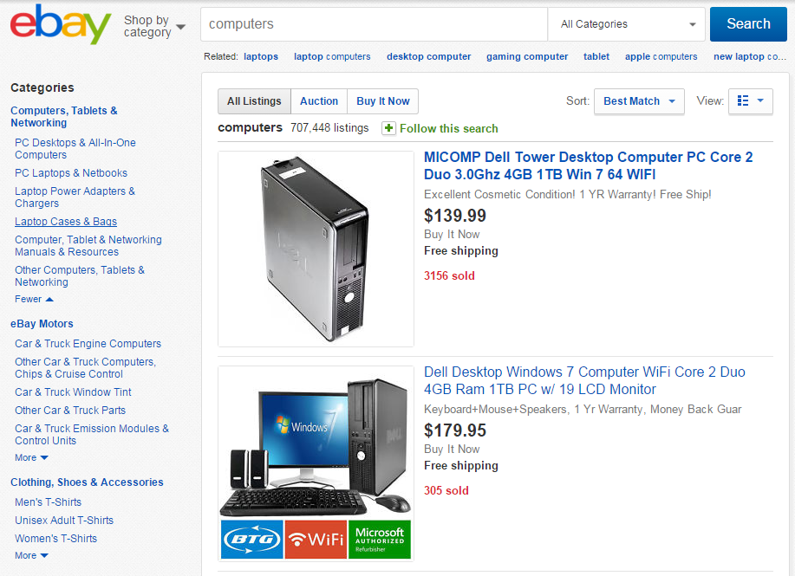
Searching, Viewing & Biding
Notes:
Narrow down your search by selecting categories that appear on the side of the screen.

Slide 21
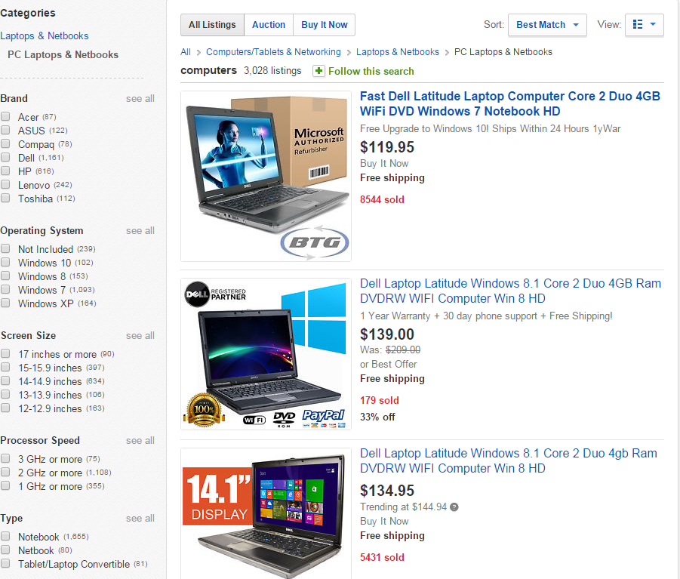
Searching, Viewing & Biding
Notes:
Further specify what you want by checking modifiers that also appear on the left side of the screen.

Slide 22
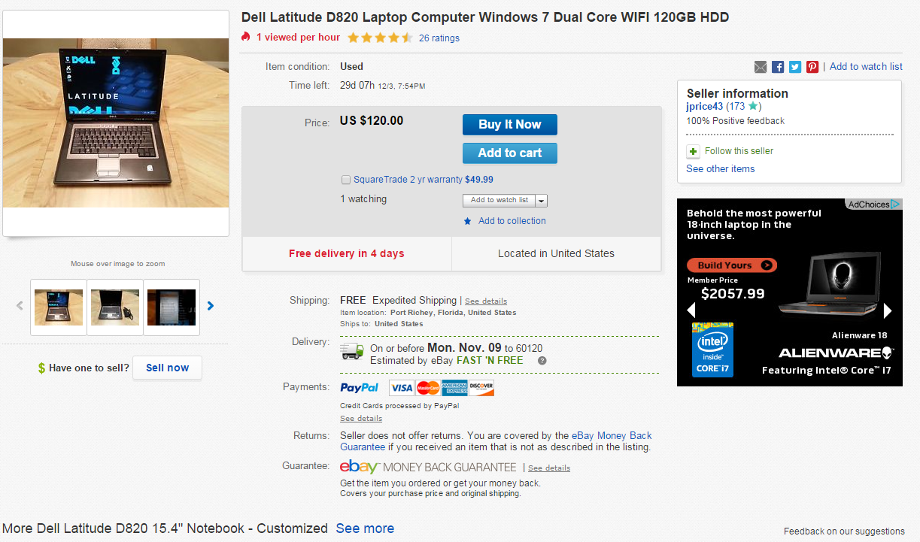
Searching, Viewing & Biding
Notes:
Information such as Item Condition, Time left to purchase item, Price, Buying Options, basic Shipping, and item images are listed at the top of the ad

Slide 23
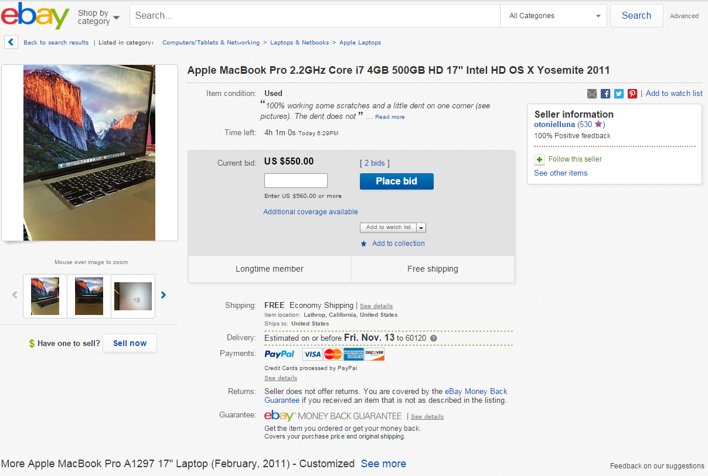
Searching, Viewing & Biding
Notes:
Pay close attention to the details of the items listed and seller information

Slide 24
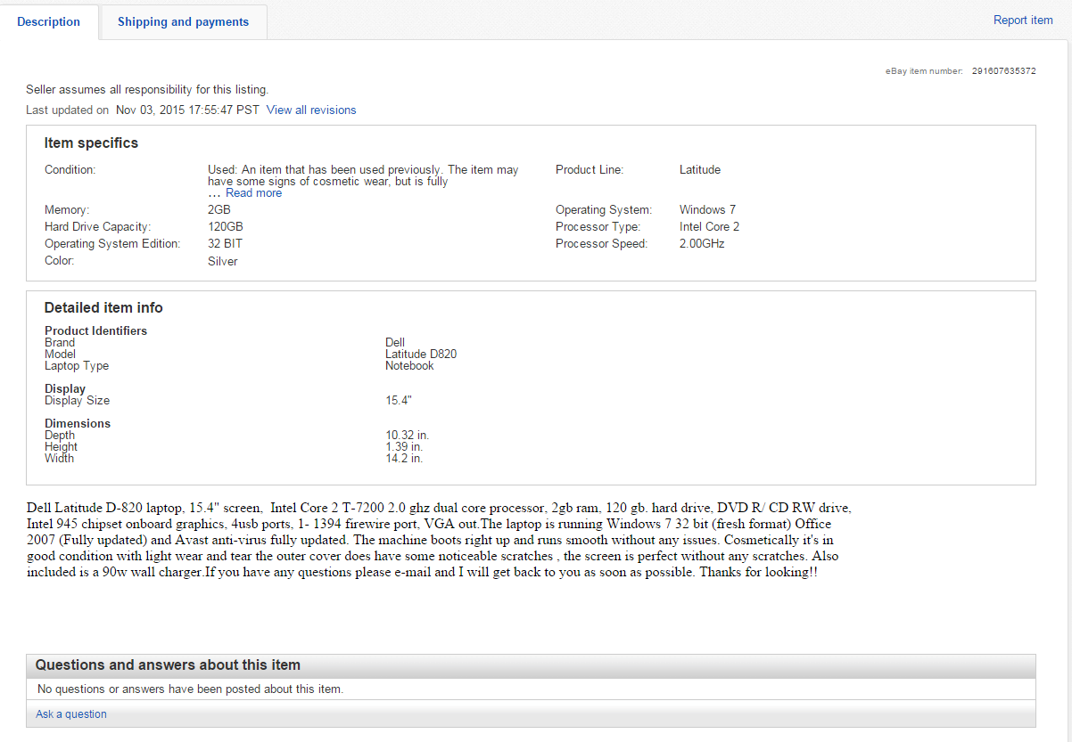
Searching, Viewing & Biding
Notes:
Scroll down and you’ll find an item description and specifics (if the seller has provided this information) plus the rest of the shipping information in the middle of the add. Sometimes questions have been asked by other prospective buyers.

Slide 25
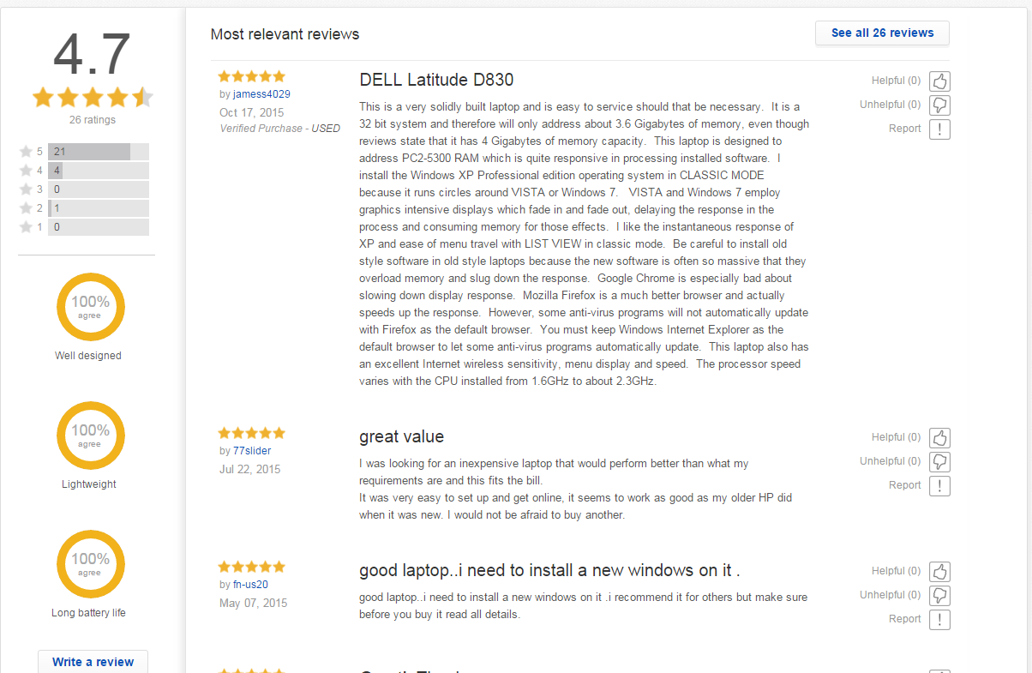
Searching, Viewing & Biding
Notes:
If buying a product from a company, consumer reviews may be available at the bottom of the ad

Slide 26
Exploring My eBay
.

Slide 27
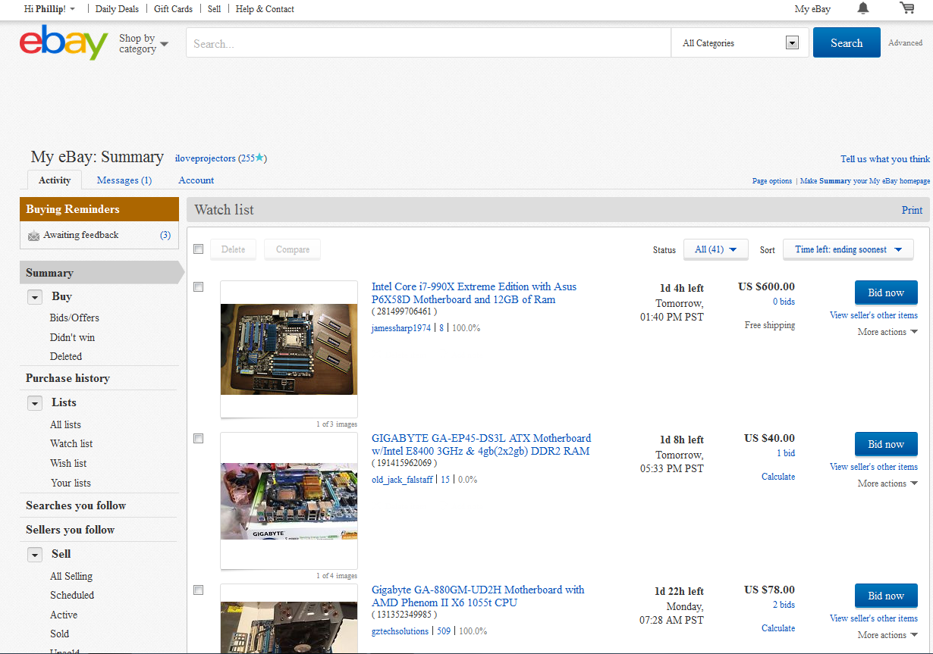
Exploring My eBay

Slide 28
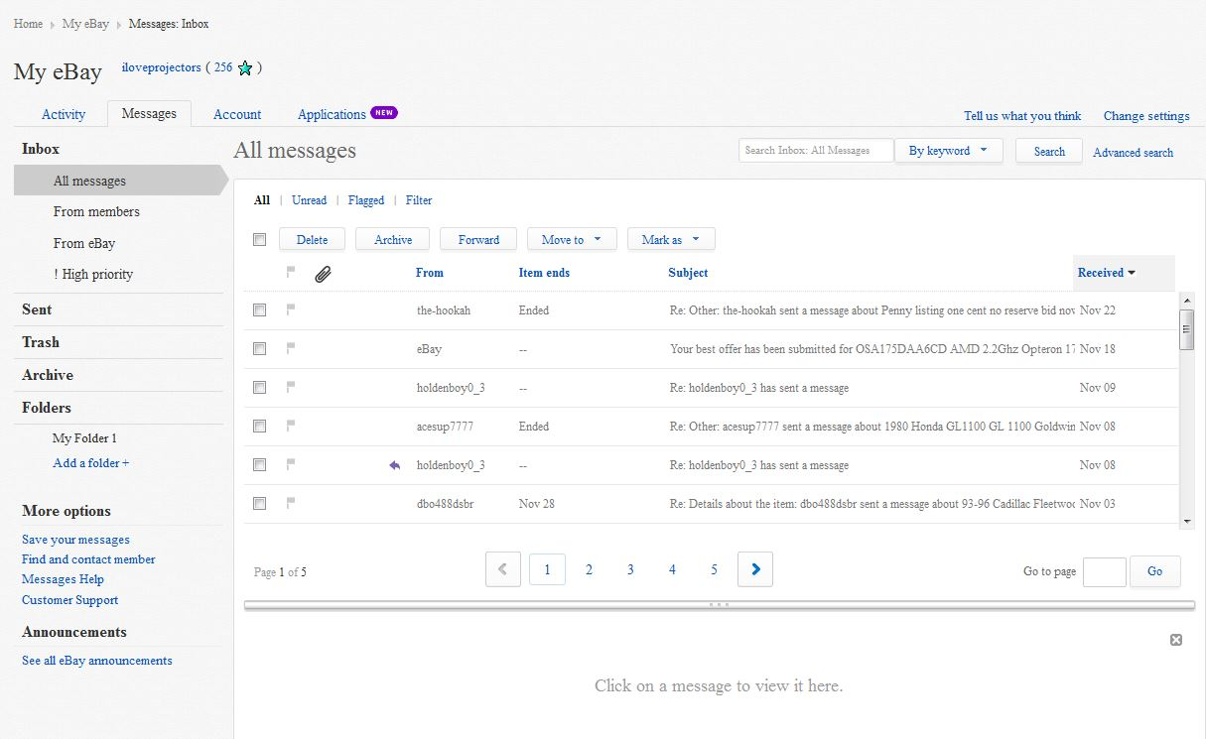
Exploring My eBay
Notes:
eBay messages allows you to send and receive messages with other eBay users. This can be helpful in learning more about an item.

Slide 29
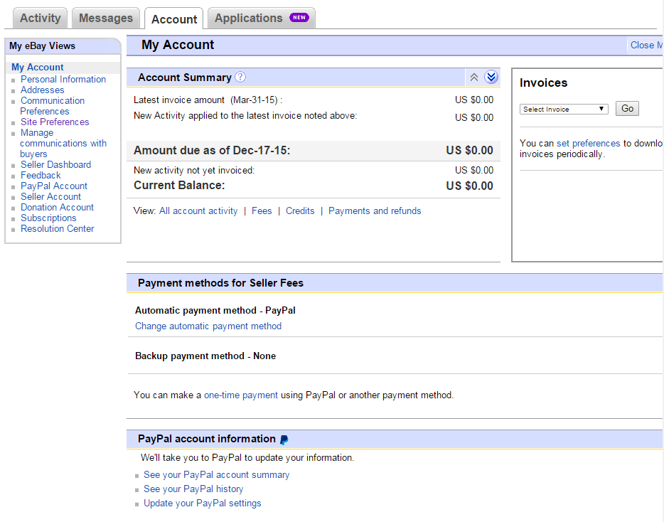
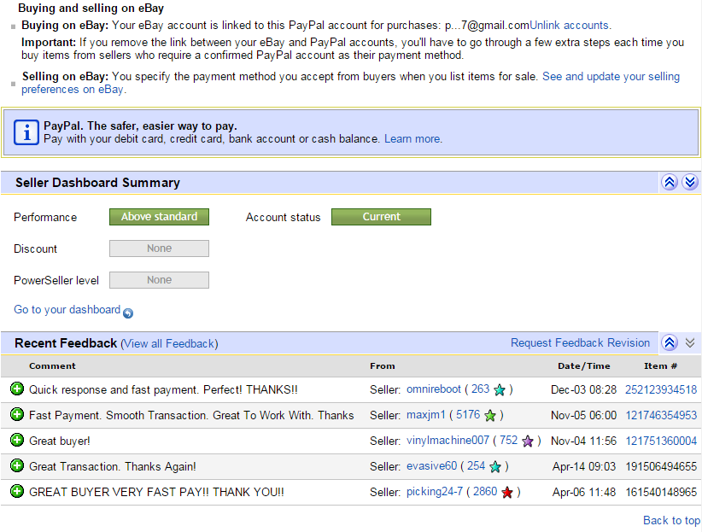
Exploring My eBay
Notes:
The Account tab contains everything you need to know about your account

Slide 30
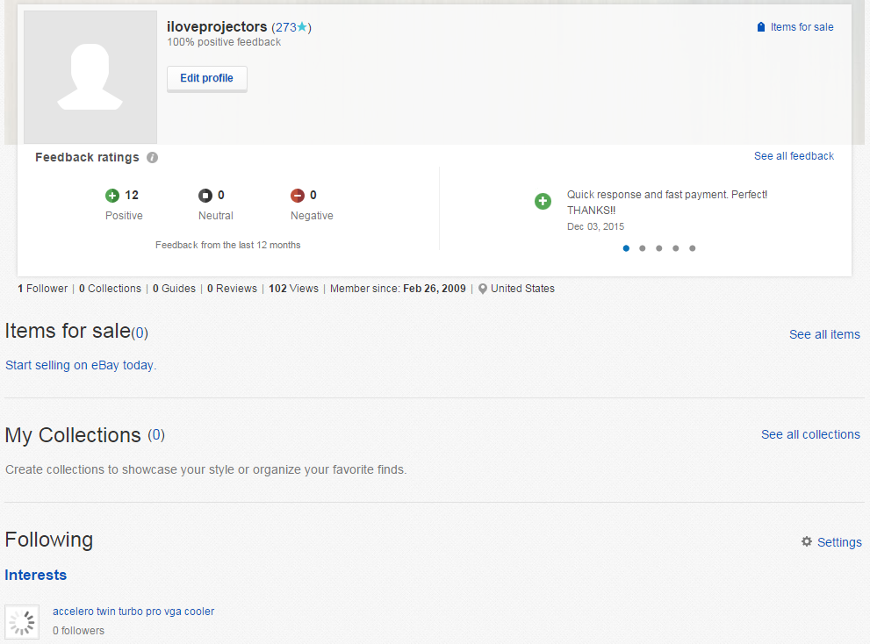
Exploring My eBay
Notes:
eBay messages allows you to send and receive messages with other eBay users. This can be helpful in learning more about an item.

Slide 31
Making a Purchase

Slide 32
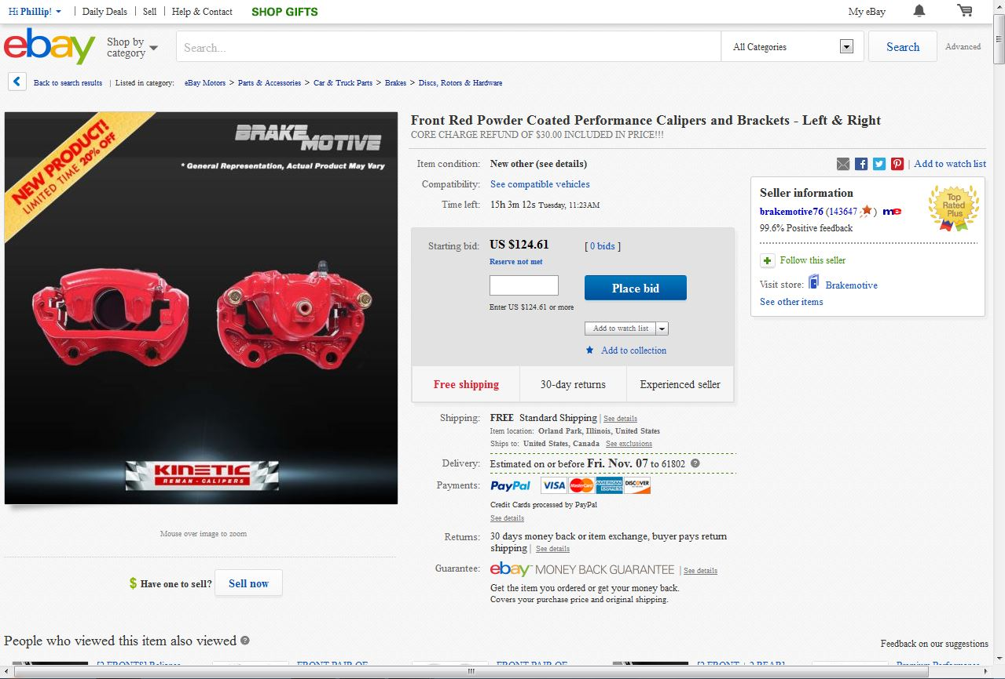
Making a Purchase
Notes:
To bid on an item (for those not listed as “Buy it Now”), enter a dollar amount in the box (ex: the listing price or slightly higher) and click Place Bid

Slide 33
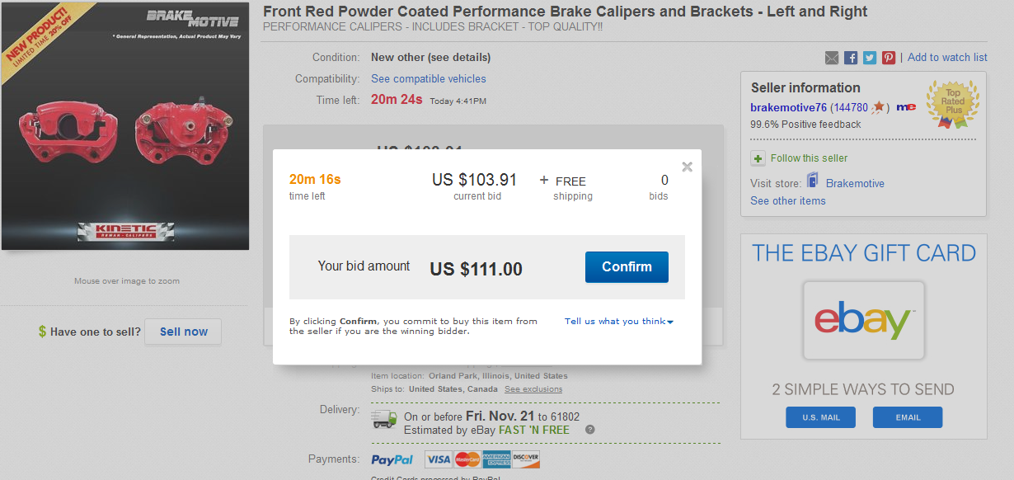
Making a Purchase
Notes:
Review your bid and click Confirm. If you’ve made an error, click the X in the upper right corner to reenter the correct information

Slide 34
Making a Purchase
Bid your highest plus $1
Be aware of the auction countdown time. You may need to add a counter offer at the last second.
Create a watch list that contains multiples of the same item, then bid on the item ending soonest. If you are outbid bid, move on the next item.
Notes:
If buying a product from a company, consumer reviews may be available at the bottom of the ad

Slide 35
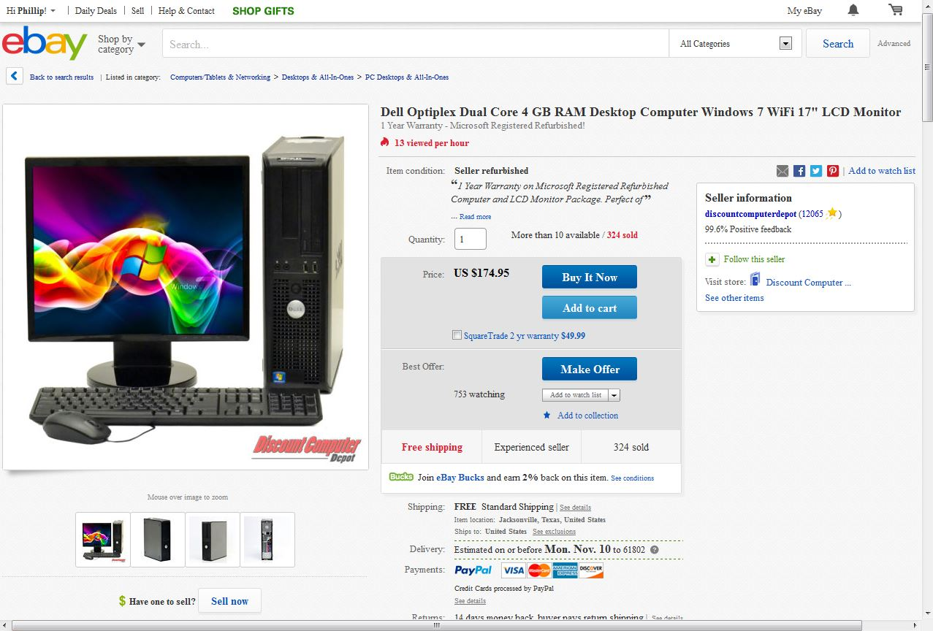
Making a Purchase
Notes:
Some sellers allow for buyers to make an offer based on a specific amount they are looking for. Your offer may or may not be accepted. (Explain difference between auctions, offers, and Buy it Now)

Slide 36
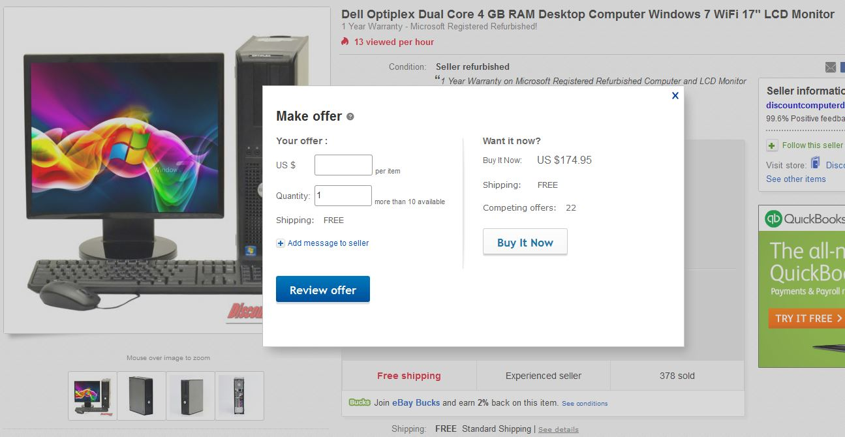
Making a Purchase
Notes:
Enter your offer and other info if necessary. Click Review offer

Slide 37
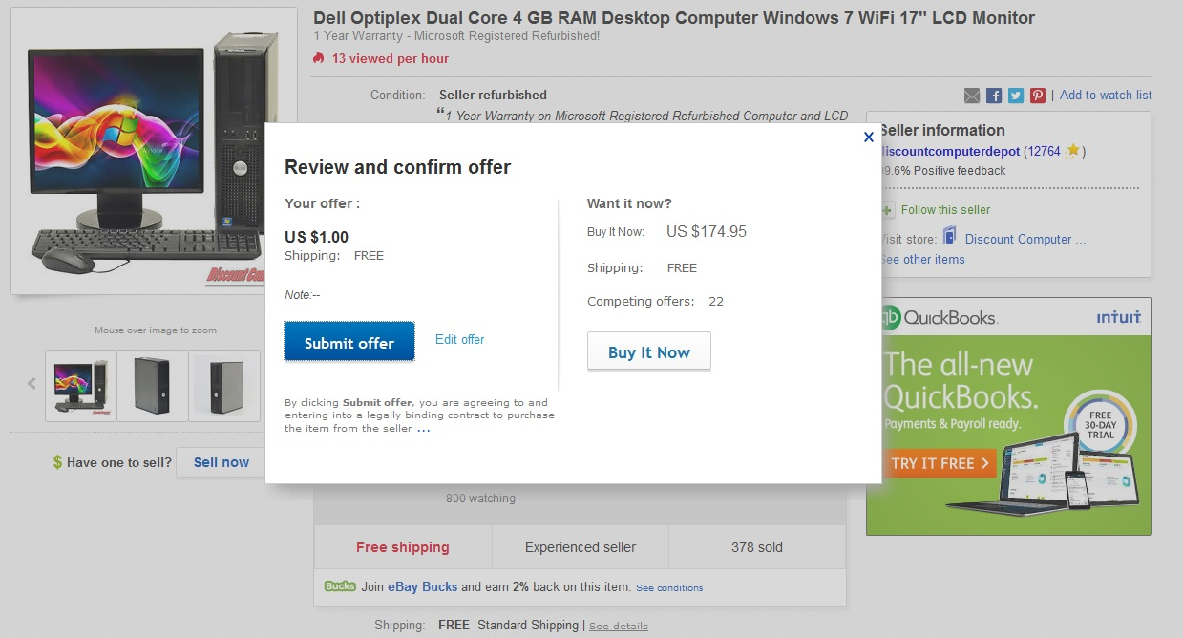
Making a Purchase
Notes:
If satisfied, click Submit Offer. If you made a mistake or have second thoughts, click Edit offer to make changes.

Slide 38
Making a Purchase
    After you make an offer, the seller has 48 hours to decide. They can:
        Accept
        Counter
        Decline
    You are allowed to make 3 offers per item
    If your offer is accepted, you will be notified with instructions to pay for the item

Slide 39
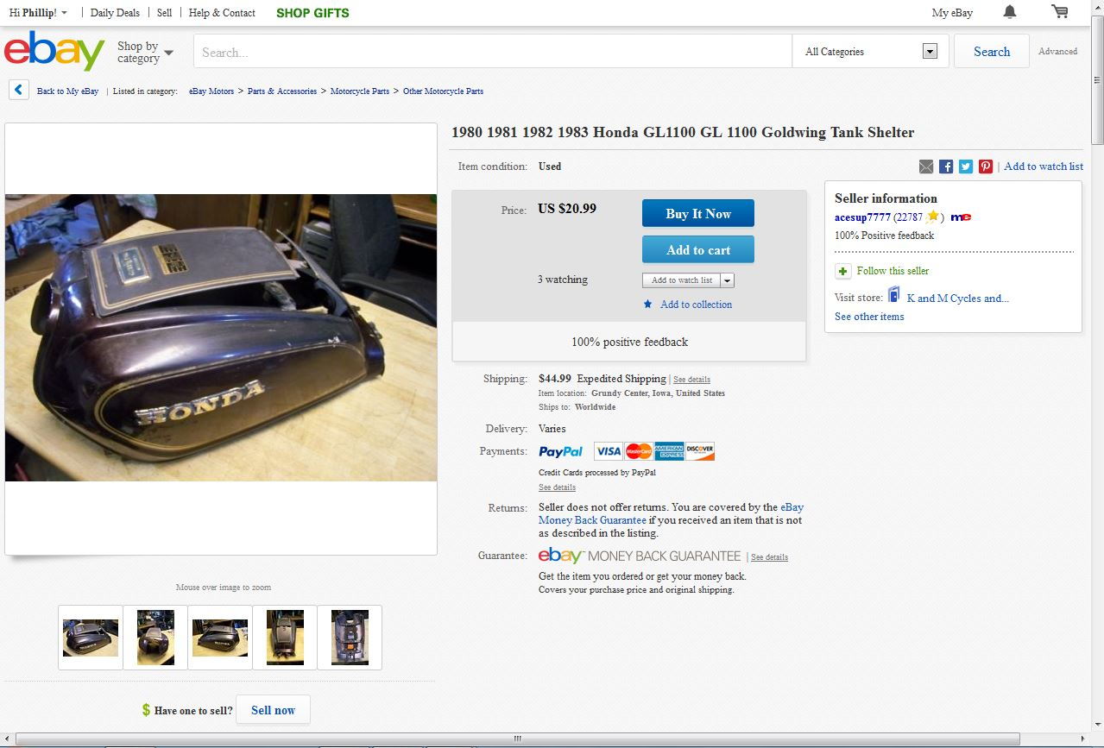
Making a Purchase
Notes:
Other items are listed with a “Buy it Now” option. There is no auction or offer process. Click the Buy it Now and proceed to pay for the item.

Slide 40
Paying with PayPal
.

Slide 41

Paying with PayPal
Notes:
In My eBay, click on Purchase History to see items that required payment

Slide 42
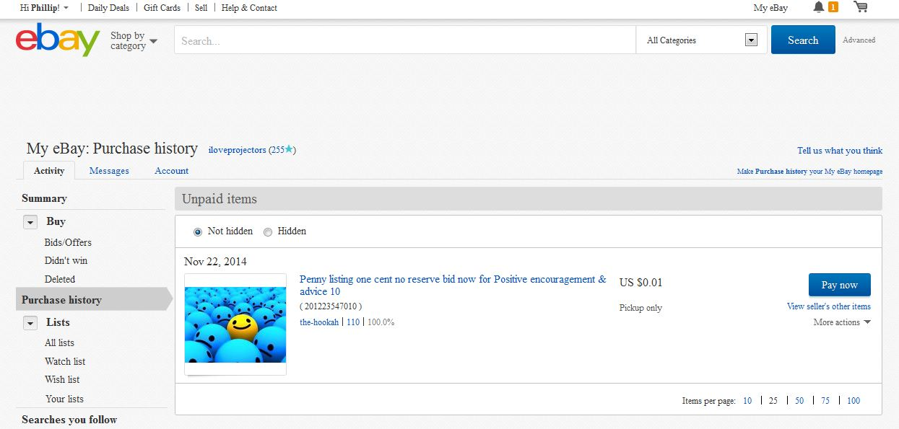
Paying with PayPal
Notes:
Click Pay now to begin your transaction

Slide 43
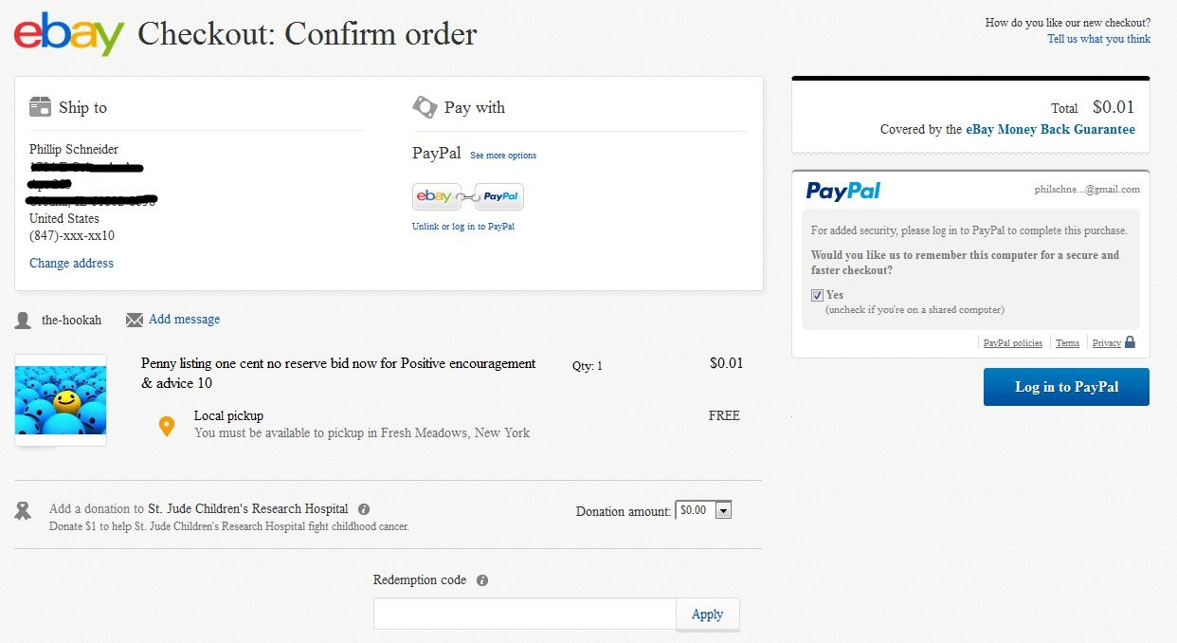
Paying with PayPal
Notes:
You will need to log-in to PayPal if you haven’t done so already. Click log in

Slide 44
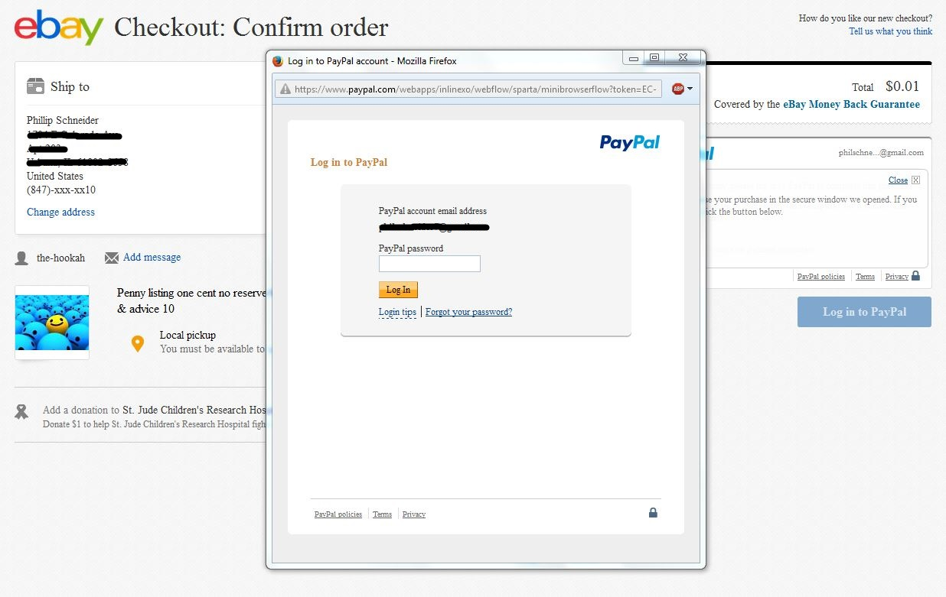
Paying with PayPal
Notes:
Enter your password and click log in

Slide 45
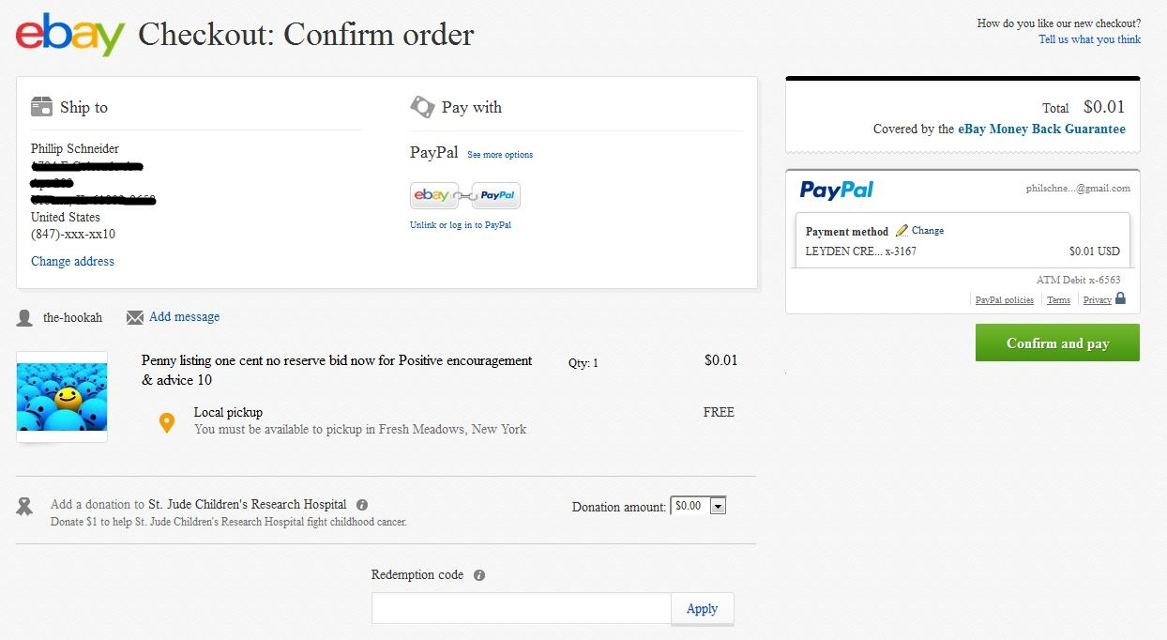
Paying with PayPal
Notes:
Review your information such as shipping address and payment type and click Confirm and pay

Slide 46
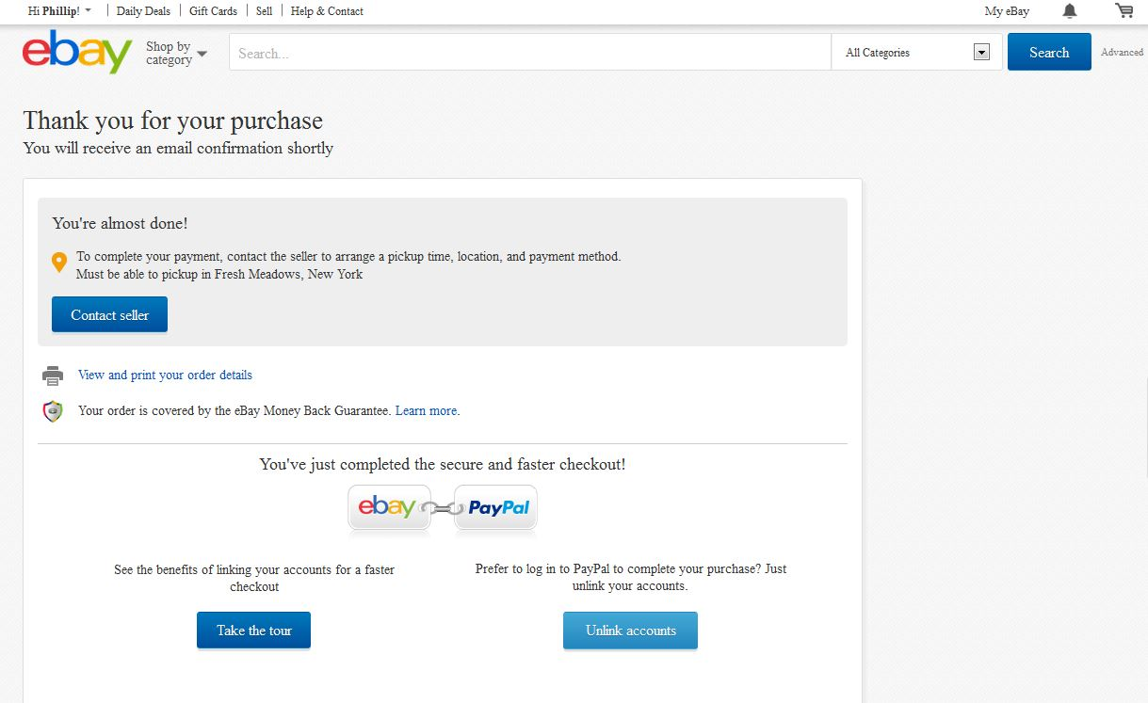
Paying with PayPal
Notes:
Congrats! Your purchase is complete. Additional actions will be prompted

Slide 47
After You Pay
.

Slide 48
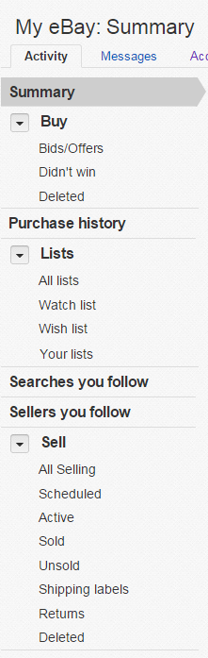
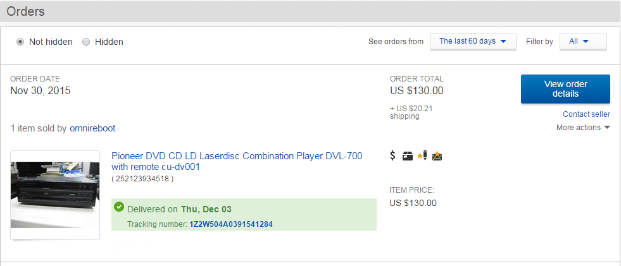
After You Pay
Click purchase history for information about your purchased item.
Notes:
Congrats! Your purchase is complete. Additional actions will be prompted

Slide 49

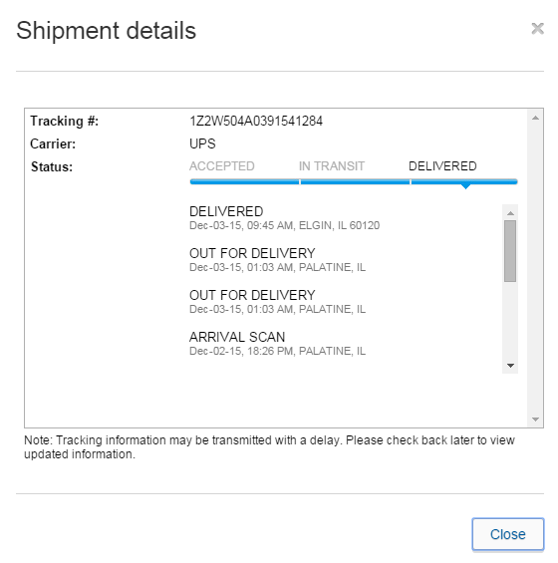
After You Pay
Click on the Tracking number to check on your package
Notes:
Congrats! Your purchase is complete. Additional actions will be prompted

Slide 50
After You Pay
These symbols represent completed transaction objectives.
Notes:
Congrats! Your purchase is complete. Additional actions will be prompted

Slide 51
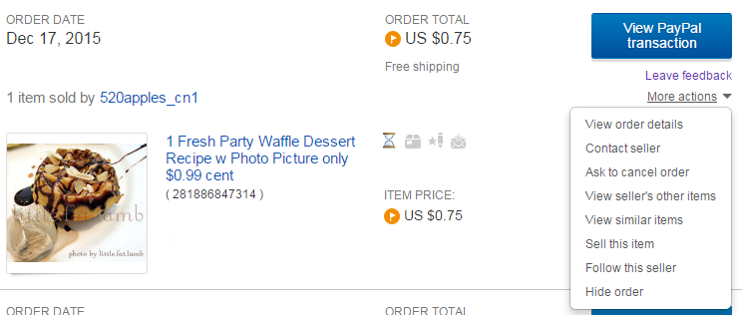
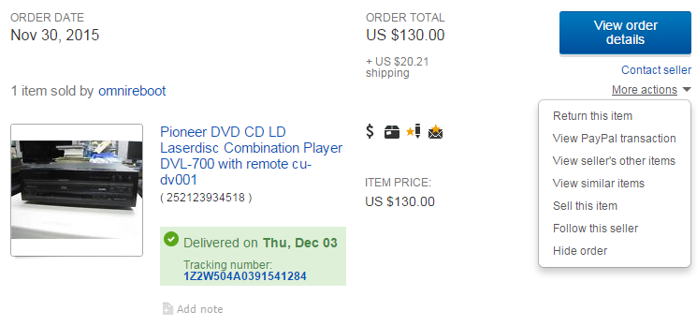
After You Pay (Returning an item)
Made a mistake? Request to cancel your purchase.
Item not as described? Request a return.
Notes:
Congrats! Your purchase is complete. Additional actions will be prompted

Slide 52
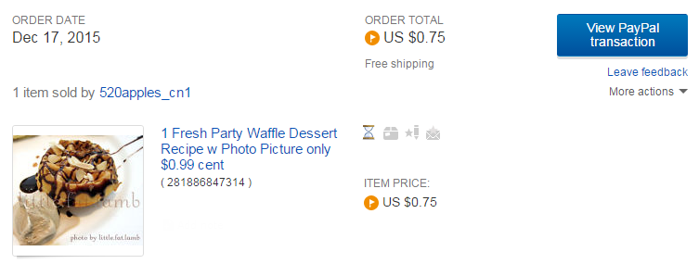
After You Pay
After your receive your item leave feedback.
Notes:
Congrats! Your purchase is complete. Additional actions will be prompted

Slide 53
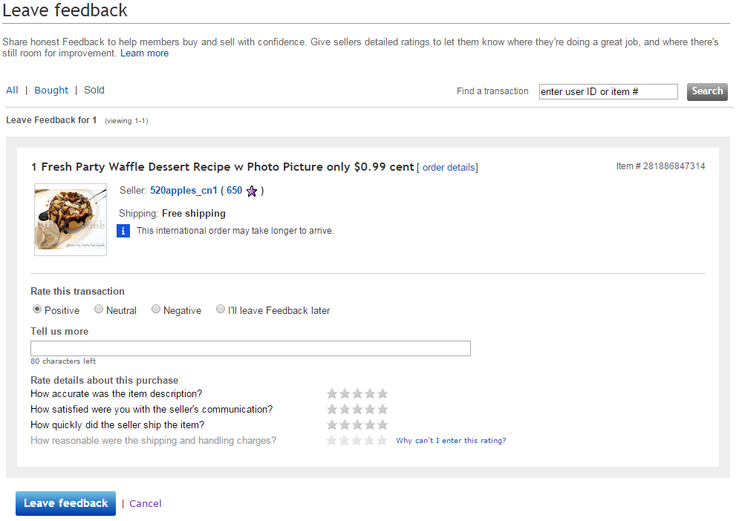
After You Pay
Notes:
Congrats! Your purchase is complete. Additional actions will be prompted

Slide 54
Questions?
THANK YOU FOR COMING!
Part Two Next Week
Selling on eBay

