Slide 1

Cybersecurity Basics
Volunteer Instructor Name:
Instructor Affiliation:
Location Name:
Disclaimer: None of the other companies whose names or logos appear in these educational materials have been involved in the creation of these materials, or approve, sponsor, or are affiliated in any way with these materials.
Notes:
USE POWERPOINT
Workshop Introduction
ADDITIONAL DETAILS: Please update this slide with the appropriate information:
Instructor name
Instructor affiliation (for example, AT&T employee, library staff, community volunteer, and so on)
Location name
INSTRUCTOR NOTE: Before the workshop, please review the Instructor Outline. It provides guidance on what to do to prepare for the workshop, how to conduct the workshop, and what you should do once the workshop ends.

Slide 2

Welcome!
Today’s training is provided by
AT&T and the Public Library Association
Disclaimer: None of the other companies whose names or logos appear in these educational materials have been involved in the creation of these materials, or approve, sponsor, or are affiliated in any way with these materials.
Notes:
USE POWERPOINT
Workshop Introduction
INSTRUCTOR NOTE: Please use the Volunteer Instructor Guide for talking points for the presentation. In that document, slide notations begin on page 5.
Welcome! Today’s workshop is provided by AT&T and the Public Library Association.
INSTRUCTOR NOTE: Include thank-you to community collaborator if applicable.
My name is <your name here> and I am <brief description of yourself>. Before we get started, here are a few housekeeping items: [Mention the items that are relevant to your workshop.]
Where are the restrooms?
Where are the emergency exits?
When/how to ask questions. Point to the page number located on each slide for participants to write down along with the question.
If you have a cell phone with you, please make sure to either turn it off or set to silent.
Will there be a break?
If the workshop is virtual, include instructions on how learners can mute and unmute themselves.

Slide 3
Today’s Agenda
Introduction
  What is cybersecurity?
Skill Building
  How to create safe and secure accounts and passwords
  Learn about the most common types of scams
  How to recognize the warning signs
  What to do when you recognize a scam
  How to report a scam
Tips and Tricks
Practice
Notes:
USE POWERPOINT
Workshop Introduction
In this workshop, you will learn about cybersecurity—in other words, keeping your accounts and identity safe online. We’ll work on building skills and confidence to keep you safe online.
This will include creating safe and secure accounts and passwords, identifying the most common types of scams, recognizing the warning signs, knowing how to respond when you suspect something is a scam, and reporting a scam.
You’ll also learn Tips and Tricks to protect yourself and avoid scams. And, you will have opportunities to Practice what you’ve learned.
Let’s get started!

Slide 4
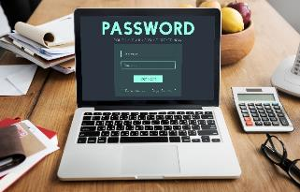
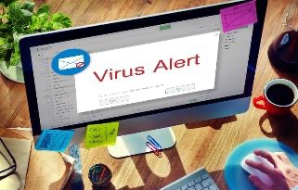
Introduction
Cybersecurity:
Personal data is not accessible to others.
Devices work properly and are free from malware.
Notes:
USE POWERPOINT
Introduction
Today we are going to talk about how to use the internet safely. This is also called Cybersecurity. Cybersecurity is how we protect and keep safe —our identity, our personal data, and our financial assets— when we’re online.
For people like you and me, cybersecurity means that 1) your personal data is only accessible to you or others you authorize and safe from those we do not want to have access to it, and that 2) our devices—laptops, desktop computers, smartphones, tablets, and gaming devices — work properly, are secure and free from malware like viruses.

Slide 5
What is Malware?
Also known as malicious software
It is a virus created to infect a computing device.
It tracks your online activities.
Notes:
USE POWERPOINT
Introduction
Malware, short for malicious software, is a virus created to harm a computing device. It can take many shapes—from viruses that infect your favorite devices to spyware and adware that tracks your online activities.
Fraudsters and scammers use malware to steal sensitive information, such as your identity, money from your accounts, or other information you do not want to share with others. Use caution when downloading software or clicking on links from sources you do not know – it could be malware.

Slide 6




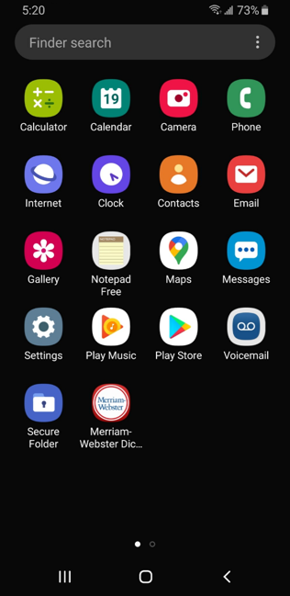





Online Activities
Notes:
USE POWERPOINT
Introduction
You can do a lot of great things online. Examples include
Connect with family and friends
Listen to music
Watch a tv show or movie
Attend a class
Learn a new skill
Pay bills
Check bank statements
Find a recipe
Figure out how to repair something
But sometimes we may not feel safe when doing these activities.

Slide 7

Feeling Safe Online: Discussion
Have you ever felt unsafe doing something online?
Why did you feel unsafe, and what did you do to protect yourself?
Notes:
USE POWERPOINT
Introduction: Question
INSTRUCTOR NOTE: Ask the questions on the slide of attendees, have them share their thoughts. Or, you can ask the question, allow a moment for the attendees to think about it, and then discuss. The conversation should be approximately 2-3 minutes.
Have you ever felt unsafe doing something online?
Why did you feel unsafe and what did you do?
Examples could feel unsafe include:
I did not know the sender
They were trying to pressure me into acting now
It did not seem like I could trust them.
They wanted information I did not want to share e.g. credit card number, username and password, Social Security Number.
What did you do to protect yourself? Examples include:
I deleted the email or text messages
I hung up on the caller
I closed my browser window
I called a friend or family member for help

Slide 8
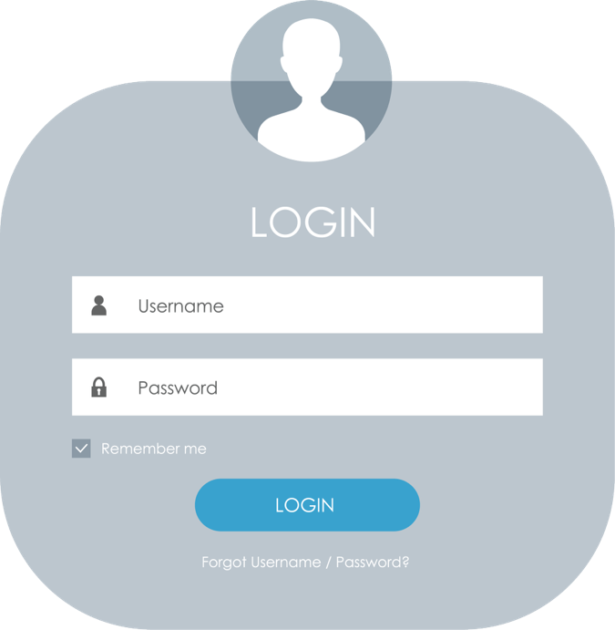
Personal Accounts
Notes:
USE POWERPOINT
Personal Accounts
Many websites and mobile apps allow you to create a personal account. Your account has a unique username and password. You create a personal account so your information is accessible only to you.

Slide 9
Personal Accounts: Discussion
What kinds of online accounts have you created?
Notes:
USE POWERPOINT
Personal Accounts: Questions
INSTRUCTOR NOTE: Facilitate a brief discussion with participants. What kind of accounts have you created? The conversation should be approximately 2-3 minutes.
Possible kinds of accounts that attendees may discuss: email, social media, job search sites, schools, banks, credit cards, media and news platforms, video streaming sites, retail sites.

Slide 10
Personal Accounts
Notes:
USE POWERPOINT
Personal Accounts
A personal account is essential for things like email, where you want to have your own account that’s private to you. Many websites and mobile apps offer or sometimes require a personal account to use them.
A primary reason to create a personal account is so you can keep track of what you do on a website or app—watch streaming videos, apply for jobs, track purchases, and more. Some features of websites are available only if you’ve logged into your account. With an online account, you can pay bills for things like phones, rent or mortgage, and utilities. An online account is critical for things like bank accounts and other financial accounts. Why? So only you can access them.

Slide 11
Strong Passwords: Discussion
How do you come up with a password?
How do you make it strong and secure?
Notes:
USE POWERPOINT
Personal Accounts
Most personal accounts require that you create a password to ensure that only you have access to the information in the account.
INSTRUCTOR NOTE: Facilitate a brief discussion with attendees— “How do you come up with a password?” “How do you make it strong and secure?” The conversation should be approximately 2-3 minutes.
Good answers. Let's learn more on how we can create strong passwords.

Slide 12
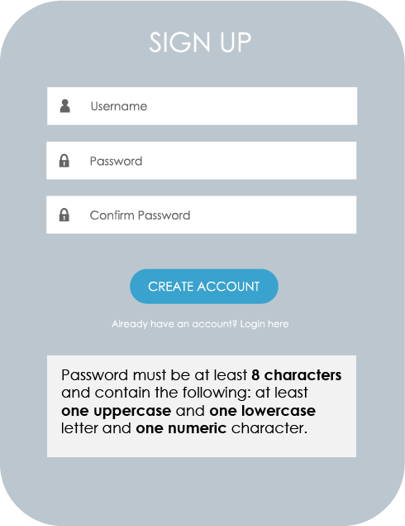
Common Requirements
Can usually include:
Numbers
Uppercase and lowercase letters
Symbols, such as punctuation marks
Notes:
USE POWERPOINT
Personal Accounts
Most websites and mobile apps include password requirements on their signup forms. These requirements are either listed underneath the form or will display on the screen when the password you create does not meet the requirements.
INSTRUCTOR NOTE: Click enter to see the items in the bulleted list.
Passwords can usually include numbers, uppercase and lowercase letters, and symbols such as punctuation. If your first try isn’t acceptable, review the website or application requirements. They try adding a capital letter number, or symbol, or making the password longer.
In this example, the password must be at least eight characters long, and must contain at least one uppercase letter, one lowercase letter, and one number.

Slide 13


Tips for Strong Passwords
  Don’t use common words like “password”
  Don’t include personal information
  Don’t use the same password on multiple accounts and sites
  Don’t share with others—keep them private
Notes:
USE POWERPOINT
Personal Accounts
What makes a strong password? Here are some Dos and Don’ts.
INSTRUCTOR NOTE: Press enter to see the first bullet
Avoid weak passwords like “password” (the most commonly used password!) or “123456.”
INSTRUCTOR NOTE: Press enter to see the second bullet
Don’t include personal information, such as your address or name.
INSTRUCTOR NOTE: Press enter to see the third bullet
Don’t use the same password on multiple accounts and websites.
INSTRUCTOR NOTE: Press enter to see the fourth bullet
Don’t share your password with others. Passwords are the secret key that unlocks your account. They should be kept private.

Slide 14

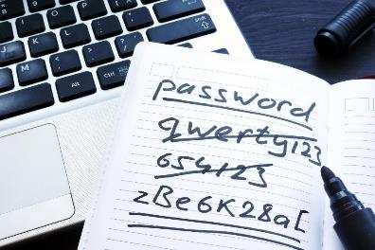
Tips for Strong Passwords (continued)
Make the password longer.
Hard to remember.
Use short phrases that are easier to remember.
“cowshelpmakecheese”
Notes:
USE POWERPOINT
Personal Accounts
Do make the password longer. The best defense is length.
INSTRUCTOR NOTE: Press enter to see the first bullet
Longer passwords don’t need to be complex and hard to remember.
INSTRUCTOR NOTE: Press enter to see the second bullet
But we can make a long, secure password that’s easier to remember by using short phrases. An example might be “Cows help make cheese.”
Remember, many websites have requirements for passwords. These requirements are usually listed underneath the password field or identified once you click on the password field. They may require you to include uppercase and lowercase letters, numbers, and symbols.

Slide 15
Keeping Track of Passwords
Notes:
USE POWERPOINT
Personal Accounts
Now that we’ve discussed creating a strong password, let’s talk about how we can keep track of our passwords.
You may have created a lot of accounts on many websites or mobile apps. Your passwords may be different on each site—and it’s more secure if they are—so it can be a challenge to remember them.
Let’s look at a few different approaches we might take to remembering our passwords.

Slide 16
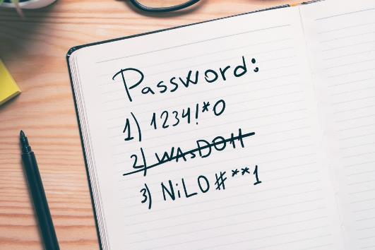


1. Notebook
Store in a safe place
Instead of writing the actual password, write down something that helps you remember which password it is.
Notes:
USE POWERPOINT
Personal Accounts
You could write your passwords down in a notebook. If you do this, make sure to store the notebook in a safe and secure place.
INSTRUCTOR NOTE: Press Enter to see the Tip
Instead of writing the actual password, write down something that helps you remember which password it is.

Slide 17
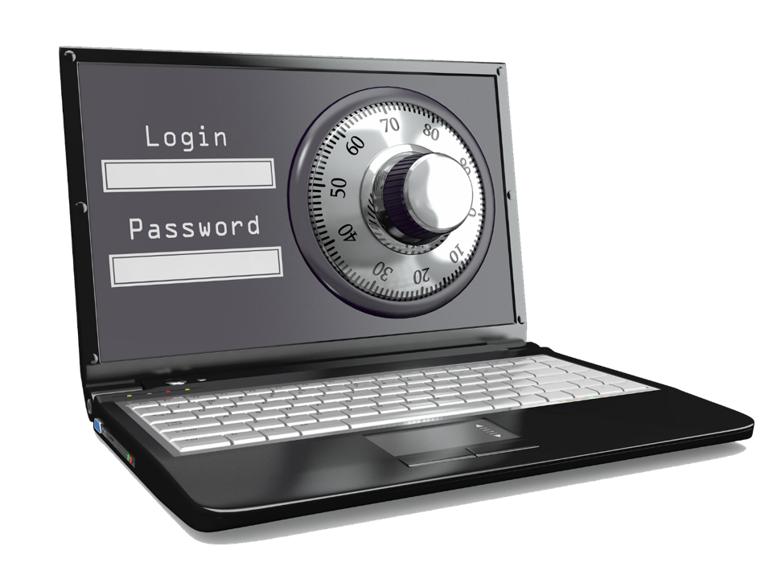
2. Password Software
Notes:
USE POWERPOINT
Personal Accounts
You may choose to use a secure password management mobile app or website that can help keep track of your passwords. Most password managers are available with a paid subscription. These programs are usually unlocked with a single master password, which allows you to access all your passwords when you need them. The apps will also generate passwords for you that are complex combinations of letters, numbers, and special characters.

Slide 18

3. Phrase
You can make your passwords longer and stronger by using a phrase. Example: “Cows help make cheese.”​
Notes:
USE POWERPOINT
Personal Accounts
Phrase – soon this will be the standard. You can make your passwords longer and stronger by using a phrase. Example: “Cows help make cheese.”

Slide 19
Activity # 1
Notes:
USE POWERPOINT AND LEARNER ACTIVITY
Personal Accounts
INSTRUCTOR NOTE: Point attendees to Activity 1a and 1b on the Activity Sheet.
In this lesson, we learned how to create strong passwords to protect our online accounts. Let’s practice what we learned.
Remember we will be discussing your answers, so please DO NOT use any real passwords.
INSTRUCTOR NOTE: Point attendees to Activity 1a and 1b on the Activity Sheet.
In this lesson, we learned how to create strong passwords to protect our online accounts. Let’
Remember we will be discussing your answers, so please DO NOT use any real passwords.
INSTRUCTOR NOTE: When attendees have completed the activities, use the next two slides to facilitate a discussion on what people came up with.

Slide 20
Using the password requirements in the Sign Up form above, create a strong password that meets the criteria.
Notes:
USE POWERPOINT AND LEARNER ACTIVITY SHEET
Activity 1
Using the password requirements in the Sign Up form in 1a of the Learner Activity Sheet, create a strong password that meets the criteria. Remember we will be discussing your answers, so please DO NOT use any real passwords.
INSTRUCTOR NOTE: After the attendees have time to complete the activity, ask them about the passwords they created.

Slide 21
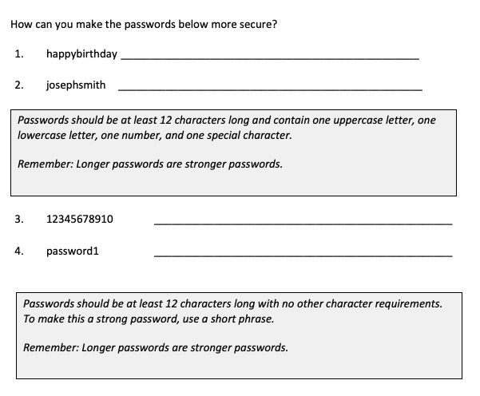
Notes:
USE POWERPOINT AND LEARNER ACTIVITY SHEET
Activity 1
INSTRUCTOR NOTE: Use slide to debrief the activity or as a guide for yourself if you are doing a demonstration.
Use the information from the course on strong passwords to discuss the participant responses. Examples:
happybirthday – H@PPyBirthD@y$0$
josephsmith – 212Joe!Smith212
Criteria: Passwords should be at least 12 characters long and contain one uppercase letter, one lowercase letter, one number, and one special character.
1234567890 – onetwobuckleymyshoe
password1 – keepmypasswordsafe
Criteria: Passwords should be at least 12 characters long with no other character requirements. To make this a strong password, use a short phrase.
Remember: Longer passwords are stronger passwords.
After learners complete Activity 1: Great job, everyone! Before we move to the next section, do you have any questions?
INSTRUCTOR NOTE: Review and address items in the “parking lot”.
ADDITIONAL DETAILS: For information about what the parking lot is, see the “Before the Workshop Begins” section of the Instructor Guide.

Slide 22
Online Scams
Notes:
USE POWERPOINT
Online Scams
In the last lesson, we learned that creating strong passwords is one step you can take to protect your information online.
There are bad actors out there trying to access your personal information. Let’s look at some common scams you may encounter.

Slide 23
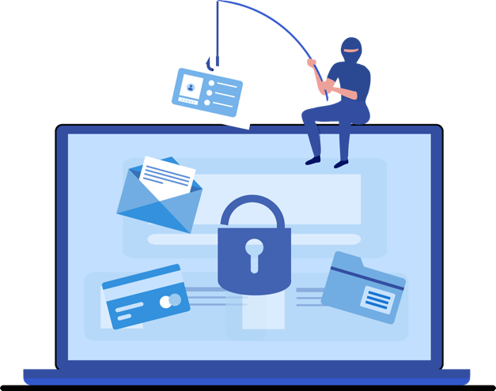
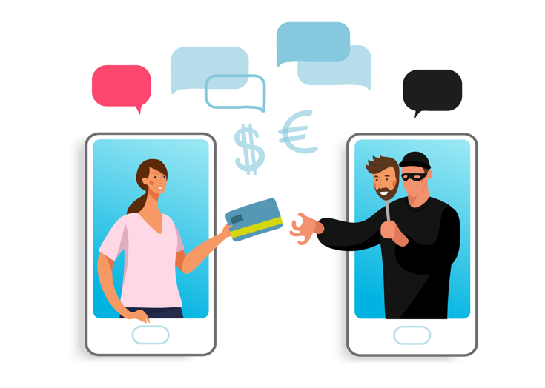
Online Scams
Phishing
Social Engineering
Notes:
USE POWERPOINT
Online Scams
Online scams can take many forms. The most common types include phishing and social engineering.
You may encounter these scams on a website, in an email, text message, or phone call, in an online game, or even in a pop-up window on your computer.

Slide 24





Phishing
Emails
Text messages
Social media profiles
Websites
Phone calls
Notes:
USE POWERPOINT
Online Scams
Phishing occurs when fraudsters or scammers use fake emails, text messages, social media profiles, websites, or phone calls to fish for sensitive information like passwords, Social Security Numbers, credit card and bank account details, or personal data. The scammers can use this information to gain access to your money or steal your identity.

Slide 25

Phishing Scams
Try to win your trust
Claim to be from a real person or organization
Ask for your personal and/or financial information
Steal your money or identity
Notes:
USE POWERPOINT
Online Scams
These messages can look real, but when you dig deeper, you find it’s fake. Phishing scams try to win your trust, by pretending to be a trusted person or organization. The fraudster wants you to share personal information about yourself that you would not normally share with a stranger. The fraudster then uses this personal information to gain access to your finances or steal your identity.
Let’s explore some examples of phishing scams that you may experience when using your smartphone, computer, or tablet.

Slide 26
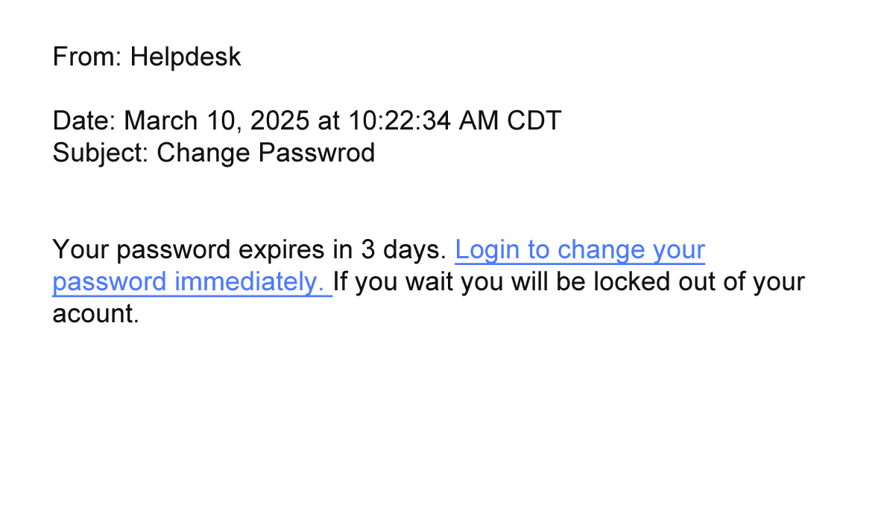
Email Scam
Notes:
USE POWERPOINT
Online Scams
You may receive an email that pretends to be from someone you know. In this example, the email says it is from your employer’s helpdesk and asks you to log into a website to update your password.
INSTRUCTOR NOTE: Press ENTER to display the spelling errors.
If you look closely, you will notice the email includes misspellings.
In this example, a fraudster pretends to work at the same organization to access personal information. If you had filled out the form, the fraudster could have used your account to access your employer’s systems.

Slide 27
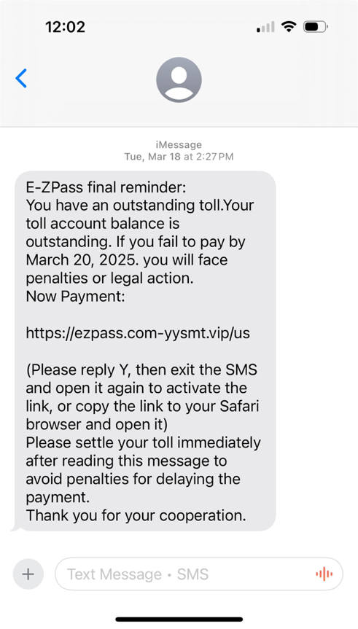
Text Message Scam
Notes:
USE POWERPOINT
Online Scams
Fraudsters also use text messages to scam you. In this example, it appears a state agency is sending an urgent text message asking you to pay an unpaid toll immediately.
Like the email phishing example, text message scams try to trick people into sharing personal information. States don’t send texts to ask for toll payments. If you had clicked to pay the bill, you may have unwittingly provided your financial information to a fraudster.

Slide 28


Phone Call Scam
Who am I talking to?
Notes:
USE POWERPOINT
Online Scams
You may also receive phone calls pretending to be from an official organization, like a government agency, bank, or insurance company, to gain your trust and access to your personal information.
For example, you might receive a phone call from someone who says they work at your health insurance company. They then ask for your personal information and credit card information so they can send you a medical device. If you had provided the information, the fraudster would have had personal information and your credit card number.

Slide 29
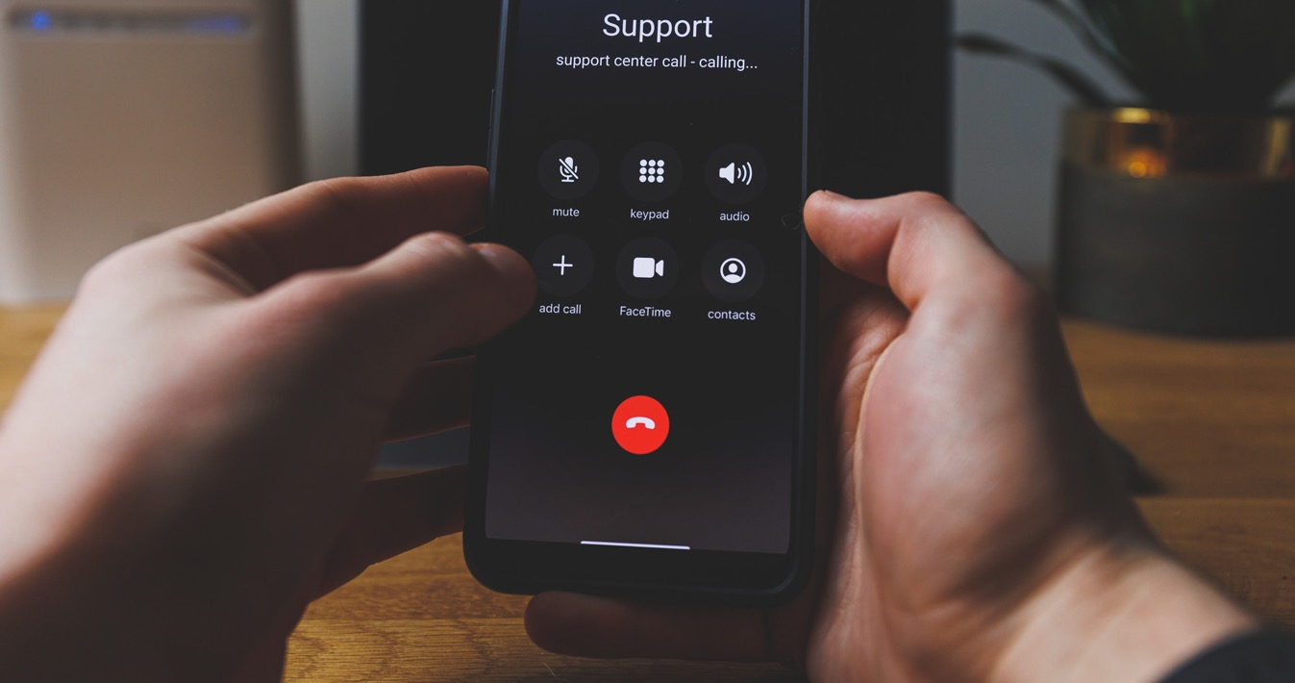
Phone Call Scam: Caller ID Spoofs
Beware! You can’t trust your Caller ID. The call is not from Support. It is a scammer pretending to be Support.
Notes:
USE POWERPOINT
Online Scams
Beware! You can’t trust your Caller ID. Fraudsters can spoof Caller ID to make it appear that a trusted organization is making the call, even when it isn't.

Slide 30

Social Media Scam
Notes:
USE POWERPOINT
Online Scams
There are also scammers on social media platforms. They try to trick you into sharing personal information by pretending to be an individual or organization. One scam occurs after you complain about a product or service on social media. The next time you log into your social media account, someone claiming to be from the company contacts you and promises to resolve your issue. They then ask for your password so they can fix the problem. Companies should not need your password to fix a problem.

Slide 31

Free Wi-Fi Scams
Not all free Wi-Fi networks are safe and secure.
Notes:
USE POWERPOINT
Online Scams
Not all free Wi-Fi networks are safe and secure. When visiting a coffee shop, restaurant, or lobby, ensure you are using the organization’s secure Wi-Fi and not a fake network set up by a scammer. Connecting to an unofficial Wi-Fi network allows the scammer to see and track everything you do online. If you log into your bank account or credit card portal, the scammer can view your login details and potentially access your accounts.

Slide 32
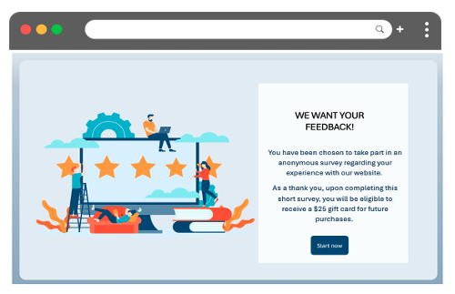
Survey and Online Quiz Phishing Scam
Don’t share personal information with online surveys and quizzes, such as your SSN, answers you have used for account security questions, etc.
Notes:
USE POWERPOINT
Online Scams
Beware of surveys and online quizzes found in online ads, social media, mobile games, email, or text messages. Fraudsters can use surveys and quizzes to gather sensitive information about you, which they can later use to steal your identity or gain access to your bank account or credit card information. Don’t provide your usernames, passwords, Social Security number, credit card details, answers you have used for account security questions, or any other personal information used to answer online security questions. While the promise of a gift certificate or the chance to win a vacation can be enticing, it’s not worth the potential harm of sharing personal information.

Slide 33


Online Gaming Scams
Malware is a virus created to damage your computer and steal sensitive information you don't want to share.
Notes:
USE POWERPOINT
Online Scams
Fraudsters will also use online or mobile games to access personal information. When you create a gaming account or communicate with other players, do not share private information – fraudsters can exploit that information to attempt to steal your identity.
INSTRUCTOR NOTE: Press ENTER to display pop-up advertisement.
Pop-up advertisements may appear within the game to promote a new game or application. If you click on the ad you may install malware software onto your device. Malware shares your personal information with a fraudster.
INSTRUCTOR NOTE: Press ENTER to display malware definition.
Remember, malware is a virus created to harm a computing device. Fraudsters and scammers use malware to steal sensitive information, such as your identity, money from your accounts, or other information you do not want to share with others. Use caution when downloading software or clicking on links from sources you do not know.

Slide 34
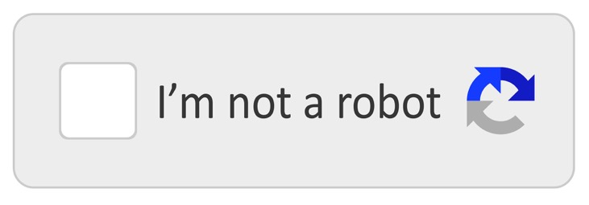
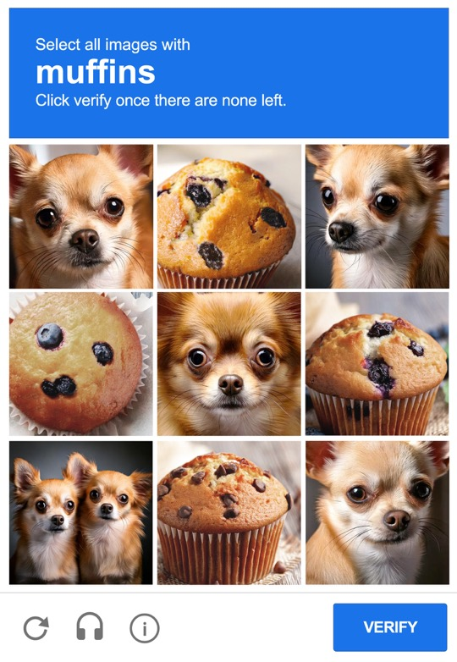
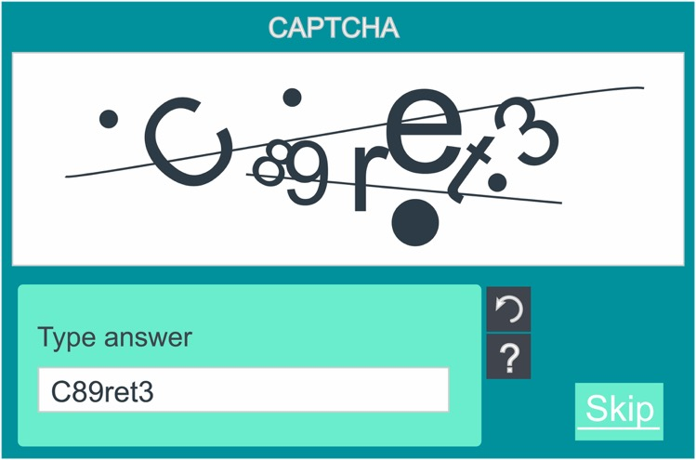
CAPTCHA Malware Scam
Notes:
USE POWERPOINT
Online Scams
Another malware scam involves the CAPTCHA verification tool. A CAPTCHA is a checkbox or puzzle that websites use to verify that the person using the website is a human and not a bot. However, some bad actors now use fraudulent CAPTCHAs to install malware on your computer. It starts out working just like a real CAPTCHA. You visit a website and are asked to click a checkbox that you are not a robot, type the letters you see on the screen into the textbox or select all of the pictures that match the prompt. The scam begins after you complete the first step.

Slide 35
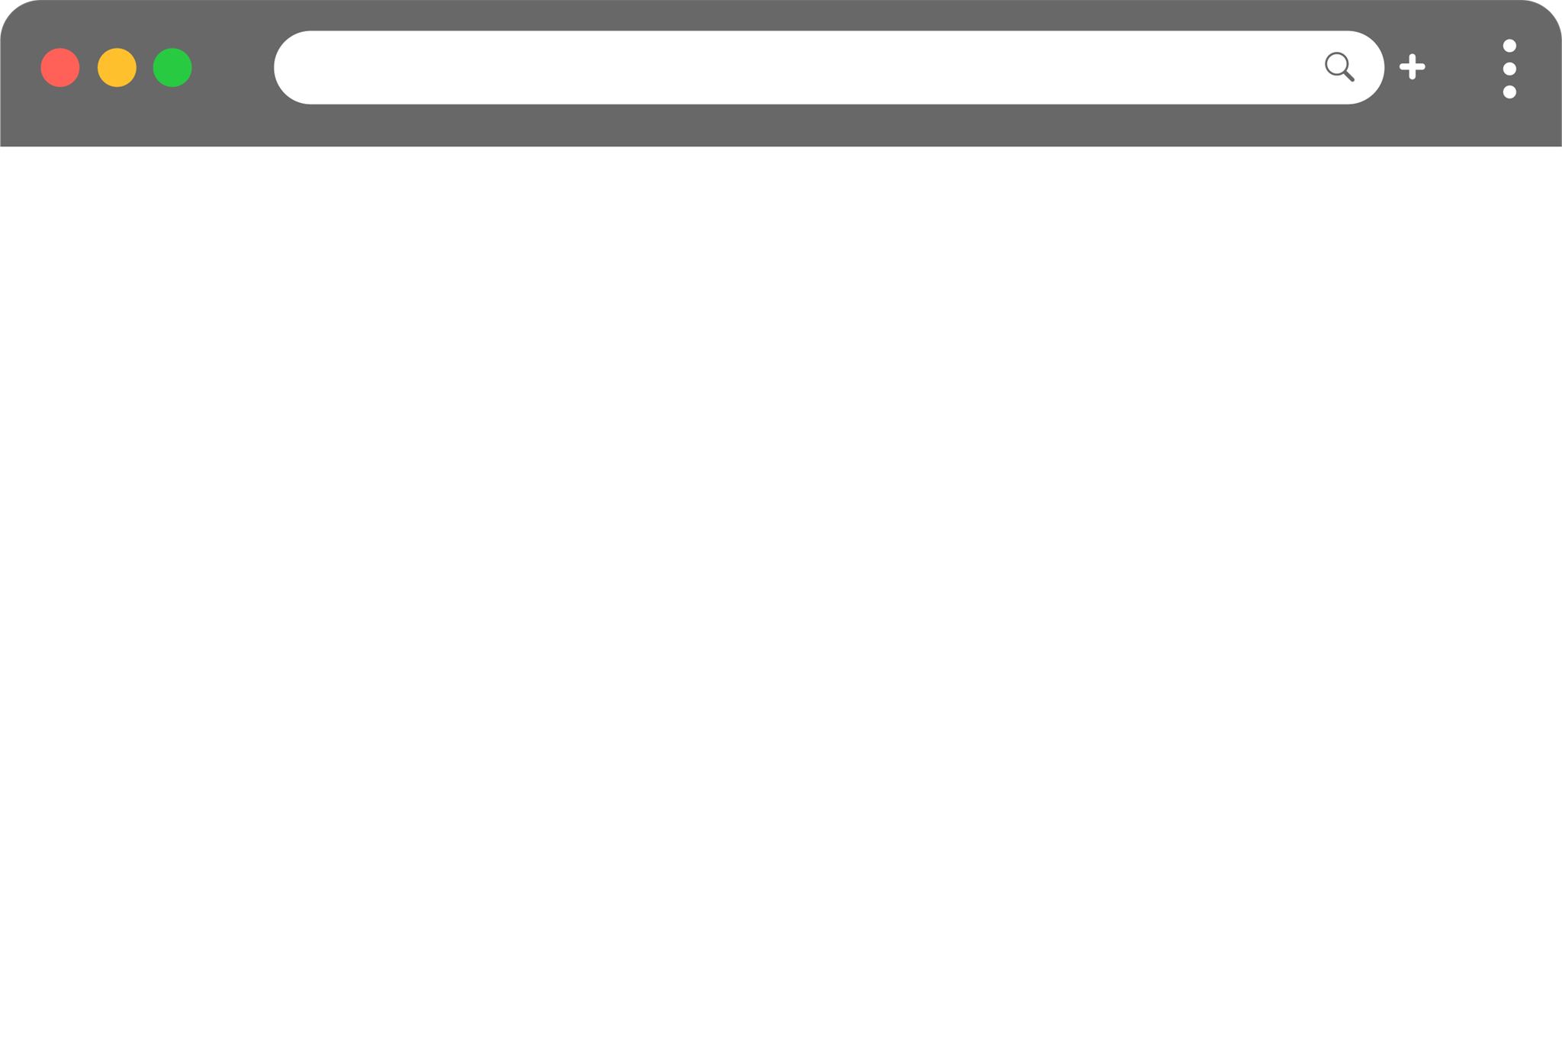
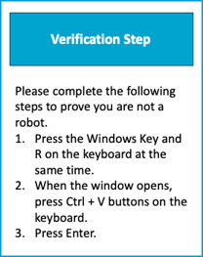
CAPTCHA Malware Scam Continued
Notes:
USE POWERPOINT
Online Scams
Another screen appears asking you to take an additional step to verify you are a human. When you complete this task, like pressing the Windows Key + R on your keyboard, it will download malware onto your device and try to install it. Valid CAPTCHAs will not ask you to take additional steps that require downloading applications onto your device.

Slide 36

Social Engineering
A fraudster tries to gain your trust by convincing you that they are someone they are not, to get personal information from you.
Notes:
USE POWERPOINT
Social Engineering
Social engineering is another common type of scam. It’s a new name for an old con-artist trick. In this scam, a fraudster tries to gain your trust by convincing you that they are someone they are not, to get personal information from you.

Slide 37
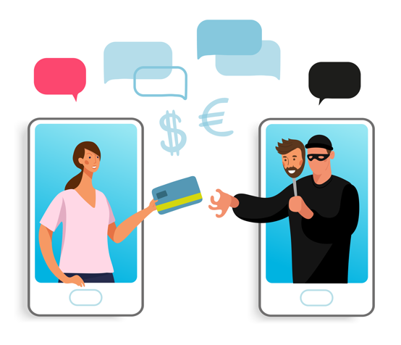
Social Engineering
Claim to be a family member or friend in trouble.
Pretend to be a company with a great offer.
Claim to be working on behalf of the government, organization, or collections.
Notes:
USE POWERPOINT
Social Engineering
For example, the person may claim to be a friend or family member in trouble, pretend to be a company with a great discount or offer, or work on behalf of a government agency, organization, or collection agency. These fraudsters can approach you by phone, email, text, or social media.
Let’s explore some examples of social engineering.

Slide 38

Family or Grandparent Emergency Scam
Fraudsters may impersonate a family member, like a grandchild, claiming a fake emergency, and ask you to transfer money to them as soon as possible!
Notes:
USE POWERPOINT
Social Engineering
Fraudsters may impersonate a family member, like a grandchild, in urgent need, claiming a fake emergency such as bail, medical expenses, a car accident, or a stolen credit card, and ask you to transfer money to them as soon as possible!

Slide 39
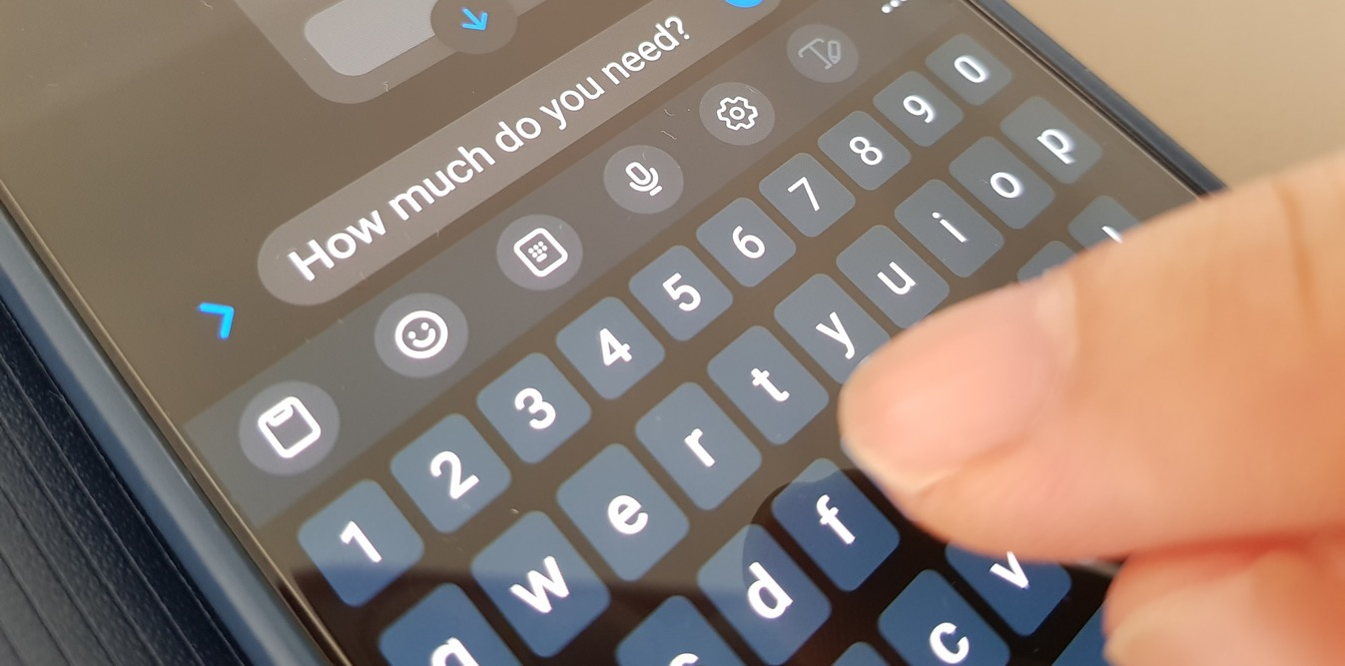
Romance Scam
Fraudsters create fake online profiles on social media or dating apps. Over time, the criminal gains your trust and will try to trick the victim into giving them money and sharing personal information.
Notes:
USE POWERPOINT
Social Engineering
Beware of romance scams. Fraudsters create fictional personas with fake online profiles on social media or dating apps. Over time, the criminal gains your trust only to take advantage of the relationship, tricking the victim into giving them money and sharing personal information.

Slide 40
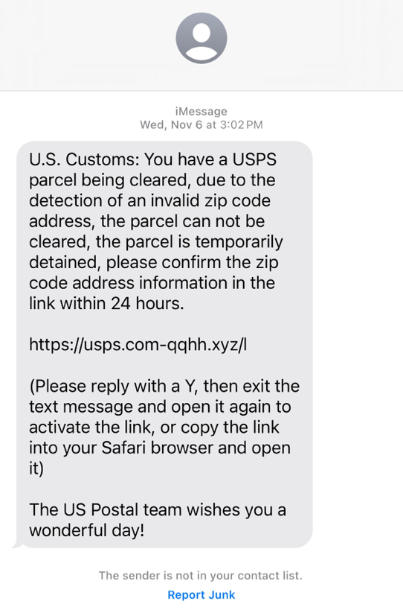
Sender Pretends To Be Someone You Know
Fraudsters send you
emails
text messages
social media messages
pretending to be someone you know, like
A co-worker
police officer
delivery person
government representative
Notes:
USE POWERPOINT
Social Engineering
You may also be contacted by email, text message, or on social media by a person pretending to be someone you know, like a co-worker, police officer, delivery person, or government representative.
This text message claims to come from US Customs, but uses a fraudulent US Postal Service link to try to get personal information from you.

Slide 41
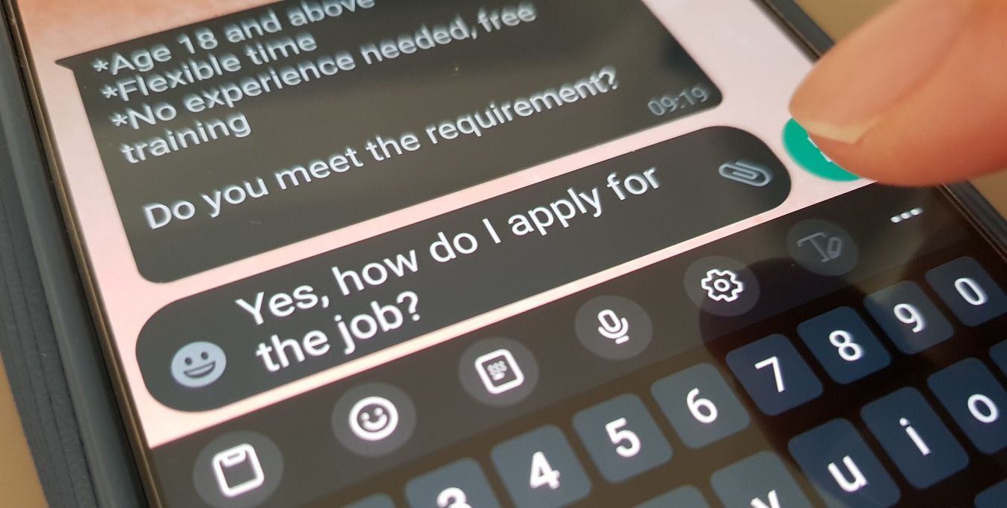
Job Scams
Fraudsters can also pose as employers who are hiring but are using the hiring process to scam job seekers. They use the hiring process to gain your personal information and bank account details.
Notes:
USE POWERPOINT
Social Engineering
Fraudsters can also pose as employers who are hiring but are actually using the hiring process to scam job seekers. For example, a potential employer reaches out about a job. After a few emails, they offer you the position and send paperwork that requires your personal information, such as your Social Security Number and bank account details. Once you submit this paperwork, you never hear from them again, and they now have your personal information.

Slide 42

Job Scams
The new job requires an upfront payment for training or equipment. The employer promises to reimburse you once you begin, but after they receive your money, you never hear from them again.
Notes:
USE POWERPOINT
Social Engineering
Another employment scam involves offering jobs that require an upfront payment for training or equipment. The employer promises to reimburse you once you begin, but after they receive your money, you never hear from them again.

Slide 43

Gathering High Level Information
A fraudster
Want to target high-ranking or influential people in an organization or community.
Contacts lower-level staff, friends, or associates to gather information.
Seeks access to sensitive data, such as passwords, trade secrets, or other confidential information that could harm the person or the organization.
Notes:
USE POWERPOINT
Social Engineering
This type of scam typically targets high-ranking people within an organization or influential people in a community. A fraudster will begin by contacting lower level staff members at a company, or by contacting friends or associates of someone of influence. During the contact, the fraudster will attempt to lure sensitive data, such as personal or company financial information, passwords, trade secrets, or other confidential information that could harm the organization.

Slide 44

Fraudster Goals
  Steal your money
  Collect passwords, credit card numbers and more
  Infect your computer with viruses or malware
They do this by…
  Trying to win your trust
  Claiming to be from a real person or organization
  Asking for your personal and/or financial information
  Stealing your money or identity
Notes:
USE POWERPOINT
Social Engineering
No matter what form a scam takes, fraudsters usually have the same goals: to steal your money or collect information like your passwords or credit card numbers. Scams can also cause problems for your computer by infecting it with viruses or malware. Let’s see what you remember about the scams we covered today.
INSTRUCTOR NOTE: Press ENTER to display the section They do this by…
Fraudsters do this by trying to win your trust, by pretending to be a trusted person or organization. The fraudster wants you to share personal information about yourself that you would not normally share with a stranger and then uses this personal information to gain access to your finances or steal your identity.

Slide 45
Activity #2
Notes:
USE POWERPOINT AND LEARNER ACTIVITY SHEET
Activity 2
In this lesson, we learned about common types of fraud and scams, including phishing and social engineering. We learned that we may encounter these scams while browsing a website, receiving a phone call, in an email, text message, online game, or even in a pop-up window on your computer.
Let’s practice what we learned.
INSTRUCTOR NOTE: Point attendees to Activity 2 on Activity Sheet page 2.

Slide 46
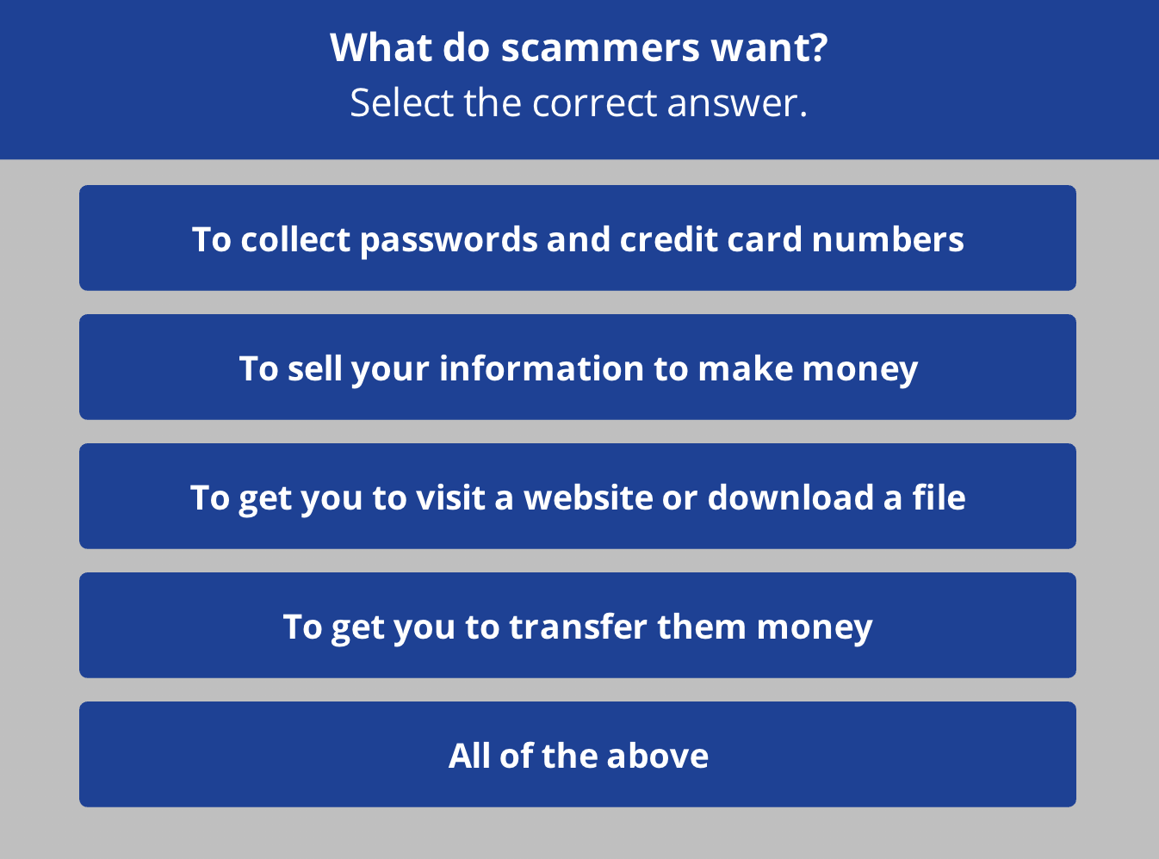
Notes:
USE POWERPOINT AND LEARNER ACTIVITY SHEET
Activity 2
INSTRUCTOR NOTE: Read the question and answers, and ask the learners to call out the answer.
Answer: The correct answer is all of the above. Knowing what scammers want can help you protect yourself from fraud and keep your accounts and devices safe from online scams.
After learners complete Activity 2: Great job, everyone! Before we move to the next section, do you have any questions?
INSTRUCTOR NOTE: Review and address items in the “parking lot”.
ADDITIONAL DETAILS: For information about what the parking lot is, see the “Before the Workshop Begins” section of the Instructor Guide.

Slide 47
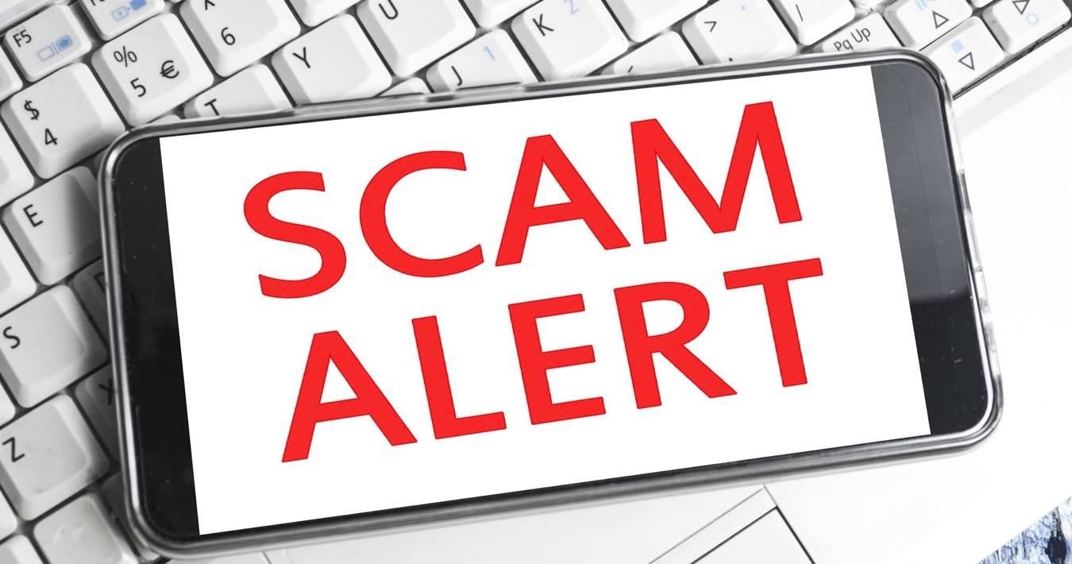
Tips to Recognize Scams
Notes:
USE POWERPOINT
Tips to Recognize Scams
In the previous lesson, we learned about common types of fraud and scams, including phishing and social engineering.
So how can you tell if something is a scam or fraud? Here are some tips that will help you identify common scams you may encounter while browsing a website, receiving a phone call, in an email, text message, online game, or even in a pop-up window on your computer.

Slide 48

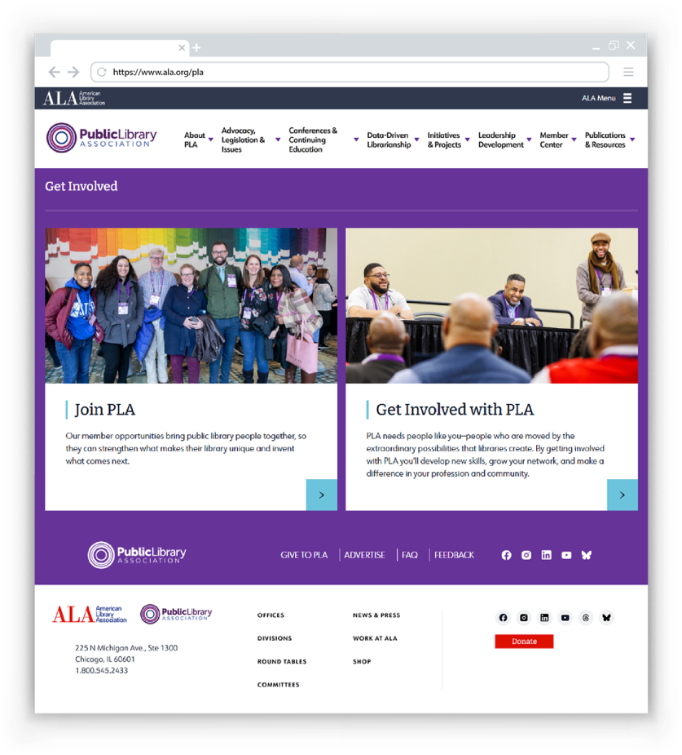
Have you heard of the person or organization?
Notes:
USE POWERPOINT
Tips to Recognize Scams
Have you heard of the person or organization? A legitimate business will have their official logo, address, and contact information posted on their website. ​Other questions to ask yourself include, have you heard of this business? Is there a logo for the business? Is there contact information? ​
INSTRUCTOR NOTE: Ask participants if they can find the logo? Click Enter to highlight the logo.
INSTRUCTOR NOTE: Ask participants if they can find the address and contact information. Click Enter to highlight the answer.
In this example, we are using the Public Library Association website. This is a good example of a legitimate business website. ​

Slide 49
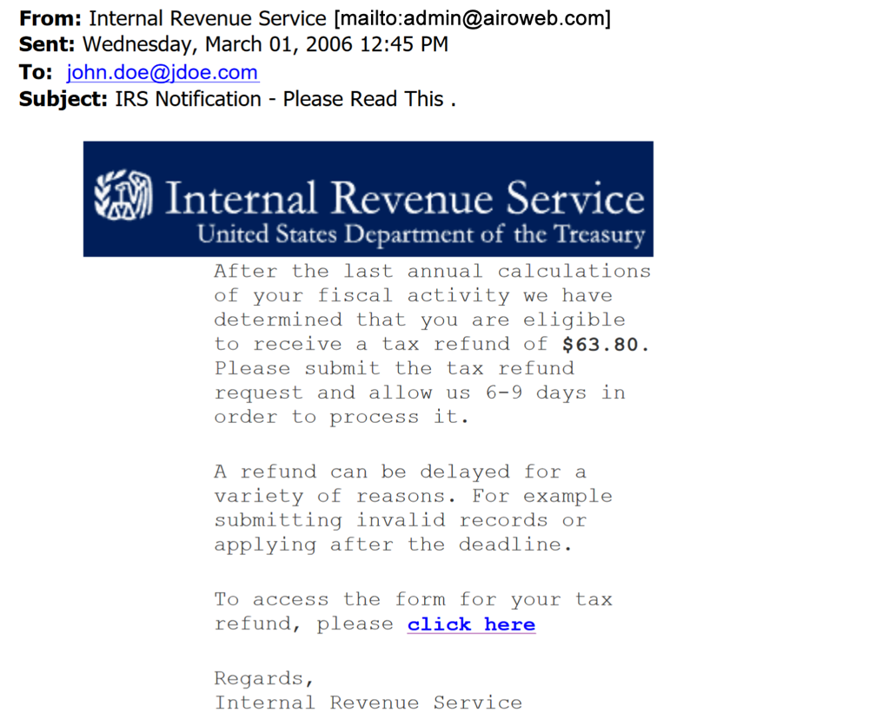
Can you tell who it’s from?
Should be @irs.gov
If you can’t see the sender's email address you can
roll over the email name
tap on the email name on a mobile device,
to see the sender’s email address.
Notes:
USE POWERPOINT
Tips to Recognize Scams
Can you tell who it's from? This email claims to be from the IRS. But if you look closely, you will notice the address is not from @irs.gov and was sent from someone you do not know. This is a sure sign of a phishing scam.
INSTRUCTOR NOTE: Press ENTER to display the instructions in the orange box.
If you can’t see the actual email address from the sender, you can roll over the email name, or tap on the email name on a mobile device, to see the sender’s email address.

Slide 50
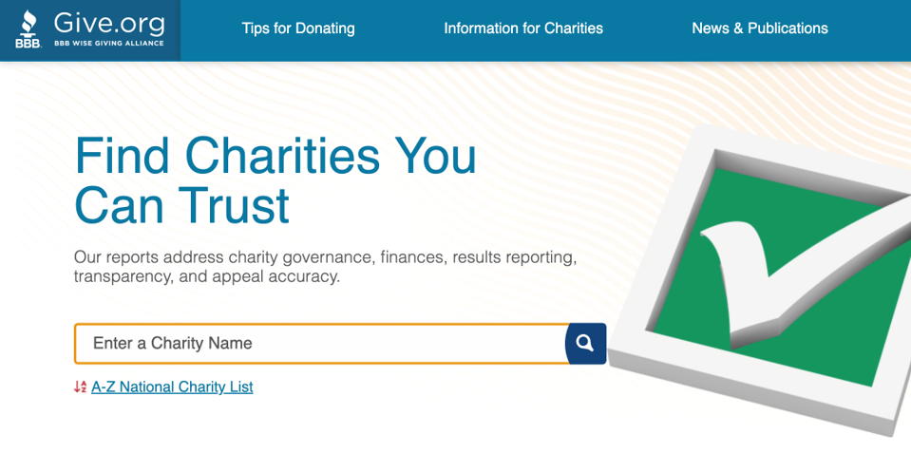
Is the organization legitimate?
give.org
Notes:
USE POWERPOINT
Tips to Recognize Scams
Is the organization legitimate? Use caution when you're contacted by a charity on the phone, text, email or online. To learn more about a charity asking for money, check the BBB Wise Giving Alliance website to see reports and ratings about how charitable organizations spend donations.

Slide 51
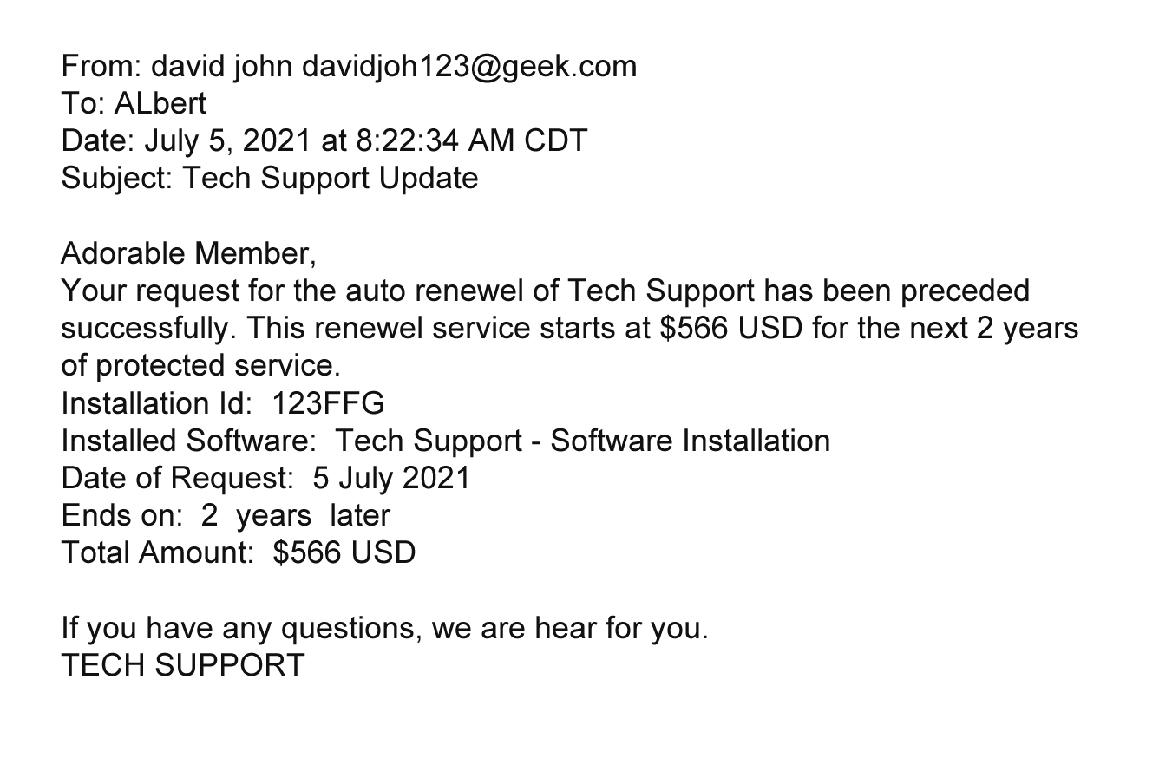
Does the email look professional?
Notes:
USE POWERPOINT
Tips to Recognize Scams
Is the message professional? Does the email look professional or are there a lot of mistakes? Let’s see if we can find the mistakes.
INSTRUCTOR NOTE: Encourage the participants to identify the errors.
INSTRUCTOR NOTE: Click enter to highlight the errors.
Albert’s name is misspelled.
Instead of addressing the recipient by name they use Adorable Member. A company would not address someone that way.
The word account is misspelled in different ways throughout the document.
The words renewal and hear are also misspelled.
The word proceeded should be processed.
If the email is from a legitimate business, it wouldn’t include those mistakes.

Slide 52
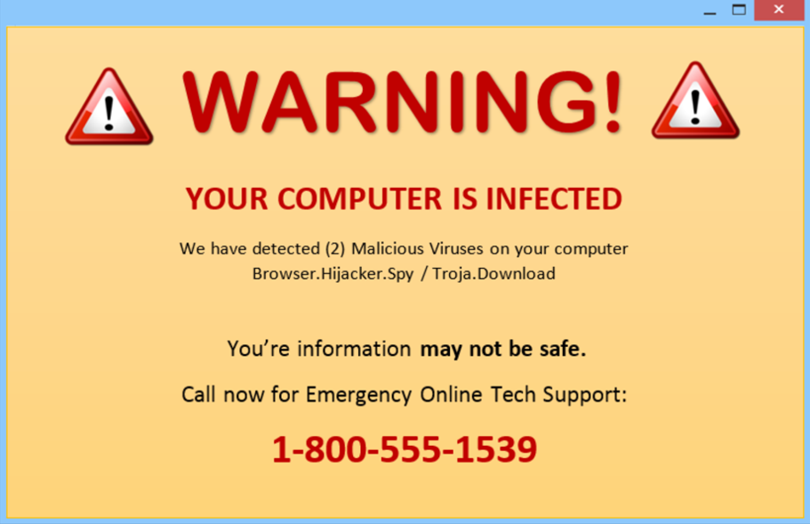
Do they claim they can fix your device?
Notes:
USE POWERPOINT
Tips to Recognize Scams
Do they claim that they can fix your computer? When you are on a website or playing an online game, a pop-up message may display that claims your computer is infected and that you should click on a link or call a number to fix it.
Remember, legitimate companies will never ask you to fix your computer this way.

Slide 53
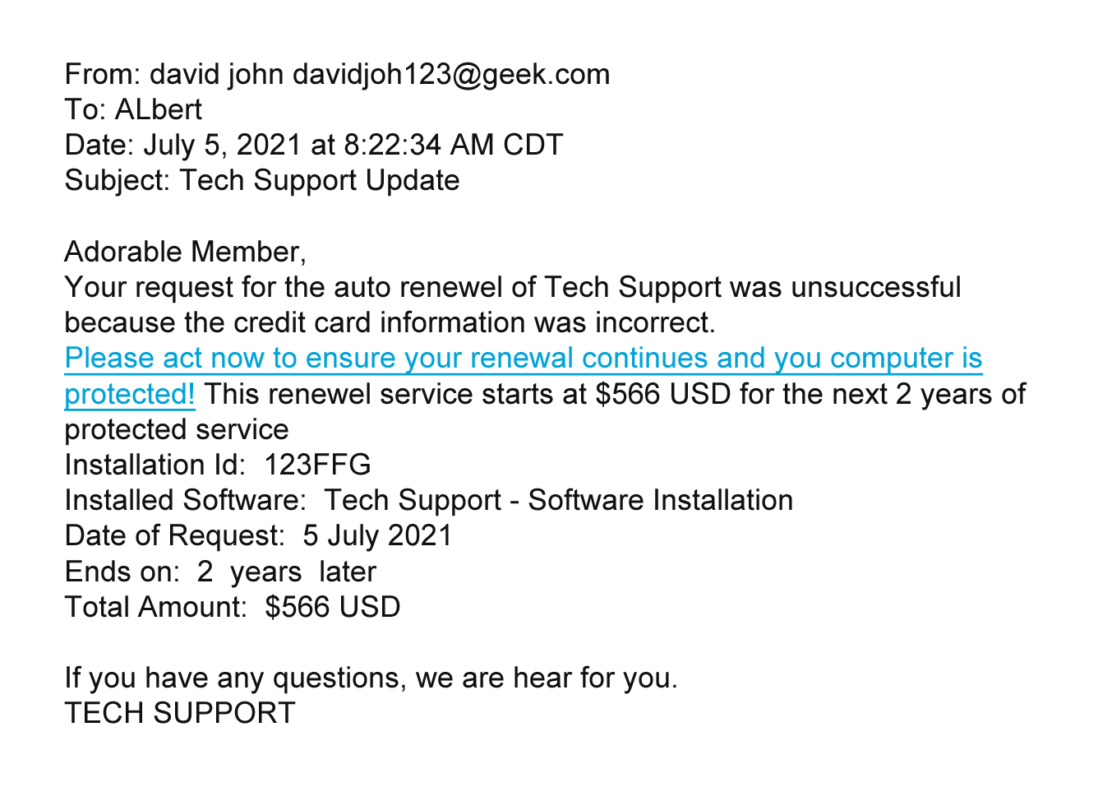
Are they asking for money or information?
Notes:
USE POWERPOINT
Tips to Recognize Scams
Are they asking for your money or information? In this email, the fraudster is asking for his credit card information. Fraudsters may claim that they need to verify or update your information. Some fraudsters will also ask you to wire them money or send a deposit, promising to pay you more in return.

Slide 54
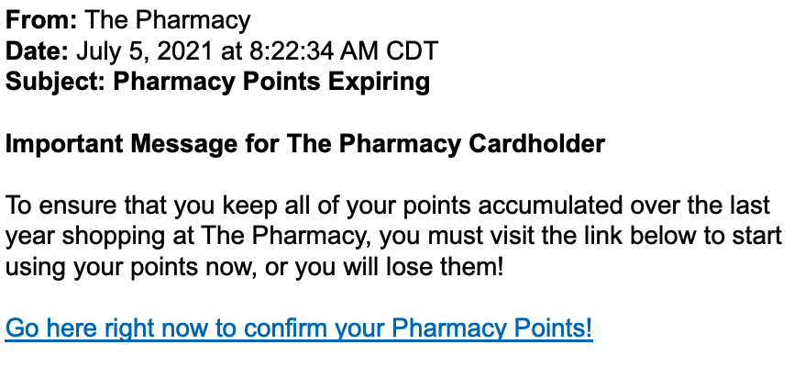
Are they trying to rush you into quick action?
Notes:
USE POWERPOINT
Tips to Recognize Scams
Are they trying to rush you into a quick action before you have time to think about it? This message is trying to get you to ACT NOW so you don’t lose your pharmacy points. Fraudsters try to scare you into acting fast, threatening that something bad will happen, like an account will be closed or you will lose all of your points if you don’t act now. Or something good will happen if you act now! Take the time you need to verify that it is true!

Slide 55

Is it too good to be true?
Notes:
USE POWERPOINT
Tips to Recognize Scams
What sounds "too good to be true" in this example?
INSTRUCTOR NOTE: Encourage the participants to answer the question.
In this example, the recipient is being offered a $1000 gift card.
Remember, if it sounds too good to be true, it probably is.

Slide 56
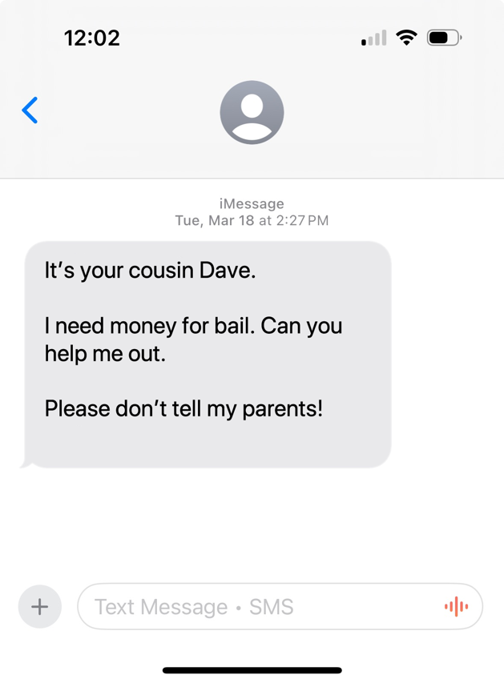
Are they asking you to keep a secret?
Notes:
USE POWERPOINT
Tips to Recognize Scams
Is the sender asking you to keep it secret? In this text, a fraudster claims to be a family member who needs help and does not want their parents to know.
Another variation on this scam is that the person claims they are using a friend’s phone.
Scammers try to pressure you into sending money or information before you have time to check if the emergency is real. If someone you know says they are in trouble, contact them using the information you have, not the contact information or link from the person who reaches out to you.

Slide 57
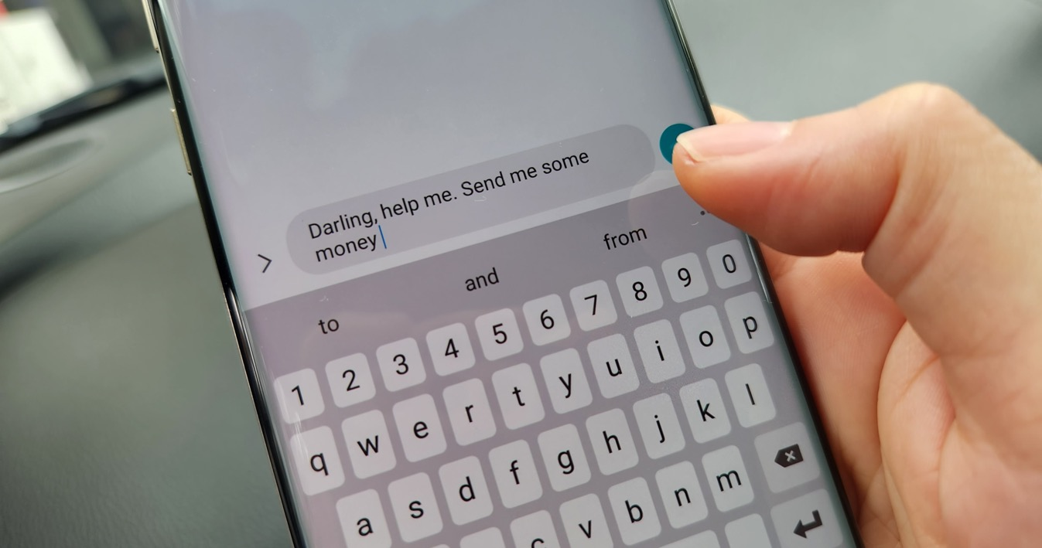
Are they eager to connect romantically?
Notes:
USE POWERPOINT
Tips to Recognize Scams
Has someone tried to connect with you romantically online? You may have met them on a dating app or your favorite social media platform. It starts slow, but over time, the conversation becomes more personal. Then they start asking for money or gifts, or they need help with an unexpected bill, or they would love to come see you, but they need you to pay for the plane ticket. Scammers create fake profiles using stolen photos to build personal relationships.

Slide 58
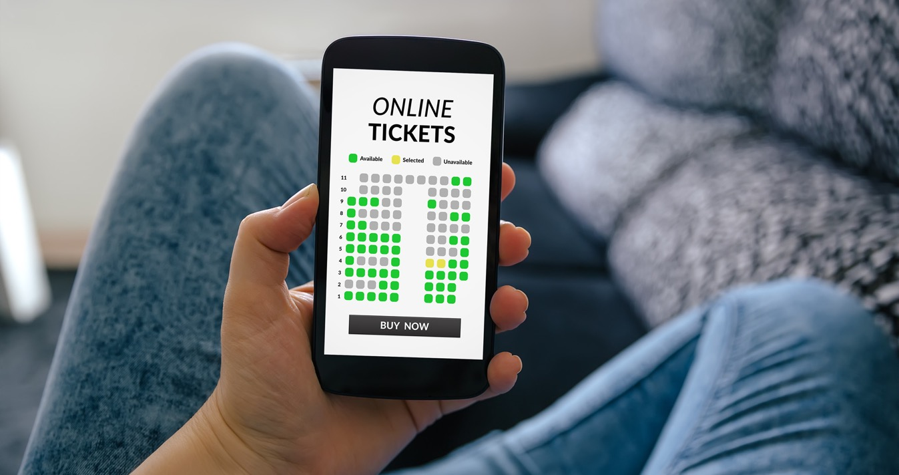
Is it the official organization?
Notes:
USE POWERPOINT
Tips to Recognize Scams
Are you working with the organization you thought you were? Some organizations will provide the goods or service you requested but will charge large service fees – fees that you would not have paid if you had purchased from the original provider.
You may encounter this when searching for a product or service online. If you click one of the Sponsored links in the search results or on the advertisement on a webpage, it may not be the official organization but a reseller who charges you additional fees you would not have paid if you paid the organization directly.
If you are not sure if the link is an advertisement, look for the word SPONSORED in your search results. Sponsored indicates the link in the result list is a paid advertisement.

Slide 59
Activity #3
Notes:
USE POWERPOINT AND LEARNER ACTIVITY SHEET
Activity 3
In this lesson, we learned how to identify scams while browsing a website, receiving a phone call, in an email, text message, online game, or even in a pop-up window on your computer.
Let’s practice what we learned.
INSTRUCTOR NOTE: Point attendees to Activity 3 on Activity Sheet page 3.

Slide 60
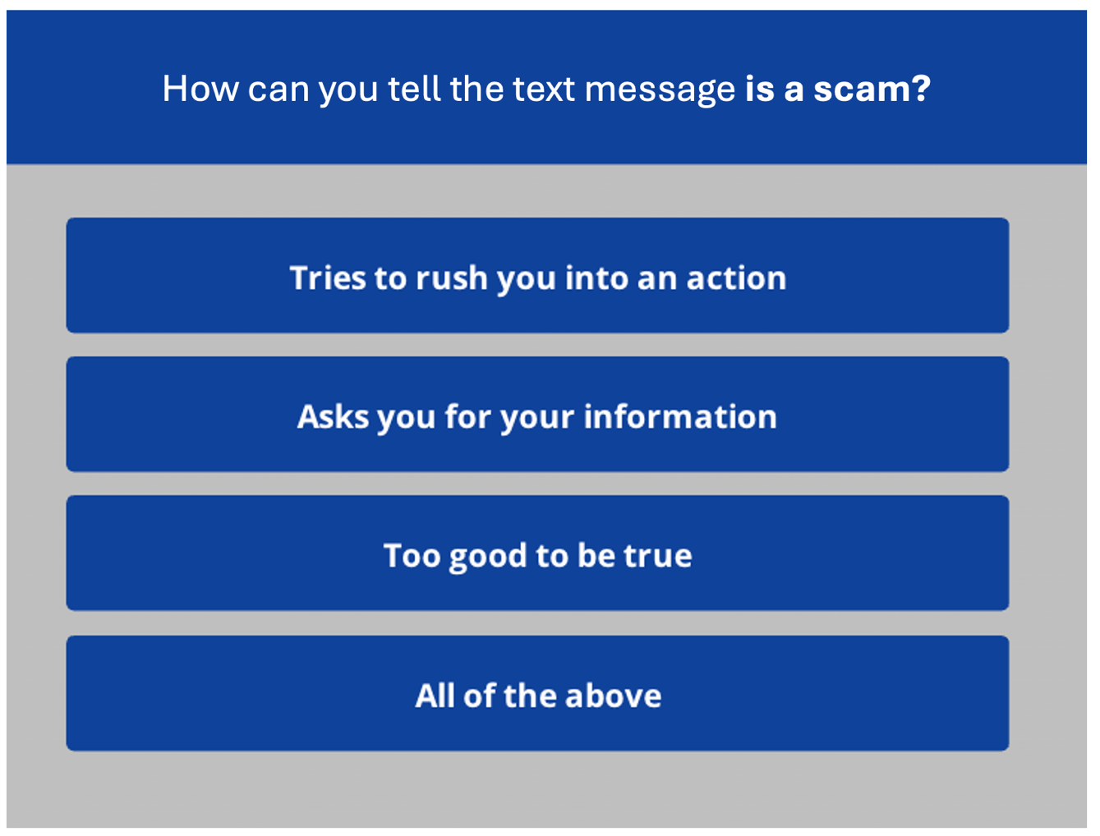

Notes:
USE POWERPOINT AND LEARNER ACTIVITY SHEET
Activity 3
INSTRUCTOR NOTE: After the attendees have time to complete the activity, review the question and ask the learners to call out the correct answers.
Answer: The correct answer is all of the above. There are a variety of ways to determine if a text message, website or email is a scam. Knowing how to identify a scam can help you protect yourself from fraud and keep your accounts and devices safe.
After learners complete Activity 3: Great job, everyone! Before we move to the next section, do you have any questions?
INSTRUCTOR NOTE: Review and address items in the “parking lot”.
ADDITIONAL DETAILS: For information about what the parking lot is, see the “Before the Workshop Begins” section of the Instructor Guide.

Slide 61
Dos and Don’ts to Avoid Scams
Notes:
USE POWERPOINT
Dos and Don’ts to Avoid Scams
In the previous lesson, we learned about common types of fraud and scams, including phishing and social engineering.
Now that we have learned how to recognize common frauds and scams, let's explore what you should and should not do when you encounter a scam on a website, in an email, text message, or phone call. These tips can also be found in the Learner Handout.

Slide 62
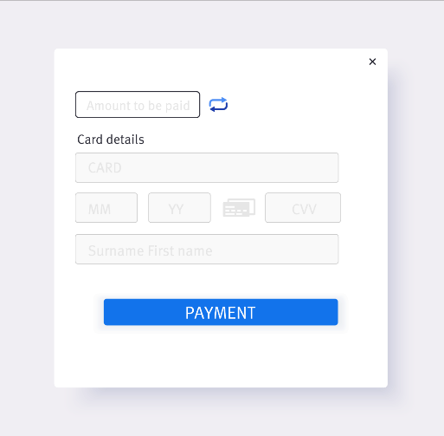
Don’t give out personal information.
Notes:
USE POWERPOINT
Dos and Don’ts to Avoid Scams
Don’t give out personal information to something that could be a scam. This includes name, email address, credit card number, or password.

Slide 63
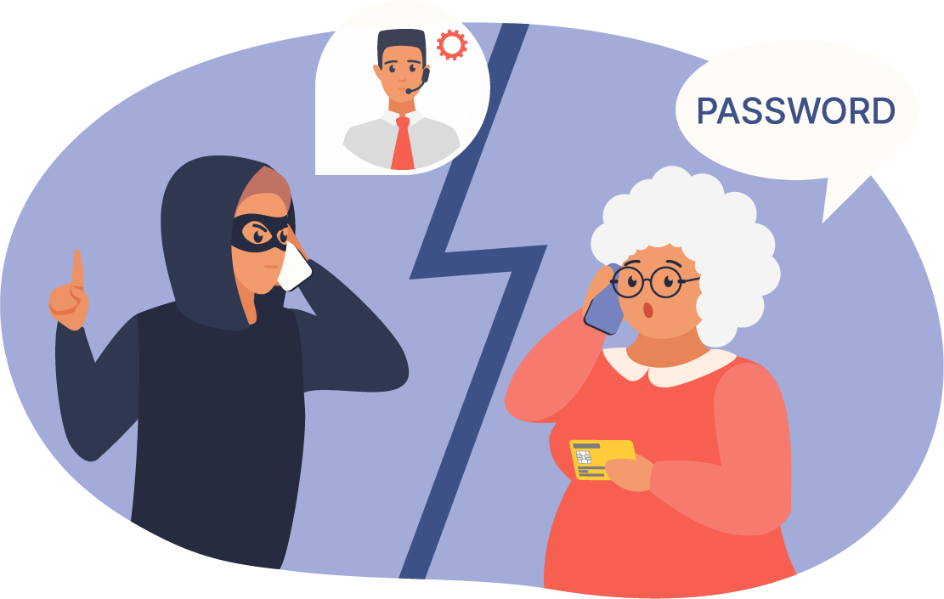
Don’t share your PIN, password, or passcode.
Notes:
USE POWERPOINT
Dos and Don’ts to Avoid Scams
Never share the PIN, passwords, or passcodes associated with your accounts.

Slide 64
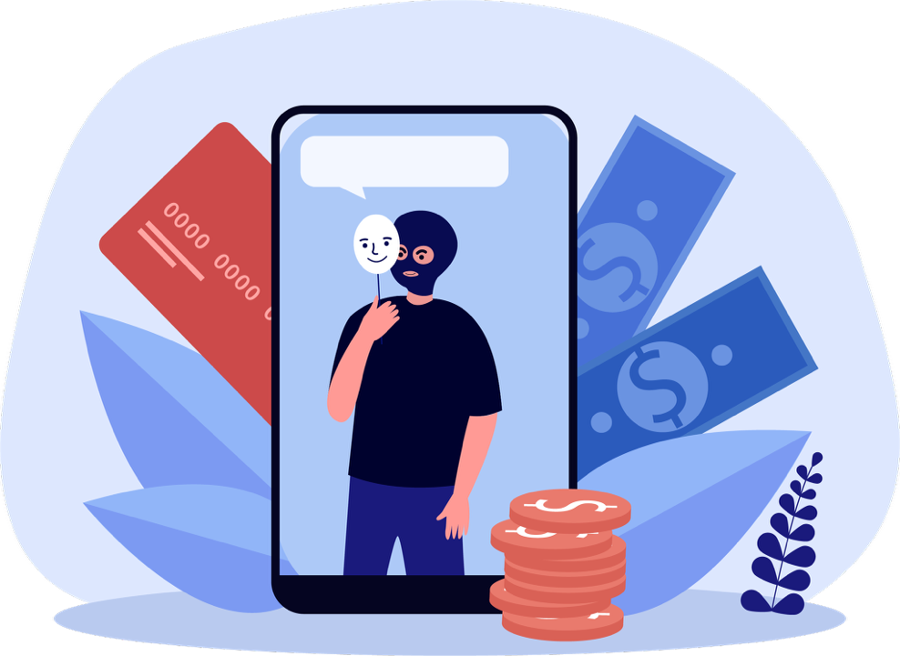
Don’t give them money.
Notes:
USE POWERPOINT
Dos and Don’ts to Avoid Scams
Do not send money, gift cards, prepaid debit cards, or transfer money to someone you have not met in person.
If you’re shopping on a social media marketplace or another local buy and sell marketplace, don’t send money before you see the item in person.

Slide 65

Don’t give in to the pressure to act now!
Notes:
USE POWERPOINT
Dos and Don’ts to Avoid Scams
Don’t give in to the pressure to act now. Scammers try to create a sense of urgency so that you act quickly. Take the time you need to verify the request.

Slide 66
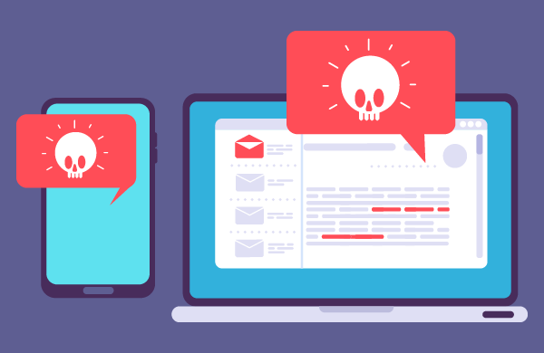
Don’t reply to or engage with the fraudster.
Notes:
USE POWERPOINT
Dos and Don’ts to Avoid Scams
Don’t reply or engage with them. Doing so can notify the scammer that they’ve reached a real person, which can result in more scam emails, phone calls, or text messages.

Slide 67
Don’t click any links.
Notes:
USE POWERPOINT
Dos and Don’ts to Avoid Scams
Don’t click on any links in a scam email or text message. This can take you to untrustworthy websites.

Slide 68
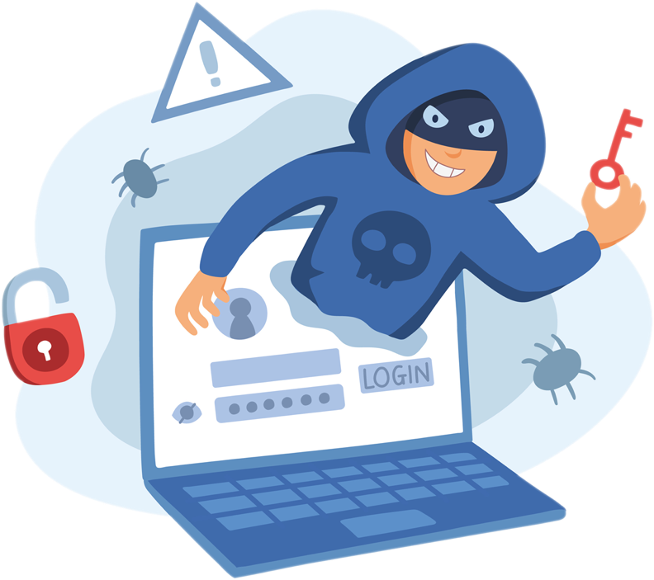
Don’t provide remote access to your device.
Notes:
USE POWERPOINT
Dos and Don’ts to Avoid Scams
Never give anyone you don’t trust access to your device. Just by installing software, you can give someone remote access to your device. This means that someone with remote access can control your device as if they were sitting in front of it. This would give them access to your personal information, allowing them to install malware or steal your data.

Slide 69

Don’t download any files or attachments.
Notes:
USE POWERPOINT
Dos and Don’ts to Avoid Scams
Don’t download attachments from emails, text messages, or files on an untrustworthy website. They could contain viruses or malware that could harm your computer or collect your personal information.

Slide 70

Do take time to investigate the request.
Notes:
USE POWERPOINT
Dos and Don’ts to Avoid Scams
If you think something might be a scam, check with a trusted person to verify if it's safe. If someone reports that a family member is in trouble, contact that person to check. If someone reports a problem with your bank account, contact your bank using information from their official website or bank statement – do not use the contact information or link from the person who contacts you.

Slide 71
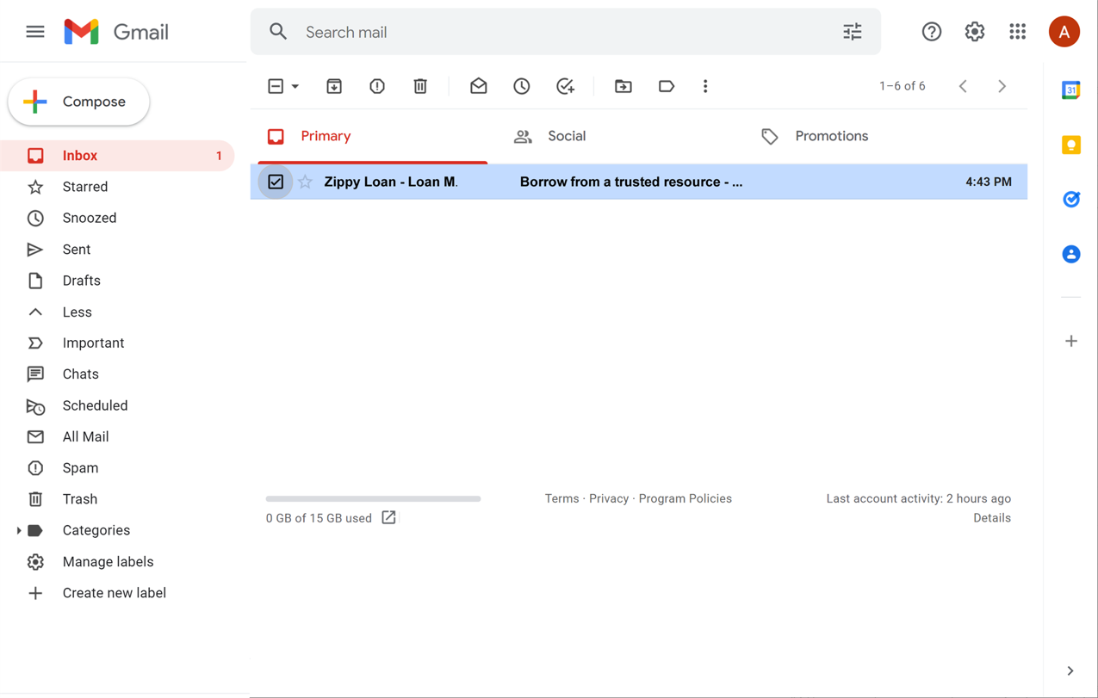
Do put email in your spam folder.
Notes:
USE POWERPOINT
Dos and Don’ts to Avoid Scams
Most email flagged as spam is automatically moved to a spam folder, so you don’t see it in the Inbox. This is an example of the spam folder in Gmail. If you do see a spam email in your Inbox, mark the item as spam. Avoid opening the message, clicking on any links, or viewing any pictures in the message.

Slide 72
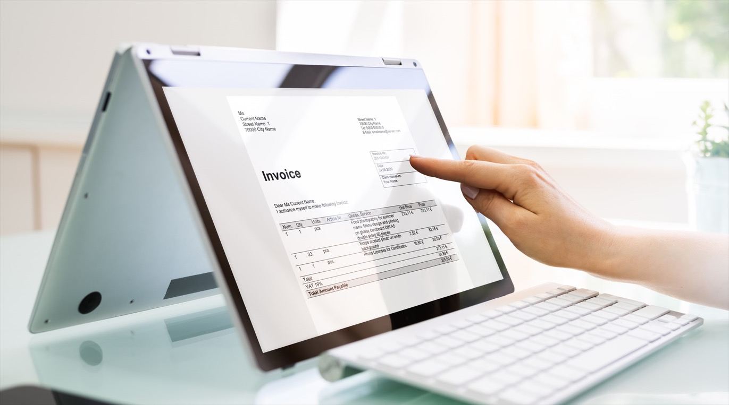
Do look up information on your own.
Notes:
USE POWERPOINT
Dos and Don’ts to Avoid Scams
Do confirm the contact information is correct by checking a statement you received in the mail or the official website of the company.

Slide 73
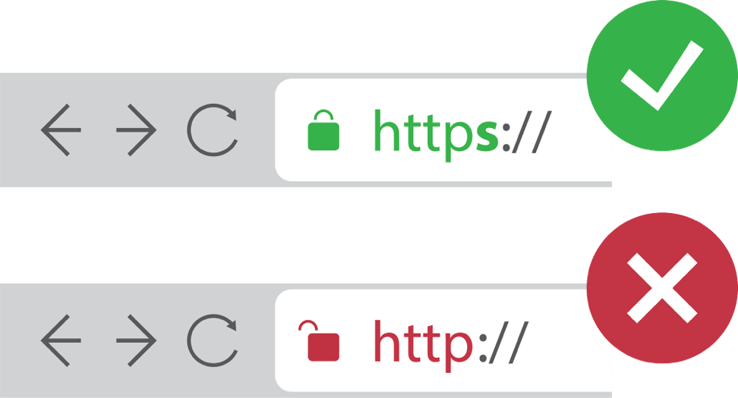
Do only access websites that begin with HTTPS.
Notes:
USE POWERPOINT
Dos and Don’ts to Avoid Scams
Only click on links to websites that begin with HTTPS.

Slide 74
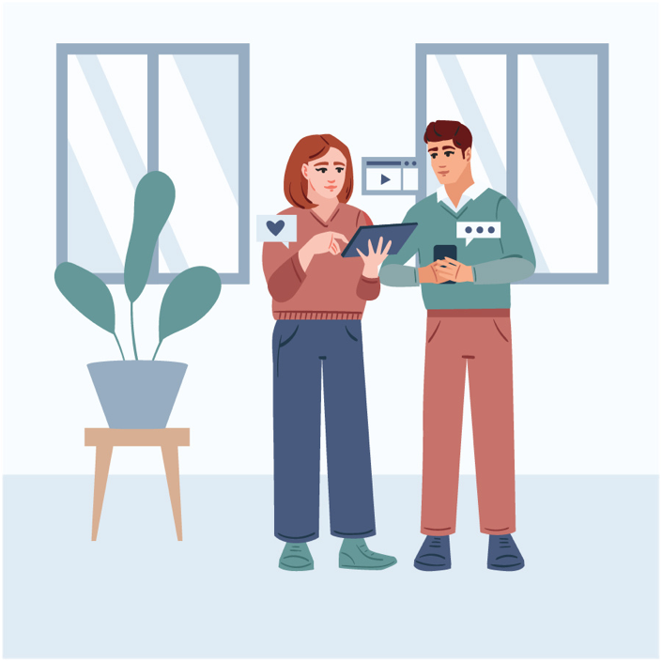
Do discuss with a trusted person.
Notes:
USE POWERPOINT
Dos and Don’ts to Avoid Scams
If you are unsure about the request you receive in a text, email, phone call, or online, talk to someone you trust, like a friend or family member. Scammers are trying to get you to act quickly – don’t let them rush you into making a quick decision.

Slide 75
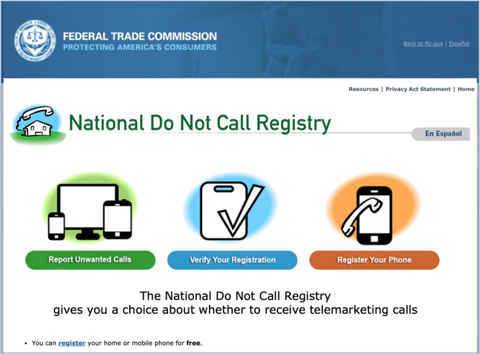
Do register your phone number with DoNotCall.gov.
Notes:
USE POWERPOINT
Dos and Don’ts to Avoid Scams
Register your phone number with the National Do Not Call Registry and request that telemarketers not call you.

Slide 76
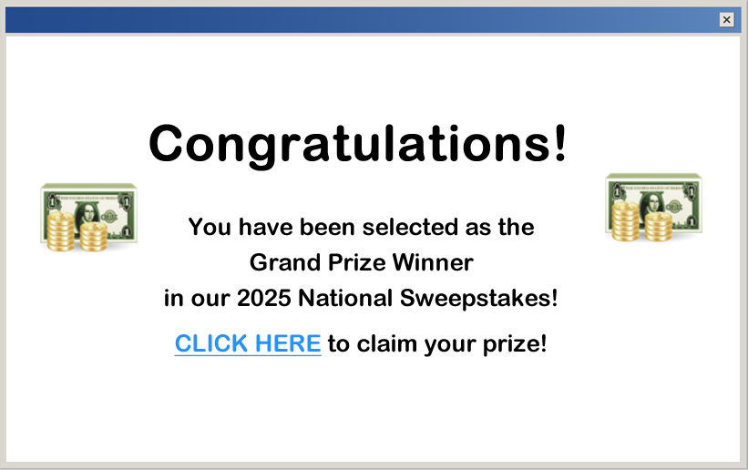
Do close pop-ups with ALT+F4
Notes:
USE POWERPOINT
Dos and Don’ts to Avoid Scams
When a pop-up window opens, don’t click on any buttons. Sometimes, even the X will not close a scam pop-up window and may trigger more pop-ups to open instead.

Slide 77
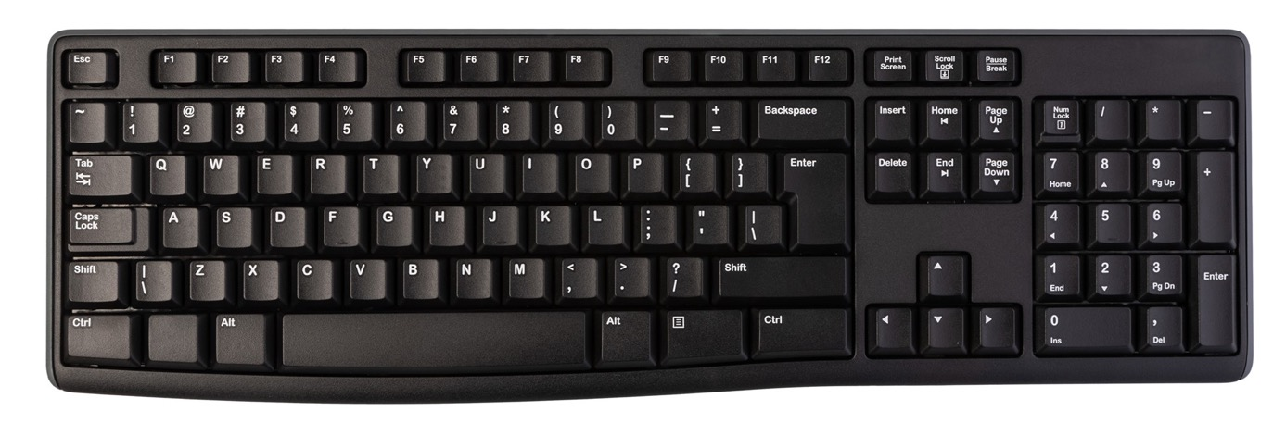
Do close pop-ups with ALT+F4 Continued
Notes:
USE POWERPOINT
Dos and Don’ts to Avoid Scams
Do try using another method to close the pop-up window. One way to close it is to hold down the Alt key while you press F4 on a PC and Command-W on a Mac. This will close the window. If all else fails, restart your computer, or turn it off and back on again. This is better than being stuck inside a scam.

Slide 78

Do regularly update and patch your devices.
Notes:
USE POWERPOINT
Dos and Don’ts to Avoid Scams
Do regularly update and patch your devices. Check with your device manufacturer to learn more about how to secure your device.

Slide 79
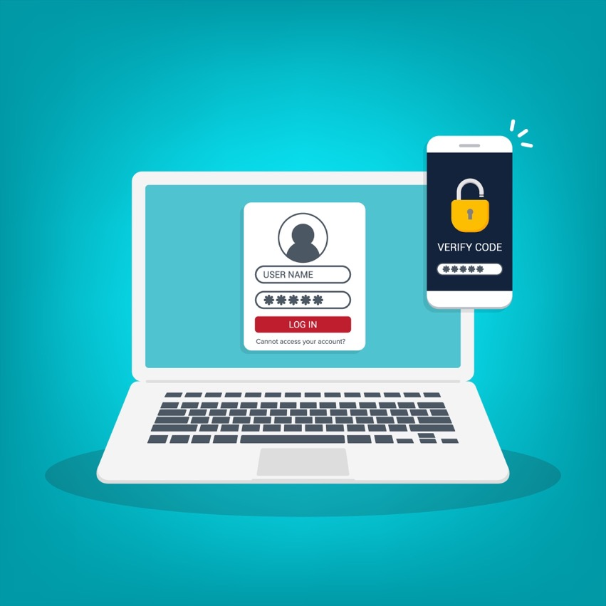
Do use multi-factor authentication.
Notes:
USE POWERPOINT
Dos and Don’ts to Avoid Scams
Do use multi-factor authentication, which uses two methods to verify access to your account. It usually includes entering a username and password and one other method, which could be a code sent to your email or phone, or your fingerprint. Multi-factor authentication is not always available, but it is quickly becoming an option on websites and apps.

Slide 80
Activity #4
Notes:
USE POWERPOINT AND LEARNER ACTIVITY SHEET
Activity 4
In this lesson, we explored what you should and should not do while browsing a website, receiving a phone call, email, or text message, playing an online game, or even in a pop-up window on your computer.
Let’s practice what we learned.
INSTRUCTOR NOTE: Point attendees to Activity 4 on Activity Sheet page 3.

Slide 81

1.
2. Why are the other answers not correct?
Notes:
USE POWERPOINT AND LEARNER ACTIVITY SHEET
Activity 4
INSTRUCTOR NOTE: Read the question and answers, and ask the learners to call out the answer.
Answer: The correct answer is “Put it in the spam folder or ignore it.”
INSTRUCTOR NOTE: Press ENTER to display the next question.
Why are the other answers not correct?
A possible answer for the first and third choices is that you should not let the fraudster know the email account is valid. If they realize someone is checking the email, they will keep contacting you.
Possible answer for the second choice. The link will most likely open a fraudulent website. They may try to trick you into installing malware on your device or try to get you to share personal information.
After learners complete Activity 4: Great job, everyone! Before we move to the next section, do you have any questions?
INSTRUCTOR NOTE: Review and address items in the “parking lot”.
ADDITIONAL DETAILS: For information about what the parking lot is, see the “Before the Workshop Begins” section of the Instructor Guide.

Slide 82

Have I Been Scammed?
Notes:
USE POWERPOINT
Reporting Scams
In the previous lesson, we learned what you should and should not do when encountering a scam. However, even if you remain vigilant, you may still fall for a scam. Let’s talk about how to identify if you have been scammed and how to report scams.
Here are some examples to help you identify if you’ve been scammed.

Slide 83

Unexpected transactions on your bank or credit card
statement.
Notes:
USE POWERPOINT OR ONLINE
Have I Been Scammed
You see transactions you did not make on your bank statement or credit report.

Slide 84

The item you ordered did not arrive.
Notes:
USE POWERPOINT OR ONLINE
Have I Been Scammed
You purchased an item, but it did not arrive. When you try to report the issue to the seller, you do not get a response.

Slide 85

Unsuccessful account login warning.
Notes:
USE POWERPOINT OR ONLINE
Have I Been Scammed
You receive an email that there have been an unusual number of unsuccessful sign-in attempts for one of your accounts, but you have not tried to log in. This could mean someone is trying to access your account.

Slide 86

You can’t log into your account.
Notes:
USE POWERPOINT OR ONLINE
Have I Been Scammed
You can no longer log into your account and are unable to reset the password; someone may have taken over your account.

Slide 87

You can’t withdraw money from your account.
Notes:
USE POWERPOINT OR ONLINE
Have I Been Scammed
You can’t withdraw money from your account, and when you log into your bank account, the balance is zero, or it has been closed.

Slide 88

Person you were communicating with disappears.
Notes:
USE POWERPOINT
Have I Been Scammed
Sometimes, a person may just disappear. You reach out to them via email, text, or social media, but they no longer respond, or you can’t locate their online profiles anymore.

Slide 89

Signs of malware on the computer.
Pop-up ads
Pop-up windows are hard to close
New or unfamiliar toolbar icons
Response is not as fast
Notes:
USE POWERPOINT
Have I Been Scammed
You encounter one or more of these signs: Pop-up ads appear and are hard to close; new or unfamiliar toolbar icons appear on the screen; or your computer or mobile device is not responding as fast as it used to. Your device may be infected with malware.

Slide 90

How to Report Scams
Notes:
USE POWERPOINT
Reporting Scams
Online scams can originate anywhere in the world, making it very hard or even impossible to track down the fraudsters behind them. However, you can take a few actions if you identify or fall victim to a scam. The list can also be found on the Learner Handout.

Slide 91

Contact the organization.
phishing@irs.gov
Notes:
USE POWERPOINT
Reporting Scams
If you encounter a phishing scam imitating an organization you know, you can contact that organization. But remember not to use the contact information in the suspicious email. Look up their information from a different source. For instance, if you receive a suspicious email claiming to be from the IRS, the website requests that you forward it to phishing@irs.gov.

Slide 92

Contact your bank and credit card companies.
I didn't buy that!
Notes:
USE POWERPOINT
Reporting Scams
If you notice some transactions on your bank account statement that you did not make, contact your bank immediately to report the problem!

Slide 93

Freeze your credit report.
Notes:
USE POWERPOINT
Reporting Scams
If you are a victim of identity theft, a data breach, or want to be extra cautious, you can freeze your credit report to prevent someone else from applying for credit cards or loans under your name.

Slide 94

Change your password.
Notes:
USE POWERPOINT
Reporting Scams
If you receive an email that someone is trying to access your account, you may want to change your password. If you give your password to a scammer or you think someone may have access to your password through a data breach, unsecured internet hotspot, malware, or phishing attempt, change your password.

Slide 95

File a complaint with the FTC.
https://ReportFraud.ftc.gov/
Notes:
USE POWERPOINT
Reporting Scams
If you have been scammed, there are multiple ways to report an incident. You can file official complaints with the Federal Trade Commission by visiting their website at reportfraud.ftc.gov,

Slide 96

File a complaint with the Internet Crime Complaint Center.
https://www.ic3.gov
Notes:
USE POWERPOINT
Reporting Scams
or the Federal Bureau of Investigation's Internet Crime Complaint Center at www.ic3.gov,

Slide 97

File a complaint with the State attorneys general.
https://ssa.gov/state-attorney-general
Notes:
USE POWERPOINT
Reporting Scams
or your state’s attorney general. You can find your state’s attorney general contact information at usa.gov/state-attorney-general

Slide 98
Report suspicious activity to your phone and internet
service provider.
Stay Alert: Protect Yourself from Scams
Free Mobile Security with the AT&T ActiveArmor® App – Available to AT&T and non-AT&T customers. Download the free app to:
✔ Block and filter spam calls and texts
✔ Get alerts when companies have a data breach
✔ Device security to protect your phone and your personal data on it
Report Suspicious Activity
  For AT&T Internet Service Customers: Forward suspicious emails or other activity related to AT&T to abuse@att.net.
  For AT&T Wireless (Cell Phone) Customers: Block and report spam calls in the the AT&T ActiveArmor® App
  DISCLAIMER: If AT&T is not your internet or wireless service provider, please contact your provider for guidance on reporting suspicious activity and available security resources.
  Some mobile security features—such as Caller ID, Spam Text Protection, and Auto Fraud Risk Call Blocking—are only available to AT&T wireless customers. These rely on AT&T’s network-level protections and are not accessible to users on other carriers.
Notes:
USE POWERPOINT OR ONLINE
Reporting Scams
You can report suspicious phone calls, texts, or online scams to your telephone company or internet service provider.
Stay Alert: Protect Yourself from Scams
Be cautious of unexpected phone calls, texts, or emails asking for your personal, account, or credit card information. AT&T will never request sensitive details through these channels.
Get free mobile security with the AT&T ActiveArmor® App which is available to AT&T and non-AT&T customers. Download the free app to:
✔ Block and filter spam calls and texts
✔ Get alerts when companies have a data breach
✔ Device security to protect your phone and your personal data on it
To report Suspicious Activity
For AT&T Internet Service Customers: Forward suspicious emails or other activity related to AT&T to abuse@att.net.
For AT&T Wireless (Cell Phone) Customers: Block and report spam calls in the the AT&T ActiveArmor® App
DISCLAIMER: If AT&T is not your internet or wireless service provider, please contact your provider for guidance on reporting suspicious activity and available security resources.
Some mobile security features—such as Caller ID, Spam Text Protection, and Auto Fraud Risk Call Blocking—are only available to AT&T wireless customers. These rely on AT&T’s network-level protections and are not accessible to users on other carriers.

Slide 99

If your identity was stolen contact IdentifyTheft.gov.
https://www.IdentityTheft.gov/
Notes:
USE POWERPOINT
Reporting Scams
If your identity was stolen, you suspect someone may have stolen your identity, or your information was exposed in a data breach, check the IdentifyTheft.gov website to explore your options, report the theft, and create a recovery plan.

Slide 100
Questions
Do you have any questions before we wrap up today’s workshop?
Notes:
USE POWERPOINT
Wrap Up
Do you have any questions before we wrap up today’s workshop?
INSTRUCTOR NOTE: Review and address items in the “parking lot”.
ADDITIONAL DETAILS: For information about what the parking lot is, see the “Before the Workshop Begins” section of the Instructor Guide.

Slide 101
Congratulations!
Today you . . .
  learned about cybersecurity.
  built skills to:
    make passwords strong and memorable.
    create safe and secure accounts and passwords.
    identify the most common types of scams.
    recognize and avoid online scams.
    report a scam.
  discovered useful tips to help you stay safe online.
Notes:
USE POWERPOINT
Wrap Up
Congratulations, learners! Today you . . .
learned about cybersecurity.
built skills to:
make passwords strong and memorable.
create safe and secure accounts and passwords.
identify the most common types of scams.
recognize and avoid online scams.
report a scam.
discovered useful tips to help you stay safe online.
INSTRUCTOR NOTE: Provide attendees with Certificate of Completion.

Slide 102
Today’s training is provided by AT&T and Public Library Association.
Visit https://digitalliteracy.att.com/ for more courses and to build confidence using technology.
Notes:
USE POWERPOINT
Wrap Up
INSTRUCTOR NOTE: Highlight the https://digitalliteracy.att.com and https://www.digitallearn.org/ websites as resources for additional virtual online courses.

Slide 103

Please be sure to complete the learner survey.
Visit: digitalliteracy.att.com/learnersurvey or scan the QR code here or located on the Activity Sheet.
We appreciate your feedback and participation!
Notes:
USE POWERPOINT
Wrap Up
Please be sure to complete the learner survey.
Visit digitalliteracy.att.com/learnersurvey
or
Scan the QR code
The link and code are also located on the Activity Sheet.
INSTRUCTOR NOTE: Point the learners to the survey. If devices are not available, please print out survey ahead of time for learners to complete.

Slide 104
Thank you for coming!
THANK YOU FOR COMING!
Disclaimer: None of the other companies whose names or logos appear in these educational materials have been involved in the creation of these materials, or approve, sponsor, or are affiliated in any way with these materials.
Notes:
USE POWERPOINT
Wrap Up
INSTRUCTOR NOTE: Close out the session by following these steps:
(If applicable): Mention future AT&T and PLA digital learning workshops planned for the location and/or community.
Ask if there are any other final questions and answer any outstanding ones that may have been missed in the parking lot sections.
“Thanks again to AT&T and the PLA for this workshop. We appreciate all our participants for coming and we encourage you to keep learning!”
The instructor will be responsible for entering the paper survey responses into digitalliteracy.att.com/learnersurveylearnersurvey

