Slide 1

Cut the Cable Cord
Name
Title
Library Name
Courtesy of Gail Borden Public Library
and the Public Library Association

Slide 2
What is Cord Cutting?
Devices
Streaming Services
Selecting Internet Service
Scenarios
Resources

Slide 3
Searching through ads
What is Cord Cutting?

Slide 4

What is Cord Cutting?
People all around the world are removing their cable service and replacing it with streaming subscriptions and devices instead of cable.

Slide 5
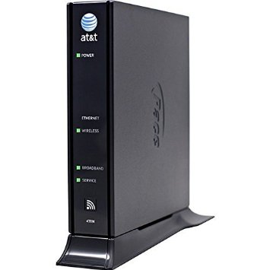
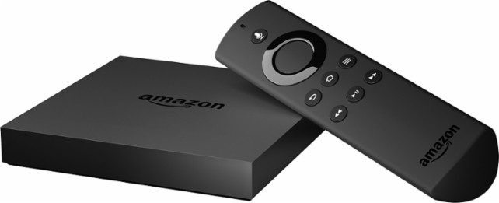

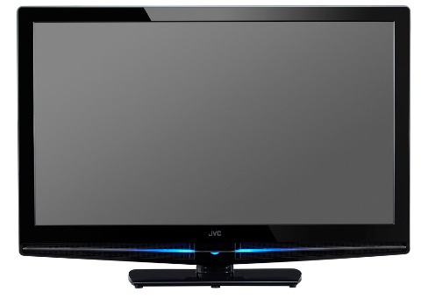
How Do I Stream?
Wireless internet
A Steaming device
A subscription to a streaming service
A TV with an HDMI port

Slide 6
Pros & Cons
Pros of Cable Cutting
Usually cheaper
Pay for only what you want/watch
Usually has no commercials
Everything is “on demand”
Cons of Cable Cutting
Usually less content
Must purchase at least one streaming device
Will miss out on some exclusive content
If you watch a lot of TV, it could end up costing more to get the same content

Slide 7
Searching through ads
Devices

Slide 8
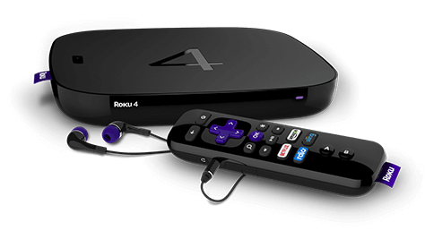
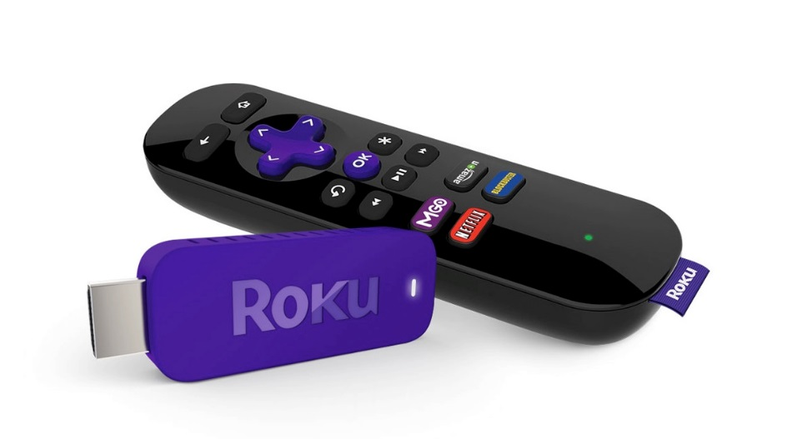
Devices
Roku stick $40 (HD)
Roku Premiere $80 (4K ready)
Roku Ultra $130(4K HDR ready)

Slide 9
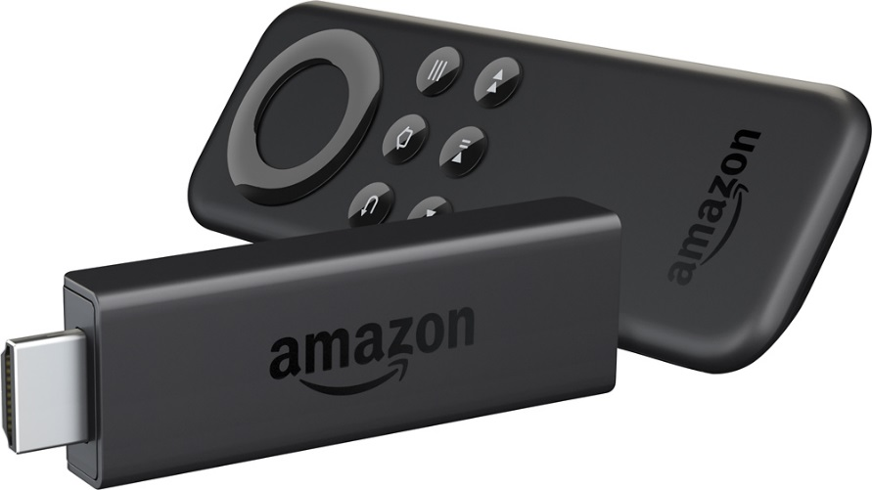
Devices
Fire stick $40 (HD ready)
Fire TV $90 (4K ready)

Slide 10
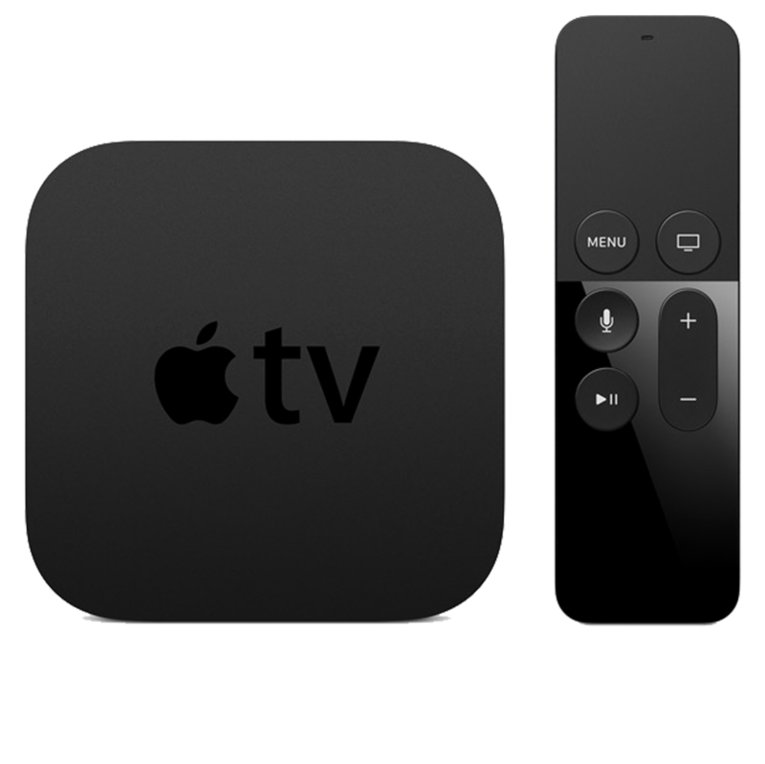
Devices
Apple TV 32 gigs $150 (HD ready)
Apple TV 64 gig $200 (HD ready)
Rumors claim the next 4th generation apple TV will be 4K ready

Slide 11



Devices
Video game console of your choice
$150-400 (HD)
PlayStation Pro or Xbox Scorpio

Slide 12
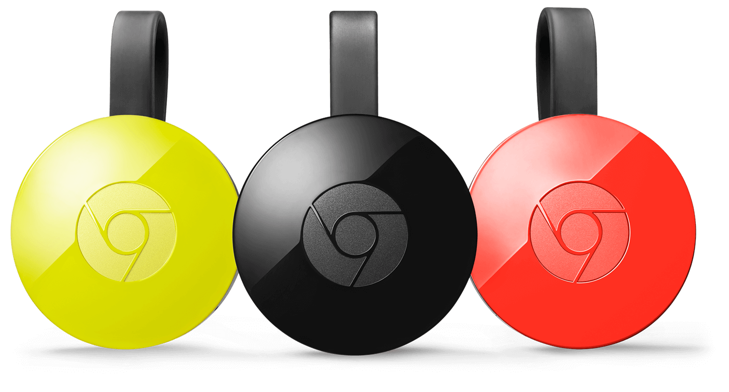
Devices
Chromecast $35 (HD ready)
Chromecast ultra $70 (4K and HDR ready)

Slide 13
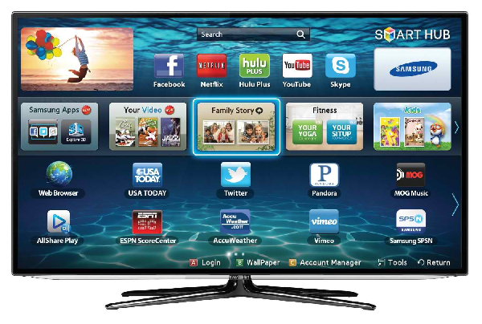
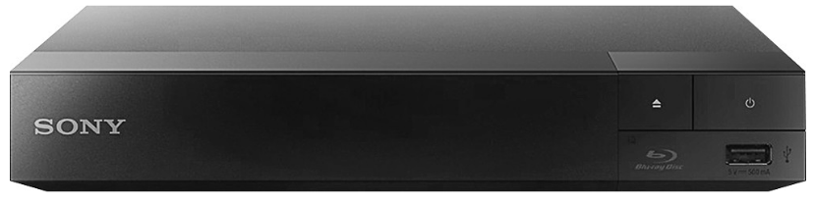
Devices
Smart TV $250+or Smart Blu-ray player $60+
Make sure the device supports the apps you want
Convenient all in one setups

Slide 14

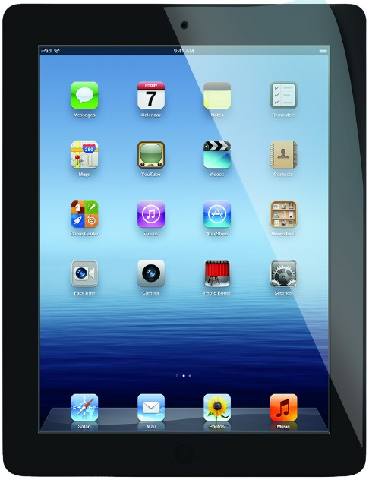

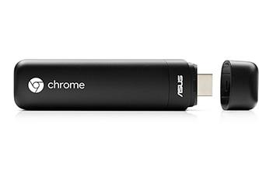
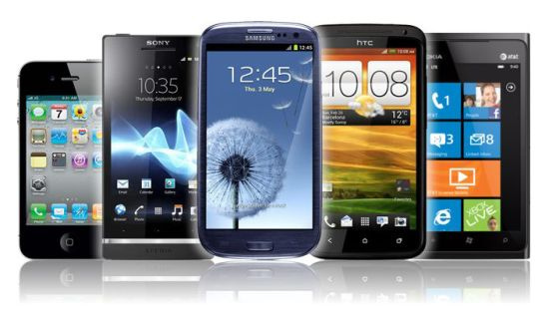
Devices
You can stream on most modern devices
    Tablets
    Smart Phones
    Laptops
    Chrome books

Slide 15
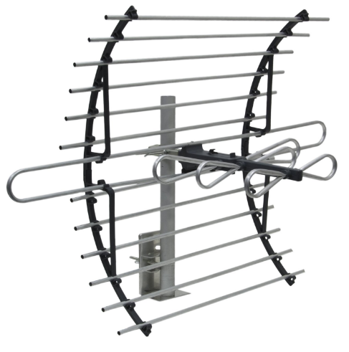
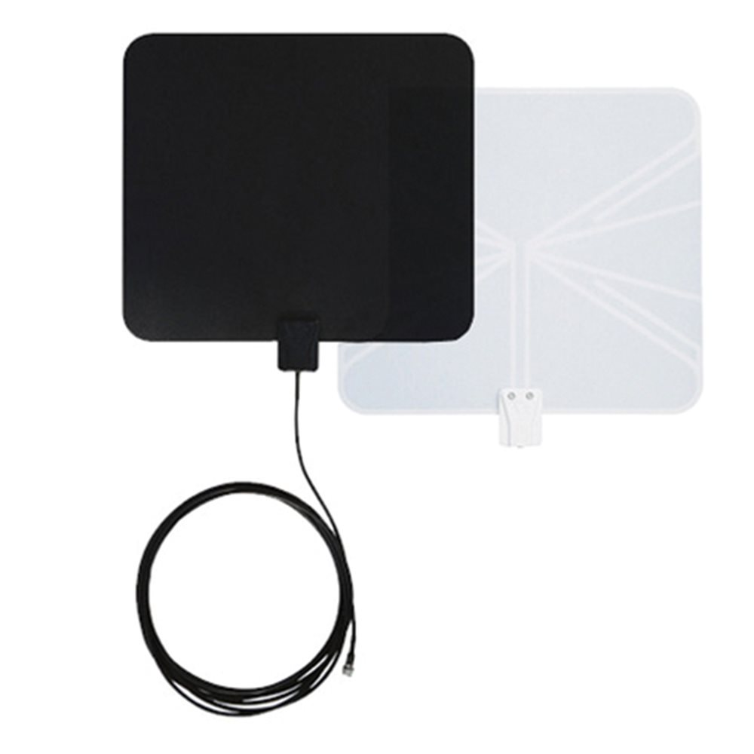
Devices
HD antenna $12-150
The amount of channels vary by location and antenna range. Channels to expect 20-50.

Slide 16
Searching through ads
Streaming Services

Slide 17

Streaming Services
Price plans are $7.99-$11.99 per month
One month free trial
Watch TV shows, movies and Exclusives
Download content to view offline via app
HD and 4K content depending on subscription

Slide 18

Streaming Services
$7.99 a month or $11.99 a month for no commercials
One week free trial
TV shows, movies and exclusives
HD content

Slide 19

Streaming Services
Amazon Prime $99 per year or $10.99 a month
Watch movie and TV for free with Amazon Prime
Other perks of Amazon Prime
HD content

Slide 20

Streaming Services
Free one month Trial
$14.99 per month
HD content

Slide 21
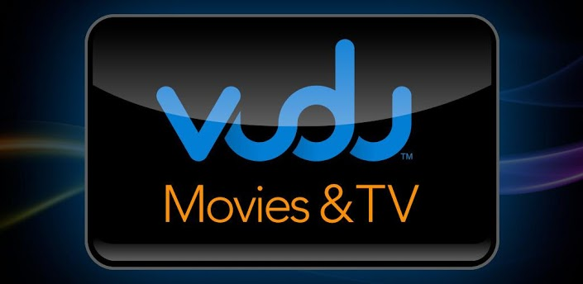



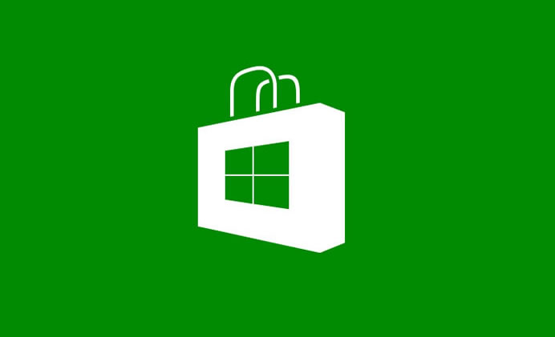
Streaming Services
Pay per item Movies and TV
Rent or Purchase your content
Cost varies from $1.99 and up
HD and 4K when available

Slide 22

Streaming Services
Free to stream but limited in content and includes commercials
Has Movies and TV
No HD content

Slide 23
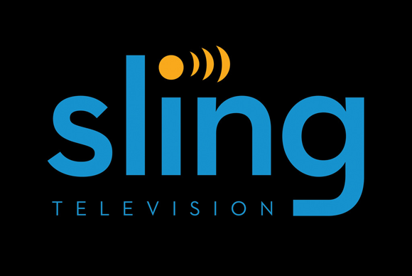
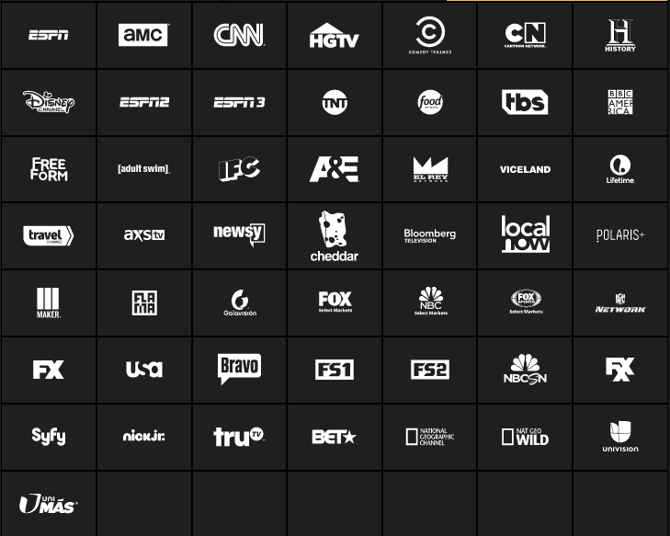
Streaming Services
Packages ranging from $20-40
7 day free trial
HD content

Slide 24

Streaming Services
Packages ranging from $40-75
7 day free trial
HD content
Allows you record content to the cloud for 28 days

Slide 25
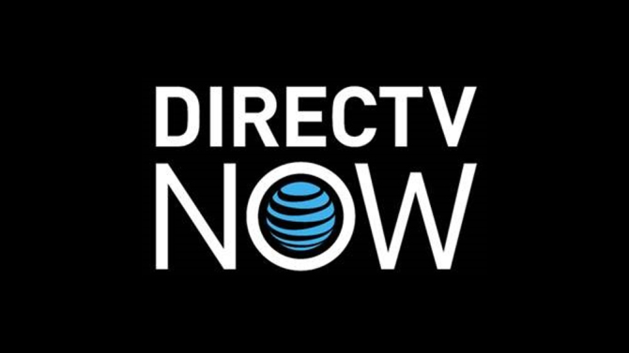
Streaming Services
Price varies from $35-70
60-120+ depending on package.
HD content

Slide 26
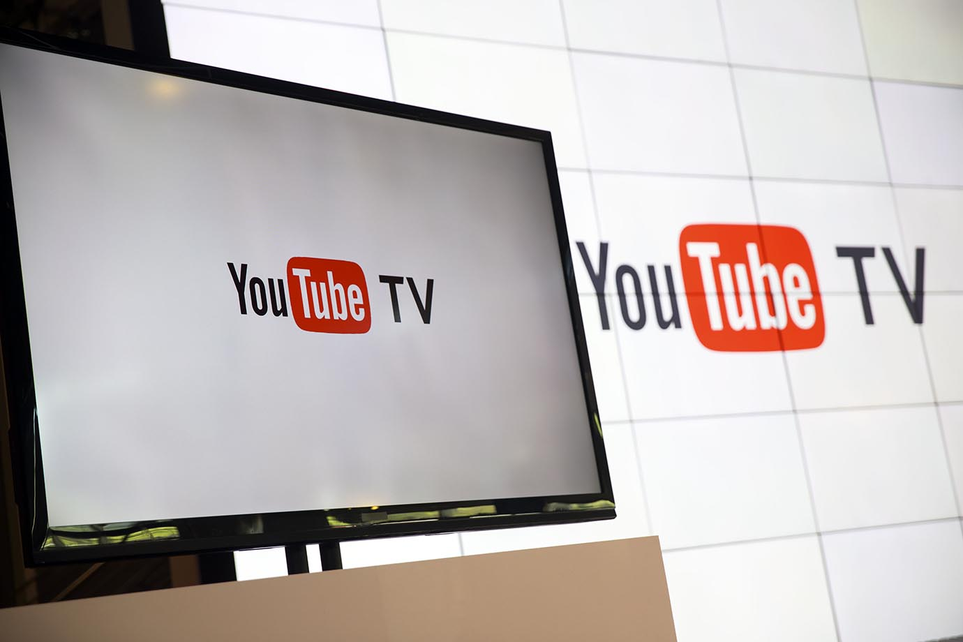
Streaming Services
$35 a month
40 TV channels including ABC, CBS, Fox, ESPN, etc.
HD content
Allows you record content to the cloud for 9 months

Slide 27






Streaming Services
Most major networks have apps now that will allow you to view their content. Price, content and device compatibility will vary.

Slide 28

Streaming Services
Free, library provided service
Limit of 5 items per month
Movies/TV: 3 day loans
Music: 7 day loans
Audiobooks, eBooks, and Comics: 21 day loans

Slide 29
Searching through ads
Selecting Internet Service

Slide 30
Selecting Internet Service
Major Providers in Elgin
    Comcast (Average)
    AT&T (most expensive)
    WOW (cheapest)

Slide 31
Selecting Internet Service
Average price per speed below. Varies by provider and promotions.
    5-10 mbps = $20-30 per month
    25-30 mbps = $40-50 per month
    75-100 mbps = $55-80 per month
HD streaming needs 5-7mbps per device
4K streaming needs 25-30 mbps per device

Slide 32
Selecting Internet Service
Strategies for Cutting the Cost
When streaming on a mobile device, use Wi-Fi unless you have unlimited data.
When your contract ends…
    Switch companies to receive promotional pricing
    Have someone else in your household make a new contract.
    Call your provider
Notes:
You can demand a better price and/or faster internet speeds if another provider is offering a better deal for the same service.

Slide 33
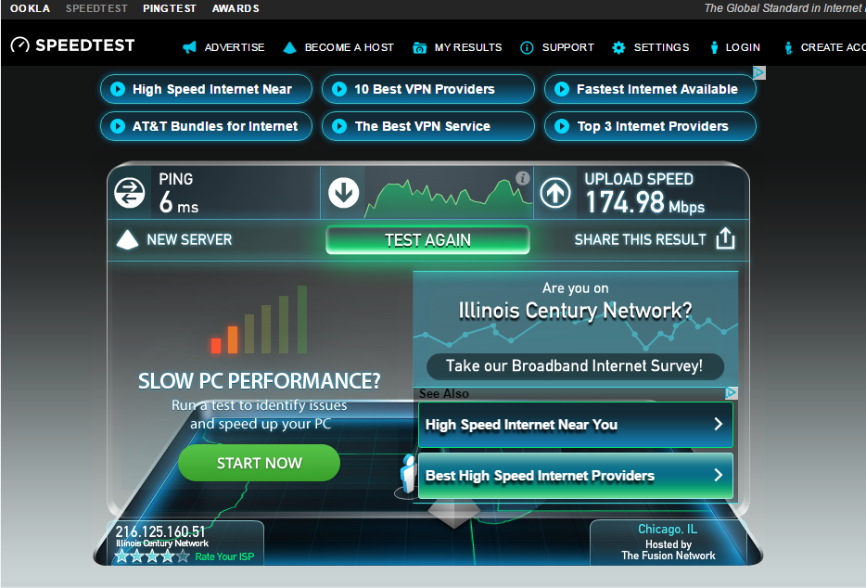
Selecting Internet Service
Do I need faster internet to stream?
Use Ookla speed test (www.speedtest.net)

Slide 34
Searching through ads
Scenarios

Slide 35
Scenarios
Example One
(Sports lover and basic TV 1080p HD)
HD antenna $50
Roku $40
Sling TV Orange package $20 a month
Initial investment $90
$20 month for every year after that

Slide 36
Scenarios
Example Two
(Movie Lover with a 4K HD TV)
Fire TV $90
Amazon Prime Video $99 a year
Netflix premium $12 a month
HBO now $15 a month
Initial investment $90
$35.25 a month for every year after that

Slide 37
Scenarios
Example Three
(Smart phone user who watches
Movies and TV Occasionally 1080p)
Chromecast $35
Netflix basic $8 a month
Amazon Prime $99 a year
Initial investment $35
$16.25 a month for every year after that

Slide 38
Scenarios
Example Four
(Avid TV Watcher 1080p)
Roku Premiere $80
Direct TV NOW “Gotta Have it” with HBO and Cinemax package $80
Netflix standard $10 a month
Initial investment $80
$90 a month for every year after that

Slide 39
Searching through ads
Resources

Slide 40
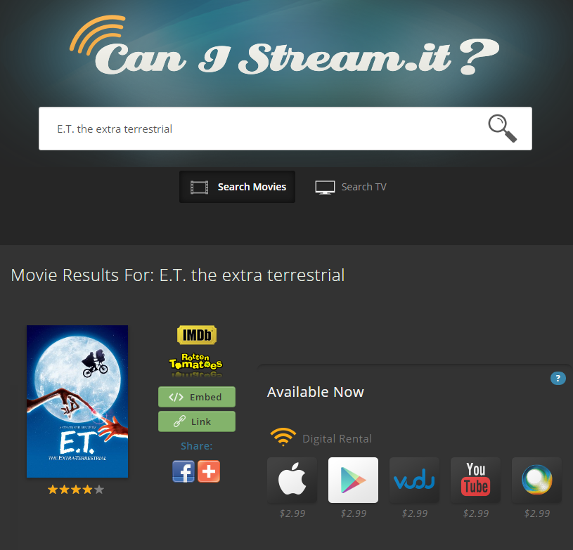
Resources
www.canistream.it

Slide 41
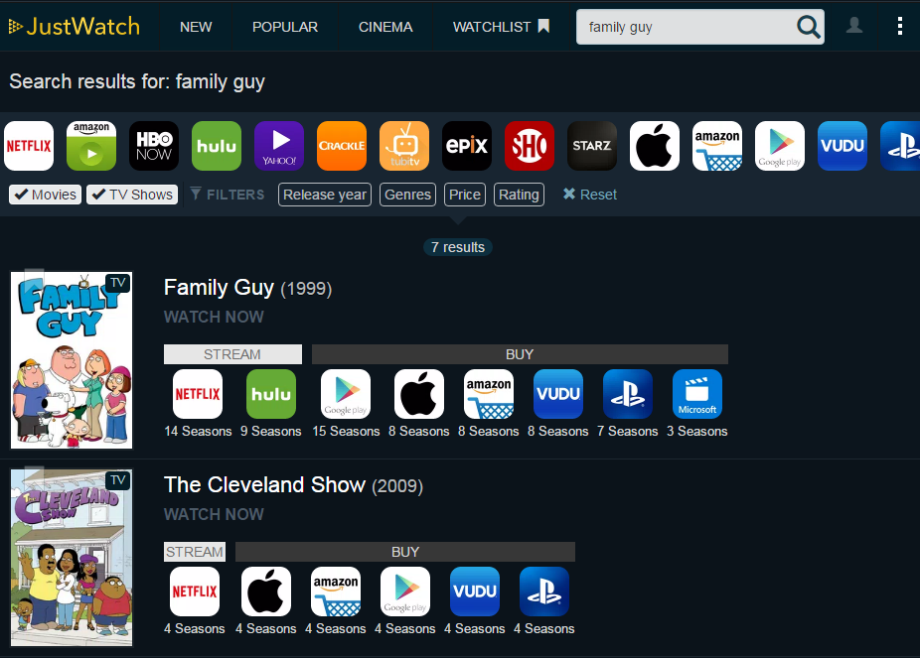
Resources
www.justwatch.com/us

Slide 42
Resources
The Pros and Cons of Cutting the Cable Cord 2016
  http://bit.ly/2hKGqcO
The Ultimate Cord Cutter’s Guide
  http://bit.ly/2cmyzjT
Your Guide to Cable TV Cord-Cutting
  http://bit.ly/1rRLhCe
Citizens Utility Board Guide to Cutting Cable
  http://bit.ly/2lOVapM

Slide 43
Questions?
THANK YOU FOR COMING!

