Slide 1

Customizing Your Resume
Part 2
Instructor Name
Instructor Title
Library Name
Courtesy of Gail Borden Public Library
and the Public Library Association

Slide 2
Agenda
Skills
Work Experience
Education
Additional Sections

Slide 3
Skills

Slide 4
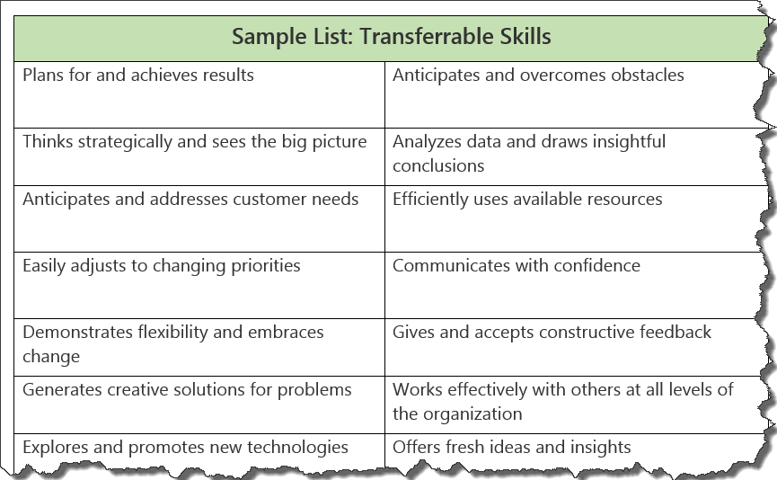
Review: Transferable Skills
Skills that can be applied to any type of position.

Slide 5
Examples: Transferable Skills
Leadership
Three years of management experience leading a company of eight while serving in the United States Marine Corp.
Technological Proficiencies
Five years of experience providing one-on-one and group training on Microsoft Office products in the corporate sector.

Slide 6
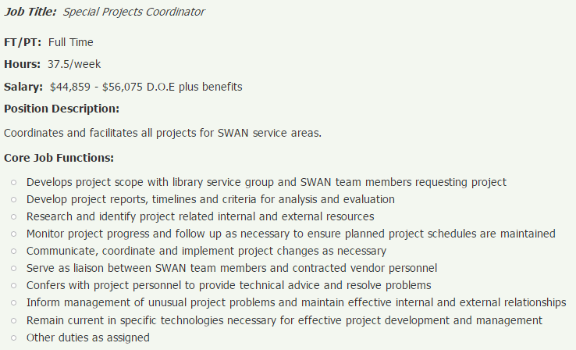
Pulling Skills from a Posting
Planned, coordinated, and managed enterprise-wide projects teams including vendors, customers, and staff

Slide 7
Activity #1

Slide 8
Work Experience

Slide 9
Tips & Tricks
Include the last 1-3 jobs you’ve had
Limit your resume to the last 10 years of experience
List your most recent job first and work backward
Include the following pieces of information about each position:
    Name and location of employer (City & State)
    Employment dates (YYYY)
    Job title when you left the organization
    Roles and responsibilities
    Key accomplishments

Slide 10
Roles & Responsibilities
Write a brief 1-4 sentence summary of your key roles and responsibilities at each job
OR
List the key roles and responsibilities at each job in bullet point format
  NOTE: Do not include everything you did, only the roles and responsibilities that highlight job fit and transferable skills

Slide 11
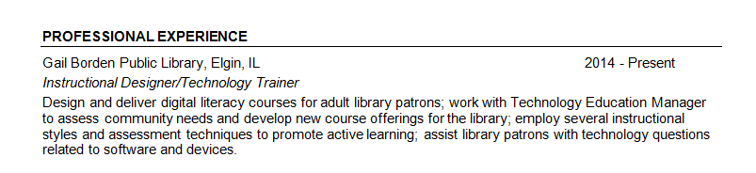
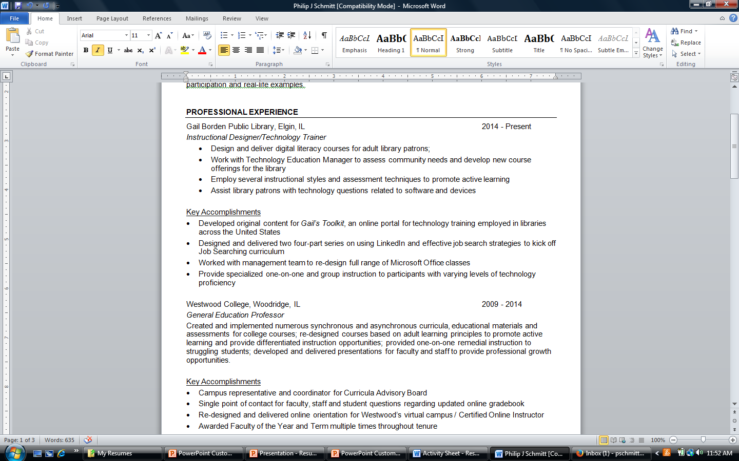
Sample

Slide 12
Things to Think About
Communication
Organization
Creativity
Teamwork
Management
Leadership
Planning/strategy
Collaboration

Slide 13
Accomplishments
What did you achieve at a job that brought you a sense of pride?
What would you like to be remembered for doing well at a job?
What process/task/situation did you improve as a result of your idea or effort?
What special project/committee/task were you selected for based on your performance?

Slide 14
Things to Review
Promotions
Merit increases
Commendations from managers, clients, or customers
Budgets
Performance reviews/evaluations
Awards
Letters of recommendation

Slide 15
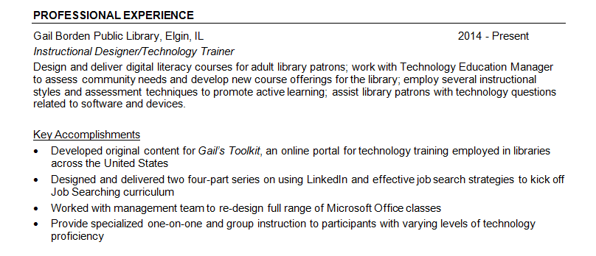
Example

Slide 16
Activity #2

Slide 17
Education

Slide 18
Categories
Higher Education (may include graduate and post-graduate work)
Professional certifications, training and/or licenses
High School

Slide 19
Specifics
Name of the institution
Location (Town & State)
Degree/certification earned
Year of degree/certification

Slide 20
Examples
Northwestern University, Evanston, IL 2005
Project Management Certification
Northern Illinois University, DeKalb, IL 1989
Bachelor’s Degree - Business Management
Elgin Community College, Elgin, IL 1987
Associate’s Degree - Business Management

Slide 21
Optional information
Grade Point Average (GPA): 3.72 / 4.0 GPA
Graduating with Honors:
Cum Laude – 3.5 to 3.7 GPA
Magna Cum Laude – 3.8 to 3.9 GPA
Summa Cum Laude – 4.0+ GPA
Example
Northern Illinois University, DeKalb, IL 1989
Bachelor’s Degree- Business Management
Magna Cum Laude, 3.85 GPA

Slide 22
Activity #3

Slide 23
Additional Sections
Volunteer Work
Military Service
Internship / Externship
Presentations
Professional Development

Slide 24
Activity #4

Slide 25
QUESTIONS?
THANK YOU FOR ATTENDING!
Next in the series:
Resume Open Lab

