Slide 1

Customizing Your Resume
Part 1
Instructor Name
Instructor Title
Library Name
Courtesy of Gail Borden Public Library
and the Public Library Association

Slide 2
Agenda
Resume Types
Format & Language
Heading
Objective vs. Profile
Skills

Slide 3
Resume Types

Slide 4
Review: Resume Types
FUNCTIONAL
Stresses transferrable skills
Minimizes gaps in employment history
Good for those who:
  Are returning to the workforce
  Have limited employment history
  Have worked in a variety of industries
CHRONOLOGICAL
Stresses continuous employment in a specific field
Highlights promotions & key accomplishments
Good for those who:
  Have consistent and robust employment history
  Have worked primarily in one or two fields

Slide 5
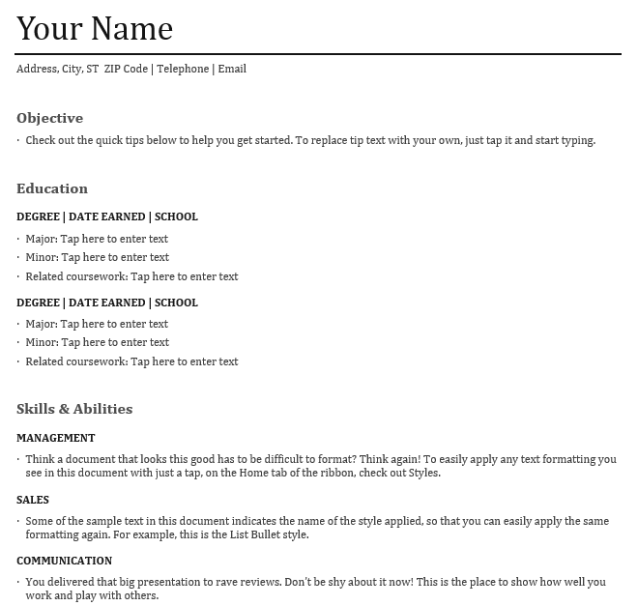
FUNCTIONAL

Slide 6
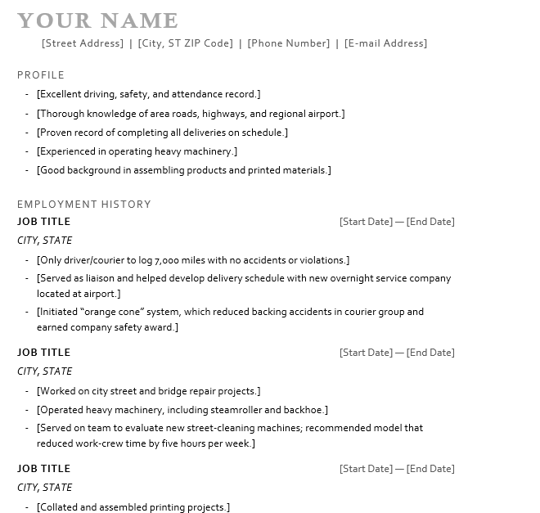
CHRONOLOGICAL

Slide 7
Activity #1

Slide 8
Format & Language

Slide 9
Review: Format & Language
Readability
  Visually appealing, looks professional, properly ordered sections
Fonts
  Size, style, and color are appropriate and professional
Grammar & Spelling
  Proper punctuation and spelling, parallel structure, error free, minimal abbreviations and/or jargon
Descriptions
  Specific, concise, use strong action-oriented words
    ex. “Hired, trained and managed production team”

Slide 10
Review: Format & Language
Voice
  3rd person objective
    ex. “Managed production team”
Length
  1-2 pages
Margins & spacing
  Right amount of content, plenty of white space
Format
  Nice paper (print), MS Word, PDF
Get them interested so they will bring you in to learn more!

Slide 11
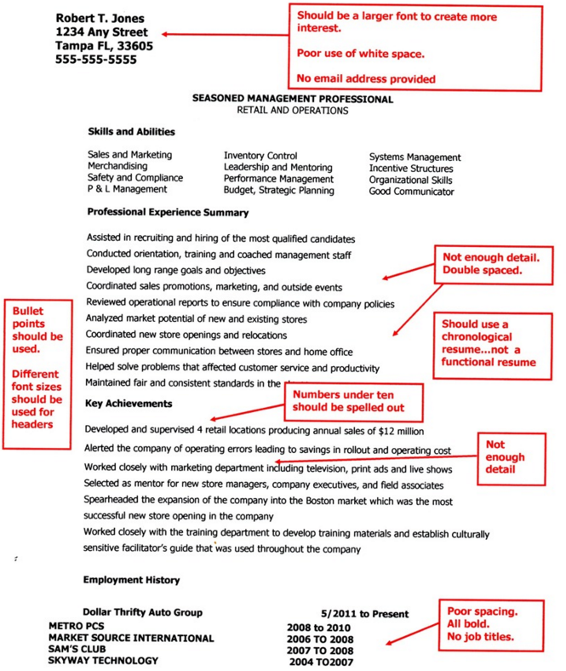
Bad Example

Slide 12
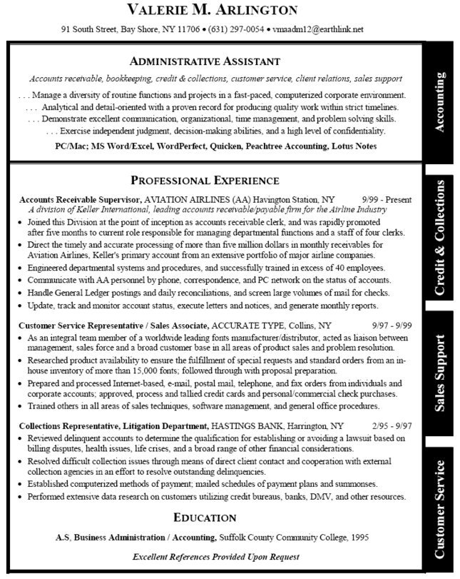
Good Example

Slide 13
Activity #2

Slide 14
Heading

Slide 15
Heading Review
Headings include the following pieces of information:
  Name
  Phone Number
  Email address
They also may include the following:
  Address
  URL for LinkedIn profile, website, or portfolio

Slide 16
Examples
John R. Doe
555-555-5555 | jdoe@gmail.com | www.linkedin.com/in/johndoe
John R. Doe
1400 Spring St., Elgin, IL 60120
(847) 555-1000
johndoe@gmail.com

Slide 17
Tips & Tricks
Use your given name as it appears on your driver’s license, state ID, or social security card
List the number you answer most often (preferably a cell) in the phone number section
Be sure your email address is both professional AND uses a modern service provider, such as Gmail, Outlook, or Yahoo
Ex. John.Doe@outlook.com

Slide 18
Activity #3

Slide 19
Objective vs. Profile

Slide 20
Review: Objective vs. Profile
OBJECTIVE
A brief statement that defines the type of employment you seek and your career goals
What I Want From You
PROFILE
A 2-3 sentence statement that grabs the reader’s attention and highlights the skills and abilities you have to offer potential employers as related to the job for which you’re applying
What I Can Offer You

Slide 21
Examples
OBJECTIVE
To obtain a production manager position with supervisory responsibilities at Aramark Industries
PROFILE
A tactical, innovative, hands-on educator with on-ground and online
teaching experience in a collegiate, public, and non-profit
environment. Expertise working with students from kindergarten to
college, particularly those with educational and environmental
challenges. Skilled in numerous teaching and assessment strategies
that create an interactive learning environment and engage students
through active participation and real-life examples.

Slide 22
Activity #4

Slide 23
Skills

Slide 24
Review: Components
Identify the skills listed in the job posting(s) and/or desired within your career field and include the ones you possess in your resume
Depending on your resume style, you can include them in one or more of the following sections:
  Skills (Functional)
  Profile (Chronological)
  Work Experience (Chronological)
Key skills to highlight include:
  Communiciation
  Teamwork
  Leadership
  Technical Proficiency

Slide 25

Example
Work Experience
Marketing Assistant, Nabisco Foods 1999-2013
Worked daily with Marketing Managers to analyze sales numbers, chart customer purchasing trends, and develop new product strategies to increase customer demand for new and existing products.

Slide 26
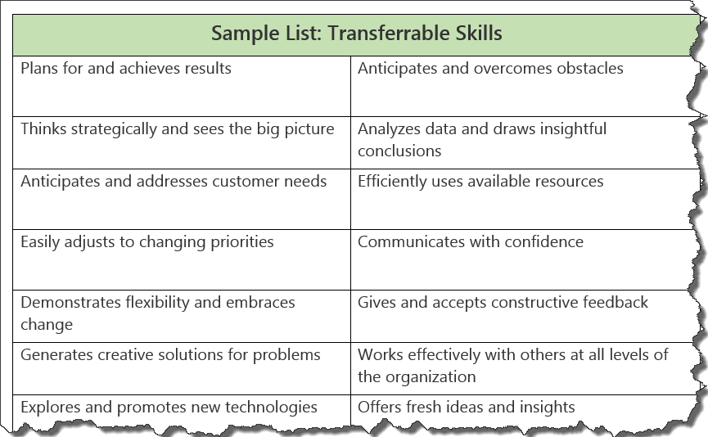
Transferable Skills
Skills that can be applied to any type of position.

Slide 27
Activity #5

Slide 28
QUESTIONS?
THANK YOU FOR ATTENDING!
Next in the series:
Customizing Your Resume Part 2

