Slide 1

Craigslist Basics
Phillip Schneider
Information Services Librarian
Gail Borden Public Library
Courtesy of Gail Borden Public Library
and the Public Library Association

Slide 2
Agenda
Getting Started
Searching Through ads
Making a Deal
Avoiding Scams
Creating an Account
Creating a Classified ad
Craigslist Policies and Resources

Slide 3
Getting Started

Slide 4
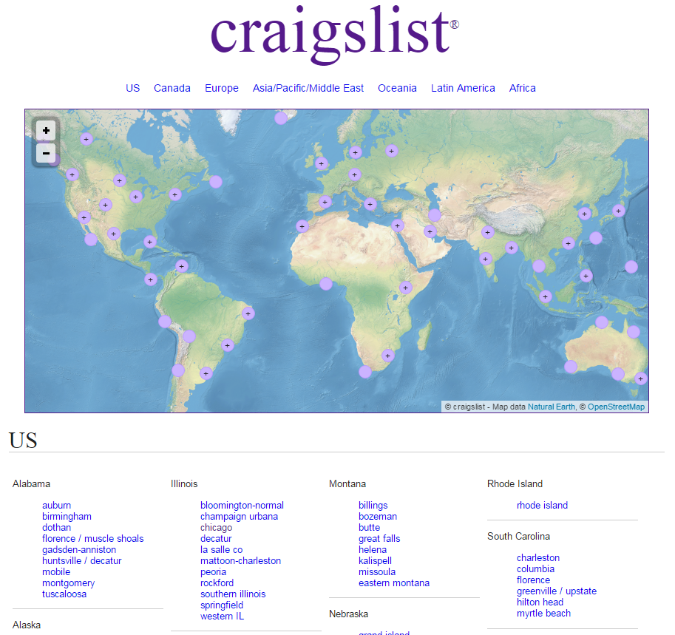
Getting Started

Slide 5
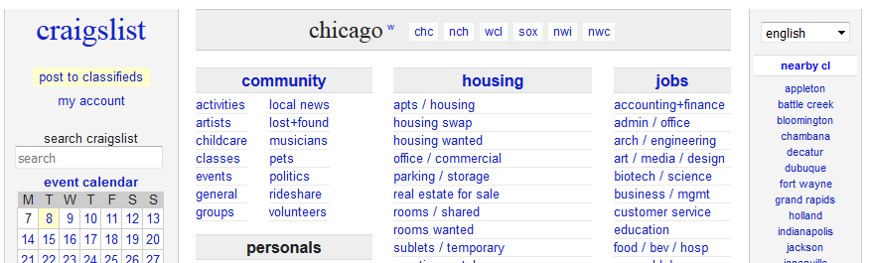
Getting Started
Narrow down your search to a specific area at the top of the window
  nch = North Chicagoland, wcl = West Chicagoland, etc.
  For Elgin area choose nwc = Northwest Suburbs.

Slide 6
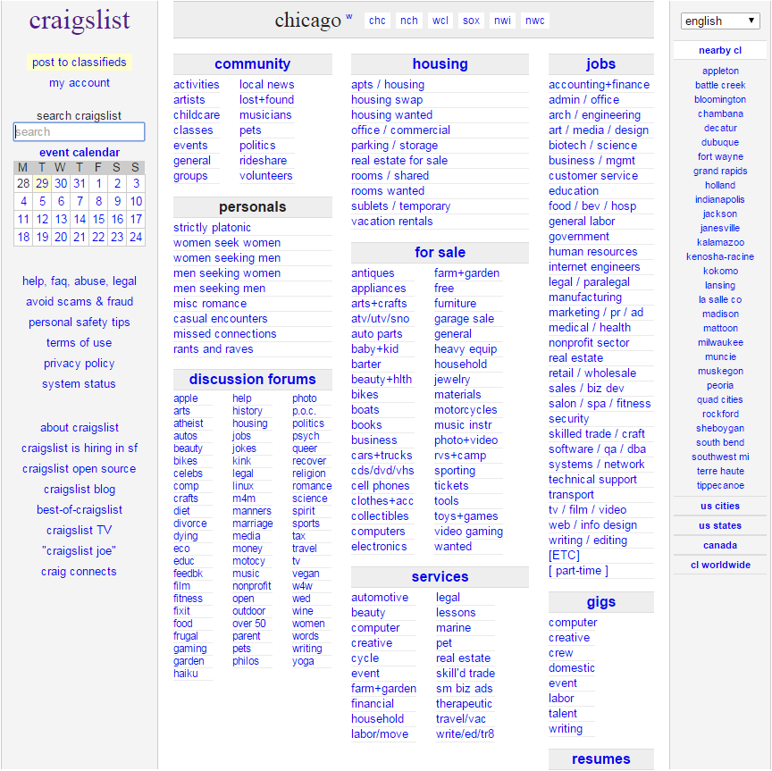
Getting Started

Slide 7
Searching through ads
Searching Through Ads

Slide 8
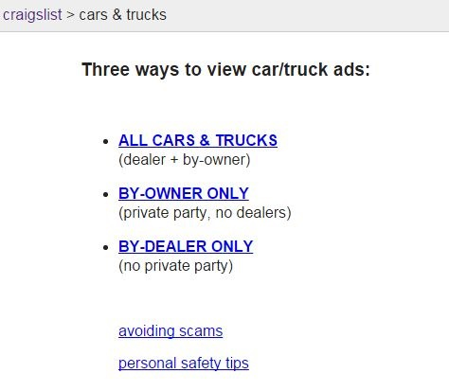
Searching Through Ads
Some categories give you the option to filter your search by seller.

Slide 9
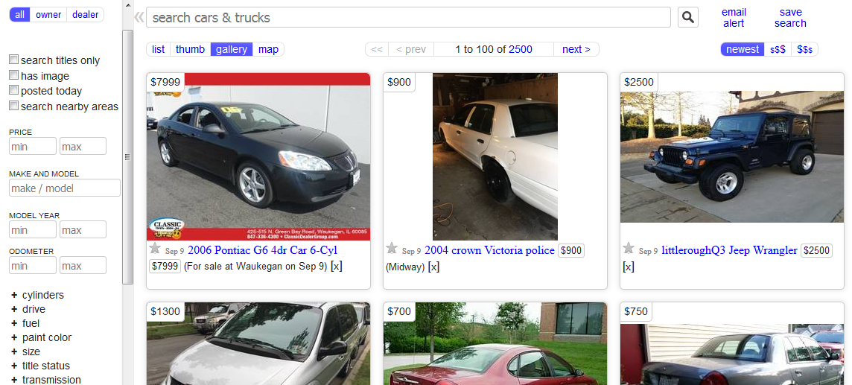
Searching Through Ads

Slide 10
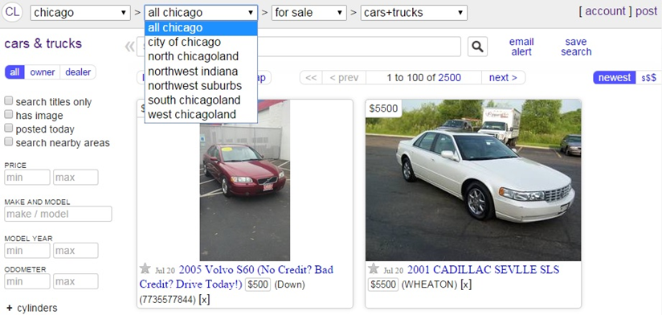
Searching Through Ads

Slide 11
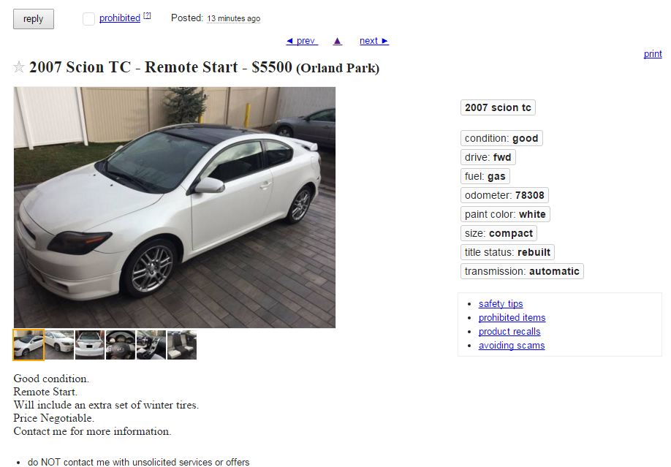
Searching Through Ads

Slide 12
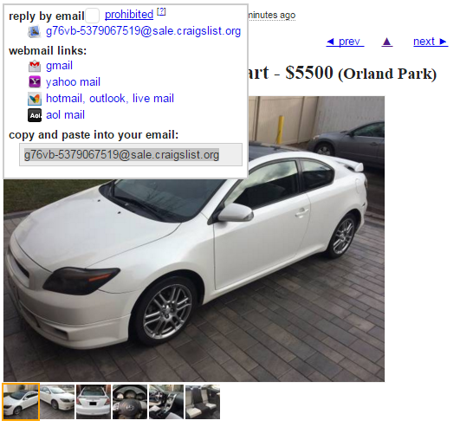
Searching Through Ads

Slide 13
Making a Deal
Making a Deal

Slide 14
Making a deal
Read the ad carefully and follow the sellers request for best contact method
Unless a seller states that their price is as listed, you could attempt to offer 10-20% less
Be courteous. If you think you may insult a seller move on to another ad.
If an item is priced below market value, contact the person quickly as that item will likely sell fast

Slide 15
Making a deal
Make offers on many ads to increase your chance of getting a good deal.
It is best to pay with cash or offer a trade. Checks are an option but they may be fraudulent.
Agree on a price before setting up a meeting.
Meet at a safe, public area. Many local police stations will allow you to meet in a lobby area. Bring a friend if possible.
Unlike eBay, Craigslist offers no buyer or seller protection

Slide 16
Making a deal
Test the item to make sure it works before paying the seller. For electronic devices, meet at a spot with outlets (Ex: coffee shops or fast food restaurants.)
It is best to pay with cash or offer a trade. Checks are an option but they may be fraudulent.
Agree on a price before setting up a meeting
Meet at a safe, public area. Many local police stations will allow you to meet in a lobby area. Bring a friend if possible.
Unlike eBay, Craigslist offers no buyer or seller protection

Slide 17
Making a deal
Test the item to make sure it works before paying the seller. For electronic devices, meet at a spot with outlets (Ex: coffee shops or fast food restaurants).
Use your intuition. If something feels off, do not feel obligated to purchase the item. With a verbal agreement, you can walk away at any time.
When making a large purchase (ex: car), write a contract with the seller and take home a copy as your receipt.

Slide 18
Avoiding Scams
Avoiding Scams

Slide 19
Avoiding scams
Avoid transactions where the seller insists on you sending money over MoneyGram, mailing a check, or using Paypal.
If a seller makes any threats, immediately end contact and block their number if necessary.
Overseas scammers often use phone numbers with US area codes, so gather as much info about the seller as you can prior to meeting.
Notes:
Speaker note: This link covers the items that are unable to be listed on Ebay. As a rule of thumb, if you are unsure if your item will be allowed, make sure to review the official eBay website. http://pages.ebay.com/help/policies/items-ov.html

Slide 20
Avoiding scams
Complete transactions in person. If the buyer/seller will not exchange in person, be wary.
For large purchases you may want to invest in a marker that can check if large bills are real. A couple dollar investment is worth it to help you feel safe when receiving hundreds or thousands of dollars in large bills.
Notes:
Speaker note: This link covers the items that are unable to be listed on Ebay. As a rule of thumb, if you are unsure if your item will be allowed, make sure to review the official eBay website. http://pages.ebay.com/help/policies/items-ov.html

Slide 21
Creating an Account
Creating an Account

Slide 22
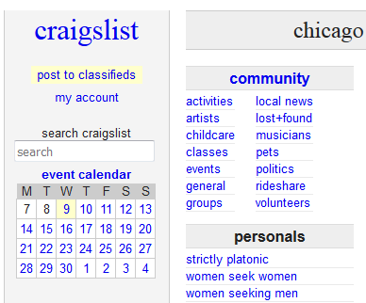
Creating an Account
Click on My Account from the main ads homepage
Notes:
Explain to the class that you can use Craigslist without an account unless you are posting ads that cost money.

Slide 23
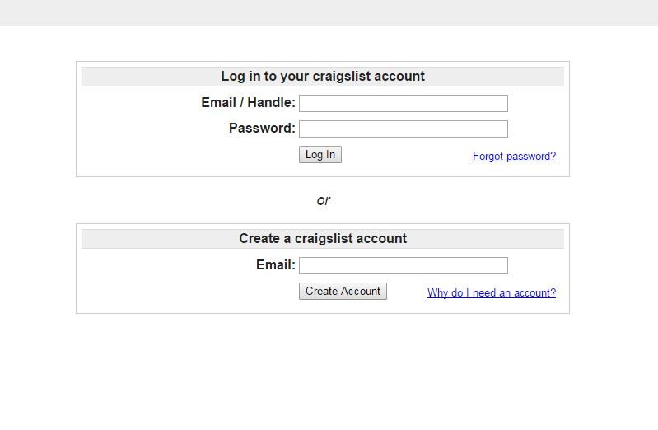
Creating an Account

Slide 24
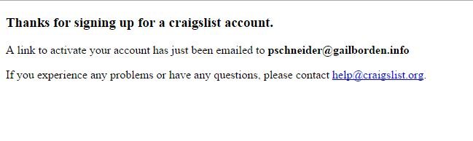
Creating an Account
A confirmation email will be sent to the address you supplied
Log into your email to verify your account

Slide 25
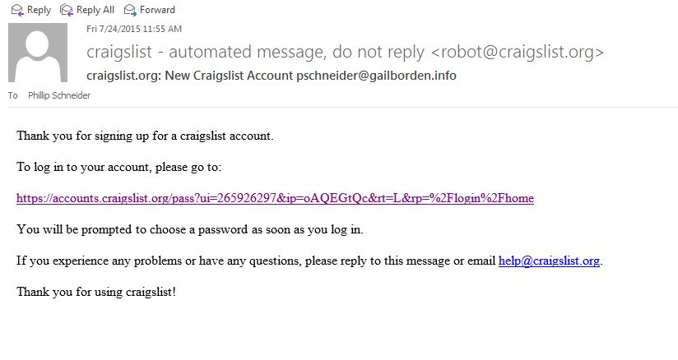
Creating an Account
Click on the link in the email to continue creating your account

Slide 26
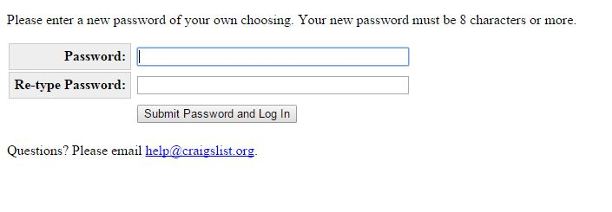
Creating an Account
Create a password (8 character minimum) for your account
When creating passwords, add in a number, special character, and capital letter to make it complex

Slide 27
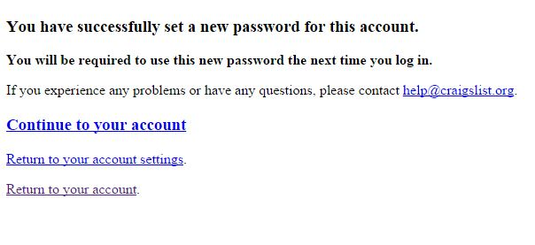
Creating an Account
Once you create a password, you’re set!
Review your account and become familiar with your settings then explore the ads

Slide 28
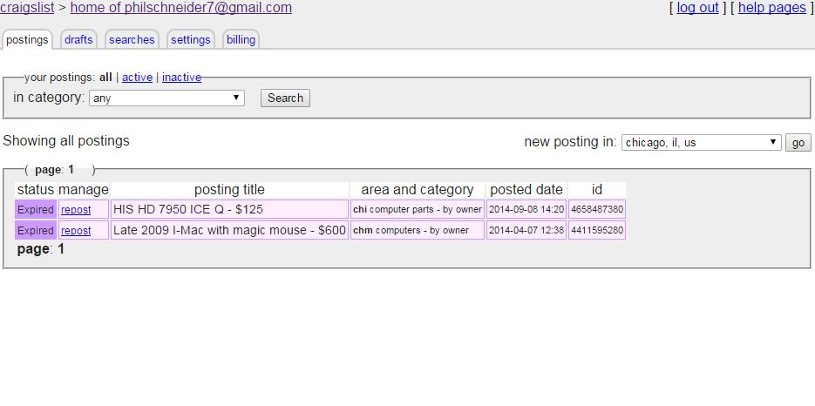
Creating an Account

Slide 29
Creating a Classified Ad
Creating a Classified Ad

Slide 30

Creating a Classified Ad

Slide 31
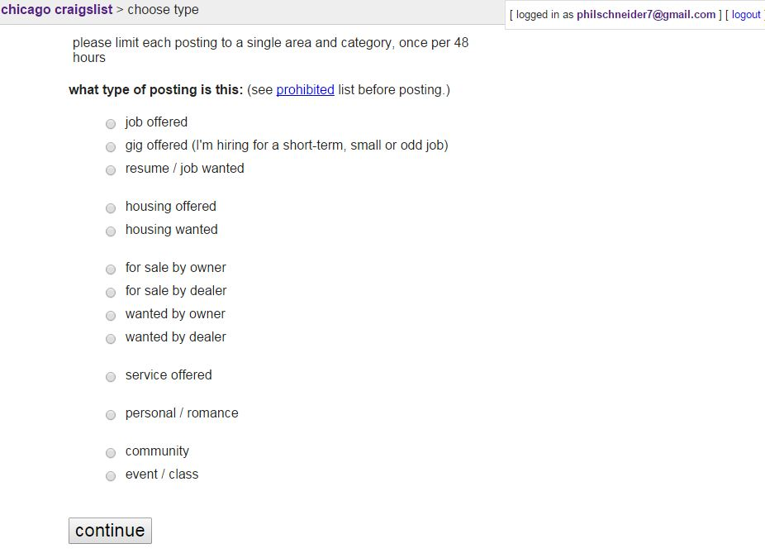
Creating a Classified Ad

Slide 32
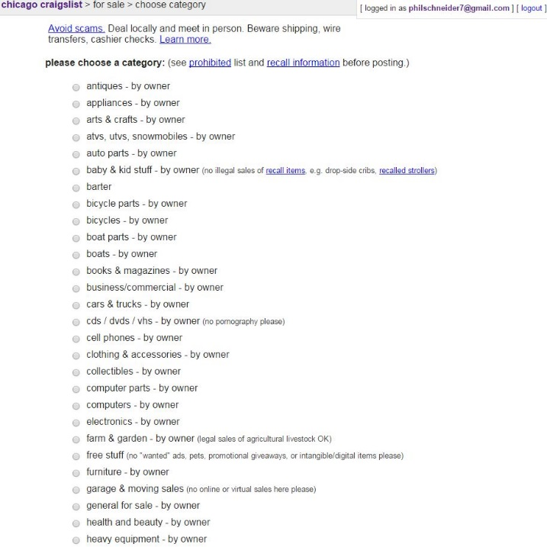
Creating a Classified Ad

Slide 33
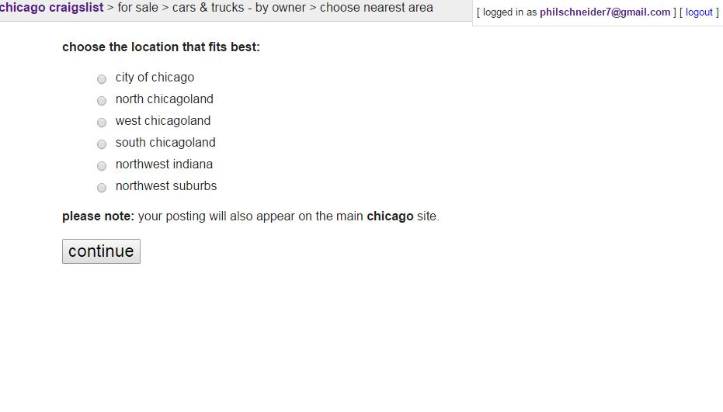
Creating a Classified Ad

Slide 34
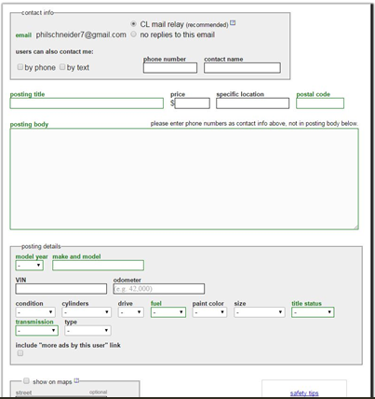
Creating a Classified Ad

Slide 35
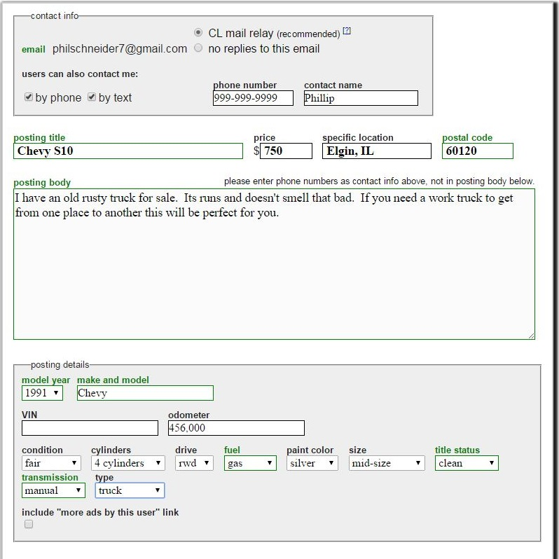
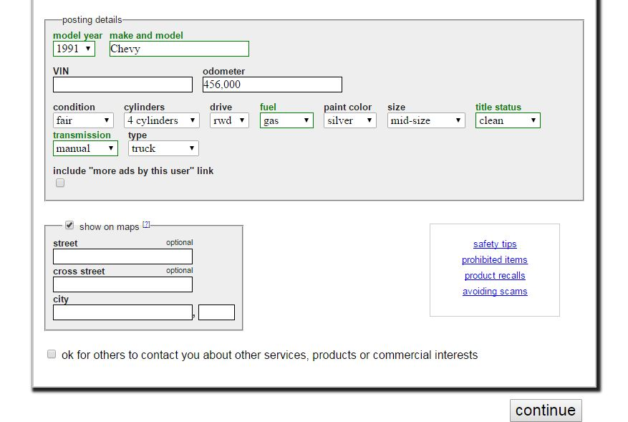
Creating a Classified Ad
Fill out the form as fully as possible then click Continue.

Slide 36
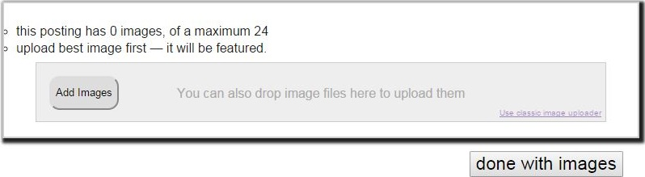
Creating a Classified Ad
Take pictures from all different angles
Put the item on a neutral background is possible
Use good lighting
Use the best camera available (phone/tablet cameras are usually fine)

Slide 37
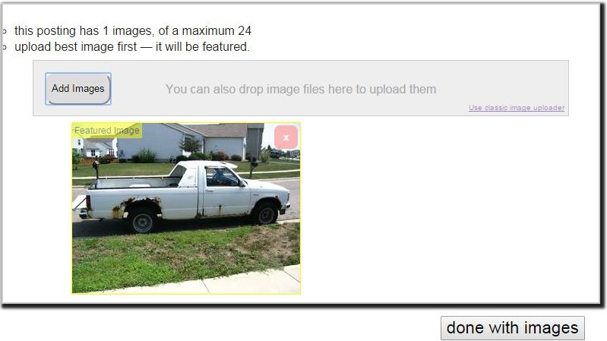
Creating a Classified Ad

Slide 38
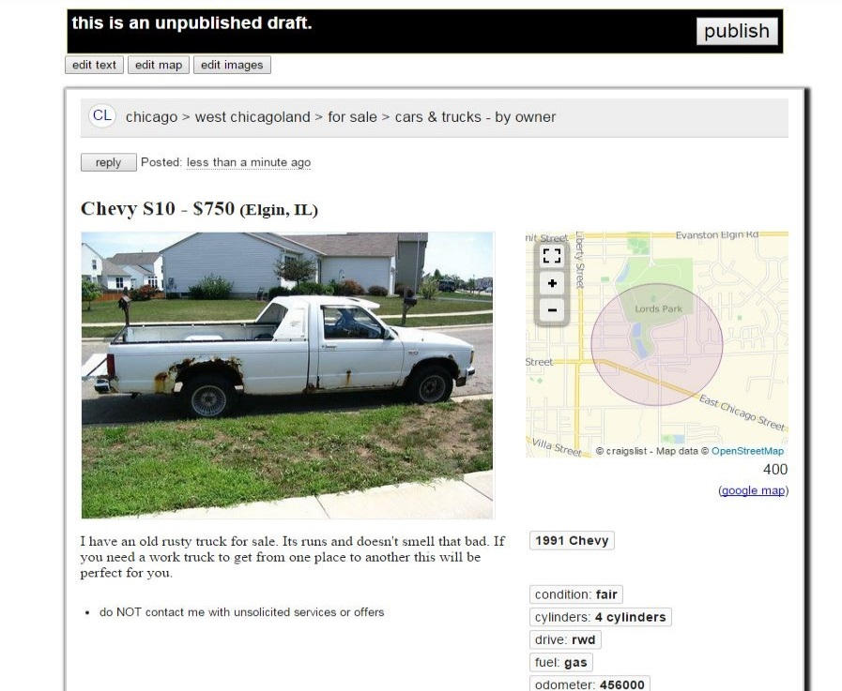
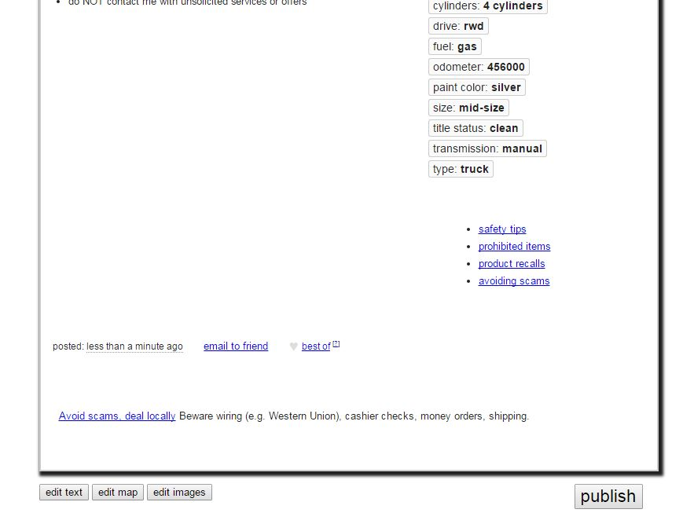
Creating a Classified Ad
View your ad for errors and make changes if needed.
When you are satisfied with your ad click publish.

Slide 39
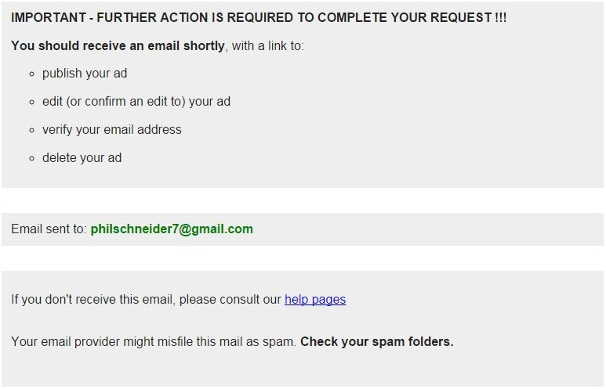
Creating a Classified Ad

Slide 40
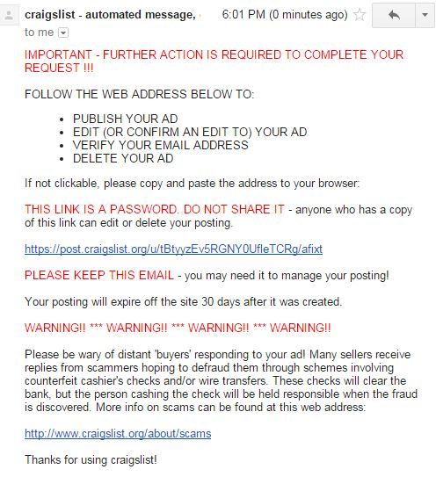
Creating a Classified Ad

Slide 41
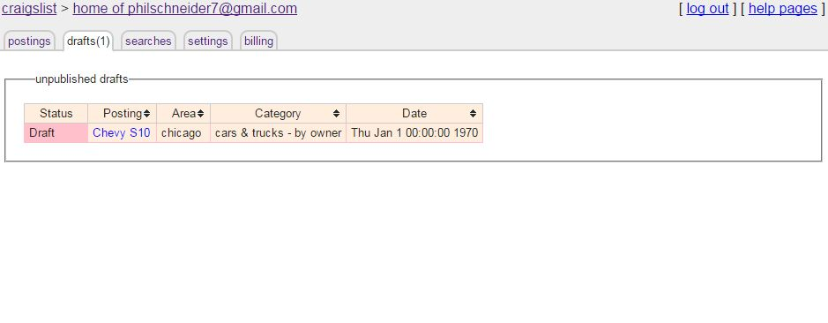
Creating a Classified Ad

Slide 42
Craigslist Policies and Resources
Craigslist Policies & Resources

Slide 43
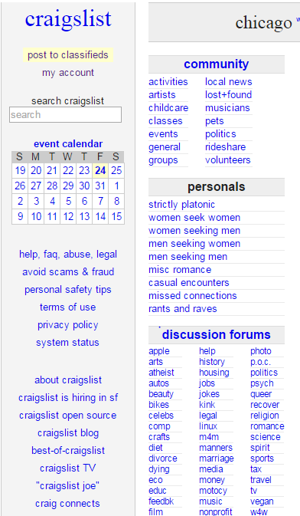
Craigslist Policies & Resources
You can not post ads for illegal items, services, and/or weapons.
Craigslist has the right to moderate and take down your ad if it is deemed inappropriate.
Craigslist does not give away, save, or sell your personal information.
Craigslist is not responsible for your safety, scams, or bad deals.
For more info visit the left sidebar on their website.

Slide 44
Questions?
Thank you!

