Slide 1

Computer Maintenance Basics
Phillip Schneider
Digital Services Librarian
Gail Borden Public Library District
Courtesy of Gail Borden Public Library
and the Public Library Association

Slide 2
Agenda
Computer longevity
Hardware Maintenance
Laptop Protection
Software
Viruses
Backup
Performance

Slide 3
Searching through ads
Computer Longevity

Slide 4
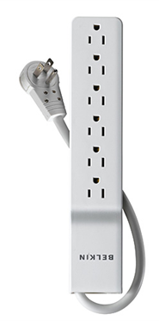
Computer Longevity
General Care
  Keep food or liquids away from your laptop/computer to prevent unnecessary damage.
  Plug into a surge protector
  When not in use turn off or sleep your computer.

Slide 5
Computer Longevity (Laptop)
Battery Care
  Don’t keep a laptop plugged in all the time
  Don’t expose to extreme temperatures
  Avoid charging before 10% or less battery life
  Avoid fully draining the battery.

Slide 6
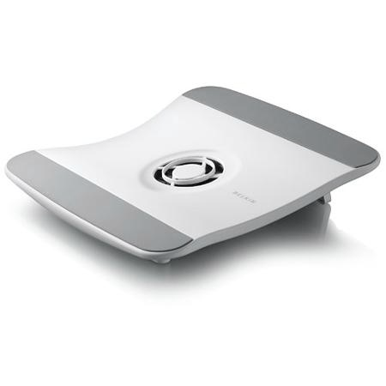
Computer Longevity (Laptop)
Temperature
  Operate your computer in a cool, dry and well ventilated area
  Cooling pads will extend the life of your laptop
  Do not place a laptop on…
      Bed
      Blanket
      Unstable furniture
      Near the edge of anything
      Anything that will block the fans

Slide 7
Computer Longevity (Desktop)
  Desktop placement
  Operate your computer in a well ventilated, cool and dry area
  Do not cover up fans with books, papers, etc.
  Do not place where it can easily fall or be hit
  Locations to avoid
  Under your desk
  Near a window
  Near a heat vent

Slide 8
Searching through ads
Hardware Maintenance

Slide 9
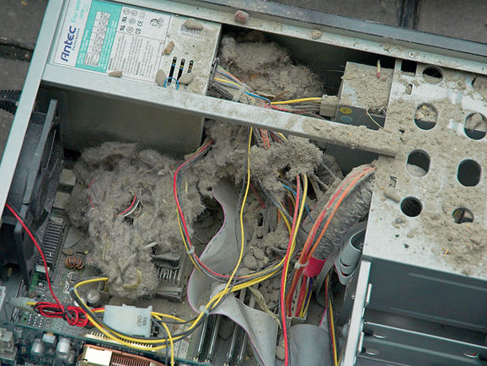
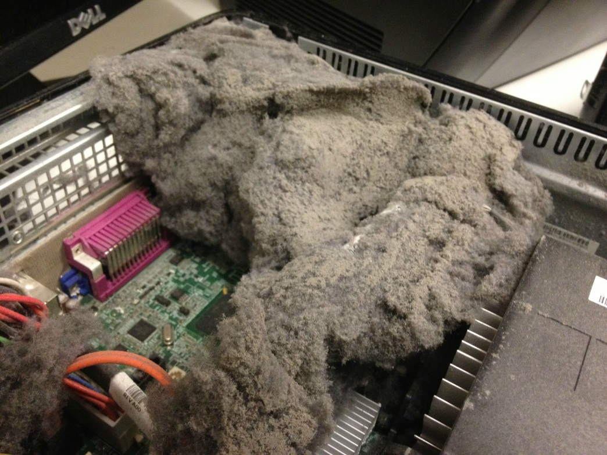
Hardware Maintenance
Don’t let your computer look like this!

Slide 10
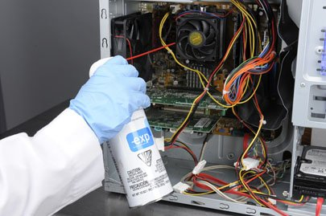
Hardware Maintenance
Warning! Before doing any cleaning or work turn off and unplug your computer.
Use an air compressor or compressed air canisters to remove dust.
    Remove the side panel and blow dust off components.

Slide 11
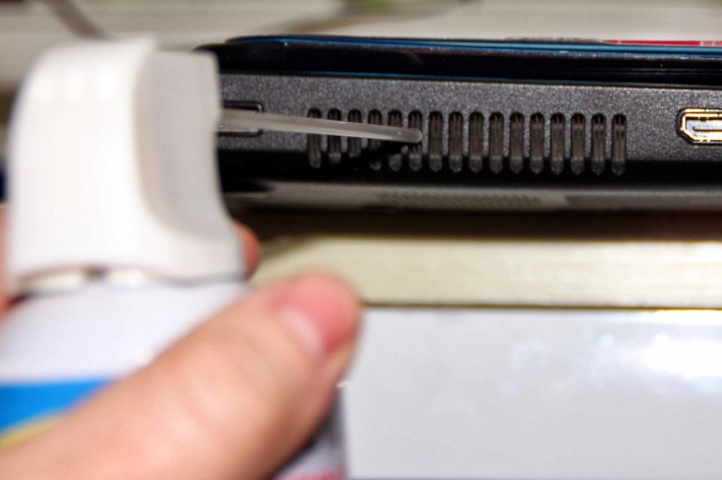
Hardware Maintenance
Warning! Before doing any cleaning or work on your laptop turn it off, unplug it, and remove the battery
Use an air compressor or compressed air canisters to remove dust.
    Blow into all exhaust
    ports and fans

Slide 12
Hardware Maintenance
Screen Cleaning
Clean your screen with a microfiber cloth and screen cleaning solution. Apply solution to your cloth and gently wipe.
Use electronics cleaning solution or make your own
    You can make your own solution with one part 70% isopropyl alcohol and one part water.

Slide 13
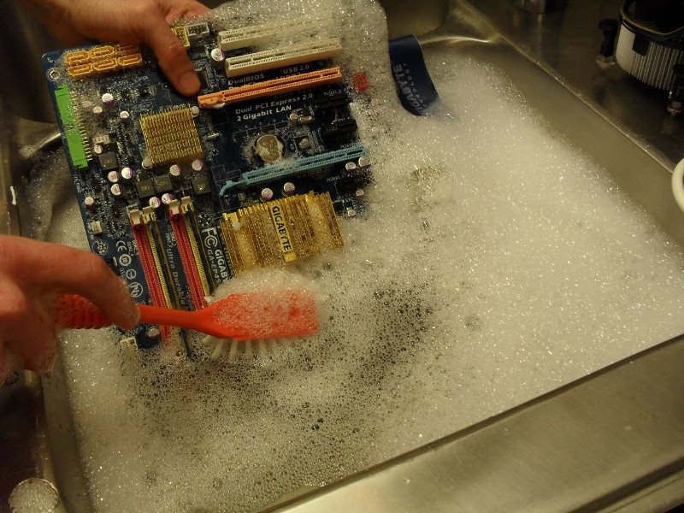
Hardware Maintenance
In extreme cases, components can be washed with soap and water, a gentle dish washer, or isopropyl alcohol 70% or greater.
Do not wash!
    Laptops
    Monitors
    Power supplies
    Hard drives
    Batteries
Let your components dry 100% before using them to avoid damage.

Slide 14
Searching through ads
Laptop Protection

Slide 15
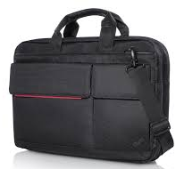
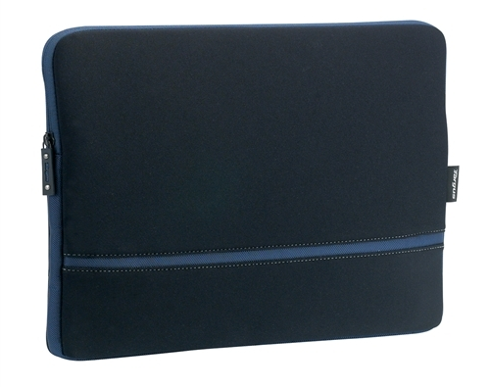
Laptop Protection
Traveling with a laptop
  Purchase a laptop bag or cover
  Properly pack the laptop safely before travel
  Keep the laptop secure while traveling
  Keep in the climate controlled cabin

Slide 16
Searching through ads
Software

Slide 17
Software
Windows XP and Vista are no longer supported with any security updates!
If possible purchase a new computer or upgrade to a newer version of Windows
If not possible only use the computer offline, or be very careful about safe internet usage

Slide 18




Internet Browsers
Best Internet browsers for security and speed
    Firefox, Chrome, Opera, or Edge
Updates
Set all of your updates to automatic to avoid forgetting to update them.
        Windows
        Web browsers
        Antivirus software
        Java

Slide 19
Searching through ads
Viruses

Slide 20
What is a Virus?
A Virus is a malicious set of code meant to harm you and/or your computer
Preventing viruses
Windows Defender
    Comes with free with Windows 8 and higher
Paid antiviruses
    Kaspersky
    BitDefender Plus
    Norton
    McAfee
Notes:
source: http://computer.howstuffworks.com/virus.htm

Slide 21
Searching through ads
Performance

Slide 22
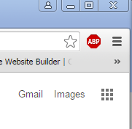
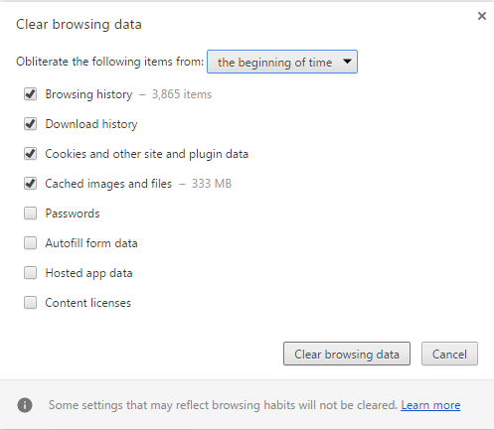
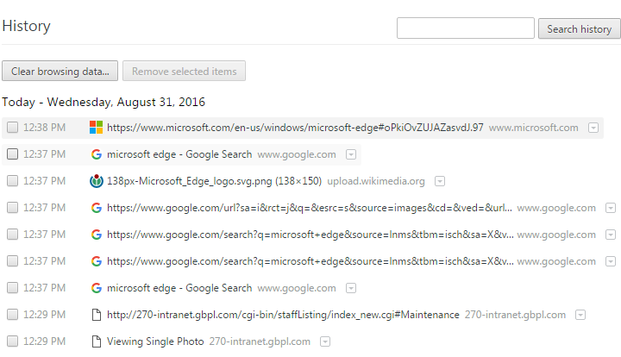
Clearing History - Chrome
Click on 3 lines in top right corner and choose History. (Chrome)

Slide 23
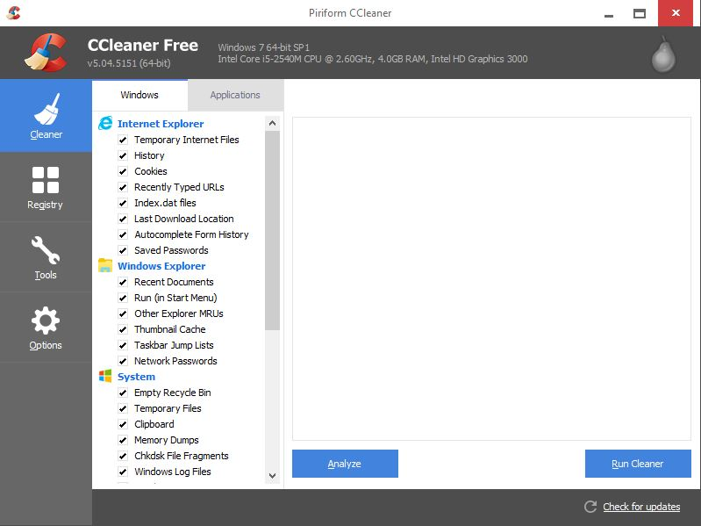
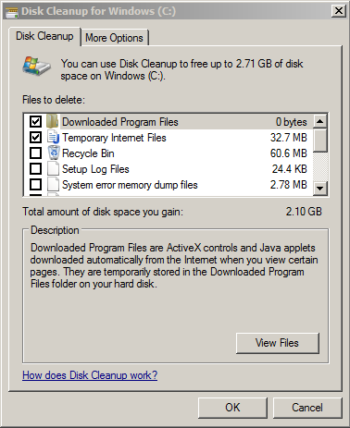
Ccleaner / Disk Cleanup

Slide 24
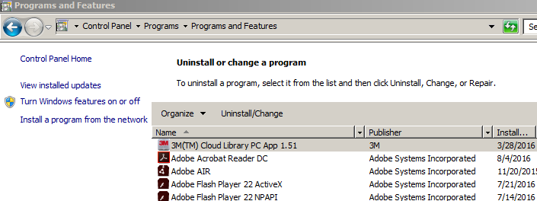
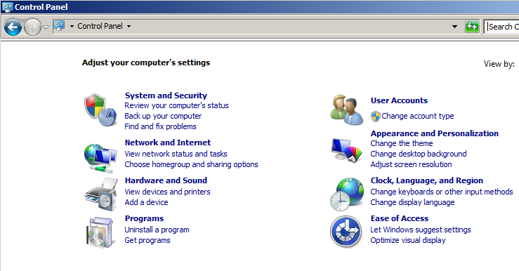
Deleting unwanted programs
Uninstall programs you never use to free up hard drive space
Notes:
Windows task manager (Windows 8-10); msconfig (Windows 7)

Slide 25
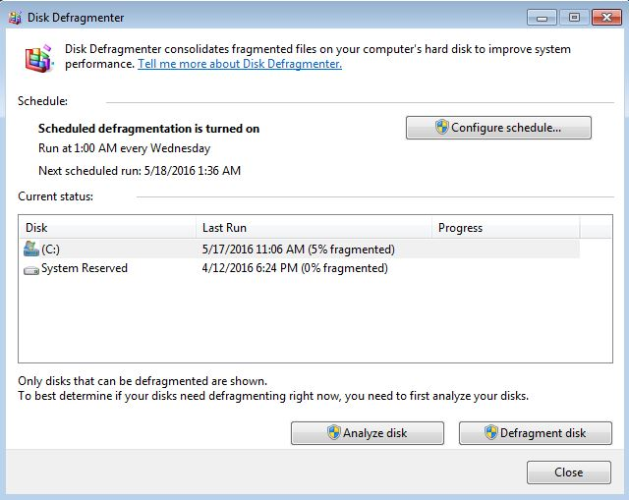
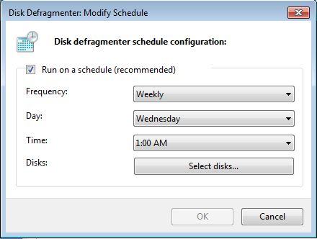
Defragmentation
Note: not necessary for Solid State hard drives

Slide 26
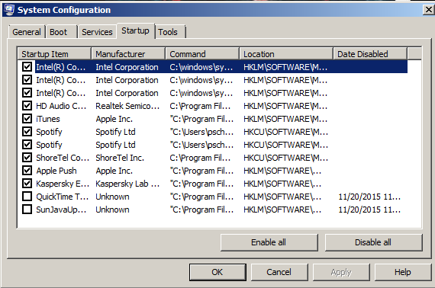
Task Manager
How many start up programs are running?
How to access the startup programs?
  Windows 7 msconfig
  Windows 8-10 in the task manager
Notes:
Windows task manager (Windows 8-10); msconfig (Windows 7)

Slide 27
Searching through ads
Backup

Slide 28





Cloud Storage
iCloud
Google Drive
One Drive
Drop Box
Amazon cloud drive
iCloud
Google Drive
One Drive
Drop Box
Amazon Cloud Drive

Slide 29
Alternative Backup Sources
Physical Back up
Backup up important files to an external Hard drive or large Flash drive often (manually)
    Flash drive 32-128gb
    External hard drive 500gb-4tb
Paid backup
Carbonite (cloud storage)
Novastor Backup (cloud and/or physical storage)
Acronis Backup (cloud and/or physical storage)
Notes:
Example
There are several options for those who want a physical backup of their files.
Option one is to purchase a devices—such as an external hard drive or flash drive—and save the files to the device. Pros are that users include only a one-time cost; cons are that if your home computer gets fried, there’s a good likelihood your device may get fried as well.
Option two is to pay for a backup service—such as Nova, Acronis, or Genie—to save your files for you. Pros are that you don’t have to worry about equipment; cons are that it may involve a monthly subscription cost.

Slide 30
Backup Windows and Programs
Windows
Use System Restore to periodically make Windows restore points
Use a Windows disc or a system restore disc to try to repair Windows.
Follow the computer’s instructions to Factory reset your computer
Programs
Programs can not be backed up
    Keep your discs and codes for easy reinstallation
Notes:
Example
There are several options for those who want a physical backup of their files.
Option one is to purchase a devices—such as an external hard drive or flash drive—and save the files to the device. Pros are that users include only a one-time cost; cons are that if your home computer gets fried, there’s a good likelihood your device may get fried as well.
Option two is to pay for a backup service—such as Nova, Acronis, or Genie—to save your files for you. Pros are that you don’t have to worry about equipment; cons are that it may involve a monthly subscription cost.

Slide 31
Questions?
THANKS FOR COMING!
Need more help?
Schedule a 1 on 1 appointment with a librarian!

