Slide 1

Computer Basics
Instructor Name
Instructor Title
Library Name
Courtesy of Gail Borden Public Library
and the Public Library Association

Slide 2
Agenda
Terminology & Descriptions
Desktop Elements
Starting Up & Shutting Down
Creating, Saving, & Accessing Files
Creating Folders & Renaming Files

Slide 3
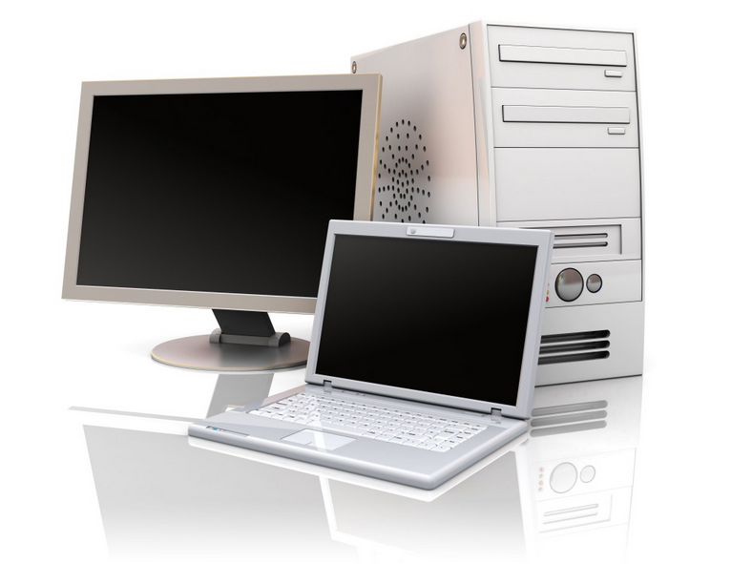
Terminology & Descriptions
Computer
An electronic device for storing and processing data based on a program or logic sequence involving numbers and codes

Slide 4
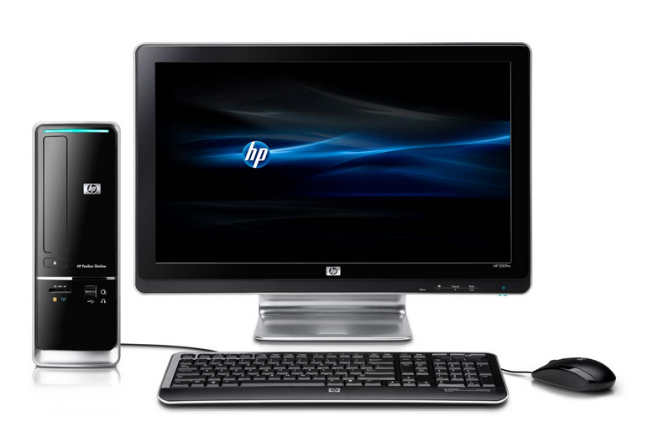
Terminology & Descriptions
Desktop Computer
A computer with a separate monitor, processor, and keyboard

Slide 5
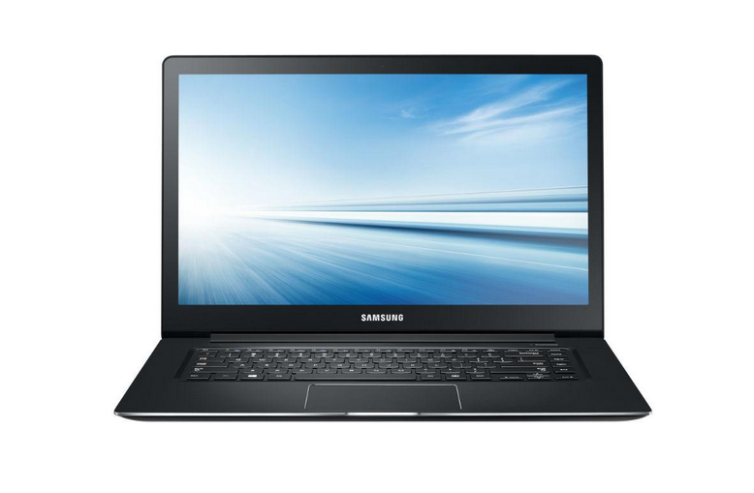
Terminology & Descriptions
Laptop Computer
A portable computer that contains the monitor, keyboard, and processor in one unit

Slide 6
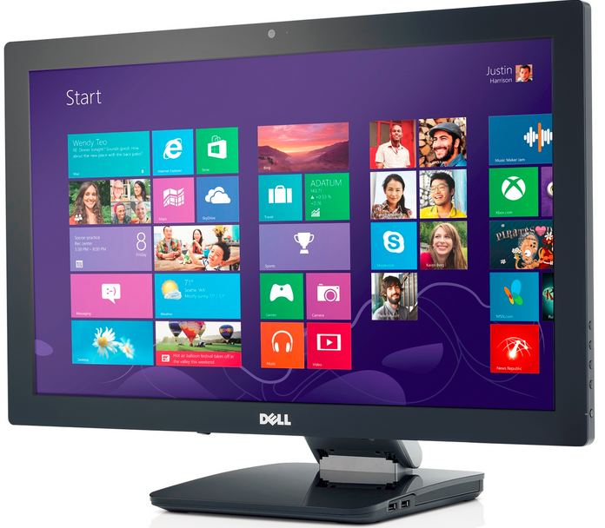
Terminology & Descriptions
Monitor
The computer component that allows users to view images

Slide 7
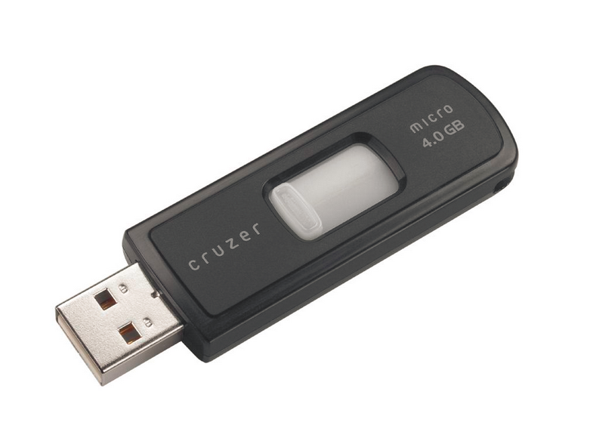
Terminology & Descriptions
  Flash Drive
  A pocket-sized data storage device used to save electronic files

Slide 8
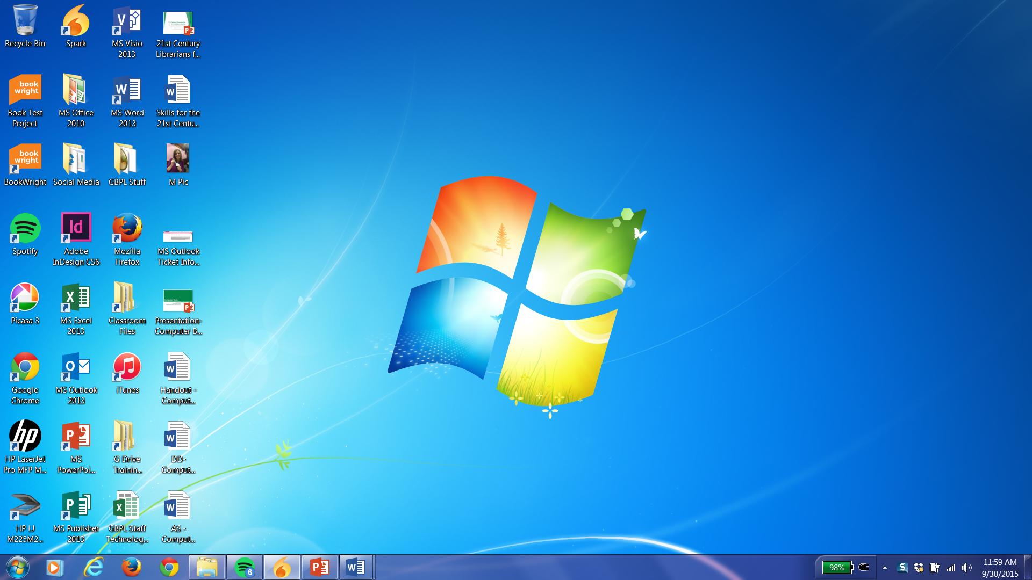
Terminology & Descriptions
  Desktop
  The primary display area on the computer screen

Slide 9
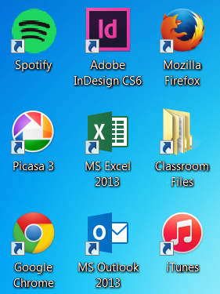
Terminology & Descriptions
  Icon
  A small graphical representation of a computer program

Slide 10
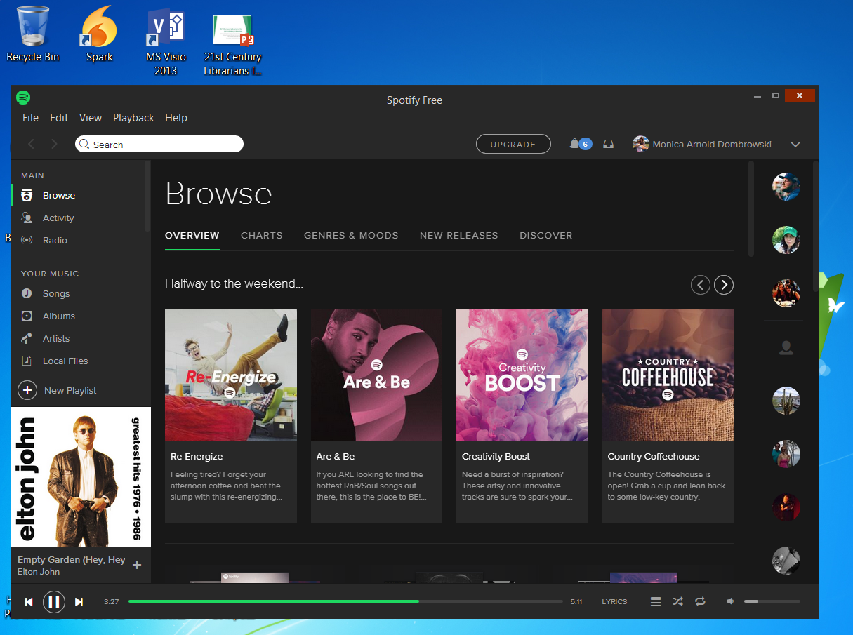
Terminology & Descriptions
  Window
  An area of the screen that displays information for a specific program independent of other parts of the screen

Slide 11
Terminology & Descriptions
  Taskbar
  A stationary strip of icons used to access frequently-used programs like Internet browsers and Microsoft products

Slide 12

Terminology & Descriptions
  System Tray
  A stationary taskbar that contains icons for system functions like time, date, and audio volume

Slide 13
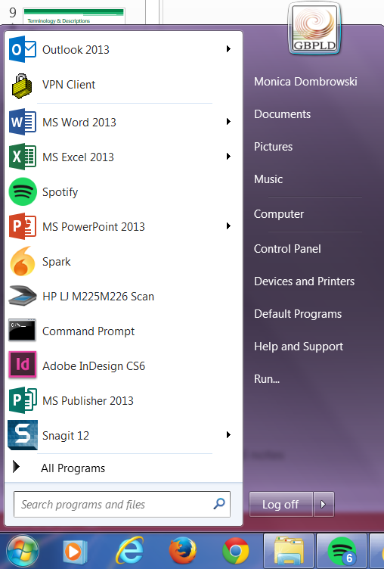
Terminology & Descriptions
  Start Menu
  The central launching point for programs and tasks on a Windows computer

Slide 14
Activity #1

Slide 15
Desktop Elements
  Desktop = Home Base

Slide 16
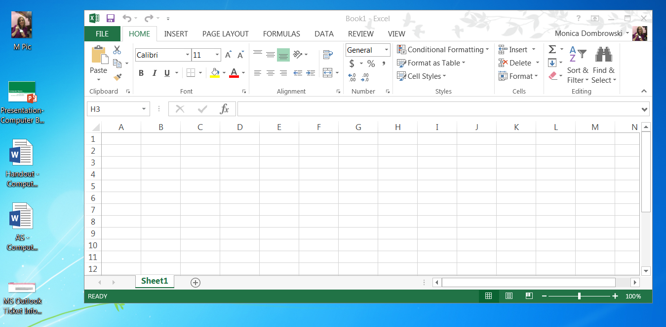
Desktop Elements
  Open a program in a new window

Slide 17
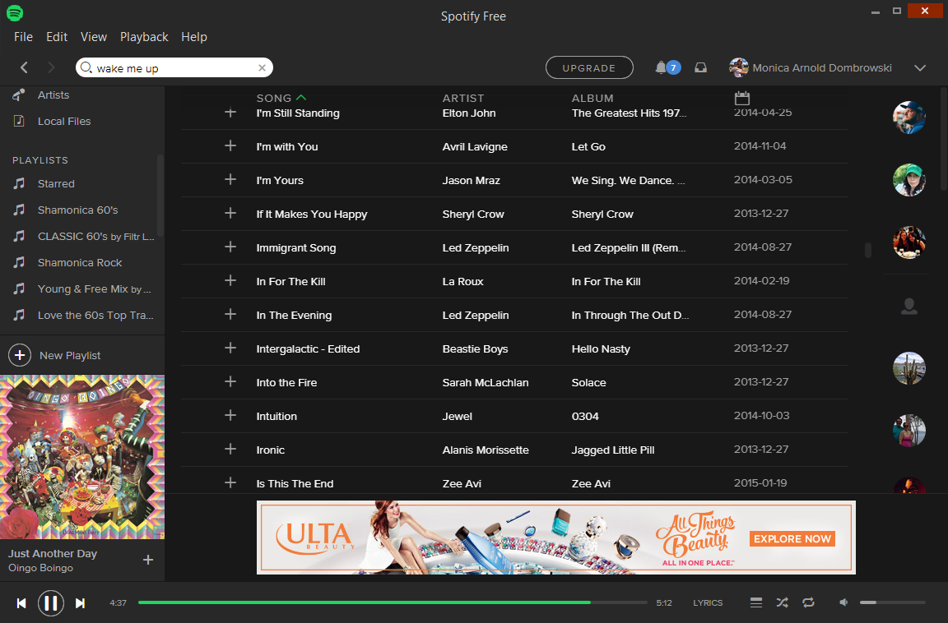
Desktop Elements
  Close or minimize a program

Slide 18
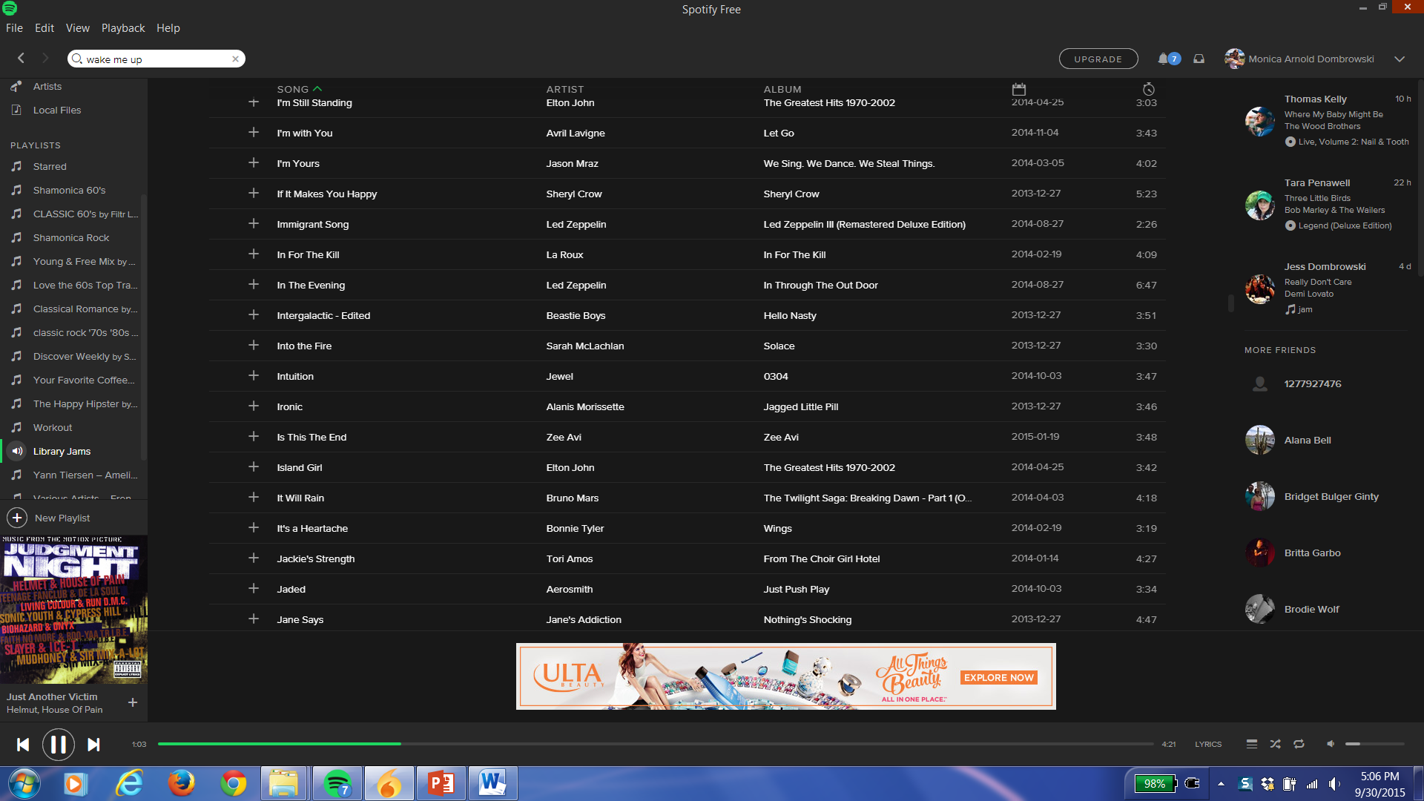
Desktop Elements
  Full Screen View

Slide 19
Desktop Elements
  Window View

Slide 20
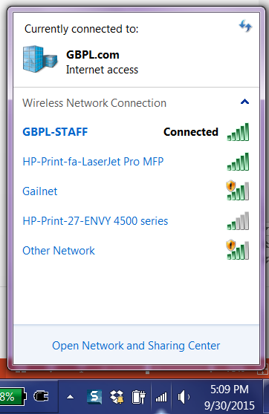
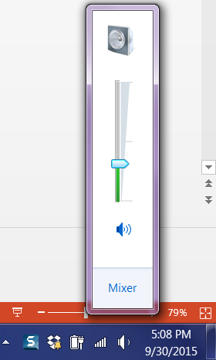
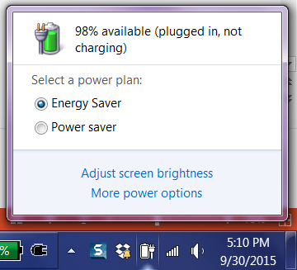
Desktop Elements
  System Tray functions

Slide 21
Desktop Elements
  Start menu

Slide 22
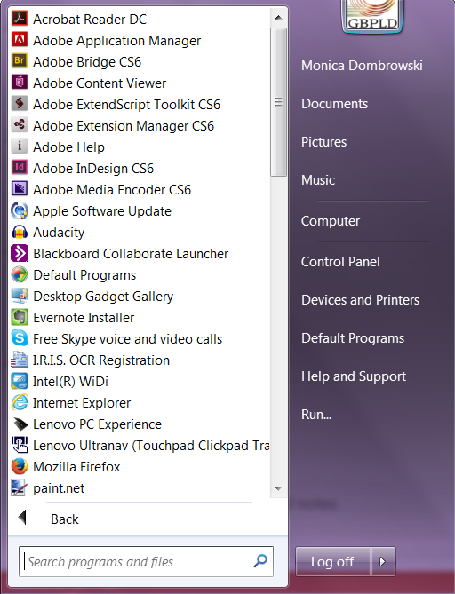
Desktop Elements
  All Programs

Slide 23
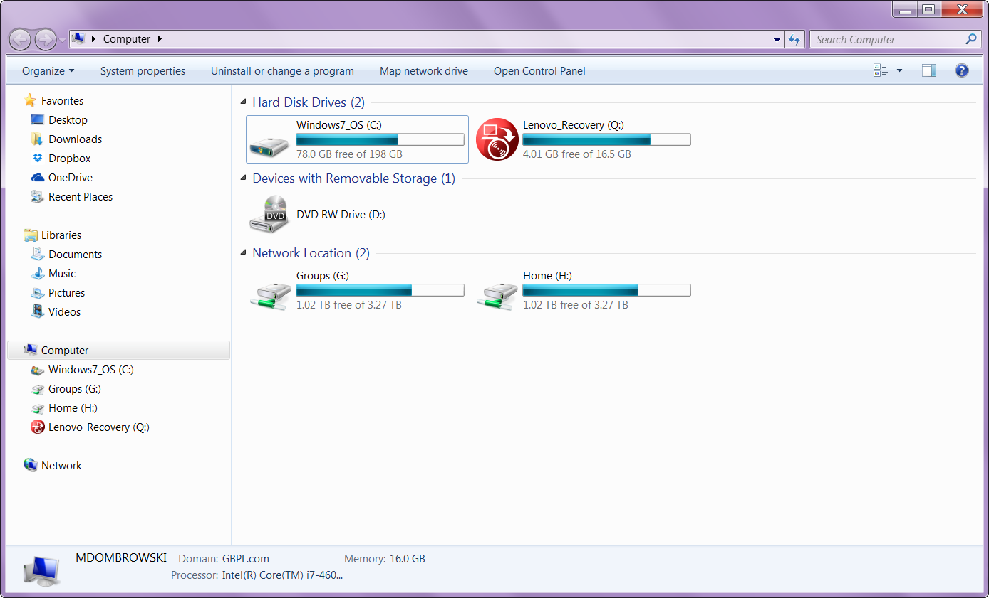
Desktop Elements
  Computer

Slide 24
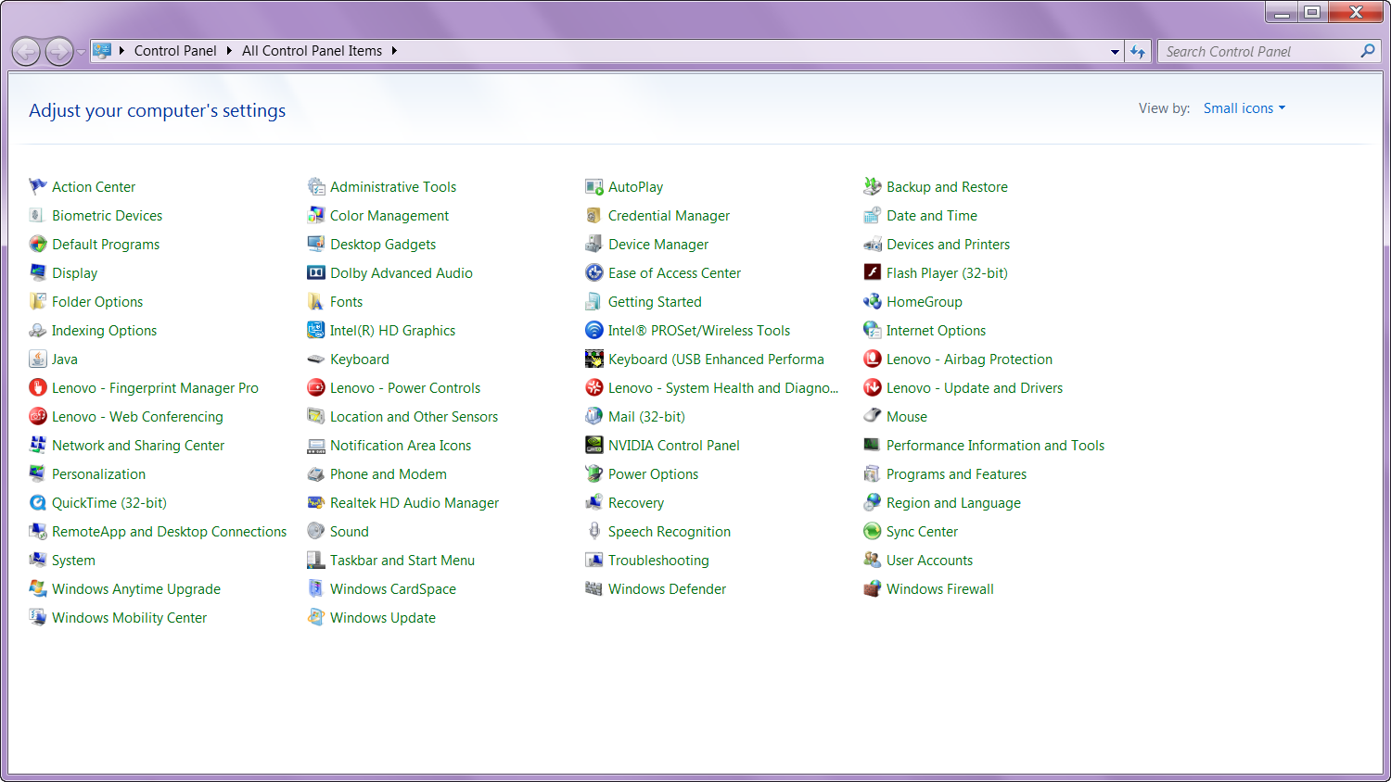
Desktop Elements
  Control Panel

Slide 25
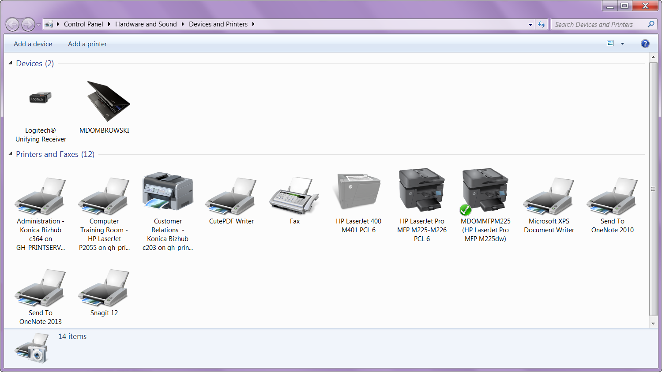
Desktop Elements
  Devices and Printers

Slide 26
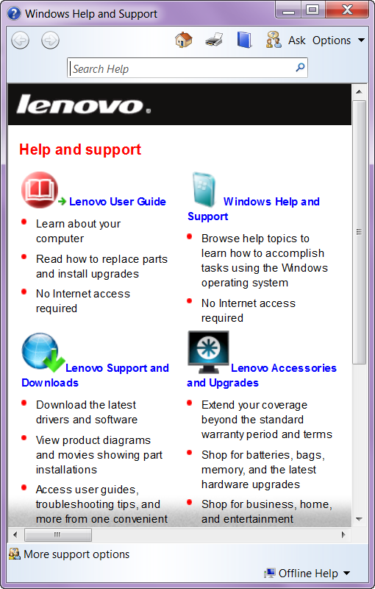
Desktop Elements
  Help and Support

Slide 27
Activity #2

Slide 28
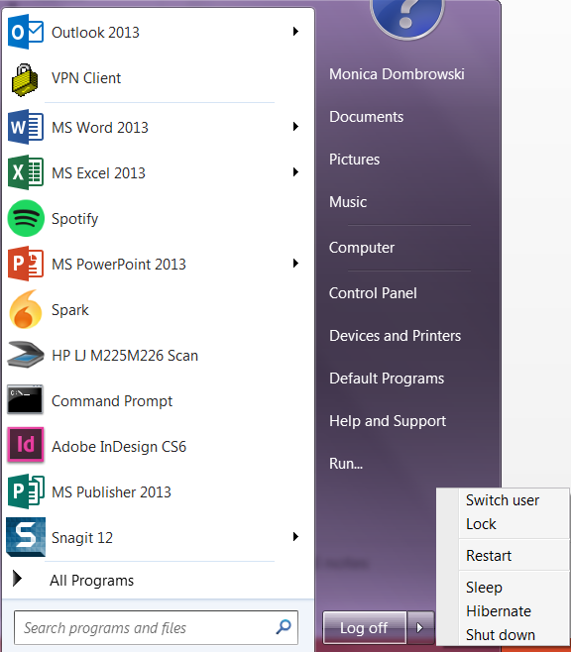
Starting Up & Shutting Down
  Manage Your Computer’s Activity Level with:
    Log Off
    Lock
    Restart
    Sleep
    Hibernate
    Shut Down

Slide 29
Activity #3

Slide 30
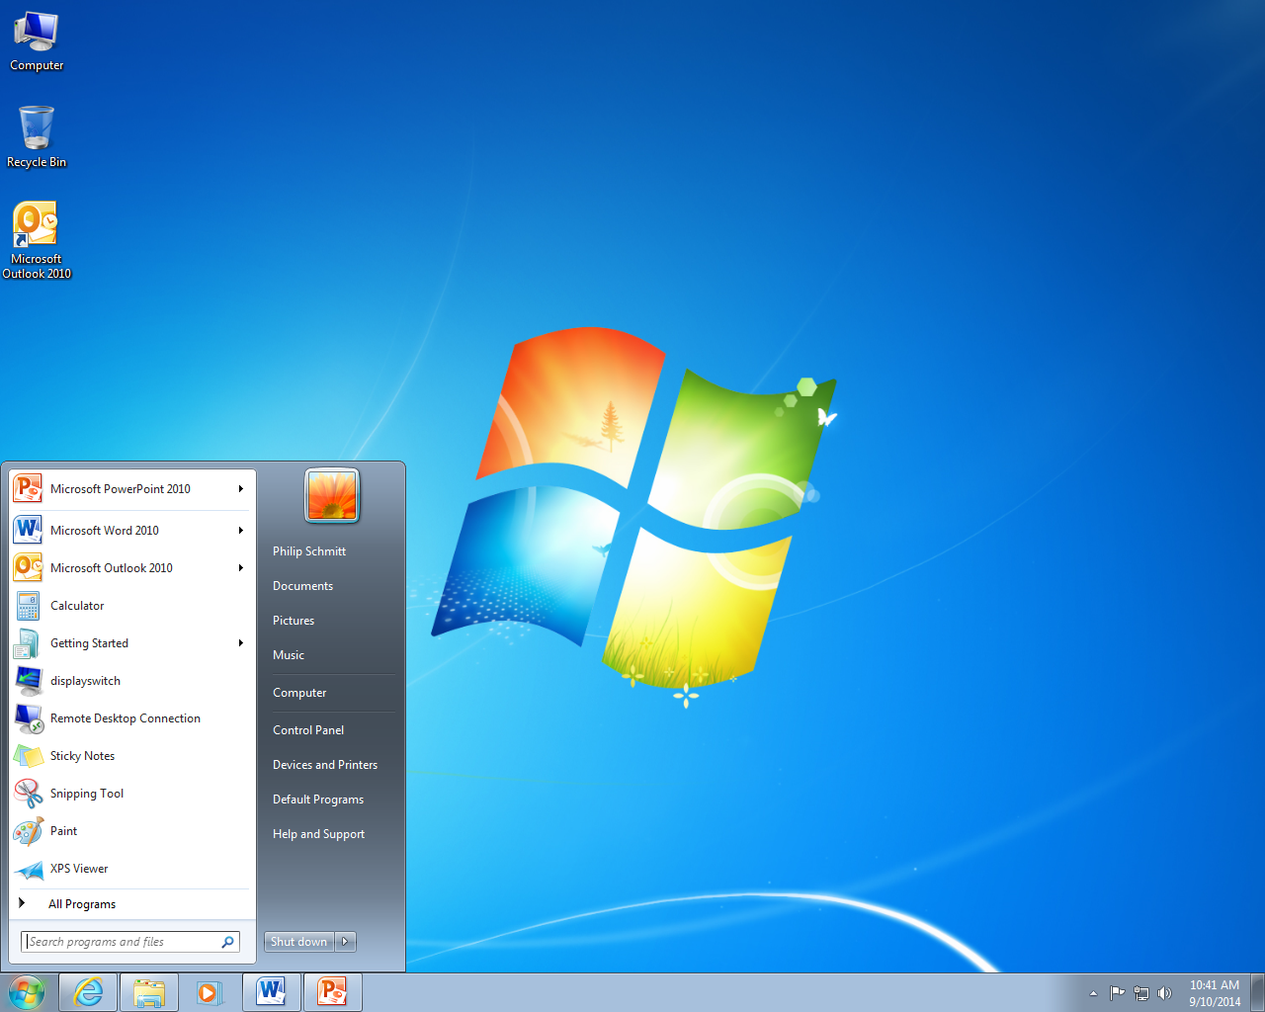
Creating, Saving, & Accessing Files
Click Start >Microsoft Word 2010

Slide 31
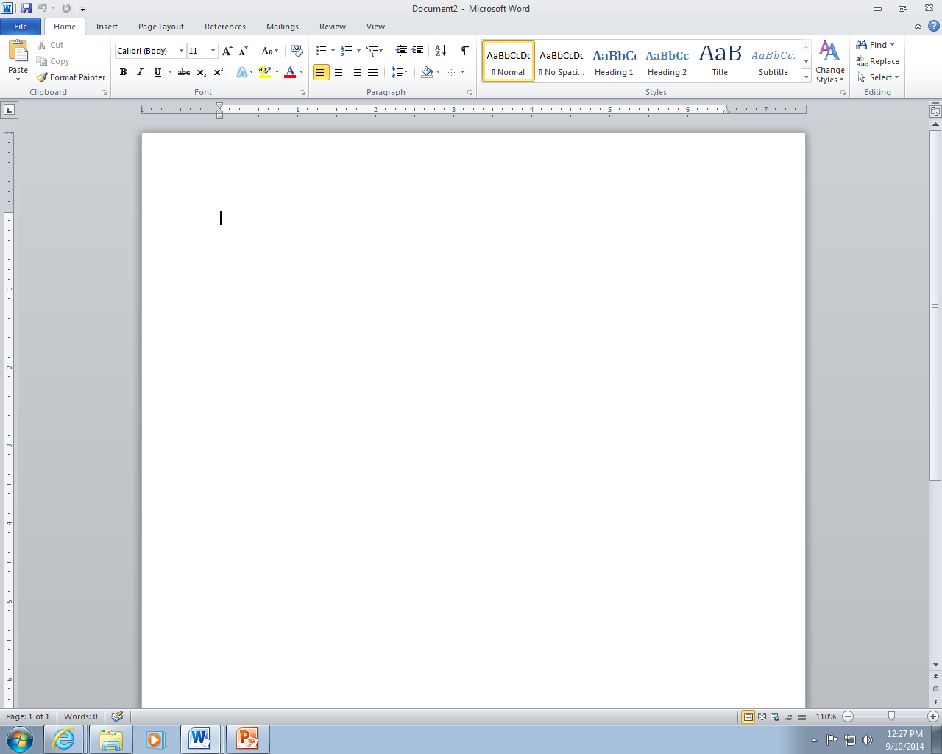
Creating, Saving, & Accessing Files
Blank Microsoft Word document

Slide 32
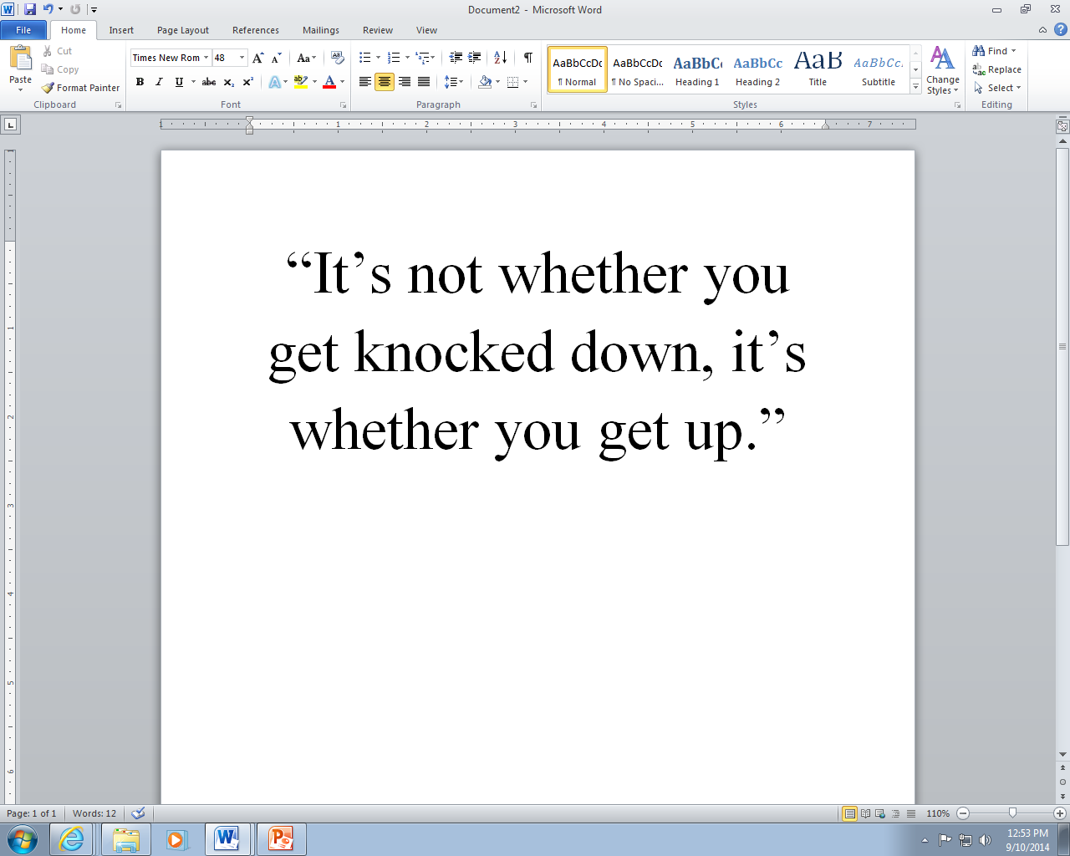
Creating, Saving, & Accessing Files
Click the File Tab
I am so excited to learn about computers!

Slide 33
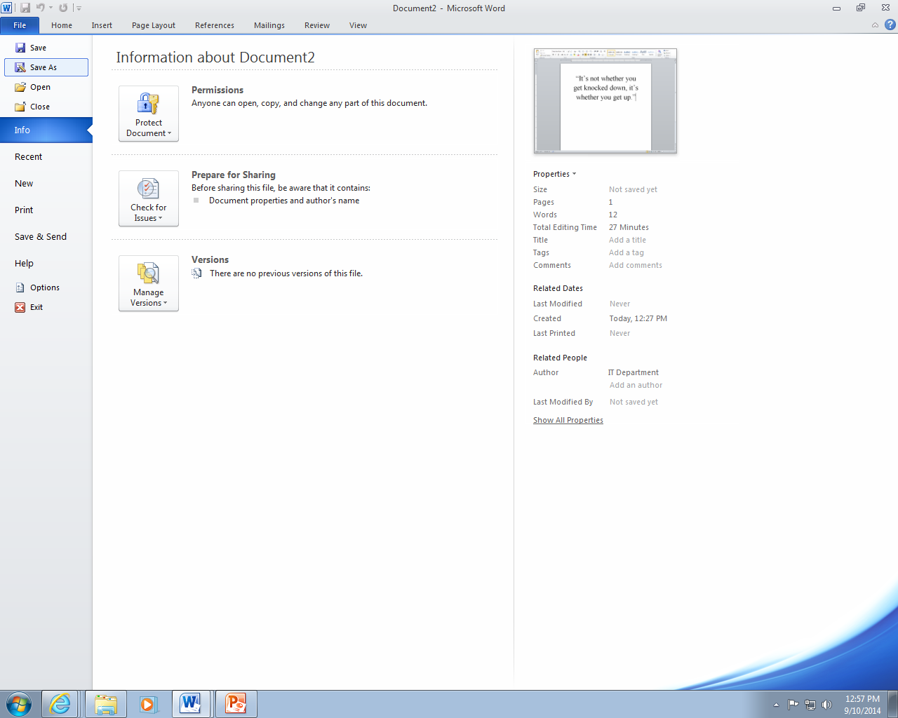
Creating, Saving, & Accessing Files
Click Save As

Slide 34
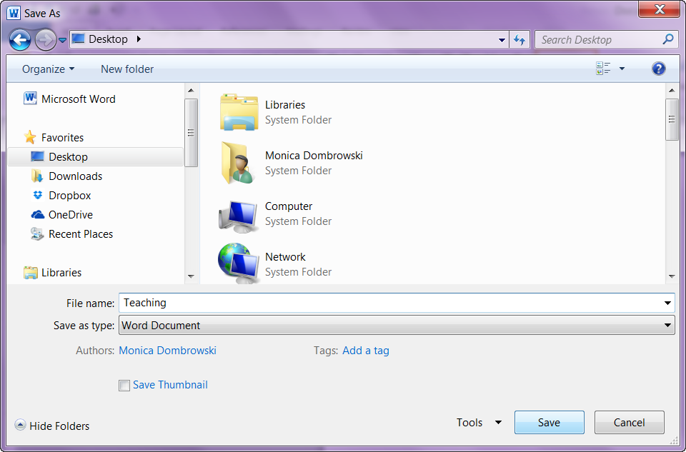
Creating, Saving, & Accessing Files
Click on Desktop
Type the File name
Click the Save button

Slide 35
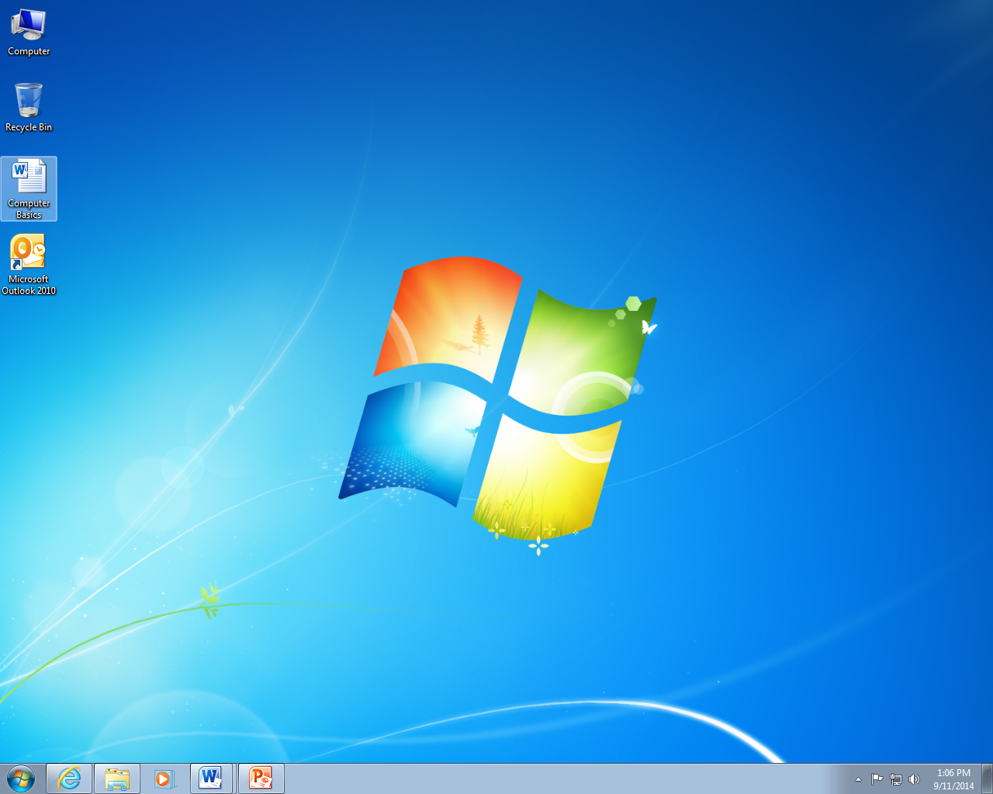
Creating, Saving, & Accessing Files
Double click on the file icon to open a saved file
Notes:
From the Desktop

Slide 36
Activity #4

Slide 37
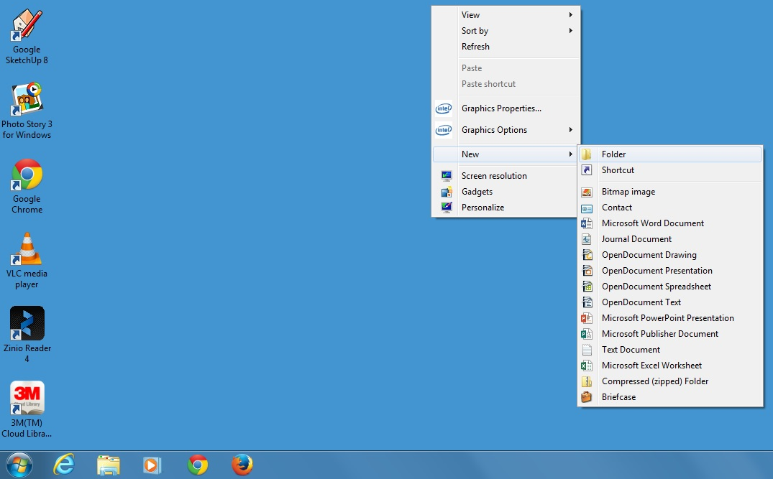
Creating Folders & Renaming Files
Right-click on the desktop
Move the mouse down to New
Move the mouse over to Folder
Notes:
From the Desktop

Slide 38
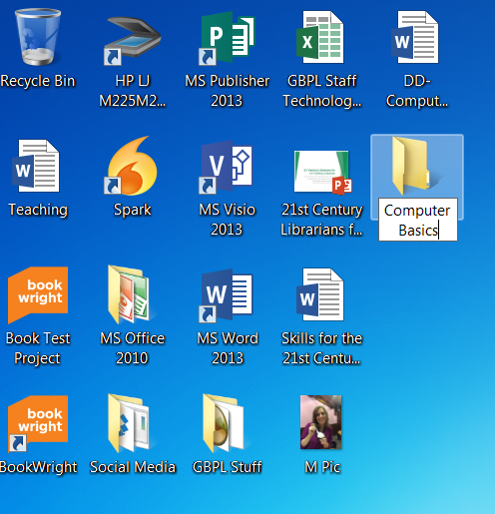
Creating Folders & Renaming Files
Type in the new name
Notes:
From the Desktop

Slide 39
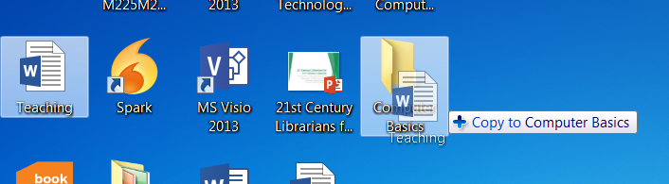
Creating Folders & Renaming Files
Click and drag to move a file into a folder
Notes:
From the Desktop

Slide 40
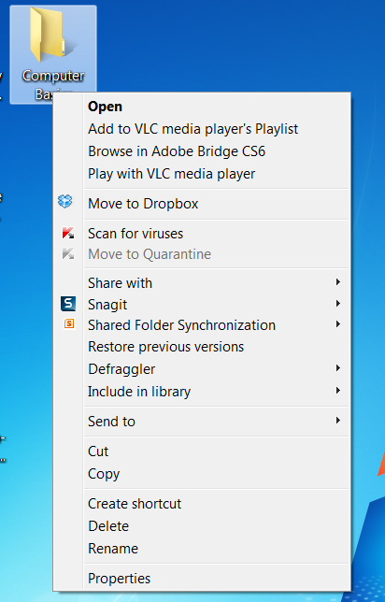
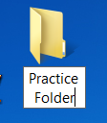
Creating Folders & Renaming Files
To rename a file or folder:
Right-click on file or folder
Move the mouse down to Rename
Type the new name
Press the Enter key
Notes:
From the Desktop

Slide 41
Activity #5

Slide 42
Questions?
THANK YOU FOR COMING!
Part Three Next Week
Internet Basics

