Slide 1

Computer Basics (Windows 10)
Instructor Name:
Instructor Affiliation:
Location Name:
Your Logo Here
Provided by AT&T and the Public Library Association
Notes:
INSTRUCTOR NOTE: Please update this slide with the appropriate information:
Instructor name
Instructor affiliation (for instance, AT&T employee, library staff member, community volunteer, etc.)
Location name
INSTRUCTOR NOTE: Before the workshop, please review the Instructor Outline for guidance on what to do to prepare for the workshop. You’ll find notes on how to conduct the workshop and details on what you should do once the workshop ends. In that document, slide notations begin on page 5.
Today’s workshop is provided by AT&T and the Public Library Association.
INSTRUCTOR NOTE: Include thank-you to community collaborator if applicable.
My name is <your name here> and I am <brief description of yourself>. Before we get started here are a few housekeeping items: <mention the items that are relevant to your workshop>:
Where are the restrooms?
Where are the emergency exits?
When/how to ask questions—Note where to locate the page number on each slide for participants to include if they have questions to ask later.
If you have a cell phone with you, please make sure to either turn it off or set to silent.
Will there be a break?

Slide 2
Today’s Agenda
Introduction
  Learn about operating systems
Skill Building
  Find and navigate the desktop
  Find and organize files and folders
  Manage the windows of an application
  Save and close files
  Delete files
Tips for Using a PC
Practice
Notes:
In today’s workshop you will learn about a computer’s operating system.
Introduction
Learn about operating systems
Skill Building
Find and navigate the desktop
Find and organize files and folders
Manage the windows of an application
Save and close files
Delete files
Tips for Using a PC
Practice
Let’s get started!

Slide 3

Introduction
What types of things do you want to do with the computer?
Notes:
INSTRUCTOR NOTE: Ask learners the question on the slide. Lead learners in a brief discussion about what people can do with a computer. Allow a moment for the learners to think about it, and then proceed with the conversation. Examples include: create online accounts, email family and friends, shop online, apply for jobs, communicate with children’s teachers, and so on. The conversation should last two or three minutes at most.

Slide 4
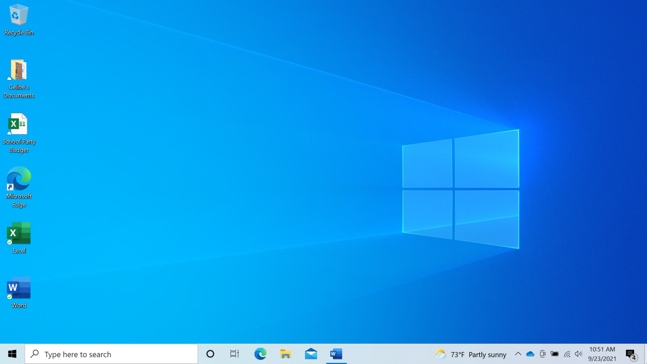

Operating System: Definition
  Operating System: The software that handles the functions of the computer to make sure everything is working together
Notes:
The operating system is the software handles the functions of the computer to make sure everything is working together.

Slide 5

Operating System: Definition (continued)
  Operating System
Notes:
Just as your brain works to manage your body to make sure you are breathing and your heart is pumping, the operating system manages the functions of the computer to make sure everything is working together.
In today’s class we are going to learn and use the Windows 10 operating system.

Slide 6
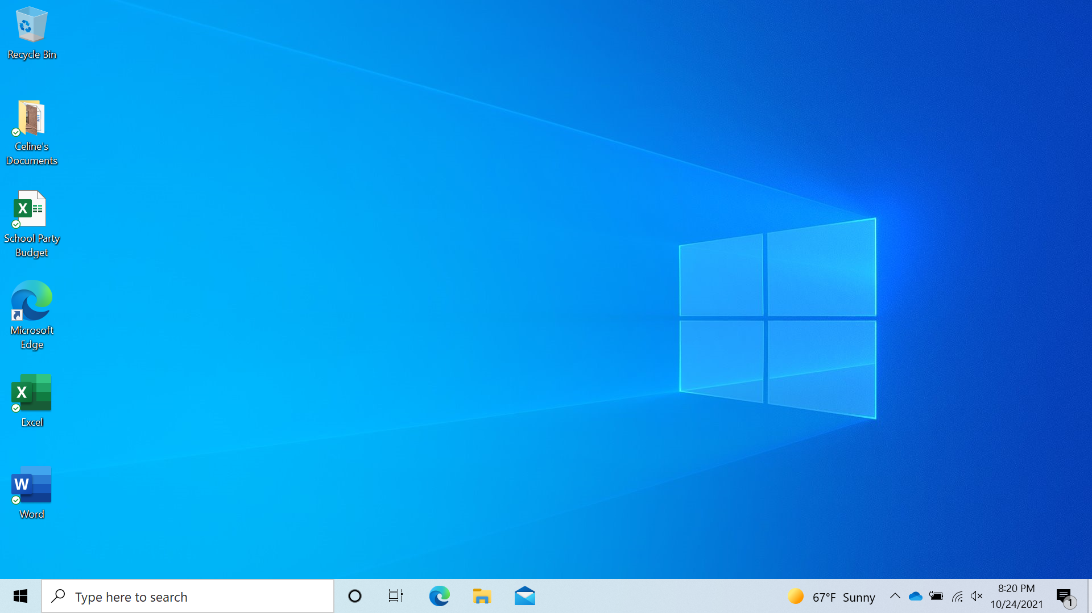
Working from the Desktop
Notes:
INSTRUCTOR NOTE: For the “Working from the Desktop” section (slides 6 through 21), use PowerPoint or a live demonstration.
This is the Windows 10 desktop. Let’s explore different sections of the computer’s desktop, including the task bar, start menu, and more.
If you’re using a Windows computer that has a different version of the operating system running, the desktop may look different.

Slide 7

Working from the Desktop (continued)
Notes:
The Windows 10 desktop is just like the top of your desk at home or at work, where you keep different folders with papers in them. The desktop also has other tools you need to get things done, such as a calculator, a pen, or a reference work.
Just as you have folders and tools on your physical desk, you also have those tools and folders on the computer, which you can access through the desktop.

Slide 8
Working from the Desktop (continued)
Taskbar: Located at the bottom of the screen, it includes shortcut icons for commonly used applications
Notes:
The taskbar is at the bottom of the screen. It can also show shortcut icons for commonly used applications, much like the icons on the desktop.

Slide 9

Working from the Desktop (continued)
Taskbar
Notes:
The taskbar also shows an icon for any task or program that is currently open. You can use these buttons on the taskbar to switch between the different windows you have open.
Information like the date, time, and volume control are also on the right edge of the taskbar.

Slide 10


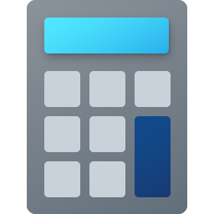
Working from the Desktop (continued)
Applications: Tools that allow you to do things on a computer
Notes:
Applications are tools that allow you to do things on a computer. In today’s example we will use the icon for Microsoft Word, which allows you to open a document. We’ll also take a quick look at the Edge browser, which allows you to search the web, and a calculator, which allows you to do math.

Slide 11

Working from the Desktop (continued)
Search: Find a specific file, computer setting, or application
Notes:
If you can’t find what you are looking for on your computer—such as a specific file, computer setting, or application—you can use the search box located in the taskbar. The search box will also search for things on the web. The search box is at the bottom left-hand side of the screen.

Slide 12
Working from the Desktop (continued)
Searching
Notes:
To search for a file, type a word or phrase in the search box. In this example we are searching for a “to do list.”
INSTRUCTOR NOTE: Please use the “To Do List” document that you downloaded from the lesson materials before the workshop began.

Slide 13
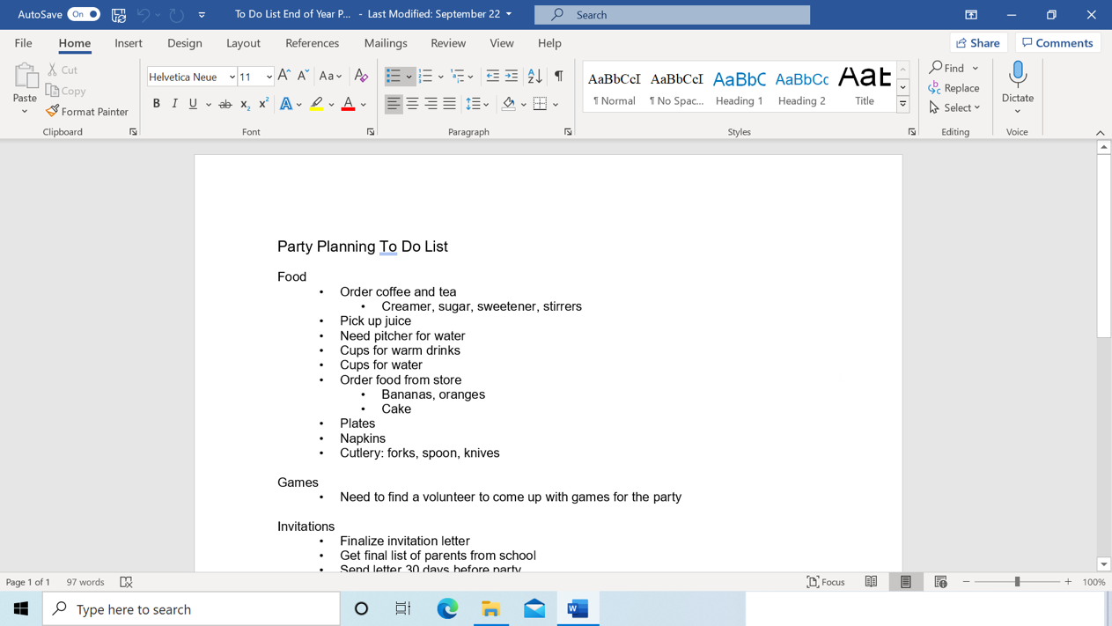
Working from the Desktop (continued)
Search Results
Notes:
And the file opens!
INSTRUCTOR NOTE: If you’re doing a live demonstration, close or minimize the file before moving to the next task.

Slide 14

Working from the Desktop (continued)
Windows Icon
Notes:
Back on the desktop, we can see that the taskbar also includes the Windows icon. While the taskbar has the most commonly used applications on it, it may not have all of the applications available on this particular computer.
INSTRUCTOR NOTE: Demonstrate taskbar features and invite learners to follow along if computers are available.

Slide 15
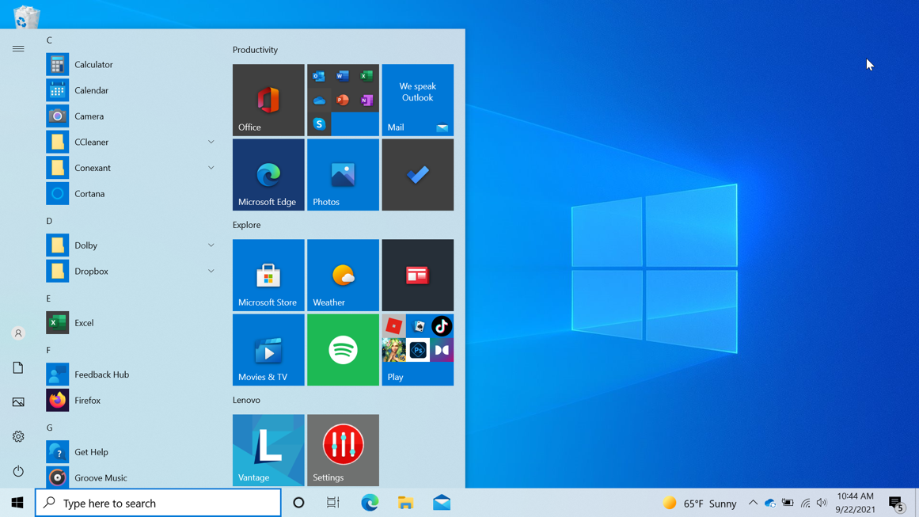
Working from the Desktop: Start Menu
Start Menu: One of the ways to open applications, such as Microsoft Word
Notes:
When you click on the Windows icon, it will launch the Start menu. The Start menu allows you to see all of the computer’s applications.
The Start menu is another way you can open applications available on the computer, such as Microsoft Word.

Slide 16
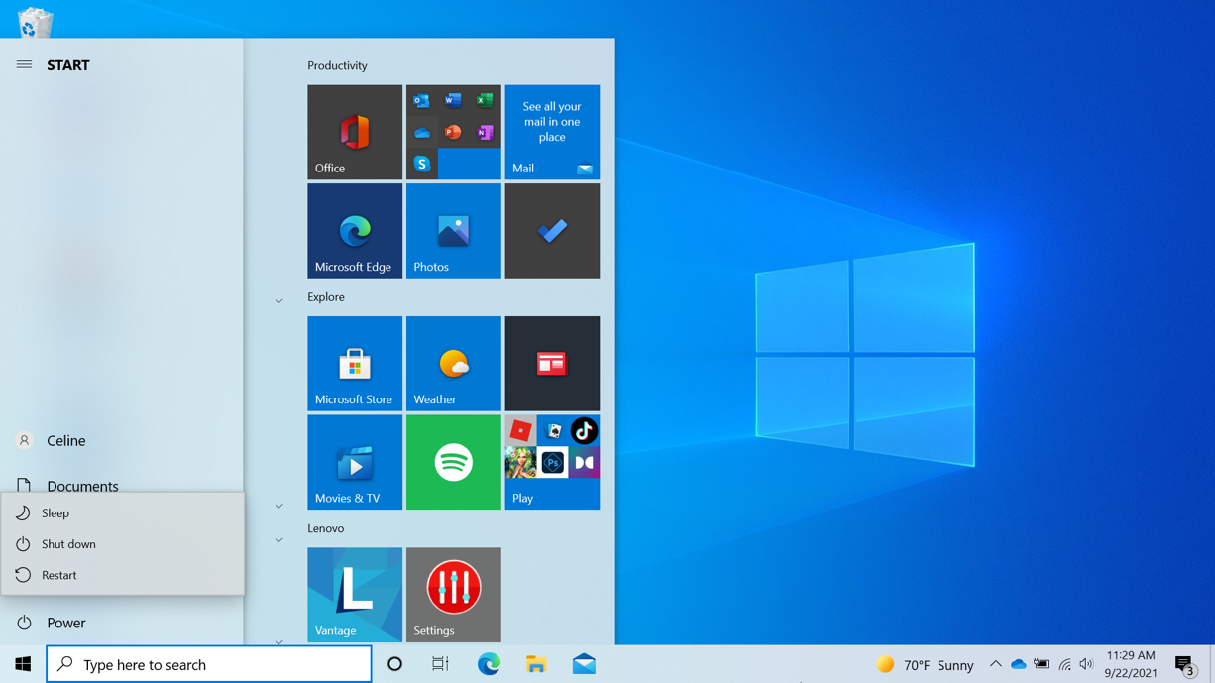
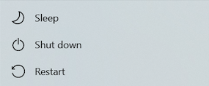
Working from the Desktop: Start Menu (continued)
Power: Menu used to restart the computer, shut it down, or put it into sleep mode
Notes:
The power button opens a menu where you can choose to restart the computer, shut it down, or put it into sleep mode.

Slide 17

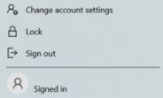
Working from the Desktop: Start Menu (continued)
Account: Menu used to sign out of your account, lock your account, or change settings that are unique to your account on the computer
Notes:
When you click on the name of the account, which in this example is Celine, in the Start menu, the account menu appears. From this menu you can sign out of your account, lock your account, or change settings that are unique to your account on the computer.

Slide 18
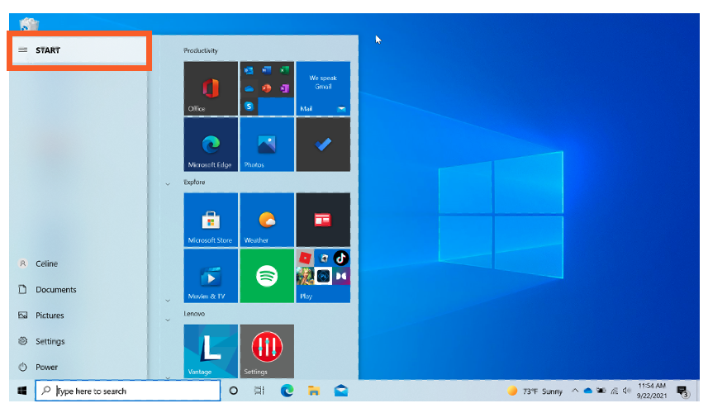
Working from the Desktop: Start Menu (continued)
Start: Menu that shows what applications are available on this computer
Notes:
When you click on Start, the left menu collapses so that you can see a list of all the applications available on the computer in alphabetical order.

Slide 19
Working from the Desktop: Start Menu (continued)
Close
Notes:
To close the menu, click on the Windows icon.

Slide 20
Working from the Desktop: Start Menu (continued)
Close
Notes:
And the menu closes.

Slide 21

Working from the Desktop
Different ways to open an application:
Double-click on the desktop icon
Single-click on the taskbar icon
Single-click from the Start menu
Search and select from the Search box
Notes:
INSTRUCTOR NOTE: Use the PowerPoint slide for this part of the presentation, even if you are doing a live demonstration.
There’s more than one way to open an application on the computer. You can double-click on the Desktop icon, click on the Taskbar icon, select it from the Start menu, and search for it using the Search box.
INSTRUCTOR NOTE: Before moving to Activity 1, review “parking lot” questions. If there are no questions in the parking lot, ask the attendees if they have any questions before you move to Activity 1.

Slide 22
Activity #1
Notes:
INSTRUCTOR NOTE: Point attendees to Activity 1 on Activity Sheet page 1. Review the topics in this section. Go to the desktop. Ask the learners to call out the answers to the questions on the next slide. If the learners have computers, encourage them to follow along on their computers. Encourage them to call out answers, and then confirm the correct answer to have them update their Activity Sheet.

Slide 23
ACTIVITY #1: Working from the Desktop
Use the computer desktop to answer the following questions.
If you don’t have your own computer, follow along with the instructor.
1. Name three ways in which you can open an application like Microsoft Word or the Edge browser.
a.
b.
c.
2. If you want to search for a file on your computer, where would you enter your search term?
3. Where would you click to shut down the computer?
Notes:
INSTRUCTOR NOTE: Use the slide to debrief the activity or as a guide for yourself if you are doing a demonstration. For each question, demonstrate the answer.
1. Name three ways in which you can open an application like Microsoft Word or the Edge browser.
Answers:
a. From the Desktop shortcut
b. From the Start menu
c. From the taskbar
2. If you want to search for a file on your computer, where would you enter your search term?
INSTRUCTOR NOTE: Use the search term “To Do List” to find the file “To Do List End of Year Party.docx.”
Answer: In the search box, which is in the taskbar.
3. Where would you click to shut down the computer?
INSTRUCTOR NOTE: Only the Instructor should demonstrate the answer. Do so without clicking on Shut Down.
Answer: Start menu
After learners complete Activity 1: “Great job, everyone! In the next section, you’ll learn how to use files and folders.”

Slide 24
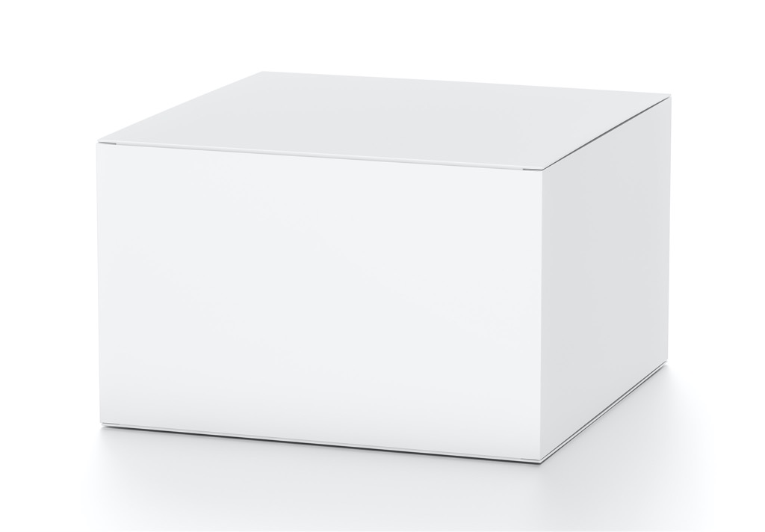
Files and Folders
File: A file is a package of information.
Notes:
INSTRUCTOR NOTE: For the “Files and Folders” section (slides 24 through 51), use PowerPoint or a live demonstration.
What is a file? A file is a package of information.

Slide 25




Files and Folders (continued)
Applications: Software or tools that allow you to perform tasks
Notes:
Applications are software or tools that allow you to perform tasks. Some applications allow you to work on text documents. Others allow you to edit pictures, watch videos, listen to music, or access the internet.

Slide 26
Files and Folders (continued)
Different Ways to Open a File: Double-click on the Desktop icon
Notes:
As we learned, there is more than one way to open a file. You can double-click on the Desktop icon or in the taskbar Start menu. You can also search for the file using the search box, click on the taskbar icon, or select it from the Start menu.

Slide 27
Files and Folders (continued)
Opening a File
Notes:
Any time you open a file, it will open inside a related software application.

Slide 28

Files and Folders (continued)
Folder: A method for storing and organizing files
Notes:
A folder provides a method for storing and organizing files, just like the folders you’d find on a physical desk.
INSTRUCTOR NOTE: Please use the “Celine’s Documents” folder, which you downloaded before the class, as an example.

Slide 29
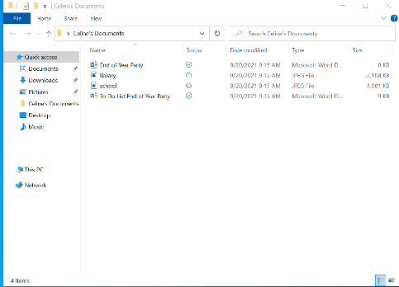
Files and Folders (continued)
Open Folder
Notes:
When you double-click a folder, it will open the folder and show the files inside.
Let’s open Celine’s folder by double-clicking it and selecting the file End of Year Party.docx. To open the file, you double-click End of Year Party.docx.
INSTRUCTOR NOTE: Please use the “Celine’s Documents” folder and End of Year Party.docx file for examples. You should have downloaded these before class began. If you’re doing a live demonstration, close the folder before moving to the next task.

Slide 30
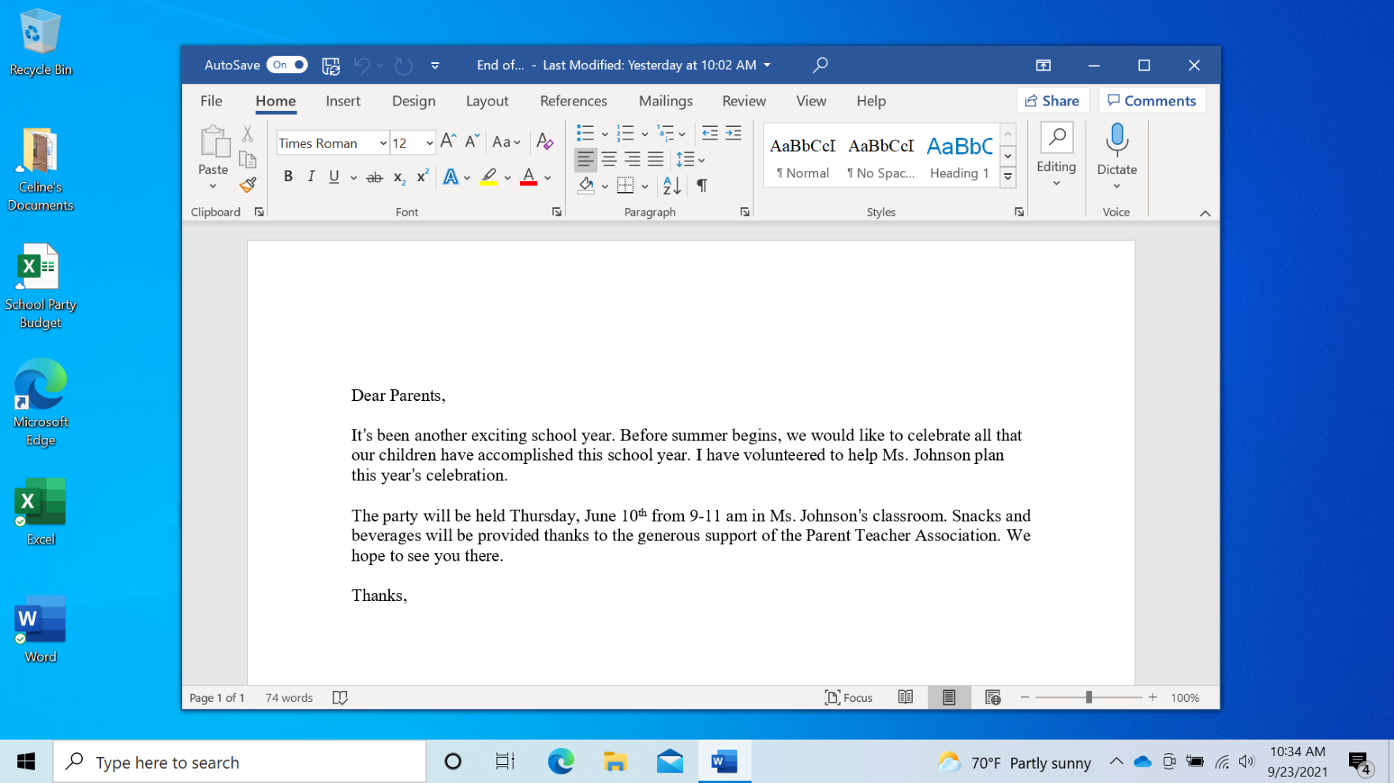
Files and Folders (continued)
File Opens
Notes:
The document file opens.
INSTRUCTOR NOTE: If you’re doing a live demonstration, minimize the file before moving to the next task. You will use this document again later in the presentation.

Slide 31

Files and Folders (continued)
Notes:
Let’s review opening a file on the desktop. How would you open the file “School Party budget”?
INSTRUCTOR NOTE: Ask the learners to call out the answer to this question.
That’s right—you would double-click the file.
INSTRUCTOR NOTE: Demonstrate how to open the file by double-clicking the “School Party budget” file that you downloaded before the class began.

Slide 32
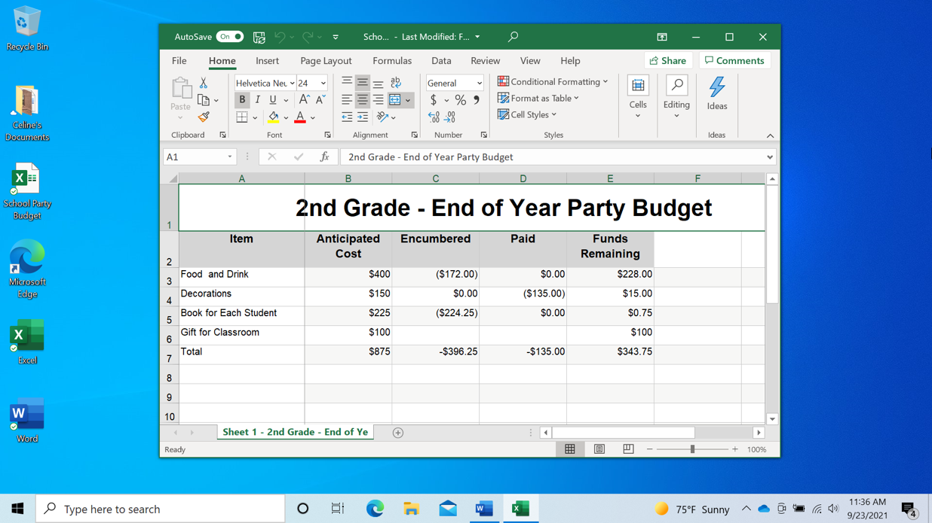
Files and Folders (continued)
What Is a Window?
Notes:
The file opens!
INSTRUCTOR NOTE: Do not close the file before moving to the next task.
Every time you open and use applications, files, and folders, you see them inside a window. The window is your working area.

Slide 33
Files and Folders (continued)
Changing the Size of the Window
Notes:
Sometimes, the window may be too big or too small. To change the size of the window, use your mouse or touchpad to place the cursor on the edge of the window.
INSTRUCTOR NOTE: Use the file “School Party Budget” to demonstrate how to change the size of the window.

Slide 34


Files and Folders (continued)
Changing the Size of the Window
Notes:
When you do this, the cursor will change into a double-headed arrow.
You can then click and hold the left mouse button to “grab” the edges of the window. Then drag the mouse to the left to change the size of the window.
INSTRUCTOR NOTE: Again, use the file “School Party Budget” to demonstrate how to change the size of the window.

Slide 35
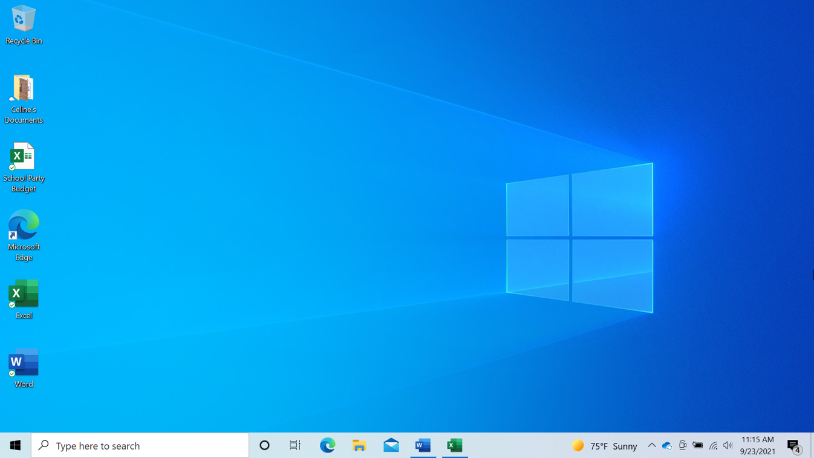
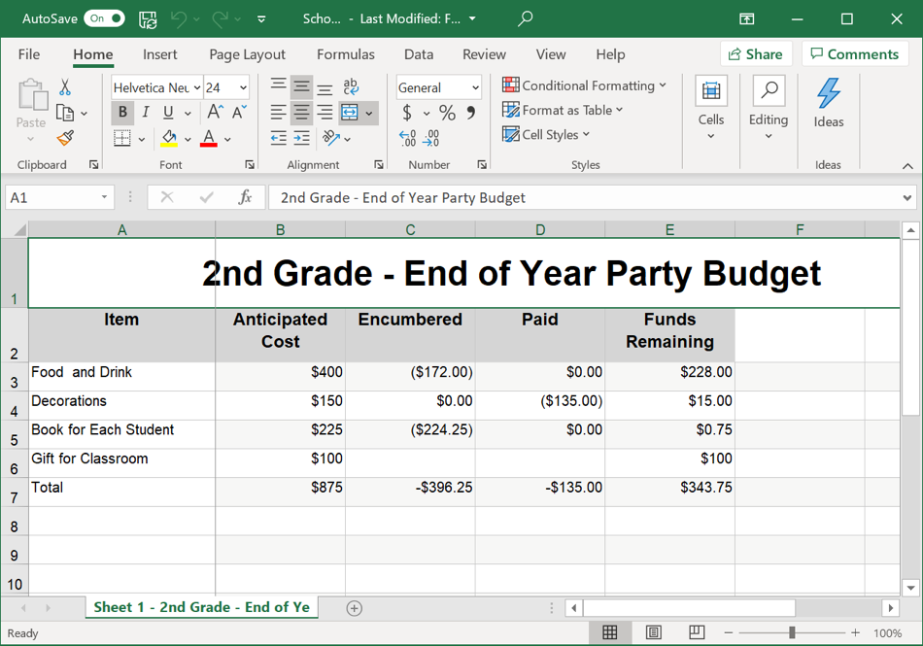
Files and Folders (continued)
Changing the Size of the Window
Notes:
Release the mouse button when the window is the desired size.

Slide 36
Files and Folders (continued)
Title Bar
Notes:
The title bar is at the top of a window.

Slide 37
Files and Folders (continued)
Title Bar
Notes:
The right-hand corner of the title bar includes buttons that help you manage the window.

Slide 38
Files and Folders (continued)
Maximize Button: Expand the window to fill the desktop
Notes:
The Maximize button looks like a square. When you click on it, the window will expand.

Slide 39

Files and Folders (continued)
Maximize Button
Notes:
The window expands to fill the desktop. Here’s an example of what it looks like when the window is maximized.

Slide 40

Files and Folders (continued)
Restore Button
Notes:
The Restore button makes the window smaller again. The Restore button looks like a double rectangle. When you maximized this window, the Restore button replaced the Maximize button.

Slide 41

Files and Folders (continued)
Restore: Returns the window to the size it was before it was maximized
Notes:
Here’s an example of what it looks like when the window is restored to the previous size.

Slide 42

Files and Folders (continued)
Scroll: Use this tool to see more of the file contents that aren’t visible in the window at its current size.
Notes:
You can scroll inside the window to display more of the file contents by using the scroll bar. To do this, you move the cursor to the scroll bar, left-click the mouse, and hold the button, which “grabs” the scroll bar. You then drag the mouse down to scroll down in the document.

Slide 43
Files and Folders (continued)
Minimize Button: Hides the file in the taskbar
Notes:
When you need to see other files or folders on the desktop, you can use the Minimize button to move this window out of the way. This button looks like a dash, and it will collapse the window into the taskbar at the bottom of the screen.

Slide 44
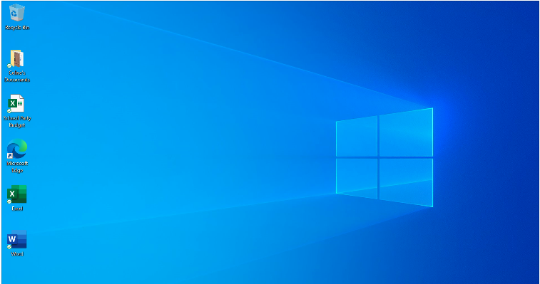
Files and Folders (continued)
Minimize
Notes:
The file is minimized and appears on the taskbar as an icon. You can get back to it at any time by clicking on this icon.
Let’s review. How would you restore the file “School Party budget”?
INSTRUCTOR NOTE: Demonstrate how to restore the file by clicking on its icon in the task bar.

Slide 45
Files and Folders (continued)
Working with More Than One Window
Notes:
The file “School Party Budget” has been restored!
It’s common to have many windows open at the same time. People find it easy to switch between tasks or work between multiple files.
If you have more than one window open, moving them around or resizing them may be helpful. Let’s restore the “End of Year Party” document by clicking on the Word file in the task bar.
INSTRUCTOR NOTE: Please use the “End of Year Party” file you minimized in the previous lesson.

Slide 46
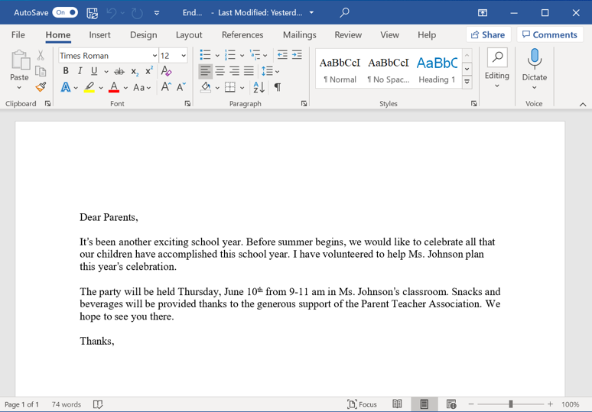
Files and Folders (continued)
Working with More Than One Window
Notes:
There are now two windows open: “School Party Budget” and “End of Year Party.” To move a specific window, you can pick it up by moving the cursor to the title bar.

Slide 47
Files and Folders (continued)
Working with More Than One Window
Notes:
Click and hold the mouse button to move the window around.
INSTRUCTOR NOTE: Do not close documents.

Slide 48

Files and Folders (continued)
Working with More Than One Window
Notes:
The task view is another way to manage having more than one window open.

Slide 49
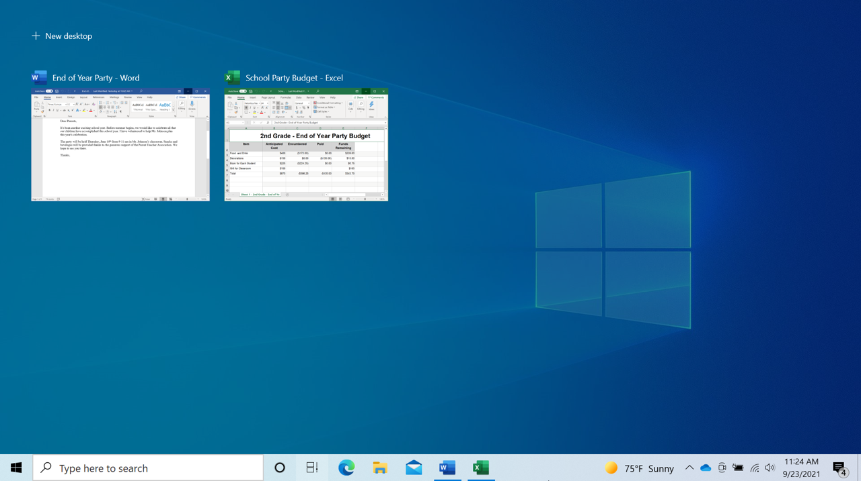
Files and Folders (continued)
Task View: Displays all the windows that are currently open on the computer
Notes:
Clicking the task view button in the task bar displays all the windows that are currently open. From the task view, you can close or select an application.

Slide 50

Files and Folders (continued)
Task View
Notes:
To exit this view, just click outside the windows.

Slide 51
Files and Folders (continued)
Task View
Notes:
Or you can click on the task view buttons again, like a toggle switch.
INSTRUCTOR NOTE: Do not close the “School Party Budget” and “End of Party” before moving to the next section. Before moving to Activity 2, review “parking lot” questions. If there are no questions in the parking lot, ask the attendees if they have any questions before you move to Activity 2.

Slide 52
Activity #2
Notes:
INSTRUCTOR NOTE: Point attendees to Activity 2 on Activity Sheet pages 1 and 2. Review the topics in this section. Go to the desktop. Ask the learners to call out the answers to the questions on the next slide. If the learners have computers, encourage them to follow along on their computers. Encourage them to call out answers, and then confirm the correct answer to have them update their Activity Sheet.

Slide 53
ACTIVITY #2: Working with Files
Use the computer desktop to answer the following questions.
If you don’t have your own computer, follow along with the instructor.
1. Open the web browser and keep it open.
2. Make the browser window wider. Move the browser window to the right side of the screen.
3. What button do you click on to expand or maximize the window to fill the desktop?
4. What button do you click on to make the window smaller again?
5. Use search to see if the computer has a calculator. Is there one?
6. How do you see all of the windows open at one time?
7. In the web browser address bar, go to https://www.digitallearn.org/. Scroll to the bottom of the webpage.
8. Name one of the links under the Learn More section at the bottom of the page.
Notes:
INSTRUCTOR NOTE: Use slide to debrief the activity or as a guide for yourself if you are doing a demonstration. For each item, demonstrate the answer.
1. Open the web browser and keep it open.
2. Make the browser window wider. Move the browser window to the right side of the screen.
3. What button do you click on to expand or maximize the window to fill the desktop? Answer: Click on the square at the top right-hand side of the window.
4. What button do you click on to make the window smaller again? Answer: Click on the double square at the top right-hand side of the window.
5. Use search to see if the computer has a calculator. Is there one? Answer: You will need to search to see if the calculator is available on this computer.
6. How do you see all of the windows open at one time? Answer: Task view
7. In the web browser address bar, go to https://www.digitallearn.org/ Scroll to the bottom of the webpage.
8. Name one of the links under the Learn More section at the bottom of the page.
Answer:
About DigitalLearn.org
Get DigitalLearn for Your Library
Privacy Policy | Terms
See all Our Work in Action
After learners complete Activity 2: “Great job, everyone! In the next section, you’ll learn how to use save and close.”

Slide 54
Saving and Closing Files
Saving a File
Notes:
INSTRUCTOR NOTE: For the “Saving and Closing Files” section (slides 54 through 69), use PowerPoint or a live demonstration.
Occasionally, while you are working on a file, or before you close it, you will want to save your work.
We are finished working in this Excel document, and we need to save our work before closing the file. This file has been saved before, and we want to keep the same file name and location of the file.

Slide 55
Saving and Closing Files (continued)
Saving a File
Notes:
To save the file, click the Save option, which is in the toolbar.

Slide 56
Saving and Closing Files (continued)
Saving a File
Notes:
Some applications, including Microsoft Excel and Microsoft Word, save the file as you go. You can see that this file was saved.

Slide 57

Saving and Closing Files (continued)
Saving a File
Notes:
The toolbar will show you the saved status of the document.

Slide 58
Saving and Closing Files (continued)
Saving a File for the First Time
Notes:
What if this is the first time you’re saving the file? In that case, click File.

Slide 59
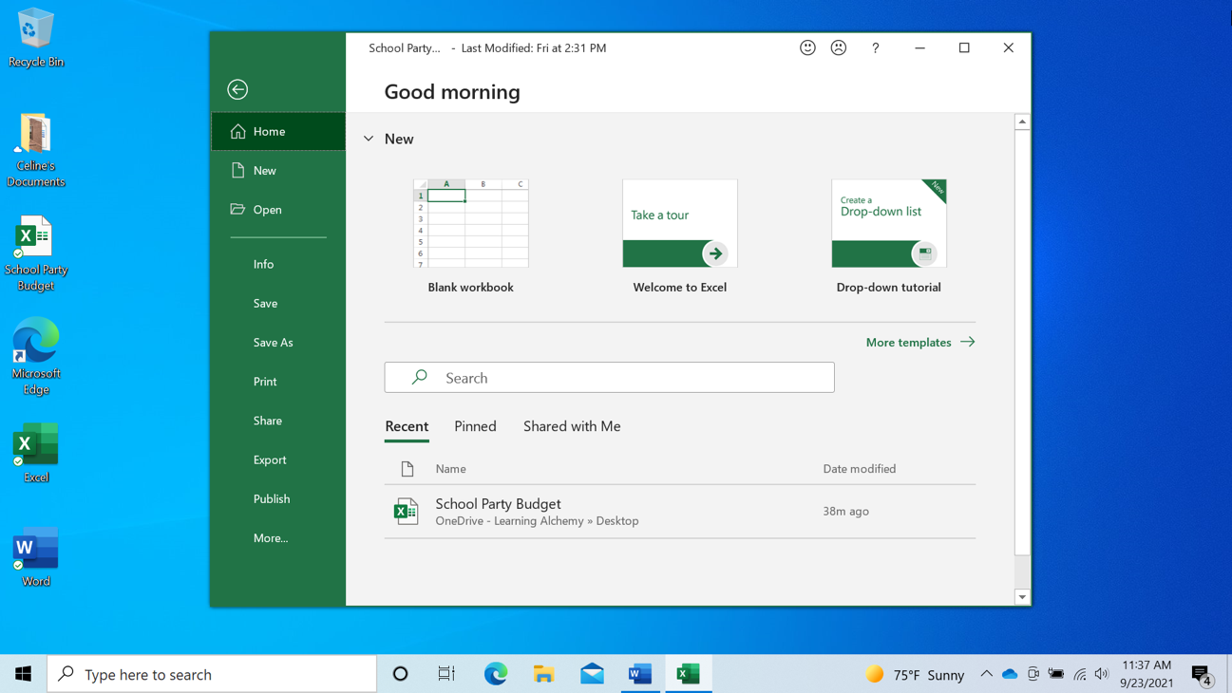
Saving and Closing Files (continued)
Saving a File for the First Time
Notes:
Then select Save As.

Slide 60
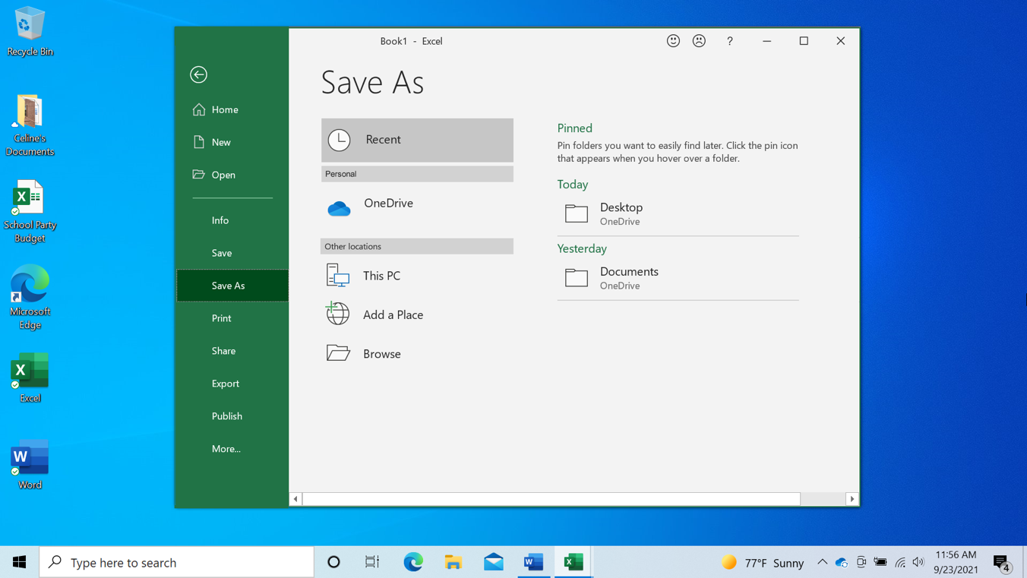
Saving and Closing Files (continued)
Saving a File for the First Time
Notes:
A “Save As” window opens. This allows you to select where on your computer to save the file.

Slide 61
Saving and Closing Files (continued)
Saving a File for the First Time
Notes:
It also lets you enter a name for the file.
Let’s save the file to the desktop.

Slide 62
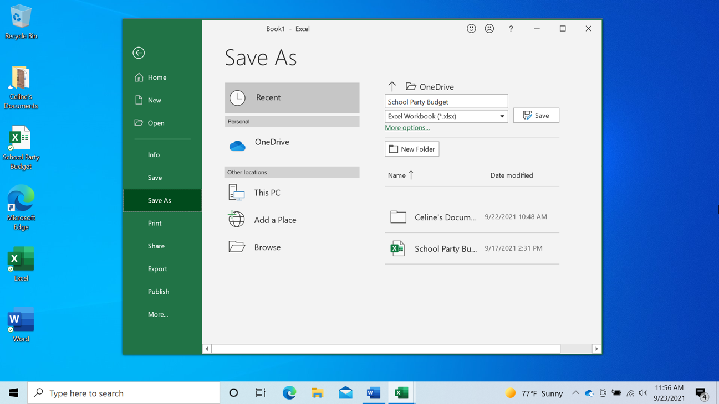
Saving and Closing Files (continued)
Saving a File for the First Time
Notes:
You can also use the navigation pane on the left to choose a different location for your file. Be sure to choose a location you can remember easily, such as on the desktop or in a clearly labeled folder. We need to enter a file name before clicking the Save button.

Slide 63

Saving and Closing Files (continued)
Saving a File to Another Location
Notes:
If you want to save the file to a different location on your computer, click on Save a Copy.

Slide 64
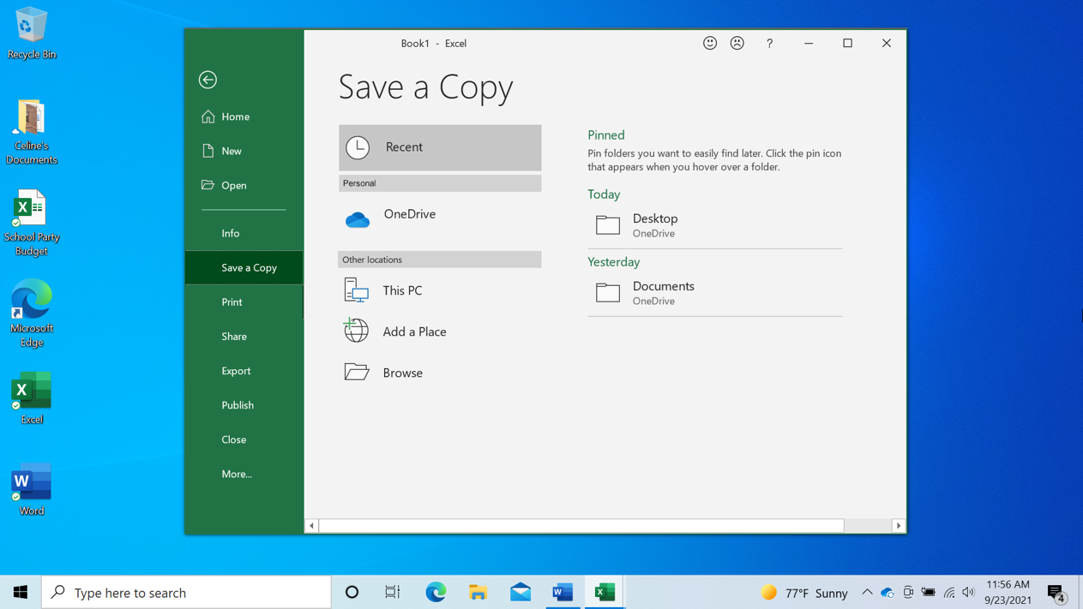
Saving and Closing Files (continued)
Saving a File to Another Location
Notes:
A “Save a Copy” window opens. This allows you to select where the saved file will be located on the computer. We want to save the file to the Documents folder, so we will click on This PC.

Slide 65
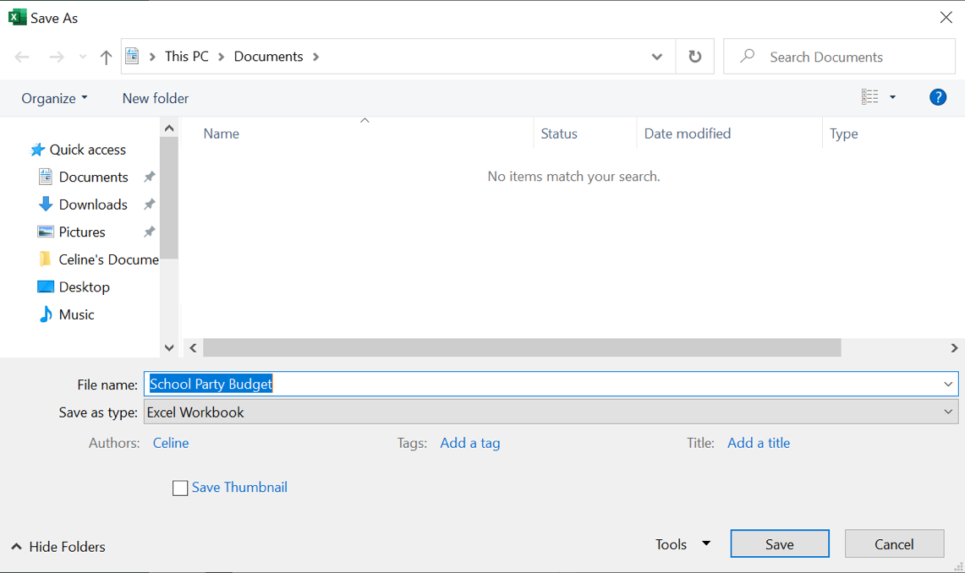
Saving and Closing Files (continued)
Saving a File to Another Location
Notes:
The Save As folder opens. Because we want to save the file to the Documents folder, we click on the Documents icon on the left-hand menu.

Slide 66
Saving and Closing Files (continued)
Saving a File to Another Location
Notes:
Because we do not want to change the file name, we can click Save.

Slide 67
Saving and Closing Files (continued)
Saving a File to Another Location
Notes:
The file is now saved to the new folder.
If you use a public computer, there may be restrictions on where you can save files. Using a USB or flash drive is a common way to save your files when using a public computer.

Slide 68
Saving and Closing Files (continued)
Saving a File to Another Location
Notes:
Now that we have saved the file, we can close it. To do this, click the X in the title bar. Excel will automatically save the file before it closes.

Slide 69

Saving and Closing Files (continued)
Saving a File to Another Location
Notes:
The file is now closed.
INSTRUCTOR NOTE: Before moving to Activity 3, review “parking lot” questions. If there are no questions in the parking lot, ask the attendees if they have any questions before you move to Activity 3.

Slide 70
Activity #3
Notes:
INSTRUCTOR NOTE: Point attendees to Activity 3 on Activity Sheet page 2. Review the topics in this section. Go to the desktop. Ask the learners to call out the answers to the questions on the next slide. If the learners have computers, encourage them to follow along on their computers. Encourage them to call out answers, and then confirm the correct answer to have them update their Activity Sheet.

Slide 71
Activity 3: Saving a File
Use the computer desktop to answer the following questions.
If you don’t have your own computer, follow along with the instructor.
1. Open Microsoft Word.
2. Type “Hello World” in the document.
3. Save the document to the desktop. In the File name box, type “Hello” and click Save.
4. Close the file.
Notes:
INSTRUCTOR NOTE: Use this slide to debrief the activity or as a guide for yourself if you are doing a demonstration. For each item, demonstrate the answer.
Open Microsoft Word.
2. Type “Hello World” in the document.
3. Save the document to the desktop. In the File name box, type “Hello” and click Save.
4. Close the file.
After learners complete Activity 3: “Great job, everyone! In the next section you’ll learn how to delete files.”

Slide 72

Deleting Files
Recycle Bin
Notes:
INSTRUCTOR NOTE: For the “Deleting Files” section (slides 72 through 87), use PowerPoint or a live demonstration.
To delete files, you will use the Recycle Bin, which is located on the desktop.

Slide 73
Deleting Files (continued)
Delete
Notes:
There are files in Celine’s folder that we want to delete. How do we open the folder?
INSTRUCTOR NOTE: Ask the learners to call out the answer. Then demonstrate the step.
That’s right! You double-click the folder.

Slide 74
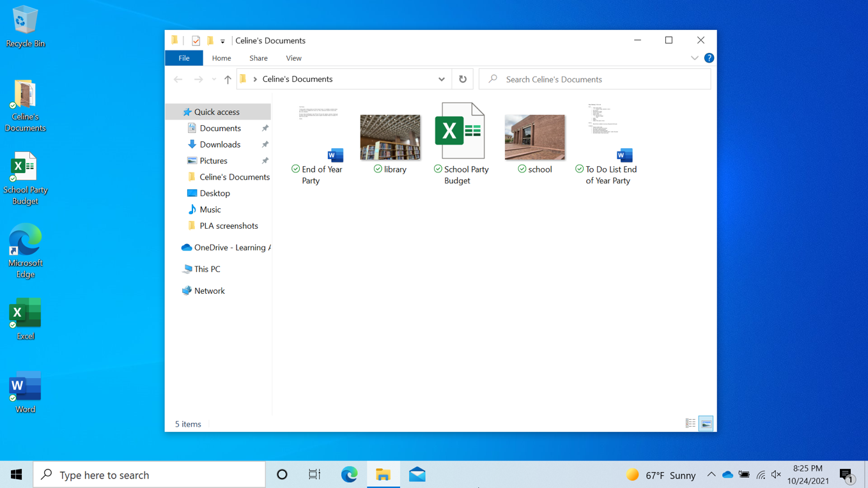
Deleting Files (continued)
Notes:
Celine’s folder is now open. To delete a file, move your cursor to the file you want to delete. In this example, we’re deleting the “To Do List End of the Year Party” document. Click and hold down the left mouse button to select the file. Then drag it to the Recycle Bin on the desktop.

Slide 75
Deleting Files (continued)
Notes:
You can also delete a file by clicking once to select it. In this example, we’re deleting the library picture.

Slide 76
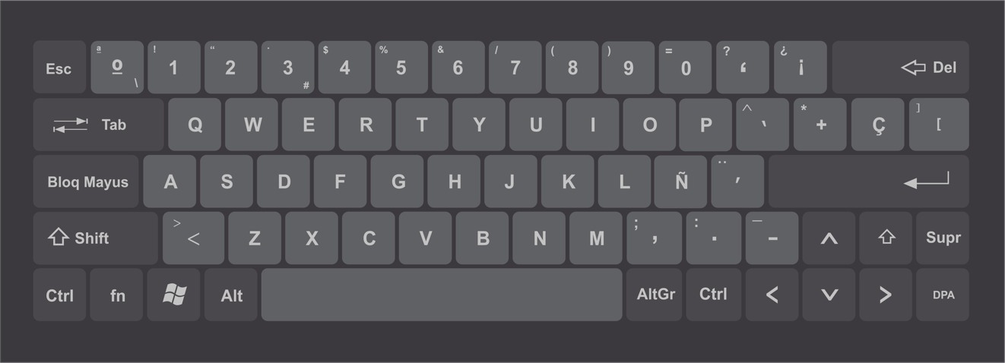
Deleting Files (continued)
Notes:
Tap the Delete key on your keyboard. The Delete button may be in a different location depending on your keyboard.

Slide 77
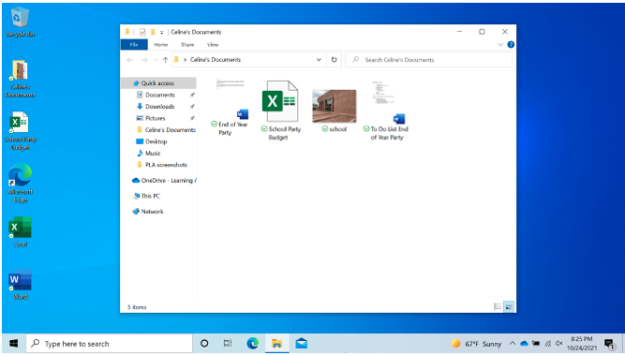
Deleting Files (continued)
Notes:
Now that the library picture and the To Do List file have both been deleted, they no longer display in Celine’s folder.

Slide 78

Deleting Files (continued)
Recycle Bin
Notes:
The files are inside the Recycle Bin. The Recycle Bin is a temporary holding place for deleted files.
Just like a recycle bin in your home, the contents stay in the bin until you empty it and take it out.
If you move a file to the Recycle Bin and later realize you want to keep the file, you can still get the file back—as long as nobody has emptied the Recycle Bin. To open the Recycle Bin, double-click the icon.

Slide 79
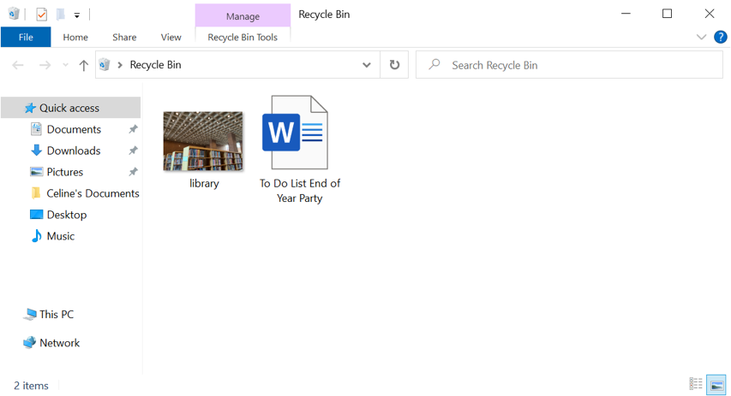
Deleting Files (continued)
Notes:
The Recycle Bin folder will open and a list of the files in the folder will appear.

Slide 80
Deleting Files (continued)
Notes:
To keep a file after placing it in the Recycle Bin, left-click on the file and hold the mouse button down while dragging the file to the desktop or other location where you want to keep it.

Slide 81

Deleting Files (continued)
Notes:
In this example the file was saved to the desktop.

Slide 82
Deleting Files (continued)
c
Notes:
Let’s place the To Do List back in the Recycle Bin. When you are certain that you are done with everything in the Recycle Bin, you can empty it to permanently delete those files.

Slide 83
Deleting Files (continued)
Notes:
One way to empty the Recycle Bin is to move your cursor over the Recycle Bin icon and then right-click on your mouse.

Slide 84
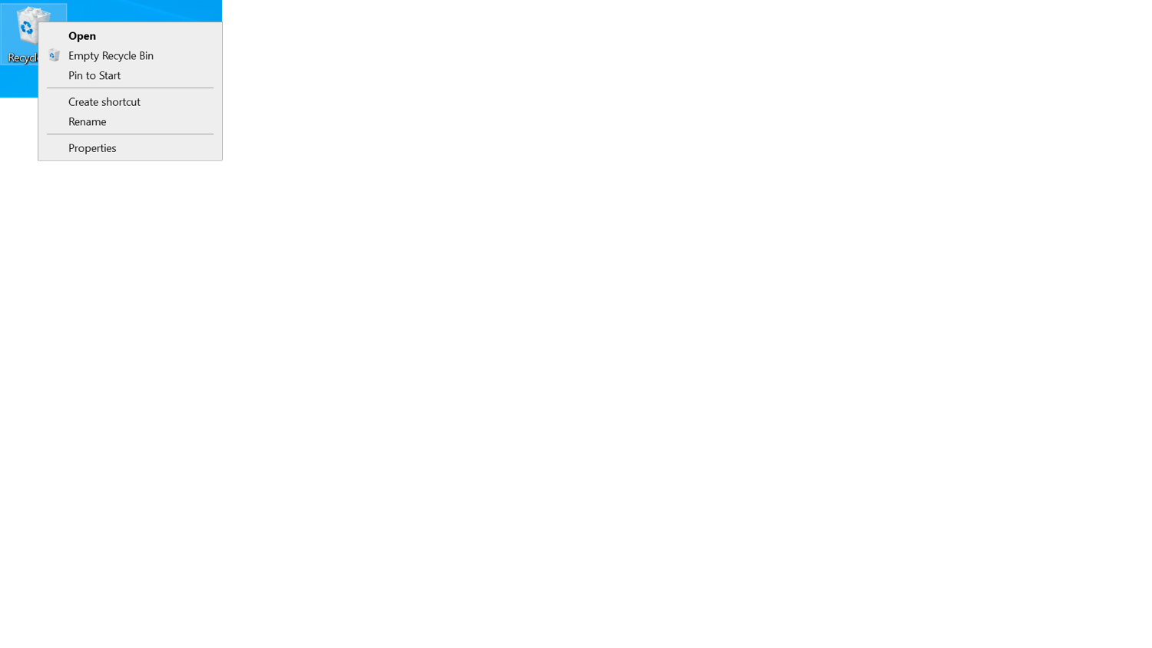
Deleting Files (continued)
Notes:
In the menu that appears, you would click on “Empty Recycle Bin.”

Slide 85
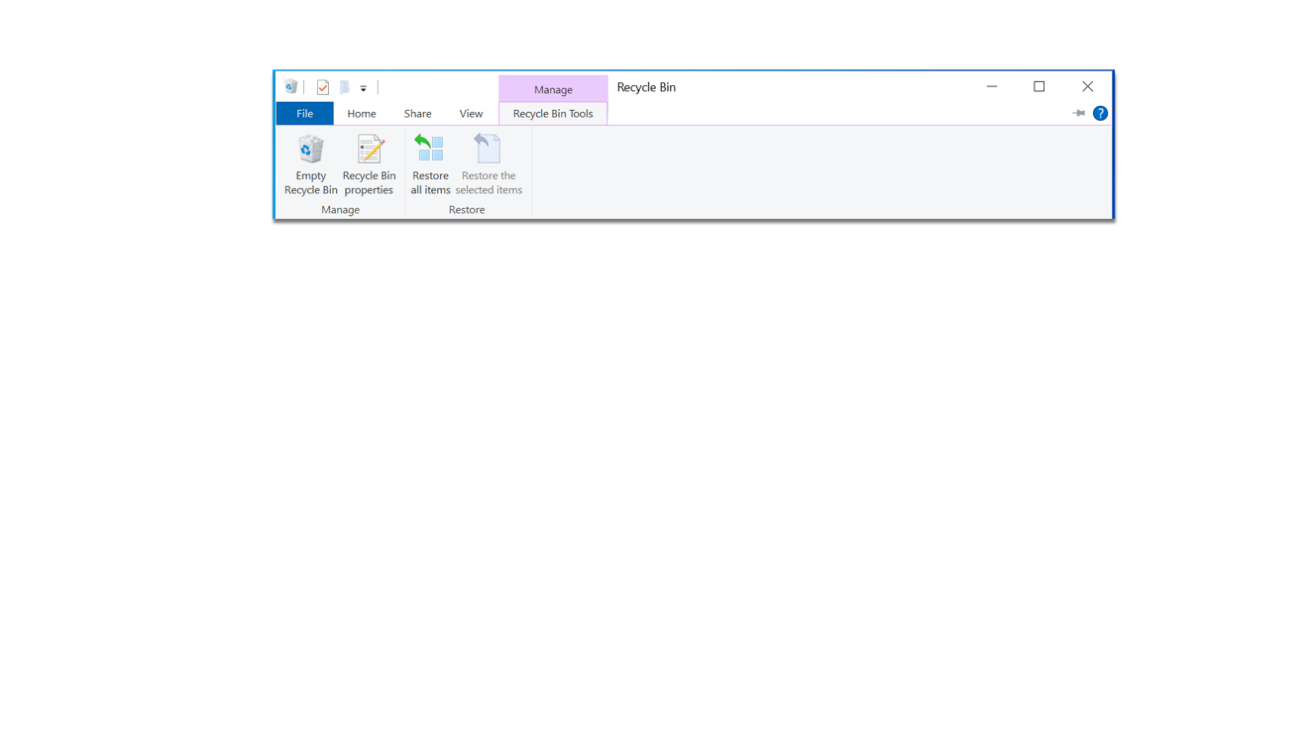
Deleting Files (continued)
Notes:
You can also empty the Recycle Bin from the Recycle Bin folder. To do this, click on the Empty Recycle Bin icon.

Slide 86
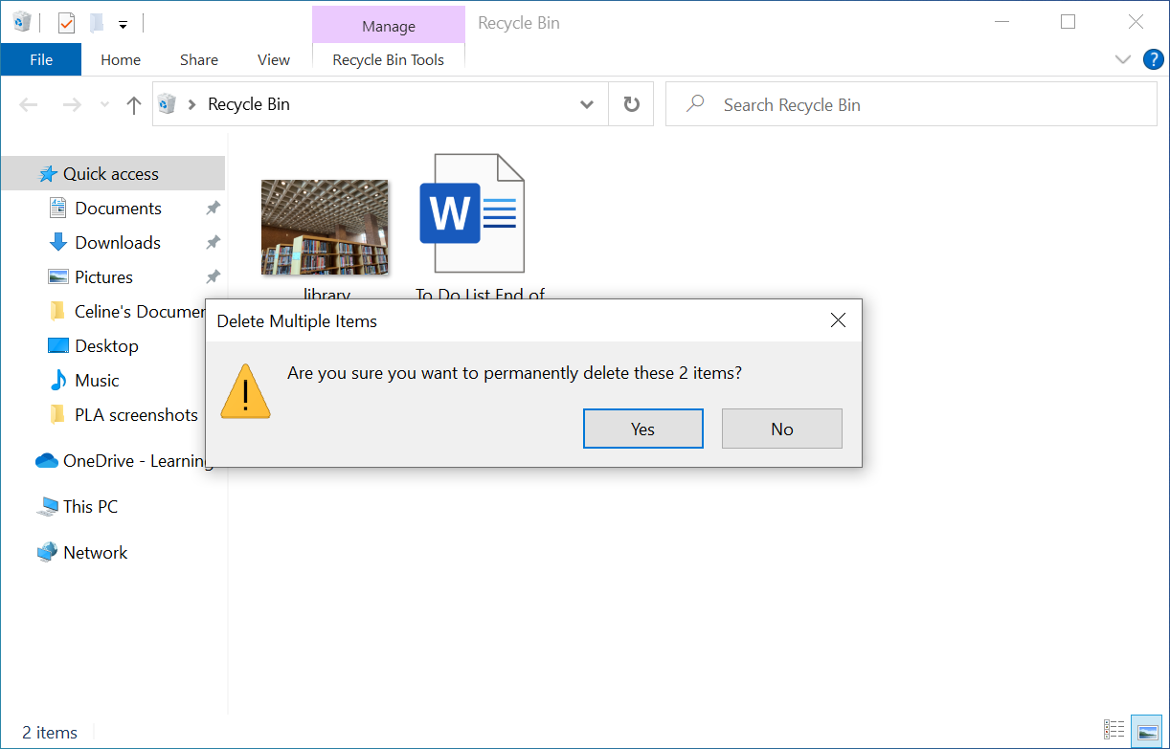
Deleting Files (continued)
Notes:
You will be asked to confirm that you want to delete the file. If you do want to delete the files, click Yes.
Remember that once you click Yes, you will not be able to retrieve the files!

Slide 87
Deleting Files (continued)
Notes:
The Recycle Bin is now empty.
INSTRUCTOR NOTE: Before moving to Activity 4, review “parking lot” questions. If there are no questions in the parking lot, ask the learners if they have any questions before you move to Activity 4.

Slide 88
Activity #4
Notes:
INSTRUCTOR NOTE: Point attendees to Activity 4 on Activity Sheet page 2. Review the topics in this section. Go to the desktop. Ask the learners to call out the answers to the questions on the next slide. If the learners have computers, encourage them to follow along on their computers. Encourage them to call out answers, and then confirm the correct answer to have them update their Activity Sheet.

Slide 89
Activity 4: Deleting Files
Use the computer desktop to answer the following questions.
If you don’t have your own computer, follow along with the instructor.
1. Move the file named Hello.docx on the desktop to the Recycle Bin.
2. Empty the Recycle Bin using one of the two methods you learned today.
Notes:
INSTRUCTOR NOTE: Use the slide to debrief the activity or as a guide for yourself if you’re doing a demonstration. For each item, demonstrate the answer.
1. Move the file named Hello.docx on the desktop to the Recycle Bin.
2. Empty the Recycle Bin using one of the two methods you learned today.
Answer: Right-click on the Recycle Bin or open the Recycle Bin and click on Empty Recycle Bin.
After learners complete Activity 4: “Great job, everyone! In the next section you’ll learn tips for using a PC.”

Slide 90

Tips for Using a PC
Different ways to open an application
The desktop and taskbar are useful tools to access common applications and documents.
Task View allows you to see all the open windows at one time.
Folders help you organize files.
The search box allows you to quickly locate folders and documents.
You can restore documents from the Recycle Bin, but only if nobody has emptied it.
Notes:
Remember:
The desktop and taskbar are useful tools to access common applications and documents.
Task View allows you to see all the open windows at one time.
Folders helps you organize files.
The search box allows you to quickly locate folders and documents.
You can restore documents from the Recycle Bin, but only if nobody has emptied it.
INSTRUCTOR NOTE: Before moving to Activity 5, review “parking lot” questions. If there are no questions in the parking lot, ask the learners if they have any questions before you move to Activity 5.

Slide 91
Activity #5
Open Using a PC Practice Module
Notes:
Let’s practice what you’ve learned.
INSTRUCTOR NOTE: You can either:
Launch the Practice section online by clicking on the link “Open Using a PC Practice Module” on the slide
OR ask learners if they would prefer a demo to walk through these instructions, which are also listed on the Learner Activity Sheet (pages 2 and 3).
In the address bar of the web browser, enter www.digitallearn.org. > Click on “Using a PC (Windows 10)” > Click on “Practice Lesson”
Use the next four slides to review what students have learned in this section.
Learners should follow along as you go through each question. Engage them by asking them to call out answers. Then confirm the correct answer.

Slide 92
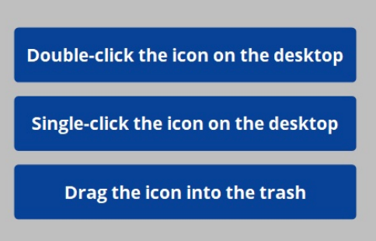
If you want to open an application on the desktop, what do you need to do?
Notes:
INSTRUCTOR NOTE: For the rest of this section (slides 93 through 97), use PowerPoint or a live demonstration.
If you want to open an application on the desktop, what do you need to do?
Answer: Double-click the icon on the desktop.

Slide 93
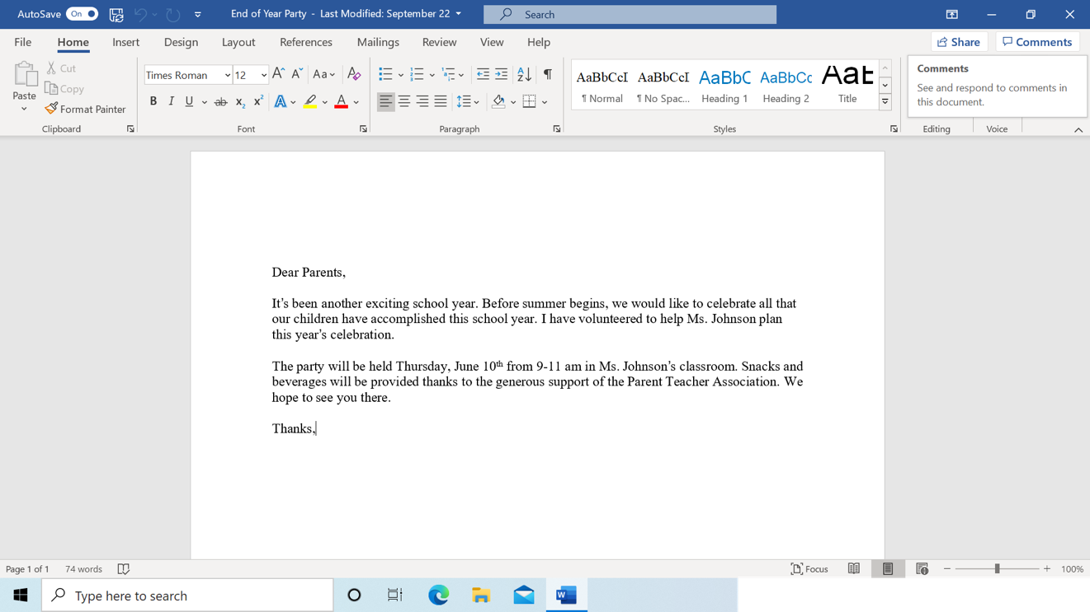
If you want to minimize the window currently open on your screen, which icon would you click?
Notes:
If you want to minimize the window currently open on your screen, which icon would you click?
Answer: It’s the icon that looks like a line at the top-right side of the window.
INSTRUCTOR NOTE: Point out the icon.

Slide 94
If you want to close the window, what icon would you click?
Notes:
If you want to close the window, what icon would you click?
Answer: It’s the icon that looks like an X at the top-right side of the window.
INSTRUCTOR NOTE: Point out the icon.

Slide 95

If you want to save a document, which icon would you click?
Notes:
If you want to save a document, what icon would you click?
Answer: You can click the File menu or click the Save icon.
INSTRUCTOR NOTE: Point out the File menu and the Save icon.

Slide 96

If you accidentally delete a file, where can you find and retrieve it?
Notes:
If you accidentally delete a file, where can you find and retrieve it?
Answer: You would click the Recycle Bin icon.
INSTRUCTOR NOTE: Point out the Recycle Bin icon.

Slide 97
Congratulations, Learners!
Today you have learned:
What an operating system is
The skills you need to use the Windows 10 operating system, including:
  Finding and navigating the desktop
  Finding and organizing files and folders
  Managing the windows of an application
  Saving and closing files
  Deleting files
Tips for using Windows 10
Notes:
Congratulations, learners! Today you have learned:
What an operating system is
The skills you need to use the Windows 10 operating system, including:
Finding and navigating the desktop
Finding and organizing files and folders
Managing the windows of an application
Saving and closing files
Deleting files
Tips for using Windows 10
INSTRUCTOR NOTE: Provide each learner with a Certificate of Completion.

Slide 98
Today’s training is provided by AT&T and the Public Library Association.
Visit <insert libraries URL here> and https://www.digitallearn.org for more courses and to build confidence using technology.
Provided by AT&T and the Public Library Association.
Notes:
INSTRUCTOR NOTE: Highlight the library’s website and https://www.digitallearn.org/ websites as resources for additional virtual online courses.

Slide 99
Thank you for coming!
THANK YOU FOR COMING!
Provided by AT&T and the Public Library Association.
Notes:
Thanks again to AT&T and PLA for this workshop. We appreciate all our participants for coming and we encourage you to keep learning!

