Slide 1

Computer Basics (macOS 11)
Instructor Name
Instructor Title
Library Name
Your Logo Here
Provided by AT&T and Public Library Association
Notes:
INSTRUCTOR NOTE: Please update this slide with the appropriate information:
Instructor name
Instructor affiliation (for instance, library staff member, community volunteer, etc.)
Location name
INSTRUCTOR NOTE: Before the workshop, please review the Instructor Outline for guidance on what to do to prepare for the workshop. You’ll find notes on how to conduct the workshop and details on what you should do once the workshop ends.
INSTRUCTOR NOTE: Please use the Volunteer Instructor Guide for talking points for the presentation. In that document, slide notations begin on page 6.
Today’s workshop is provided by AT&T and the Public Library Association.
INSTRUCTOR NOTE: Include thank-you to the community collaborator if applicable.
My name is <your name here> and I am <brief description of yourself>. Before we get started here are a few housekeeping items: <mention the items that are relevant to your workshop>:
Where are the restrooms?
Where are the emergency exits?
When/how to ask questions—Note where to locate the page number on each slide for participants to include when they have questions to ask later.
If you have a cell phone with you, please make sure to either turn it off or set to silent.
Will there be a break?

Slide 2
Today’s Agenda
Introduction
  Learn about Mac operating systems
Skill Building
  Find and navigate the desktop
  Find and organize files and folders
  Manage the windows of an application
  Save and close files
  Delete files
Tips for using a Mac operating system
Practice
Notes:
In today’s workshop, you will learn about a computer’s operating system. Here’s a preview of what you’ll learn.
Introduction
Learn about operating systems
Skill Building
Find and navigate the desktop
Find and organize files and folders
Manage the windows of an application
Save and close files
Delete files
Tips for using a Mac operating system
Practice
Let’s get started!

Slide 3

Introduction
What types of things do you want to do with a computer?
Notes:
INSTRUCTOR NOTE: Ask attendees the question on the slide. Allow a moment for the attendees to think about it. Then lead a brief discussion about how using a computer can make life better, easier, or more fun. The conversation should be about two or three minutes.

Slide 4
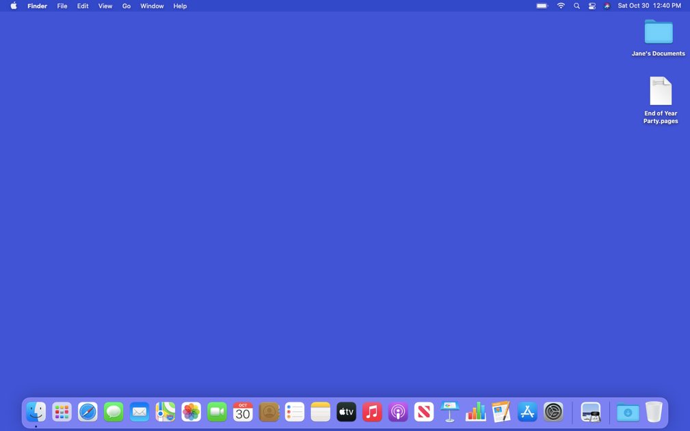

Definition
  Operating System: the software that handles the functions of the computer to make sure everything is working together.
Notes:
Introduction to the macOS 11 operating system
The operating system is the software that handles the functions of the computer to make sure everything is working together.

Slide 5

Definition (continued)
  Operating System
Notes:
Introduction to the macOS 11 operating system
Your brain works to manage your body to make sure you are breathing and your heart is pumping. In a similar way, the operating system manages the functions of the computer to make sure everything is working together.
A Mac computer’s operating system is called macOS (pronounced “Mac oh ess”).

Slide 6


Definition (continued)
  Operating System
Notes:
INSTRUCTOR NOTE: Use PowerPoint or live demonstration.
Introduction to the macOS 11 operating system
You can tell what version of the operating system you have by the number that follows. To see what version of the macOS the computer is using, click on the Apple icon on the desktop.

Slide 7
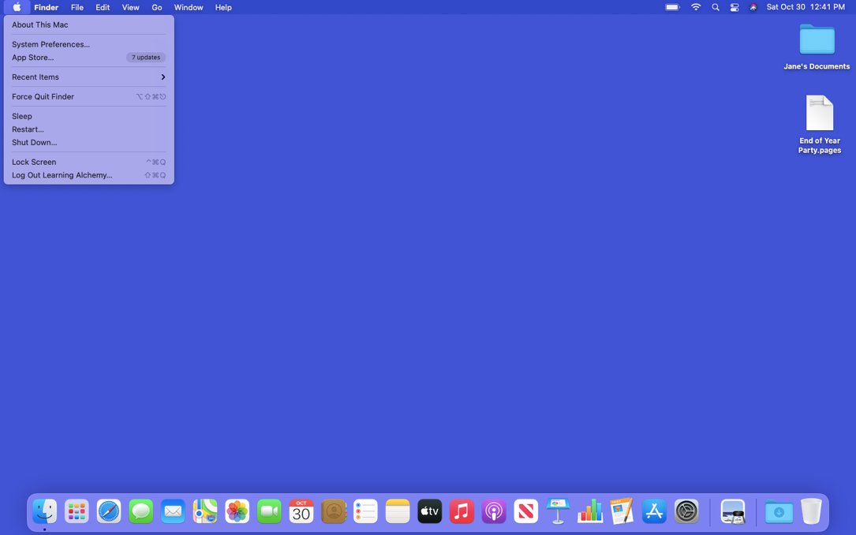
Definition (continued)
  Operating System
Notes:
INSTRUCTOR NOTE: Use PowerPoint or live demonstration.
Introduction to the macOS 11 operating system
Then choose About this Mac from the pull-down menu.

Slide 8
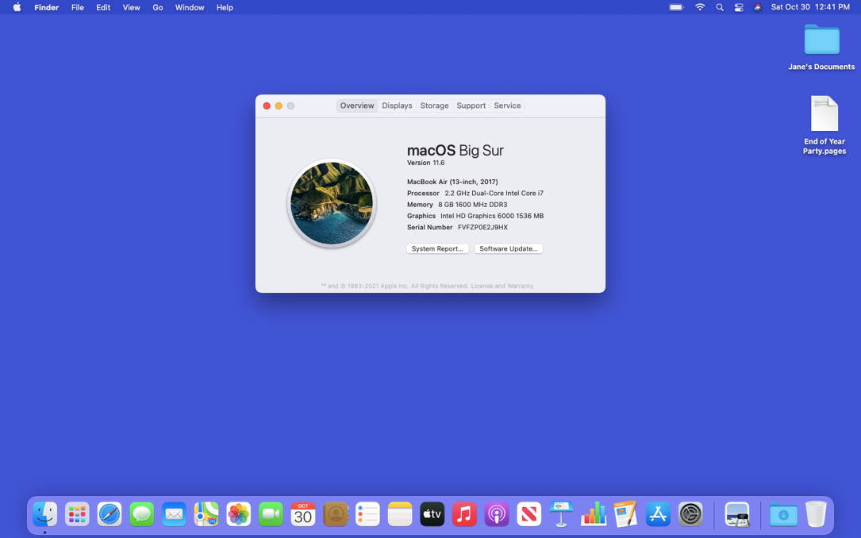
Definition (continued)
  Operating System
Notes:
INSTRUCTOR NOTE: Use PowerPoint or live demonstration.
Introduction to the macOS 11 operating system
A dialog box appears that lets you know which version of macOS you are using. In this example, the computer is running macOS Big Sur, the name for macOS 11.

Slide 9
Working from the Desktop
Notes:
INSTRUCTOR NOTE: Use PowerPoint or live demonstration.
Demonstrate the main features of a macOS 11 desktop.
This is the macOS 11 desktop. Let’s explore different sections of the computer’s desktop, including the Dock, Apple Menu, and more.
If you’re using an Apple computer that has a different version of the operating system, the desktop may look different.

Slide 10

Working from the Desktop (continued)
Notes:
INSTRUCTOR NOTE: Use PowerPoint or live demonstration.
Demonstrate the main features of a macOS 11 desktop.
The macOS 11 desktop is just like the top of your desk at home or at work. It’s where you keep different folders with papers in them, and other tools you need to get things done, such as a calculator, pen, or reference book.
Just like you have folders and tools on your physical desk, you also have those tools and folders on the computer, which you can access through the desktop.

Slide 11
Working from the Desktop (continued)
Dock: Usually located at the bottom of the screen, it is where you find frequently accessed applications, open files and empty trash.
Notes:
INSTRUCTOR NOTE: Use PowerPoint or live demonstration.
Demonstrate the main features of a macOS 11 desktop.
The Dock is usually located at the bottom of the screen, but it can also appear on the left or right side of the desktop. This is where you can find frequently accessed applications, open files, and empty the trash.

Slide 12



Working from the Desktop (continued)
Applications: Tools that allow you to do things on a computer.
Notes:
INSTRUCTOR NOTE: Use PowerPoint or live demonstration.
Demonstrate the main features of a macOS 11 desktop.
Applications are tools that allow you to do things on a computer. In today’s example we will use Pages, which allows you to open a document. We’ll also use Photos which allows you to look at and manage your photos. And then we’ll use a calculator, which allows you to do math.

Slide 13
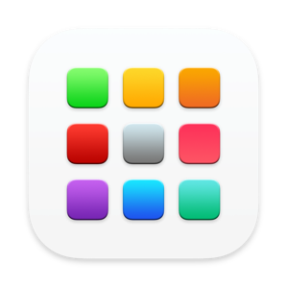
Working from the Desktop (continued)
Launchpad: Lists all applications available on the computer.
Notes:
INSTRUCTOR NOTE: Use PowerPoint or live demonstration.
Demonstrate the main features of a macOS 11 desktop.
The Dock lists the most commonly used applications on the computer. If you want to see all of the applications on a computer, click the Launchpad icon. To open an application from the Launchpad, single-click on the icon.

Slide 14
Working from the Desktop (continued)
Menu Bar: Includes the Apple Menu, the date, time, volume control and more. The Menu Bar changes depending on the program that is open date
Notes:
INSTRUCTOR NOTE: Use PowerPoint or live demonstration.
Demonstrate the main features of a macOS 11 desktop.
The Menu Bar includes the Apple Menu, the date, time, volume control, and more. The Menu Bar changes depending on which program is open.
INSTRUCTOR NOTE: Point out the parts of the menu bar on the screen.

Slide 15


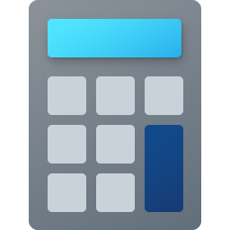

Working from the Desktop (continued)
Siri: A virtual assistant that responds to voice commands by using the computer speakers.
Notes:
INSTRUCTOR NOTE: Use PowerPoint or live demonstration.
Demonstrate the main features of a macOS 11 desktop.
Siri is a virtual assistant that responds to voice commands by using the computer speakers. To ask Siri for help, click on the icon and speak to Siri with your question or request. For example, you might ask, “Siri, what is the weather in Chicago today?”

Slide 16

Working from the Desktop (continued)
Search: Find a specific file, computer setting, or an application a computer.
Notes:
INSTRUCTOR NOTE: Use PowerPoint or live demonstration.
Demonstrate the main features of a macOS 11 desktop.
What if you can’t find what you are looking for on your computer? For example, you might want to find a specific file, a certain computer setting, or an application. In that case, you can use the Search located in the Menu Bar.

Slide 17

Working from the Desktop (continued)
Different ways to open an application
Double-click on the Desktop icon
Single-click on the icon in the Dock
Single-click from the Launchpad menu
Search and single-click options using Siri or search
Notes:
INSTRUCTOR NOTE: Use PowerPoint slide to display list.
Demonstrate the main features of a macOS 11 desktop.
There is more than one way to open an application on a computer. You can double-click on a Desktop icon, single-click on the Dock icon, select the application from the Launchpad menu, or search and select the application using the Siri virtual assistant or search.
INSTRUCTOR NOTE: Before moving to Activity 1, review “parking lot” questions. If there are no questions in the parking lot, ask the attendees if they have any questions before you move to Activity 1. For details on the parking lot concept, please see the “Before the Workshop Begins” section of the Instructor Outline.

Slide 18
Activity #1
Notes:
INSTRUCTOR NOTE: Review the topics learned in this section. Go to the desktop. Ask the learners to call out the answers to these questions. If the learners have computers, encourage them to follow along on their computers. Invite them to call out answers, and then confirm the correct answer to have them update their Activity Sheet.
Let’s practice what you’ve learned.

Slide 19
ACTIVITY #1: Working from the Desktop
Use the computer desktop to answer the following questions.
If you don’t have your own computer, follow along with the instructor.
1. What would you click on to see what version of macOS is running on the computer?
2. Name three ways in which you can open an application like Pages or the Safari browser.
3. What icon would you click on to search for a file on your computer using your voice?
4. Where would you click to shut down the computer?
Notes:
INSTRUCTOR NOTE: Use this slide to debrief the activity or as a guide for yourself if you are doing a demonstration.
1. What would you click on to see what version of macOS is running on the computer?
INSTRUCTOR NOTE: Demonstrate the answers one by one and ask learners with computers to follow along.
Answer: Apple Icon for Menu → About This Mac
2. Name three ways in which you can open an application like Pages or the Safari browser.
Answers:
From the Desktop icon
From the Dock
From the Launchpad menu
Using Siri or search
3. What icon would you click on to search for a file on your computer using your voice?
Answer: Click on the Siri icon in the Menu bar.
4. Where would you click to shut down the computer?
INSTRUCTOR NOTE: Only the Instructor should demonstrate the answer. Do not actually shut down the computer.
Answer: Click on the Apple icon in the top-right corner. Then choose Shut Down from the drop-down menu.
After learners complete Activity 1:
Great job, everyone! In the next section you’ll learn how to use files and folders.

Slide 20

Files and Folders
File: A file is a package of information.
Notes:
Demonstrate how to use files and folders on a macOS desktop.
What is a file? A file is a package of information.

Slide 21




Files and Folders
Applications: Software or tools that allow you to do things on the computer with the file.
Notes:
Demonstrate how to use files and folders on a macOS desktop.
Applications are software or tools that allow you to complete tasks. Some applications allow you to work on text documents. Others allow you to edit pictures, watch videos, listen to music, or access the internet.

Slide 22
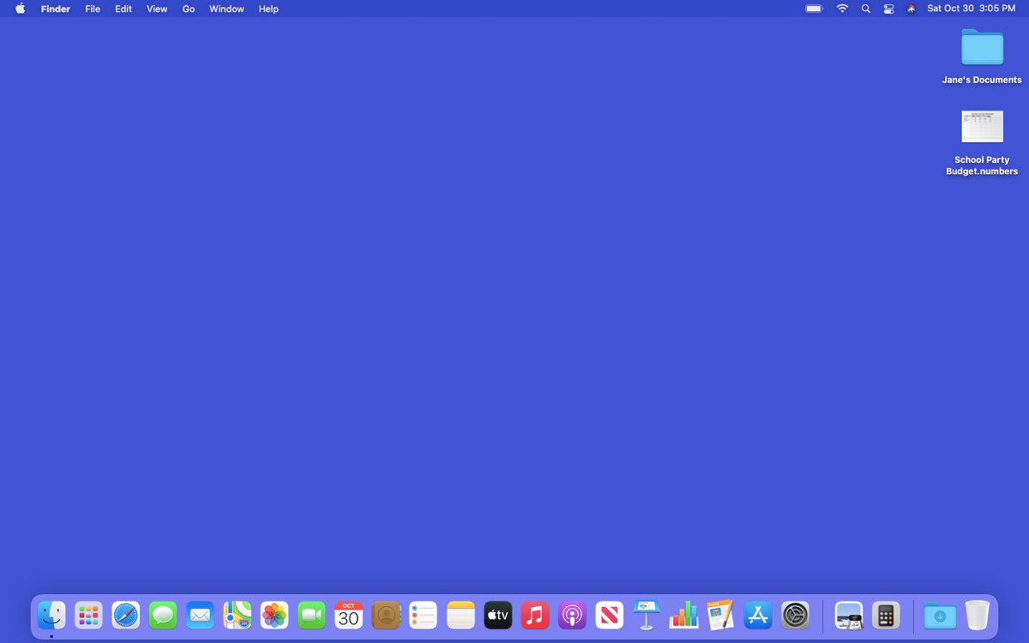
Files and Folders
Opening a File
Notes:
INSTRUCTOR NOTE: Use PowerPoint or live demonstration.
Demonstrate how to use files and folders on a macOS desktop.
Just like an application, there are several ways you can open a file. To open a file on the desktop, use your mouse or touchpad to move the cursor to the file. Then double-click on the file to open it. Let’s give it a try.
INSTRUCTOR NOTE: Please use the “School Party Budget.numbers” file you downloaded before the class to use as an example.

Slide 23
Files and Folders (continued)
Opening a File
Notes:
INSTRUCTOR NOTE: Use PowerPoint or live demonstration.
Demonstrate how to use files and folders on a macOS desktop.
Let’s open the file School Party Budget.numbers. To open the file, double-click it.

Slide 24
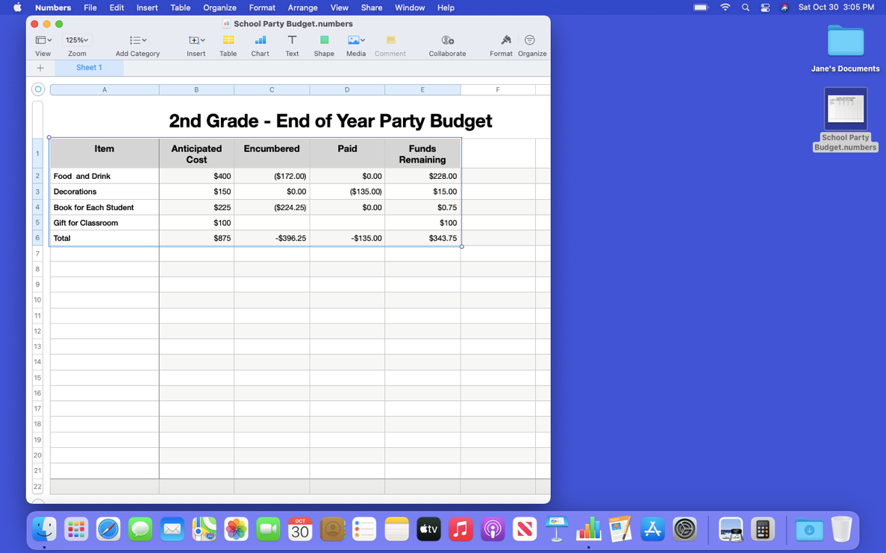
Files and Folders (continued)
File Opens
Notes:
INSTRUCTOR NOTE: Use PowerPoint or live demonstration.
Demonstrate how to use files and folders on a macOS desktop.
Any time you open a file, it will open inside a related software application. In today’s example, the file opens in Numbers, since that was the application that was used to create it.
INSTRUCTOR NOTE: If doing a live demonstration, close the file before moving to the next task.

Slide 25
Files and Folders (continued)
Opening a File in a Folder
Notes:
INSTRUCTOR NOTE: Use PowerPoint or live demonstration.
Demonstrate how to use files and folders on a macOS desktop.
You can also open files that are in folders. I want to open a file in Jane’s Documents folder. To see the files in the folder, I would double-click on it.

Slide 26
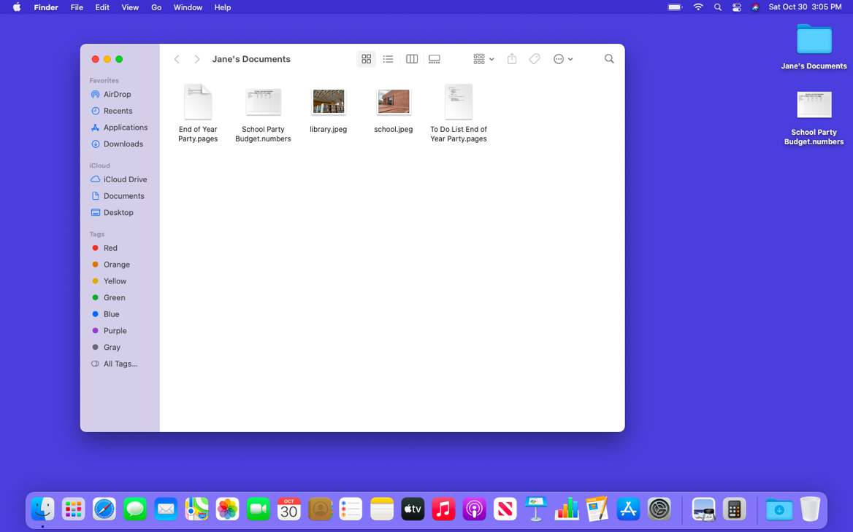
Files and Folders (continued)
Open Folder
Notes:
INSTRUCTOR NOTE: Use PowerPoint or live demonstration.
Demonstrate how to use files and folders on a macOS desktop.
And the folder opens and lists the files that are in the folder.

Slide 27
Files and Folders (continued)
Open Folder
Notes:
INSTRUCTOR NOTE: Use PowerPoint or live demonstration.
Demonstrate how to use files and folders on a macOS desktop.
How would you open the file "End of Year Party.pages”?
INSTRUCTOR NOTE: Ask the learners to call out the answers to this question.
INSTRUCTOR NOTE: Please use the “End of Year Party.pages” file that is in the “Jane’s Documents” folder you downloaded before the class.

Slide 28
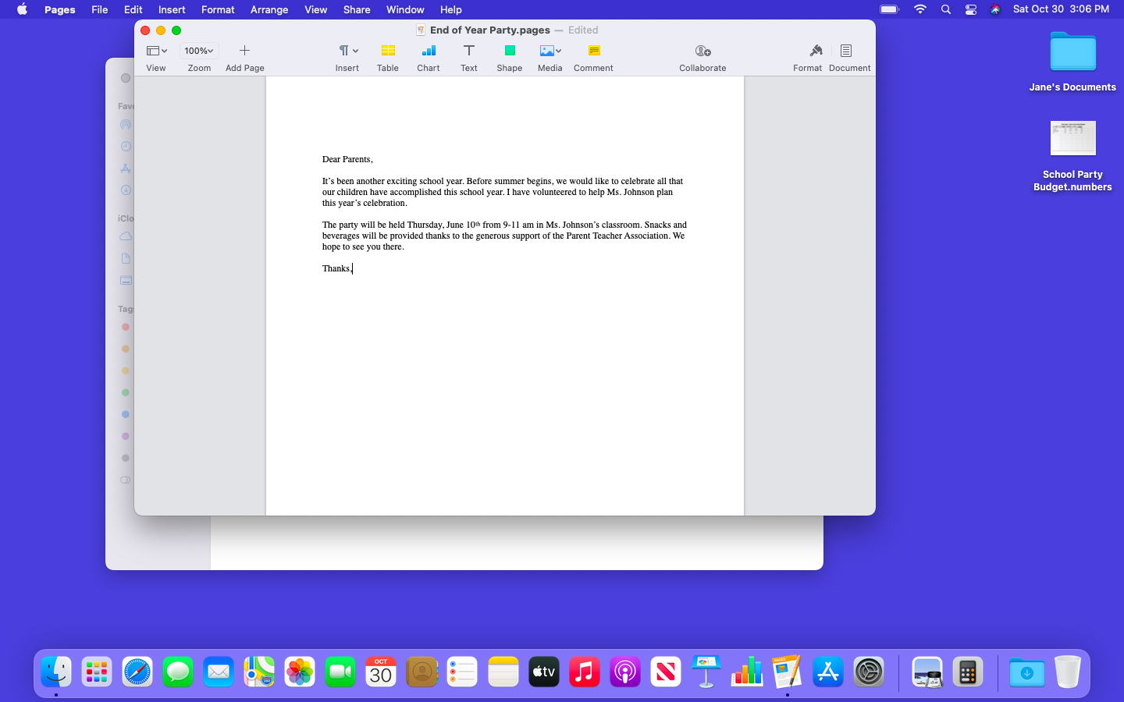
Files and Folders (continued)
Notes:
INSTRUCTOR NOTE: Use PowerPoint or live demonstration.
Demonstrate how to use files and folders on a macOS desktop.
That’s right! You would double-click on the file. When you do this, it opens.
INSTRUCTOR NOTE: Demonstrate how to open the file by double-clicking the file named End of Year Party.pages.
INSTRUCTOR NOTE: If doing a live demonstration close the folder before moving to the next task but leave the file open.

Slide 29
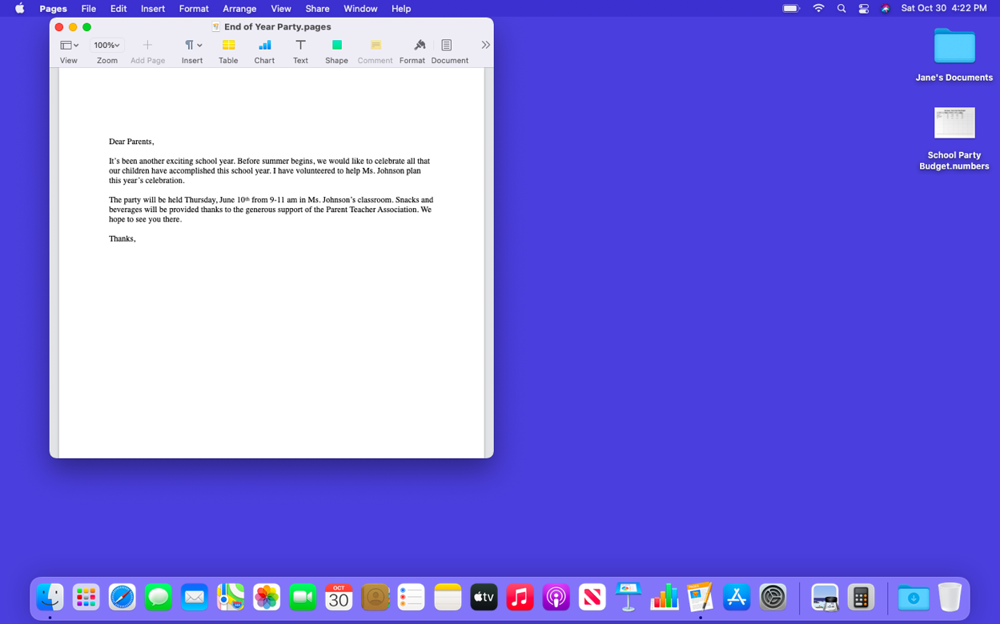
Files and Folders (continued)
What Is a Window?
Notes:
INSTRUCTOR NOTE: Use PowerPoint or live demonstration.
Demonstrate how to use windows on a macOS desktop.
Every time you open and use applications, files, and folders, they appear inside a window. The window is your working area.
INSTRUCTOR NOTE: Use the file “End of Year Party.pages” to demonstrate how to change the size of the window.

Slide 30
Files and Folders (continued)
Changing the Size of the Window
Notes:
INSTRUCTOR NOTE: Use PowerPoint or live demonstration.
Demonstrate how to use windows on a macOS desktop. Resize a window.
Sometimes the window may be too big or too small. To change the size of the window, use your mouse or touchpad to place the cursor on the edge of the window.

Slide 31



Files and Folders (continued)
Changing the Size of the Window
Notes:
INSTRUCTOR NOTE: Use PowerPoint or live demonstration.
Demonstrate how to use windows on a macOS desktop. Resize a window.
When you do this, the cursor will change into a double-headed arrow.
You can then click and hold the left mouse button to “grab” the edges of the window. Then drag the mouse to the left to change the size of the window.

Slide 32
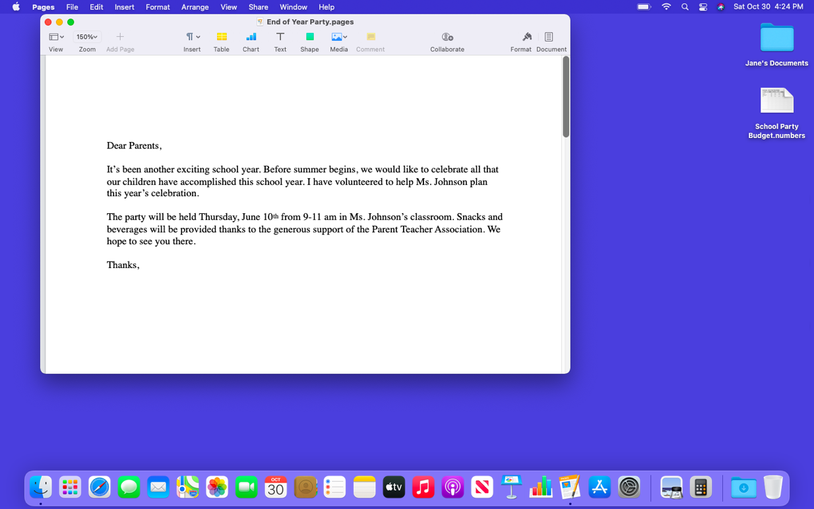
Files and Folders (continued)
Changing the Size of the Window
Notes:
INSTRUCTOR NOTE: Use PowerPoint or live demonstration.
Demonstrate how to use windows on a macOS desktop. Resize a window.
Release the mouse button when the window is the desired size.

Slide 33
Files and Folders (continued)
Notes:
INSTRUCTOR NOTE: Use PowerPoint or live demonstration.
Demonstrate how to use windows on a macOS desktop.
At the top of the window, there are tools to help you manage the size and shape of the window.

Slide 34

Files and Folders (continued)
Maximize Button: Expand the window to fill the desktop.
Notes:
INSTRUCTOR NOTE: Use PowerPoint or live demonstration.
Demonstrate how to use Windows on a Mac OS desktop.
If you want the window to fill the whole desktop, you can click the green button on the top-left corner of the window. Let’s give it a try.

Slide 35

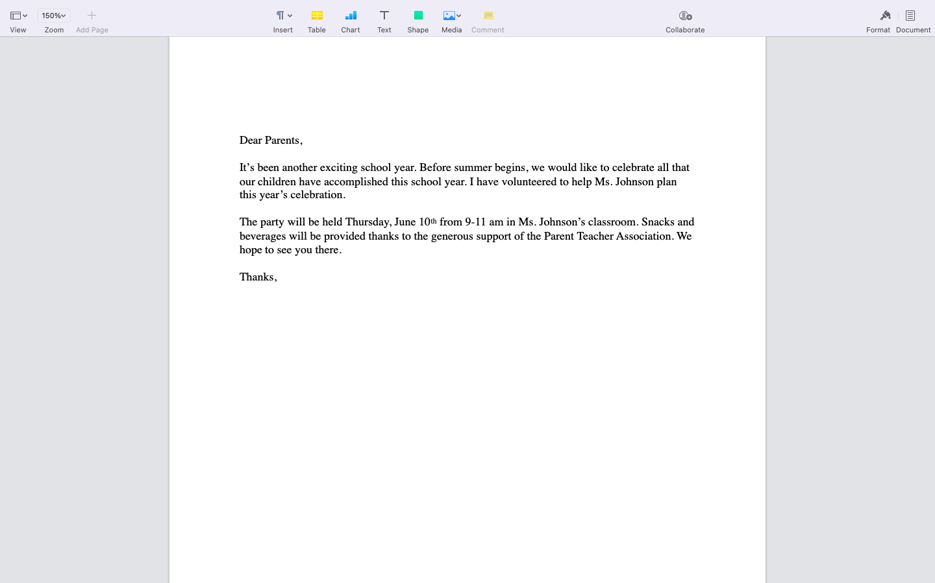
Files and Folders (continued)
Maximizing the Window
Notes:
INSTRUCTOR NOTE: Use PowerPoint or live demonstration.
Demonstrate how to use windows on a macOS desktop.
When you click on the green button, the window fills the entire screen. When you want to make the window smaller again, it can be a bit tricky since the menu bar is hidden. In order to see the menu when a window is in full screen, you need to move the mouse all the way to the top of the screen.

Slide 36
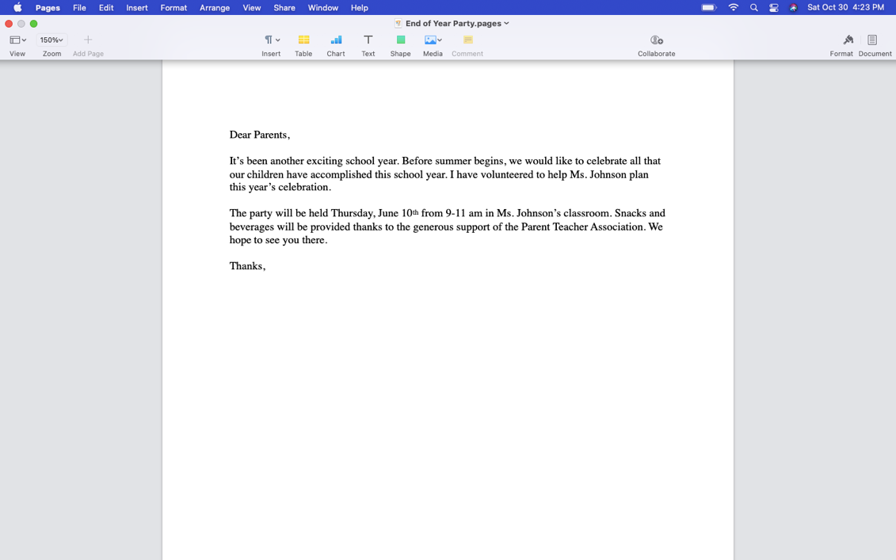
Files and Folders (continued)
Restore: Returns the window to the size it was before it was maximized.
Notes:
INSTRUCTOR NOTE: Use PowerPoint or live demonstration.
Demonstrate how to use windows on a macOS desktop.
The menu bar appears again and the green button is visible. What happens when you click on the green button?

Slide 37

Files and Folders (continued)
Restored Window
Notes:
INSTRUCTOR NOTE: Use PowerPoint or live demonstration.
Demonstrate how to use windows on a macOS desktop.
The window returns to its original size.

Slide 38

Files and Folders (continued)
Scroll: Use this tool to see more of the file contents that are not visible on the current screen.
Notes:
INSTRUCTOR NOTE: Use PowerPoint or live demonstration.
Demonstrate how to use windows on a macOS desktop.
You can scroll in the window to display different parts of the document. Scrolling will move you up and down the page, similar to turning the pages of a multipage document.

Slide 39
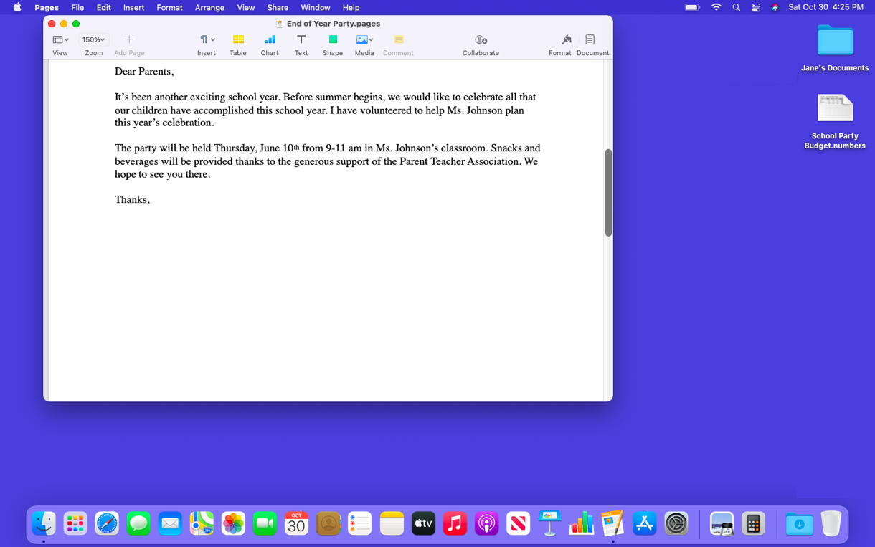
Files and Folders (continued)
Scrolling
Notes:
INSTRUCTOR NOTE: Use PowerPoint or live demonstration.
Demonstrate how to use windows on a macOS desktop.
To scroll, move the cursor to the scroll bar. Then click and hold the left mouse button to “grab” it. After that, drag it to move down in the document.

Slide 40
Files and Folders (continued)
Minimize: Collapse the window into the Dock at the bottom of the screen so you can see and use the desktop.
Notes:
INSTRUCTOR NOTE: Use PowerPoint or live demonstration.
Demonstrate how to use windows on a macOS desktop.
If you would like to access other files or folders on the desktop while this file is open, click on the yellow button at the top left of the window to minimize it. This will collapse the window into the Dock at the bottom of the screen, so you can see and use the desktop.

Slide 41
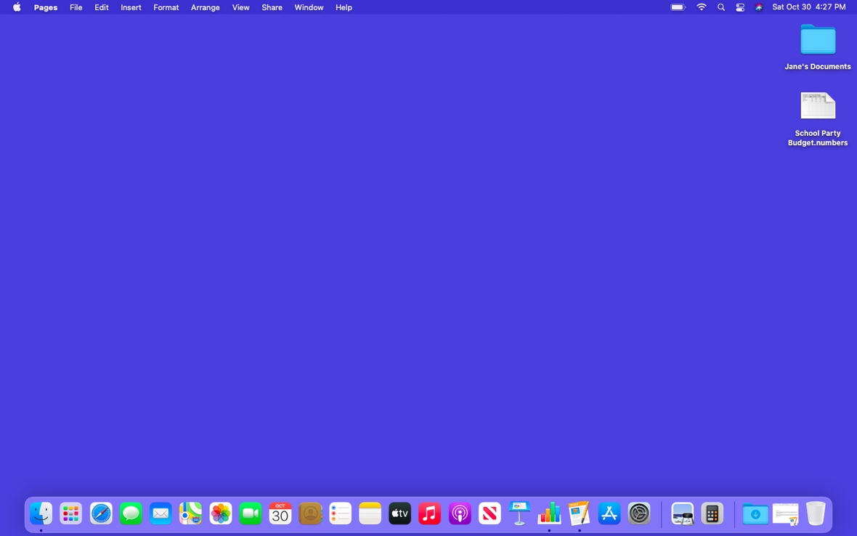
Files and Folders (continued)
Minimize
Notes:
INSTRUCTOR NOTE: Use PowerPoint or live demonstration.
Demonstrate how to use windows on a macOS desktop.
Now that the first file is minimized, it appears on the Dock at the bottom as an icon. This frees up the desktop so that you can find another file.

Slide 42
Files and Folders (continued)
Working with More Than One Window
Notes:
INSTRUCTOR NOTE: Use PowerPoint or live demonstration.
Demonstrate how to use windows on a macOS desktop.
Let’s open the School Party Budget.numbers file on the desktop. How do we open this file?
INSTRUCTOR NOTE: Encourage the learners to call out the answer.

Slide 43
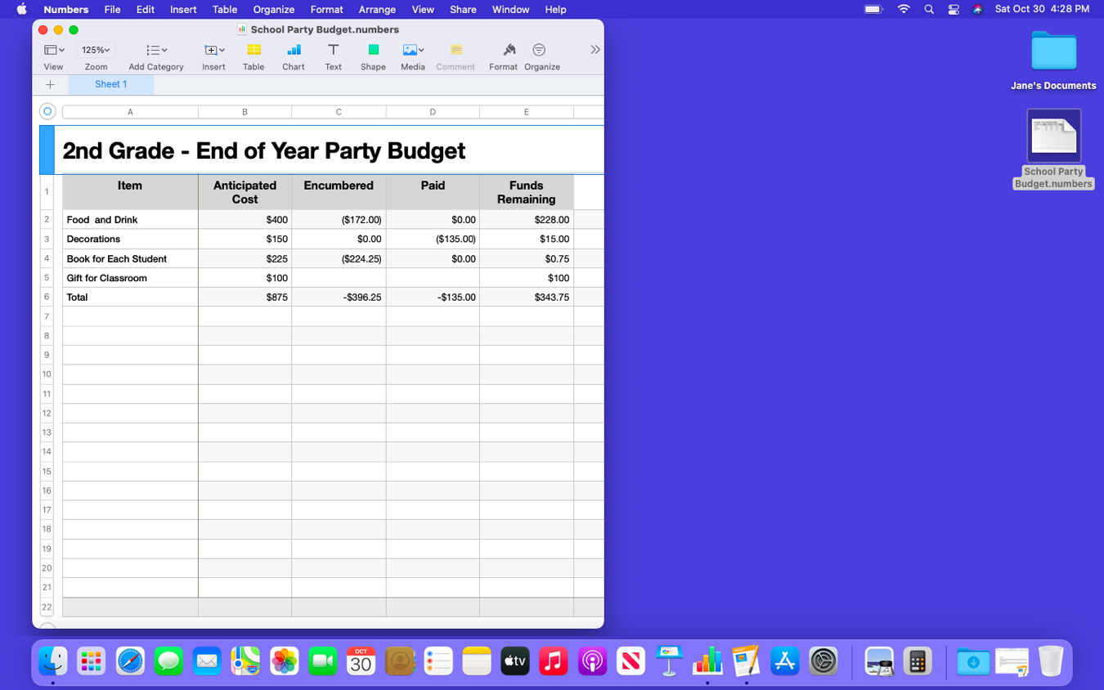
Files and Folders (continued)
Working with More Than One Window
Notes:
INSTRUCTOR NOTE: Use PowerPoint or live demonstration.
Demonstrate how to use windows on a macOS desktop.
That’s right: you double-click on the file on the desktop. The file opens in Numbers because that is the application that was used to create the file. Now let’s open the End of Party.pages file in the Dock. How do we open this file?
INSTRUCTOR NOTE: Encourage the learners to call out the answer.

Slide 44
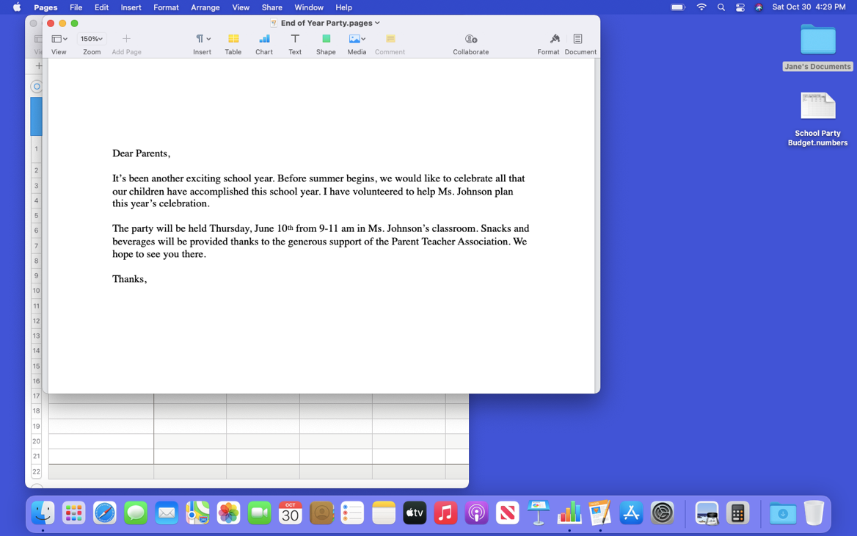
Files and Folders (continued)
Working with More Than One Window
Notes:
INSTRUCTOR NOTE: Use PowerPoint or live demonstration.
Demonstrate how to use windows on a macOS desktop when multiple windows are open.
You’ve got it! You single-click the file in the Dock to open it. In this example, the file in the Dock opens in the application called Pages, but this will work for any kind of file that is open in the Dock.
There are now two windows open: “School Party Budget” and “End of Party.”

Slide 45
Files and Folders (continued)
Working with More than One Window
Notes:
INSTRUCTOR NOTE: Use PowerPoint or live demonstration.
Demonstrate how to use windows on a macOS desktop when multiple windows are open.
To move a specific window, you can pick up that window by moving the cursor to the gray bar at the top. To do this, place the cursor above the gray bar and click down on your mouse button.

Slide 46
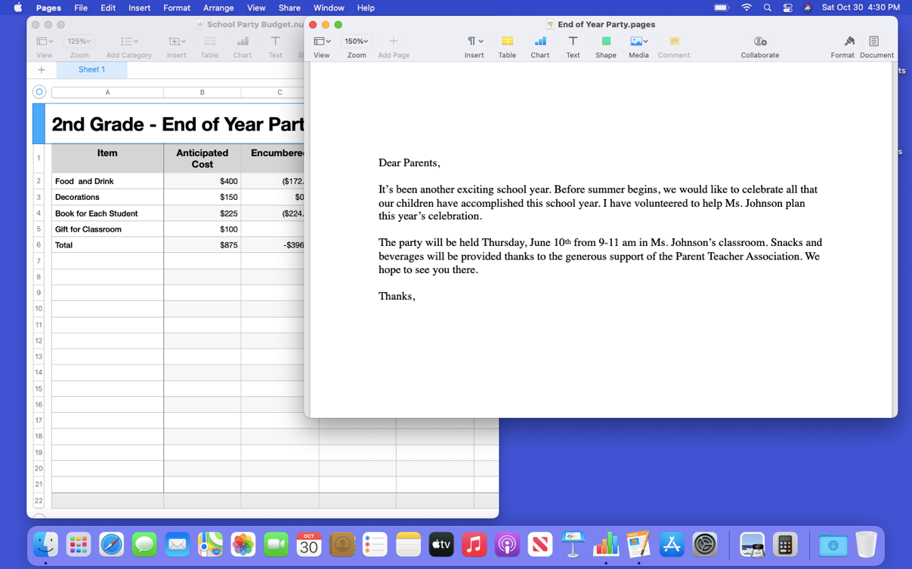
Files and Folders (continued)
Working with More than One Window
Notes:
INSTRUCTOR NOTE: Use PowerPoint or live demonstration.
Demonstrate how to use windows on a macOS desktop when multiple windows are open.
While still holding down the mouse button, move the window. When the window is where you want it, release the mouse button to place the window. You can also resize the windows to make it easier to work between them.
INSTRUCTOR NOTE: Close only the Pages document before moving to the activity.
INSTRUCTOR NOTE: Before moving to Activity 2, review “parking lot” questions. If there are no questions in the parking lot, ask the attendees if they have any questions before you move to Activity 2.

Slide 47
Activity #2
Notes:
INSTRUCTOR NOTE: Review the topics learned in this section. Go to the desktop. Ask the learners to call out the answers to these questions. If the learners have computers, encourage them to follow along on their computers. Encourage them to call out answers, and then confirm the correct answer to have them update their Activity Sheet.
Let’s practice what you’ve learned.
If the learners have computers, ask them to complete the tasks. Then review the answers by asking the learners to call out the answers for each question.
If learners do not have computers, ask the learners to call out the answers to these questions.

Slide 48
ACTIVITY #2: Working with Files
Use the computer desktop to answer the following questions.
If you don’t have your own computer, follow along with the instructor.
1. Open the web browser and keep it open.
2. Make the browser window wider. Move the browser window to the right side of the screen.
3. What button do you click on to expand or maximize the window to fill the desktop?
4. What button do you click on to make the window smaller again?
5. Use the search feature to see if the computer has a calculator. Is there a calculator?
6. In the web browser address bar, go to https://www.digitallearn.org/ and then scroll to the bottom of the webpage.
7. Name one of the links under the Learn More section at the bottom of the webpage.
Notes:
INSTRUCTOR NOTE: Use the slide to debrief the activity or as a guide for yourself if you are doing a demonstration. Demonstrate each answer as you go over the items.
1. Open the web browser and keep it open.
2. Make the browser window wider. Move the browser window to the right side of the screen.
3. What button do you click on to expand or maximize the window to fill the desktop? Answer: Click on the green button at the top left-hand side of the window.
4. What button do you click on to make the window smaller again? Answer: Move your mouse over the gray bar. Then click on the green button at the top left-hand side of the window.
5. Use the search feature to see if the computer has a calculator. Is there a calculator? Answer: You will need to search to see if the calculator is available on this computer.
6. In the web browser address bar, go to https://www.digitallearn.org/ and scroll to the bottom of the webpage.
7. Name one of the links under the Learn More section at the bottom of the webpage.
Answers:
About DigitalLearn.org
Get Digital Learn for Your Library
Pricing and Features
Privacy Policy | Terms
See Our Work in Action
After learners complete Activity 2:
Great job, everyone! In the next section, you’ll learn how to use save and close.

Slide 49
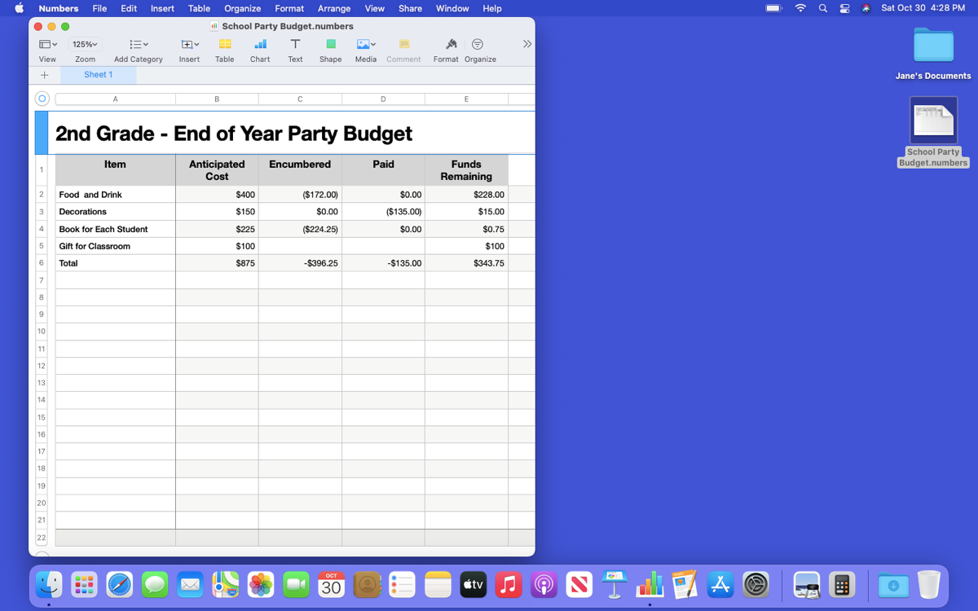
Saving and Closing Files
Menu Bar
Notes:
INSTRUCTOR NOTE: Use PowerPoint or live demonstration.
Demonstrate how the menu bar changes in macOS 11.
When an application is open on your Mac, you will notice that the menu bar is specific to the application you are in, rather than the general Finder menu bar you learned about earlier in this course. Since Numbers is open, so the menu bar is specific to Numbers.

Slide 50
Saving and Closing Files (continued)
Menu Bar
Notes:
INSTRUCTOR NOTE: Use PowerPoint or live demonstration.
Demonstrate how the menu bar changes in macOS 11.
Let’s see how the menu bar changes when you open a file in a new application. We’ll open a Pages file. The file we want is in Jane’s Documents folder, so we will double-click the folder.

Slide 51
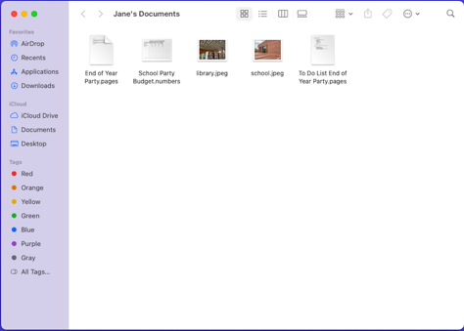
Files and Folders
Menu Bar
Notes:
INSTRUCTOR NOTE: Use PowerPoint or live demonstration.
Demonstrate how the menu bar changes based on which application is open.
The file we want to open is called To Do List End of Year Party.pages. Let’s double-click on it to open it.
INSTRUCTOR NOTE: Please use the To Do List End of Year Party.pages file that is in the “Jane’s Documents” folder that you downloaded before the class.

Slide 52
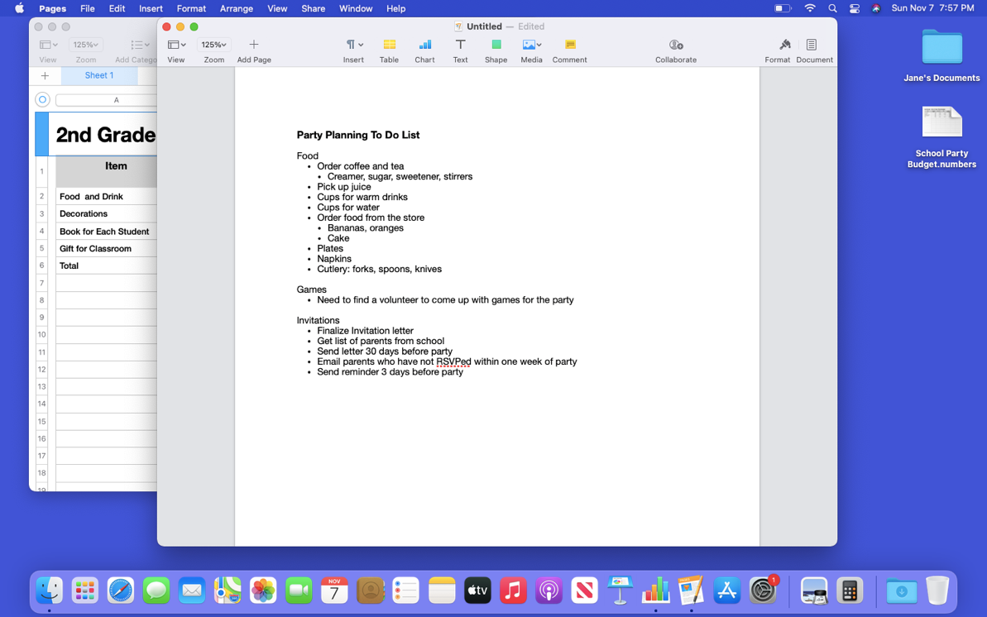
Files and Folders (continued)
Menu Bar
Notes:
INSTRUCTOR NOTE: Use PowerPoint or live demonstration.
Demonstrate how the menu bar changes based on which application is open.
Now that Pages is open, notice how the menu bar is specific to Pages.

Slide 53
Files and Folders (continued)
Saving a File
Notes:
INSTRUCTOR NOTE: Use PowerPoint or live demonstration.
Demonstrate how to save folders in macOS 11.
Occasionally, while you are working on a file, or before you close it, you will want to save your work.
To save a file, click File in the menu bar.

Slide 54
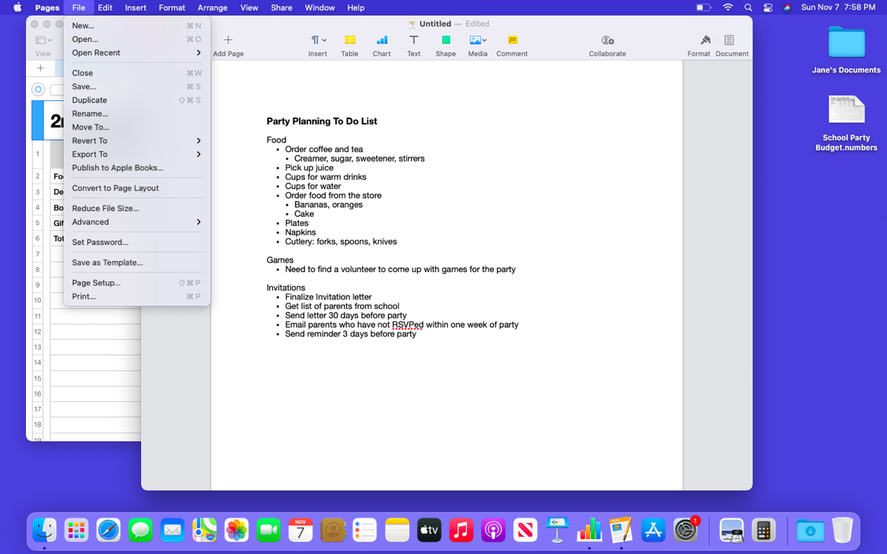
Files and Folders (continued)
Saving a File
Notes:
INSTRUCTOR NOTE: Use PowerPoint or live demonstration.
Demonstrate how to save folders in macOS 11.
A drop-down menu appears. Options for saving the file appear in the drop-down menu. There are a lot of options!

Slide 55
Files and Folders (continued)
Saving a File
Notes:
INSTRUCTOR NOTE: Use PowerPoint or live demonstration.
Demonstrate how to save files in macOS 11.
Let’s say you had already saved this file, and you knew both the file name and the location. In that case, you can simply click on the Save option in the menu. For today’s workshop, we are going to demonstrate the steps as if it is the first time you are saving the file.

Slide 56
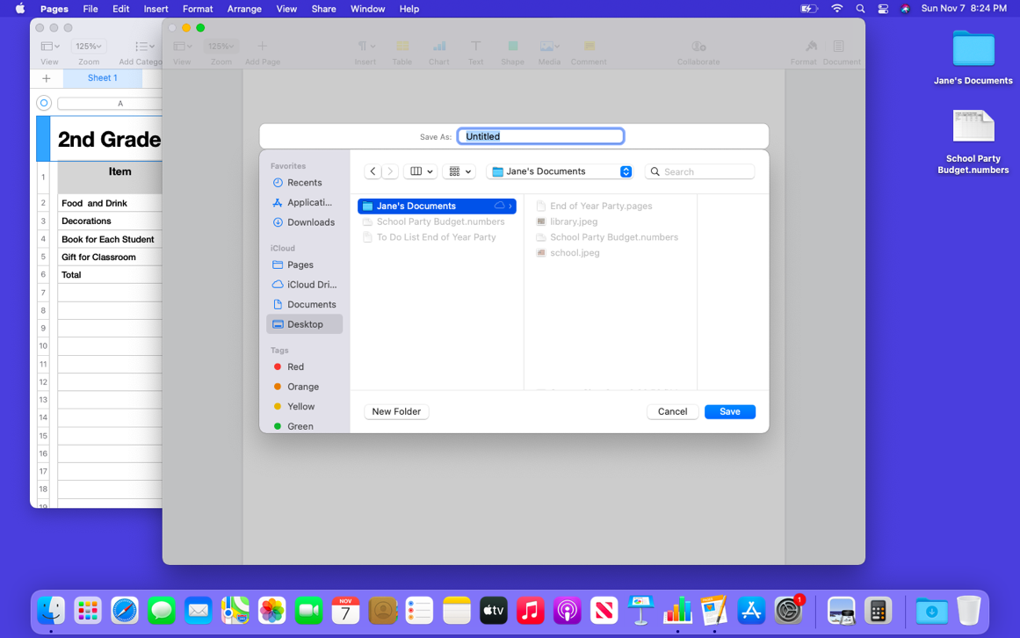
Files and Folders (continued)
Saving a File
Notes:
INSTRUCTOR NOTE: Use PowerPoint or live demonstration.
Demonstrate how to save files in macOS 11.
A new dialog box will appear.

Slide 57

Files and Folders (continued)
Saving a File
Notes:
INSTRUCTOR NOTE: Use PowerPoint or live demonstration.
Demonstrate how to save files in macOS 11.
The first thing you will want to do is name the file in the “Save as” box.

Slide 58
Files and Folders (continued)
Saving a File
Notes:
INSTRUCTOR NOTE: Use PowerPoint or live demonstration.
Demonstrate how to save files in macOS 11.
Name the file. Then select where you want to save the file. Be sure to choose a location that you will remember, such as on the desktop or in a specific folder. In this example, we are saving this file in the Jane’s Documents folder that is on the desktop.

Slide 59
Files and Folders (continued)
Saving a File
Notes:
INSTRUCTOR NOTE: Use PowerPoint or live demonstration.
Demonstrate how to save files in macOS 11.
Once you choose a file name and a location to save the file, click the Save button. The file is saved.

Slide 60
Files and Folders (continued)
Moving a File
Notes:
INSTRUCTOR NOTE: Use PowerPoint or live demonstration.
Demonstrate how to move a file in macOS 11.
If you want to move the file to another location, you can select the “Move To…” option in the file menu.

Slide 61
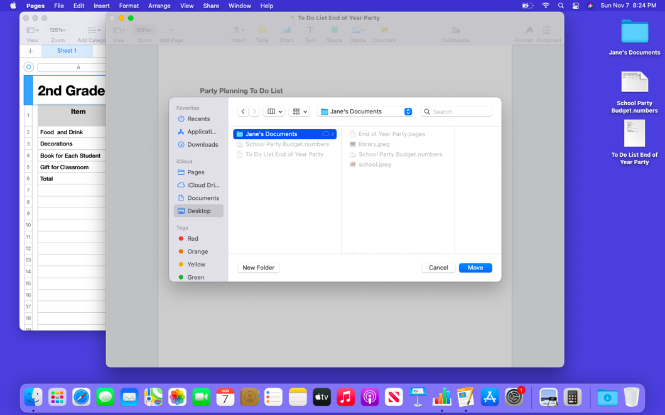
Files and Folders (continued)
Moving a File
Notes:
INSTRUCTOR NOTE: Use PowerPoint or live demonstration.
Demonstrate how to move a file in macOS 11.
The “Move to” pop-up menu appears. Click on the drop-down arrow to choose a new location.

Slide 62
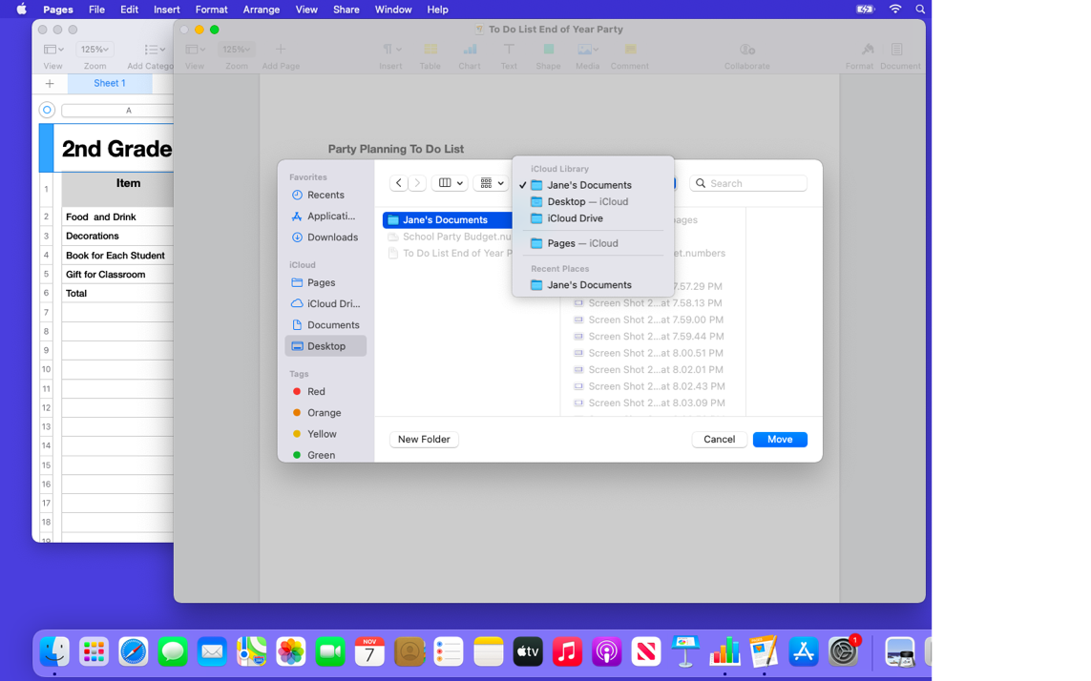
Files and Folders (continued)
Moving a File
Notes:
INSTRUCTOR NOTE: Use PowerPoint or live demonstration.
Demonstrate how to move a file in macOS 11.
A list of possible locations to save the file appears.

Slide 63
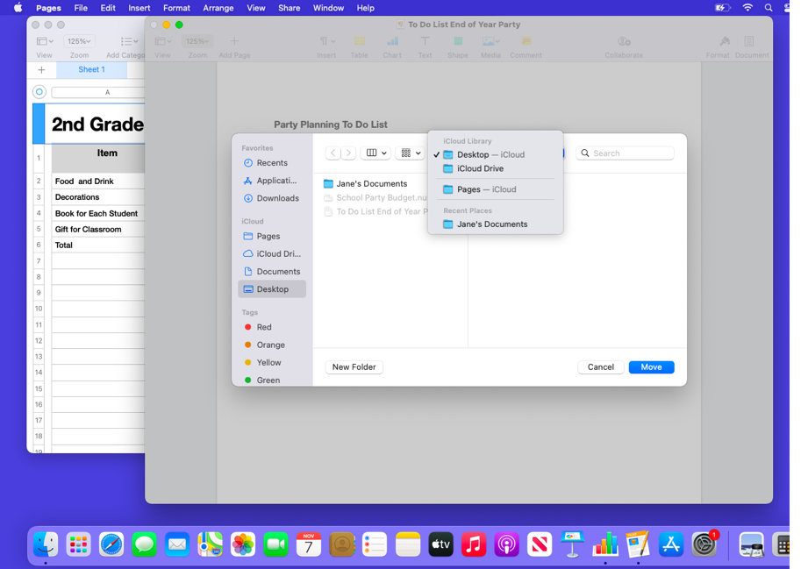
Files and Folders (continued)
Moving a File
Notes:
INSTRUCTOR NOTE: Use PowerPoint or live demonstration.
Demonstrate how to move a file in macOS 11.
Let’s save the file to the desktop.

Slide 64
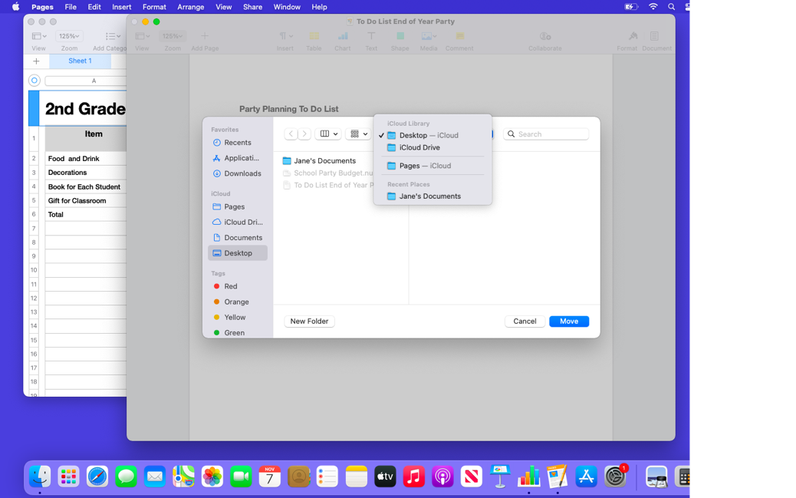
Files and Folders (continued)
Moving a File
Notes:
INSTRUCTOR NOTE: Use PowerPoint or live demonstration.
Demonstrate how to move a file in macOS 11.
Then click Move.

Slide 65
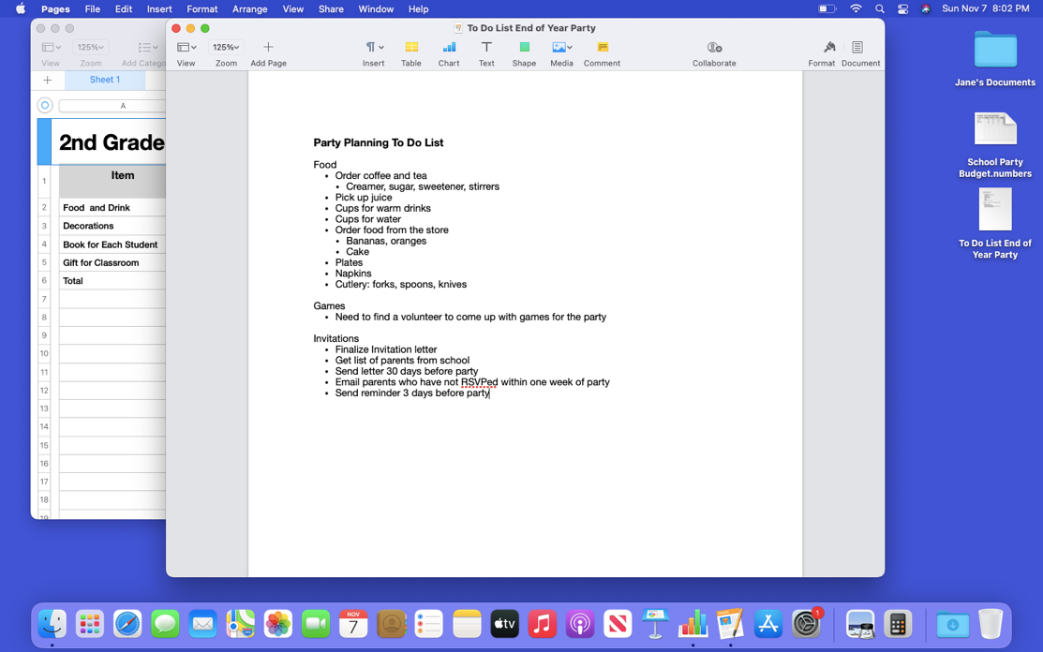
Files and Folders (continued)
Moving a File
Notes:
INSTRUCTOR NOTE: Use PowerPoint or live demonstration.
Demonstrate how to move a file in macOS 11.
The file has been moved to the desktop.
If you are using a public computer, there may be limits on where you can save files. Feel free to seek help from a staff person at the computer center for more information on saving files on a public computer.

Slide 66
Files and Folders (continued)
Closing a File
Notes:
INSTRUCTOR NOTE: Use PowerPoint or live demonstration.
Demonstrate how to close files in macOS 11.
When you are done with a file and you have saved it, you will want to close it. To close the file, click on the red button at the top left of the window. If you have made changes to the document since the last time it was saved, Pages will automatically save the changes to the file before it closes. Most applications will ask you if you want to save the changes before you close a file.

Slide 67
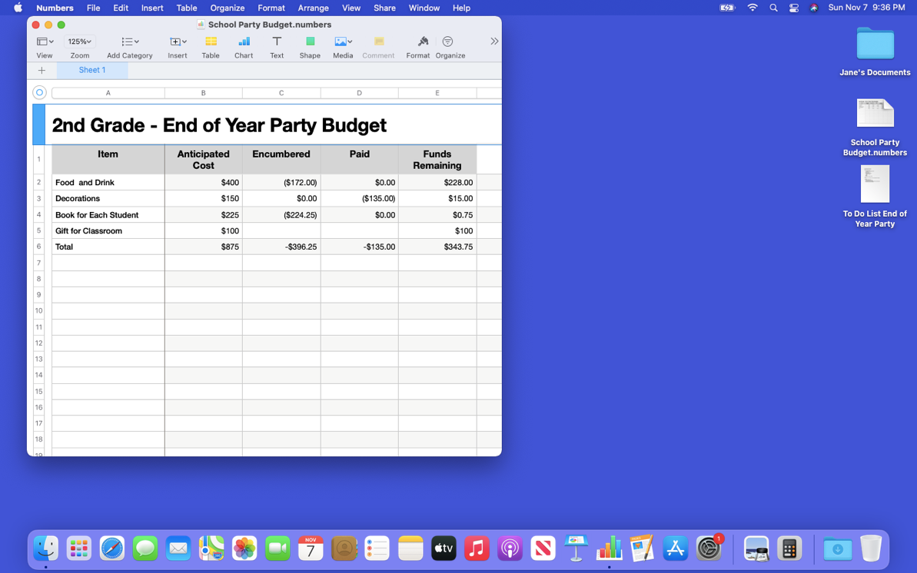
Files and Folders (continued)
Closing a File
Notes:
INSTRUCTOR NOTE: Use PowerPoint or live demonstration.
Demonstrate how to save and close files and folders in macOS 11.
The Pages file is now closed. How would I close the Numbers document that is currently open?
INSTRUCTOR NOTE: Ask the learners for the answer.

Slide 68
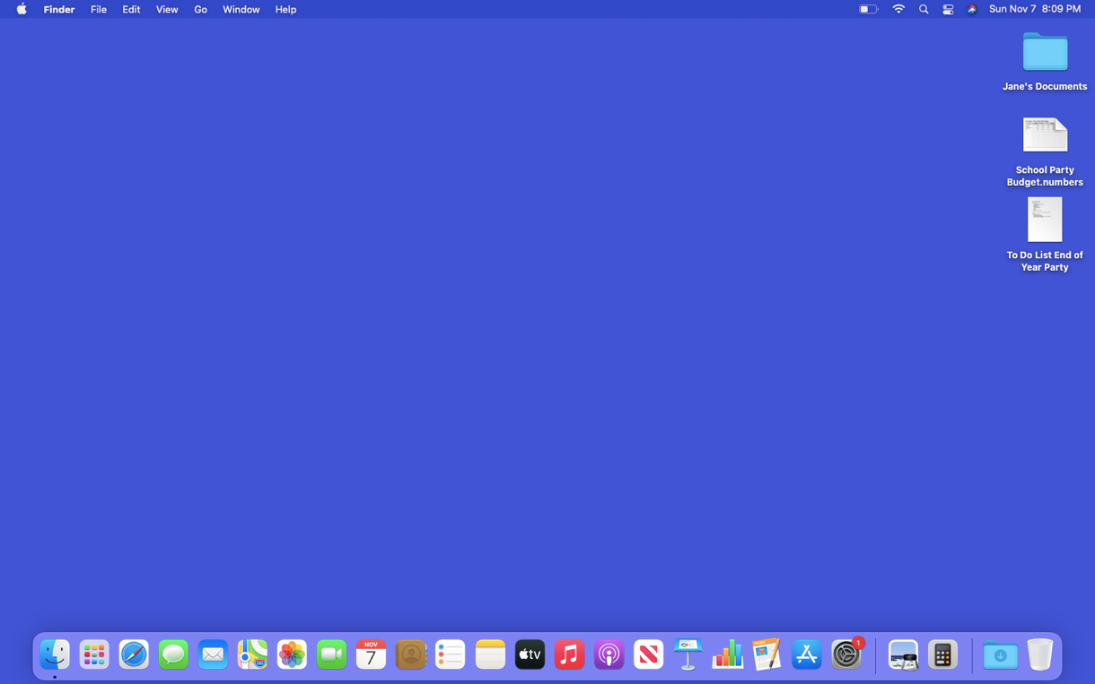
Files and Folders (continued)
Closing a File
Notes:
INSTRUCTOR NOTE: Use PowerPoint or live demonstration.
Demonstrate how close files in macOS 11.
That’s right! To close the file, I would click on the red button at the top left of the window.
INSTRUCTOR NOTE: Before moving to Activity 3, review “parking lot” questions. If there are no questions in the parking lot, ask the attendees if they have any questions before you move to Activity 3.

Slide 69
Activity #3
Notes:
INSTRUCTOR NOTE: Review the topics learned in this section. Go to the desktop.
Let’s practice what you’ve learned.
If the learners have computers, ask them to complete the tasks. Then review the answers by asking the learners to call out the answers for each question.
If learners do not have computers, ask learners to call out the answers to these questions.

Slide 70
Activity 3: Saving a File
Use the computer desktop to answer the following questions.
If you don’t have your own computer, follow along with the instructor.
1. Open Pages.
2. Type “Hello World” in the document.
3. Save the document to the Desktop. In the File name box, type “Hello” and click Save.
4. Close the file.
Notes:
INSTRUCTOR NOTE: Use slide to debrief the activity or as a guide for yourself if you are doing a demonstration. Demonstrate each answer as you go over the items.
Open Pages.
2. Type “Hello World” in the document.
3. Save the document to the Desktop. In the File name box, type “Hello” and click Save.
4. Close the file.
After learners complete Activity 3:
Great job, everyone! In the next section, you’ll learn how to delete files.
INSTRUCTOR NOTE: Make sure to close the Hello document before moving to the next section.

Slide 71

Deleting Files
Trash
Notes:
INSTRUCTOR NOTE: Use PowerPoint or live demonstration.
Demonstrate how to delete files on a macOS 11 desktop.
To delete files, you will use the trash can, which is located in the Dock at the bottom right of the screen. When there is nothing in the Trash, the icon will appear empty.

Slide 72
Deleting Files (continued)
Deleting a File
Notes:
INSTRUCTOR NOTE: Use PowerPoint or live demonstration.
Demonstrate how to delete files on a macOS 11 desktop.
To delete a file, move your cursor to the file you want to delete. Then click on it and hold down the left mouse button. The file is selected.

Slide 73
Deleting Files (continued)
Deleting a File
Notes:
INSTRUCTOR NOTE: Use PowerPoint or live demonstration.
Demonstrate how to delete files on a macOS 11 desktop.
Drag the selected file to the trash bin on the right side of the Dock.

Slide 74
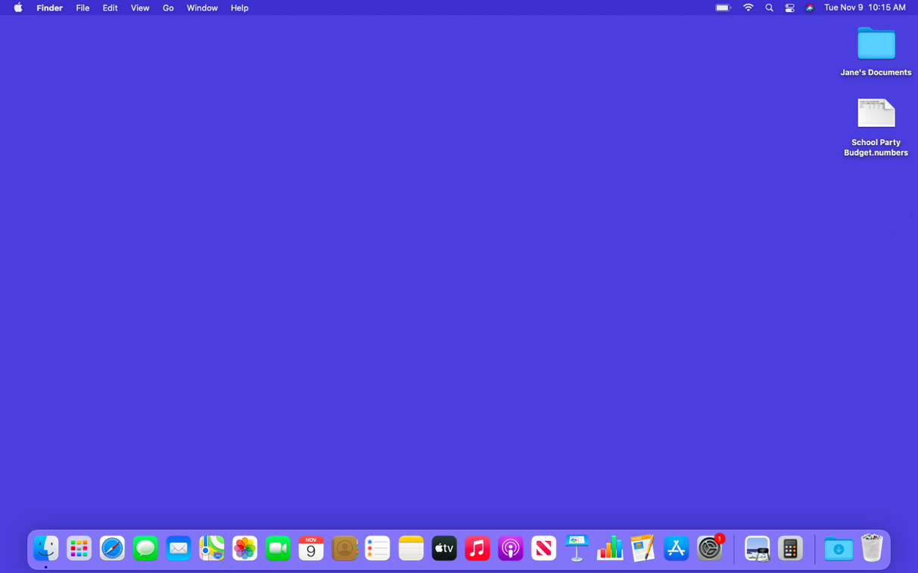

Deleting Files (continued)
Deleting a File
Notes:
INSTRUCTOR NOTE: Use PowerPoint or live demonstration.
Demonstrate how to delete files on a macOS 11 desktop.
Once there are items in the Trash, the icon will appear full.

Slide 75
Deleting Files (continued)
Deleting a File
Notes:
INSTRUCTOR NOTE: Use PowerPoint or live demonstration.
Demonstrate how to delete files on a macOS 11 desktop.
You can also delete files from folders. Let’s double-click on Jane’s Documents folder.

Slide 76
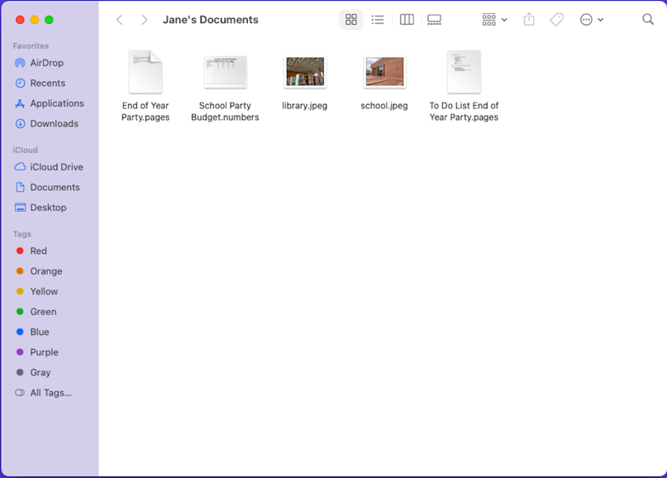
Deleting Files (continued)
Deleting a File
Notes:
INSTRUCTOR NOTE: Use PowerPoint or live demonstration.
Demonstrate how to delete files on a macOS 11 desktop.
Let’s delete the school.jpeg file. To do that, drag the file to the Trash and then close the folder.

Slide 77
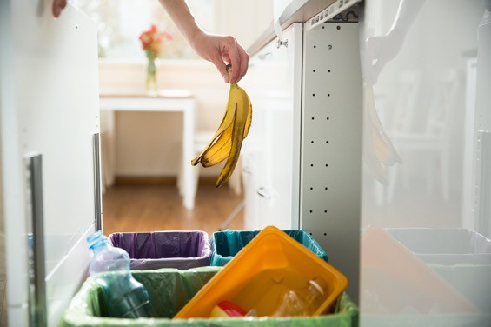
Deleting Files (continued)
Deleting a File
Notes:
INSTRUCTOR NOTE: Use PowerPoint or live demonstration.
Demonstrate how to delete files on a macOS 11desktop.
Like the trash bins in your home, things stay in the trash until you empty the trash and take it out. That means you can still access a file you placed in the Trash, as long as you haven’t “emptied” it. Let’s see what happens when I click on the Trash icon.

Slide 78
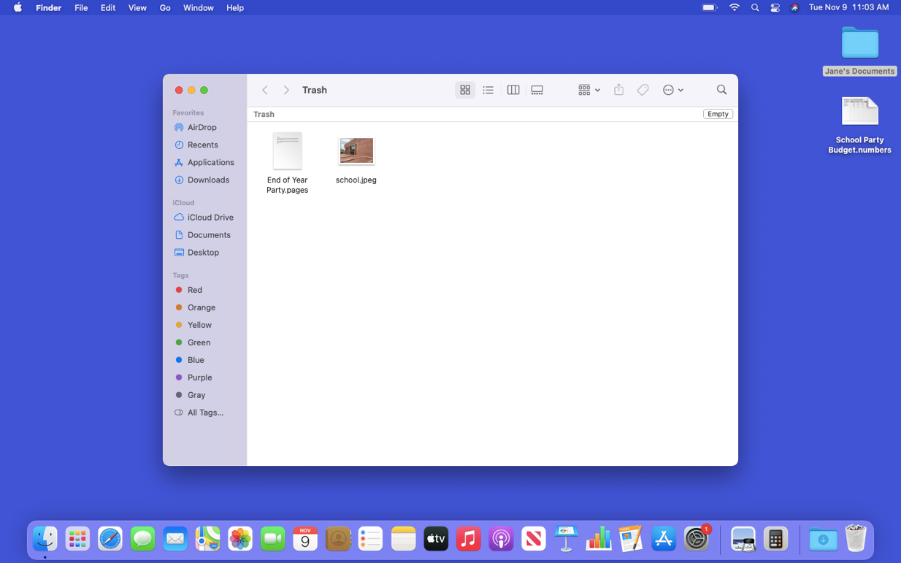
Deleting Files (continued)
Deleting a File
Notes:
INSTRUCTOR NOTE: Use PowerPoint or live demonstration.
Demonstrate how to delete files on a macOS 11 desktop.
When you click on the Trash icon, a window showing the contents of the Trash will open. You can remove a file you placed in the Trash.

Slide 79
Deleting Files (continued)
Deleting a File
Notes:
INSTRUCTOR NOTE: Use PowerPoint or live demonstration.
Demonstrate how to delete files on a macOS 11 desktop.
To do this, move the cursor to the file. Then click and hold down the left mouse button.

Slide 80
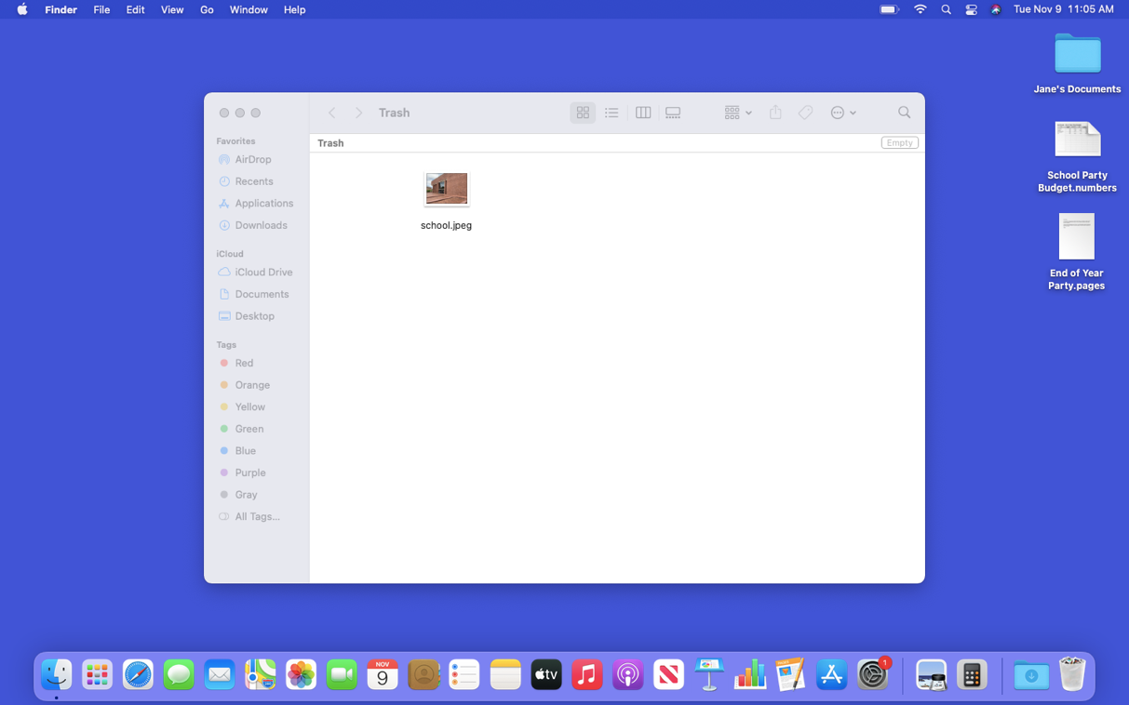
Deleting Files (continued)
Deleting a File
Notes:
INSTRUCTOR NOTE: Use PowerPoint or live demonstration.
Demonstrate how to delete files on a Mac OS 11 desktop.
Now that the file is selected, you can drag it to the desktop.

Slide 81
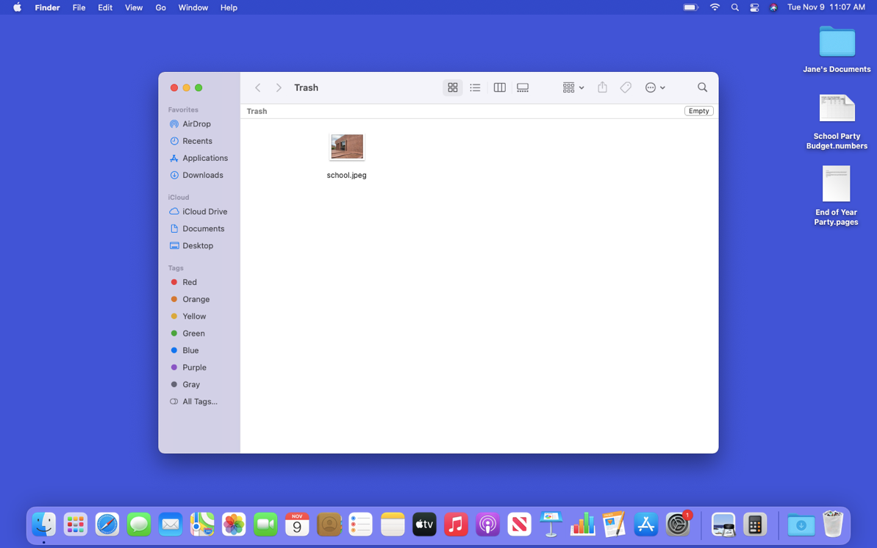
Deleting Files (continued)
Deleting a File
Notes:
INSTRUCTOR NOTE: Use PowerPoint or live demonstration.
Demonstrate how to delete files on a macOS 11 desktop.
When you are sure you are done with everything in the trash, you can “empty” it. The files will disappear permanently.
To empty the trash, click on the Empty button in the right-hand corner of the window.

Slide 82
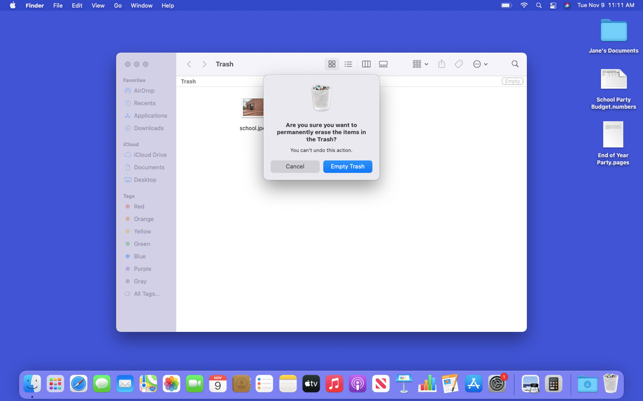
Deleting Files (continued)
Deleting a File
Notes:
INSTRUCTOR NOTE: Use PowerPoint or live demonstration.
Demonstrate how to delete files on a macOS 11 desktop.
A dialog box will appear, asking you to confirm that you want to permanently erase the files in the Trash. You are sure, so click on the blue Empty Trash button. This permanently removes those files from this computer.

Slide 83
Deleting Files (continued)
Deleting a File
Notes:
INSTRUCTOR NOTE: Use PowerPoint or live demonstration.
Demonstrate how to delete files on a macOS 11 desktop.
The Trash is now empty.
INSTRUCTOR NOTE: Before moving to Activity 4, review “parking lot” questions. If there are no questions in the parking lot, ask the attendees if they have any questions before you move to Activity 4.

Slide 84
Activity #4
Notes:
INSTRUCTOR NOTE: Review the topics learned this section. Go to the desktop. Ask the learners to call out the answers to these questions. If the learners have computers, encourage them to follow along on their computers. Invite them to call out answers, and then confirm the correct answer to have them update their Activity Sheet.
Let’s practice what you’ve learned.
If the learners have computers, ask them to complete the tasks and then review the answers by asking the learners to call out the answers for each question.
If learners do not have computers, ask the learners to call out the answers to these questions.

Slide 85
Activity 4: Deleting Files
Use the computer desktop to answer the following questions.
If you don’t have your own computer, follow along with the instructor.
1. Move the file named Hello.docx on the Desktop to the Trash.
2. Empty the Trash.
Notes:
INSTRUCTOR NOTE: Use this slide to debrief the activity or as a guide for yourself if you are doing a demonstration. Demonstrate each answer as you go over the items.
1. Move the file named Hello.docx on the desktop to the Trash.
2. Empty the Trash.
Answer: Open the Trash and click on Empty.
After learners complete Activity 4:
Great job, everyone! In the next section, you’ll learn tips for using a Mac.

Slide 86

Tips for Using a Mac
The desktop and Dock are useful tools to access
common applications and documents.
The launchpad allows you to see all applications on your computer.
Folders help you organize files.
The search box and Siri allow you to quickly locate folders and documents.
Documents can be restored from the Trash only if nobody has emptied it.
Notes:
INSTRUCTOR NOTE: Use PowerPoint or live demonstration.
Learn tips for using macOS 11.
Remember:
The desktop and Dock are useful tools to access common applications and documents.
The launchpad allows you to see all the applications on your computer.
Folders help you organize files.
The search box and Siri allow you to quickly locate folders and documents.
Documents can be restored from the Trash only if nobody has emptied it.
INSTRUCTOR NOTE: Before moving to Activity 5, review “parking lot” questions. If there are no questions in the parking lot, ask the attendees if they have any questions before you move to Activity 5.

Slide 87
Activity #5
Open Using a Mac Practice Module
Notes:
Let’s practice what you’ve learned.
INSTRUCTOR NOTE: You can either:
Launch the Practice section online by clicking on the link “Open Using a Mac Practice Module” on the slide
OR
Ask learners if they would prefer a demo to walk through these instructions, which are also listed on the Learner Activity Sheet.
In the address bar of the web browser, enter https://www.digitallearn.org/courses/ Then click on “Using a Mac (OS 11)” and then click on “Practice.”
OR
Use the next four slides to review what students have learned in the Computer Basics (Mac OS 11) section.
Participants should follow along as you go through each question. Engage them by asking them to call out answers. Then confirm the correct answer.

Slide 88
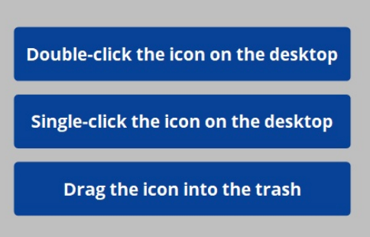
If you want to open an application on the desktop, what do you need to do?
Notes:
INSTRUCTOR NOTE: Use PowerPoint or live demonstration.
Review concepts from Computer Basics: Using a Mac.
If you want to open an application on the desktop, what do you need to do?
INSTRUCTOR NOTE: Ask learners for answers.
Answer: Double-click the icon on the desktop to open the application.

Slide 89
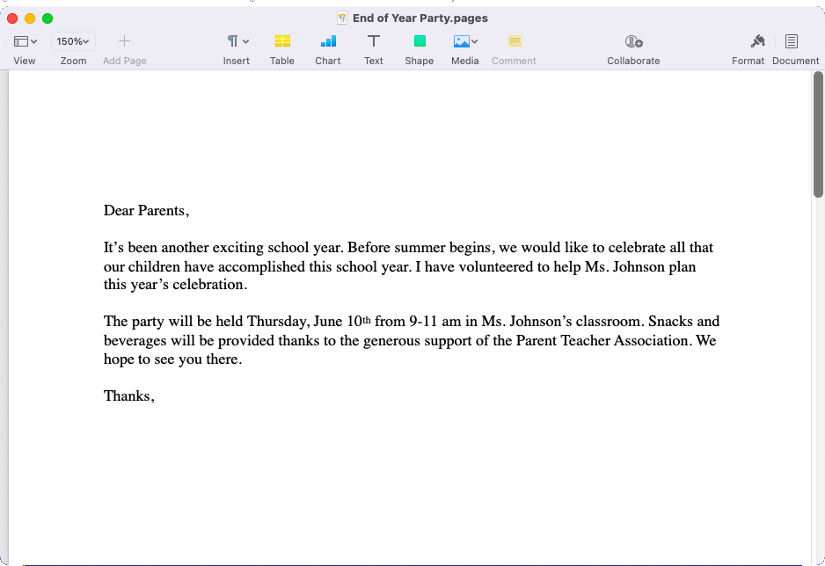
If you want to minimize the window currently open on your screen, what icon would you click?
Notes:
INSTRUCTOR NOTE: Use PowerPoint or live demonstration.
Review concepts from Computer Basics: Using a Mac.
If you want to minimize the window currently open on your screen, what icon would you click?
INSTRUCTOR NOTE: Ask learners for answers.
Answer: Click on the yellow button at the top-left side of the window.
INSTRUCTOR NOTE: Point out the yellow button.

Slide 90
If you want to close the window, what icon would you click?
Notes:
INSTRUCTOR NOTE: Use PowerPoint or live demonstration.
Review concepts from Computer Basics: Using a Mac.
If you want to close the window, what icon would you click?
INSTRUCTOR NOTE: Ask learners for answers.
Answer: Click on the red button at the top-left side of the window.
INSTRUCTOR NOTE: Point out the red button.

Slide 91
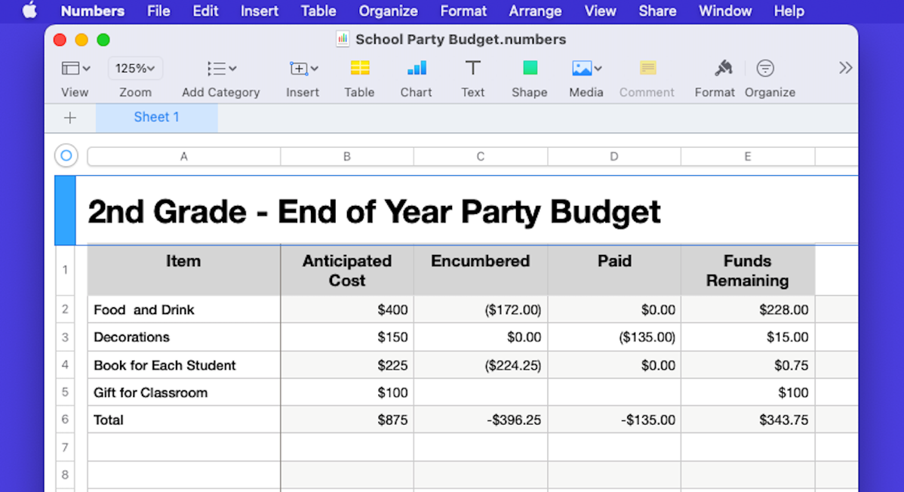
If you want to save a document, what would you click?
Notes:
INSTRUCTOR NOTE: Use PowerPoint or live demonstration.
Review concepts from Computer Basics: Using a Mac.
If you want to save a document, what would you click?
INSTRUCTOR NOTE: Ask learners for answers.
Answer: You can click the File menu.
INSTRUCTOR NOTE: Point out the File menu.

Slide 92

If you accidentally deleted a file, where can you find and retrieve it?
Notes:
INSTRUCTOR NOTE: Use PowerPoint or live demonstration.
Review concepts from Computer Basics: Using a Mac.
If you accidentally deleted a file, where can you find and retrieve it?
INSTRUCTOR NOTE: Ask learners for answers.
Answer: You would click the Trash icon.
INSTRUCTOR NOTE: Point out Trash icon.

Slide 93
Congratulations!
Today you have learned:
What an operating system is
The skills you need to use macOS 11, including:
  Navigating the desktop
  Finding and organizing files and folders
  Managing the windows of an application
  Saving and closing files
  Deleting files
Tips for using macOS 11
Notes:
Congratulations! Today you have learned:
What an operating system is
The skills you need to use macOS, including:
Navigating the desktop
Finding and organizing files and folders
Managing the windows of an application
Saving and closing files
Deleting files
Tips for using macOS 11
INSTRUCTOR NOTE: Provide each learner with a Certificate of Completion.

Slide 94
Today’s training is provided by AT&T and the Public Library Association.
Visit <insert libraries URL here> and https://www.digitallearn.org for more courses and to build confidence using technology.
Provided by AT&T and Public Library Association.
Notes:
INSTRUCTOR NOTE: Highlight the library and https://www.digitallearn.org/ websites as resources for more online courses.

Slide 95
Questions?
THANK YOU FOR COMING!
Provided by AT&T and Public Library Association.
Notes:
INSTRUCTOR NOTE: Close out session with:
If applicable: Mention future AT&T and Public Library Association digital learning workshops planned for the location and/or community.
Ask if there are any other questions and answer any outstanding ones that may have been missed in the parking lot sections.
Remind learners to complete their Learner Survey.
Thanks again to AT&T and PLA for this workshop. We appreciate all our participants for coming and we encourage you to keep learning!

