Slide 1

Designing with Canva
Avery Smith
BranchManager
Tangipahoa Parish Library
Courtesy of Gail Borden Public Library
and the Public Library Association

Slide 2
Agenda
Defining and Accessing Canva
Tour and Finding a Template
Navigating the Design Screen
Naming and Downloading Documents
Navigating the “All Your Designs” Screen
Notes:
How presentation will benefit audience: Adult learners are more interested in a subject if they know how or why it is important to them.
Presenter’s level of expertise in the subject: Briefly state your credentials in this area, or explain why participants should listen to you.

Slide 3
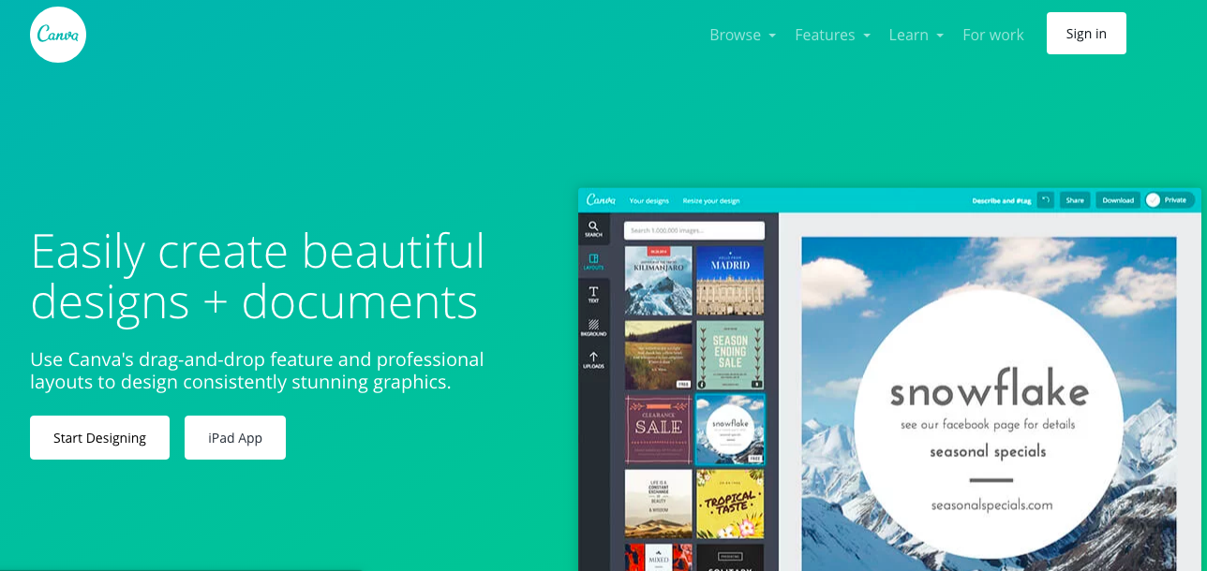
Defining Canva
Canva is a free web-based graphic design software that can help you easily create fliers, social media posts, and more.
You can pay to unlock more features (such as additional images)

Slide 4
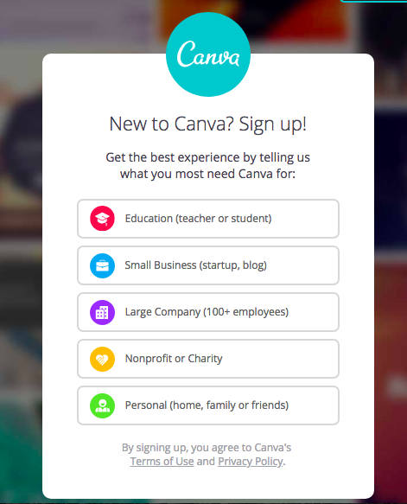
Accessing Canva
Are you a teacher or student? Choose this option.
Using Canva to promote the large or small company, or nonprofit, that you work for? Choose one of these options.
Using Canva to promote your own creative work or personal project, or just not sure? Choose this option.

Slide 5
ACTIVITY #1

Slide 6
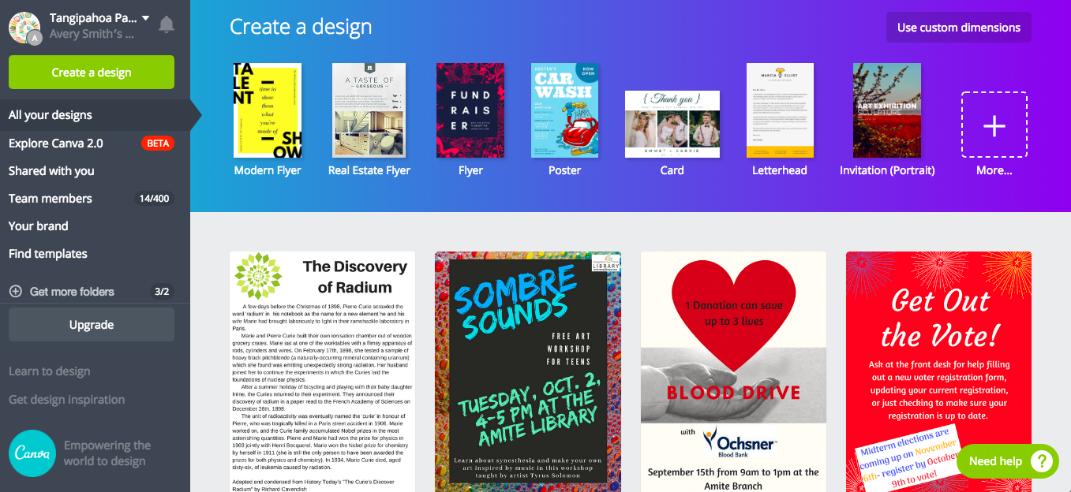
Tour of the Landing Page
Suggested templates are found here
Teamwork and branding features are found here
Any designs you create will be stored here.

Slide 7
Finding Templates
There are a few different places to view all of the templates available on Canva

Slide 8
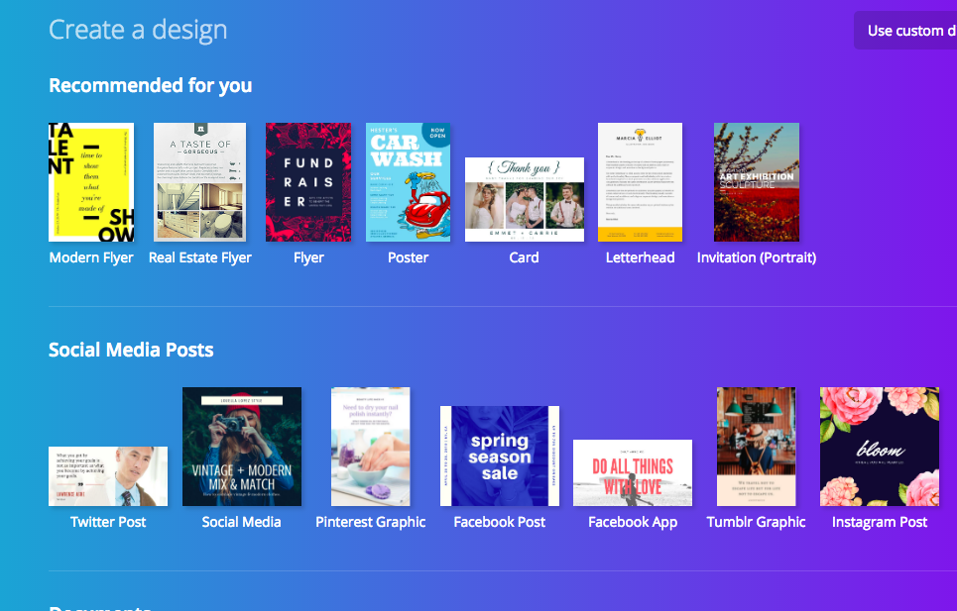
Selecting a Template
1. Choose a design category

Slide 9
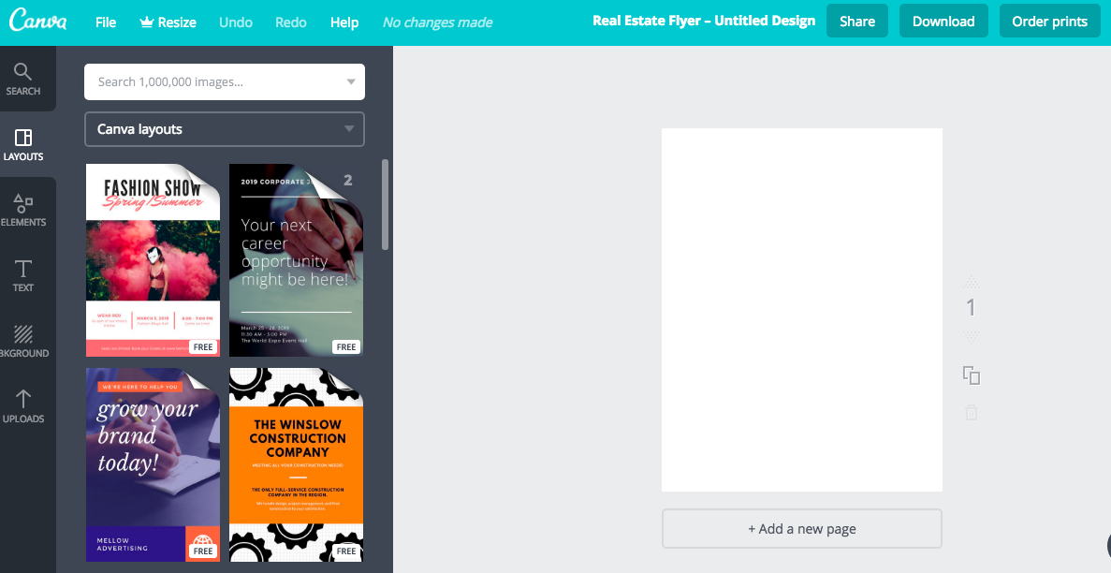
Selecting a Template
2. Choose one of the template options from the category you’ve selected.
Scroll for more template options
Check here to see whether the template is free or part of Canva Pro/costs extra

Slide 10
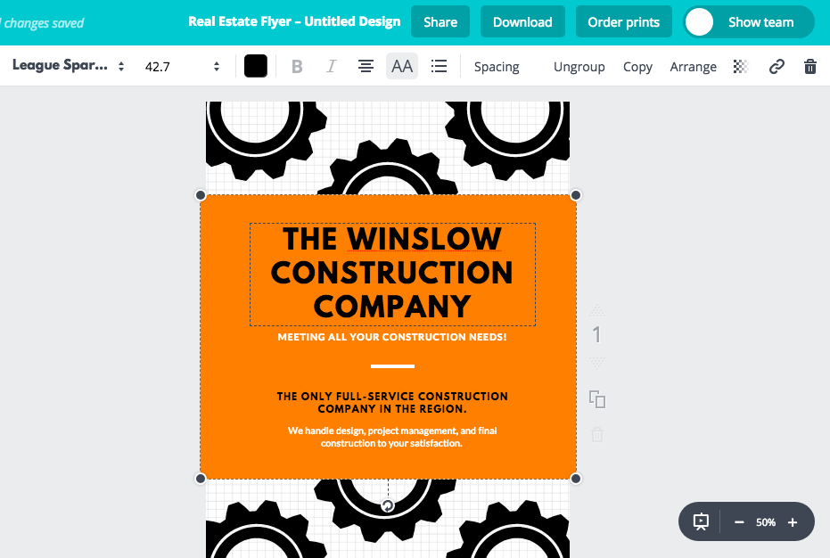
Editing a Template
Tools for working with different elements
Canva’s font formatting tool bar, functions similar to Microsoft Office programs
Zoom in or out

Slide 11
ACTIVITY #2

Slide 12
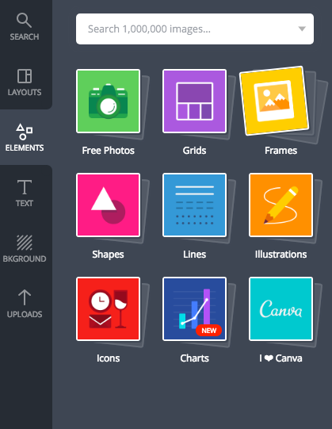
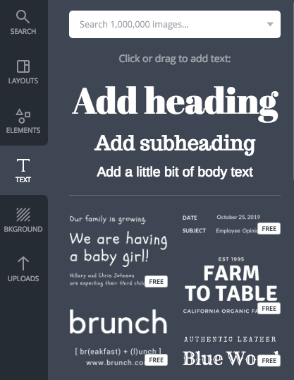
Editing a Template: Elements and Text
Add text to your design. You can always change the font and size later!
Add photos, shapes, illustrations, charts, and more to your design.

Slide 13
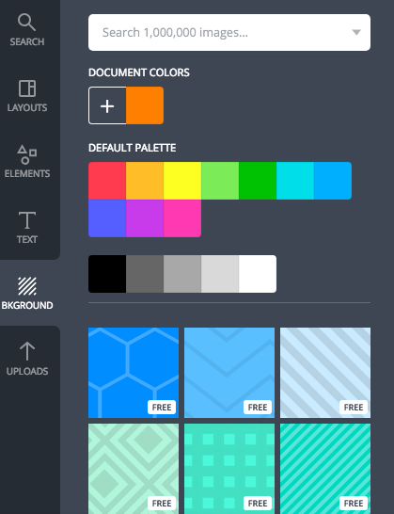
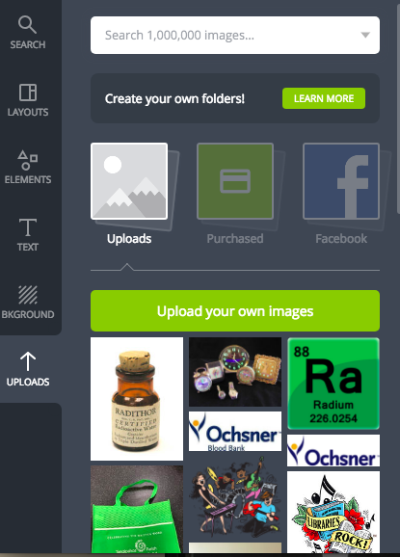
Editing a Template: Background and Uploads
Upload your own images to Canva for inclusion in your design
Select a design or color for the background of your design

Slide 14
ACTIVITY #3

Slide 15
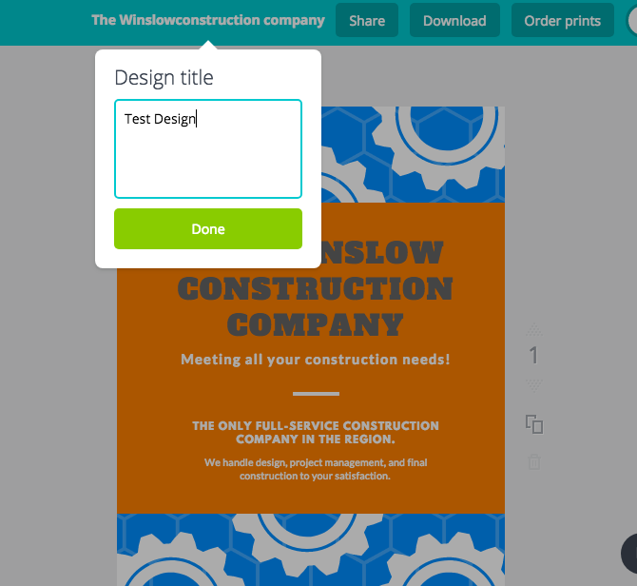
Naming and Downloading a Design
Click on the default title to rename your design
Rename your design in the dropdown box

Slide 16
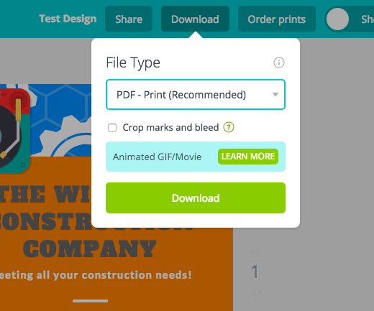
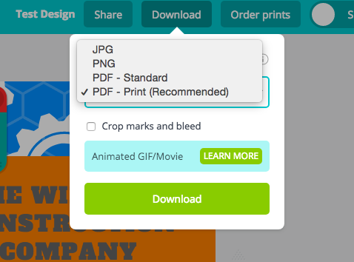
Naming and Downloading a Design
Click the “Download button” to open the Download options
Use dropdown menu to select your preferred download format

