Slide 1

Best Travel Apps
Name
Title
Library Name
Courtesy of Gail Borden Public Library
and the Public Library Association

Slide 2
Agenda
App Availability
Location Services
  Planning Your Adventure
  Takin’ a Road Trip
  Things To Do
  Don’t Get Lost
  Always Be Prepared
  Over the Border
  Connecting While Away
Questions
Notes:
How presentation will benefit audience: Adult learners are more interested in a subject if they know how or why it is important to them.
Presenter’s level of expertise in the subject: Briefly state your credentials in this area, or explain why participants should listen to you.

Slide 3
App Availability

Slide 4
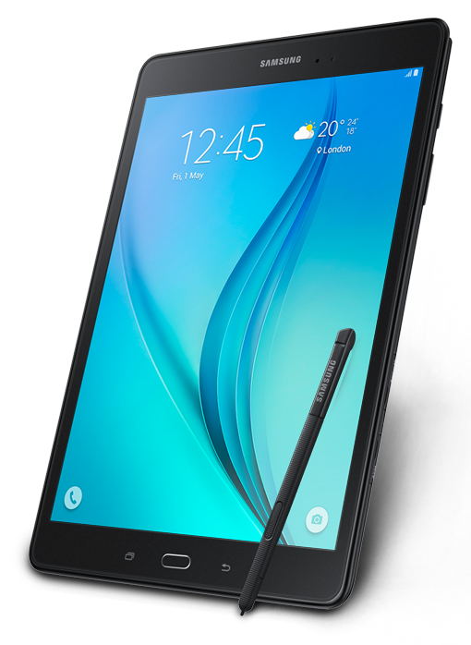
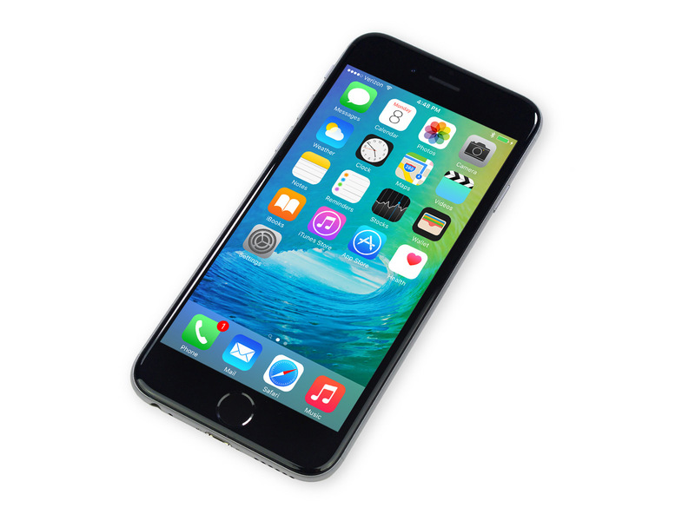


App Availability
Download these apps and related ones from your app store
Notes:
How presentation will benefit audience: Adult learners are more interested in a subject if they know how or why it is important to them.
Presenter’s level of expertise in the subject: Briefly state your credentials in this area, or explain why participants should listen to you.

Slide 5
Location Services

Slide 6
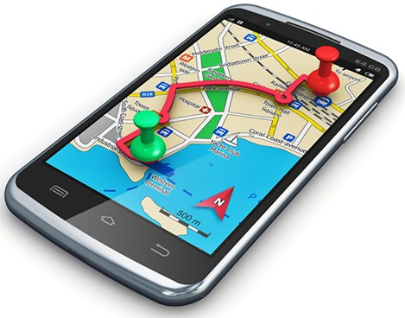
Location Services
Built in feature for smartphones/tablets
Must be enabled to work
Provides apps with real-time coordinates
Allows features such as mapping, navigation, destination searches, etc.
Notes:
How presentation will benefit audience: Adult learners are more interested in a subject if they know how or why it is important to them.
Presenter’s level of expertise in the subject: Briefly state your credentials in this area, or explain why participants should listen to you.

Slide 7
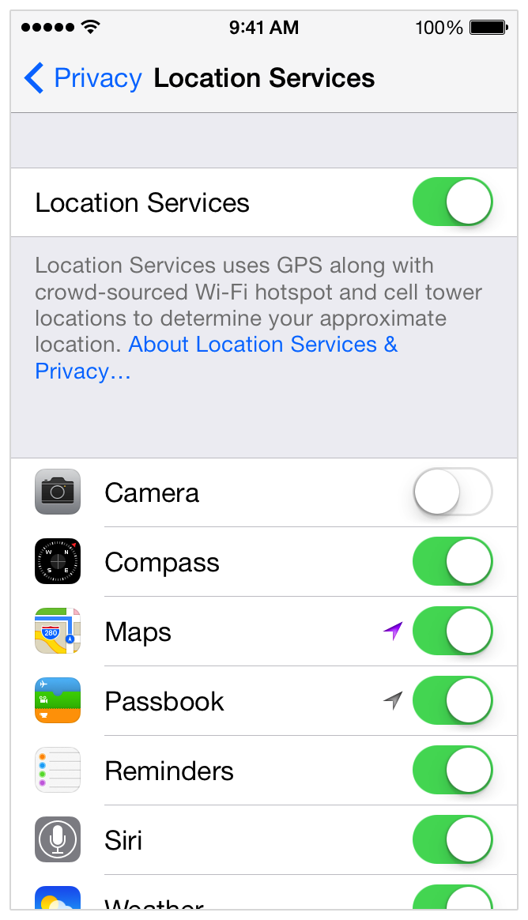
iOS
Tap Settings
Tap Privacy
Tap Location Services
Tap the toggle button to enable Location Services
Notes:
How presentation will benefit audience: Adult learners are more interested in a subject if they know how or why it is important to them.
Presenter’s level of expertise in the subject: Briefly state your credentials in this area, or explain why participants should listen to you.

Slide 8
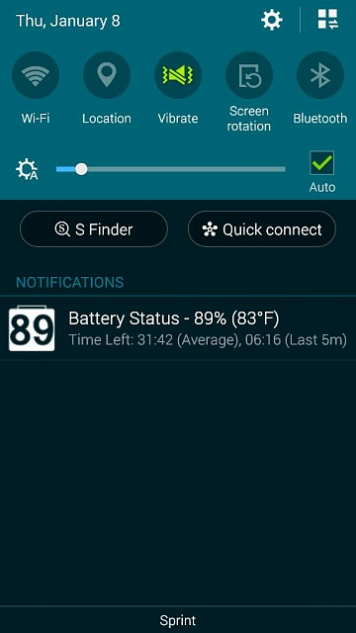
Android
Slide down your Notifications Screen
Tap Location to enable Location Services
Notes:
How presentation will benefit audience: Adult learners are more interested in a subject if they know how or why it is important to them.
Presenter’s level of expertise in the subject: Briefly state your credentials in this area, or explain why participants should listen to you.

Slide 9

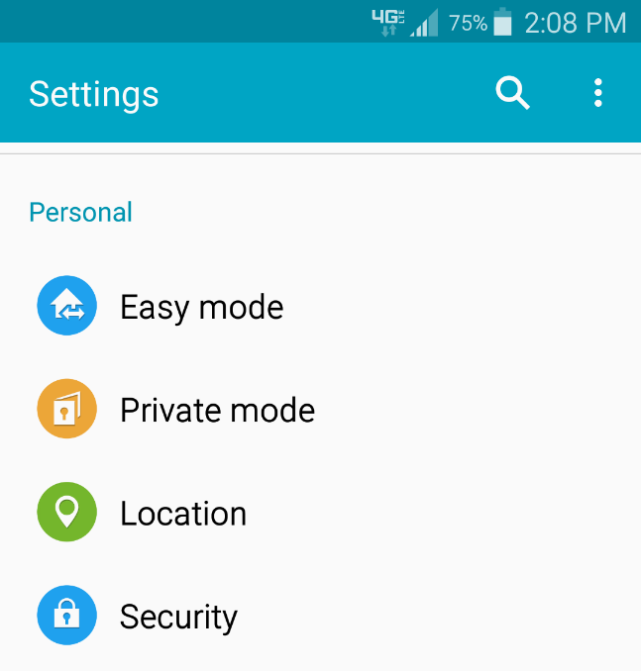
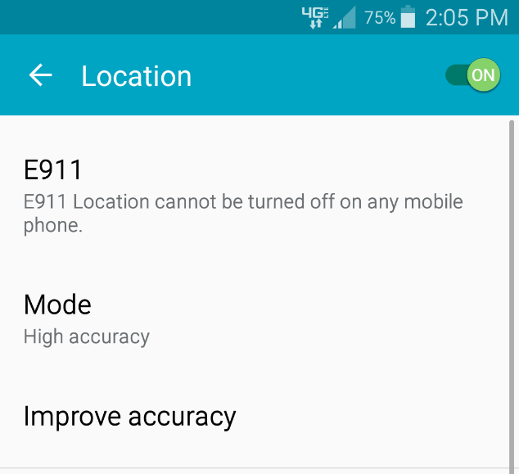
Android
If Location Services does not appear on the Notifications screen…
Tap Settings
Tap Location
Tap the toggle button to enable Location Services
Notes:
How presentation will benefit audience: Adult learners are more interested in a subject if they know how or why it is important to them.
Presenter’s level of expertise in the subject: Briefly state your credentials in this area, or explain why participants should listen to you.

Slide 10
Planning Your Adventure

Slide 11

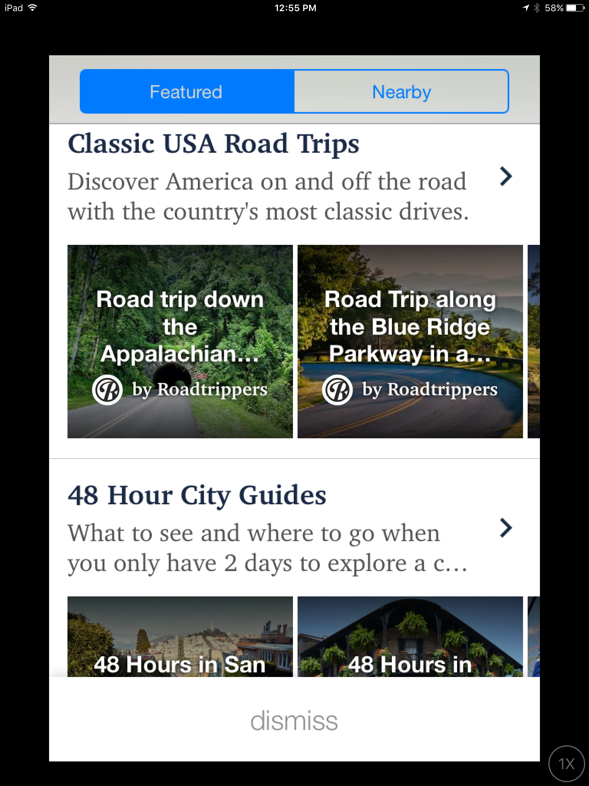
RoadTrippers
Features trip guides for locations all over the United States
Based on scenery, movie filming locations, family interest, and more
Notes:
How presentation will benefit audience: Adult learners are more interested in a subject if they know how or why it is important to them.
Presenter’s level of expertise in the subject: Briefly state your credentials in this area, or explain why participants should listen to you.

Slide 12
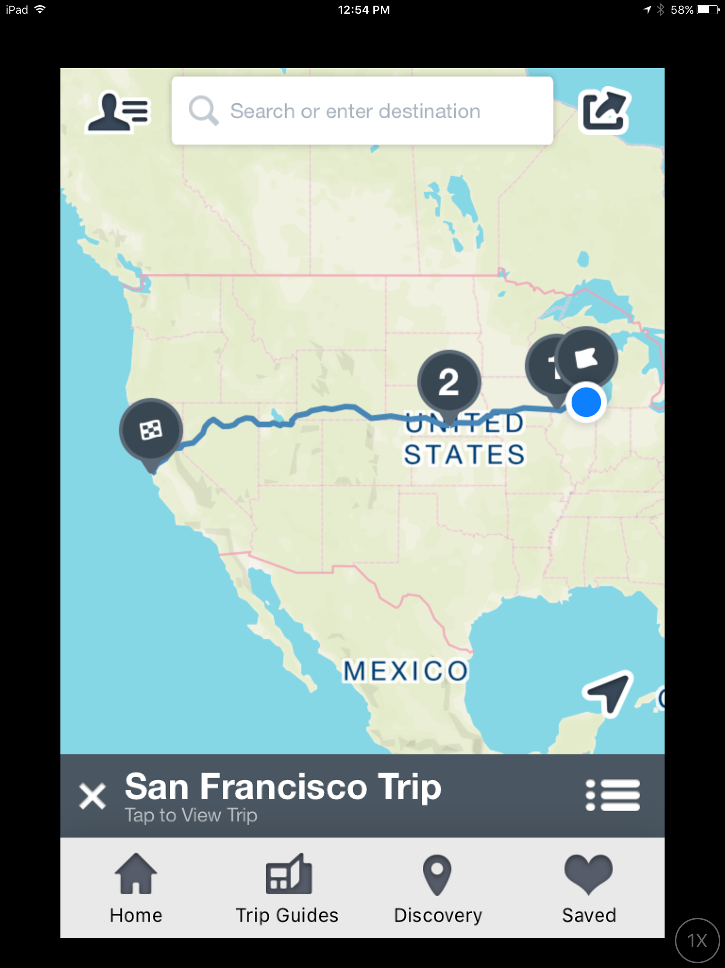
RoadTrippers
Create a custom trip by adding start and finish points
Use the Discovery button in the menu to find interesting stops along the way
Notes:
How presentation will benefit audience: Adult learners are more interested in a subject if they know how or why it is important to them.
Presenter’s level of expertise in the subject: Briefly state your credentials in this area, or explain why participants should listen to you.

Slide 13
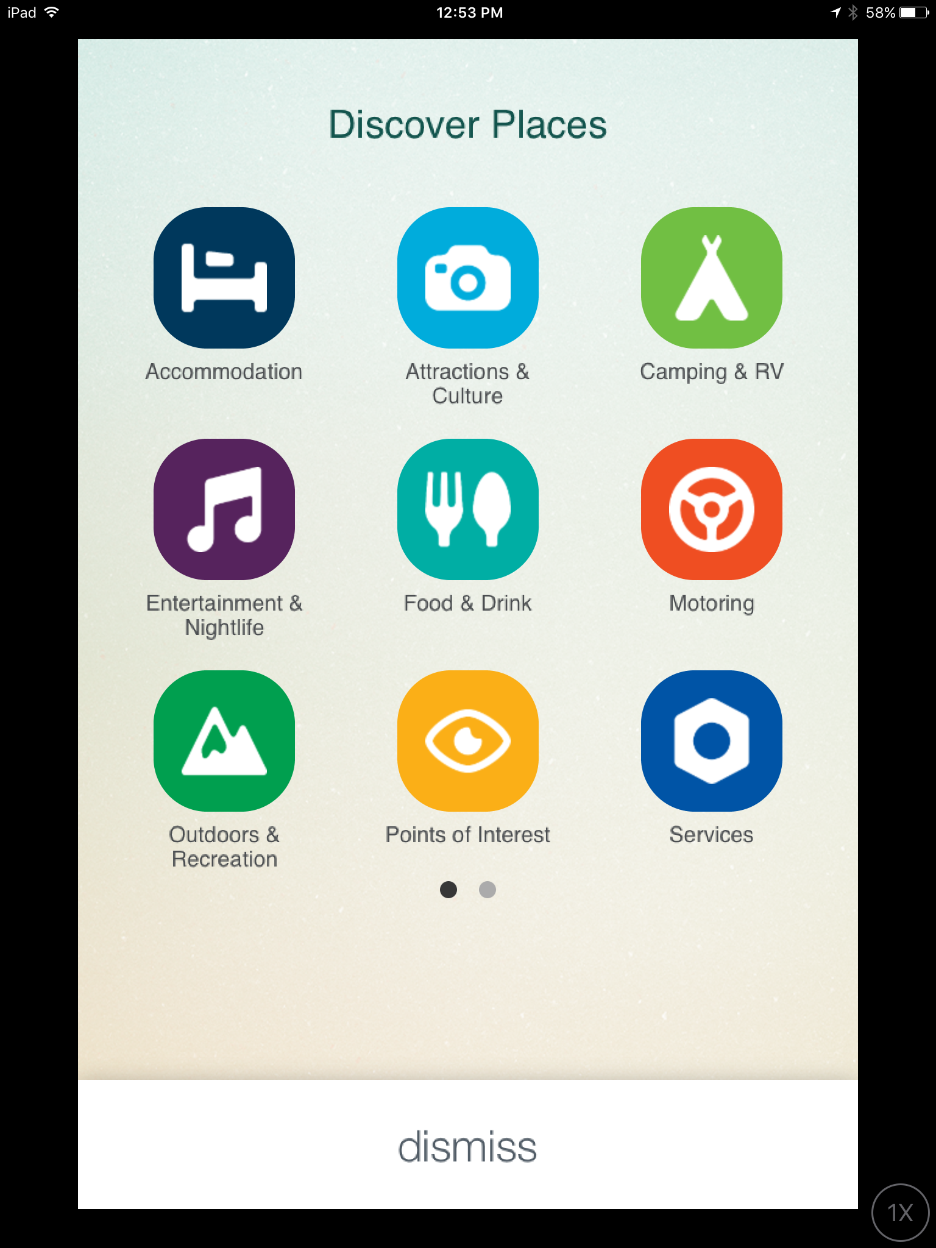
RoadTrippers
Add stops along your route by browsing through categories
Notes:
How presentation will benefit audience: Adult learners are more interested in a subject if they know how or why it is important to them.
Presenter’s level of expertise in the subject: Briefly state your credentials in this area, or explain why participants should listen to you.

Slide 14

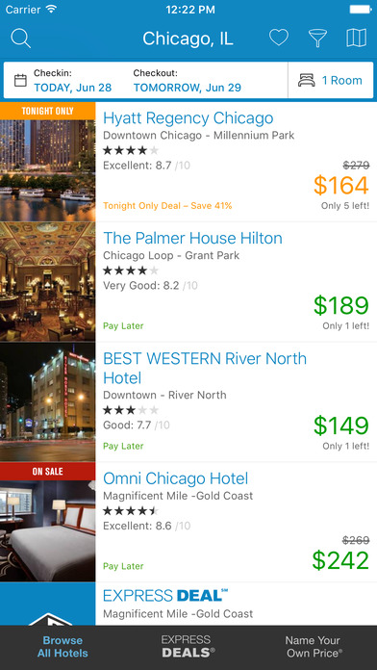
Priceline
Search for travel deals
Compare hotels for location, price, ratings
View special deals
Notes:
How presentation will benefit audience: Adult learners are more interested in a subject if they know how or why it is important to them.
Presenter’s level of expertise in the subject: Briefly state your credentials in this area, or explain why participants should listen to you.

Slide 15

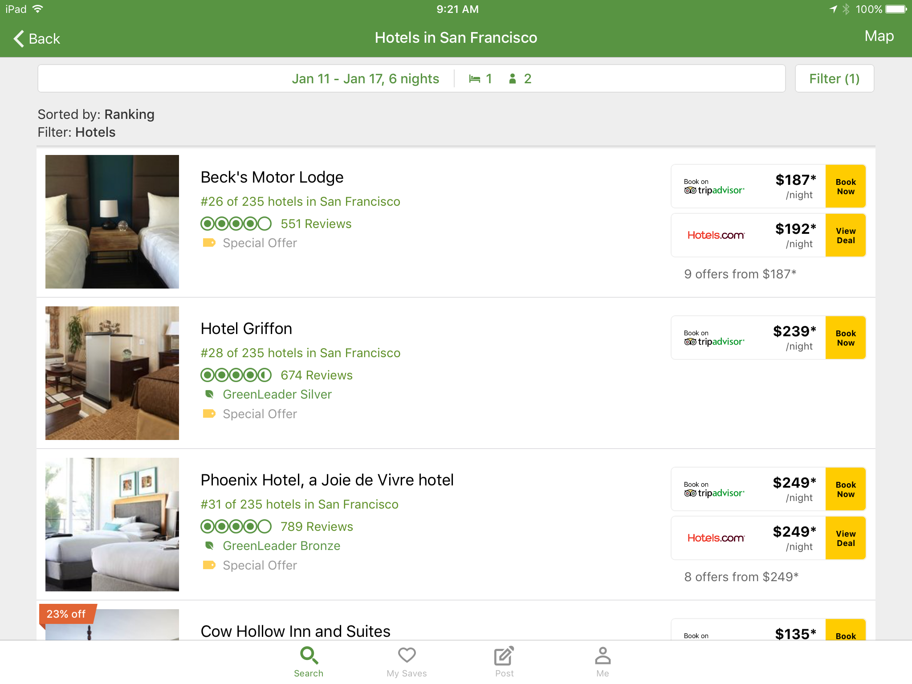
TripAdvisor
Compare hotel prices
Read Reviews
Immediate booking
Notes:
How presentation will benefit audience: Adult learners are more interested in a subject if they know how or why it is important to them.
Presenter’s level of expertise in the subject: Briefly state your credentials in this area, or explain why participants should listen to you.

Slide 16

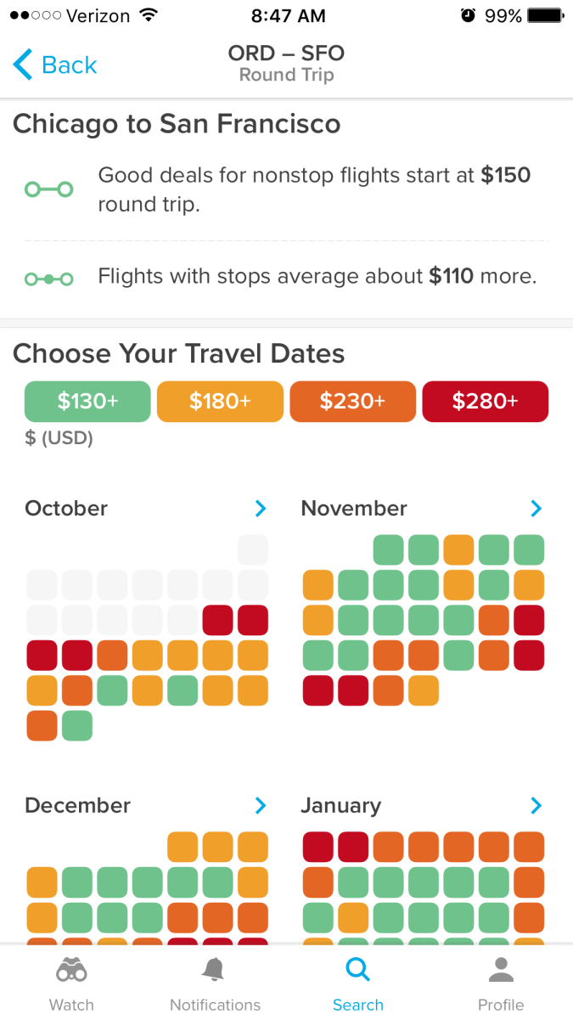
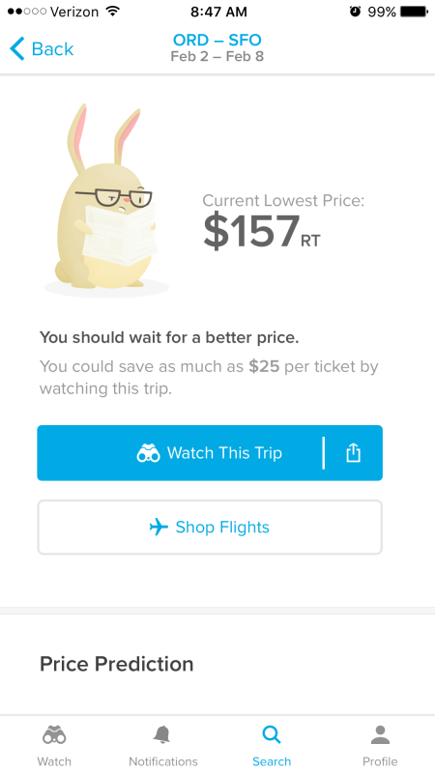
Hopper
Search for airline prices by destination
Visual depiction of prices
Notifications for price drop
Notes:
How presentation will benefit audience: Adult learners are more interested in a subject if they know how or why it is important to them.
Presenter’s level of expertise in the subject: Briefly state your credentials in this area, or explain why participants should listen to you.

Slide 17

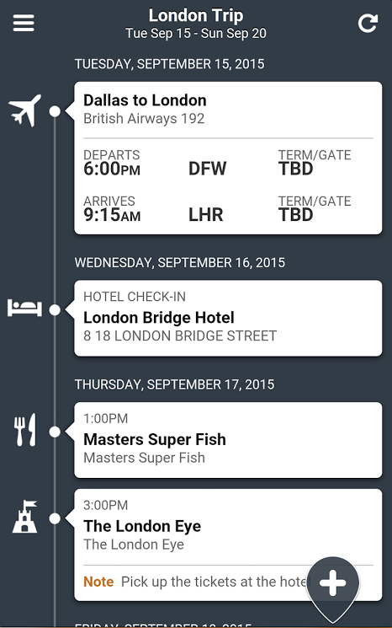
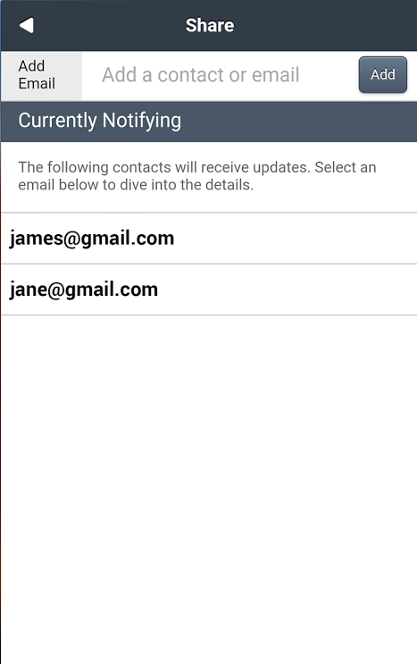
Tripcase
Organize your itinerary
View details
Notify preset contacts of updates
Notes:
How presentation will benefit audience: Adult learners are more interested in a subject if they know how or why it is important to them.
Presenter’s level of expertise in the subject: Briefly state your credentials in this area, or explain why participants should listen to you.

Slide 18

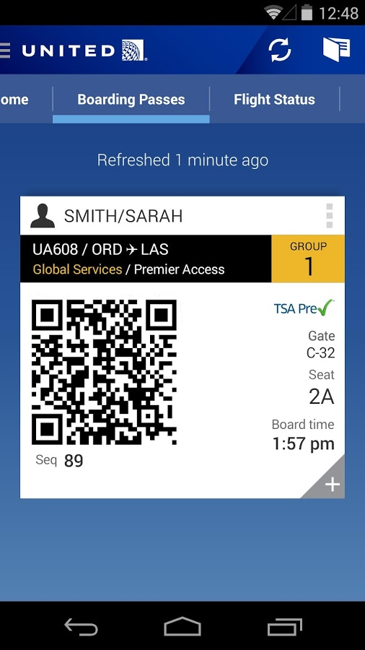



Airlines & Hotel
Airlines
Mobile check in
Boarding pass
Updates, including gate changes
Hotels
View your reservation
Access other details like WiFi and amenities
Notes:
How presentation will benefit audience: Adult learners are more interested in a subject if they know how or why it is important to them.
Presenter’s level of expertise in the subject: Briefly state your credentials in this area, or explain why participants should listen to you.

Slide 19
Takin’ a Road Trip

Slide 20

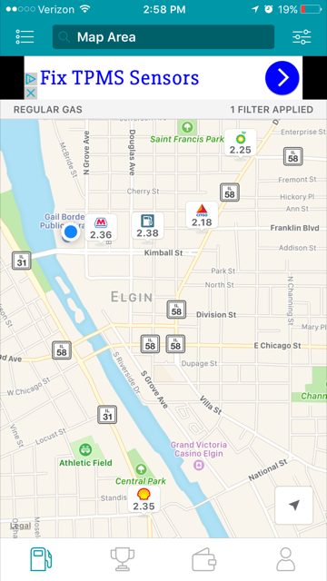
GasBuddy
View nearby gas stations
Find the lowest price
Map view helps you navigate
Notes:
How presentation will benefit audience: Adult learners are more interested in a subject if they know how or why it is important to them.
Presenter’s level of expertise in the subject: Briefly state your credentials in this area, or explain why participants should listen to you.

Slide 21

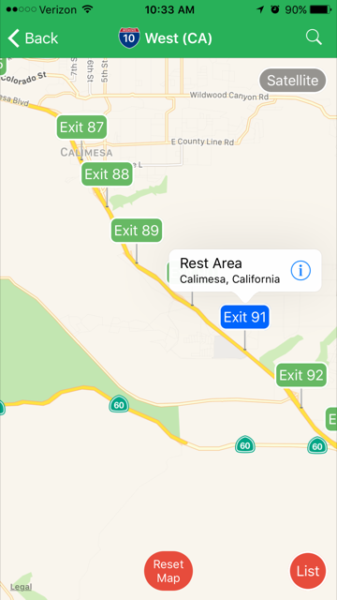
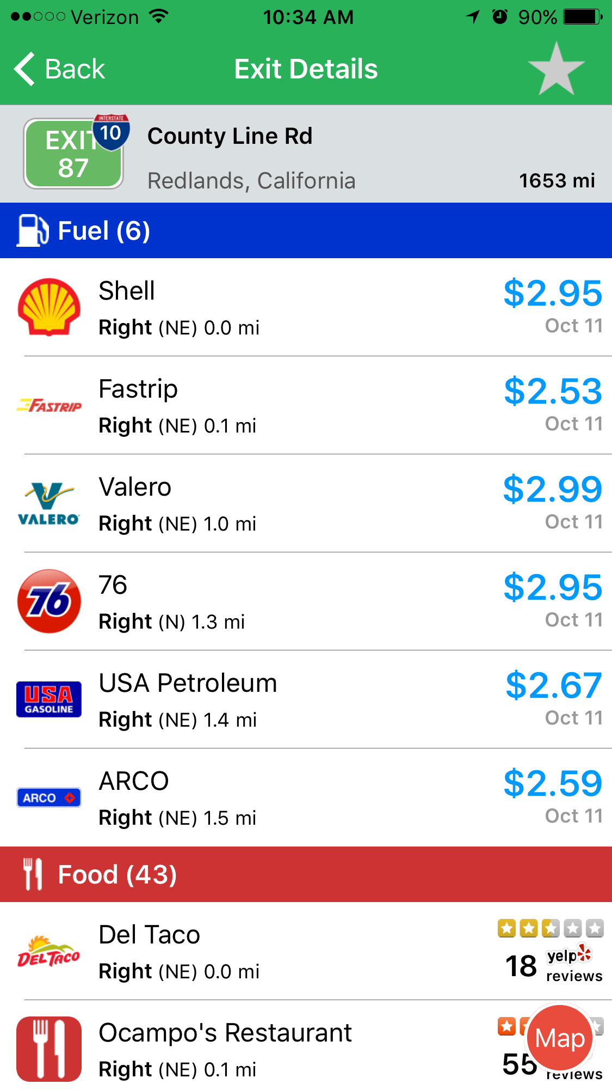
iExit $0.99
“How far to the next bathroom?”
“I’m hungry”
View exits on a map or as a list
Enable location services
Notes:
How presentation will benefit audience: Adult learners are more interested in a subject if they know how or why it is important to them.
Presenter’s level of expertise in the subject: Briefly state your credentials in this area, or explain why participants should listen to you.

Slide 22

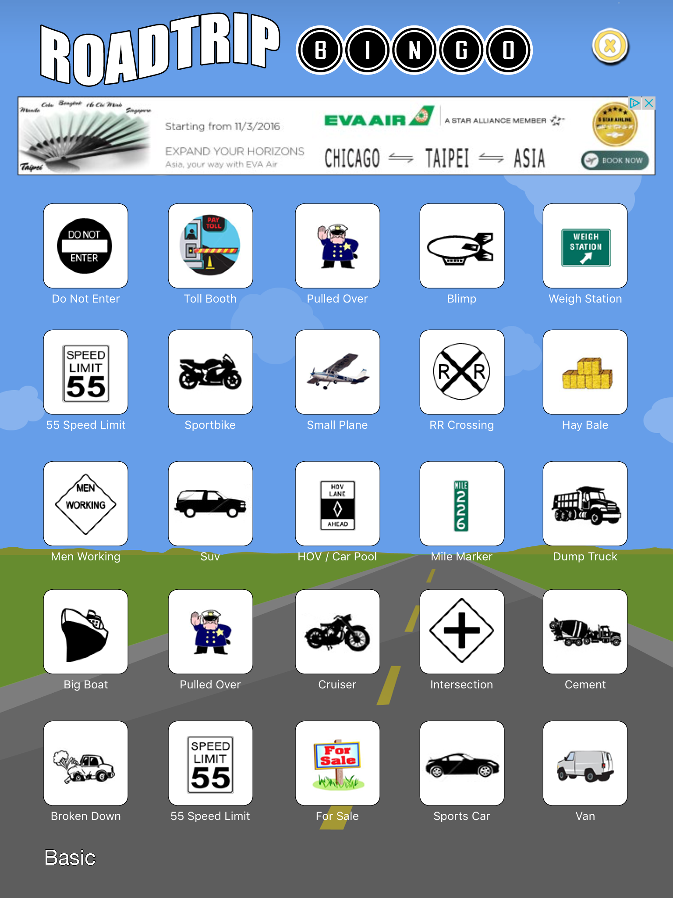


Road Trip Travel Games
Variety of games in App Store or Google Play Store
Instructions
More than one player
Notes:
How presentation will benefit audience: Adult learners are more interested in a subject if they know how or why it is important to them.
Presenter’s level of expertise in the subject: Briefly state your credentials in this area, or explain why participants should listen to you.

Slide 23
Things To Do

Slide 24

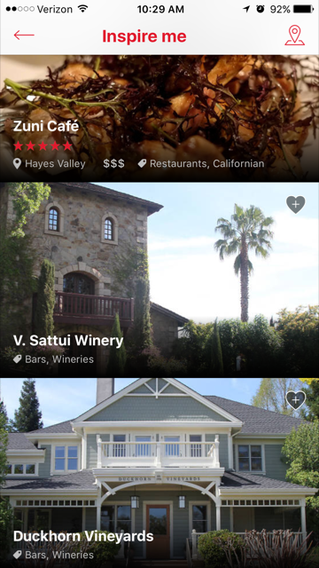
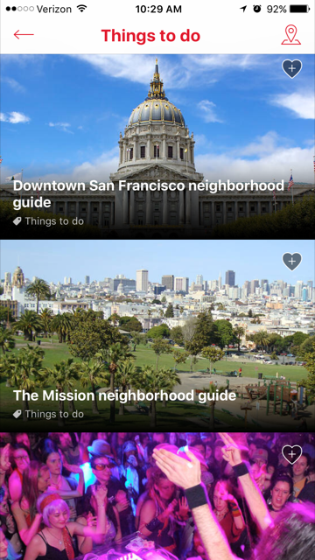
Time Out
Find information on major cities that include food, attractions, events, and user-made lists
Time Out also has individual apps for some cities
Notes:
How presentation will benefit audience: Adult learners are more interested in a subject if they know how or why it is important to them.
Presenter’s level of expertise in the subject: Briefly state your credentials in this area, or explain why participants should listen to you.

Slide 25

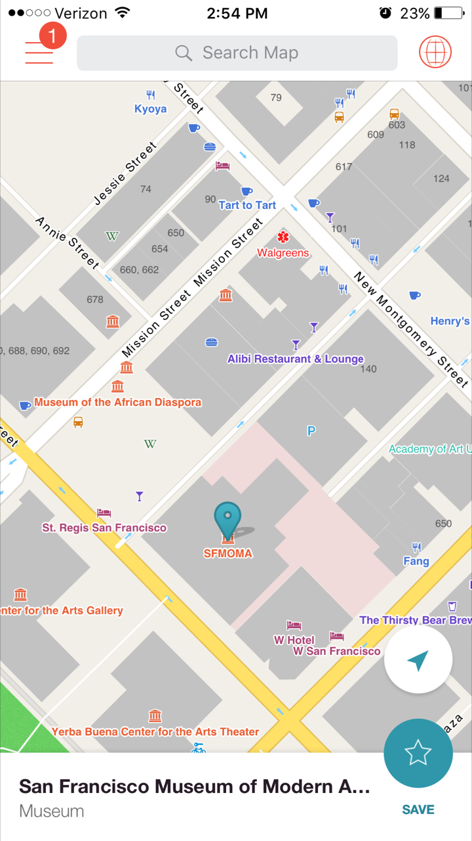
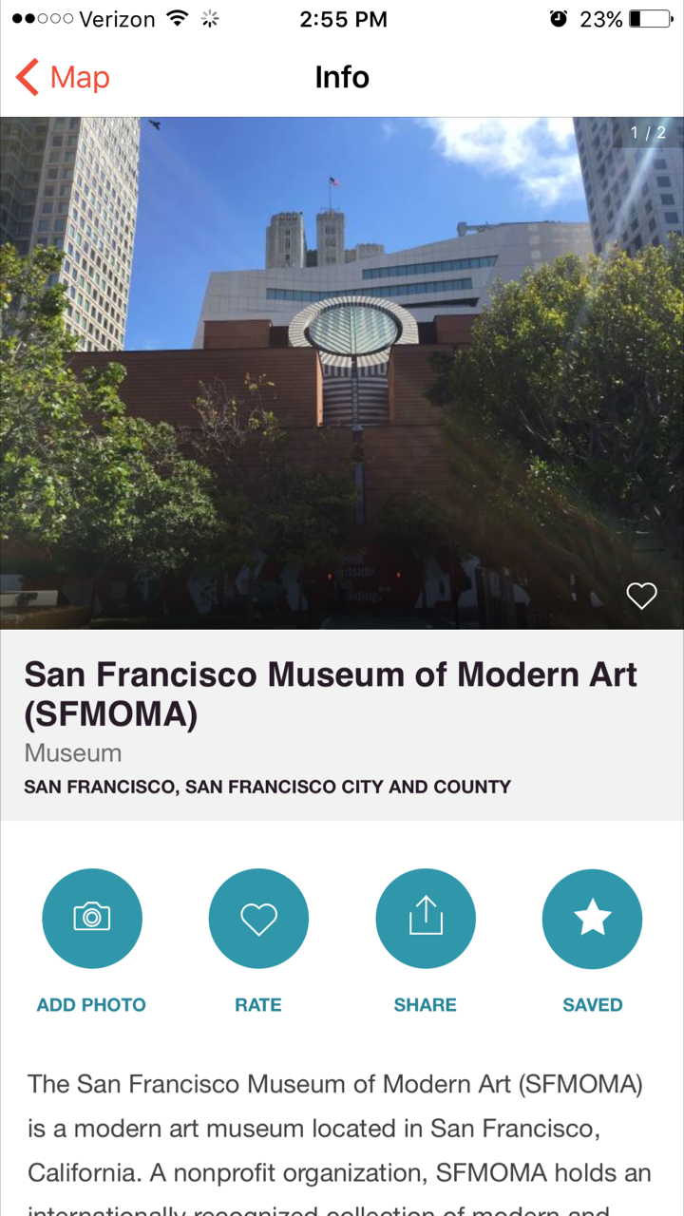
Travel Guide: San Fran
Example of app for travelers, city specific
Enable location services
View nearby attractions and details
Notes:
How presentation will benefit audience: Adult learners are more interested in a subject if they know how or why it is important to them.
Presenter’s level of expertise in the subject: Briefly state your credentials in this area, or explain why participants should listen to you.

Slide 26

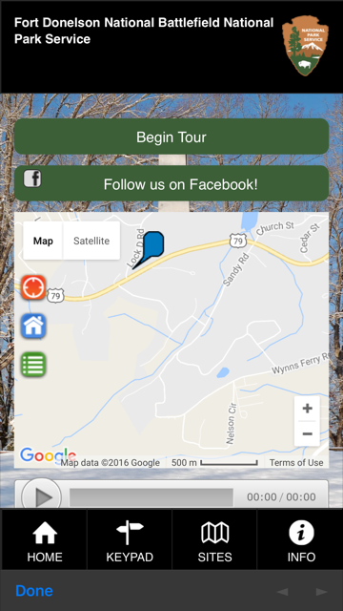

National Park Service
Everglades audio tour
Listen to audio recordings while touring National Parks
See also: apps about specific parks
Notes:
How presentation will benefit audience: Adult learners are more interested in a subject if they know how or why it is important to them.
Presenter’s level of expertise in the subject: Briefly state your credentials in this area, or explain why participants should listen to you.

Slide 27
Don’t Get Lost

Slide 28

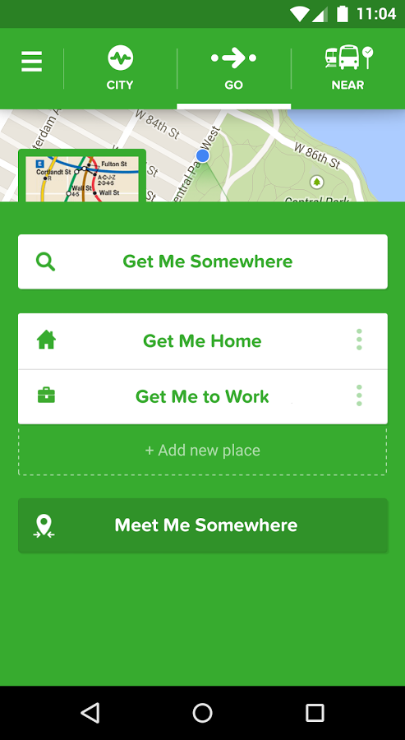
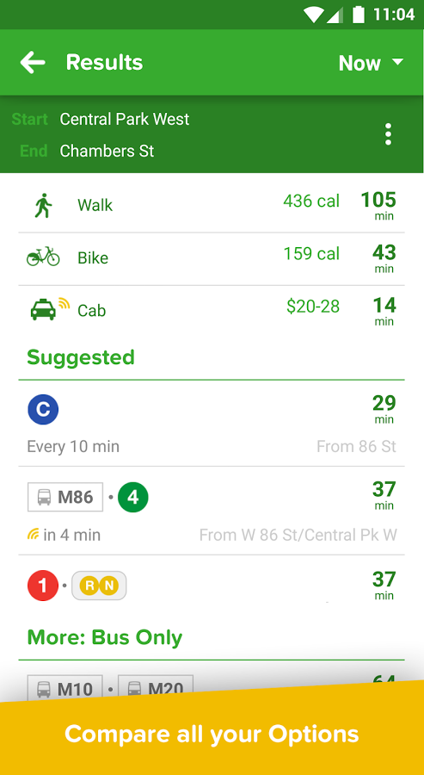
City Mapper
All inclusive maps for travelers
Quick links for getting home or to work
View transport options and time
Notes:
How presentation will benefit audience: Adult learners are more interested in a subject if they know how or why it is important to them.
Presenter’s level of expertise in the subject: Briefly state your credentials in this area, or explain why participants should listen to you.

Slide 29

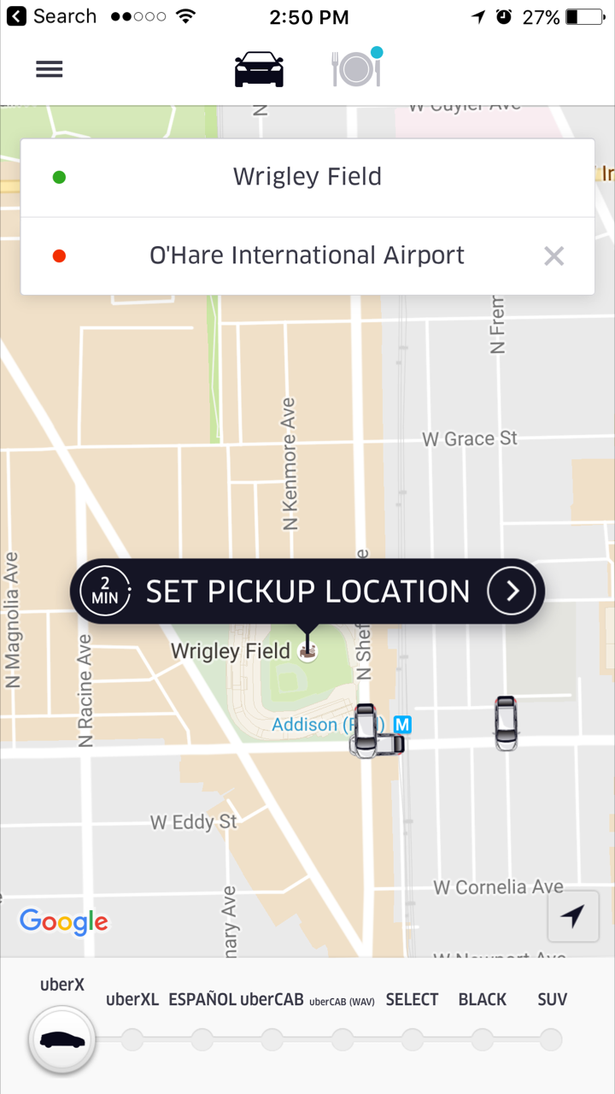
Uber
Alternative to taxi service
Set your pickup location and destination
Choose a car size
Pay directly through the app
Notes:
How presentation will benefit audience: Adult learners are more interested in a subject if they know how or why it is important to them.
Presenter’s level of expertise in the subject: Briefly state your credentials in this area, or explain why participants should listen to you.

Slide 30

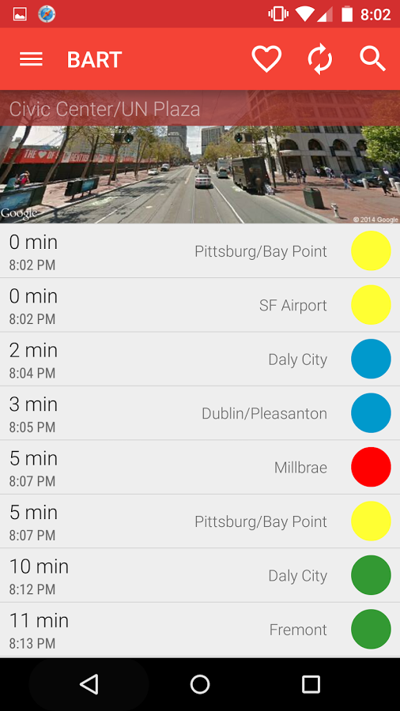
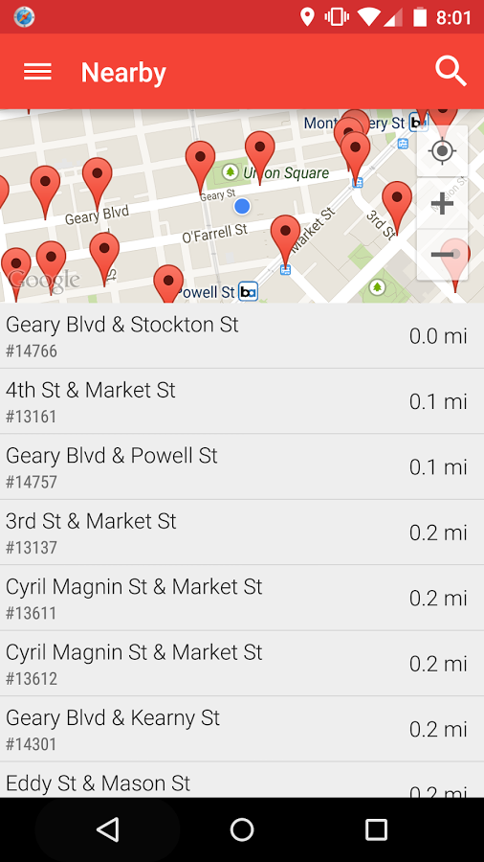
Metro San Francisco
Great example of transport app
Enable location services
Find nearby stops and view routes
Notes:
How presentation will benefit audience: Adult learners are more interested in a subject if they know how or why it is important to them.
Presenter’s level of expertise in the subject: Briefly state your credentials in this area, or explain why participants should listen to you.

Slide 31
Always Be Prepared

Slide 32

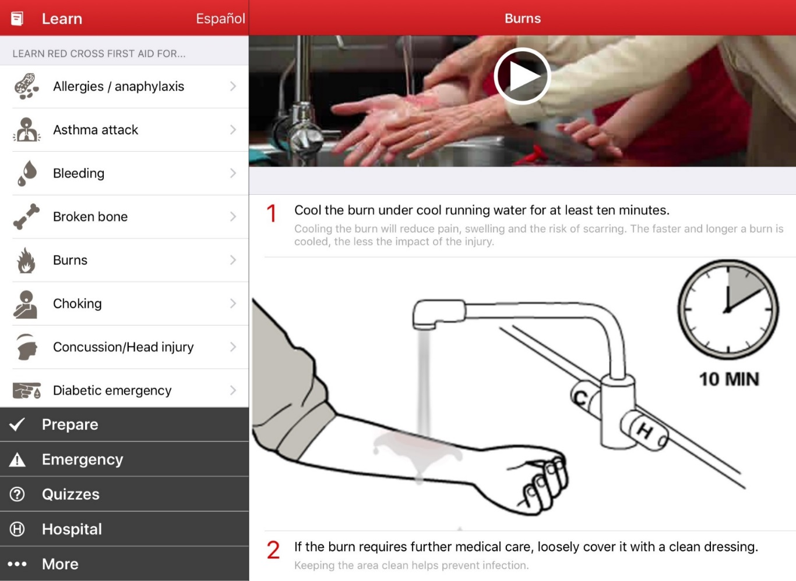
First Aid
Respond quickly
Illustrations
Step by step
Locate a hospital
Notes:
How presentation will benefit audience: Adult learners are more interested in a subject if they know how or why it is important to them.
Presenter’s level of expertise in the subject: Briefly state your credentials in this area, or explain why participants should listen to you.

Slide 33

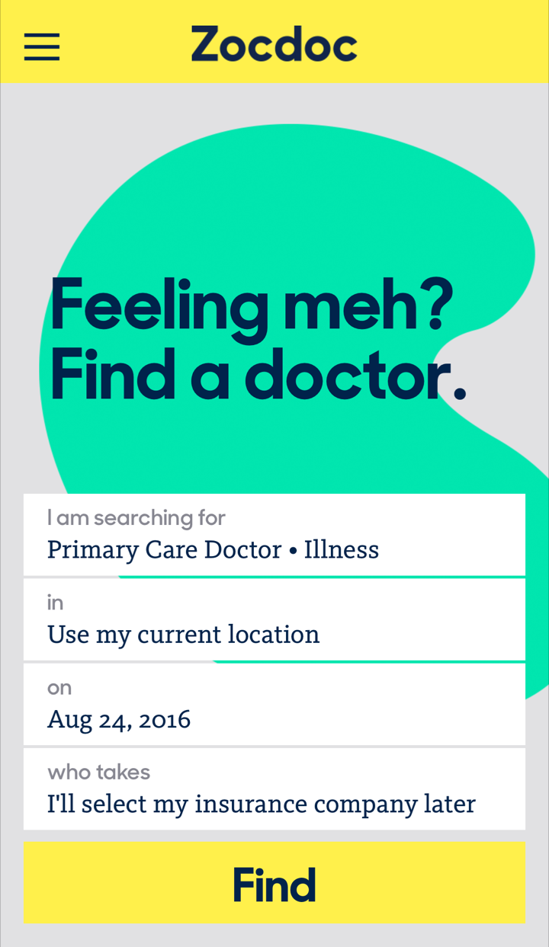
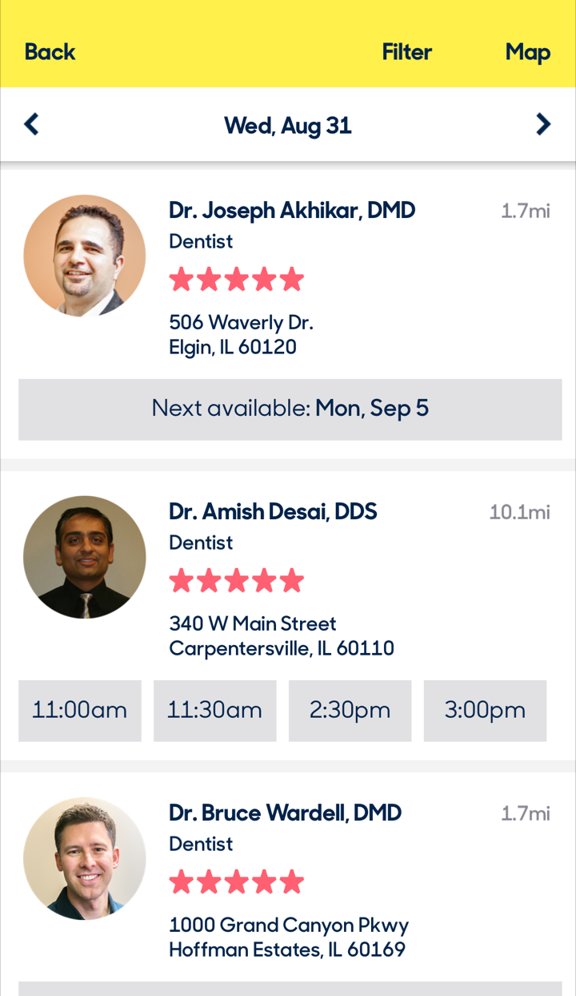
Zocdoc
Find a doctor quickly
Include insurance info
Read reviews
Make appointment
Notes:
How presentation will benefit audience: Adult learners are more interested in a subject if they know how or why it is important to them.
Presenter’s level of expertise in the subject: Briefly state your credentials in this area, or explain why participants should listen to you.

Slide 34
Over the Border

Slide 35

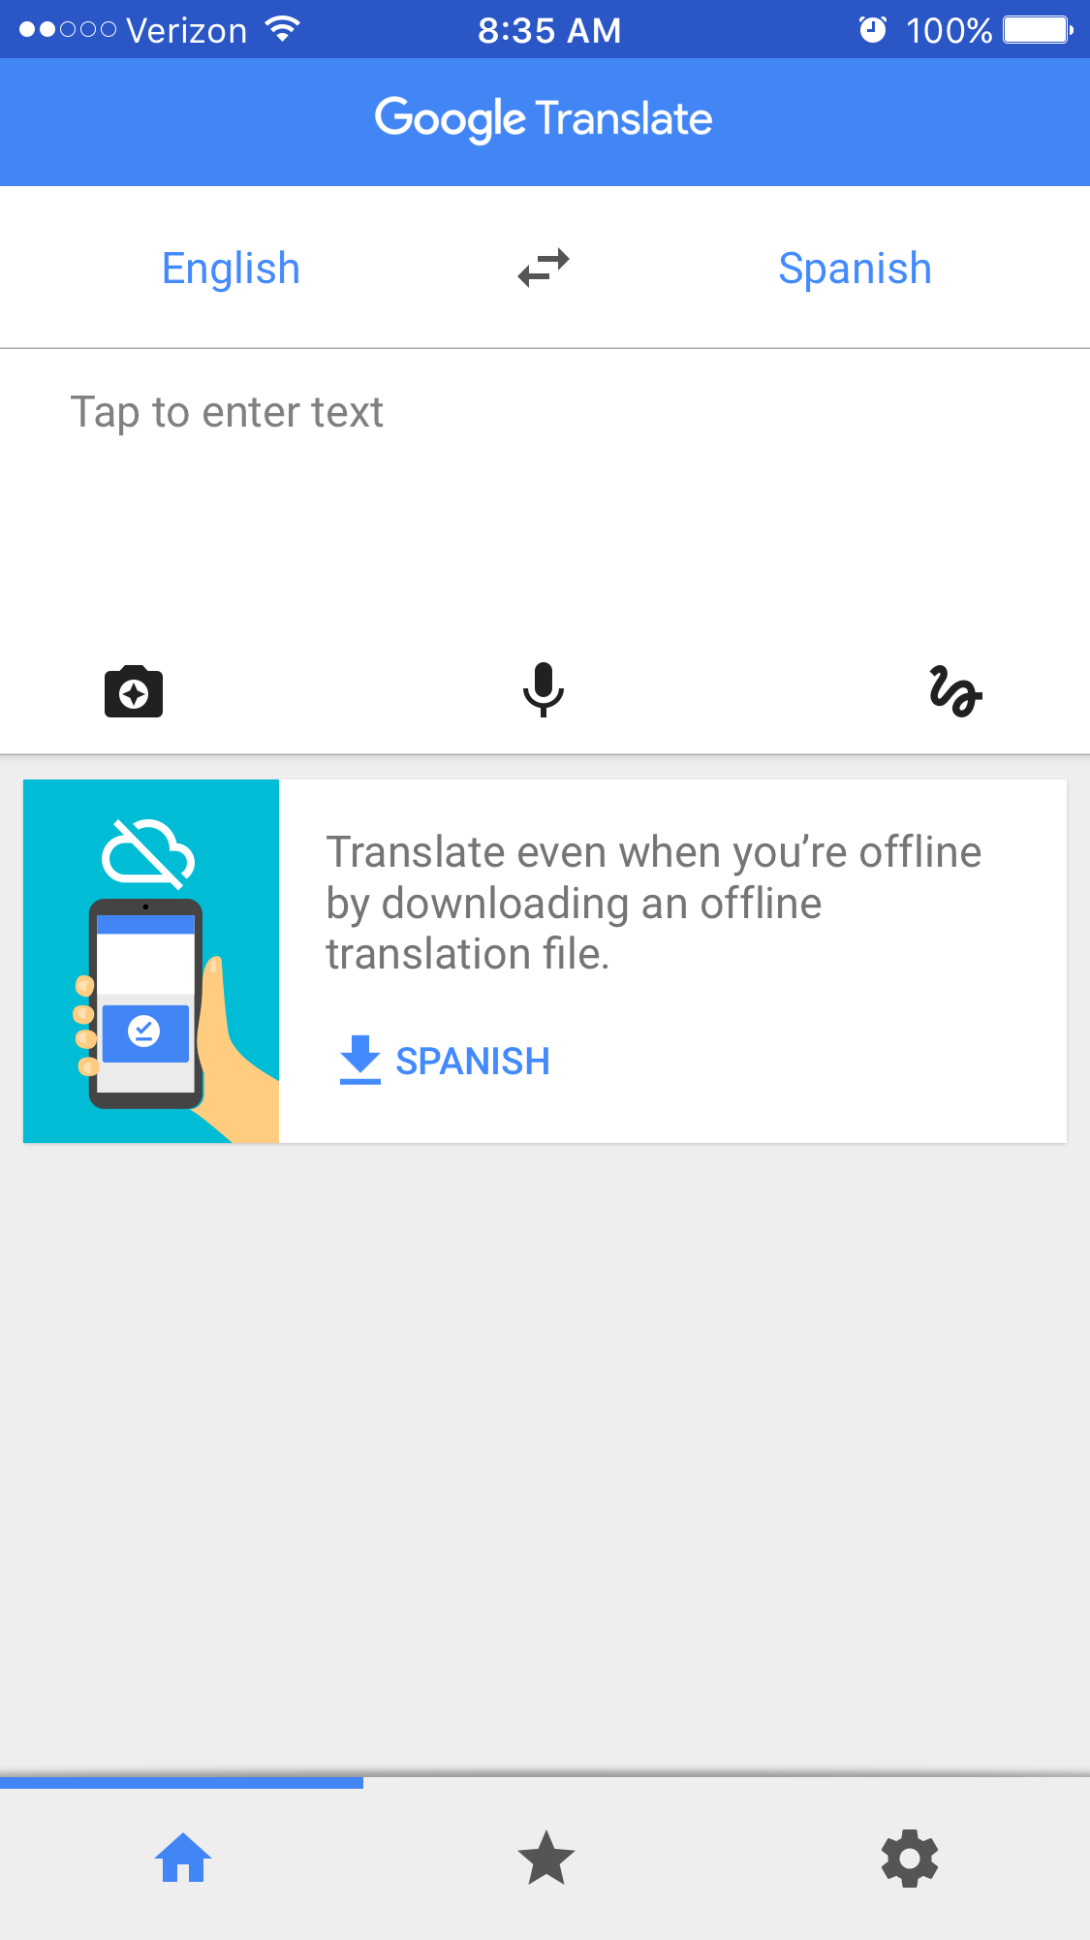
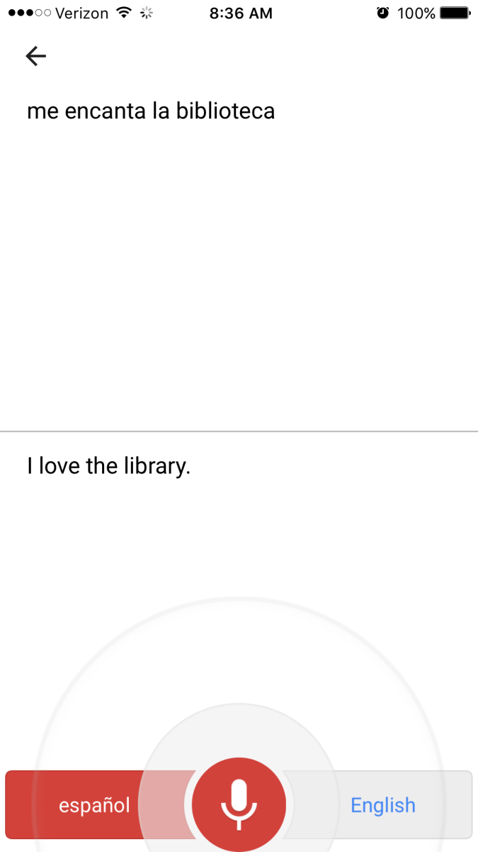
Google Translate
Type to translate text
Download a translation file for offline use
Immediate translation using the microphone
Notes:
How presentation will benefit audience: Adult learners are more interested in a subject if they know how or why it is important to them.
Presenter’s level of expertise in the subject: Briefly state your credentials in this area, or explain why participants should listen to you.

Slide 36

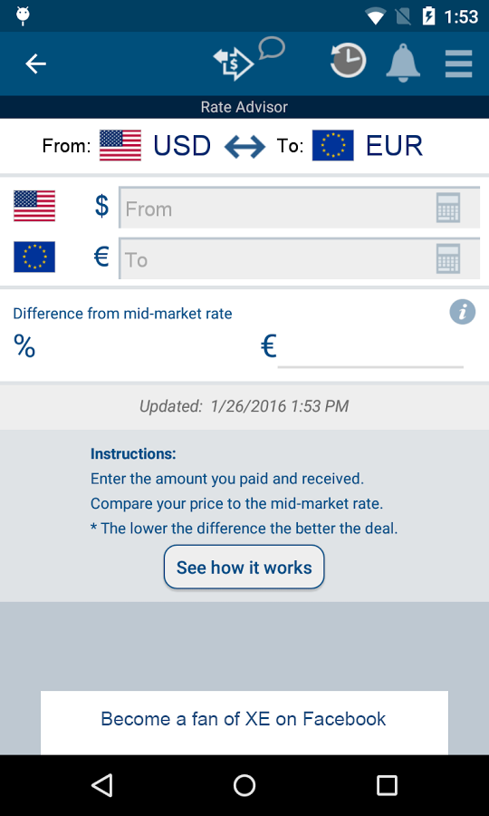
XE Currency
Quickly convert amounts on the go
Ensure honesty
View chart of exchange rates
Notes:
How presentation will benefit audience: Adult learners are more interested in a subject if they know how or why it is important to them.
Presenter’s level of expertise in the subject: Briefly state your credentials in this area, or explain why participants should listen to you.

Slide 37
Connecting While Away

Slide 38

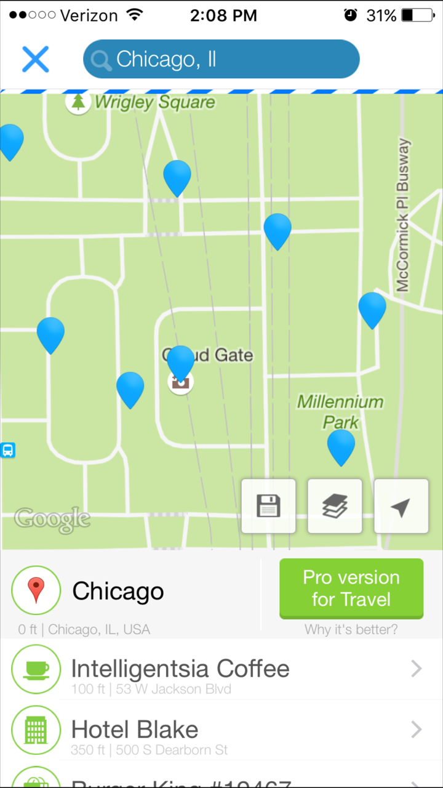
WiFi Map
For security, rely on open networks and use your own security measures
Enable location services to automatically search around you
Notes:
How presentation will benefit audience: Adult learners are more interested in a subject if they know how or why it is important to them.
Presenter’s level of expertise in the subject: Briefly state your credentials in this area, or explain why participants should listen to you.

Slide 39

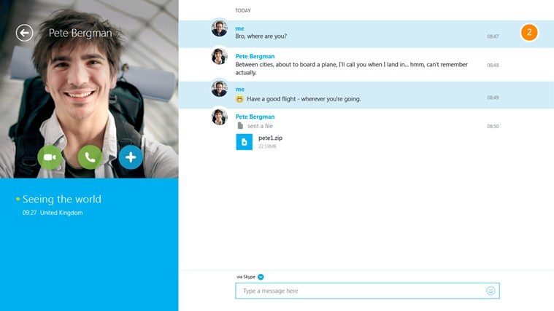
Skype
Video chat or call
Useful if you only have WiFi connection
Setup account and contacts ahead of time
Notes:
How presentation will benefit audience: Adult learners are more interested in a subject if they know how or why it is important to them.
Presenter’s level of expertise in the subject: Briefly state your credentials in this area, or explain why participants should listen to you.

Slide 40
Questions?
THANKS FOR ATTENDING!
Need more help?
Schedule a 1 on 1 appointment with a librarian!

