Slide 1

Build Your Own Desktop PC –
Part 1
Name
Title
Library Name
Courtesy of Gail Borden Public Library
and the Public Library Association

Slide 2
Agenda
What do you want from your PC?
Computer parts
Operating system
Peripherals
Purchasing
Trusted Brands
Buying Used

Slide 3
What Do You Want From Your PC?

Slide 4
Things to Consider
Price
Size
Intended use
Speed
Performance
Noise levels

Slide 5
Typical User Profiles
Light users
    Internet browsing
    Video watching
    Light photo editing
Moderate Users
    Play older/less graphically intensive video games
    Light photo/video editing
    Views 4K videos
    Runs high resolution and/or multiple displays
Power User
    Play latest video games at max settings
    Heavy video/photo editing and/or autoCAD

Slide 6
Searching through ads
Computer Parts

Slide 7
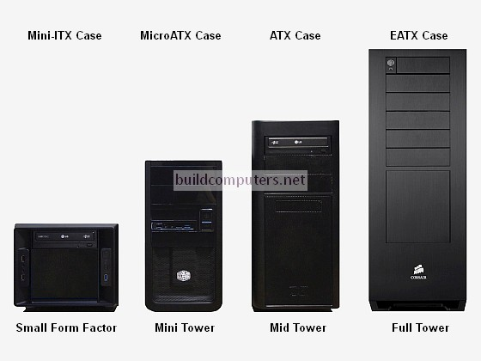
Computer Case
The case houses all the parts to create the PC Tower
Sizes:
Mini-ITX
Micro-ATX
ATX Mid Tower
ATX Full tower
ATX Super Tower
Price Range:
$20-350
Notes:
HD

Slide 8
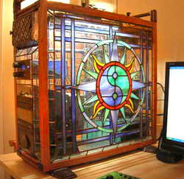
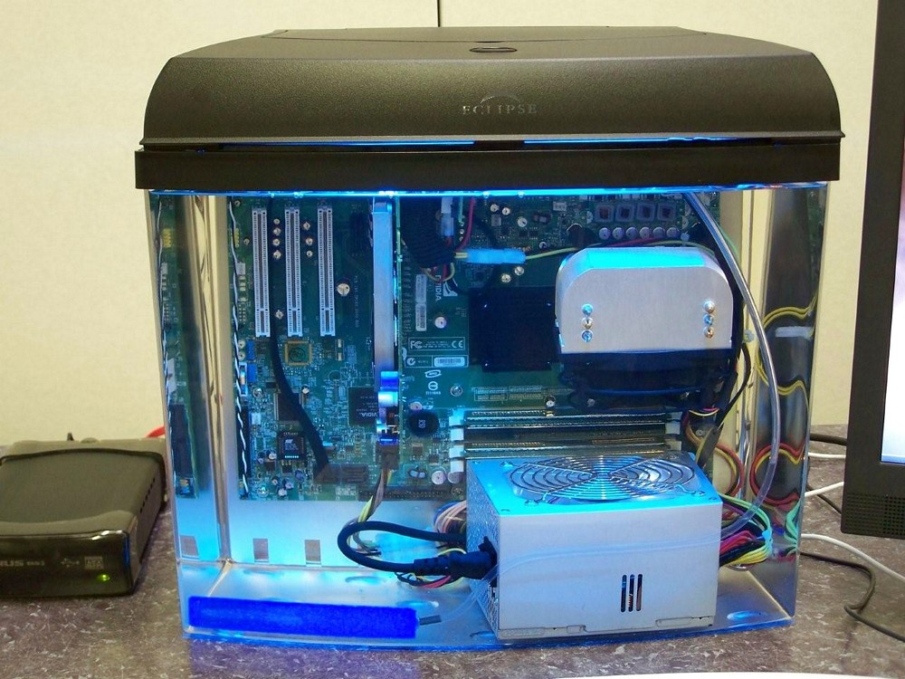
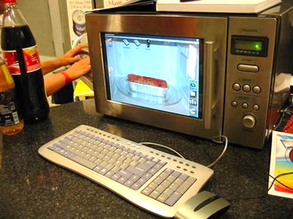
Computer Case
Save money by using an old computer case or get creative and build your own!

Slide 9
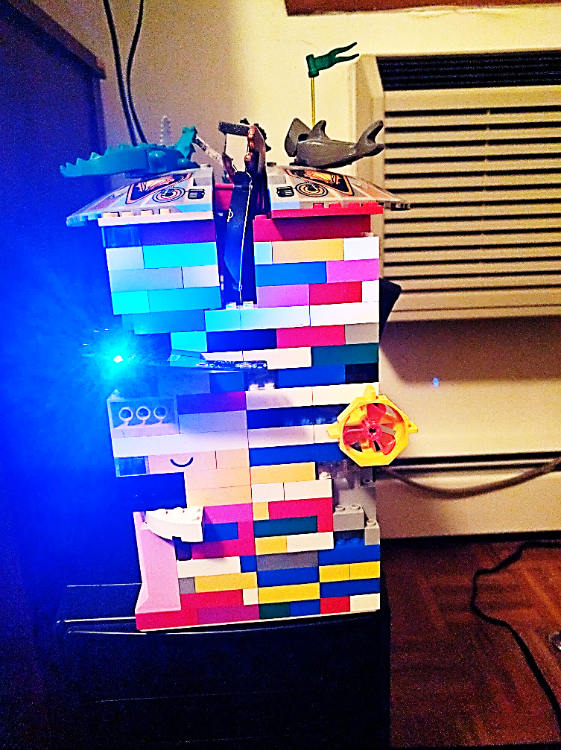
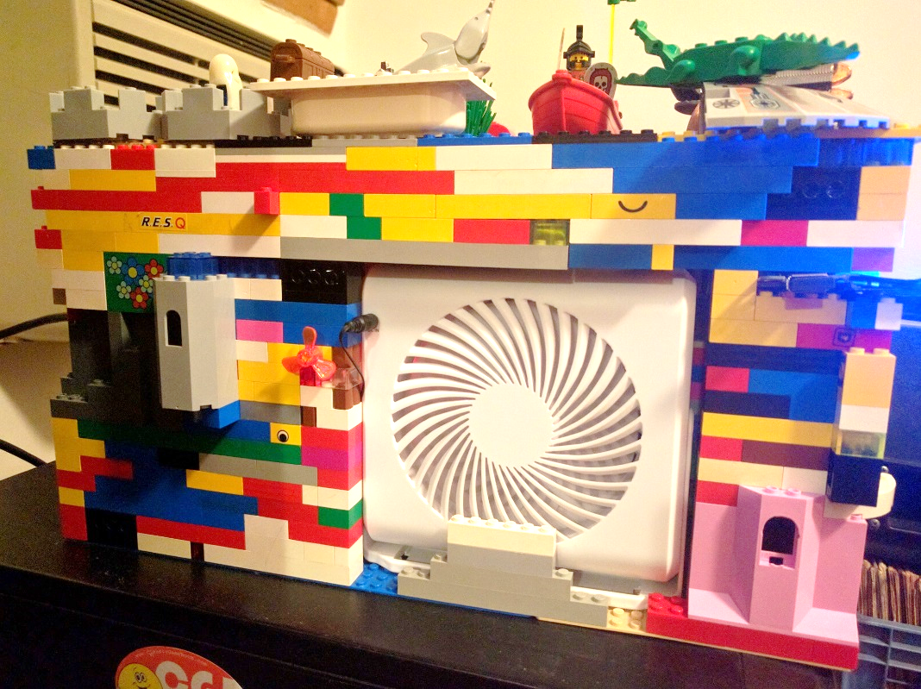
Computer Case
After my laptop case was destroyed I used the parts to create a Lego Desktop!

Slide 10
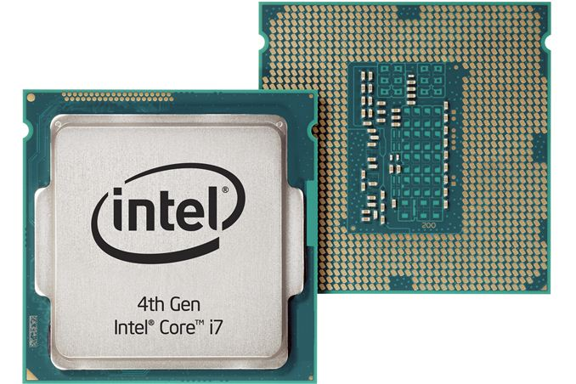
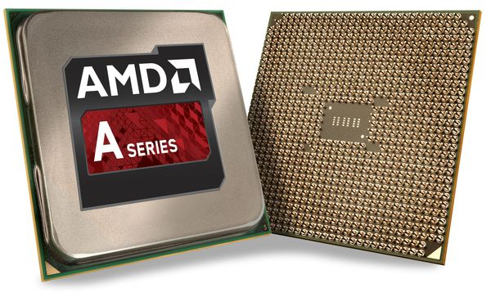
CPUs & APUs
The main chip on your computer that runs programs and apps
  CPU = Central Processing Unit / APU = Accelerated Processing Unit
  APU = A CPU with graphics included
 | Light User | Moderate User | Power User
Passmark Score | APU: 3000+ | APU/CPU: 5000+ | APU/CPU: 8000+
Price Range | $55-$100 | $110-$180 | $200-$1000
Notes:
HD

Slide 11
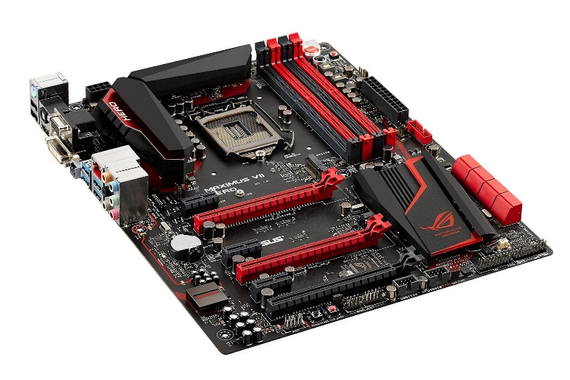
Motherboard
The mainboard that connects all your components
Does your motherboard support your CPU?
    Match brands: Intel or AMD supported motherboard
    Match motherboard with CPU socket
Choose a Motherboard that will fit in your case
  Light user: $35-$60
  Moderate user: $80-$120
  Power user: $120-$350
Notes:
HD

Slide 12
Motherboard Features
Purchase a board based off features
    Higher Price = more features (not equal to quality or performance)
Features to consider
Ram support (speed, # of slots, and Max ram)
# of Sata slots
    Sata connects hard drives and DVD/Blu-ray drives
Onboard video support
# of ports (usb, audio, HDMI, etc.)
# of PCI/PCI express slots
# of fan connectors
Wireless internet
Notes:
HD

Slide 13
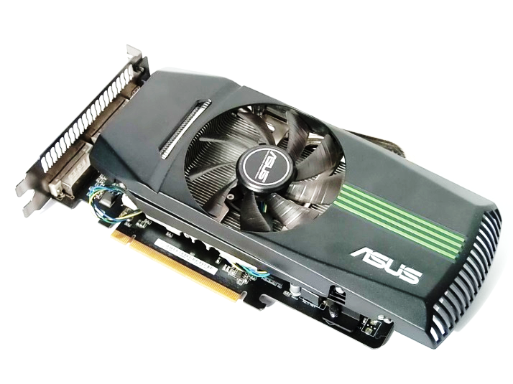
GPU
The graphics card is what creates and allows images to be displayed on the screen
GPU=Graphics Processing Unit
Workstation GPU is for video editing, 3d rendering, and scientific data crunching.
 | Light User | Moderate User | Power User
Passmark Score | No GPU (APU will handle graphics) | GPU: 4000+ | GPU: 7000+
Price Range | $0 | $120-$200 | $250-$1000
Notes:
HD

Slide 14
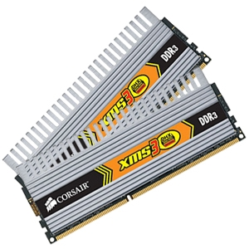
RAM
The memory stick used to run all of your programs and apps (It does not save files)
RAM = Random Access Memory
Size
  Minimum: 4 GB
  Recommended: 8 GB+
Price Range: $5-$10 per GB
Must be compatible with your motherboard
DDR3 vs DDR4
    DDR 4 is the new standard, making it faster & expensive
    DDR 4 will only help APU performance
Notes:
HD

Slide 15
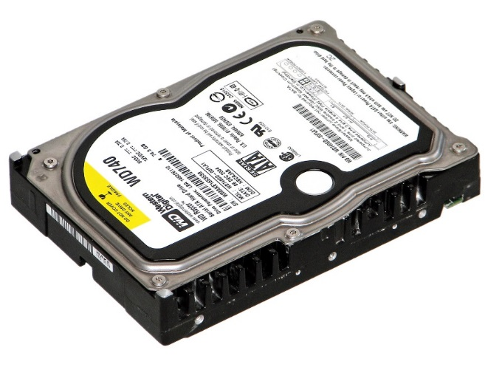
Hard Drive(s)
Saves your files, programs, and apps to the computer
Types of Hard drives
    SSD drives (fastest)
    Hybrid drives (fast with high storage)
    Mechanical hard drive (slowest highest storage)
 | SSD HD User | Mechanical HD User
Capacity | 120GB-240 GB | 500GB-2TB
Price Range | $45-$120 | $40-$150
Notes:
HD

Slide 16
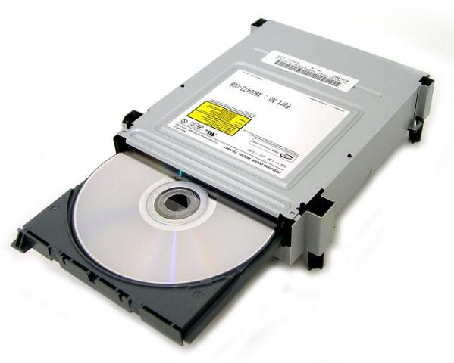
Optical Drives
Get a Blu-Ray or DVD drive based on use
  DVD: $20
  Blu-ray: $50-200
If you do not use discs (for software or videos) forgo an optical drive
Notes:
HD

Slide 17
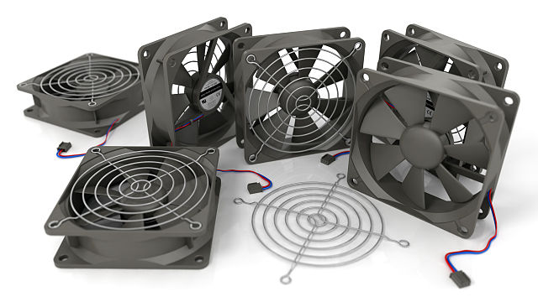
Cooling Fans
    Fans keep the parts cool to prevent overheating/damage
    Cases often come with one fan installed, which is enough for a light user
    Two or more for moderate and power users
For quiet fans look for 17dB or less
Make sure your case supports the size of your fan
    120mm, and 92mm are the most common sizes
Price Range: $6-$40 per fan
Notes:
HD

Slide 18
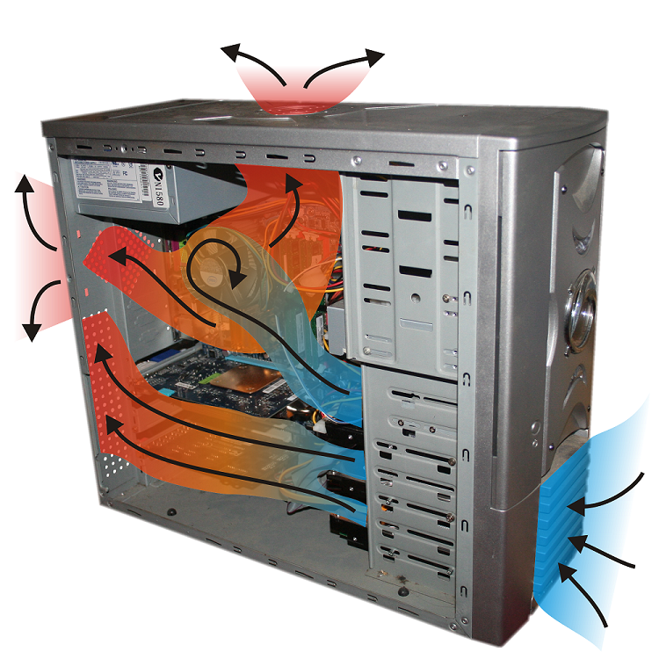
Cooling Fans

Slide 19
PSU
PSU powers all of your components
PSU = Power Supply Unit
Use a PSU calculator to determine exact wattage needs
    http://outervision.com/power-supply-calculator
 | Light User | Moderate User | Power User
Watts | 300-350 | 400-500 | 600+
Price Range | $25-$40 | $40-$50 | $60-$400
Notes:
HD

Slide 20
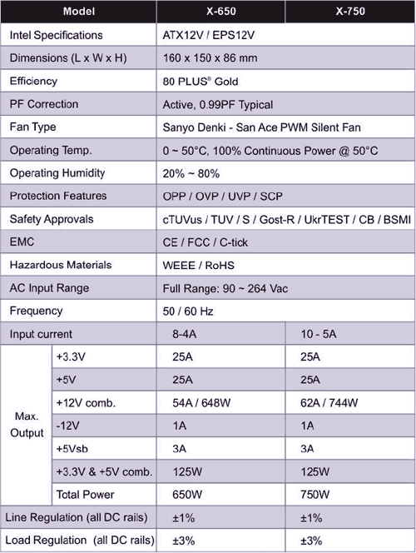
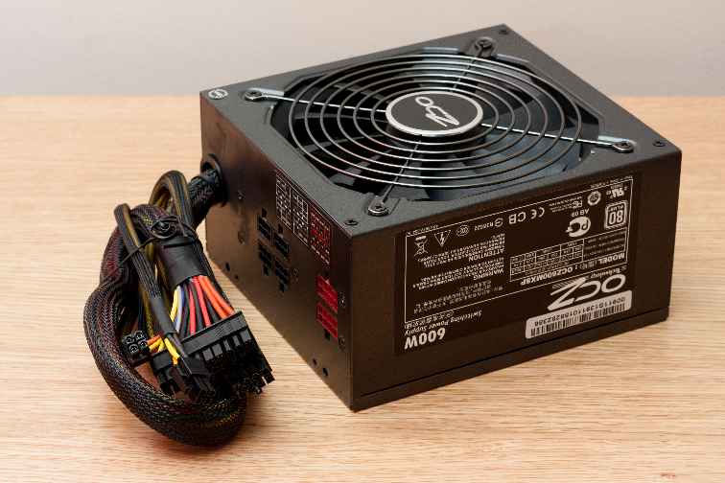
PSU
If you are buying a graphics card make sure your 12-volt rail has enough Amps to power it.
Notes:
HD

Slide 21
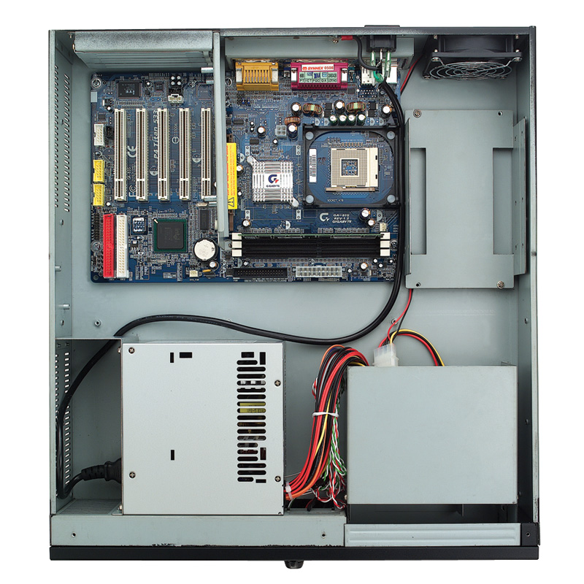
Bare Bones Computer
Comes with a case, fan, motherboard, and power supply pre installed
Good base start for a first time builder
Barebones are often very small cases

Slide 22
Searching through ads
Operating Systems

Slide 23
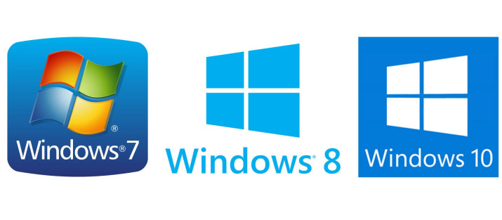
Windows
Windows 7 security updates until 1/14/20
Windows 8 security updates until 1/10/23
Windows 10 security updates until 10/14/25
Windows 10
Longer support
Better software compatibility
Supports Direct X 12
Multiple Desktops
Light-Moderate users: Windows 10 home $100
Power User: Windows 10 Pro $140
Notes:
HD

Slide 24


Linux
Pros
Free alternative to Windows
Easy to install and get started
Usually recognizes hardware and runs great
Cons
Poor software support
Harder to use for those new to computers
Best Linux OS
Ubuntu, Mint, Lumbuntu
OS X (Apple/MAC)
Can not legally install on a home built computer
Notes:
HD

Slide 25
Searching through ads
Peripherals

Slide 26
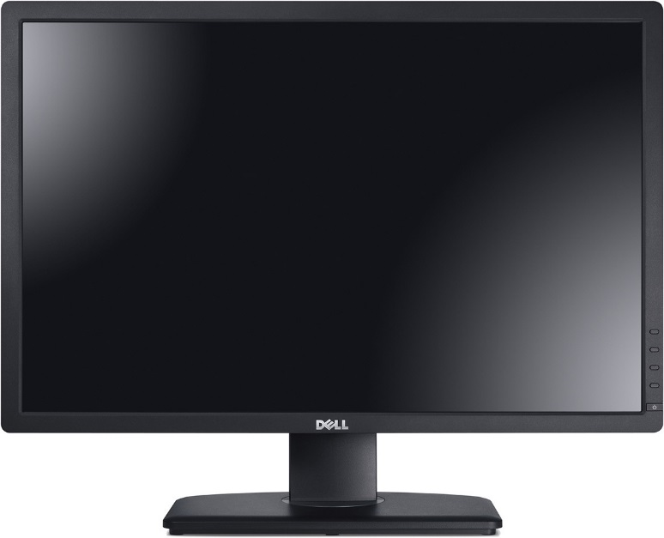
Display
TV vs Monitor
    TV = cheaper, larger and has speakers
    Monitor better image quality (on average)
Things to consider
    Video input compatibility
    Refresh rate
    Contrast
    Size
    Resolution
    LCD vs LED vs IPS
Light to Moderate User: $80-150
Power User: $200-1000

Slide 27
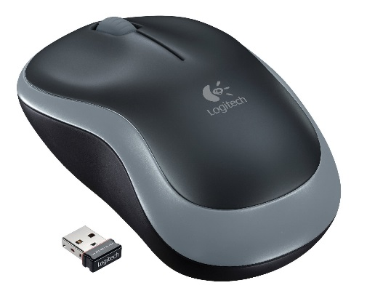
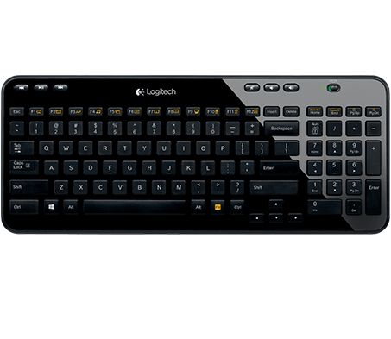
Keyboard & Mouse
Comfort is key!
Things to consider
    Wired vs wireless
    Keyboard Number pad
Types of keyboard
        Standard dome
        Low Profile keys
        Mechanical
Light User: $30-40
Moderate User: $40-60
Power User: $80-300
Notes:
HD?

Slide 28
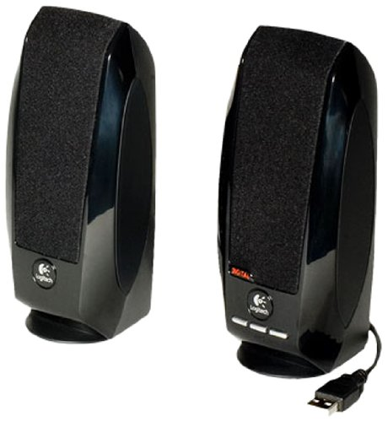
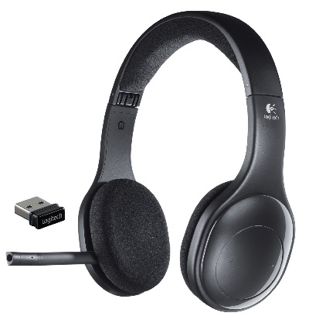
Sound
Best Speaker Brands
Bose
Creative
Logitech
Polk Audio
Harman Kardon
Best Mic Brands
Blue
Audio Technica
Sony
Best Headset Brands
Sennheizer
Razer
Logitech
Steel Series
Light user: $25
Moderate user: $50
Power user: $100+
Notes:
HD?

Slide 29
Searching through ads
Purchasing

Slide 30
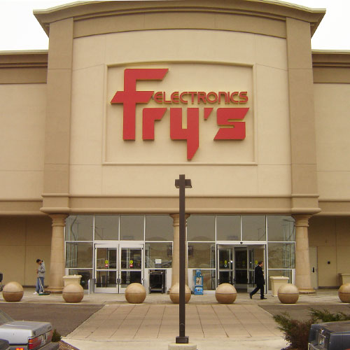
In Person: Fry’s Electronics
Location: 3300 Finley Road
Downers Grove, IL
Price Match
Friendly knowledgeable staff
Products out to see and test
Massive selection
Notes:
HD

Slide 31
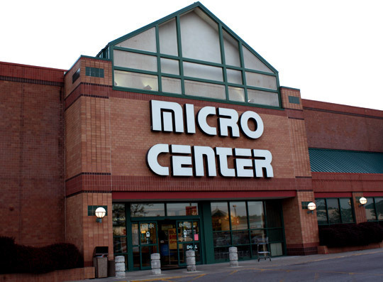
In Person: Micro Center
Location: 80 East Ogden Avenue Westmont, IL 60559
Price Match
Friendly knowledgeable staff
Products out to see and test
Massive selection
Notes:
HD

Slide 32
Online
Newegg/Amazon
Great reviews for all items
Great customer service and return policies
Fast shipping
Lower or no Taxes
Lower Prices
Notes:
HD

Slide 33
Searching through ads
Trusted Brands

Slide 34
Trusted Brands
Asus
Gigabyte
MSI *
Kingston
Corsair *
*Favorite brands I’ve used
Adata *
Western Digital
EVGA *
XFX
Zotac
Notes:
HD

Slide 35
Less Reliable Brands
Patriot
(ECS)Elite-Group
Biostar
Lepar
Logisys
Super Talent
Or anything you never heard of
Notes:
HD

Slide 36
Searching through ads
Buying Used

Slide 37
Buying Used
Craigslist/eBay/Amazon
Computer parts average roughly 5 years
Look for warranty refurbished parts on Newegg.com
Do not buy used hard drives!
Best items to look for used (lasts more than 5 years)
    Monitor/TV
    RAM
    Keyboard, mouse, and other peripherals
    Computer case
Notes:
HD

Slide 38
Questions?
THANKS FOR COMING!
Remember to come next week when we disassemble and reassemble computers!
Wear clothes you don’t mind getting a bit dusty
Computers and tools will be provided

