Slide 1

Acing Your Job Interview – Part 2
Alex Brotsos
Career Services Librarian
Phil Schmitt
Technology Trainer

Slide 2
Agenda
Interview Styles
Marketing Yourself/Branding

Slide 3
Interview Styles

Slide 4

Virtual Interviews
Space considerations
  Noise level
  Internet connection
  Lighting
Laptop/PC preferable
Test the software
Dress as if you were meeting in-person
Look at the camera when speaking
Have your resume & notes ready

Slide 5

Phone Interviews
Find a quiet room
Avoid distractions
Answer clearly with a pleasant greeting
Tone of voice matters – you can “hear” a smile
Have resume & notes ready

Slide 6

Screening Calls
Usually a Human Resources representative
“Checking off boxes” –minimum requirements to proceed

Slide 7
Panels
More than one interviewer
Answer to all – use eye contact
Bring enough paper copies of your resume

Slide 8

Second Round
Often used to narrow the field down
More intricate questions and/or testing

Slide 9

Impromptu/On the Spot
Sending out multiple resumes could lead to multiple calls – know who you’re talking to
Turning in an application in-person could result in a quick interview

Slide 10

Informational Interviews
Networking tactic used by job seeker to gain knowledge of industry and roles
Could lead to job shadowing
Not meant for asking about current open positions

Slide 11
Marketing Yourself/Branding

Slide 12
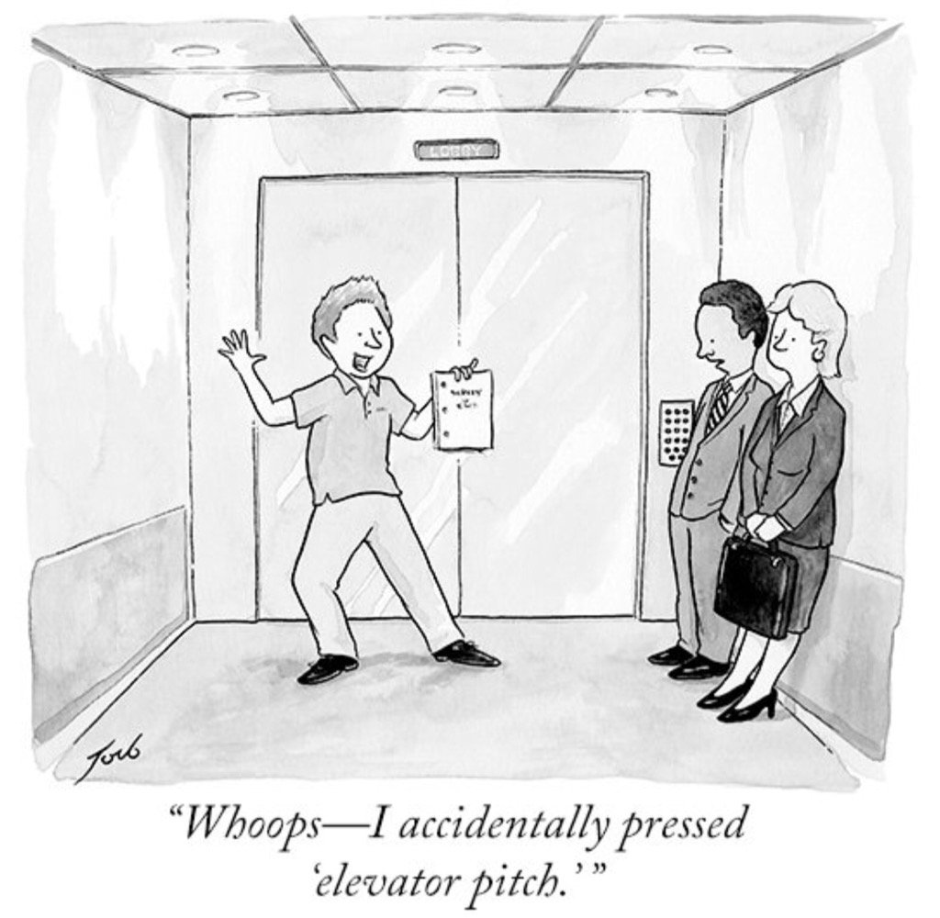
The Elevator Pitch
30 Seconds
Who you are
What you do
What you’re looking for
A “hook”
A closing statement

Slide 13
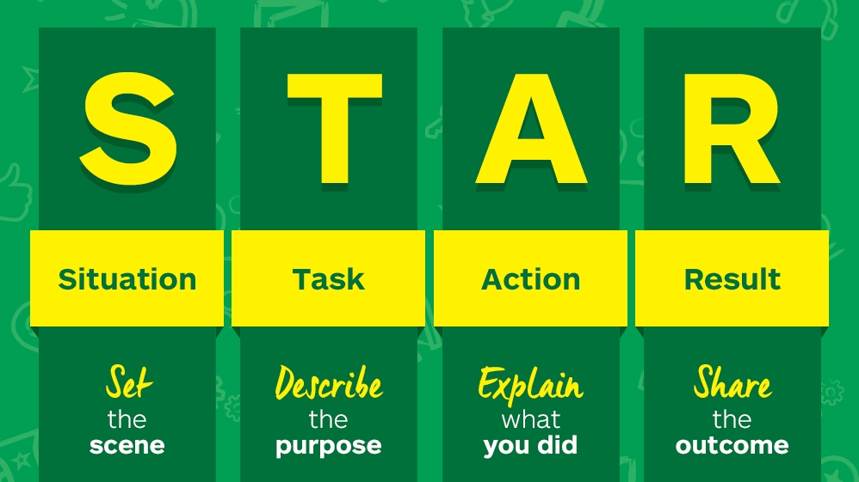
STAR Method
Notes:
Develop ready example to back up points on your resume
Image credit: https://careersblog.enterprise.co.uk/tips-on-using-the-star-technique-to-answer-job-interview-questions/

Slide 14
How to Analogize
If not familiar with a product/process, compare it
“I haven’t used ABC, but I have experience with XYZ and learned that while handling…”

Slide 15

Final Thoughts
Interviews are a two-way street

Slide 16
QUESTIONS?
GBPL resources for job seekers: https://www.gailborden.info/learn/job-career

