Slide 1

Acing Your Job Interview – Part 1
Alex Brotsos
Career Services Librarian
Phil Schmitt
Technology Trainer

Slide 2
Agenda
Pre-Interview Work
Interview Strategies
Post-Interview Tips

Slide 3
Pre-Interview Work

Slide 4

Do Your Research
Identify the interview style and who will be present
Look into the company
  Reviews, recent news, goals/mission, staff, culture
Talk to your references & contacts
Salary range

Slide 5

Write this Down…
Print paper copies of your resume and review it
  Be able to elaborate on skills & accomplishments
List questions you want to ask the employer
Portfolio required?

Slide 6

Don’t forget….
Select your outfit ahead of time
Map your route & plan to arrive early
Determine what to bring with you (ex: notepad)
Practice interviewing
Interviews are a two-way street

Slide 7
Interview Strategies

Slide 8

Behavioral Interviews
Notes:
Image credit: https://dotfoodscareers.com/behavioral-interviews/

Slide 9
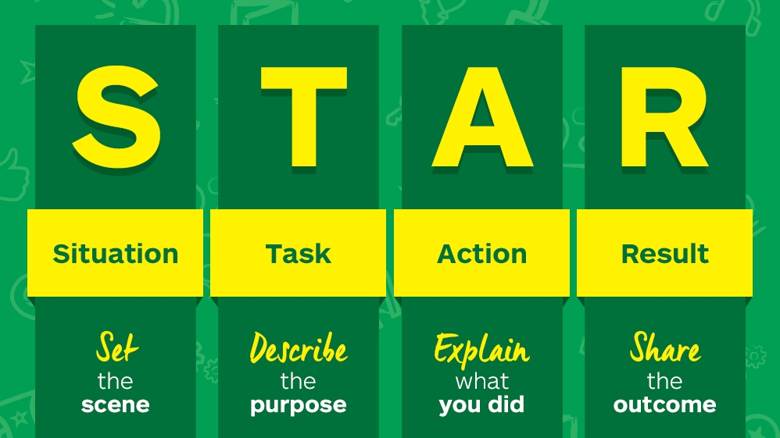
STAR Method
Notes:
Image credit: https://careersblog.enterprise.co.uk/tips-on-using-the-star-technique-to-answer-job-interview-questions/

Slide 10

“Selling” Yourself
The Elevator Pitch
Meaningful language & pauses
Humor?
WEAKNESSES

Slide 11

Clarifying Questions
Related to the job, the organizational structure, the culture, a typical workday
What does the interviewer enjoy about working there?
What questions do you have?
Can I take notes?

Slide 12
Wrapping It Up
Thanking the interviewer(s)
Potential Lack of Feedback
Next Steps

Slide 13
Post-Interview Tips

Slide 14

Following Up
Sending a thank you email
Revise any notes taken during the interview
Checking in when time has passed
If you don’t succeed…

Slide 15
QUESTIONS?
Next in the series:
Acing Your Job Interview – Part 2

