Slide 1

Microsoft Word: Basics
Name
Title
Library Name
Courtesy of Gail Borden Public Library
and the Public Library Association

Slide 2
Agenda
Terminology & Descriptions
Accessing Word
Basic Elements
Tabs & Groups
Saving Documents
Creating & Opening Documents
Printing Documents
Notes:
Review agenda with participants so they know what to expect. Ask them to hold their questions until you review all the features, in case it’s part of the agenda.

Slide 3
Terminology & Descriptions

Slide 4
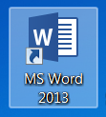
Terminology & Descriptions
Microsoft Word
  An application for creating and working with text-based documents
  Examples include letters, memos, resumes, cover letters, and flyers

Slide 5
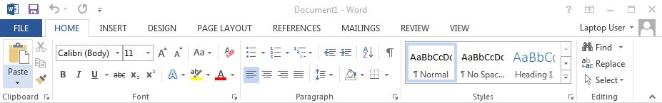
Terminology & Descriptions
  The Ribbon
  The area at the top of the screen where commands are organized into Tabs, icons, and Groups

Slide 6
Terminology & Descriptions
Tabs
There are 8 Tabs in addition to the File tab
Home, Insert, Page Layout, References, Mailings, Review and View

Slide 7
Terminology & Descriptions
Groups
Related task functions are organized into Groups
The name of the group is below its task buttons
Additional tasks are accessible by clicking on the Dialog Box in the lower right-hand corner

Slide 8
Accessing Word

Slide 9
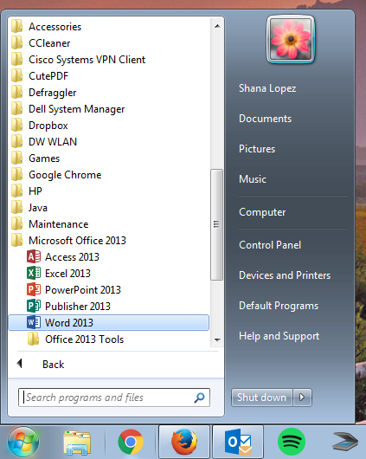
Accessing Word
Using Start and the Program Menu

Slide 10

Accessing Word
From the Desktop icon (at Gail Borden PL)

Slide 11
Activity #1

Slide 12
Basic Elements

Slide 13
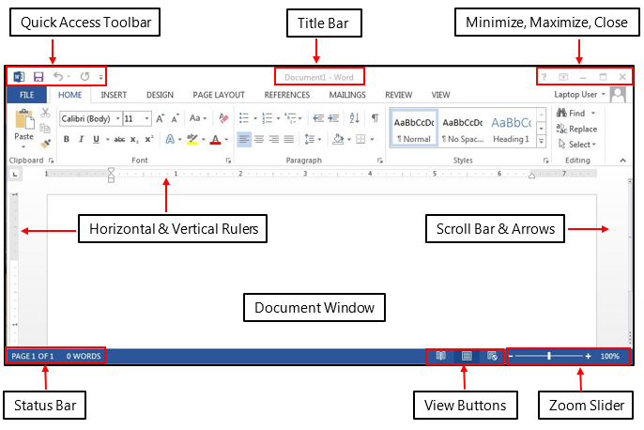
Basic Elements

Slide 14
Activity #2

Slide 15
Tabs & Groups

Slide 16
Tabs & Groups
  The Home tab includes these groups: Clipboard, Font, Paragraph, Styles, and Editing

Slide 17
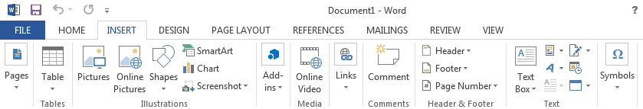
Tabs & Groups
The Insert tab includes these groups: Pages, Tables, Illustrations, Links, Header & Footer, Text, and Symbols

Slide 18
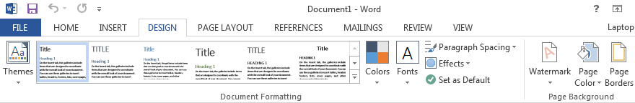
Tabs & Groups
The Design tab includes these groups: Themes, Document Formatting, and Page Background

Slide 19
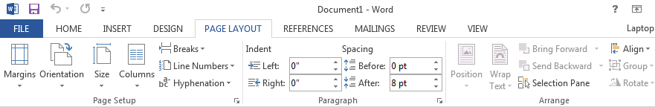
Tabs & Groups
  The Page Layout tab includes these groups:
  Page Setup, Paragraph, and Arrange

Slide 20
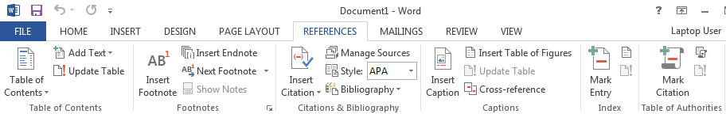
Tabs & Groups
  The References tab includes these groups: Table of Contents, Footnotes, Citations & Bibliography, Captions, Index, and Table of Authorities

Slide 21
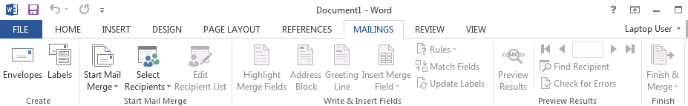
Tabs & Groups
  The Mailings tab includes these groups: Create, Start Mail Merge, Write & Insert Fields, Preview Results, and Finish

Slide 22
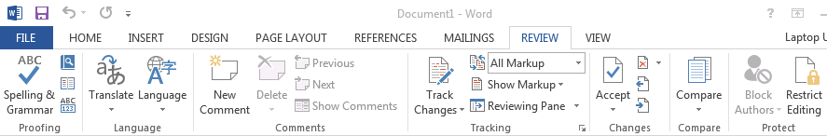
Tabs & Groups
The Review Tab includes these groups: Proofing, Language, Comments, Tracking, Changes, Compare, and Protect

Slide 23
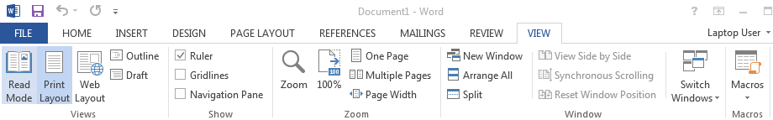
Tabs & Groups
  The View Tab includes these groups: Document Views, Show, Zoom, Window, and Macros

Slide 24
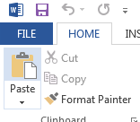
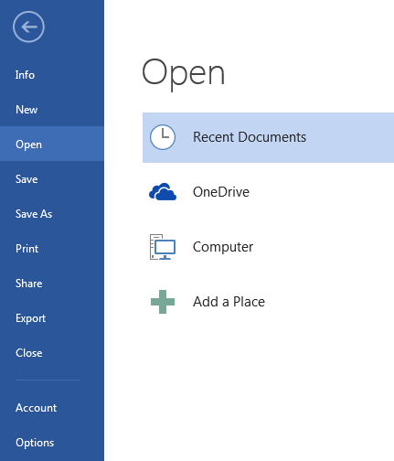
Tabs & Groups
  The File tab includes these commands: Info, New, Open, Save, Save As, Print, Share, Export, Close, Account, and Options

Slide 25
Activity #3

Slide 26
Saving Documents

Slide 27
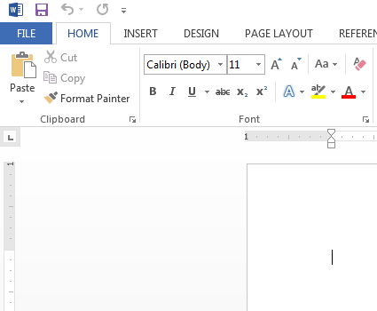
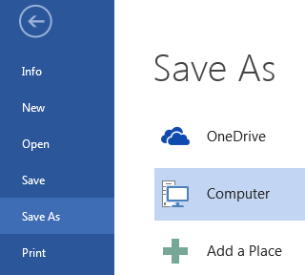
Saving Documents
Save As = Recommended for 1st time you save a document

Slide 28
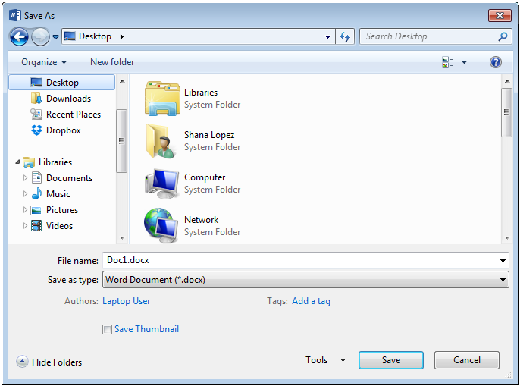
Saving Documents
Click on the location where you want to save the file
Click inside the File Name box (if not already highlighted) and type in a name
Click the Save button

Slide 29
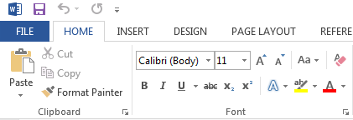
Saving Documents
Once the document has been saved:
Save additional changes to the document by click on the Save button located in the Quick Access Toolbar

Slide 30
Activity #4

Slide 31
Creating & Opening Documents

Slide 32
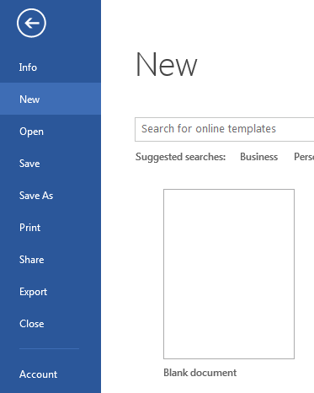
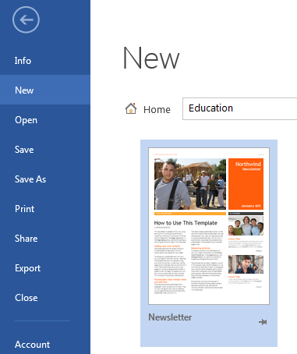
Creating & Opening Documents

Slide 33
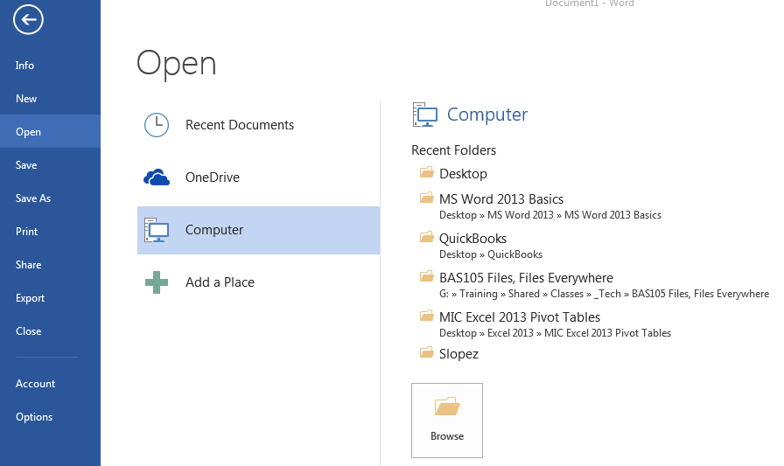
Creating & Opening Documents

Slide 34
Activity #5

Slide 35
Printing Documents

Slide 36
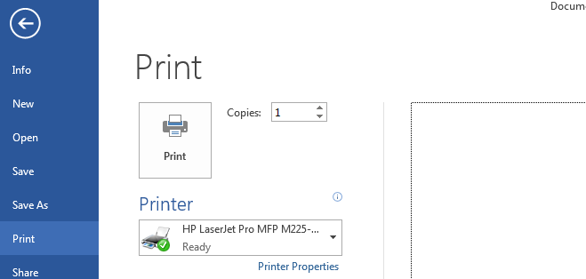
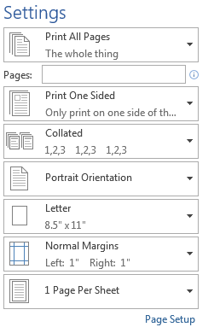
Printing Documents

Slide 37
Activity #6

Slide 38
Questions?
THANK YOU FOR COMING!
Part Two Next Week
Formatting Documents
Notes:
Thank participants for coming and ask if there are any outstanding questions.
Hand out the class surveys and encourage them to write in ideas for any additional classes.
When they submit their surveys, exchange them for handouts.
Encourage them to look for upcoming classes and register to attend

