Slide 1
Paws to Read
Gail Borden Public Library

Slide 2
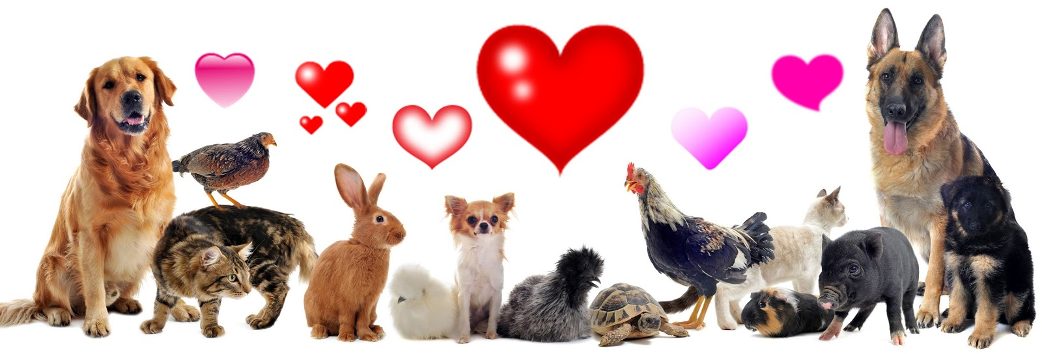
Animals of GBPL
Daring Dogs
Comical Cats
Amusing Animals

Slide 3
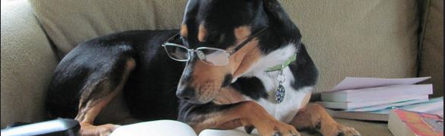
Daring Dogs

Slide 4
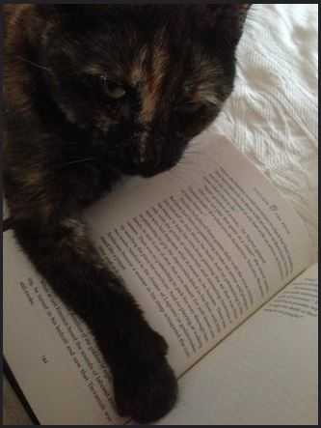
Crazy Cats

Slide 5
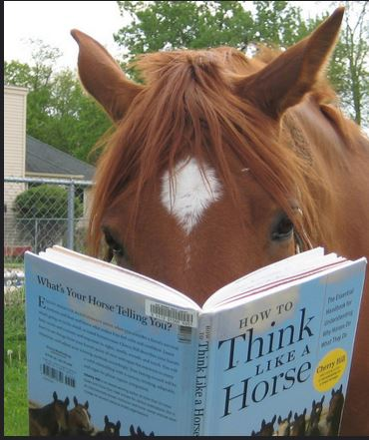
Amusing Animals

