Slide 1
City of Elgin
Gail Borden Public Library

Slide 2
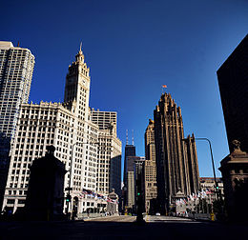
Location
Between Chicago and Rockford
Fox River Valley
Straddles the Fox River
Just south if I-90

Slide 3

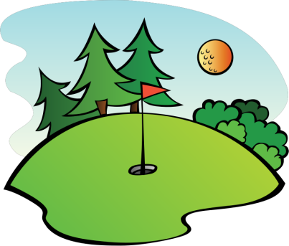
Things to do
Hemmens
Elgin Symphony
Downtown neighborhood
Sports
  Golf
  Swimming
  Biking – Fox River Trail

Slide 4
Things to do - continued
Taking classes at the Library
Historical Society
Hanging out at the Centre
Going to the Farmer’s Market
Boating and Fishing
Gambling at the Casino

Slide 5
Events
Fox Trot
4th of July Parade
Zombie Fest
Concerts at Hemmens
Art & Soul
Historical House Walk

