Slide 1

Microsoft PowerPoint: Basics
Name
Title
Gail Borden Public Library District
Courtesy of Gail Borden Public Library
and the Public Library Association

Slide 2
Agenda
Terminology & Descriptions
Creating a Presentation
Adding Slides & Content
Modifying Slides
  Adjusting Slide Layout
  Rearranging Slide Order
  Deleting Slides
  Duplicating Slides
  Applying a Theme
Playing a PowerPoint Presentation (“Slideshow”)
Notes:
Review agenda with participants so they know what to expect. Ask them to hold their questions until you review all the features, in case it’s part of the agenda.

Slide 3
Terminology & Descriptions

Slide 4
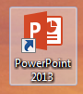
Terminology & Descriptions
Microsoft PowerPoint
  An application for creating custom slide show presentations
  Examples include work reports, school projects, personal interest presentations, etc.

Slide 5
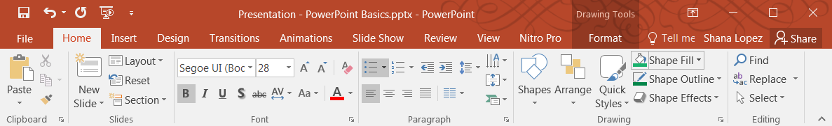
Terminology & Descriptions
  The Ribbon
  The area at the top of the screen where commands are organized into Tabs, icons, and Groups

Slide 6
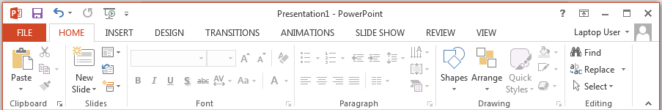
Terminology & Descriptions
Tabs
There are 8 Tabs in addition to the File tab
Home, Insert, Design, Transitions, Animations, Slide Show, Review and View

Slide 7
Terminology & Descriptions
Groups
Related task functions are organized into Groups
The name of the group is below its task buttons
Additional tasks are accessible by clicking on the Dialog Box in the lower right-hand corner

Slide 8
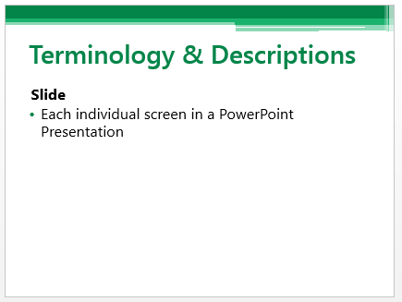
Terminology & Descriptions
Slide
Each individual screen in a PowerPoint Presentation

Slide 9
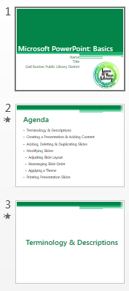
Terminology & Descriptions
Navigation Pane
The display pane on the left side of the PowerPoint window that provides a preview of all slides in your presentation and allows for quick navigation

Slide 10
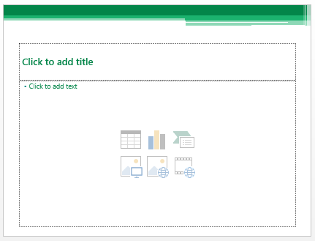
Terminology & Descriptions
Layout
The pre-arranged placeholders on each slide that allows for content to be quickly added
Example: Title and Content Layout

Slide 11
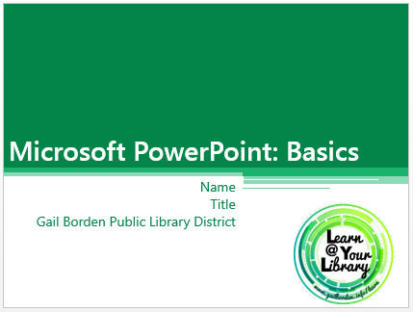

Terminology & Descriptions
Themes
Pre-designed background graphics, color combinations, and font pairings that enhance the image of your slides

Slide 12
Creating a New Presentation

Slide 13
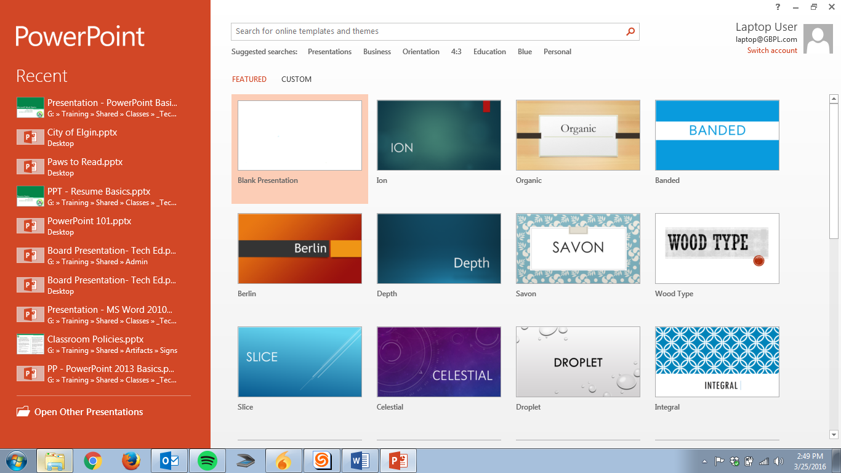
Creating a New Presentation

Slide 14
Activity #1

Slide 15
Adding Slides & Content

Slide 16
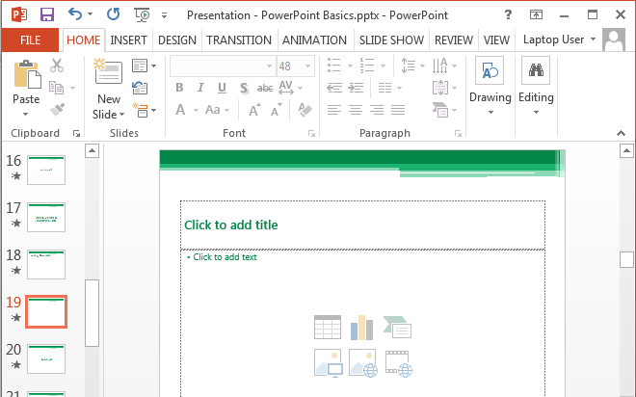
Adding New Slides

Slide 17
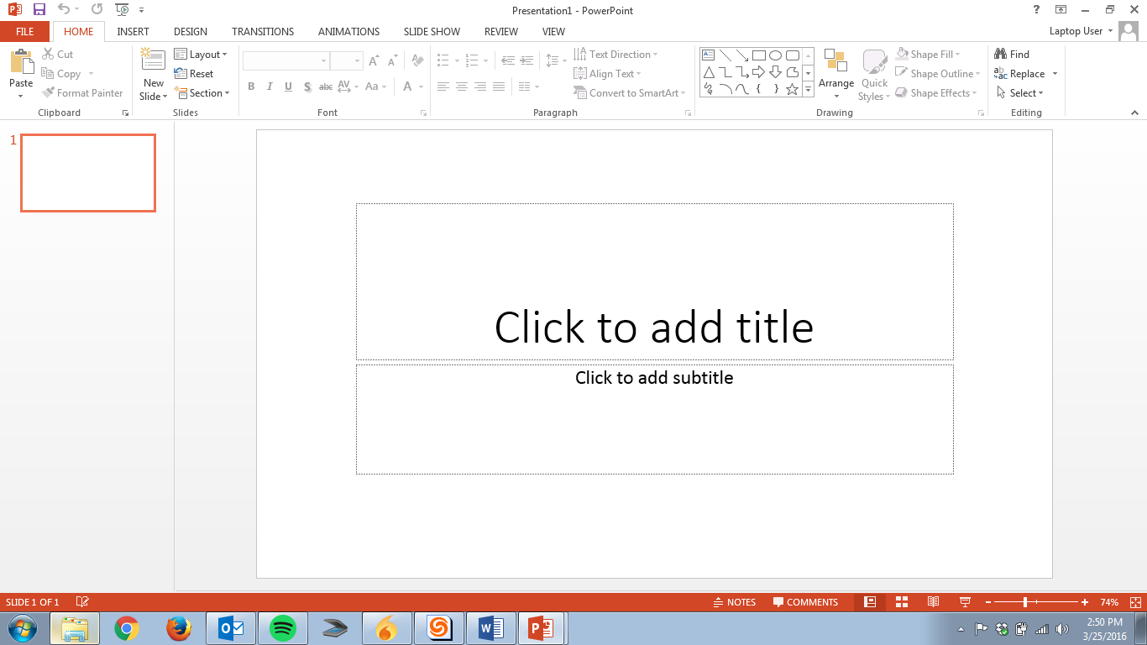
Adding Content

Slide 18
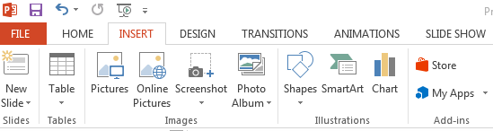
Adding Content
Inserting Images
Click on the Insert tab
Click on Pictures to insert one of your photos or Online Pictures to search for an image to use

Slide 19
Activity #2

Slide 20
Modifying Slides

Slide 21
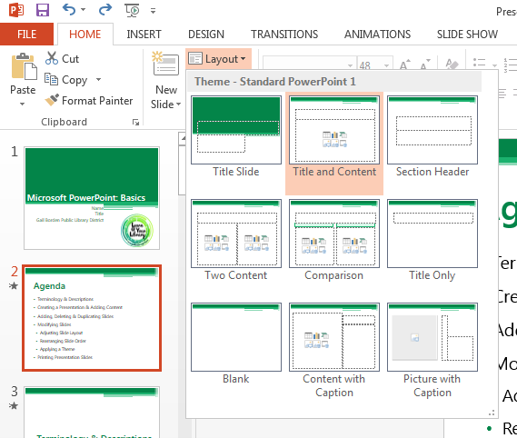
Adjusting Slide Layouts

Slide 22
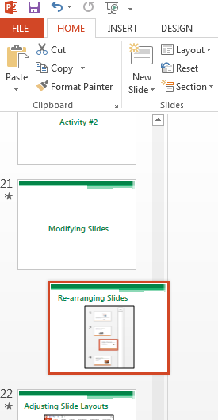
Re-arranging Slides

Slide 23
Activity #3

Slide 24
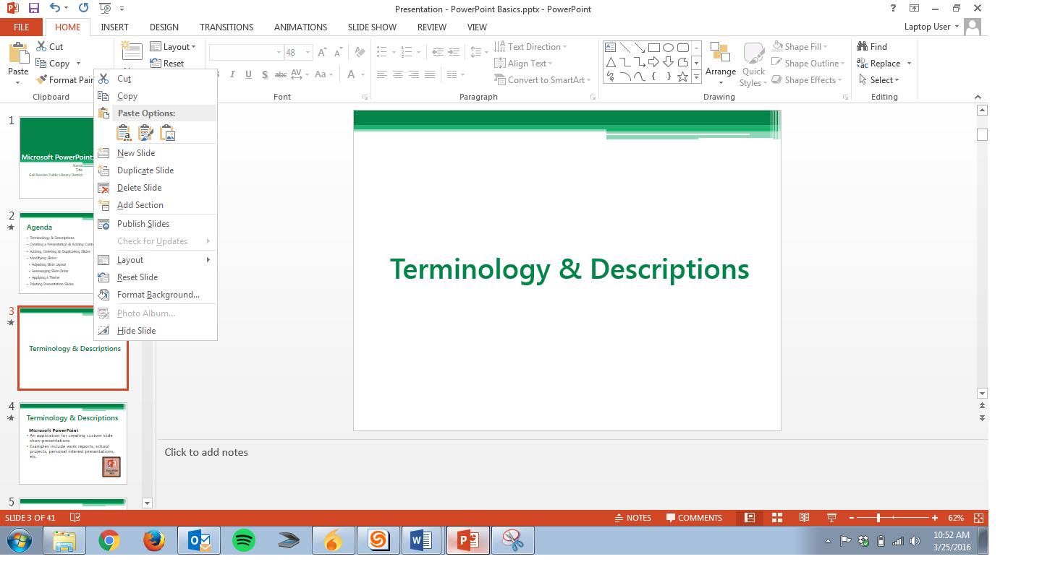
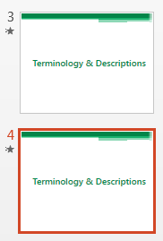
Duplicating Slides

Slide 25
Deleting Slides

Slide 26
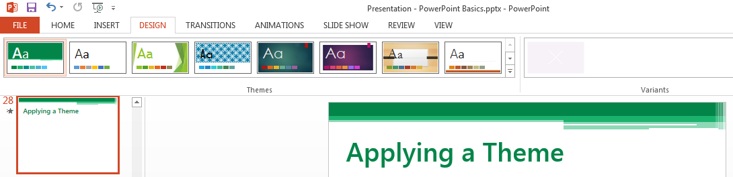
Applying a Theme

Slide 27
Activity #4

Slide 28
Playing a PowerPoint Presentation (“Slide Show”)

Slide 29
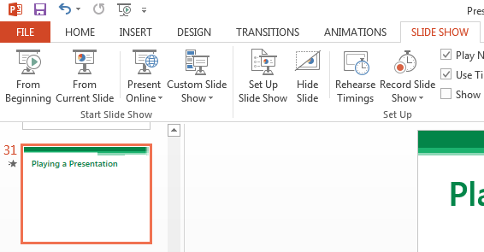
Playing a Presentation

Slide 30
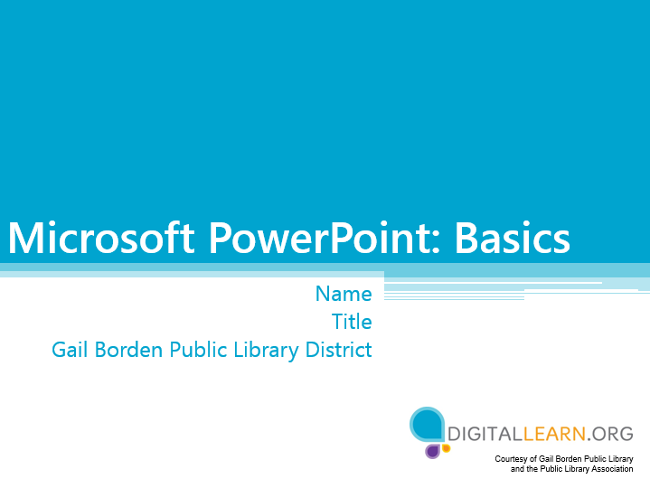
Playing a Presentation

Slide 31
Activity #5

Slide 32
Questions?
THANK YOU FOR COMING!
Part Two Next Week
Microsoft PowerPoint:
Special Effects
Notes:
Thank participants for coming and ask if there are any outstanding questions.
Hand out the class surveys and encourage them to write in ideas for any additional classes.
When they submit their surveys, exchange them for handouts.
Encourage them to look for upcoming classes and register to attend

