Slide 1

Microsoft Word 2010: Formatting Documents
Instructor Name
Job Title
Library Name
Courtesy of Gail Borden Public Library
and the Public Library Association

Slide 2
Agenda
Review
Home tab > Font Group
Home tab > Paragraph Group

Slide 3
Review

Slide 4
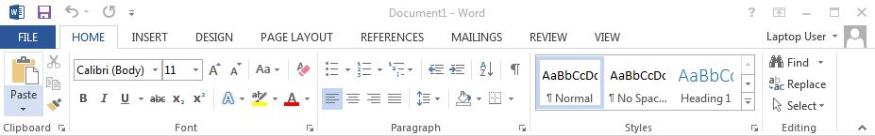
Review
The Ribbon
Tabs
Groups

Slide 5
Home tab > Font group

Slide 6
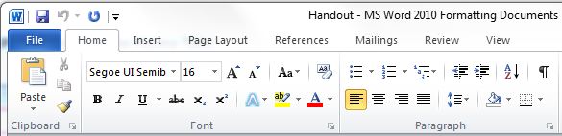
Home tab > Font group

Slide 7
Activity #1

Slide 8
Home tab > Paragraph group

Slide 9
Home tab > Paragraph group

Slide 10
Activity #2

Slide 11
Activity #3

Slide 12
Questions?
THANK YOU FOR COMING!
Part Three Next Week
MS Word 2010: Editing Tools

